Slide 1
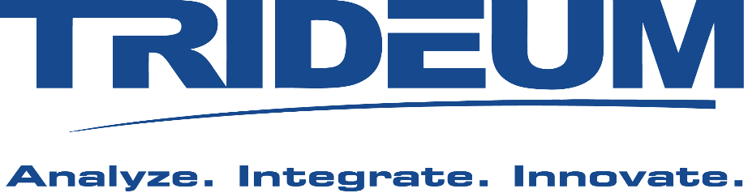
LVC Interoperability 101
Mr. Kurt Lessmann, Chief Technology Officer, Trideum Corporation
Mr. Damon Curry, Business Development, Pitch Technologies

Slide 2
Agenda
Learning Objectives
LVC Interoperability Overview
Interoperability Through Standards
Interoperability Using Gateways and Cross Domain Solutions
LVC Interoperability Use Case
Summary

Slide 3
1. Learning Objectives
The tutorial is intended for decision makers who need a top-level understanding of Live, Virtual and Constructive (LVC) interoperability and the supporting standards, technology and processes.
The tutorial will provide:
An overview of recommended concepts, processes and tools needed to achieve interoperability
Use Case that demonstrates interoperability solutions meeting a military training need
Summary with recommendations
The objective of this tutorial is to provide managers and those new to LVC technology the high-level insight needed to support intelligent decision making when encountering a need for interoperability

Slide 4
2. LVC Interoperability Overview
Simulation Definitions
LVC Interoperability Definitions
Distributed Environment Overview
Notes:
Thinking we need to describe simulation and interoperability

Slide 5
LVC Interoperability Overview
Simulation
A software model that runs over time
All but war is simulation
Simulation Interoperability
The ability of connected systems to communicate and function together
Interoperable components can be combined to create an application… applications can be composed to create a system, and systems can be combined to create a System of Systems (SoS)
Notes:
Thinking we need to describe simulation and interoperability

Slide 6
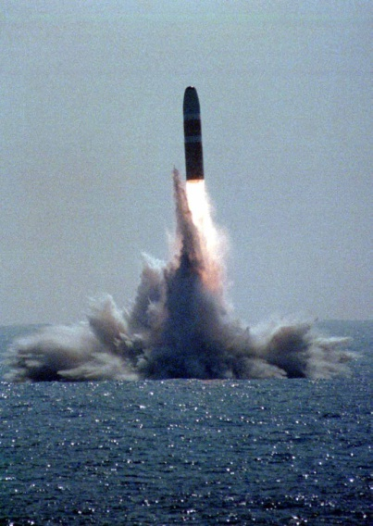
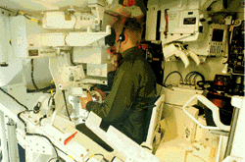
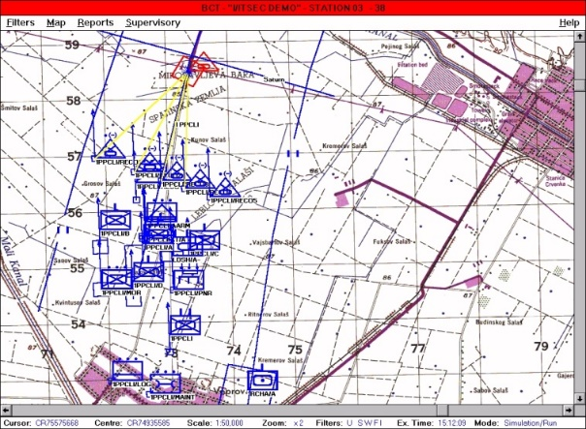
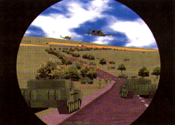
Live Virtual Constructive (LVC) Definition
Virtual Simulation
“Real people operating simulated systems”
Constructive Simulation
“Simulated People operating simulated systems”
Live Simulation
“Real people operating real systems”
Real environment
Real systems
Real people
Real-time
Various kinds of platform simulators
Virtual Environment
Real-time
Computer Generated Forces (CGF)
Virtual Environment
Faster/slower than real-time

Slide 7

Distributed Simulation
A distributed simulation is a system that:
Involves several independent processes executing on one or more computational nodes
Interoperates using a common services and/or protocol over a network
Simulations can be distributed over a number of different components, ideally loosely coupled or “federated”
Allows growth over time
Allows components to be replaced or upgraded easily
Add additional computational power if needed
Distributed Simulation can be used to support
Warfighter Training, Command Post Exercises, Enhanced Modeling and Simulation Objectives, Research, Development Test and Evaluation (RDT&E), etc
Notes:
Thinking we need to describe simulation and interoperability

Slide 8
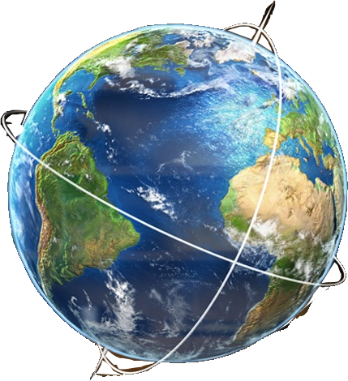
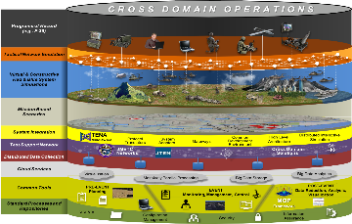
Distributed LVC Event
Distributed LVC Event
An activity to integrate and execute LVC simulations in a virtual environment so that “real-world” processes and “things” can be exercised to investigate and solve complex issues
Real-time for live systems, Can be faster than real-time for virtual and constructive systems
Technique used to enhance weapons system development, test and training
Can be an effective tool to enhance effectiveness, reduce risk, reduce cost
Examples include
Stimulating a ”real” fire control radar with simulated targets to conduct common operator training exercises at multiple training locations
Integrated with
Running over time
Connected LVC systems
Virtual and/or Real Environment
LVC Event
Notes:
Thinking we need to describe simulation and interoperability

Slide 9
Interoperability Requirements
Interoperability Requires
An ability to meaningfully communicate
A common “language” to describe the LVC systems
A data distribution mechanism with well-defined rules and/or services
A reliable network
A common context
A common understanding of the environment and time
A common technical process
Efficient software reuse and composability is enabled by
Well-defined software interfaces and access to reusable components
The ability to replace models at the component level, without interrupting the larger system or requiring software changes or recompilation to other system components

Slide 10
Typical Interoperability Discussions
It’s a unique language and skill set that takes time to understand and adopt
Involvement with the interoperability community optimizes this process
Applying standard architectures, processes, technologies and lexicon is a key to success
What is the Information Data Exchange Model?
What is the conceptual model of the entire exercise?
Which coordinate systems are used? Conversions?
What logical sequences of interactions are required?
Fair fight?
What algorithms (such as line of sight) need to be shared?
What object names (marking) are used? Object types?
What representation of the environment is used?
Time handling? Starting and stopping? Scenario handling?

Slide 11
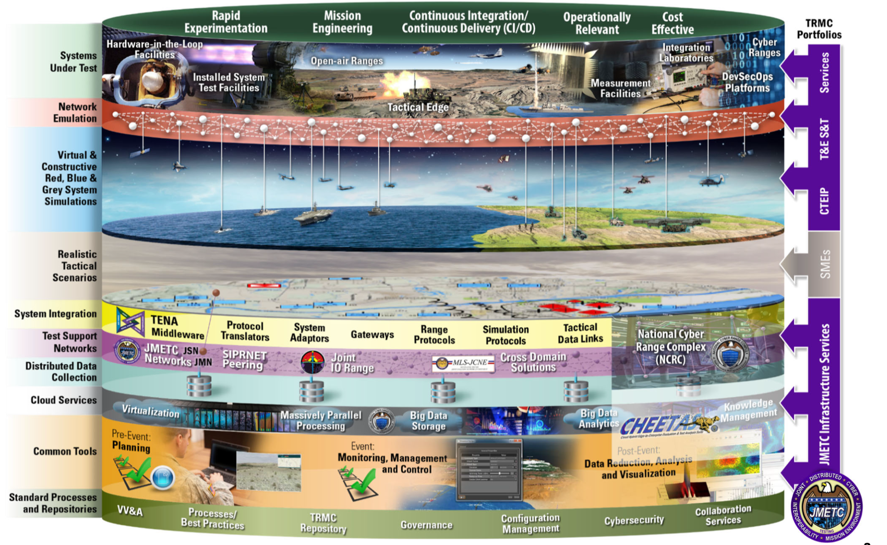
LVC Distributed Event Environment
Joint Mission Environment Test Capability (JMETC) vision of Standards-based LVC Event Environment

Slide 12
3. Interoperability through Standards
The Value of Standards
Past and Current Interoperability Standards
DIS, HLA and TENA
Recommended LVC Integration Approach

Slide 13


The Value of Interoperability Standards
Open Standard
Solutions
Use my proprietary architecture!
Use my proprietary architecture!
Use my proprietary architecture!
Data Model
Application Programmers Interface (API)
Integration Processes
Use my proprietary architecture!
Remove Stovepipes
Good for me right now
Good for all
now and in the future
13

Slide 14
Goals of Interoperability Standards
Technical Aspects
Business Aspects
Enable efficient distributed simulation
Throughput, latency, scalability etc.
Support simulation specific requirements
Not limited to data distribution
Provide common services (Remote Methods, Time Management, Ownership (control over data elements), etc.)
Isolate simulator from physical transport method (i.e. network)
Avoid technology lock-in
Promote interoperability and reuse
Leverage exiting solutions for other needs
Increased customer support
Vendor independent
Vendors and organizations equally comfortable with the standard
Open standard for contributions and influence
Easily replace interoperability implementation
Domain neutral
Support the simulation market as a whole, multi-purpose
Possibility to attract a large number of vendors and users
14

Slide 15
Interoperability Approaches of the Past
Standardize on a vendor solution
Optimized for a specific need
Creates a vendor-lock situation for computers and/or software
Standardize on programming language
Optimized for a specific need
Problems may occur when maintaining code developed using older programming languages and compilers…the remember ADA mandate?
Incorporation of new software technologies becomes very difficult (Service Oriented Architectures (SOA), cloud based solutions, scripting languages, etc.)
This approach was adopted when reuse, composability and interoperability were not high priorities
15

Slide 16
Modern Interoperability Approaches
Standardize on the Data Model
Data Model is the defined network protocol or message format
This defines the data needed to interoperate
Standardize on a software Application Programmers Interface (API)
Provides software interface to interoperability services and solutions for distributed simulations
Standardize on Processes
These Modular Open Systems Architecture (MOSA) concepts enable success and solution flexibility … now and in the future
16

Slide 17
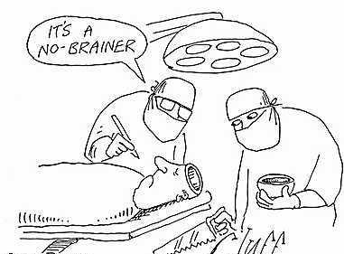

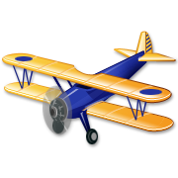


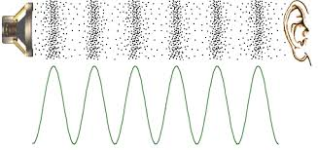
Interoperability Standard: Data Models
Enable semantic interoperability among simulation applications
Provide the “common language” that all simulation applications use to communicate
Data Models = Object Model(OM) = Data Exchange Agreement (DEM)
Conceptual Level
(common understanding
of information)
Pragmatic/Dynamic Level
(common use of information)
Object Model
A document describing the data that will be exchanged
Semantic Level
(information exchange)
Syntactic Level
(data exchange)
Airplane!
Technical Level
(networking)
Levels of Interoperability (Tolk)
17
Notes:
The FOM describes the information exchange in a federation. It is different for defense, space, manufacturing, etc
The HLA standard defines a format or an Object Model Template for how to define the language needed to exchange the required data.
With the HLA Evolved update of the standard it is possible to use FOM modules and extend existing modules without ´breaking backward compatibility.

Slide 18
Interoperability Standard: API
Application Programmers Interface (API) is a software interface to software services that enable interoperability
Time Management
Manage and synchronize time between participating applications
Quality of Service (in simulation)
Services for managing how data is distributed on the network
Ownership Management
Transfer of modelling responsibility from one participating application to another
Data Distribution Management, DDM
Data filtering based on regions or any other attribute to reduce data load
Remote Method Invocation, RMI
Participating applications can have methods that can be remotely invoked by other applications
These services have made significant enhancements to LVC interoperability. Understanding these capabilities and implementing them using common practices improves performance and reduces risk
18

Slide 19
Interoperability Standards: Integration Process
A well-defined Integration Process is critical to success
First step in planning for an LVC Environment is identification and adoption of a proven process to support the design, integration and execution of the environment
To ensure the environment is designed and configured to meet the event requirements, a structured process is necessary to properly identify needs, deigns and solutions.
Several standard, and proven, processes exist.
Do not add risk to your program by “winging it” through a very complex endeavor

Slide 20
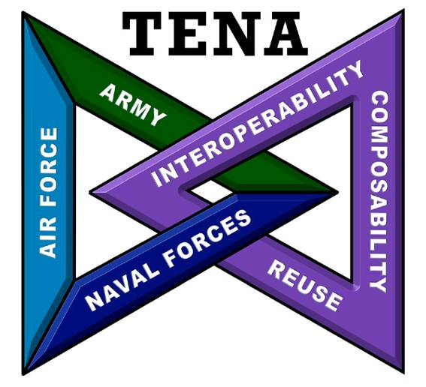

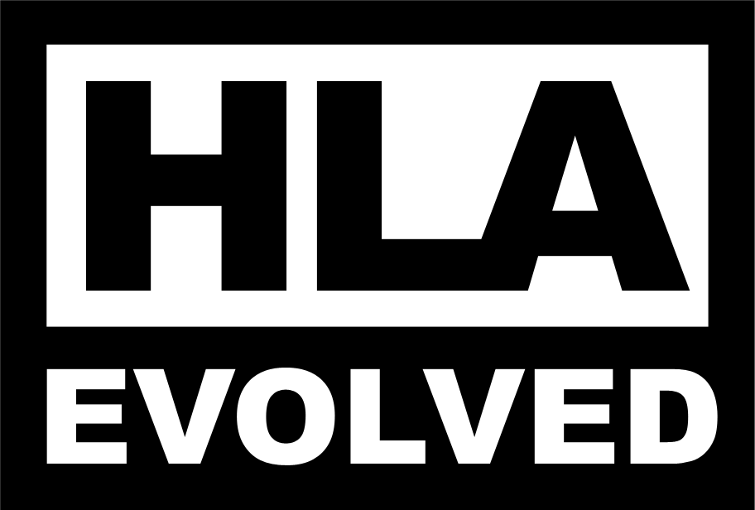
Open Standards
According to the Software Engineering Institute a system is open if:
It is fully defined
Available to the public
Maintained according to group consensus
Support Organizations for Interoperability Standards include:
Institute of Electrical and Electronics Engineers (IEEE) https://www.ieee.org/standards/index.html
Simulation Interoperability Standards Organization(SISO) https://www.sisostds.org/
TENA Architecture Management Team https://www.tena-sda.org
20

Slide 21
The “Big 3” LVC Interoperability Architecture Standards
Distributed Interactive Simulation (DIS) - IEEE 1278
Protocol standard
Covers several levels of interoperability
Broadcast/Multicast UDP (Best effort)
Interoperability Standard:
Data Model
High Level Architecture (HLA) – IEEE 1516-2010 and NATO STANAG 4603
API standard
Separate semantic model expressed in a (Federation) Object Model
Services standard – A rich set of interoperability services
Interoperability Standard:
Data Model, API & Process
Test and Training Enabling Architecture (TENA)
API standard –auto-generated user software for quality and usability
Semantic model expressed in a Standard Object Model
Includes standard object model, extensive middleware services and a set of interoperability & event support tools
Interoperability Standard:
Data Model, API & Process
21

Slide 22
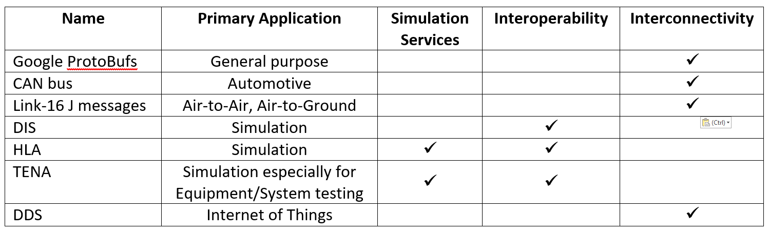
Interoperability vs Interconnectivity
LVC “Interoperability” requires data exchange with other systems without requiring modification to already connected systems, thus permitting flexible connections.
“Interconnectivity” involving some data exchange protocols requires system-wide changes, recompilations of source code, re-linking to new software libraries, etc, thus implementing specific connections.
Many (an infinite number?) of data messaging methods exist. Examples are:
22

Slide 23
Interoperability vs Interconnectivity
Data Distribution Service (DDS)
API standard
Available through the Object Management Group (OMG) … www.omg.org
For real-time interconnectivity of systems exchanging data via DDS
Common application is for “Internet of Things” (IoT), to enable interconnected systems to exchange data over a network
DDS uses some similar concepts as TENA and High Level Architecture (HLA)
Publish-Subscribe architecture
Data model … HLA has a “Federation Object Model” … DDS has a “Data Space”
Targeted use = interconnectivity, e.g. Internet of Things (IoT) applications
Does not provide runtime interoperability services (e.g. time management) like HLA
Cannot be used in place of HLA but could be used in conjunction with HLA
Often confused item:
HLA has a “Run Time Infrastructure” (RTI) … DDS has no equivalent
The best known company providing DDS software is “Real-Time Innovations” (RTI)
23

Slide 24

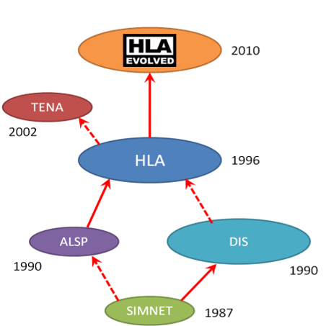
Timeline Of Interoperability Standards
TENA V6.0.9
early 2023
DIS v8
2023+
2022
TENA V6.0.8
2018
Space FOM
2021
TENA V6.0.7
NATO standard NETN FOM
2019
2013
DIS v7
TENA V6.0.6
2012
2018
TENA V6.0.5
2010
2016
RPR FOM
24

Slide 25
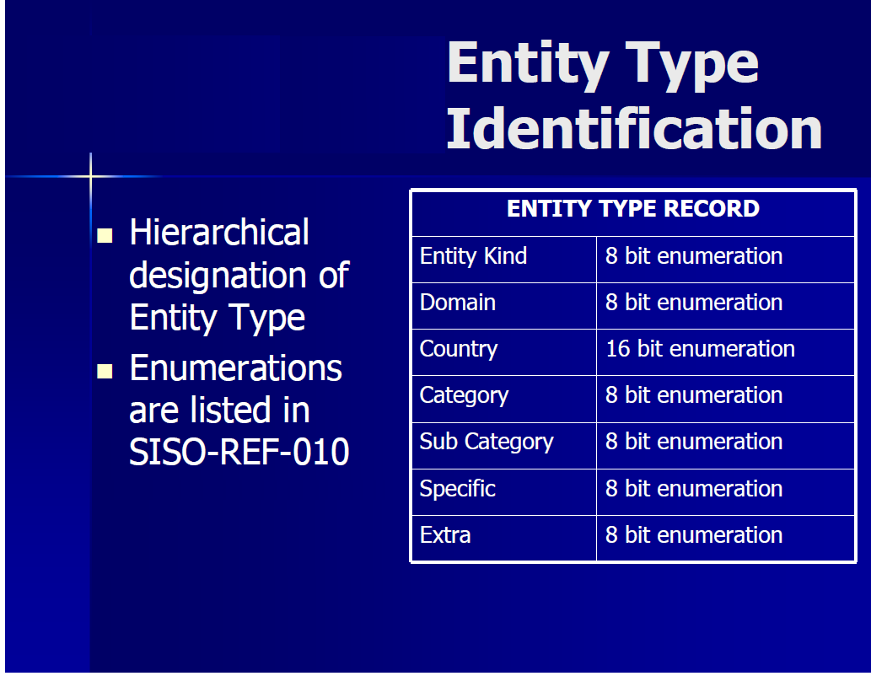
Distributed Interactive Simulation (DIS) Overview
DIS
Applications
Network
DIS IEEE 1278 is an “Over the Wire” specification
Defines the structure of data sent over the network
using a Protocol Data Unit (PDU)
Is a binary protocol where individual bits are defined and bit order and byte order is mandated
Defines behavior of message handling. Receiving participants must review each packet for applicability
Does not include an “API” or implementation details or solutions
Follows the COTS and Open Source business models
Primarily focuses on military systems/requirements
DIS participants must Broadcast or Multicast data on a local network using UDP network transfer protocol
25

Slide 26
Distributed Interactive Simulation (DIS) Example PDU
DIS
Applications
Network
Examples: DIS “Entity Type” PDU
USAF F-16C Falcon
Entity Kind = 1
Domain = 2
Country = 225
Category = 1
Sub Category = 3
Specific = 3
Extra = 0
USAF F-22B Raptor
Entity Kind = 1
Domain = 2
Country = 225
Category = 1
Sub Category = 6
Specific = 2
Extra = 0
26

Slide 27
High Level Architecture (HLA) Overview
Defines services for simulation data exchange and coordination provided by a Run-Time Infrastructure (RTI)
Services are accessed through a standardized interface.
A data model (Federation Object Model FOM) expressed in a standardized text file, using the xml standard, defines how objects interact with each other
Information exchange governed by Federation Agreements and supporting federation Information Data Exchange Models (IDEM)
e.g. when, where and how to utilize the service to distribute data in order to exchange information
Uses COTS and Open Source business models
Federates
Federation Object Model
<FOM>
<Shared object classes>
<Shared interaction classes>
<More>
</FOM>
HLA API
RTI Services
Federation Management
Declaration Management
Object Management
Ownership Management
Time Management
Data Distribution Management
27

Slide 28
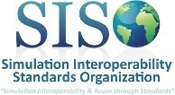
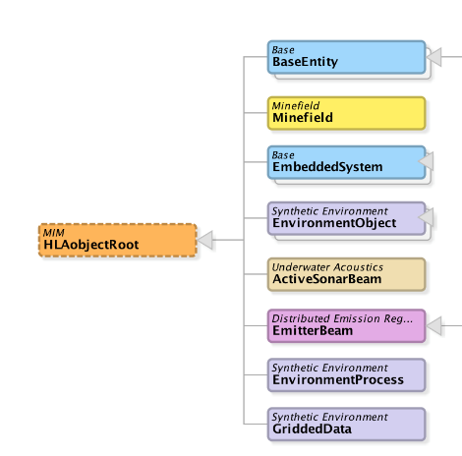










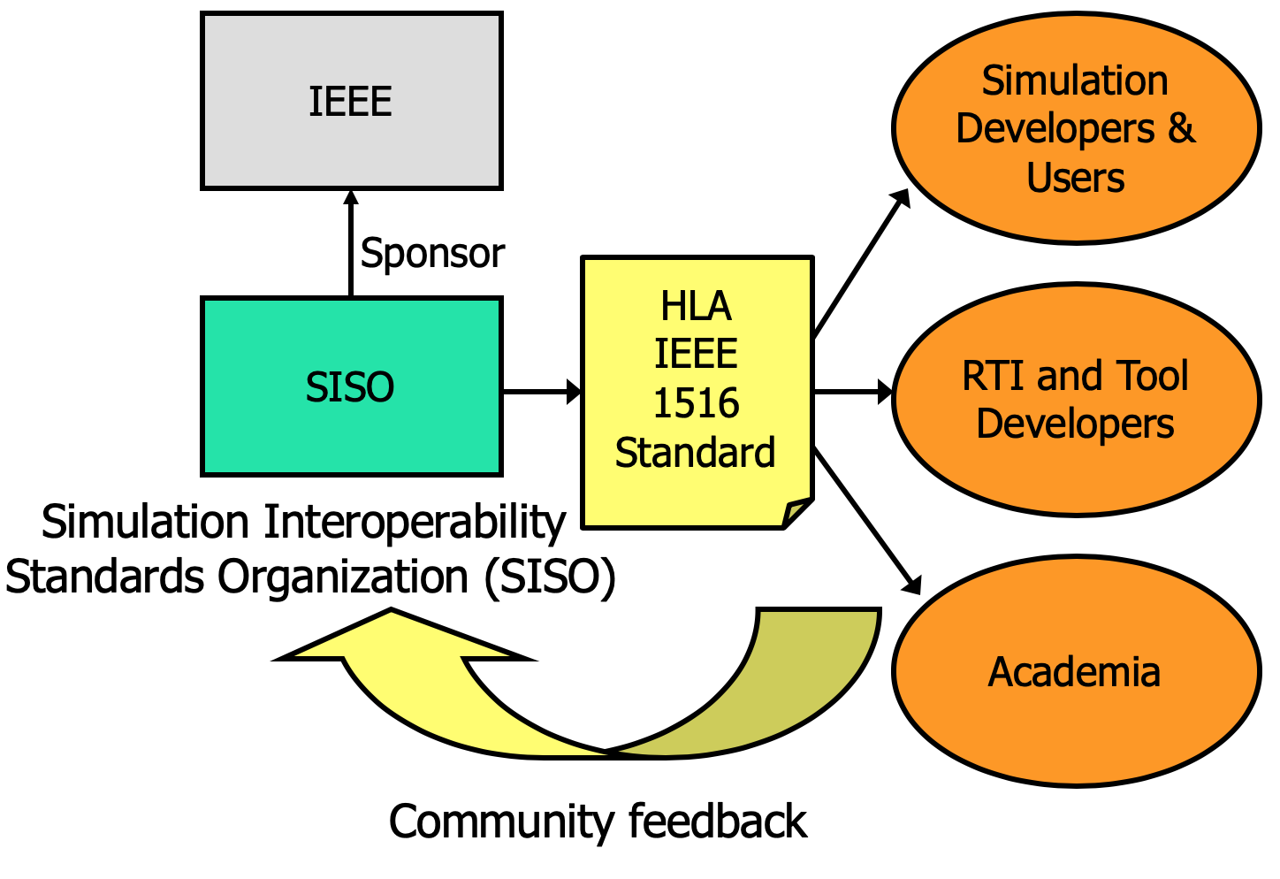
DIS and HLA Data Model & Standardization
“Objectification”
Physical Entities
Aggregates
Radio
Logistics
Synthetic Environment
Warfare
Underwater
Acoustics
Minefield
Simulation Management
Emissions
HLA Real-time Platform Reference FOM (RPR-FOM) SISO-STD-001
DIS IEEE 1278 Data Model
- Government
Industry
Academia
- Etc
DIS and HLA are maintained through SISO
- COTS, GOTS
In-house
Open source
- Other
IEEE is the external standards body for SISO
Research
Student projects
Courses
28

Slide 29
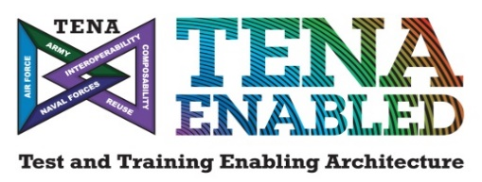
TENA Overview
TENA is the DoD GOTS live range integration architecture
What does TENA enable?
Interoperability between inter- and intra-range systems
Elimination of proprietary interfaces to range instrumentation
Efficient incremental upgrades range capabilities
Integration of Live, Virtual, and Constructive assets (locally or distributed)
Sharing and reuse of common capabilities across existing and new investments
What is included in the TENA architecture?
Customizable “data contracts” that standardize repeatable information exchange
Interoperability-enabling, auto-code generated software libraries
A core set of tools that address common test and training requirements
Collaboration mechanisms that facilitate sharing and reuse
TENA is continuing to be evolved and has institutional funding from DoD

Slide 30
TENA-Enabled Interoperability
Common specifications for test and training data
Data Dissemination across variable applications, platforms,
programming languages, networks, and classification levels
Data Collection and Playback
Local and Remote Command and Control
Health & Status Monitoring
Simulation Interoperability(Virtual, Constructive, Digital Twin)
Integration of live sensors and instrumentation
Connecting range systems using Gateways, Adaptors and Transmogrifiers
Eliminating proprietary interfaces to range instrumentation
Sharing and reuse of common range tools and capabilities
Online Collaboration and File Sharing
Data Management
Event Management
LVC Integration
Sharing & Reuse

Slide 31
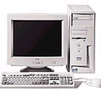
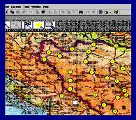
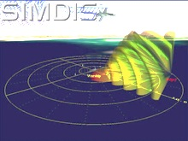
Test and Training Enabling Architecture (TENA) Overview
TENA Applications
TENA Tools
TENA Middleware
100% Government off the Shelf (GOTS)
Initially developed to support the demands of live system testing
Provides tools for common Event Planning, Execution, and Analysis functions
Provides Subject Matter Experts to support distributed exercise and system integration
Community-managed Open Architecture and Standards
Constantly improved to meet new user requirements
Download TENA Middleware and tool set
http://www.tena-sda.org
HWIL
Range Resource
Application
Range Resource
Application
Range Resource
Application
Reusable Applications
Reusable Applications
TENA
Object
TENA
Object
TENA
Object
TENA
Repository
Logical Range Data Archive
TENA Middleware
TENA Common Infrastructure
Infrastructure Management and Planning Utilities
TENA
Data Collectors
Repository Utilities
Gateways
Object Model Utilities
Non-TENA Communications
Non-TENA System
Non-TENA System
TENA Utilities
Non-TENA Applications
31

Slide 32
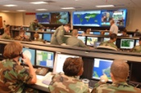
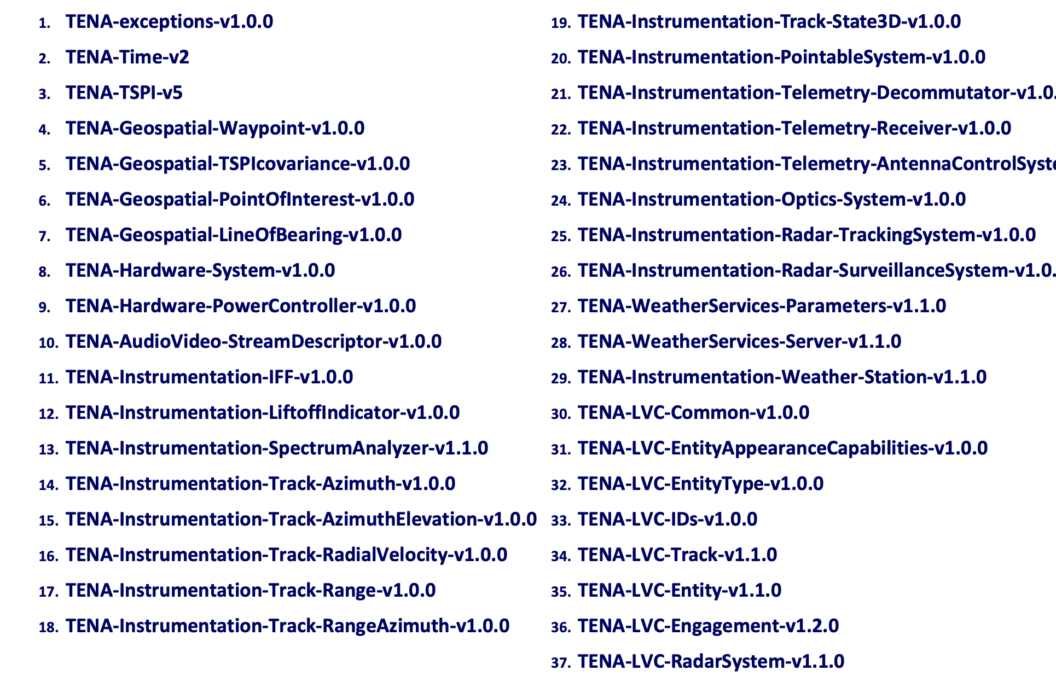
TENA Data Model & Standardization
The DoD maintains the extensive and extendable TENA Standard Object Model V2.0
TENA-LVC OMs align with DIS IEEE 1278 PDUs
32

Slide 33
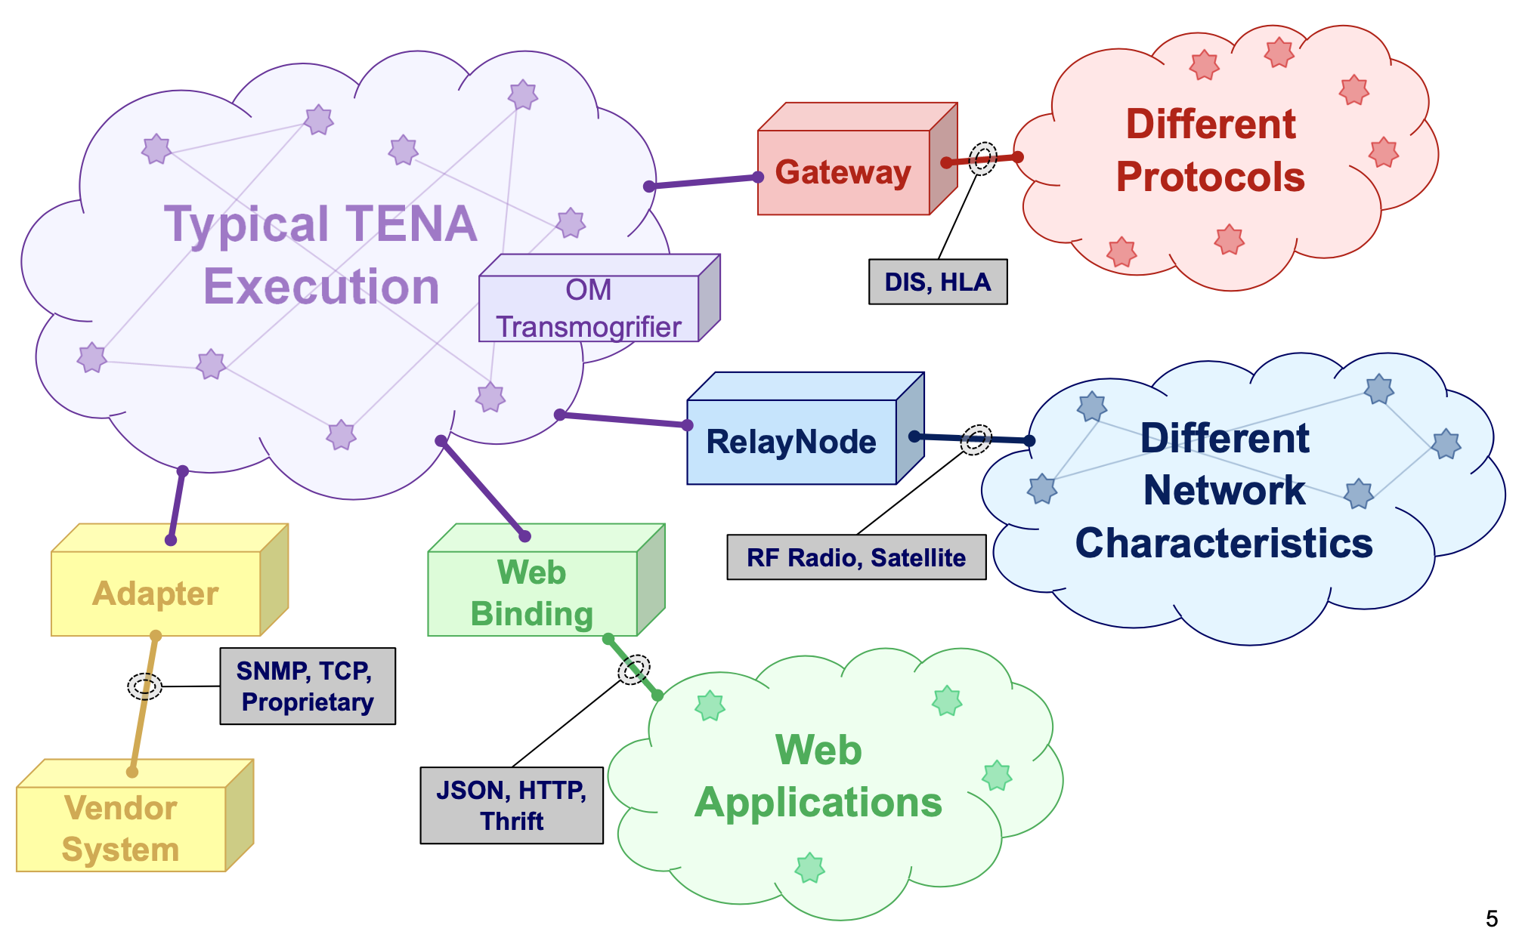
TENA-Enabled Interoperability
Gateways – Applications that enables interoperability with existing protocols (TENA to Many)
Adapters – Similar to Gateways but are purpose built to a legacy system (TENA to One)
Transmogrifiers – Fun name given to a gateway that enables interoperability between legacy TENA and current TENA OMs

Slide 34
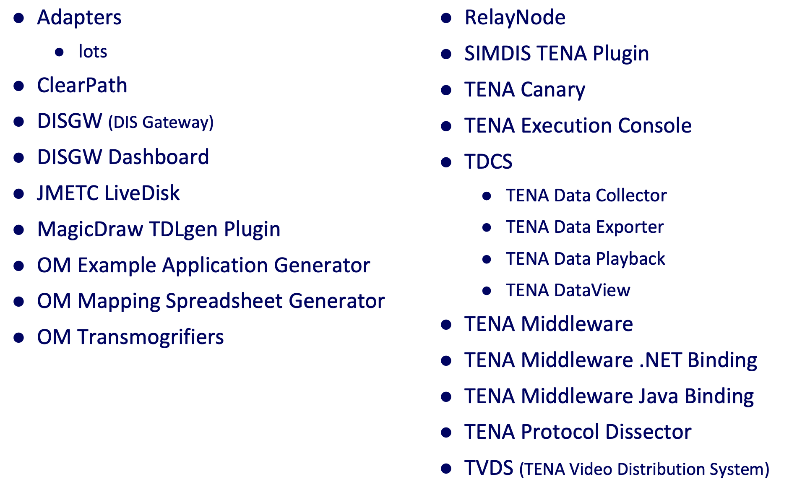
TENA Tools
34

Slide 35
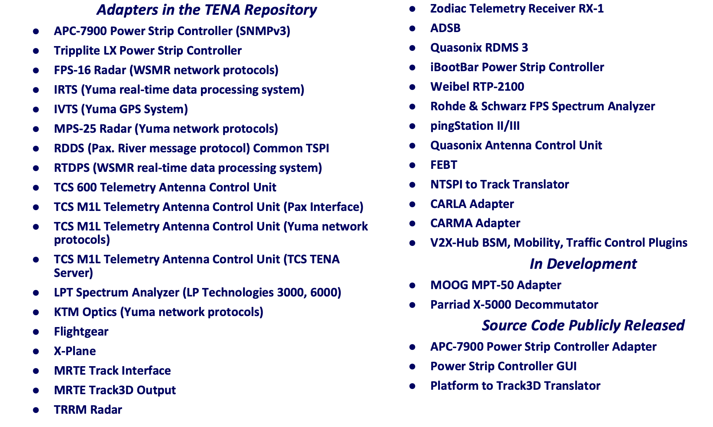
TENA Adapter Library

Slide 36
Recommended Integration Approach
Identify a Common Architecture
Utilize horizontal Integration using Enterprise Service Bus (ESB) concept (HLA, TENA, etc.) when possible
ESB Provides Ability to Meaningfully Communicate for Reuse and Composability
Standard Data Model to describe the data communicated
Standard Services Interfaces (API)
Software provides the Standard Services using Standard APIs
e.g. Services to distribute the data model
Subsystems are called Federates. The Integrated System is called a Federation.
Federates
API and
Data Models
Software infrastructure
36

Slide 37
Identify Integration Process
Suggested standards and guidelines include
IEEE Std 1730-2010 - IEEE Recommended Practice for Distributed Simulation Engineering and Execution Process (DSEEP)
IEEE Std 1730.1-2013 - IEEE Recommended Practice for Distributed Simulation Engineering and Execution Process Multi-Architecture Overlay (DMAO)
TENA Concepts of Operations (CONOPS)
HLA Distributed Simulation Engineering and Execution Process (DSEEP) Overview
IEEE 1730-2010 was developed based on authoritative systems engineering processes that were adopted and extended to address distributed simulation requirements
Identifies and describes the sequence of activities necessary to construct and run distributed simulations
A high-level process that is relevant to and can facilitate the development of solutions
Is independent of interoperability architectures
Define Simulation Environment Objectives
Perform Conceptual Analysis
Design Simulation Environment
Develop Simulation Environment
Integrate and Test Simulation Environment
Execute Simulation Environment
Analyze Data and Evaluate Results
1
2
3
4
5
6
7

Slide 38
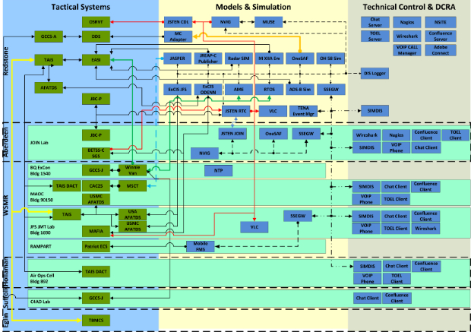
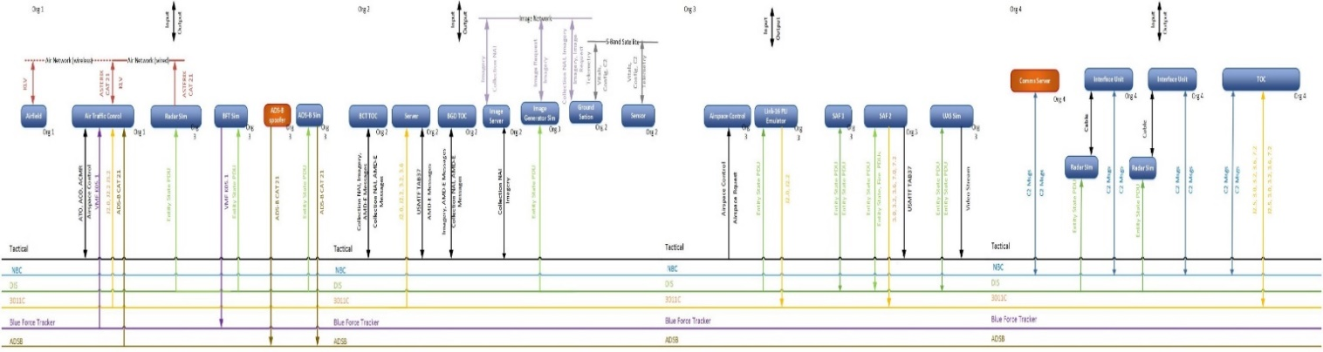
Focus on Integration Process and Communication
Tools that enable the process are effective at communicating event design across the team
Clear communication reduces risk and optimizes event execution and data collection
These diagrams ensure clear communication and ensures event implementation mirrors design
Key data includes: Location, IP, Port, Protocol, messages, and system names
Notional Interface Matrices and Connectivity Diagrams
For additional information and diagram clarity, please attend I/ITSEC 2022
“Distributed LVC Event Process Workshop”
Zinzer, LeSueuer, Boren, O’Connor
Friday 0800, Room 307C

Slide 39
4. Interoperability Using Gateways
Complex LVC environments may require interoperability between simulation federations using different architectures
Gateways are bridges between different simulation architectures
Examples:
TENA used at a test range interoperating with other facilities using DIS, HLA, or both
Legacy DIS-based system interoperating with newer HLA-based system
Example gateway
HLA/DIS Gateway
HLA 1516-2010
HLA
DIS
DIS v7
39

Slide 40
Interoperability Using Gateways
Gateways
Translate data and services between different middleware, object models, and services
Can filter data, transferring some data while blocking other data
Can provide logging, monitoring, and detection and notification of errors or issues
Caution: Placing a gateway may create a single point of failure for the system. Careful system design can minimize this potential problem.
A top level “system design” trade-off analysis that considers schedules, costs, technical factors, etc., should determine the best of two implementation methods
Selecting a common architecture for the entire LVC environment, or
Implementing, integrating, testing, operating and maintaining gateways.
40

Slide 41

Interoperability Using Gateways
Commonly used gateways are available as Commercial Off-The-Shelf (COTS) products from numerous vendors.
Check carefully the product’s list of translated data types, models, and services!!
TENA-related gateways can be downloaded from the TENA website.
Sometimes unique modifications are needed, especially when a gateway is interfaced to a “stove-piped” (non-standards-based) system.
41

Slide 42
Multiple Levels of Security
Definitions:
Security Domain
System or group of systems operating under a common security policy
Cross Domain Solution (CDS) … aka Multi Domain Operations (MDO)
An information assurance solution that provides the ability to access or transfer information between two or more security domains
Enables data transfers between Unclassified, Secret, Top Secret, Top Secret/SCI
When establishing a complex distributed environment, information transfer between two or more security domains may be needed
Most organizations do not have any effective means to address this issue
As a result, too often the “solution” is a brute-force denial of access to information, thus severely limiting system effectiveness

Slide 43
Purpose of Cross Domain Solutions
(totally open)
Level of Trust
(totally protected)
Rule Set
Logic, Math, & Comparative Operations
Low Security Domain
Network 1
High Security Domain
Network 2
Filter Decisions
Block
Sanitize
Pass
Enforces Relevant Security Classification Guidance
The CDS default state is to block all traffic.
Data owner guidance is implemented through user-definable, event-specific, Rule Sets.
Rule Sets define if and how designated traffic can pass through.
Rules must support event objectives and classification guidance.
Logical operations (e.g. AND, OR, NOT)
Mathematical operations involving object attributes (e.g. addition, subtraction, multiplication, division, exponents, logs, trig)
Comparative operations (<, ≤, >, ≥, =): how object attributes relate to fixed values

Slide 44
CDS: Multiple Protocol Example
Gateways enable broader use of existing CDSs
HLA Source
HLA/TENA Gateway
CDS
HLA/TENA Gateway
HLA Destination
Unclassified Network
Classified Network
There are two federations running in different Security domains, each using HLA to interoperate
The example CDS meets requirements yet has a native interface
Gateways are used to translate between HLA-based simulations and TENA
Approach enables HLA-based environments to use existing TENA-based CDS
HLA
TENA

Slide 45

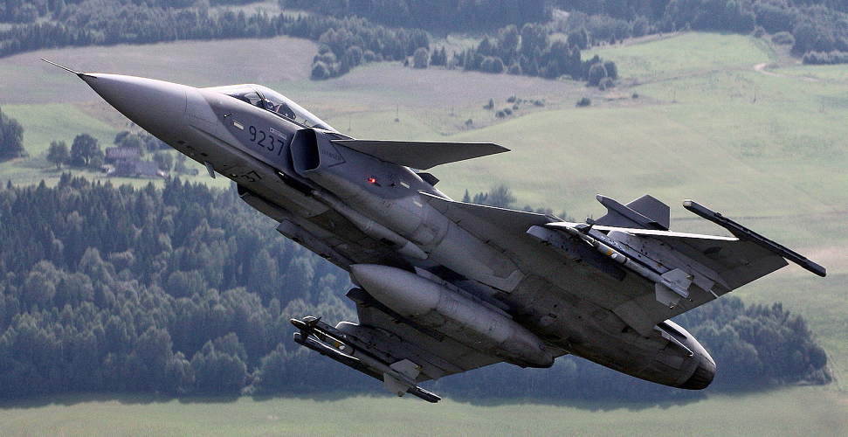
5. LVC Interoperability Use Case
The Task: A ground-based Command and Control (C2) system is being enhanced and must be tested.
The present test method stimulates the C2 system under test with real data sent from a live aircraft via a Tactical Data Link (radio).
This is a *very* expensive way to test a ground-based C2 system.
Great savings would be achieved if the tests used a flight simulator instead of a real aircraft.
C2 system under test
Tactical Data Link (TDL), e.g. Link16

Slide 46
LVC Interoperability Use Case
An available flight simulator has a Link 16 “Data Link Processor” (interface), so the flight simulator can be used to stimulate the C2 system under test.
C2 system under test
Tactical Data Link (TDL), e.g. Link16
Data Link Processor
Everything’s good … right?

Slide 47
LVC Interoperability Use Case
Analysis of the “real world” reveals:
The flight simulator has an older HLA 1.3 interface … and uses a vendor-modified version of the RPR-FOM (“Didn’t anyone tell them to avoid building stove-pipes?!!”)
A scenario generator, with DIS & SIMPLE interfaces, is available to insert simulated tracks of other aircraft into the Link 16 network.
The data link processor has a SIMPLE interface.
Link 16 is represented in two ways, standards-based and non-standards-based.
C2 system under test
Tactical Data Link (TDL), e.g. Link16
HLA 1.3 with proprietary additions to FOM
Data Link Processor
SIMPLE
DIS
Scenario
Generator

Slide 48
LVC Interoperability Use Case
DSEEP-driven feasibility study suggested:
Use HLA as the common interoperability solution
Insert an HLA to HLA bridge to filter/modify vendor-specific (non-standard) RPR-FOM extensions
Use a gateway from HLA/RPR-FOM to DIS, to connect with the Scenario Generator
Some Limitations Accepted:
Simulator data is accepted as the “ground truth”
“J messages” from flight simulator are not bridged
No voice communications
C2 system under test
Tactical Data Link (TDL), e.g. Link16
HLA 1.3 with proprietary additions to FOM
Data Link Processor
standard HLA 1516
SIMPLE
Bridge
HLA 1.3 to
HLA 1516
Gateway
HLA-DIS
DIS
Scenario
Generator

Slide 49
LVC Interoperability Use Case
Integration spiral demonstrated:
Selecting HLA as a standard was appropriate due to HLA technology and performance plus existing HLA-based solutions and experience
RPR-FOM extensions, HLA to DIS gateway, and HLA to HLA bridge concepts were acceptable
The DIS network did not work due to computer clocks not being in sync (or set correctly)
The scenario generator’s DIS interface only worked in one direction
Security aspects needed further analysis
Success! Initial tests produced good results with previously known limitations
Additional actions required:
Updating the Scenario Generator’s DIS interface
Getting approval from responsible authorities to synchronize the computer clocks
Getting approval to run tests with a dedicated Link16 network and the participating real aircraft on the ground (when the flight simulator was not being used as a substitute for the real aircraft, and to validate data)
49

Slide 50
6. Summary: Standards
There are several standards available for Live-Virtual-Constructive interoperability
Some are especially made to support simulation
Some are focused on use with live systems
Standards needs to be maintained and updated
New requirements emerge over time
Standards need to be balanced between stability and flexibility
Stable enough to allow systems to be developed that support the same version of the standard
Flexible enough to be useful and support current requirements plus new and evolving requirements

Slide 51
Summary: Standards (2)
Standards should not be selected only on technical merits
A “Community of Users” helps tremendously
Ensures long-term use of a standard … avoids obsolescence
Promotes evolution of a standard
Communication forum about common LVC applications, problems, and solutions
Industry Support (the marketplace) is very important
Government and Commercial Off-The-Shelf (GOTS/COTS) products, generally costing less than custom-developed solutions
On-demand training courses
On-demand technical assistance
Promotes adoption and evolution of standards (e.g. trade show demos)
Organizations should try to use a limited number of interoperability LVC standards
Deviations must be expected to fit unusual situations
Develops “in-house” skills and experience that will be needed on future programs
Adopt Gateways as initial approach to integrate disparate architectures

Slide 52
Summary: Standards (3)
Integrating LVC-based systems via distributed simulation is a powerful capability
LVC interoperability across domains, e.g. involving multiple military groups, creates operationally realistic environments
Supplementing a single system with other LVC systems greatly enhances realism of training
The whole is greater than the sum of its parts
Integrating C2 systems with LVC systems builds environments that are operationally realistic
“Train As We Fight”
Standards enhance integration and reuse of other LVC assets, tools and technologies
Standards eliminate or greatly reduce time, cost, and performance risks of developing specialized systems (remember: “Avoid stove-pipes.”)
Standards-based instrumentation and management functions within an environment provide coordination of planning and execution, data collection and analysis, and repeatability
Leveraging existing standards and existing networks let program managers “do more with less”

Slide 53
Summary: Standards (4)
Distributed simulation has advanced greatly since first attempts in the 1980’s. Simulation developers today can establish LVC environments to solve very complex problems, at the System of Systems level, relatively easily and quickly.
Selection of the appropriate interoperability architecture … DIS, HLA, or TENA … is sometimes at the user’s discretion, but other factors may favor one architecture over the others, such as technical features, the need to connect with systems already in place, or organizational policies.
Be sure to choose between DIS, HLA, or TENA, based on current information!
We’re in the year 2022 now, not 1986, 2000, or even 2010
Best advice…Get involved!!!
53

Slide 54
Bibliography
IEEE Std 1278.1-2012 - IEEE Standard for Distributed Interactive Simulation Application Protocols, IEEE Standard 1278.1, 2012.
IEEE Std 1516.1-2010 (Revision of IEEE Std 1516.1-2000) - IEEE Standard for Modeling and Simulation (M&S) High Level Architecture (HLA)-- Federate Interface Specification, IEEE Standard 1516.1,2010
IEEE Std 1516-2010 (Revision of IEEE Std 1516-2000) - IEEE Standard for Modeling and Simulation (M&S) High Level Architecture (HLA)-- Framework and Rules, IEEE Standard 1516,2010
IEEE Std 1730-2010 - IEEE Recommended Practice for Distributed Simulation Engineering and Execution Process (DSEEP) , IEEE Standard 1730, 2010
Powell, Edward, et al (2006). Test and Training Enabling Architecture (TENA) Architecture Reference Document (ARD), Office of the USD(AT&L) Test Resources Management Center (TRMC), 2016
Tolk, Andreas, et al (2003) The Levels of Conceptual Interoperability Model, 2003 Fall Simulation Interoperability Workshop, 2003
Websites
TENA Project: https://www.tena-sda.org/.

