Slide 1
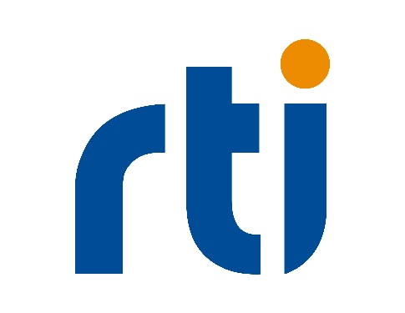
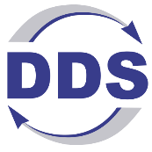

Secure Distributed Simulation Training Systems Anywhere, with Object Management Group (OMG) Data Distribution Service TM (DDS)
Presenter 1, Rob Proctor/Real-Time Innovations
Presenter 2, John Breitenbach/Real-Time Innovations

Slide 2
Agenda
The Modular Open Systems Approach and the US DoD Data Strategy
  Why is the DoD calling for Data-Centricity
  Why are these are required for all DoD systems
Introduction to Interoperability and Interconnectivity
  What are the different levels of interoperability
  What are the requirements for semantic interoperability
Intro to Data Distribution Service (DDS) an Object Management Group (OMG) Standard
  The history and makeup up the OMG DDS standards
  How OMG DDS is a data-centric publish-subscribe protocol
  How do the features of OMG DDS provide interoperability within and between systems, including APIs, Quality of Service (QoS), Discovery, and Wide Area Network (WAN) connectivity
Intro to OMG DDS Secure, OMG Standard
  Authentication, Role-Based Access Control, Encryption, Data Tagging, and Event Logging
  Fine-grained security configuration including securing individual data topics
Examples of securing real-time distributed LVC simulations with OMG DDS
OMG DDS within Simulation Interoperability Standards Organization (SISO)
  Common Image Generator Interface (CIGI)
  Simulation Scale (SimScale)

Slide 3
Tutorial Learning Objectives
After taking this tutorial you should be able to:
Understand the Requirements for MOSA and Data-Centricity
Understand the different layers of interoperability
Describe the OMG DDS suite of standards
Explain the principles of the OMG DDS Secure standard for securing communications between distributed simulations over WAN/Cloud/RF/Lossy networks
Explain how OMG DDS works with the simulation standards TENA, HLA and DIS
Summarize how OMG DDS works with real-world Hardware In the Loop (HIL) for secure distributed LVC simulations at scale
Describe how OMG DDS is working within SISO

Slide 4
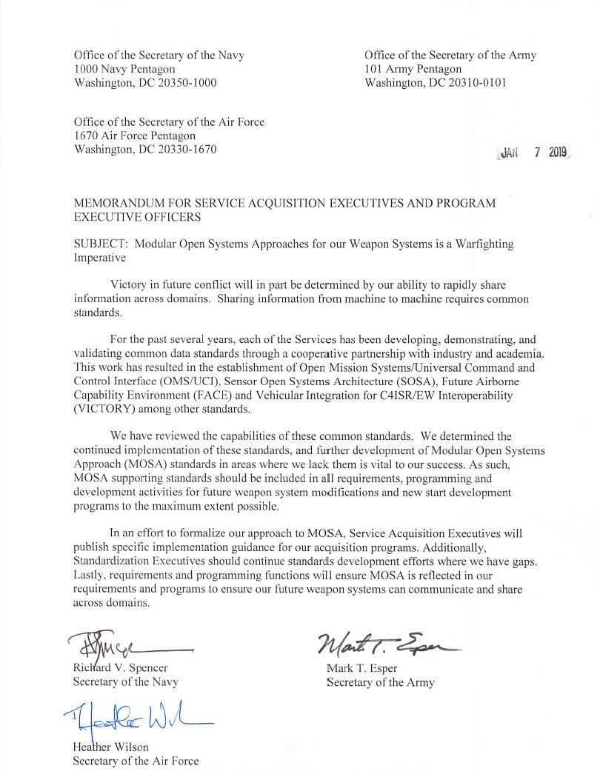
OMG DDS with MOSA Requirement
Tri-Service acquisition memorandum signed by the Secretaries of the U.S. armed services – directed using Modular Open Systems Approach (MOSA)
Specifically cites standards
  Sensor Open Systems Architecture (SOSA)
  Open Mission Systems/Universal Command and Control Interface (OMS/UCI)
  Future Airborne Capability Environment (FACE)
  Vehicular Integration for C4ISR/EW Interoperability (VICTORY)
  …“as vital to our success”
OMG DDS is certified conformant and/or aligned to every standard called out in the provided memorandum

Slide 5
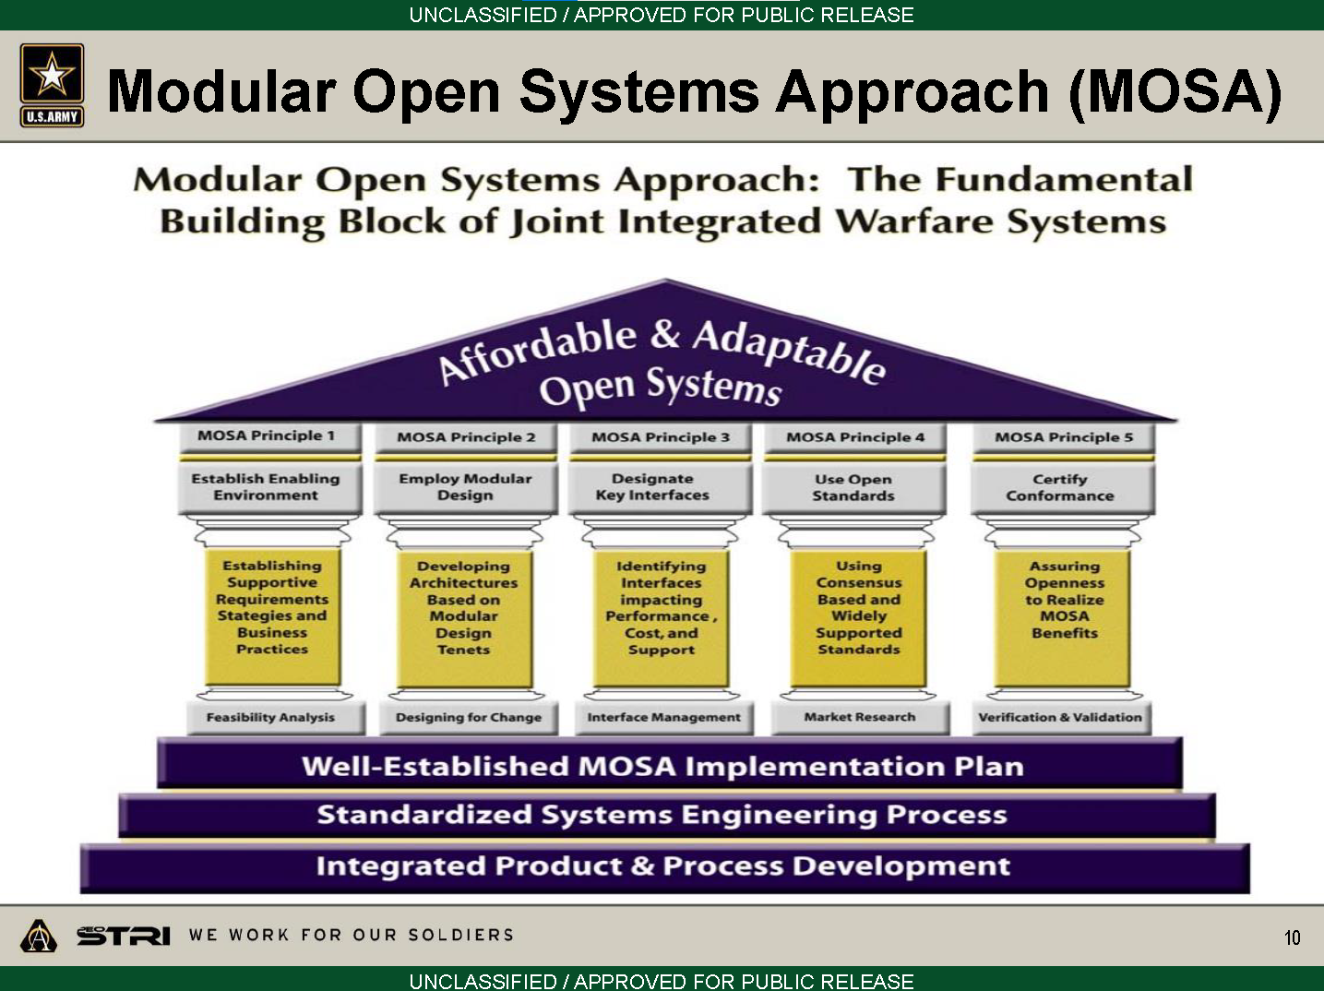

Slide 6
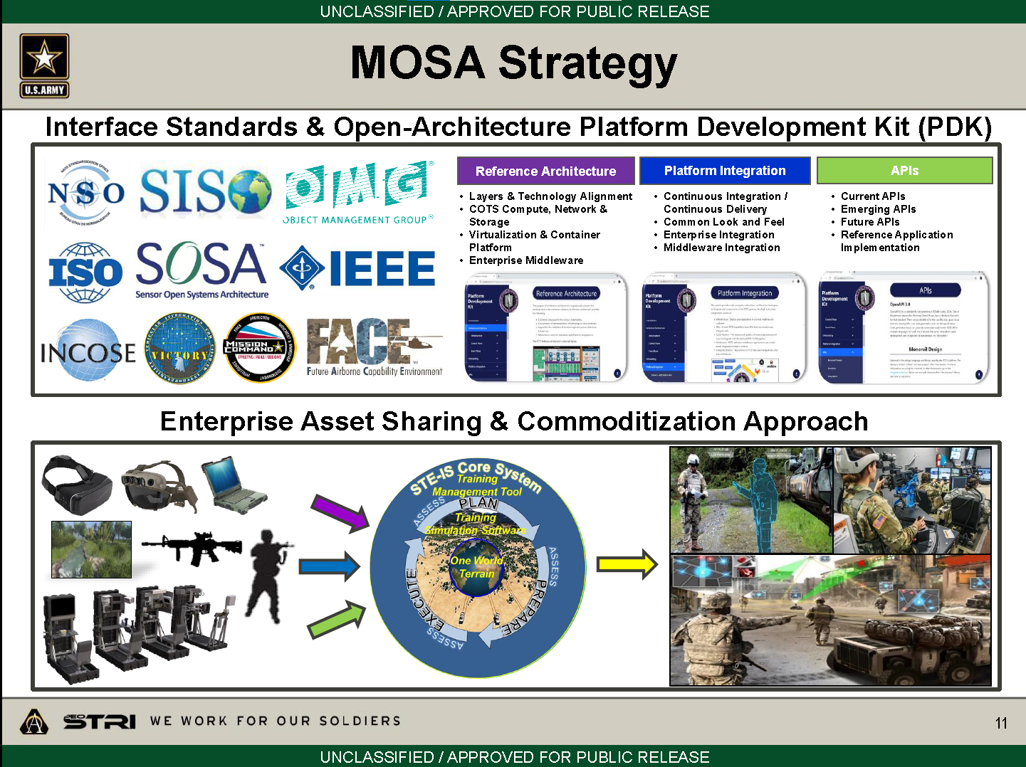

Slide 7
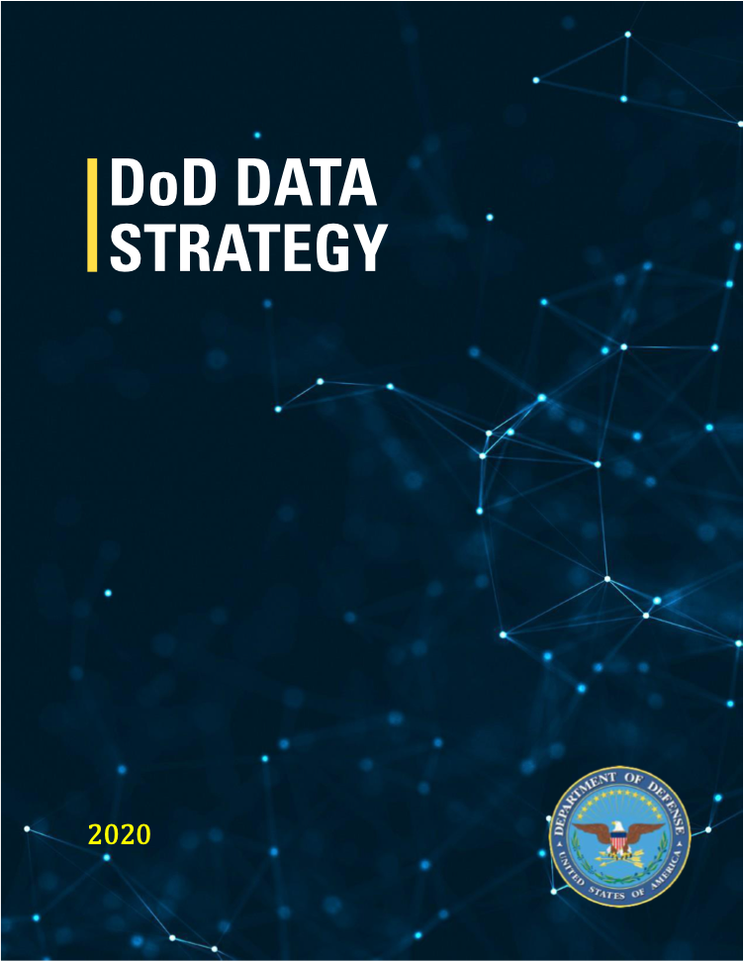
The Demand for Data-Centricity also applies to LVC
DoD Data Strategy
Unleashing Data to Advance the National Defense Strategy
“It is the responsibility of all DoD leaders to treat data as a weapon system and manage, secure, and use data for operational effect”
Vision: “The DoD is a data-centric organization that uses data at speed and scale for operational advantage and increased efficiency”
Notes:
Vision: “The DoD is a data-centric organization that uses data at speed and scale for operational advantage and increased efficiency”
One of the guiding principles:
Data for Artificial Intelligence Training – Data sets for A.I. training and
algorithmic models will increasingly become the DoD’s most valuable digital
assets and we must create a framework for managing them across the data lifecycle
that provides protected visibility and responsible brokerage.

Slide 8
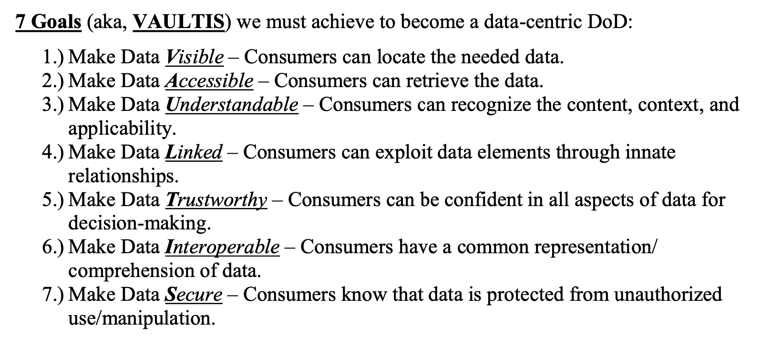
7 Goals to Becoming a Data-Centric DoD
Notes:
VAUL&I: are core DDS data-centric, data-model capabilities
T&S: Trustworthy and Secure are enable by DDS Secure
1. Make Data Visible -- Consumers can locate the needed data
2. Make Data Accessible -- Consumers can retrieve the data
3. Make Data Understandable -- Consumers can recognize the content, context, and applicability
4. Make Data Linked - Consumers can exploit data elements through innate relationships
5. Make Data Interoperable -- Consumers have a common representation / comprehension of data
6. Make Data Trustworthy -- Consumers can be confident in all aspects of data for decision-making
7. Make Data Secure -- Consumers know that data is protected from unauthorized use / manipulation
So, sims for training need to be interoperable meanwhile there are these new MOSA and Data-Centric requirement mandates.

Slide 9
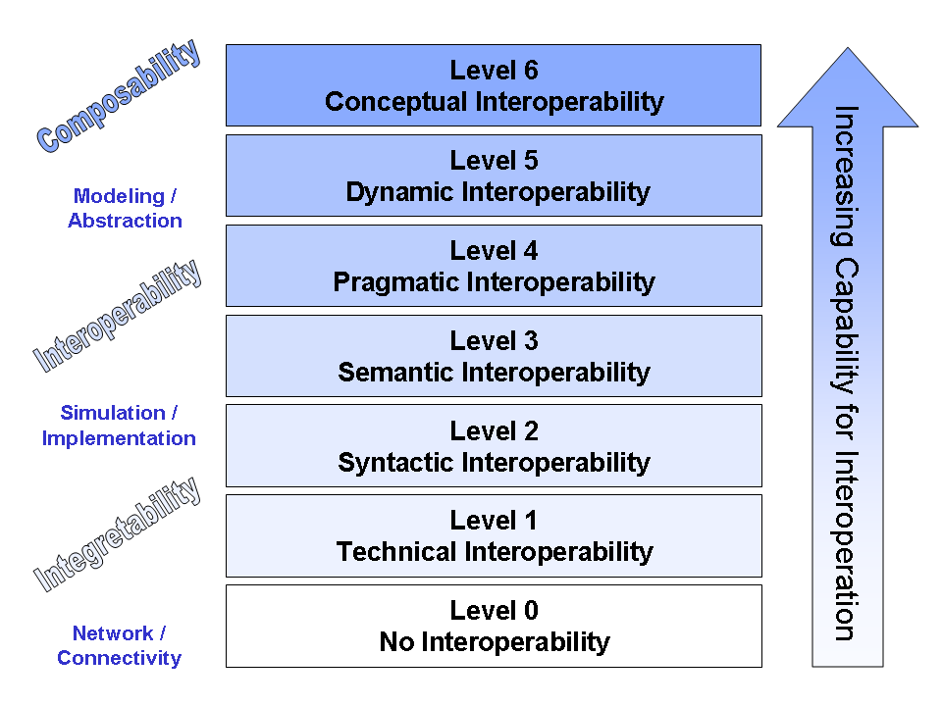
Levels of Interoperability
Shared data context
Shared data structure
Shared opaque data
Notes:
IIRA defines: Connectivity = Infrastructure for Communications Interoperability
Example: Two people are integrable (level 1) if both are able to speak and listen; interoperable (level 2) if they speak the same language; and composable (level 3+) if they share similar educational background so that enables them to collaborate on specific tasks.
Syntactic interoperability: make it easy to share types. Evolve those types. Be typesafe
Semantic interoperability: select an existing or industry-specific model and use it. Generic data modeling is hard. Mandate all lower levels.
Stop here. Above this is human work
Level 0: Stand-alone systems. No Interoperability.
Level 1: Technical Interoperability. A communication protocol exists for exchanging data between participating systems. On this level, a communication infrastructure is established allowing systems to exchange bits and bytes, and the underlying networks and protocols are unambiguously defined.
Level 2: Syntactic Interoperability. A common structure to exchange information; i.e., a common data format is used. On this level, a common protocol to structure the data is used; the format of the information exchange is unambiguously defined. This layer defines structure.
Level 3: Semantic Interoperability. The meaning of the data is shared; the content of the information exchange requests are unambiguously defined. This layer defines (word) meaning. There is a related but slightly different interpretation of the phrase semantic interoperability, which is closer to what is here termed Conceptual Interoperability, i.e. information in a form whose meaning is independent of the application generating or using it.
Level 4: Pragmatic Interoperability is reached when the interoperating systems are aware of the methods and procedures that each system is employing. In other words, the use of the data – or the context of its application – is understood by the participating systems; the context in which the information is exchanged is unambiguously defined. This layer puts the (word) meaning into context.
Level 5: Dynamic Interoperability: As a system operates on data over time, the state of that system will change, and this includes the assumptions and constraints that affect its data interchange....
Level 6: Conceptual Interoperability …

Slide 10
IIoT Connectivity Stack Model
Participant X
Participant Y
Distributed Data
Interoperability and Management
Information (Data in Context)
Distributed Data
Interoperability and Management
Semantic
Interoperability
(data context)
Information
Framework
Data (State, Events, Streams)
Framework
Syntactic
Interoperability
(data structures)
Connectivity
Transport
Messages
Transport
Technical
Interoperability
(bytes)
IICF Focus
Network
Packets
Network
Networking
Link
Frames
Link
Physical
Bits
Physical
Notes:
Framework & Transport Layer
How to get interoperable data?
What is the lingua franca?
Get all parties to communicate!
Assume, Networking layer already setup
People know how to do this
Recognize the other layers

Slide 11
Connectivity Transport Layer
Framework
Distributed Data Interoperability & Management
Transport
Connectivity
Transport
Functions
Messaging Protocol
Technical
Interoperability
Communication Modes
Endpoint
Addressing
Connectedness
Prioritization
Timing & Synchronization
Security
Network
Link
Physical

Slide 12
Connectivity Framework Layer
Framework
Distributed Data Interoperability & Management
API
Governance
Connectivity
Framework
Functions
Publish-Subscribe
Request-Reply
Discovery
Exception Handling
Quality of Service (QoS)
Security
Syntactic
Interoperability
Data Resource Model
Id and Addressing
Data Type System
Lifecycle (CRUD)
State Management
Transport
Network
Link
Physical
Notes:
Data Resource Model = Meta-Model for modeling application data/resources
Exception Handling = e.g. disconnects. Or when QoS cannot be met. System detects changes that cannot be healed.

Slide 13
OMG DDS Interoperability
OMG DDS is
  An interoperability framework for Real-Time systems
  That uses the notion of a logical software-based Databus
  OMG DDS supports ANY data model, and makes the Data itself the interface
  In fact, the OMG DDS connectivity framework is something that you build upon when you set out to create a new interoperability standard based on an industry-specific data model
  The result is that OMG DDS underpins a lot of familiar standards…
OMG DDS provides interoperability between
  Other implementations of OMG DDS
  Any communication standards (DIS, TENA, HLA, Modbus, OPC-UA, etc.)
  1000s of DoD live systems
Notes:
Current simulation standards are a great what and why. DDS is the best how.

Slide 14
OMG DDS is under the hood of many standards
Standard | Industry
Modular Healthcare Simulation and Education System (MoHSES) | Simulation / Healthcare
ALert MAnagement Service (ALAMS) | Defense
Application Management and Systems Monitoring (AMSM) | Defense
Future Airborne Capabilities Environment (FACE) | Defense
Generic Vehicle Architecture (GVA) NATO Generic Vehicle Architecture (NGVA) | Defense
Land Open Systems Architecture (LOSA) | Defense
Medical Simulation Training Architecture (MSTA) | Simulation / Healthcare
Open Field Message Bus (OpenFMB) | Power / Energy
Open Mission Systems (OMS) | Aerospace
Open Process Automation Forum (OPAF) | Process Automation
Standard | Industry
Open Robotics Robotic Operating System v2 (ROS2) | Horizontal / Robotics
Sensor Open System Architecture (SOSA) | Defense
Tactical Microgrid Standards Consortium (TMSC) | Energy
Unmanned Systems (UxS) Control Segment (UCS) Architecture | Defense
Robot Operating System-Military; Robotic Technology Kernel (ROS-M and RTK) | Defense / Robotics
Joint Architecture for Unmanned Systems (JAUS) | Defense / Robotics
Naval Open Systems Architecture (OSA) | Defense
Control Architecture for Robotic Agent Command and Sensing (CARACaS) | Aerospace / Autonomous Vehicles
Multi-Robot Operator Control Unit (MOCU) | Aerospace / Robotics
Unmanned Maritime Autonomy Architecture (UMAA) | Defense / Autonomous Vehicles

Slide 15
Why is OMG DDS so widely used ‘under the hood’ for these standards?
Hypertext Transfer Protocol (HTTP) – UNIVERSAL TRANSPORT
Representational State Transfer (REST) – UNIVERSAL API
  Used together they build the vast majority of web-based applications
  Good for human speed, but tends to be 1-1; you connect to the bank, email, website, etc.
But what about real-time applications?
  And live real-time systems that might have communication needs such as:
    1 to many
    many to 1
    many to many (thousands of actual participants to millions of entities)
    with real-time speeds and security requirements

Slide 16
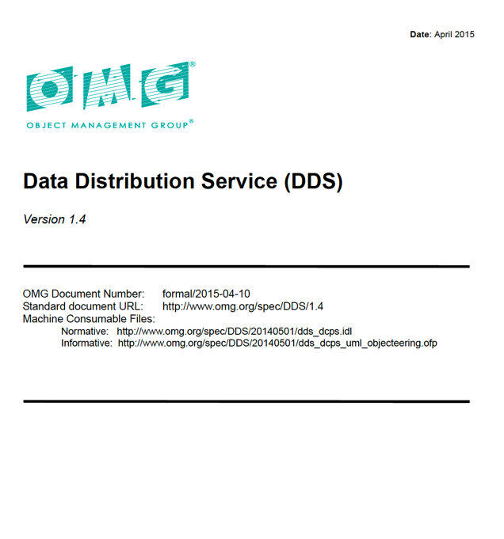
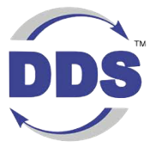
OMG Data Distribution Service Standard
From OMG, systems software standards organization
  Digital Twin Consortium
  UML, XML, IDL, CORBA, DDS
  Standard can be downloaded for free by anyone
  More than a dozen commercial implementations available
First version of the OMG DDS standard was released in 2004
  Most recent updates were May 2019
A family of 13 standards covering API, wire protocol, security, type evolution, etc.

Slide 17
OMG Data Distribution Service Standard
OMG DDS is a standard for data-centric connectivity and interoperability for real-time systems
Data-Centric Publish-Subscribe model for distributed application communication and integration
Standardizes wire protocol, serialization format and API
OMG DDS is open and multi-vendor
  Open Standard and Open Source
  12+ implementations
Interoperability between source
written for different vendors
OMG DDS APIs: Data Centric Publish Subscribe (DCPS)
OMG DDS Security
Plug-In
QoS
Distribution Fabric
QoS
QoS
Real-Time Publish Subscribe
Wire Protocol (RTPS)
Interoperability between applications
running on different implementations

Slide 18
OMG Data Distribution Service Standard
OMG DDS is Publish-Subscribe, Data-Centric, and Peer-to-Peer
  OMG DDS also supports request-reply and queueing
Designed for real-time mission critical and safety critical systems
  Started in Robotics and SW Defined Radios using Tactical Data Links
  Navy wanted it turned into an open standard, now widely used in the Navy
OMG DDS applications share large amounts of data quickly, securely, and reliably at massive scale
OMG DDS provides location transparency, decentralized operation, dynamic scalability, and real-time performance
Its widespread use in distributed real-time military systems has led to strong interest in the modeling, simulation and training community

Slide 19
OMG DDS is made for real-time interoperability
OMG DDS defines
  Open API for portability
  Open wire protocol for interoperability
    Transport agnostic
  Open explicit defined QoS and discovery
    Highly configurable
Multiple language bindings
  C, C++, Java, C# .NET, Ada
  LabVIEW, MATLAB/Simulink
  Python, NodeJS
Multi platform support
  Windows, Linux, Unix, embedded OS, Docker, Kubernetes
Application
Standard
API
OMG DDS Middleware
Data Management (QoS)
OMG DDS Security
Standard
Protocol
UDP
TCP
RT-WAN
Shmem
Operating System

Slide 20

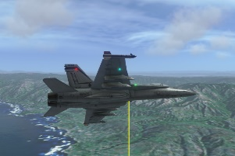
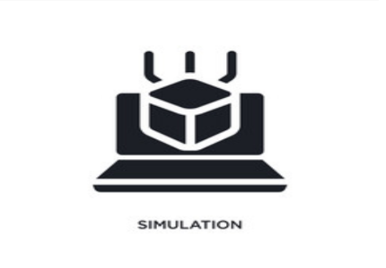
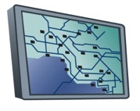
Data-Centric Publish Subscribe
Global Data Space
Sensor
Source** | string
Speed | float
Altitude | float
Actuator
Id** | string
Command | string
Status | float
Reliable
100 Hz
OMG DDS Databus
Reliable
25 Hz
Altitude < 5000 ft
Best effort
2x / Sec

Slide 21
OMG DDS Data-Centric Model
Data objects addressed by Domain ID, Topic and Key
  Domains provide a level of isolation
  Topic groups homogeneous subjects (same data-type & meaning)
  Key is a generalization of subject
Domain
Data Writer
Key (subject)
Topic
Data Reader
License Plate | Speed | Battery Remaining | GPS Location
DKW 8307 | 41 | 73% | 39.9524, -75.1636
YQC 4149 | 64 | 55% | 28.3794, -81.5494
Data Writer
Instance
YQC 4149 | 68 | 48% | 28.3903, -81.5141
Data Reader
YQC 4149 | 70 | 47% | 28.4118, -81.4802
Data Writer
Traffic Light | State | Time Left | Operational Mode
35803 | Green | 23 sec | Automatic
82915 | Red | 6 sec | Manual Override
Data Writer
Data Reader
Notes:
Introduction to definitions

Slide 22
OMG DDS Data Centric Publish Subscribe API
The OMG DDS API lets applications publish data to, and subscribe to data from the OMG DDS Databus
This OMG DDS API is called Data Centric Publish Subscribe (DCPS)
The API is standardized in the OMG DDS v1.4 standard, as a “Platform Independent Model” (PIM)
API operations are mapped to different languages through a “Platform Specific Model” (PSM)
The DCPS API is divided up into “entities” (way different than a simulation entity) which allow an application to:
  connect to the DDS Databus
  create topics
  get notified of infrastructure-level events (new subscriber, new publisher, …)
  publish and subscribe to application data
Each OMG DDS entity has a set of QoS settings that determine the behavior of the entity

Slide 23
OMG DDS Publish Subscribe API: Entities
DomainParticipant
Create & manage connection to OMG DDS Databus

Slide 24
OMG DDS Publish Subscribe API: Entities
DomainParticipant
<< creates >>
Topic
Create a proxy to a topic in the application

Slide 25
OMG DDS Publish Subscribe API: Entities
DomainParticipant
<< creates >>
<< creates >>
Manages group of DataWriters
Manages group of DataReaders
Publisher
Topic
Subscriber
<< creates >>
<< creates >>
DataWriter
DataReader

Slide 26
OMG DDS Publish Subscribe API: Entities
DomainParticipant
Publisher
Topic
Subscriber
<< creates >>
<< creates >>
DataWriter
<< uses >>
DataReader
<< uses >>
Publishes data to OMG DDS Topic
Subscribes to data from OMG DDS Topic

Slide 27
OMG DDS Publish Subscribe API: Entities
DataReaders (DR) and DataWriters (DW) are strongly typed
Their APIs are generated from Interface Definition Language (IDL)
struct ShapeType {
string<128> color;
long x;
long y;
long shapesize;
};
ShapeTypeDataWriter_write
ShapeTypeDataWriter_dispose
ShapeTypeDataReader_read
ShapeTypeDataReader_take

Slide 28
OMG DDS Topic Data Types
struct MyType {
long sensorID; //@Key
long plantID; // @Key
float sensorVal0;
float sensorVal1;
float sensorVal2;
float sensorVal3;
float sensorVal4;
Version version;
Time currentTime;
}
struct Version {
string firmwareVersion;
string hardwareVersion;
string modelNumber;
string serialNumber;
}
struct MyType {
long sensorID; //@Key
long plantID; // @Key
string data;
string version;
}
Where data =
<SENSOR>
<Value0>21.0546</Value0>
<Value1>43.6</Value0>
<Value2>56.34</Value0>
<Value3>12.11</Value0>
<Value4>20.00</Value0>
</SENSOR>
version =
<VERSION>
<firmware>1.24b</firmware>
<hardware>2.39</hardware>
<model>M56A743</model>
<serial>1429709<serial>
</VERSION>
struct MyType {
string data;
}
Where data =
<SENSOR>
<SensorID>438</SensorID>
<PlantID>192</PlantID>
<Value0>21.0546</Value0>
<Value1>43.6</Value0>
<Value2>56.34</Value0>
<Value3>12.11</Value0>
<Value4>20.00</Value0>
<firmware>1.24b</firmware>
<hardware>2.39</hardware>
<model>M56A743</model>
<serial>1429709<serial>
</SENSOR>
Strongly Typed
Mixed Type
Loosely Typed
Notes:
Tesla vs Hybrid vs DDS as a Truck

Slide 29
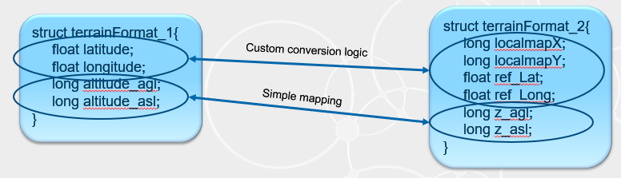
Data Type Extensibility
Final Type
  Type definitions are strictly defined
Extensible Type
  Newer applications can add fields to existing base types
Mutable Type
  Type representations can differ from each other with Additions, Deletions and Transpositions
  Support for Optional Fields
struct Track {
long id; //@key
float range;
float bearing;
}
struct Track {
long id; //@key
float range;
float bearing;
}
struct Track {
long id; //@key
float range;
float bearing;
}
struct AirTrack {
long id; //@key
float range;
float bearing;
float elevation;
}
struct Track {
long id; //@key
float range;
float bearing;
}
struct AirTrack {
long id; //@key
float elevation;
}
Notes:
Standard provides a mechanism for a chain of extensibility to evolve over time

Slide 30
Simple API Interface
void publisher_main(int domain_id) {
// Initialize
dds::domain::DomainParticipant participant (domain_id);
// Create a Topic
dds::topic::Topic<foo::TopicType> topic (participant, "MyTopic");
// Create a Data Writer
dds::pub::DataWriter<foo::TopicType> writer(dds::pub::Publisher(participant), topic);
// Create some data
foo::TopicType sample("Hello World");
// Write the data
writer.write(sample);
}

Slide 31
Common Distributed Application Challenges
OMG DDS QoS Features
Reliability
In-Order Delivery
Content Filtering
Resource Limits
Partition
Deadline
Batching
Presentation
Ownership
Transports
Time Based Filter
Durability
Lifespan
Flow Control
Multi-Channel
Liveliness
Latency Budget
History
User, Group, Topic Data
Async Publisher
Transport
UDP
TCP
1-1, 1-Many
1 to 1
No Reliability
Reliability
Flow Control

Slide 32


Using OMG DDS QoS to Shape Data Flow
Collision
avoidance
application
Publisher
Radar Track
Topic
Reliable; 1 Hz;
get history
Subscriber
Publish reliably
10 Hz
600 sample history
Best effort; 0.2 HZ;
get history
NOC Sim
Subscriber
Nearby tracks with
altitude < 5000m
ATC Sim
Subscriber
Discovery matches publishers and subscribers of a topic
Topics tied to Data type, allowing smarter databus
Quality of Service describing application data needs must be compatible to communicate
Specifying and relying only on these data properties enables decoupled, resilient systems

Slide 33
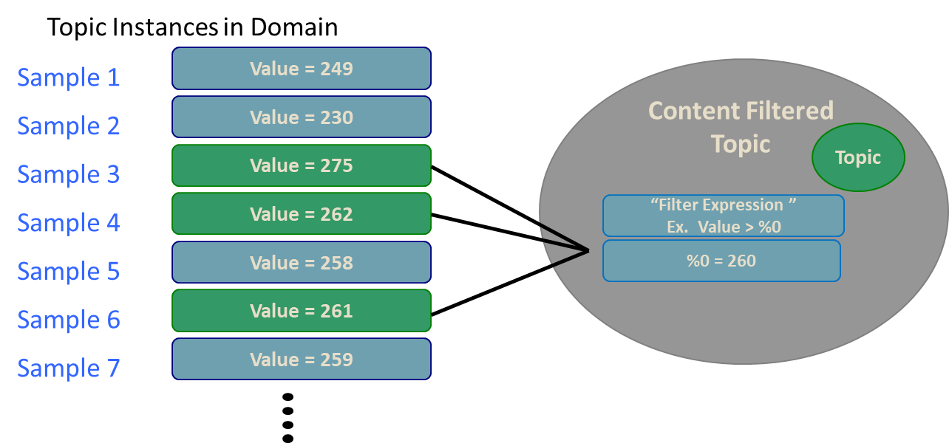
Content Filtered Topics
The Filter Expression and Arguments will determine which instances of the Topic will be received by the subscriber

Slide 34
OMG DDS Publish Subscribe API: QoS conflicts
The DataReader and DataWriter QoS must match if connectivity is to be established
QoS does not need to be equal. It is ok if a DataWriter offers “more” than what a DataReader asks for
    Example: DW = Reliable, DR = Best Effort
DataReader
BEST EFFORT
BEST EFFORT
DataWriter
DataReader
RELIABLE

Slide 35
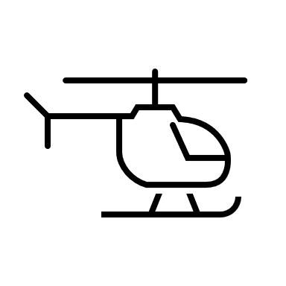
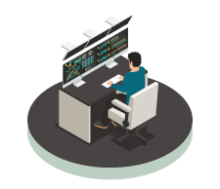
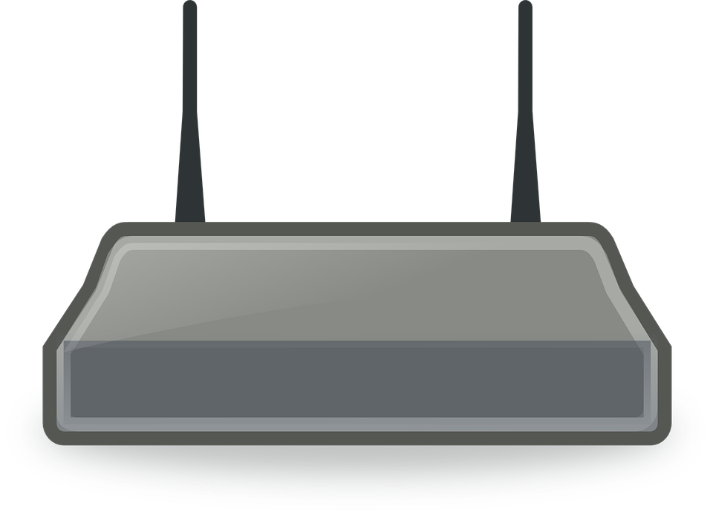

Wide Area Distributed Applications
Asset at the Edge
On-site Operation Center
Wide area distributed applications have more technical challenges
Network changes over time (ex. Wi-Fi to Cellular)
Scalability of data transport and cloud services
Edge device authentication and data security
INTELLIGENT LOGGING AND ANALYTICS, ASSISTANCE
MULTI-VEHICLE ANALYTICS, ASSIST, STORE & FORWARD LOGGING
NAT
NAT
OMG DDS WAN Databus
Cloud
Remote Monitoring, Analytics and Assistance
NAT
MULTI-SITE ANALYTICS & ML, STORE LOGGING

Slide 36

Data Flow Over the Wide Area Network (WAN)
Require:
High performance connectivity across diverse networks
Device mobility support across networks
Scalability with a much larger number of endpoints
Data security at minimal cost (bandwidth, latency etc.)
NAT traversal support

Slide 37
OMG DDS real-time WAN Transport
Smart transport enabling secure, scalable, and high-performance communication over WANs, including public networks
Features include:
UDP based WAN connectivity
Network Address Translator (NAT) traversal
Support for IP mobility
No third-party system dependence, such as STUN servers
Direct Edge-Edge communication
OMG DDS Databus @ Edge
Real-Time WAN Transport
Gateway
OMG DDS Databus @ WAN
Real-Time WAN Transport
OMG DDS Application

Slide 38

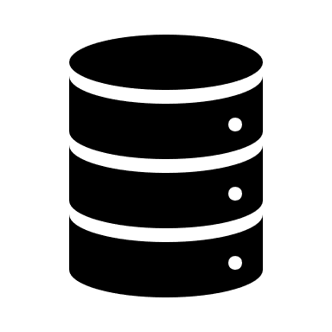




OMG DDS Across a WAN
Edge-to-Data Center connectivity across a WAN
Edge-to-Edge connectivity across a WAN
OMG DDS connectivity within Data Centers and Edge Systems
Data
Center
Analyze
Store
Aggregate
Databus
NAT
Real-Time WAN Transport
OMG DDS WAN Databus
Edge
Systems
NAT
Databus
System Component
Real-Time WAN Transport
Notes:
Not only can edge systems communicate back to a central system, but they can also communicate with each other.

Slide 39

Peer-to-Peer Connectivity Over the WAN
Applications can communicate peer-to-peer over the WAN using the WAN Transport
OMG DDS Databus @ WAN
Real-Time WAN Transport
OMG DDS Application
Notes:
Note - that the participants will be fixed, since multicast is not available.. and only if each participant is accessible through a public address

Slide 40
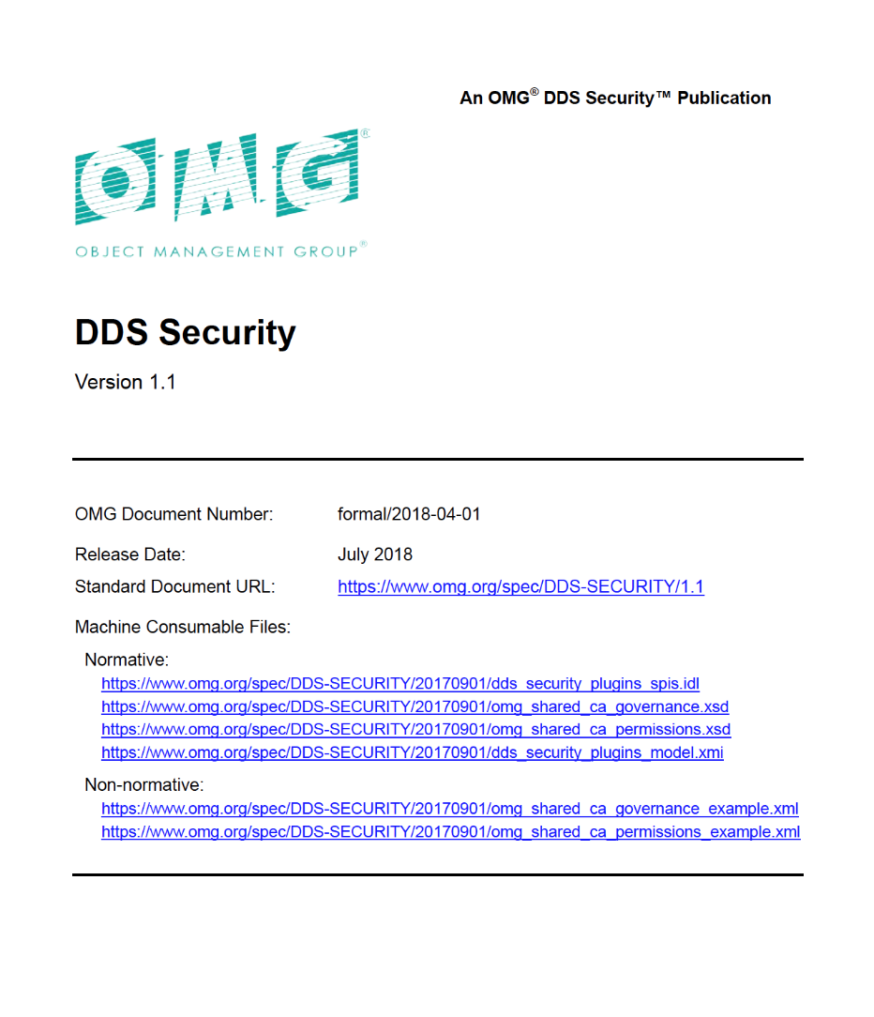

OMG DDS Security Standard
OMG released the DDS Security specification (v1.1) in July 2018
Collaboratively developed by several OMG DDS vendors
Defines:
  OMG DDS Security Model
  Service Plugin Interface (SPI) Architecture

Slide 41
OMG DDS Security Standard
Security Plugs into OMG DDS Middleware
  Secures data-in-motion throughout the system
  Can easily take DIS PDUs or TENA / HLA FOMs and convert them to Secure OMG DDS Topics
  Programming language and Operating System interoperability
Decentralized, Peer-to-Peer, and Highly Configurable
  Fine-grained access control and security levels for each topic and partition
  Each participant separately authenticated through mutual authentication
OMG DDS Security has been vetted at the Cybersecurity Warfare ranges at Quantico, VA and Orlando, FL
  USAF has funded a SBIR project for Multi-Level Security for LVC simulations
OMG DDS Security is a natural fit for Multi-Domain Operations systems
  Joint Battle Command Platform JBC-P
  Integrated Air and Missile Defense Battle Control System IBCS
  Cooperative Engagement Capability CEC
  Universal Ground Control Station UGCS
  All branches of the military, including Space Force, use OMG DDS

Slide 42
OMG DDS: Data-Centric, Fine-Grained Security
Per-Data-Topic Security
  Control r,w access for each function
  Ensures proper dataflow operation
Complete Protection
  Discovery authentication
  Data-centric access control
  Cryptography
  Tagging and logging
  Non-repudiation
  Secure multicast
  100% standards compliant
Simulate
Visualize
Control
Operator
Applications
Data Topics
BaseEntity
Detonation
Fire
Data Topic Security model:
Simulate: Fire(r), BaseEntity(w)
Visualize: BaseEntity(r), Detonation(w)
Control: BaseEntity(r), Fire(w)
Operator: *(r), Fire(w)

Slide 43
Pluggable Architecture
Requires trivial or no change to existing OMG DDS apps and adapters
Includes default plugins; customizable
Runs over any transport
  Including low bandwidth, unreliable
  Does not require TCP or IP
  Multicast for scalability, low latency
Completely decentralized
  High performance and scalability
  No single point of failure
Application
Authentication
OMG DDS Security Library
Access Control
Encryption
Logging
Data Tagging
Any Transport
(e.g., TCP, UDP, multicast, RT-WAN, shared memory…)

Slide 44
Standard Capabilities (Built-in Plugins)
Authentication | X.509 Public Key Infrastructure (PKI) with a pre-configured shared Certificate Authority (CA) Digital Signature Algorithm (DSA) with Diffie-Hellman and RSA for authentication and key exchange
Access Control | Configured by domain using a (shared) Governance file Specified via permissions file signed by shared CA Control over ability to join systems, read or write data topics
Cryptography | aes-128-ctr for encryption HMAC-SHA256 for message authentication and integrity aes-128-gcm, aes-192-gcm and aes-256-gcm for encryption with authentication Certicom and Windows CNG for FIPS 140-2
Logging | Log security events to a file or distribute securely over OMG DDS
Data Tagging | Tags specify security metadata, such as classification level Can be used to determine access privileges (via plugin)

Slide 45
Domain Governance File
The domain governance document is an XML document that specifies which OMG DDS domain IDs shall be protected and the details of the protection
It is signed by the permissions CA

Slide 46
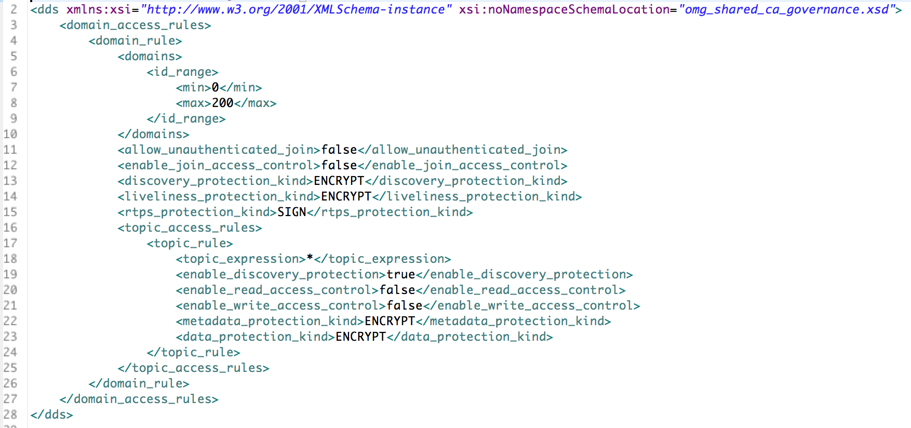
A Sample Governance File

Slide 47
Configuration Possibilities
Are “legacy” or un-identified applications allowed in the Domain?
  If yes, an unauthenticated application will:
    See the “unsecured” discovery Topics
    Be allowed to read/write the “unsecured” Topics
Is a particular Topic discovered over protected discovery?
  If so, it can only be seen by “authenticated applications”
Is access to a particular Topic protected?
  If so, only authenticated applications with the correct permissions can read/write
Is data on a particular Topic protected? How?
  If so, data will be sent signed or encrypted then signed
Are all protocol messages signed? Encrypted?
  If so, only authenticated and authorized applications will see anything

Slide 48
Permissions Document
For each participant, specifies:
  What domains it can join
  What Topics it can read/write
  What Partitions allowed for publish and subscribe
  What Tags are associated with Readers & Writers

Slide 49
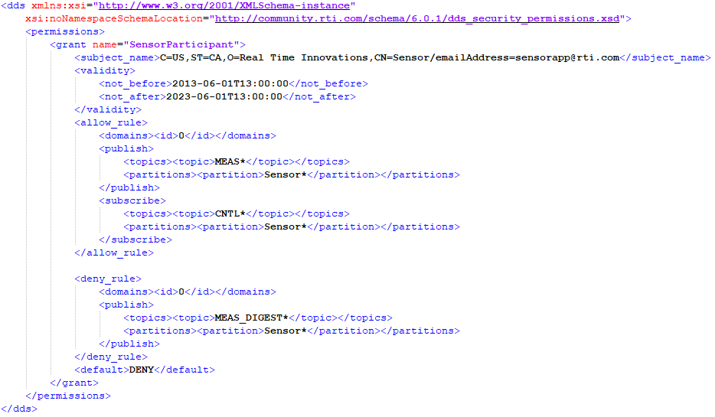
A Sample Permissions File

Slide 50
OMG DDS Publish Subscribe API: Entities
DomainParticipant
OMG DDS Security
OMG DDS Security
Publisher
Topic
Subscriber
<< creates >>
<< creates >>
DataWriter
<< uses >>
DataReader
<< uses >>

Slide 51
Configuring & Deploying OMG DDS Security
Participant 1
Participant 2
P1 Permissions File
P2 Permissions File
P1 Identity Certificate
P2 Identity Certificate
P1 App
P2 App
P1 Private Key
P2 Private Key
Shared By All Participants
Domain Governance
Document
Identity CA Public Certificate
Permissions CA Public Certificate

Slide 52
Configuring & Deploying OMG DDS Security
Security Administration (Out of Band)
Identity CA Private Certificate
Permissions CA Private Certificate
Participant 1
Participant 2
P1 Permissions File
P2 Permissions File
P1 Identity Certificate
P2 Identity Certificate
P1 App
P2 App
P1 Private Key
P2 Private Key
Shared By All Participants
Domain Governance
Document
Identity CA Public Certificate
Permissions CA Public Certificate

Slide 53
Using OMG DDS with distributed LVC simulations
Can leverage/ integrate existing system software
  Over one thousand separate DoD systems (Navy, Air, Army) use OMG DDS
    OMG DDS is mandated by Navy OA for combat management systems
    OMG DDS specified by US DoD for the unmanned vehicle control (OSD-UCS)
    OMG DDS specified by UK-MOD for all Ground Vehicle Architectures
    OMG DDS is a transport for MOSA standards, FACE, SOSA, OMS, UCI
With OMG DDS, simulation systems are able to reuse and integrate software components from actual systems
  This has already been happening for years
OMG DDS is the logical technology for integrating disparate data models in distributed LVC

Slide 54
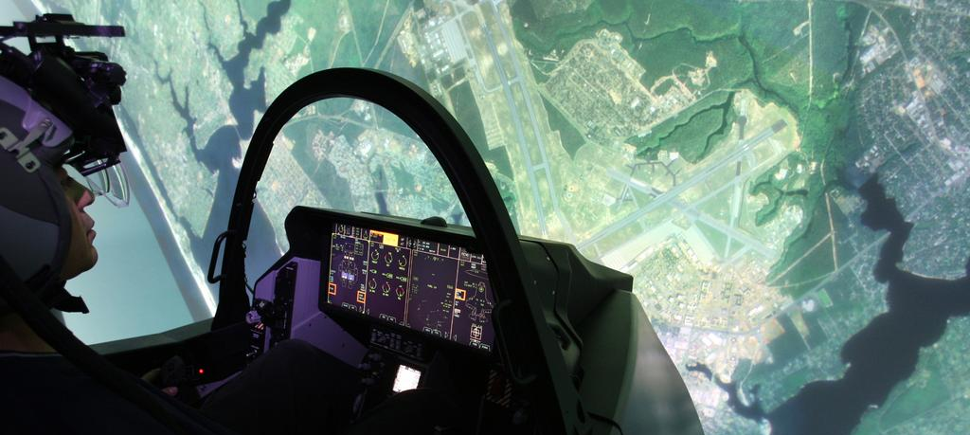
Air Force’s Simulators Common Architecture Requirements and Standards (SCARS) program

Slide 55
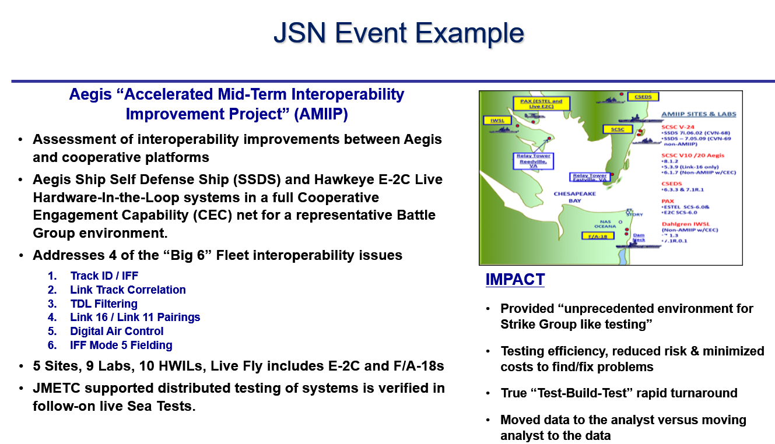
OMG DDS in Simulation: JMETC

Slide 56
Securing distributed LVC simulations with OMG DDS
Can leverage/integrate mission data
  Recorded data from actual mission execution could be combined with simulation data and be used for training
    This approach is already followed in the US Navy OATM
  Rapid feedback from mission to training is key to an agile and effective force.
Can leverage/integrate OMG DDS Security into new distributed simulations
  Secure training and simulations over WAN/Cloud/RF/Lossy Networks/TDL
  Role-based access allow for joint Coalition forces to train alongside US forces
  Multiple SBIRs with different defense agencies for secure LVC simulations

Slide 57
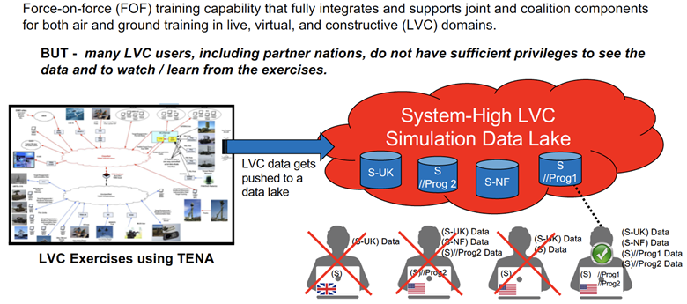
Multi Level Secure MLS, Live Virtual Constructive LVC Simulations

Slide 58
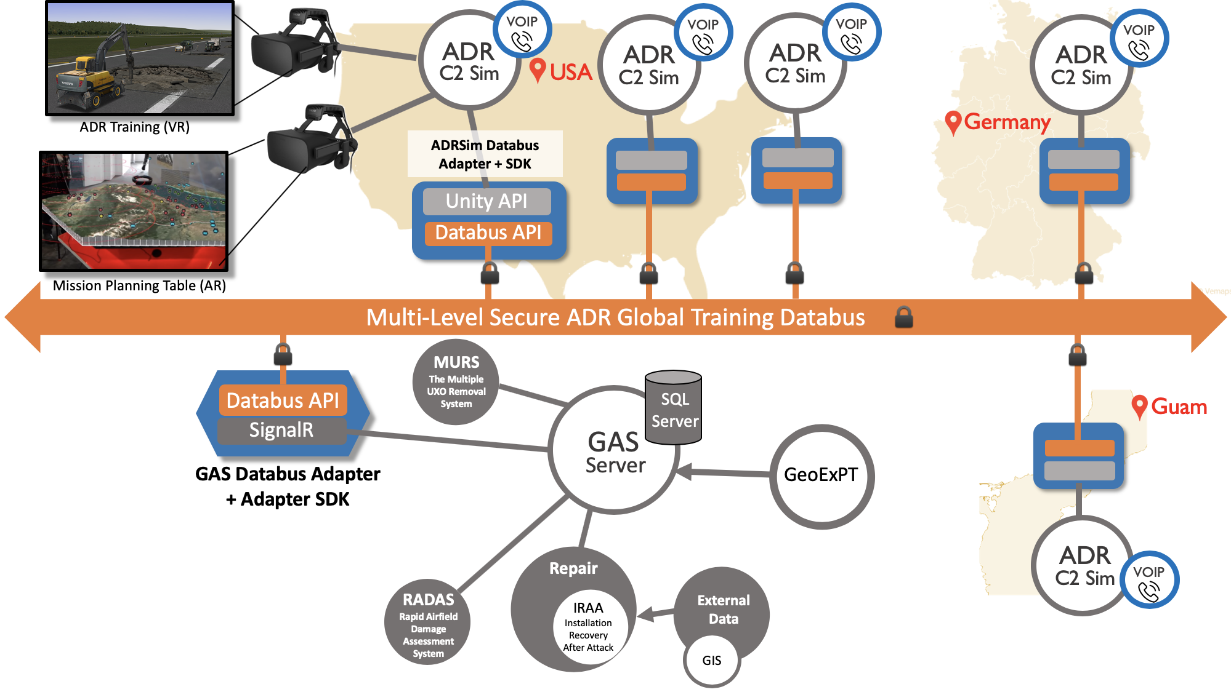
Global Connectivity for USAF Training Simulations

Slide 59
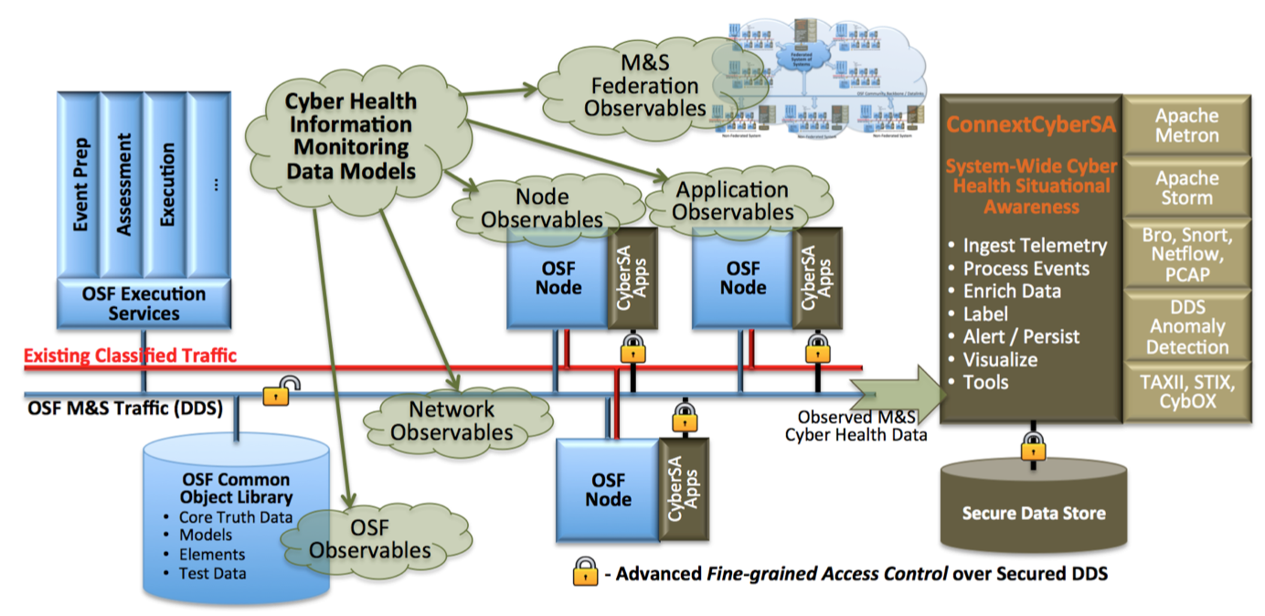
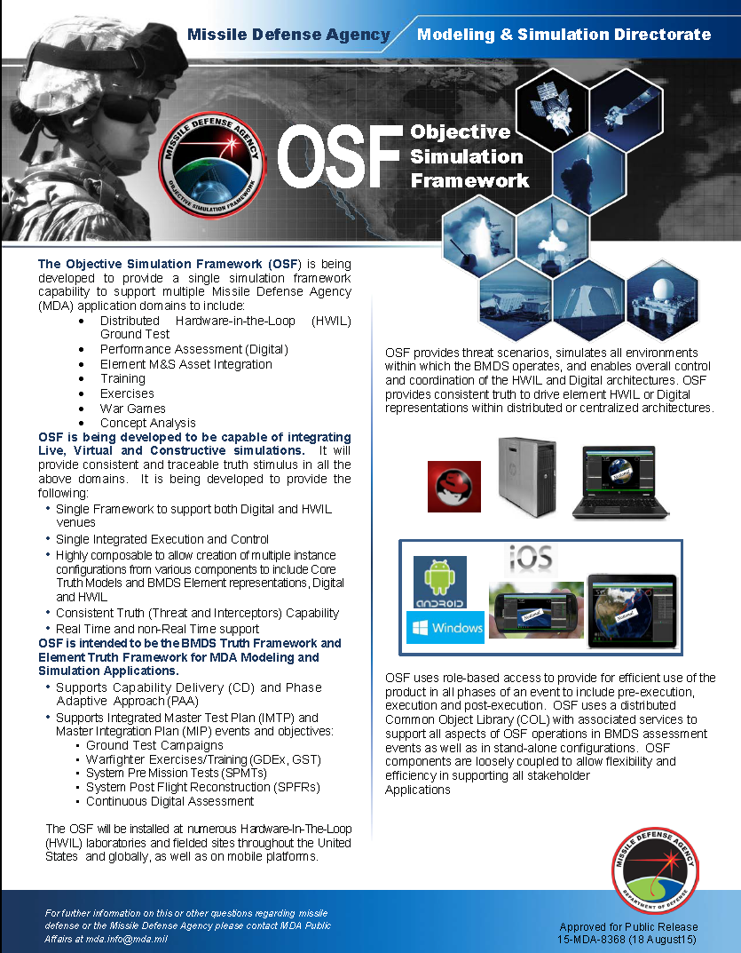
Missile Defense Agency – Objective Simulation Framework
Fully Distributed, Real-Time,
Secure Cyber Situational Awareness for MDA OSF

Slide 60

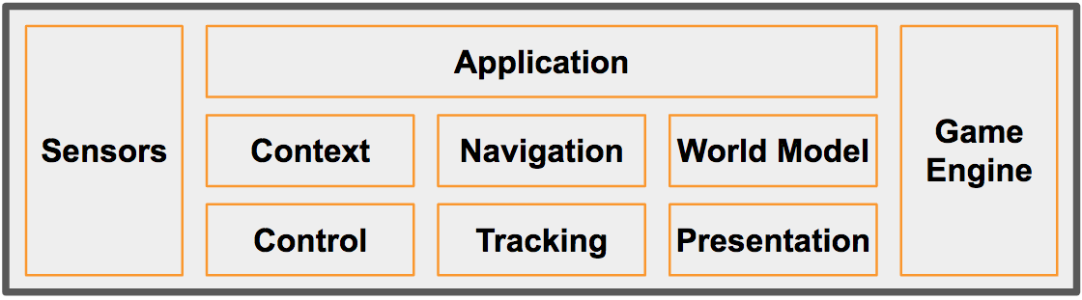
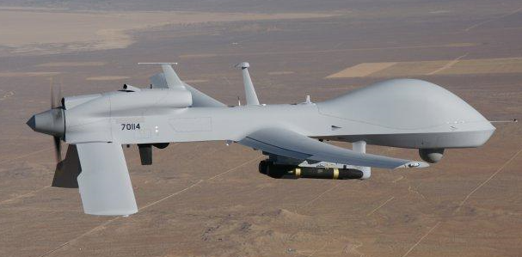
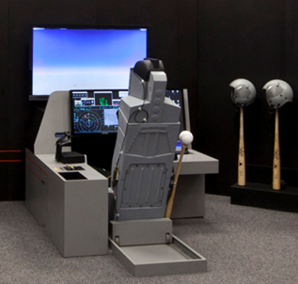

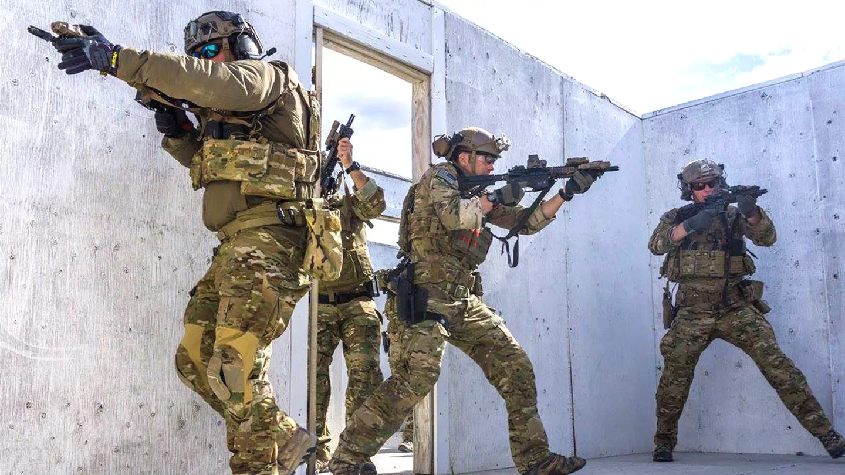
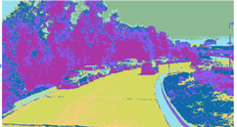
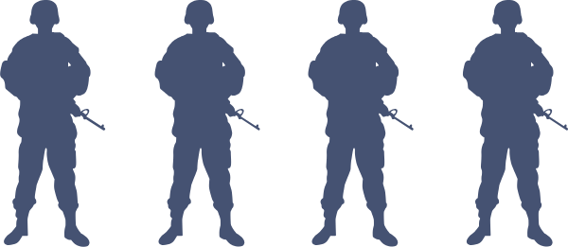
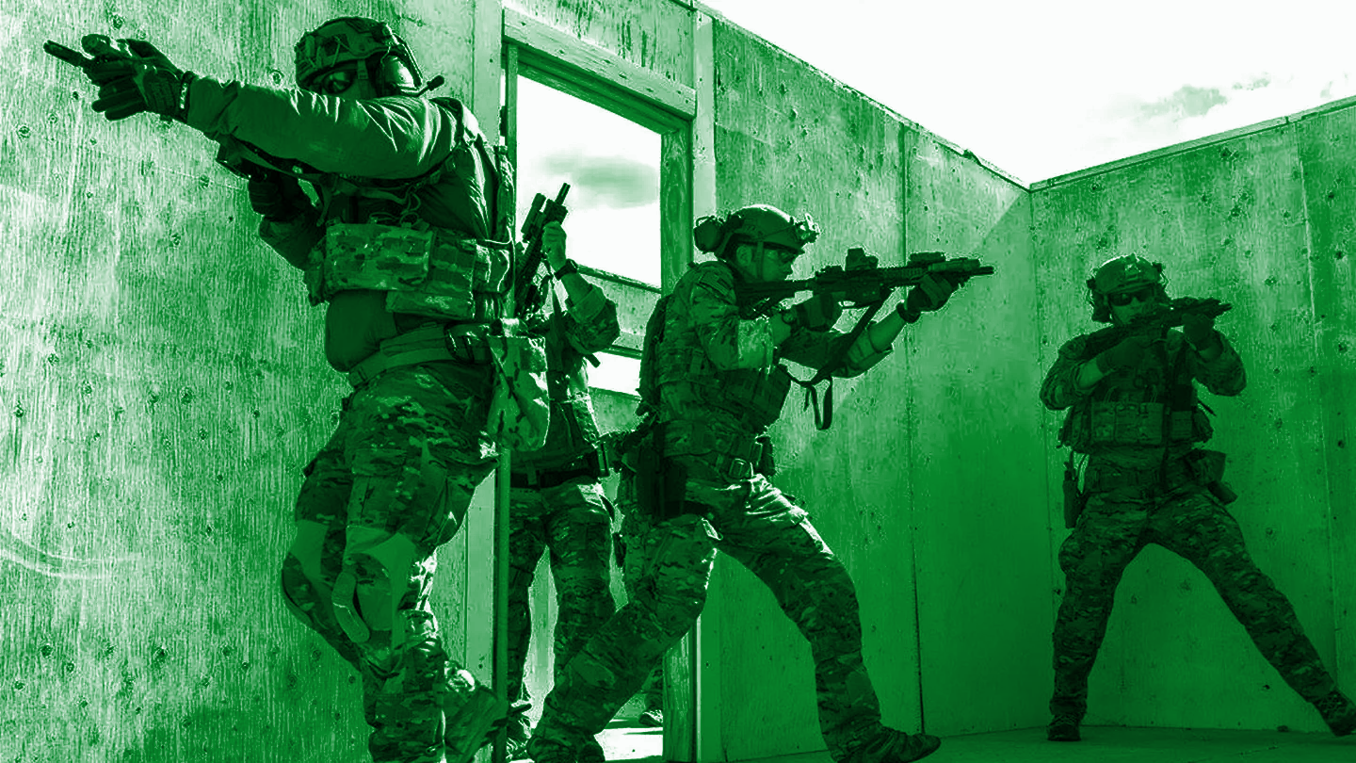
Mixed-Reality Wargaming Platform
Cloud
A Hierarchical, Loosely-Coupled Design Enables:
Local Ownership
Disconnected Operation
Open Architecture
Capability-as-a-Service
  e.g., AI, Simulation, Data, Devices
Management
Logging
Analytics
Other
Services
Secure Global OMG DDS Databus
Secure
Gateway
Protocol/Data Interoperability
Data Routing/Filtering
Management
Logging
Analytics
Secure Cross-System OMG DDS Databus (Local/Regional)
OMG DDS
Processing Location Agnostic / Transparent
DataBus
Gateway
AI Training
Scenarios
Protocol
Gateway
One World
Terrain
Protocol XYZ
OtherSim
Autonomous Systems
AI/ML/DL
Augmented
Reality
Real World Twin
Local Mgmt
Simulated Worlds
Simulation DataBus
Simulation DataBus
Real World
Sim@ NATO 2
Simulation Connext DataBus
Sim@ NATO 1
Air
Helo
Sim@ SOCOM
Edge
Unity
Unreal
Maritime
Ground
Simulated
Actors
Digital
Twins

Slide 61
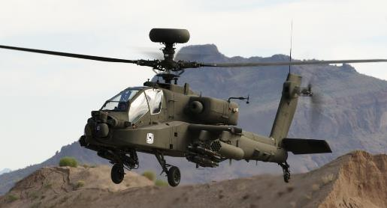
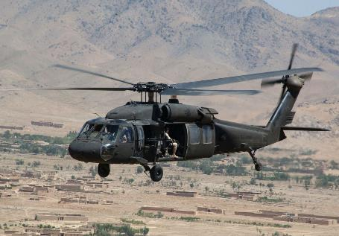
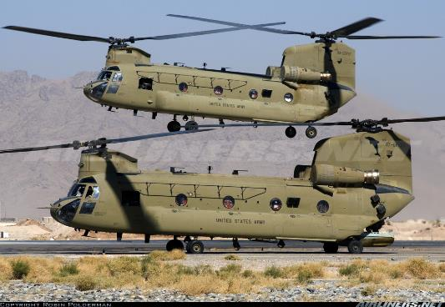
CCDC Aviation& Missile Center - SED System Integration Labs
Hardware-in-the-Loop labs for the UH-60V, CH-47F and AH-64E Army Helicopters

Slide 62
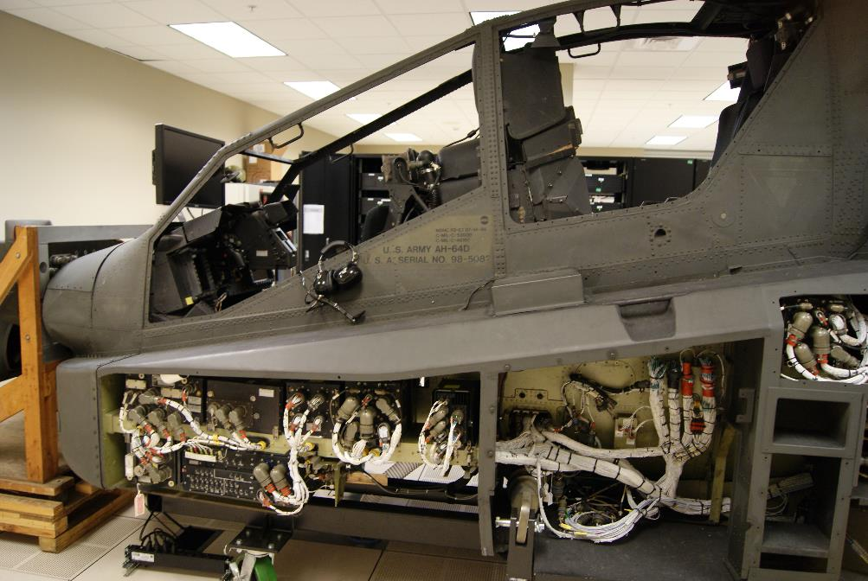
CCDC AvMC S3I - Apache AH-64E
HAT/HOT
Flight Model
Visuals
Flight
Controls
Visuals
Image Generators
Database
OMG DDS
Data Record /
Playback
Data Analysis
Workstation
TBD
LabVIEW
Science
Experiments
RadAlt Model
Aberdeen I/O
ADC Model
EGI Model

Slide 63
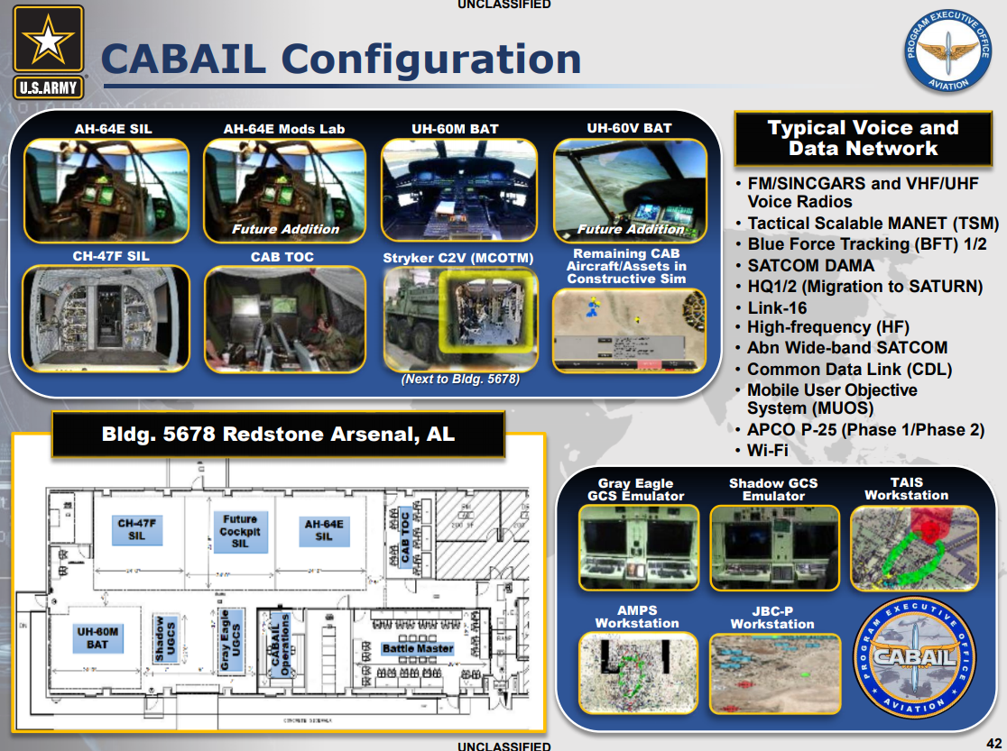
PEO Aviation - Combat Aviation Brigade Architecture Integration Lab CABAIL
AH-64E and CH-47F SILs already use OMG DDS to reduce hardware and development costs for HIL experimentation
JBC-P Network Operations Center(NOC) was re-architected using OMG DDS for significant code reduction and performance improvement

Slide 64
Using OMG DDS with Simulation Standards
The OMG DDS specification has been be leveraged for the middleware APIs as well as the wire protocol
APIs could use the OMG DDS API
Wire protocol communications could use the Interoperability Wire protocol from OMG DDS
This combination would leverage the performance, scalability, robustness and interoperability from OMG DDS.
The simulation entities from TENA/HLA/DIS could be leveraged
They would provide the “entity data model dictionary”
This would leverage the conventions and semantics of the simulation standards
The simulation defined types could be described using the OMG DDS Extensible Types
This leverages the extensibility, dynamic APIs and backwards compatible path to type evolution of the DDS Type system
Gateways/brokers exist
HLA-RTI provider supports multiple OMG DDS Vendors

Slide 65
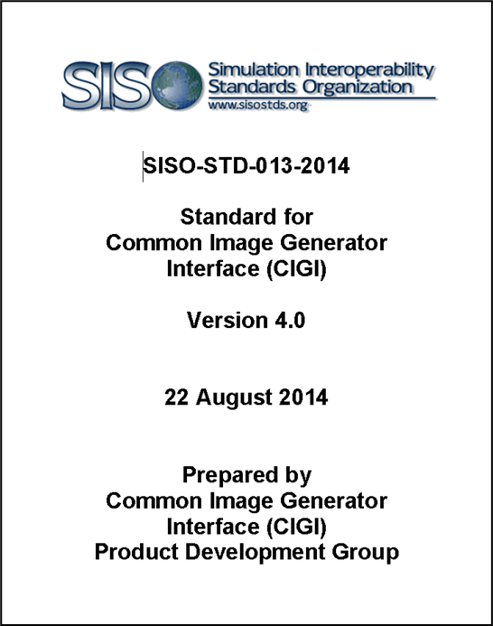
SISO CIGI and OMG DDS
Common Image Generator Interface (CIGI) is an on-the-wire data protocol that allows communication between an Image Generator and its host simulation
The interface is designed to promote a standard way for a host device to communicate with an image generator (IG) within the industry
“CIGI Next” now rebranded as the Synthetic Environment Generation Interfaces (SEGI) is considering using OMG DDS as a transport
  Could eliminate the need for hosts, you would communicate directly to the IG
  Please join the SISO CIGI PDG!

Slide 66
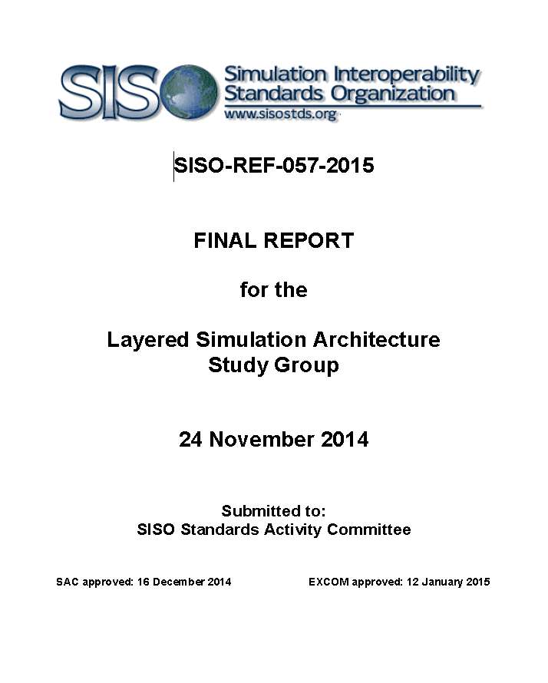
Using OMG DDS at SISO?
Layered Simulation Architecture
  Study Group at SISO
  Putting OMG DDS ‘under the hood’ of HLA/DIS
    Use OMG DDS RTPS with Simulation Entities as topics
  Study Group recommended that LSA become a SISO standard; stalled at that point
Need a coalition of the willing to revive this
  Open-source prototype would be needed
  OMG DDS Security was not considered at the time of this study group, but could easily be added and add much needed security to the Simulation standards

Slide 67
Conclusions
DDS is a mature standard from OMG
  Platform neutral: Operating Systems and Programming Languages
  Mandated and deployed worldwide in many military systems with demanding real-time applications
  Portable API DCPS and Interoperable Wire Protocol RTPS
  Deployed DDS Security Standard specification
OMG DDS focuses on efficient data-distribution for real-time &
high-performance systems
OMG DDS is suited for integration of distributed training systems
  Authentication, Role-Based Access to data, Multiple Levels of Security (MLS)
  Evolvable Type System
  Real-Time Quality of Service (QoS)
  Integration and reuse of system software and mission data

Slide 68
Original Tutorial Learning Objectives
After taking this tutorial you should be able to:
Describe how OMG DDS enables semantic interoperability
Describe the OMG DDS standard
Explain the principles of the OMG DDS Secure standard for securing communications between distributed simulations over WAN/Cloud/RF/Lossy networks
Explain how OMG DDS works with the simulation architectures TENA, HLA and DIS
Summarize how OMG DDS works with real-world Hardware In the Loop (HIL) for secure distributed LVC simulations at scale
Describe how OMG DDS is working within SISO

