Slide 1


Addressing the Challenges
of Rigorous Model Validation
Simone M. Youngblood
The Johns Hopkins University Applied Physics Laboratory
240-228-7958 Simone.Youngblood@jhuapl.edu
Mikel D. Petty, Ph.D.
University of Alabama in Huntsville
256-824-6140 pettym@uah.edu

Slide 2
Rigorous Validation Tutorial Learning Objectives
Primary Objective: Define how to identify, collect, and combine validation referent data and to apply that data when performing simulation results/referent validation comparison. When adopted, these concepts will support the implementation of rigorous validation.
Key Learning Objectives:
The learner will be able to define and distinguish key verification and validation terms.
The learner will be able to list and compare the various approaches used to assemble an effective referent.
The learner will be able to define what constitutes rigorous validation.
The learner will be able to match validation methods to the available referent.
The learner will be able to determine the viability of the validation method selected.

Slide 3
Presentation Outline
Background
Motivation
Definitions
Validation uncertainty and risk
Verification and validation processes and methods
Assembling an effective referent
The ideal referent as the basis for validation comparison
Challenges and obstacles to developing the ideal referent
Best practices and obstacle mitigation
Examples
Selecting and applying the appropriate method
Referent and intended use data relationships
Examples of applying validation methods for both point value and time series data based on the referent
Validation Method Evaluation Framework
Conclusions and recommendations

Slide 4
Presentation Outline: Background
Background
Motivation
Definitions
Validation uncertainty and risk
Verification and validation processes and methods
Assembling an effective referent
The ideal referent as the basis for validation comparison
Challenges and obstacles to developing the ideal referent
Best practices and obstacle mitigation
Examples
Selecting and applying the appropriate method
Referent and intended use data relationships
Examples of applying validations methods for both point value and time series data based on the referent
Validation Method Evaluation Framework
Conclusions and recommendations

Slide 5
Rigorous Validation: Motivation
Decision makers are demanding that previous “informal” methods of validation be supplemented or replace with quantitative, defensible, rigorous methods
All M&S, when used to support operational tests and evaluations, should not be accredited until a rigorous comparison of live data to the model's predictions is done … and those predictions are found to have replicated live results with sufficient accuracy for the intended evaluation in the intended domain [Gilmore, 2016]
I expect the validation of M&S to include the same rigorous statistical and analytical principles that have become standard practice when designing live tests. [Gilmore, 2016]

Slide 6
Rigorous Validation: Simuland and Referent Definitions
Simuland. The subject of a model or simulation.
A real-world (or notional) system of interest
Object, phenomenon, or process to be simulated
Referent. The body of knowledge available to the modeler or validation agent regarding the simuland.
Quantitative and formal, e.g., differential equations for aircraft flight dynamics
Qualitative and informal, e.g., pilot’s expectation of buffet before stall
Referent: “The best of most appropriate codified body of information available that describes characteristics and behavior of the reality represented in the simulation from the perspective of validation assessment for the intended uses of the simulation.”

Slide 7
Rigorous Validation: Referent Sources
Information used as the referent may consist of
Empirical data; observations of the simuland, collected either under controlled circumstances, e.g., tests or experiments, or in the field
Theoretical data; calculated using equations or algorithms that describe simuland characteristics, behaviors, and relationships; equations known or assumed to be correct
Simulation data; results generated by simulations; models known or assumed to be valid
Subject Matter Expert knowledge
Combinations of these

Slide 8
Rigorous Validation Tutorial Learning Objectives
Intended use. The purpose for or function of a model; what the model will be used for; the problem to be addressed by the model. [DOD, 2012]
Characteristics [Piersall, 2014]
“Not a capability, solution, or implementation”
Expressed from the perspective of the user
Should be formally specified
“Any attempt to suppress the role of the intentions of the investigator, B, leads to circular definitions or to ambiguities about essential features ...” [Minsky, 1965]
“Modeling and simulation is always goal-driven, … , we should know the purpose of our potential model before we sit down to create it.” [Cellier, 1991]

Slide 9
Rigorous Validation: Verification Definition
Verification. The process of determining that a model implementation and its associated data accurately represents the developer’s conceptual description and specifications. [DOD, 2009]
Transformational accuracy [Balci, 2002]
Transform specifications to code
Software engineering quality
Software engineering methods apply

Slide 10
Rigorous Validation: Validation Definition
Validation. Determining the degree to which a model or simulation and its associated data are an accurate representation of the real world from the perspective of the intended uses of the model. [DOD, 2009]
Comparing model results with experimental data [Velten, 2009]
Representational accuracy [Balci, 2002]
Recreate simuland with results
Modeling quality
Special validation methods needed

Slide 11
Rigorous Validation: Sources of Uncertainty
Sources of uncertainty in M&S [Pace, 2009]
Application domain
(simuland)
knowledge and theory
Simulation results
interpretation
Uncertainty
Simulation purpose,
intended use,
and requirements
Validation referent
Conceptual model
and software design
Simulation inputs
and use
Software
implementation

Slide 12
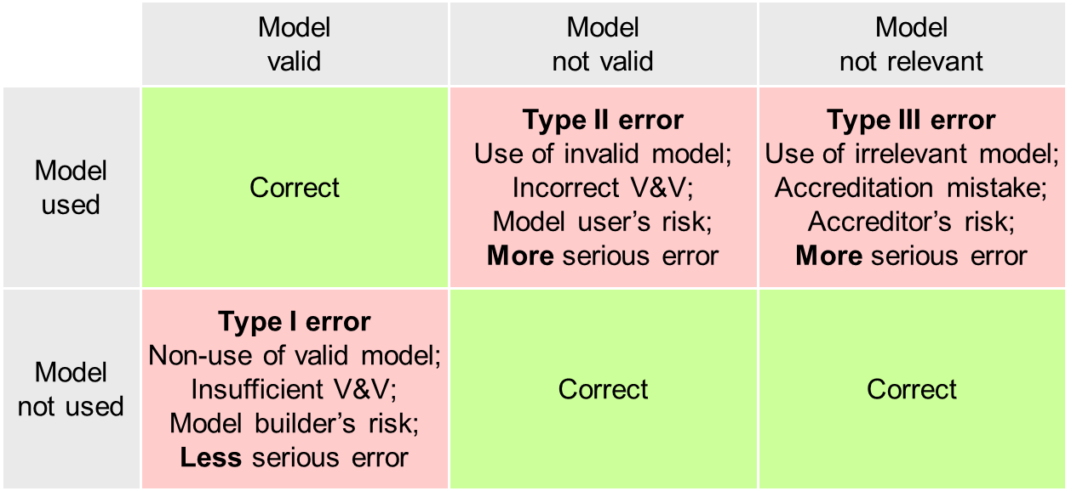
Rigorous Validation: VV&A Errors and Risks
VV&A errors and risks [Balci, 1981] [Balci, 1985] [Balci, 1998]

Slide 13
Rigorous Validation: Relationship of VV&A Processes
Requirements
analysis
Requirements
Simuland
Modeling
Accreditation
Modeling
Validation
Validation
Verification
Results
Conceptual
model
Simulation
Implementation
Verification
Transformation
Comparison
Executable
model
[Petty, 2010]

Slide 14
Rigorous Validation: Overview of V&V Methods
Many V&V methods available, ~85 in 1998 [Balci, 1998], more developed since [Balci, 2002] [Petty, 2010]
Different purposes, advantages, suitable models
[Balci, 1998]
Informal | Static | Dynamic | Formal
-Audit -Desk checking -Documentation Checking -Face validation -Inspections -Reviews -Turing test -Walkthroughs | -Cause-Effect Graphing -Control Analysis -Data Analysis -Fault/Failure Analysis -Interface Analysis -Semantic Analysis -Symbolic Evaluation -Syntax Analysis … | -Acceptance Testing -Alpha Testing -Assertion Checking -Beta Testing -Bottom-up Testing -Comparison Testing -Statistical Techniques -Submodel/Module Testing … | -Induction -Inductive Assertions -Inference -Logical Deduction -Lambda Calculus -Predicate Calculus -Predicate Transformation -Proof of Correctness

Slide 15
Presentation Outline: Assembling the Referent
Background
Motivation
Definitions
Validation uncertainty and risk
Verification and validation processes and methods
Assembling an effective referent
The ideal referent as the basis for validation comparison
Challenges and obstacles to developing the ideal referent
Best practices and obstacle mitigation
Examples
Selecting and applying the appropriate method
Referent and intended use data relationships
Examples of applying validation methods for both point value and time series data based on the referent
Validation Method Evaluation Framework
Conclusions and recommendations

Slide 16
Rigorous Validation: The Ideal Referent
The ideal referent for validation comparison
Covers the operational/domain space of interest as bounded by the intended use [Gilmore, 2016]
Provides data on the aspects of the operational envelope/behavior space that will be covered by the M&S
Addresses variations in factors affecting performance/behavior w. r. t. response variables of interest
Supports interpolation between known data points vice extrapolation beyond known data
Is drawn from observations of the simuland [RPG, 2011]
Under controlled circumstances such as tests and experiments
Under natural or operational circumstances
Is drawn from authoritative data
Test data adjudicated by Data Authentication Group review to address measurement errors, incomplete data, etc. [ATEC, 2004]
Identifies any areas of known uncertainty

Slide 17
Rigorous Validation: Referent Challenges and Obstacles
Challenges and obstacles to developing the ideal referent
Ill defined intended use
Lack of definition of the model/simulation’s coverage of the domain space
Lack of test scenarios that will align test and simulation data
Inconsistencies between referent and simulation data
Metrics of interest
Factors that affect performance
Limited/no referent data available
Complexity of system/behaviors represented imposes limitations (e.g., resource, economic) on the development of quantitative referent data
Domain of Interest does not support quantitative referent development (e.g., Department of Energy, NASA)
Economic limitations

Slide 18
Rigorous Validation: Referent Best Practices
Best practices and obstacle mitigation
Start early – validation referents take time to develop
Need to identify scope of information needed
Need to coordinate with others (e.g., testers, SMEs) to produce referent data
Need to budget for referent development
Ensure accreditation authority concurrence
“Grow” referent information over time
Leverage all sources of test data (e.g., ground test, HWIL, live fire)
Maximize extent of referent coverage of the operational/behavioral space as defined by the intended use
Define areas of uncertainty
Limitations of M&S coverage
Limitations of referent data

Slide 19
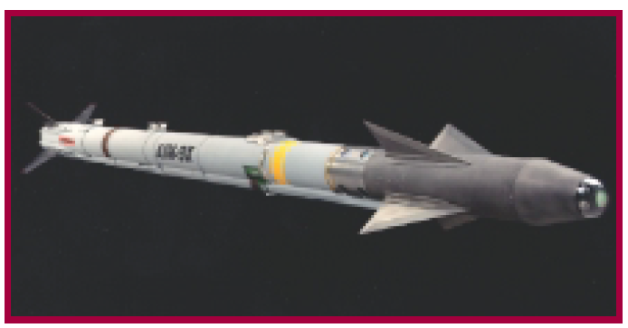
Rigorous Validation: AIM9X Example
AIM9X: Simulation Enhanced Operational Test
Limited test shots, with maximum operational envelope coverage to support validation referent development
Adopted Model-Test-Model [Mansager, 1994] paradigm to continually assess validation referent development
Applied a statistical methodology (Fisher Test) to validate the simulation
Validated M&S used to satisfy all system performance requirements [IDA Research Summaries, 2001]
Significantly decreased the number of test shots (DT and OT) needed [DOT&E, 2000]
AIM9X awarded NTSA 2001 M&S Industry Award
AIM9X Missile

Slide 20
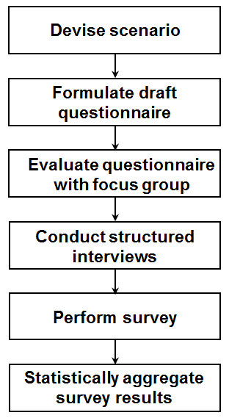
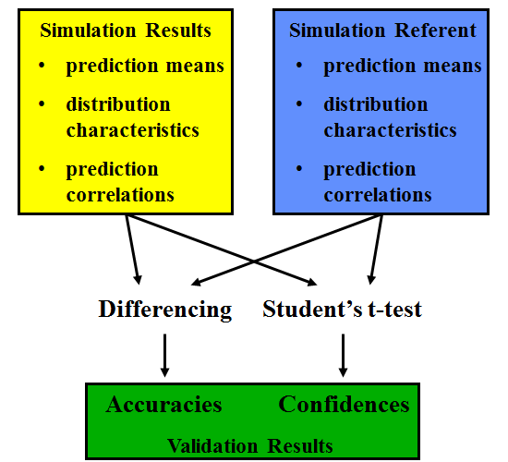
Rigorous Validation Tutorial Learning Objectives
Developing a rigorous SME referent [Metz, 2001]
Validation focus - a campaign-level simulation
No real world referent available - thus reliant on SME assessment
Increase SME sample size (from one to multiple)
Apply best practice in survey research to develop questionnaire
Statistical assessment of survey results to identify common trends and sources of referent uncertainties
Knowledge of referent uncertainty is necessary for evaluating the risk of simulation use

Slide 21
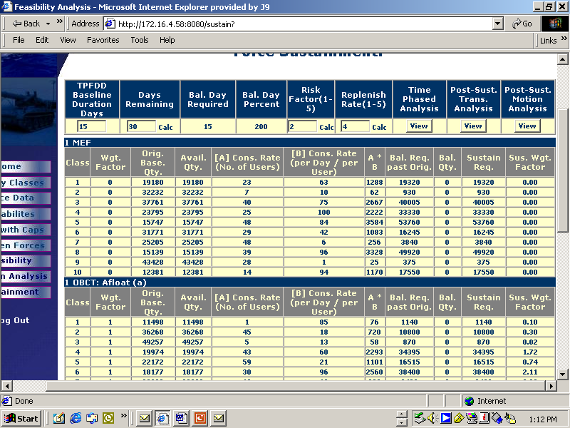
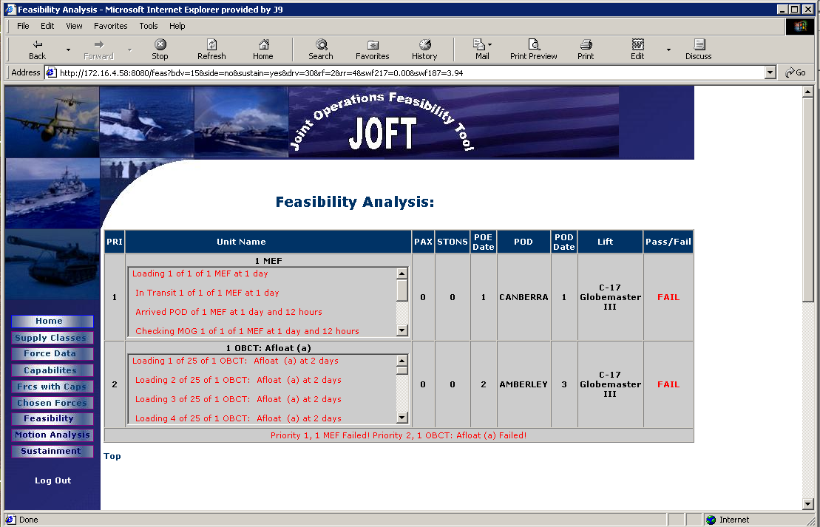
Rigorous Validation: Structured Face Validation Example
Structured face validation example [Belfore, 2004]
Joint Operations Feasibility Tool
Assess deployment transportation feasibility
Assess logistical sustainment feasibility
Validation process
Special scenarios exercise full range of capabilities
20 SMEs with extensive experience evaluated model
Assessments elicited via written questionnaires
Process structure addressed face validation limits

Slide 22
Presentation Outline: Selecting Methods
Background
Motivation
Definitions
Validation uncertainty and risk
Verification and validation processes and methods
Assembling an effective referent
The ideal referent as the basis for validation comparison
Challenges and obstacles to developing the ideal referent
Best practices and obstacle mitigation
Examples
Selecting and applying the appropriate method
Referent and intended use data relationships
Examples of applying validation methods for both point value and time series data based on the referent
Validation Method Evaluation Framework
Conclusions and recommendations

Slide 23
Rigorous Validation: Challenges
Challenges associated with Rigorous Validation
Referent
Coverage
Availability
Selection of Validation Method
Driven by available Referent Data
Characteristics of Validation Metric (e.g., point value, time series, multimodal)
Viability of Validation Method
Measuring the performance of the validation methods used to assess model accuracy
Understanding Uncertainty
“I expect the validation of M&S to include the same rigorous statistical and analytical principles that have become standard practice when designing live tests.” [Gilmore, 2016]

Slide 24

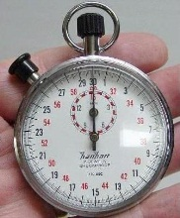
Rigorous Validation: V&V Methods Considerations
Considerations when selecting V&V methods
01010100010100101
10010101000100101
10101011101010111
10110010100101000
10010101101010101
h(t) = –4.9t² + vt + s
Model
Referent
Certain methods
apply best to specific
types of model
Certain methods
require specific types
or amounts of referent data
Method
Some methods
require more resources than others
Some methods
require specific
skills to apply
Resources
Skills
Problems can arise if the considerations conflict

Slide 25
Rigorous Validation: Referent and Intended Use Data Relationships
x₂
x₂
U
R
R
R
U
Data range of
Referent
x₁
x₁
R ⊆ U
U ⊆ R
x₂
x₂
U
U
U
Data range of
Intended use
R
R
x₁
x₁
R ⊈ U, U ⊈ R, R ∩ U ≠ ∅
R ∩ U = ∅

Slide 26
Rigorous Validation: Referent to Validation Method Mapping
Simplified Mapping
Sources of
referent information
Forms of
referent information
Applicable rigorous
validation methods
Empirical data
Single observation
or few observations
Confidence intervals
Multivariate confidence intervals
Theoretical data
Many observations
Hypothesis tests for
means, variances,
proportions, and distributions
Simulation data
Paired observations
Regression analysis
Subject Matter
Expert knowledge
Expectations and
experience
Structured face validation
Turing test

Slide 27
Rigorous Validation: Confidence Intervals
Confidence intervals [Brase, 2015] [Petty, 2012] [Petty, 2013]
Validation concept and interpretation
Useful when only one (or few) simuland observations available
Determine if simuland observation consistent with model results
Calculate confidence interval for model response variable
If confidence interval contains observed simuland value(s), then model considered valid for that response variable
Comments
Interval calculated from simulations is for model, not simuland
Population is all possible simulations with the model, sample is the simulations actually executed
No statistical justification or refutation for validation interpretation

Slide 28
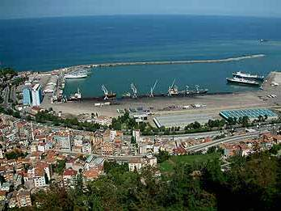
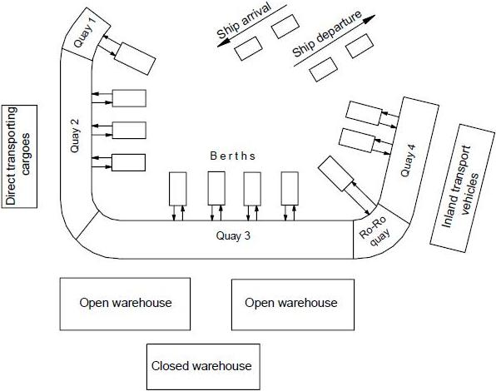
Rigorous Validation: Confidence Interval Example
Confidence intervals example [Demirci, 2003]
Comparison of simuland value with model mean
Simuland
Seaport of Trabzon Turkey
Quays for berthing, unloading, loading ships
Three types of ships: G1, G2, G3
Model
Discrete event simulation
Represents ships, cargos, quays, warehouses, cranes

Slide 29
Rigorous Validation: Confidence Interval Calculations
Confidence interval calculations
Mean processed (count) for each ship type and total
Sample size (number of model runs) n = 45
Confidence level c = 0.95 (95%)
Distribution: Student t
Degrees of freedom d.f. = n – 1 = 44
Critical value t_{c} = 2.015
Ship Type | Simuland count μ₀ | Model |  | Confidence interval |  | Within Interval?
 |  | Mean x̅ | Std dev s | L | U
G1 | 109 | 111.14 | 14.45 | 106.8 | 115.5 | Yes
G2 | 169 | 174.42 | 16.07 | 169.6 | 179.2 | No
G3 | 19 | 17.28 | 5.26 | 15.7 | 18.8 | No
All Types | 297 | 303.68 | 35.89 | 292.9 | 314.5 | Yes
2 of 4 intervals
contain simuland value
Notes:
Confidence interval procedure
Select model response variable x to use for validation
Select number of model executions, i.e., sample size n
Execute model n times, producing sample x₁, x₂, … x_{n}
Calculate sample mean x̅ and sample std dev s
Select distribution normal z or Student t
Select confidence level c
Calculate confidence interval [L, U]
If known simuland value y within [L, U], i.e., L ≤ y ≤ U, declare model valid (or not invalid) for x

Slide 30
Rigorous Validation: Hypothesis Testing
Hypothesis testing [Brase, 2015]
Validation concept and interpretation
Useful when multiple simuland observations available
Test whether simuland observations consistent with model results
Perform hypothesis test comparing means, variances, and/or distributions of simuland and model for response variable
If hypothesis test does not reject assumption of validity, then model considered valid for that response variable
Comments
Simuland population is all possible observations, sample is the observations actually obtained
Model population is all possible simulations with the model, sample is the simulations actually executed
Conventional assumption (null hypothesis) is that the parameters being tested are equal, i.e., model is valid

Slide 31
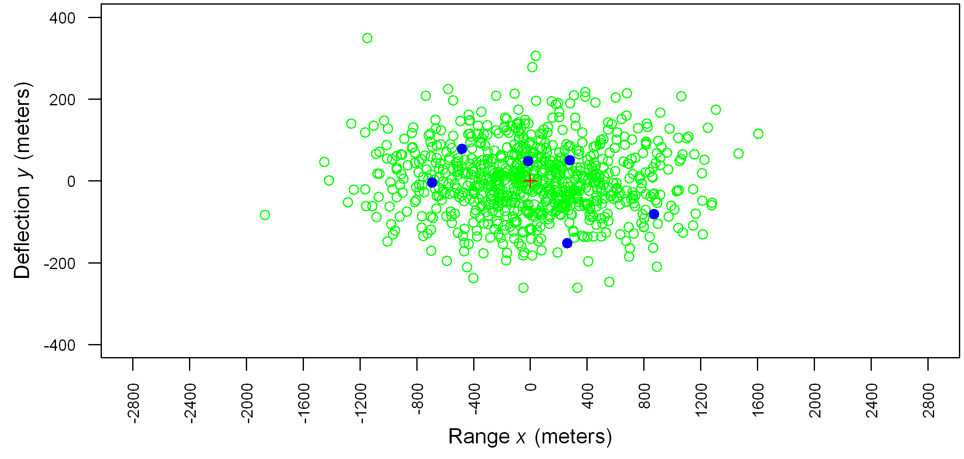
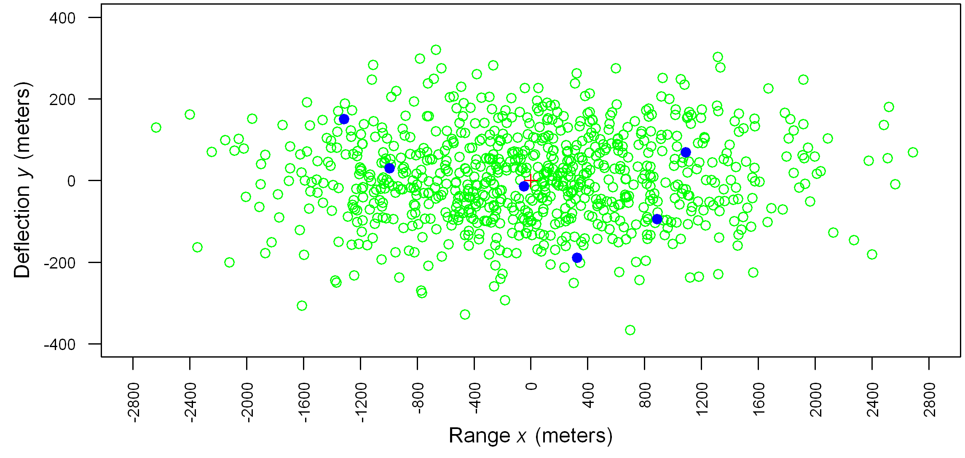
Rigorous Validation: Hypothesis Test Example
60 Km
Source
x err s
y err s
n
Model
535.08
85.75
800
Live
558.52
90.35
6
100 Km
Source
x err s
y err s
n
Model
921.39
111.25
800
Live
980.52
120.68
6

Slide 32
Rigorous Validation: Hypothesis Test Calculations
Hypothesis test calculations
60 Km
100 Km
s₁
558.52
90.35
980.52
120.68
} Simuland
s₂
535.08
85.75
921.39
111.25
} Model
F
1.0895
1.1102
1.1325
1.1767
Test statistic F calculated from simulation results
P-value: probability of test statistic value, assuming H₀ true
Test: P-value < α → reject H₀
Interpretation: Do not reject H₀ → results match, i.e., model valid for x, y variances
d.f._{N}
5
5
5
5
d.f._{D}
799
799
799
799
P-value
0.3646
0.3534
0.3415
0.3188
F distribution P-value in Excel =FDIST(F,d.f._{N},d.f._{D})
Notes:
F-test: Hypothesis test for equality of variances
Obtain samples, calculate sample statistics
Set notation so that
Select level of significance α; often α = 0.05
Formulate hypotheses H₀ and H₁
Calculate test statistic F using formula
Given F, find P-value (table or software)
If P-value ≤ α, then reject H0, else accept H0

Slide 33
Rigorous Validation: Point Value Referent Data vs Time Series
Point Value: A single sample metric from a referent data set
Examples:
Miss distance
Time of flight
Percent of time in a specific mode
Time Series: A time series of single sample metrics from a referent data set
Examples:
Position
Orientation
Regardless of time series or point value, both are considered a single sample of the underlying distribution, since the flight test represents only one sample.

Slide 34
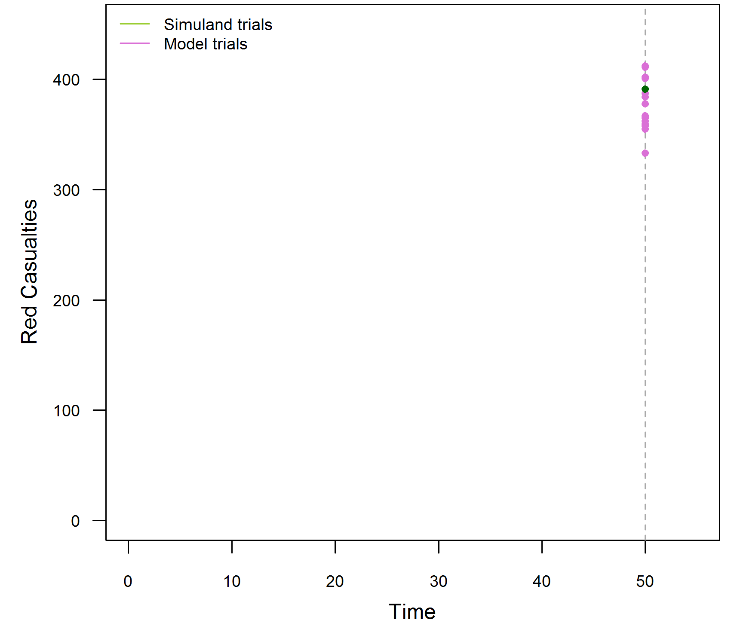
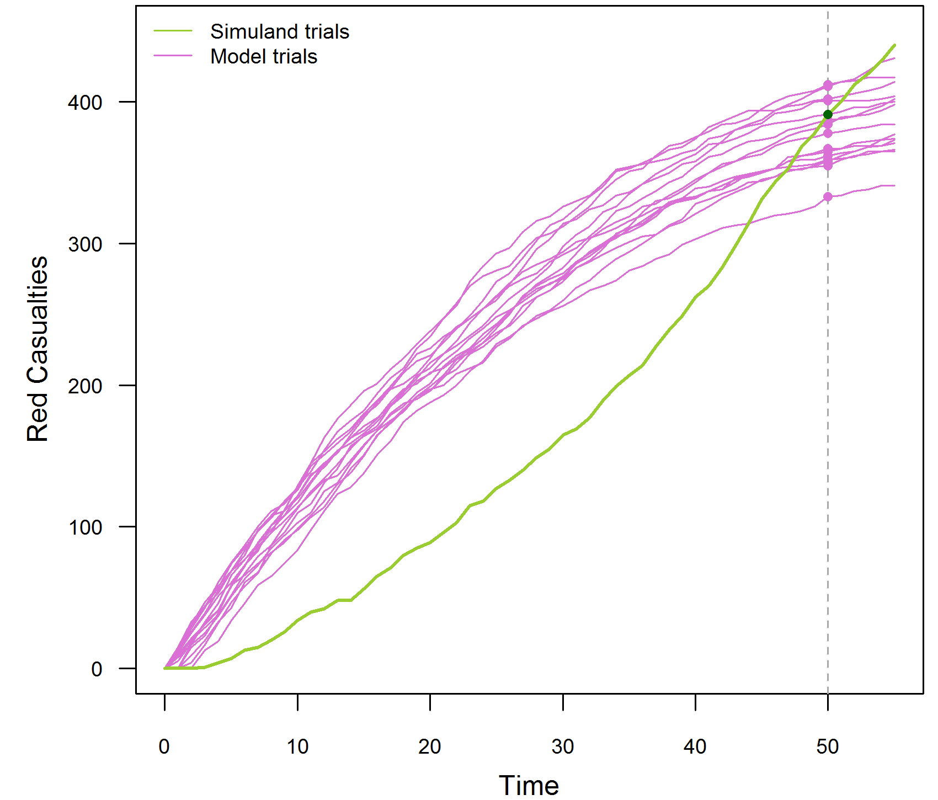
Rigorous Validation: Time Series Example
Time series example: Red casualties
1 “trial” of simuland, e.g., data from actual battle
15 trials (executions) of a model of the same battle
Red casualties at time 50 only
Model ≈ simuland
→ Model valid?
Red casualties at times 0–50
Model mostly ≠ simuland
→ Model not valid?

Slide 35
Rigorous Validation: Time Series Validation Methods
Time Series Validation: Advanced Methods
Confidence interval methods (examples follow)
Method
Simuland
trials
Model
trials
Interval
bounds
OOB
limit
Examples & Sources
A
1
1
Simuland ± SME ε
SME
[Engel, 1954]
[Petty, 2010]
B
1
Multiple
Model 95% c. i.
SME
[Herington, 2002]
[Champagne, 2007]
C
Multiple
Multiple
Simuland 95% c. i.
Model 95% c. i.
SME
[Law, 2015]
ε = time step value error tolerance
OOB = time steps out of bounds

Slide 36
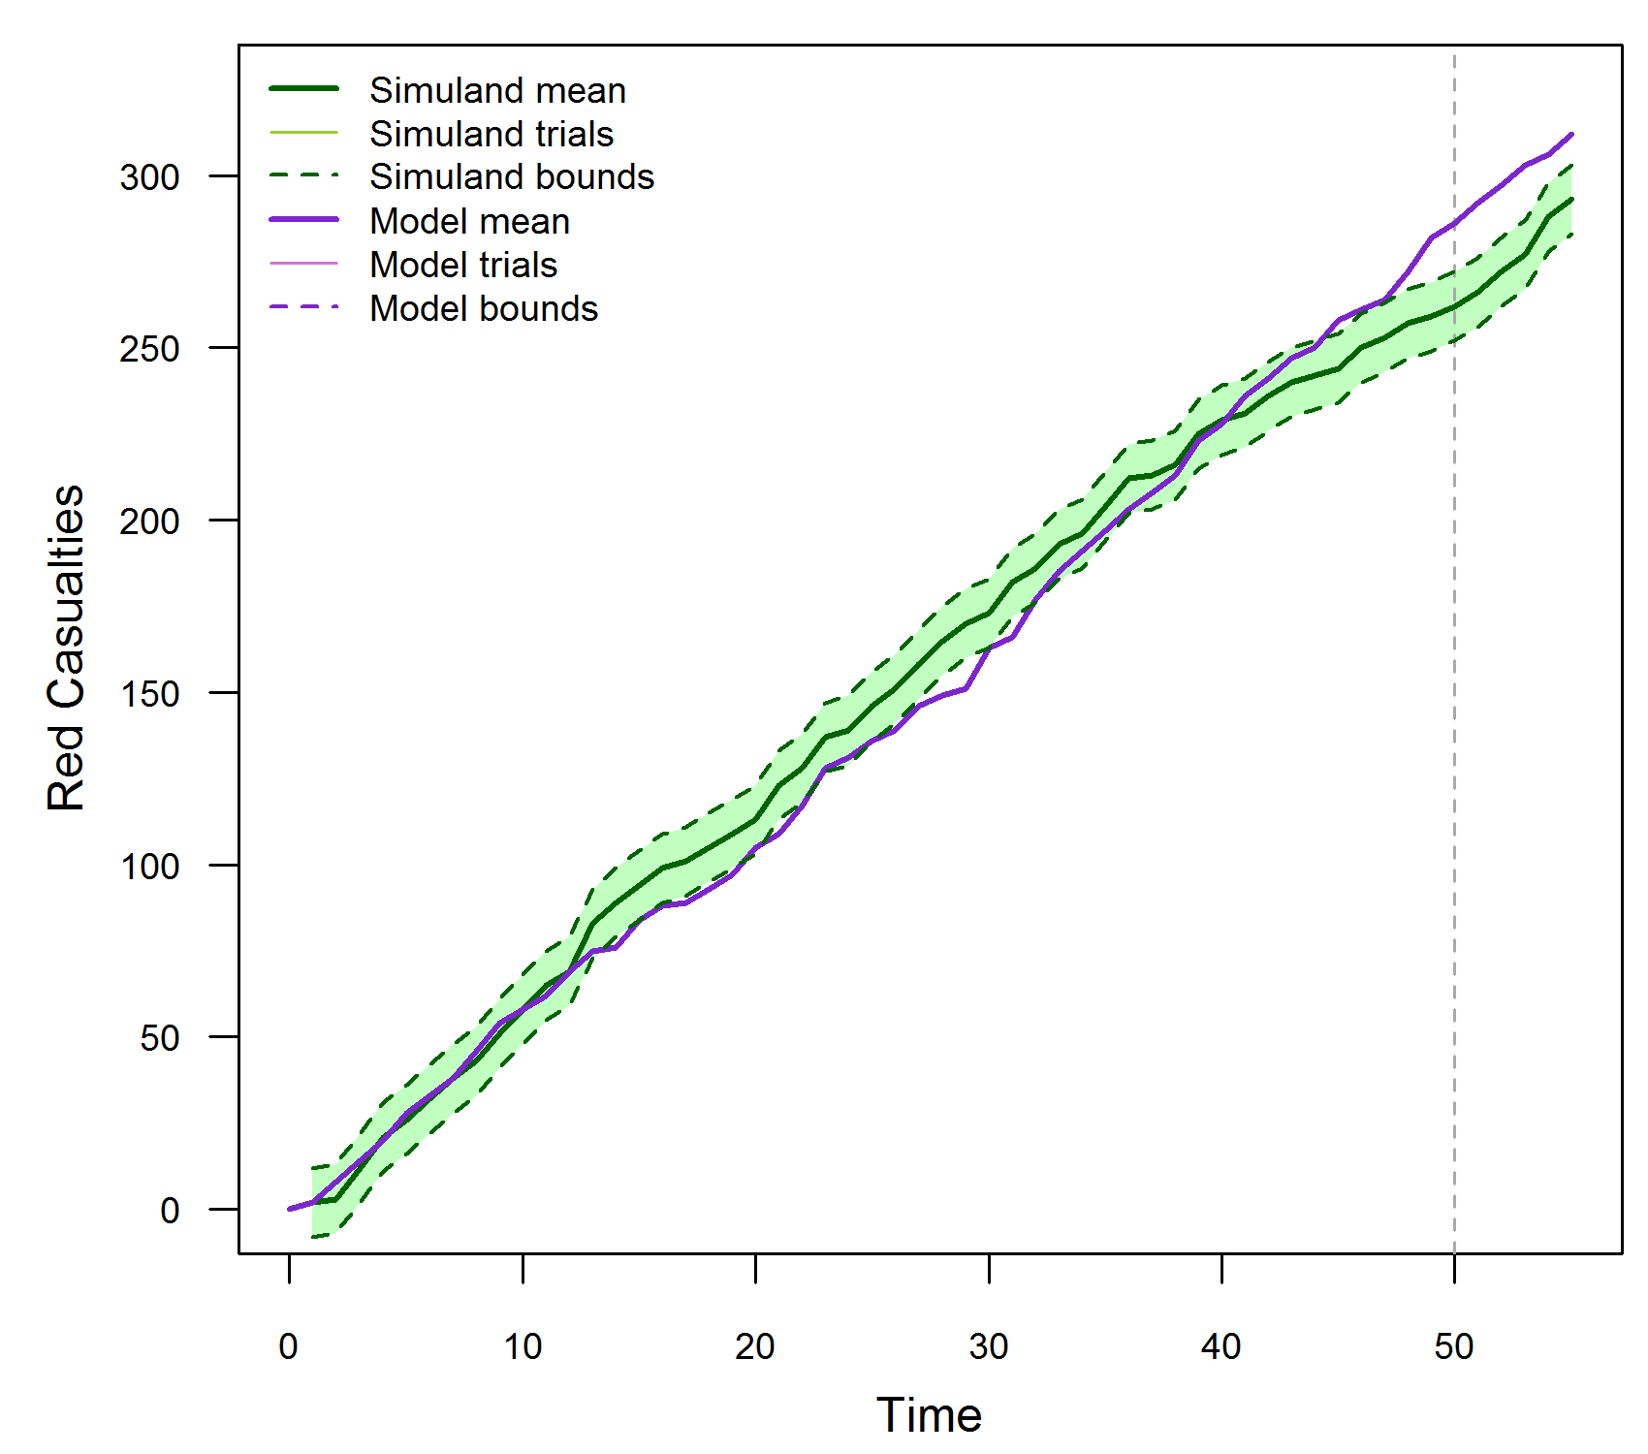
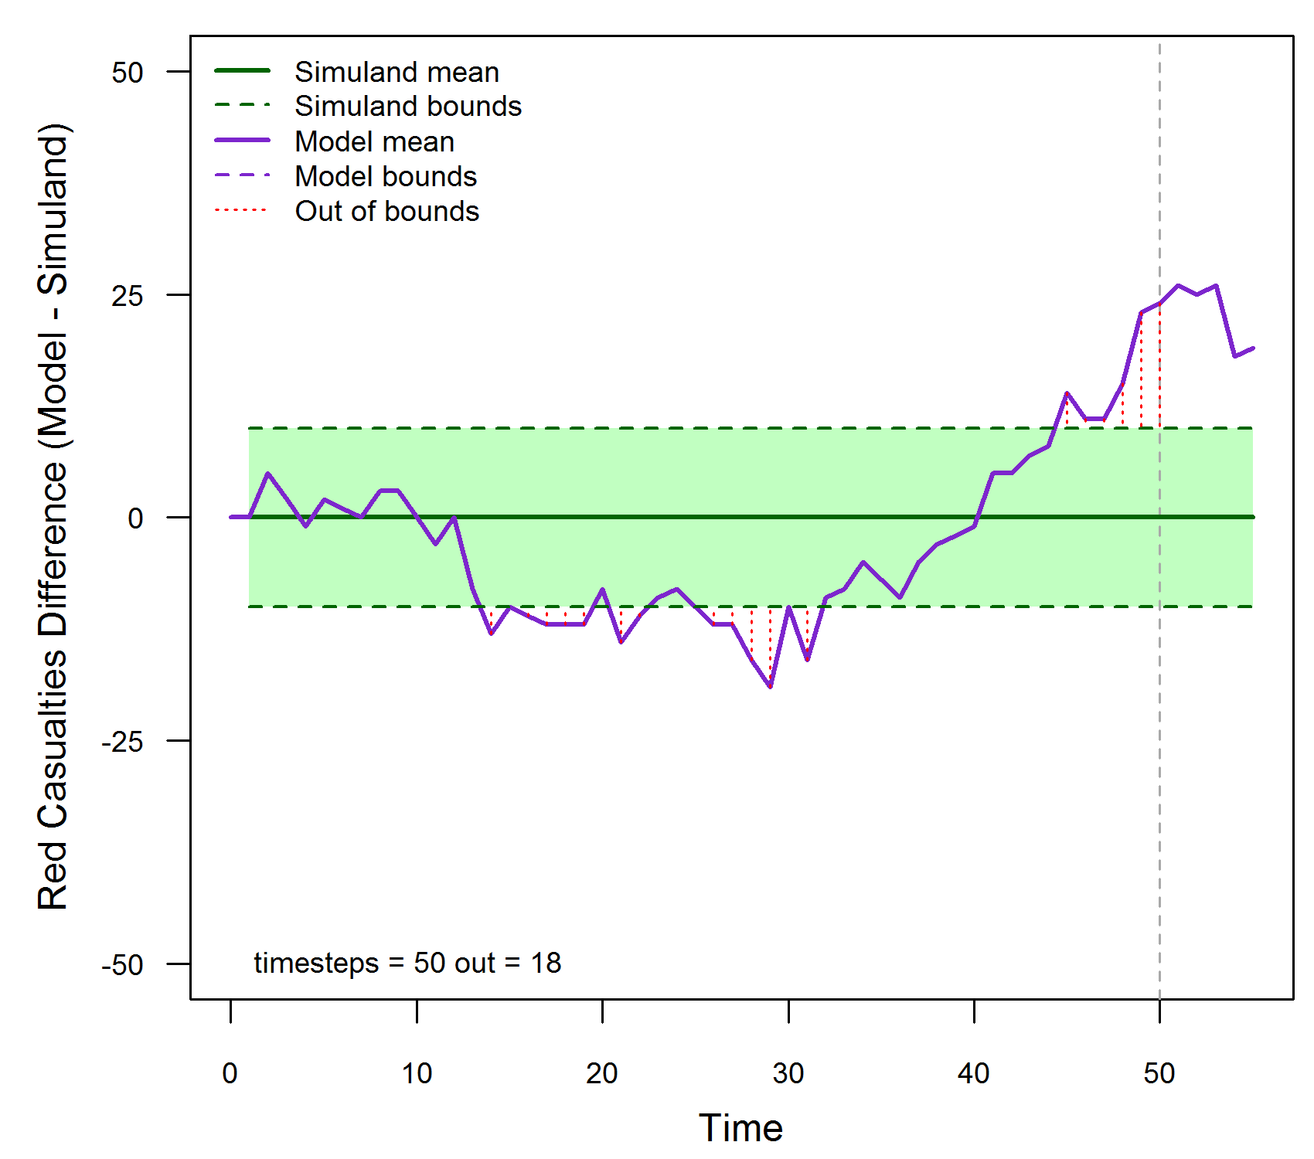
Rigorous Validation: Time Series Method A
Example model: Method A (1 - 1)
SME: ε = 5, OOB limit = 10% = 5 time steps
Simuland: 1 trial with ± SME ε interval per time step
Model: 1 trial
OOB time steps > OOB not valid

Slide 37
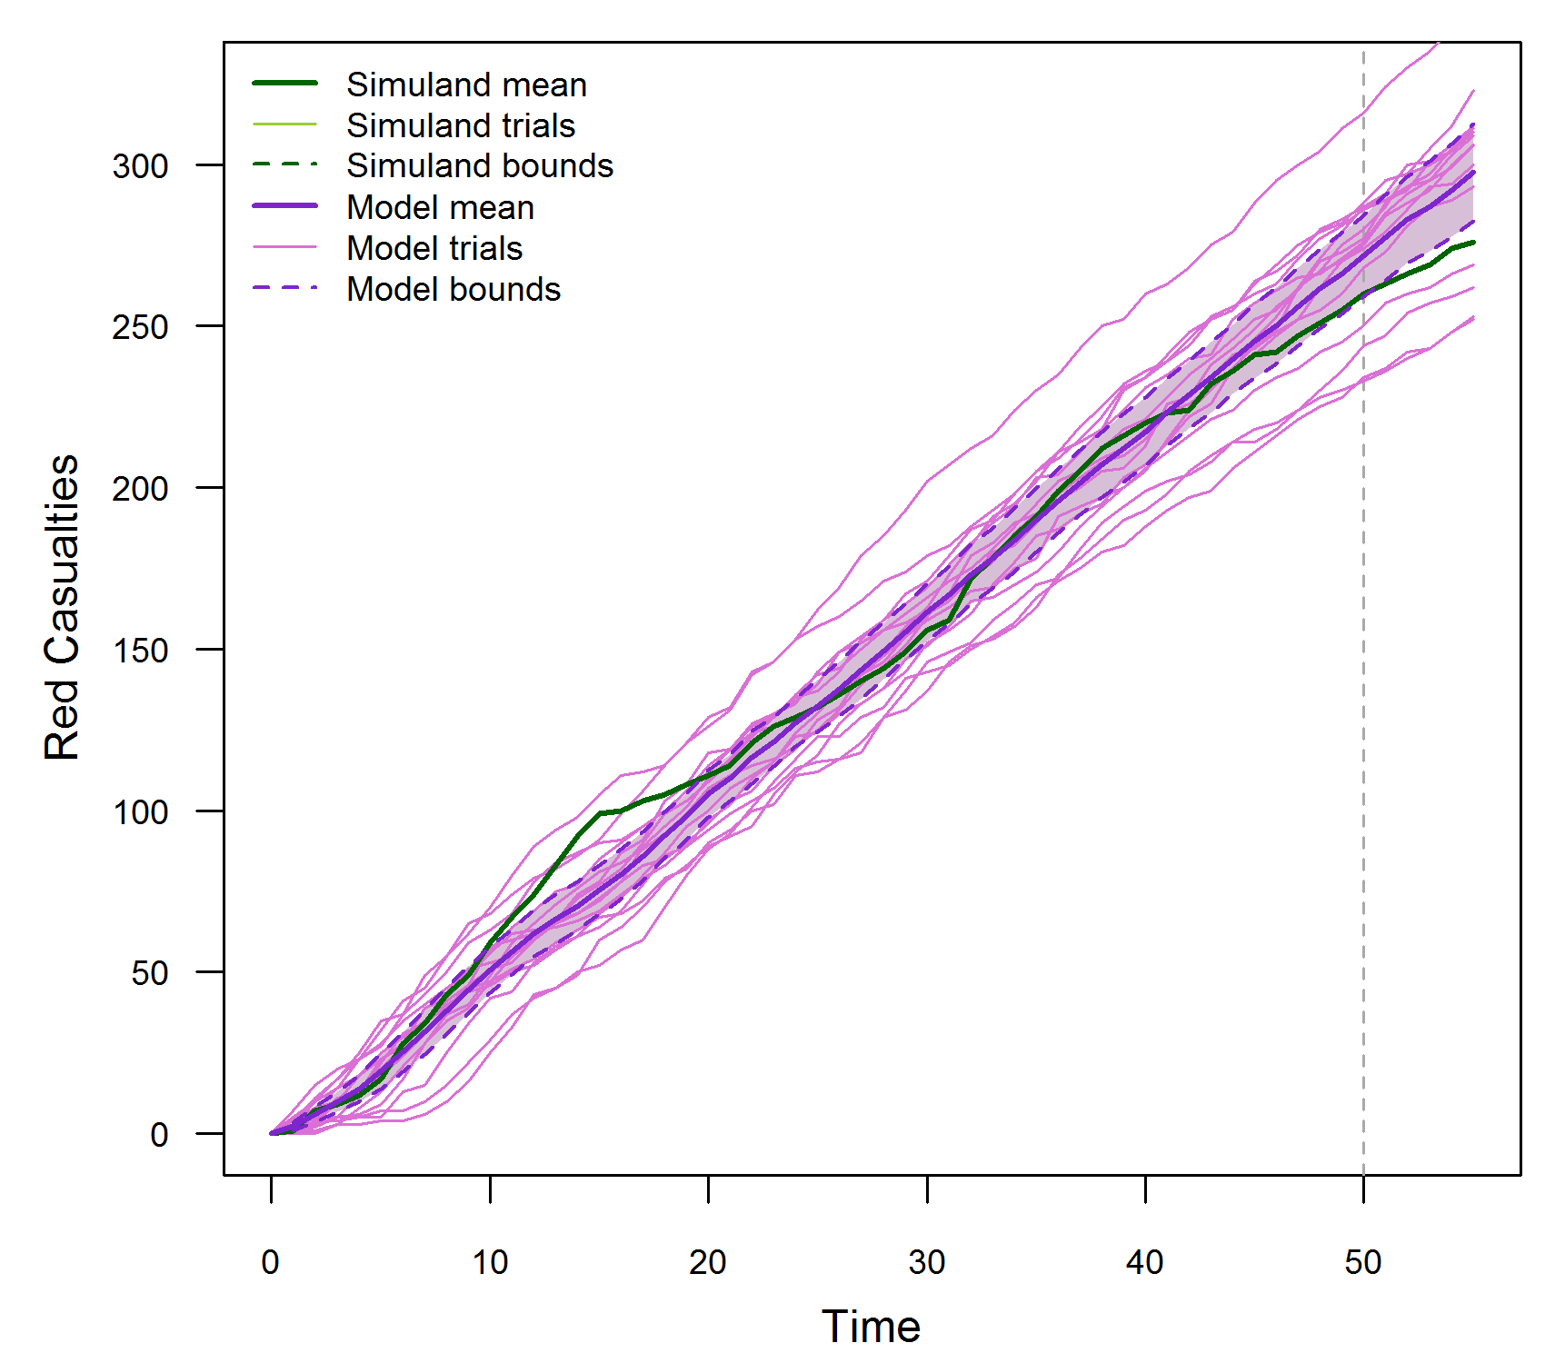
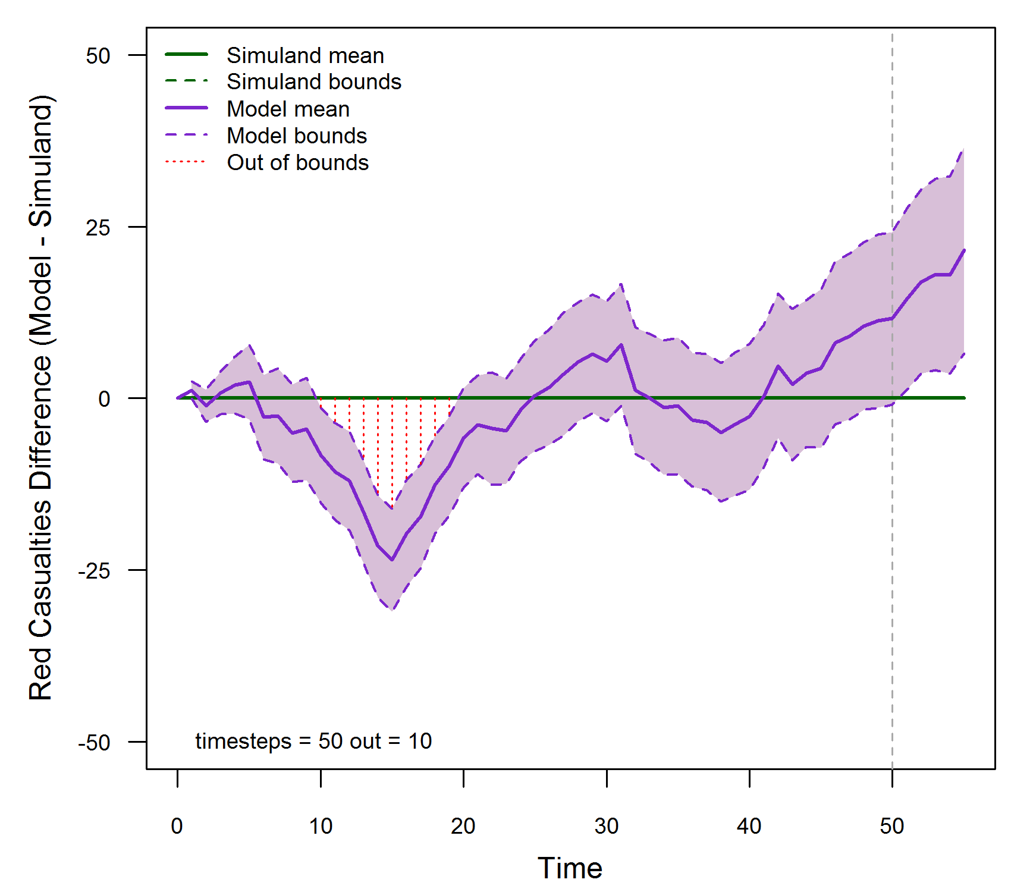
Rigorous Validation: Time Series Method B
Example model: Method B (1 - multiple)
SME: OOB limit = 10% = 5 time steps
Simuland: 1 trial
Model: 15 trials with 95% confidence interval per time step
OOB time steps > OOB limit → model not valid

Slide 38
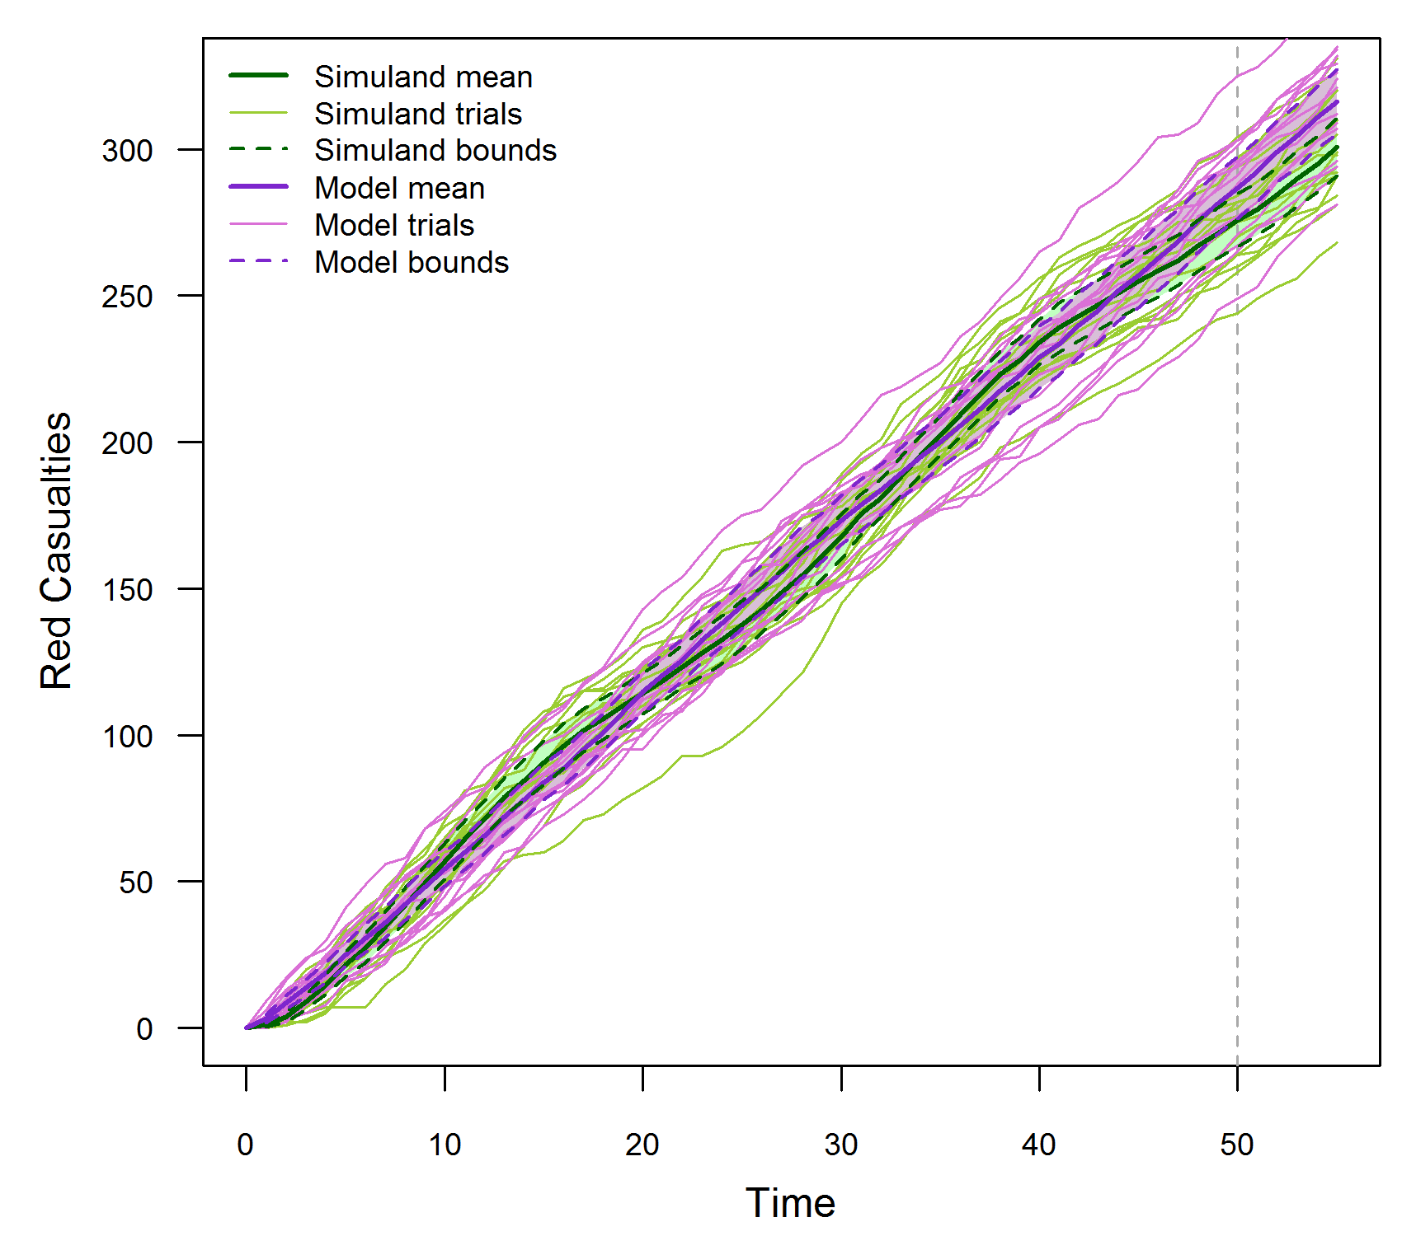
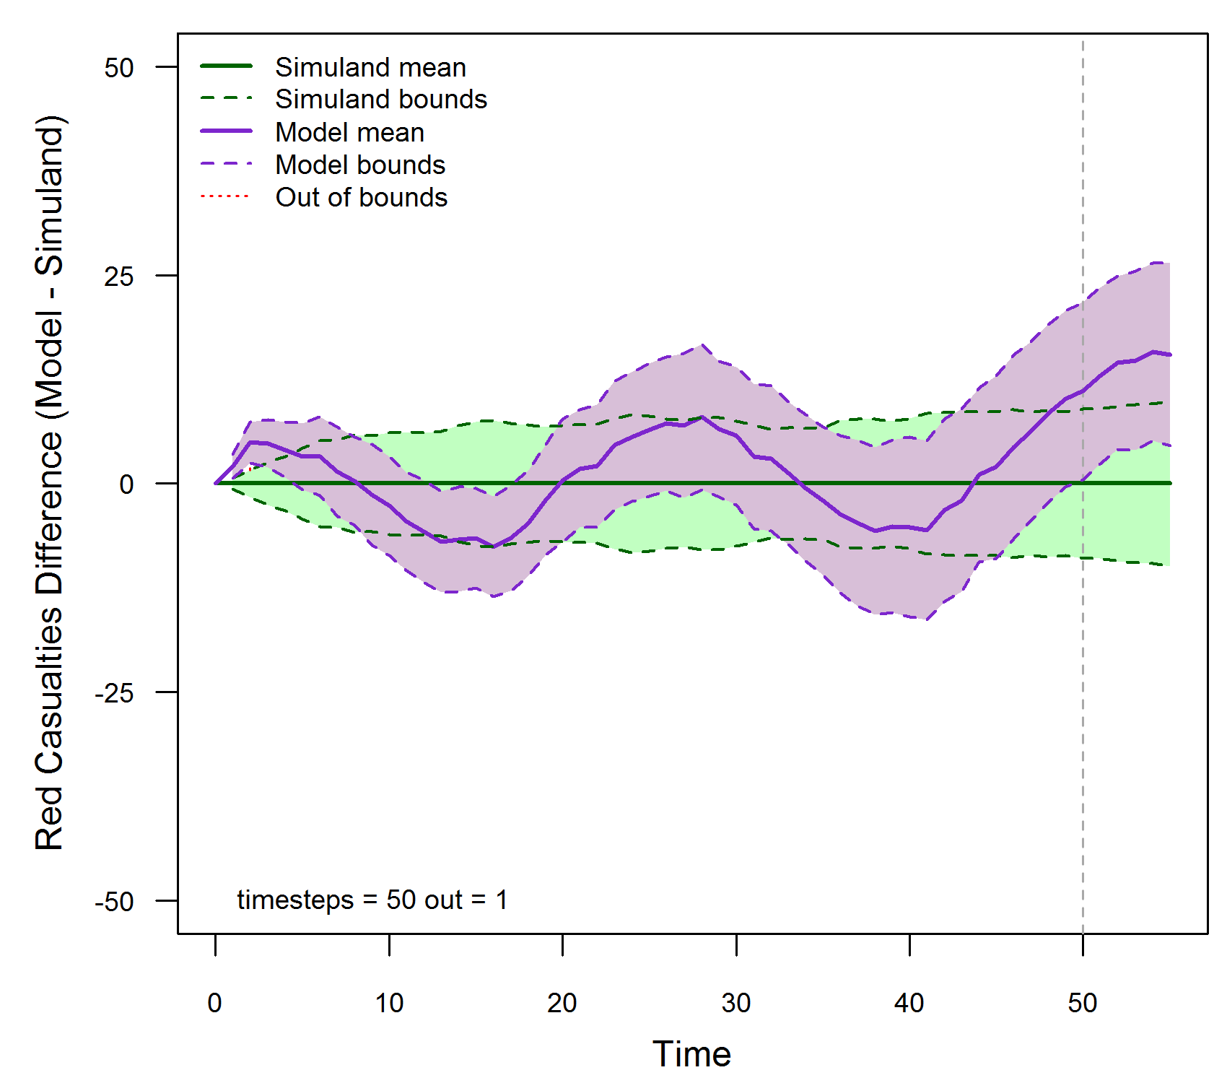
Rigorous Validation: Time Series Method C
Example model: Method C (multiple - multiple)
SME: OOB limit = 10% = 5 time steps
Simuland: 15 trials with 95% confidence interval per time step
Model: 15 trials with 95% confidence interval per time step
OOB time steps > OOB limit → model not valid

Slide 39
Rigorous Validation Tutorial Learning Objectives
Time Series Validation Method: Advanced Methods (not covered)
Spectral analysis [Fishman, 1967] [Naylor, 1971] [McNickle, 2004]
Parametric time series model [Hsu, 1977]
Standardized time series [Schruben, 1983] [Chen, 1987] [Goldsman, 1990]
Regression analysis [Kleijnen, 1998]
Bootstrapping [Kleijnen, 2000] [Kleijnen, 2001]
Granger causality [Granger, 1969]

Slide 40
Presentation Outline: Validation Method Evaluation Framework
Background
Motivation
Definitions
Validation uncertainty and risk
Verification and validation processes and methods
Assembling an effective referent
The ideal referent as the basis for validation comparison
Challenges and obstacles to developing the ideal referent
Best practices and obstacle mitigation
Examples
Selecting and applying the appropriate method
Referent and intended use data relationships
Examples of applying validation methods for both point value and time series data based on the referent
Validation Method Evaluation Framework
Conclusions and recommendations

Slide 41
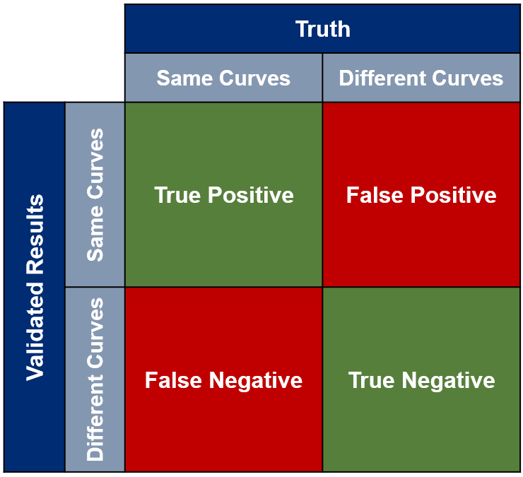

Rigorous Validation: Evaluation Framework to Assess Validation Methods
Given:
Validation of simulation results against data derived from a physical test (“Field” Referent)
A time series validation metric
Objective of the Evaluation Framework
Classify results of applying validation method as:
TP – test data set correctly classified as in-family to distribution of simulation metric results
TN – test data set correctly classified as out-of-family
FP – test data set incorrectly classified as in-family
FN – test data set incorrectly classified as out-of-family
Maximize TP (sensitivity) and TN (specificity) rates
The four measurements can be used to produce a contingency matrix
$$\text{Performance} \text{Accuracy}= \frac{N_{\text{TP}} +N_{\text{TN}}}{N_{\text{TP}} +N_{\text{TN}}+N_{\text{FP}} +N_{\text{FN}}}$$
[Su, McCarty, et al., 2022]

Slide 42
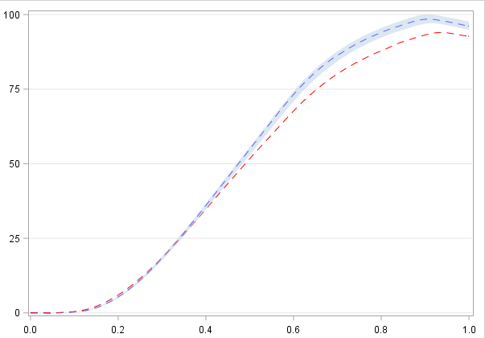
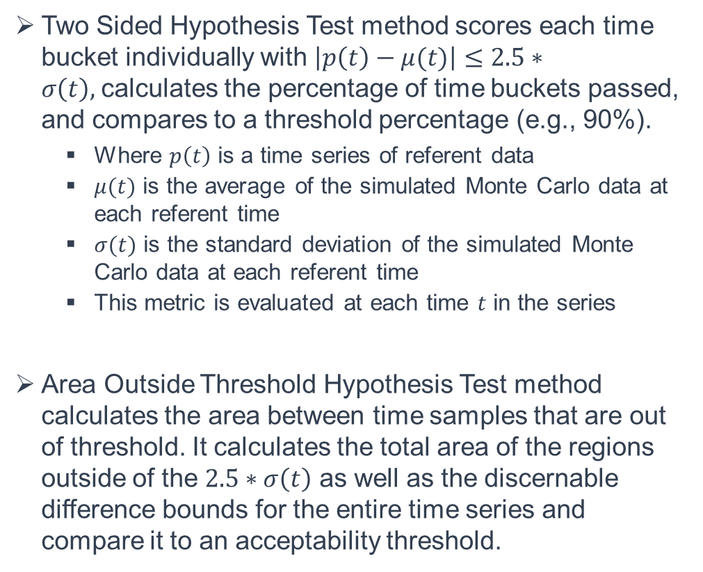
Rigorous Validation: Validation Methods Assessed
Two Sided Hypothesis Test method scores each time bucket individually with $\left|p\left(t\right)−μ(t)\right|≤2.5∗σ\left(t\right),$calculates the percentage of time buckets passed, and compares to a threshold percentage (e.g., 90%).
Where $p\left(t\right)$ is a time series of referent data
$μ(t)$ is the average of the simulated Monte Carlo data at each referent time
$σ(t)$ is the standard deviation of the simulated Monte Carlo data at each referent time
This metric is evaluated at each time $t$ in the series
Area Outside Threshold Hypothesis Test method calculates the area between time samples that are out of threshold. It calculates the total area of the regions outside of the $2.5∗σ\left(t\right)$ as well as the discernable difference bounds for the entire time series and compare it to an acceptability threshold.
Count number of times outside the boundary
Calculate the area outside

Slide 43
Rigorous Validation: Evaluation Framework Implementation Steps
Step 1: Identify metrics of interest for analysis
Step 2: For each metric of interest, generate N (e.g., 300) simulation functional data curves
Step 3: Identify a base scenario and a scenario extremely different from the base scenario
Step 4: For the base scenario
Cull out a single curve
Treat the curve left out as the “test data” and the remaining N-1 simulation runs as the “model results”
Apply the validation method and determine if the “test data” is declared similar or different from the “model results”
Repeat for the remaining comparisons
This will provide calculations for the True Negative and False Positive calculations
Step 5: For a specific “extremely different” scenario
Treat each curve from “extremely different” scenario as the test data, compare each curve to the N simulation runs from the base scenario
Apply the validation method and determine if “test data” is declared similar or different from the “model results
Repeat for the remaining N-1 comparisons
This will provide calculations for the True Positive (TP) and False Negative calculations (FP)
Repeat Step 5 for additional selected scenarios (ranging from mild to moderately different from the base case)

Slide 44
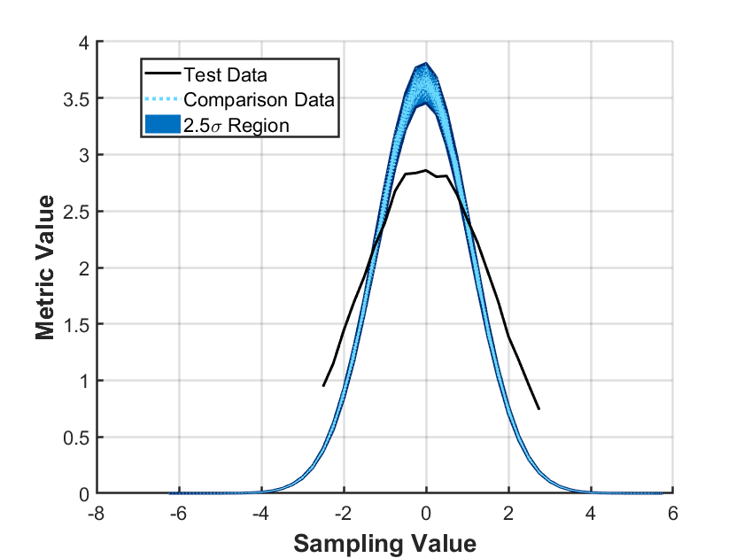
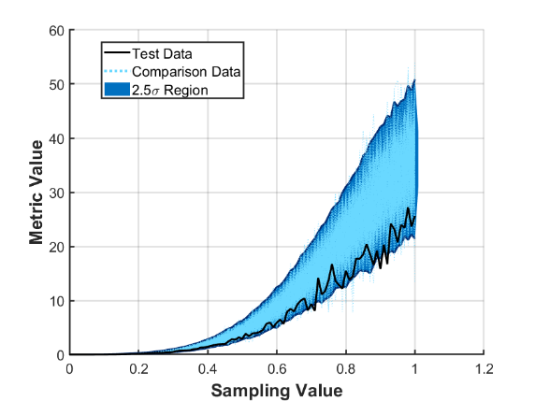
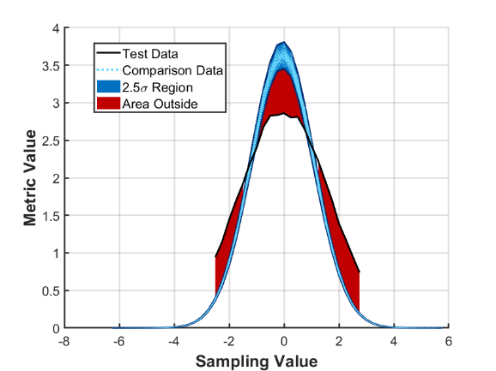
Rigorous Validation: Example Methods
In-family comparison between model results and test data set for Two Sided Test
Out-of-family comparison between model results and test data set for Two Sided Test
An example of out-of-family for the Two Sided Test when data run along the edge of the threshold region
Depiction of Area Outside of Threshold Test

Slide 45
Rigorous Validation Tutorial Learning Objectives
Two Sided Hypothesis Test Results:
Near 100% TP rates for all four metrics
100% TN rates for two of the four metrics
TN rates for other two metrics - not as good
Overall averaged accuracy of 76.1% across all metrics
This method is still able to consistently separate the test data from the out-of-family comparison data
Area Outside Threshold Hypothesis Test Results:
Using the 90th percentile threshold, method improved TP rate compared with the two-sided threshold hypothesis test
Less effective at identifying TN rates
The method resulted in an averaged accuracy of 62.9% across all metrics
Applying a stricter 50th percentile threshold resulted in similar TP and TN rates to the two-sided threshold test, but no percentile resulted in improvement
Need to uniquely calculate the percentile threshold for each comparison data set – not ideal
Two-sided hypothesis test results for 4 metrics of interest (shown in shades of blue)
Area outside threshold hypothesis test results for 4 metrics of interest with a 90% threshold

Slide 46
Presentation Outline: Conclusion and Recommendations
Background
Motivation
Definitions
Validation uncertainty and risk
Verification and validation processes and methods
Assembling an effective referent
The ideal referent as the basis for validation comparison
Challenges and obstacles to developing the ideal referent
Best practices and obstacle mitigation
Examples
Selecting and applying the appropriate method
Referent and intended use data relationships
Examples of applying validation methods for both point value and time series data based on the referent
Validation Method Evaluation Framework
Conclusions and recommendations

Slide 47
Rigorous Validation: Conclusions and Recommendations
Quality and quantity of referent effects validation rigor
Rigorous validation is possible, but it depends on an effective referent, i.e., sufficient data, well aligned with the model’s intended use
Acquiring an effective referent should be started early in the simulation life cycle
Given the best possible referent, a range of quantitative validation methods are available
Application of statistical validation methods
Most quantitative (statistical) validation methods make specific assumptions
If a statistical method is used when the assumptions are not met, its results are meaningless and potentially misleading
Validating time series data
Validating a model using output at a single time step can be misleading
Methods exist to validate models using time series output
Confidence interval methods; relatively simple
Advanced methods; mathematically complex

Slide 48
Rigorous Validation: References and bibliography (1 of 4)
[ATEC, 2004] Army Test and Evaluation Command (ATEC) Pamphlet 73-1, System Test and Evaluation Procedures, April 19 2004.
[Balci, 1981] O. Balci and R. G. Sargent, “A Methodology for cost-risk analysis in the statistical validation of simulation models”, Communications of the ACM, Vol. 27, No. 4, pp. 190-197.
[Balci, 1985] O. Balci and R. E. Nance, “Formulated problem verification as an explicit requirement of model credibility”, Simulation: Transactions of the Society for Modeling and Simulation International, Vol. 45, No. 2, pp. 76-86.
[Balci, 1998] O. Balci, “Verification, Validation, and Testing”, in J. Banks (Editor), Handbook of Simulation: Principles, Methodology, Advances, Applications, and Practice, John Wiley & Sons, New York NY, 1998, pp. 335-393.
[Balci, 2002] O. Balci, R. E. Nance, J. D. Arthur and W. F. Ormsby, “Expanding Our Horizons in Verification, Validation, and Accreditation Research and Practice”, Proceedings of the 2002 Winter Simulation Conference, San Diego CA, December 8-11 2002, pp. 653-663.
[BanksC, 2010] C. M. Banks, “Introduction to Modeling and Simulation”, in J. A. Sokolowski and C. M. Banks (Editors), Modeling and Simulation Fundamentals: Theoretical Underpinnings and Practical Domains, John Wiley and Sons, Hoboken NJ, 2010, pp. 1-24.
[Belfore, 2004] L. A. Belfore, J. J. Garcia, E. K. Lada, M. D. Petty, and W. P. Quinones, “Capabilities and Intended Uses of the Joint Operations Feasibility Tool”, Proceedings of the Spring 2004 Simulation Interoperability Workshop, Arlington VA, April 18-23 2004, pp. 596-604.
[Cellier, 1991] F. E. Cellier, Continuous System Modeling, Springer-Verlag, New York NY, 1991.
[Chen, 1987] B. Chen and R.G. Sargent, “Using Standardized Time Series to Estimate the Difference between Two Stationary Stochastic Processes,” Operations Research, Vol. 35, 1987, pp. 428-436.
[DOD, 2009] Department of Defense, Instruction 5000.61, M&S VV&A, 2009.

Slide 49
Rigorous Validation: References and bibliography (2 of 4)
[DOD, 2012] Department of Defense Standard Practice, MIL-STD-3022 with Change 1, Documentation of Verification, Validation, and Accreditation (VV&A) for Models and Simulations, April 5 2012.
[DOT&E, 2000] DOT&E Report, AIM-9X Sidewinder Air-to-Air Missile, 2000.
[Fischer, 2001] K. Fischer, “AIM-9X…Surpassing the M&S Challenge,” Unpublished presentation, 2001.
[Fishman, 1967] G. S. Fishman and P. J. Kiviat, “The Analysis of Simulation-Generated Time Series”, Management Science, Vol. 13, 1967, pp. 525-557.
[Gilmore, 2016] Director Operational Test and Evaluation Memorandum, Guidance on the Validation of Models and Simulation used in Operational Test and Live Fire Assessments, 14 March 2016.
[Goldsman, 1990] D. Goldsman and L. Schruben, “Confidence Interval Estimators Using Standardized Time Series”, Management Science, Vol. 36, No. 3, March 1990, pp. 393-397.
[Granger, 1969] C. W. J. Granger, “Investigating Causal Relations by Econometric Models and Cross-spectral Methods”, Econometrica, Vol. 37, No. 3, pp. 424-438.
[Kleijnen, 1998] J. P. C. Kleijnen, B. Bettonvil, and W. Van Groenendaal, “Validation of Trace-Driven Simulation Models: A Novel Regression Test”, Management Science, Vol. 44, 1998, pp. 812-819.
[Kleijnen, 2000] J. P. C. Kleijnen, R.C.H. Cheng, and B. Bettonvil, “Validation of Trace-Driven Simulation Models: More on Bootstrap Techniques”, Proceedings of the 2000 Winter Simulation Conference, Orlando FL, December 10-13 2000, pp. 882-892.
[Kleijnen, 2001] J. P. C. Kleijnen, R.C.H. Cheng, and B. Bettonvil, “Validation of Trace-Driven Simulation Models: Bootstrap Tests”, Management Science, Vol. 47, 2001, pp.1533-1538.

Slide 50
Rigorous Validation: References and bibliography (3 of 4)
[Law, 2015] A. M. Law, Simulation Modeling and Analysis, Fifth Edition, McGraw-Hill Education, New York NY, 2015.
[McNickle, 2004] D. McNickle, G. C. Ewing, and K. Pawlikowski, “Refining Spectral Analysis for Confidence Interval Estimation in Sequential Simulation”, Proceedings of the 16th European Simulation Symposium, Budapest Hungary, October 17-20 2004, pp. 99-103.
[Naylor, 1971] T. H. Naylor, Computer Simulation Experiments with Models of Economic Systems, John Wiley & Sons, New York NY, 1971.
[IDA, 2001] AIM-9X: A Modeling and Simulation Success Story, IDA Research Summaries, Vol. 8, Number 1, Summer/Fall 2001, pp. 8-12.
[Mansager, 1994] B. Mansager, Model Test Model, Naval Postgraduate School Technical Report NPS-MS-94-007.
[Metz, 2001] M. Metz, Using Subject Matter Experts for Results Validation of a Complex Theater Warfare Simulation, 01F-SIW-036, August 2001.
[Minsky, 1965] M. L. Minsky, Matter, Mind, and Models, Artificial Intelligence Memo No. 77, Massachusetts Institute of Technology, March 1965, Online at http://dspace.mit.edu/bitstream/handle/1721.1/6119/AIM-077.pdf ?sequence=2, Accessed, July 19 2015.
[Pace, 2009] D. K. Pace, “Simulation Uncertainty and Validation”, Proceedings of the Spring 2009 Simulation Interoperability Workshop, San Diego CA, March 23-27 2009.
[Petty, 2010] M. D. Petty, “Verification, Validation, and Accreditation”, in J. A. Sokolowski and C. M. Banks (Editors), Modeling and Simulation Fundamentals: Theoretical Underpinnings and Practical Domains, John Wiley & Sons, Hoboken NJ, 2010, pp. 325-372.
[Petty, 2012] M. D. Petty, “Calculating and Using Confidence Intervals for Model Validation”, Proceedings of the Fall 2012 Simulation Interoperability Workshop, Orlando FL, September 10-14 2012, pp. 37-45.

Slide 51
Rigorous Validation: References and bibliography (4 of 4)
[Petty, 2013] M. D. Petty, “Advanced Topics in Calculating and Using Confidence Intervals for Model Validation”, Proceedings of the Spring 2013 Simulation Interoperability Workshop, San Diego CA, April 8-10 2013.
[Piersall, 2014] C. H. Piersall and F. E. Grange, “The Necessity of Intended Use Specification for Successful Modeling and Simulation of System-of-Systems”, CrossTalk, September/October 2014, pp. 20-24.
[RPG, 2011] DoD VV&A Recommended Practices Guide, RPG Validation Referent Special Topic Paper, https://vva.msco.mil/, January 2011.
[Schruben, 1983] L. Schruben, “Confidence Interval Estimation Using Standardized Time Series”, Operations Research, Vol. 31, No. 6, November-December 1983, pp. 1090-1108.
[Su, McCarty, et al., 2022] S.Y. Su, S.K. McCarty, J.D. Warfield Jr., E.J. Uthoff, and S.M. Youngblood, Evaluation Framework for Assessing Validation Methods on Modeling and Simulation Models, JHU/APL Technical Digest, May 2022.
[Velten, 2009] K. Velten, Mathematical Modeling and Simulation, WILEY-VCH, Weinheim Germany, 2009.
[Zhang, 2008] W. Zhang, F. Li, Z. Wu, and R. Li, “Emulation of Rocket Trajectory Based on a Six Degree of Freedom Model”, Proceedings of the Seventh International Symposium on Instrumentation and Control Technology: Measurement Theory and Systems and Aeronautical Equipment, Proceedings of the SPIE Vol. 7128, Beijing China, October 10 2008, doi:10.1117/12.806878.

Slide 52
Rigorous Validation: Contact Information
Additional information
Simone M. Youngblood
The Johns Hopkins University Applied Physics Laboratory
240-228-7958
Simone.Youngblood@jhuapl.edu
Mikel D. Petty, Ph.D.
University of Alabama in Huntsville
256-824-6140
pettym@uah.edu

