Slide 1

Introduction to HLA
With an update on HLA 4
Björn Möller, Pitch Technologies
Dr. Katherine L. Morse, Johns Hopkins University / APL

Slide 2
Agenda
The High-Level Architecture (HLA)
Purpose
Terminology
Object model template
Services
Use cases
HLA IEEE 1516-2010 – “HLA Evolved”
HLA IEEE 1516-202x – “HLA 4”
LVC gateways, performance, tools and security
Common federation object models
Summary and additional reading

Slide 3
What’s New in this Year’s HLA Tutorial
More emphasis on HLA 4
Modeling
Security
Scalability
Deployment & Cloud
Federation Object Models
RPR FOM
CyberDEM
General updates
Standards development
Use cases

Slide 4
Learning Objectives
After taking this tutorial you should be able to:
Describe the requirements for interoperability in distributed simulation
Explain the principles of the HLA standard
Explain how the HLA standard is used for distributed training purposes
Describe the new features of HLA 1516-2010 and HLA 4
Describe some common Federation Object Models (FOMs) for defense training

Slide 5



Purpose of HLA
Provide one single interoperability standard
Meet a broad set of distributed simulation requirements
Support training, analysis, test & evaluation, concept development, engineering, etc.
Support a variety of domains and sub-domains with different and evolving object models
Enable reuse of simulation components, thus reducing cost
Vendor-neutral interoperability through open standardization
Facilitate an open eco-system for COTS, GOTS and in-house simulations
COTS = Commercial-off-the-shelf
GOTS = Government-off-the-shelf
IEEE = Institute of Electrical and Electronics Engineers
SISO = Simulation Interoperability Standards Organization

Slide 6



Overview of HLA Capabilities
Connect
Exchange
information
Synchronize
Manage &
Monitor
Object models
Connects simulations running on different hosts
Services for information exchange using publish-subscribe and filtering
Services for synchronization of startup, execution and simulation time
Services for managing and monitoring the simulations
Support for object models for different domains

Slide 7
HLA Timeline
(HLA 1.0)
(HLA 1.1) (HLA 1.2)
IEEE
1516-2010
“HLA Evolved”
IEEE
1516-202x
”HLA 4”
DMSO HLA 1.3
IEEE
1516-2000
Proto-federations
1995
2000
2005
2010
2015
2020
HLA was initiated in the US DoD in the early 1990s
After developing several proto-federations, HLA 1.3 was released in 1998
It was brought to open standardization through IEEE, resulting in HLA IEEE 1516-2000
The standard was updated in 2010 with several new features – “HLA Evolved”
The standard is currently under revision – “HLA 4”

Slide 8
The HLA “Lollipop View”
Federate A
Federate B
Federate C
Federation Object Model <FOM>
<Shared object classes>
<Shared interaction classes>
<More>
</FOM>
Runtime Infrastructure (RTI)
Each participating member is called a Federate
Information is exchanged using a Runtime Infrastructure (RTI)
The information exchange follows a Federation Object Model (FOM)
The federates together with the FOM and the RTI are called a Federation
A session with a federation is called a Federation Execution

Slide 9
Objects vs. Interactions
The HLA shares data between federates via two mechanisms:
Objects
Persistent
Usually represent long-lived entities in the federation
State is represented by attributes
State can be partially updated by owning federate
Example: Aircraft, Human
Interactions
Not persistent
Usually represent events in the federation
State is represented by parameters
Full state must be sent in the interaction
Example: Fire, Radio signal

Slide 10
HLA Works Like an “Information Bus”
Publish truck,
aircraft, command
Publish aircraft,
command
Publish weather
Publish truck,
aircraft
Subscribe truck,
aircraft
Subscribe aircraft,
weather, command
Subscribe aircraft,
weather, command
Subscribe command
Federate A
Federate B
Federate C
Federate X
Runtime Infrastructure
A federate can publish the information that it produces to the federation.
Another federate can subscribe to information that it requires.
Publishing and subscribing is based on the Federation Object Model (FOM).
The RTI routes any relevant information to a subscribing federate – no need for federates to connect directly to other federates.
Allows for multiple RTI implementations, including central server and peer-to-peer
Enables interoperability and reuse

Slide 11
Structure of the Formal Standard
HLA Rules – For the federation and the federates
HLA Object Model Template – A standardized format for Information Exchange Data Models
HLA Interface Specification – A standardized set of services for interoperability
Also in C++, Java and Web Services format
Implemented in an RTI (Runtime Infrastructure)

Slide 12
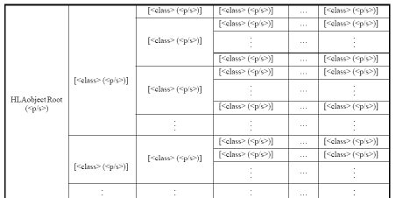
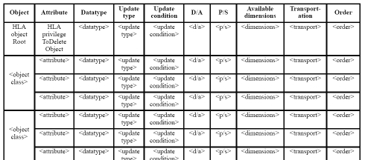
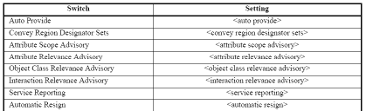
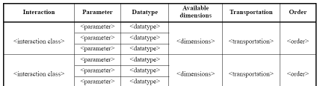
HLA Object Models and the OMT
Federation Object Model (FOM)
A description of all shared information (objects, attributes, and interactions) essential to a particular federation.
Simulation Object Model (SOM)
Describes objects, attributes and interactions in a particular federate that can be used externally in a federation.
Object Model Template (OMT)
Provides a common framework for HLA object model documentation.
Fosters interoperability and reuse of simulations via the specification of a common representational framework.

Slide 13
Object Model Template – Minimal Version
Object Class
Identification
Name, version, purpose, etc., of the Object Model
Object Classes with Attributes
Interaction Classes with Parameters
Data Types
Simple, records, enumerations, etc.
Used for Attributes and Parameters
Aircraft
Type
Marking
Position
Interaction Class
Fire
FiringObject
TargetObject
MunitionType
Data type
PositionRecord
Latitude
Longitude
Altitude

Slide 14
Object Model Template – Full Version
Object model identification table
Object class structure table
Interaction class structure table
Attribute table
Parameter table
Dimension table
Time representation table
User-supplied tag table
Synchronization table
Transportation type table
Update rate table
Switches table
Datatype tables
Notes table
Interface specification services usage table

Slide 15
Object Class Structure Table
HLAobjectRoot (<p/s>) | [<class> (<p/s>)] | [<class> (<p/s>)] | [<class> (<p/s>)]
 |  | [<class> (<p/s>)] | [<class> (<p/s>)]
 |  |  | [<class> (<p/s>)]
 |  |  | [<class> (<p/s>)]
 | [<class> (<p/s>)] | [<class> (<p/s>)] | [<class> (<p/s>)]
 |  | [<class> (<p/s>)] | [<class> (<p/s>)]
 |  | … | …
 |  | … | …
Provides a mechanism for representing the class-subclass hierarchy of HLA object classes

Slide 16
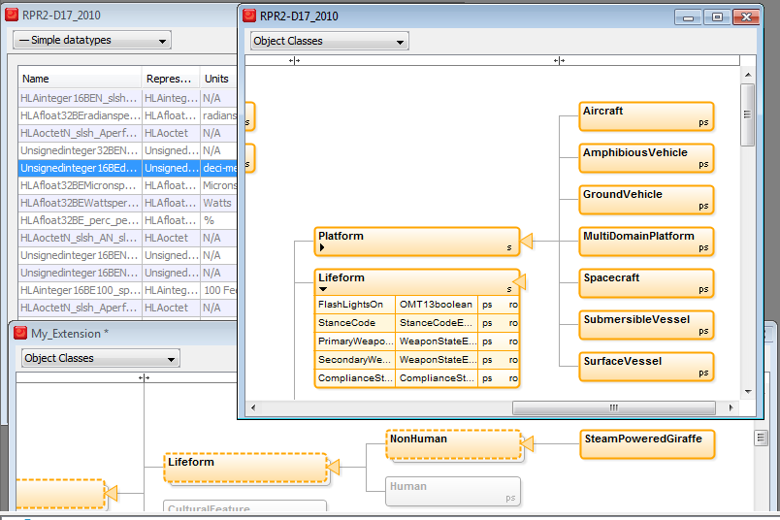
Object Class Structure Table Example
An alternative visual representation

Slide 17
Interface Specification
Defines the services of the RTI. Also includes the C++, Java and Web Services APIs for these services
Federation Management
Declaration Management
Object Management
Ownership Management
Time Management
Data Distribution Management
Support Services

Slide 18
Federation Management
Purpose: Establish well-managed sessions with a controlled set of simulations.
Functionality: Creating federation executions. Coordinated start-up. Synchronization points. Check pointing.
Essential HLA Services
Connect to the RTI, create and join federation execution.
Resign. Destroy federation execution. Disconnect.
Synchronization points.
Save/restore.

Slide 19
Declaration Management
Purpose: Declare what data each federate will send or wishes to receive, based on the federation object model (FOM), in order to optimize the data exchange.
Functionality: Publish and subscribe object classes with attributes, and interaction classes with parameters.
Essential HLA Services
Publish.
Subscribe.

Slide 20
Object Management
Purpose: Data exchange.
Functionality: Create and delete object instances that are shared between federates. Update their attributes. Send and receive interactions.
Essential HLA Services
Register, discover, delete and remove object instances.
Update and reflect attribute values.
Send and receive interactions.
Request updates.

Slide 21
Ownership Management
Sample use case: enable a constructive simulation to hand over the responsibility for simulating an aircraft to a virtual simulation.
Functionality: Hand over the ownership (responsibility for updating) of attributes from one federate to another during execution. This can be either “push” or “pull,” and with or without negotiation.
Essential HLA Services:
Request ownership acquisition for an attribute.
Divest ownership for an attribute.
Query attribute ownership.

Slide 22
Time Management
Sample use case: run exercises in real-time, scaled real-time, varying speed, as-fast-as-possible. Run Monte-Carlo simulations as fast as possible.
Functionality: Manage the time advancement for federates and time-stamped data exchange between federates for consistency and repeatability. This can be time-stepped or event-driven.
Essential HLA Services:
Enable/disable sending and receiving of time-stamped data.
Request and grant advancement to a given time.
Request and grant advancement to the time of the next message.
Query the RTI for current time values.

Slide 23
Data Distribution Management
Sample use case: build large federations by enabling federates to focus on a smaller part of the battlefield or on entities belonging to a particular force.
Functionality: Enable federates to filter data not only on class and attribute, but also on their static or dynamic data (like friendly/opposing or latitude/longitude).
Essential HLA Services:
Create and modify regions that specify data ranges for filtering.
Send attribute updates and interactions with associated regions.
Subscribe to attributes and interactions with associated regions.

Slide 24
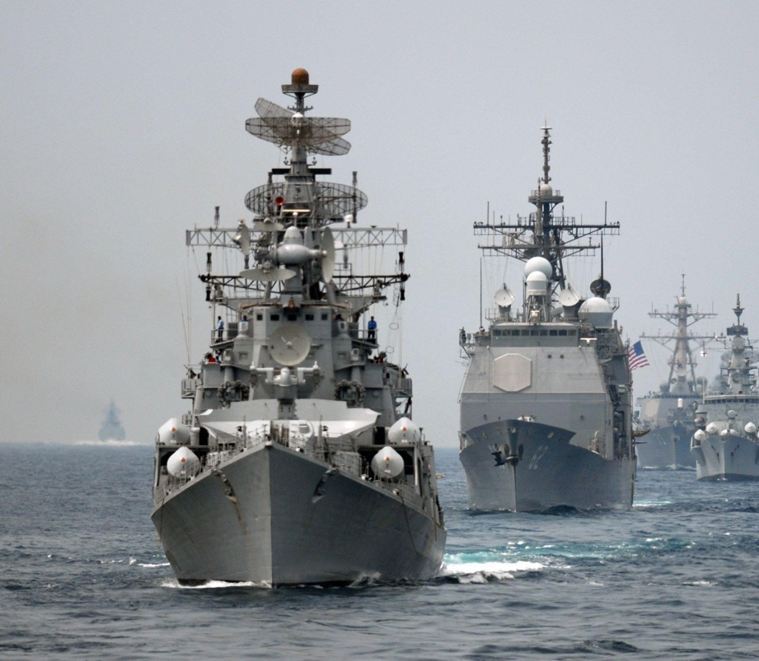
HLA Use Case: US Navy NCTE
US Navy Continuous Training Environment
Navy Enterprise Tactical Training Network
Develops, delivers, and maintains live, virtual, and constructive training environment to support Naval Forces
50 Navy shore sites, 140 combatant ships, 8 networks, 5 classification levels
Based on HLA IEEE 1516-2010, RPR FOM 2.0, Link 16 and Simple
FOM modules (as of 2018):
29 stable (“core”)
29 rapid development (“aux”)
RPR FOM = Real-Time Platform Reference FOM

Slide 25

HLA Use Case: UK Air Force – “Gladiator”
Distributed training environment for the UK Royal Air Force
Enables pilots to train collectively with ground and maritime forces from their home bases without the need to co-locate
Initially supporting Typhoon, F-35 expected to be added in 2021
Based on HLA IEEE 1516-2010, RPR FOM and NETN FOM with several extensions
NETN FOM = NATO Education and Training Network FOM

Slide 26
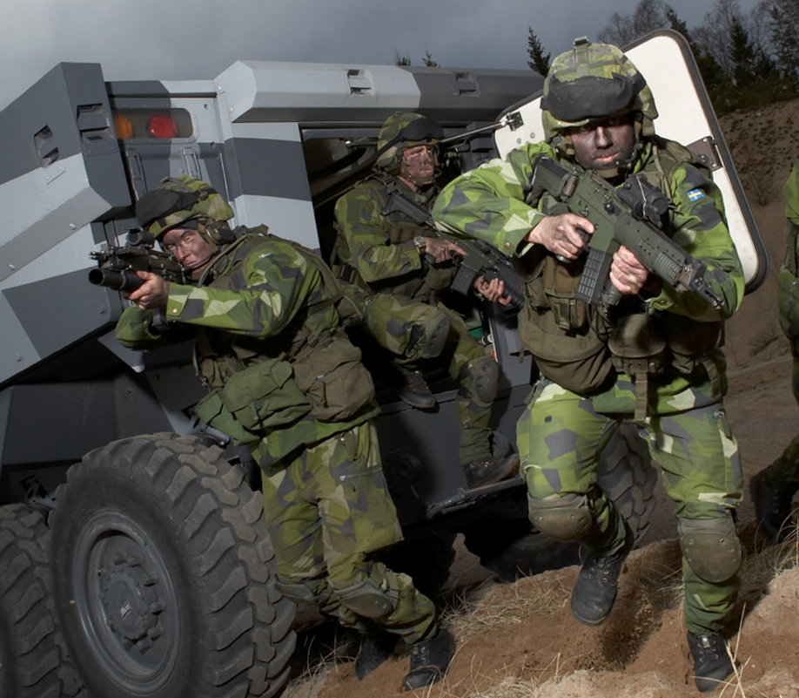
HLA Use Case: Civil Military Exercise “Viking”
Series of US & Swedish-led command and control exercises (2022)
Planning and conducting a UN mandated Chapter VII Peace Operation/Crisis Response Operation
Civilian, military and police
2500 participants, 50 nations, 70 organizations, 8 training sites + 2 MSaaS sites
Based on HLA IEEE 1516-2010, RPR FOM 2.0, NETN FOM v3.0, MSDL and additional standards
MSDL = Military Scenario Definition Language

Slide 27
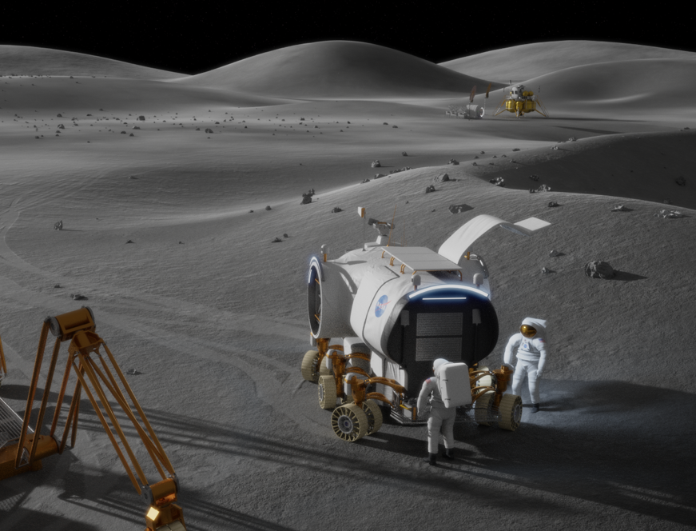
HLA Use Case: NASA and ESA Space Exploration
Engineering and training federations for space exploration
NASA: Federations in support of the Artemis program that will land the first woman and next man on the surface of the Moon by 2024
ESA: Mars sample return and low-gravity landing vehicle
Based on HLA IEEE 1516-2010 and the SISO Space Reference FOM
Multiple reference frames, HLA time management, hard real-time and more
NASA = National Aeronautics and Space Administration
ESA = European Space Agency

Slide 28
HLA is an Open International Standard
IEEE
Simulation
Developers &
Users
Government
Industry
Academia
Etc.
Sponsor
HLA
IEEE 1516
Standard
COTS
GOTS
In-house
Open source
Other
Simulation Interoperability
Standards Organization
RTI and Tool
Developers
Academia
Research
Student projects
Courses
Community feedback

Slide 29
HLA Evolved – FOM Modules
All Objects and Interactions
Weapons
Platforms
Radio
Common Data
The same FOM as before, but split into modules
Remember: It was a long time ago since we gave up developing computer programs as one large chunk of code.
More efficient and flexible development, maintenance, reuse and standardization
Projects/programs can reuse and extend standardized modules and add their own modules.

Slide 30
HLA Evolved – Fault Tolerance
Federate Lost!
Federate Lost!
Not Connected!
Federate
Federate
Federate
RTI
HLA Evolved introduced a mechanism for fault tolerance
Connected federates can discover that a federate has been lost
The lost federate can discover that it has lost connection
Enables several design patterns (fail-over federates, reconnecting federates, …)

Slide 31
HLA Evolved – Web Services API
Virtual Training Center
Internet
HLA over Web Services
Loose coupling
Works well on Wide Area Networks
Good performance but not as high as regular HLA
http://mytraining.army.mil/PSOscenario
User: GI5532
Password: *********

Slide 32
Important New Features in HLA 4
More powerful modeling
Directed Interactions
Easier to extend reference FOMs
Security
Secure authorization of federates
Secure communication
Deployment
Support unreliable links, like 3G/4G/5G
Support more programming languages
Increased vendor-independence
Scalability
Cloud-based simulation with local deployment
“Elastic cloud” scalability
Improved data distribution management
Business models
Modeling and Simulation as a Service
IEEE Balloting planned for 2022

Slide 33
Object Modeling: Directed Interactions
Classic “Global” Interactions
Directed Interactions
StartDriving
Delivered to all
subscribing federates.
StartDriving
Delivered to subscribing
federates that model (update) a particular car.

Slide 34
Object Modeling: Easier to Extend Models
Standardized “Reference Object Models” are one of the key benefits with HLA. They provide a baseline for interoperability. They are key for reuse.
HLA 4 adds several features that makes it easier to extend existing information models with application-specific data.
Example: add attributes to already defined object classes
Standard Aircraft
Entity Type
Entity ID
Side
Spatial (position etc)
Damage State
Extensions
Maintenance Date
Maintenance Type

Slide 35


HLA 4 – Federate Authentication
Federates may be required to provide credentials to connect and join a federation
Support for passwords, PKI certificates (X.509), etc
Flexible mechanism through plug-in
May connect to existing authorization services
May implement different policies
Also useful for Zero Trust Architectures
Certificate
Authority
Private Key
Certificate
Certificate
Certificate
Federate A
Federate B
Federate C
Runtime Infrastructure (RTI)
Public Key

Slide 36







HLA 4 – Federate Protocol
A federate can call the RTI using a protocol instead of calling a local library
Separates the federate from the RTI
Better support for Live with 3G/4G links
More cloud-friendly (containers, etc)
Simplifies accreditation
Additional languages/OS
Standardized API
Standardized protocol
Federate
Federate
Network
“Join” API call
“Join” network packet
RTI Lib (LRC)
RTI Server
Network
Network

Slide 37
HLA 4 Based Architecture for Cloud, Scalability and MSaaS
On-site
Public or Private Cloud
Classic Training System
HLA 4 Federate Protocol + Authentication
HLA 4 RTI
RPR FOM
Game Based Trainer
HLA 4 Federate Protocol + Authentication
L16 FOM
Web Based Client
https/html/REST/Vert.x/etc
Web Server
HLA 4 API
or protocol
NATO FOM
C2 System
C2 Sim/C2 Protocol
C2 Gateway
HLA 4 API
or protocol
Space FOM
Data Recorder
HLA 4 API
or protocol
HLA 4 supports mixed cloud and on-site deployment
Scalable CGFs and data recorders may execute in cloud environments
Training audience may operate classic training systems, web-based interfaces or game-based trainers
Custom FOM
Scalable CGF
HLA 4 API
or protocol

Slide 38
HLA 4 – More New Features
Better support for scalability through enhanced DDM
Easier to specify dimensions for entire object class, inheritance to subclasses
Add DDM to existing FOMs using separate module
More complete and flexible Dimension specification
Relaxed DDM
Many minor improvements
Ownership management – user supplied tags
Specify for what attributes values are required vs optional
Fault tolerance – handling unplanned leaving federate
New datatypes to better support RPR FOM
Glyph that follows html conventions
Switches – defaults
Exception handling
Updated sample FOM modules

Slide 39
HLA and LVC – Gateways
DIS
Link 16
Command and Control
Federate
DIS Gateway
L16 Gateway
C2 Gateway
Runtime Infrastructure (RTI)
HLA can handle both Live, Virtual and Constructive simulation
In LVC settings, information may still need to be bridged between different architectures
Standard FOMs exist for bridging
The RPR FOM matches the DIS information model
Tactical Data Link (TDL) such as Link 16
C2SIM – connect to C2 systems
Custom gateways may be needed

Slide 40

HLA and Performance
HLA is a standard
It has no particular performance
Actual RTI implementations exhibit performance
May be optimized for different use cases
Sample RTI performance on regular Windows workstations in 2020
Hundreds of systems
100 000’s of updates per second, typically up to 90% of the network’s raw bandwidth
900 Mbps on Gigabit LAN
100 000 object instances
Latency of 0.13 ms on 100 Mbps LAN
Common federation bottlenecks:
LAN bandwidth
WAN latency and bandwidth
Federate processing time for incoming data
Plan for performance!
Analyze performance requirements
Analyze federate and network capabilities

Slide 41
HLA and Tools
Sample tool chain
OMT Editor
Code Generator
RTI
Data Logger
2D/3D Visualizer
A wide range of HLA compliant tools and federates are available
Development tools (OMT editor, middleware, code generators, data loggers)
Visualizers (2D, 3D, game based, …)
Federates (Computer Generated Forces, flight models, dynamics, …)
Bridges (HLA-DIS, HLA-HLA, HLA-TENA, HLA-games, HLA-DDS, …)
TENA = Test and Training Enabling Architecture
DDS = Data Distribution Services

Slide 42
HLA and Cross Domain Security/MLS
CDS/MLS solution
Simulation
Simulation
Proxy
Guard
Proxy
Simulation
Simulation
RTI
Policy
RTI
Low Domain
Release
High Domain
It is possible to simulate with controlled data exchange between classification levels
The federation is partitioned into different domains
May be different classifications within one nation or simulation between different nations
There are security solutions that can connect to multiple domains, provide separation and release data based on a release policy
Different topologies: one host, several hosts, hardware/software guards, etc
Different solutions meet different levels of assurance

Slide 43










Common Aerospace and Defense FOMs
The RPR FOM 2.0 is the most commonly used FOM for defense simulation
Complete refresh done during 2012 – 2013
RPR FOM 3 now being finalized
IFF, InfOps, etc
NATO Education and Training Network FOM (NETN)
Builds on top of RPR FOM
Growing number of modules
SISO Space Reference FOM
EUROCAE Air Traffic Management FOM
Medical FOM (US Army)
Physical Entities
Aggregates
Radio
Logistics
Synthetic Environment
Warfare
Underwater
Acoustics
Minefield
Simulation Management
Emissions
FOMs have been developed for many other domains:
Railroad
Road traffic
Medical
Offshore oil production

Slide 44
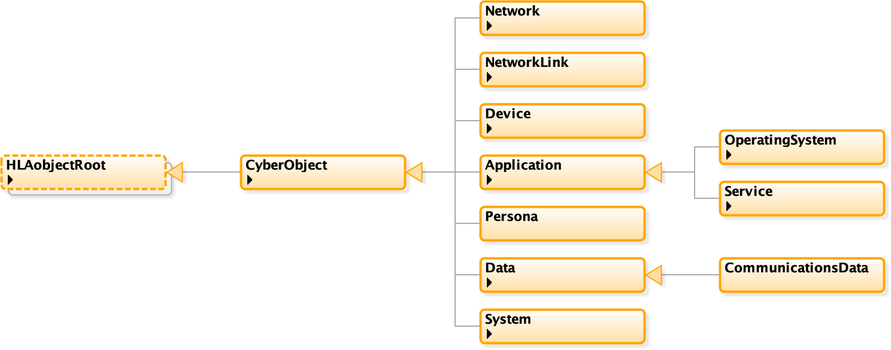
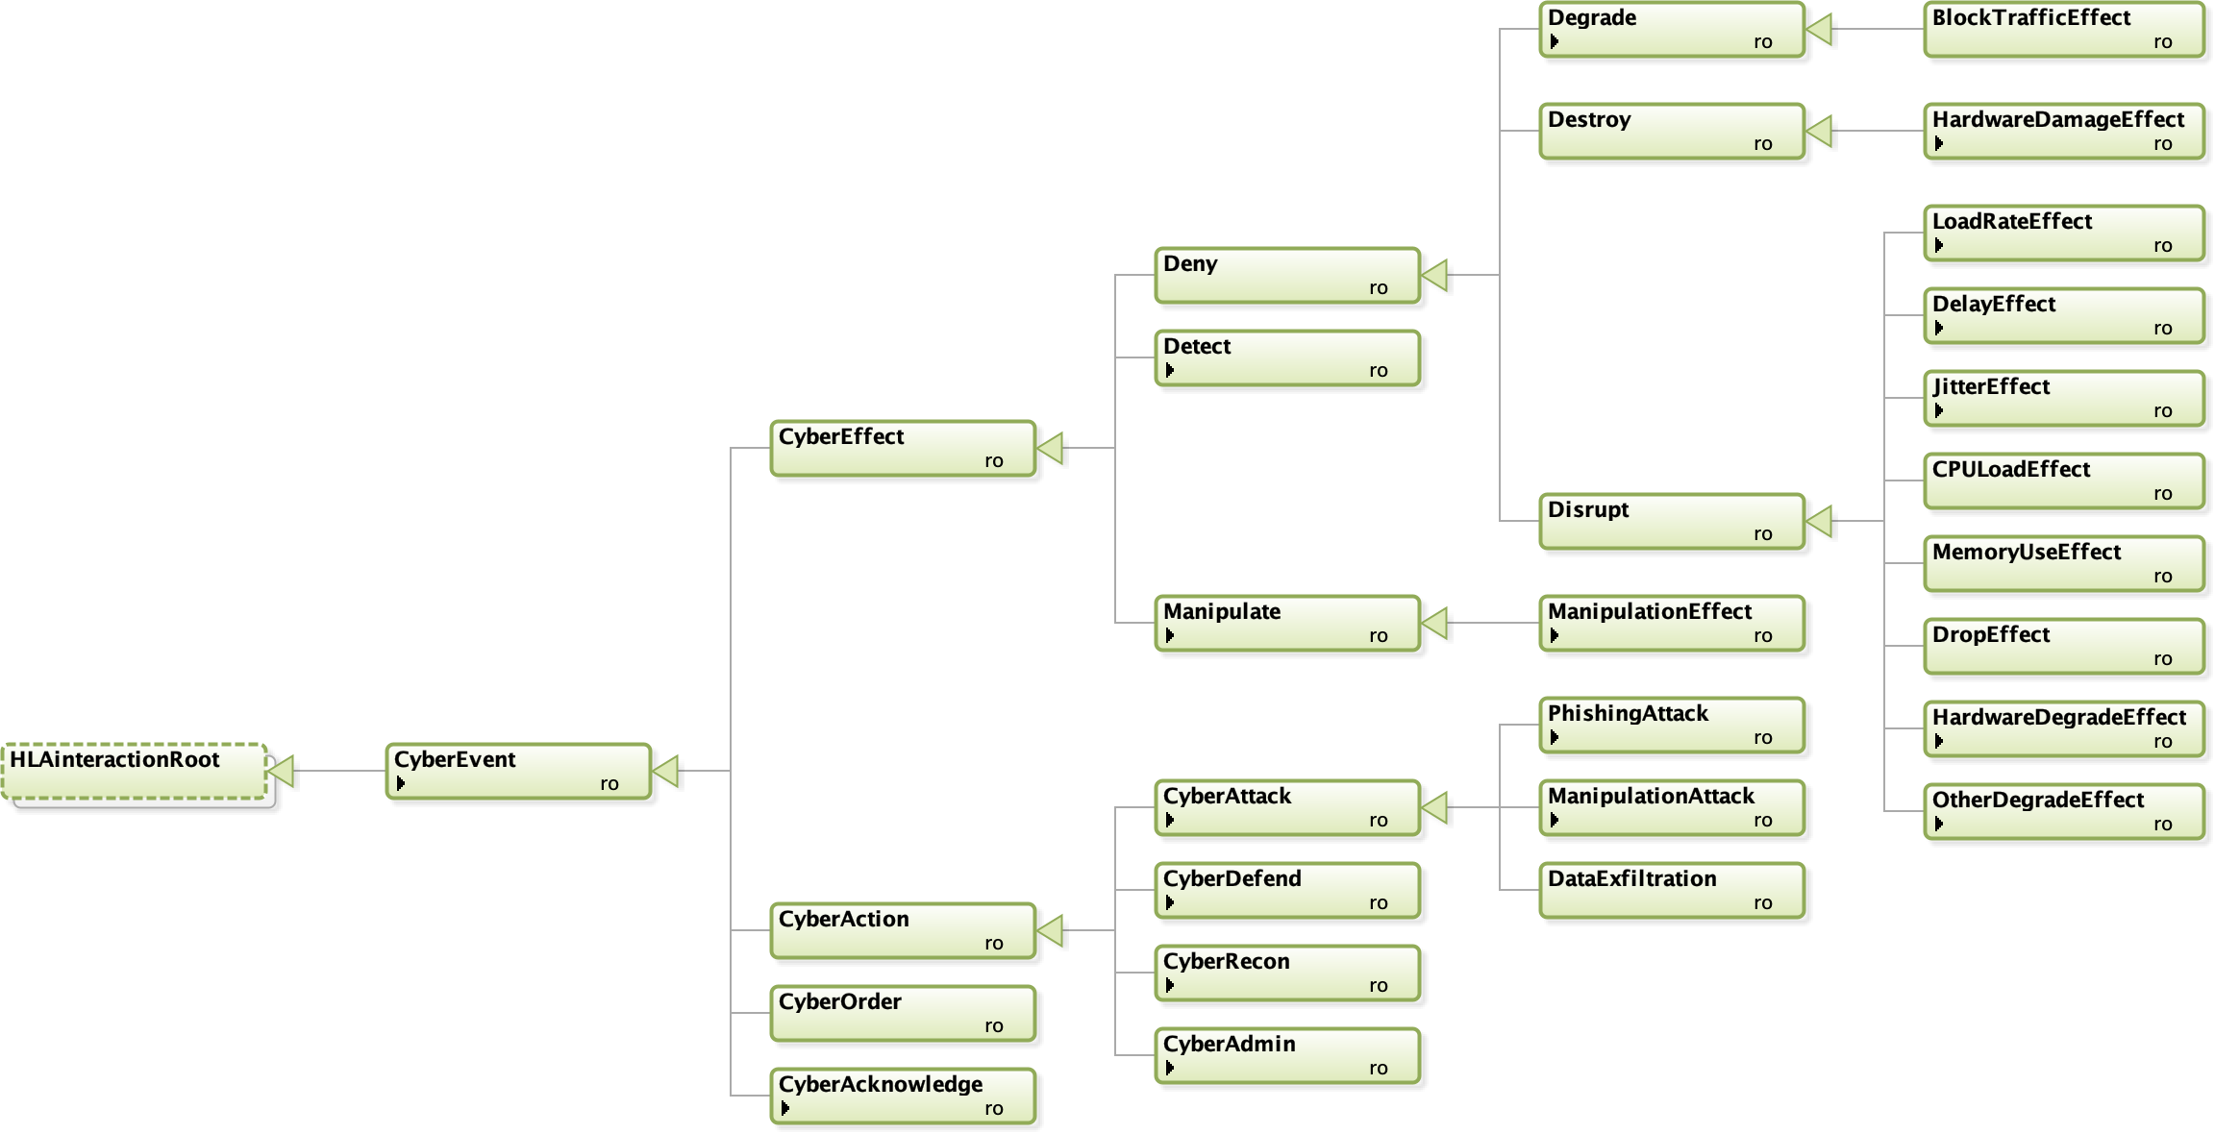
New: Cyber Data Exchange Model (DEM) and Federation Object Model (FOM
SISO is developing a Cyber DEM standard to represent cyber events and objects in a format independent of simulation interoperability solutions, but which is unambiguously translatable to those solutions. The Cyber DEM will enable integration of cyber simulations, cyber ranges, and kinetic simulations. A follow-on effort is planned to standardize a Cyber FOM based on the Cyber DEM.
Draft Interaction Class Structure
Draft Object Class Structure

Slide 45
Federation Engineering
The Distributed Simulation Engineering and Execution Process (DSEEP, IEEE 1730):
A clear, concise systems engineering process for development, integration, and execution of distributed simulations
Based on:
Authoritative systems engineering best practices
Successes and failures of past distributed simulation environments
Defines a generic, tailorable framework
Consists of a graphical model and supporting textual description
Provides a common reference point for communication between federation development team members
Provides a common foundation for defining functional overlays to the federation development process, e.g. VV&A, security, tools
Define Simulation Environment Objectives
Perform Conceptual Analysis
Design Simulation Environment
Develop Simulation Environment
Integrate and Test Simulation Environment
Execute Simulation
Analyze Data and Evaluate Results
1
2
3
4
5
6
7
Corrective Actions / Iterative Development

Slide 46
Federation Agreements
FOMs are an essential, prescribed component of a federation, but there are many other agreements that are necessary to establish a fully consistent, interoperable federation.
The DSEEP identifies the need for such federation agreements (simulation environment agreements), but does not prescribe their specific content or format.
The SISO standard for federation agreements, the Federation Engineering Agreements Template (FEAT) [SISO-STD-012-2013] provides a standardized format for recording federation agreements to increase their usability and reuse.

Slide 47
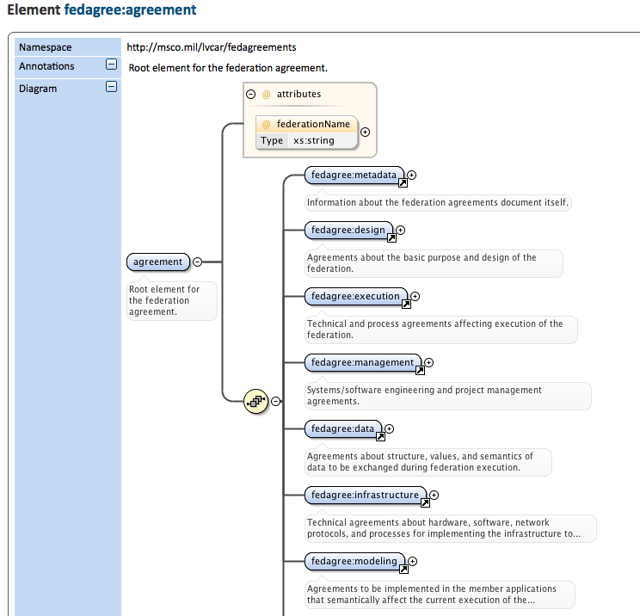
FEAT Overview
The FEAT is an eXtensible Markup Language (XML) schema from which compliant XML-based federation agreement documents can be created. XML was chosen for encoding agreements documents because it is both human and machine-readable and has wide tool support. Creating the template as an XML schema allows XML-enabled tools to both validate conformant documents, and edit and exchange agreements documents without introducing incompatibilities. The federation agreements are decomposed into eight categories:
Metadata — Information about the federation agreements document itself.
Design — Agreements about the basic purpose and design of the federation.
Execution — Technical and process agreements affecting execution of the federation.
Management — Systems/software engineering and project management agreements.
Data — Agreements about structure, values, and semantics of data to be exchanged during federation execution.
Infrastructure — Technical agreements about hardware, software, network protocols, and processes for implementing the infrastructure to support federation execution.
Modeling — Agreements to be implemented in the member applications that semantically affect the current execution of the federation.
Variances — Exceptions to the federation agreements deemed necessary during integration and testing.

Slide 48
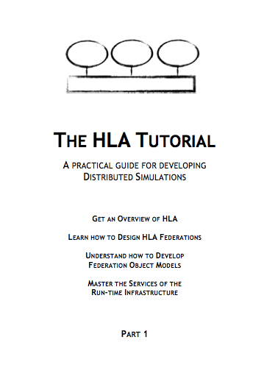
Additional Reading
Standards and Interpretations
HLA IEEE 1516-2010, www.ieee.org
The HLA Tutorial
Free, redistributable PDF
www.pitchtechnologies.com/hlatutorial
Plenty of SISO papers (www.sisostds.org)
Also on ResearchGate
I/ITSEC Papers (www.iitsec.org)
“Evolving the High Level Architecture for Modeling and Simulation.” I/ITSEC 2005, Paper No. 2157
The HLA Evolved and HLA 4 Product Development Group (PDG) discussion archives (www.sisostds.org)

Slide 49
Learning Objectives Revisited
After taking this tutorial you should be able to:
Describe the requirements for interoperability in distributed simulation
Explain the principles of the HLA standard
Explain how the HLA standard is used for distributed training purposes
Describe the new features of HLA 1516-2010 and HLA 4
Describe some common Federation Object Models (FOMs) for defense training

Slide 50
Questions?
Björn Möller
Dr. Katherine L. Morse
Bjorn.Moller@pitch.se
Katherine.Morse@jhuapl.edu

