Slide 1
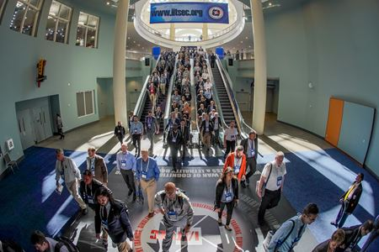

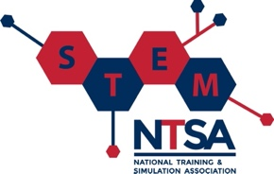
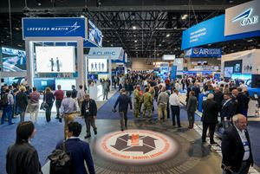


The I/ITSEC Professional Development Primer :
M&S Fundamentals, Certification, and Contemporary Applications
Kevin F. Hulme, Ph.D., CMSP

Slide 2

Presentation Topics
Overview/Motivation
Learning Objectives
I/ITSEC – Essential Concepts
I/ITSEC – Professional Development
The CMSP (3.0) – Professional Distinction
I/ITSEC – Contemporary Applications
Tutorial Summary
Bibliography
Acknowledgements
Q/A

Slide 3
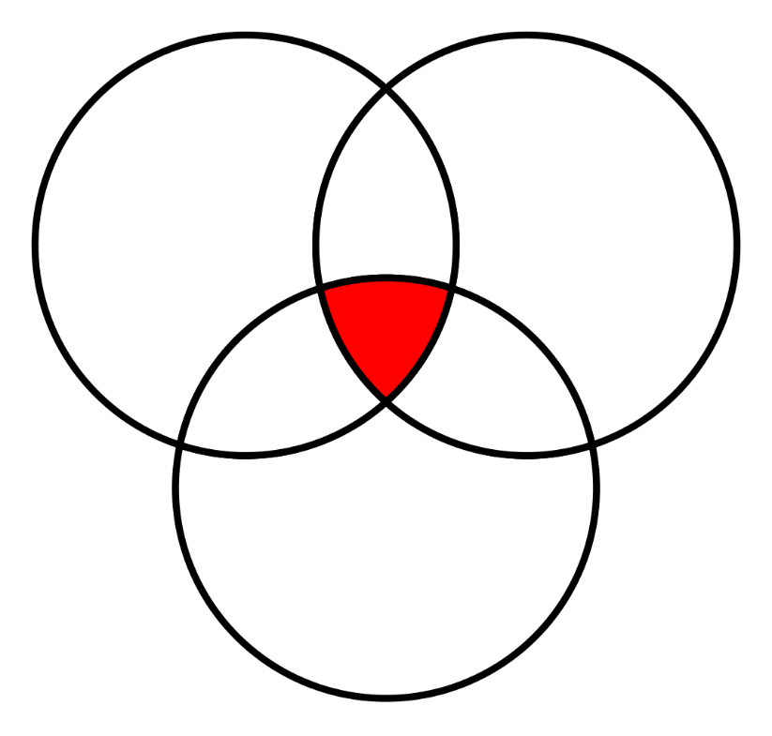

I/ITSEC – Overview/Motivation
I/ITSEC – Training, Simulation, and Education
  The three foundational pillars of the Conference
Training: the specialized process of acquiring skillsets or competencies to improve task/mission preparedness
Simulation: exploration of how synthetic environments apply to research – the applied science of M&S
Education: theories, strategies, methods, technologies, and best practices that advance the science of learning
T
S
E

Slide 4
Overview/Motivation
Primary Impetus and Motivation for this Tutorial
I/ITSEC offers a full week of opportunity for Professional Development
  Monday: Tutorials, Special Events, Exhibition Hall
  Tuesday-Thursday: Papers, Special Events, Exhibition Hall
  Friday: Professional Development Workshops
Learn more about the Certified Modeling & Simulation Professional (CMSP, v3.0)
Learn more about current applications within M&S across disciplines
Use this Tutorial as a springboard to other Tutorials within this Track

Slide 5

Overview/Motivation
2022 Overarching Conference Theme
Accelerate Change by Transforming Training: “It’s Time to ACTT!”
Accelerate Change: Better adapt to an ever-evolving global landscape
  New/advanced technologies (e.g., XR, AI, 5G, IoT)
  Unexpected world events (e.g., COVID-19, politics)
Transforming Training: An annual priority at I/ITSEC
  Assuring readiness and situational awareness given current global uncertainties
  Improving “mission” preparedness within the military, academic, and private sectors

Slide 6
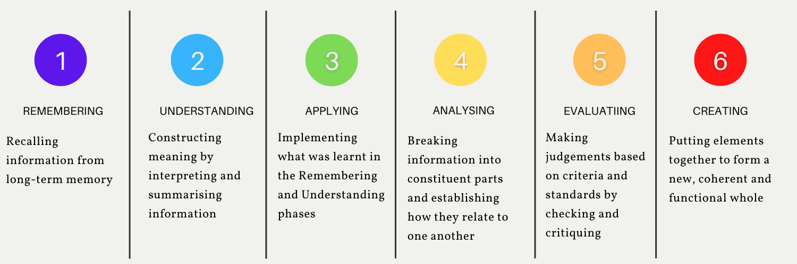
Learning Objectives
1) Define core and fundamental concepts of I/ITSEC from a notional perspective
2) Classify varied/convergent opportunities at I/ITSEC for Professional Development
3) Examine M&S as a field of discipline and professional distinction (CMSP)
4) Evaluate advanced applications of LVCA current practice within disparate fields
5) Summarize outcomes, determine next steps, (and ACTT accordingly)!
McNulty 2021

Slide 7
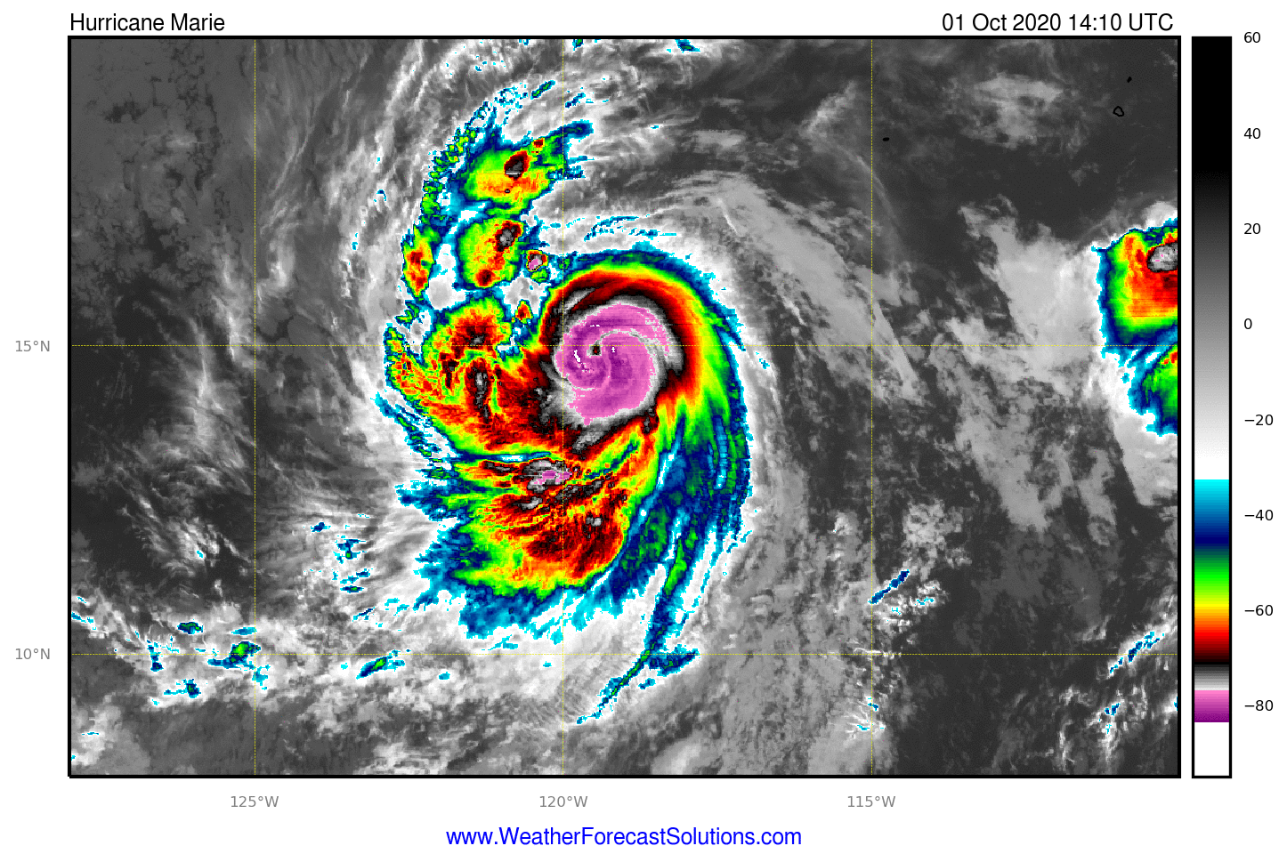
I/ITSEC – Essential Concepts
The lynchpin at I/ITSEC is the discipline of Modeling & Simulation (M&S)
  Model: A product (physical or digital) that represents a system of interest
  Simulation: The process of using a model to study the performance of an actual system
Yin-yang between M&S – a model is functional with an accompanying Simulation
Track #6 / Tutorial #22T22 (12:45 pm): more details on M&S Fundamentals
Marla, 1997

Slide 8
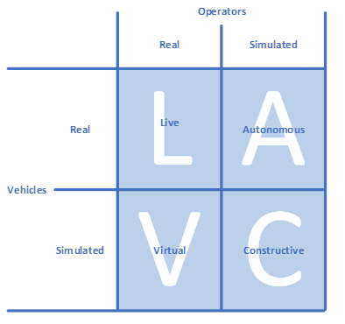
I/ITSEC – Essential Concepts
Live, Virtual, Constructive, Autonomous (LVCA): taxonomy for classifying M&S
  Live: real people / real system
  Virtual: real people / simulated system
  Constructive: simulated people / simulated system
  Autonomous: simulated people / real systems
Operators
Real
Simulated
Real
System
Simulated

Slide 9
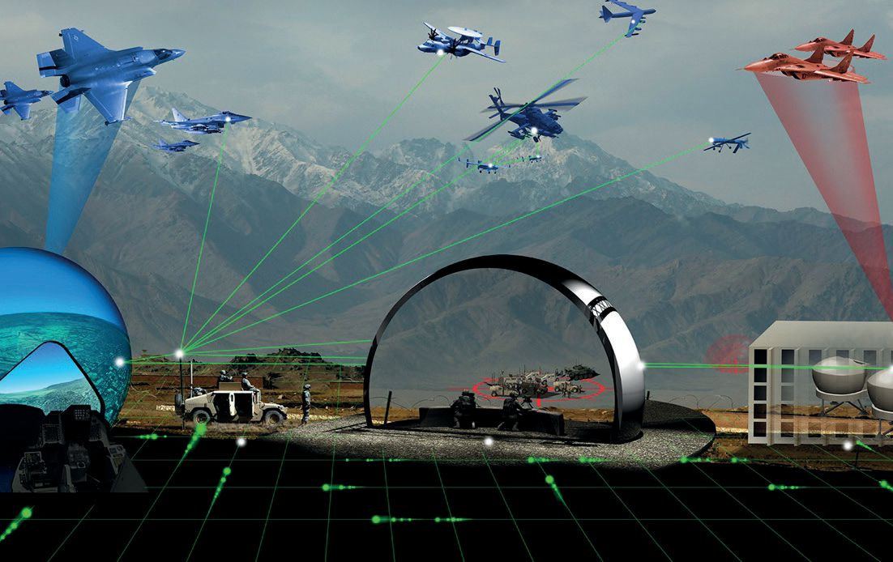
I/ITSEC – Essential Concepts
Live, Virtual, Constructive, Autonomous (LVCA) – taxonomy for classifying M&S
Track #9 / Tutorial #22T29 (12:45): more details on LVC 101 and interoperability
Autonomous
Live
Virtual
Constructive
(blended) Combat Simulation
Military Simulation and Training (MST), 2020
Department of Defense (DoD), 1998

Slide 10
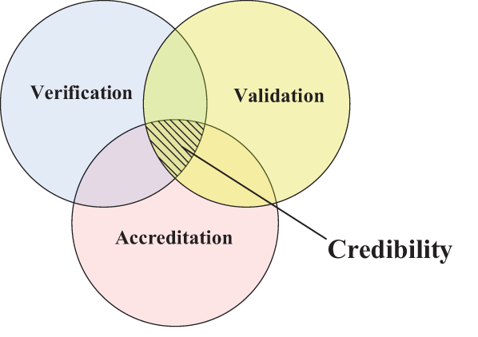
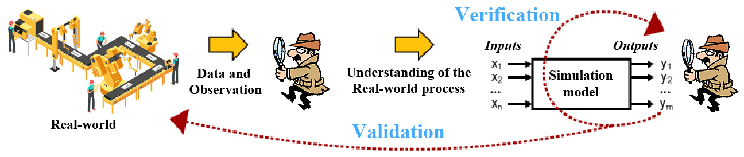
I/ITSEC – Essential Concepts
Verification, Validation, & Accreditation (VV&A) - M&S for new and innovative technologies rely on credible assumptions (risk management) for LVCA testing
  Verification: is the model right? (“It works the way it was designed.”)
  Validation: is it the right model? (“It looks and acts like the real thing.”)
  Accreditation: external certification (“We can use it on the job!”)
Track #4 / Tutorial #22T26 (12:45): more specifics on the VV&A pipeline
Udomsawat, 2022
Petty, 2008

Slide 11

I/ITSEC – Essential Concepts
Continuing Education Units (CEU)
  An I/ITSEC opportunity - standardized unit of measurement to quantify continuing education and training activities featured at I/ITSEC
  Sponsored by UCF; see the I/ITSEC 2022 Agenda for more details
The I/ITSEC Knowledge Repository
  Sponsored by the National Training and Simulation Association (NTSA), an affiliate of the National Defense Industrial Association (NDIA)
  A comprehensive archive of past papers at I/ITSEC (www.iitsecdocs.com)

Slide 12
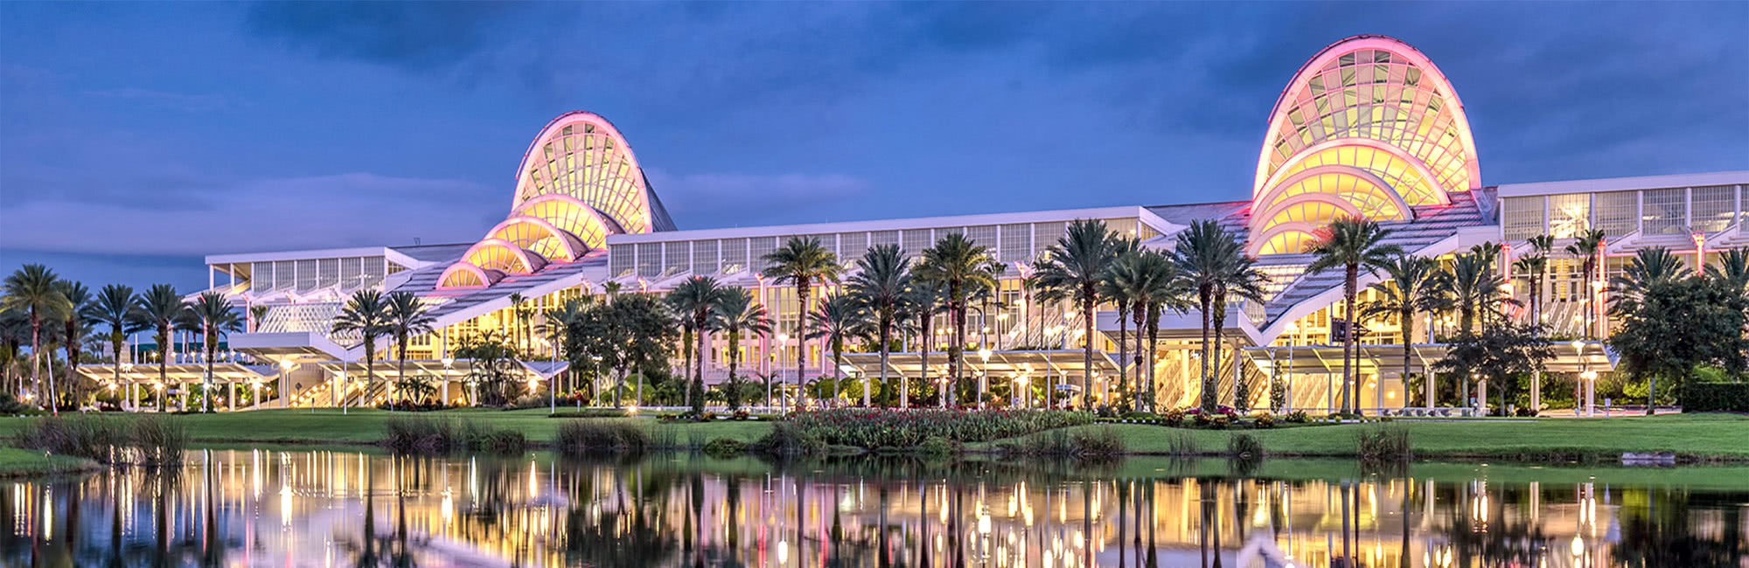
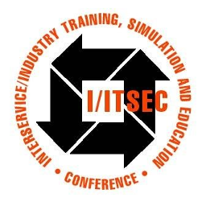

I/ITSEC – Professional Development
The weekly structure of the Conference
  A continuum of Professional Development across a wide spectrum of activities

Slide 13

I/ITSEC – Professional Development
Monday
I) Tutorials
  Goals and Objectives
    Extended presentations (90 minutes in length)
    Diverse topic areas that align with Training, Simulation, Education
    Alignment with other I/ITSEC subcommittee priority areas
  Three (3) primary areas of interest/priority
    Foundations of Modeling & Simulation (M&S)
    Certified Modeling & Simulation Professional (CMSP)
    Emerging Topics of broad interest

Slide 14
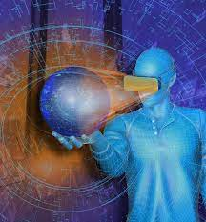
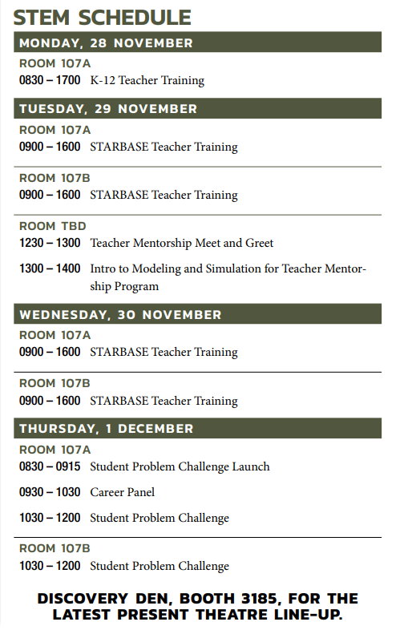
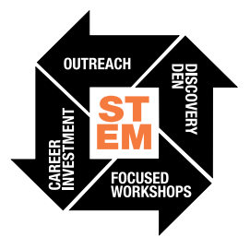

I/ITSEC – Professional Development
Monday - Friday
II) Workforce Development: The EcosySTEM of Learning
  Debuting with I/ITSEC 2021: Science, Technology, Engineering, and Mathematics | Modeling, Simulation & Training (MS&T)
    Opportunities for Students: a forum to learn about critical technologies
    Opportunities for Teachers: opportunities to engage ambitious student minds
    Opportunities for Workforce: insights to increase future preparedness’
  Outreach | Discovery Den | Focused Workshops | Career Investment
  Refer to I/ITSEC 2022 full Agenda for further details

Slide 15

I/ITSEC – Professional Development
Tuesday - Thursday
Paper Sessions (30-minute technical briefings)
  6 I/ITSEC priority areas (Subcommittees):
  Training, Simulation, Education (TSE)
    Subcommittees for each of the 3 primary I/ITSEC foundational pillars
  Human Performance Analysis and Engineering (HPAE)
    Focus on the human dimension (e.g., human-systems interaction)
  Policies, Standards, Management, Acquisition (PSMA)
    Requirements for training systems development, delivery, sustainment
  Emerging Concepts and Innovative Technologies (ECIT)
    Bleeding-edge technologies, methodologies, concepts that advance TSE

Slide 16
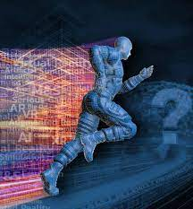


I/ITSEC – Professional Development
Monday - Thursday
Special Events
  Signature Events - Must-see (Flag) events
    General/Flag Officers Panel
    Congressional Panel
  Focus Events
    Serious Games Showcase - premier venue for recognition of excellence in Serious Game development
    IronDev - team competition to develop a training solution to improve warfighter readiness
  International Events
    1,000 International participants from 47 countries were present at I/ITSEC 2021 (!)
    International Pavilion - learn more about the conference, and interact with international colleagues

Slide 17

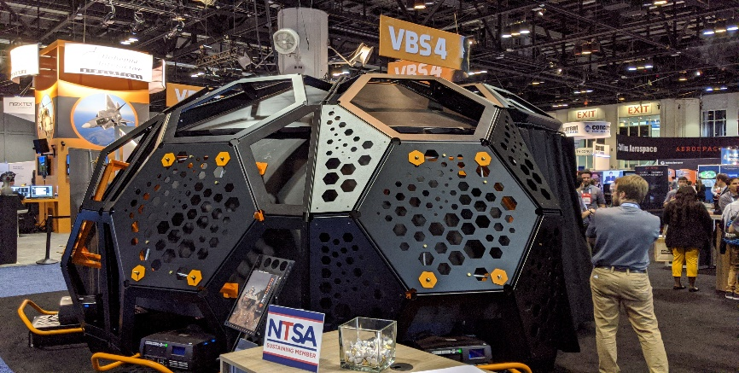
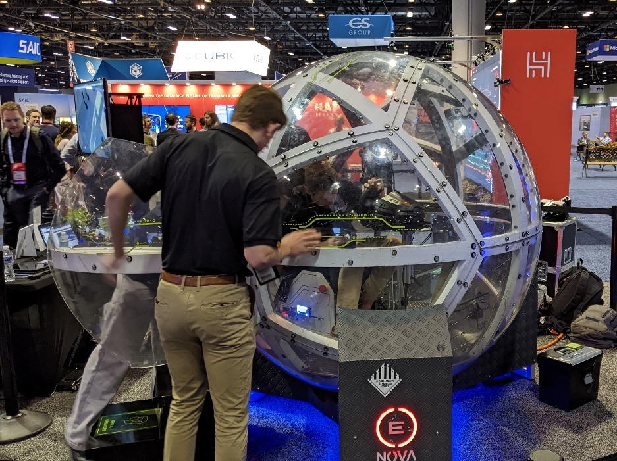
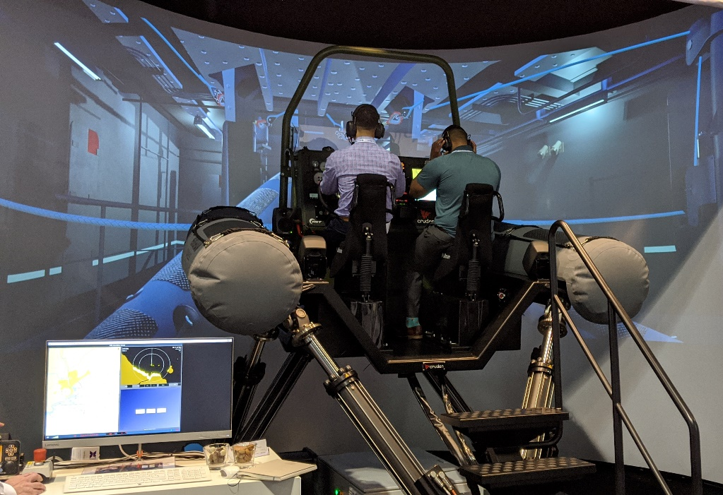
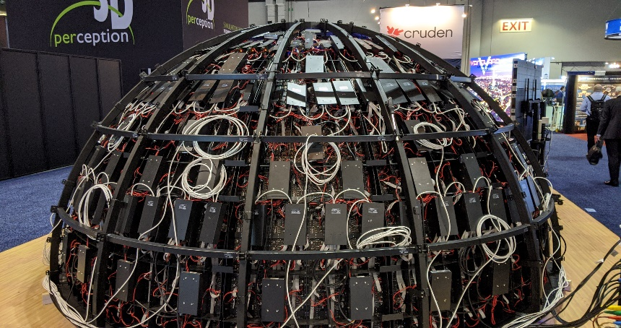
I/ITSEC – Professional Development
Monday - Thursday
Exhibition Hall
  A world-class offering of featured technologies
  Technical/financial focal point and anchor for I/ITSEC

Slide 18
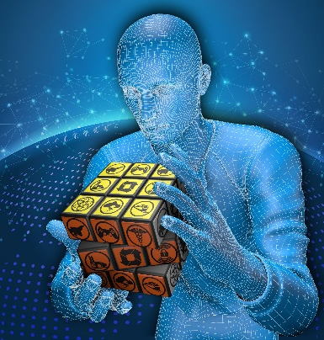
I/ITSEC – Professional Development
Friday
Professional Development Workshops (240 minutes in length)
  Topics that are in-depth and promote interactive engagement
  Areas of interest/priority
    Current and emerging I/ITSEC (NTSA/NDIA) priorities
    Certified Modeling & Simulation Professional (CMSP)
      A featured topic of discussion in this Tutorial
    Topics of broad interest (training, education, human performance, simulation)
    Couplings/pairings with Tutorials and Research Papers are strongly encouraged

Slide 19
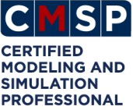

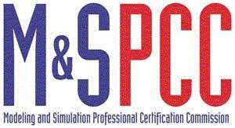

The CMSP (3.0) – Professional Distinction
Certified Modeling & Simulation Professional (CMSP)
Provides the M&S community with its own professional certification
Host Organizations / Oversight
  The National Defense Industrial Association (NDIA)
  The National Training and Simulation Association (NTSA)
  The Modeling & Simulation Professional Certification Commission (M&SPCC)
Brief History
  Program originally conceived in 2001 (v 1.0)
    Preliminary guidelines for establishing professional competency within M&S
  First primary modification in 2010 (v 2.0)
    Strengthen validity of program; improve examination consistency
M&SPCC, 2012
Petty, Reed and Tucker, 2017

Slide 20
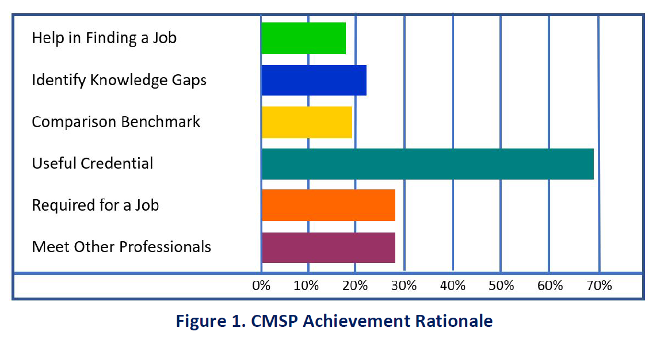
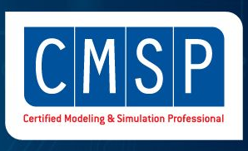
The CMSP (3.0) – Professional Distinction
Obtaining the CMSP designation
Application and Background requirements
  Education and work experience
  Three professional letters of recommendation
Online CMSP Exam*
  Certification is valid for 4 years
Re-certification (every 48 months)
  Track record of Continuing Education within the M&S field
Petty, 2016

Slide 21
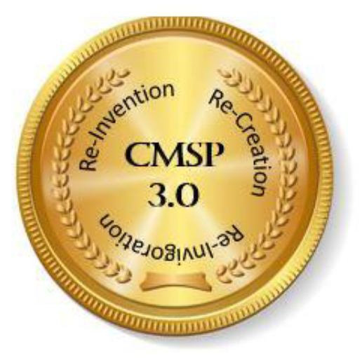
The CMSP (3.0) – Professional Distinction
CMSP 3.0
Second program re-launch (2021)
Creation of Certification committees:
  Executive committee (and 5 subcommittees)
2021/2022 committee accomplishments:
  Exam: updated the CMSP exam content, format and exam site (UCF)
  Engagement: started a CMSP Newsletter to engage the CMSP Nation
  Outreach: started a CMSP LinkedIn page
  Awareness/Demand: has hosted CMSP webinars
  Operations: NTSA have coordinated the work of the committees

Slide 22
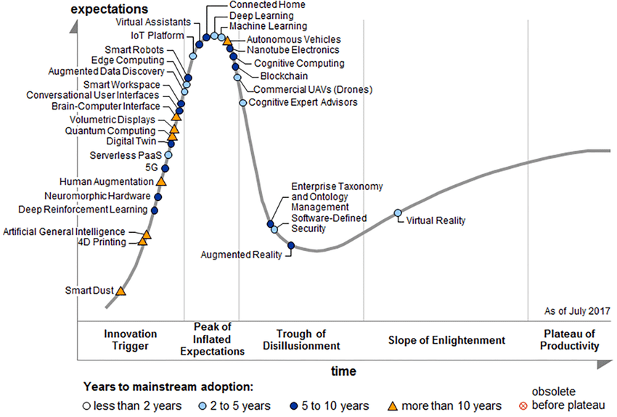
The CMSP (3.0) – Professional Distinction
CMSP 3.0
Exam revisions and updates
  Subtopics and questions covering new technologies and related M&S disciplines
Potential topics and priority areas
  XR (VR/AR/MR)
  Data Analytics, Blockchains, 5G
  Machine Learning, AI, Autonomous systems
  Gaming Technologies (serious play, gamification)
  Medical Simulation (i.e., response to COVID-19)
  Advanced Manufacturing (3D and 4D Printing)
Gartner, 2017

Slide 23
The CMSP (3.0) – Professional Distinction
CMSP 3.0 exam specifics
150 questions (2000 candidate) | multiple choice | 70% passing criterion
8 topics and 54 subtopics
  Concepts and Context – core definitions
  M&S Applications – analysis, test, evaluation, engineering
  Domains of Use – aerospace, medicine, transportation, manufacturing
  Modeling Methods – physics-based, human behavior, stochastic
  Simulation Implementation – distributed simulation, semi-automated forces, VR/AR
  M&S Supporting Tools – infrastructures, repositories, organizations
  Business and Management – ethics, economics, workforce development
  Communities of Practice – statistics, mathematics, software
Oswalt, 2021

Slide 24
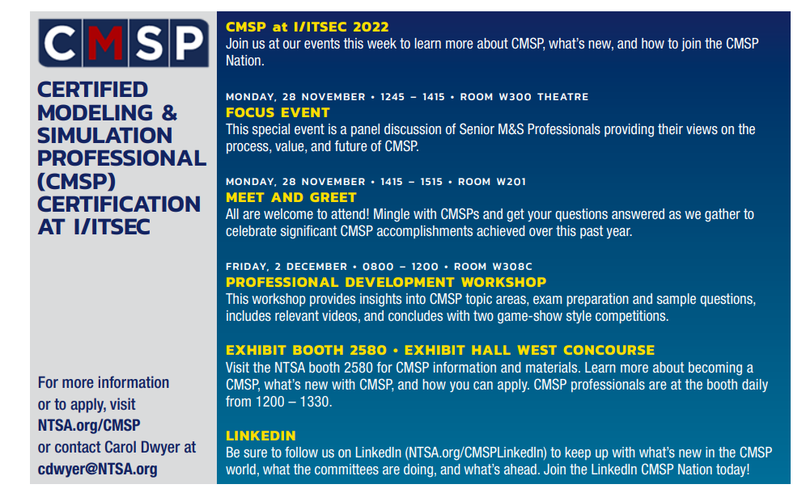
The CMSP (3.0) – Professional Distinction
CMSP 3.0 activities at I/ITSEC 2022

Slide 25
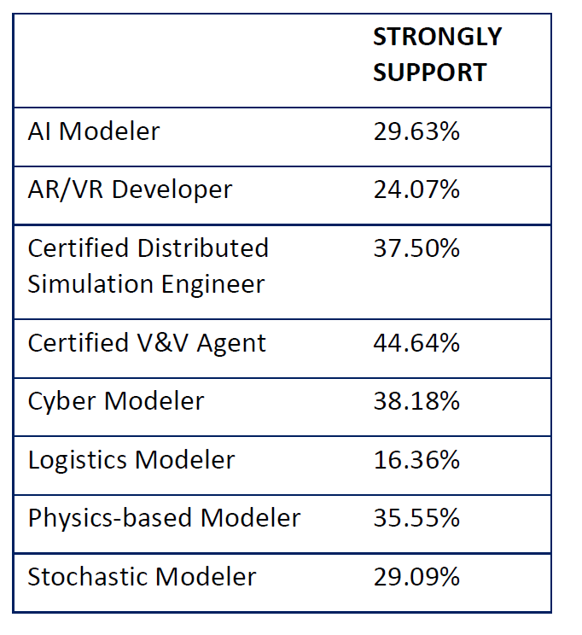
The CMSP (3.0) – Professional Distinction
CMSP 4.0?
The vast potential for what lies ahead..
NTSA are working with the Exam Committee to begin a three tier CMSP program
  Apprentice, Practitioner and Master
Consider mechanisms to better recognize wide array of Certification needs
  M&S user, M&S acquirer, M&S manager, M&S developer
CMSP Micro-credentialing (i.e., sub-certifications)?
Suggestions - other thoughts and ideas?
  Please see me afterwards!

Slide 26
The CMSP (3.0) – segment acknowledgements
Chair: Ivar Oswalt, PhD, CMSP
Co-Chair: David ‘Fuzzy’ Wells, PhD, CSMP
Members: David Gross, PhD; Linda Brent, EdD, CMSP; Neal Finkelstein, PhD; Steve Gordon, PhD; Robert Gravitz, CMSP; Alan Lynch; Sean Osmond, CMSP; Gregory Reed, PhD, CMSP; George Stone, PhD; Eric Weisel, PhD
Facilitator: Carol Dwyer (NTSA Associate Director, Member Services)
NTSA 2020a and 2020b

Slide 27

I/ITSEC – Contemporary Applications
Overview of Case Studies and Examples
Example-driven exploration of contemporary M&S applications
Visualize how core principles (e.g., M&S, LVCA, VV&A) are being actively leveraged within diverse fields (and across I/ITSEC subcommittees)
  Military
  Manufacturing
  Transportation
  STEM
  Public Health
  Entertainment
Simulation
ECIT
PSMA
Education
HPAE
Training

Slide 28
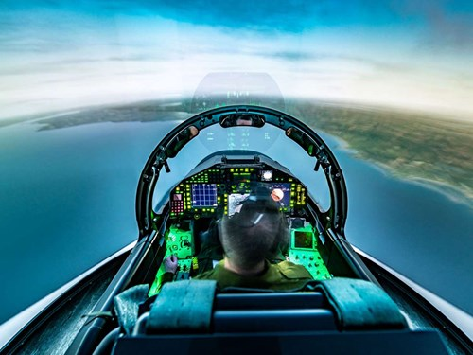
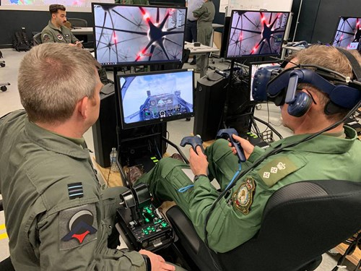
I/ITSEC – Contemporary Applications
Simulation
1. Digital Modeling & Simulation to enhance Pilot Training
Objective: How can “digital twins” be employed to improve Ukrainian Pilot readiness?
  High-end simulator training devices replicate a cockpit (i.e., displays, controls, systems, and performance characteristics)
  However, such systems cannot replicate the physical/psychological demands of real combat
Woolley, 2022

Slide 29
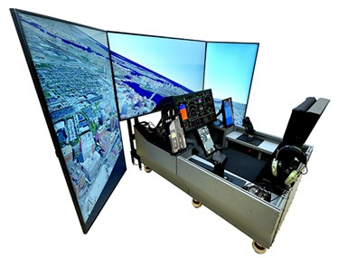
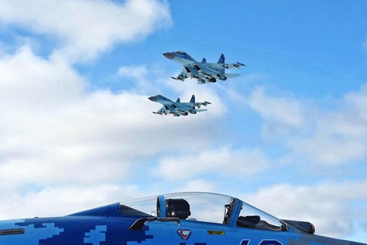
I/ITSEC – Contemporary Applications
Simulation
1. Digital Modeling & Simulation to enhance Pilot Training
  USAF now experimenting with low-cost consumer simulators to accelerate training (i.e., digital media, Laptops, iPads, VR/haptics)
  Such devices are more portable, interactive, and adaptive, and continuously coordinating content delivery to trainee’s progress
  Synthetic Theatre of War (SToW) simulation places pilots into an authentic representation of a “real world” environment
Woolley, 2022

Slide 30
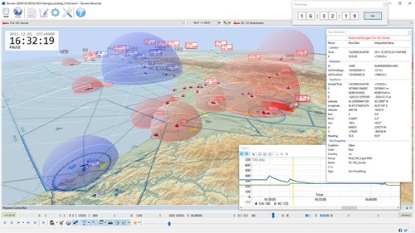
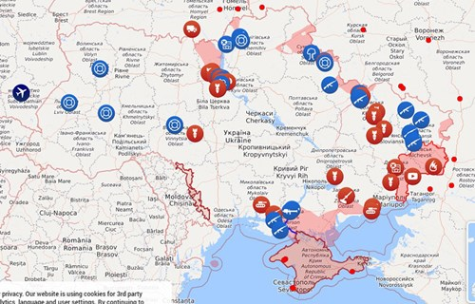
I/ITSEC – Contemporary Applications
Simulation
1. Digital Modeling & Simulation to enhance Pilot Training
  Digital Twin: near real-time replica of a physical object/process
  Fuses live updates, satellite imagery, and social media with classified intelligence
  Can replicate war scenarios in Ukraine as the conflict proceeds
  Enables rapid training of new combat capabilities
  Such training is particularly useful during preliminary missions (i.e., which are often least productive and most hazardous)
Rawlins, 2020

Slide 31
I/ITSEC – Contemporary Applications
ECIT
2. Engineering Design and Advanced Manufacturing
Objective: What are the parallels between M&S and Design for Additive Manufacturing (DFAM)?
  Design and Manufacturing process pipeline necessitates conceptual design and planning
  Also involves continual interplay between prototype modeling, and simulation/analysis (i.e., iterative design)
Saptarshi & Hulme, 2019

Slide 32
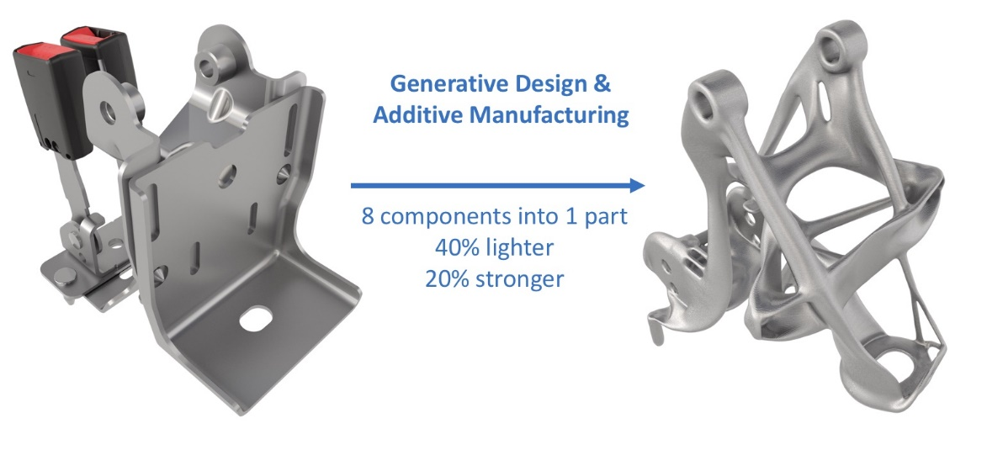
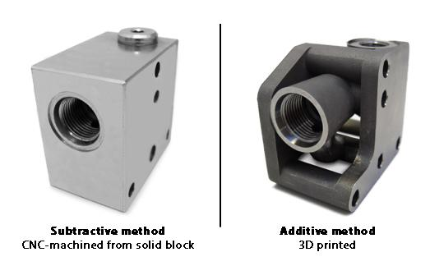
I/ITSEC – Contemporary Applications
ECIT
2. Engineering Design and Advanced Manufacturing
DFAM: product design capitalizes upon the increased flexibility afforded by Additive Manufacturing (AM)
  Consolidate parts (i.e., single-piece manufacturing)
  Design for print process optimization (e.g., Finite Element Analysis)
  Generative Design (i.e., efficient permutations/iterations of design candidates)
Subtractive (CNC)
Additive (3DP)
Saptarshi & Hulme, 2021

Slide 33
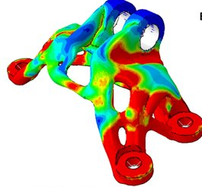
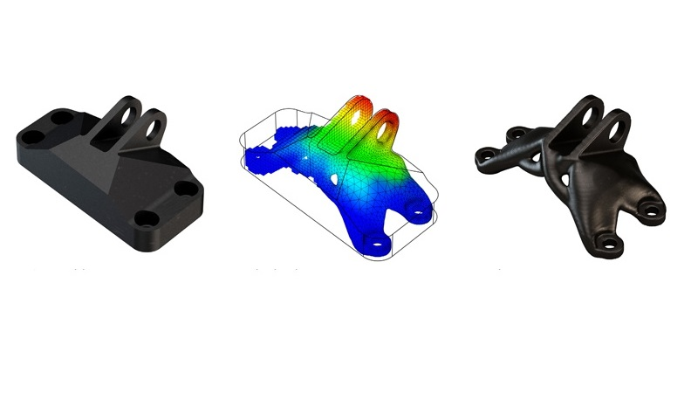
I/ITSEC – Contemporary Applications
ECIT
2. Engineering Design and Advanced Manufacturing
Topological Optimization
  Remove material where applied forces (and constraints) dictate redundancy
  Uses finite elements to evaluate design performance against defined criteria
  Final model is obtained by “smoothing” the design-optimized component model
In this example: 70% weight reduction while meeting all functional requirements
Karlsson et al., 2020
3D Systems, 2022

Slide 34

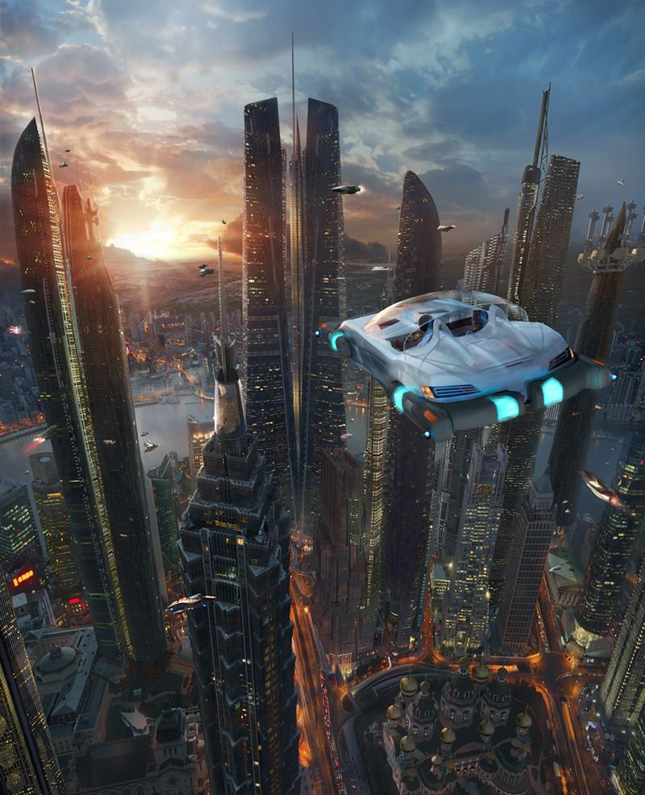
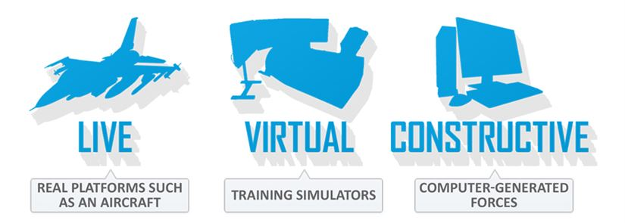
I/ITSEC – Contemporary Applications
PSMA
3. Transportation Engineering
Objective: How is the LVCA taxonomy essential to advise and sustain the future of human mobility?
  The “Transportation Network of Tomorrow”
    Science fiction or science fact?
    Flying Autonomous Vehicles: commercial use by 2025?
  LVCA, M&S, VV&A will all be essential for near-term testing, experimentation, evaluation, validation
  Critical downstream impacts upon all 6 of our subcommittees: TSE, HPAE, PSMA, ECIT
AUTONOMOUS (learning systems)
Hulme et al., 2019a

Slide 35
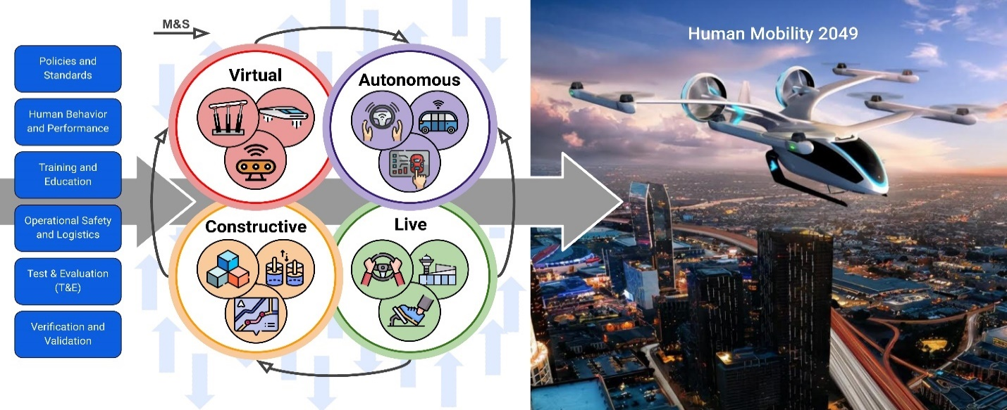

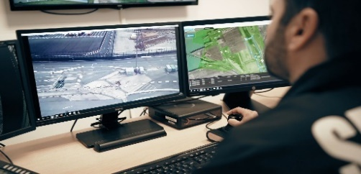

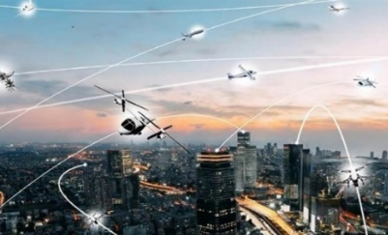
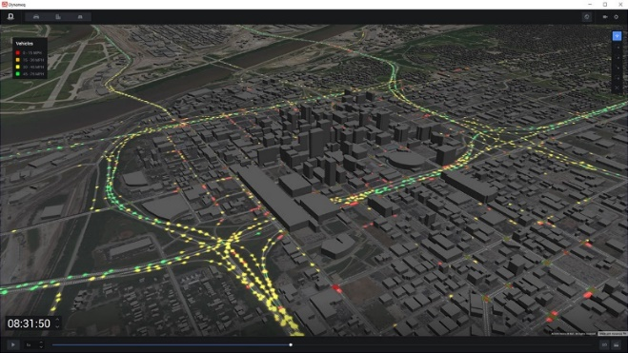
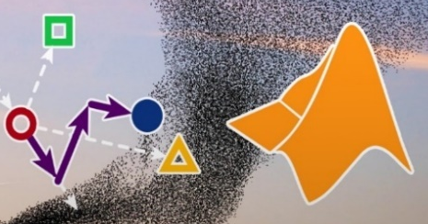
I/ITSEC – Contemporary Applications
PSMA
3. Transportation Engineering
Autonomous systems
  Prioritize safety, maximize efficiency
  Vehicle-to-everything (V2X) technology
Constructive modeling
  Traffic coordination and cooperation
  Micro/Meso/Macroscopic flow models
Hulme et al., 2021a

Slide 36
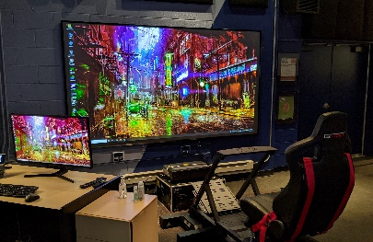
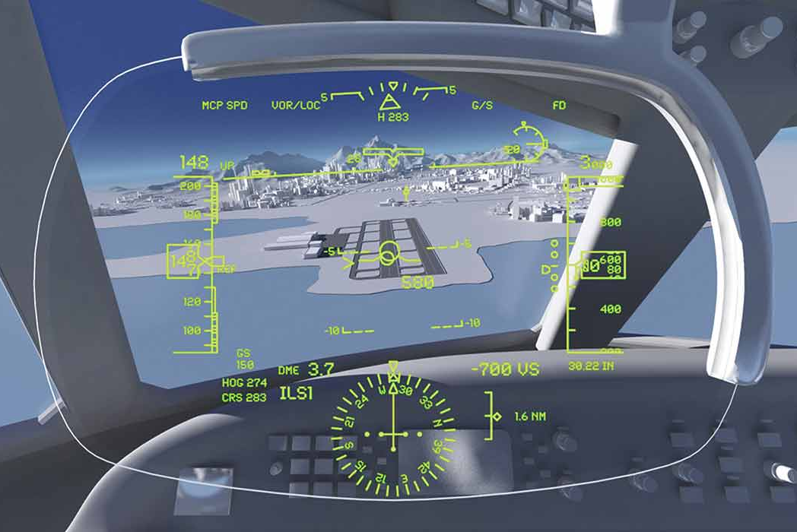
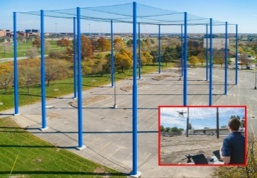
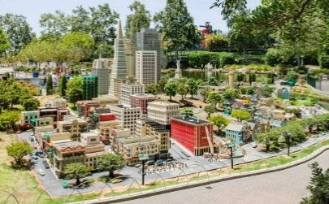

I/ITSEC – Contemporary Applications
PSMA
3. Transportation Engineering
Virtual simulation
  Assess human-machine interaction
  Hardware-software system integration
Live prototyping
  Scaled T&E in a physical environment
  Infrastructural strategic vision
Hulme et al., 2022

Slide 37


I/ITSEC – Contemporary Applications
Education
4. STEM and Experiential Learning
Objective: How are gaming elements incorporated to improve learning outcomes (e.g., knowledge retention, trainee engagement)?
  Education effectiveness enhanced through “experiential” learning (i.e., learn by doing)
  Infuse Game-based Learning (GBL) – novelties of entertainment (e.g., badges, rewards)
Hulme et al., 2018b

Slide 38




I/ITSEC – Contemporary Applications
Education
Hulme et al., 2019b
4. STEM and Experiential Learning
Gaming elements can be implemented to assign educational goals, rather than pre-defined outcomes
Gamification can improve practical skill sets (e.g., hand-eye coordination, multi-tasking, cognition, general problem-solving)

Slide 39







I/ITSEC – Contemporary Applications
Education
4. STEM and Experiential Learning
Circular proving grounds to analyze vehicle understeer characteristics (weight distribution)
Triple Curve raceway to maximize vehicle acceleration within limitations of tires (cornering)
Moose Test double-evasive maneuver to observe impact of yaw stabilization (ISO 3888-2)
Positive impacts on safety (i.e., vehicle and driver)
Hulme et al., 2021b

Slide 40



I/ITSEC – Contemporary Applications
HPAE
Weissman et al., 2020
Pellis et al., 2021
5. Health Care
Objective: How has advanced M&S been implemented for analytical and predictive methodologies with relation to the COVID-19 pandemic?
Apply M&S to investigate COVID-19–induced strain on hospital capacity
Model: doubling time (T_{d}) | Simulation: Monte Carlo | Data: Philadelphia hospitals

Slide 41



I/ITSEC – Contemporary Applications
HPAE
5. Health Care
Efficacy of Mask-wearing using M&S
  Simulated breathing with artificial test head
  Human subject simulations
  Model: live participants (N=10) using masks of different material types
  Simulation: Observe particle dispersion
  Primary Outcomes: masks reduce emitted expiratory particles – study did not directly measure virus emission
Asadi et al., 2020
Mayo Clinic, 2020

Slide 42

I/ITSEC – Contemporary Applications
HPAE
5. Health Care
The Math behind Social distancing
  R₀ – reproduction number of diseases – how many people each person will infect
  Figure shows COVID-19 transmission rates relative to other viruses
  Data-driven M&S has been employed as a tool to determine the magnitude and timing of social distancing measures
Zhang et al., 2020
LePan, 2020

Slide 43

I/ITSEC – Contemporary Applications
HPAE
5. Health Care
Simulation Assumptions:
  Contraction w/ 5-day incubation period
  Symptoms; self quarantine
  Linear correlation between social interactions and R₀
Simulation Outcomes:
  NO ACTION: 65% | 4-week delay: 45%
  3-week delay: 21% | 2-week delay: 7%
Lu, 2020
Kelso et al., 2009

Slide 44

I/ITSEC – Contemporary Applications
Training
6. Entertainment
Objective: How is M&S incorporated into cutting-edge amusement parks and thrill rides, for which Orlando serves as a primary world hub?
  Limited engagement in present-day training
  Simulators are an effective training tool
  Components employed in Entertainment Industry
    Gaming elements | Large displays
    Virtual/Augmented/Mixed realities | Scenarios
Nunaley, 2021

Slide 45




I/ITSEC – Contemporary Applications
Training
6. Entertainment
BIG BUSINESS – Disney: 58 million guests | 70% Orlando tourism share
Simulator Rides & Attractions have common components of M&S:
  Queueing: ride theming during the (extended) wait in line
  Pre-show area: staging, illustrations, topical ride props
  Simulator: cabin, ride dynamics, motion cueing, image generation, displays
  Post-show: concessions, merchandise, attraction-related memorabilia
Bartel, 2003
Wesner, 2014
Hulme et al., 2018a

Slide 46







I/ITSEC – Contemporary Applications
Training
6. Entertainment (Smuggler’s Run | 2019)
Park: Disney’s Hollywood Studios
Experience: simulated interactive ride on Millennium Falcon
Motion: Falcon cockpit pod operates on a hexapod platform
Visuals: Projection “cones” installed on four giant turntables
BlogMickey_a, 2019
Bilbao, 2019

Slide 47





I/ITSEC – Contemporary Applications
Training
6. Entertainment (Rise of the Resistance | 2020)
Park: Disney’s Hollywood Studios
Experience: Join the Resistance (good guys) to battle the First Order (bad guys)
Motion: Trackless dark ride, motion simulator, and drop ride system
Visuals: Animatronics, practical sets, projection mapping and screen-based media
BlogMickey_b, 2019
Stella, 2019

Slide 48


Slide 49




I/ITSEC – Contemporary Applications
Training
BlogMickey_c, 2019
6. Entertainment (Cosmic Rewind | 2022)
Park: EPCOT
Experience: Intergalactic chase through space & time
Motion: track vehicles translate with full yaw capability
Visuals: immersive dome projection screen imagery
BlogMickey_d, 2021

Slide 50


Tutorial Summary
I/ITSEC: the world’s largest Training, Simulation, and Education Conference
  Initiated in 1966 as the Naval Training Device Center/Industry Conference
    Became “I/ITSEC” in 1997
    https://www.iitsec.org/about-iitsec/history
  Organized by the National Training & Simulation Association (NTSA)
    National Defense Industrial Association (NDIA) affiliate
    Promotes interdisciplinary cooperation within the fields of M&S, training, education, analysis, and related disciplines

Slide 51
Tutorial Summary
I/ITSEC offers a full week of opportunity for Professional Development
  Tutorials Papers Workshops {Exhibition Hall}
  Foundational concepts (M&S, LVCA, VV&A)
  Accelerate Change by Transforming Training: “It’s Time to ACTT!”
Training, Simulation, and Education – our three foundational pillars
  Improve preparedness | Applied science of M&S | The science of learning
Certified Modeling & Simulation Professional (CMSP)
  Recognized M&S Professional Distinction | Recent upgrades (3.0) | Path forward (4.0)

Slide 52
Tutorial Summary
Overview of contemporary M&S applications across disciplines and subcommittees
  Military/Simulation: Digital Twins for Ukraine Pilots
  Manufacturing/ECIT: Inherent process parallels between M&S and DFAM
  Transportation/PSMA: LVCA taxonomy to advise future advanced air mobility
  Experiential Learning/Education: Games to improve engineering education outcomes
  Public Health/HPAE: Predict COVID-19 best practices in health science applications
  Entertainment/Training: High-fidelity M&S for effective thrill ride applications

Slide 53
Learning Objectives (revisited)
1) Define core and fundamental concepts of I/ITSEC from a notional perspective
2) Classify varied/convergent opportunities at I/ITSEC for Professional Development
3) Examine M&S as a field of discipline and professional distinction (CMSP)
4) Evaluate advanced applications of LVCA current practice within disparate fields
5) Summarize outcomes, determine next steps, (and ACTT accordingly)!
McNulty 2021

Slide 54
Bibliography
3D Systems, 2022
  Topology Optimization and Direct Metal 3D Printing (DMP) in GE Aircraft Engine Bracket Challenge
  https://www.3dsystems.com/learning-center/case-studies/topology-optimization-and-dmp-combine-meet-ge-aircraft-engine-bracket
Asadi et al., 2020
  Efficacy of masks and face coverings in controlling outward aerosol particle emission from expiratory activities
  https://doi.org/10.1038/s41598-020-72798-7
Bartel, 2003
  “Engineering in Entertainment”, Teachers @ I/ITSEC
  Sponsored by Moog, Inc., {shared Power Point presentation}.
Bilbao, 2019
  How it works: Patent behind Disney's Millennium Falcon: Smugglers Run ride
  https://www.bizjournals.com/orlando/news/2019/10/04/how-it-works-patent-behind-disneys-millennium.html
BlogMickey_a, 2019
  Behind-the-Scenes Look at Millennium Falcon Motion Pod and Turntable in Star Wars: Galaxy’s Edge
  https://blogmickey.com/2019/12/behind-the-scenes-look-at-millennium-falcon-motion-pod-and-turntable-in-star-wars-galaxys-edge/
BlogMickey_b, 2020
  Disney Offers Behind-the-Scenes Look at Exhilarating ‘Rise of the Resistance’ Finale Effect
  https://blogmickey.com/2019/12/disney-offers-behind-the-scenes-look-at-creation-of-rise-of-the-resistance-special-effects/
BlogMickey_c, 2019
  Permit Points to Large Projection Dome Installation Inside Guardians of the Galaxy Roller Coaster
  https://blogmickey.com/2019/03/permit-points-to-large-projection-dome-installation-inside-guardians-of-the-galaxy-roller-coaster/
BlogMickey_d, 2021
  Imagineering: Show Element Install Coming for Cosmic Rewind at EPCOT
  https://blogmickey.com/2021/04/imagineering-show-element-install-coming-for-cosmic-rewind-at-epcot/

Slide 55
Bibliography
Department of Defense (DoD), 1998
  "DoD Modeling and Simulation (M&S) Glossary", DoD 5000.59-M, DoD, January 1998
Gartner, 2017
  Hype Cycle for Emerging Technologies (2017)
  https://blogs-images.forbes.com/louiscolumbus/files/2017/08/hype-cycle-for-emerging-technologies-2017.jpg
Hulme et al., 2018a
  The Science of Thrills: Applied M&S in the Entertainment Industry, I/ITSEC (BEST TUTORIAL 2018)
  https://doi.org/10.13140/RG.2.2.34075.08487
Hulme et al., 2018b
  Game-based Proving-grounds Simulation to assess Driving & Learning Preferences”, I/ITSEC 2018 (Simulation)
  http://www.iitsecdocs.com/download/2018/2018_18003
Hulme et al., 2019a
  The Flying Car - Emergent Modeling & Simulation (M&S) Policies and Standards concerns, I/ITSEC 2019 (PSMA)
  https://www.xcdsystem.com/iitsec/proceedings/index.cfm?Year=2019&CID=48&AbID=26604
Hulme et al., 2019b
  Game-based Learning to Enhance Post-secondary Engineering Training Effectiveness”, I/ITSEC 2019 (Training)
  https://www.xcdsystem.com/iitsec/proceedings/index.cfm?Year=2019&CID=48&AbID=26598
Hulme et al., 2021a
  Advanced Air Mobility (AAM) – Innovating Modeling & Simulation to Revolutionize the Future of Transportation, I/ITSEC (BEST TUTORIAL 2021)
  https://www.xcdsystem.com/iitsec/proceedings/index.cfm?Year=2021&CID=862&AbID=95594
Hulme et al., 2021b
  Incorporation of Modeling, Simulation, and Game-Based Learning in Engineering Dynamics Education to enhance Learning Outcomes towards improving Vehicle Design and Driver Safety, Safety, 7(2), 30.
  https://doi.org/10.3390/safety7020030

Slide 56
Bibliography
Hulme et al., 2022
  Human Mobility 2049 - It’s Time to “ACTT” (Aeronautical Conceptualization for Tomorrow's Transportation), I/ITSEC 2022 (Simulation)
  Publication status pending
Karlsson, Pejryd, & Strömberg, 2020
  Generative Design Optimization and Characterization of Triple Periodic Lattice Structures in AlSi10Mg.
  https://doi.org/10.1007/978-3-030-54334-1_1
Kelso et al., 2009
  Simulation suggests that rapid activation of social distancing can arrest epidemic development due to a novel strain of influenza
  https://doi.org/10.1186/1471-2458-9-117
LePan, 2020
  Visualizing the History of Pandemics | Visual Capitalist
  https://www.visualcapitalist.com/history-of-pandemics-deadliest/
Lu, 2020
  The Math Behind Social Distancing | Visual Capitalist
  https://www.visualcapitalist.com/the-math-behind-social-distancing/
M&SPCC, 2012
  Certified Modeling & Simulation Professional Program – Management Plan (v1.1), November, 2012 (shared PDF)
Marla, 1997
  Introduction to Modeling and Simulation
  https://doi.org/10.1145/268437.268440
Mayo Clinic, 2020
  Mask Containment Study (video link)
  https://www.youtube.com/watch?v=g_bM1y1IpJY

Slide 57
Bibliography
McNulty, 2021
  Everything you’ve ever wanted to know about Bloom’s Taxonomy
  https://www.niallmcnulty.com/2019/12/introduction-to-blooms-taxonomy/
Military Simulation and Training (MST), 2020
  True Blended LVC Combat Training
  https://bluetoad.com/publication/?m=34018&i=657661&view=articleBrowser&article_id=3655144&ver=html5
Nunaley, 2021
  What Is The 70-20-10 Rule In Learning & Development?
  https://www.thinkific.com/blog/70-20-10-learning-model/
NTSA, 2020a and 2020b
  Certified Modeling and Simulation Professional - CMSP 3.0 - Re-Invention! (shared PDF)
  The National Training & Simulation Association’s (NTSA) Final Response to the CMSP 3.0 Committee Report (shared PDF)
Oswalt, 2021
  “Certified Modeling and Simulation Professional – Professional Development Workshop”
  https://content.trainingsystems.org/-/media/sites/ntsa/cmsp/iitsec-2021---cmsp-pdw---course---20211202.ashx
Pellis et al., 2021
  Challenges in control of COVID-19: short doubling time and long delay to effect of interventions
  https://doi.org/10.1098/rstb.2020.0264
Petty, 2008
  Principles of Modeling and Simulation: A Multidisciplinary Approach | Chapter 6: Verification & Validation
  https://doi.org/10.1002/9780470403563.ch6
Petty, 2016
  “Certified Modeling and Simulation Professional Examination Preparation”
  https://www.ntsa.org/-/media/sites/ntsa/cmsp/cmsp-exam-prep-workshop-slides-iitsec-2016.ashx
Petty, Reed and Tucker, 2017
  The Profession of M&S, Chapter 6: The Certified Modeling and Simulation Professional Certification and Examination
  https://www.bookdepository.com/Profession-Modeling-Simulation-Andreas-Tolk/9781119288084

Slide 58
Bibliography
Rawlins, 2020
  Aerial Duel: The Rise of the Digital Twin to Train Combat Air Pilots of the Future | Thales
  https://www.thalesgroup.com/en/united-kingdom/news/aerial-dual-rise-digital-twin-train-combat-air-pilots-future
Saptarshi & Hulme, 2019
  M&S Case Study Analysis: Design for Additive Manufacturing & 3D Printing
  https://www.xcdsystem.com/iitsec/proceedings/index.cfm?Year=2019&CID=48&AbID=26508
Saptarshi & Hulme, 2021
  Design for Additive Manufacturing (DFAM) and Cybersecurity: State-of-the-art and Future Vision, I/ITSEC 2021 (Tutorial)
  https://www.xcdsystem.com/iitsec/proceedings/index.cfm?Year=2021&CID=862&AbID=96974
Stella, 2019
  Top 10 Special Effects from Star Wars: Rise of the Resistance
  https://orlandoparkstop.com/feature/theme-park-facts/top-10-special-effects-from-star-wars-rise-of-the-resistance/
Udomsawat, 2022
  Understand the Difference between Verification and Validation
  https://www.isixsigma.com/tools-templates/measurement-systems-analysis-msa-gage-rr/understand-the-difference-between-verification-and-validation/
Weissman et al., 2020
  Locally Informed Simulation to Predict Hospital Capacity Needs During the COVID-19 Pandemic
  https://doi.org/10.7326/M20-1260
Wesner, 2014
  “Entertainment Engineering”, ETC Press, ISBN: 978-1-304-35183-8
  http://repository.cmu.edu/cgi/viewcontent.cgi?article=1012&context=etcpress
Woolley, 2022
  Building a 'digital twin' of the Ukraine conflict | Royal Aeronautical Society
  https://www.aerosociety.com/news/building-a-digital-twin-of-the-ukraine-conflict/
Zhang et al., 2020
  Estimation of the reproductive number of novel coronavirus (COVID-19) and the probable outbreak size on the Diamond Princess cruise ship: A data-driven analysis
  https://doi.org/10.1016/j.ijid.2020.02.033

Slide 59



Acknowledgements and Q/A
Carol Dwyer (NTSA) for assistance with CMSP background material
Ongoing fiscal support and strategic vision casting from the University at Buffalo Stephen Still Institute for Sustainable Transportation and Logistics (SSISTL)
EPIC MegaGrants for providing partial (student) funding support towards various research projects described within this Tutorial

