Slide 1

The WHY & How of eXtended Reality (XR) Enterprise Adoption
I/ITSEC 2022 Tutorial
Kay M. Stanney, Design Interactive, Inc.
Matt Archer, Design Interactive, Inc.

Slide 2


Contact Information
Dr. Kay Stanney
CEO & Founder
Kay@designinteractive.net
Matt Archer
COO
Matt.Archer@designinteractive.net

Slide 3
What are we here to talk about today: eXtended Reality
eXtended Reality
(XR)
Virtual Reality
(VR)
Augmented Reality
(AR)
Mixed Reality
(MR)
Virtual Content
High
Low
Medium
Real Content
Low
High
High
Interactivity
Low
Medium
High
Notes:
Source:
https://doi.org/10.1016/j.autcon.2020.103254
https://www.researchgate.net/publication/329484177_Progress_in_virtual_reality_and_augmented_reality_based_on_holographic_display

Slide 4
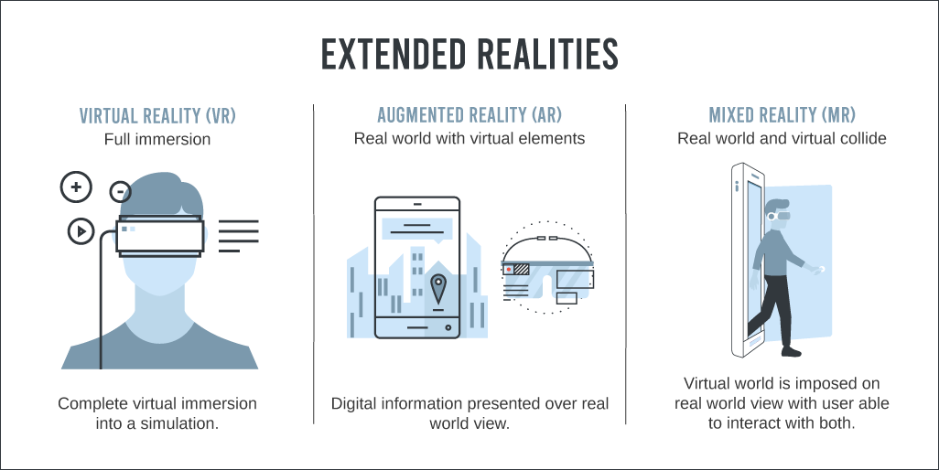
Terminology
Augmented Reality (AR) overlays provide guidance, information, attention cues, etc. to instruct and inform
Mixed Reality (MR) provides link between real and augmented worlds to support physical embodiment that internalizes behaviors
Virtual Reality (VR) provides contextually rich scenarios to immerse and engage
AR
MR
VR
Instruct &
Inform
Embody &
Internalize
Immerse &
Engage
XR

Slide 5
Terminology
eXtended Reality: All real-and-virtual combined environments and human-system interactions generated by computer technology and wearables, including representative forms such as augmented reality (AR), mixed reality (MR) and virtual reality (VR); the blending of AR/MR/VR
Enterprise: A business or company
Digital Twin: A virtual representation of an object or system that spans its lifecycle, is updated from real-time sensor data, and uses simulation, machine learning and reasoning to help decision-making
Digital Phenotype: Moment-by-moment quantification of an individual human in situ (e.g., behavioral patterns, sleep, social interactions, physical mobility, gross motor activity, cognitive functioning, speech and language production) using data from personal digital devices and other sensors (e.g., eye tracking, hand tracking)
Metaverse: Ecosystem that perpetually merges physical reality & human state with digital virtuality
  Embodies multiuser immersive digital spaces that are highly realistic, ubiquitous, self-sustaining interoperable, open, hardware-agnostic, networked, and continuously aware of physical system state and human state

Slide 6
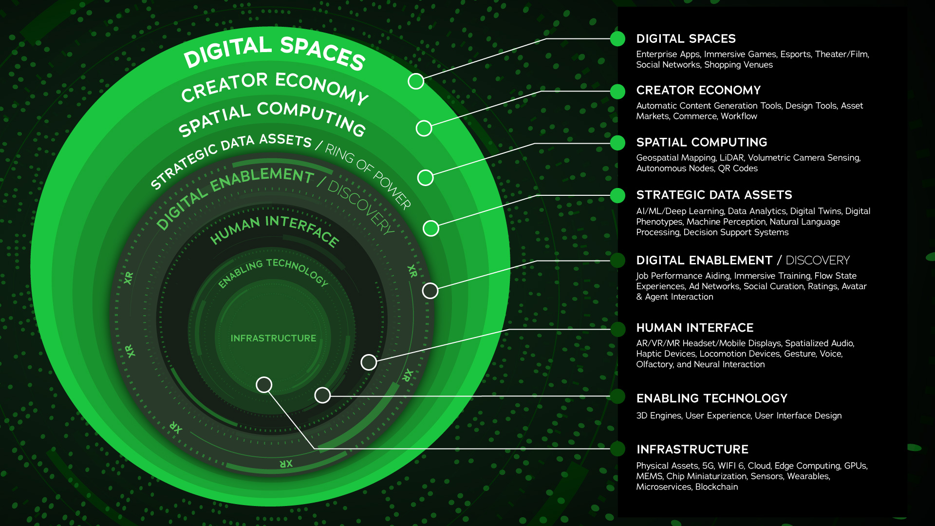
XR is a Multi-Layer Within the Metaverse
source: jradoff.medium

Slide 7
Learning Objectives
Learning Objective 1: Understand key drivers of XR enterprise adoption
Learning Objective 2: Understand key barriers to XR enterprise adoption
Learning Objective 3: Understand how to start XR adoption
Learning Objective 4: Describe human-centered XR design process
Learning Objective 5: Define how to assess and quantify gains of XR implementation

Slide 8
Facilitating XR Enterprise Adoption
To facilitate XR adoption there is a need to:
  Build a roadmap to align high value use cases with XR capabilities
  Reduce start-up costs through implementation of XR Architectures/Infrastructures that support scalability and sustainability
  Take a human-centered approach to XR development to facilitate generation of compelling content with anticipated high-end user experience that maximizes engagement while minimizing cybersickness
  Develop ways to track and assess learning outcomes and performance gains to quantify ROI

Slide 9
Facilitating XR Enterprise Adoption
Build Roadmap to Align High Value Use Cases with XR Capabilities
Implement XR Architecture and Infrastructure
Take a Human-Centered Approach to XR Development
Track and Assess Gains and Quantify ROI

Slide 10
Facilitating XR Enterprise Adoption
Build Roadmap to Align High Value Use Cases with XR Capabilities
Implement XR Architecture and Infrastructure
Take a Human-Centered Approach to XR Development
Track and Assess Gains and Quantify ROI
Learning Objective 1
Understand key drivers of XR enterprise adoption
Learning Objective 2
Understand key barriers to XR enterprise adoption

Slide 11
Build Roadmap to Align High Value Use Cases with XR Capabilities
Learning Objective 1
Understand key drivers of XR enterprise adoption:
  XR Enterprise Market: Current landscape of XR adoption with the enterprise
  XR Enterprise Economics: Expected value of XR adoption within the enterprise
  XR Enterprise Use Cases: High-value enterprise use cases that can fulfill potential of XR adoption

Slide 12
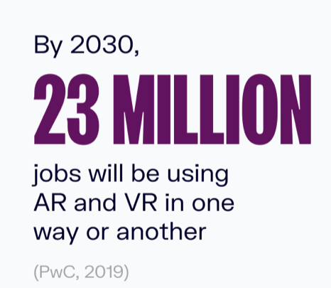

Current Landscape of XR Adoption
Build Roadmap to Align High Value Use Cases with XR Capabilities
VR Market CAGR 45.2%
AR Market CAGR 31.5%
VR-$156.2B
AR-$15.2B
AR-$90.8B
VR-$11.64B
2021
2028
https://www.globenewswire.com
Notes:
Sources:
https://www.globenewswire.com/en/news-release/2022/06/28/2470583/0/en/Global-Opportunities-in-Augmented-Reality-Market-Size-Will-Grow-Over-US-90-8-Billion-by-2028-at-31-5-CAGR-Growth-AR-Industry-Demand-Share-Trends-Statistics-Key-Players-Segments-Ana.html
https://www.globenewswire.com/news-release/2022/06/01/2453932/0/en/At-45-2-CAGR-Virtual-Reality-Market-To-Be-Worth-USD-227-34-billion-by-2029.html
https://www.softwaretestinghelp.com/future-of-virtual-reality/
https://www.grandviewresearch.com/industry-analysis/augmented-reality-market
https://www.grandviewresearch.com/press-release/global-virtual-reality-vr-market
https://www.digitaljournal.com/pr/virtual-reality-market-is-projected-to-expand-at-a-cagr-of-15-0-from-2022-to-2030-grand-view-research-inc
https://www.oberlo.com/blog/virtual-reality-statistics
https://www.zippia.com/advice/virtual-reality-statistics/
https://www.iboson.io/augmented-reality-statistics-you-must-know-in-2022
https://www.grandviewresearch.com/industry-analysis/augmented-reality-market
https://g-mnews.com/en/extended-reality-market-keeps-on-boosting/

Slide 13

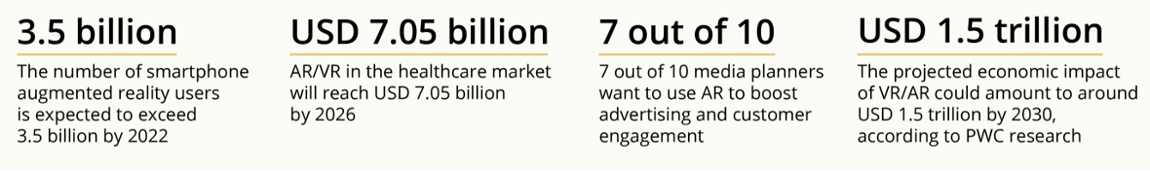
Expected Revenue by Industry: Military XR Market Comparatively Small
Build Roadmap to Align High Value Use Cases with XR Capabilities
Industry Sectors Anticipated to Experience Most Growth in XR by 2025
(anticipated revenue by sector)
Why It’s Time to Adopt AR & VR
https://onix-systems.com
Notes:
Source:
https://onix-systems.com/blog/top-10-applications-of-ar-and-vr-in-business

Slide 14
Build Roadmap to Align High Value Use Cases with XR Capabilities
Learning Objective 1
Understand key drivers of XR enterprise adoption:
  XR Enterprise Market: Current landscape of XR adoption with the enterprise
  XR Enterprise Economics: Expected value of XR adoption within the enterprise
  XR Enterprise Use Cases: High-value enterprise use cases that can fulfill potential of XR adoption

Slide 15
Expected Value of XR Enterprise Adoption
Build Roadmap to Align High Value Use Cases with XR Capabilities
Manufacturing:
  Overall, 28% of organizations have implemented, piloted, or planned to implement XR technology in manufacturing sector
    Global spending by manufacturing sector ~$1.66B
  Estimate up to 30% of work time in manufacturing can be augmented through XR:
    Accelerating digitalization of work processes (77%)
    Task automation (54.3%)
    Upskilling (40 %)
Upskilling: ConEd Using Blowtorch and Streaming with XR-based Training
Notes:
Sources:
https://www.iiot-world.com/industrial-iot/connected-industry/the-key-role-of-augmented-reality-in-industry-4-0-for-manufacturing-part-1/
https://financesonline.com/virtual-reality-statistics/
https://hbr.org/2017/11/why-every-organization-needs-an-augmented-reality-strategy
https://www.cgsinc.com/blog/augmented-reality-manufacturing-our-future-and-future-now
https://www.sme.org/technologies/articles/2022/march/is-manufacturing-ready-for-xr-technologies/

Slide 16
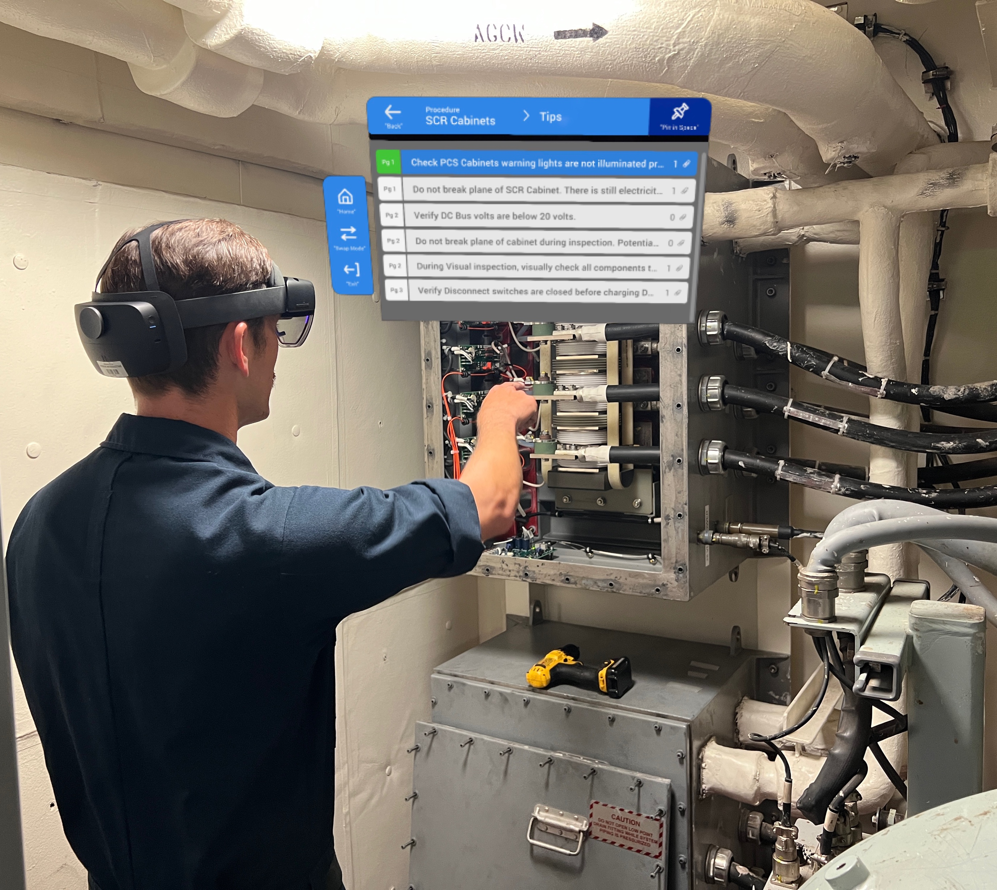
Expected Value of XR Enterprise Adoption
Build Roadmap to Align High Value Use Cases with XR Capabilities
Manufacturing:
  Examples of benefits:
    Newport News Shipbuilding uses AR to inspect ships, which reduces inspection time by 96%—from 36 hr to just 90 min, time savings of 25%+ for typical manufacturing tasks
    Use of VR technology has enabled Airbus to reduce duration of maintenance processes by 25%
    KPN uses AR to make better decisions about how to resolve issues, producing an 11% reduction in costs for service teams, a 17% decrease in work-error rates
    GE used voice commands in AR to enable factory workers to perform complex wiring processes in wind turbines—achieving a 34% increase in productivity
    Intel and DHL use AR in warehouses to achieve a 25%-29% reduction in picking time, with error rates falling to near zero
    Xerox uses AR to connect field engineers with experts instead of providing service manuals and telephone support, increasing first-time fix rates by 67% and engineers’ efficiency by 20%
AR-based Job Performance Aids Onboard CVN 78
Notes:
Sources:
https://www.iiot-world.com/industrial-iot/connected-industry/the-key-role-of-augmented-reality-in-industry-4-0-for-manufacturing-part-1/
https://financesonline.com/virtual-reality-statistics/
https://hbr.org/2017/11/why-every-organization-needs-an-augmented-reality-strategy
https://www.cgsinc.com/blog/augmented-reality-manufacturing-our-future-and-future-now
https://www.sme.org/technologies/articles/2022/march/is-manufacturing-ready-for-xr-technologies/

Slide 17
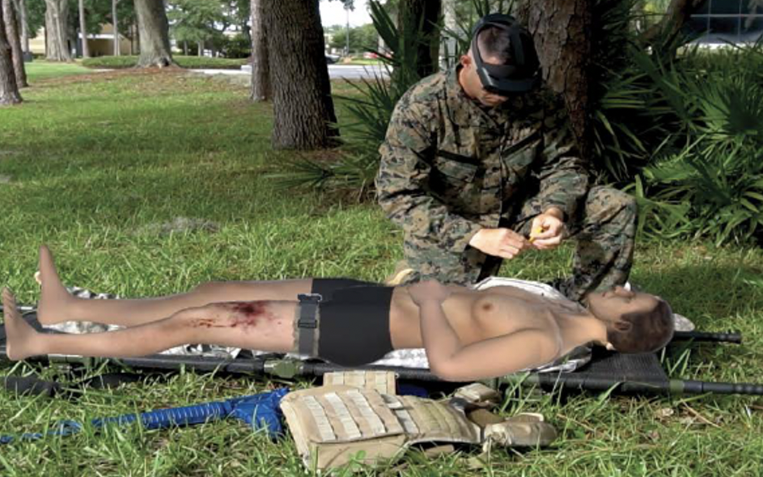
Current Landscape of XR Adoption
Build Roadmap to Align High Value Use Cases with XR Capabilities
Training:
  Overall, 26% of businesses are using XR to train employees, with 39% of large organizations leveraging XR technology to facilitate training in simulated environments
  Immersive training and education revenues expected to more than double to $6.7B by 2026
  XR training has a retention rate of 75%, beating out lectures (5%), reading (10%), and audio-visual learning (20%)
TCCC XR Blended Training
Notes:
Sources:
https://www.seriousplayconf.com/downloads/2021-xr-metaari-report/
https://www.iiot-world.com/industrial-iot/connected-industry/the-key-role-of-augmented-reality-in-industry-4-0-for-manufacturing-part-1/
https://financesonline.com/virtual-reality-statistics/
https://hbr.org/2017/11/why-every-organization-needs-an-augmented-reality-strategy
https://www.cgsinc.com/blog/augmented-reality-manufacturing-our-future-and-future-now
https://www.sme.org/technologies/articles/2022/march/is-manufacturing-ready-for-xr-technologies/

Slide 18
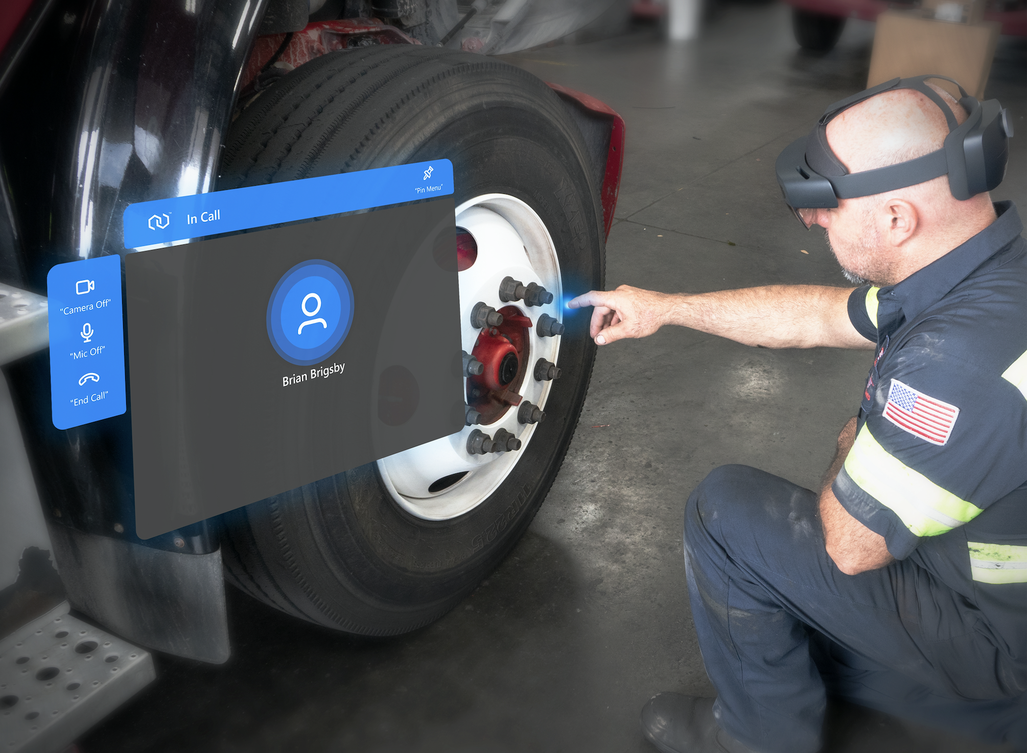
Expected Value of XR Enterprise Adoption
Build Roadmap to Align High Value Use Cases with XR Capabilities
Training:
  Examples of benefits:
    Penske delivered >11,000 hr of XRMentor™ training to remote technicians saving significant time and money due to increased throughput and reduction of employee travel
    Boeing cut training time by 75% by implementing VR technology and # of trainees with little or no experience who could perform operation correctly the first time increased by 90%
    Police officers who received virtual training 2.7x more likely to participate in successful missions
    Intel projects 5-year ROI of a single VR-based course could reach 300%
    90% of all DHL workers who use XR technology laude platform for helping them improve efficiency and work more effectively
AR-based Remote Collaborative Training
Notes:
Sources:
https://www.seriousplayconf.com/downloads/2021-xr-metaari-report/
https://www.iiot-world.com/industrial-iot/connected-industry/the-key-role-of-augmented-reality-in-industry-4-0-for-manufacturing-part-1/
https://financesonline.com/virtual-reality-statistics/
https://hbr.org/2017/11/why-every-organization-needs-an-augmented-reality-strategy
https://www.cgsinc.com/blog/augmented-reality-manufacturing-our-future-and-future-now
https://www.sme.org/technologies/articles/2022/march/is-manufacturing-ready-for-xr-technologies/

Slide 19
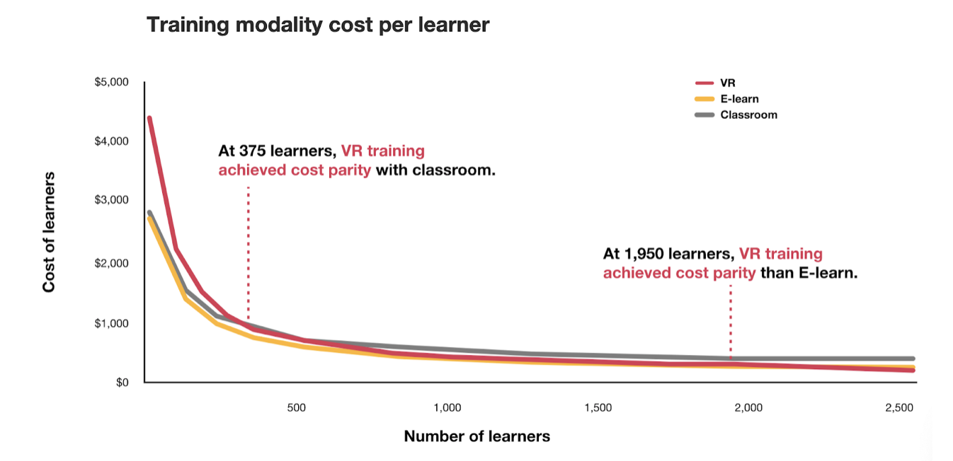
XR Training Cost Parity Points
Build Roadmap to Align High Value Use Cases with XR Capabilities
https://www.virtualbodyworks.com
Notes:
Source:
https://www.virtualbodyworks.com/posts/virtual-reality-is-leading-all-industries-into-the-future

Slide 20
Build Roadmap to Align High Value Use Cases with XR Capabilities
Learning Objective 1
Understand key drivers of XR enterprise adoption:
  XR Enterprise Market: Current landscape of XR adoption with the enterprise
  XR Enterprise Economics: Expected value of XR adoption within the enterprise
  XR Enterprise Use Cases: High-value enterprise use cases that can fulfill potential of XR adoption

Slide 21
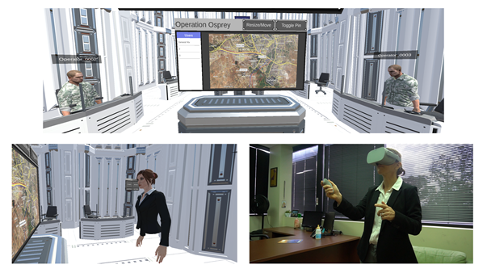
High Value XR Enterprise Use Cases
Build Roadmap to Align High Value Use Cases with XR Capabilities
Immersive Training – XR playing important role in personnel training by offering hyper-realistic, immersive tools to support learning and retaining critical job skills in a highly efficient, effective, and engaging manner with real-time performance metrics (e.g., eye/hand tracking, digital phenotypes)
Operational Support – XR assists operators at point of need with info assets to support procedures, situation assessment, wayfinding, troubleshooting
Field Operations / Remote Collaboration – XR improves field operations by allowing workers to present problem states and spatially collaborate, receiving remote expert assistance that guides them through remote processes
XR-based Remote Collaboration between Senior Leaders and Distributed Team that are Virtually Co-located and Multi-present

Slide 22
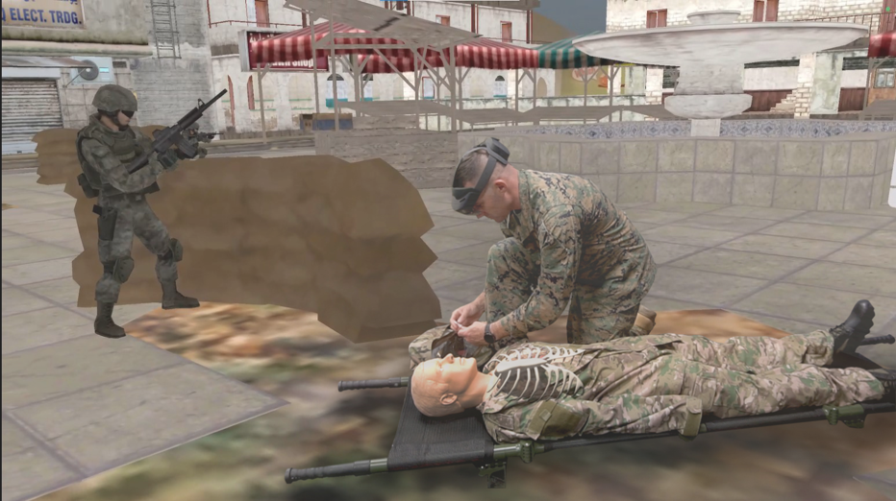
High Value XR Enterprise Use Cases
Build Roadmap to Align High Value Use Cases with XR Capabilities
Virtual Prototyping – XR is transforming design by enabling teams to demo designs, present plans, explore digital twins, and deliver concepts in real-time from anywhere to support enhanced creativity and collaborative design
Healthcare – XR has demonstrated extensive potential in the healthcare industry by helping improve a wide range of services such as self-care, treatment, and surgical procedures, reducing costs, increasing access, and improving patient outcomes with real-time reports and accurate diagnosis.
AR-based TCCC Training

Slide 23
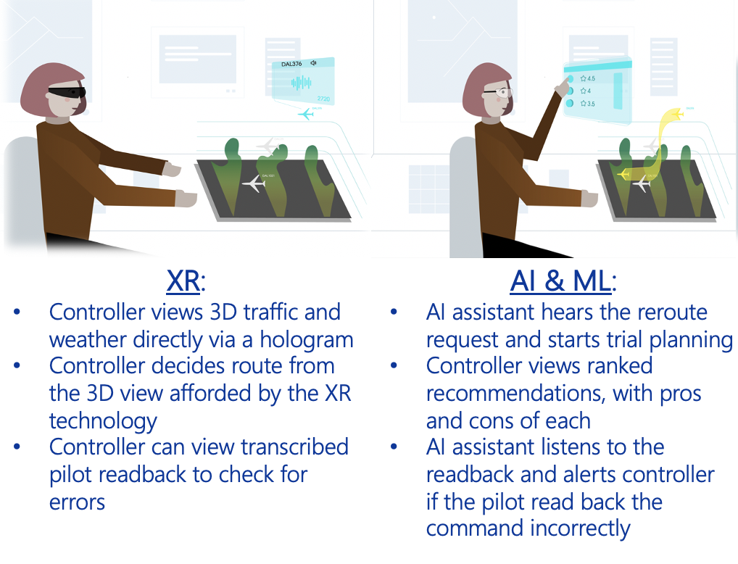
High Value XR Enterprise Use Cases
Build Roadmap to Align High Value Use Cases with XR Capabilities
Data Analytics & Storytelling – XR can support data analytics by displaying data in multiple dimensions and allowing users to immerse themselves in and explore data representation, while also supporting data storytelling, say by presenting data as a narrative to non-expert audiences, like executives or potential decision makers
Remote Operations – Synthetic data generated from XR simulations guided robots in high-risk work environments, reducing risks
Decision Support – XR/AI empowers people to access data and display in front of their eyes to support real-time decision making
Future Concepts for Air Traffic Control Decision Support Enabled by XR & AI/ML

Slide 24
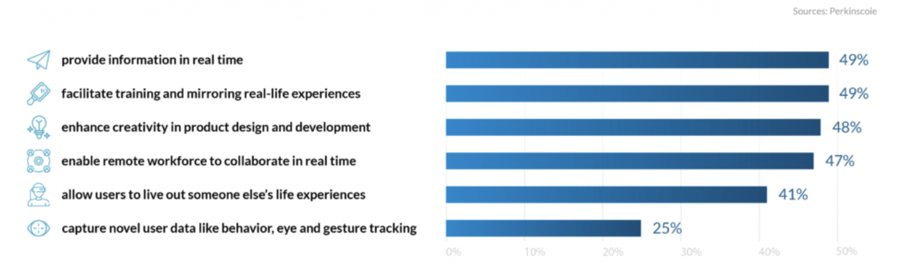
High Value XR Enterprise Use Cases
Build Roadmap to Align High Value Use Cases with XR Capabilities
Operational support, training, design primary use cases
Using data derived through XR experience as a strategic asset is under utilized, yet holds great potential
Provide information in real time
Facilitate training and mirroring real-life experience
Enhance creativity in product design & development
Enable remote workforce to collaborate in real time
Capture novel user data (e.g., behavior, eye & gesture tracking)
49%
48%
48%
47%
25%
Notes:
Source:
https://financesonline.com/virtual-reality-statistics/

Slide 25
Determine Targeted XR Support and Select Corresponding Suitable XR Form Factor
Build Roadmap to Align High Value Use Cases with XR Capabilities
Suitable XR
Form Factor
Declarative Knowledge
Procedural Knowledge
Troubleshooting & In-Context Problem-Solving
In-Context Decision Support
Communication, Collaboration
Behavior, Soft Skills
Data Analytics
X
X
X
X
X
X
AR
MR
MR
XR
XR
XR
VR
X
X
X
X
X
X
X
X
X
X
X
X
X
X
X
X
X
X
X
X
X
X
X
Targeted XR Support
X
X
X
X
X
X
X
X
X
X
X
X
X
X
X
X
X
X
X
X
X
X
X
X
X
X
X
X
X
X
X
X
X
X
X
X
X
X
X
X
Learning
Elements
Basic Interaction (point, click)
Passive Observation
Physical Interaction
Moving Around in Space
Assembling
Interaction with Others
Role Management
Performance Capture via Sensors
Making Meaningful Choices
Real-time Feedback
Knowledge Test
Realistic Surrounding Context
Real-time Instructions
Screen Sharing
Generate Novel Scenarios
Notes:
Source:
https://www.sciencedirect.com/science/article/pii/S0360131519303276

Slide 26
Determine Targeted Performance Gains and Select Corresponding Suitable XR Form Factor
Build Roadmap to Align High Value Use Cases with XR Capabilities
Suitable XR
Form Factor
X
X
X
X
X
X
X
X
X
X
X
X
Increase Efficiency
Increase First-time Fix Rate
Reduce Errors
Increase Compliance
Reduce Time to Proficiency
Increase Resilience
Increase Troubleshooting
Increase Negotiation Skills
MR
MR
MR
MR
AR/MR
XR
XR
XR
X
X
X
X
X
X
X
X
X
X
X
X
X
X
X
X
X
X
X
X
X
X
X
X
X
X
X
X
X
X
X
X
X
X
X
Performance Gains
X
X
X
X
X
X
X
X
X
X
X
X
X
X
X
X
X
X
X
X
X
X
X
X
X
X
X
X
X
X
X
X
X
X
X
Learning
Theories
Ausubel’s Subsumption Theory
(cognitive structures, advanced organizers)
Knowles’ Andragogy
(self-directed, relevant, problem-centered instruction)
Mager’s Criterion Ref. Instruction
(learning objectives, associated KSAs, repetition)
Reigeluth’s Elaboration Theory
(elaborative sequence (simple to complex, summary/ synthesis, context, concepts, procedures, principles)
Wertheimer’s Gestalt Theory
(perception, structure, problem-solving, gaps, incongruities)
Sternberg’s Triarchic Theory
(metacognition, analogies, syllogistic reasoning, novelty)
Skinner’s Operant Conditioning
(stimulus-response with immediate feedback)
Spiros Cognitive Flexibility Theory
(restructure knowledge, multiple representations)
Bruner’s Constructivist Theory
(schema, mental models)
Bandura’s Social Learning Theory
(observing & modeling behaviors, attitudes, emotions
Sweller’s Cognitive Load Theory
(worked examples, reduce redundancy, multimodality)
Roger’s Experiential Theory
(personal involvement, self-initiated, self-evaluated)
Lave’s Situated Learning
(cognitive apprenticeship, active perception in context)
Thorndike’s Connectionism
(habitual responses, identical elements, action sequences)
Gagne’s Conditions of Learning
(levels of learning, from gaining attention to transfer)
Merrill’s Component Display Theory
(remember, use, generalize)
Vygotsky’s Zone of Proximal Development
Notes:
Sources:
https://icebreakerideas.com/learning-theories/
https://www.sciencedirect.com/science/article/pii/S0360131519303276

Slide 27
Learning Objective 2
Understand key barriers to XR enterprise:
  Content Bottleneck: Difficult to convert from current training and operational support due to lack of XR content
  Lack of High-end User Experience (UX): Usability often limited because XR UX is often stuck in 2D GUI paradigm
  Paucity of Empirical Studies on Learning Outcomes and Performance Gains: Little evidence XR is markedly better than status quo
  Cybersickness Challenges: Susceptibility can limit accessibility
  Lack of Support for Scalability and Sustainability: Need tools to support moving from one-off solutions to rapid XR solution generation that enables digital transformation (covered in next section)

Slide 28
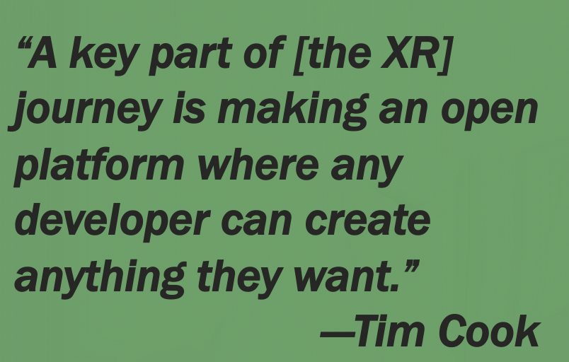


Barrier to XR Adoption: Content Bottleneck
Content Generation: Capabilities are needed that can readily overcome current lack of XR content by automating production process
  Content bottleneck. Lack of content and difficulty in generating content huge problems in XR space
    When Oculus Rift was released, there was almost no content
  Few companies right now know how to make empowering, high value XR content

Slide 29
Barrier to XR Adoption: Content Bottleneck
Content Generation: Capabilities are needed that can readily overcome current lack of XR content by automating production process
Value-Added: Point-of-need XR support increases efficiency; must couple with XR enablers to realize full potential of digital enablement, including:
  Innovative XR-specific user experience design paradigms that drive contextually rich, intuitive, and personalized 3D interaction
  AI/ML to drive adaptive support that increases operator effectiveness
  Digital twin plug-ins that reflect reality and complexity of real-world systems to fuel predictive and prescriptive analytics and close the loop between XR display and system
  Digital phenotype plug-ins that reflect reality and complexity of human cognitive, psychomotor, and affective capabilities to fuel responsive interaction and close the loop between human user, XR display, and system
Future of industry relies on ability of such XR ecosystems and XR enablers to generate value-added use cases that not only justify adoption costs but proportionally outweigh them

Slide 30
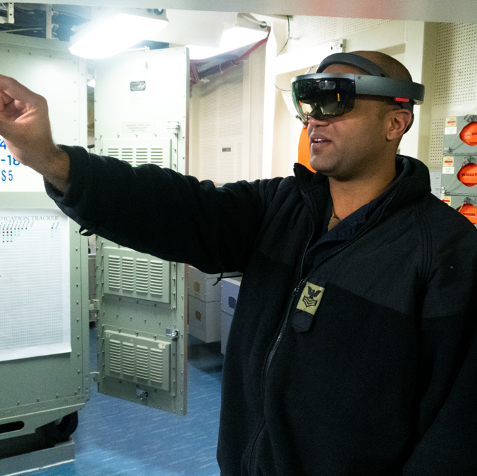
Use XR Technology to Capture Knowledge
& Generate XR Content
Capture Expertise
Tailored Approach
XR can empower organizations to maintain SME knowledge during transition via XR-based knowledge capture and content generation tools
Experts can use XR to capture and document their explicit and implicit knowledge as they perform a task step-by-step
Immersing SMEs in context is also highly effective in capturing high-value tribal knowledge (tacit), which is generally lost during transition
Job Aid & Training Integration
Acquired knowledge can be used to generate point-of-need AR-based JPAs and immersive VR/XR training solutions that can be broadly distributed to support trainees in rapidly gaining proficiency
Situating experts in context during knowledge elicitation process triggers emergence and application of tacit (deep) knowledge

Slide 31
Learning Objective 2
Understand key barriers to XR enterprise:
  Content Bottleneck: Difficult to convert from current training and operational support due to lack of XR content
  Lack of High-end User Experience (UX): Usability often limited because XR UX is often stuck in 2D GUI paradigm
  Paucity of Empirical Studies on Learning Outcomes and Performance Gains: Little evidence XR is markedly better than status quo
  Cybersickness Challenges: Susceptibility can limit accessibility
  Lack of Support for Scalability and Sustainability: Need tools to support moving from one-off solutions to rapid XR solution generation that enables digital transformation (covered in next section)

Slide 32
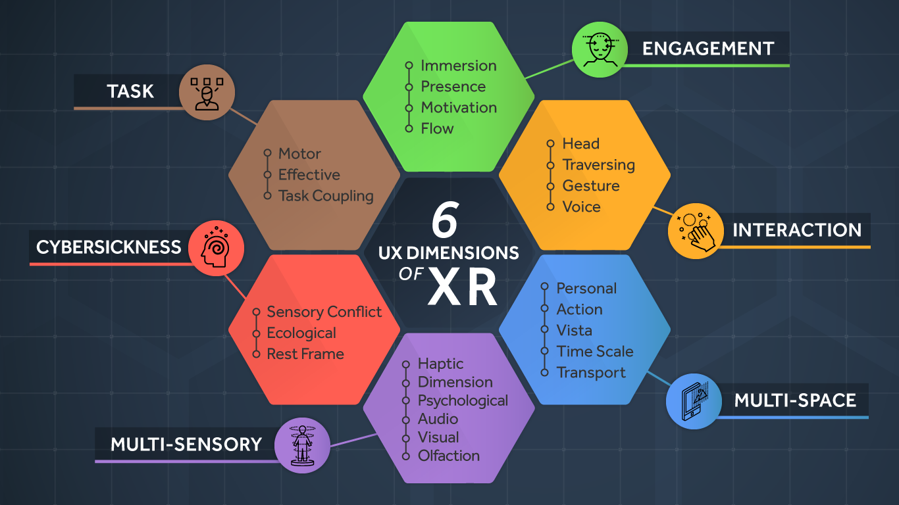
Barrier to XR Adoption: XR UI/UX
Build Roadmap to Align High Value Use Cases with XR Capabilities
XR specific UI/UX design paradigm is needed that uniquely supports and standardizes 3D design and interaction
“The biggest barrier to wide adoption of immersive technologies is the lack of good user experience design. 3D interface design is difficult and expensive, and there are few people with the necessary design skills to overcome these issues.”
Cognitive
Affective
~ Gartner
Notes:
Source:
https://blog.tonic3.com/vr-ar-design-ux

Slide 33
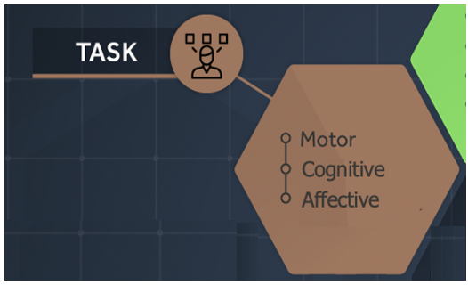
Barrier to XR Adoption: XR UI/UX
Build Roadmap to Align High Value Use Cases with XR Capabilities
XR UI/UX Design: Task
  Type of task can be separated between psychomotor, cognitive, and affective (emotional)
  Based on task type, each can be further categorized into a type-attribute with specific implementations for XR
    Psychomotor (physical action-based) tasks involve movement, coordination, dexterity, strength, flexibility, speed
    Cognitive (knowledge-based) tasks involve perception, attention, decision-making, problem-solving, remembering, reasoning
    Affective (emotional-based) tasks involve attitudes, emotions, and feelings
  In AR, task coupling with real-world must be carefully designed to ensure effective training of psychomotor tasks
  In VR, haptic interfaces are needed to simulate psychomotor tasks, which may hinder training effectiveness

Slide 34
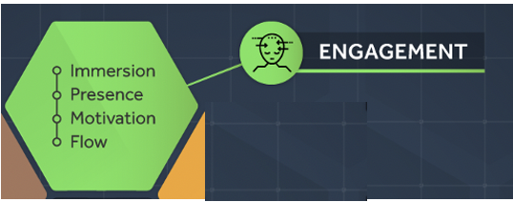
Barrier to XR Adoption: XR UI/UX
Build Roadmap to Align High Value Use Cases with XR Capabilities
XR UI/UX Design: Engagement
  Immersion involves supporting unique bond between coupled virtual and physical dimensions, through embodiment (i.e., sense of self-location, sense of agency, sense of body ownership), identity construction (i.e., superpowered direct embodiment in AR/MR or digitally embodied representation via an avatar in VR), direct manipulation of digitized content in 3D spaces
  An end goal being presence – the psychological perception of “being in” or “existing in” immersive environment, where users have sense that actions are successfully supported within digitized space
  Understanding user’s motivation for becoming engaged is crucial in realization of another end goal, that of “flow” - when performance excels “in the zone” (Csikszentmihalyi)
“The best moments in our lives are not the passive, receptive, relaxing times . . . The best moments usually occur if a person’s body or mind is stretched to its limits in a voluntary effort to accomplish something difficult and worthwhile.”
~ Csikszentmihalyi, 1990

Slide 35

Barrier to XR Adoption: XR UI/UX
Build Roadmap to Align High Value Use Cases with XR Capabilities
XR UI/UX Design: Interaction
  Avoid PowerPoint in the headset; get users embodied in value-added interaction
  Further, user interactions need no longer be directed through unwieldly peripherals (mouse, joystick), can be directly fueled by:
    Ability to track eye gaze and head orientation (3 DoF) to support digital interaction while looking around environment in an HWD
    Ability to track limb/body movement and traversal (6 DoF) to support digital interaction with real world objects and environments
  Taken together, bring interaction design to a point in which natural and intuitive multisensory designs can be achieved that are ubiquitous with the space around users
  Higher level of awareness of user’s whereabouts fundamentally alters what it means to achieve user-centered interaction design… need to define new design rules

Slide 36
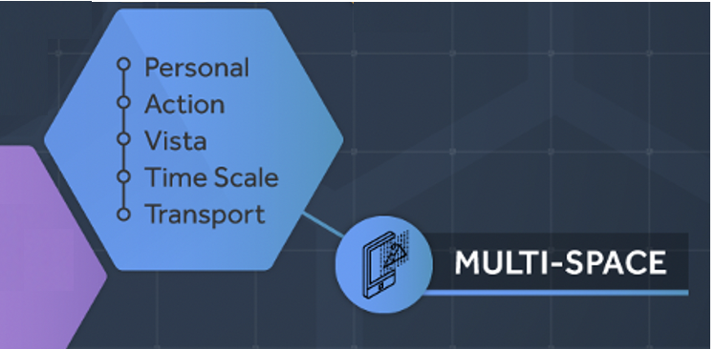
Barrier to XR Adoption: XR UI/UX
Build Roadmap to Align High Value Use Cases with XR Capabilities
XR UI/UX Design: Multi-Space
  Physical space around user is interaction space for XR
  With user as center point, space can be divided into personal, action, and vista - with each area providing a specific rule set and best practices
  In addition, time can be manipulated by determining time-scale space that best fits task and desired outcome
Within an XR environment, personal space should not be designed as a passive “out there” structure… it should be created to support a complex and dynamic exchange in which the virtual space informs human knowledge and affords user interaction, thereby shaping the way users learn and interact in an XR space.

Slide 37
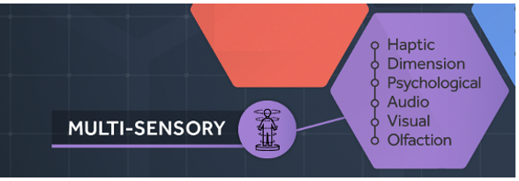
Barrier to XR Adoption: XR UI/UX
Build Roadmap to Align High Value Use Cases with XR Capabilities
XR UI/UX Design: Multi-Sensory Cues
  XR provides capability to integrate multiple senses to create an experience that feels real
  Each application should consider level of fidelity necessary (number of included characteristics of reality to simulate) to determine implementation for each multi-sensory attribute
    Link and justify fidelity to human performance objectives and costs:
      Start with identifying human performance objectives
        Sensory Task Analysis (STA) (Milham et al., 2008)
      Define system specifications
      Then conduct Cue Fidelity Analysis (CFA) and use results to support:
        Derive cue fidelity requirements
        Support TERL (Training Effectiveness Readiness Level) Analysis
        ROI Analysis
Notes:
Sources:
Milham, L., Carroll, M., Stanney, K., & Becker, W. (2008). Training systems requirements analysis. In D. Schmorrow, J. Cohn, & D. Nicholson (Eds.), The Handbook of Virtual Environment Training: Understanding, Predicting and Implementing Effective Training Solutions for Accelerated and Experiential Learning (Vol 1, Sec 2, pp. 165-192). Westport, CN: Praeger Security International.
Champney, R., Milham, L. M., Carroll, M.B., Ahmad, A., Stanney, K.M., Cohn, J., & Muth, E. (2008). Conducting training transfer studies in complex operational environments. In D. Schmorrow, J. Cohn, & D. Nicholson (Eds.), The Handbook of Virtual Environment Training: Understanding, Predicting and Implementing Effective Training Solutions for Accelerated and Experiential Learning (Vol 3, Sec 2, pp. 243-253). Westport, CN: Praeger Security International.

Slide 38
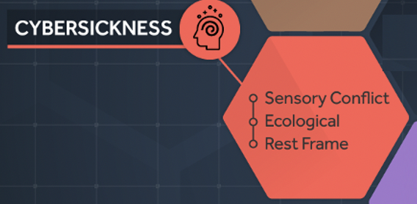
Barrier to XR Adoption: XR UI/UX
Build Roadmap to Align High Value Use Cases with XR Capabilities
XR UI/UX Design: Cybersickness
  Take a theoretical approach to XR design to minimize cybersickness:
    Sensory Conflict Hypothesis: Synchronization between visual-vestibular cues
    Ecological or Postural Instability Hypothesis: Help users anticipate impending motion – via sensory cues that provide anticipated direction of motion and via audio cues that represent speed
    Rest Frame Hypothesis: Sensory anchoring to provide frame of reference, for example, via a fixed horizon that grounds as physically stationary user to a fixed visual cue

Slide 39
Build Roadmap to Align High Value Use Cases with XR Capabilities
Learning Objective 2
Define key barriers to XR enterprise:
  Content Bottleneck: Difficult to convert from current training and operational support due to lack of XR content
  Lack of High-end User Experience (UX): Usability often limited because XR UX is often stuck in 2D GUI paradigm
  Paucity of Empirical Studies on Learning Outcomes and Performance Gains: Little evidence XR is markedly better than status quo
  Cybersickness Challenges: Susceptibility can limit accessibility
  Lack of Support for Scalability and Sustainability: Need tools to support moving from one-off solutions to rapid XR solution generation that enables digital transformation (covered in next section)

Slide 40
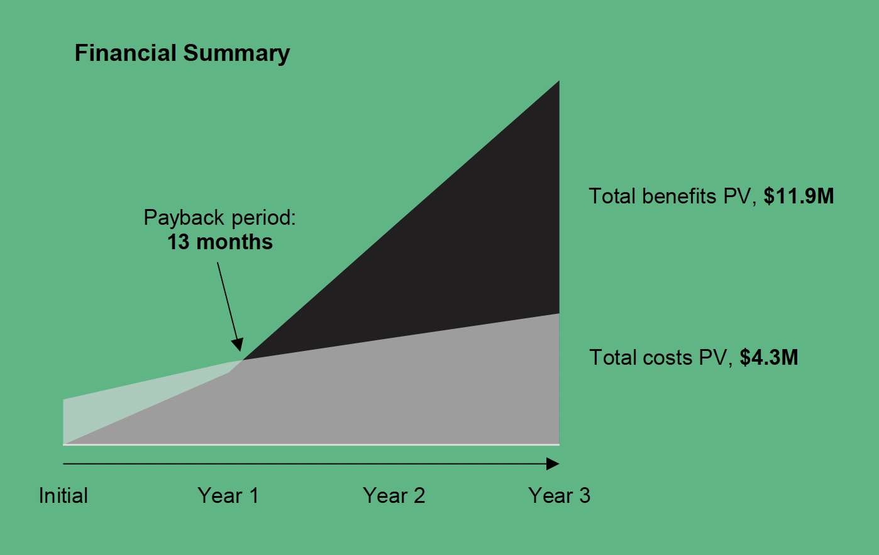
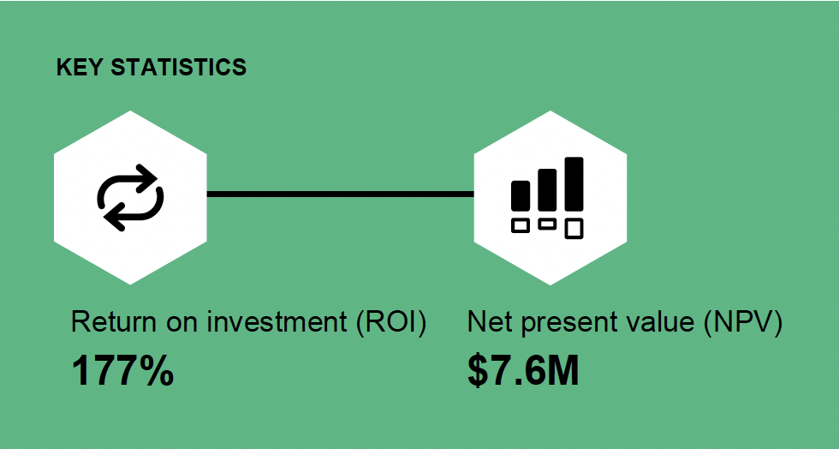
Barrier to XR Adoption: Quantified Benefits
Forrester
Notes:
Source:
Forrester-Total-Economic-Impact-Mixed-Reality-Microsoft-HoloLens-2_Cover.pdf&usg=AOvVaw2zcJiwWDhfVNVtr3JwO2Hf

Slide 41
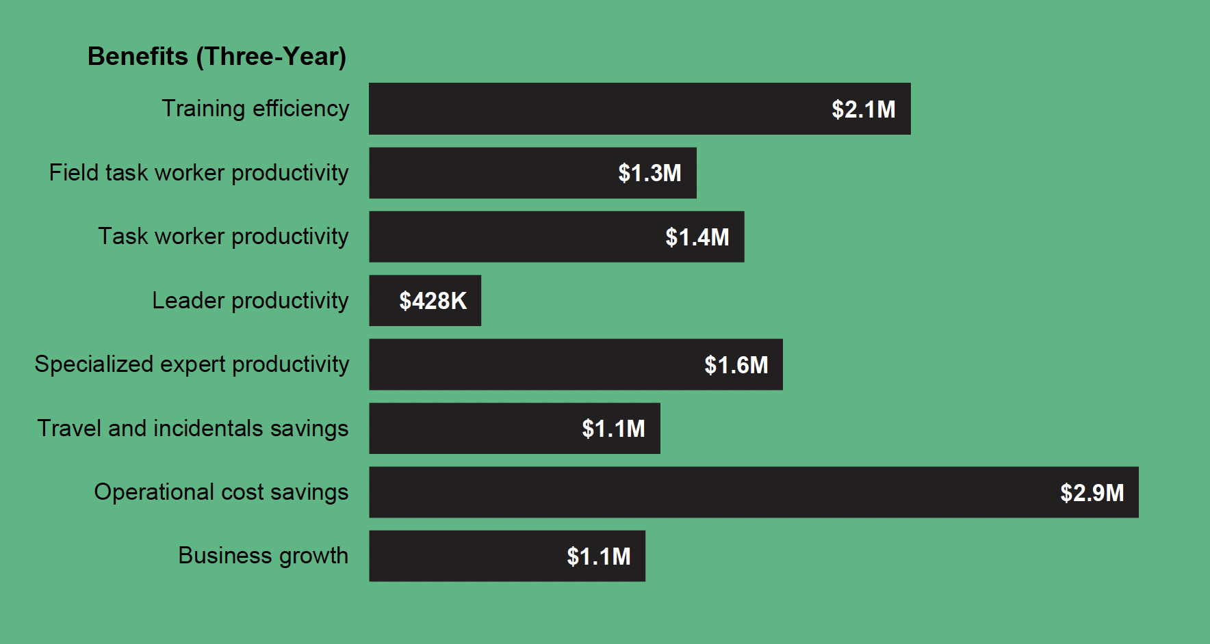
Barrier to XR Adoption: Quantified Benefits
Forrester
Notes:
Source:
Forrester-Total-Economic-Impact-Mixed-Reality-Microsoft-HoloLens-2_Cover.pdf&usg=AOvVaw2zcJiwWDhfVNVtr3JwO2Hf

Slide 42
Barrier to XR Adoption: Quantified Benefits
Learning gains (pre- to post- test) from VR training quantified via meta-analysis
2.5% more per 1⁄4 hour of training for cognitive skills versus traditional training
2.95% per hour gain in technical skills versus traditional training
~30% more performance efficiency/ equivalent fewer errors versus traditional training
~30% more confidence and self-efficacy though standard deviations tend to be high
Learning gains (pre- to post- test) from AR training quantified via meta-analysis
Overall average effect sizes in medium range (0.61-0.67)
Average effect sizes in large range (0.8) on learning gains when using AR in informal (non-classroom) settings
Average effect sizes in very large range (1.24) when using AR in manufacturing settings
http://www.worldbank.org/prwp
https://doi.org/10.1016/j.edurev.2019.04.001
Notes:
Sources:
http://www.worldbank.org/prwp
https://doi.org/10.1016/j.edurev.2019.04.001

Slide 43
Build Roadmap to Align High Value Use Cases with XR Capabilities
Learning Objective 2
Describe key barriers to XR enterprise:
  Content Bottleneck: Difficult to convert from current training and operational support due to lack of XR content
  Lack of High-end User Experience (UX): Usability often limited because XR UX is often stuck in 2D GUI paradigm
  Paucity of Empirical Studies on Learning Outcomes and Performance Gains: Little evidence XR is markedly better than status quo
  Cybersickness Challenges: Susceptibility can limit accessibility
  Lack of Support for Scalability and Sustainability: Need tools to support moving from one-off solutions to rapid XR solution generation that enables digital transformation (covered in next section)

Slide 44
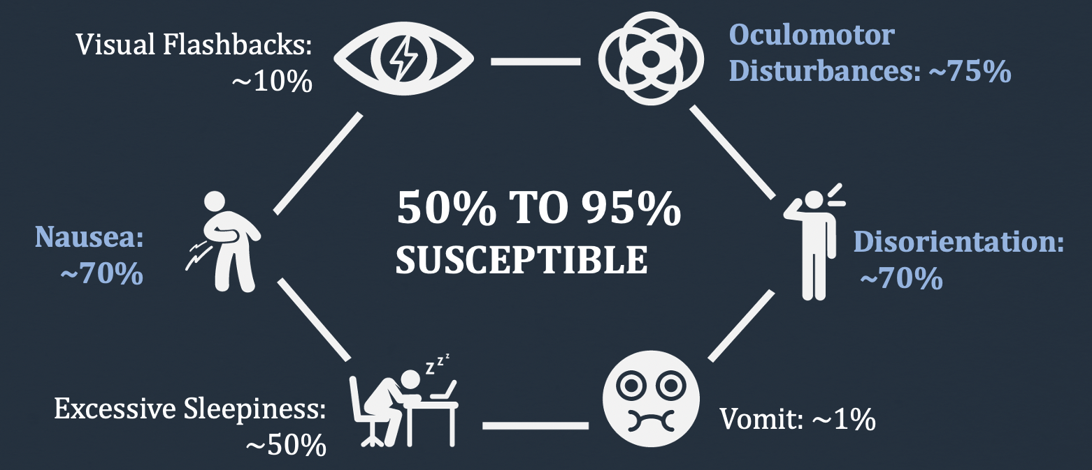
Barrier to XR Adoption: Cybersickness
HOW BIG A PROBLEM IS IT?
Susceptible individuals experience in VR…
VR
Data Source: Design Interactive, Inc.

Slide 45
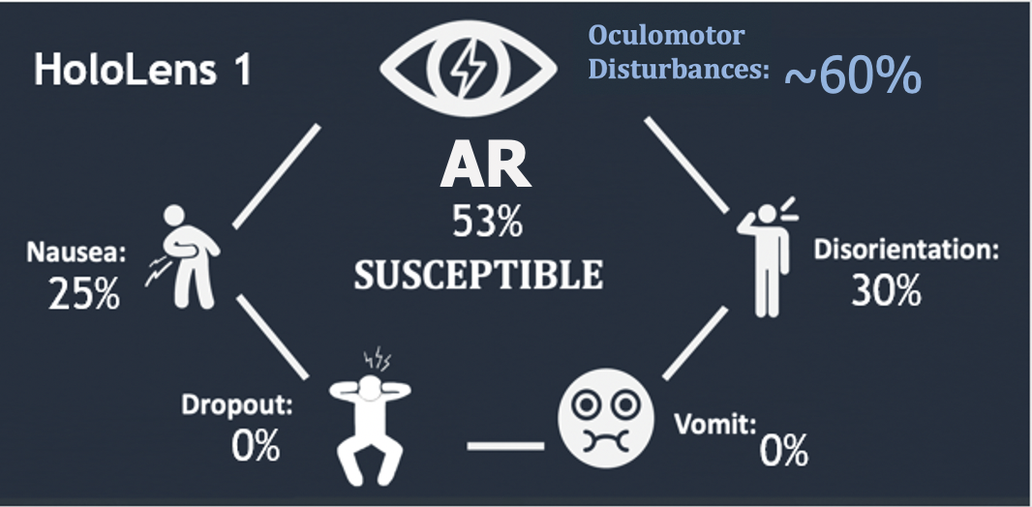
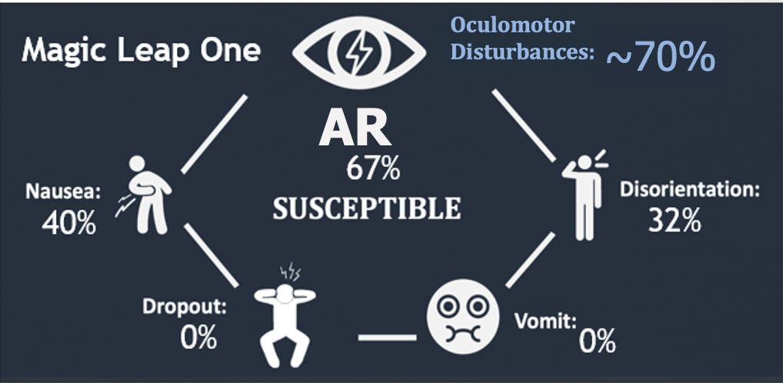
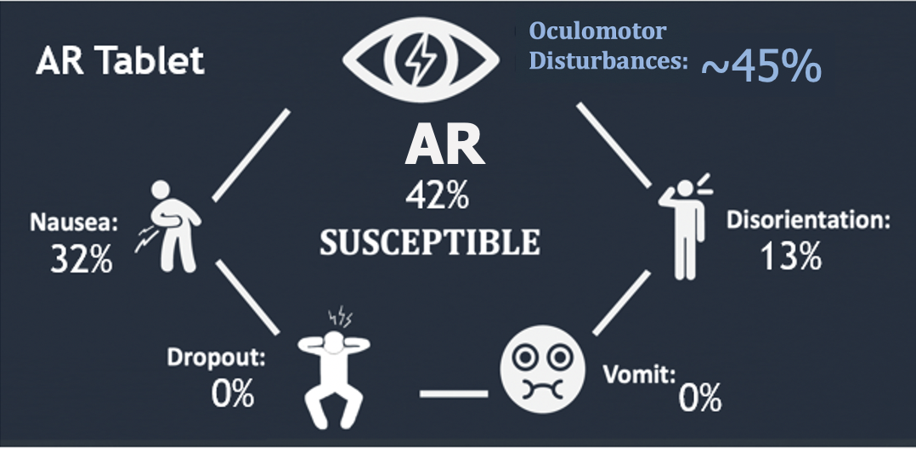
Barrier to XR Adoption: Cybersickness
HOW BIG A PROBLEM IS IT?
Susceptible individuals experience in AR…
AR
Data Source: Design Interactive, Inc.

Slide 46
Barrier to XR Adoption: Cybersickness
ACCESSIBILITY: VR (not AR) Has Accessibility Limitations Due to Physiological Impact; VR and AR Have Safety Concerns in terms of Physiological Aftereffects
Virtual Reality
  Dropout rate: ~13%
    Dropouts higher with longer exposure duration
  Emetic response rate: ~1%
  Rates ~ same with latest generation of VR headsets
  VR is physiologically self-limiting, as those who are susceptible often dropout, which poses accessibility limitations
    Accessibility limitations related to system engineering choices (i.e., IPD, content design)
Augmented Reality
  Dropout rate: 0% for operational; ~10% for provocative
  Emetic response rate: 0%
  Operational AR is not physiologically self-limiting, no dropouts expected
    Thus, no accessibility limitations expected due to physiological impact
    But impacts hand-eye coordination, which could pose safety concerns
  Provocative AR is physiologically self-limiting in manner similar to VR
Data Source: Design Interactive, Inc.

Slide 47
Barrier to XR Adoption: Cybersickness
2-hour VR exposure, current generation VR headset
Never Recovered
2-hour AR exposure, current generation AR headset
Never Recovered
Data Source: Design Interactive, Inc.

Slide 48



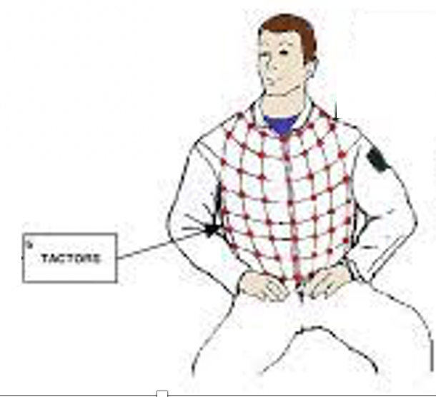
Barrier to XR Adoption: Cybersickness
No definitive theory of what causes motion sickness but a number of hypotheses
Most prominent hypotheses include:
  Sensory Conflict Hypothesis: Synchronization
  Ecological or Postural Instability Hypothesis: Railings; Slips, trips-and falls
  Evolutionary or Poison Hypothesis : Vomit bags
  Rest Frame Hypothesis: Sensory anchoring

Slide 49
Facilitating XR Enterprise Adoption
Build Roadmap to Align High Value Use Cases with XR Capabilities
Implement XR Architecture and Infrastructure
Take a Human-Centered Approach to XR Development
Track and Assess Gains and Quantify ROI
Learning Objective 3
Understand how to start XR adoption

Slide 50
Implement XR Architecture and Infrastructure
Learning Objective 3
Describe how to start XR adoption:
  Perform Current Systems Analysis: Ensure current systems can be effectively integrated with XR technology and XR-generated data can be used as a strategic asset across the enterprise
  Develop a Technical Architecture: Define set-up requirements for deployment in a demanding operational environment
  Support Sustainability: Define how XR applications will be deployed and operated on a day-to-day basis with adequate bandwidth, security, and scalability

Slide 51
Implement XR Architecture & Infrastructure: Current Systems Analysis
Implement XR Architecture and Infrastructure
Reduce start-up costs through implementation of XR Architectures/ Infrastructures that support scalability and sustainability
  Start by ensuring current systems can be effectively integrated with XR technology and XR-generated data can be used as a strategic asset across the enterprise
An architecture that is loosely coupled will allow solution to scale
Objective is to allow each container/microservice focus on specific task
Older systems would be “monolithic” or “tightly coupled”
  Monolithic means any changes need to be implemented by a developer
  Would require a new version to be deployed
  Changes in one section could impact functionality in a completely different section of the application

Slide 52
Implement XR Architecture and Infrastructure
Learning Objective 3
Describe how to start XR adoption:
  Perform Current Systems Analysis: Ensure current systems can be effectively integrated with XR technology and XR-generated data can be used as a strategic asset across the enterprise
  Develop a Technical Architecture: Define set-up requirements for deployment in a demanding operational environment
  Support Sustainability: Define how XR applications will be deployed and operated on a day-to-day basis with adequate bandwidth, security, and scalability

Slide 53
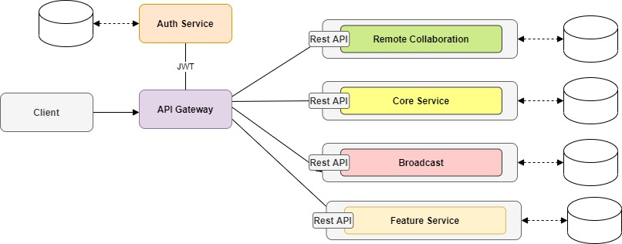
Implement XR Architecture & Infrastructure: Develop Technical Architecture
Implement XR Architecture and Infrastructure
Loosely coupled architecture allows microservices to be deployed independently
  If cloud based, updates / modifications could be transparent to the user
  Allows specialization of job functions:
    DB engineers can focus on the database
    Content developers can focus on content
    Front end developers can focus on the XR portion
    Back end developers can update the infrastructure

Slide 54
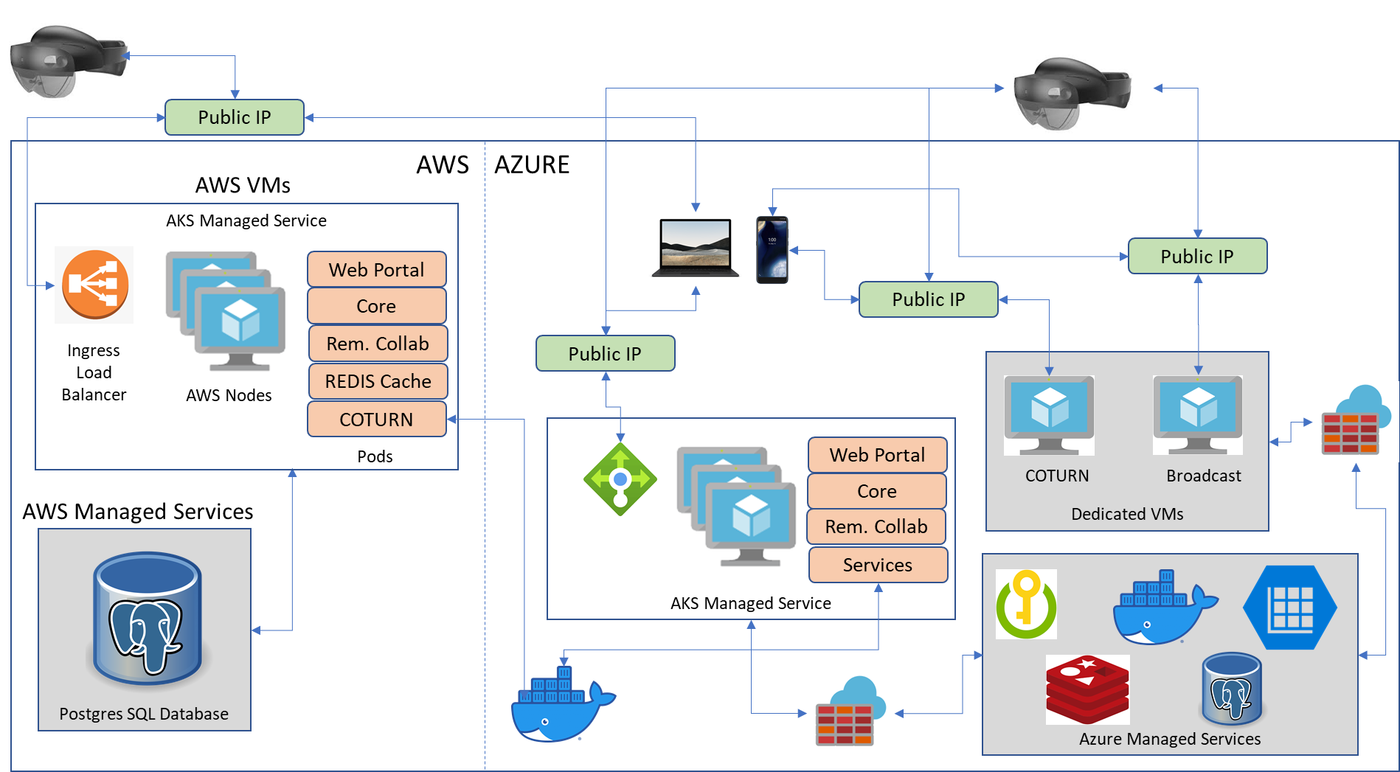
Implement XR Architecture:
Tightly Coupled Architecture
Implement XR Architecture and Infrastructure

Slide 55
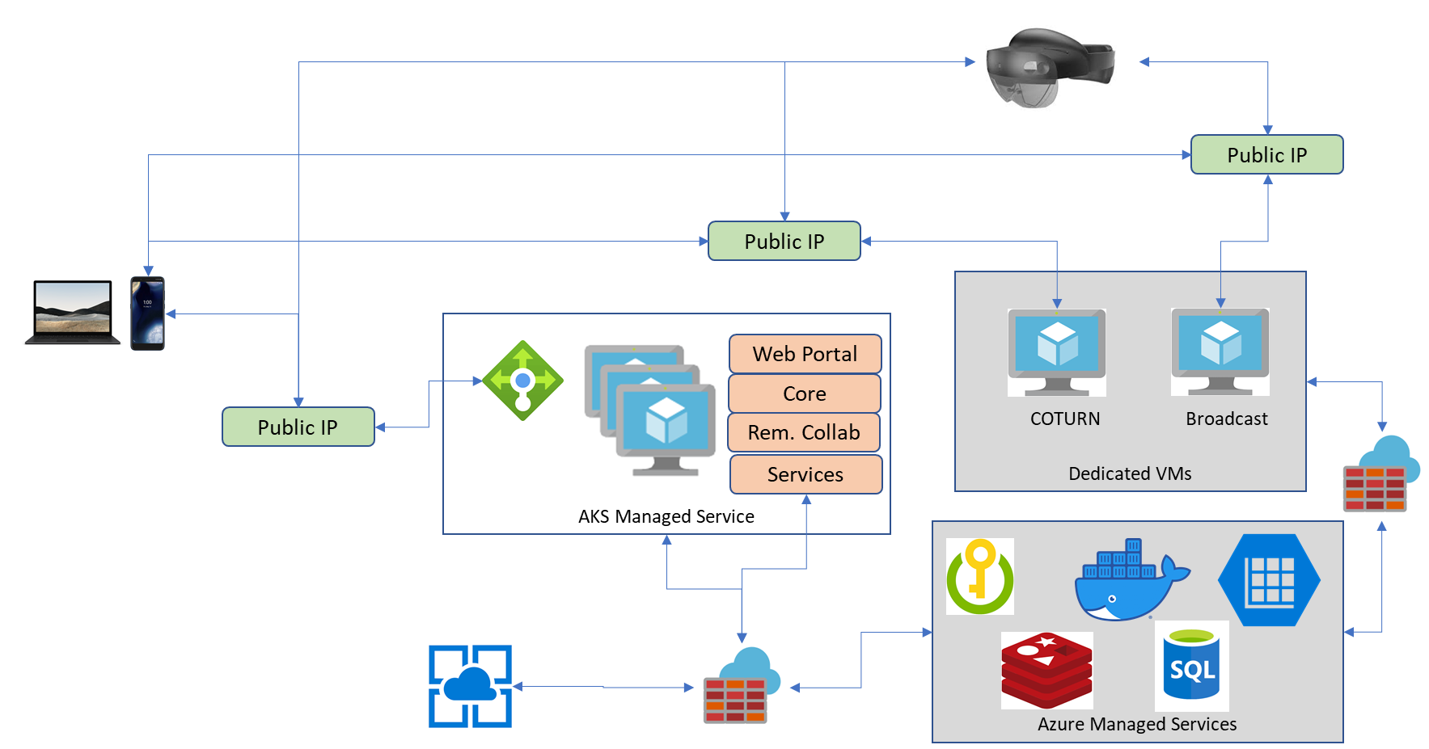
Implement XR Architecture & Infrastructure: Loosely Coupled Architecture
Implement XR Architecture and Infrastructure

Slide 56
Implement XR Architecture & Infrastructure: Develop Technical Architecture
Implement XR Architecture and Infrastructure
Why go through all this? Just build it, and they will come…
But when they do? An architecture that is loosely coupled will allow the ultimate solution to be sustainable
Recommendations:
  Deploy to a cloud service
  Utilize proven toolsets
  Target proven hardware and GPUs
  Integration of both digital twins and digital phenotypes

Slide 57
Implement XR Architecture & Infrastructure: Develop Technical Architecture
Implement XR Architecture and Infrastructure
Pros:
  Cloud services are so vast and rich in capability and capacity they will ensure sustainability
  Becoming more portable
Cons:
  It costs money
  It takes a little bit longer and might require DevOps expertise
  Picking one can be difficult
  Most are FEDRAMP certified

Slide 58
Implement XR Architecture and Infrastructure
Learning Objective 3
Describe how to start XR adoption:
  Perform Current Systems Analysis: Ensure current systems can be effectively integrated with XR technology and XR-generated data can be used as a strategic asset across the enterprise
  Develop a Technical Architecture: Define set-up requirements for deployment in a demanding operational environment
  Support Sustainability: Define how XR applications will be deployed and operated on a day-to-day basis with adequate bandwidth, security, and scalability

Slide 59
Implement XR Architecture & Infrastructure: Support Sustainability
Implement XR Architecture and Infrastructure
Proven toolsets include those tools that are XR specific, as well as those services that are proven to be sustainable
  Unity3D
  Unreal Engine
  Microsoft Mixed Reality Toolkit (MRTK)
  Apple ARKit
  Google ARCore
  Oculus platform
All have large budgets and are backed by the largest tech companies

Slide 60
Implement XR Architecture & Infrastructure: Support Sustainability
Implement XR Architecture and Infrastructure
Hardware that is sold commercially or built for a specific audience
  Avoid custom hardware
  If using custom hardware, utilize proven toolsets to minimize deployment risk
  Define any compute requirements
  Work with government customers on what’s been deployed in the past
  Start small; perhaps a mobile device for an initial deployment

Slide 61
Implement XR Architecture & Infrastructure: Support Sustainability
Implement XR Architecture and Infrastructure
Principles to help novice developers:
  Avoid over-engineering
  Prefer separation of state
  Prefer containers as part of your deployment
  Use pagination with collections of data
  Prefer queues for long running jobs
  Prefer CQRS when load is moderate
  Use good logical separation
  Use good schema separation

Slide 62
Implement XR Architecture & Infrastructure: Support Sustainability
Implement XR Architecture and Infrastructure
Scalability is ability of system to adapt to increasing user demands
  Microservices architecture on the back end will sustain this
  Using AKS clusters in our architectures, which allows each service to scale independently
  Scale is important on the back end
  If developed as a stand-alone application, might not be as important (use AUGMED® example)
  The bigger issues still need to be addressed…

Slide 63
Implement XR Architecture & Infrastructure: Support Sustainability
Implement XR Architecture and Infrastructure
Scalability is important, but so is interoperability
  Leverage existing standards for interoperability (SCORM, REST, etc.)
  Report results to bigger systems (LMS, LRS)
  Interoperability among systems (use DIS/HLA?)
    These problems need to be solved, but require SISO or other standards bodies to take on this challenge

Slide 64
Facilitating XR Enterprise Adoption
Take a Human-Centered Approach to XR Development
Build Roadmap to Align High Value Use Cases with XR Capabilities
Implement XR Architecture and Infrastructure
Take a Human-Centered Approach to XR Development
Track and Assess Gains and Quantify ROI
Learning Objective 4
Describe human-centered XR design process

Slide 65
Learning Objective 4
Describe human-centered XR design process:
  Process: Describe elements of human-centered XR design process
  Design Efficacy: Describe what drives XR design efficacy
  Training Efficacy: Describe what drives XR training efficacy

Slide 66
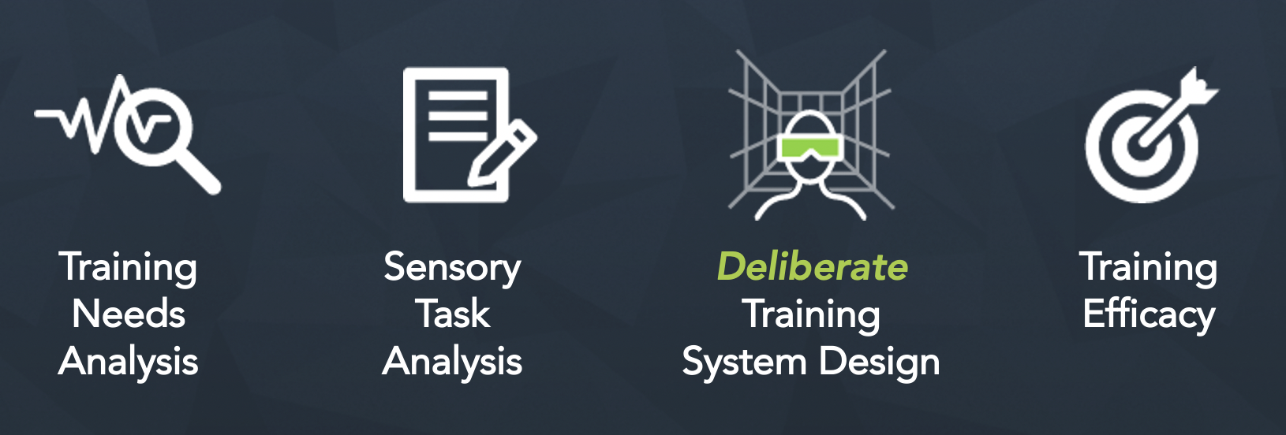
Human-Centered Approach to XR Development
Take a Human-Centered Approach to XR Development
It is not just the AR/VR technology,
It is the process

Slide 67
Human-Centered Approach to XR Development
Take a Human-Centered Approach to XR Development
Training Needs Analysis
Characterize target users and target environment
Identify critical performance gap(s)
Collect operational data
Develop models, metrics, fidelity requirements, and scenarios
Outcomes:
User profile(s)
Establish training goals and objectives
Fidelity requirements
Training needs analysis matrix
Training Design
Specify composition of material to be trained
Characterize target training community
Estimate cost of delivery
Identify operational requirements
Outcomes:
Blended training solution
Measures of effectiveness (MOE)
Measures of performance (MOP)
Training Metrics
Develop training metrics that link training objectives to operational requirements MOEs and MOPs
Outcomes:
Process measures
Outcome measures (skill-based, cognitive, attitudinal, physiological)

Slide 68
Learning Objective 4
Describe human-centered XR design process:
  Process: Describe elements of human-centered XR design process
  Design Efficacy: Describe what drives XR design efficacy
  Training Efficacy: Describe what drives XR training efficacy

Slide 69
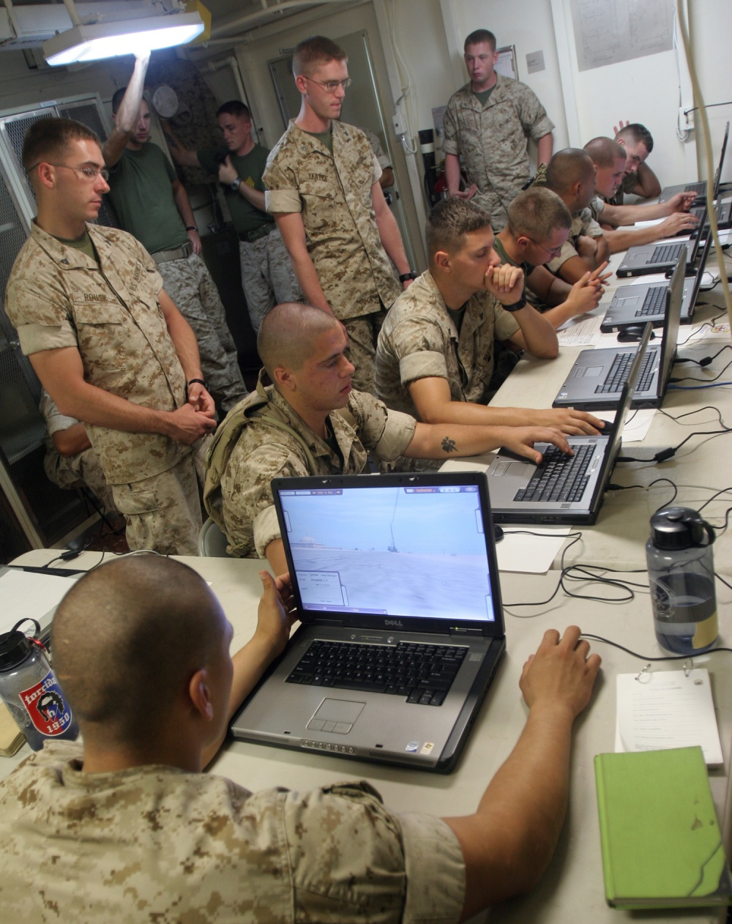
Human-Centered Approach to XR Development
Take a Human-Centered Approach to XR Development
Design Efficacy:
Benefits of Aligning Cue Fidelity with Training Objectives
Problem:
  Sensory cue fidelity in XR is different than in real world
  Cost of training higher with increase in fidelity
  Lack of relationship between fidelity and training objectives
Evaluation:
  Training Needs Analysis (TNA) and Sensory Task Analysis (STA) data used to align training objectives with requisite sensory cues that must be supported by DVTE (Deployable Virtual Training Environment) training system design
Design Efficacy:
  Desktop VR redesigned according to STA led to:
    34% increase in ability to support training objectives
    40% increase in perceived ease of use
Data Source: Design Interactive, Inc.
Notes:
Source:
Milham, L.M., Carroll, M.B., Jones, D.L., Dean, S.E., & Chang, D. (2008). Cue fidelity evaluation: a requirements-driven approach to training
effectiveness evaluation. In Proceedings of the Interservice/Industry Training, Simulation, and Education Conference (I/ITSEC) Annual Meeting. Orlando, FL.

Slide 70
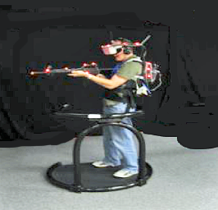
Human-Centered Approach to XR Development
Take a Human-Centered Approach to XR Development
Design Efficacy:
Impacted by Haptic and Vestibular Cue Design
Sensory Task Analysis:
  Are haptic and vestibular cues needed?
Evaluation:
  Evaluated effectiveness of adding haptic cues (i.e., single point tactile metaphoric distance and incoming fire cues) in a VR MOUT compared to those who trained without haptic cues; trained with/without head tracking that provided vestibular cues of heading
Design Efficacy Leads to Training Efficacy:
  Use of metaphoric cues in VR MOUT led to:
    Reduced missed shots by ~40%
    Reduced redundant shots by ~39%
    Reduced time in ELOS (Enemy Line of Sight) by ~55%
    Benefits of single point tactile distance cue may be impacted by concordant vestibular cues, as greater benefits when cues paired with head tracking as compared to gamepad interaction
Data Source: Design Interactive, Inc.
Notes:
Source:
Virtual Environment Military Operations on Urbanized Terrain (MOUT) research testbed developed under the ONR VIRTE Program.
See: http://etd.fcla.edu/CF/CFE0001414/Hale_Kelly_S_200612_PhD.pdf
Metaphoric distance cue designed to enhance visual distance estimation, which is known to be inaccurate in virtual environments… Four tactors around the upper chest (located at approximately 1, 5, 7, 9 o’clock headings) were used to provide cues regarding incoming fire, and four tactors around the waist provided cues regarding distance to targets (activated when participants were within 3’-4’ of target).

Slide 71
Learning Objective 4
Describe human-centered XR design process:
  Process: Describe elements of human-centered XR design process
  Design Efficacy: Describe what drives XR design efficacy
  Training Efficacy: Describe what drives XR training efficacy

Slide 72
Human-Centered Approach to XR Development
Take a Human-Centered Approach to XR Development
Training Efficacy:
Increase Speed & Depth of Learning
Problem:
  Live MOUT training provides highest fidelity but comes with high cost and low throughput
Evaluation:
  Compare high fidelity VR MOUT to desktop VR to refresher video pre-training, then all groups tested in live shoothouse
Training Efficacy:
  Use of high-fidelity VR:
    Reduced number of trials to reach criterion performance by ~30%
    Increased outcome performance by ~10-20%
    Stabilized performance ~50% faster (<5% performance variability over 5 consecutive trials)
Data Source: Design Interactive, Inc.
Notes:
Source:
Virtual Environment Military Operations on Urbanized Terrain (MOUT) research testbed developed under the ONR VIRTE Program.
See: Champney, R.K., Stanney, K.M., Milham, L., Carroll, M.B. and Cohn, J. (2017). An examination of virtual environment training fidelity on training effectiveness. International Journal of Learning Technology, 12(1), 42–65.

Slide 73
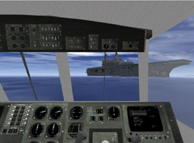
Human-Centered Approach to XR Development
Take a Human-Centered Approach to XR Development
Training Efficacy:
Decrease Performance Errors
Problem:
  LCAC (Landing Craft Air Cushioned) Full Mission Trainers are expensive to procure and operate
Evaluation:
  Virtual Environment LCAC (VELCAC), which uses all virtual displays, with exception of the “throttle” which gives haptic feedback, was compared to a non-interactive condition that reviewed Best Practices (BP)
  Evaluated efficacy of VR training for LCAC skill improvement
Training Efficacy:
  VELCAC training led to 2x - 4x fewer errors for both checklist performance and during causality mitigation
Data Source: Design Interactive, Inc.
Notes:
Source:
https://www.google.com/url?sa=t&rct=j&q=&esrc=s&source=web&cd=1&cad=rja&uact=8&ved=2ahUKEwjFsK-rmv3gAhUCi6wKHeQFD6kQFjAAegQIChAB&url=https%3A%2F%2Fwww.researchgate.net%2Fpublication%2F235120272_Virtual_Technologies_and_Environments_for_Expeditionary_Warfare_Training&usg=AOvVaw1yDojOHbgmtgBLokaWE_VE

Slide 74
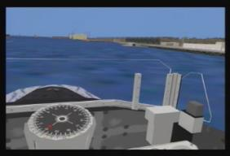
Human-Centered Approach to XR Development
Take a Human-Centered Approach to XR Development
Training Efficacy:
Impacted by Trainee Experience Level
Problem:
  Land-based simulation training for Submarine Piloting and Navigation teams does not provide detailed harbor and channel ship handling training for Officer of the Deck (OOD)
  OOD training primarily obtained via OJT (On-the-Job Training)
Evaluation:
  Evaluated efficacy of Virtual Environment Submarine (VESUB) training for OOD skill improvement
Training Efficacy:
  Significant learning at all experience levels (0-14 years)
  11 of 15 skills improved, but experience level impacted training efficacy trends
Data Source: Design Interactive, Inc.
Notes:
Source:
VESUB (Virtual Environment for Submarine)
See: https://apps.dtic.mil/dtic/tr/fulltext/u2/a349219.pdf

Slide 75
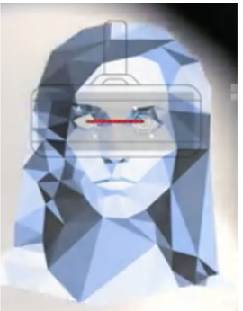
Human-Centered Approach to XR Development
Take a Human-Centered Approach to XR Development
Training Efficacy:
Impacted by Trainee Attributes - Interpupillary Distance (IPD)
Problem:
  Females thought to be more susceptible to cybersickness than males; yet in a meta-analysis only ~55% found higher levels of susceptibility in females as compared to males - so what is driving differences
Evaluation:
  Sex differences in cybersickness largely contingent on whether VR display could be fit to user’s IPD; with a substantially greater proportion of females unable to achieve a good fit
HWD Redesign:
If XR headset manufacturers implement an IPD adjustable range of 50 to 77 mm to capture > 99% of both females and males, anticipate far greater number of females will be able to harness performance enhancing potential of XR technology
Impact to Training Efficacy:
  Susceptibility differences could create accessibility limitations, with those who can handle VR exposure advancing due to better training and operational support, while those who are susceptible are left on sidelines watching this new era of XR empowered productivity passing them by
Notes:
Source:
https://doi.org/10.3389/frobt.2020.00004

Slide 76
Human-Centered Approach to XR Development
Take a Human-Centered Approach to XR Development
Training Efficacy:
Impacted by Environmental Factors
Problem:
  Will ambient lighting levels impact the training efficacy of VR MOUT?
Evaluation:
  Evaluated impact of environmental lighting levels on training effectiveness of VR with audio cues (both non-spatial and generalized spatial)
Training Efficacy:
  Use of metaphoric distance cues in VR MOUT led to:
    Training in a well-lit environment was ~18% more accurate than in dim lit conditions, regardless of audio condition
Data Source: Design Interactive, Inc.
Notes:
Source:
Virtual Environment Military Operations on Urbanized Terrain (MOUT) research testbed developed under the ONR VIRTE Program

Slide 77
Facilitating XR Enterprise Adoption
Build Roadmap to Align High Value Use Cases with XR Capabilities
Implement XR Architecture and Infrastructure
Take a Human-Centered Approach to XR Development
Track and Assess Gains and Quantify ROI
Learning Objective 5
Define how to assess and quantify gains of XR implementation

Slide 78
Track and Assess Gains and Quantify ROI
Learning Objective 5
Define how to assess and quantify gains of XR implementation:
  User Acceptance: Define how to assess user acceptance
  Measurement Specifics: Define what to measure to qualify and quantify gains
  Transfer Efficacy: Define how to assess XR transfer efficacy

Slide 79
Quantifying XR Benefits: XR Acceptance
Track and Assess Gains and Quantify ROI
Recent study on XR acceptance in workplace settings
  Key finding 1: The perfect workplace XR system provides contextual support to increase productivity and enhance safety without violating user privacy
  Key finding 2: Functional benefits constitute a main technical driver for wearable XR adoption decisions at the user level, while ease of use and monitoring play a minor role
  Key finding 3: User privacy might be monetized and compensated
  Key finding 4: Breaking down the heterogeneity in preferences leads to three clusters with significantly different utility patterns each:
    Strivers (30.39%): Intend to use XR systems if generate high functional benefits; not concerned about privacy violations, willing to share performance data with the employer
    Payroll Hunters (33.83%): Intend to use XR systems if receive a financial incentive for use and privacy concerns are minimized
    Privacy Keepers (35.78%): Intend to use XR systems only if their high level of privacy concerns and low legal trust can be overcome
https://doi.org/10.1007/s10257-021-00529-0
Notes:
Source:
https://link.springer.com/content/pdf/10.1007/s10257-021-00529-0.pdf

Slide 80
Track and Assess Gains and Quantify ROI
Learning Objective 5
Define how to assess and quantify gains of XR implementation:
  User Acceptance: Define how to assess user acceptance
  Measurement Specifics: Define what to measure to qualify and quantify gains
  Transfer Efficacy: Define how to assess XR transfer efficacy

Slide 81
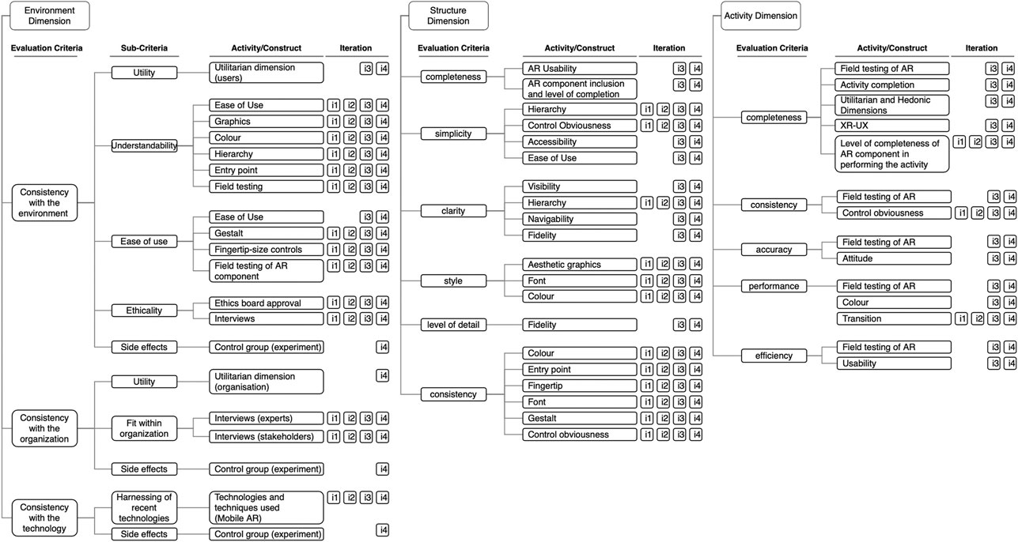
Quantifying XR Benefits: Measurement Specifics
Track and Assess Gains and Quantify ROI
Notes:
Source:
https://www.frontiersin.org/files/Articles/713718/frvir-02-713718-HTML-r1/image_m/frvir-02-713718-g004.jpg

Slide 82
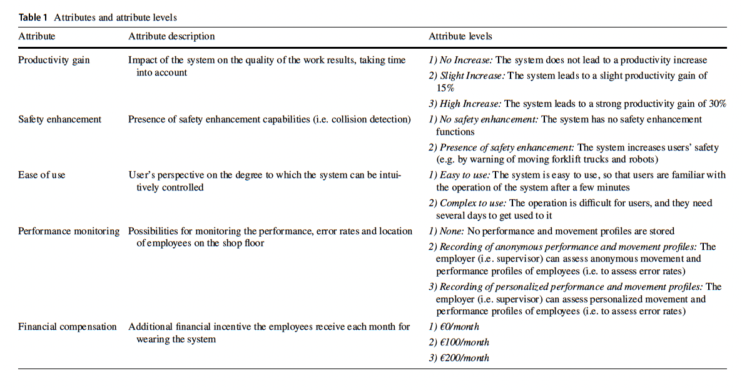
Quantifying XR Benefits: Measurement Specifics
Track and Assess Gains and Quantify ROI
Notes:
Source:
https://link.springer.com/content/pdf/10.1007/s10257-021-00529-0.pdf

Slide 83
Learning Objective 5
Define how to assess and quantify gains of XR implementation:
  User Acceptance: Define how to assess user acceptance
  Measurement Specifics: Define what to measure to qualify and quantify gains
  Transfer Efficacy: Define how to assess XR transfer efficacy

Slide 84
Quantifying XR Benefits: Transfer Assessment
Track and Assess Gains and Quantify ROI
Transfer Efficacy:
How to Measure
If TNA and STA have led to design efficacy
  which has in turn through deliberate UCD led to training efficacy
  then transfer efficacy should be achieved thereby leading to operational readiness and mission effectiveness
How to measure transfer efficacy…
  Live training is a vital yet costly and accessibility limited component of military training
  Saving live training trials via XR pre-training is one way of assessing transfer efficacy
Notes:
Source:
Virtual Environment Military Operations on Urbanized Terrain (MOUT) research testbed developed under the ONR VIRTE Program.
See; Champney, R.K., Stanney, K.M., Milham, L., Carroll, M.B. and Cohn, J. (2017). An examination of virtual environment training fidelity on training effectiveness. International Journal of Learning Technology, 12(1), 42–65.

Slide 85
Quantifying XR Benefits: Transfer Assessment
Track and Assess Gains and Quantify ROI
Transfer Efficacy:
Save Live Training Trials
VR MOUT provided opportunity to practice key skills and work out performance issues in a more cost-effective environment, leading to more efficient use of live training
ONR VIRTE:
  4-person teams received pre-training on room clearing task via either low fidelity VR, high fidelity VR, or refresher video pre-training
  After pre-training, all groups transferred to a live shoothouse for 20 test trials
  Results suggest that it may be possible to save ~0.165 trials of live training for every trial of high-fidelity VR pre-training, i.e., ~6 trials of VR pre-training may save ~1 trial of live training (number will depend on training context)
Data Source: Design Interactive, Inc.
Notes:
Source:
Virtual Environment Military Operations on Urbanized Terrain (MOUT) research testbed developed under the ONR VIRTE Program.
See; Champney, R.K., Stanney, K.M., Milham, L., Carroll, M.B. and Cohn, J. (2017). An examination of virtual environment training fidelity on training effectiveness. International Journal of Learning Technology, 12(1), 42–65.

Slide 86
Conclusions
Build Roadmap to Align High Value Use Cases with XR Capabilities
Best Practices in XR Adoption
  Start by building a roadmap to align high value use cases with XR capabilities
  Always keep in mind where you are investing, whether it’s people, products or processes
  Assess workplace readiness:
    Is your workforce on board?
    Workplace infrastructure ready for XR-based solutions?
    Is there sufficient dedicated physical space for XR application?
    Is there sufficient XR content to support proof-of-concept?
  Identify where tangible business outcomes can be realized with XR technology
  Start small, scale as momentum is gained
  Quantify use case proof points using established KPIs
  Promote high value use cases to grow community of interest
Notes:
Sources:
https://www.sme.org/technologies/articles/2022/march/is-manufacturing-ready-for-xr-technologies/
https://www.softwaretestinghelp.com/future-of-virtual-reality/
https://www.researchgate.net/publication/338367313_Empirical_Study_on_the_Factors_Affecting_Individuals%27_Switching_Intention_to_AugmentedVirtual_Reality_Content_Services_Based_on_Push-Pull-Mooring_Theory

Slide 87
Conclusions
Build Roadmap to Align High Value Use Cases with XR Capabilities
Best Practices in XR Adoption
  Minimize adoption resistance drivers, including low perceived usefulness, functional simplicity (low content diversity and functionality), and perceived inefficiency
  Maximize pull effects, high levels of interactivity, hands-on experience-ability, and amplified enjoyment
  Evaluate adoption risks (e.g., age/resistance, lack of content, device sharing)
  Ensure business requirements are well-defined to align most effective XR application areas
  Determine what kind of data and how much/ how must be collected within XR applications
  Carefully evaluate integration needs and risks, such as integration with ERP, quality reporting, LMS
  Do not overlook IT policies, portability, privacy and cybersecurity concerns
  Reduce start-up costs through implementation of XR Architectures/Infrastructures that support scalability and sustainability
  Take a human-centered approach to XR development to facilitate generation of compelling content with anticipated high-end user experience that maximizes engagement while minimizing cybersickness
  Establish metrics to calculate return on investment: Develop ways to track and assess learning outcomes and performance gains to quantify ROI
Notes:
Sources:
https://www.sme.org/technologies/articles/2022/march/is-manufacturing-ready-for-xr-technologies/
https://www.softwaretestinghelp.com/future-of-virtual-reality/
https://www.researchgate.net/publication/338367313_Empirical_Study_on_the_Factors_Affecting_Individuals%27_Switching_Intention_to_AugmentedVirtual_Reality_Content_Services_Based_on_Push-Pull-Mooring_Theory

Slide 88


