Slide 1


Distributed Event Integration and Execution
Michael J. O’Connor
Trideum
Kenneth G. LeSueur
US Army Redstone Test Center

Slide 2
Learning Objectives
At the end of this tutorial, students will be able to:
  List the activities required to perform integration and execution of a distributed simulation event
  Describe an event in the terms required to plan the integration
  Select the integration activities required for an event
  Develop an outline for an integration plan for a distributed simulation event
  Describe the key roles in a distributed event integration and execution

Slide 3
Process Purpose
Distributed Live Virtual Constructive (LVC) events are conducted to support training, testing, research & development, and mission rehearsal
For many years, these environments were created by a small set of very experienced teams
  Events with less skilled teams often failed, overran costs, or did not meet schedules
A well-defined process allows for less reliance on highly skilled practitioners
It is critical that the users of data from distributed LVC environments trust the results
  An incorrectly created environment can lead to negative training, false test results, bad research, and failed missions

Slide 4
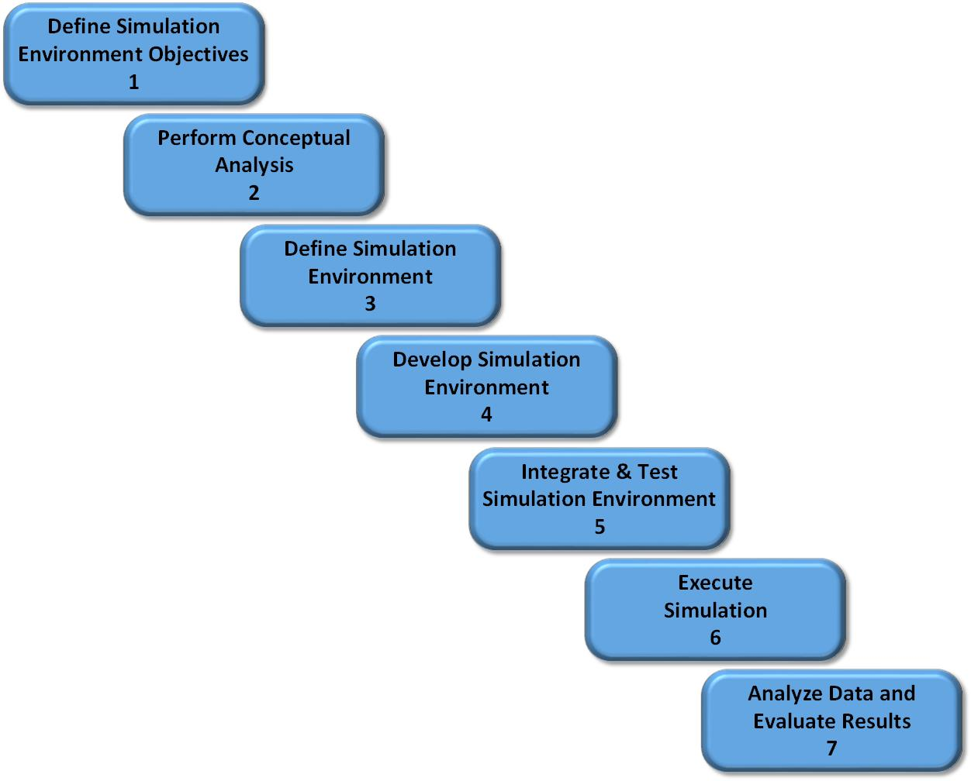
DSEEP
Distributed Simulation Engineering and Execution Process (DSEEP)
IEEE Std 1730-2010, developed by Simulation Interoperability Standards Organization (SISO)
Distributed simulation architecture independent
Process model for the integration of distributed simulations
The Process model must be instantiated with a set of processes and supporting material
Each Step in DSEEP is divided into activities

Slide 5
Process
This process is based on the DSEEP model
The processes documented here are based on years of experience integrating distributed LVC simulation events
Distributed simulation events come in different sizes and have different objectives, but the same approach can be used for all of them with some tailoring
This tutorial describes how to adjust based on the size and nature of the event being planned

Slide 6
It Is All About Risk
There are many risks in Integrating and Executing a distributed event
These role up into two fundamental risks:
  Risk that the integration will fail, and execution will not be possible
  Risk that the distributed LVC environment is not accurate, and the results will be invalid

Slide 7
Integration Failure Risk
This risk will likely be readily apparent to all participants
Causes of the risk:
  Poorly defined objectives result in the wrong environment being built
  Incomplete planning leaves gaps in the environment
  Lack of documentation means all of the required interfaces are not present
  Inadequate testing does not find issues with system behaviors
Results of the risk:
  Environment only partially meets objectives
  Integration fails completely and can not be executed

Slide 8
Invalid Environment Risk
This risk is likely not recognized before the event is conducted
Causes of this Risk:
  Lack of understanding the real-world environment
  Creating artificial virtual interoperability that does not exist in the real-world environment
  Not validating the virtual environment
Results of the Risk:
  For R&D focused events the results may drive research in wrong directions
  For Training Events, participants may receive negative training that could result in real world accidents
  For acquisition focused events, poor decisions may be made in the selection of new systems

Slide 9
Process to Mitigate Risk
Both risks are bad outcomes of an integration
The Invalid Environment Risk may be more significant because the failure will not become apparent until later when the damage is recognized
A well-defined process does not eliminate the risk, but does mitigate it
A process only works if it is followed, everyone must embrace the process
  Top-level management support is critical – If mangers do not consider the process important it will not be followed
  Practitioners must be trained in the process and accept that there is a reason to perform it
When there is schedule pressure, the process is almost always the first cut
  The schedule pressure is likely the result of not following the process, poor planning for an example
  Further reduction in following the process will likely produce more schedule slippage
The verification activities in the process mitigate the Integration Failure risk
The validation activities in the process mitigate the Incorrect Environment risk

Slide 10
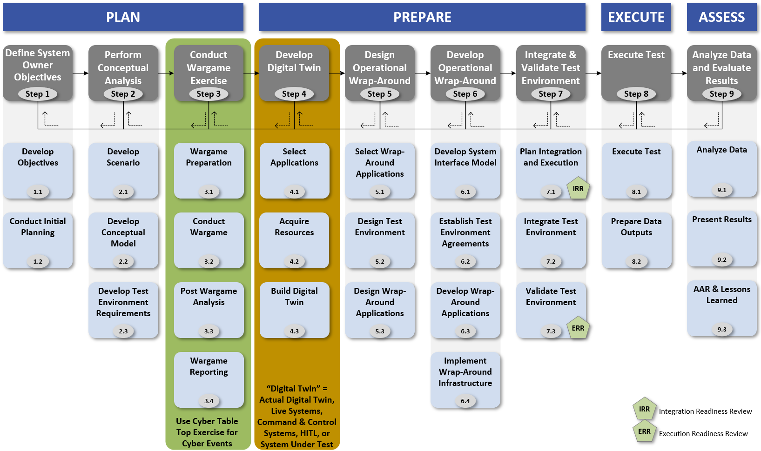
Process Overview
Notes:
Describe the overall process. Say the full process will be briefed at the Professional Development workshop (assuming proposal is accepted). Discuss way you would conduct a CTT and describe why you would need a digital twin

Slide 11
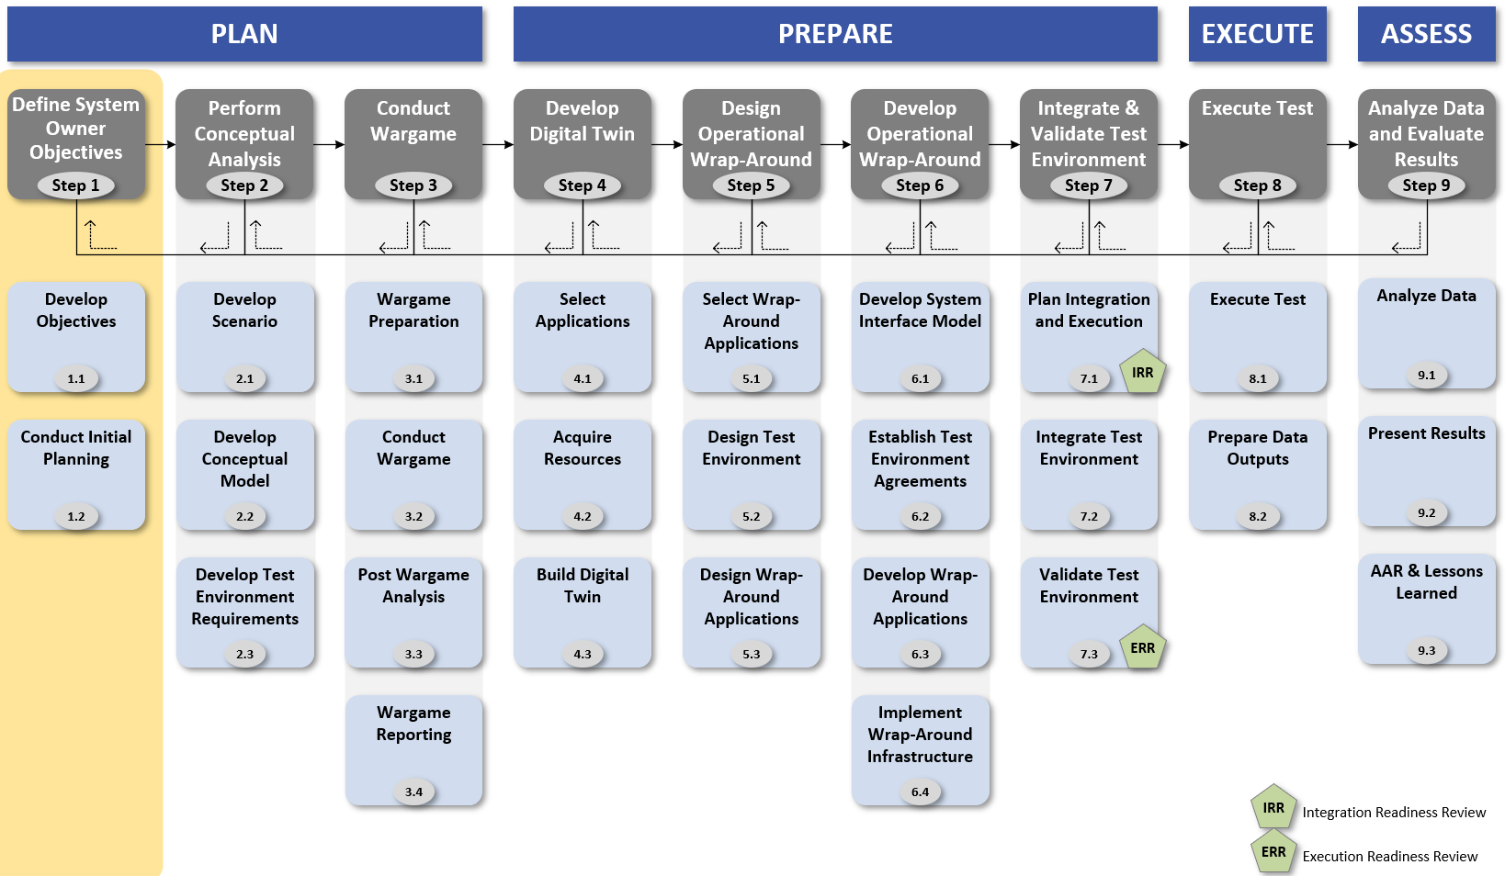
Step 1

Slide 12
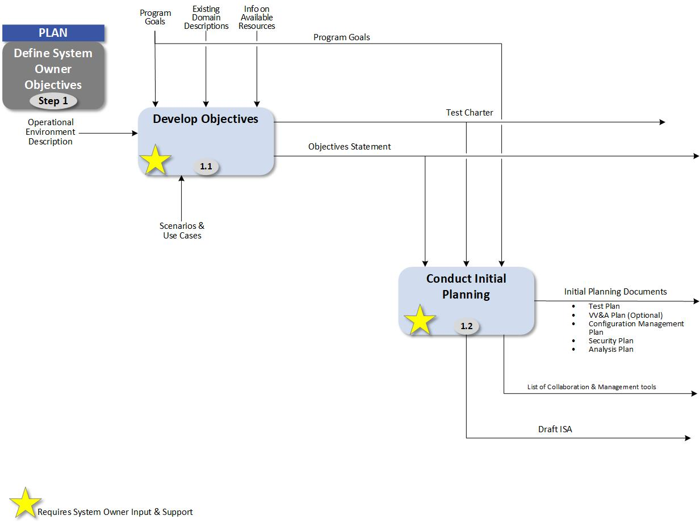
Step 1 Activities
Step 1 Purpose:
Formally define the objectives and to initiate planning for the test
Support and participation from the System Owner is critical throughout this step to provide guidance and scope the test

Slide 13
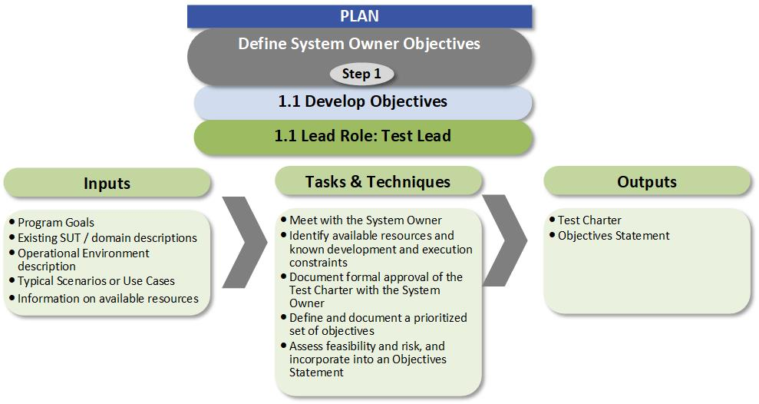
Step 1 Activity 1

Slide 14
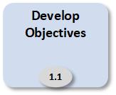
Objectives
Objectives are critical to the success of the Event
This does not require a formal document
  This can be as simple as a set of bullets
  Or it can be a detailed document
Measurable objectives are often not provided by the Event Requestors
  In this case is still critical to convert their direction into objectives
  Once these are created, they should be shared with the Event Requestors for concurrence
The objectives can be revised during the process, but significant changes can require rework.

Slide 15
Step 1 Activity 2

Slide 16
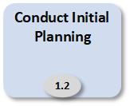
Working Groups
Execution Control Group (EXCON): Lead by the Test Lead, this team identifies and coordinates the plan of action and milestones for the event and produces the Test Plan.
Technical Working Group (TWG): Lead by the Test Coordinator, this team develops the architecture products and builds the Test Environment
Scenario Working Group. Lead by the Battle-Master, this team develops the scenarios, vignettes, and test threads and provides the operational context to the event.
Network Working Group. Lead by the Test Coordinator, this team develops the network requirements and implements the test network infrastructure.
Analysis Working Group. Lead by the Analyst (Mission Impact) Lead, this team develops the analysis plan and defines the data collection requirements, identifies the strategy for data collection, management, and analysis.
Security planning. Lead by the Test Lead, this team identifies the level of security for the Test Environment.

Slide 17
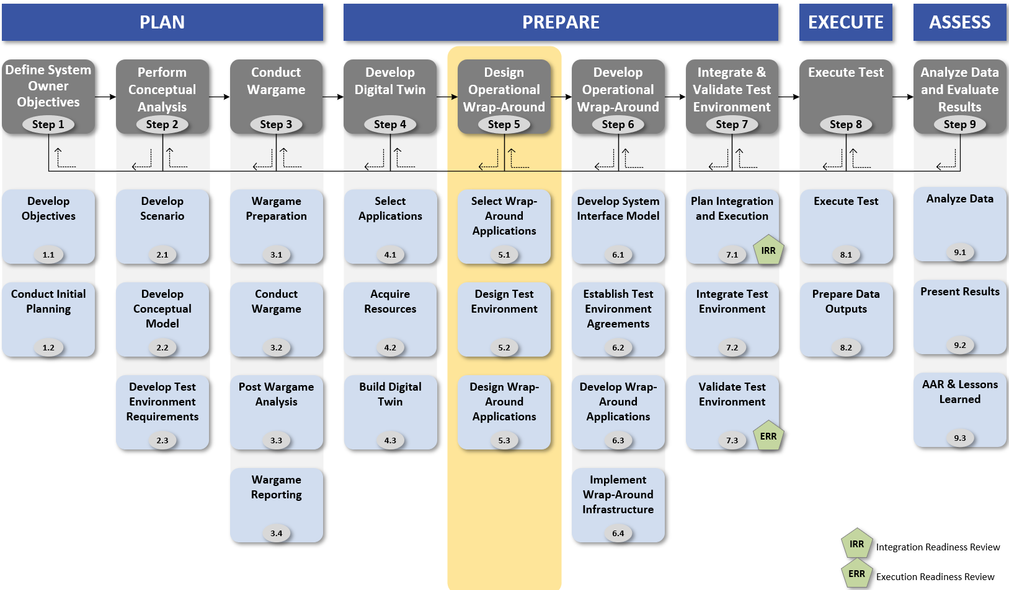
Step 5

Slide 18
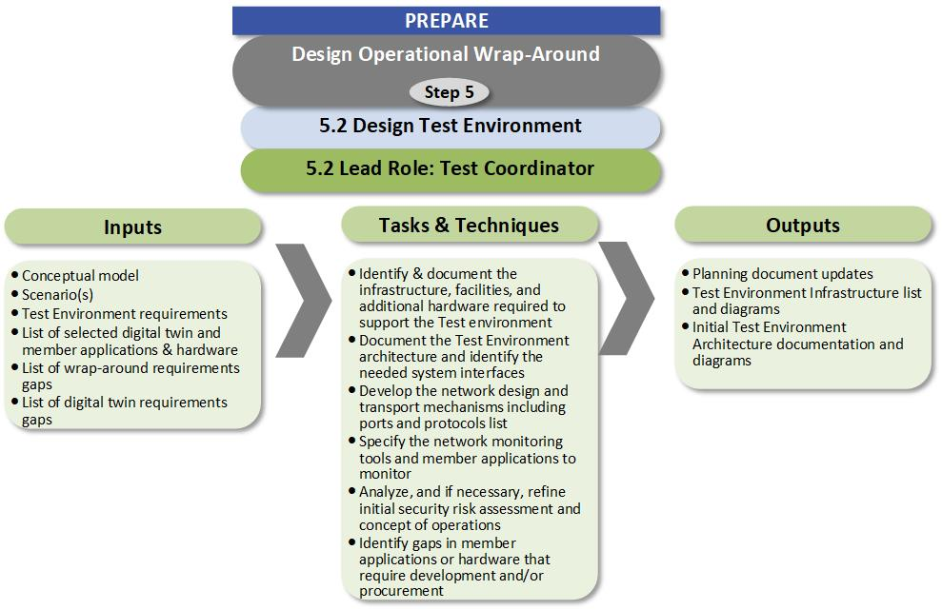
Activity 5.2

Slide 19
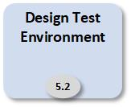
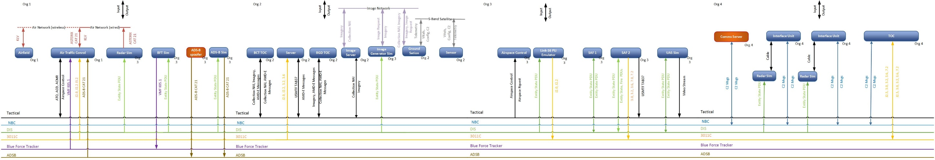
Connectivity Diagram
The purpose of this diagram is to convey the connectivity between systems
The representation and data vary by event
Key data includes: Protocol, messages, and system names
A key consideration in the selection of format is how well it can be briefed

Slide 20
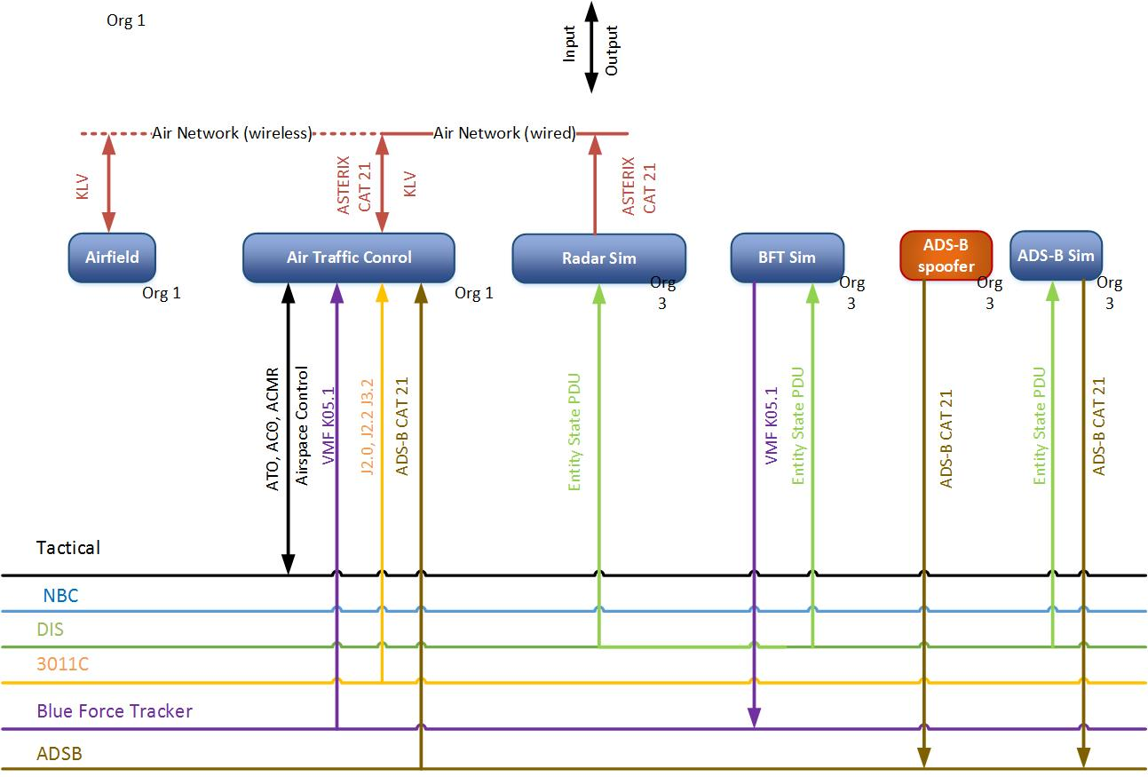
Connectivity Diagram Detail

Slide 21
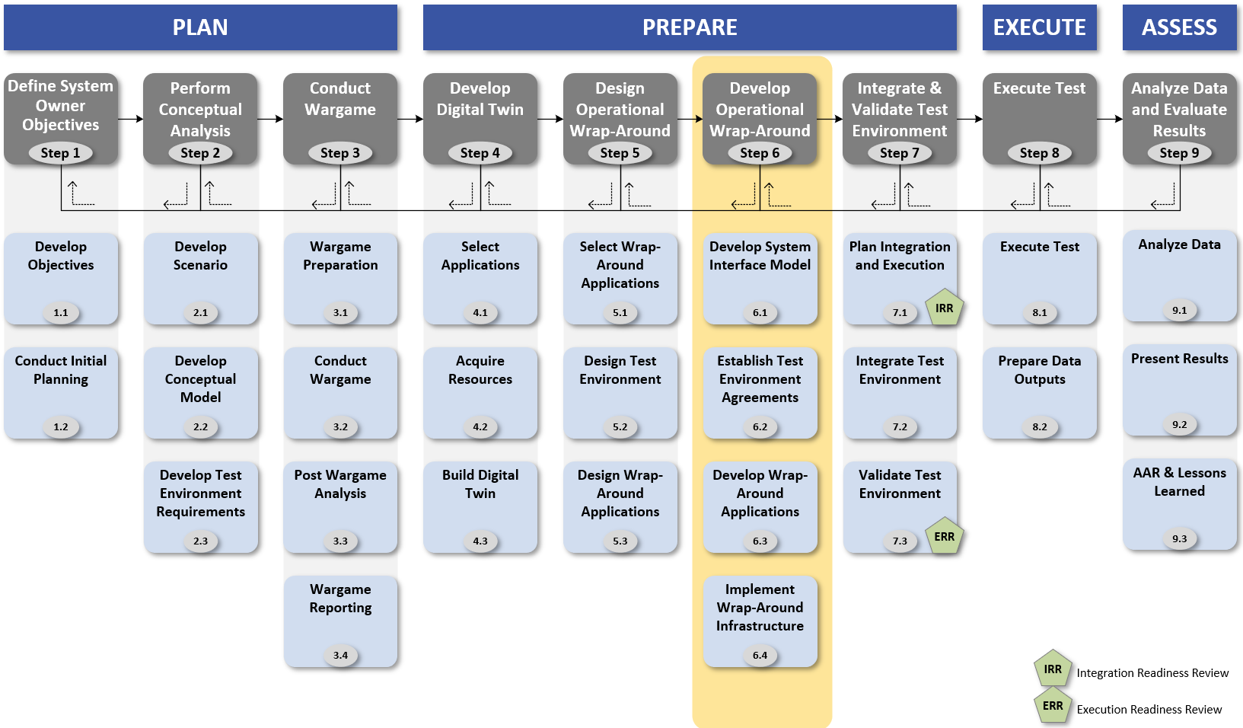
Step 6

Slide 22
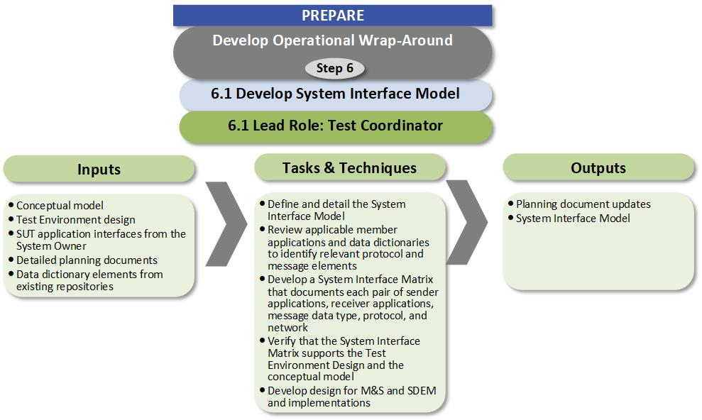
Activity 6.1
Notes:
Next activity is 6.1

Slide 23
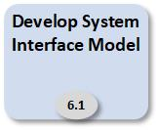
Interface Matrix
The Interface Matrix documents all messages sent and received in the distributed LVC environment
  This includes all simulation and tactical messages
It is based on the data documented in the Connectivity Diagram
  If additional interfaces are identified when the Interface Matrix is developed, the Connectivity Diagram should be updated
This is used in Activity 7.2 to integrate the environment
In addition to listing each Source/Target/Message, the matrix includes all of the configuration information for the interface
  All of the configuration data may not be known in the initial versions of the matrix

Slide 24
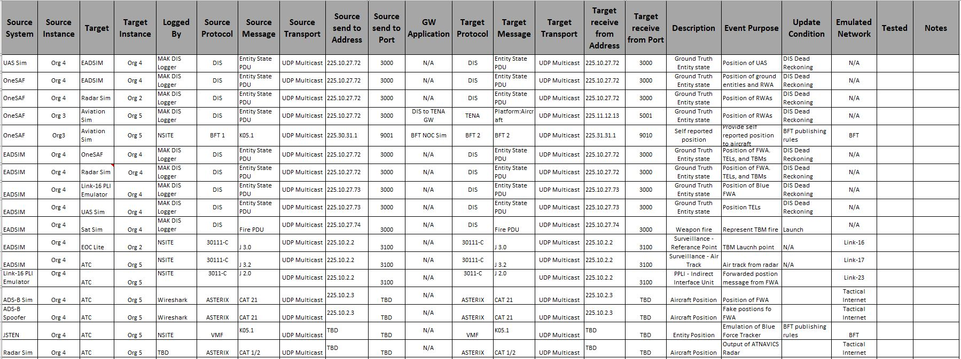
Interface Matrix
One row for each data message by source and target
Columns for all information required to configure and test the systems
All addresses are notional

Slide 25
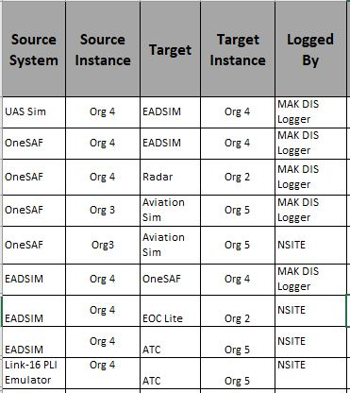
Interface Matrix Detail
System that is the source of the message
System that is the Target of the message
It is critical to list how the message is logged
There may be more than one instance of the system potentially at different sites
There is a line for every source/target pair even if it is the same message

Slide 26
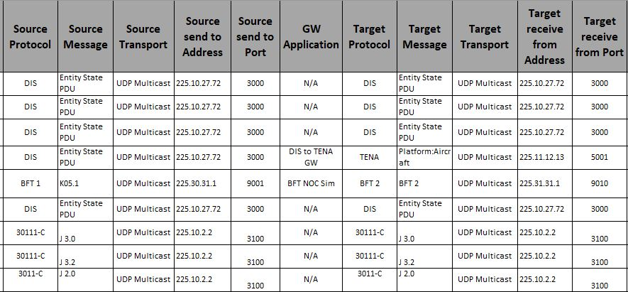
Interface Matrix Detail
Name of Gateway Application
Protocol can be distributed sim or tactical
The actual message being sent
Transport Examples: UDP Multicast, UDP Broadcast, TCP Unicast
There may be a “middle-man” between the sending and receiving applications
Therefore the address the message is sent to may not be the one the target application receives it on
The most common example of this is distributed simulation gateways, but is also used for some tactical systems as well
Address the message is sent to
Port the message is sent to
All addresses are notional

Slide 27
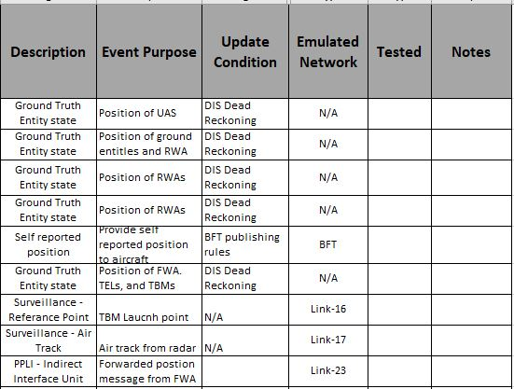
Interface Matrix Detail
Description of the message
Used to indicate that the receipt of the message by the target has been confirmed
The name of real network the message would be sent on, or the VLAN used in the Event
The specific purpose of the message for the event, the same message may have different purposes based on the source/target pair
Update condition may be trigger based or rate based

Slide 28
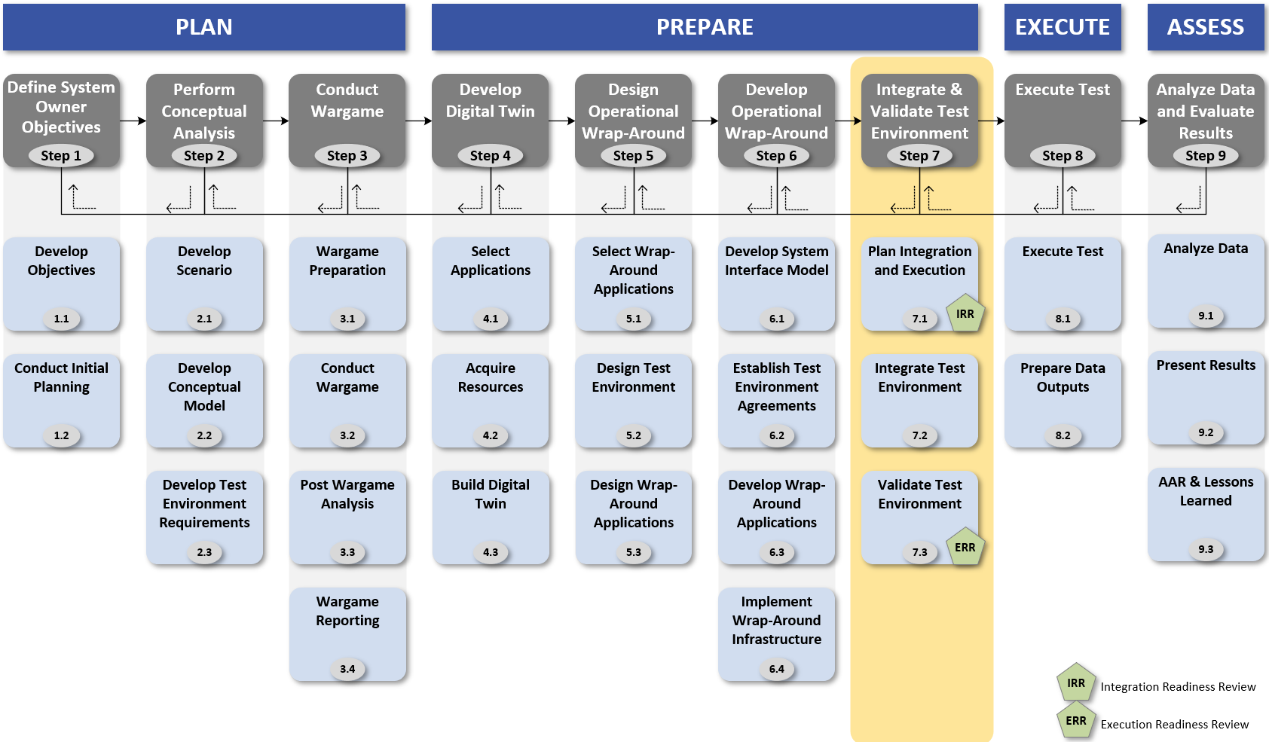
Step 7
Notes:
Next we will discuss all of the activities in Step 7

Slide 29
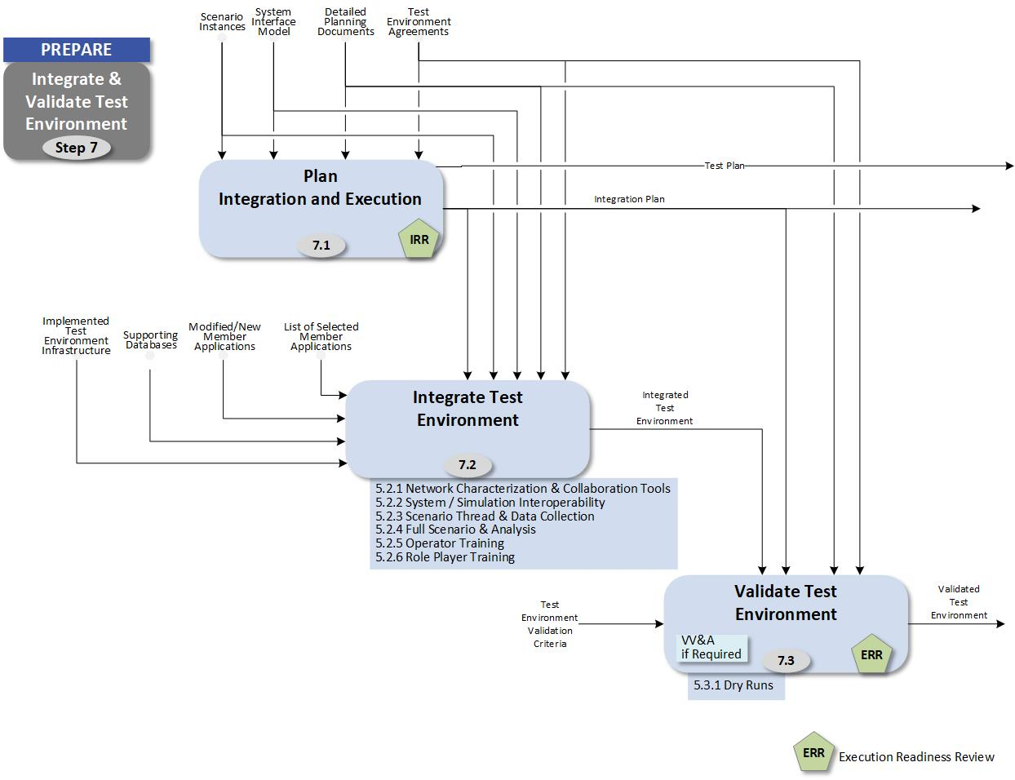
Step 7 Activities: Integration Planning and Execution
Step 7 Plans the integration of the distributed LVC environment
A key part of the integration is the execution of the 7 integration blocks (defined in the following slides)
The plan is created in activity 7.1
Integration Blocks 1 through 6 are performed in activity 7.2
Block 7 is performed in activity 7.3

Slide 30
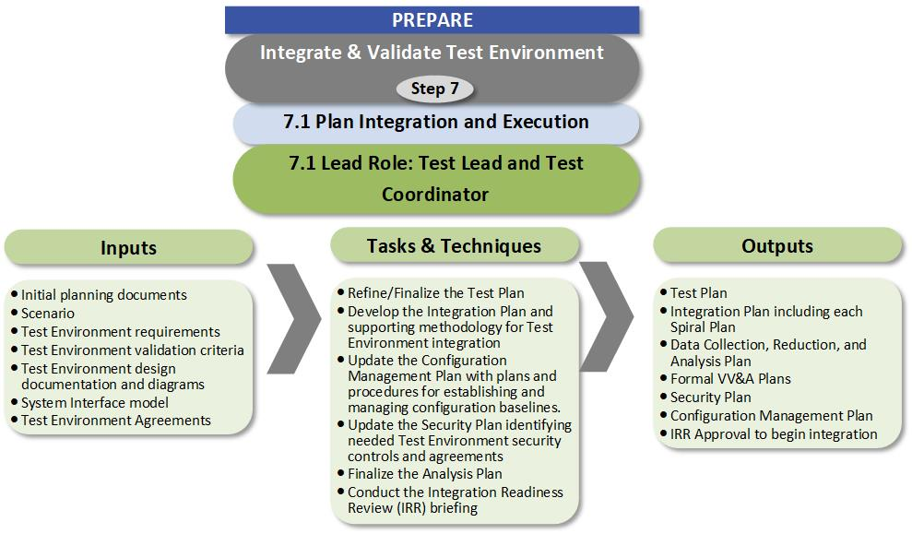
Activity 7.1

Slide 31
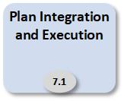
Integration Planning
Integration Plan
Integration Blocks
  Set of activity blocks to integrate a distributed simulation system
Integration Planning
  Mapping activity blocks to integration spirals
  Scheduling integration spirals
  Integration Plan development
Spiral Planning
  Expanding Integration Plan
  Developing detailed integration spiral plan

Slide 32
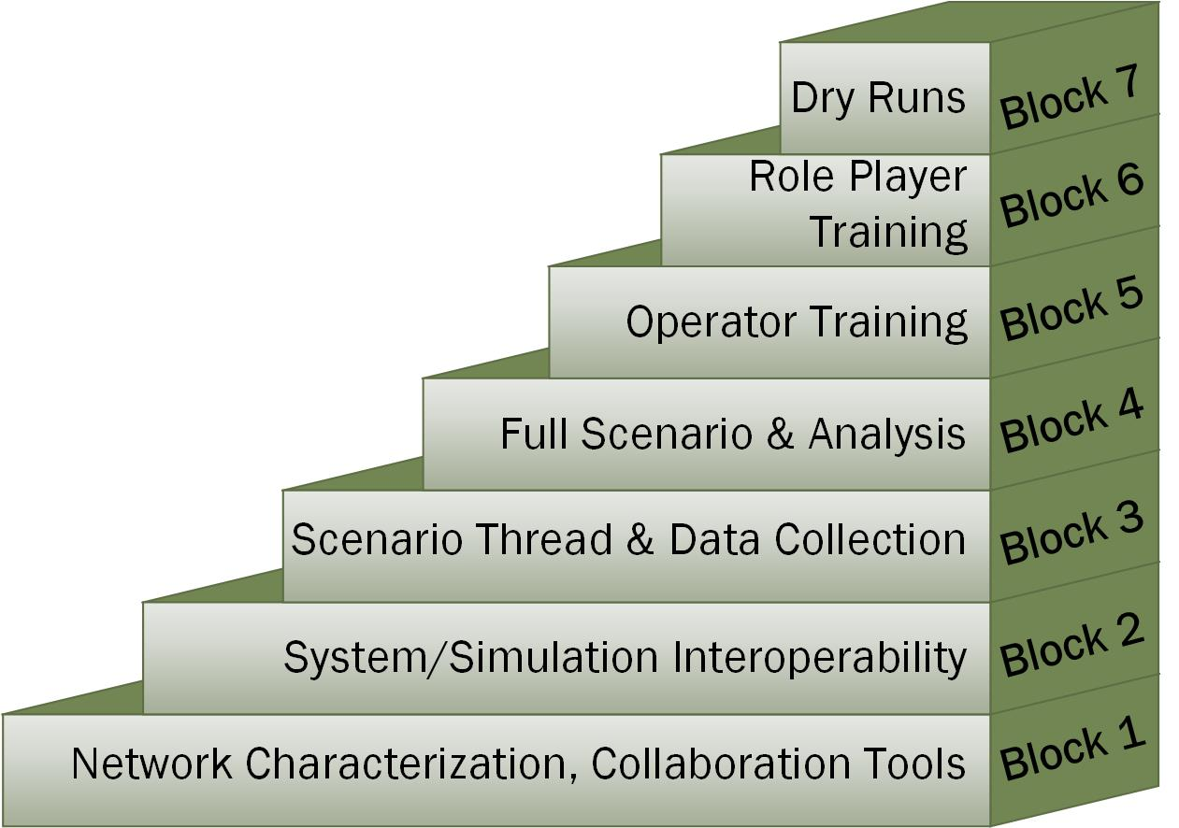
Integration Activity Blocks
The activities required to integrate the system are divided into a series of seven blocks
Each block has a focus
The block builds on the previous blocks
Based on the nature of the event, all of the block activities may not be required

Slide 33
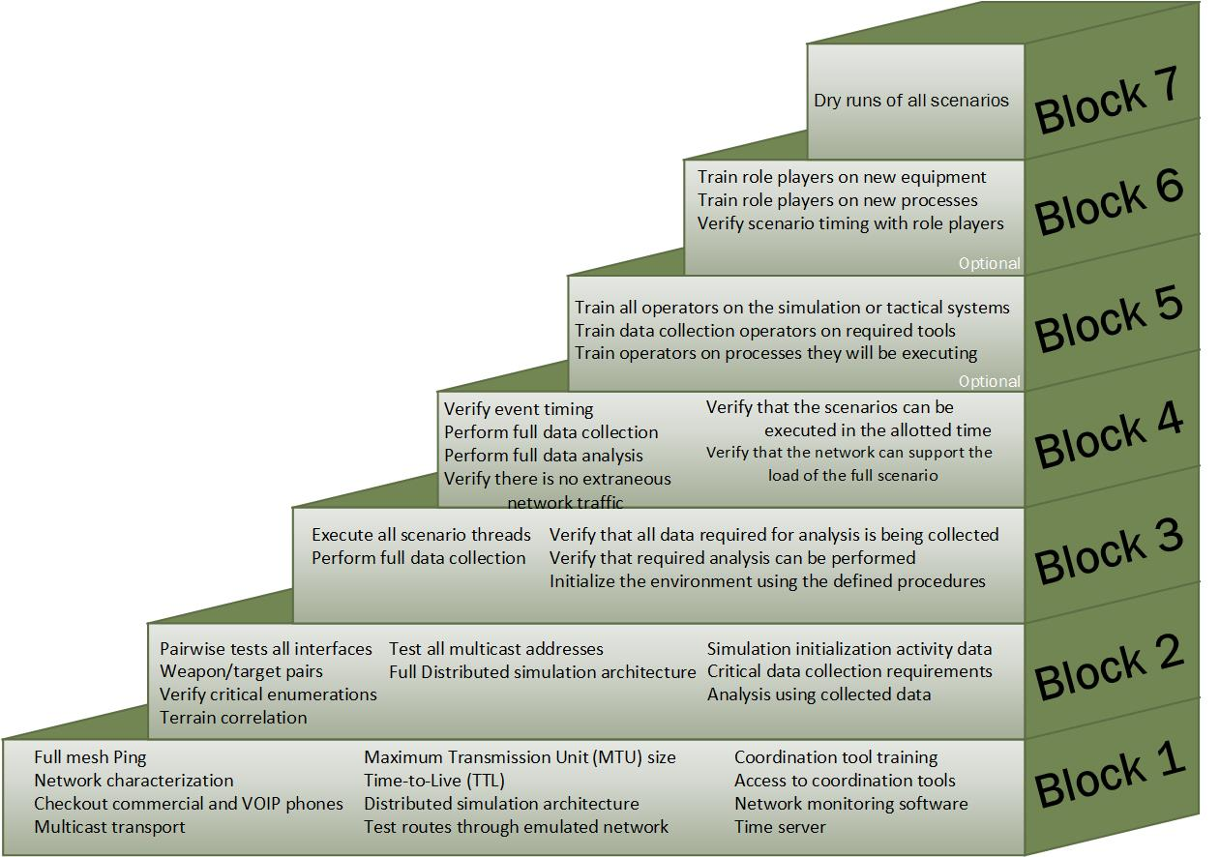
Integration Activity Blocks
The activities required to integrate the system are divided into a series of seven blocks
Each block has a focus
The block builds on the previous blocks
Based on the nature of the event, all of the block activities may not be required
Notes:
This in not meant to be readable

Slide 34
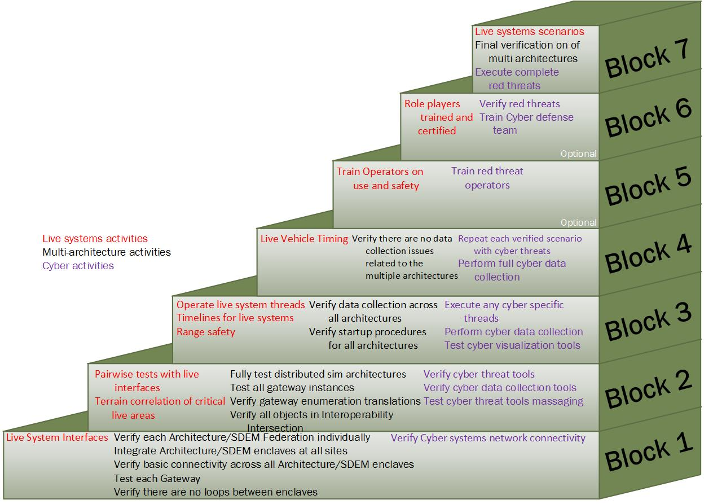
Integration Activity Blocks – Cyber, Live, & Multi Architecture
Additional activities may be required for some events
  Live systems require additional testing
  Multiple distributed simulation architectures require additional activities
  Cyber events have additional activities
Notes:
This is not meant to be readable

Slide 35
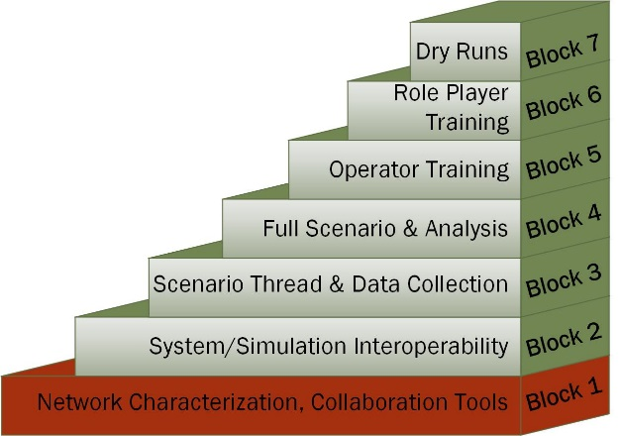
Block 1: Network Characterization, Collaboration Tools
Block 1 activities focuses on establishing:
  the network
  infrastructure tools
The minimum entrance requirements for this block are:
  all sites on the network
  infrastructure tools installed

Slide 36
Block 1 Activities: Network Characterization, Collaboration Tools
General
Ping all sites from all other sites to verify full mesh connectivity
Perform full mesh network characterization to determine network latencies, jitter, and bandwidth
Checkout voice coordination lines, commercial and VOIP as required
If multicast transport is required, verify at least one multicast address is working to make sure the rendezvous point is correctly configured
Determine the correct Maximum Transmission Unit (MTU) size for the network, and make sure all computers have correctly set the MTU
  MTU size is critical when tunnels or encryptors are used
Verify systems have Time-to-Live (TTL) set based on network configuration

Slide 37
Block 1 Activities: Network Characterization, Collaboration Tools
General
Check out connectivity using the selected distributed simulation architecture(s)
Verify all sites have access to coordination/collaboration tools
Provide training for coordination tools including chat, file share, Time Ordered Event List (TOEL) server, visualization, and VTC
Implement and test network monitoring system
Verify all sites have access to a time server (need to determine if a single or multiple time servers will be used)
If emulated networks are being used – verify routes through the emulated network
Live
Test connectivity to software and systems used to convert live data to simulation

Slide 38
Block 1 Activities: Network Characterization, Collaboration Tools
Multi-Architecture
Verify each Architecture/SDEM Federation individually that is used for the test
Integrate Architecture/SDEM enclaves at all sites
Verify basic connectivity across all Architecture/SDEM enclaves
Test an instance of each Gateway
Verify there are no loops between enclaves
Cyber
Verify Cyber systems network connectivity
SDEM: Simulation Data Exchange Model

Slide 39
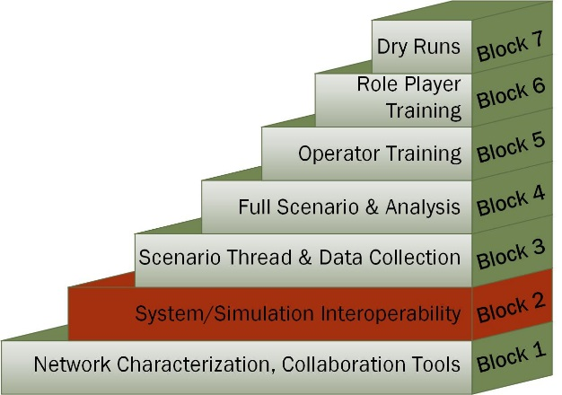
Block 2: System/Simulation Interoperability
Block 2 Activities are focused on data interchanges between systems enumerations and terrain correlation
The minimum entrance requirement for this block is an interface matrix showing all data exchanged between systems
It may be necessary to develop temporary data files, configurations, or stimulations to test pair-wise messaging between simulations/systems

Slide 40
Block 2 Activities System/Simulation Interoperability
General
Perform pairwise tests of all defined interfaces
Verify that all weapon/target pairs work as expected
Verify that critical enumerations are processed correctly
Perform terrain correlation to the level required for the event
Test all multicast addresses required for the event
Fully test distributed simulation architecture
Collect data for simulation initialization activities
Check critical data collection requirements
Perform limited analysis using collected data

Slide 41
Block 2 Activities: System/Simulation Interoperability
Live
Perform pairwise tests with live interface systems using surrogates if the live systems are not available
Verify terrain correlation with live systems in critical areas
Multi-Architecture
Fully test distributed sim architectures across all sites
Test all gateway instances
Verify gateway enumeration translations
Verify all objects in Interoperability Intersection

Slide 42
Block 2 Activities: System/Simulation Interoperability
Cyber
Verify cyber threat tools
Verify cyber data collection tools
If cyber threat tools send messages to other systems, include the cyber tools in pair-wise testing

Slide 43
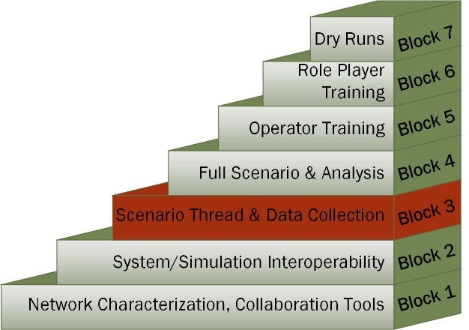
Block 3: Scenario Thread & Data Collection
Block 3 Activities are focused on testing scenario threads
The minimum entrance requirement is having all scenarios defined
A set of configuration files may have to be developed in advance to allow the threads to be executed
Issues found in thread testing include
  Timing issues: The activities can not be performed in the time specified
  Message issues: The simulations or tactical systems do not generated the expected output from the inputs
  Capability issues: The simulations or tactical systems can not or do not perform the activities
Resolution of issues may require:
  Changes to the simulations
  Change in tactics
  Modification of the scenario

Slide 44
Scenario Testing Concept
Avoid the “Big-Bang” approach where the scenario is run full up the first time
Review the scenario to look for:
  Activities that are repeated multiple times
  Critical activities that are key to the scenario
  Activities that have not been performed before
  Very complex activities
  Activities that involve a large number of participants
Document the message flows and actions required for each of the identified threads
GOAL: eliminate issues at a small scale before attempting the full scenario

Slide 45
Definitions
Scenario: The scenario is the overall set of simulation and tactical activities required to create an operationally relevant LVC environment
  Contains multiple similar activities that occur simultaneously
  Contains multiple different activities that occur simultaneously
  Involves all participants in the event
  Is long in duration
  Includes initial conditions for all entities (i.e. starting location, fuel state, etc.)
Thread: A thread is a single chain of events that include simulation and tactical activities that are a part of an operationally relevant LVC environment
  Is a single activity
  Involves a subset of participants in the event
  Is short in duration
  Includes the conditions for the entities involved in the thread at start of the thread

Slide 46
Block 3 Activities: Scenario Thread & Data Collection
General
Execute all scenario threads and verify correct execution
Perform full data collection for each thread
Verify that all data required for analysis is being collected for each thread
Verify that required analysis can be performed
Initialize the environment using the defined procedures
Live
Operate live systems as part of threads
Determine timelines to get live vehicles on station
Ensure threads do not violate range safety constraints

Slide 47
Block 3 Activities: Scenario Thread & Data Collection
Multi-Architecture
Verify data collection across multiple architectures
Verify startup procedures are correct for the multi-architectures
Cyber
Execute cyber specific threads
Perform cyber data collection
Test cyber visualization tools

Slide 48
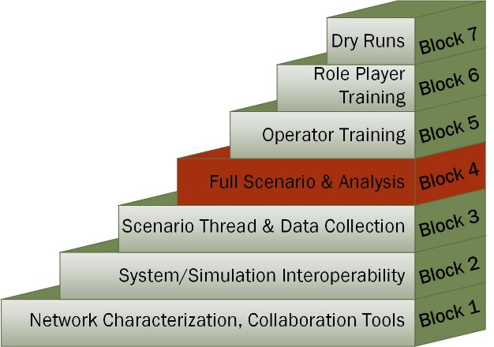
Block 4: Full Scenario & Analysis
Block 4 Activities are focused on executing full scenarios
Complete data analysis is also conducted
The minimum entrance requirement is that all scenario threads have been verified

Slide 49
Block 4 Activities: Full Scenario & Analysis
General
Execute each scenario to verify event timing
Perform full data collection for each scenario
Perform full data analysis for each scenario
Verify that the required number of scenarios can be executed in the allotted time
Verify that the network can support the load of the full scenario
Verify there is no extraneous network traffic
Live
Verify timing of live vehicles as part of the scenario

Slide 50
Block 4 Activities: Full Scenario & Analysis
Multi-Architecture
Verify there are no data collection issues across the multiple architectures
Cyber
Repeat each verified scenario with cyber threats
Perform full cyber data collection
Perform full cyber analysis for each scenario

Slide 51
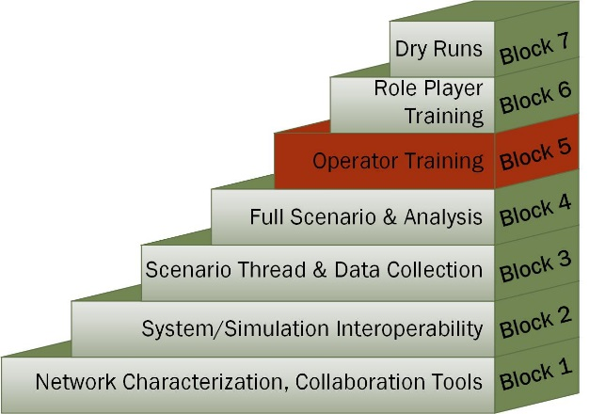
Block 5: Operator Training
Block 5 activities are focused on training simulation operators on the systems and tools required for the event
Depending on the requirements for the event, this set of activities may have been met in the performance of the previous activities

Slide 52
Block 5 Activities: Operator Training
General
Train all operators on the simulation or tactical system they will be using
Train data collection operators on required tools including digital and manual collection
Train operators on processes they will be executing
Live
Train all operators on the use and safety requirements of live systems
Cyber
Train red threat operators

Slide 53
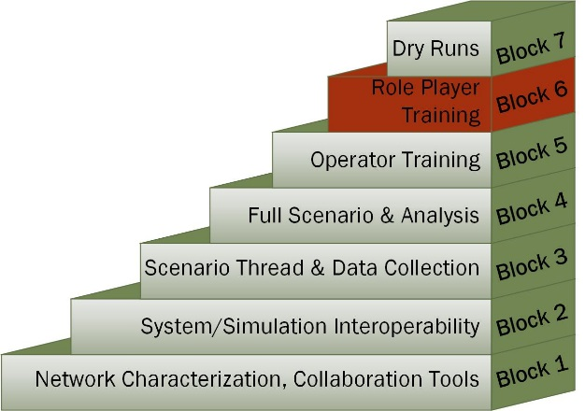
Block 6: Role Player Training
Block 6 activities are focused on training role players that will be used during the event
If role players are not being used in the event this block of activities can be omitted
This set of activities is required if the equipment being used is new to the role players or the processes being used are different than the ones the role players normally use
Cyber threat introduction if applicable to the event

Slide 54
Block 6 Activities: Role Player Training
General
Train role players on new equipment
Train role players on new processes
Verify scenario timing with role players
Verify cyber threats can be performed
Live
Verify roles players are properly trained and certified to operate the live systems
Cyber
Verify red threats
Cyber defense team training

Slide 55
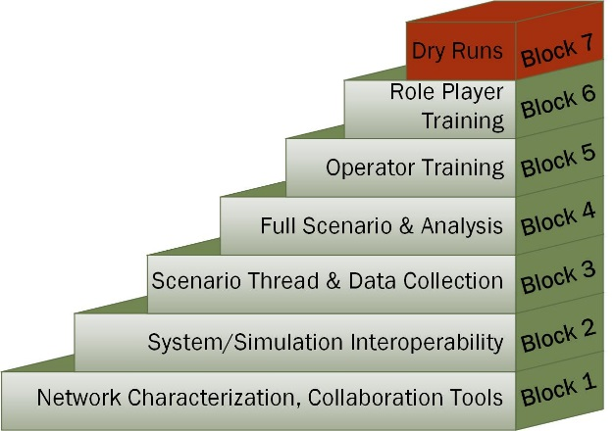
Block 7: Dry Runs
Block 7 activities are Focused on conducting dry-runs of scenarios to be executed during the event
This set of activities is required when data collection, test, or training requirements are dependent on an exact scenario execution

Slide 56
Block 7 Activities: Dry Runs
General
Run each scenario with full data collection and role players
Live
For each of the scenarios, conduct at least one dry run with all live systems
Multi-Architecture
Final verification of distributed simulation architectures used in the event
Cyber
Execute complete red threats

Slide 57
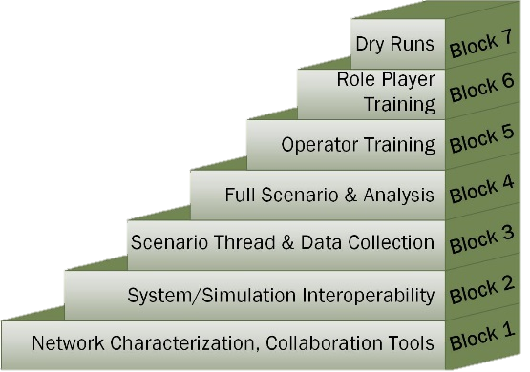
Integration Planning - Spiral Scheduling
The number, duration, and schedule of the integration spirals is dependent on the nature of the event and the participating sites
In general, a spiral is scheduled for one week
A nominal schedule for a medium sized event is three integration spirals over three months with the following assumptions:
  Medium sized event with experienced sites
  Neither dedicated operator nor role play training is required
  The number and complexity of the scenarios is such that Block 3 and 4 activities can be performed in a single spiral
  Dry runs can be performed if required

Slide 58
Nominal Spiral Schedule
Spiral | Activities | Week
Spiral 1 | Block 1 | Week 1
Spiral 2 | Block 2 | Week 4
Spiral 3 | Block 3 & Block 4 | Week 7
Spiral 4 (optional) | Block 7 | Week 10
Execution |  | Week 11 (week 10 if dry runs are not required)

Slide 59
Scheduling Considerations
One key issue that is not always understood is that the time between the spirals is as important as the spiral
If spirals are performed too close together there will not be time to address issues that arise in a previous spiral or prepare for the next spiral
In general at least two weeks should be planned between integration spirals
The exception would be spirals for Block 5 and 6 activities that can be performed back-to-back
The amount of time between spirals is also dependent on the confidence level that the activities can be performed in the time scheduled for the spiral

Slide 60
Block 1 Planning Considerations
In general Block 1 activities can be performed in a single integration spiral
An event with a very large number of participants or an event with a large number of inexperienced participants could require more than one spiral to complete Block 1 activities
Another option is to schedule a single two-week spiral

Slide 61
Block 2 Planning Considerations
Block 2 activities can generally be performed in a single spiral
If there are a large number pairwise interfaces, hardware-in-the-loop (WHIL) systems, or live elements, more than one spiral may be required to complete all of the Block 2 activities
If more than one spiral is required to complete Block 2 activities the systems and sites should be grouped by common interfaces
If more than one spiral is required to complete Block 2 activities, these may be scheduled with only one week in between
HWIL systems and live systems often require special scheduling considerations

Slide 62
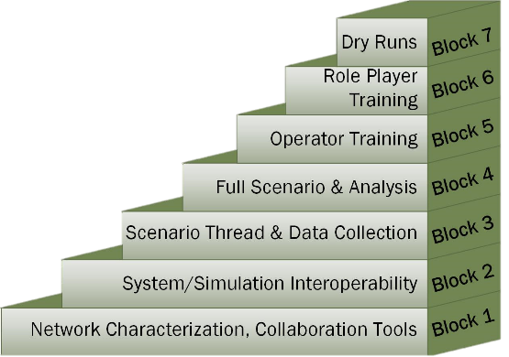
Block 3 & 4 Planning Considerations
For medium sized events Block 3 and 4 activities can generally be combined into a single spiral
If there are a large number of threads, Block 3 and 4 activities may have to be assigned to separate spirals
A large number of scenarios may also require scheduling separate spirals for Block 3 and 4 activities
The duration of the scenarios is also a factor

Slide 63
Block 5 & 6 Considerations
Block 5 and 6 activities are only performed if they are required
Depending on the level of training required, a single spiral may be used perform both activities
If Block 5 and 6 activities are performed in a single spiral, the week should be divided so the operator training is performed in the first half of the week and the role player training in the second half of the week
Depending on the source of the role players, scheduling them is generally a long lead time item
  Planning is required to make sure that role player time is used wisely

Slide 64
Block 7 Considerations
The amount of time required for Block 7 activities depends on the number of scenarios, the length of each scenario, and the number of iterations required
If completing the block 7 activities requires more than one week, the spiral should be scheduled for consecutive weeks
Block 7 activities and the event execution can be performed in consecutive weeks

Slide 65
Integration Plan Development
An Integration Plan is created to communicate with the full team the objectives, schedule, and mechanisms for the integration
This document is developed and published prior to the start of integration
In general this document is not updated after the Test Readiness Review
Changes after that are described in the individual Spiral Plans
The format of this document can vary, but there are several sections that should be included

Slide 66
Integration Plan Sections
Introduction: General information, overall schedule
Communication Plan: Phone numbers, data stores
Distributed Simulation: Architectures/Simulation Data Exchange Models (SDEMs), network configurations
Scenario/Operational: Terrain databases, scenarios, systems under test
Spiral Overview: Dates, objectives, participating sites, entrance & exit criteria
Documentation Plans: Spiral plans, spiral reports, problem reports

Slide 67
Example Objectives
ID | Objective
1 | Establish network connectivity between DTCC and JOIN Lab
2 | Characterize network performance over several days and times of day
3 | RTC users log-in to Confluence using accounts on Active Directory
4 | JOIN Lab users log-in to Confluence using accounts on Active Directory
5 | Have a TENA application (Canary) join TENA EM at DTCC
6 | Pass TENA platform data from DTCC to SIMDIS located at JOIN Lab
7 | Test VOIP call manager
Notes:
Example of the objectives that might be listed in the Integration Plan

Slide 68
Example Entrance Criteria
Site | Entrance Criteria
All | Verify site is available to participate in spiral
All | ISA signed and approved
All | User accounts created for at least one person at each NLT Friday 13 November 2015
Org1 | JMN in place
NOC | JMN in place
DTCC | JMN in place
NOC | Verify all CSTB PoC Sites connected on JMN
Org1 | Network check (ping test)
Org2 | Network check (ping test)
NOC | Establish multicast Rendezvous Point (RP)
DTCC | Distribute VoSIP phone information to all sites
NOC | VoSIP call manager operational
NOC | Chat server operational
DTCC | Confluence site created
DTCC | Adobe site created
All | Download network characterization tools from Confluence
Org1 | Have Linux computer on the network for network characterization tool
Org2 | Have Linux computer on the network for network characterization tool
NOC | Have Linux computer on the network for network characterization tool
DTCC | Have Linux computer on the network for network characterization tool
DTCC | Configure collaboration tools to use event LDAP
Notes:
Examples of the Entrance Criteria in an Integration Plan

Slide 69
Exit Criteria Example
Site | Exit Criteria
Org1 | All user accounts for the distributed sites have been verified
All | Network performance is sufficient for event requirements
All | VoSIP, chat, and Confluence between participating sites verified
All | Verified All sites connected to JMN
DTCC | Verified multicast group functionality
DTCC | Verified network monitoring approach
All | Infrastructure training complete: Confluence, Adobe Connect, Chat, and EventMan
Notes:
Example of an exit Criteria

Slide 70
Technical Interchange Meeting
The purpose of the Technical Interchange Meeting (TIM) is to brief the technical leads at each site on the integration plan and processes that will be used during the integration spirals
This meeting is led by the Test Conductor or Technical Working Group lead (ideally the same person) depending on the organization of the program
It is preferable for this to be an in-person meeting lasting two days for mid-sized event
The TIM can be conducted via a teleconference, but this will not allow the team building aspect of an in-person meeting
When possible, this meeting should be limited to the technical staff

Slide 71
Test Readiness Review
The Test Readiness Review (TRR) is the final programmatic meeting prior to the start of the integration spirals
  Ideally this is an in-person meeting, but a teleconference is acceptable
  This meeting should be led by the Test Director
In this meeting the Test Conductor briefs the status of the technical preparation for the event and makes a recommendation to proceed or not proceed with the start of the integration spirals
The Battlemaster briefs the status of the scenario preparation and role player preparation for the event and makes a recommendation to proceed or not proceed with the start of integration

Slide 72
Test Readiness Review
The leads for analysis and networking also brief their status and recommendations
The decision-making authority for proceeding to integration spirals should be defined prior to the TRR
Based on the inputs from the various team leads, the decision-making authority determines if the spirals will proceed
If it is determined that the environment is not ready, the following should be performed:
  Document the deficiencies
  Assign tasks to resolve the deficiencies
  Schedule another TRR

Slide 73
Detailed Spiral Planning
A Spiral Plan is created for each integration spiral
  The initial input for the plan is drawn from the Integration Plan
  The list of objectives, entrance criteria, and exit criteria may be extended and refined from what is listed in the Integration Plan
Any unmet exit criteria or other issues from the previous spiral are also input to the Spiral Plan
  If a large number of objectives were not met in the previous spiral, the addition of interim spirals may be required
The Spiral Plan is based on a template that can be modified to meet the needs of a specific program

Slide 74
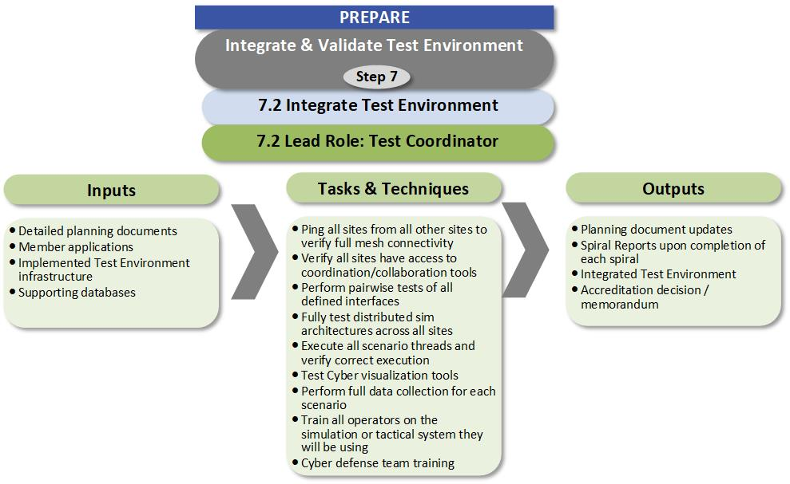
Activity 7.2

Slide 75
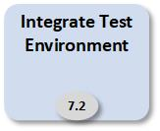
Spiral Execution
The hotwash on the final day of the spiral should review all of the activities assigned to the spiral and determine the status of their completion
The exit criteria should be reviewed and the status for each criterion determined
Once the spiral is completed, a Spiral Report should be developed to document the results of the spiral plan
  A critical element of the Spiral Report is any uncompleted activities that will have to be performed in the following spiral

Slide 76
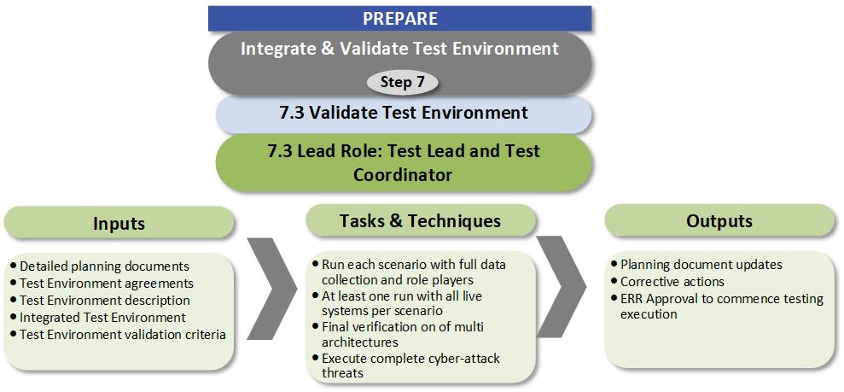
Activity 7.3

Slide 77
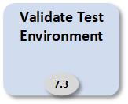
Verification and Validation
The level Verification and Validation required depends on the event
Completing the Integration Blocks provides sufficient information to determine if the test environment is valid for the test objects
Formal V&V will require completing the MIL-STD-2033 documentation

Slide 78
Event Readiness Review
Once the LVC Environment has been fully integrated and validated, a decision to proceed with the test must be made
The level of this decision is based on the Event, but is generally made by the Test Director
  The System Owner may be involved in the decision
For most events, an Event Readiness Review is conducted to determine if the environment is ready for execution
  The Test Conductor presents the technical readiness of the environment
    For large events, the Analysis lead reports of the readiness of analysis
  The Battlemaster presents the readiness of the scenario and the level of operational realism
If the Test Director is satisfied with the status the Event is conducted
If the Test Director is not satisfied, any deficiencies are documented and plan to address them is developed

Slide 79
Integration Blocks Summary
Blocks | Block Name | All Events | Live Event | Multi-Architecture Events | Cyber Events
Block 1 | Network Characterization, Collaboration Tools | Full Mesh Ping Network Characterization Phone Checkout Multicast transport Maximum Transmission Unit size Time-to-Live Distributed Simulation Architecture Coordination tool Training Access to coordination tools Network Monitoring Software Time Server Test routes through emulated network | Live system Interfaces | Verify each Architecture/SDEM Federation individually Integrate Architecture/SDEM enclaves at all sites Verify basic connectivity across all Architecture/SDEM enclaves Test each Gateway Verify there are no loops between enclaves | Verify Cyber systems network connectivity
Block 2 | System/Simulation Interoperability | Pairwise test all interfaces Weapon/target Pairs Verify Critical Enumerations Terrain Correlation Test all multicast addresses Full distributed Simulation Architecture Simulation initialization activity data Critical data collection requirements Limited analysis using collected data | Pairwise tests with live interfaces Terrain correlation of critical live areas | Fully test distributed sim architectures Test all gateway instances Verify gateway enumeration translations Verify all objects in Interoperability Intersection | Verify cyber threat tools Verify cyber data collection tools Test cyber threat tool messaging
Block 3 | Scenario Thread & Data Collection | Execute all scenario threads Perform full data collection Verify that all data required for any analysis is being collected Verify that required analysis can be performed Initialize the environment using the defined procedures | Operate live system threads Timelines for live systems Range safety | Verify data collection across all architectures Verify startup procedures for all architectures | Execute any cyber specific threads Perform cyber data collection Test cyber visualization tools
Block 4 | Full Scenario & Analysis | Execute each scenario to verify event timing Perform full data collection for each scenario Perform full data analysis for each scenario Verify that the scenarios can be executed in the allotted time Verify that the network can support the load of the full scenario Verify there is no extraneous network traffic | Live Vehicle Timing | Verify there are no data collection issues related to the multiple architectures | Repeat each verified scenario with cyber threats Perform full cyber data collection
Block 5 | Operator Training | Train all operators on the simulation or tactical systems Train data collection operators on required tools Train operators on processes they will be executing | Train Operators on use and safety |  | Train red threat operators
Block 6 | Role Player Training | Train role players on new equipment Train role players on new processes Verify scenario timing with role players | Role players trained and certified |  | Verify red threats Train Cyber defense team
Block 7 | Dry Runs | Dry runs of all scenarios | Live systems scenarios | Final verification on of multi architectures | Execute complete red threats
Notes:
This slide is only provided as a reference, it is not briefed

Slide 80
Learning Objectives
At the end of this tutorial, students will be able to:
  List the activities required to perform integration and execution of a distributed simulation event
  Describe an event in the terms required to plan the integration
  Select the integration activities required for an event
  Develop an outline for an integration plan for a distributed simulation event
  Describe the key roles in a distributed event integration and execution

Slide 81
Wrap-Up
A successful distributed LVC event depends on the completeness and correctness of the environment created
A well-defined process provides the structure for a verification and validation of the environment by ensuring that all required products and procedures are followed.
DSEEP provides a good process model for distributed simulation event integration
The goal of the process is to mitigate risk
  The activities in the process lessen the risk that the creation of complete environment will fail
  Following the validation activities in the process will reduce the chance of creating an incorrect environment that could have long reaching impacts

