Slide 1


A Comprehensive Introduction to Medical Simulation
Tutorial # 2105
Roger Smith, PhD, SoarTech Inc.
rdsmith@modelbenders.com
Danielle Julian, MS, AdventHealth
Danielle.Julian@AdventHealth.com
Alyssa Tanaka, PhD, SoarTech Inc.
Alyssa.Tanaka@soartech.com
Notes:
Welcome to this tutorial on Medical Simulation. We will provide an introduction to all of the different types of simulation and training devices that are used for medical simulation and training. Danielle and I both began our careers in defense simulation and then transitioned into civilian healthcare education, training, and simulation. So our experience and our exposure includes both domains.

Slide 2
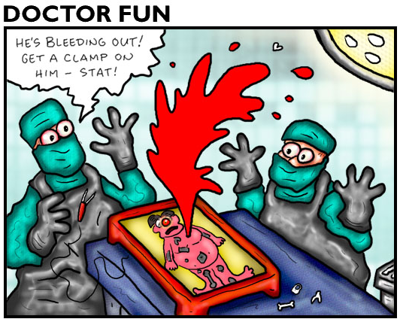
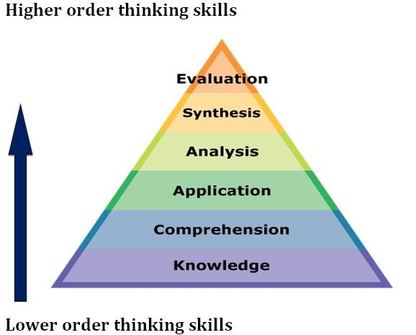
Learning Objectives
Evaluate the effectiveness of devices and programs.
Synthesize new simulation solutions.
Analyze the benefits of medical simulation systems.
Apply existing tools to selected problems.
Comprehend existing medical simulation systems and practices.
Knowledge of unique modifications for military medical training problems.
Notes:
The Learning Objectives for this tutorial are as follows:
Evaluate the effectiveness of devices and programs.
Synthesize new simulation solutions.
Analyze the benefits of medical simulation systems.
Apply existing tools to selected problems.
Comprehend existing medical simulation systems and practices.
Knowledge of unique modifications for military medical training problems.

Slide 3

History of Medical Simulation
Notes:
Section Divider
We will provide a short history to some of the most interesting devices and practices in the history of medical simulation. We want to show the roots of practices that are universal today.

Slide 4
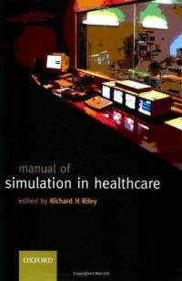
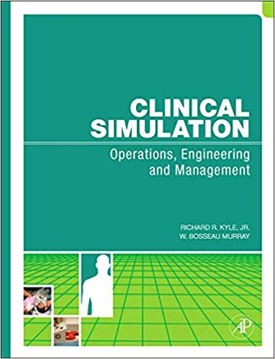
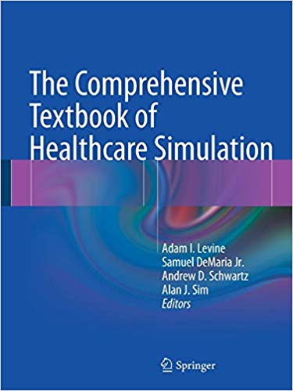
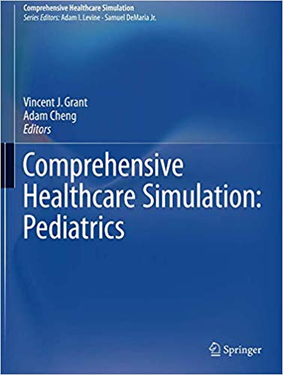
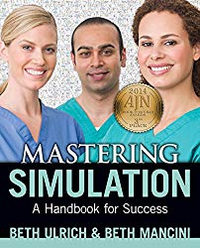
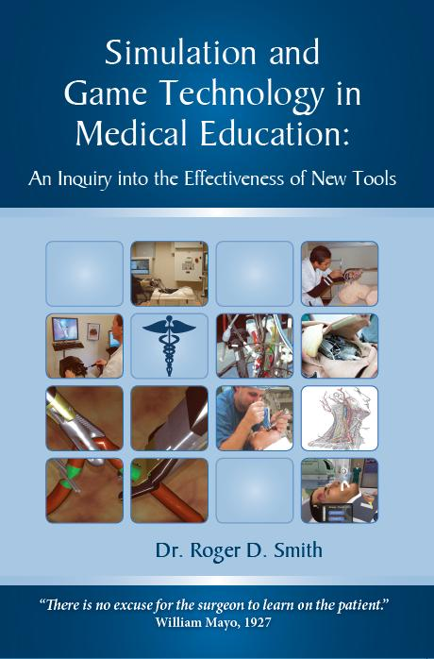
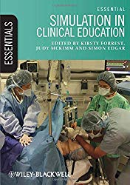
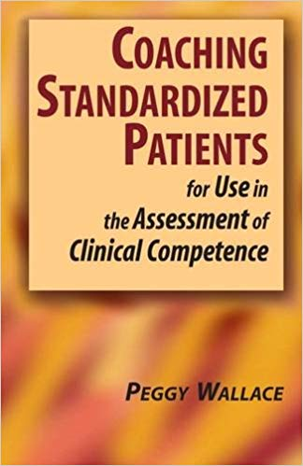
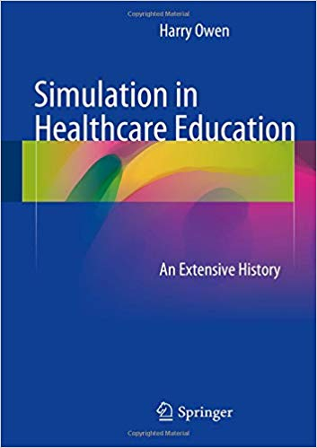
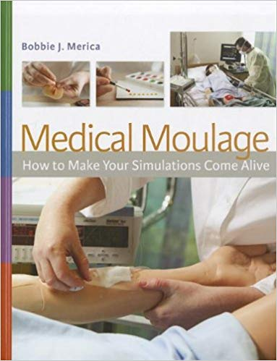
Plentiful Reference Books
Notes:
Defense simulation technology is very poorly recorded in published textbooks. All information remains in conference papers/presentations like I/ITSEC. But in healthcare, there are literally dozen of reference textbooks on every type of simulation-based training. Publishers and authors have embraced the subject and produced texts that sell only a few thousand copies, but enough to make it viable.
Every topic is covered:
Surgical simulation
Standardized Patients
Assessment
Moulage
Live Events
Facilities Design
Equipment Selection
History

Slide 5
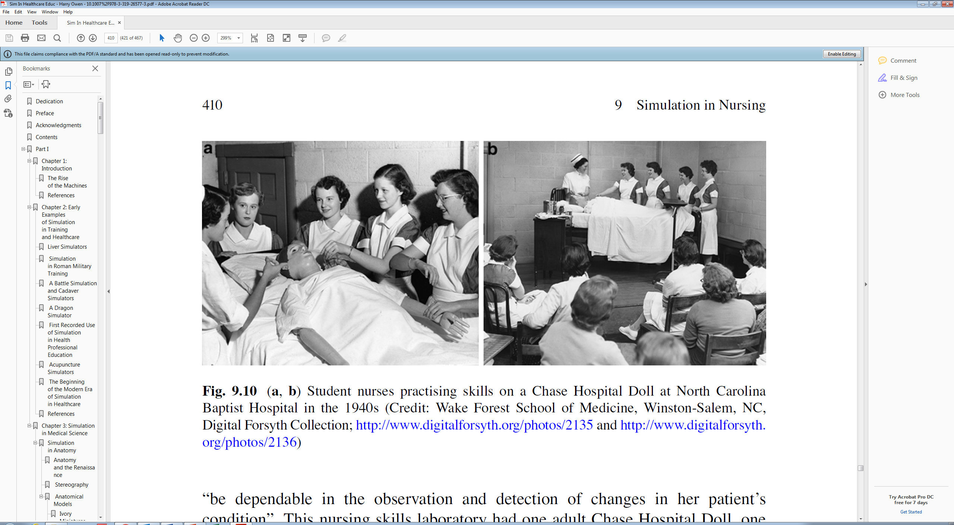
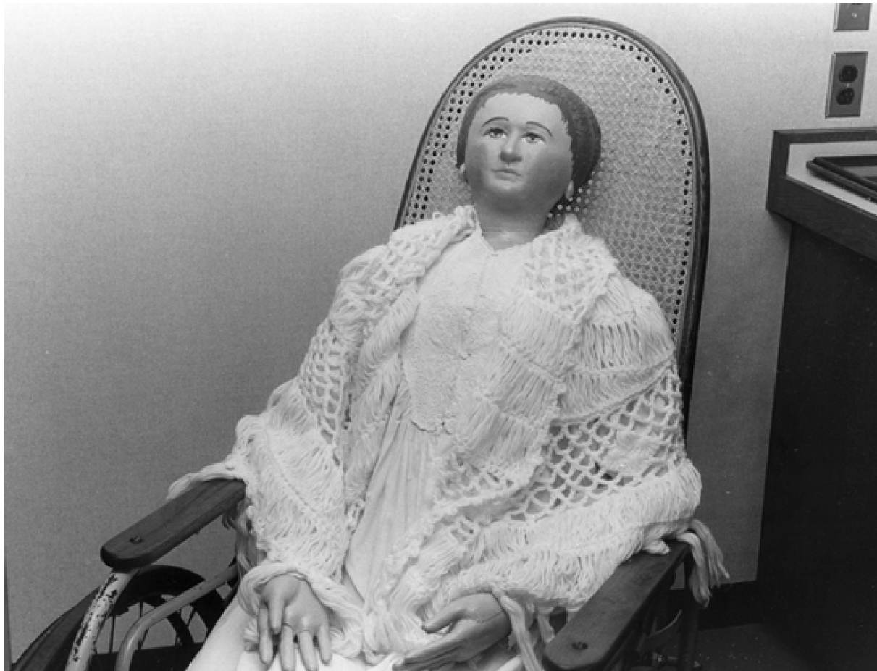
Josephine Chase Dolls
1911
Josephine Chase Doll
Hartford Hospital, CT
Owen H. (2016) Simulation in Healthcare Education. Springer.
Notes:
Josephine Chase dolls were created for training in the Hartford Hospital in 1911. Applied to:
Lifting
Turning
Changing clothes
Transfer
Application of dressings
Etc.
She was one of the originators of the manikin (non-responsive models).
Owen, page 407
https://basicmedicalkey.com/simulation-in-nursing/
Martha Jenks Chase (1851–1925) had started making dolls in 1889 as a hobby and gave them to children in the neighborhood. The doll business began when a buyer for a Boston department store happened to see one she had made and insisted she took an order [3, p. 114]. Dolls at that time were either imported from France and Germany and had fragile bisque heads and were typically overdressed in adult fashions or locally made folk dolls which had flat heads and were generally crude. The Chase dolls, made of stockinette and with round heads and raised, hand-painted facial features looked like babies and were soft to touch, durable and realistic. The Chase dolls were popular and production was scaled up they became available nationally through major department stores. The dolls were made in a workshop behind the Chase’s house in Pawtucket, Rhode Island which was known as the Doll House.
In 1910 Miss A. Lauder Sutherland, principal of the Hartford (CT) Hospital Training School for Nurses asked Chase to make an adult-sized doll with same characteristics of realism and durability as the play dolls that could be used for teaching nursing skills. Apparently, the school already had some straw-filled mannequins that were unsatisfactory [4, p. 85–86]. A prototype adult female doll was tested at Pawtucket’s Memorial Hospital [5] and the first “Chase Hospital Doll” was delivered to Hartford in 1911 where it was called Josephine Chase [6]. The height of the doll (5′ 4″) and proportions were based on Martha Chase. Several early Chase Hospital Dolls have survived including one at Hartford where she was conceived (see Fig. 9.5). Another, purchased in 1914 by the Auxiliary of JC Blair Hospital, Huntingdon, Pennsylvania is now on display there [7, p. 31].
https://www.yumpu.com/en/document/view/9736230/remembering-mrschase-national-student-nurses-association

Slide 6
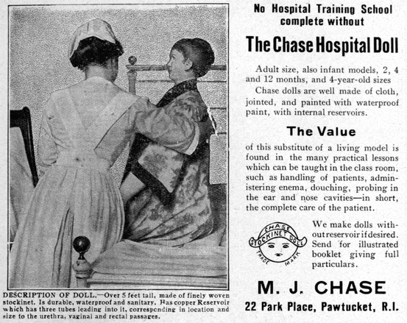
1921 Advertisement

Slide 7
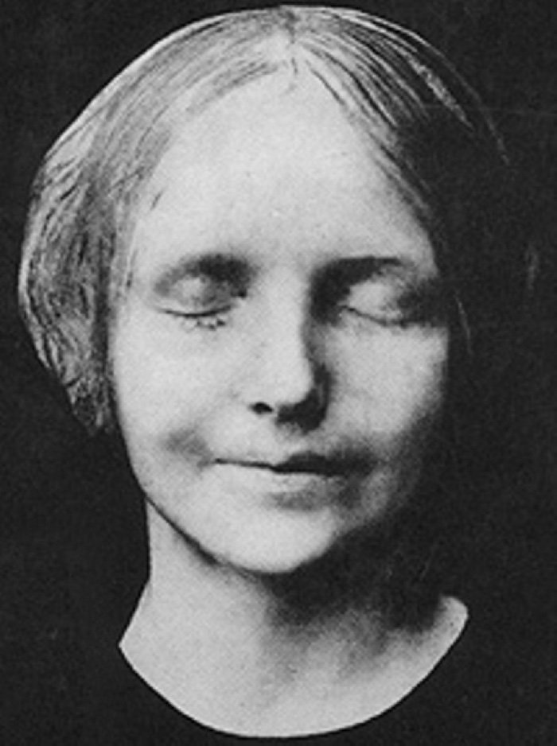
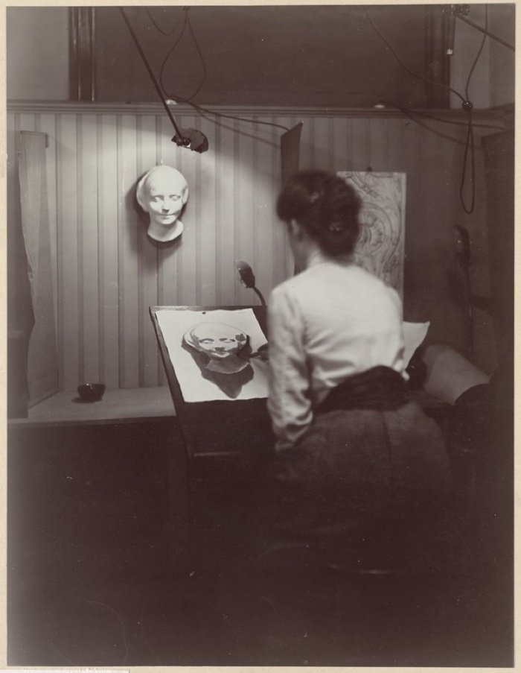
16-year-old Drowns in Paris
L'Inconnue de la Seine ~1880
(The Unknown Woman of the Seine)
Notes:
Due to this experience with soft plastics, The Norwegian Civil Defense called on Laerdal to design natural-looking imitation wounds for military training. In 1958, Åsmund Laerdal was approached by Norwegian anesthesiologist Dr. Bjorn Lind after learning from Dr. Peter Safar about the need for a lifelike manikin to train the new concept of mouth-to-mouth ventilation (3). Together, Åsmund Laerdal, Dr. Lind and Dr. Peter Safar developed the world’s first patient simulator, Resusci Anne, which was introduced in 1960.
Fascinating Article: https://www.sciencealert.com/how-dead-girl-paris-ended-up-most-kissed-lips-in-history-l-inconnue-de-la-seine-resusci-anne-cpr-annie-death-mask

Slide 8
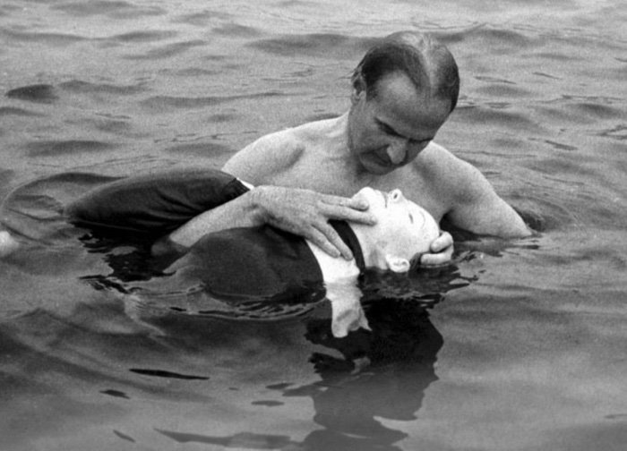
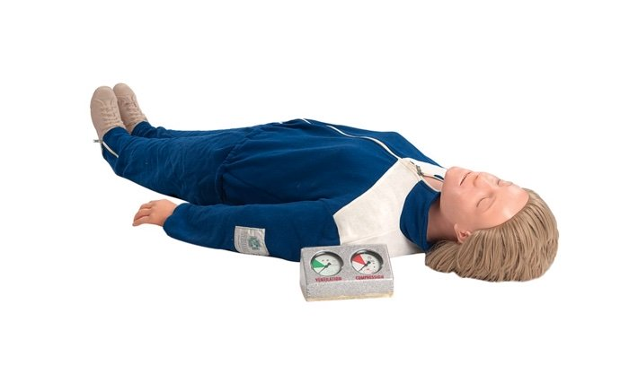
Asmund Laerdal
1960
Resusci-Anne
Notes:
Due to this experience with soft plastics, The Norwegian Civil Defense called on Laerdal to design natural-looking imitation wounds for military training. In 1958, Åsmund Laerdal was approached by Norwegian anesthesiologist Dr. Bjorn Lind after learning from Dr. Peter Safar about the need for a lifelike manikin to train the new concept of mouth-to-mouth ventilation (3). Together, Åsmund Laerdal, Dr. Lind and Dr. Peter Safar developed the world’s first patient simulator, Resusci Anne, which was introduced in 1960.
Fascinating Article: https://www.sciencealert.com/how-dead-girl-paris-ended-up-most-kissed-lips-in-history-l-inconnue-de-la-seine-resusci-anne-cpr-annie-death-mask

Slide 9
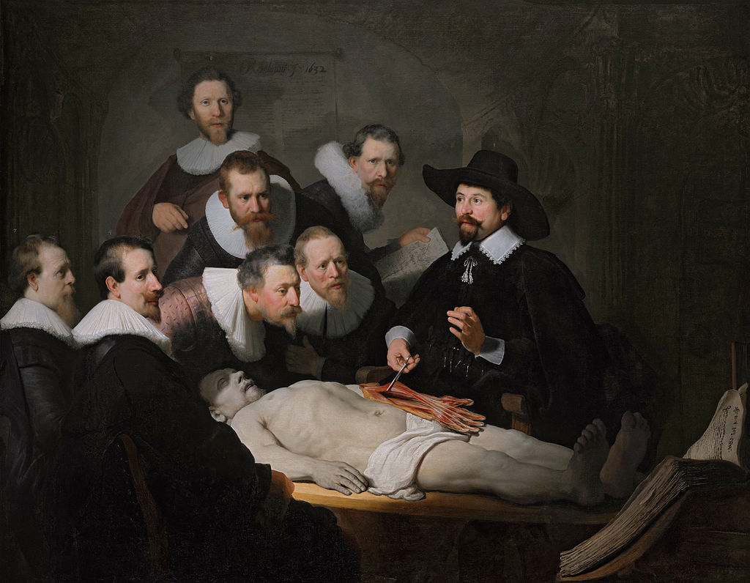
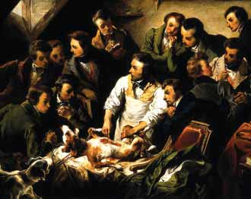
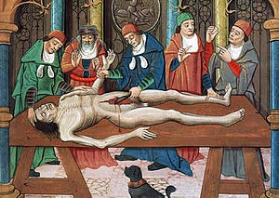
Cadaver & Animal Models
The Anatomy Lesson of Dr. Nicolaes Tulp, by Rembrandt va Rijn, 1632
Vivisection performed on a dog, by Emile-Edouard Mouchy, 1832.
Notes:
Criminals who were executed for their crimes were used as the first cadavers. From the 16th century until 1832, and the passage of the Anatomy Act, in Britain the only cadavers legally available for dismemberment came from executed murderers.
Cadavers as teaching tools
Animals are surrogates for humans. Hundreds of years have evolved a mapping of specific animals to specific human anatomy nd conditions.

Slide 10
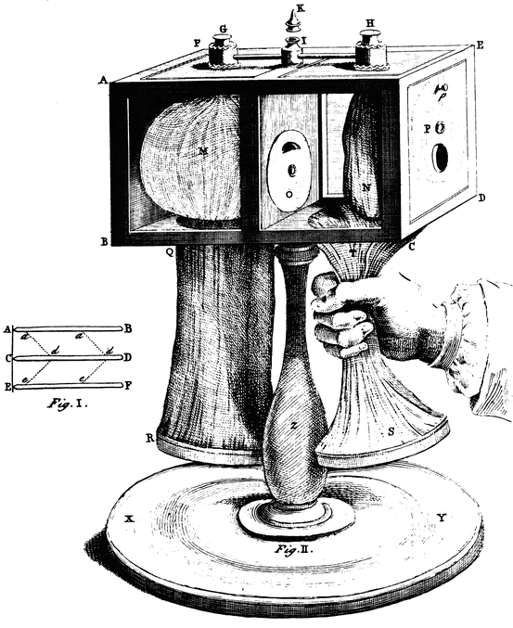
Early Mechanical Simulators
Circa 1740AD
“Breathing Venus” Lung Simulator by Benjamin Hoadly.
- Orfila Museum, Paris
Owen H. (2016) Simulation in Healthcare Education. Springer.
Notes:
A few days after Bucke visited an exhibition of anatomical models in London (see above), he visited a “wax works” where he saw a very life-like model of Napoleon lying on a couch and “breathing, ”As we approached, we perceived the chest heave. We were greatly startled at this at first; but becoming reconciled to the delusion, we stood still, some time noting the undulation, consequent upon the breathing. We then touched the body; when, taking our fingers away, we saw they had left indentations, which disappeared soon after, as if the substance, we had touched, were actual flesh. It was, indeed, in all external respects, a perfect emblem of breathing life. Where flesh should be it appeared to be flesh; where bone should, bone; where cartilage, cartilage. [80]
The Orfila Museum in Paris also had a breathing “Venus.”
Movement of the chest to signify breathing is now taken for granted in simulators. In the middle of the nineteenth century this caused surprise and wonderment.

Slide 11
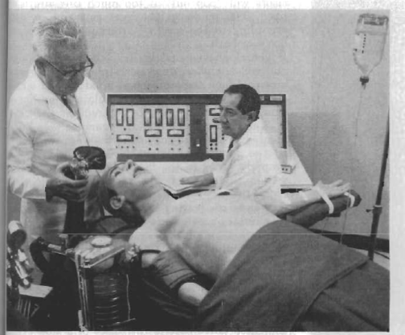
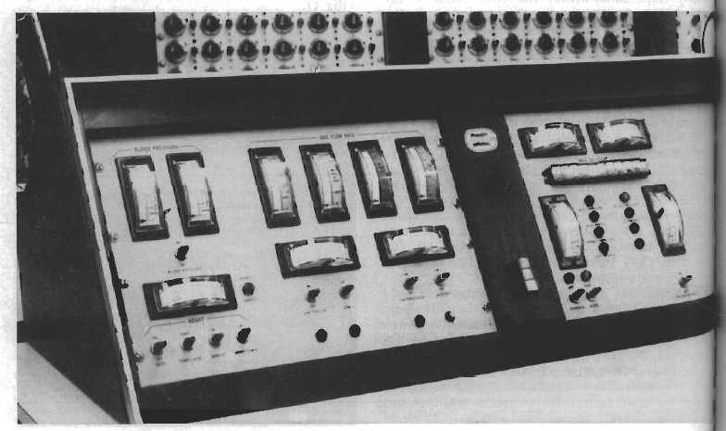
Computerized Mechanical Simulators
Sim One (1967):
Computers, Mechanics,
& Manikins
Respiration
Heartbeat, Pulse, and BP
Eye Blink
Physiologic Response to Drugs
Denson JS, Abrahamson S. A computer-controlled patient simulator. Journal of the American Medical Association 1969; 208:504–8.
Notes:
Leaping forward to a much more modern era, we find one of the first truly modern simulators to train the use of anesthesia.
The “Sim One” computerized mannequin is considered one of the first applications of computers to medical training. This system was conceived at an aerospace company in 1964, funded with a $272,000 grant from the Department of Education, and first demonstrated on March 17, 1967. Sim One delivered a mechanically animated, computer controlled mannequin that could receive and respond to two forms of gaseous anesthesia and four forms of injection. The “patient” breathed, had a heart beat, presented temporal and carotid pulse, and maintained blood pressure. The mannequin opened and closed its mouth, blinked its eyes, and changed these behaviors in response to anesthesia administered through a mask or a tube (Abrahamson, 1997). The device was enhanced in 1971 to deliver training in respirator application, endotrachael intubation, intramuscular injection, recovery room care, and the measurement of pulse and respiration (Hoffman & Abrahamson, 1975).

Slide 12
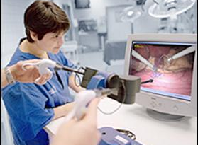
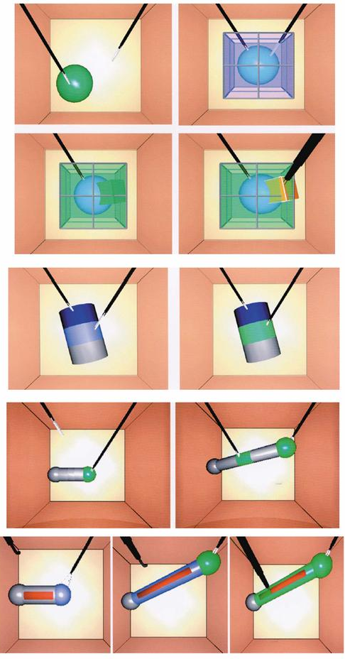
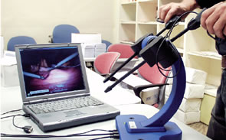
Virtual Reality Simulators
Circa 1995
Minimally Invasive Surgery Trainer – Virtual Reality (MIST-VR).
- Bob Stone, UK
Notes:
Minimally Invasive Surgery Trainer Virtual Reality (MIST-VR) and other VR simulators for laparoscopic surgeries have been shown to improve performance in the operating room (15,16). Today, VR simulators combine actual surgical tools used in the operating room with extremely realistic computerized images. These “hybrid simulators” mimic entire operations with high fidelity (17).
Minimally Invasive Surgical Trainer–Virtual Reality (MISTVR) device. The MIST-VR provides a crude visual representation of a laparoscopic field on a desktop computer screen and uses laparoscopic instrument handles with electronic sensors as the interface device. One of the 5 groups received no training between reassessments. There was improvement in performance with each of the practice methods, using time to completion as the outcome measure. There are 2 articles by Torkington et al29,30 that attempt to validate the MIST-VR device as a training tool. In the first case, 30 medical students were assessed and then received training on either the MISTVR device or by standard training methods or no training. Hand movements, distance, speed, and time were used as the outcome variables. Both methods of training showed advantage over no training, but there was no significant difference in performance following the 2 training methods.29 The same group tested 13 surgical trainees who either trained with the MIST-VR or did not train and was able to show that there is a learning effect associated with the use of the simulator compared with no training.30 Jordan et al31 tested 32 participants with no laparoscopic experience on a simulated cutting task under normal laparoscopic visualization, before and after training with the MIST-VR, a video-box simulator, or no training. Once again, training showed statistically significant benefit over no training, but there was a trend for a greater degree of improvement using the MIST-VR. Strom et al32 support the use of simulators as a pedagogical tool for medical students based on observed improvement during practice on 2 distinct simulators, with and without haptic feedback. An article by Gallagher et al33 measured the performance of 210 surgeons who had performed at least 50 laparoscopic cholecystectomies, on both the MIST-VR simulator and a mechanical box trainer. They found that 12% of those tested had performance scores more than 2 standard deviations from the mean. Because the cohort was identified by self-reporting on a questionnaire and because no reference measurement was available on their actual laparoscopic performance, construct validity could not be ascribed. However, the study could be interpreted to reflect significant variation in the measurable skills of even experienced surgeons or to reflect a limitation in the ability of the simulators to accurately measure the skills of experienced surgeons.

Slide 13
Medical Simulation’s Response to COVID
Notes:
Section Divider

Slide 14
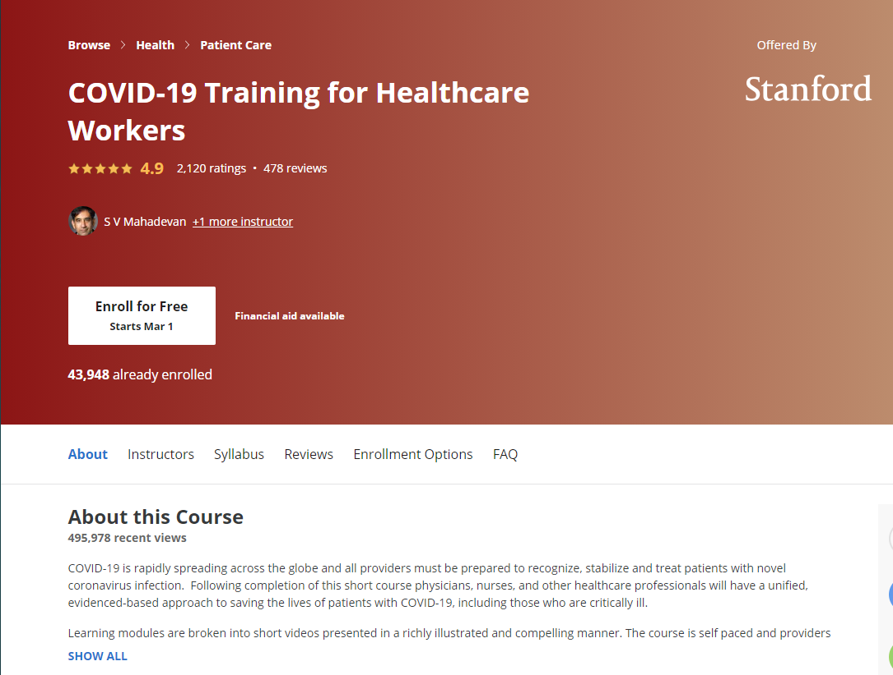
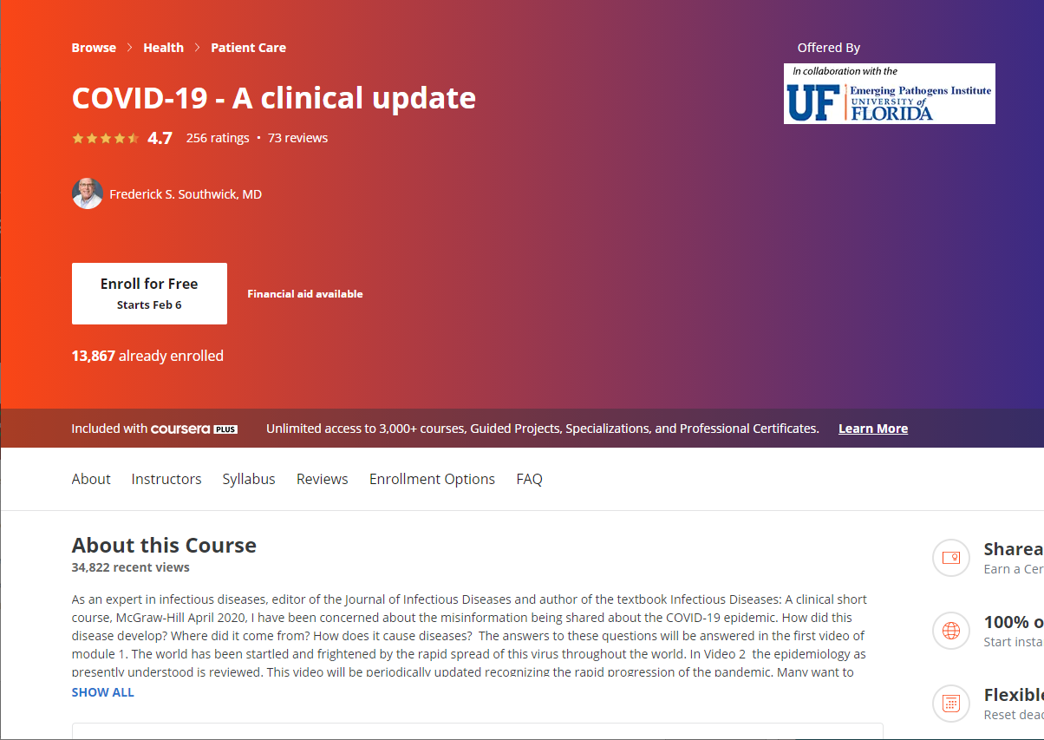
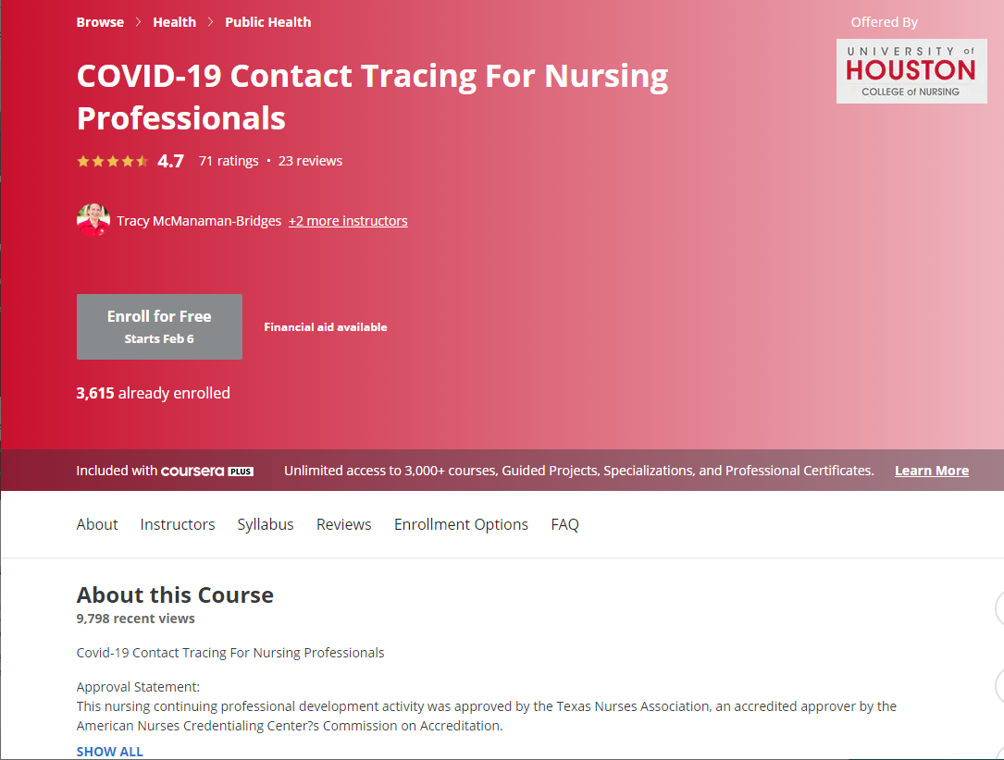
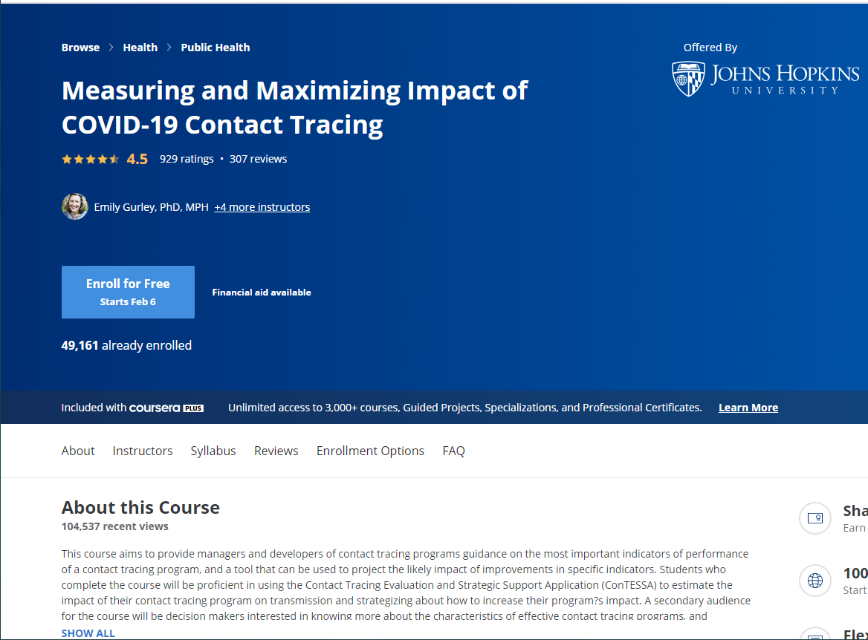
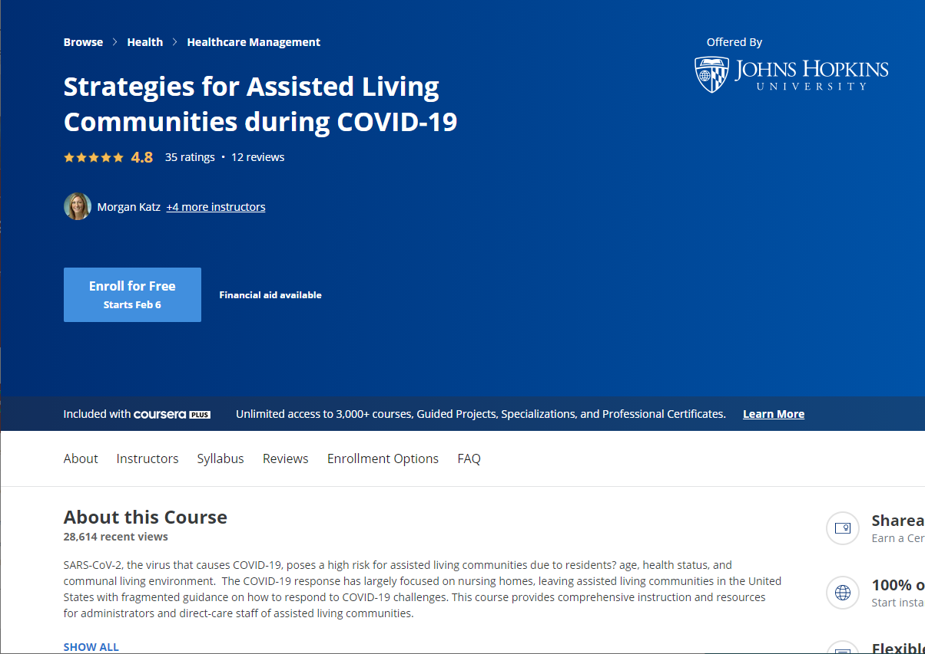
Courses on Coursera by Leading Universities
Notes:
The instant response to the COVID pandemic resulted in a number of very reputable institutions creating training materials and delivering them for free use to the world. One place where these online courses appeared was Coursera.com – where Stanford, Johns Hopkins University, University of Florida, University of Houston, and others all published instructional materials with video, text, and evaluations at no cost to those who needed it.

Slide 15
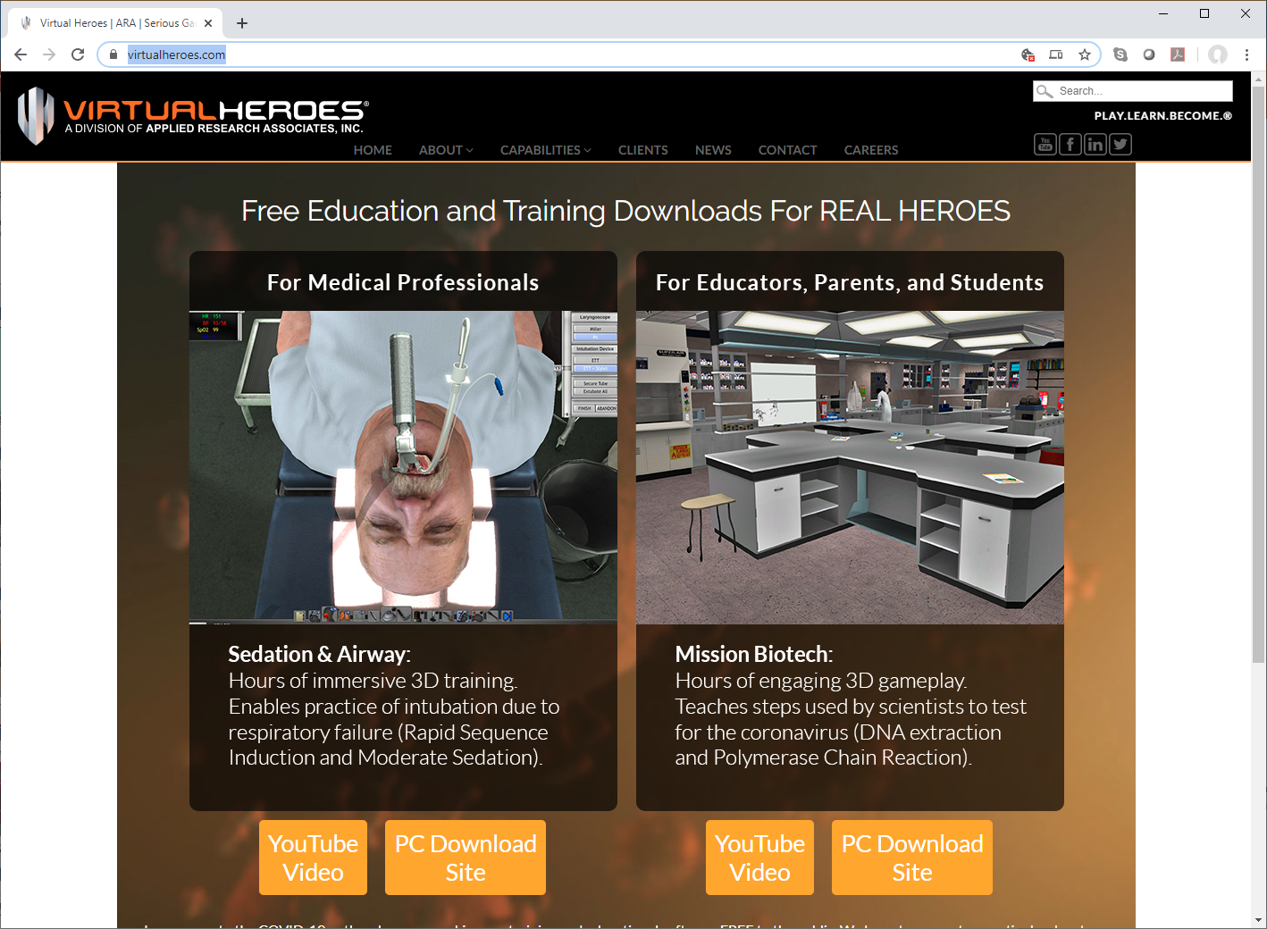
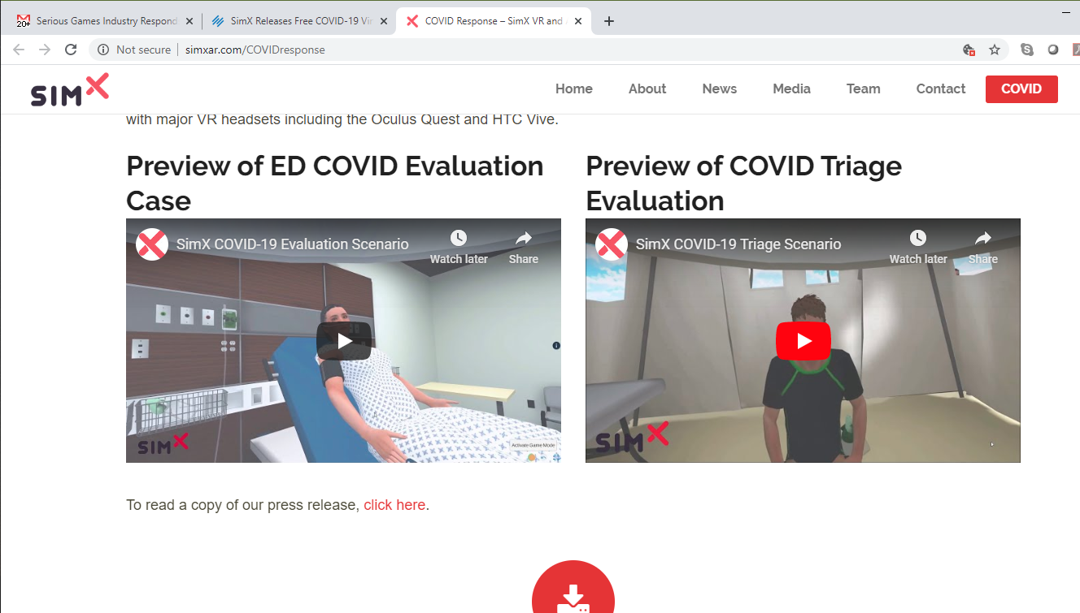
Serious Games for COVID Treatment
Relevant skills and education in existing serious games.
Open access in a time of crisis.
Virtual Heroes / ARA Inc.
http://www.virtualheroes.com
SimX Inc.
http://www.simxar.com/COVIDresponse
Notes:
Virtual Heroes posted two Serious Games on their home web page to allow anyone to download games that contained content relevant to COVID. Sedation & Airways is a training game which teaches the fundamentals of assisting patients with breathing problems. Mission Biotech is an educational game that explains how biotech is used to invent antiviruses for contagions like COVID.

Slide 16
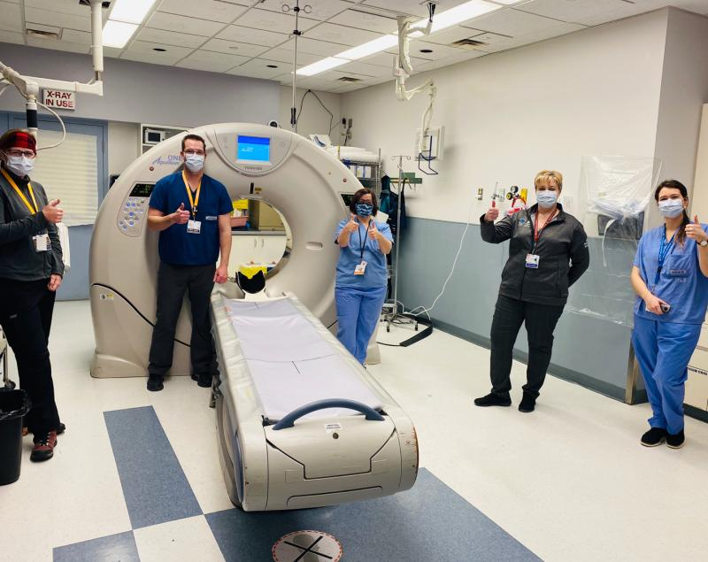
Hospital CT Treatment Sim during COVID
Real-time creation of new simulated training programs.
Lead time to rehearse with hospital staff while crisis was in Italy, before impact in US & Canada
  Ottawa Hospital, Department of Radiology
Notes:
In-hospital teams immediately created lie training scenarios for their staff. Most hospitals had a time buffer between the crises that occurred in China, Italy, and NYC before it arrived in their community. So, they had the time to create and use these training programs before the stress test arrived at their hospitals.

Slide 17
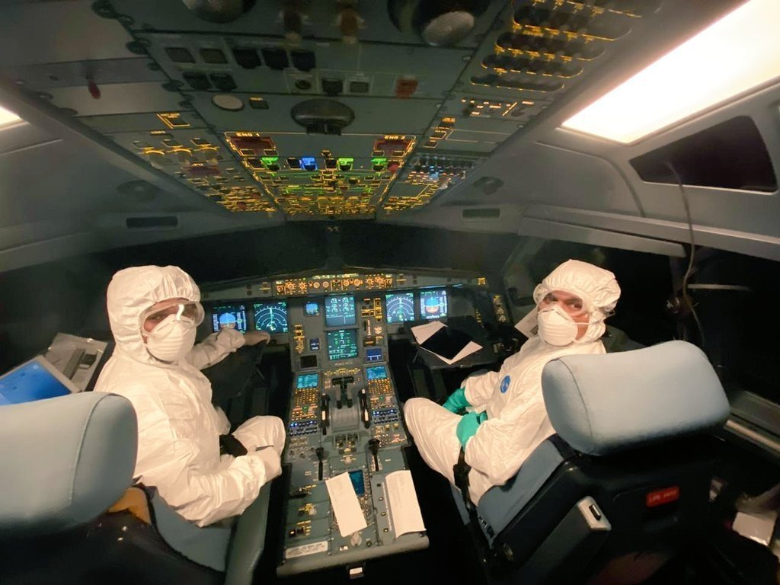
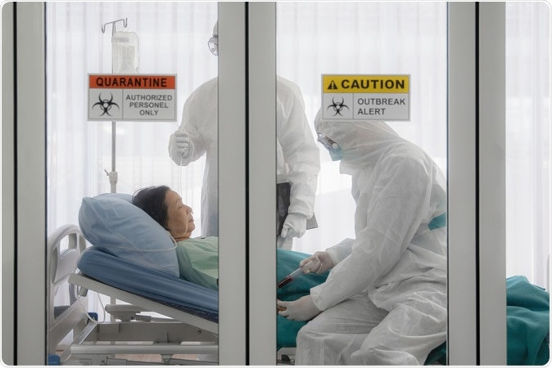
COVID-19 Training Events
Industries creating COVID-19 Training Events
  Airlines
  Hospitals
  Government Agencies
  Elder Care Facilities
Focus
  Reinforce or enhance sterility, isolation, diagnosis procedures
  Leverage lessons from previous SARS, MERS, Ebola training
Notes:
Frontline industries like hospitals, airlines, hotels, senior care facilities, and government agencies are developing COVID training programs. These all began in February when it was clear the virus was on its way, but not here yet. Then when March arrived, most orgs were busy putting their plans into practice, so the creation of live simulation curricula was put on hold. [We will update this description in June before slide submission, to include the latest developments.]

Slide 18
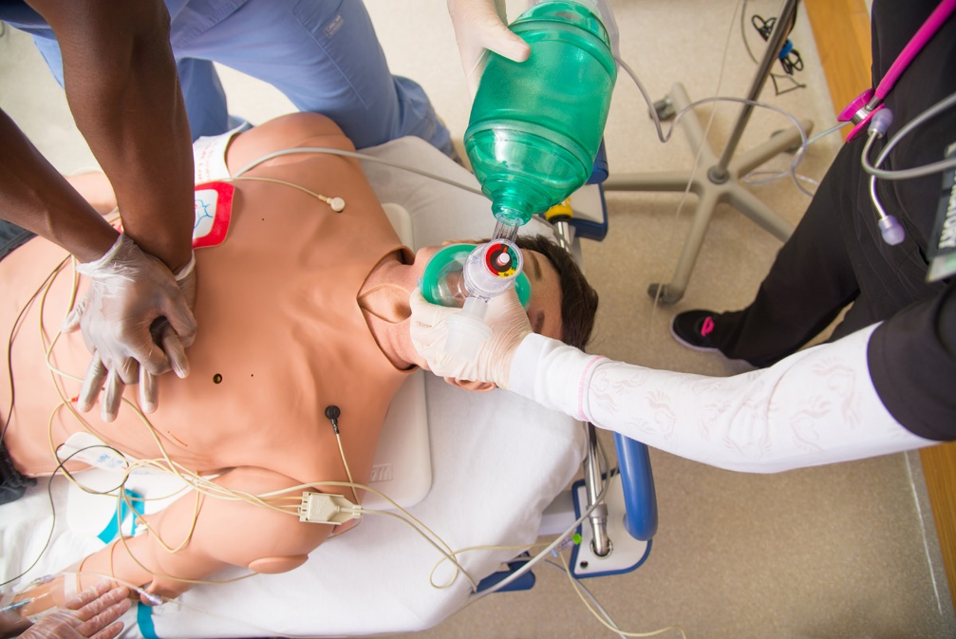
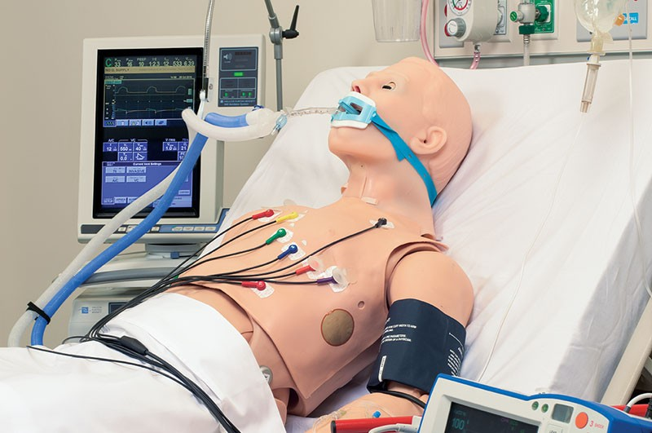
Manikin Training for COVID
Practice with unique sterility requirements
Program existing manikins to exhibit COVID-19 symptoms
  Create alarms on specific conditions
  Rehearse treatment procedures
Examples:
  CAE Health: https://caehealthcare.com/covid19/
  Laerdal: https://www.laerdal.com/us/information/coronavirus-covid-19-resource-center/
Notes:
Companies like CAE Health and Laerdal quickly created COVID training modules that could be used with their existing manikins in the field. These extended the capabilities and metrics that already existed in the manikin and in the control software. Future versions will contain COVID-specific programming which will be more accurate. But these changes created an immediate training capability.

Slide 19
Simulator Taxonomies
Notes:
Section Divider
Multiple organizations like the American College of Surgeons, and authors like Richard Satava, have sought to create a high-level taxonomy for the medical simulator domain. The IITSEC community is very familiar with the LVCG taxonomy, which has informed the medical simulator domain but is not quite a perfect fit for it.

Slide 20
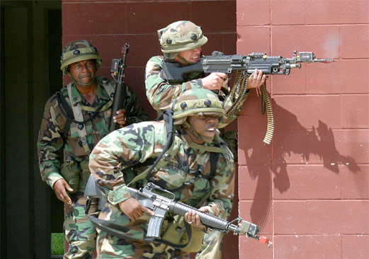
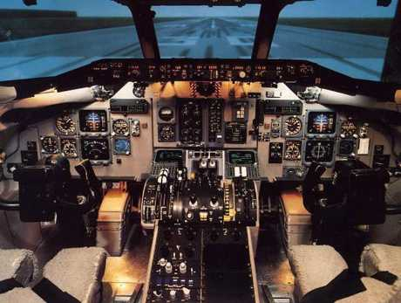
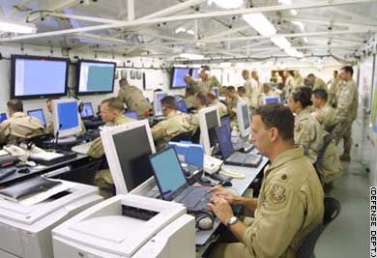
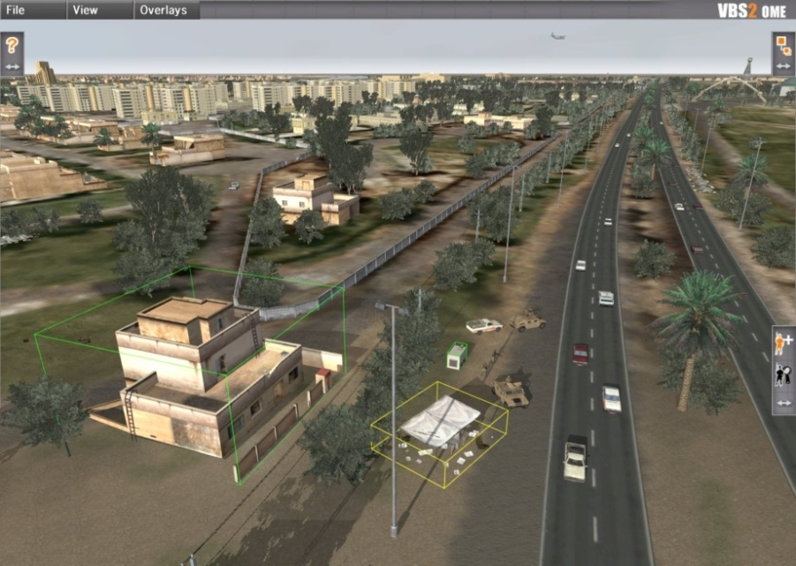
LVCG Military Simulation Taxonomy
Live
Virtual
Constructive
Games
Gorman, P. (1991). “The Future of Tactical Engagement Simulation.” The Proceedings of the 1991 Summer Computer Simulation Conference. The Society for Computer Simulation, San Diego, 1991. 1181-1186.
Notes:
Military LVCG taxonomy was very useful for organizing programs, funding, engineering & science in military MS&T.
A similar model for medical simulation would be very useful to a much larger community. Such taxonomies have been proposed.
However, Live, Virtual & Constructive are not the appropriate categories for the medical domain. It will require a new perspective.

Slide 21
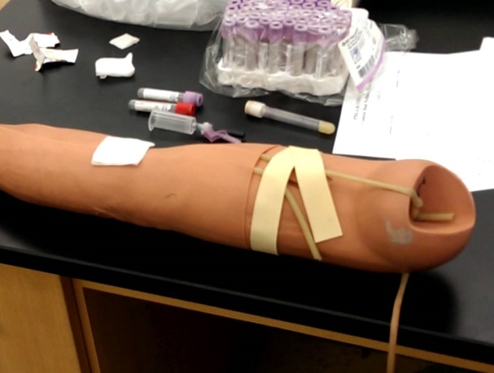
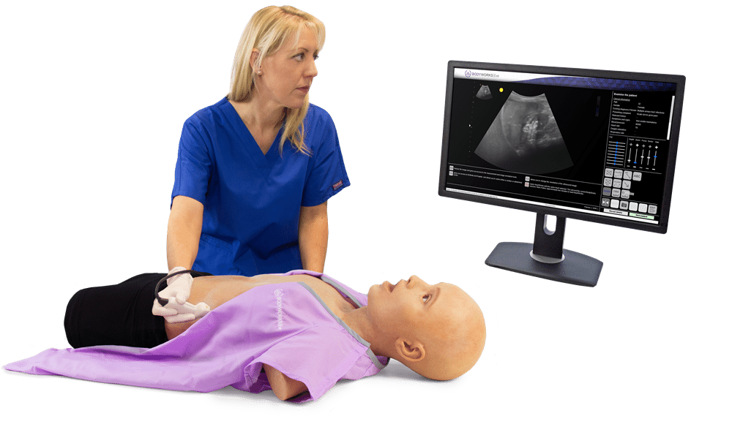
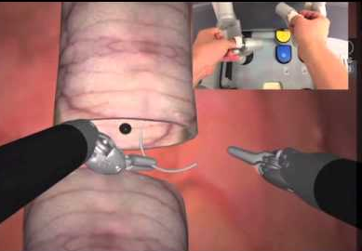
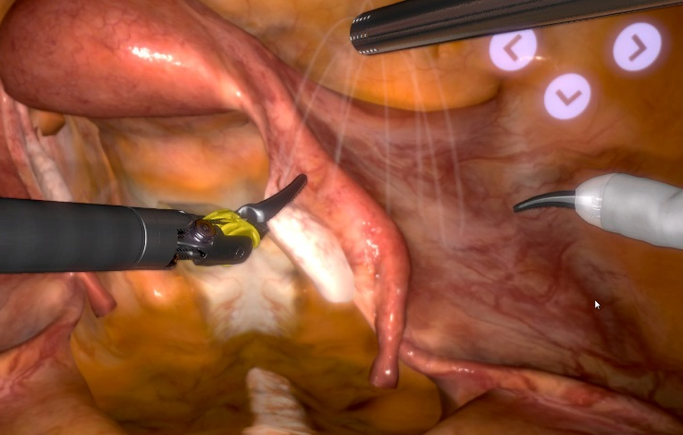
Progressive Complexity
Precision
Placement
Simple
Manipulation
Complex
Manipulation
Integrated
Procedure
Needle placement
for blood draw
Ultrasound wand
manipulation
Anastomosis suturing
Multiple steps
of hysterectomy
Fits very specific types of treatment
Satava, R. (2001). Surgical education and surgical simulation. World J. of Surgery, 25.
Notes:
Richard Satava’s taxonomy is based on level of complexity and quickly leads into surgery. It is a good description of the progression of complexity, but not broad enough for all of the modes that are used in healthcare simulation.

Slide 22
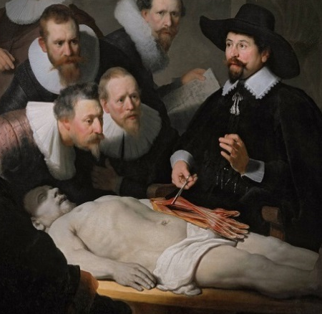
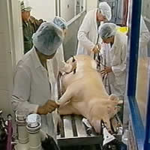







Taxonomy of Mechanism and Application
Biological
Mechanical
Virtual
Smith, Julian. (2018) A Comprehensive Introduction to Medical Simulation. 2018 I/ITSEC Tutorial.
Notes:
Our own original taxonomy begins with 3 categories - Biological, Mechanical, and Virtual which roughly emerged sequentially as the technology became available to bring each into existence.
Smith, Julian. (2018) A Comprehensive Introduction to Medical Simulation. 2018 I/ITSEC Tutorial.

Slide 23
Taxonomy of Mechanism and Application
Cadaver
Animal
Patient
Live
Team
Biological
Standardized
Mannikin
White Box
Part
Task
Mechanical
VR
Games
Virtual
Two Layers/Dimensions.
Useful for organizing products.
Smith, Julian. (2018) A Comprehensive Introduction to Medical Simulation. 2018 I/ITSEC Tutorial.
Notes:
Our own original taxonomy begins with 3 categories - Biological, Mechanical, and Virtual which roughly emerged sequentially as the technology became available to bring each into existence.
Smith, Julian. (2018) A Comprehensive Introduction to Medical Simulation. 2018 I/ITSEC Tutorial.

Slide 24


Healthcare Simulation Modalities
Virtual Reality
Simulation
Part Task
Trainers
Human
Patient
Simulator
Hybrid
Simulation
Standardized
Patients
Chiniara, G, et al. (2013) Simulation in healthcare: A taxonomy and a conceptual framework for instructional design and media selection, Medical Teacher, 35:8
Notes:
This taxonomy is simpler with 4 categories that cover most devices and practices very clearly. It also acknowledges that most uses of simulation include more than one modality or class of device. This is the taxonomy most likely to fill the same role that LVCG does for the military. Perhaps called VPHS.

Slide 25
Learning Theory
Notes:
Medical Education and Simulation is generally grounded in learning theory to a larger degree than is often found in military simulation.

Slide 26
Progression Through Education
Didactic Learning
Partial Task Trainer
Human Patient Simulator
Team Training
Aligns with Satava’s Taxonomy of Complexity
Notes:
Simulation based learning experience in healthcare aim to allow deliberate hands on practice of clinical skills and behaviors throughout the professional life of a health care provider. This learning experience using simulation is using an array of approaches from task trainers to high fidelity simulators, standardized participants and interprofessional experiences
What is the primary purpose of simulation-based learning experience in health care? With deliberative and repetitive practice of a knowledge, skill or behavior with assessment, reflection and feedback, allow information to be accumulated and stored in long-term memory and free up working memory to focus on new and unexpected in the practice setting

Slide 27

Experiential Learning Theory
Engage students in a process that enhances learning.
Draw out students’ prior beliefs and ideas.
Cycle between reflection and action.
Learning happens in interactions between the person and the environment.
Learning is more than memory; it also involves reasoning, feeling, perceiving, and behaving.
https://www.growthengineering.co.uk/
what-is-experiential-learning/
Kolb, A.Y. & Kolb, D.A. (2005). Learning Styles and Learning Spaces: Enhancing Experiential Learning in Higher Education. Academy of Management & Learning Education, 4(2), 193-212.
Notes:
Engaging students in a process that enhances learning.
Feedback on the effectiveness of their learning efforts
Focus on the process, not the outcome.
Students have prior beliefs and ideas.
Draw out these beliefs & ideas, re-examining & re-testing them against the topic
Forming new ideas will lead to learning
Learning is a process which cycles between reflection and action,
“Conflict, differences, and disagreement are what drive the learning process”
Learning happens in interactions between the person and the environment
Learning is more than memory; it also involves reasoning, feeling, perceiving, and behaving.

Slide 28

Bloom’s Taxonomy of Learning
Maturity & Competency
Bloom, B. S.; Engelhart, M. D.; Furst, E. J.; Hill, W. H.; Krathwohl, D. R. (1956). Taxonomy of educational objectives: The classification of educational goals. Handbook I: Cognitive domain. New York: David McKay.
Notes:
Bloom’s taxonomy is used to guide the creation of objectives in a hierarchal order from simple to complex and concrete to abstract. Simulation as a learning strategy is focused on the higher order learning categories of Bloom’s taxonomy. Higher-order thinking involves the learning of complex judgmental skills such as critical thinking and problem solving, which are the analysis, evaluation and creation level of taxonomy. Boom’s Taxonomy provides a framework for developing and leveling objectives to meet expected outcomes. The taxonomy classifies three domains of learning: cognitive, psychomotor, and affective.

Slide 29

Miller's Taxonomy of Clinical Assessment
Miller GE, The Assessment of Clinical Skills/Competence/Performance: Academic Medicine. 1990:65(9): 63-67. Adapted by Drs. R. Mehay & R. Burns, UK (Jan 2009)
Notes:
When it comes to medical education, we are more interested in what our learner’s can do than what they know. To that end, Miller (1990) created a four-level framework on which to assess clinical competency. The levels are associated with it’s assessment tool. The base of the pyramid is the knowledge of how to perform a skill. Knowledge acquisition can be assessed by using traditional testing such as multiple choice questions. Knowledge is a prerequisite for the next level of knowing how. This is the application level of the knowledge, which can be demonstrated in case presentations, however it still at the cognition level. Then showing how within a simulation and finally transferring this skill to clinical practice.
Simulation in healthcare is used in a variety of modalities that can affect individual, team and organizational, and system levels. However, valid and reliable tools are necessary to measure instructional objectives. High-quality simulation begins with learning objectives that are the guiding tools to facilitate achievement of simulation-based outcomes. These objectives focus on what’s to be evaluated whether individual or team performance.
In a similar manner to Bloom’s taxonomy the pyramid helps understand what it is that we are testing and asks the question as to whether our assessments are valid. It makes us strive to make our assessments as valid as we can. The higher we assess on Miller’s pyramid the more valid the assessment.

Slide 30
Constructive Medical Simulation
Notes:
Constructive simulation exists in medicine but is primarily a tool for business management or future prediction, not a tool for training leaders.

Slide 31

Command Center Operations & Training
AdventHealth Command Center, Orlando, FL
Notes:
Major hospital systems are beginning to install command centers which collect, monitor, and act on real-time data from all hospital campuses and departments. The data identifies capacity usage across the system and is used to direct patients and clinicians to the point of need. These centers also participate in disaster training scenarios within the system and in cooperation with city and county exercises.

Slide 32

Hospital Efficiency
Traditional Discrete Event Simulation with Animation
Study:
Physical Layout
Clinical Staffing
Admin Staffing
Patient Influx
Process Changes
Facility Loss
Notes:
There are a large number of Discrete Event Simulation tools that are commercially available. These are used to play product flow through factories, customers through a theme park, design the layout of bank or drive-thru. These tools work equally well for hospitals in which questions about the physical layout of an ER or patient floor need to be studied, clinical staffing levels evaluated, the impacts of administrative staff on patient throughput, changes in patient arrival rates, and the effects of losing power in part of the facility. These are analytical rather than training tools.

Slide 33

Past Data for Future Simulation
JHU COVID Dashboard shows the past. Simulation predicts the future.
https://coronavirus.jhu.edu/map.html
Notes:
Unfortunately, we have all become too familiar with the JHU Dashboard tracking COVID worldwide. But this renders data about the past, what has already happened. The data can be very useful for creating models to study the past and perhaps predict the future, but the dashboard is not a model itself.

Slide 34

Crush Model: Simple Agents
Simple assumptions
Clear animation
Effective communication
Limited fidelity
JHU APL COVID Crush Model
https://ecals.cals.wisc.edu/2020/05/04/apl-debuts-covid-crush-virus-transmission-simulation-game/
Notes:
JHU and other organizations have created a number of dynamic simulations of the spread of the disease. This Crush model is an early and simple representation of transmission in which agents have a probability of infecting, a rate of dying, and a rate of recovery. It is very simple, but also useful in explaining contagion and transmission. More complex models include more specifics about the agents/people as well as the density of population and patterns of movement.

Slide 35

EpiSim: More Complex Variables Added
Video: https://youtu.be/jvrvHpxaEsI
Source Code: https://github.com/irawinder/EpiSim
Notes:
EpiSim was a much more specific model of the spread of a pandemic, identifying different types of spaces in the geographic environment and six different categories of people. The model was originally developed for transmission of the common cold, but quickly adapted to COVID.

Slide 36

CDC Mathematical Modeling
https://www.cdc.gov/coronavirus/2019-ncov/covid-data/forecasting-us-previous.html
Notes:
Data, such as that collected by JHU, can be used to create models like this one at the CDC which predict future infection levels based on data about the past and assumptions about current behaviors. The cones of deviation are similar to those found in hurricane track models.

Slide 37
Military Medical Simulation
Notes:
Now we want to illustrate some of the unique simulators and devices that are used for military MedSim.

Slide 38

Military Medical Treatment Chain
Notes:
The military medical treatment chain is defined as having 5 unique roles or steps in the process. Role 1 is the point of injury on the battlefield. Role 2 is slightly removed to a Forward Surgical Team, away from the threat of direct fire, but still near the field of engagement. Most military-specific simulation devices are focused on the injuries and treatment in Roles 1 & 2. Roles 3-4-5 are similar to the treatment that occurs within a civilian hospital system, from the ER, to the OR, to extended treatment. For these roles, the military largely allows the traditional civilian methods and devices for training and rehearsal to be used.

Slide 39
Military Medical Treatment Chain
Military-specific Training & Devices
Rely on Civilian Training & Devices
Notes:
The military medical treatment chain is defined as having 5 unique roles or steps in the process. Role 1 is the point of injury on the battlefield. Role 2 is slightly removed to a Forward Surgical Team, away from the threat of direct fire, but still near the field of engagement. Most military-specific simulation devices are focused on the injuries and treatment in Roles 1 & 2. Roles 3-4-5 are similar to the treatment that occurs within a civilian hospital system, from the ER, to the OR, to extended treatment. For these roles, the military largely allows the traditional civilian methods and devices for training and rehearsal to be used.

Slide 40


Medical Simulation Training Centers
Notes:
The Army stood up dozens of MSTC’s, almost starting from scratch, in the early 2000’s. These centers were responses to the casualties occurring in OEF and OIF which could be addressed by frontline medics and peer battle buddies. The centers literally trained ten-of-thousands of soldiers every year. The primary focus of these centers was on live events with manikins and moulage. These were affordable and fieldable without the complexity of computers and the power, facilities, and staff required to support them.

Slide 41



TC3 Simulation
USA
France
Notes:
Initial TC3 games applied the graphic engine and interface methods directly from entertainment games to the MedSim domain. These were a great starting point from which to begin to understand the requirements of the domain and the best ways to address it with 3D rendering. Learning curve has been very rapid, especially when you recognize that this mode has not had the advantage of 200 years of prior experience as with manikins and biological tissue modes of simulation.

Slide 42



TC3 Simulation
Increasing graphic realism, Improved VR interface
Notes:
Graphic realism has improved significantly, carried by improvement to computer gaming engines like Unity and Unreal. These Serious Games are also beginning to integrated VR headsets and gloves to move the human interface away from the keyboard and mouse and toward something that is much more natural, realistic, and with better transfer for learning to real world activities.

Slide 43


CBRN & HAZMAT Training
Direct application of Military Live Training model to MedSim
Notes:
CBRN and HAZMAT training follow the model created for live combat training, which includes mock environments, real protective equipment, and real medical treatment equipment. Civilian and military events are designed and carried out very similarly, differing mostly in their uniforms and host locations.

Slide 44
Standardized Patients
Notes:
Standardized Patients are one form of “Live” simulation. Real humans pretending to have a condition for diagnosis and treatment. It can be very difficult to pretend to have a heart murmur, hence the need for both the human and technology to make the training realistic.

Slide 45


Standardized Patient Modes
Human as concerned family
Human as living model
Human as host for moulage
Notes:
Dr. Howard S. Barrows, M.D., a neurologist and medical educator, created the first standardized patient in 1963 for his third-year neurology clerkship while teaching at the University of Southern California. He worked with a physician who spent an hour with every medical student, watching them work up a patient from beginning to end. By directly observing the students, Barrows and the physician realized that a number of skills were being incorrectly performed because students were unaware of the inaccuracy. Barrows also experienced difficulties when he tried to find patients with specific findings for Psychiatry and Neurology board examinations for and realized that some findings could be simulated. Thus Barrows was inspired to create his first "simulated patient." The case was based on an actual patient Barrows had treated, so he knew all the signs and all the symptoms the patient would have to exhibit for an accurate portrayal. He chose a case that could be reproduced for every student the same way. It was also important to Barrows that the person who represented the case had the knowledge to record what happened in each encounter. To make the process easier for the standardized patient (SP), Barrows created a checklist for the SP to complete at the end of each encounter. Initially, he monitored the SP and the students but eventually the SP became primarily responsible for recording what happened during the encounter.
The birth of the simulated patient came out of a need for a more comprehensive method to evaluate the clinical skills of third-year medical students. In the 1960s, Barrows’ innovative teaching and assessment methodologies were not widely accepted amongst his peers. But he believed that his concept was working and that his method provided an objective clinical measure to evaluate students.
Paula Stillman, M.D., a pediatrician, has also been significantly responsible for establishing SPs as both a credible teaching and evaluation methodology. In the early 1970s when she was a pediatric clerkship director at the University of Arizona in Tucson, she started using "simulated mothers" as a technique for teaching interviewing skills to medical students. These simulated mothers gave histories of common pediatric complaints to the students when they were interviewed. Stillman believed she could develop a better instrument for teaching and assessing both the content and the process of medical interviewing. She developed an instrument that was based on behaviors that could be used to give feedback to the students. The Arizona Clinical Interview Rating Scale (ACIR) or Arizona Scale which we use at the University of Kentucky was the first behaviorally-anchored Likert scale to assess medical interviewing skills. Stillman taught the simulated mothers complicated histories involving several children, how to use the checklist to grade the student, and how to give feedback to the students on their interviewing skills. https://meded.med.uky.edu/origin-standardized-patients-united-states
Simulated patients (SP) are extensively used in medical and nursing education to allow students to practice and improve their clinical and conversational skills for an actual patient encounter. SPs commonly provide feedback after such encounters. They are also useful to train students to learn professional conduct in potentially embarrassing situations such as pelvic or breast exams. SPs who perform such training are given titles such as Gynecological Teaching Associate (GTA) or Urological Teaching Associate (UTA), as covered in more detail below. SPs are also used extensively in testing of clinical skills of students, usually as a part of an objective structured clinical examination. Typically, the SP will use a checklist to record the details of the encounter.
SPs can be further trained as teaching associates. A Standardized Patient Teaching Associate is a person who acts as both instructor and patient, utilizing his/her own body to instruct and evaluate in the technique of the head-to-toe physical exam in a non-threatening, standardized, positive encounter.

Slide 46



Human/Manikin Hybrid Simulators
Healthcare’s equivalent of the trauma cut suit
Notes:
What we have presented so far are examples of simulation using standardized patients for history taking, physical exams and communication skills. Earlier, we talked about using task trainers or HPS for clinical skills. However, simulation is often limited to bench models and focuses exclusively on technical skills and procedural steps which lacks the realism of actual clinical experiences.
Recognizing these limitations, Kneebone et al conceptualized a need for hybrid simulation to provide training that better approximates clinical practice. Specifically, a hybrid simulation combines standardized patients (SPs) with inanimate simulators or other pieces of equipment.
Having a trained simulated patient who requires a clinical procedure brings added fidelity to the simulation. These trained actors can portray emotional responses to clinical procedures that a static manikin cannot.
An example of a military application for a hybrid simulation is using a Cut Suit. This is an experiential immersive learning service wherein a medically trained acting professional wears a moulage suit over chest, torso and limbs in-order to present a live-victim engagement. What is really unique about the CUT SUIT, is the ability of medical response teams to deal with realistic wounds on a live patient in real time. The benefit involved with creating a realistic military or trauma scenario and actually be able to have learners make surgical cricothyroidotomy cuts into a live patient while under fire.
As the field of simulation grows, so does the uses for simulated patients for training. They can be added to manikin based simulation as a concerned family member, they can portray workplace violence scenarios, and they can be used in mass casualty events

Slide 47
Part Task Trainers
Notes:
My colleague, Dr. Roger Smith explained the history of simulation all the way to standardized patients being used today…. The rest of the tutorial will cover other tools used for simulating external care and simulating internal/surgical anatomy.

Slide 48






Part-Task Trainers
Notes:
A task trainer is a model that represent an anatomical part. They usually focus on one or two tasks. They’re used to train a fairly simple medical task and the steps associated with it. Really focuses on getting the muscle memory down. Something like placing a tourniquet or where to place a needled when extracting blood. Some devices may have a mechanical or electronical feedback to the learner on their procedural skills.
]These simulators provide an opportunity for the learner to practice a skill in a deliberate and repetitive manner. They are portable, and require far less resources that standardized patients. The issue with these simulation types, is that there is usually little to no environmental stimulation. As we go through these slides we will learn how important this is in the medical field.

Slide 49



High Fidelity Patient Simulators
Notes:
A high fidelity simulator provides a somewhat hybrid between standardize patients and part task trainers. The patient is not real, but provides realistic feedback and reacts to stimuli. Meaning that the mannequin breaths, cries, can make sounds and noises, but also reacts to things like CPR or can respond in reaction to interventions (e.g., giving meds/drugs). This technique is less resource exhaustive than the standardized patient, meaning we no longer need an actor, however the technology itself has to be monitored and ran. HFP can provide learners with automated feedback both with objective metrics (e.g., CPR compressions not deep enough, timing off) and by simulated responses to the interventions.
SSH dictionary defines high fidelity simulator as a term used to refer to the broad range of full-body manikins that have the ability to mimic, at a very high level, human body
functions.
High fidelity simulator can be used in health care simulation to educate learners on scenarios requiring high-level decision making. Another arena is interprofessional education where health care professionals with different but complementary knowledge and skills are brought together in a simulated environment that promotes a collaborative team approach. Simulation activities can be utilized to facilitate quality, patient safety, risk management, organization improvement, and quality outcomes projects. System integration is one of the standards of SSH accreditation of a simulation program.

Slide 50


“Screen Based” Simulation
Manikin, bed, equipment in VR
Retaining immersion
Physically performing steps
Ease of access
Staff support for system
Notes:
Screen based of VR simulations for external procedures introduce a simulated environment for the learner. These are typically used to train procedural or protocol knowledge. Helps to train important steps, at ease, with little to know support, However these simulations are not typically used or ideal for psychomotor skills like surgical skills or those needle insertions or tourniquet placement….because they don’t allow the learner to psychically control equipment or anatomy.

Slide 51
Team Training

Slide 52



Team Training
Cooperative teamwork in
ER, OR, and Delivery
Notes:
Team training helps the learner to progress the knowledge learned in a separate scenario and practice those skills in a more realistic environment. These trainings are built to represent the stressful, high paced environment where the learned skills will be applied. In medicine your team is only as strong as the weakest team member. You rely on a team, majority of a healthcare career will never be completed solo or individually, there is typically multiple opinions, multiple hands, and multiple jobs to be completed simultaneously. Team training allows every role to play their part while learning and understanding the other roles and parts needed to complete the ultimate goal.
Team training help a healthcare learner to progress from knowledge assessment and discipline based tasks to multidisciplinary and system – based training with the ultimate goal of ensuring patient safety and improved outcomes

Slide 53


Teamwork Standards
TeamSTEPPS
Strategies & Tools to Enhance Performance and Patient Safety
Notes:
To help foster teamwork and communication, several teamwork standards have been developed. Historically, their was a hierarchy is the ER, OR, or any medical event, where the surgeon called the shots---- they’re the ones doing the procedure, carrying liability, and educated to complete the task at hand, so the remaining staff was too afraid or just didn’t know how to communicate to this leader. Standards like the two above have been implemented to help remove the hierarchy and open the walls of communication for the safety of the patient. For example, if the nurse noticed their needle count is off, they must feel comfortable, providing the communication tools learned via these standards, to confront the surgeon for the overall safety of their patient.
Teaming as described by Amy Edmonson involves fluid, collaborative, interdependent work across shifting projects and with a shifting mix of partners, often across organizational boundaries.
For example, in the every day activities of an acute care hospital, patient-care tasks require the real-time integration of diverse skills and expertise, and coordination across shifts. There is also a constantly shifting mix of physicians, nurses, and other caregivers. Every patient has his or her unique needs and physiologic and pathologic characteristics that affect treatment decisions. These human factors play a significant role in ensuring safe patient care.
To operationalize this concept of teaming certain skills and competencies are required for the embraced and embedd patient safety culture in a healthcare organization.
•Crisis Resource Management (CRM) refers to the non-technical skills required for effective teamwork in a crisis situation
•TeamSTEPPS is an evidence-based teamwork system to improve communication and teamwork skills among health care professionals.

Slide 54
Surgical Simulators (Dry, Wet, & VR)
Notes:
Before we can dive into the types of surgical simulators we should understand the current state of surgery itself.

Slide 55

Surgical Modalities
Notes:
Currently surgery is being completed through two methods, laparotomy or “open” surgery where there is a larger incision and the surgeon works with their hands and tools inside of the patients body, or the newer approach laparoscopic or “key hole surgery” where the surgeon uses small incisions and longer surgical instruments outside of the patients body…. And more recently, around the year 2000, the introduction of robotics, where the surgeon manipulated these longer surgical instruments from a separate console that translates movements of robotic arms where these instruments are attached.

Slide 56



Open Surgical Simulation
Cadaver
VR
Animal
Bench Models
Notes:
The skills needed for open surgical procedures are the essential basis that a surgical trainee needs to grasp before attempting more technical procedures such as laparoscopic procedures. In this current climate of medical practice with reduced hours of surgical exposure for trainees and where the patient’s safety and outcome is key, open surgical simulation is a promising adjunct to modern surgical training, filling the void between surgeons being trained in a technique and a surgeon achieving fluency in that open surgical procedure.
Open surgical simulators really consist of live animals, cadavers, bench models, virtual reality, and software-based computer simulators. There are few VR simulators for open surgery. Most VR surgical simulators focus on laparoscopic and computer assisted (or robotic).
The example shown here is called OSSIM Ortho-Sim . Can be PC based. Offers procedures aimed to match residency curriculum requirements “tool handling” (like cutting and placing k-wires, bone clamps, needle insertion), spine (fusions, laminectomy,…..), knee (osteotomy, Partial knee replacement…), Trauma (Fixation-wires, external fixator placement). Hip and Scoliosis coming soon. Provides learner immersive VR training, tactile feedback, and prompt evaluation and metrics.
The skills needed for open surgical procedures are the essential basis that a surgical trainee needs to grasp before attempting more technical procedures such as laparoscopic procedures. In this current climate of medical practice with reduced hours of surgical exposure for trainees and where the patient’s safety and outcome is key, open surgical simulation is a promising adjunct to modern surgical training, filling the void between surgeons being trained in a technique and a surgeon achieving fluency in that open surgical procedure.
Open surgical simulators really consist of live animals, cadavers, bench models, virtual reality, and software-based computer simulators. There are few VR simulators for open surgery. Most VR surgical simulators focus on laparoscopic and computer assisted (or robotic).
The example shown here is called OSSIM Ortho-Sim . Can be PC based. Offers procedures aimed to match residency curriculum requirements “tool handling” (like cutting and placing k-wires, bone clamps, needle insertion), spine (fusions, laminectomy,…..), knee (osteotomy, Partial knee replacement…), Trauma (Fixation-wires, external fixator placement). Hip and Scoliosis coming soon. Provides learner immersive VR training, tactile feedback, and prompt evaluation and metrics.

Slide 57



Laparoscopic Surgery Simulators
Simulation explosion in laparoscopy
Enabled by disintermediation of surgeon by instruments and monitors
Motivated by extreme difficulty of tasks
Notes:
Laparoscopic simulation tends to use a computer-based, graphic simulation approach. Since the real procedure introduces a computer monitor between the surgeon and the view of the internal organs (using a scope and looking at a 2d monitor to see anatomy, not through the actual incision), it is an obvious place to slip in a simulator to generate the images. There are a large number and wide variation of solutions in this space. The larger stand-up models contain a powerful computer which can contain dozens or hundreds of different exercises. But there are also simple “white boxes” in which a tablet of phone is used as the camera and display system for a completely physical simulator. The tissue for these devices can be silicon plastics, excised animal tissue, or simple objects to develop dexterity.

Slide 58



Surgical Skill Trainers - Dry
Part Task Trainers for Surgeons
Notes:
Whether the surgeon is training for open or lap surgery, there are dry lab simulations built to train specific skills. These are extremely inexpensive (as much as anything in healthcare can be at least) they allow for repeat practice, low resources, and can aid in training essential surgical skills like suturing, dexterity, grasping, and retracting.

Slide 59




Surgical Skill Trainers - Dry
Notes:
More advanced dry lab surgical skills trainers aim to train multiple surgical skills all in one location. These devices train over 16 psychomotor skills through 7 exercises. They are reusable and affordable. The dome shaped device was developed as a psychomotor training device for robotic surgeons specifically, but can be used for both open and lap training. The flat training device was built specifically for laparoscopic surgeons both provide the trainee with several exercises all housed on the same device.

Slide 60



Surgical Skill Trainers - Wet
Notes:
Another surgical trainer often used as the next step to the dry lab trainers is anything wet….. We often use things like excised animate and cadaveric tissue. Utilizing these types of trainings allows for a more realistic feel. The surgeons can learn and practice on the silicone models pictured on previous slides, but they then must practice on something that feels more like human anatomy. Excised tissue allows for surgeon to get this feel for a low cost…. Excised tissue is also one of the only part task trainers that allow surgeons to utilize enegery application which is essential in surgery these days.

Slide 61












Robotic Surgery Simulators
Intuitive DVSS
Mimic dV-Trainer
Sim Surg RoSS
Simbionix Robotix Mentor
Notes:
The da Vinci robot is an extremely augmented version of laparoscopic surgery. The robot costs between $1.5 and 2.0 million so access to one is often limited to use in a real operating room. This has generated a market for stand-alone simulators that can be used at a much lower price point (typically $100,000 range). Four different simulators have been created for the da Vinci robot and compete for customers based on their unique physical configurations and the capabilities of the many exercises programmed into them. These simulators are helpful because they allow surgeons to practice core skills without the use of the more expensive robotic system.
Other surgical robots have begun to appear on the market. Eventually these will also have training simulators of their capabilities, both because of the economic advantages of using a lower cost simulator, and because of the FDA’s insistence on a progressive, objective, and measurable training program for any robot that receives approach for use in the USA.

Slide 62

Robotic Surgery Simulator Assessments
Computers are good at objective metrics.
But what you can measure and what you want to measure are not always the same.
Notes:
These simulators are helpful because they allow surgeons to practice core skills without the use of the more expensive robotic system. They also allow surgeons, and surgeons in training, to practice various exercises without a proctor. Each simulator provides the user with an assessment of each exercise, scoring critical things like blood loss, excess force of instruments and efficiency scores like time to complete, and total movement of instrumentation. Each of the simulation systems has developed thresholds scores to indicate acceptable and unsatisfactory scoring levels. These thresholds were based on expert robotic surgeons’ performance on each exercise.

Slide 63

Simulating Internal Anatomy
Notes:
This is a short clip of a VR robotic surgical simulator exercise (the RobotiX Mentor). This exercise is one of the very few procedural exercises; this clip specifically is a Novice robotic surgeon uses the simulator to complete a simulated robotic hysterectomy- from start to finish. While the initial imagery and anatomical setting looks great, there are several software issues and glitches. In addition, it is very difficult to simulated and program properties that react like tissue will. That is, if I pull here, the tissue will react this way… and if I cut here, the tissue will split this way. This is why in video games we see such great programming and detail, and in medical VR we are still behind.

Slide 64
Medical Simulation Certification
Notes:
So we have no discussed several types of medical simulation from standardized patient to virtual reality simulation, but now lets talk about how to take the technology and equipment and transition into a simulation program. The next few slides I will discuss some of the industries best practices and guidelines for creating and accrediting a medical simulation program.

Slide 65




Simulation Program Standards and Processes
Notes:
Currently there are zero globally accepted standards that comprehensively describe a simulation education center or educator. While there is not an “one size fits all” several societies have outlined benchmarks for creating an creditable simulation program. Specifically, the American College of Surgeons (ACS), Society for Simulation in Healthcare, American Society of Anesthesiologist, and American College of Obstetricians and Gynecologist. While it is likely that other health professional organizations are also exploring an accreditation process for simulation-based efforts, these are the four most frequently referred to to-date.
By describing each underlying framework and process involved in these programs, it can provide researchers, educators, and policy makers an understanding of the potential ways to build a their own simulation-based program.
Why accredit? Obtaining accreditation requires the commitment of resources from larger organizations (medical school or hospital), The process can be used by a simulation program to validate requests for resources such as capital, personnel, and hardware, investing in a better simulation program. But MAINLY: simulation programs can benefit by using the accreditation as an external validation of quality---leading to increased client base, improved funding, and ability to attract collaborators.
Even if you are not looking to have a program accredited, these organizations outline what they feel is imperative for an effective simulation program.
ACS list 76 accredited simulation centers
SSH 27

Slide 66




Characteristics of a Simulation Program
Four main domains of a simulation program:
Curriculum/Assessment
Instructor/Personnel
Equipment/Technology
Supporting
Infrastructure
Notes:
So there are a four categories that each of the previous societies mention for successful simulation programs (and this is really no surprise): well developed curricula and assessments, the appropriate instructor and supporting personnel, the simulation equipment and technology, and an infrastructure that will continuously support the simulation program, larger organizations like hospitals or medical schools. But each of the societies mentioned on the slide above puts more of their focuses or highlights one or two of these four core areas.

Slide 67
Summary of Characteristics
Organization | Format Focus
 | Curricula and Learners | Instructor/ Personnel Requirements | Equipment and Technology | Organization and Infrastructure | Other
Society for Simulation in Healthcare | ✓ | ✓ | ✓ | ✓ | ✓ Research, system integration
American College of Surgeons | ✓ | ✓ | ✓ | ✓
American Society of Anesthesiologist | ✓ | ✓ | ✓ | ✓
American Congress of Obstetricians and Gynecologists | ✓ |  | ✓ | ✓ | ✓ Shared curricula
Notes:
Here is an example of the areas where some of the societies focuses more heavily on than others. This table is meant to provide a snapshot of areas that each society focuses heavily on. Red areas indicate where the emphases of accreditation is and areas that the societies strongly differ. I should be able to look at this chart and find where my program lies, that is, if I want to develop an accredited program for multiple medical specialties, that has a research component, but I don’t have infrastructure as large as ACS accreditation requires (e.g., train at least 20 people), then SSiH guidelines and accreditation process would be the best fit of the four.
Examples of each:
SSH: beyond core requirements SSH defines standards in four separate domains: assessment, teaching and education, and system integration and patient safety. Must first be accredited in one of the first three before receiving accreditation in the last. OTHER: focus of research and system integration
ACS: defines accreditation at two different level across all four areas listed above, Most apply for level 1 comprehensive, (level 2, basic smaller, more narrowly focused simulation centers [e.g.,., robotics]). ACS more than any other program specifies infrastructure and equipment requirements including minimum dedicated simulation and office space, tele conferencing capabilities, and availability of support facilities (e.g., locker space) to enable hands-on training for at least 20 learners. Aim: Sustainability? Resident size course?
ASA: emphases on instructor/personnel, program director (phd), and other requirements, ASA member, hold appointment in department of anaestologist ***focus on program personnel. Financial model needed to show sustainability of long term course, facilities should be sufficient for coursework offered, written course/facility policy and procedures must be complete.
ACOG:, no clearly defined personnel requirements, learners mainly graduate medical education toward resident education, curricula must focus on simulation based surgical skills education with focus of patient safety, with the goal of curricula by each can be taught by other consortium institutions (accredited ACOG institutions), and with the goal of all curricula to become validated. … State of the art surgical simulation centers, develop standardized teaching methods that can be used by other institutions.

Slide 68
Summary of Characteristics
Organization | Scope (General vs. Specific)
 | Physician | Medical Students | Nurses | Other Health Care Professionals
Society for Simulation in Healthcare | ✓ | ✓ | ✓ | ✓
American College of Surgeons | ✓ | ✓ | ✓ | ✓
American Society of Anesthesiologist | ✓
American Congress of Obstetricians and Gynecologists | ✓
Notes:
But before you choose a society for accreditation consider the end users.
An obvious thing to consider when developing a simulation program is who the end users will be. The aforementioned accrediting institutes are divided into broad and specialty specific accreditation and therefore provide recommendations for either a very specific program (e.g., ACOG) or provide guidelines for creating a broad accredited program (SSIH or ACS).
SSH: accreditation requirements to support- broadest simulation and simulation-based education. Requirements for instructors, equipment, and processes are left flexibly defined to include wide variability in programs and centers.
ACS: Board accreditation requirements to support continuing processional education and resident training (thus supporting training in surgical fields), but also support training of medical students, nurses, and other health professionals.
ASA: focuses of accrediting institutions providing anesthesia based training and highlights offerings targeting licensed, practicing physicians
ACOG: focusing of graduate medical education and continuing education in obstetrics and gynecology. Shares similarities to with goals and objectives of ASA simulation committee, but focuses toward resident education rather than continuing medical education

Slide 69
Artificial Intelligence
Notes:
So we have no discussed several types of medical simulation from standardized patient to virtual reality simulation, but now lets talk about how to take the technology and equipment and transition into a simulation program. The next few slides I will discuss some of the industries best practices and guidelines for creating and accrediting a medical simulation program.

Slide 70



AI Generated Training Content
GANs generate large sets of x-rays, CT scans, MRI, etc.
Products to support training on specific conditions.
Shin, H., et al. (2018). Medical Image Synthesis for Data Augmentation and Anonymization using Generative Adversarial Networks. SASHIMI@MICCAI.
Notes:
Generative Adversarial Networks have been more famously used as tools to teach a computer to play a video game or to generate a picture in the style of a known artist (e.g. StyleGAN). But they have also been used to generate medical imagery that can be used for training. Using a set of real scans (x-ray, CT, ultrasound, etc.), a GAN can create other images in that style. The GAN has a learning phase in which it generates many (perhaps thousands) of images that are very poor approximations. But eventually it teaches itself which images are most like the originals (the real ones). The best are then extracted from the pool and used for teaching.
Advantages:
Given a small number of images with a specific pathology like a tumor, the GAN can generate many more that possess “tumors” that are in different locations, different sizes, etc. So, the training set has much more variety, without requiring the collection of all of those examples from real patients.
The GAN-generated images are not from a real person. So, they are by their nature free of HIPAA regulations and sharing them is less restrictive.
Disadvantages:
GAN’s generate many thousands of very poor copies of the good image. So, a human must sort through all of the images created and eliminate those that are not good enough for raining.
GAN’s rely on the “style” of an original, so as image tech and quality improve, the algorithm has to be used again to generate images at the new level of quality.

Slide 71

AI Augmented AR (AIA AR?)
AR systems are equipped to overlay imagery from textbooks, patient x-rays/CT/etc., telemedicine consultation markups
AI can supplement the graphic overlays with guidance, suggestions, and warnings based on both the physical patient and the digital AR data.
E.g., the markups labeled “d” and “e” may be added by the human clinician or the AI
Moawad, Gaby N et al. “Augmented Realities, Artificial Intelligence, and Machine Learning: Clinical Implications and How Technology Is Shaping the Future of Medicine.” Journal of clinical medicine vol. 9,12 3811. 25 Nov. 2020, doi:10.3390/jcm9123811
Notes:
Augmented Reality systems exist to overaly imagery from textbooks or from real patient scans onto a patient during a procedure, examination, or surgery. This image shows a surgeon performing an orthopedic leg reconstruction while using AR to overlay a computer enhanced image of the bones. AI can assist with this by processing both the real image received from the live camera and the previously stored image. With this information it can add annotations or graphic indicators suggesting the best placement for screws, avenues of approach, the location of blood vessels which should be avoided, etc.

Slide 72



Smarter Manikins
Empowering manikins to speak for themselves
Speech recognition + Intelligent Understanding + Language Generation​
Vlado Delić, et al, "Speech Technology Progress Based on New Machine Learning Paradigm", Computational Intelligence and Neuroscience, vol. 2019.
Notes:
Patient manikins are often “animated” or given speech capabilities through the use of speakers/microphones that are connected to a human trainer “behind the curtain” or in an observation room.
Researchers have begun to add AI to patient manikins to replace the need for a human to provide this responsiveness. A full-loop of verbal communication requires that the software include:
speech-to-text recognition to “hear” the person being trained,
text understanding such as Transformer model so the computer understands what the text means,
an AI production/expert system to determine how to respond, and
a text-to-speech engine to turn the prescribed response back into audio.
Even all of these capabilities can only respond to knowledge questions. It cannot answer a question like “Does it hurt when I push here?” because the software does not know where “here” is. That would require additional sensors to be able to sense what the training is touching and how hard.

Slide 73

Education (with Sim/Demo) About AI in Medicine
“Medical students of today will experience all the opportunities and challenges associated with use of AI in medicine throughout their career as future doctors. Current medical education does not prepare future physicians for the impending AI revolution in healthcare.” – Imran (2020)
Imran, N., & Jawaid, M. (2020). Artificial intelligence in medical education: Are we ready for it?. Pakistan journal of medical sciences, 36(5), 857–859. https://doi.org/10.12669/pjms.36.5.3042
Notes:
There is a concern that medical students, residents, and fellows face a future in which AI systems are embedded in healthcare, but the clinicians have not been educated to understand how these systems work, what they are capable of, what their limitations are, and how best they can be leveraged. There may also be legal constraints on the role that the systems can play. Medical Educators are suggesting that there is a growing need for education about AI in healthcare to be included in the curricula.

Slide 74
Medical Education Concerns about AI
Black Box vs. Transparency
  Instruction and assessment must be explainable to students and instructors
Privacy and Control Over Data
  Patient and student data must be verifiably protected
Standards for Use of Artificial Intelligence in Patient Care and Liability
  AI use in Residency instruction/assistance must be aligned with legal parameters
Physicians learn to interpret the results and communicate to the patient
  Learning to present AI-based diagnoses to a patient is a new clinician skill
Paranjape, Ketan et al. “Introducing Artificial Intelligence Training in Medical Education.” JMIR medical education vol. 5,2 e16048. 3 Dec. 2019, doi:10.2196/16048
Notes:
Finally, as with all domains that are experimenting with or adopting AI-based tools, there are concerns about how well it will fit into the legal, ethical, social, and cultural standards of the industry. In healthcare, some of these that have been identified are:
Black Box vs. Transparency - Instruction and assessment must be explainable to students and instructors
Privacy and Control Over Data - Patient and student data must be verifiably protected
Standards for Use of Artificial Intelligence in Patient Care and Liability - AI use in Residency instruction/assistance must be aligned with legal parameters
Physicians learn to interpret the results and communicate to the patient - Learning to present AI-based diagnoses to a patient is a new clinician skill

Slide 75
Innovating and Accelerating Training
Notes:
We created a special section on AI emerging in healthcare because it is such a hot topic right now. But there are other new technologies coming into the domain that are both virtual and physical devices.

Slide 76


Integrating Surgical Simulators
da Vinci Robot with Appended Simulator
SPORT Robot with Embedded Simulator
Robotic surgical platforms are natural hosts for VR simulation
Notes:
Two decades previously, the MedSim community discovered the wonderful opportunity to insert a virtual world into the electronic space between physician and patient with Laparoscopic surgical systems. Today that opportunity is much larger with robotic surgical systems. All of the large robotic platforms have created a simulator as either an appended device or as an embedded device in their robotic systems. This allows a surgeon in training to work with the real robot hand and foot interfaces and to receive visual and auditory stimuli from the same system they use in the OR. Though the realism of the VR exercises is still short of human-tissue realistic, the experience is as close to real as has been created without the use of animal or cadaveric tissue.

Slide 77



Animated Tissue
Excised porcine organs
Non-clotting blood substitute
Connected to transfusion pump
Installed in synthetic body shell
Notes:
Combining plastic and silicone models with extracted bio organs (cadaveric and animal).
Realistic and reusable external approach.
Realistic, one-time-use internal organs for surgery.
Real tissue feel, bleeding, organ motion.
Materials costs are same as most lab training. Extra staff costs to prepare the combined system.

Slide 78


Perfused Fresh Cadavers
Fresh cadavers
Non-clotting blood substitute
Connected to transfusion pump
Restores circulation, color, bleeding, active heart
Notes:
Similar idea, but on a much larger scale.
Full cadaver.
Prepped by plugging major circulatory leaks.
Create simulated, non-clotting blood substitute (very inexpensive).
Attach blood pump to circulate fluids.
Heart will respond to the fluid movement, looks like it is pumping, but not living cyclic.
Tissue returns to its plump, red appearance. Dry, yellow, flat jaundiced appearance that is typical of cadavers goes away.
Surgeons report that tissue is almost indistinguishable from a live patient in color, elasticity, stickiness, and response to instruments.
Tissue bleeds when cut.

Slide 79


Fork in the Road - Synthetic & Virtual
“Two roads diverged in a wood, and we—
we took both, And that has made all the difference.”
(Our Apologies to Robert Frost)
SynDaver Inc., Tampa Florida
Envision Experience.com
Notes:
The Road Not Taken
By Robert Frost
Two roads diverged in a yellow wood,
And sorry I could not travel both
And be one traveler, long I stood
And looked down one as far as I could
To where it bent in the undergrowth;
Then took the other, as just as fair,
And having perhaps the better claim,
Because it was grassy and wanted wear;
Though as for that the passing there
Had worn them really about the same,
And both that morning equally lay
In leaves no step had trodden black.
Oh, I kept the first for another day!
Yet knowing how way leads on to way,
I doubted if I should ever come back.
I shall be telling this with a sigh
Somewhere ages and ages hence:
Two roads diverged in a wood, and I—
I took the one less traveled by,
And that has made all the difference.

Slide 80
Review Learning Objectives
Evaluate the effectiveness of devices and programs.
Synthesize new simulation solutions.
Analyze the benefits of medical simulation systems.
Apply existing tools to selected problems.
Comprehend existing medical simulation systems and practices.
Knowledge of unique modifications for military medical training problems.
Notes:
Reiterating the learning objectives that we set out to accomplish.

Slide 81

Summary
Learning
Theory
Patient
Simulators
History
Taxonomies
Computer-
based
Simulation
Procedural
Simulation
Simulated
Patient
Hybrid
Simulation
Simulated
Clinical
Immersion
Standardized
Patients
Surgical
Simulators
Team Training
Best Practices
AI
Notes:
This tutorial has explored the major areas of medical simulation, to include its history, proposed taxonomies of classification, learning theory that is specific to medical training with simulation devices, human patient simulators or manikins, the standardized patient programs, team training standards and frameworks, surgical simulators, and best practices as prescribed by the leading medical and simulation societies that are focused on this area (ACS, SSiH, ASA, and AAGL), the emerging role of AI , and some additional future capabilities.

Slide 82

Questions & Discussion
Notes:
Seed Questions:
Q1. Where would we go for specific medical training plans and curricula?
A1. You can find some fully formed curricula at the four societies that provide accreditations. These also appear in several of the textbooks you saw at the beginning and others you can find on Amazon.
Q2. Are there government agencies that have experience with medical simulation, devices, and teaching curricula?
A2. The two places that I am most familiar with are the US Army PEO-STRI which acquires a lot of the simulator devices, and the Defense Health Agency which is gradually consolidating medical simulation and training from the various services.Also, the Air Force Center for the Sustainment of Trauma and Readiness Skills (C-STARS).

Slide 83
References
History
Denson JS, Abrahamson S. A computer-controlled patient simulator. Journal of the American Medical Association 1969; 208:504–8.
Hofer, R & Loper M. (1995). Distributed interactive simulation today. Proceedings of the IEEE, 83(8).
Owen H. (2016) Simulation in Healthcare Education. Springer.
Team Training
Jeffries, P. (2014). Clinical Simulations in Nursing Education Advanced Concepts, Trends, and Opportunities. Wolters Kluwer/Lippincott, Williams & Wilkins
Palaganas, J., Maxworthy, J., Epps, C., & Mancini, M. (2014). Defining Excellence in Simulation Programs. Lippincott, Williams & Wilkins
Sawyer, T., Eppich, W., Brett-Fleegler, M., Grant, V., & Cheng, A. (2016). More than one way to debrief: A critical review of healthcare simulation debriefing methods. Simulation in Healthcare, 11:3. 209-217.
Sewell, C., Morris, D., Blevins, N., Dutta, S., Agrawal, S., Barbagli, F., & Salisbury, K. (2008). Providing metrics and performance feedback in a surgical simulator, Computer Aided Surgery, 13:2, 63-81. DOI:10.3109/10929080801957712
Taxonomy
Chiniara, G, et al. (2013) Simulation in healthcare: A taxonomy and a conceptual framework for instructional design and media selection, Medical Teacher, 35:8
Gorman, P. (1991). “The Future of Tactical Engagement Simulation.” The Proceedings of the 1991 Summer Computer Simulation Conference. The Society for Computer Simulation, San Diego, 1991. 1181-1186.
Owen H. (2016) Simulation in Medical Science. In: Simulation in Healthcare Education. Springer, Cham
Pott, L., Budde, A., Murray, W. (2009). A Proposed classification of simulators. Middle East Journal of Anesthesiology, 20(2).
Satava, R. (2001). Surgical education and surgical simulation. World J. of Surgery, 25.
Smith, R. (2009). Simulation and Game Technology in Medical Education. Modelbenders Press.
Sulistio, A, Yeo, C., & Buyya, R. (2004). A Taxonomy of computer-based simulations and its mapping to parallel and distributed systems simulation tools. Software Practice and Experience, 34
Padilla, J, Diallo, S, Armstrong, R. (2018). Toward live virtual constructive simulation in healthcare learning. Simulation in Healthcare, 13(35), S35-S40.

Slide 84
References
Learning Theory
Miller GE, The Assessment of Clinical Skills/Competence/Performance: Acad. Med. 1990:65(9): 63-67
Kolb, A.Y. & Kolb, D.A. (2005). Learning Styles and Learning Spaces: Enhancing Experiential Learning in Higher Education. Academy of Management & Learning Education, 4(2), 193-212.
Simulating External Anatomy and Physiology
Jeffries, P. (2014). Clinical Simulations in Nursing Education Advanced Concepts, Trends, and Opportunities. Wolters Kluwer/Lippincott, Williams & Wilkins
Cheng, A., Belanger, C., Wan, B., Davidson, J., & Lin, Y. (2017). Effect of Emergency Department Mattress Compressibility on Chest Compression Depth Using a Standardized Cardiopulmonary Resuscitation Board, a Slider Transfer Board, and a Flat Spine Board. Simulation in Healthcare: The Journal of the Society for Simulation in Healthcare,1. doi:10.1097/sih.0000000000000245
Pongpaibul, A., Chiravirakul, P., Leksrisakul, P., Silakorn, P., Chumtap, W., Chongpipatchaipron, S., . . . Jitvichai, E. (2017). Rectal Carcinoma Model. Simulation in Healthcare: The Journal of the Society for Simulation in Healthcare,12(3), 189-195. doi:10.1097/sih.0000000000000214
Medical Simulation Best Practices
Fernandez, R., Sherman, M., Strother, C., Benedetti, T., & Andreatta, P. (2013). Program and Center Accreditation. The Comprehensive Textbook of Healthcare Simulation (pp. 641-648). New York, NY: Springer Science+Business.
Society for Simulation in Healthcare Accreditation Committee. SSH Accreditation Process. http://www.ssih.org/Portals/48/AccreditationSSH%20Accreditation%20Informational%20Guide.pdf?ver=2017-03-09-133118-517. Accessed 28 August 2018.
American College of Surgeons Division of Education. Accredited Education Institutes. https://www.facs.org/~/media/files/education/aei/aei%20requirements.ashx.
American Society of Anesthesiologist. ASA simulation program endorsement application. http://simapps.asahq.org/. Accessed 26 August 2018.
Artificial Intelligence
Vlado Delić, et al, "Speech Technology Progress Based on New Machine Learning Paradigm", Computational Intelligence and Neuroscience, vol. 2019.
Shin, H., et al. (2018). Medical Image Synthesis for Data Augmentation and Anonymization using Generative Adversarial Networks. SASHIMI@MICCAI.
Moawad, Gaby N et al. “Augmented Realities, Artificial Intelligence, and Machine Learning: Clinical Implications and How Technology Is Shaping the Future of Medicine.” Journal of clinical medicine vol. 9,12 3811. 25 Nov. 2020.
Paranjape, Ketan et al. “Introducing Artificial Intelligence Training in Medical Education.” JMIR medical education vol. 5,2 e16048. 3 Dec. 2019.
Wartman SA, Combs CD. Reimagining Medical Education in the Age of AI. AMA J Ethics. 2019 Feb 1;21(2):E146-152
Imran, N., & Jawaid, M. (2020). Artificial intelligence in medical education: Are we ready for it?. Pakistan journal of medical sciences, 36(5), 857–859.

Slide 85
Thank You

