Slide 1


An Introduction to RIEDP Concepts for Environmental Data Sharing
(Tutorial 20020 )
Reuse and Interoperation of Environmental Data and Processes (RIEDP)
Jean-Louis GOUGEAT (jlgougeat@sogitec.fr )

Slide 2
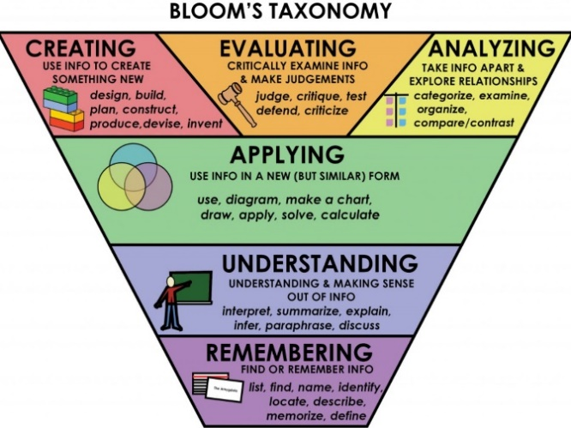
Tutorial Objectives
At the completion of this tutorial the attendee will be able to:
Recognize the main interoperability and reuse issues associated with use of terrain/environmental data in distributed simulation
Discuss the general process steps in creation of environmental databases, and the various data involved
Recognize/name the two SISO RIEDP Products, their role, and their main components
Employ the appropriate RIEDP products and principles to efficiently share environmental databases
Contrast details of the RIEDP components with the issues to solve
Judge the use of RIEDP in a simulation project
Support the evolutions of the RIEDP Products
Product = Result of a SISO standardization effort
Non-commercial !
2

Slide 3
Problem – Importance - Relevance
What is the problem
Building terrain databases still very expensive
Sharing saves cost, and also increases consistency, but …
Shared data often not clear - Conventions and Semantics not always uniform or standardized
This leads to interoperability problems and high costs
Why is this important
Consistency in Terrain Representation key to Fair Fight in Distributed Simulation / LVC
Consistency required for Services, Joint and International /Coalition Training
Who should care
Customers/Users, Program Managers, Engineers in Distributed Simulation / LVC
Interested in stand-alone or networked M&S applications, including visualization, training, analysis, rehearsal, testing (using traditional, VR, or AR visualizations)
3

Slide 4
How RIEDP adresses this
RIEDP is a SISO standard for communicating and sharing environmental data
Building M&S environmental data products (or databases) requires various types of source data, including (but not limited to) data in popular GIS formats
RIEDP leverages those popular formats and standardizes a comprehensive framework comprising:
A data generation process model to align/understand completeness of shared terrain data
A data model to represent and organize terrain data, and
The semantics, rules, methods and conventions to unambiguously share the data
RIEDP does not impose internal solutions on data producers
4

Slide 5
Agenda
The Operational Context
The RIEDP Approach
The RIEDP Components
RPM Stages
RADM
RADM Parts
Semantics for RIEDP data sharing
RIEDP and Other Similar Initiatives
Summary and Q/A

Slide 6
The Operational Context
6

Slide 7

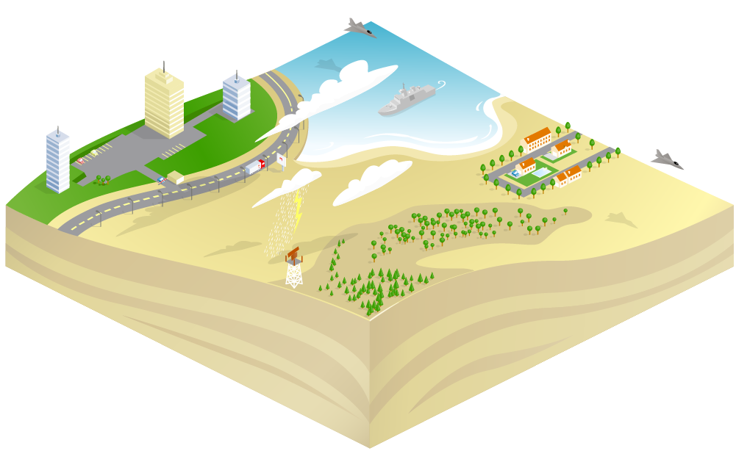

Live Virtual Constructive Training
Full Mission Sim 1
Heavy Constraints on
Synthetic Environment
Full Mission Sim 2
Computer Generated Forces
Real Actors
Exercise Controller
Ground Based Air Defence
HLA or other Protocol
At Stake : Avoiding duplication of costs, Inconsistency during execution, …
Solution : Standard? But not if every Organization has its own!
7

Slide 8
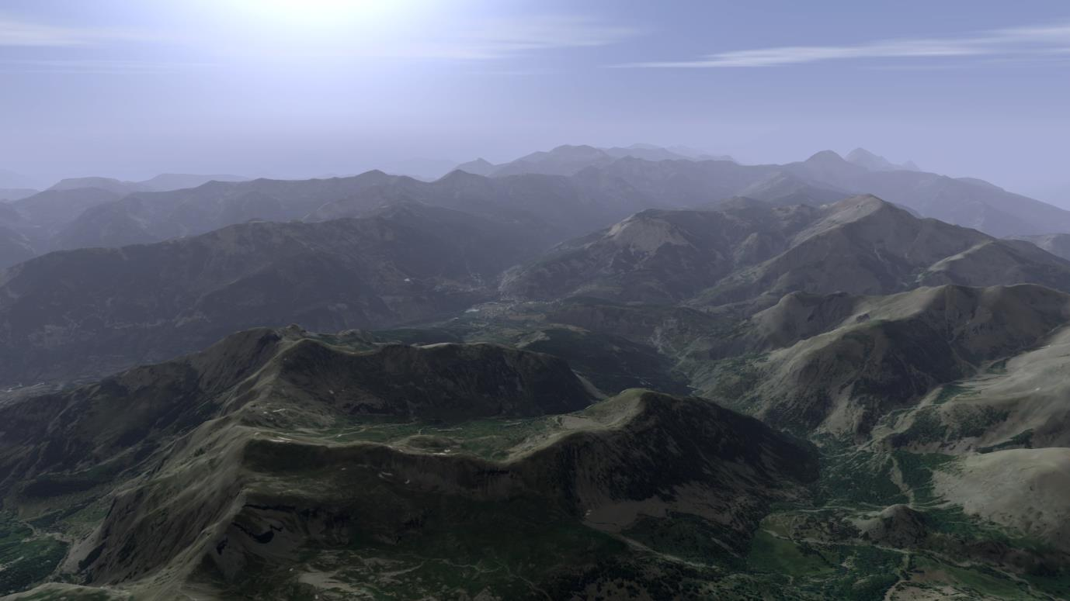
SE Requirements for an Aircraft Simulator (1/7)
Large Areas
Diversity of Terrain Natures

Slide 9
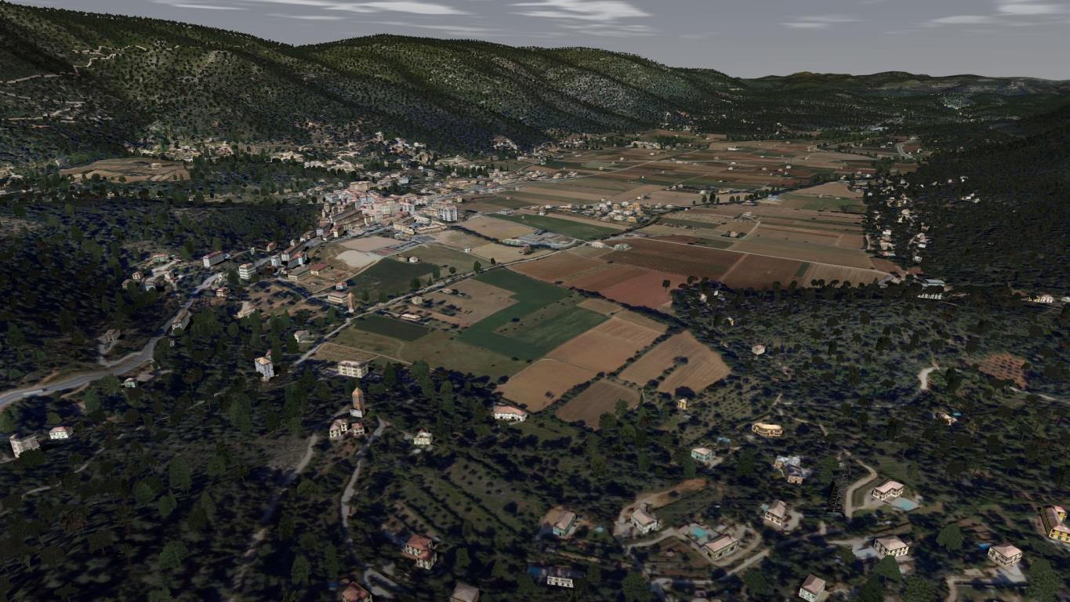
SE Requirements for an Aircraft Simulator (2/7)
Large Areas
Diversity of Terrain Natures

Slide 10
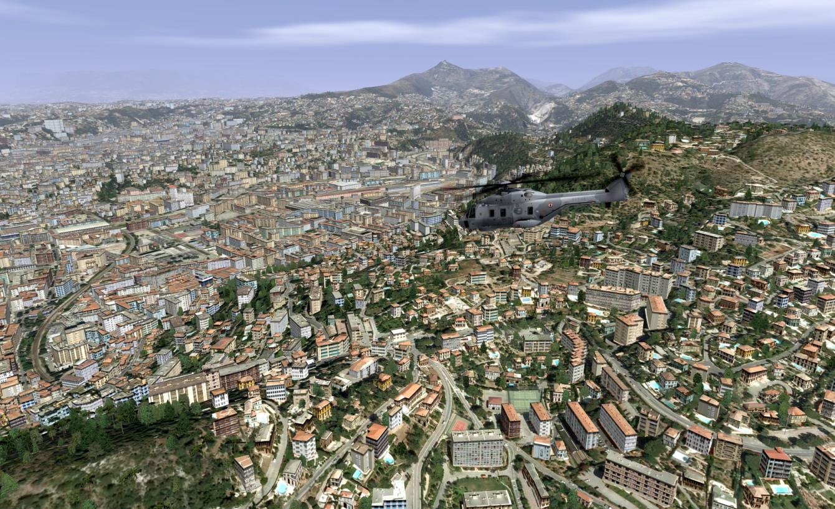
SE Requirements for an Aircraft Simulator (3/7)
Large Areas
Diversity of Terrain Natures

Slide 11
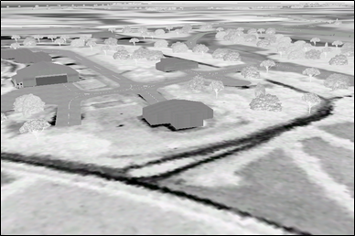
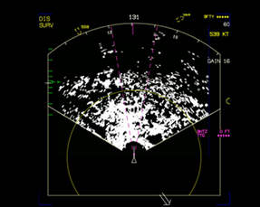

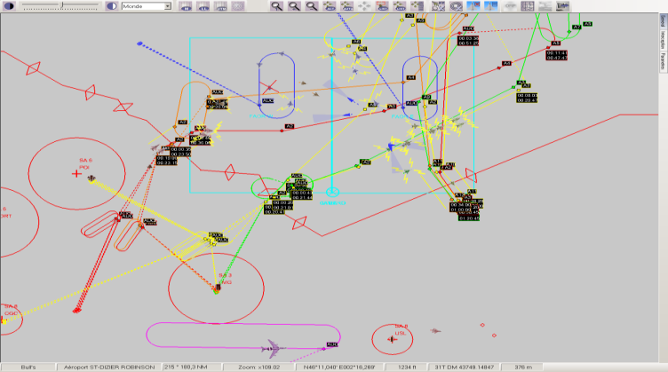
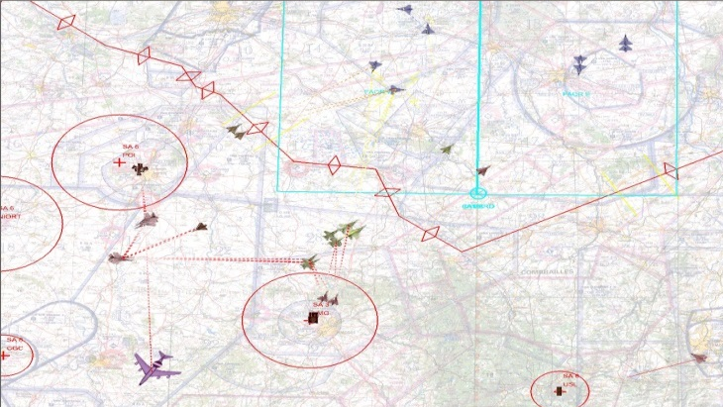
SE Requirements for an Aircraft Simulator (4/7)
Large Areas
Diversity of Terrain Natures
Diversity of Target applications
(Visuel, Sensors, IOS, CGF, C2…)

Slide 12

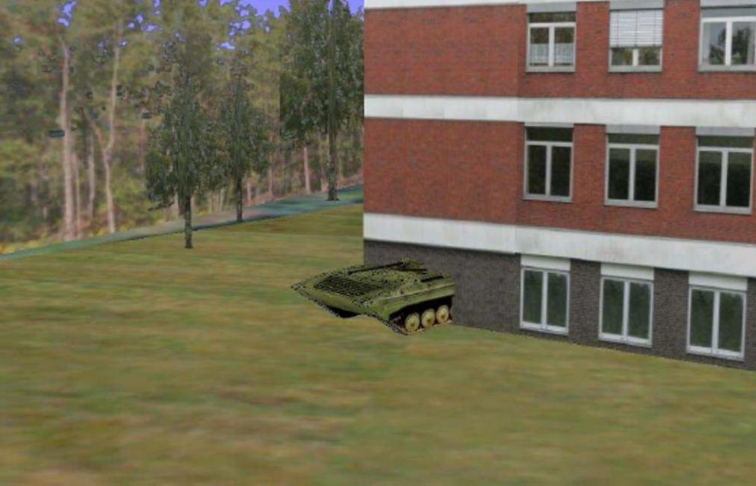

SE Requirements for an Aircraft Simulator (5/7)
Well, it is not really in the edge of the treeline !!
Can you see the Tank at the edge of the treeline ?
© Images courtesy of Aditerna

Slide 13
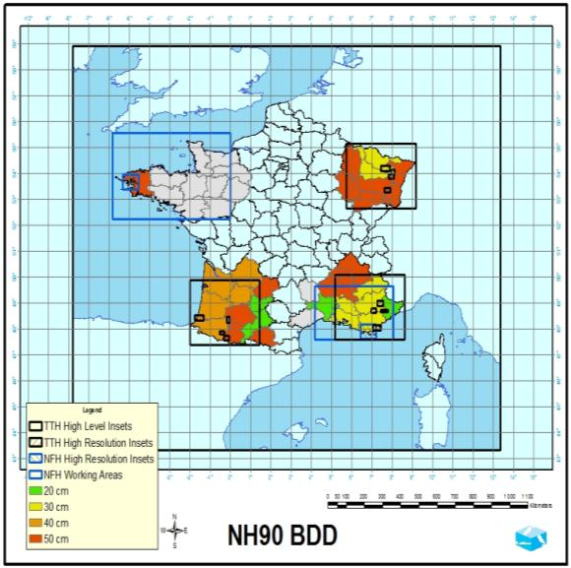
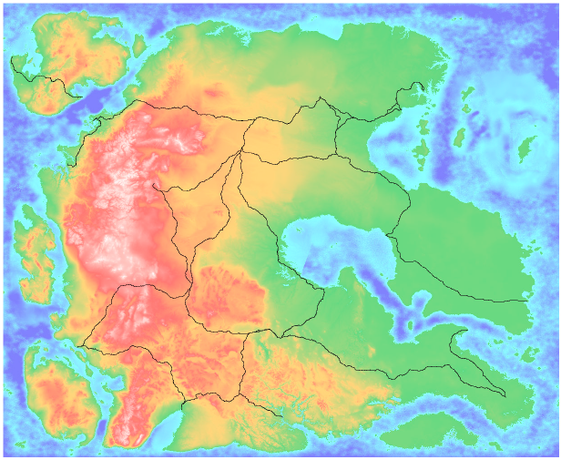
SE Requirements for an Aircraft Simulator (6/7)
NATO “Missionland”
2000x2000 km

Slide 14
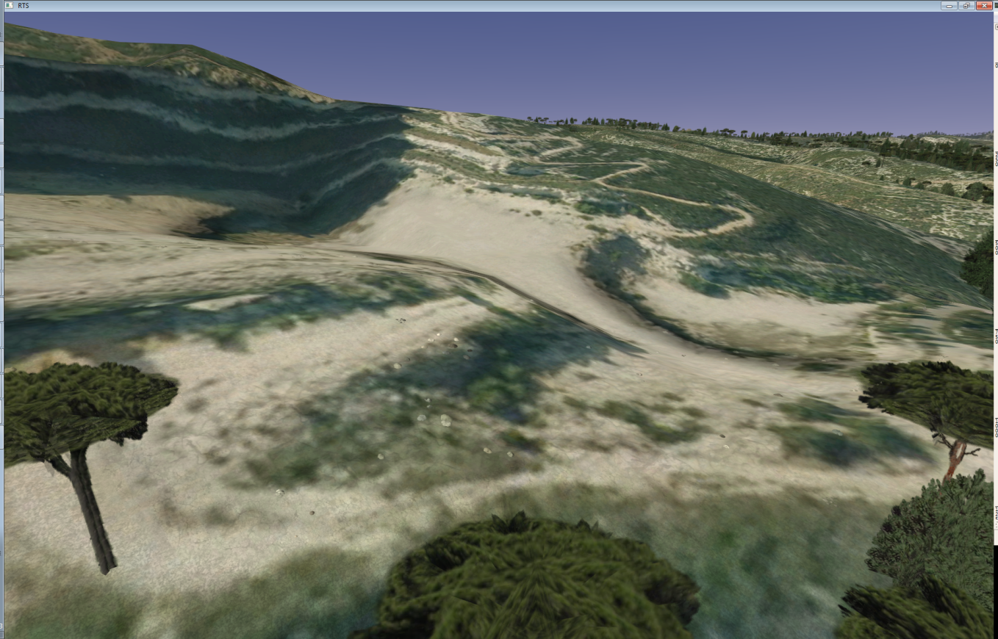
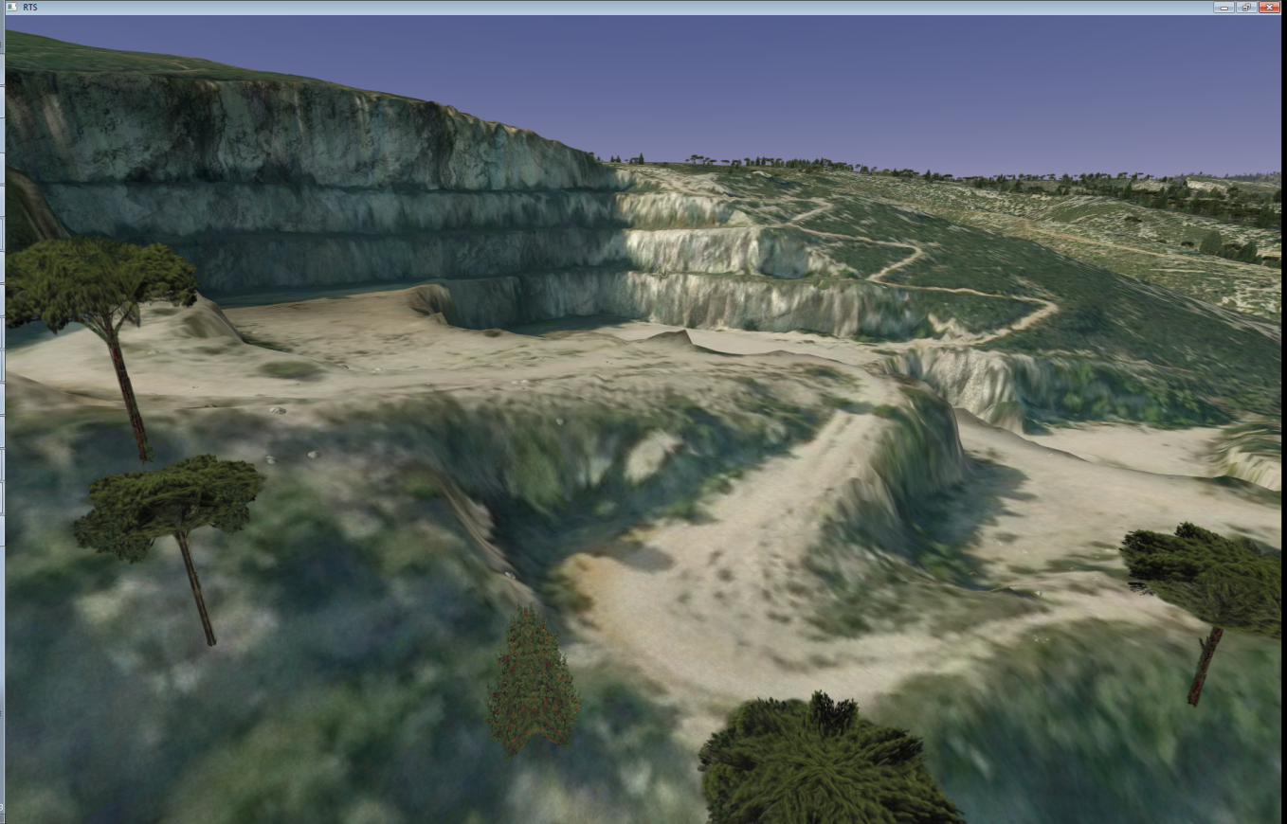
SE Requirements for an Aircraft Simulator (7/7)
Elevation Grid: 25 m
Elevation Grid: 1 m

Slide 15




Building a Simulator Database
€ / $
Target
Databases
Database Requirements
Visual DB
Source
Data
Database
Creation
Radar DB
Infra Red DB
Other Sensors
CGF DB
Operate !
Geospatial & Others
Find the data
Solve IPR
Clean the data
Correlate the data
Create missing data
Format the data
Intensify the data
Specialize the data
Maps
Others
Not so Easy

Slide 16
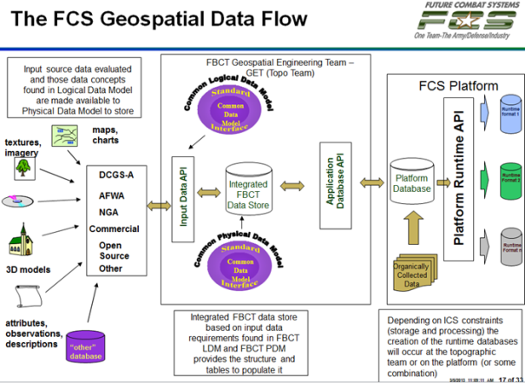
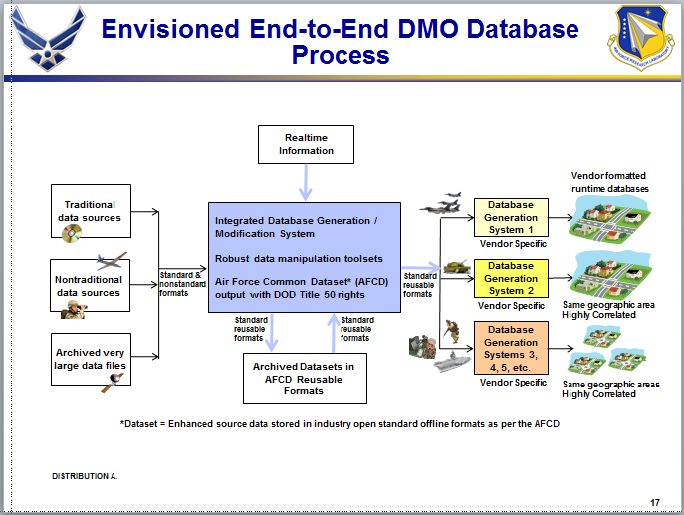
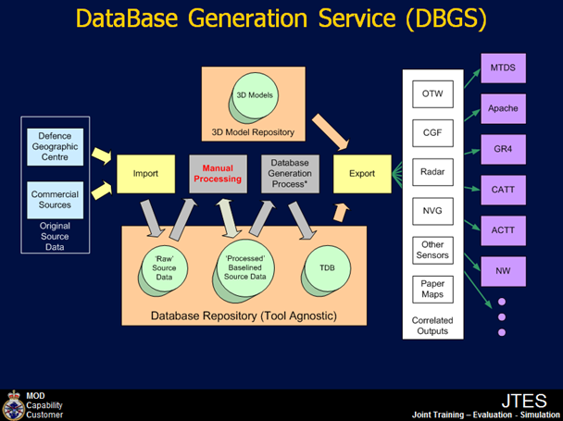
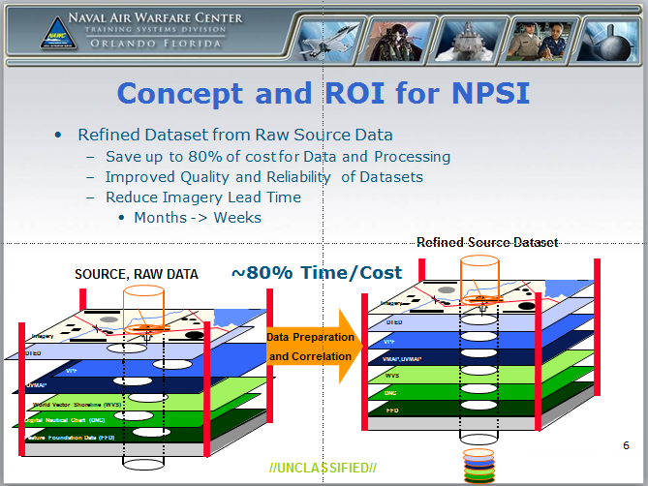
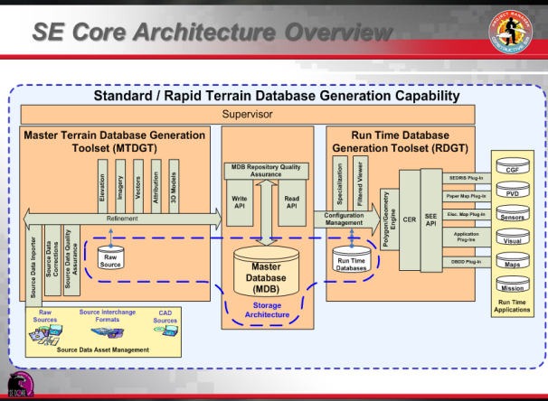
Terrain Database Generation – A Universal Process
It looks very similar
But the Devil is in the details
Images courtesy of their respective programs

Slide 17
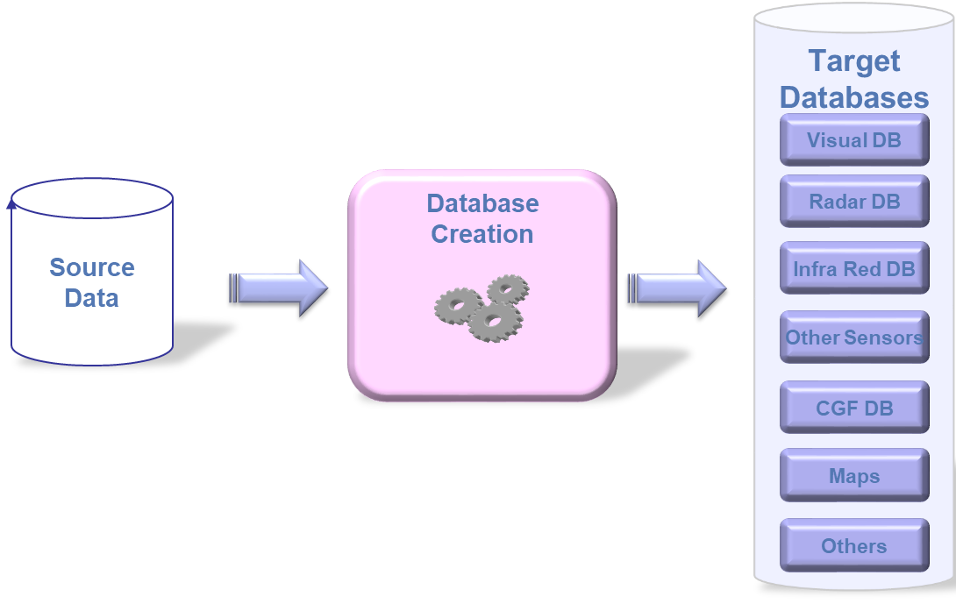



Additional issues for Distributed Simulation / LVC Reuse – Correlation – Interoperability …. (1/2)
Sim A - Provider 1
Requirements
Sim B - Provider 2
Sim C – Provider 3

Slide 18







Additional issues for Distributed Simulation / LVC Reuse – Correlation – Interoperability …. (2/2)
Duplication of efforts
Duplication of Cost
Time to market
Sim A - Provider 1
Consistency ?
Schedule ?
Requirements
Sim B - Provider 2
M&S Interoperability is
even more critical in the International Arena
with
Multiple Providers and Multiple M&S Solutions
Sim C – Provider 3

Slide 19
Examples of Interoperability issues in Large Exercises
Events: I/ITSEC Operation Blended Warrior (OBW), NATO MSG-165 Spartan
Typical Issues
Many points of view: Ops Team, Tech Team, Sim. providers, data providers/consumers …
Different understanding – sometimes wrong understanding – of the concepts
Communication/Miscommunication, Semantics (Example case – Sample dialog)
Significant contributors to these Semantics problems:
Terrain-related issues
Interchange standards
Interoperability and reuse suffer from these issues
Critical in the International Arena with Multiple Providers and Multiple M&S Solutions
19

Slide 20


M&S Interoperability
What it is NOT
The same Product and associated Solutions for everyone
Does not work, certainly not in the International Arena
Puts Innovation at risk
What product to choose? Single Solution sufficient? What constraints?
What it is
Consistency in Modelling, associated Data and Semantics at Component Level
Allowing Components to work together at System & System-of-Systems Levels
Fostering Multiple-Provider Solutions (e.g. : I/ITSEC/OBW Federations)
Simulation Interoperability relies on Appropriate Standards
Open, based on Consensus, not Vendor Specific
Within the simulation community : SISO

Slide 21
The RIEDP approach
21

Slide 22
Data Transformation Process – Two main phases (1/3)
Target
Databases
Visual DB
Source
Data
Database
Creation
Radar DB
IR DB
Other Sensors
CGF DB
Maps
Others

Slide 23
Data Transformation Process – Two main phases (2/3)
Target
Databases
GIS World
M&S World
Visual DB
Source
Data
Synthetic
Environment
Intermediate
Data
Phase 1
Data
Cleaning &
Enhancement
Phase 2
Target
DBs
Generation
Radar DB
IR DB
Other Sensors
CGF DB
Maps
Others

Slide 24
Data Transformation Process – Two main phases (3/3)
Target
Databases
GIS World
M&S World
Visual DB
Source
Data
Synthetic
Environment
Intermediate
Data
Phase 1
Data
Cleaning &
Enhancement
Phase 2
Target
DBs
Generation
Radar DB
IR DB
Other Sensors
Standardize here
at appropriate Intermediate stages
CGF DB
Maps
Manual Work: 80% 20%
Computation Time: 20% 80%
Others

Slide 25
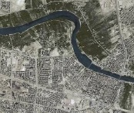

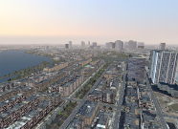
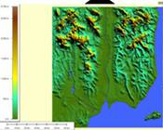
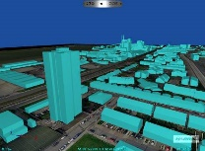
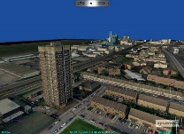

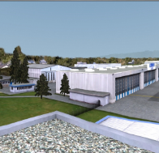
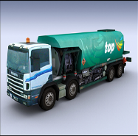
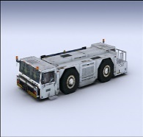

Source Data from Various Origins
From GIS world : DTED, DFAD, VMAP, SHAPEFILE, GEOTIFF, GML, KML, …
Application to simulation
Elevation, Vector (roads, rivers and building positions), Geo-referenced satellite imagery
From Photography World : BMP, ECW, JPEG ,JPEG 2000, RGB, TIFF™
Application to simulation
Texture for Terrain or objects to add visual realism, without complex geometric models
From Architecture/Game Worlds : COLLADA, OpenFlight™, VRML, X3D, …
Application to simulation
Formats from 3D modelers (e.g. 3DS ™, Maya ™, Creator ™, ... )
Application to simulation : Dedicated to 3D Objects modeling for visual Systems.
Notes:
25

Slide 26
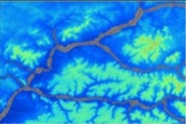

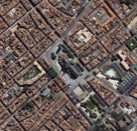
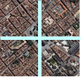
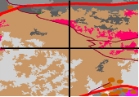
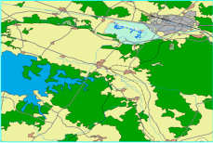




Phase1 : Generation of the Intermediate Datasets
Source Dataset
Projection Conversions
Format Conversions
Tiling (mosaïc)
Harmonisation (between Tiles)
Corrections of Source errors
Reconciliation between Layers
Intermediate
Dataset
Elevation
Geographical
Added Value
Elevation (Tiled )
Imagery
Imagery (Tiled )
Material Classification
Classification
Planimetry
Attribution Definition
Assignation of 3D models to Classes
Definition of Procedural Generation Rules for Features (Off or on line)
Planimetry
& Attribution
Simulation
Added Value
3D Models
Attribution Definition
Creation of new models in Library
3D Models
26

Slide 27
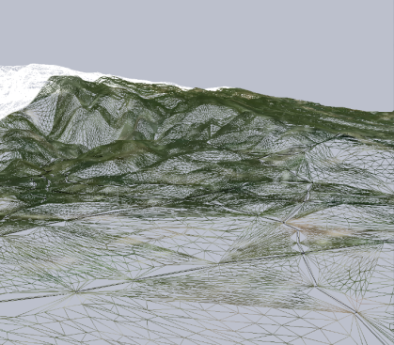
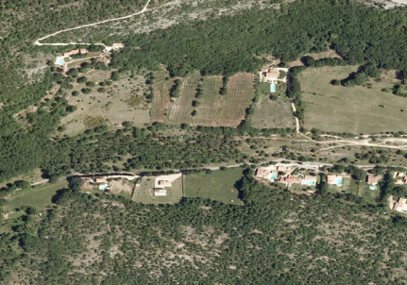
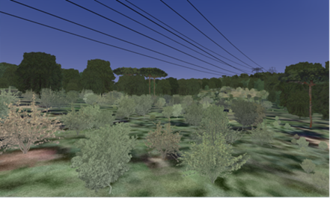
Phase 2 : Generation of Target DBs
Intermediate
Datasets
Runtime DB
Creation of 3D Terrain (Polygons, Levels of Detail, …)
Elevation (Tiled )
3D Terrain
Images (Tiled )
Texturation (projection of images on the 3D Terrain)
Classification
Enrichment of terrain with 3D elements (Cultures, Buildings, Networks,..)
Geo-specific
Textures
Features
& Attribution
Competition ➔ Proprietary
Solutions & Formats
3D Models
3D objects

Slide 28
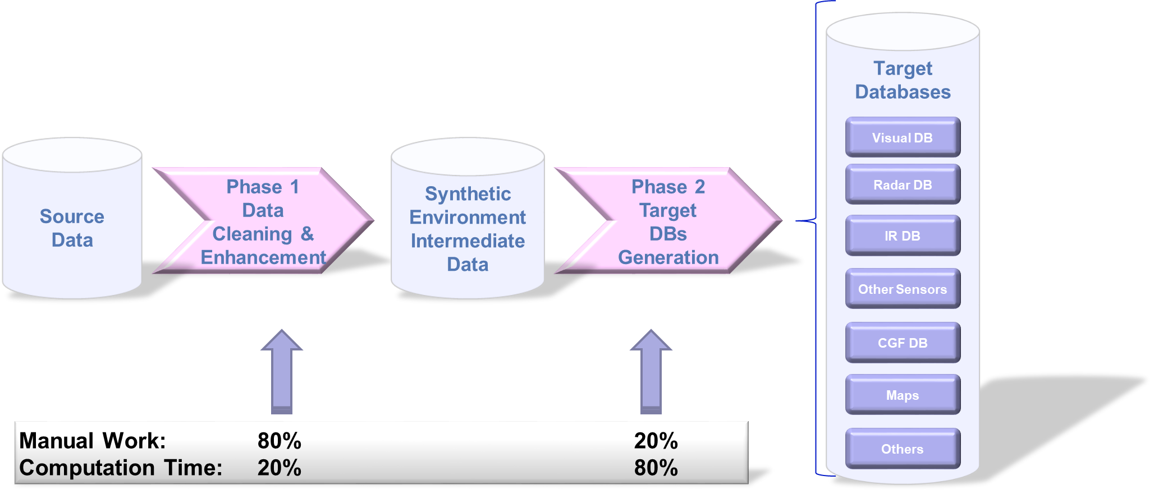
Data Transformation Process – Possible Improvement (1/4)
The process may be made more efficient in Mission Training via Distributed Simulation (MTDS)
28

Slide 29

Data Transformation Process – Possible Improvement (2/4)
The process may be made more efficient in Mission Training via Distributed Simulation (MTDS)
Hardly Reusable
(Unless same target platforms)
Competition
Various Trade-offs
29

Slide 30
Data Transformation Process – Possible Improvement (3/4)
The process may be made more efficient in Mission Training via Distributed Simulation (MTDS)
If Source data is comprehensive and consistent
Within each and between the layers → Depends on Data Providers
If previous creation efforts may be reused
At Source Data Level (Linked to GIS World)
Hardly Reusable
(Unless same target platforms)
Providers
Data Diversity
Data Quality
Competition
Discovery & Access
Metadata
Repository
Various Trade-offs
30

Slide 31

Data Transformation Process – Possible Improvement (4/4)
The process may be made more efficient in Mission Training via Distributed Simulation (MTDS)
If Source data is comprehensive and consistent
Within each and between the layers → Depends on Data Providers
If previous creation efforts may be reused
At Source Data Level (Linked to GIS World)
At Intermediate Level
Requires Common Processes, Representations, and Formats at this level
RIEDP
Reuse of Intensification efforts
Hardly Reusable
(Unless same target platforms)
Providers
Data Diversity
Data Quality
Competition
Discovery & Access
Metadata
Repository
Various Trade-offs
31

Slide 32
Key Topics for Database sharing
When reusing data from a partner, you need to know
How the database was built → Tasks performed or not
How the database is represented → Conceptual Model
How the database is spatially referenced → Spatial Reference Model
How the database is structured → Physical data model
How the database is organized on the media → Files/Folders/Hierarchies
How well the database conforms to Standards → Compliancy & Profiles
Information about the data product → Metadata
No existing solution fully satisfies all of these requirements

Slide 33
International M&S Initiatives & Standardization Efforts (1/2)
Process oriented
DB oriented
Nature | M&S standards |  | Projects / Initiatives |  |  |  |  |  | Geospatial
Name | SIF | SEDRIS | NPSI | AFCD | MDB | CDB | Mission Land | Other | OGC CDB
Origin | US DOD | US DOD | US Navy | USAF | US Army | US SOCOM | NATO | e.g. French Air Force | PRESAGIS
Introduction Date | 1991 | 1994 | 2004 | 2006 | 2008 | 2004 | 2010 | 2006 | 2013
Publication Date | Yes | 2005 | - | - | - |  |  |  | 2016
Standard | Yes | Formal ISO/IEC | User Standard | User Standard | User Standard | User & Commercial Standard | User Standard | User Standard | Formal OGC
Open Standard | Format according to standard | Yes | limited | limited | limited | Limited | limited | limited | Yes
Approach | Obsolete | Standardized Semantics and Data Model + Format according to standard |  |  |  |  |  |  | Similar to US SOCOM CDB but with formalized semantics and Conceptual Data Model
Availability of Commercial Support Tools | SIF | Tools developed in SEDRIS COI |  |  |  |  |  |  | PRESAGIS tools
Based on de-facto standard formats (GIS Source)
but
- No consistent Semantics or Data Model
- Similar but not Standard Data Generation Process
Commercial tools
for commercial & standard formats
AFCD: Air Force Common Dataset
EDS: Enterprise Data Services
NPSI: NAVAIR Portable Source Initiative
CDB: Common Database MDB : SE Core Master Data Base
SIF: SSDB (Standard Simulator Database) Interchange Format
33

Slide 34
International M&S Initiatives & Standardization Efforts (2/2)
Process oriented
DB oriented
Nature | M&S standards |  | Projects / Initiatives |  |  |  |  |  | Geospatial
Name | SIF | SEDRIS | NPSI | AFCD | MDB | CDB | Mission Land | Other | OGC CDB
Origin | US DOD | US DOD | US Navy | USAF | US Army | US SOCOM | NATO | e.g. French Air Force | PRESAGIS
Introduction Date | 1991 | 1994 | 2004 | 2006 | 2008 | 2004 | 2010 | 2006 | 2013
Publication Date | Yes | 2005 | - | - | - |  |  |  | 2016
Standard | Yes | Formal ISO/IEC | User Standard | User Standard | User Standard | User & Commercial Standard | User Standard | User Standard | Formal OGC
Open Standard | Format according to standard | Yes | limited | limited | limited | Limited | limited | limited | Yes
Approach | Obsolete | Standardized Semantics and Data Model + Format according to standard |  |  |  |  |  |  | Similar to US SOCOM CDB but with formalized semantics and Conceptual Data Model
Availability of Commercial Support Tools | SIF | Tools developed in SEDRIS COI |  |  |  |  |  |  | PRESAGIS tools
RIEDP addresses these Topics
(see how in RPM and RADM)
Based on de-facto standard formats (GIS Source)
but
- No consistent Semantics or Data Model
- Similar but not Standard Data Generation Process
Commercial tools
for commercial & standard formats
AFCD: Air Force Common Dataset
EDS: Enterprise Data Services
NPSI: NAVAIR Portable Source Initiative
CDB: Common Database MDB : SE Core Master Data Base
SIF: SSDB (Standard Simulator Database) Interchange Format
34

Slide 35
RIEDP – Two Products
RIEDP provides what is needed to share Environmental data :
A Reference Process Model (RPM)
A Reference Abstract Data Model (RADM)
A Tiling Scheme and Spatial Referencing
A List of Formats from the GIS and M&S worlds
A Consistent Semantics (through Features, attribution rules)
An Organization on the Media
A Metadata structure
A set of Exchange Profiles
Product 1: RIEDP Data Model Foundations
Product 2: RIEDP Detailed Features Description

Slide 36
The RIEDP Components: The RPM
Reference Process Model
36

Slide 37
RIEDP Reference Process Model / Process Flow (1/2)
Standardized model of Typical Generation Process for a Database

Slide 38
RIEDP Reference Process Model / Process Flow (2/2)
Requirements
Standardized model of Typical Generation Process for a Database
Export Stage
Using RIEDP does not require
changes to the user’s workflow
7 Creation Stages
Target DB Stage

Slide 39
RIEDP Reference Process Model - Data Flow
Export Stage
See RPM details in Product 1 - § 4.2.2
Runtime Stage

Slide 40
The RIEDP Components: The RADM
Reference Abstract Data Model
40

Slide 41
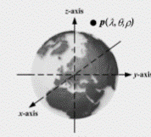
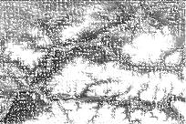
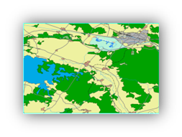
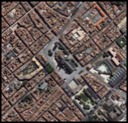
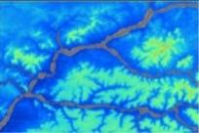
Main Components of a Database
Repository
Spatial
Reference Frame
Catalog
DB
Metadata
Tiling
Metadata
Library
Metadata
Layers
3D Models
Feature Templates
Metadata
Attribution
Textures
Special Areas
Other Raster
Reference Tables
Features
Imagery
Elevation

Slide 42
RIEDP Reference Abstract Data Model (upper part - 1/2)

Slide 43
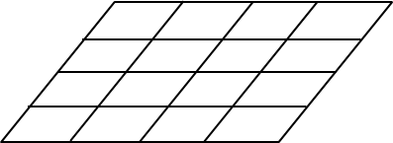

RIEDP Reference Abstract Data Model (upper part - 2/2)
Repository
Catalogue
DB
Metadata
Special Areas
Reference Tables
Feature Templates
3D Models
Textures

Slide 44
RIEDP Reference Abstract Data Model (Lower part)

Slide 45
RIEDP Reference Abstract Data Model (Lower part)
Layers
Library
Special Areas
Reference Tables
Feature Templates
3D Models
Textures
Attribution
Metadata

Slide 46
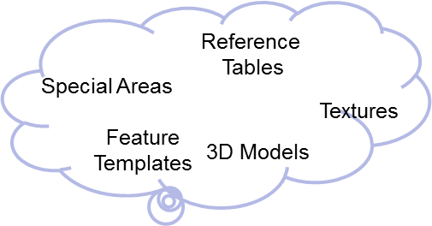
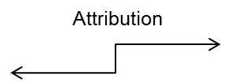
RIEDP Reference Abstract Data Model (Full)
Repository
Catalogue
DB
Metadata
See RADM details in Product 1 - § 4.3.3
Metadata

Slide 47
RIEDP Reference Abstract Data Model
High Level Concepts of a Database
Showing areas of convergence and variability among initiatives
Tiles, Layers Library,
Convergence
Common format
Variability
COTS
Attribution
Metadata,

Slide 48
The RIEDP Components: The RADM Parts
List of Formats
Spatial Reference Frame
Attribution Model
Data Organization on the Media
Metadata Schema
Profiles
48

Slide 49
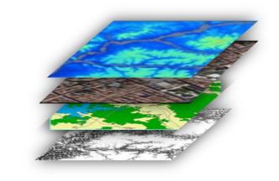
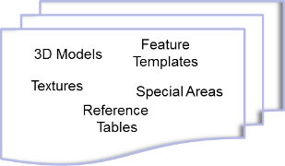
RIEDP-required formats
The data formats required for RIEDP-compliant data exchange:
GeoTIFF (revision 1.0 October 1995), for terrain elevation data.
ESRI Shapefile (technical description White Paper July 1998), for instances, and possibly for classes of terrain features and vector data.
GeoTIFF (revision 1.0 October 1995) or JPEG 2000 (ISO/IEC 15444 – Part 1) for terrain imagery data, as well as other raster-based data.
OpenFlight (version 16.0 or higher), for 3D models, both natural and man-made, placed on the terrain or dynamically included in the environment.
PNG (ISO/IEC 15948:2004), SGI RGB or SGI RGBA, image formats for texture maps, used in portraying object surfaces and some terrain surfaces.
In addition, XML (and associated XML schema) is used to provide those RIEDP-required data that is not supported through the above formats.
NOTE :
RIEDP does NOT impose RIEDP-required Formats for use within a Data Producer’s internal Processes
The list of RIEDP-required formats may be extended, updated, or modified through amendment or revision of this specification. Condition : Candidate formats shall comply with the RADM principles.
See details in Product 1 - § 4.4
See details in Product 1 - § 4.6
49

Slide 50
Export Database
GeoTIFF
Shapefiles
XML
OpenFlight
PNG RGB
RIEDP Exchange Formats
Additional formats can be introduced through
SISO EDRS Product Support Group
XML

Slide 51
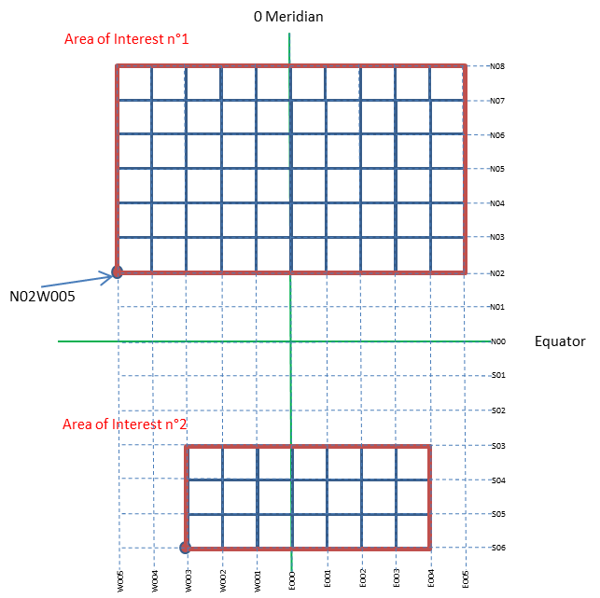
RIEDP Geospatial Conventions / Tiling
Tiling:
Division of the area of interest
1square degree
Region
Single Block
For those who do not consider Tiles
See details in Product 1 - § 4.3.3.2.7

Slide 52

RIEDP Geospatial Conventions / Spatial Reference
RIEDP-compliant <Database> conforms to the following:
Database_SRF: GEODETIC_WGS_1984
Database_Origin: longitude value, latitude value, (and optionally, height value)
Database_Spatial_Domain:
Coordinate values : longitude, latitude, (and optionally height)
for the Lower Left and Upper Right corners of the database, in that order
3DModel_SRF: LOCAL_SPACE_RECTANGULAR_3D SRF
OrientationVectorSpace_SRF: LOCAL_TANGENT_SPACE_EUCLIDEAN
Orientation_Values_Convention: Intrinsic_Euler_ZYX or ZY’X”
See details in Product 1 - § 4.3.3.2.5

Slide 53
RIEDP Attribution Model
Related to Feature instances and Templates
Detailed Characterization of their Properties
For Geospatial information
For Formats Organization (structure of the data in a format)
For Process guidance (how to eventually process the data)
Factored out into Library through Templates
Example : A road
Concept from the Real World : Polyline + Size + Lanes Number + Type
Based on GIS Attributes from the Provider
Augmented with attributes of the instance or from a template in the Library
Cross Section, Visual representation, Sensor representation
Rules for conforming to the terrain
Detailed properties captured in Reference Tables
Standardized Semantics and Attribution Schema (next chapter)
See details in Product 1 - § 4.3.3.3

Slide 54
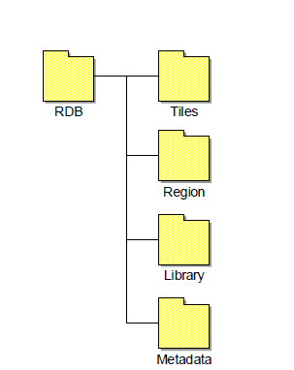
RIEDP Data Organization
Physical Organization on the Media
Layers in Tiles or Region Folder
Library
Metadata
See details in Product 1 - § 4.5

Slide 55
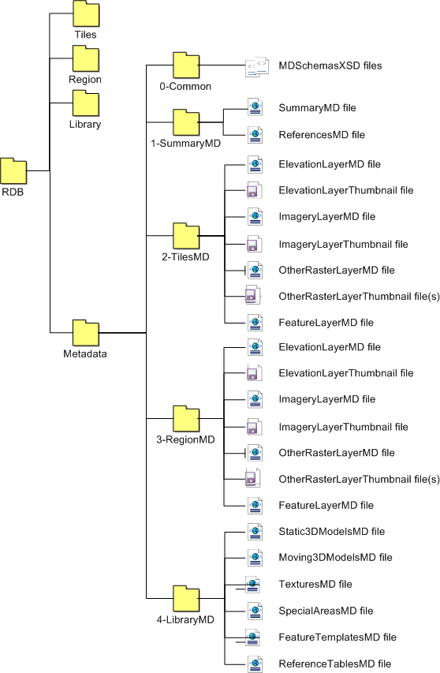
RIEDP Metadata - Organization
Metadata
Successful data exchange relies heavily on the appropriate use of metadata
RIEDP Compliant Data products shall include the appropriate metadata classes, as specified by the RADM
Structured metadata
Based on XML files for each component of the RADM
According to rules captured in XML schemas
See details in Product 1 - § 4.3.3.4

Slide 56
RIEDP Profiles
RIEDP-compliant Data Products shall conform to one of the RIEDP Profiles
A Profile specifies:
A stage in the RPM
Mandatory and Optional Data in accordance with the RADM
See details in Product 1 - § 4.7.
56

Slide 57
Conformance
RIEDP specifies the conformance requirements for:
RIEDP RPM stages,
RIEDP RADM classes,
RIEDP Profiles, and
RIEDP-compliant data products.
The conformance requirements apply to any of the following:
Database generation systems or processes,
Data models that represent RIEDP products,
Interchange of RIEDP data products,
Applications that produce or consume RIEDP data products.
Conformance requirements define the degree of flexibility allowed for all uses of RIEDP.
See details in Product 1 - § 5

Slide 58
Semantics for RIEDP data sharing
58

Slide 59
Areas of data semantics in RADM
Feature Instances & Feature Templates
Lights Characteristics
Material Characteristics
3D Model Characteristics
Visual Characteristics
Other Characteristics
Elevation and Imagery Attribution
And Process Attributes (which apply within areas above for data generation and consumption)
4
5
1
7
3
2
6
59

Slide 60
Product 2 - Detailed Features Description - Goal
Improve Data Interoperability through:
Identification of List of concepts and associated definitions (next slide)
Providing the Information needed by the International Training Community
Allowing future Evolution
Not reinventing the wheel by using to Standard Dictionaries
EDCS, + DFDD and AMDB for Airport as needed
and RIEDP notions when not enough
Use of Existing definitions (Changes to be requested to Source Organization)
RIEDP own Code Space

Slide 61
Relating Features and Attributes
List of Tables Related to the Semantics of Features and/or Attributes
Features
Attributes
Including Process-related attributes
Associated enumerations
Supplementary
Including Themes, Units , Scales…
Prescribed feature-attribute combinations along with their:
Valid value ranges,
Their specific enumerations (if any),
Default values (including enumerates)
Applicable units, scale
These tables are evaluated through test DB conversion efforts
Table structures are specified in Product 2

Slide 62
Feature Instance & Feature Templates
A template allows to factor out common characteristics of features
(saved in Library).
Note: The RADM representation for Features is not specific to Shapefiles

Slide 63
Vector data in shapefiles
A Shapefile stores geographic features (point, linear, and areal) and attribute data as a collection of files
.shp - the file that stores the geometry of feature instances.
Each record describes a shape with a list of its vertices.
.dbf - the dBASE file that stores the attribute information of feature instances.
Each record contains attributes for a feature.
.shx - the file that connects the geometry file and the attributes file via index values.
.shp
.dbf
.shx
Records
Shape 1
Shape 2
Shape n
Attrib 1 | Attrib 2 |  | Attrib n
Values

Slide 64

RIEDP Attribution Model : Features (Shapefiles + XML)
Characterization of Feature instances and Templates
64

Slide 65
Example : Material Characteristics (1/3)
Areal
x
y
z
LinkTo_Template |  |  |  | LinkTo_MatChar
TemplateX
TemplateY
 |  |  |  | Wood
<Feature_Templates>
<FTEntry>
<Name>TemplateX
<Attribute n>
<LinkTo_LightChar></LinkTo_LightChar>
<LinkTo_MatChar> Wood</LinkTo_MatChar>
<LinkTo_VisualChar></LinkTo_VisualChar>
<LinkTo_OtherChar></LinkTo_OtherChar>
</FTEntry>
<FTEntry>
<Name>TemplateY
<Name>TemplateZ
<MatChar_Table>
<MatChar_Entry> Name « Wood »
<Group> « Basic_Mode »
<Group> « Advanced_Mode »
<Group> « Expert_Mode »
<MatChar_Entry> Name « Metal »
<Group> « Basic_Mode »
<Group> « Advanced_Mode »
<Group> « Expert_Mode »
<MatChar_Entry> Name « Soil »
<Group> « Basic_Mode »
<Group> « Advanced_Mode »
<Group> « Expert_Mode »
For Basic rendering
For Training purposes
For Physics Experts
12 Feb 2020
Tutorial RIEDP - SISO SIW 20

Slide 66
Example : Material Characteristics (2/3)
Areal
x
y
z
LinkTo_Template |  |  |  | LinkTo_MatChar
TemplateX
TemplateY
 |  |  |  | Wood
<Feature_Templates>
<FTEntry>
<Name>TemplateX
<Attribute n>
<LinkTo_LightChar></LinkTo_LightChar>
<LinkTo_MatChar> Wood</LinkTo_MatChar>
<LinkTo_VisualChar></LinkTo_VisualChar>
<LinkTo_OtherChar></LinkTo_OtherChar>
</FTEntry>
<FTEntry>
<Name>TemplateY
<Name>TemplateZ
<MatChar_Table>
<MatChar_Entry> Name « Wood »
<Group> « Basic_Mode »
<Group> « Advanced_Mode »
<Group> « Expert_Mode »
<MatChar_Entry> Name « Metal »
<Group> « Basic_Mode »
<Group> « Advanced_Mode »
<Group> « Expert_Mode »
<MatChar_Entry> Name « Soil »
<Group> « Basic_Mode »
<Group> « Advanced_Mode »
<Group> « Expert_Mode »
For Basic rendering
For Training purposes
For Physics Experts
12 Feb 2020
Tutorial RIEDP - SISO SIW 20

Slide 67

Example : Material Characteristics (3/3)
Areal
x
y
z
LinkTo_Template |  |  |  | LinkTo_MatChar
TemplateX
TemplateY
 |  |  |  | Wood
<Feature_Templates>
<FTEntry>
<Name>TemplateX
<Attribute n>
<LinkTo_LightChar></LinkTo_LightChar>
<LinkTo_MatChar> Wood</LinkTo_MatChar>
<LinkTo_VisualChar></LinkTo_VisualChar>
<LinkTo_OtherChar></LinkTo_OtherChar>
</FTEntry>
<FTEntry>
<Name>TemplateY
<Name>TemplateZ
Does it make sense for features ?
Yes, for Predominant Material
<MatChar_Table>
<MatChar_Entry> Name « Wood »
<Group> « Basic_Mode »
<Group> « Advanced_Mode »
<Group> « Expert_Mode »
<MatChar_Entry> Name « Metal »
<Group> « Basic_Mode »
<Group> « Advanced_Mode »
<Group> « Expert_Mode »
<MatChar_Entry> Name « Soil »
<Group> « Basic_Mode »
<Group> « Advanced_Mode »
<Group> « Expert_Mode »
3D Model/Polygon/Texture
For Basic rendering
Wood
For Training purposes
For Physics Experts
or for 3D Model
Metal
Raster/Pixel
Mapping Table
RVB - Index → MatChar_Entry
0/0/255 – 1 → « Water »
or OtherRaster Layer
See details in Product 2
12 Feb 2020
Tutorial RIEDP - SISO SIW 20

Slide 68
The Experts’ Corner
Experts interested in details of the following topics can consult the listed documents/sections:
Topic | Document and Section
RPM Stages (details) | Product 1 - § 4.2.2 and 4.2.3
RADM Component (details) | Product 1 - § 4.3.3
Spatial Referencing | Product 1 - § 4.3.3.2.5
Tiling (details) | Product 1 - § 4.3.3.2.7
3D Model Structure (details) | Product 1 - § 4.3.3.2.15 & Product 2 – being assigned
Library Concepts | Product 1 - § 4.3.3.2.6
Feature Templates (Object reuse) | Product 1 - § 4.3.3.2.14 & Product 2 – being assigned
Reference Tables | Product 1 - § 4.3.3.2.17 & Product 2 – being assigned
Profiles | Product 1 - § 4.7
Conformance | Product 1 - § 5
Metadata details | Product 1 - § 4.3.3.4
Introducing new formats in RIEDP | Product 1 - § 4.6
68

Slide 69
RIEDP and the other Initiatives
How do they relate ?
69

Slide 70

RIEDP and other Initiatives - Process view
Alternate use of RPM!
RIEDP Scope
AFCD / NPSI Scope
CDB scope
SE Core Scope
SEDRIS Scope

Slide 71
Comparison of different database sharing solutions
Topics | SEDRIS | AFCD | NPSI | CDB | SECORE | RIEDP
Process Model | û | û | û | û | ü | ü RPM
Data Model | ü DRM | û | û | K | û | ü RADM
Attribution | ü EDCS | û | û | ü | ü | ü EDCS +
Spatial Reference | ü SRM | K | K | ü | ü | ü 3 SRF
Formats | ü STF | ü COTS | ü COTS | ü COTS | ü COTS | ü COTS
Physical Org | ü STF | K | K | ü | ü | ü
Metadata | ü | û | K | K | K | ü
Profile | K | û | û | û | û | ü
Scope (vs RIEDP/RPM) | All stages but "RT Target Gen" | Until stage "Align…" | Until stage "Align…" | "RT Target Gen" | All stages | All stages but "RT Target Gen"
Expressed
Non-existent or unexpressed
Partial or specific or limited
71

Slide 72
Summary & Conclusion
72

Slide 73





RIEDP – Two Products
RIEDP provides what is needed to share Environmental data :
A Reference Process Model
A Reference Abstract Data Model
A Tiling Scheme and Spatial Referencing
A List of Formats from the GIS and M&S worlds
A Consistent Semantics (through Features, attribution rules)
An Organization on the Media
A Metadata structure
A set of Exchange Profiles
RIEDP Data Model Foundations
RIEDP Detailed Features Description

Slide 74
Take away
RIEDP
Takes benefit of the lessons learnt from all related Initiatives
Reuses and relies on existing standards (such as SEDRIS ISO/IEC standards and PNG ISO/IEC standard), as well as formats commonly used in the community
Represents the best common denominator by providing a Reference Process Model (RPM), a formal Reference Abstract Data Model (RADM), relying on use of existing Formats, specifying unique Profiles, and focusing on metadata and attribution semantics
Does not impose internal solutions on producers
Provides a common data sharing approach that relies on a formal abstract data model (RADM), along with specific metadata and attribution (Product #2)
This allows the best sharing of data, independently from target applications implementation,
with a current scope addressing static terrain.
See NATO Group MSG-156 on dynamic terrain and weather
74

Slide 75
Tutorial Objectives (reminder)
At the completion of this tutorial the attendee will be able to:
Recognize the main interoperability and reuse issues associated with use of terrain/environmental data in distributed simulation
Discuss the general process steps in creation of environmental databases, and the various data involved
Recognize/name the two SISO RIEDP Products, their role, and their main components
Employ the appropriate RIEDP products and principles to efficiently share environmental databases
Contrast details of the RIEDP components with the issues to solve
Judge the use of RIEDP in a simulation project
Support the evolutions of the RIEDP Products
Product = Result of a SISO standardization effort
Non-commercial !
75

Slide 76

Q & A
More information:
Download the Specification from www.sisostds.org
PDG SISO Library File Folder – Access PDG Documents
Select SISO Digital Library > Development Groups > RIEDP PDG
Get involved in RIEPD PDG and EDRS PSG
Any questions on:
The Requirements ?
The RIEDP Products ?
How is RIEDP different ?
Other challenges for Environmental databases ?
Any other Environmental Data related subject ?
76

Slide 77
Backup slides for the Q&A session
77

Slide 78
RIEDP-Required formats Guidelines for Evaluation of Candidate Formats
For the exchange of RIEDP-compliant products and databases, RIEDP specifies existing file formats applicable to the various layers of the RADM.
In response to dynamic changes in technology and evolving requirements, the list of RIEDP-exchange formats may be extended, updated, or modified through amendment or revision of this specification.
All changes shall conform to the following criteria:
Preservation of RADM and/or RPM compatibility shall be the primary objective, when modifications or replacement of existing formats are being considered.
Candidate formats shall comply with the RADM principles.
For instance, the addition of a new 3D model or feature format shall include the definition and compliancy of the corresponding attributes and attribution rules. As needed, open and free tools will be provided to ensure conversion to and from the candidate format are possible.
This is to be analyzed during the Support Phase.
78

Slide 79


Current Status of RIEDP Products
Product n°1
RIEDP Data Model Foundations
SISO Guidance Document
Submitted to Balloting : During March ’18
Approval During Fall ’18 SIW
Published
Product n°2
RIEDP Detailed Features Description
SISO Standard Document
Development initiated Summer 2017
Conclusion expected End ’20
RIEDP DM Foundations
V 1.2a
79

