Slide 1

5G Mobile Network Modeling and Simulation
A comprehensive introduction to mobile networks and network modeling and simulation
Adapting to an Unexpected Future!
Paul Davis, CACI
Steven Kropac, CACI
Philip Lamoureux. CACI
Patrick Lawrence, CACI
Dan Wojciechowski, CACI
This material consists of CACI International Inc general capabilities information that does not contain controlled technical data as defined within the International Traffic in Arms (ITAR) Part 120.10 or Export Administration Regulations (EAR) Part 734.7-10. (PR ID364).

Slide 2
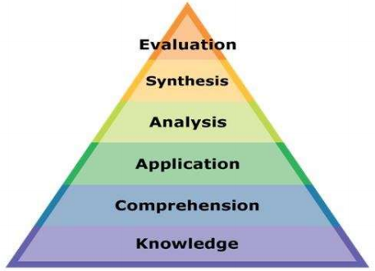
Learning Objectives
Understand the relentless evolution into 5G mobile wireless networks as they influence the 21st century battlefield
Knowledge of History, Terminology, Basics for mobile networks
Progression into modern mobile networks
Definition of terms and current / next architectures
Technology advancement and increasing complexity
Comprehension & Application of Mobile Network Simulations
Existing network simulation taxonomies, and practices
Ability to Create new 5G Modeling and Simulation Scenarios
Analyze new Radio frequency (RF) simulation scenarios
Analyze emulation activity with integrated hardware scenario
Network Scenarios with Cyber Events
Synthesize Multi-domain operations in the 5G environment
Security evaluation of 5G RAN and core
Learning Theory

Slide 3
Learning Methodology
Does
Shows How
Knows How
Knows
Create new cyber scenarios,
incorporate into live tests, gauging readiness
Does
Shows How
Knows How
Knows
Exercise mobile network simulation applications,
analyze and evaluate results
Competency, Skill, Experience, Expertise
Does
Shows How
Knows How
Knows
Apply understanding of mobile networks to a
cyber modeling & simulation environment
Does
Shows How
Knows How
Knows
Learn and recall Knowledge of basic facts and concepts, help demystify acronyms

Slide 4
Motivation
“Fifth-generation wireless communications technologies (5G) currently in development promise orders of magnitude improvements in multiple areas, including speed, connectivity, and reduced latency…
“Ubiquitous high-speed connectivity will also transform the way militaries operate. Tomorrow's warfighters will use local and expeditionary 5G networks to move massive amounts of data to connect distant sensors and weapons into a dense, resilient battlefield network…
“5G is a critical strategic technology: those nations that master advanced communications technologies and ubiquitous connectivity will have a long-term economic and military advantage.”
- Department of Defense (DoD) 5G Strategy, 2020

Slide 5
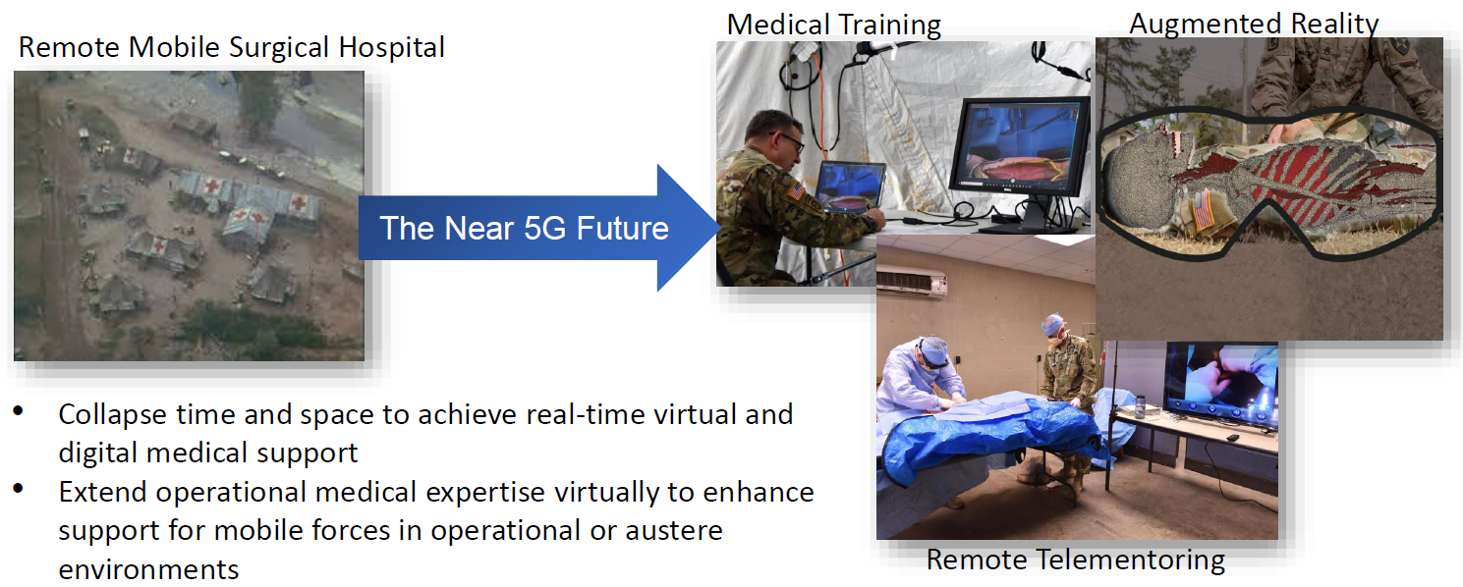
5G Impacts to Training – Telemedicine
Broussard, G, Kelley, B., Thomas, D. (2021), JBSA Experiment Update 2013 5G Core Security – Telemedicine Industry Day: DoD 5G Tranche NSC/SF Industry Day. (May 6, 2021 presentation)

Slide 6
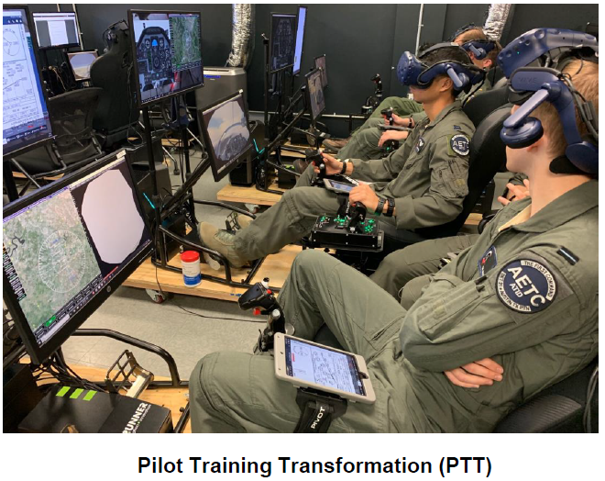
5G Impacts to Training – Flight Simulator
Pilot Training Transformation – Pilot Training Flight Simulator (PTT-PTFS) selected by Joint Base San Antonio for 5G testing
PTT-PTFS technologies include augmented reality (AR), virtual reality (VR), high-definition (HD) video, and internet of things (IoT)-based data transfer and analysis
PTT-PTFS flight simulators also involve intensive graphics processing workloads and data transfer
Requires access to flight simulators both locally and remotely
Broussard, G, Kelley, B., Thomas, D. (2021), JBSA Experiment Update 2013 5G Core Security – Telemedicine Industry Day: DoD 5G Tranche NSC/SF Industry Day. (May 6, 2021 presentation)

Slide 7
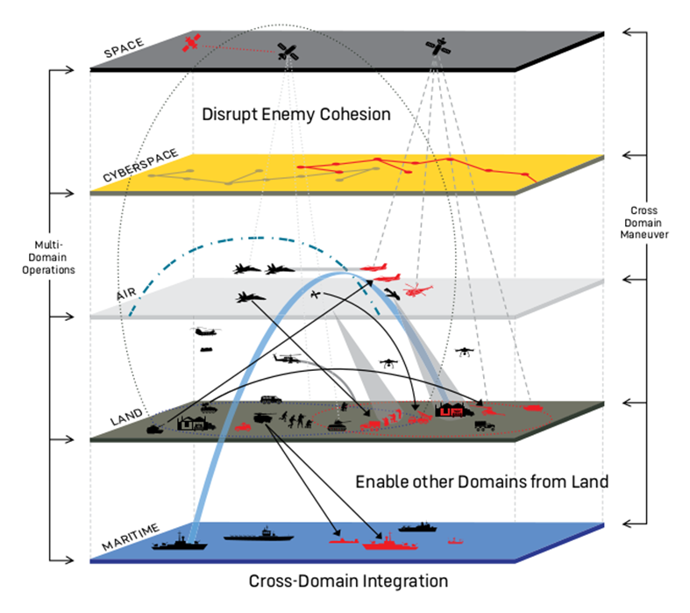
Modeling and Simulation in Multi-Domain Operations
Understanding how modeling and simulation supports multi-domain operations (MDO) with integrated high-fidelity cyber scenarios is key to modernizing the military’s test, train, exercise, and analysis activities
Military organizations must develop new strategies for how they will both defend their nation and fight future conflicts
Full-spectrum modeling and simulation systems are needed to span MDO to evaluate the art of the possible that tests the real world
High-fidelity modeling and simulation systems that support systems of systems integration and hardware in the loop allow trainees to best understand and assess MDO scenarios in detail
space
cyber
air
land
sea
Multi-Domain Modeling and Simulation
Notes:
https://www.tradoc.army.mil/Publications-and-Resources/Article-Display/Article/1987883/a-new-joint-doctrine-for-an-era-of-multi-domain-operations/

Slide 8
Why do we care about MDO?
MDO forces the adversary to confront multiple threats simultaneously
Example:
A cyberspace attack that disables a prominent base station outside a government embassy will limit communications to/from that embassy
A coordinated and synchronized land attack would leave the embassy potentially defenseless
space
cyber
air
land
sea
*
* wikipedia.org

Slide 9
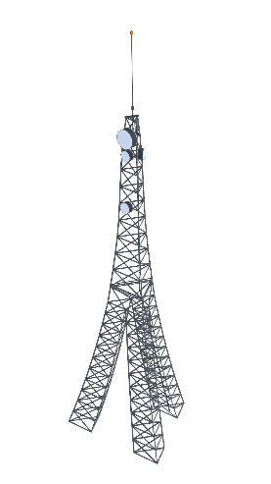
High Fidelity MDO
MDO impact will differ based on the technologies in place
Example:
A cyberspace attack that disables a prominent base station outside a government embassy will NOT limit communications to/from that embassy if it is served by a 5G network
A coordinated and synchronized land attack would be thwarted by early warning messages and continued communications
High-fidelity cyber scenarios with different results drives need for improved test and train

Slide 10
5G Cyber Modeling and Simulation Questions
Why did the attack not work on the 5G network?
Can we model and simulate this type of scenario and scenarios like it?
Can we re-create current events?
How do we experiment with new scenarios?
How do we test and train with those existing and new capabilities?

Slide 11
Knows
History, Terminology, Basics (of Mobile Networks)

Slide 12
History, Terminology and Basics of Mobile Networks
Mobile networking continues to evolve, with each year advancing new standards
Knows - Agenda
Progression into modern mobile networks
4G/LTE smartphone architecture, terms, and attach sequence
5G non-standalone (NSA) & standalone (SA) architecture, terms, and sequence evolution
5G stand alone advanced capabilities, network resiliency, radio evolution
5G stand alone slicing
Does
Shows How
Knows How
Knows

Slide 13
Progression of Mobile Networks – 1st & 2nd Generation
First generation (1G) of wireless cellular technology, introduced in the 1980s
Using analog radio signals from the handset to the cell tower
Focus was on reliable voice services
Second generation (2G), launched in 1991
Digitized the signal between the handset and cell tower making it more reliable
Introduced plain text-based messages with the Short Message Service (SMS)
Allowed for more secure voice communication and later low-speed data
Code Division Multiple Access (CDMA) in North America
Global System for Mobile Communication (GSM) used in most of the world outside North America
Evolution: 2.5G General Packet Radio Service (GPRS), 2.75G Enhanced Data rates for GSM Evolution (EDGE)
Notes:
2.5G – huge advancement for data services
For every generation, there are incremental improvements and standards enhancements
Mention themes based on security of networks

Slide 14
Progression of Mobile Networks – 3rd and 4th Gen
Third generation (3G), initial commercial deployment in 2001
Universal Mobile Telecommunications System (UMTS) was designed to provide both voice and data transfer rate of at least 144 kbit/s
Evolution: 3.5G High Speed Downlink Packet Access (HSDPA) - first internet protocol (IP)-based network backhaul, 3.75G High Speed Packet Access (HSPA) - higher speed uplink/downlink
Evolution: Introduces other form factors for better area coverage such as small cells
Fourth generation (4G), initial commercial deployment in 2009
Long Term Evolution (LTE) introduced voice over IP-based telephony (VoLTE)
Peak download data speeds of 100 Mbit/s were targeted
Evolution: 4.5G (LTE Advanced), 4.9G (LTE Advanced Pro)
Evolution: Additional form factors: Femto Cells (improved indoor coverage), private networking support

Slide 15
Progression of Mobile Networks – 5th Gen
5G NSA, deployments began in 2019
Data rates targeting 1Gbit/s
New radio bandwidth improvements/frequency overlays existing LTE bands
Leverages updated 4G/LTE core, which is becoming virtualized on commodity servers
Starts incorporation of external services within the mobile core
5G (SA, deployments look to be rolling out in late 2021
Data rate targeting > 1Gb/s to multiple users simultaneously
Low latency (< 1ms), necessary for machine-to-machine communications
Autonomous driving
Dispersed mobile robotics
Network Slicing, secure, dynamically-tailored network on shared equipment
Evolution: distributed cell hardware, partially running on commodity servers
Notes:
Mention of Industrial Ethernet, coordinated multipoint

Slide 16
4G/LTE Architecture – Radio Access Network
Radio Access Network (RAN) components and roles
Base station (eNodeB) - region’s single point of connectivity
Phone (user equipment = UE) - also industrial wireless modems, cellular IoT, & laptops
Radio Access Network (RAN)
Enhanced Packet Core Network (EPC)
Data (Internet)
VoIP (VoLTE)
Messaging

Slide 17
4G/LTE Architecture – Evolved Packet Core
Evolved Packet Core (EPC) components and roles Control Plane:
Mobility management (MME) - coordinate
Home subscriber server (HSS) - authenticate
Policy, charging, & rules function (PCRF) – authorize
User Plane:
Serving gateway (S-GW) - edge router
Packet gateway (P-GW) - core router
Radio Access Network (RAN)
Enhanced Packet Core Network (EPC)
Data (Internet)
VoIP (VoLTE)
Messaging

Slide 18
4G/LTE Smartphone Attach Sequence
What happens when you click to come out of airplane mode?

Slide 19
4G/LTE Smartphone Attach Sequence (cont.)
Now can surf, text, & call … after attaching to those additional systems
Notice how late the call goes secure, on only the radio network

Slide 20
4G/LTE Evolution into 5G NSA
Control Plane versus User Plane
Unlike traditional networking, mobile telecom was designed to separate the network control from the user data
Traffic shaping
Higher security
High reliability using redundant equipment
This is overlaid on routed networks that are microwave/optically connected
Statically configured using redundant links
LTE is evolving user data control/user plane separation moving to 5G
Take advantage of virtualization running on commodity hardware
However, control vs. data is becoming more blurred for low latency

Slide 21
4G/LTE Control Plane User Plane Separation
Control and User Plane Separation (CUPS), part of 4.9G LTE
Breaks the intelligence from the data transport, allowing for virtualization
Radio Access Network (RAN)
Enhanced Packet Core Network (EPC)
Control
Data (Internet)
VoIP (VoLTE)
Messaging
Data

Slide 22
5G NSA Architecture
5G NSA
Starts the evolution smoothly, leveraging the existing 4G control then adding 5G high speed data on the RAN
Adds external services hosted in the core, aka. application functions (AF)
Radio Access Network (RAN)
Enhanced Packet Core Network (EPC)
Control
Control
+ Data
+ High Speed Data
Data

Slide 23
5G SA Architecture
5G SA
Carrier aggregation simultaneously connects to multiple base stations
Distribute the core as virtualized elements, to be spun up/spun down at will
Control the dynamic software defined network down to the optical layer
Radio Access Network (RAN)
5G Core Network (5GC)
Control
Data

Slide 24
5G Core Terms
5G packet core (5GC) components and roles
Access & mobility function (AMF) - coordination
Session management function (SMF) - data control
User plane function (UPF) - data transfer
Authentication server function (AUSF) - auth.
Unified data management (UDM)
Network exposure function (NEF) - broker
Radio Access Network (RAN)
5G Core Network (5GC)
Control
Data

Slide 25

5G SA Capabilities
Support real-time distributed machine-to-machine communications over low latency links
Dynamically add services within the core, including at RAN edge compute
Reconfigure the network to meet changing needs
Radio Access Network (RAN)
5G Core Network (5GC)
Control
Data

Slide 26
5G SA Resiliency
RAN: Loss of frequencies or loss of basestations just redistributes traffic
5GC: Loss of connectivity or loss of servers just reconfigures core
Hardening the network from external intrusion with integrated firewalls (another virtualized function)
Radio Access Network (RAN)
5G Core Network (5GC)
Control
Data (Internet)
VoIP (VoLTE)
Messaging
Data

Slide 27
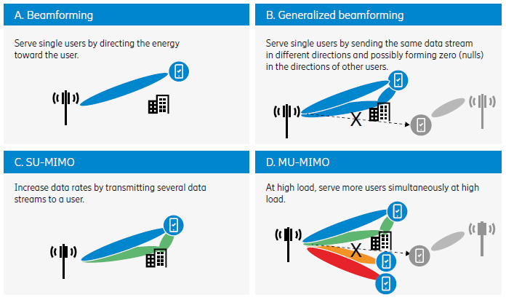
5G New Radio Evolution
In the RAN 5G New Radio (NR) extends frequency spectrum, simultaneous multi-band communications to a base station/multi-base station access:
Frequency Range 1 (FR1) – 410 to 7125 MHz
Frequency Range 2 (FR2) – 24250 to 52600 MHz
Massive Multiple-Input Multiple-Output (mMIMO)
MIMO uses multiple antennas to increase radio signals focus/ jammer nulling
MIMO also acts as a bandwidth multiplier while using the same frequencies
Massive MIMO utilizes larger antennas arrays increase that focus & bandwidth
Base stations can communicate with multiple users simultaneously
Users to multiple base stations simultaneously
From Ericsson white paper GFMC-18-000530, November 2018
Advanced Antenna Systems for 5G networks

Slide 28
5G SA Slicing
Virtualized network elements running on shared hardware enables slicing
Software defined networking multiplexes those virtualized and independent logical networks on the same physical infrastructure
Each network slice is an isolated end-to-end network, tailored to fulfill diverse requirements requested by a particular customer or application
Control
Data

Slide 29
5G SA Attach Sequence
Slicing is supported as the 5G sequence allows choosing the network elements at each stage

Slide 30
5G SA Attach Sequence (cont.)
Security during connectivity has improved

Slide 31
5G SA Attach Sequence (cont.)
Now can connect to application function services positioned within the core

Slide 32
Knows How
Mobile Network Simulation

Slide 33
Mobile Network Simulation
Create and apply to mobile network simulation scenarios
Knows How - Agenda
Mobile network modeling and simulation taxonomies
Modeling and simulation progressive elaboration
Simulation mechanism and application
Does
Shows How
Knows How
Knows

Slide 34
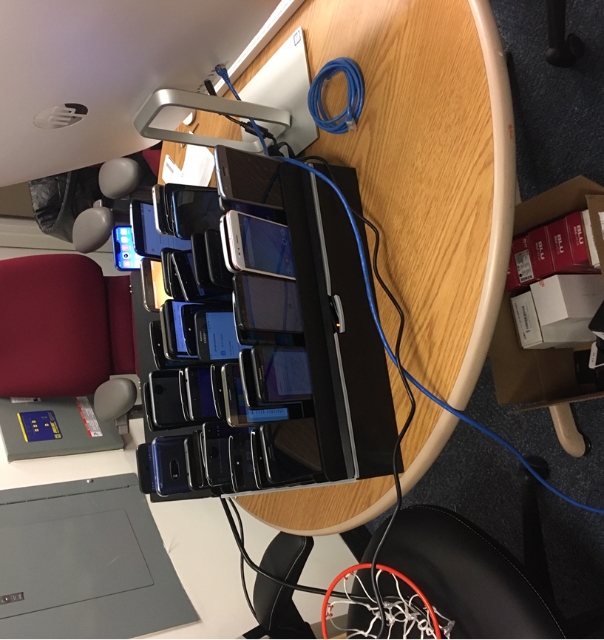
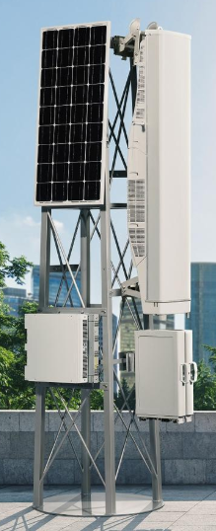
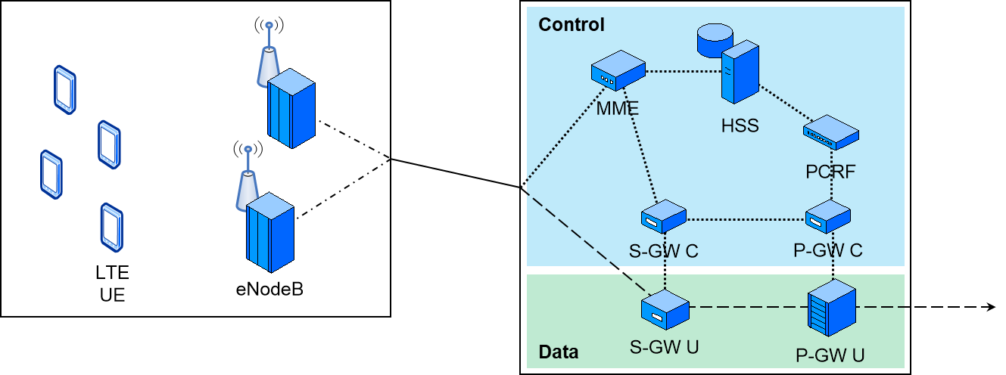
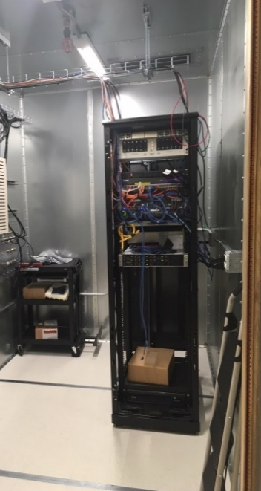
Mobile Network Modeling and Simulation Taxonomies
Live user equipment (phones), base stations, and core network elements (not shown)
Virtual
emulated systems
Constructive simulations
Note that some core elements in legacy systems were run on big iron machines, however, in today’s environment may now be live but virtualized software running on commodity servers

Slide 35
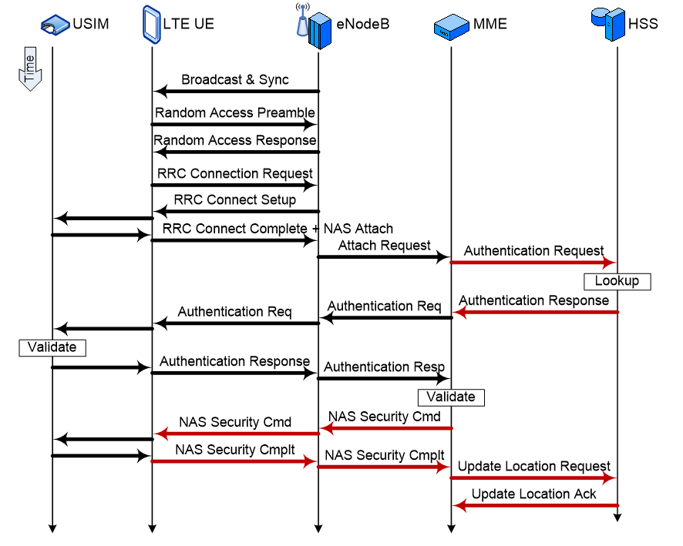
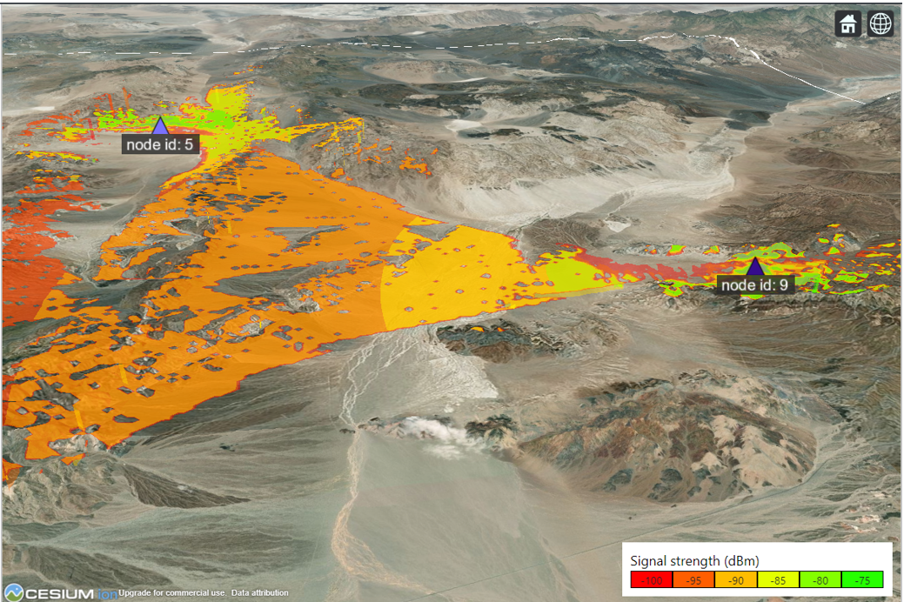
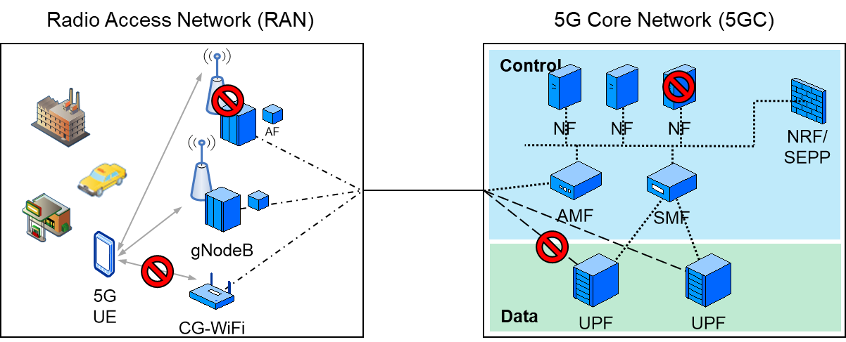
Modeling and Simulation Progressive Elaboration
Precision
Placement
Simple
Scenarios
Complex
Scenarios
Complex
Manipulation
Insert new RAN device
Hardened phone
IoT device
Jammer
IMSI catcher
New device protocol analysis
Test multi-location
multi-frequency multi-rate
simultaneous access
Cyber integration heterogeneous live/virtual/emulated network elements with distributed connectivity

Slide 36
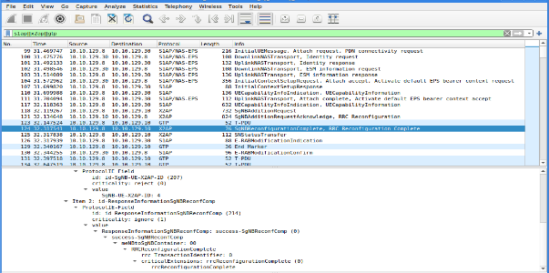
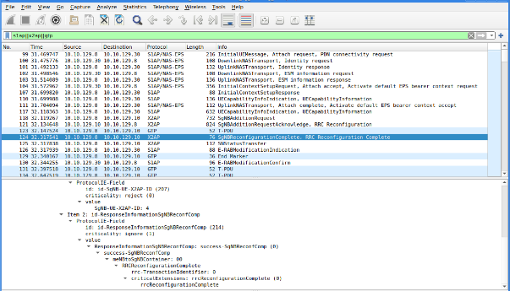
Simulation Mechanism and Application
Simulation UI
Simulation Fidelity
Live evaluation/analysis
Fully simulated
Simulated call flows
Emulation
Bit-accurate call flows
Emulation w hardware in the loop
(Hardware may be virtualized network elements)
Bit-accurate call flows
Test and train with live systems

Slide 37
Shows How
5G Modeling and Simulation Scenarios

Slide 38
5G Modeling and Simulation Scenarios
Exercising 5G modeling and simulation scenarios
Shows How - Agenda
RF coverage mapping
Mobility user equipment movement, monitoring offload from 4G to 5G
Bit-accurate packet captures for analysis
Does
Shows How
Knows How
Knows

Slide 39
5G Modeling and Simulation of RF Coverage
Modeling and simulation of new radio for mission rehearsal
EXata release 7.2 5G NSA/SA simulations with terrain
Coverage of two 5G base stations (approximately 22 miles apart)

Slide 40
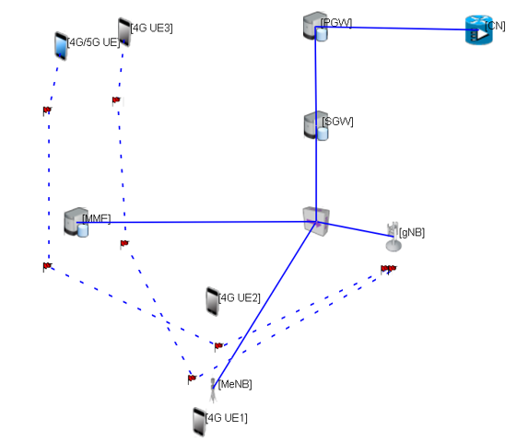
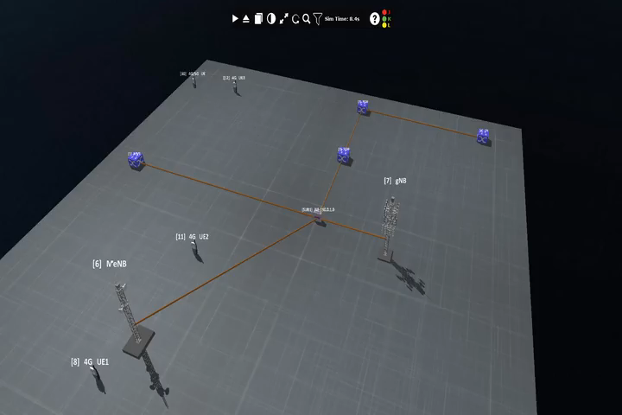
5G Modeling and Simulation of 4G & 5G Phones Movement
5G NSA offloading scenario – user equipment movement video

Slide 41
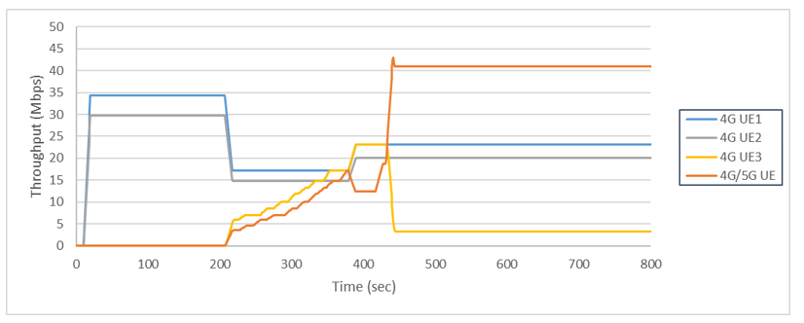
5G Modeling and Simulation of 4G & 5G Phone Analysis
5G NSA offloading scenario – user equipment throughput
Test scenarios can simulate location, RF jamming, and kinetic/cyber effects
Same scenarios can emulate on a test range using bit accurate models to live hardware

Slide 42
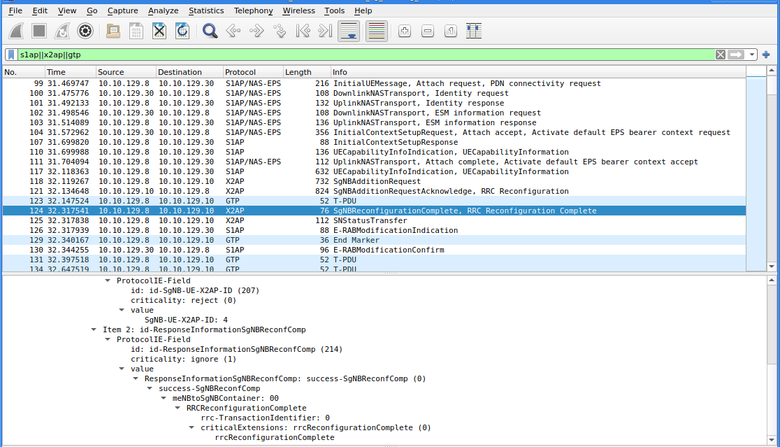
5G NSA Attach Sequence
Using standard network analysis tool Wireshark to capture of traffic across the live and emulated network to a live UE to 4G/5G NSA RAN

Slide 43
Does
Network Scenarios with Cyber Events

Slide 44
Network Scenarios with Cyber Events
Use of 5G mobile network simulation scenarios
Does - Agenda
Security evaluation of 5G RAN and Core
Multi-domain operations in the 5G environment
Does
Shows How
Knows How
Knows

Slide 45


Security Evaluation of 5G Radio Access Network
Radio Access Network (RAN)
5G Core Network (5GC)
Control
Data
Live SIM Card
IMSI Catcher
Validation of enhanced cybersecurity 5G Cybersecurity Protection
Test IMSI Catching in 4G and 5G Scenarios → 5G protects against IMSI catcher
Incorporation of secure protocols throughout the RAN → 5G encrypted backhaul protects RAN
Automated reporting of rogue base station lure attempts → 5G management system id rogue elements

Slide 46
Security Evaluation of 5G Core Network
Radio Access Network (RAN)
5G Core Network (5GC)
Control
Data
Live SIM Card
Validation core configuration threat resistance 5G Cybersecurity Protection
Probe Security Edge Protection Proxy (SEPP) firewall → 5G protects from bad external control traffic
Check Network Exposure Function (NEF) M2M comms → 5G brokering internal services packets
Disrupt critical servers & links to ensure failover → 5G effects on live virtualized/sim network

Slide 47






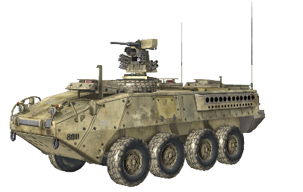
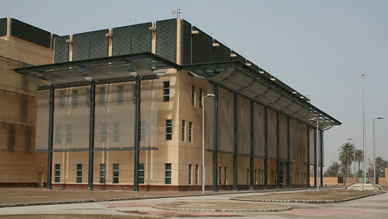
Multi-Domain Operations in the 5G Environment
Remote IIoT power station
Combined forces
Response
High value target
Perform combined operations on high value target test range
Introduce cyber effect on integrated live elements
Compromise of target infrastructure leading to physical degradation
Simultaneous 5G enabled UAS attack, reporting, and counter-attack
Mitigation through pre-simulated machine analytics
5G resiliency contributing to high-speed communications mission support

Slide 48
Conclusion
This presentation provides a comprehensive introduction to mobile networks and network modeling and simulation
5G increases the complexity, security and resiliency of modern mobile networks
Modeling and simulation systems that can train the warfighter on 5G EW/cyber scenarios is key to minimizing risk and increasing situational awareness
With the expansion of our military including cyber and Space forces, training systems need to be modernized to incorporate high-fidelity interaction between cyber and other new/traditional domains
Understanding how modeling and simulation supports MDO with integrated cyber scenarios is key to modernizing the military’s test, train, exercise, and analysis activities!

Slide 49
Standards Reference
The 3rd Generation Partnership Project (3GPP) – www.3gpp.org
European Telecommunications Standards Institute (ETSI), has now grown to worldwide standards development & promulgating their adoption
Initially developed standards for 3G (hence the increasingly obsolete name):
UMTS Terrestrial Radio Access Network (UTRAN)
UTRAN / W-CDMA core network
Release 8 specification introduced 4G LTE networks
Releases 9 through 14 cover additional LTE features
Release 15 introduces 5G technologies
Release 16 up to currently 17 improving 5G capabilities

Slide 50
References
Motivation and Use Cases
DOD (2020). Department of Defense (DoD) 5G Strategy (U).
INSA (2019). The National Security Challenges of Fifth Generation (5) Wireless Communications. Winning the Race to 5G Securely. Cyber Council
Broussard, G, Kelley, B., Thomas, D. (2021), JBSA Experiment Update 2013 5G Core Security – Telemedicine Industry Day: DoD 5G Tranche NSC/SF Industry Day. (May 6, 2021 presentation)
Learning Theory
Miller GE. (1990). The Assessment of Clinical Skills/Competence/Performance: Acad. Med.
History, Terminology, Basics
5GPPP, A. W. (2020). View on 5G Architecture. European Commission: 5GPPP.
Tabbane, S. (2019). 5G Networks and 3GPP Release 15, ITU PITA Workshop on Mobile network planning and security, Nadi, Fiji Islands: ITU.
de Looper, Christian (March 27, 2020). What is 5G; The next Generation network explained. Digital Trends
TR 21.915. (2019). 3rd Generation Partnership Project; Technical Specification Group Services and System Aspects; Release 15 Description; Summary of Rel-15 Work Items. Valbonne, France: 3GPP
TS 22.261. (2020). 3rd Generation Partnership Project: Technical Specification Group Services and System Aspects; Service requirements for the 5G system; Stage 1 (release 17). Various: 3GPP.
Ericsson (2018). Advanced antenna systems for 5G networks, GFMC-18-000530

