Slide 1


Addressing the Challenges
of Rigorous Model Validation
Simone M. Youngblood
Johns Hopkins University Applied Physics Laboratory
240-228-7958 Simone.Youngblood@jhuapl.edu
Mikel D. Petty, Ph.D.
University of Alabama in Huntsville
256-824-6140 pettym@uah.edu

Slide 2
Rigorous Validation Tutorial Learning Objectives
Primary Objective: Define how to identify, collect, and combine validation referent data and to apply that data when performing simulation results/referent validation comparison. When adopted, these concepts will support the implementation of rigorous validation.
Key Learning Objectives:
  The learner will be able to define and distinguish key verification and validation terms.
  The learner will be able to define the central role of the referent.
  The learner will be able to list and compare the various approaches used to assemble an effective referent.
  The learner will be able to define what constitutes rigorous validation.
  The learner will be able to match validation methods to the available referent.

Slide 3
Presentation outline
  Background
    Motivation
    Definitions
    Validation uncertainty and risk
    Verification and validation processes and methods
  Assembling an effective referent
    The ideal referent as the basis for validation comparison
    Challenges and obstacles to developing the ideal referent
    Best practices and obstacle mitigation
    Examples
  Selecting and applying the appropriate method
    Referent and intended use data relationships
    Examples of applying validation methods for both point value and time series data based on the referent
  Conclusions and recommendations

Slide 4
Presentation outline
  Background
    Motivation
    Definitions
    Validation uncertainty and risk
    Verification and validation processes and methods
  Assembling an effective referent
    The ideal referent as the basis for validation comparison
    Challenges and obstacles to developing the ideal referent
    Best practices and obstacle mitigation
    Examples
  Selecting and applying the appropriate method
    Referent and intended use data relationships
    Examples of applying validations methods for both point value and time series data based on the referent
  Conclusions and recommendations

Slide 5
Motivation
Decision makers are demanding that previous “informal” methods of validation be supplemented or replace with quantitative, defensible, rigorous methods.
All M&S, when used to support operational tests and evaluations, should not be accredited until a rigorous comparison of live data to the model's predictions is done … and those predictions are found to have replicated live results with sufficient accuracy for the intended evaluation in the intended domain [Gilmore, 2016]
I expect the validation of M&S to include the same rigorous statistical and analytical principles that have become standard practice when designing live tests. [Gilmore, 2016]

Slide 6
Definition: Model
Model. A physical, mathematical, or otherwise logical representation of a system, entity, phenomenon, or process. [DOD, 2011]
To an observer B, an object A* is a model of an object A to the extent that B can use A* to answer questions that interest him about A. [Minsky, 1965]
  Representation of a real or notional system
  Some aspects of the modeled system are represented in the model, others are not (abstraction)

Slide 7
Definition: Simulation
Simulation. [Executing] a model over time. [DOD, 2011]
The imitation of the operation of a real-world process or system over time. [BanksJ, 1998]
A technique for testing, analysis, or training in which real world systems are used, or where a model reproduces real world and conceptual systems. [DOD, 1996]
Alternative uses of the term
  A large composite model (avoid)
  Software implementation of a model (avoid)
  Application of a model to solve a problem [Velten, 2009]
  An experiment performed on a model [Fritzson, 2004]
  Several others [Ören, 2009] [BanksC, 2010]

Slide 8
Definitions: Simuland and Referent
Simuland. The subject of a model or simulation.
  A real-world (or notional) system of interest
  Object, phenomenon, or process to be simulated
Referent. The body of knowledge available to the modeler or validation agent regarding the simuland.
  Quantitative and formal, e.g., differential equations for aircraft flight dynamics
  Qualitative and informal, e.g., pilot’s expectation of buffet before stall
Referent: “The best of most appropriate codified body of information available that describes characteristics and behavior of the reality represented in the simulation from the perspective of validation assessment for the intended uses of the simulation.”

Slide 9
Referent sources
Information used as the referent may consist of
  Empirical data; observations of the simuland, collected either under controlled circumstances, e.g., tests or experiments, or in the field
  Theoretical data; calculated using equations or algorithms that describe simuland characteristics, behaviors, and relationships; equations known or assumed to be correct
  Simulation data; results generated by simulations; models known or assumed to be valid
  Subject Matter Expert knowledge
  Combinations of these

Slide 10
Definition: Intended use
Intended use. The purpose for or function of a model; what the model will be used for; the problem to be addressed by the model. [DOD, 2012]
Characteristics [Piersall, 2014]
  “Not a capability, solution, or implementation”
  Expressed from the perspective of the user
  Should be formally specified
“Any attempt to suppress the role of the intentions of the investigator, B,
leads to circular definitions or to ambiguities about essential features ...” [Minsky, 1965]
“Modeling and simulation is always goal-driven, … , we should know the purpose
of our potential model before we sit down to create it.” [Cellier, 1991]

Slide 11
Definition: Verification
Verification. The process of determining that a model implementation and its associated data accurately represents the developer’s conceptual description and specifications. [DOD, 2009]
  Transformational accuracy [Balci, 2002]
    Transform specifications to code
  Software engineering quality
    Software engineering methods apply

Slide 12
Definition: Validation
Validation. Determining the degree to which a model or simulation and its associated data are an accurate representation of the real world from the perspective of the intended uses of the model. [DOD, 2009]
Comparing model results with experimental data [Velten, 2009]
  Representational accuracy [Balci, 2002]
    Recreate simuland with results
  Modeling quality
    Special validation methods needed

Slide 13
Sources of uncertainty in M&S [Pace, 2009]
Application domain
(simuland)
knowledge and theory
Simulation results
interpretation
Uncertainty
Simulation purpose,
intended use,
and requirements
Validation referent
Conceptual model
and software design
Simulation inputs
and use
Software
implementation

Slide 14
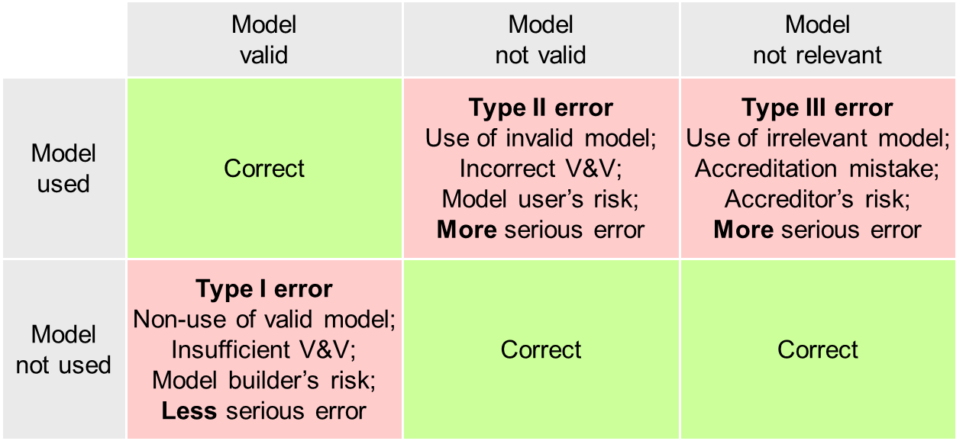
VV&A errors and risks [Balci, 1981] [Balci, 1985] [Balci, 1998]

Slide 15
Summary of VV&A processes
Requirements
analysis
Requirements
Simuland
Modeling
Accreditation
Modeling
Validation
Validation
Verification
Results
Conceptual
model
Simulation
Implementation
Verification
Transformation
Comparison
Executable
model
[Petty, 2009b]
[Petty, 2010]

Slide 16
Summary of V&V methods
  Many V&V methods available, ~85 in 1998 [Balci, 1998],
  more developed since [Balci, 2002] [Petty, 2010]
  Different purposes, advantages, suitable models
[Balci, 1998]
Informal | Static | Dynamic | Formal
-Audit -Desk checking -Documentation Checking -Face validation -Inspections -Reviews -Turing test -Walkthroughs | -Cause-Effect Graphing -Control Analysis -Data Analysis -Fault/Failure Analysis -Interface Analysis -Semantic Analysis -Symbolic Evaluation -Syntax Analysis … | -Acceptance Testing -Alpha Testing -Assertion Checking -Beta Testing -Bottom-up Testing -Comparison Testing -Statistical Techniques -Submodel/Module Testing … | -Induction -Inductive Assertions -Inference -Logical Deduction -Lambda Calculus -Predicate Calculus -Predicate Transformation -Proof of Correctness

Slide 17
Presentation outline
  Background
    Motivation
    Definitions
    Validation uncertainty and risk
    Verification and validation processes and methods
  Assembling an effective referent
    The ideal referent as the basis for validation comparison
    Challenges and obstacles to developing the ideal referent
    Best practices and obstacle mitigation
    Examples
  Selecting and applying the appropriate method
    Referent and intended use data relationships
    Examples of applying validation methods for both point value and time series data based on the referent
  Conclusions and recommendations

Slide 18
The ideal referent for validation comparison
  Covers the operational/domain space of interest as bounded by the intended use
  [Gilmore, 2016]
    Provides data on the aspects of the operational envelope/behavior space that will be covered by the M&S
    Addresses variations in factors affecting performance/behavior w. r. t. response variables of interest
    Supports interpolation between known data points vice extrapolation beyond known data
  Is drawn from observations of the simuland [RPG, 2011]
    Under controlled circumstances such as tests and experiments
    Under natural or operational circumstances
  Is drawn from authoritative data
    Test data adjudicated by Data Authentication Group review to address measurement errors,
    incomplete data, etc. [ATEC, 2004]
  Identifies any areas of known uncertainty

Slide 19
Challenges and obstacles to developing the ideal referent
  Ill defined intended use
    Lack of definition of the model/simulation’s coverage of the domain space
    Lack of test scenarios that will align test and simulation data
  Inconsistencies between referent and simulation data
    Metrics of interest
    Factors that affect performance
  Limited/no referent data available
    Complexity of system/behaviors represented imposes limitations (e.g., resource, economic) on the development of quantitative referent data
    Domain of Interest does not support quantitative referent development (e.g., Department of Energy, NASA)
  Economic limitations

Slide 20
Best practices and obstacle mitigation
  Start early – validation referents take time to develop
    Need to identify scope of information needed
    Need to coordinate with others (e.g., testers, SMEs) to produce referent data
    Need to budget for referent development
  Ensure accreditation authority concurrence
  “Grow” referent information over time
    Leverage all sources of test data (e.g., ground test, HWIL, live fire)
  Maximize extent of referent coverage of the operational/behavioral space as defined by the intended use
  Define areas of uncertainty
    Limitations of M&S coverage
    Limitations of referent data

Slide 21
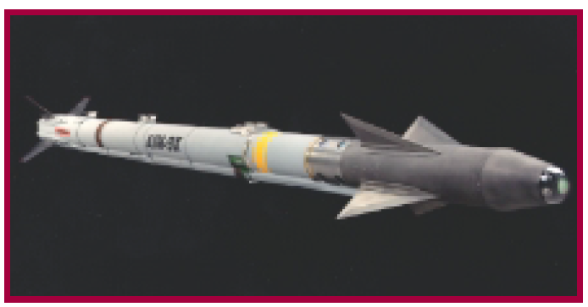
AIM9X: Simulation Enhanced Operational Test
  Limited test shots, with maximum operational envelope coverage to support validation referent development
  Adopted Model-Test-Model [Mansager, 1994] paradigm to continually assess validation referent development
  Applied a statistical methodology (Fisher Test) to validate the simulation
  Validated M&S used to satisfy all system performance requirements [IDA Research Summaries, 2001]
  27 DT/OT shots in 2000 time frame vice 103 DT/69 OT shots in the 1980s [DOT&E, 2000]
  AIM9X awarded NTSA 2001 M&S Industry Award
AIM9X Missile

Slide 22
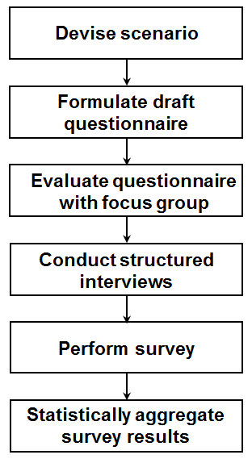
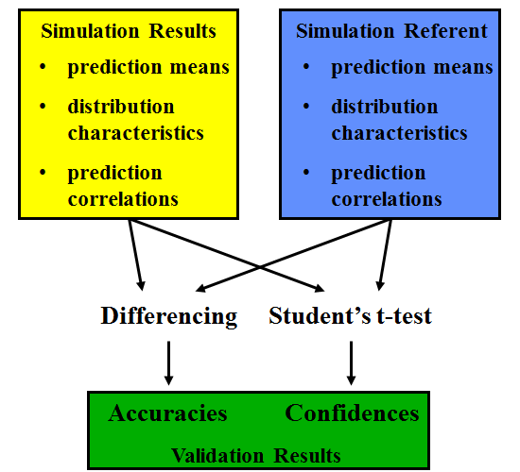
Developing a rigorous SME referent [Metz, 2001]
  Validation focus - a campaign-level simulation
  No real world referent available - thus reliant on SME assessment
  Increase SME sample size (from one to multiple)
  Apply best practice in survey research to develop questionnaire
  Statistical assessment of survey results to identify common trends and sources of referent uncertainties
  Knowledge of referent uncertainty is necessary for evaluating the risk of simulation use

Slide 23
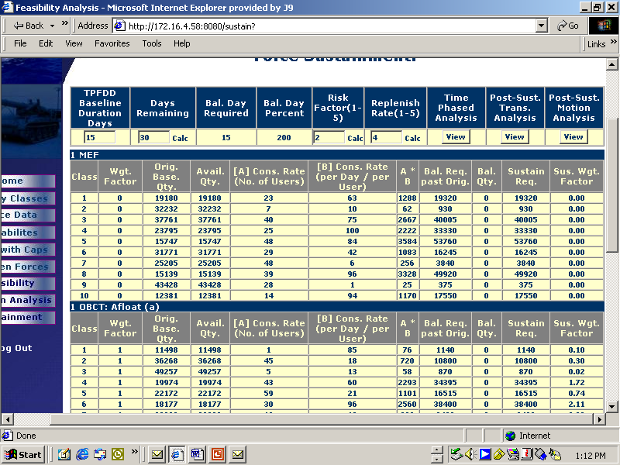
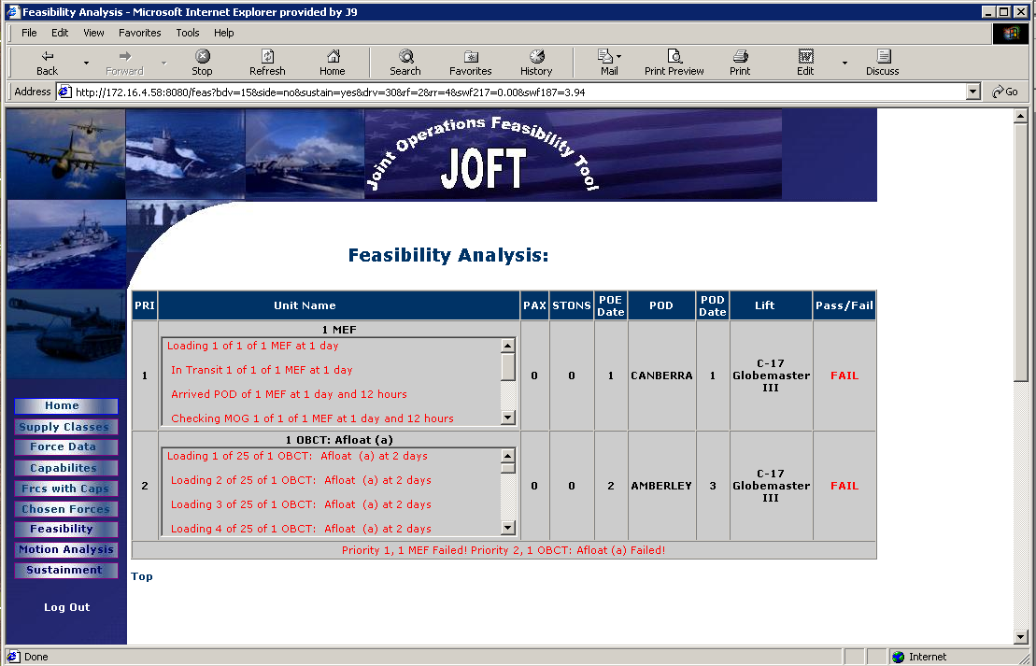
Structured face validation example [Belfore, 2004]
  Joint Operations Feasibility Tool
    Assess deployment transportation feasibility
    Assess logistical sustainment feasibility
  Validation process
    Special scenarios exercise full range of capabilities
    20 SMEs with extensive experience evaluated model
    Assessments elicited via written questionnaires
  Process structure addressed face validation limits

Slide 24
Presentation outline
  Background
    Motivation
    Definitions
    Validation uncertainty and risk
    Verification and validation processes and methods
  Assembling an effective referent
    The ideal referent as the basis for validation comparison
    Challenges and obstacles to developing the ideal referent
    Best practices and obstacle mitigation
    Examples
  Selecting and applying the appropriate method
    Referent and intended use data relationships
    Examples of applying validation methods for both point value and time series data based on the referent
  Conclusions and recommendations

Slide 25

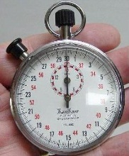
Considerations when selecting V&V methods
01010100010100101
10010101000100101
10101011101010111
10110010100101000
10010101101010101
h(t) = –4.9t² + vt + s
Model
Referent
Certain methods
apply best to specific
types of model
Certain methods
require specific types
or amounts of referent data
Method
Some methods
require more resources
than others
Some methods
require specific
skills to apply
Resources
Skills
Problems can arise if the considerations conflict

Slide 26
Referent/intended use data relationships
x₂
x₂
U
R
R
R
U
Data range of
Referent
x₁
x₁
R ⊆ U
U ⊆ R
x₂
x₂
U
U
U
Data range of
Intended use
R
R
x₁
x₁
R ⊈ U, U ⊈ R, R ∩ U ≠ ∅
R ∩ U = ∅

Slide 27
Referent to validation method mapping (simplified)
Sources of
referent information
Forms of
referent information
Applicable rigorous
validation methods
Empirical data
Single observation
or few observations
Confidence intervals
Multivariate confidence intervals
Theoretical data
Many observations
Hypothesis tests for
means, variances,
proportions, and distributions
Simulation data
Paired observations
Regression analysis
Subject Matter
Expert knowledge
Expectations and
experience
Structured face validation
Turing test

Slide 28
Hypothesis testing [Brase, 2015]
  Validation concept and interpretation
    Useful when multiple simuland observations available
    Test whether simuland observations consistent with model results
    Perform hypothesis test comparing means, variances, and/or distributions of simuland and model for response variable
    If hypothesis test does not reject assumption of validity, then model considered valid for that response variable
  Comments
    Simuland population is all possible observations, sample is the observations actually obtained
    Model population is all possible simulations with the model, sample is the simulations actually executed
    Conventional assumption (null hypothesis) is that the parameters being tested are equal,
    i.e., model is valid

Slide 29
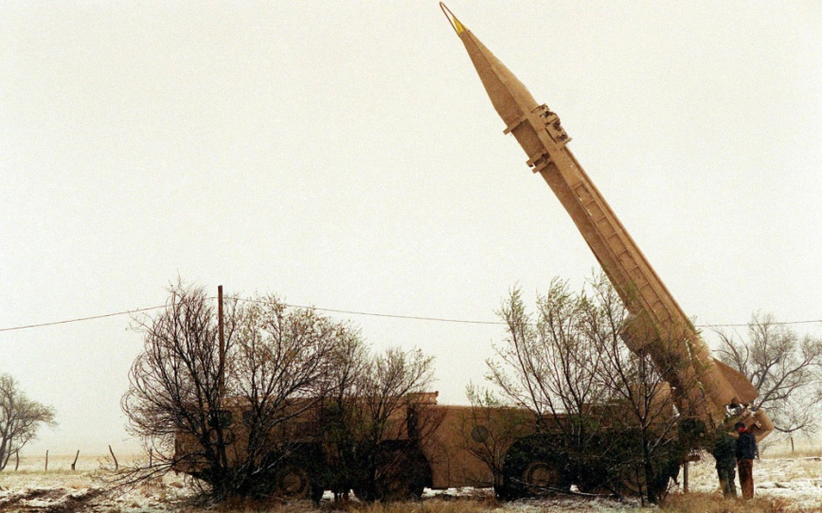
Hypothesis testing example [Zhang, 2008]
  Comparison of simuland and model variances
  Simuland: Scud missiles
    Scud: single stage liquid fuel tactical ballistic missile
    Range 180 Km (Scud-A) to 700 Km (Scud-D)
    Deployed and used widely in Middle East and Asia
  Model: Missile flight
    Physics-based 6DOF model
    MATLAB SIMULINK
    Initial conditions set using Monte Carlo methods
  Validation
    Do model and simuland impact dispersion match?
    Validated for x (range) and y (deflection) miss distances
    Validated for 60 Km and 100 Km
    6 live tests, 800 Monte Carlo trials at each distance

Slide 30
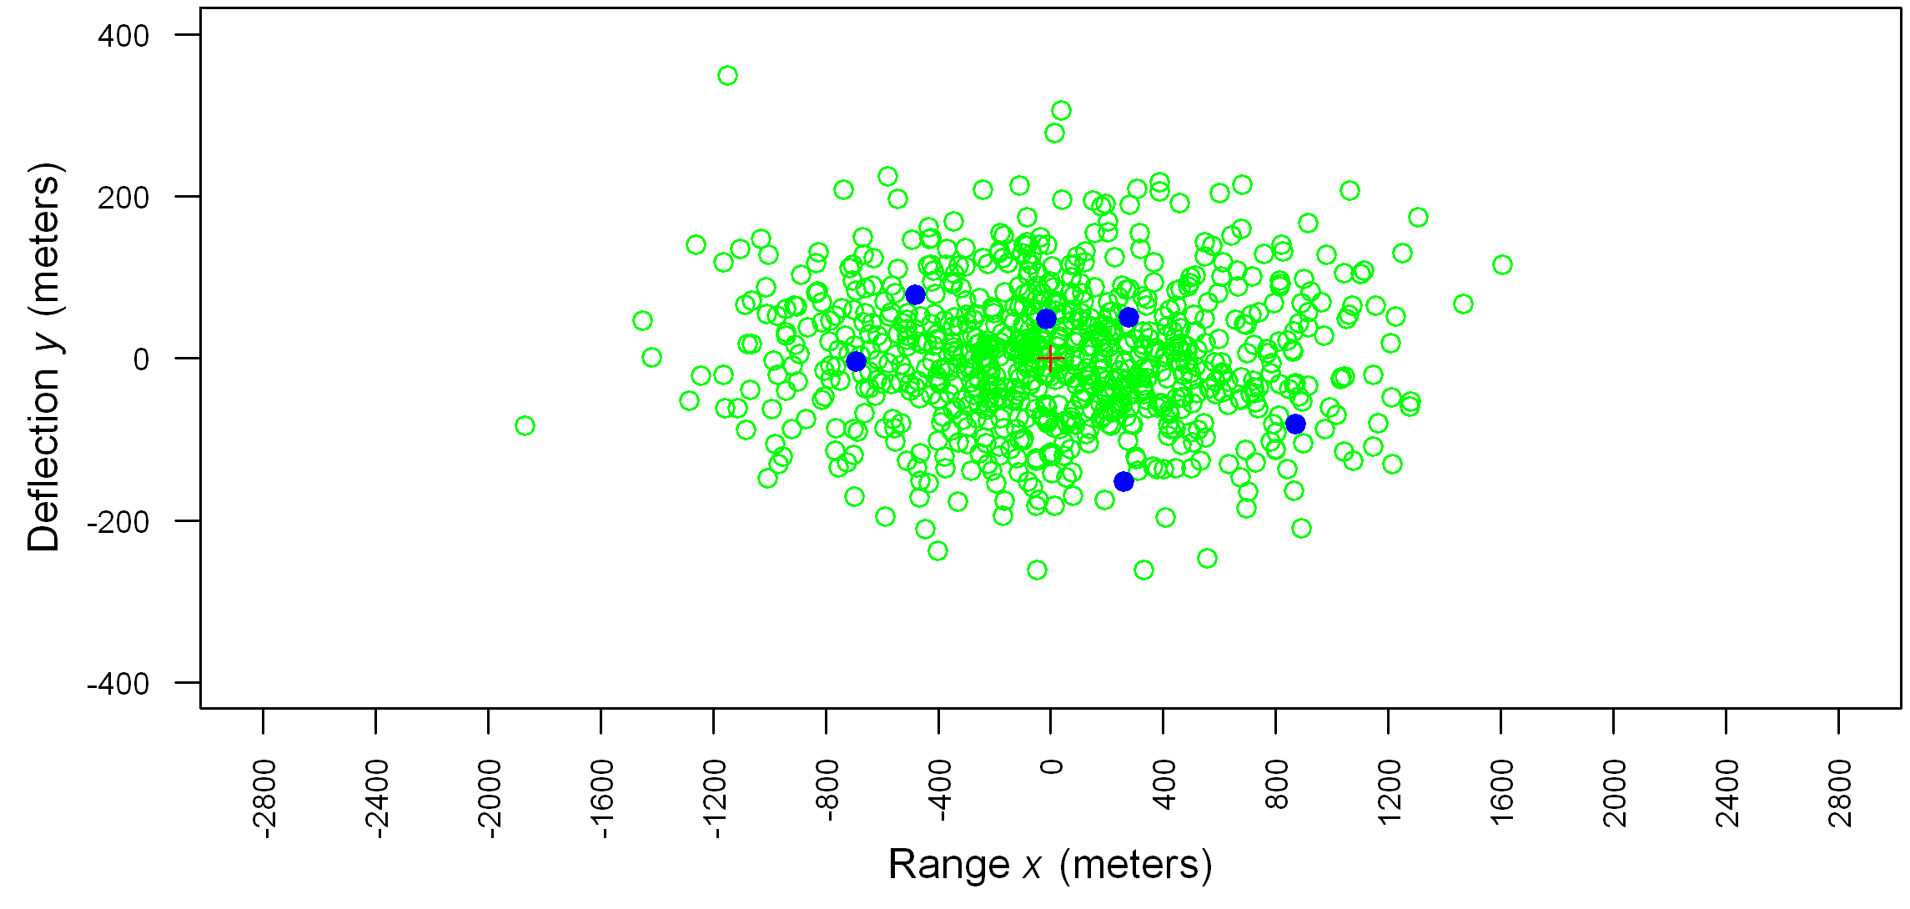
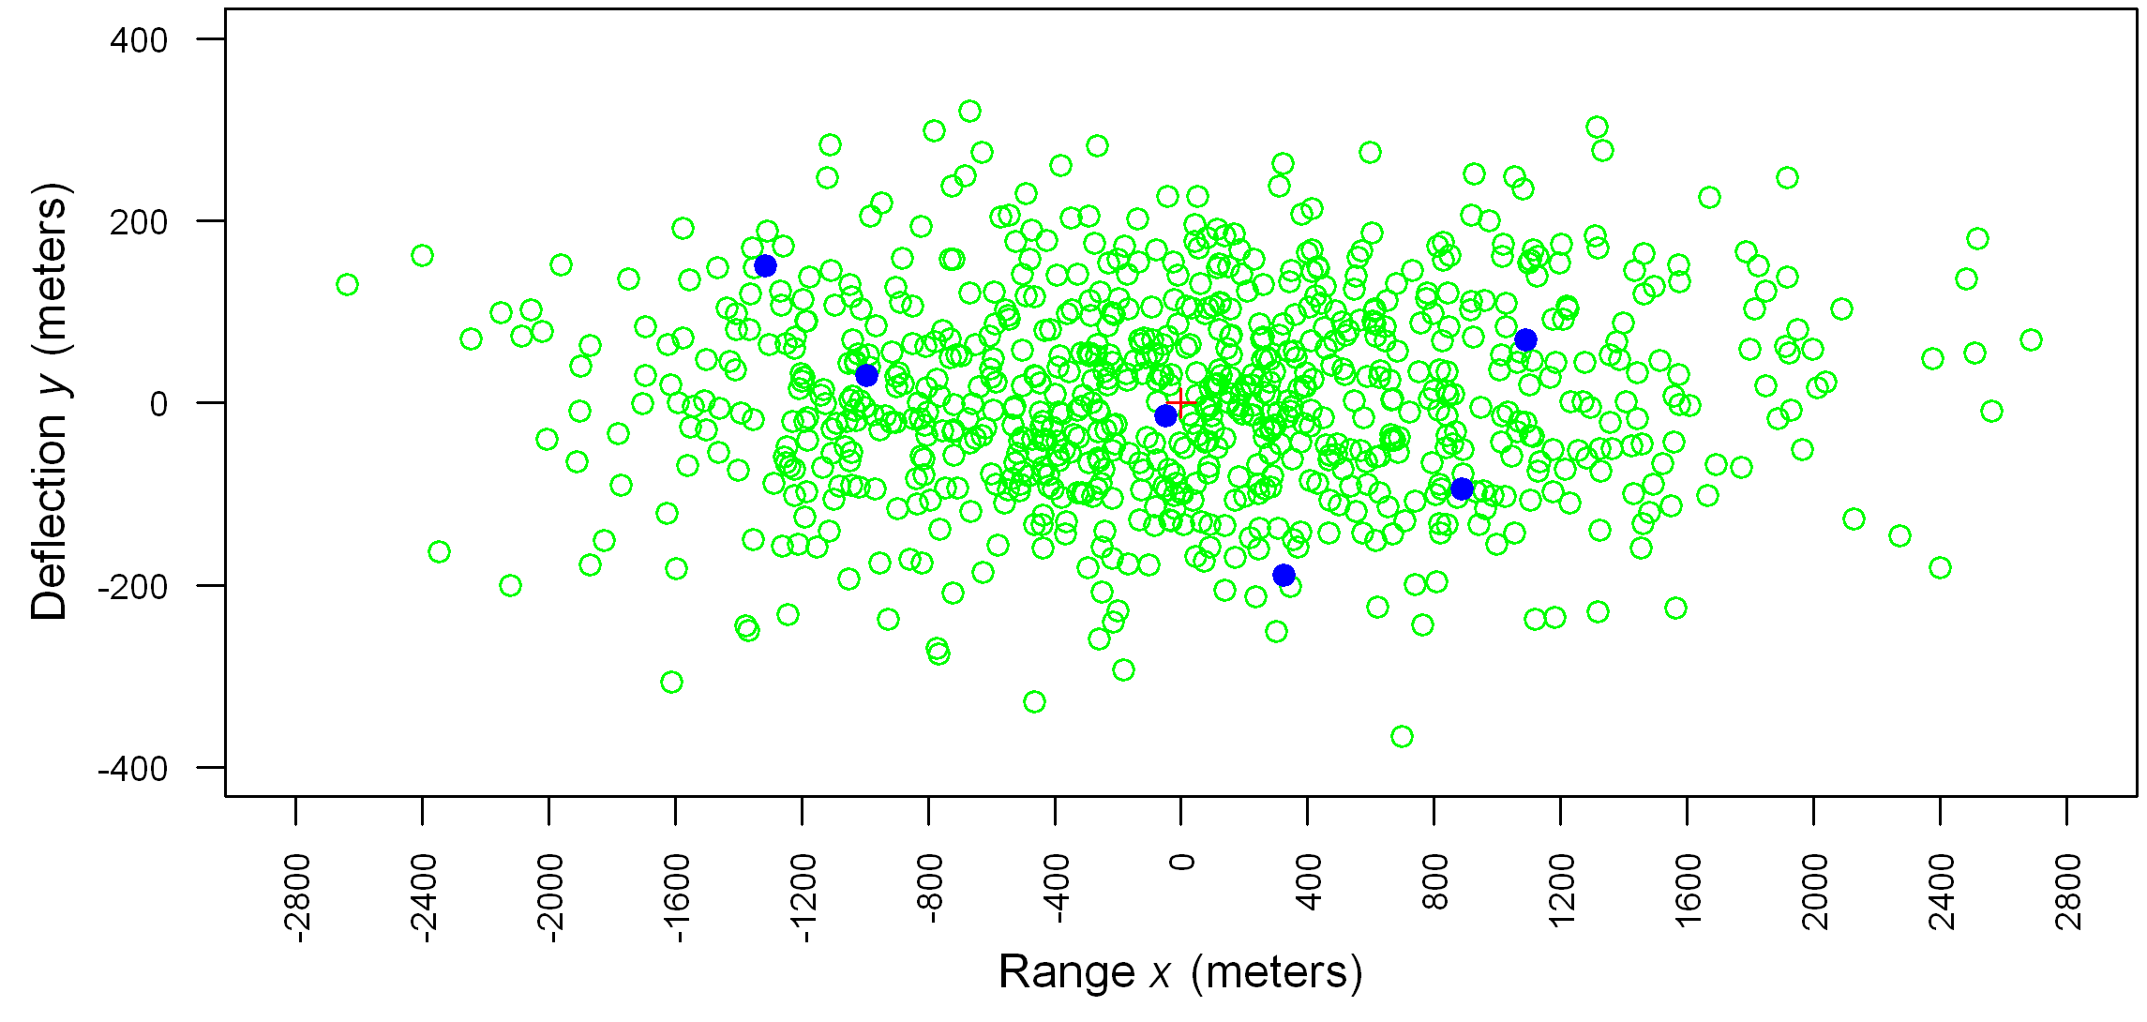
Validation Assessment Results
60 Km
Source
x err s
y err s
n
Model
535.08
85.75
800
Live
558.52
90.35
6
100 Km
Source
x err s
y err s
n
Model
921.39
111.25
800
Live
980.52
120.68
6

Slide 31
F-test: Hypothesis test for equality of variances
  Obtain samples, calculate sample statistics
  Set notation so that
  Select level of significance α; often α = 0.05
  Formulate hypotheses H₀ and H₁
  Calculate test statistic F using formula
  Given F, find P-value (table or software)
  If P-value ≤ α, then reject H₀, else accept H₀

Slide 32
Hypothesis test calculations
60 Km
100 Km
s₁
558.52
90.35
980.52
120.68
} Simuland
s₂
535.08
85.75
921.39
111.25
} Model
F
1.0895
1.1102
1.1325
1.1767
  Test statistic F calculated from simulation results
  P-value: probability of test statistic value, assuming H₀ true
  Test: P-value < α → reject H₀
  Interpretation: Do not reject H₀ → results match,
  i.e., model valid for x, y variances
d.f._{N}
5
5
5
5
d.f._{D}
799
799
799
799
P-value
0.3646
0.3534
0.3415
0.3188
F distribution P-value in Excel =FDIST(F,d.f._{N},d.f._{D})

Slide 33
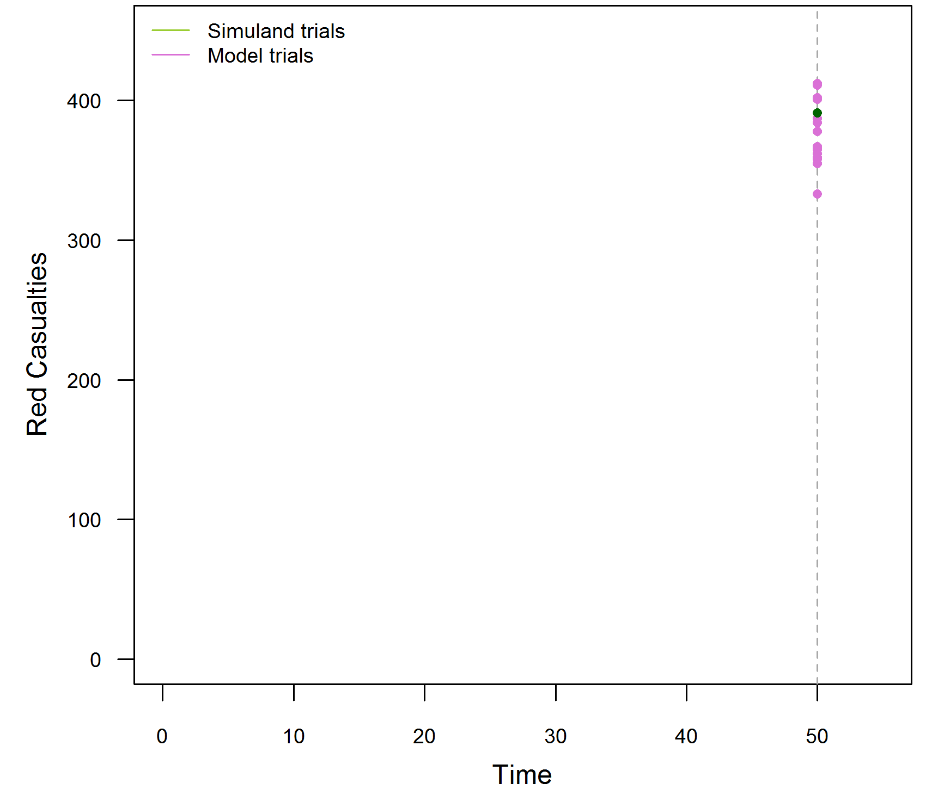
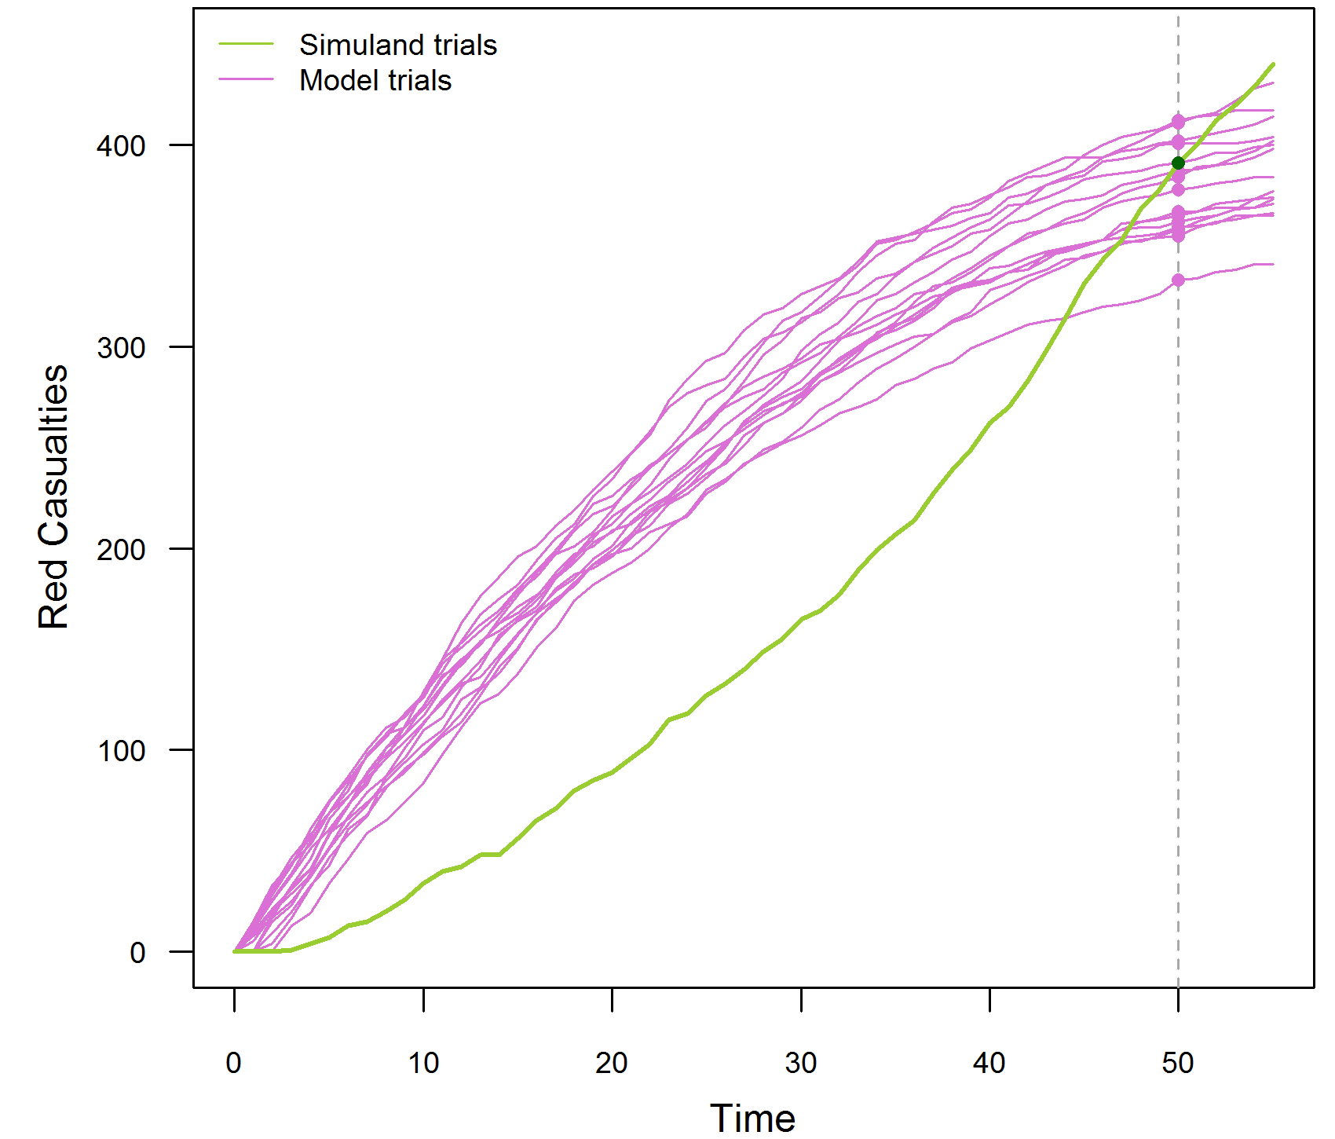
Time series example: Red casualties
1 “trial” of simuland, e.g., data from actual battle
15 trials (executions) of a model of the same battle
Red casualties at time 50 only
Model ≈ simuland
→ Model valid?
Red casualties at times 0–50
Model mostly ≠ simuland
→ Model not valid?

Slide 34
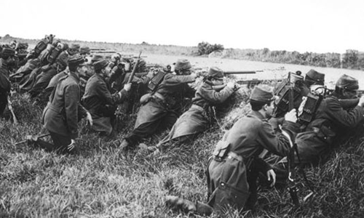
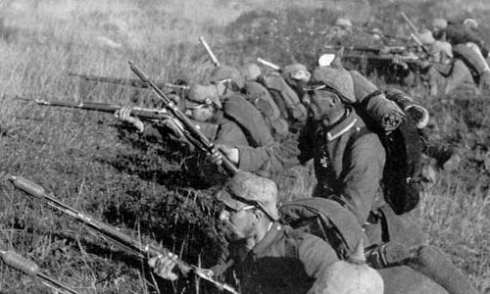
Example model: Attrition combat (1 of 4)
Description
  Force-on-force attrition
  Direct fire only
  Battle continues until one side “breaks”
  Parameters: strength, lethality, break point
  For a given set of parameter values, who wins?

Slide 35
Example model: Attrition combat (2 of 4)
Markov chain Lanchester attrition [Strickland, 2011]
Variables
  Blue strength B
  Red strength R
  Blue lethality (vs Red) K_{B}
  Red lethality (vs Blue) K_{R}
  Blue force casualty rate λ_{B} = K_{R} ∙ R
  Red force casualty rate λ_{R} = K_{B} ∙ B
  Assumptions and abstractions
  Direct fire only, no area weapons
  No maneuver
  All shooters on a side have same lethality
  Lethality does not change during battle, “stationary”
  Multiple shooters can engage a single target

Slide 36
Example model: Attrition combat (3 of 4)
Model basis
  Time between Blue casualties exponentially distributed;
  casualty rate λ_{B} = K_{R} ∙ R → mean intercasuality time 1/λ_{B}
  Time between Red casualties exponentially distributed;
  casualty rate λ_{R} = K_{B} ∙ B → mean intercasuality time 1/λ_{R}
  Model Logic
  Stochastically generate times of first Blue and Red
  casualties using the appropriate casualty rate
  Advance time to earlier casualty time
  Decrement strength of earlier casualty’s side
  Compare decremented side’s strength to break strength
  Generate time of next casualty for decremented side
  Repeat until one side breaks

Slide 37
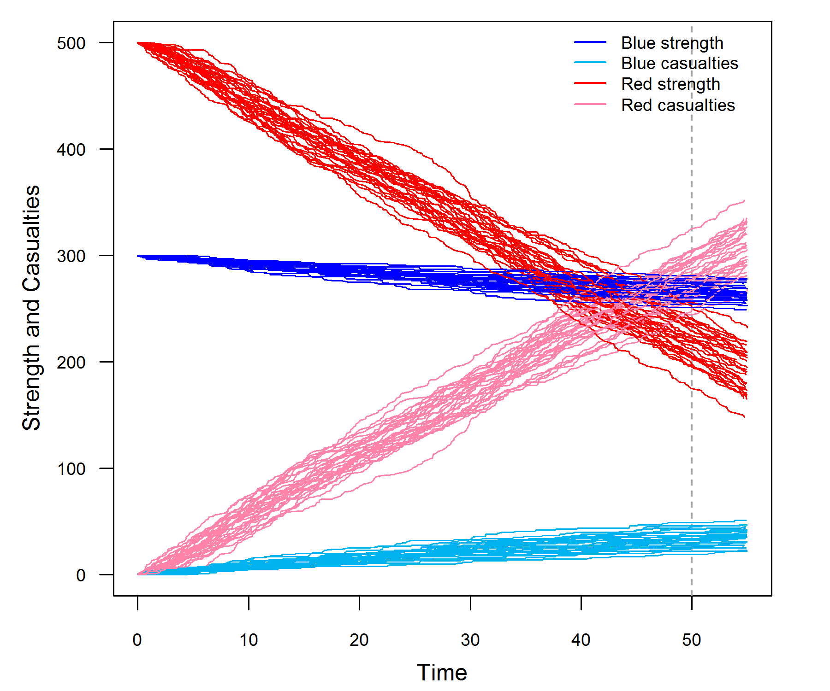
Example model: Attrition combat (4 of 4)
30 trials of model
4× time series: Red strength, casualties, Blue strength, casualties

Slide 38
Time Series Validation: Advanced Methods (not covered)
  Confidence interval methods (examples follow)
Method
Simuland
trials
Model
trials
Interval
bounds
OOB
limit
Examples
& Sources
A
1
1
Simuland ± SME ε
SME
[Engel, 1954]
[Petty, 2010]
B
1
Multiple
Model 95% c. i.
SME
[Herington, 2002]
[Champagne, 2007]
C
Multiple
Multiple
Simuland 95% c. i.
Model 95% c. i.
SME
[Law, 2015]
ε = time step value error tolerance
OOB = time steps out of bounds

Slide 39
Confidence intervals [Brase, 2015] [Petty, 2012] [Petty, 2013]
  Validation concept and interpretation
    Useful when only one (or few) simuland observations available
    Determine if simuland observation consistent with model results
    Calculate confidence interval for model response variable
    If confidence interval contains observed simuland value(s),
    then model considered valid for that response variable
  Comments
    Interval calculated from simulations is for model, not simuland
    Population is all possible simulations with the model, sample is the simulations actually executed
    No statistical justification or refutation for validation interpretation

Slide 40
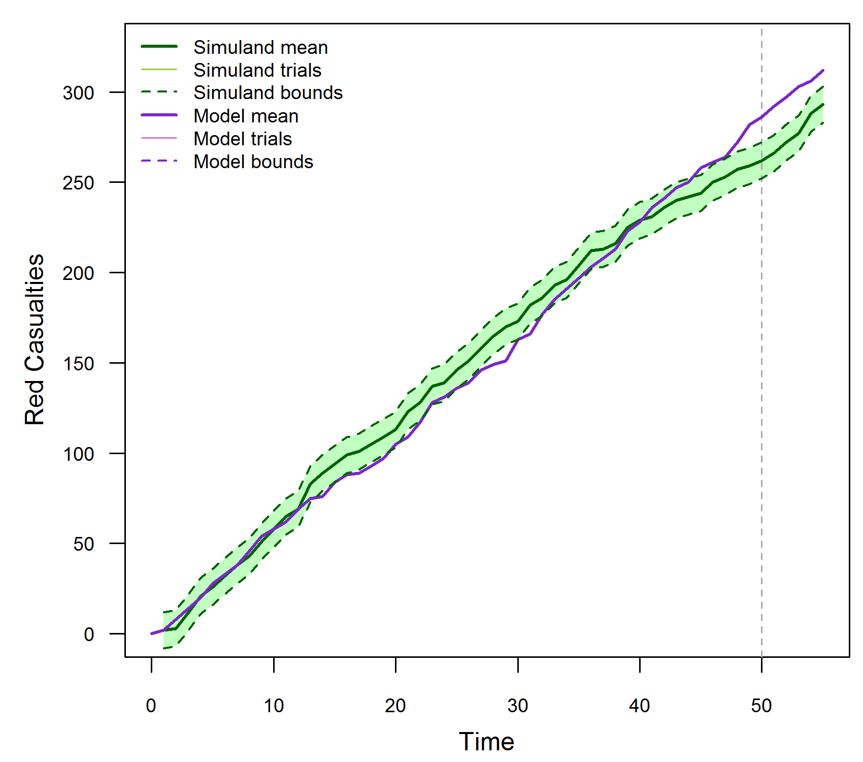
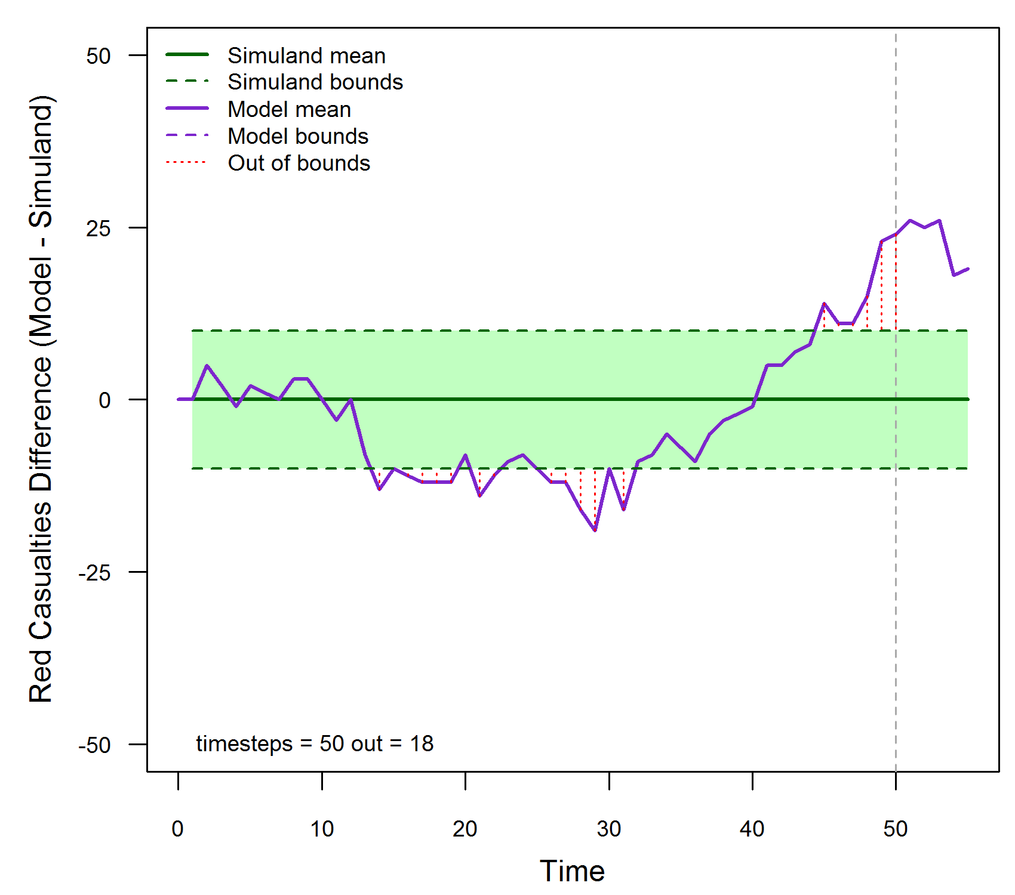
Example model: Method A (1 - 1)
SME: ε = 5, OOB limit = 10% = 5 time steps
Simuland: 1 trial with ± SME ε interval per time step
Model: 1 trial
OOB time steps > OOB limit → model not valid

Slide 41
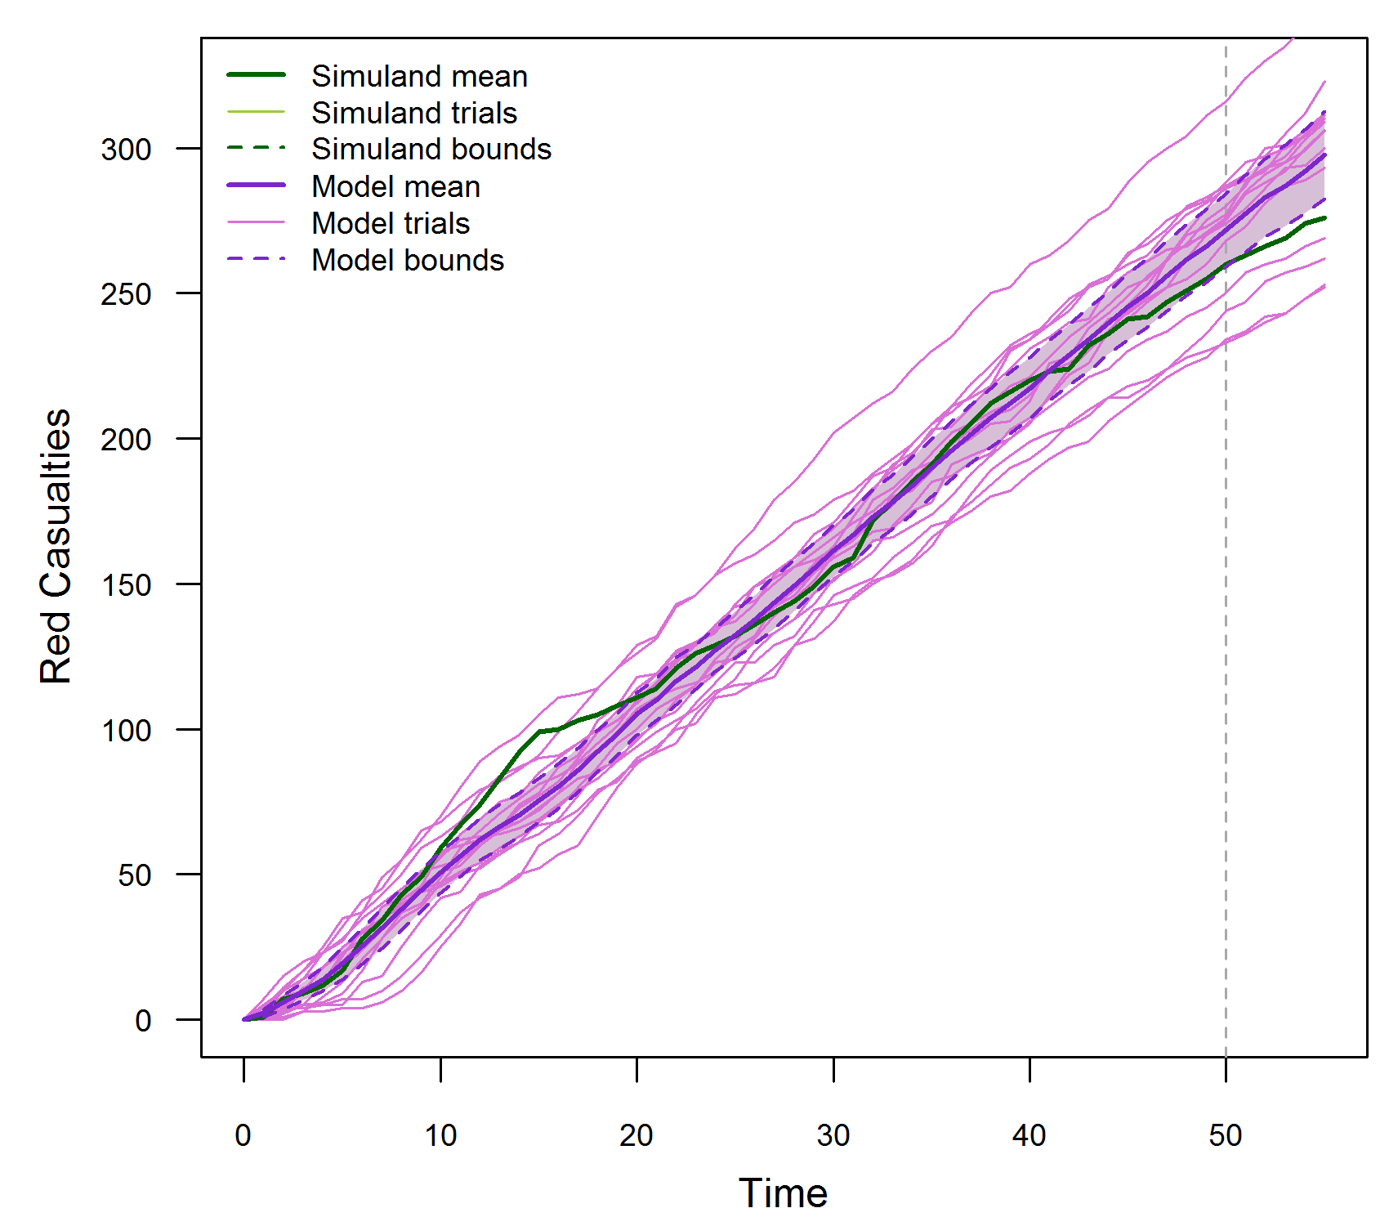
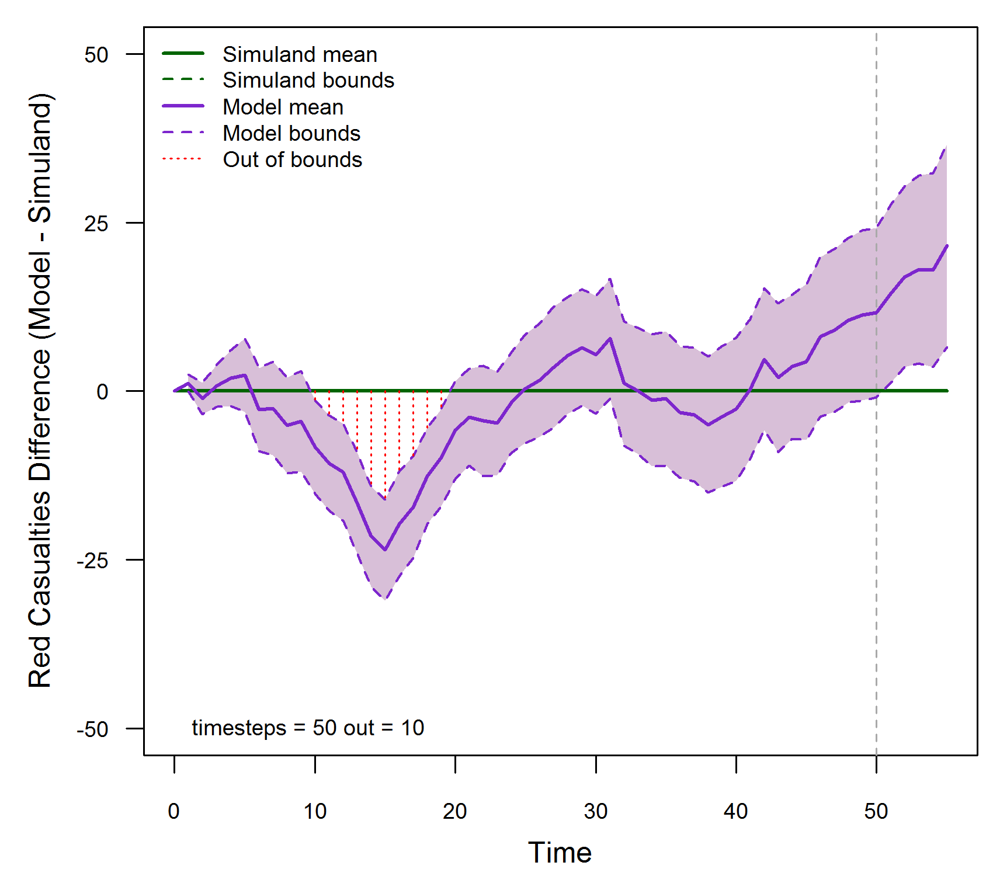
Example model: Method B (1 - multiple)
SME: OOB limit = 10% = 5 time steps
Simuland: 1 trial
Model: 15 trials with 95% confidence interval per time step
OOB time steps > OOB limit → model not valid

Slide 42
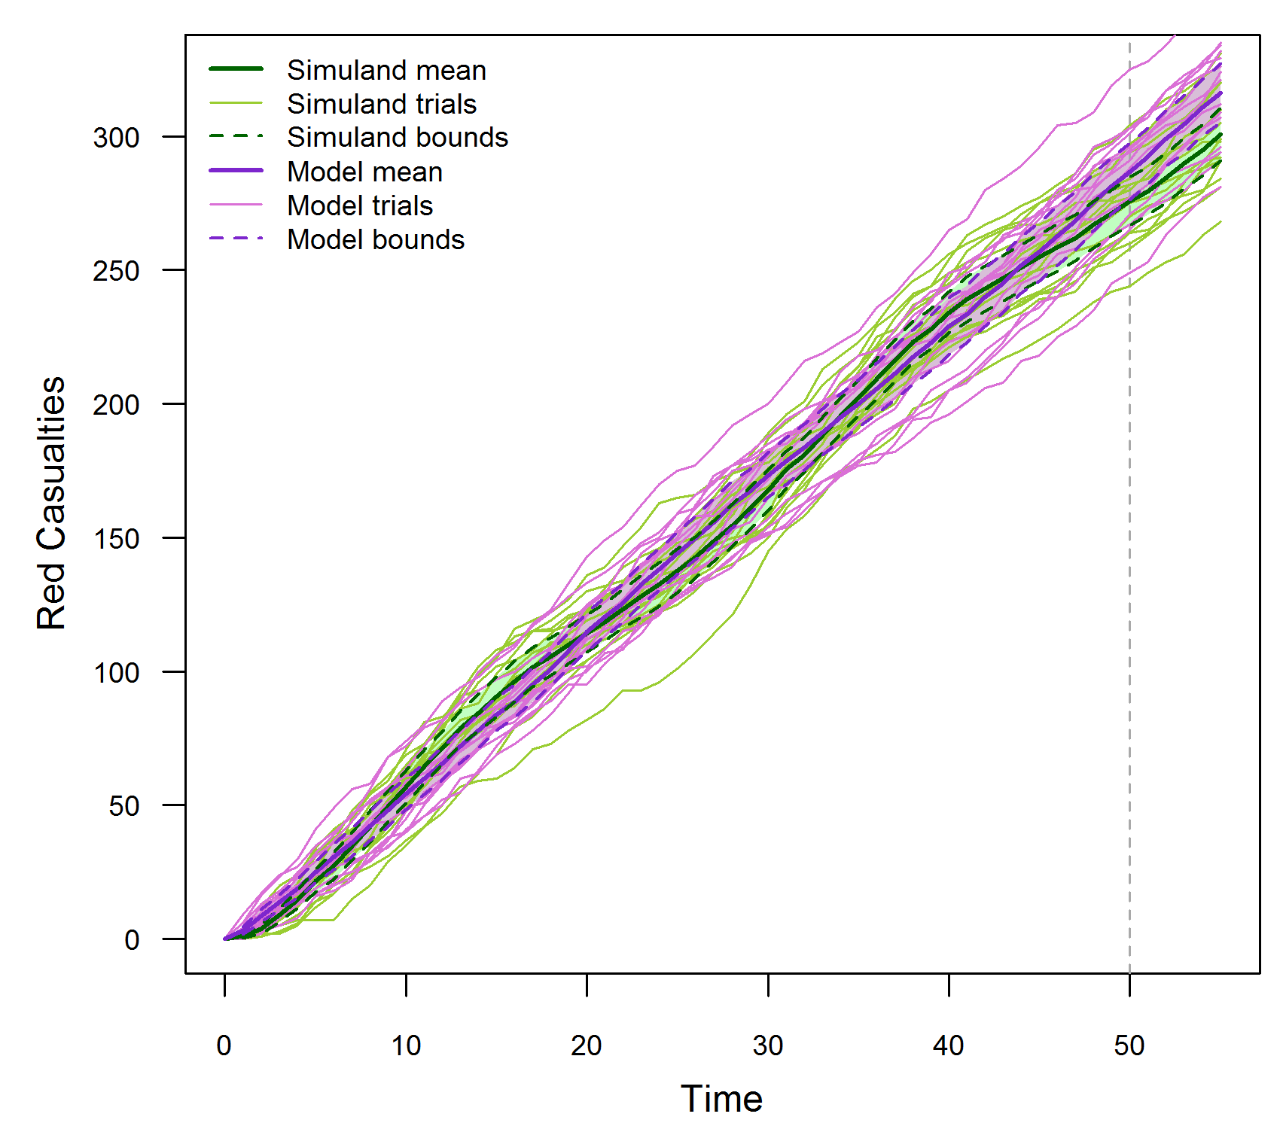
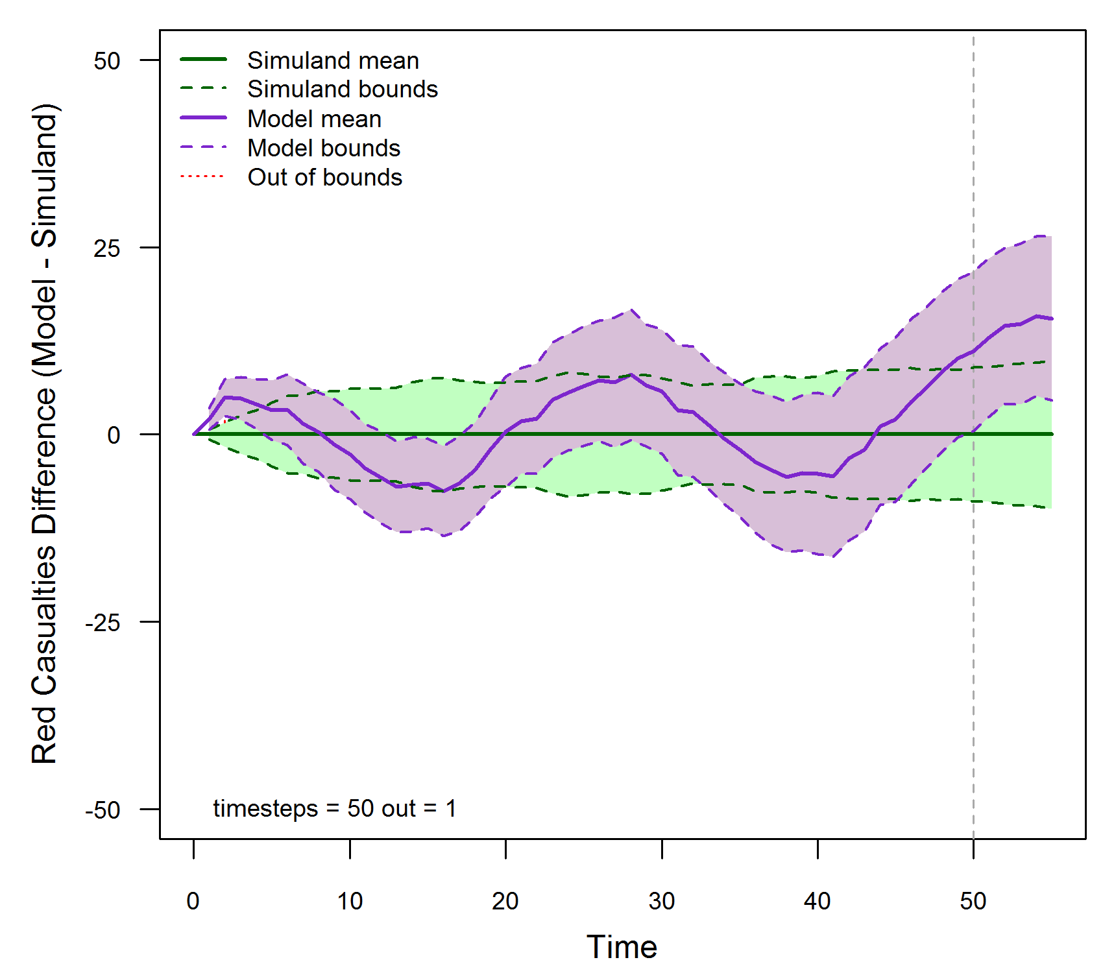
Example model: Method C (multiple - multiple)
SME: OOB limit = 10% = 5 time steps
Simuland: 15 trials with 95% confidence interval per time step
Model: 15 trials with 95% confidence interval per time step
OOB time steps > OOB limit → model not valid

Slide 43
Time Series Validation Method: Advanced Methods (not covered)
  Spectral analysis [Fishman, 1967] [Naylor, 1971] [McNickle, 2004]
  Parametric time series model [Hsu, 1977]
  Standardized time series [Schruben, 1983] [Chen, 1987]
  [Goldsman, 1990]
  Regression analysis [Kleijnen, 1998]
  Bootstrapping [Kleijnen, 2000] [Kleijnen, 2001]
  Granger causality [Granger, 1969]

Slide 44
Presentation outline
  Background
    Motivation
    Definitions
    Validation uncertainty and risk
    Verification and validation processes and methods
  Assembling an effective referent
    The ideal referent as the basis for validation comparison
    Challenges and obstacles to developing the ideal referent
    Best practices and obstacle mitigation
    Examples
  Selecting and applying the appropriate method
    Referent and intended use data relationships
    Examples of applying validation methods for both point value and time series data based on the referent
  Conclusions and recommendations

Slide 45
Conclusions and recommendations
  Quality and quantity of referent effects validation rigor
    Rigorous validation is possible, but it depends on an effective referent,
    i.e., sufficient data, well aligned with the model’s intended use
    Acquiring an effective referent should be started early in the simulation life cycle
    Given the best possible referent, a range of quantitative validation methods are available
  Application of statistical validation methods
    Most quantitative (statistical) validation methods make specific assumptions
    If a statistical method is used when the assumptions are not met,
    its results are meaningless and potentially misleading
  Validating time series data
    Validating a model using output at a single time step can be misleading
    Methods exist to validate models using time series output
      Confidence interval methods; relatively simple
      Advanced methods; mathematically complex

Slide 46
References and bibliography (1 of 4)
[ATEC, 2004] Army Test and Evaluation Command (ATEC) Pamphlet 73-1, System Test and Evaluation Procedures, April 19 2004.
[Balci, 1981] O. Balci and R. G. Sargent, “A Methodology for cost-risk analysis in the statistical validation of simulation models”,
Communications of the ACM, Vol. 27, No. 4, pp. 190-197.
[Balci, 1985] O. Balci and R. E. Nance, “Formulated problem verification as an explicit requirement of model credibility”,
Simulation: Transactions of the Society for Modeling and Simulation International, Vol. 45, No. 2, pp. 76-86.
[Balci, 1998] O. Balci, “Verification, Validation, and Testing”, in J. Banks (Editor), Handbook of Simulation: Principles, Methodology, Advances,
Applications, and Practice, John Wiley & Sons, New York NY, 1998, pp. 335-393.
[Balci, 2002] O. Balci, R. E. Nance, J. D. Arthur and W. F. Ormsby, “Expanding Our Horizons in Verification, Validation, and Accreditation Research
and Practice”, Proceedings of the 2002 Winter Simulation Conference, San Diego CA, December 8-11 2002, pp. 653-663.
[BanksC, 2010] C. M. Banks, “Introduction to Modeling and Simulation”, in J. A. Sokolowski and C. M. Banks (Editors), Modeling and Simulation
Fundamentals: Theoretical Underpinnings and Practical Domains, John Wiley and Sons, Hoboken NJ, 2010, pp. 1-24.
[BanksJ, 1998] J. Banks (Editor), Handbook of Simulation: Principles, Methodology, Advances, Applications, and Practice, John Wiley & Sons,
New York NY, 1998.
[Belfore, 2004] L. A. Belfore, J. J. Garcia, E. K. Lada, M. D. Petty, and W. P. Quinones, “Capabilities and Intended Uses of the Joint Operations
Feasibility Tool”, Proceedings of the Spring 2004 Simulation Interoperability Workshop, Arlington VA, April 18-23 2004, pp. 596-604.
[Cellier, 1991] F. E. Cellier, Continuous System Modeling, Springer-Verlag, New York NY, 1991.
[Champagne, 2007] L. E. Champagne and R. R. Hill, “Agent-Model Validation Based on Historical Data”, Proceedings of the 2007 Winter Simulation Conference, Washington DC, December 9-12 2007, pp. 1223-1231.
[Chen, 1987] B. Chen and R.G. Sargent, “Using Standardized Time Series to Estimate the Difference between Two Stationary Stochastic Processes,” Operations Research, Vol. 35, 1987, pp. 428-436.

Slide 47
References and bibliography (2 of 4)
[Doane, 2017] S. Doane, “Improving the Rigor of Navy M&S VV&A through the application of Design of Experiments Methodologies
and related Statistical Techniques”, Proceedings of the Science of Test Workshop, Washington DC, April 3 2017.
[DOD, 2009] Department of Defense, Instruction 5000.61, M&S VV&A, 2009.
[DOD, 2011] Department of Defense, Modeling and Simulation (M&S) Glossary, October 1 2011.
[DOD, 2012] Department of Defense Standard Practice, MIL-STD-3022 with Change 1, Documentation of Verification, Validation, and Accreditation
(VV&A) for Models and Simulations, April 5 2012.
[DOT&E, 2000] DOT&E Report, AIM-9X Sidewinder Air-to-Air Missile, 2000.
[Engel, 1954] J. H. Engel, “A Verification of Lanchester’s Law”, Journal of the Operations Research Society of America, Vol. 2, No. 2, May 1954, pp. 163-171.
[Fischer, 2001] K. Fischer, “AIM-9X…Surpassing the M&S Challenge,” Unpublished presentation, 2001.
[Fishman, 1967] G. S. Fishman and P. J. Kiviat, “The Analysis of Simulation-Generated Time Series”,
Management Science, Vol. 13, 1967, pp. 525-557.
[Fritzon, 2004] P. Fritzon, Principles of Object-Oriented Modeling and Simulation with Modelica 2.1, IEEE Press, Piscataway NJ, 2004
[Gilmore, 2016] Director Operational Test and Evaluation Memorandum, Guidance on the Validation of Models and Simulation used in Operational
Test and Live Fire Assessments, 14 March 2016.
[Goldsman, 1990] D. Goldsman and L. Schruben, “Confidence Interval Estimators Using Standardized Time Series”, Management Science, Vol. 36, No. 3, March 1990, pp. 393-397.
[Granger, 1969] C. W. J. Granger, “Investigating Causal Relations by Econometric Models and Cross-spectral Methods”, Econometrica, Vol. 37, No. 3, pp. 424-438.

Slide 48
References and bibliography (3 of 4)
[Herington, 2002] J. Herington, A. Lane, N. Corrigan, and J. A. Golightly, “Representation of Historical Events in a Military Campaign Simulation Model”, Proceedings of the 2002 Winter Simulation Conference, San Diego CA, December 8-11 2002, pp. 859-863.
[Kleijnen, 1998] J. P. C. Kleijnen, B. Bettonvil, and W. Van Groenendaal, “Validation of Trace-Driven Simulation Models: A Novel Regression Test”, Management Science, Vol. 44, 1998, pp. 812-819.
[Kleijnen, 2000] J. P. C. Kleijnen, R.C.H. Cheng, and B. Bettonvil, “Validation of Trace-Driven Simulation Models: More on Bootstrap Techniques”, Proceedings of the 2000 Winter Simulation Conference, Orlando FL, December 10-13 2000, pp. 882-892.
[Kleijnen, 2001] J. P. C. Kleijnen, R.C.H. Cheng, and B. Bettonvil, “Validation of Trace-Driven Simulation Models: Bootstrap Tests”, Management Science, Vol. 47, 2001, pp.1533-1538.
[Law, 2015] A. M. Law, Simulation Modeling and Analysis, Fifth Edition, McGraw-Hill Education,
New York NY, 2015.
[McNickle, 2004] D. McNickle, G. C. Ewing, and K. Pawlikowski, “Refining Spectral Analysis for Confidence Interval Estimation in Sequential Simulation”, Proceedings of the 16th European Simulation Symposium, Budapest Hungary, October 17-20 2004, pp. 99-103.
[Naylor, 1971] T. H. Naylor, Computer Simulation Experiments with Models of Economic Systems, John Wiley & Sons, New York NY, 1971.
[IDA, 2001] AIM-9X: A Modeling and Simulation Success Story, IDA Research Summaries, Vol. 8, Number 1, Summer/Fall 2001, pp. 8-12.
[Mansager, 1994] B. Mansager, Model Test Model, Naval Postgraduate School Technical Report NPS-MS-94-007.
[Metz, 2001] M. Metz, Using Subject Matter Experts for Results Validation of a Complex Theater Warfare Simulation, 01F-SIW-036, August 2001.
[Minsky, 1965] M. L. Minsky, Matter, Mind, and Models, Artificial Intelligence Memo No. 77, Massachusetts Institute of Technology, March 1965,
Online at http://dspace.mit.edu/bitstream/handle/1721.1/6119/AIM-077.pdf ?sequence=2, Accessed, July 19 2015.

Slide 49
References and bibliography (4 of 4)
[Ören, 2009] T. I. Ören, “Uses of Simulation”, in J. A. Sokolowski and C. M Banks, (Editors), Principles of Modeling and Simulation: A Multidisciplinary
Approach, John Wiley and Sons, Hoboken NJ, 2009, pp. 153-179.
[Pace, 2009] D. K. Pace, “Simulation Uncertainty and Validation”, Proceedings of the Spring 2009 Simulation Interoperability Workshop,
San Diego CA, March 23-27 2009.
[Petty, 2010] M. D. Petty, “Verification, Validation, and Accreditation”, in J. A. Sokolowski and C. M. Banks (Editors), Modeling and Simulation
Fundamentals: Theoretical Underpinnings and Practical Domains, John Wiley & Sons, Hoboken NJ, 2010, pp. 325-372.
[Petty, 2012] M. D. Petty, “Calculating and Using Confidence Intervals for Model Validation”, Proceedings of the Fall 2012 Simulation Interoperability
Workshop, Orlando FL, September 10-14 2012, pp. 37-45.
[Petty, 2013] M. D. Petty, “Advanced Topics in Calculating and Using Confidence Intervals for Model Validation”, Proceedings of the Spring 2013
Simulation Interoperability Workshop, San Diego CA, April 8-10 2013.
[Piersall, 2014] C. H. Piersall and F. E. Grange, “The Necessity of Intended Use Specification for Successful Modeling and Simulation of
System-of-Systems”, CrossTalk, September/October 2014, pp. 20-24.
[RPG, 2011] DoD VV&A Recommended Practices Guide, RPG Validation Referent Special Topic Paper, https://vva.msco.mil/, January 2011.
[Schruben, 1983] L. Schruben, “Confidence Interval Estimation Using Standardized Time Series”, Operations Research, Vol. 31, No. 6, November-December 1983, pp. 1090-1108.
[Strickland, 2011] J. S. Strickland, Mathematical Modeling of Warfare and Combat Phenomenon, Lulu, Raleigh NC, 2011.
[Velten, 2009] K. Velten, Mathematical Modeling and Simulation, WILEY-VCH, Weinheim Germany, 2009.
[Zhang, 2008] W. Zhang, F. Li, Z. Wu, and R. Li, “Emulation of Rocket Trajectory Based on a Six Degree of Freedom Model”, Proceedings of the
Seventh International Symposium on Instrumentation and Control Technology: Measurement Theory and Systems and Aeronautical Equipment,
Proceedings of the SPIE Vol. 7128, Beijing China, October 10 2008, doi:10.1117/12.806878.

Slide 50
Additional information
  Simone M. Youngblood
    Johns Hopkins University Applied Physics Laboratory
    240-228-7958
    Simone.Youngblood@jhuapl.edu
  Mikel D. Petty, Ph.D.
    University of Alabama in Huntsville
    256-824-6140
    pettym@uah.edu

