Slide 1





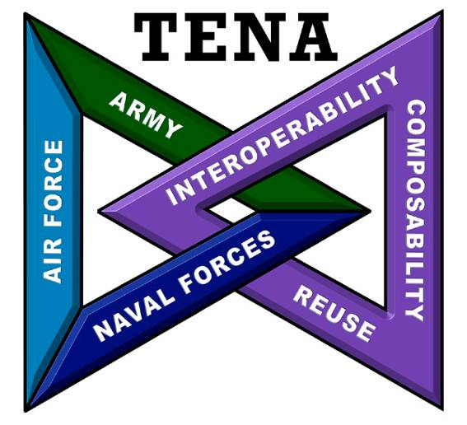



TENA/JMETC:
Live-Virtual-Constructive Integration for Test and Training
Dr. Edward T. Powell
Test Resource Management Center
@IITSEC
NTSAToday

Slide 2
Outline
Building and Using the Test and Training Enabling Architecture (TENA)
  TENA Mission and Benefits
The TENA Architecture
  Key Tenets
  Architecture Overview and Key Concepts
  Architecture Details
    Meta-Model and Object Models
    Repository
    Middleware
    Data Collection System
    Performance
    Tools and Utilities
    Adapters
The Joint Mission Environment Test Capability (JMETC)
Summary and Conclusions

Slide 3
Learning Objectives
Identify the four major aspects of TENA and be able to explain their role in promoting interoperability.
Identify at least three major differences between TENA and simulation architectures such as Distributed Interactive Simulation (DIS) and the High-Level Architecture for Modeling and Simulation (HLA).
  Each difference will be identified as TENA is described.
Identify the major purpose and use of the JMETC paradigm for distributed testing.

Slide 4
TENA Mission
Currently, range systems tend to be non-interoperable, “stove-pipe” systems
The purpose of TENA is to provide the architecture and the software implementation necessary to
Enable Interoperability among range systems, facilities, simulations, C4ISR systems in a quick, cost-efficient manner, and
Foster Reuse for range assets and for future developments
Support the warfighter
Enable simulation-based acquisition
Foster test and training integration
In the long term: SAVE MONEY!
Lay the Foundation for Future Test and Training Range Instrumentation

Slide 5
Benefits of TENA
All TENA software and support is free to users
Supports C++, Java, and .Net
TENA software is thoroughly tested and very reliable
TENA Auto-Code Generation makes creating a TENA application as simple as possible
  Auto-generated starting points mean you never start with a blank page
  Rapid development of real-time, distributed, Live-Virtual-Constructive applications
  Auto-generated test programs make integration a snap
TENA’s technical approach emphasizes cost savings and reliability
  The TENA software is hard to use wrong
  TENA catches many user errors at compile time rather than run time
  TENA Tools provide unprecedented understanding of an event
TENA has a standard object model enhancing interoperability
The TENA web site/repository has extensive documentation, training, and collaboration capabilities
TENA data is importable into the Knowledge Management/Big Data Analysis capability called CHEETAS.
TENA has a plan for evolution and funding to execute this plan.

Slide 6
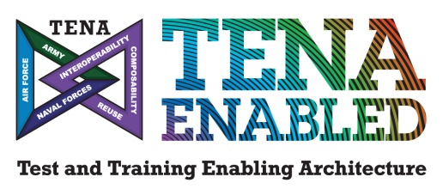
Test and Training Enabling Architecture (TENA) at a Glance
What does TENA enable?
  Interoperability between inter- and intra-range assets
  Elimination of proprietary interfaces to range instrumentation
  Efficient incremental upgrades to test and training capabilities
  Integration of Live, Virtual, and Constructive assets (locally or distributed)
  Sharing and reuse of common capabilities across existing and new investments
What is included in the TENA architecture?
  A common Middleware for data communication
  Customizable data exchange models (object models) that standardize information exchange
  Interoperability-enabling, auto-code-generated software libraries
  A core set of tools that address common test and training
  requirements
  Collaboration mechanisms that facilitate sharing and reuse
  A connection to the Knowledge Management/Big Data
  Analysis (KM/BDA) Architecture

Slide 7
TENA is an Open Architecture
The Software Engineering Institute defines an Open System as “a collection of interacting software, hardware, and human components designed to satisfy stated needs with interface specifications of its components that are fully defined, available to the public, maintained according to group consensus, in which the implementations of the components conform to the interface specifications.”
TENA is maintained according to a consensus of its users assembled as the Joint Technical Exchange (JTEX) TENA Configuration Control Board (CCB)
TENA exists and is being used to support real events
  Government owned, no proprietary software
TENA is freely releasable (Distribution A) to non-US entities
  We have many non-US users in Britain, France, Sweden, Denmark, etc.
There are no plans for standardizing TENA in the same way as DIS and HLA have been standardized using the IEEE
  TENA’s business model is not the same as the DIS and HLA business models

Slide 8
Test and Training Enabling Architecture
(TENA)

Slide 9
Core Architectural Tenets of TENA
Promote Computer Enforceable System Interfaces
Use Auto-Code Generation to Raise the Abstraction Level
Let Computer Detect Interoperability Errors as Early as Possible
Design the Middleware to Make it Hard to Use Wrong
Anticipate Better Techniques and Technologies
Emphasize Live-Virtual-Constructive Interoperability

Slide 10
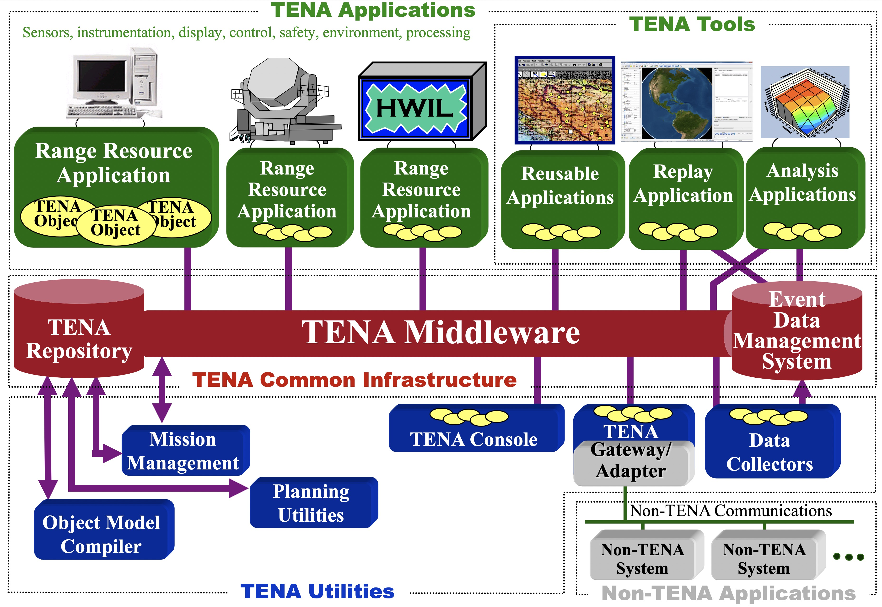
TENA Architecture Overview

Slide 11
TENA Interoperability
Architecture Illustration
Different Protocols
Gateway
Typical TENA
Execution
DIS, HLA
RelayNode
Different Network Characteristics
Adapter
Web Binding
RF Radio, Satellite
SNMP, TCP,
Proprietary
Web Applications
Vendor
System
JSON, HTTP,
Thrift

Slide 12
Logical Range
Simple Example
TENA specifies an architecture for range resources participating in logical ranges
Test
Control Station
Radar
Remote
Viewer
Communication Mechanism (Network, Shared Memory, etc.)

Slide 13
Logical Range
Simple Example
TENA specifies a peer-to-peer architecture for logical ranges:
  Applications can be both clients and servers simultaneously
  In their role as servers, applications serve TENA objects called “servants”
  In their role as clients, applications obtain “proxies,” representing other applications’ servants. Only servers can write to their servant objects’ publication state
The TENA Middleware, the TENA objects, and the user’s application code are compiled and linked together
TENA Application A
TENA Application B
TENA Application C
User
Application
Code
User
Application
Code
User
Application
Code
Test
Control Station
Remote
Viewer
Proxy
Proxy
Servant
Proxy
Servant
Servant
Servant
Proxy
Proxy
Proxy
Proxy
Servant
Proxy
TENA Middleware
TENA Middleware
TENA Middleware
Communication Mechanism (Network, Shared Memory, etc.)

Slide 14
Clients and Proxies,
Servers and Servants
A proxy is a read-only stand-in for a servant
Proxies are obtained as a result of subscription
Client Application
Server Application
Proxy Object on Client
Servant Object on Server
User
Application
Proxy for Tank 27
Tank 27
User
Application
Remote Interface
Remote Interface
Remote
Interface
Implementation
Publication
State Cache
Publication
State
Local Methods
Interface
Local Methods
Interface
Local Methods
Implementation
Local Methods
Implementation
TENA Middleware
TENA Middleware
Network

Slide 15
TENA Objects are Compiled In
Why use compiled-in object definitions?
  Strong type-checking
    Don’t wait until runtime to find errors that a compiler could detect
  Performance
    Interpretation of methods/attributes has significant impact
  Ability to easily handle complex object relationships
  Conforms to current best software engineering practices
How do you support compiled-in object definitions?
  Use a language like the Interface Definition Language to define object interface and object state structure
  Use code generation to implement the required functionality
Thus the concept of the TENA Definition Language (TDL) was created
  Very similar to IDL and C++

Slide 16
How hard is it to create a new
TENA Object Model?
1. Name the object model, including the version
file Example-Vehicle-v6.tdl
package Example {
enum Team {
Team_Red,
Team_Blue,
Team_Green };
2. Define the message or object types needed by the application
3. Define the attributes that characterize the messages and objects
class Vehicle {
};
string name;
Team team;
float64 xInMeters;
float64 yInMeters;
optional
const
4. Determine if any attributes are constant or optional
driveTo (float64 xInMeters,
float64 yInMeters);
5. Define any remote or local methods
};
TENA has a powerful meta-model for defining expressive object models, yet descriptive models are easy to create

Slide 17
The Logical Range Object Model
Logical Range Object Model (LROM)
  Those object definitions, derived from whatever source, that are used in a given logical range execution to meet the immediate needs and requirements of a specific user for a specific range event
The LROM is the common object model shared by all TENA resource applications in a logical range
Applications do not have to be linked against
every object model in the LROM—only those
the application cares about
E
App 3
App 1
A
F
B
C
D
App 2

Slide 18
TENA Communicates “Objects” in Multiple Formats
TENA Object in JSON format
TENA Object in C++ format
TENA Object in TDL format
TENA Object in SQL format

Slide 19
TENA Standard Object Models:
A Common Set of Data Definitions for the Entire Range Community
Platform Related
  TENA-Platform-v4
  TENA-PlatformDetails-v4
  TENA-PlatformType-v2
  TENA-Embedded-v3
  TENA-Munition-v3
  TENA-SyncController-v1
  TENA-UniqueID-v3
Time-Space Position Information (TSPI) Related
  TENA-TSPI-v5
  TENA-Time-v2
  TENA-SRFserver-v2
  TENA-Pointing-v1
JNTC OMs (for Training)
  JNTC-AirRange-v2
  JNTC-CounterMeasure-v2
  JNTC-IndirectFire-v2
  JNTC-Instrumentation-v2
  JNTC-NBC-v2
  JNTC-ObstacleMinefield-v2
  JNTC-Threat-v2
Others
  TENA-AMO-v2
  TENA-Engagement-v4
  TENA-Exercise-v1
  TENA-GPS-v3
  TENA-Radar-v3
In Progress
  Range Instrumentation OM Suite
  TENA-AVstream
  TENA-LiftoffDetector
  TENA-Link16
  TENA-PowerController
  TENA-SpectrumAnalyzer
  TENA-Telemetry
  TENA-Waypoint
  TENA-Weather
  TENA-LVC-Emitter
  Additional JNTC OMs for training

Slide 20
TSPI v4 with Coordinate Conversions
Case 1: Reading and writing in the same coordinate system
Client Application
Server Application
Proxy Object on Client
Servant Object on Server
User
Application
Platform 27
Platform 27
User
Application
Geocentric-
Position
TSPI
Local Methods
Interface
TSPI
Local Methods
Interface
Get
Set
Get
Set
Get
Set
Get
Set
Geocentric-Position()
Position
Local Methods
Interface
Private data
Position
Local Methods
Interface
Private data
Position()
Get
Set
Get
Set
Geocentric
SRF
Get
Set
Get
Set
Geocentric-
Position
Geocentric
SRF
Coordinate
Conversions
Local Methods
Coordinate
Conversions
Local Methods
TENA Middleware
TENA Middleware
Network

Slide 21
TSPI v4 with Coordinate Conversions
Case 2: Reading and writing in different coordinate systems
  Write in Geocentric (ECEF), read in Geodetic (latitude/longitude/altitude)
Client Application
Server Application
Proxy Object on Client
Servant Object on Server
User
Application
Platform 27
Platform 27
User
Application
Geodetic-
Position
TSPI
Local Methods
Interface
TSPI
Local Methods
Interface
Get
Set
Get
Set
Get
Set
Get
Set
Geodetic
Position()
Position
Local Methods
Interface
Private data
Position
Local Methods
Interface
Private data
Position()
Get
Set
Get
Set
Geodetic
SRF
Get
Set
Get
Set
Geocentric-
Position
Geocentric
SRF
Coordinate
Conversions
Local Methods
Coordinate
Conversions
Local Methods
TENA Middleware
TENA Middleware
Network

Slide 22
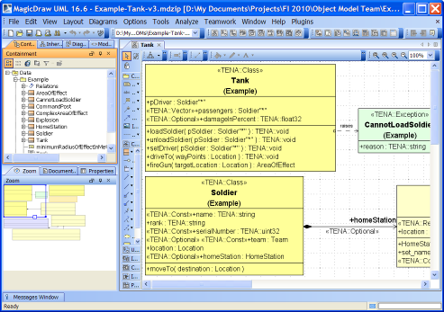
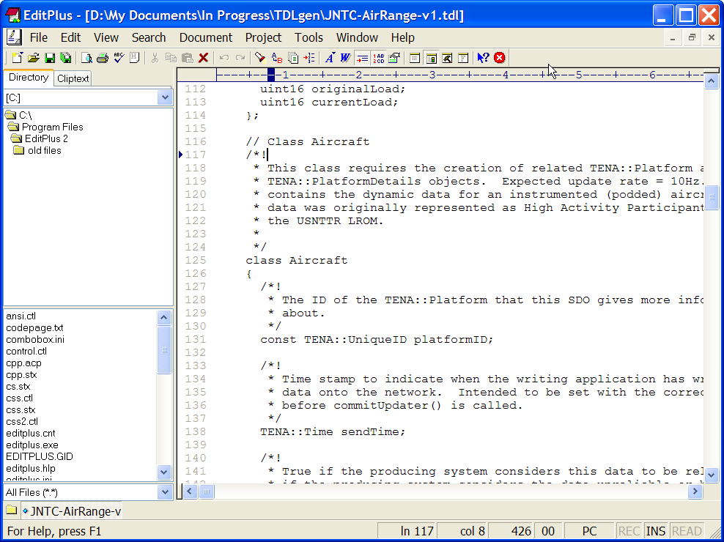
Auto-Code Generation
With TENA
Input to the TENA auto-code generator is in a standard form (TDL generated from UML)
  Use MagicDraw plug-in to create TDL from UML
API and framework available to support various “code generation plugins” used to automatically create specialized code based on FreeMarker templates
MagicDraw
with TDL
plugin
Code Generation Plugins
Parser
TENA Modeling
Language
OM
Definition
Repository Web Front End
TDL
Test
Impl
tena.omc.backend.
DataModel
Text Editor
Example
Impl
User
Plugins

Slide 23
TENA Repository
TENA Middleware
TENA Common Infrastructure
Purpose: to contain all the information relevant to
TENA that is not specific to a given logical range
Current Repository Contents:
  All TENA Object Models, both standard and user-designed
  All TENA software (middleware, helpdesk cases, tools, gateways, reusable applications, and reusable components)
  All TENA documentation
  Lessons learned from previous uses of TENA
  Provide an easy-to-use secure interface to all of this information
The Repository is a collection of technologies based around a wiki-like front end
TENA
Repository
EDMS

Slide 24
TENA Middleware
Purpose and Requirements
TENA Middleware
TENA Common Infrastructure
Purpose: high-performance, real-time, low-latency
communication infrastructure used by range
resource applications and tools during execution
Requirements:
  Support programming in C++, Java, .Net
  Fully support TENA Meta-Model
  Be easy to use and highly reliable
  Many varied communication strategies and media
    Including management of quality-of-service
    Including object-level security services
  Be high-performance, including
    Support multiple information filtering strategies
    Support user-defined filtering criteria
  Support a wide variety of range-relevant platforms (HW/OS/compiler)
  Be technology neutral
TENA
Repository
EDMS

Slide 25
Middleware 6.0.8
Computer Platform Support
Linux
  Red Hat Enterprise Linux 8.3*
  Red Hat Enterprise Linux 7.9
  Red Hat Enterprise Linux 6
  Centos 7.9.2009
  Centos 6
  Ubuntu 20.04.01
macOS
  11 Big Sur*
Windows
  Windows Server 2019 LTSC*
  Windows Server 2016
  Windows 10
Compilers for 6.0.8
  Linux GCC 10.2.1, 8.3.1, 9.3.0 (for Ubuntu)
  Mac Clang 12.0.0
  Windows Visual Studio 2019, 2017

Slide 26
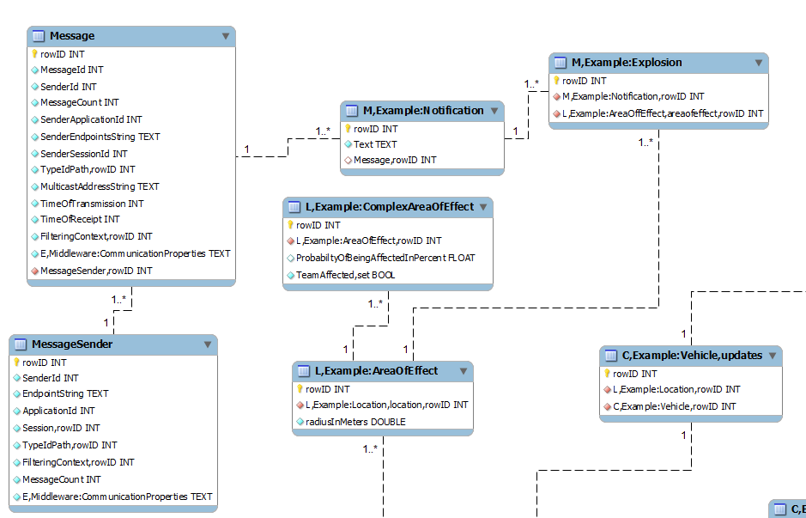
TENA Data Collection System
Purpose and Requirements
TENA Middleware
TENA Common Infrastructure
TDCS Collector
  Application that is code generated based on particular
  object model(s) to subscribe to object/message types of
  interest and store in database
  Supports SQLite files
Playback Tool
  Code generated application that will read collected data
  and replay selected object/message types
  Ability to replay certain time segments, and
  adjust faster/slower
DB Exporter
  Provides ability to extract certain data (types, time range)
  and put into format that is compatible with Microsoft Excel
Post-Event Metrics Analyzer (PEMA)
  GUI tool used to analyze data associated with a
  TENA-based event
TENA
Repository
EDMS

Slide 27
Better Tools for Analysis
TRMC has been investing in better ways to manage and analyze large data sets
  TRMC has developed CHEETAS* as the new knowledge management and big data analysis framework, based on Apache Hadoop ecosystem
  CHEETAS also has custom tools developed for DoD specific needs
How do we leverage these tools for TENA data?
  Processes to manage collections of TDCS files
  Processes to convert TDCS files into better formats for big-data analysis (e.g. parquet)
  Consideration of potential improvements and modification of how we currently collect TENA data
New capability – SQLite to parquet translation, import into KM system
  Input: acquire TDCS files generated from real-time operations
  Processing: Convert SQLite schemas to parquet tables
    Step 1: Convert each SQLite table to a parquet file
    Step 2: Reduce number of parquet files through a de-normalization process
    Step 3: Combine related data (same TENA OMs) that originated from different SQLite files
  Output: store parquet files on data analysis system
* Cloud Hybrid Edge-to-Enterprise Evaluation & Test Analysis Suite

Slide 28

Knowledge Management/Big Data Analysis Software Architecture

Slide 29
TENA Communicates Data in Multiple Formats
TENA specifies the semantics of an object (data), not the specific representation.
TENA objects will transfer smoothly and at high speed into the KM/BDA system.
TENA Object in SQL format
TENA Object in SQL format
TENA Object in Hadoop format

Slide 30
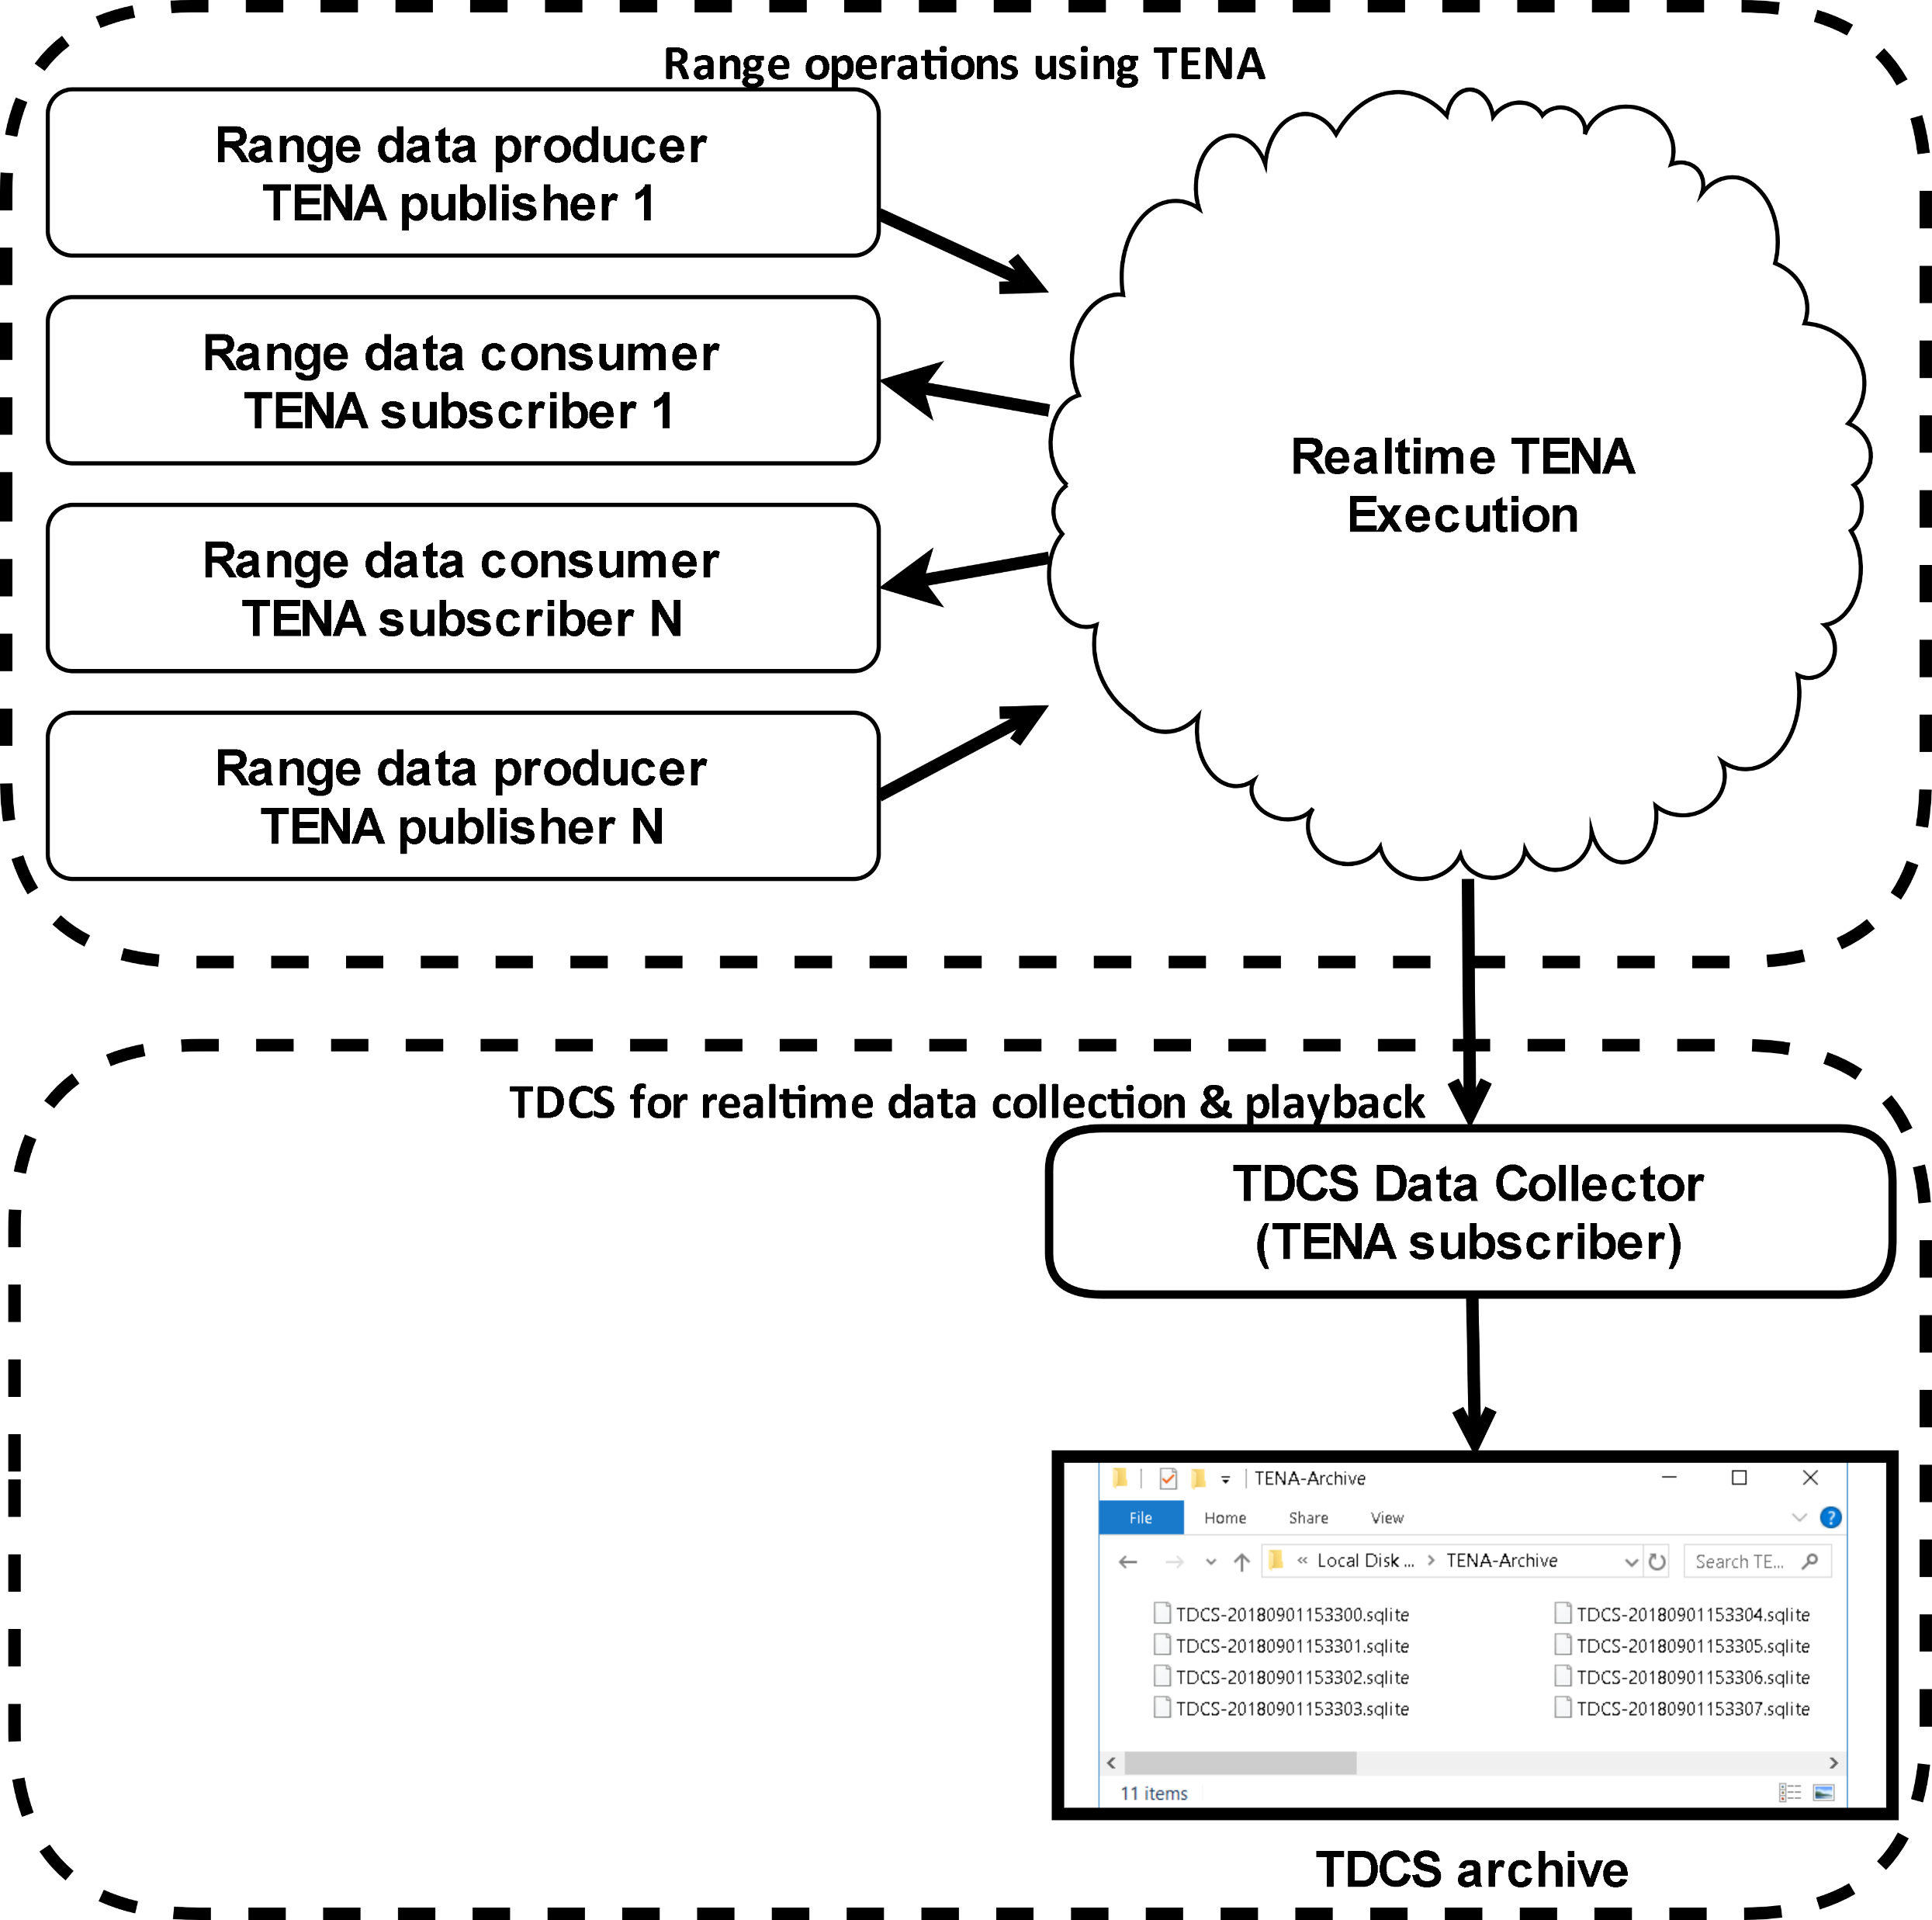
TDCS Data Collection
(normal data collection)

Slide 31
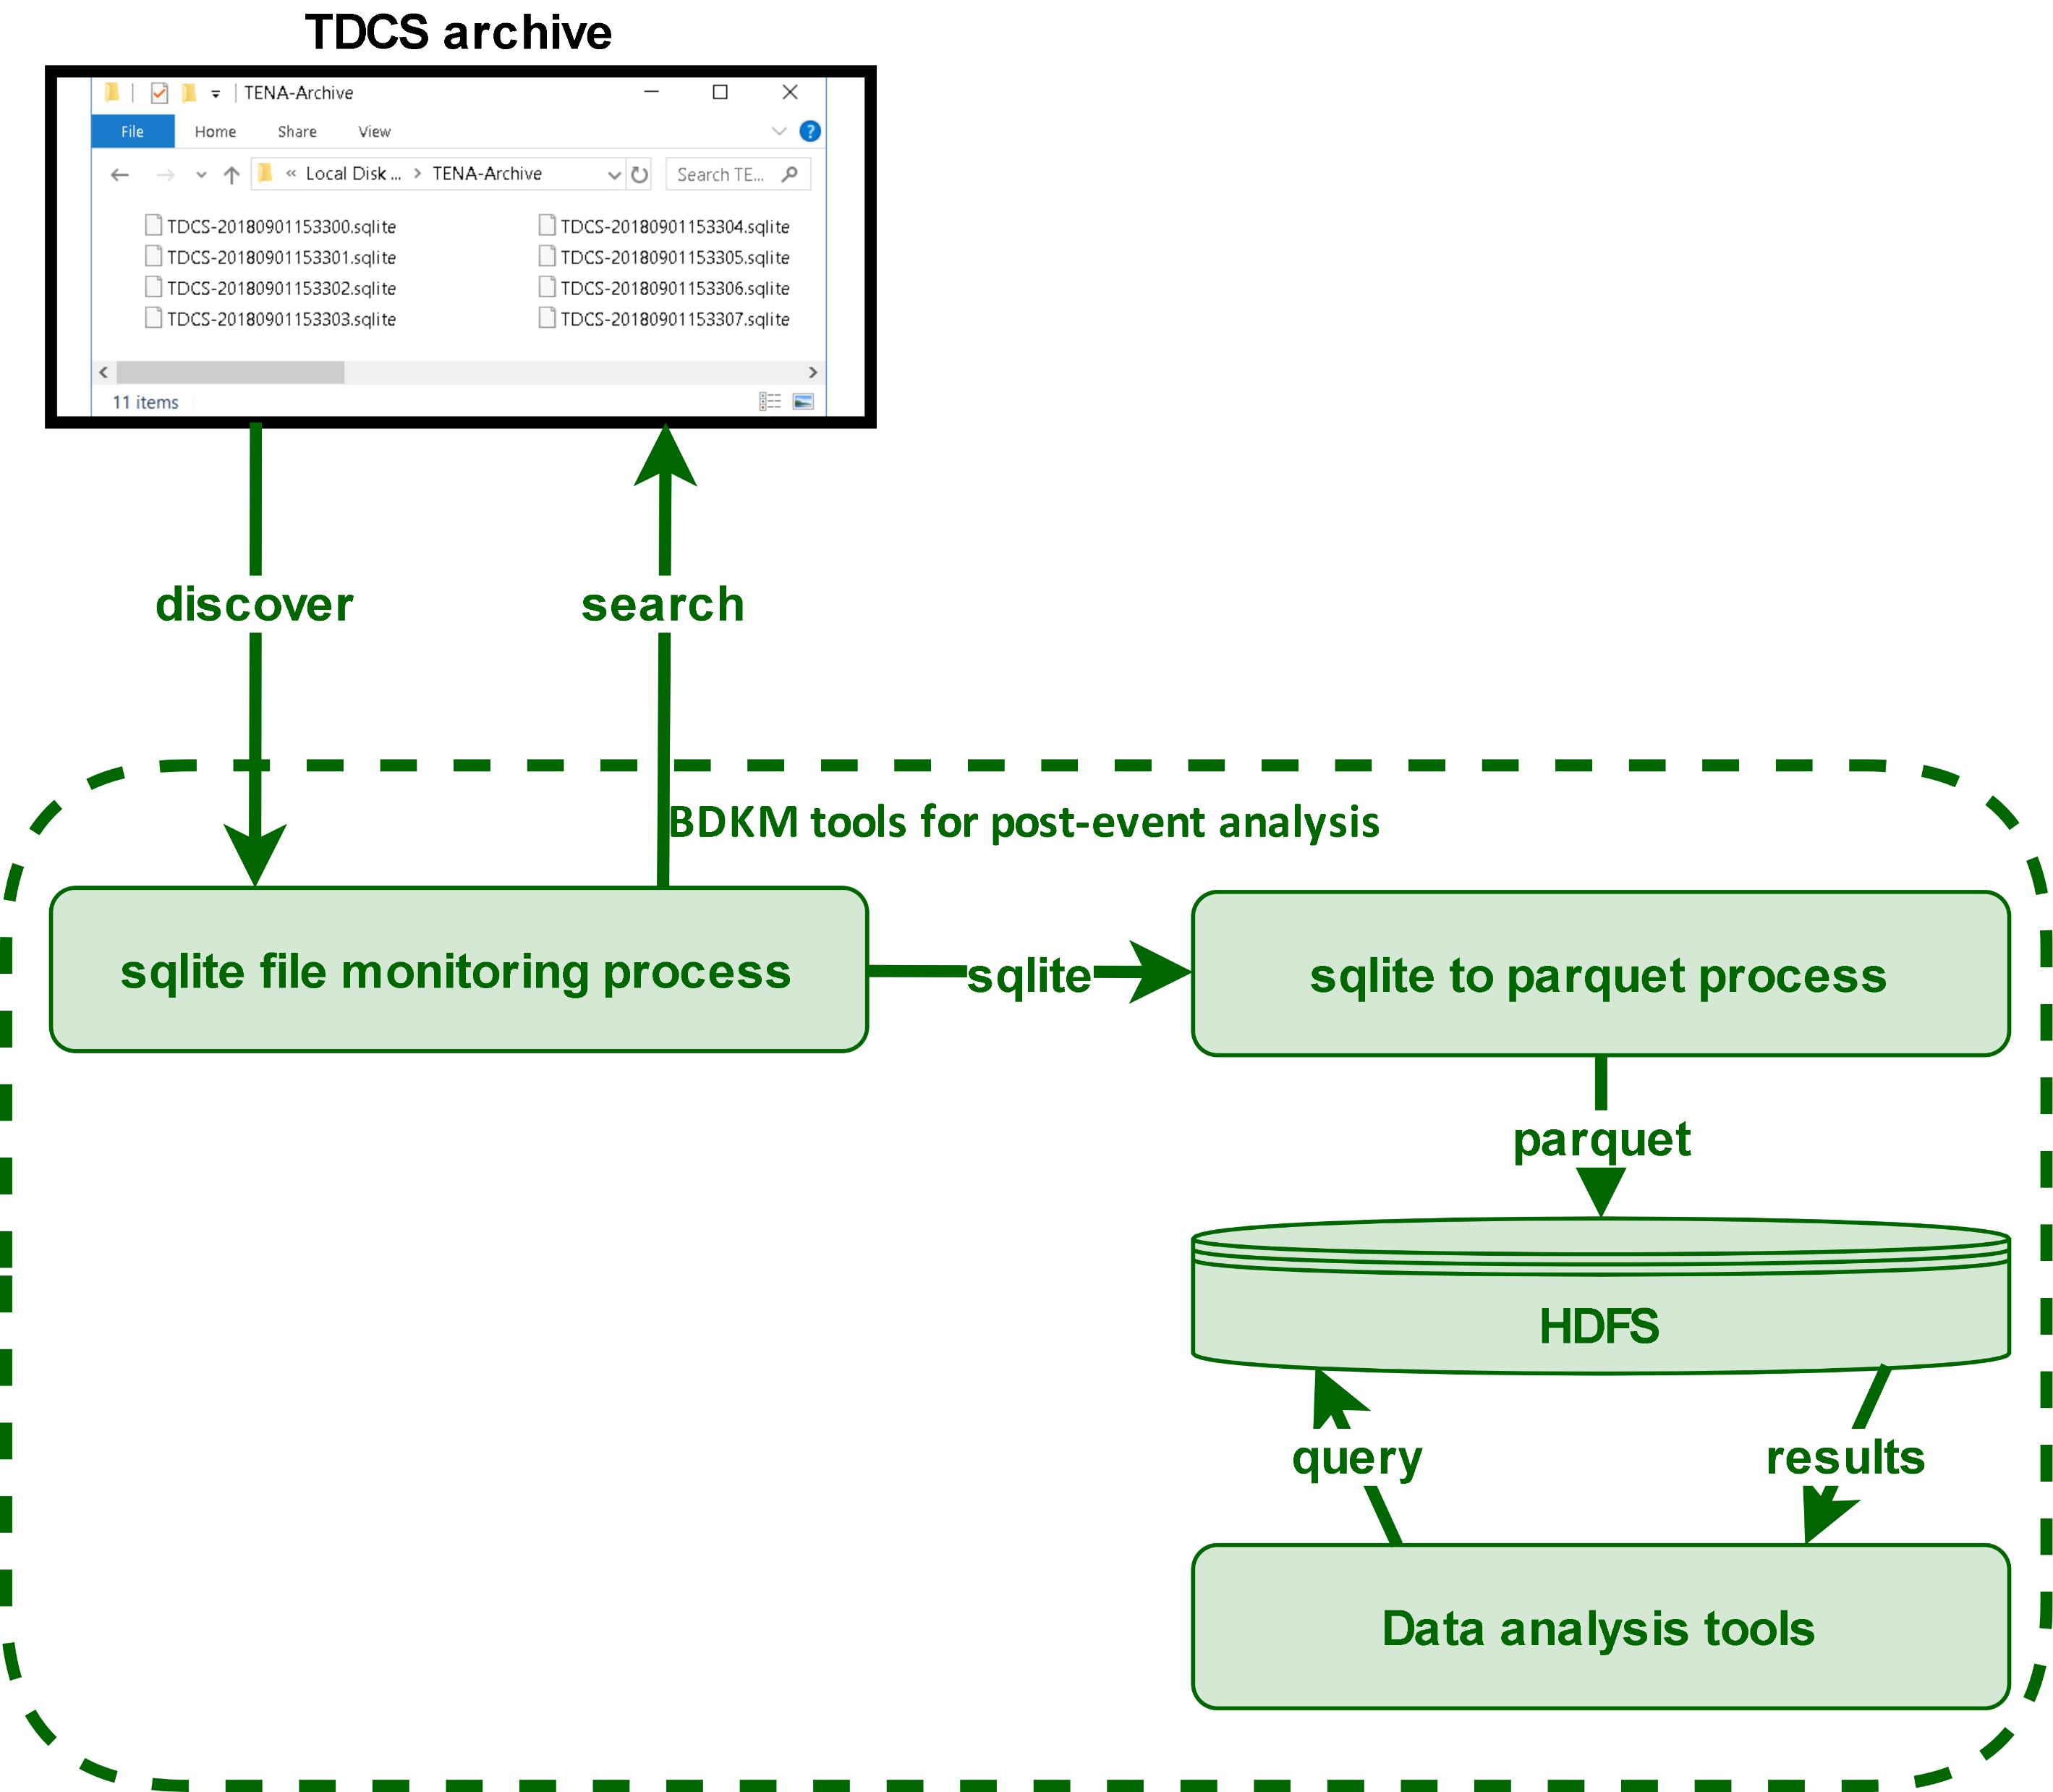
TDCS/SQLite to Parquet

Slide 32
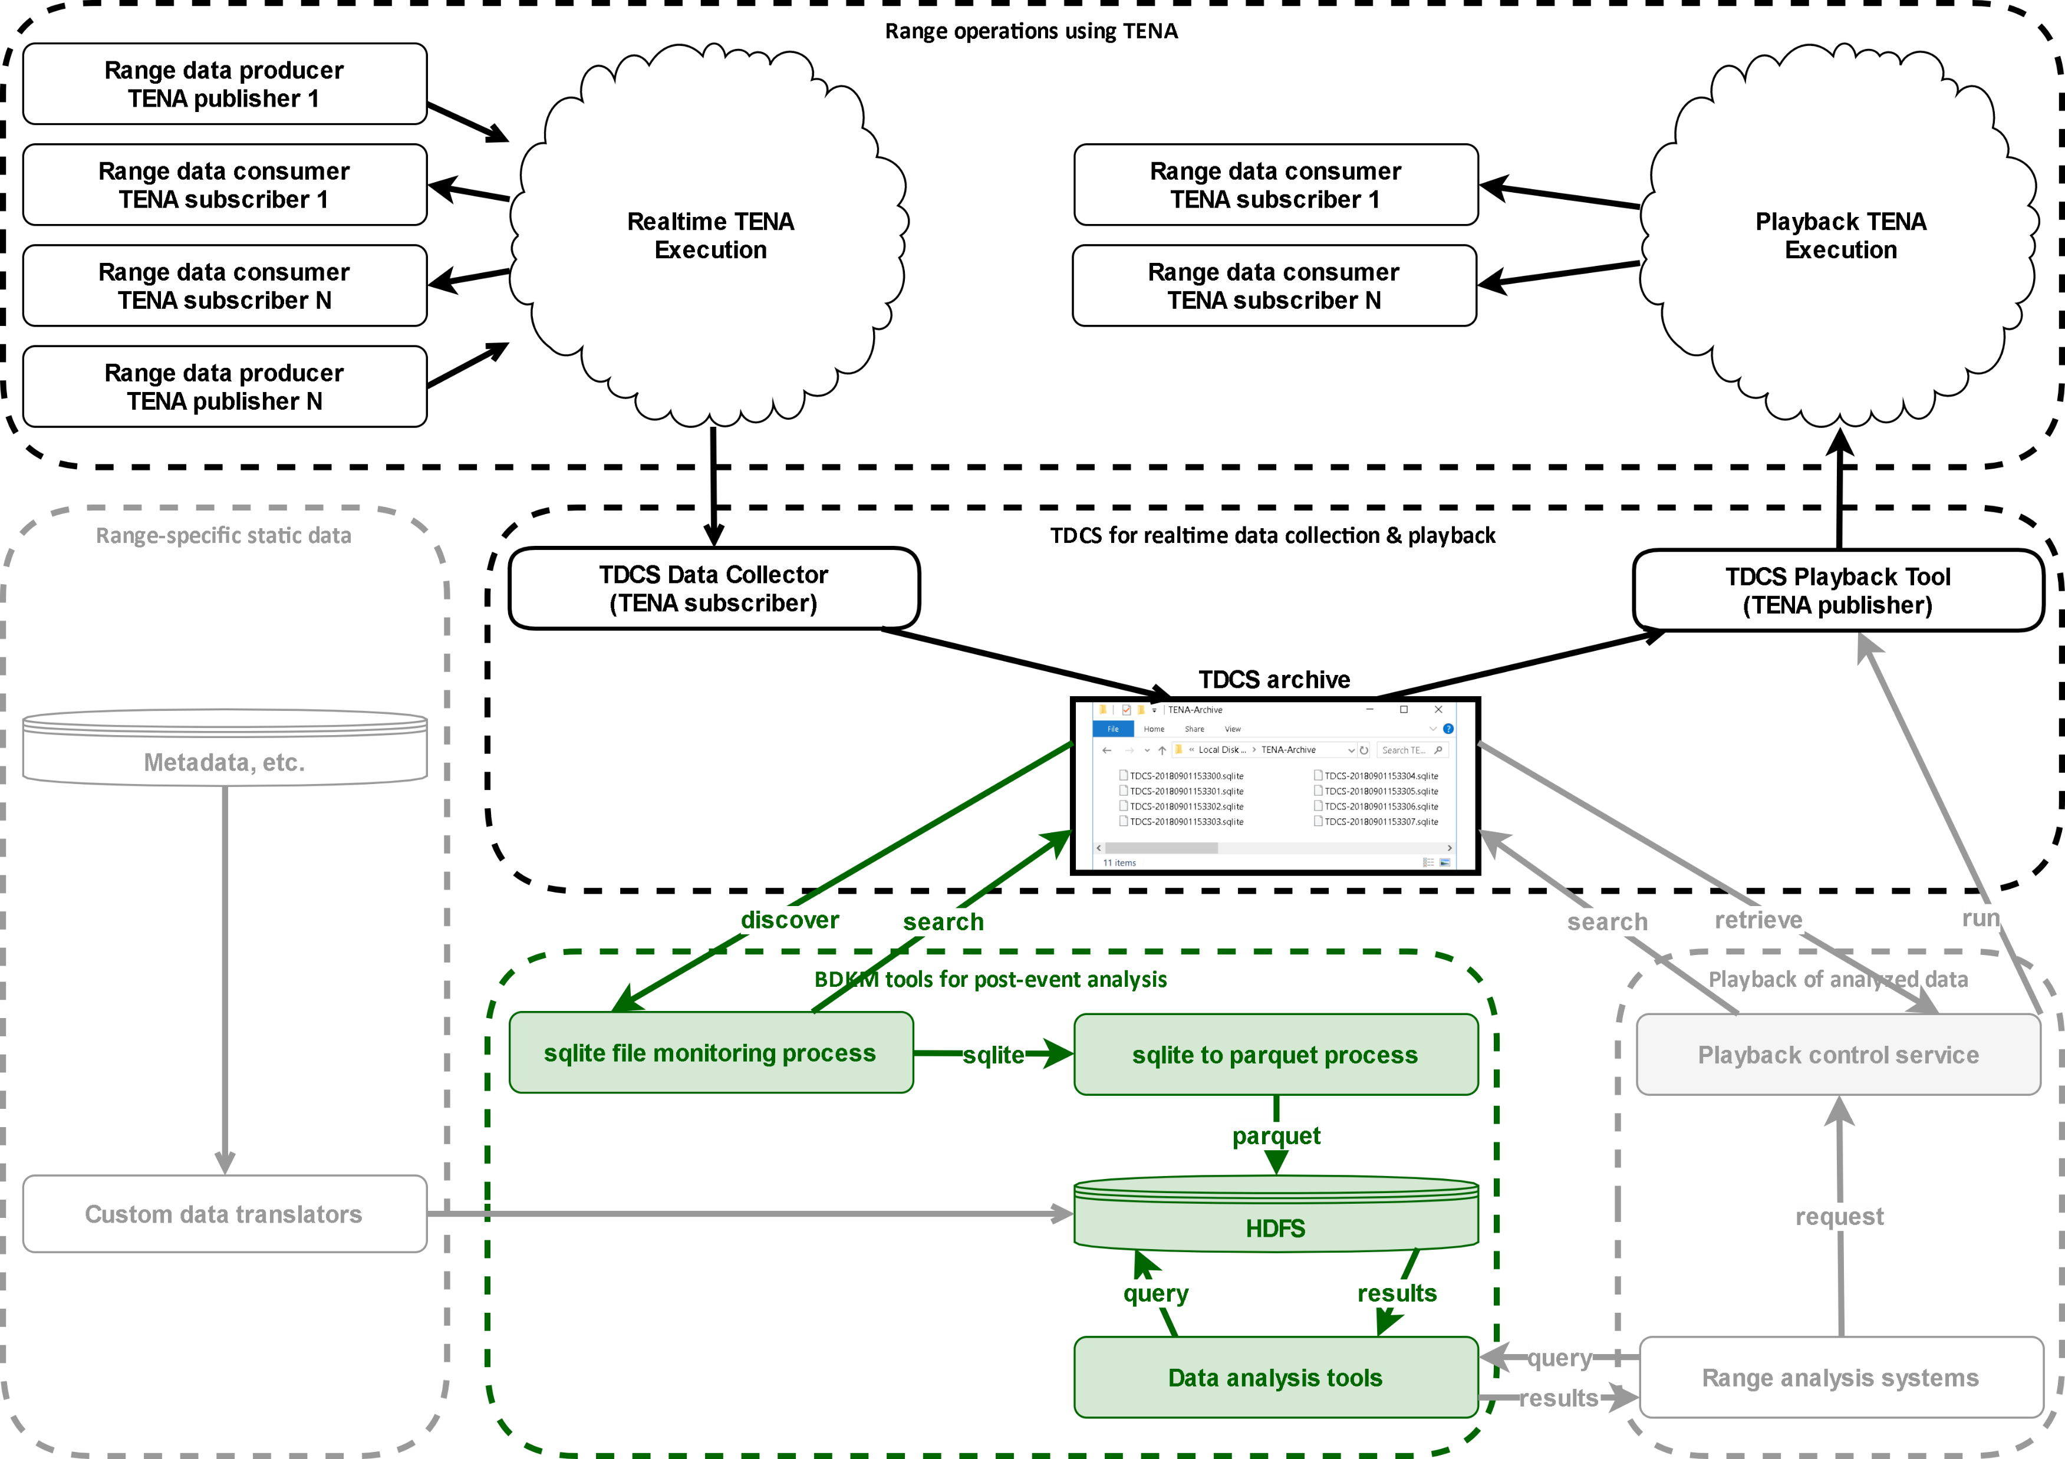
Sqlite to Parquet – Data flow

Slide 33
Will TENA Meet My Performance Requirements?
Users are encouraged to conduct experiments by customizing the auto-generated example programs to be representative of actual systems
  Use actual object models, computers, and networks
Primary requirement for TENA is to support high performance, real-time distributed communication
  TENA uses compiled code to avoid interpretive marshalling/demarshalling
  Minimizes data copies, utilize single thread to perform network write, etc.
TENA enables test & training solutions
that are cheaper to build, field, maintain, and improve

Slide 34
Update Rate vs. “Wiresize” Trade-off
(As Demostrated by the TRCE Program)
 | TENA 6.0.0 (Reliable) | TENA 6.0.0 (Best Effort) | TRCE LNC (No Compression) | TRCE LNC (Lossy Compression)
Total Update Size | 543 bytes | 511 bytes | 147 bytes | 98 bytes
Update Rate with 1 Publisher and 1 Subscriber | 6,187 Hz | 7,540 Hz | 2,352 Hz | 2,549 Hz
Update Rate with 5 Publishers and 5 Subscribers | 4,351¹ Hz | 8,305 Hz | 1,673 Hz | 1,884 Hz
3.5 x
TRCE demonstrated a reduction in wire size for TENA-Platform-v4 updates by a factor of 3.5 to 5.2
TRCE simultaneously demonstrated a reduction in throughput for TENA-Platform-v4 updates by a factor of 3.2 to 5.0
Reducing the update wire size reduced the update throughput
  All update rates are stated as the average over all subscribers
  Tests performed with 100 Mbps link & switch
  ¹ TCP flow control taking place during test
3.2 x
5.0 x

Slide 35
TENA Utilities:
Making TENA Easier to Use
TENA Repository (automated software building, community source code collaboration)
TENA Wiki (website collaboration for user groups)
TENA Issue Tracking System (task tracking system for user groups)
TENA Installer (cross platform software installation)
MagicDraw Plugin (converts UML diagrams in object model TDL syntax)

Slide 36
TENA Tools:
Helping You to Conduct and Manage Your Event
TENA Middleware (C++, Java, .NET support for ~50 computer platforms)
TENA Console and Canary (event management and network monitoring)
ClearPath (multicast network testing)
TENA Data Collection System (collector, database export, and playback tools)
Interface Verification Tool (Platform generator to support testing activities)
Web Binding (provides JSON/REST http interface to TENA systems)
RelayNode (bridges different communication domains)
SIMDIS TENA Plugin (3D visualization and analysis support for TENA object models)
TENA Video Distribution System (various tools related to video/audio stream support)
Mission Information Resource Controller (automated configuration for distributed systems)
Network Communication Tools (chat, file transfer, etc.)
SimShield Trusted Guard (Cross Domain Solution supporting many object models)
All TENA Utilities and Tools are Available from the TENA Repository

Slide 37
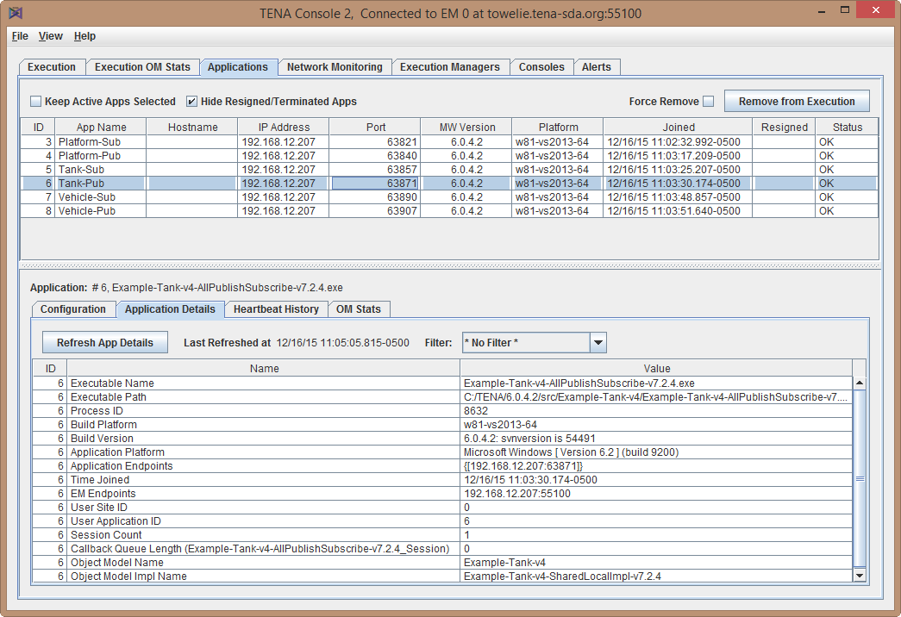
TENA Console
Application Status Screenshot
TENA Console is a GUI-based event management tool used to evaluate and monitor applications and network
Application Diagnostics
Network Monitoring
Application Alerts
“unresponsive” applications can be removed from the execution
Basic application information provided in table
Application configuration parameters listed to indicate use of non-default values

Slide 38
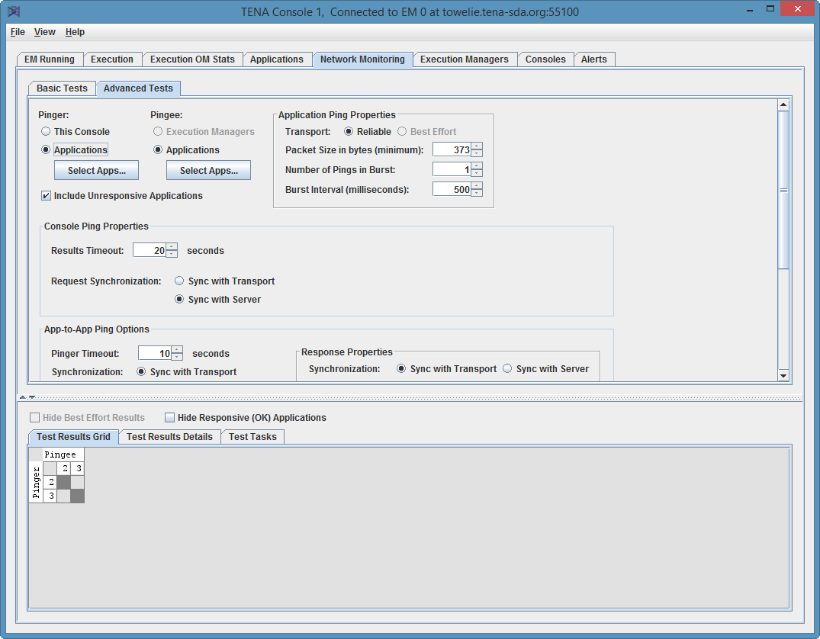
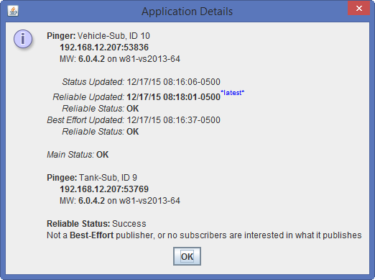
TENA Console
Network Monitoring
Network Monitoring
  Perform continuous TCP and UDP multicast communication monitoring
  Obtain system alerts regarding the operation of the distributed event over the network

Slide 39
How do we integrate TENA into an existing environment?
Gradual and Overlapping Deployment
  TENA can be introduced into an existing environment in a gradual manner
  Existing systems will typically require Adapters
Adapters for Existing Protocols and Systems
  TENA Adapters are built in a collaborative manner following a common software framework (with code generation) to create a library.
  Adapters allow the range system information and services to be available using common system interfaces and distributed communication infrastructure without changing the code to the existing systems
Redundancy during Testing
  Since existing range systems are not modified, the use of adapters permits side-by-side initial testing and operational deployment to minimize risk
TENA can be introduced to a range gradually and unobtrusively using Protocol and System Adapters

Slide 40
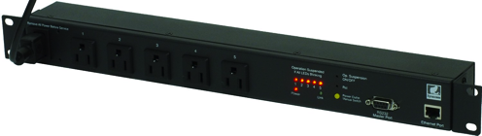
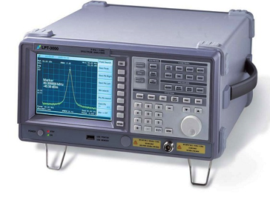
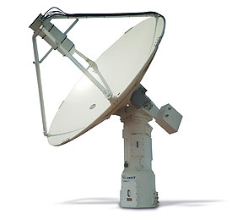
Adapter Illustration for a Telemetry Range Systems
Range Instrumentation Network
Event Management
Tools
SNMP
Power Controller
Adapter
Remote Configuration Control
VISA
Spectrum Analyzer
Adapter
Remote Operator
GUI(s)
Remote Operator
TCP/UDP
Telemetry Antenna Controller Adapter
Acme
Range Supervisor
GUI(s)
Range Superviso
TCP
Telemetry Receiver
Adapter
Data Collection, Analysis, & Playback
TCP/UDP
Telemetry Antenna Controller Adapter
Zeta
Data Visualization Tools
TCP
Telemetry Receiver
Adapter
…

Slide 41
Where Do Adapters Make Sense?
Purpose of Adapters
  Enable an existing range system to use TENA without modification
  Permit side-by-side testing/operation of Adapters with existing range protocols
Typical Range System Use Cases that Benefit from Adapters
  Legacy range systems that can’t be updated
  Commercial system with proprietary interface
  Systems without network communication
Needed Capabilities obtained with Adapters
  Remote Monitoring and Control that can support multiple operators and supervisors
  Operator efficiency improvements with ability to support multiple systems
  Integrate a non-networked system into a common communication environment
  Bring a legacy system into compliance with Information Assurance (IA) requirements
  Support coordinated data collection in support of Range Characterization activities

Slide 42
Current Adapter Library
Adapters on the TENA Repository
APC-7900 Power Strip Controller
FPS-16 Radar (WSMR network protocols)
IRTS (Yuma real-time data processing system)
IVTS (Yuma GPS System)
MPS-25 Radar (Yuma network protocols)
RDDS (Pax. River message protocol) Common TSPI
RTDPS (WSMR real-time data processing system)
TCS 600 Telemetry Antenna Control Unit
TCS M1L Telemetry Antenna Control Unit (Pax Interface)
TCS M1L Telemetry Antenna Control Unit (Yuma network protocols)
TCS M1L Telemetry Antenna Control Unit (TCS TENA Server)
Beta Adapters
iBootBar Power Strip Controller
LPT Spectrum Analyzer (LP Technologies 3000, 6000)
KTM Optics (Yuma network protocols)
In Development
MRTE Track Interface
MRTE Track3D Output
TRRM Radar
Weibel RTP-2100
Update to APC-7900 for SNMPv3
Multiple Object Tracking Radar (WSMR network protocols)
SEMCO R600A Telemetry Receiver
Smartronix 5000 Decommutator
ViaSat 3880
The TENA Team is collaborating with vendors on developing Range System Adapters for their products

Slide 43
Other TENA Integration Methods:
Web Binding
Web Binding is automatically generated based on object model
Hub provides REST API to web clients to perform middleware operations (e.g., subscribe to type Vehicle and obtain updates)
TENA data sent to and from the Hub uses JSON encoding

Slide 44
Other TENA Integration Methods:
Relay Node
RelayNode is used to bridge two executions that may have different communication characteristics
  For example, one network segment may be for a low data rate link and an update would only need to traverse that link once, and then be replicated by the RelayNode to multiple subscribers
Illustration shows a typical scenario with a
single WAN execution and multiple
LAN executions

Slide 45
TENA Information Assurance (IA) Activities
Air Force Evaluated/Approved Product List (E/APL) – approved 11/18/10
Navy Application & Database Management System (DADMS) – approved 6/27/11
Army Certificate of Networthiness (CoN) – approved 5/22/12
S/DREN (Secret/Defense Research and Engineering Network) – approved
NIPRnet – obtained ATO 12/27/12
DIACAP – approved
Security approvals are renewed according to current Risk Management Framework
Cross Domain Solutions
  TENA is used with Radiant Mercury cross domain guard for bridging information associated with certain Common Training Instrumentation Architecture (CTIA) events
  TENA-enabled cross-domain solution SimShield v2.2.0.1 on baseline list
  MILS-JCNE cross-domain solution TENA compliant and deployed.
The TENA project is working with IA organizations to reduce cost and delays with ability to operate TENA applications

Slide 46
TENA, HLA, and DIS
TENA
HLA
DIS
Government-owned
Free of charge to all users
Free support and training
Limited operating systems
Limited programming languages
Opaque network packets
Government provided
Requires centralized process
Failures detected immediately
Standard Object Model
Customizable data definitions
Robust meta-model
Objects and interactions
Some bandwidth optimization
Single middleware
Complex API
Multiple spatial reference frames
Type-safe interface
Centrally funded by TRMC
No “Time management”
Vendor-provided
Commercial, some open source
Commercial training
Limited operating systems
Limited programming languages
Opaque network packets
International standard
Some require centralized process
Some failure detection
Standard Object Model*
Customizable data definitions
Simplified meta-model
Object and interactions
Extensive bandwidth optimization
No inter-vendor interoperability
Complex API
Single spatial reference frame
Non-type-safe interface
Vendor maintained
“Time Management”
Vendor/Paper Standard
Commercial, some open source
Commercial training
Any operating system
Any programming language
Simple space efficient packets
International standard
No centralized process required
Fails silently
Standard set of PDUs
Mostly fixed data definitions*
Fixed records as meta-model
Objects are only implied
Dead-reckoning only
Many varying implementations
Relatively simple API
Single spatial reference frame
No standard interface
Volunteer maintained
No “Time Management”

Slide 47
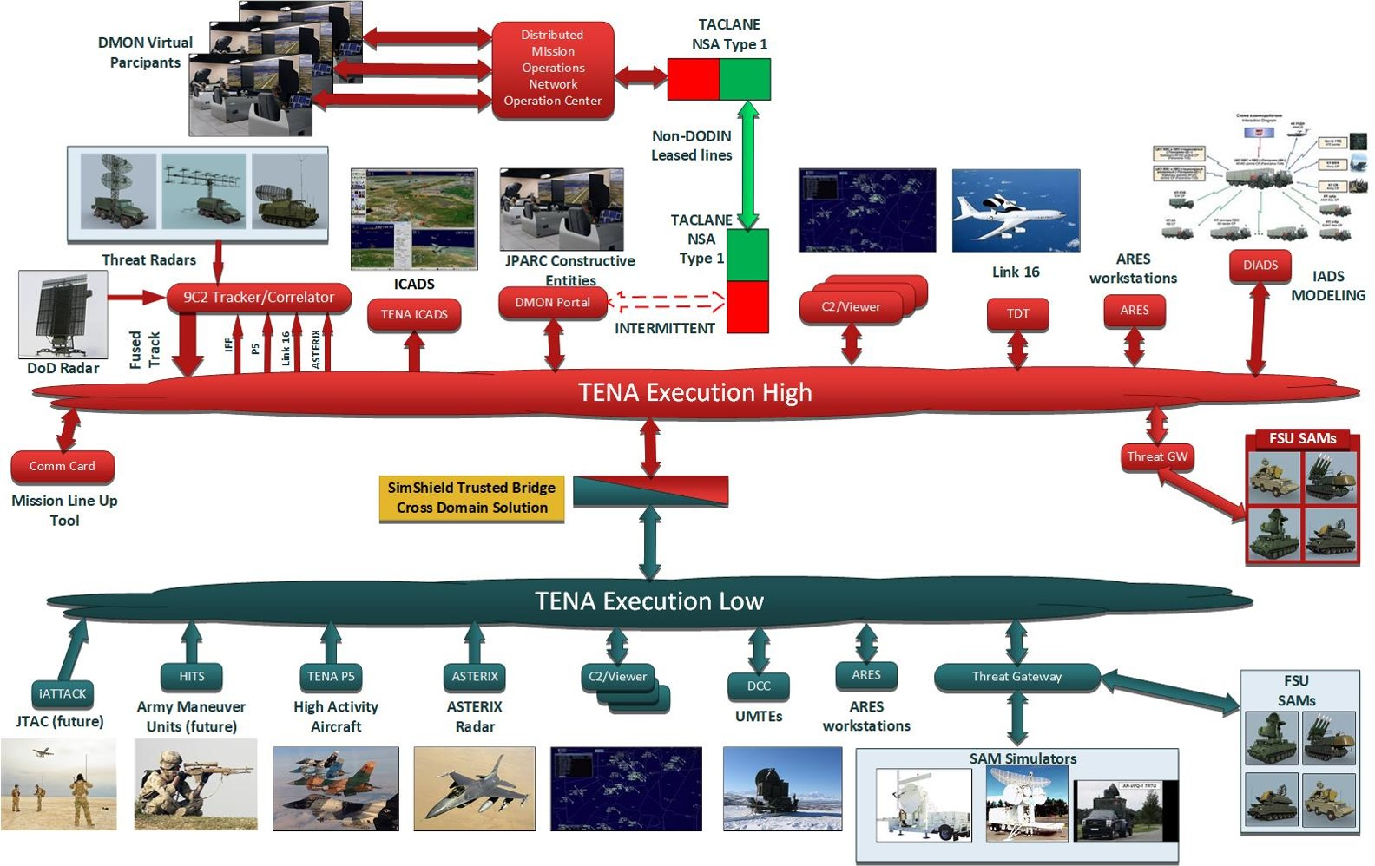
TENA in Training - JPARC

Slide 48
Lessons for Your Test or Training Events
Use the most capable interoperability architecture when judged by your own requirements
Use multiple architectures connected with gateways or adapters only when that is the most cost-effective solution, and the use of the gateways/adapters will not compromise your event
Remember that interoperability architectures only solve half the battle. Smart event design and knowledge of distributed communication issues are still required
  Beware of terrain mismatch leading to no fair fight
  Beware of fidelity mismatch leading to no fair fight
  Beware of semantic differences in interpreting the same objects
  Integrating L with V and C is much more difficult that people imagine

Slide 49
The Joint Mission Environment Test Capability
(JMETC)

Slide 50
The JMETC Mission
JMETC provides the distributed infrastructure (network, enterprise resources, integration software, tools, reuse repository) and technical expertise to integrate Live, Virtual, and Constructive (LVC) systems for test and evaluation in Joint Systems-of-Systems and Cyber environments.

Slide 51

What is JMETC?
A corporate approach for linking distributed facilities
  Enables customers to evaluate their warfighting capabilities in a Joint context
  Provides compatibility between test and training
A core, reusable, and easily reconfigurable infrastructure
  Consists of the following products:
    Persistent connectivity
    Middleware
    Standard interface definitions
    and software algorithms
    Distributed test support tools
    Reuse repository
    Data management solutions
A common joint testing process and customer support team for JMETC products and distributed testing
JMETC Networks Using DREN and SDREN
TENA Software, Object Models, Tools, Repository

Slide 52
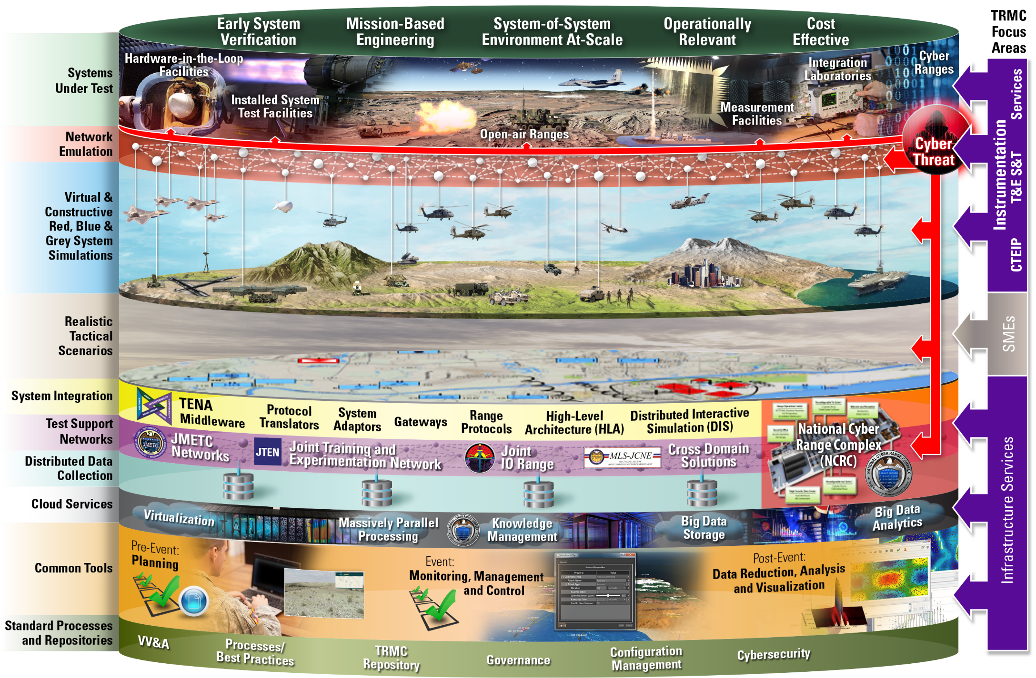
JMETC Provides an Agile Infrastructure for Distributed Testing

Slide 53
TENA/JMETC Infrastructure Overview

Slide 54
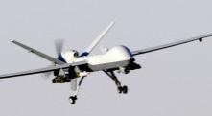
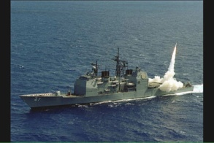

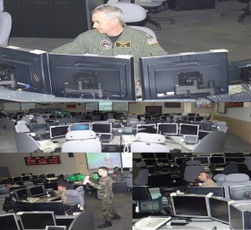

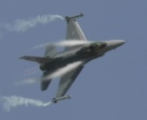
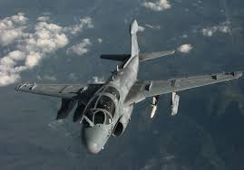
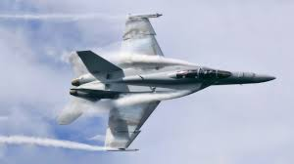
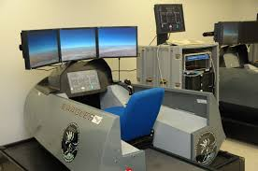



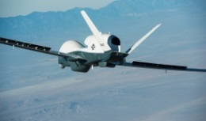

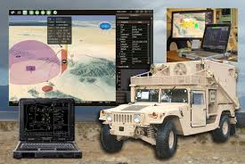
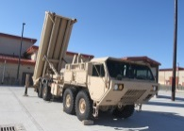
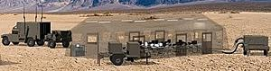
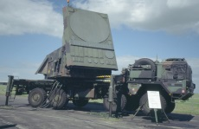
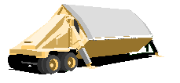
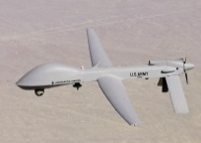

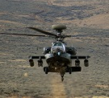
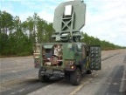
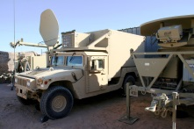
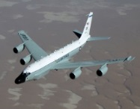
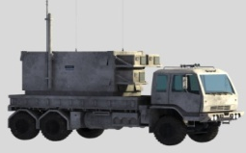
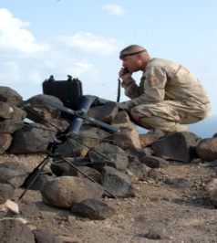


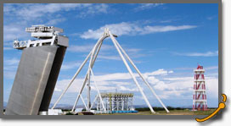
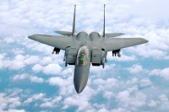
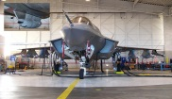


Sampling of Test and Training Assets Available on JSN
China Lake:
F/A-18, IBAR
WPAFB:
SIMAF
USSTRATCOM
Pax River: Hawkeye, Manned Flight simulator.
Dahlgren: Rapid SIL
Wallops Island : Ship Self-Defense System
McLean MITRE: National Security Experimentation Laboratory
SPAWAR Systems Center Pacific
Palmdale, Triton
NGC, Triton
Camp Pendleton
Edwards
Tinker AFB: AWACS
Redstone
WSMR IRCC
Greenville: Rivet Joint
Ft Huachuca: JITC, JTRS, C4ISR
Eglin AFB: 46th Test Squadron
Ft Hood:
TTEC, CTSF
Notes:
UNCLASSIFIED
UNCLASSIFIED
54

Slide 55
Summary of TENA/JMETC Capabilities
An Architecture for Ranges, Facilities, and Simulations to Interoperate, to be Reused, to be Composed into greater capabilities
A working implementation of the architecture
  TENA Middleware currently works on Windows, Linux, and Mac
  TENA Repository filled with information, tools, and object models
A process to develop and expand the architecture
  JMETC Users Group and AMT Meetings
A technical strategy to deploy the architecture
  JMETC process brings interoperability and reuse to test ranges
A persistent network to permanently connect test sites
  JMETC network enabled with TENA allows new tests to be performed with much less lead time and expense compared to the past

Slide 56
Learning Objectives Revisited
Four major aspects of TENA:
  Middleware – real time interoperability transport mechanism
  Data Collection System – collect event data
  Repository – place for reusable software/documentation
  Object Models – common language for interoperability
Some key differences between TENA and DIS or HLA
  TENA is a GOTS family of products and is provided for free to all users
  TENA is focused on live ranges and LVC, rather than just simulations
  TENA uses auto-code generation to provide rapid reliable development
JMETC
  Purpose is to provide a persistent interoperable suite of tools for testing and training that can be composed rapidly into a Joint Mission Environment

Slide 57
Important Contact Information
Both TENA and JMETC provide free technical assistance and training for any interested users.
  TENA Questions, Feedback, and Requests: feedback@tena-sda.org
All references can be found at the websites below:
  TENA Website: http://www.tena-sda.org or https://www.trmc.osd.mil/
  JMETC Website: http://www.jmetc.org or https://www.trmc.osd.mil/
  KM/BDA and CHEETAS Websites:
    https://www.trmc.osd.mil/wiki/display/JMETC/Big+Data+Knowledge+Management
    https://www.trmc.osd.mil/wiki/display/CHEETAS/

