Slide 1


Experimentation Campaign:
Launching into MDO
(Multi-Domain Operations)
S K Numrich, PhD, CMSP, Institute for Defense Analyses
Kevin Woods, PhD, Institute for Defense Analyses

Slide 2
Discovery Experimentation Campaign: Crafting the Future
or
How to use simulation
and human-in-the-loop capabilities of training technology, in particular,
to reduce risk in acquisition;
to assess military utility
of new technology;
or
revise tactics, techniques, and procedures
in the face of new technology (ours or theirs)

Slide 3

Learning Objectives
Distinguish discovery experimentation from other forms of experimentation
Define the flow of an experimentation campaign
Explain why one might use discovery experimentation -- provide an example
Describe the Service and Joint efforts in advancing capabilities for Mult-Domain Operations (MDO)
Explain the utility of a simulation-enabled experimentation Campaign in exploring MDO

Slide 4

Why Experimentation in the Military
“As the most powerful country on the planet, both economically and militarily, we should, without a doubt, conduct aggressive experimentation to not only learn what to do, but also actively seek to learn what not to do. We will benefit from both results, as we will develop future leaders and operators that are not afraid to take risks in pushing the edges of our own abilities.”
Try and Try Again
(Military culture must embrace experimentation and failure)
Michael Tyson,
USNEWS,(2014)
Michael Tyson is the Marine Corps senior fellow at the Atlantic Council’s Brent Scowcroft Center on International Security.

Slide 5
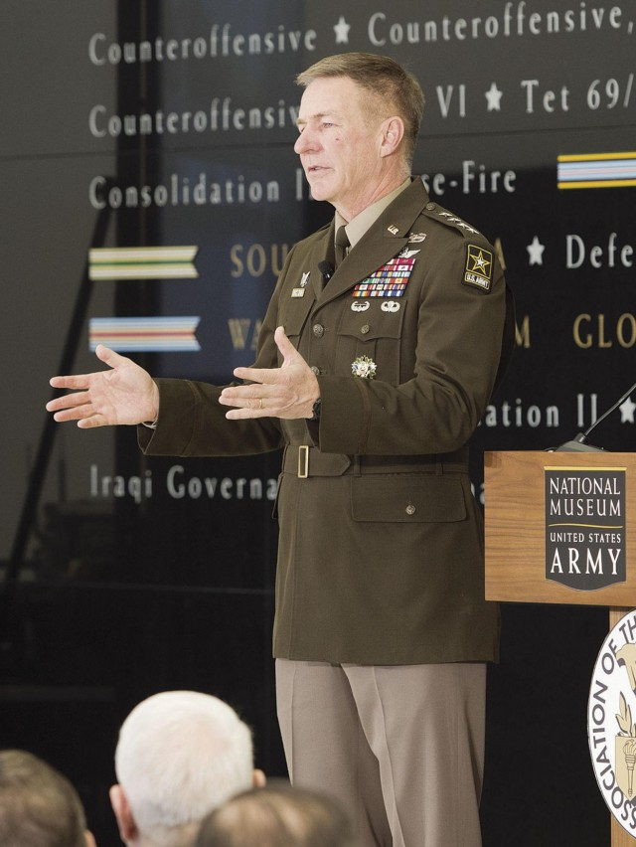
Criticality of Simulation and Experimentation
“I think modeling simulations is absolutely critical… We can save money, upfront, by modeling, simulating, whether it is designing prototypes and actually it is amazing what you can do, in a computer right now, before you actually build prototypes.
If you take a look at the strategy that we have right now… We are going to make competitors show us a detailed design, that we can actually model and simulate with before we go to prototype before we finalize our requirements, so we make sure we have the right requirements in place and we don't waste money along the way, in development.
And the same thing with training, and even testing on our systems. We are experimenting and simulating with the type of units that we are going to develop for multi-domain operations. So, we know whether they will be successful in combat or not. “
GEN James McConville, Chief of Staff of the Army
House Armed Services Committee Holds Hearing on the Fiscal 2021 Budget Request for the Army
Mar 3 2020
Photo: Paul Lara

Slide 6
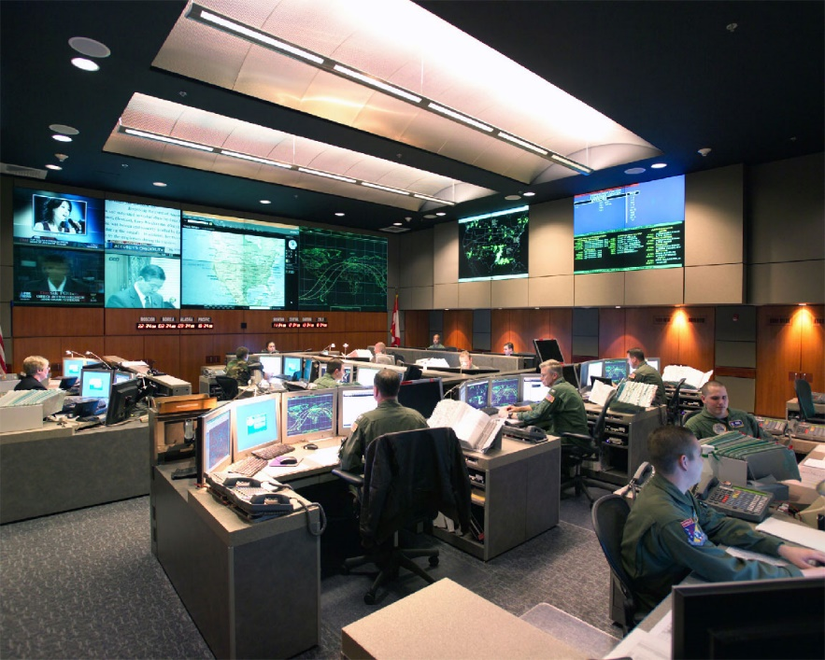
Return of an Old Idea
This idea of operational experiments,
for obtaining a quantitative insight into the operation itself,
is a new one and is capable of important results. (1946)
Properly implemented, it should make it possible for the military forces of a country
to keep abreast of new technical developments during peace,
rather than have to waste lives and energy catching up after the next war has begun.
Such operational experiments are of no use whatever if they are dealt with as ordinary tactical exercises…
Philip M. Morse and George E. Kimball, Methods of Operations Research, Operations Evaluation Group Report 54, Washington, 1946 (p. 129) // cited in The Practice of Military Experimentation, Brian McCue, CNA (2003)
Innovation in Peacetime ➔ Success in War

Slide 7
Experimentation:
Deemed Important in 1946
Confirmed in 2019
Deemed Critical in 2020
But what exactly is
EXPERIMENTATION

Slide 8
Defining Experimentation
DoD uses three primary types of experimentation (definitions used in following slides come from CCRP* Code of Best Practices: Experimentation (COBP)
Hypothesis testing experiments
Demonstration experiments
Discovery experiments
Each type of experimentation
Has specific uses within DoD
Is characterized by the type of knowledge in hand at the outset
Makes different demands on data collection
The different types of experiment can be combined into a campaign in the quest for increased capability for the military
*Command and Control Research Program (CCRP)

Slide 9
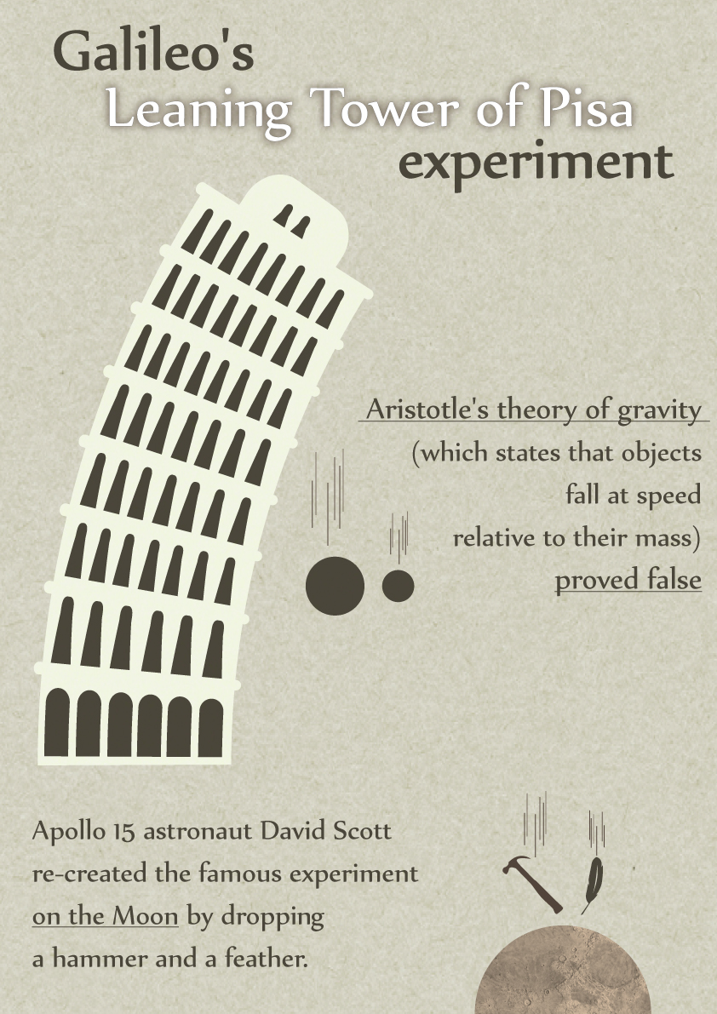
Hypothesis Testing Experiments (COBP)
Hypothesis testing experiments are the classic type used by scholars to advance knowledge by seeking to falsify specific hypotheses (specifically if…then statements) or discover their limiting conditions.
They are also used to test whole theories (systems of consistent, related hypotheses that attempt to explain some domain of knowledge) or observable hypotheses derived from such theories.
In a scientific sense, hypothesis testing experiments build knowledge or refine our understanding of a knowledge domain
Note: COPB uses a narrow definition. There are other ways to do hypothesis testing. However, this describes a particular type of experiment – what some would call a classical scientific experiment
Yathis. Retrieved from http://yathish.deviantart.com/art/
Galileo-s-Leaning-tower-of-Pisa-Experiment-358178208

Slide 10
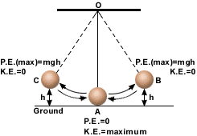
Demonstration Experiments (COBP)
Done initially as
an Hypothesis Test,
today the pendulum is
a Demonstration
DoD equivalent activities are technology demonstrations used to show operational organizations that some innovation can, under carefully orchestrated conditions, improve the efficiency, effectiveness, or speed of a military activity.
In such demonstrations,
all the technologies employed are well-established and
the setting (scenario, participants, etc.) is orchestrated
to show that these technologies can be employed efficiently and effectively under the specified conditions.

Slide 11

Discovery Experiments (COBP)
Discovery experiments involve introducing novel systems, concepts, organizational structures, technologies, or other elements to a setting where their use can be observed and catalogued.
Discovery experiments are best employed starting at the novel idea for a system and then
Rather than setting a collection of requirements
Discovery experiments use available forms of simulation to refine the concepts
Allowing for the possibility that what emerges differs significantly from the initial notion

Slide 12
Let’s Summarize (1)
Hypothesis Testing Experiments
Goal: Used to advance knowledge
falsify hypotheses (scientific theories – causal relationships) or
seek to identify bounds or limitations in the hypotheses
Conditions: laboratory-type experiments with constrained conditions
Characteristics of Evidence:
Relies on the collection of empirical data (valid, reliable, repeatable)

Slide 13
Let’s Summarize (2)
Demonstration Experiments (as used in DoD)
Goal: show that specific technologies can be efficiently and effectively used under the specific conditions of the demonstration
Seeks to show operational value of a prototype, for example
Conditions: Employ well-established technologies (may be prototyped in new devices) in carefully orchestrated conditions (may be part of training exercises)
Characteristics of Evidence:
Empirical data collection changes to observation, recording of results and noting conditions under which innovations were demonstrated

Slide 14
Let’s Summarize (3)
Discovery Experiments (as used in DoD)
Goals: : Identify promising paths and dead ends, delineate further exploration and experimentation
force the community to ask rigorous questions about benefits sought,
generate hypotheses, and
lay the foundation for more rigorous types of experiments to test those hypotheses
Conditions: uses whatever means are most suitable from tabletop wargames, to constructive or LVC simulations
Characteristics of Evidence
Uses empirical data and observation to produce findings
Results need not be validated or repeatable, but must be the result of informed and rigorous examination

Slide 15
Why Use Discovery Experimentation
Discovery Experimentation: used prior to any decision to see if an innovation has military potential
Innovations can be
New ways of using current capabilities
Exploring a new capability to discover whether or not it has military potential
Determining training requirement for new TTPs or new technologies
A well-designed (discovery) experimentation campaign can reduce risk by
Examining a new concept before it is even prototyped to see if it lives up to the promised benefit
Exploring different ways of implementing a new capability as a way of refining design, particularly the user interfaces
Demonstrating early prototypes at a stage in development where change is far less expensive
Using the refined prototype to set the requirements rather than setting requirements and then creating the prototype

Slide 16


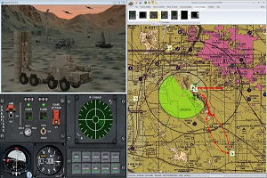
A Bit More on Discovery Experimentation
Discovery experimentation is best used BEFORE deciding upon a course of action: buy something, change tactics, introduce new training
Critical components of discovery experimentation
Best used in a “what if…”, or “suppose…” context – before a real hypothesis exists
Allow for failure – in fact, failure is an important means of refining a notional course of action
Use different types of simulation depending on issue
Always allow for Human-in-the-Loop investigation and feedback
New Concept
BOGSAT and Wargame
Simulate
Collect data at every step – observational and empirical
Examine by Experts
Simulate Known Bits
If the concept is new, simulation may not be able to capture all facets, but can be used to examine some of the “what ifs”
Feedback to Refine
Feedback to Refine

Slide 17
What About the Data?
Refining the idea
Collect subjective data in a consistent manner – carefully designed questionnaires to collect results in a formatted manner.
Keep track of all refinements as it may be necessary to step back and regroup – not all refinements are likely to play out
Wargaming the idea
Useful part of the refinement process
Collect results as above (observational) and include any computational outcomes (empirical)
Simulating the idea in quick-turn, low granularity constructive simulations
Will likely have to work around missing pieces (keep track of the work-around details)
Collect results from performance runs
Experiment with diverse scenarios as appropriate
Notes:
Slide 16 – Assuming Project Convergence qualifies as an discovery experiment (and I think some would argue that it’s a demonstration—most likely it’s the fuzzy line area between from the mix of mature and new systems), you only address subjective data. Same can be said for the Army Network Integration Events (which formally were experiments + operational tests + training events ongoing simultaneously, and yes what a mess that makes). In PC20 there was a LOT of objective data collected. Our group supports OTC, and they used our ExCIS system to collect TB/day of message traffic. Other weapons performance data was collected. The same occurred during NIEs. That data isn’t used to do hypothesis testing, but it does serve to at least generate some MOPs (e.g., sensor to shooter latency in PC20) and even MOEs.
Also, this objective data becomes valuable for doing forensic analysis when these new complex SOSs fail. Without this objective data, it’s hard to tell where where the failure point in a SOS occurred. On this topic of data, discovery experiments also a valuable source about naturally occurring variability and measurement error that later should become critical in design of experiments for developmental and operational testing. Way back when I had a full head of hair, I worked as a statistician for TVA, designing experiments and then analyzing results. The question of “what’s the right sample size?” always came up, and without understanding the sources of variability of the measures (whether by natural causes or measurement error) you cannot determine the needed sample size. We often did trail experiments (some now call this test environment validation in Army OT) prior to the tests, but discovery experiments can often yield this important data. Not saying this goes here, but maybe at the end as a discussion of how discovery experiments provide valuable info for the rest of the lifecycle. Another opportunity, see my comment on the next slide.

Slide 18
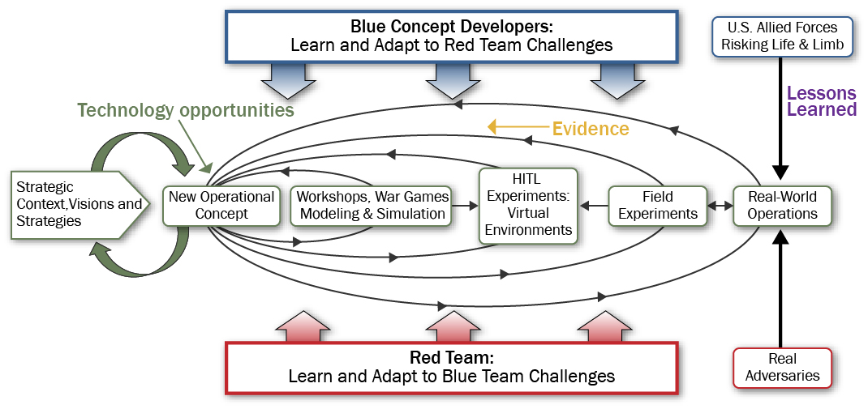
This is an Experimentation Campaign
The real power behind experimentation is development of an experimentation campaign
Prototype, Build
Live Experiments
and Tests
Grey
Actions/Reactions

Slide 19
Planning and Executing a Discovery Experiment
It doesn’t have to be complicated
It doesn’t have to take years
It doesn’t have to be extremely costly
Weapon-Centric Close Air Support (CAS) Concept Development and Experimentation
abbreviated as WCC Experiment

Slide 20
Stating and Refining the Concept
General Military Problem Area (what keeps you awake at night)
How can the Joint Force Commander create CAS effects during the early phase (before US forces establish air superiority) of a major conventional operation or campaign without incurring unacceptable risks to the joint force or its mission?
How to Use Discovery Campaign
State the problem space and define the concept
Refine the concept and seek a venue for experimentation
Add the missing pieces – future capabilities
Plan and execute data collection
Use feedback to change the environment of the experiment
Use feed forward to caveat findings and suggest further investigation

Slide 21
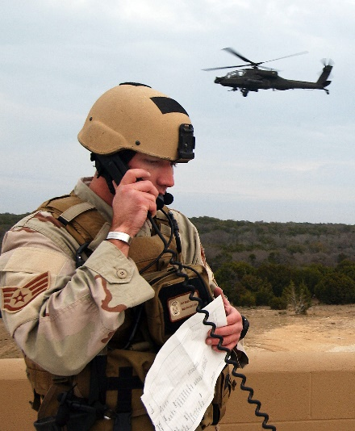
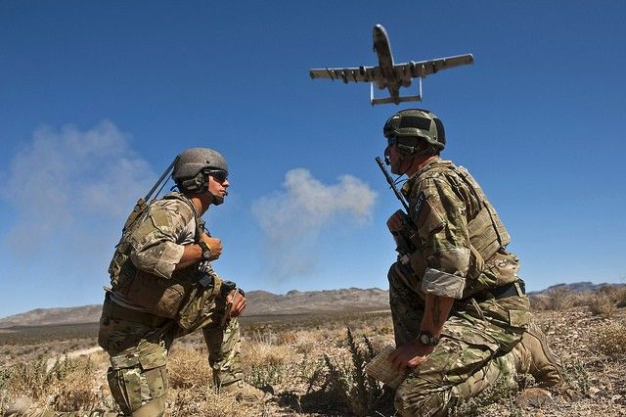
Refining the Concept
Close Air Support (CAS)
CAS is defined as “air action by fixed- and rotary-wing aircraft against hostile targets that are in close proximity to friendly forces and that require detailed integration of each air mission with the fire and movement of those forces.” (JP3-09.3, p xi”)
A contested environment is one where the adversary has the capabilities to deny US ability to operate or can restrict US freedom of action in air, space, or cyberspace.
In a highly contested environment, an adversary possesses the capabilities to interfere prohibitively in one or more domains that requires applying advanced warfighting techniques and capabilities to create desired effects.
US Air Force, Air Force ISR 2023: Delivering Decision Advantage, (Washington, DC: US Air Force Headquarters, 2013), 7.

Slide 22
Workshop and Seminars Clarified Need
Clarifying the Mission Need
A series of workshops and conferences with the CAS community (AF and USMC) confirmed the problem space
CAS mission must be accomplished when the airspace above the battlefield will likely be contested or highly contested, perhaps intermittently.
The necessity of conducting conventional ground maneuver with CAS support against a near-peer without first achieving air superiority is a significant and growing possibility.
The Concept
Shift the mission burden of CAS from the platform delivering the munition to the control of the munition from the forward ground element, the Joint Tactical Air Controller (JTAC)
Weapon-Centric CAS became the concept
Allow the ground controller to direct smart weapons (not currently in the AF inventory)
Smart weapons: Standoff Network Enabled Weapon (SNEW) and Loitering Network Enabled Weapon (LNEW)
Why SNEW: released outside the major danger zone by any capable aircraft
Why LNEW: released outside the major danger zone, loiter anywhere including close to the front

Slide 23
Absent: Constructive Simulation
Searches across Army and Air Force did not reveal any constructive simulation that included CAS specifically
Repeatable, aggregate simulations could not be run to refine the problem
Refinements had to be done in BOGSATs and with full-time participation of CAS professions (air and ground)
Campaign had to skip the constructive simulation and move directly to Human-in-the-Loop simulation
Human-in-the-Loop simulation environment found at a CAS training site (Air Force Research Laboratory)
Army and Air Force provided operational warfighters with the credentials to provide realistic response to any simulated capabilities
But there were additional shortcomings
The new concept involved operations not present in the simulation and not part of training for Joint Tactical Air Controllers
Communications, weapons, and operations were not part of traditional CAS

Slide 24
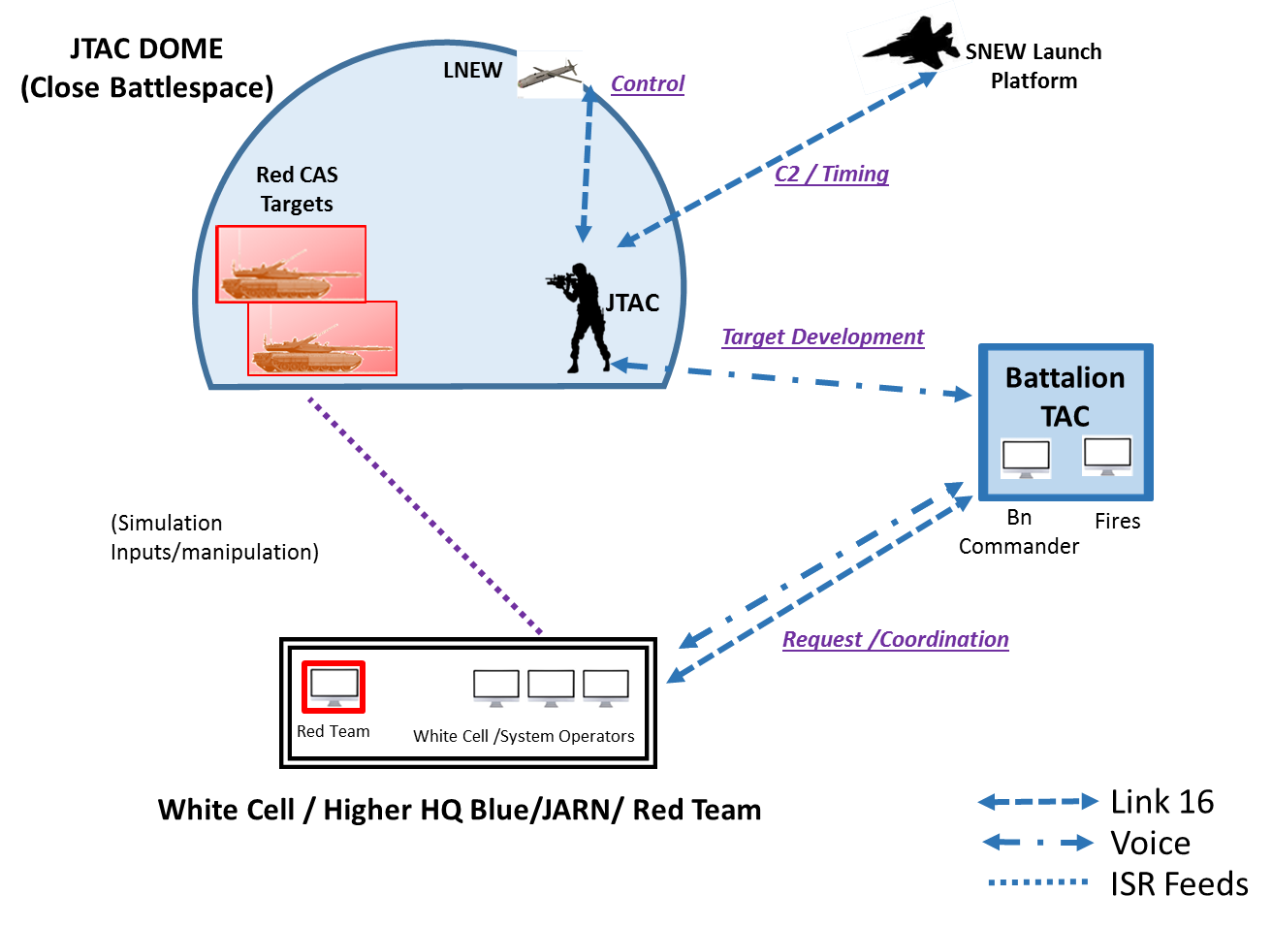
Battlespace Environment
JTAC: Joint Tactical Air Controller is the individual usually positioned forward spotting the adversary for the pilot, coordinating airspace over the battle, passing situational awareness to the pilot, and doing battle damage assessment
The need for air-delivered, precision fires is stated by the Battalion commander and coordinated if necessary with a Joint Air Request Net (JARN)
Starting Point: New Weapons, Different Communications
LNEWs: loitering weapons, powered and controllable by the pilot (now the JTAC)
SNEWs: gliding weapons with maneuver ability under the control of the pilot (now the JTAC)
Both weapons have several technical means for locating a target – GPS and sensors

Slide 25
The Simulation Environment: HITL Trials
AFRL provided the HITL facility for the Discovery Experiments (711th Human Performance Wing, Wright-Patterson Air Force Base, Dayton, Ohio)
Integrated Combat Operations Training-Research Testbed (ICOTT): a virtual, human-in-the-loop, simulation environment—allowed real-world operators (JTACs) to employ platforms, sensors, and weapons that do not exist, but were represented in the simulated world that the JTACs used in everyday training..
Simulation used: Modern Air Combat Environment (MACE). MACE is a largely physics-based, many-on-many simulation and threat environment with a large order of battle ideally suited for both stand-alone mission rehearsal and distributed mission simulation.
Needed:
Simulations of LNEW and SNEW
Interface device for controlling LNEW and SNEW
Absent: electromagnetic battlespace environment
As a training venue, the ICOTT facility was designed around a real-time, HITL construct with
a core simulation capability,
a semi-immersive visual environment for the individual being trained,
specialized interface devices (e.g., a laser designator) for the trainee to use,
a flexible C2 structure including radio and simulation interfaces, operator stations equipped with computer and radio interfaces, and
a wealth of scenarios used for training JTACs and controllers of remotely piloted aircraft.
Image courtesy of Battelspace Simulations, Inc., http://www.bssim.com/

Slide 26
Metrics, Metrics, Metrics
What we might want to know (hard data)
Number of weapons and targets one JTAC can handle
Success ratio: how many weapons were needed to kill/disable/delay a target
Second tries: how many times was a second try needed
What weapons were more successful against specific types of targets (moving, stationary)
Contextual and performance data (soft data)
What tasks were difficult
What types of difficulties were experienced
How well a scenario went – was execution improved, tasks got easier, etc.
What skills would have been nice to have going into this
Was WCC viable, given their operational experience
Subjects were all instructor level JTACs with multiple deployments in combat zones

Slide 27
Quest for Hard Data
Data Collection
Compromise between what you want and what you can get
Sometimes data you expect is not available
Training results are generally not shared or so heavily redacted that they are useless
Expected PDUs may not be available based on the way a modeled entity is designed
Human data collectors may not all focus on the same information
Table at the right shows desired and available data for the WCC experiment
Desired Data Element | Source for Extracting Data
 | Scenario Description | PDU Data | Link-16 Message | JTAC Log | Radio Log
Start Time |  |  |  | 10-30% | 100%
Weapons Available | 100%
Time Target Assignment |  |  |  | 10-30% | 50-80%
Weapon-Target Plan |  |  |  | 50-80% | 10-30%
Time Weapon-Target Pairing |  |  | 100% | 50-80% | 10-30%
Time Cleared Hot |  | 100% | 100% | 10-30% | 10-30%
Position in Flight |  | 100% SNEW only
Impact time |  | 50-80% |  | 10-30% | 10-30%
Impact Location |  | 50-80%
Damage to Target |  | 50-80% |  | 10-30% | 10-30%

Slide 28
Data Sources
Hard data provides a sense for what happened
Soft data can add context of how and why it happened
Live observation is a critical part of the data collection – needed for piecing together diverse data sets
HITL experiments can be frustrating, but they uncover facets of the concept not clear at the outset: change in C2 structure, training needs
Soft Data
Observational Data
Instrument | Subject(s) | Collection | Total Samples
NASA Task Load Index | JTAC and Observer or JTAC1 and JTAC2 | Each run in all Trials (31) | 62
Part Task Difficulty Assessments | JTAC and Observer or JTAC1 and JTAC2 | Each run in Trials 1 and 2 | 40
Elicited Response Survey (free text) | JTAC and Observer or combined JTAC1 and JTAC2 | Each run in all three Trials | 51
Outbrief Notes (IDA data collector) | JTAC and Observe or JTAC1 ad JTAC2 with Ground CDR and Fires Officer | Each run in Trials 1 and 2, after each set of 3 runs in Trial 3 | 24
After Action Review | JTACs | End of each Trial | 12
Source | Information Provided
Radio Log: researcher notes | Time of radio messages, some identification of intended targets, planned weapons, damage assessments—targets and weapons not always identified in message log
JTAC Log | Recreation of planned and executed attacks, developed during outbrief (not all clock times were recorded)
Link-16 Messages | Computer file, included cleared hot (did not identify which weapon), when an entity was killed
Simulation State Messages | Time for cleared hot, state reports for SNEWs, usually impact time, usually impact location, damage to targets
 | *Trial 1 did not have Link-16 messages.

Slide 29
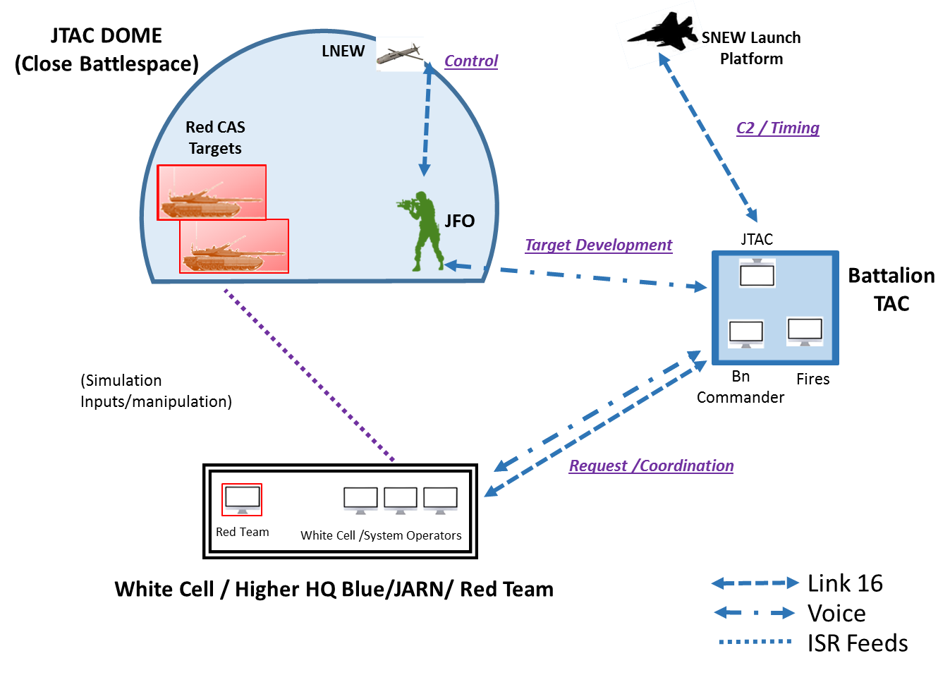
WCC Experiment: Trial 1
Initial Configuration
JTAC observes target
JTAC receives intel updated from Battalion Tactical Air Control (TAC)
TAC requests air support (deliver SNEW) from Higher HQ
JTAC develops plan of attack using SNEW or LNEW or both in combination
JTAC’s moves interact with the simulation in the dome
JTAC communicates with TAC and controls weapons comms at the same times
Bottom line: JTAC too busy with both sets of communication
Trial 1
Trial 2
Trial 3
JTAC
Dome
LNEW
SNEW Launch Platform
Weapon Control
C2 / Timing
Target Development
Battalion
TAC
JTAC
Simulation Inputs / Manipulation
Request / Coordination
White Cell / Higher HQ / Red Team

Slide 30
WCC Experiment: Trial 2
Changes using feedback
JTAC already in TAC worked all communications not directly involved with the weapon
JTAC in the field handled weapon control
Planning done collaboratively between the JTACs
Improved Performance
Needed closer coordination between communication and target plan development
Trial 2
Trial 3
Trial 1
JTAC
Dome
SNEW Launch Platform
LNEW
JTAC
Dome
JTAC
Dome
SNEW Launch Platform
Weapon Control
SNEW Launch Platform
C2 / Timing
Weapon Control
JTAC
Weapon Control
C2 / Timing
Target Development
C2 / Timing
Target Development
Battalion
TAC
JFO
JTAC
Battalion
TAC
JTAC
JTAC
Simulation Inputs / Manipulation
Battalion
TAC
Target Development
Simulation Inputs / Manipulation
Request / Coordination
Simulation Inputs / Manipulation
Request / Coordination
Request / Coordination
White Cell / Higher HQ / Red Team
White Cell / Higher HQ / Red Team
Link 16
Voice
ISR Feeds
White Cell / Higher HQ / Red Team

Slide 31
WCC Experiment: Trial 3
Using Feedback from Trial 2
Moved JTAC from field to TAC
Two JTACs
Coordinated communication
Received Intel
Developed targeting plan
Requested air support
JFO (Army, less training) in field
Spotted and communicated presence of targets
Controlled weapons once fired
Reported on damage
Feed forward
JTACS need training in targeting
Set requirements for changes in JTAC control device
Trial 3
Trial 1
Trial 2
SNEW Launch Platform
JTAC
Dome
LNEW
JTAC
Dome
SNEW Launch Platform
JTAC
Dome
SNEW Launch Platform
C2 / Timing
Weapon Control
Weapon Control
JFO
Weapon Control
C2 / Timing
C2 / Timing
JTAC
JFO
Battalion
TAC
Target Development
Target Development
JTAC
Battalion
TAC
Battalion
TAC
Simulation Inputs / Manipulation
Target Development
Simulation Inputs / Manipulation
Simulation Inputs / Manipulation
Request / Coordination
Request / Coordination
Request / Coordination
White Cell / Higher HQ / Red Team
White Cell / Higher HQ / Red Team
White Cell / Higher HQ / Red Team
Link 16
Voice
ISR Feeds

Slide 32
What Was Learned and Future Work Needed
Experiment indicated potential military utility; however, total concept validity depends on technical capabilities not as yet measured, including
LNEW and SNEW performance (notional capabilities point to utility of potential systems),
Secure communications system (affect all battlespaces systems, not just CAS),
Timely and accurate targeting sources—especially for mobile/moving targets that may require multiple location updates (potential utility of advanced surveillance system).
The WCC Experiment did not include the following elements that need closer examination in future studies
Realistic battlefield communications and networking
Questions remaining: stability and capacity of the overall network with typical loads
Representation of the end-game targeting of weapons
Would realistic end-game targeting capability change the effectiveness of the weapons and concept?
Representation of the adaptive adversary
What countermeasures would the adversary use?

Slide 33
Multi-Domain Operations: MDO
All Domain Operations
Joint All Domain Command and Control: JADC2
Concepts and Experiments
Note: multi-domain and all-domain operations usually refer to
land, sea, air, space, and cyberspace

Slide 34
The Demand – This Is Not New
Today’s security environment continues to change with adversaries more able to challenge U.S. military capabilities. It is imperative the U.S. joint force develop ways to combine its powerful capabilities across all domains (air, land, maritime, space, and cyberspace).¹ (2016)
Cross-domain synergy is “the complementary vice merely additive employment of capabilities in different domains such that each enhances the effectiveness and compensates for the vulnerabilities of others.”² (2012)
Why Joint? The answer lies in how to employ complementary capabilities
United States Joint Staff Joint Force Development (J7) – Future Joint Force Development, Cross-Domain Synergy in Joint Operations, (Washington,DC, United States Department of Defense) January 2016. https://www.jcs.mil/Portals/36/Documents/Doctrine/concepts/cross_domain_planning_guide.pdf?ver=2017-12-28-161956-230
^{2.} U.S. Department of Defense, Joint Operational Access Concept (JOAC) Version 1.0. (Washington, DC: United States Department of Defense, 2012), Foreword. http://www.defense.gov/pubs/pdfs/JOAC_Jan%2012_Signed.pdf.

Slide 35
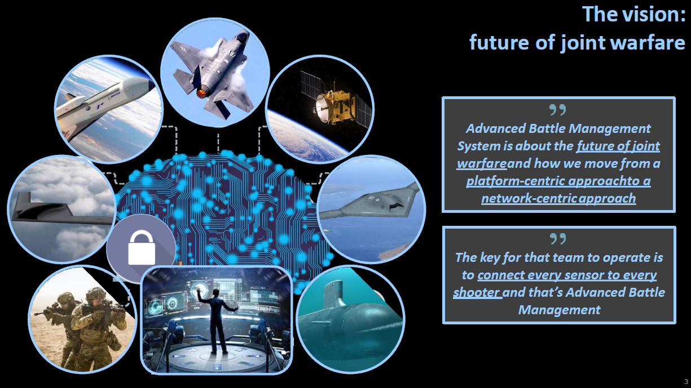
Concepts: Who Wargamed the Concept?
MDO Concepts
Concept Stage: best time to begin an Experimentation Campaign to refine Joint operational concepts before Service concepts move is different directions
Service Concepts Vary
Generally concepts revolve around
any sensor detects,
any capable weapon on any available platform engages,
any sensor detects damage
Currently viewed as a network issue
But is it really a data availability issue?
Multi-Domain Operations: Bridging the Gaps for Dominance
Congressional Research Service, “Defense Capabilities: Joint All Domain Command and Control, April 5, 2020

Slide 36
How to Use Discovery Experimentation
Discovery Experiments Abound
Army: Project Convergence
Navy: Project Overmatch
Air Force: All-Domain Operations Capability
DoD: JADC2 a concept with some side experiments, not yet dealing with the tactical level
Current State
One-off experiments, often with two services participating
How many of these will it take to uncover the gaps and capabilities?
Since we cannot do this all via experiment, are we prepared to simulate this new integrated, joint battlespace?
USAF Chief of Staff Gen. Goldfein: USAF, Navy Experimenting with Multi-Domain Operations*
Air Force and the Navy are trying to connect combat assets in new ways… to improve joint, software-driven warfare.
“We did
some pretty cool experimentation with space linked to [intelligence, surveillance, and reconnaissance] linked to [command and control] linked to shooter, and
then wrote the algorithms, put the common architecture in place, and
then worked the kill chain machine-to-machine, where the only human that was actually on the loop was the shooter.”
Joint experimentation is critical to uncovering gaps and capabilities in current force and remedy the gaps in the future force
*https://www.airforcemag.com/goldfein-usaf-navy-experimenting-with-multi-domain-operations/

Slide 37
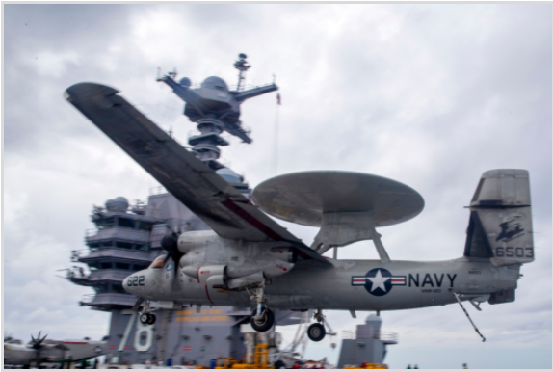
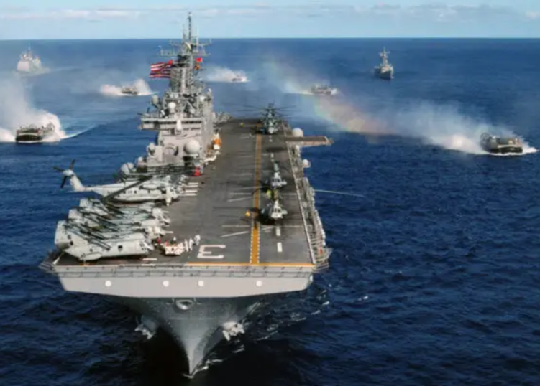
Project Overmatch
Project Overmatch is a multi-command effort aimed at enabling a Navy and Marine Corps that swarms the sea, delivering synchronized lethal and non-lethal effects from near-and-far, every axis and every domain.
Critical to Project Overmatch is the development of networks, infrastructure, data architecture, tools and analytics that support the operational and developmental environment that will enable sustained maritime dominance using manned and unmanned systems. How well can we simulate these factors?
Network integration is one of four core pillars in the Navy’s approach to JADC2, along with agile software development, common data standards and battle management applications. All of these efforts are hosted under Project Overmatch, the Navy’s JADC2 implementation program

Slide 38
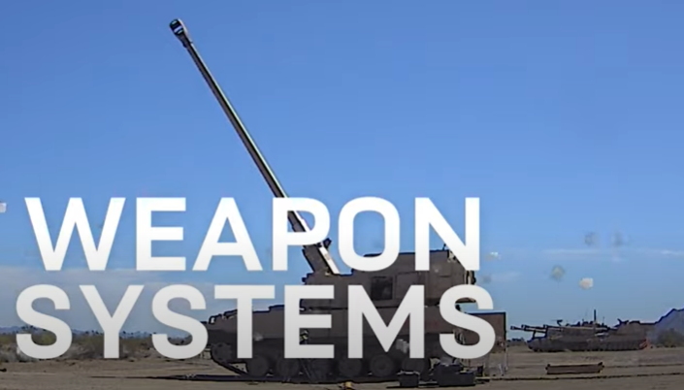
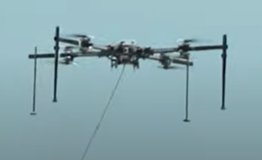
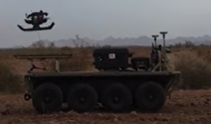
Project Convergence: Campaign of Learning
“Project Convergence is the Army’s new campaign of learning organized around a continuous, structured series of demonstrations and experiments” designed to meet the challenges posed by JADC2.
Project Convergence comprises five components:
1. ensuring the Army has the right people and talent;
2. linking current Army modernization efforts with Army Futures Command crossfunctional teams aligned to the six Army modernization priorities;
3. having the right command and control to meet increasingly fast-paced threats;
4. using AI to analyze and categorize information and transmitted across the Army network; and
5. testing capabilities in the “most unforgiving terrain.”
Experiment Program
2020 focused on new Army systems
2021 include Joint
2022 planned to include allies

Slide 39
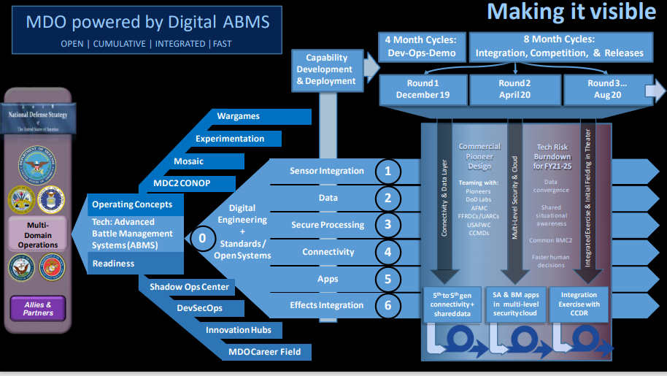
Air Force Leads JADC2 with Digital Advanced Battle Management Family of Systems (Digital ABMS)
ABMS Tenets
Access data from a wide range of sources
Prepare and present data
Provide instant and seamless access to information
Use AI aided human decision making
Use Seamless and instant communications
Communicate decisions to all stakeholders together with resources
Manage MLS
Progress through experiments executed in rapid succession
2019: F22, F35, Navy destroyer, Army Sentinel Radar system, mobile artillery system, commercial space and ground sensors
2020: AF aircraft, naval vessels, special forces, eight NATO nations in a simulated environment

Slide 40
Questions for Congressional Review
How can Congress consider JADC2-related activities in advance of validated requirements or cost estimates?
How can DOD ensure interoperability among each of the military services’ and allies’ communications systems?
How should DOD prioritize competing communications requirements for its future network?
What role will artificial intelligence play in future command and control decision-making systems?
What potential force structure changes will be necessary to meet JADC2 requirements?
How should DOD manage JADC2-related efforts?
Congressional Record Service, March 18, 2021
And from the analyst: How many experiments or demonstrations would be needed to answer these questions? Consider the combinatorials!
Notes:
fro

Slide 41
Where Does M&S Fit?
M&S as Part of a Campaign Fits Everywhere – from Requirements to Tests
Requirements for JMDO need a rigorous campaign of wargaming, HIL simulation , and campaign M&S
Interoperability is only part of the issue. But large scale interoperability under EMS and cyber stress is not feasible in live experiments.
Prioritizing requirements is difficult without evidence provided by a structured campaign of experiments that can build on one another and be extended with M&S tools.
The automotive industry has found that testing the AI-enabled systems in cars requires far too many tests to perform live – simulation is absolutely needed
M&S trials across multiple scenarios provide evidence for force structure decisions, while LVC simulations with operators can refine employment concepts.

Slide 42
Gaps and Challenges
How could an experimentation campaign benefit current efforts to enable MDO?
The same need for common, processed, parameterized and shared data needed for Digital ABMS is needed for developing MDO capability
A simulation-enabled experimentation campaign can tie together and expand upon the live exercises in a way that verifies or vitiates concepts now taken for granted
Live experiments remain expensive and suffer from the inability to control environmental conditions – simulations can extend the exploration space in a far less costly manner
BUT there are significant challenges for M&S
The new domains in MDO, particularly the electro-magnetic environment and cyber operations, are difficult to model and don’t exist in most broadly available systems
Simulating communications as well as offensive and defensive EM systems requires classified facilities and then the ability to aggregated and represent effects measured in a laboratory in a theater model is more then difficult
However
Without the discipline of an M&S enabled campaign it will take too long to execute all the experiments needed to parameterized MDO operations

Slide 43
Learning Objectives
Distinguish discovery experimentation from other forms of experimentation
Define the flow of an experimentation campaign
Explain why one might use discovery experimentation -- provide an example
Describe the Service and Joint efforts in advancing capabilities for Mult-Domain Operations (MDO)
Explain the utility of a simulation-enabled experimentation Campaign in exploring MDO

Slide 44
Contact Information
Dr. S. K. Numrich (Sue): snumrich@ida.org
Dr. Kevin Woods: kwoods@ida.org

Slide 45
References
Philip M. Morse and George E. Kimball, Methods of Operations Research, Operations Evaluation Group Report 54, Washington, 1946 (p. 129) // cited in
McCue Brian, “The Practice of Military Experimentation,” CNA (2003)
Alberts, David S., Hayes, Richard E., Code of Best Practices for Experimentation, CCRP Publication, 2002, PDF available http://internationalc2institute.org/codes-of-best-practice/ (last accessed 5/25/17)
The Role of Experimentation in Building Future Naval Forces, National Research Council, 2004, (National Academy Press online)
Jones, Anita, “Science, Technology, and Military Experimentation”, editorial, The Bridge, Volume 30, Number 3,4 (download PDF) https://www.nae.edu/File.aspx?id=7327 (last accessed 5/25/17)
Budge, L., et al., “Future Joint Force I Experiment: Final Report,” (FOUO) IDA Paper P-3738, Oct. 2002.
Tyson, Michael, “Try and Try Again: Military culture must embrace experimentation and failure,” https://www.usnews.com/topics/author/michael-tyson (last accessed 5/25/17)
Woods, K.M., Kramer, S.D., Numrich, S.K., Resnick, J., Jackson, J.A., “Weapon-Centric Close Air Support: Concept Development and Experimentation Final Report”, IDA Paper P8290, Dec. 2016
United States Joint Staff Joint Force Development (J7) – Future Joint Force Development, Cross-Domain Synergy in Joint Operations, (Washington,DC, United States Department of Defense) January 2016. https://www.jcs.mil/Portals/36/Documents/Doctrine/concepts/cross_domain_planning_guide.pdf?ver=2017-12-28-161956-230

Slide 46
References (Continued)
U.S. Department of Defense, Joint Operational Access Concept (JOAC) Version 1.0. (Washington, DC: United States Department of Defense, 2012), Foreword. http://www.defense.gov/pubs/pdfs/JOAC_Jan%2012_Signed.pdf.
Hoehn, John R., “Joint All-Domain Command and Control (JADC2),” Congressional Research Service, updated March 18, 2021, IF11493, https://crsreports.congress.gov/produt/pdf/IF/IF11493c
Hoehn, John R., “Joint All-Domain Command and Control: Background and Issues for Congress,” Congressional Research Service R46725, Updated May 24, 2021, Joint All-Domain Command and Control: Background and Issues for Congress
Rouge, Joseph (AF A2/60), Joint All-Domain Command and Control (JADC2) powered by Digital Advanced Battle Management Family of Systems, presented to AFCEA
Gamboa, Elisha, posted by Seapower Staff, “CNO Meets with Project Overmatch Team on Fleet Modernization, Sea Power Magazine, 24 February 2021, https://seapowermagazine.org/cno-meets-with-project-overmatch-team-on-fleet-modernization/
US Army Futures Command, Project Convergence 2021, https://armyfuturescommand.com/convergence/

