Slide 1



Fundamentals of
Adaptive Instructional Systems (AISs)
Jeanine DeFalco, Ph.D., Army Futures Command
Robert Sottilare, Ph.D., Soar Technology, Inc
Xiangen Hu, Ph.D., University of Memphis
Unclassified

Slide 2
Tutorial Audience
You are in the right place - this tutorial is suitable for beginners and has no pre-requisites.
The domain of Adaptive Instructional Systems is uniquely relevant to this year’s I/ITSEC theme: Winning the War of Cognition by Pushing Readiness and Lethality Boundaries.
  In brief, AISs are technologically advanced instructional platforms that are effective in improving, enabling, and advancing the preparation of warfighters thereby supporting efforts to better protect and save the lives of our military and first responders in an increasingly complex threat environment.
Professionals (corporate officers, program managers, scientists and engineers) from industry, academia and government will all benefit from attending this tutorial
AISs are products of interdisciplinary teams – learning engineers & scientists, computer scientists, military analysts and trainers, AI engineers, research psychologists and instructional system designers…
This presentation is available at www.GIFTtutoring.org

Slide 3



Facilitator introductions
Dr. Jeanine A. DeFalco is a Research Psychologist / Adaptive Training Research Scientist with the Army Futures Command’s Simulation & Training Technology Center (CCDC-STTC). Her research is focused on adaptive instruction for individual learners and teams, design of pedagogical models, and ethical considerations in the use of AISs and virtual agents.
Dr. Robert A. Sottilare is the Director of Learning Sciences at Soar Technology, Inc. and Chairman of the Board & Executive Director of the Adaptive Instructional Systems (AIS) Consortium. He has nearly 40 years of experience in the learning sciences field as a scientist, engineer and program manager. His research is focused on the application of AI to adaptive instruction. He is the father of the Generalized Intelligent Framework for Tutoring (GIFT), an open source AIS architecture, and the found chair of the AIS Conference, the GIFT Symposia, and the IEEE Project 2247 AIS Working Group.
Dr. Xiangen Hu is a professor in cognitive psychology at the University of Memphis and is a senior researcher at its Institute for Intelligent Systems (IIS). He obtained an MS in applied mathematics from Huazhong University of Science and Technology in 1985. He then completed an MA in social science in 1991 and Ph. D. in cognitive sciences in 1993 - both at the University of California, Irvine.

Slide 4

Guidance for Participants in this Tutorial
“The future is already here… its just unevenly distributed” – William Gibson, fiction writer
Please engage - invest in you
Look inward… we don’t have all the answers… we hope you do
Be objective… think critically and ask great questions

Slide 5
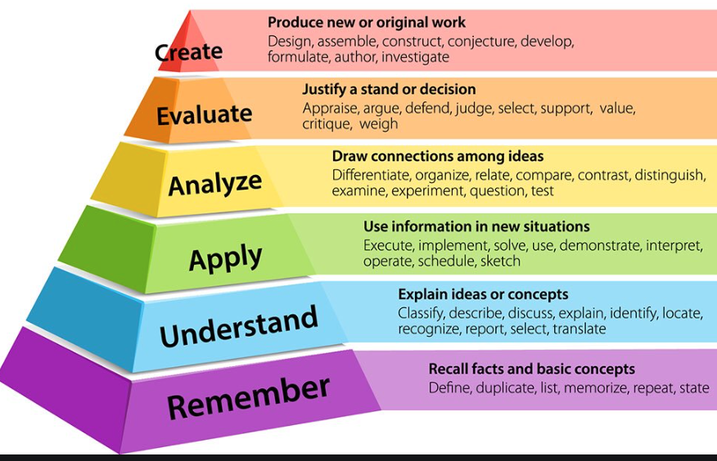
Tutorial Goal and Learning Objectives
Goal: This tutorial provides a fundamental overview of military needs, emerging standards, conceptual models, adaptive strategies, authoring processes, and the AIS marketplace
Upon completion of this tutorial, participants will be able to:
Define the fundamental principles of adaptive instruction
Identify characteristics of adaptive instructional systems (AISs)
Describe types of AISs
Interpret functional elements of AIS conceptual models
Differentiate methods for AIS development, deployment and evaluation
Appraise the important role of AI in AISs
Understand the benefits of AIS standards and recommended practices

Slide 6
Objective #1:
Understand the fundamental principles of adaptive instruction

Slide 7
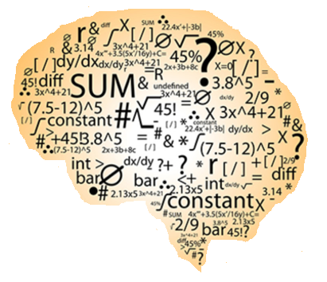
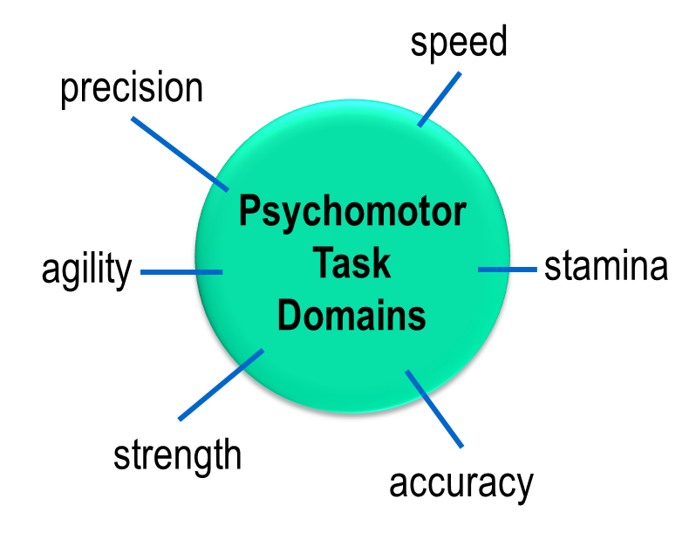

Defining Adaptive Instruction
Adaptive instruction is any training or educational experience that is tailored to the attributes (capabilities, needs, interests) of an individual learner or team of learners with the goal of optimizing the efficiency and effectiveness of their learning experience and transferring skills to operational environments
Team Task Domains
(collaborative problem solving and interdependent tasks)
Cognitive Task Domains
(problem solving and decision making)

Slide 8
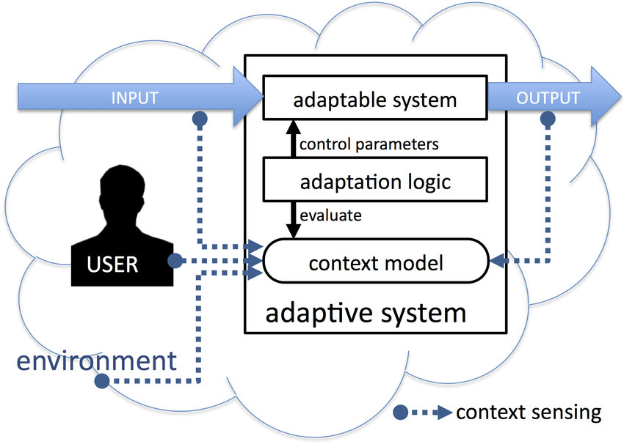
Comparing Adaptive and Adaptable Systems
Adaptable Systems – may be changed by the user (human)
  flexible control of information or system performance automation resides in the hands of the user (Oppermann, 1984)
  sub-element of adaptive systems
Adaptive Systems – change themselves to optimize desired outcomes
  possess the intellect to change themselves and act on their environment in response to changing conditions and goals
  user is artificially intelligent
Adaptive System
Stober & Nürnberger (2013)

Slide 9
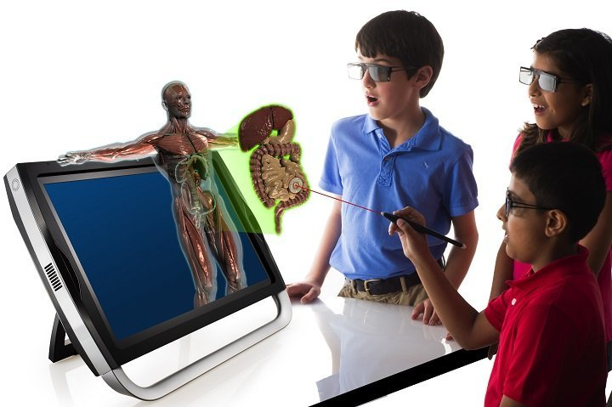
What are the characteristics of good instruction?
Individualization (measure of efficiency)
  Tailored to the individual learner states and traits (knowledge, preferences, interests, goals, emotions…)
Immediacy (measure of responsiveness)
  Feedback and instruction are timely, relevant, and credible
Interactivity (measure of engagement)
  More activity than traditional classroom environments
Sounds like
adaptive instruction

Slide 10
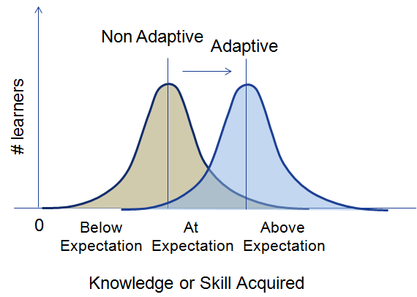
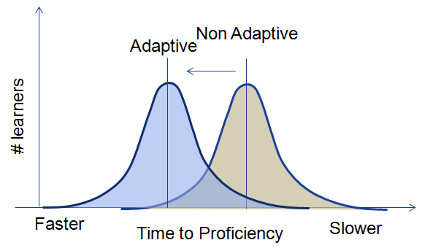
Advantages of Adaptive Instruction
Provides personalized attention, customized pace and encouragement during one-to-one instruction
Adapts to each learner’s abilities and is equivalent to expert human instruction (VanLehn, 2011)
Proven to be significantly more effective than traditional classroom instruction
Enables more efficient personalized learning by tailoring learning paths
Provides more focused interventions that target gaps in each individual’s learning
Develops metacognitive skills resulting in better study habits and higher engagement/achievement
  Note taking
  Reflection - Thinking aloud
  Question asking
Effectiveness Efficiency

Slide 11
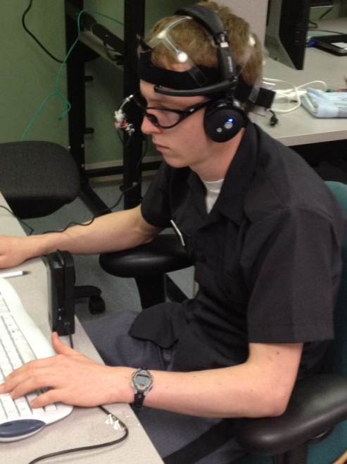
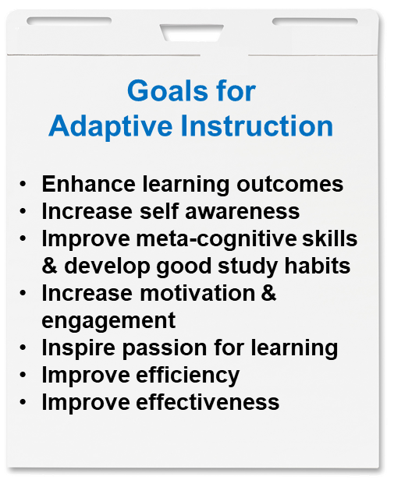
A Process for Effective Adaptive Instruction
Interact with the learner and update the learner model as changes in learner states (performance, emotions) occur
Select instructional strategies (recommendations) based on learner states and learning science principles
Select instructional tactics (actions) based on learning science principles (policies) and context
Repeat steps 1-3 until learning goals are achieved
Document achievements for use in subsequent instructional experiences (improve the learner and instructional models)

Slide 12
Objective #2:
Define characteristics of adaptive instructional systems (AISs)

Slide 13
Defining AISs
Adaptive instructional systems (AISs) are artificially-intelligent, computer-based systems that guide learning experiences by tailoring instruction and recommendations based on the goals, needs, preferences and interests of each individual learner or team in the context of domain learning objectives (Sottilare & Brawner, 2018; Sottilare, Barr, Robson, Hu, and Graesser, 2018).
Goal: Enable an individual learner or team to acquire the necessary knowledge and skill to achieve predefined learning objectives in a domain (subject or topical area) under study.

Slide 14
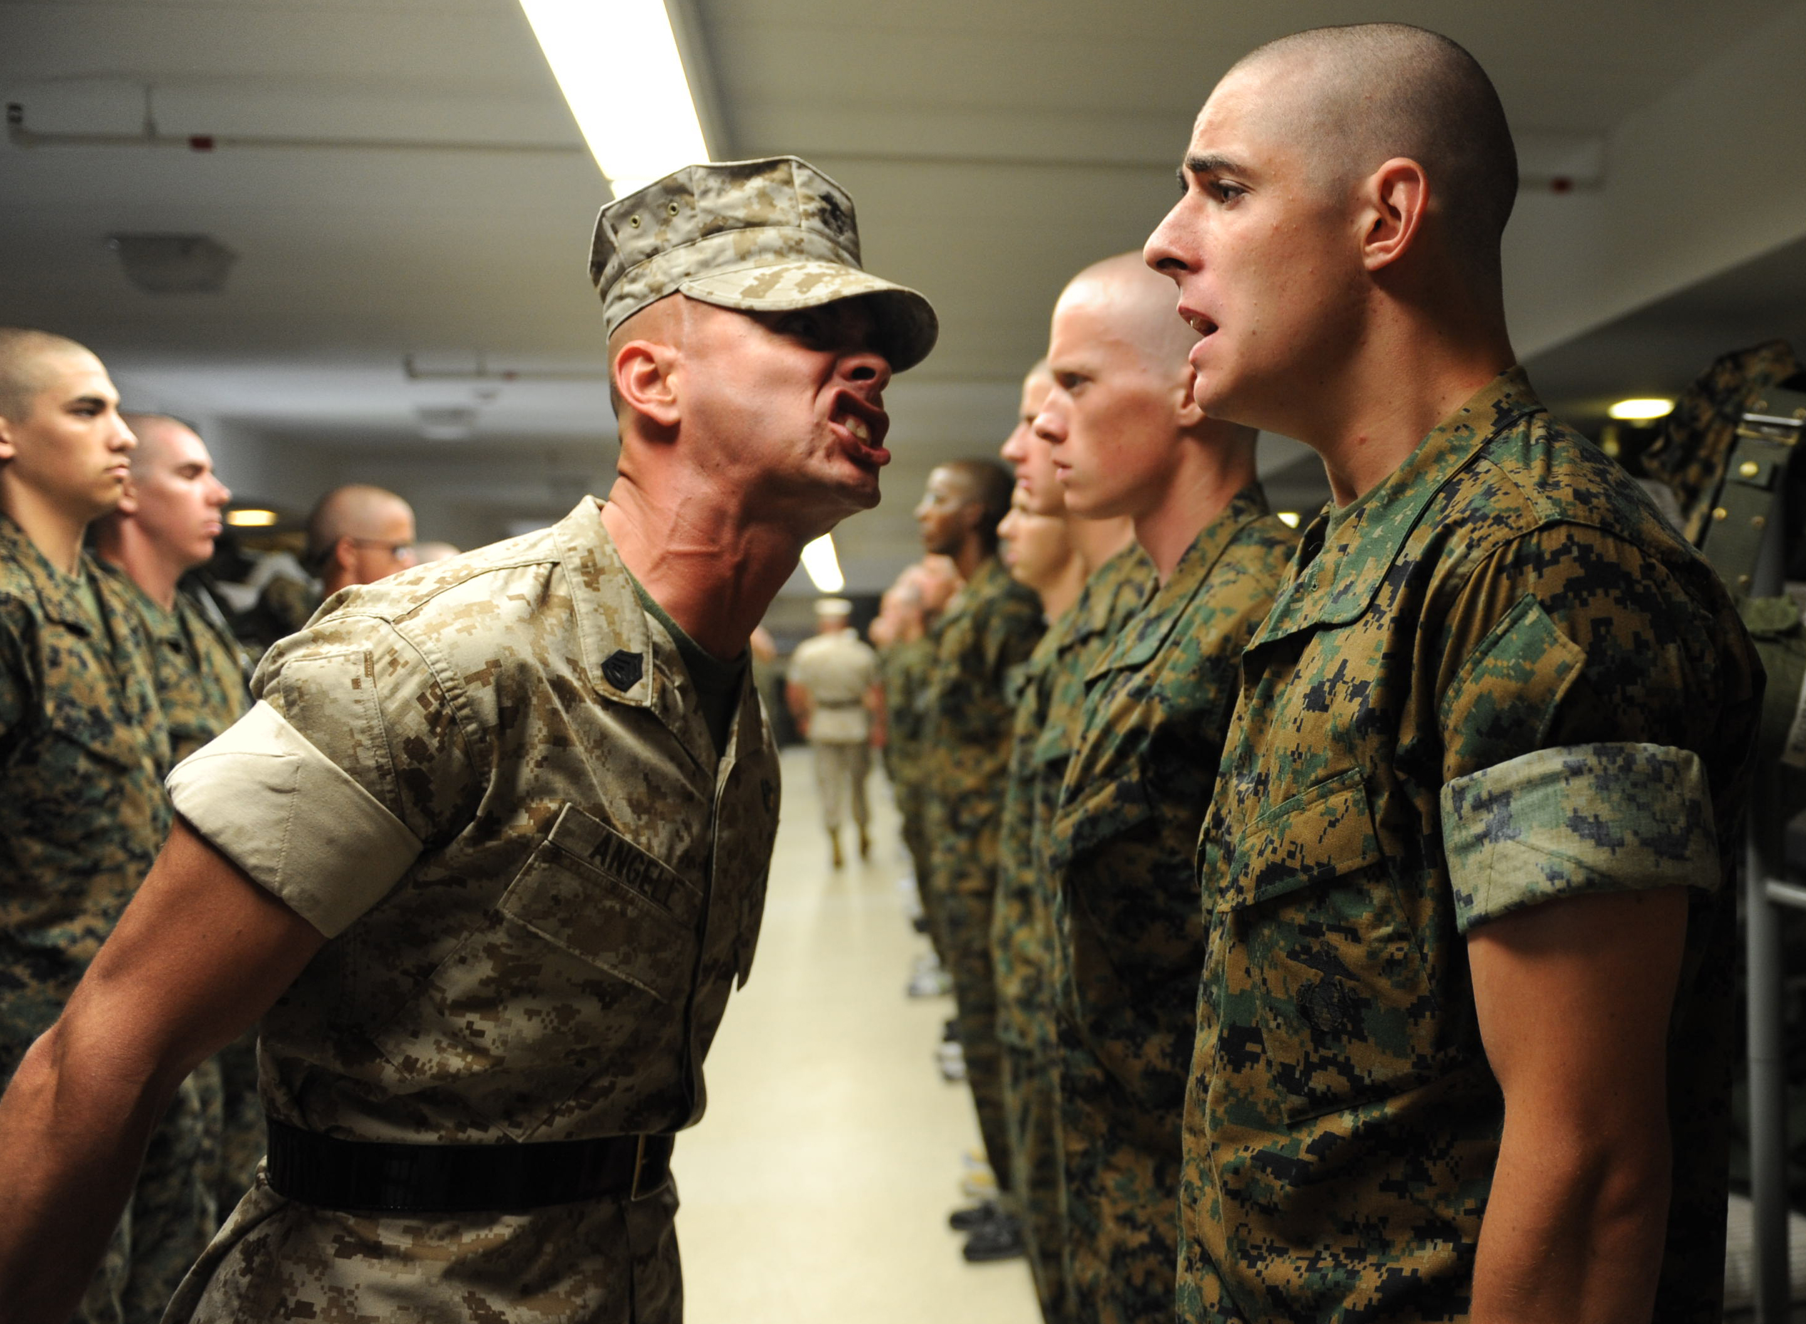
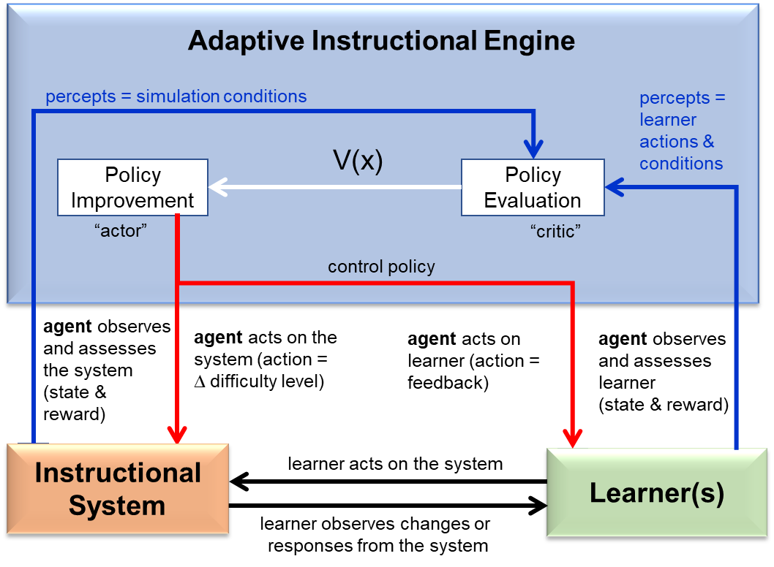
AIS Interventions
Act on the learner
  Give feedback
  Ask a question
  Prompt for more information
  Conduct an assessment
  Other?
Act on the instructional system
  modify the challenge level of the learning experience (problem or scenario)
  Other?
Sottilare, 2018

Slide 15
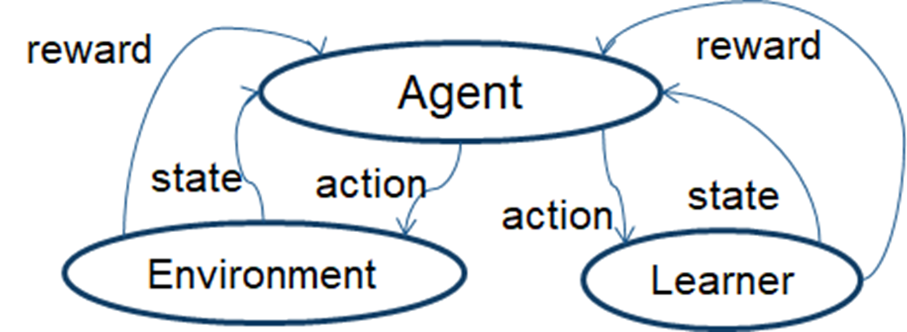
AIS Interventions
Act on the learner
  Give feedback
  Ask a question
  Prompt for more information
  Conduct an assessment
  Other?
Act on the instructional system
  modify the challenge level of the learning experience (problem or scenario)
  Other?
Sottilare, 2018

Slide 16
Objective #3:
Compare and contrast types of AISs

Slide 17
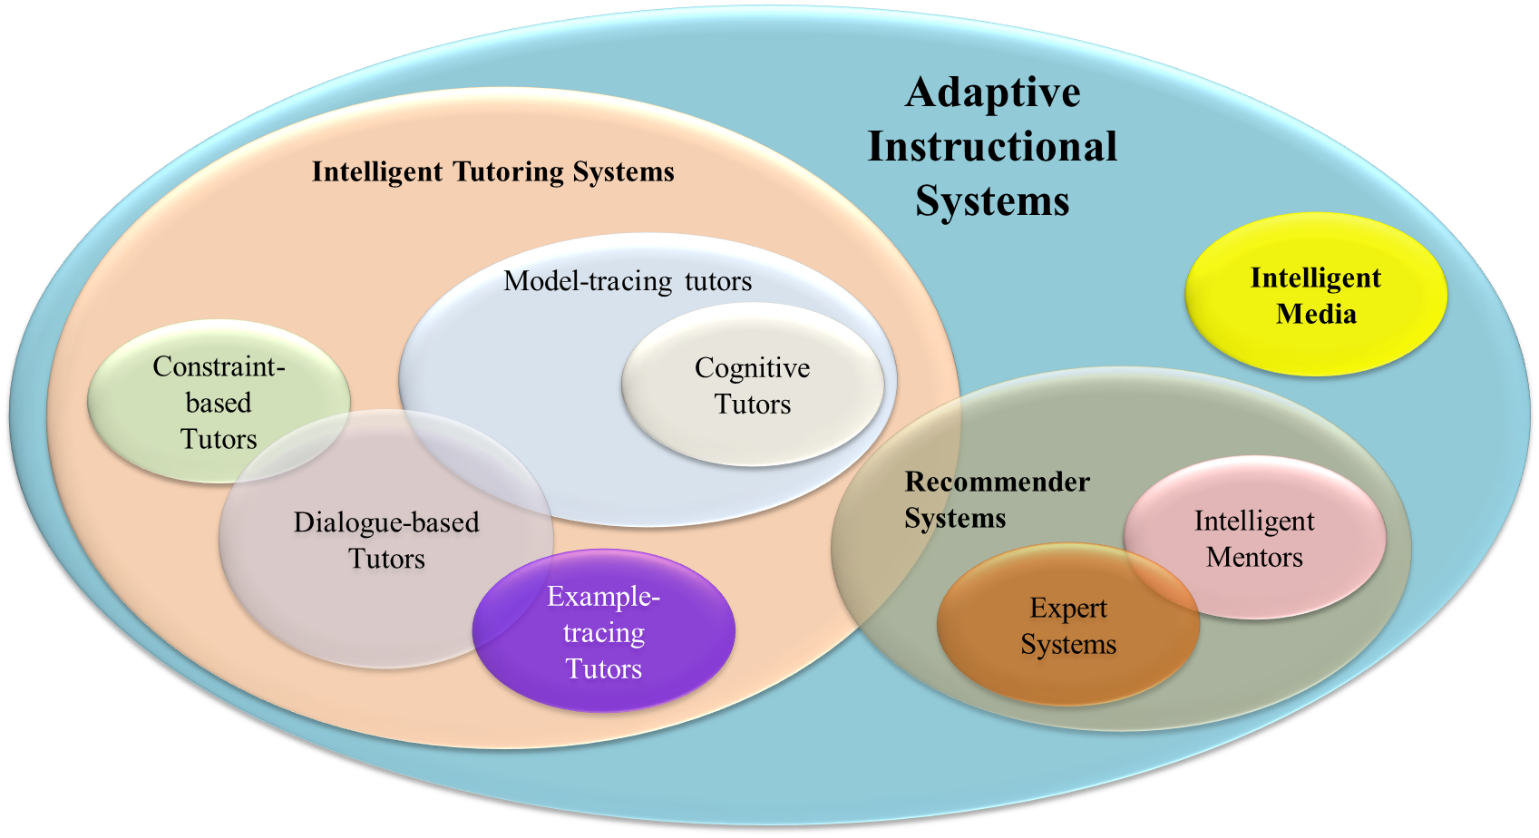
A Taxonomy of AISs

Slide 18
AIS Architectures
Generalized Intelligent Framework for Tutoring
(GIFT, US Army)
AutoTutor
(University of Memphis, USA)
Tutor-Expert System
(TexSys, University of Split, Croatia)
Cognitive Tutor (Carnegie Mellon University, USA)
Authoring Software Platform for Intelligent Resources in Education
(ASPIRE, University of Canterbury, NZ
+ many more…
Sottilare, R.A., Fletcher, J.D., Skinner, A., Perez, R., Durlach, P., Zotov, V. & Alexander, T. (2018). NATO Final Report of the Human Factors & Medicine Research Task Group (HFM-RTG-237), Assessment of Intelligent Tutoring System Technologies and Opportunities. NATO Science & Technology Organization. DOI: 10.14339/STO-TR-HFM-237. ISBN 978-92-837-2091-1.

Slide 19

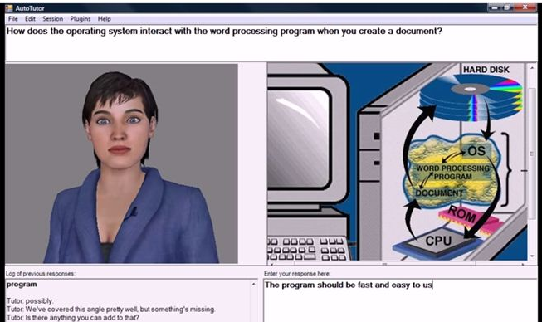
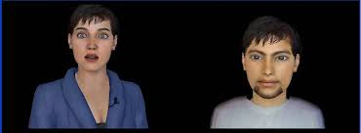
AutoTutor
  AutoTutor is a tutoring architecture used to develop ITSs that guide instruction through conversations with learners via natural language:
  produces learning gains across multiple domains (e.g., computer literacy, physics, critical thinking)
  uses human-inspired tutoring strategies
  interacts with pedagogical agents to track and guide learning
www.autotutor.org/
Trialogues (agent-based teacher and student)

Slide 20
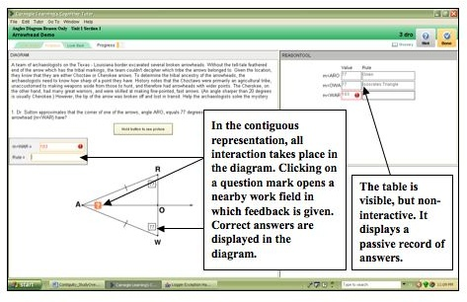

Cognitive Tutor
  The Cognitive Tutor is a tutoring architecture used to develop rule-based and example-tracing ITSs that guide instruction:
  produces learning gains across multiple domains (e.g., computer programming, physics, chemistry, thermodynamics)
http://ctat.pact.cs.cmu.edu/

Slide 21
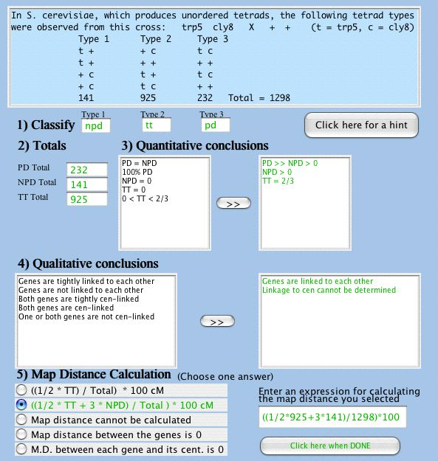
Cognitive Tutor
  Includes SimStudent for learning by teaching
http://ctat.pact.cs.cmu.edu/

Slide 22
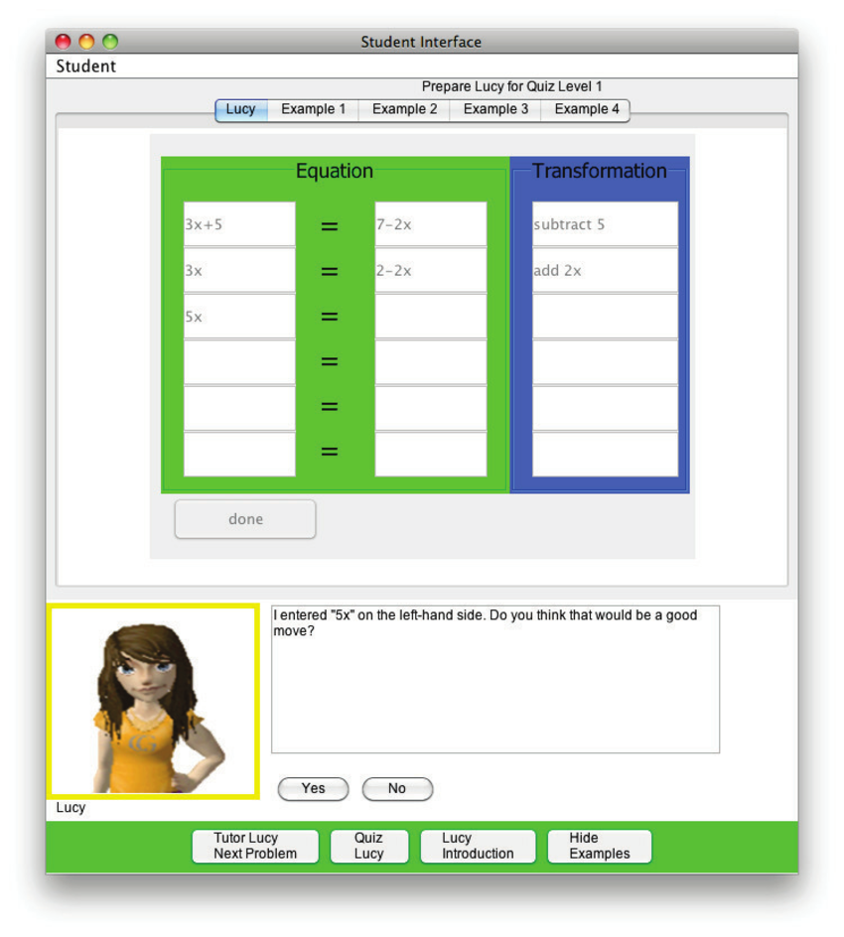
Cognitive Tutor
  Learning Tools Interoperability (LTI) compliant – edX, Canvas, Blackboard, and GIFT
http://ctat.pact.cs.cmu.edu/

Slide 23
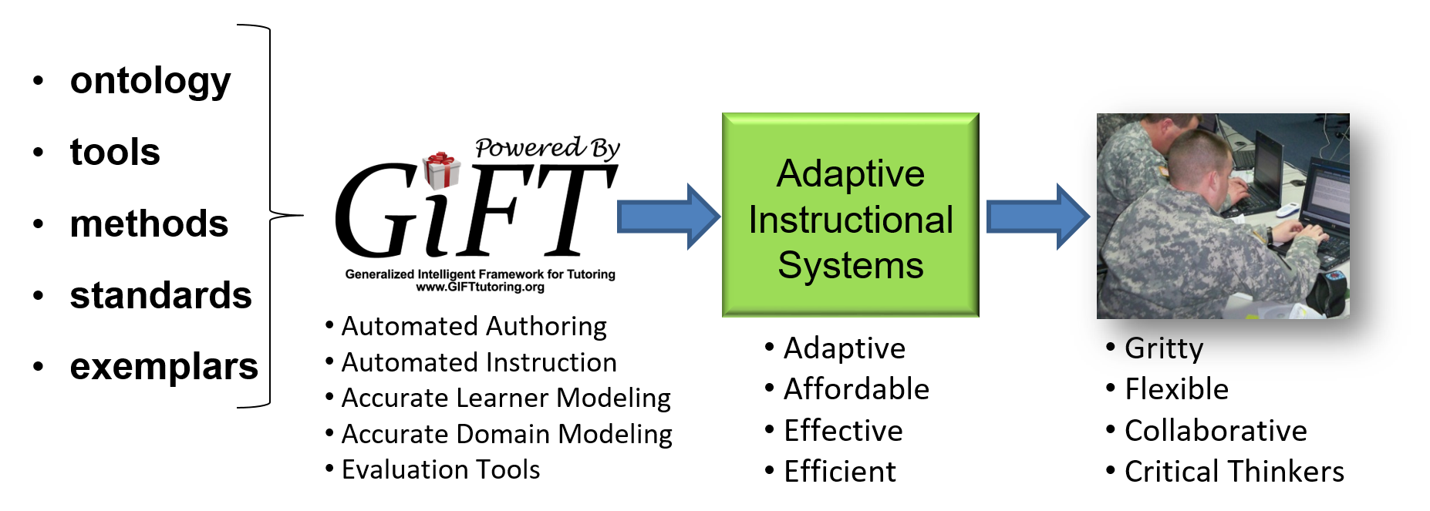

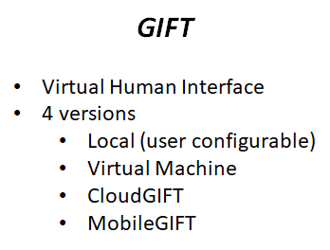
Generalized Intelligent Framework for Tutoring (GIFT)
http://GIFTtutoring.org
  A free, modular, open-source tutoring architecture:
  produces learning gains across multiple military and non-military domains (e.g., medical tasks, marksmanship, human anatomy, land navigation or orienteering) without the need for computer programming
  supports rapid authoring, reuse and interoperability of tutors
  lowers costs and entry skills needed to author ITSs via simplified drag-and-drop dashboard
  enhances the adaptiveness of ITSs to accelerate learning and support self-regulated learning (SRL)
  Learning Tools Interoperability (LTI) compliant – edX, Canvas, Blackboard & Cognitive Tutor

Slide 24
Objective #4:
Identify functional elements of AIS conceptual models

Slide 25
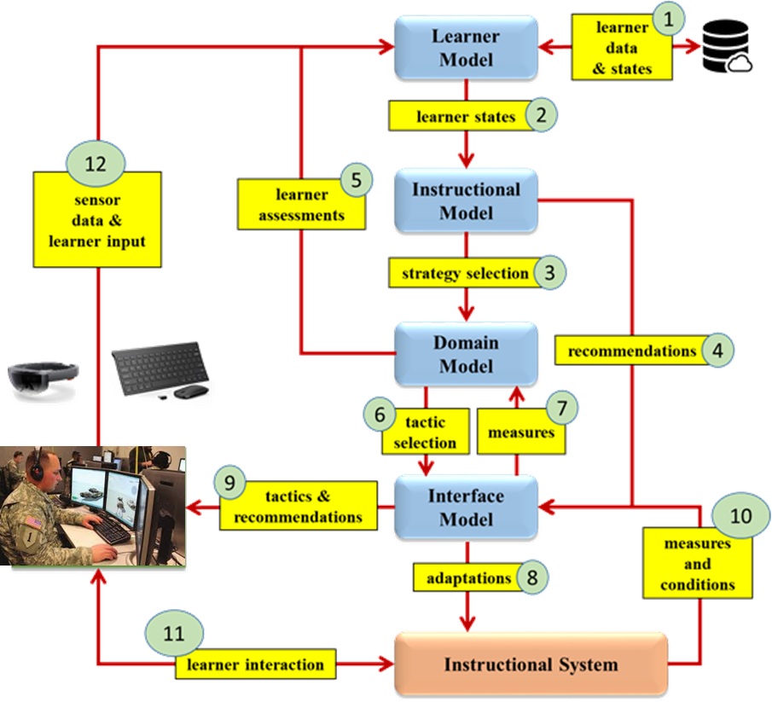
Interaction of AIS Common Models (Example 1)
learner model (basis for tailoring)
instructional model (adaptations)
domain model (content & assessment)
interface model (access & feedback)
Sottilare, Graesser, Hu & Sinatra (2018);
Sottilare, Hoehn & Tanaka (2019)

Slide 26
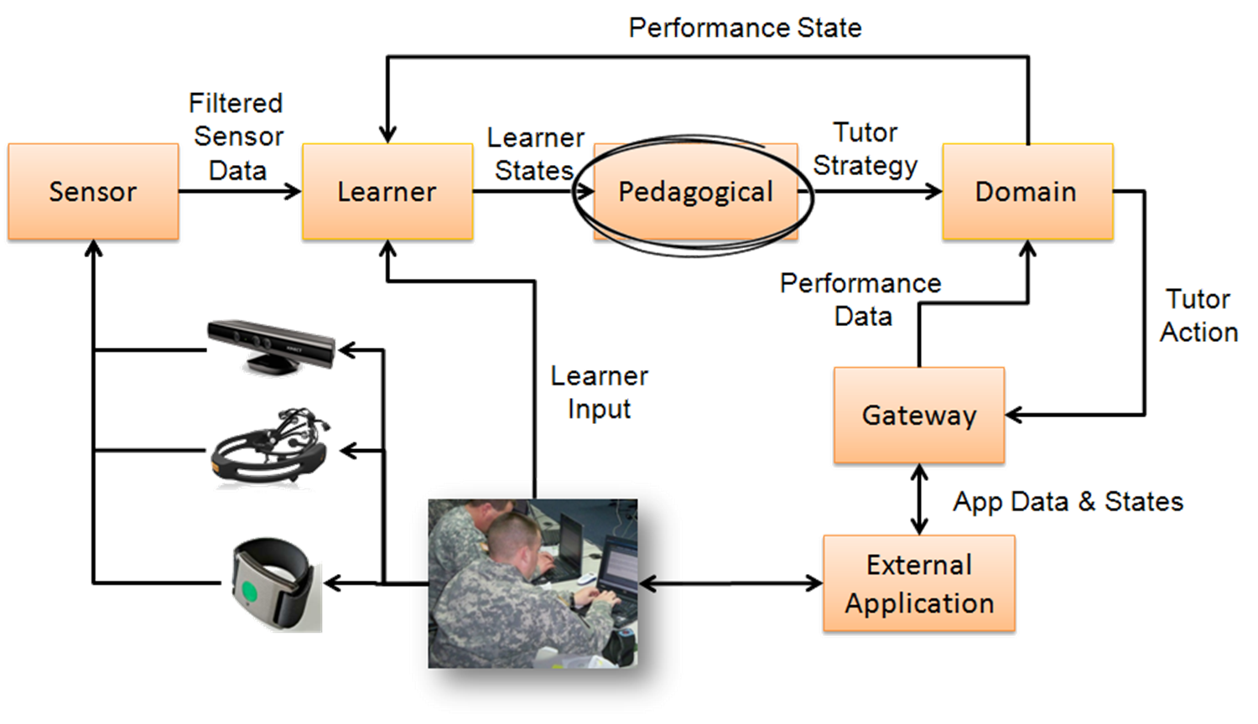
Interaction of AIS Common Models (Example 2)
Knowledge required to support adaptive instruction
  models of the learner, the instruction and the domain (including context – state of the world)

Slide 27
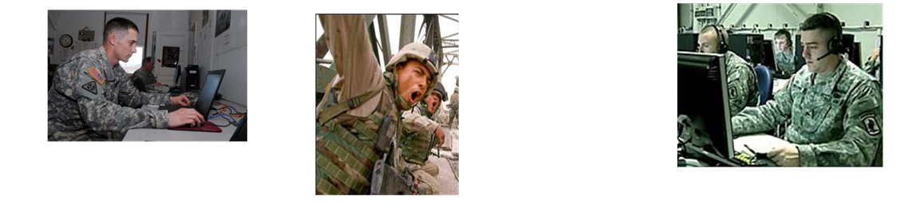
Learner Models
Learner Models – behaviors and measures of learning and performance that form the basis for tailoring instruction to enhance learning:
enhance their engagement and motivation
acquire new knowledge
and skills
meet their goals

Slide 28
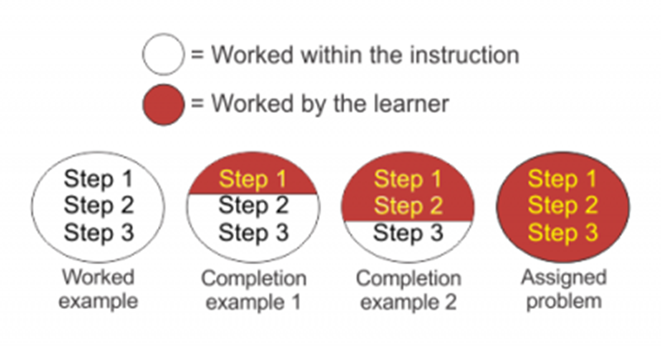
Instructional Models
Policies – recommended practices based on empirical results (Durlach & Ray, 2011)
  Error Sensitive Feedback
  Mastery Learning
  Metacognitive or Reflective Prompting
  Adaptive Spacing & Repetition
  Fading Worked Examples
Strategies – generalized models of instruction based on theories for how people learn (Gagne, 1975; Merrill, 1983; Chi & Menekse, 2015)
Tactics – models for selecting specific actions based on learner and domain states
Fading Worked Example

Slide 29

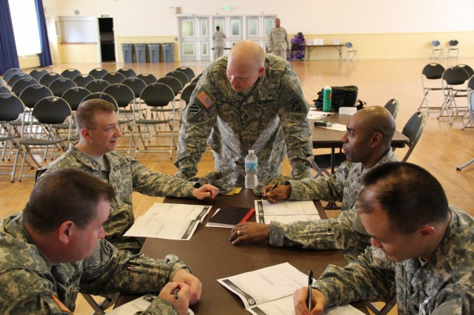
Domain Models – Cognitive Tasks
Cognitive tasks - behaviors indicating increasingly complex and abstract mental capabilities Bloom’s Revised Taxonomy (Anderson & Krathwohl, 2001)
  Cognitive Taxonomy – what machine-based interventions are needed to optimize performance?
  Creating (high): ability to put parts together to form a new whole
  Evaluating: ability to judge the value of learned material
  Analyzing: ability to break down material into its component parts
  Applying: ability to use learned material in new situations
  Understanding: ability to grasp the meaning of material
  Remembering (low): ability to recall previously learned material

Slide 30

Domain Models – Affective Tasks
Affective tasks - behaviors indicating emotional growth; the manner in which we handle emotions, such as feelings, values, appreciation, enthusiasms, motivations, and attitude (Krathwohl, Bloom and Masia, 1964)
  Affective Taxonomy – what machine-based interventions are needed to optimize performance?
  Characterizing (commitment - high): has a value system that controls their behavior
  Organizing (responsibility): organizes values into priorities; comparing, relating and synthesizing values
  Valuing (appreciation): the worth or value a person attaches to a particular object, phenomenon, or behavior
  Responding (interest): active participation on the part of the learner
  Receiving (awareness - low): awareness, willingness to hear, selected attention

Slide 31
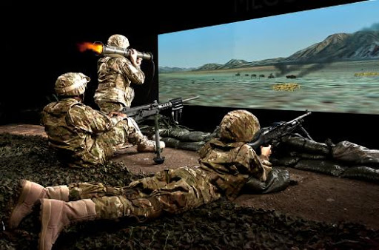
Domain Models – Psychomotor Tasks
Psychomotor tasks - includes physical movement, coordination, and the use of the motor-skill areas; development of these skills requires practice and is measured in terms of speed, precision, distance, procedures, or techniques in execution (Simpson, 1972).
  Psychomotor Taxonomy – what machine-based interventions are needed to optimize performance?
  Origination (high): creating new movement patterns to fit a particular situation
  Adaptation: skills well developed and can be modified to fit special requirements
  Complex Overt Response: skillful performance of complex movements
  Mechanism: learned responses have become habitual
  Response: early stages in learning complex skill; imitation; trial & error
  Set: readiness to act
  Perception (low): ability to use sensory cues to guide motor activity

Slide 32
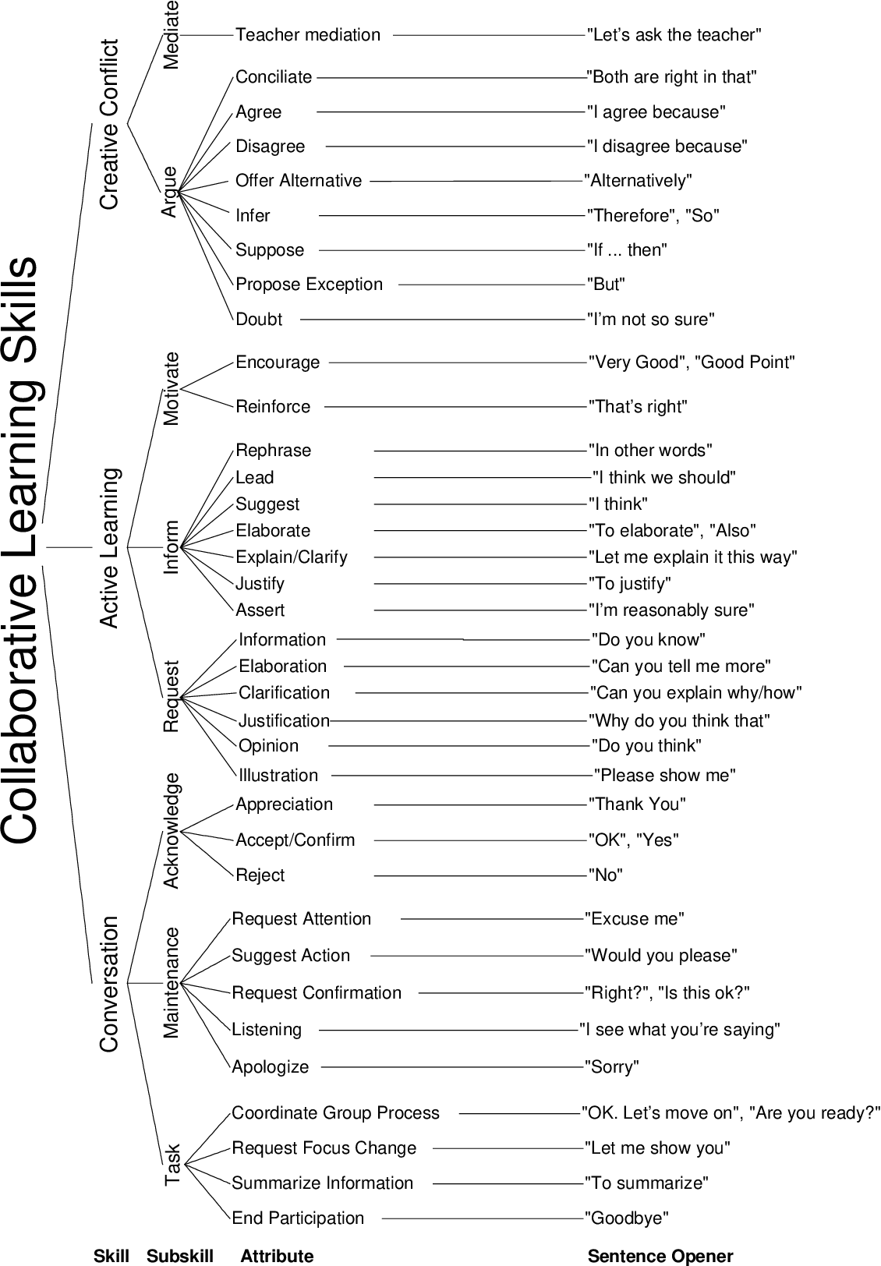
Domain Models – Social-Collaborative Tasks
Social-Collaborative tasks – tasks involving two or more people with a focus on social interaction and collaboration
  Social Taxonomy – based on Soller’s (2001) Collaborative Learning Skills Taxonomy
  Conversation
    Task, Maintain, Acknowledge
  Active Learning
    Request, Inform, Motivate
  Creative Conflict
    Argue, Mediate

Slide 33
Objective #5:
Understand methods for AIS development, deployment and evaluation

Slide 34
AIS Development – Authoring Tools
Authoring Tools support user creation of AISs
  Usually support the creation of surveys, assessments, and question banks
  Usually support some type of metadata tagging to support content selection
  Usually support some type of sequencing or path planning for lessons
  May support easy integration of external media
  May require substantial expertise to use… but some tools (GIFT) support simple drag-and-drop construction
  May or may not implement automation of development processes like content curation or scenario generation

Slide 35
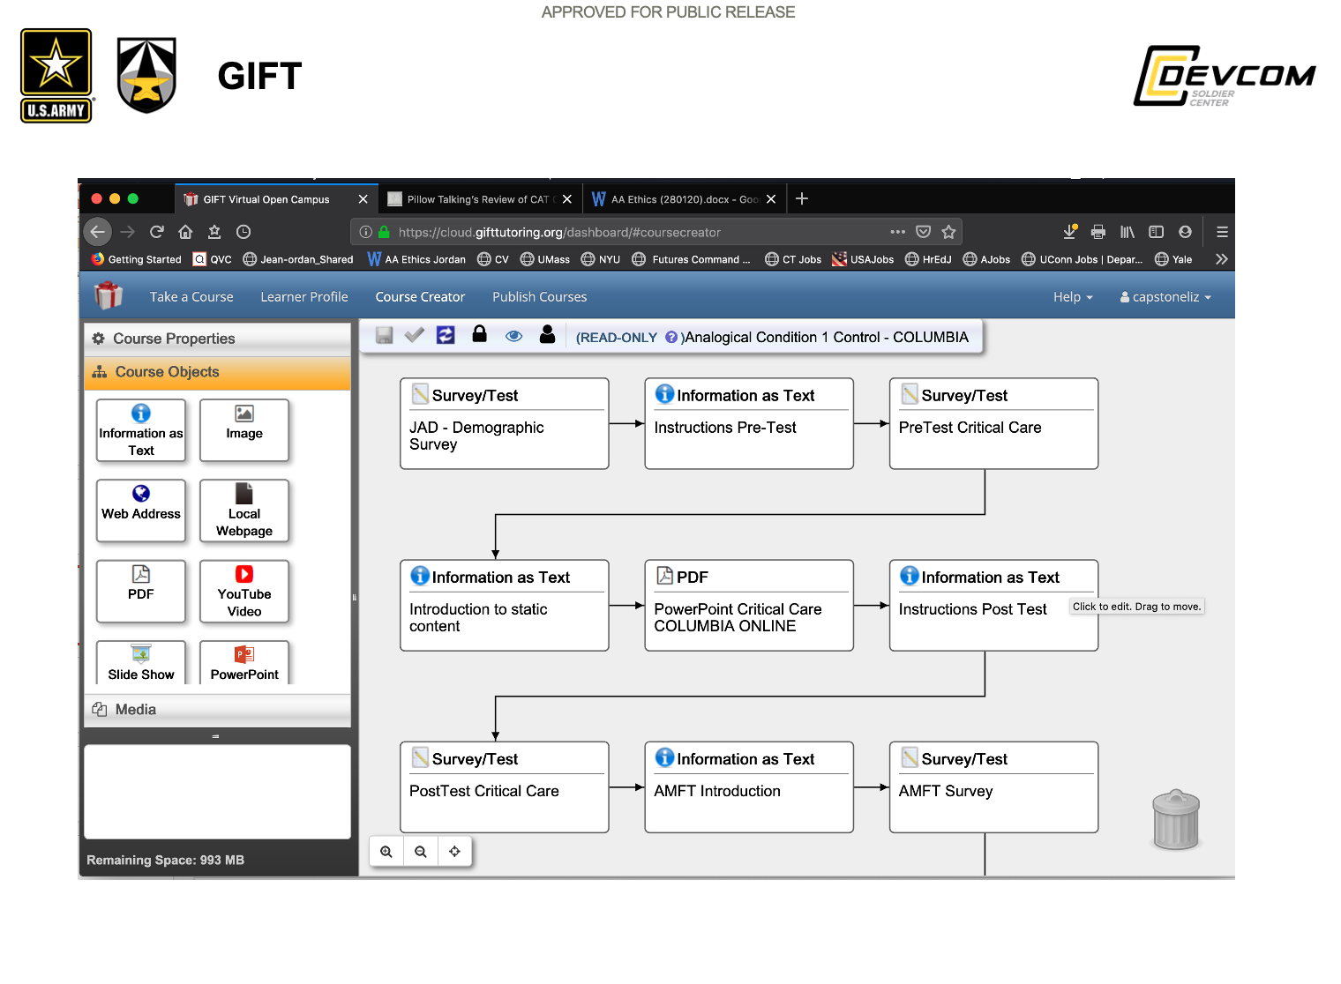
AIS Development – Authoring Tools

Slide 36
AIS Deployment – Instructional Delivery
The high volume of sensitive data and processing required to run an effective AIS means consideration should be given to where the data is processed
  Edge – process the data where the data is generated – usually most secure
  Fog – process the data at a single, secure location
  Cloud – process the data in the cloud to support thin clients

Slide 37
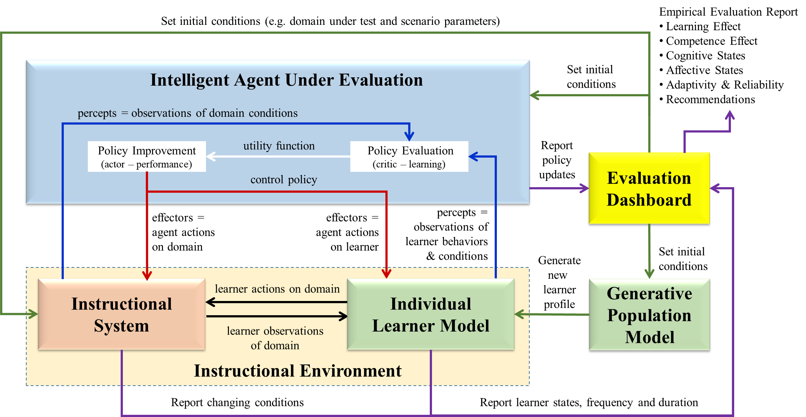
AIS Evaluation Processes

Slide 38
Yes, AIS evaluation can be complicated…

Slide 39
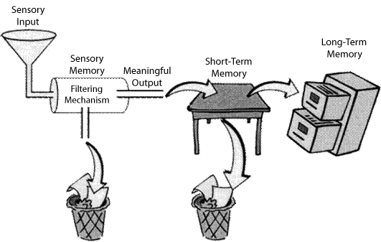
Memory, Learning and the Effectiveness of AISs
Learning
Goal: Create instructional experiences that:
reduce extraneous cognitive load
turn short term memory into long term memory
Repetition
Practice makes perfect
Perfect deliberate practice makes perfect

Slide 40
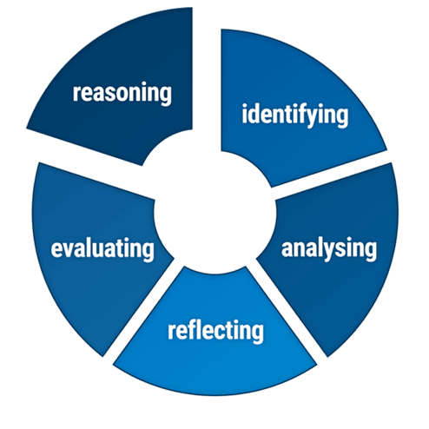
Objective #6:
Understand the role of AI in AISs

Slide 41

Comparing Artificial Intelligence (AI) and AISs
Artificial Intelligence (AI, noun) - a human-produced ability [as opposed to a naturally occurring ability] to learn, sense [take in information and judge], think abstractly and apply knowledge and skill to favorably manipulate its environment in an effort to achieve its goals” (van Lent, 2019)
AI is an enabling capability for adaptive instruction and is used by AISs to:
  Classify learner states (e.g., performance, emotions, competency, engagement, workload)
  Make decisions - Identify optimal next steps for interventions with the learner
* Highlighted procedures involve AI
AIS Observations
Learner
Data
Learner
States
AIS
Interventions
Instructional
Environment
Learner

Slide 42
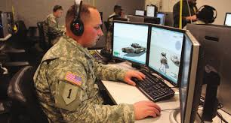
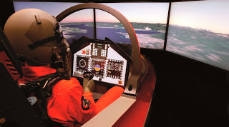
Learner Data Informing Learner States Using AI
Learner data sources
  Assessments (tests, quizzes, scenario events)
  Self-reporting (reflections, logs)
  Sensors (physiological and behavioral data)
  Interaction (input during instruction)
  Records (stored data)
Learner data types – data sources related to the assessment of states
  Learning (knowledge and skill acquisition)
  Performance (application of knowledge and skill)
  Domain competency (broad job knowledge and skill)
  Affective states (personality, mood, emotions)
  Workload, engagement, attention

Slide 43
Common AI-Based Adaptation Triggers
AISs commonly use the following learner attributes as parameters to determine when and how to adapt instruction for a particular individual learner:
  Motivation – the level of determination (grit) exhibited by the learner in pursuing their learning goals; behaviors indicative of motivation include: paying attention, asking questions, and persisting in learning activities
  Preferences – a measure of the value an individual learner places on the mode, frequency, and types of interactions with an AIS Adjustable settings (e.g., interface layout, help level, instructional agent).
  Prior knowledge – the current level of competency (knowledge and skill) in a particular domain (e.g., subject of study, theme or area of instruction)
Adaptations = Tailoring of Content, Feedback and Interventions

Slide 44
Common AI-Based Adaptation Triggers (continued)
AISs commonly use the following learner attributes as parameters to determine when and how to adapt instruction for a particular individual learner:
  Affect – personality traits, mood, and emotions as moderators/influencers of an individual’s ability to learn effectively and efficiently
  Engagement – the degree to which the individual learner demonstrates attention, curiosity, interest, optimism, and passion during adaptive instruction
  Goal-orientation – the degree to which the learner has defined long-term goals; the degree to which plans are in place to use the knowledge that the learner expects to gain during adaptive instruction; a measure of engagement and motivation
  Interest – the level of engagement in learning about a particular domain or area of instruction
Adaptations = Tailoring of Content, Feedback and Interventions

Slide 45
Objective #7:
Understand the benefits of AIS standards and recommended practices

Slide 46

Considerations in Developing Practical AIS Solutions
Enable reuse and interoperability of AISs and their components (think standards)
Lower the skills needed for development (think recommended practices)
Encourage new entities and solutions to enter the marketplace… think IEEE
You do not need to be an IEEE member to participate in standards development
You do need to be an IEEE member to be part of the balloting group for standards

Slide 47
Lowering Barriers to the AIS marketplace
AIS standards should not compromise intellectual property or hamper creativity or innovation in the marketplace
An AIS conceptual model should help practitioners to understand how they might apply their expertise in the AIS marketplace
AIS standards enable consumers of AISs to make comparisons to inform purchasing and deployment decisions
AIS standards serve as a reference that supports the exchange of data among AISs and between AISs and other education and training systems.
AIS standards incorporate and promote the principles of ethically aligned design for their use of artificial intelligence (AI).

Slide 48
IEEE Standardization Process

Slide 49
IEEE Project 2247 - AIS Standards & Recommended Practices
IEEE AIS Consortium
Chair = Richard Tong (richard@yixue.us)
Monthly meeting = 2nd Tuesday at 9am eastern: join.me/IEEE-LTSC
opportunities to get involved
IEEE AIS Standards Working Group
Chair: Drew Hampton
Monthly meeting = 2nd Thursday at 10am eastern:
https://memphis.zoom.us/j/95190468703
AIS Conceptual Modeling Subgroup
Chair = Anne Knowles (aknowles2nd@gmail.com)
Contact Anne about schedule of meetings and conference details
AIS Interoperability
Subgroup
Chair = Jim Goodell (jimgoodell@qi-partners.com)
Contact Jim about schedule of meetings and conference details
AIS Evaluation
Subgroup
Chair = Sam Wang (sam.wang@sri.com)
Day 27 of every month, 2:00 PM to 3:00 PM eastern
Contact Sam about conference details
AIS Ethics
Subgroup
Chair = Jeanine DeFalco (Jeanine.a.defalco.civ@mail.mil)
Contact Jeanine about schedule of meetings and conference details

Slide 50

AIS Consortium
A not-for-profit 501.c.6 business association formed under the IEEE Industry Standards & Technology Organization
Mission - promote the development and adoption of effective AIS solutions and to support the industry and organizations that produce them
We connect professionals and organizations who believe in the power of personalized learning and adaptive instruction to:
  enable the development and availability of affordable, practical, effective solutions in the marketplace
  improve learning outcomes and transfer of learning opportunities
  enable equitable education and training opportunities for motivated learners
  accelerate the growth of human capital through personalized learning, adaptive instruction, and learning engineering practices

Slide 51
AIS Consortium
Membership participates in three committees
  Resource Repository Committee – develops bot open source and member-only capabilities to enhance AIS technologies
  Outreach Committee – develops events to support education, networking, and technical interchange
  Evaluation & Certification Committee – develops tools to evaluate and certify adherence to emerging AIS standards and recommended practices
Promoting the development and adoption of effective AIS solutions…

Slide 52
AIS Consortium
Please consider joining today…
  Inquire on the AIS Consortium website at www.aisconsortium.org or contact Bob Sottilare directly at bob.sottilare@ieee.org
  The AIS Consortium offers organizational memberships
Promoting the development and adoption of effective AIS solutions…

Slide 53


Tutorial Goal and Learning Objectives
Goal: This tutorial provides a fundamental overview of military needs, emerging standards, conceptual models, adaptive strategies, authoring processes, and the AIS marketplace
Upon completion of this tutorial, participants will be able to:
Define the fundamental principles of adaptive instruction
Identify characteristics of adaptive instructional systems (AISs)
Describe types of AISs
Interpret functional elements of AIS conceptual models
Differentiate methods for AIS development, deployment and evaluation
Appraise the important role of AI in AISs
Understand the benefits of AIS standards and recommended practices

Slide 54
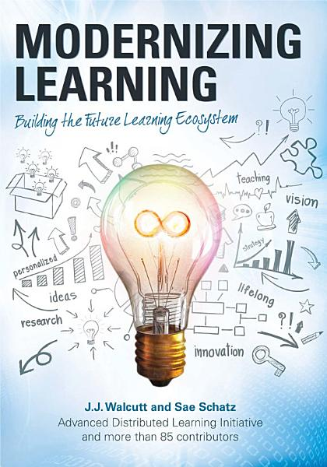
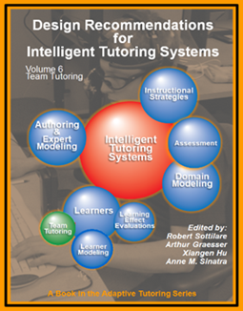
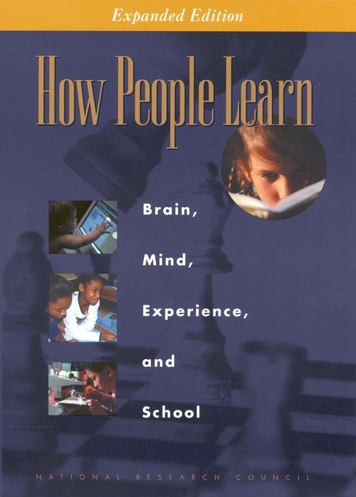

Want to Know More About AISs? Free Resources
Download free e-book
on
Google Play
Download free book series and technical publications at:
https://gifttutoring.org/projects/gift/documents
Download free pdf at:
https://www.nap.edu/login.php?record_id=9853&page=https%3A%2F%2Fwww.nap.edu%2Fdownload%2F9853

Slide 55

References

Slide 56
References
Anderson, L. W., and Krathwohl, D. R. (Eds.). (2001). A taxonomy for learning, teaching and assessing: A revision of Bloom's Taxonomy of Educational Objectives: Complete edition, New York : Longman.
Chi, M. T., & Menekse, M. (2015). Dialogue patterns in peer collaboration that promote learning. Socializing intelligence through academic talk and dialogue, 263-274.
Durlach, P., & Ray, J. (2011). Designing Adaptive Instructional Environments: Insights from Empirical Evidence. Technical Report 1297. Arlington, VA: United States Army Research Institute For the Behavioral and Social Sciences.
Gagne, R. M. (1975). Essentials of learning for instruction. Dryden Press.
Krathwohl, D.R., Bloom, B.S., and Masia, B.B. (1964). Taxonomy of Educational Objectives: Handbook II: Affective Domain. New York: David McKay Co.
Lepper MR, Woolverton M. (2002). The wisdom of practice: Lessons learned from the study of highly effective tutors. In Improving academic achievement (pp. 135-158). Academic Press.
Merrill, M. D. (1983). Component display theory. Instructional-design theories and models: An overview of their current status, 1, 282-333.
Simpson, E. (1972). The classification of educational objectives in the psychomotor domain: The psychomotor domain. Vol. 3. Washington, DC: Gryphon House.
Soller, A. (2001). Supporting social interaction in an intelligent collaborative learning system. International Journal of Artificial Intelligence in Education, 12(1), 40-62.
Sottilare, R., Barr, A., Robson, R., Hu, X., & Graesser, A. (2018). Exploring the opportunities and benefits of standards for adaptive instructional systems (AISs). In Proceedings of the Adaptive Instructional Systems Workshop in the Industry Track of the 14th International Intelligent Tutoring Systems (pp. 49-53).
Sottilare, R., & Brawner, K. (2018, March). Exploring standardization opportunities by examining interaction between common adaptive instructional system components. In Proceedings of the First Adaptive Instructional Systems (AIS) Standards Workshop, Orlando, Florida.

Slide 57
References
Sottilare, R.A., Fletcher, J.D., Skinner, A., Perez, R., Durlach, P., Zotov, V. & Alexander, T. (2018). NATO Final Report of the Human Factors & Medicine Research Task Group (HFM-RTG-237), Assessment of Intelligent Tutoring System Technologies and Opportunities. NATO Science & Technology Organization. DOI: 10.14339/STO-TR-HFM-237. ISBN 978-92-837-2091-1.
Sottilare, R. (2018, July). Community Models to Enhance Adaptive Instruction. In International Conference on Augmented Cognition (pp. 78-88). Springer, Cham.
Sottilare, R., Graesser, A., Hu, X. & Sinatra, A. (2018). Introduction to Tutoring Team Taskwork. In Sottilare, R., Graesser, A., Hu, X., & Sinatra, A. (Eds.). Design Recommendations for Intelligent Tutoring Systems: Volume 6 – Team Tutoring. Army Research Laboratory, Orlando, Florida. ISBN: 978-0-9977257-4-2.
Sottilare, R., Hoehn, R. & Tanaka, A. (2019). Adapting Existing Simulation Architectures to Enhance Tailored Instruction. In Proceedings of the 2019 Interservice/Industry Training Systems & Education Conference. Orlando, Florida, USA.
Stober S, Nürnberger A. (2013). Adaptive music retrieval–a state of the art. Multimedia Tools and Applications. 65(3):467-94.
VanLehn, K. (2011). The relative effectiveness of human tutoring, intelligent tutoring systems, and other tutoring systems. Educational Psychologist, 46(4), 197-221.
van Lent, M. (2019). Defining Artificial Intelligence. Soar Technology Tech Talk at the 2019 Interservice/Industry Training Simulation and Education Conference (IITSEC). Orlando, Florida.

Slide 58
