Slide 1
Overview and Application of xAPI, cmi5, and xAPI Profiles
Andy Johnson Advanced Distributed Learning (ADL) Initiative, SETA Contractor Art Werkenthin RISC Inc., CEO
Mike Hernandez Eduworks, Project Manager

Slide 2
Learning Outcomes
The Learner Will…
Be able to describe xAPI Concepts and how they relate to cmi5
Understand the use cases of cmi5 and its value to enable other xAPI solutions
Be able to describe xAPI Profiles and the best practices needed for data interoperability
Be able to design learning resources using xAPI and xAPI Profiles within a cmi5 framework
Understand available cmi5 resources and whether products are cmi5 compliant or not

Slide 3
Overview/Topics
Experience API Basics
cmi5 Deep Dive
xAPI Profiles
Designing xAPI Solutions Inside cmi5
Best Practices and Available Resources

Slide 4
Expected Learning Outcome #1
1
The learner will gain a baseline understanding of xAPI, such that the additional requirements of cmi5 imposed on xAPI will be comprehendible. This will include the role and structure of Statements, the Learning Record Store, and additional xAPI Resources/Endpoints that are used in a holistic approach to distributed learning.

Slide 5





Why xAPI?
Learning analytics
Not restricted to customized reports
Not restricted to basic data (scores, pass/fail)
Learning can be recorded wherever it occurs
Learning does not have to be “launched” from an LMS
Mobile apps
Social Networking
Serious Games & Simulations
Correlation of general activity with learning data
Notes:
Learning can be recorded wherever it occurs
Specialized analytics
Not restricted to customized reports
Not restricted to only basic data (scores, pass/fail)
Learning does not have to be “launched” from an LMS
Mobile apps
Social Networking
Gaming & Simulations
Correlation of general activity with learning data

Slide 6
What is xAPI?
Basic Definition (Remember this one):
xAPI statements are data generated by a Learning Record Provider (LRP) and sent to a Learning Record Store (LRS).
Technical Definition (Look once and forget if you want):
Experience API (IEEE 9274.1.1) is the JavaScript Object Notation (JSON) data model format and a Representational State Transfer (RESTful) Web Service Application Programming Interface (API) for communication between Activities experienced by an individual, group, or other entity and a Learning Record Store.
Notes:
Basic Definition (Remember this one): User Experiences within content is tracked through a Learning Record Provider (LRP) and sent to a Learning Record Store (LRS).
Technical Definition (Look once and forget if you want): Experience API (IEEE 9274.1.1) is the JavaScript Object Notation (JSON) data model format and a Representational State Transfer (RESTful) Web Service Application Programming Interface (API) for communication between Activities experienced by an individual, group, or other entity and a Learning Record Store.

Slide 7
Necessary Context
Learning Management System (LMS) |  | An entire suite of web services used in traditional (SCORM) distributed learning solutions
Learning Record Provider (LRP) |  | Sender in xAPI
Learning Record Store (LRS) |  | Receiver (Web Service) in xAPI
Statement |  | Single artifacts of activity in xAPI – “I Did This”
Documents |  | Large sets of data (name, value) that keep state in xAPI
Resource/Endpoint |  | Interface within xAPI to programming methods (Means by which to send/receive)
Content |  | Any learning asset deployed in a Distributed Learning environment
Notes:
Learning Management System (LMS) – An entire suite of web services used in traditional (SCORM) distributed learning solutions
Learning Record Provider (LRP) – Sender (Web Service) in xAPI
Learning Record Store (LRS) – Receiver (Web Service) in xAPI
Statement – Single artifacts of achievement in xAPI – “I Did This”
Documents – Large sets of data (name, value) that keep state in xAPI
Resource/Endpoint – Interface within xAPI to programming methods (Means by which to send/receive)
Content – Any learning asset deployed in a distributed learning environment

Slide 8
xAPI Components
Resource/Endpoint
Creates
LRS
LRP
Content
Statements
Stores
Documents
Stores
Modifies
LRP = Learning Record Provider, LRS = Learning Record Store

Slide 9
Statement Parts
Actor |  | Doer in the Statement
Verb |  | Action in the Statement
Object |  | “Direct Object” in the Statement, often an actual web activity
Results/Context |  | Additional necessary information
Timestamp |  | When the experience happened
These allow the basic construction of human/machine readable expressions
Notes:
Actor – Doer in the Statement
Verb – Action in the Statement
Object – “Direct Object” in the Statement, often an actual web activity
Results/Context – Additional necessary information
Timestamp – When the experience happened
These allow the basic construction of human/machine readable expressions

Slide 10
Sample Statements
Andy | launched | Chemistry Quiz (Activity ID)
Andy | initialized | Chemistry Quiz
Andy | answered | Question 1 with choice “A”
Andy | passed | Chemistry Quiz
Andy | completed | Chemistry Quiz
Andy | terminated | Chemistry Quiz
Andy | satisfied | Chemistry Quiz
Andy | satisfied | Chemistry Unit
Notes:
Andy launched Chemistry Quiz
Andy initialized Chemistry Quiz
Andy answered Question 1 with choice “A”
Andy passed Chemistry Quiz
Andy completed Chemistry Quiz
Andy terminated Chemistry Quiz
Andy satisfied Chemistry Quiz
Andy satisfied Chemistry Unit

Slide 11

Designers and Developers Speaking The Same Language
“Andy passed Chemistry”
Got it! <Andy passed Chemistry>
Credit: www.theodysseyonline.com

Slide 12

Let’s Talk About Linked Data (Semantic Web)
Linked Data is a methodology of publishing data that allows machine-readable connections on the web, allowing concepts that may have been created separately to find each other
xAPI, through both Statements and Documents, creates semantic data relationships
Statements especially, being “triples”, have a natural integration into systems that can use the semantic web, which uses a language that effectively links two resources together with a property type

Slide 13
xAPI’s Semantic Data
All of the basic xAPI Statement parts are identified uniquely, but are intentionally Uniform Resource Identifiers (URIs)
URIs are resolvable to allow for more readily available information, but also unique entities on the web, allowing machines to “crawl” them for more information
This can allow for important relationships to be defined, such as “Quiz A” is a part of “Lesson B” but is not a part of “Lesson A”
Can also be used to trace version history and derived works

Slide 14
Let’s Talk About “The Fridge”
To put a bow on “How language in xAPI works”, Let’s enable a “Smart Fridge”.
Different “Actors” interact with the Fridge, including the Fridge itself
Different actions or “Verbs” would align to functions the Fridge can perform
Different “Objects” can interact with the Fridge, these may be tangible (apples, cheese, bacon) or intangible (temperature setting)
Sometimes more details are needed, so “Results” or “Context” is used
Becky supplied apples to fridge
Tommy received bacon from the fridge
Fridge adds bacon (to shopping list)

Slide 15
Linked Fridge Data
IRIs for food can resolve to food resources and other concepts
Stores can have their items resolve to these, and link prices and availability
Could link any food resource to vitamins contained, calories, average cost, recipes that contain it, etc.
Can then order food, plan a shopping list, make a budget, plan meals
In the context of distributed learning, could have competencies that interrelate, are achieved by individuals, and aggregate for higher achievement
This can be true of learning resources as well – Courses that have “this video” are effective/ineffective

Slide 16
Statements Go To the LRS
Server-Side Implementation of xAPI
The Learning Record Store is a “triple store” Actor/Verb/Object which is RESTful
RESTful refers to web services that are light weight, highly scalable and maintainable by following a set of constraints
Very little validation is done at run-time, which makes it fast and flexible
Won’t throw out “Andy friended Biochemistry quiz”
Other services will extract meaning from the data and expose it in interesting ways to the learner

Slide 17
LMS and LRS Capabilities
User Management
Learning Records
Scheduling
LMS
Course Management
LRS
Statistics
Grade Book
Run-Time
Repository
Search
Player
Sequencing
Delivery
Preferences
Reports
Assessment
17
Notes:
SCORM is effective in describing how a learner’s active session with learning content passes learning data to an LMS. However, SCORM does not currently describe how or if the LMS displays the data to the learner. This situation means the people who need the data the most may not have access to it. For example, a course administrator may not be able to access scores for all learners in a course. The LMS stores the data, but SCORM doesn’t specify how the LMS should expose it.
There is nothing stopping a single product from having all of these capabilities
17

Slide 18
Why Do I Need a Learning Record Provider ?
If Content Sent Statements wildly to the Learning Record Store
If LRS accepted Statements that were sent from “Content”
Is my content sending data correctly?
Does my content have permission on that system?
Will I get credit?
Does the institution/instructor of my content know who I am and can they get that to the LRS?
Is the learner who they say they are?
Is the institution/instructor on this Statement real?
Did they pay for the rights to take the content?
The Learning Record Provider is the trusted partner of the Learning Record Store, ensuring data is reliable and valid
Notes:
If Content Sent Statements wildly to the LRS
Is my content sending data correctly?
Does my content have permission on that system?
Will I get credit?
Does the institution/instructor of my content know who I am and can they get that to the LRS?
If LRS accepted Statements that was sent from “Content”
Is the learner who they say they are?
Is the institution/instructor on this Statement real?
Did they pay for the rights to take the content?

Slide 19
Expected Learning Outcome #2
2
The learner will understand the subject matter of the cmi5 specification, such that it can be described using instructional design language as well as understand specific coding concepts to create cmi5 data. The learner will understand the data flow, authentication, session management, and storage capabilities of cmi5 as well as the additional requirements of a cmi5 LMS over the lesser functioning xAPI Learner Record Store (LRS). Learners will be able understand the difference between cmi5 defined and cmi5 allowed Statements.

Slide 20
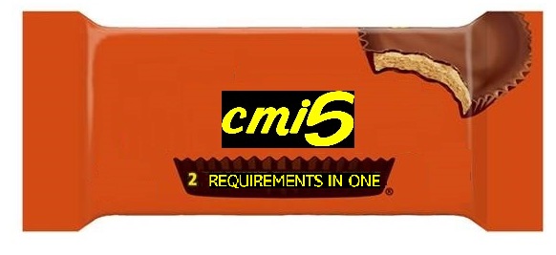
Why cmi5?
Like xAPI?
Need an LMS?

Slide 21
SCORM Negatives
To frame or not to frame! The pop-up issue
Content must reside in same domain as LMS
Cannot put content on Content Distribution Network
Inefficient bandwidth
SCORM content MUST be run in a browser
Mobile and Offline use cases do not function
Notion of a “local server” fails
Easier to Cheat
LMS Accepts “blindly” what is sent to it
No timestamps = no “paper trail”

Slide 22
What is cmi5?
cmi5 is a set of “extra rules” to apply to xAPI that fit the current Distributed Learning paradigm, but readily enables future paradigms
cmi5 INCLUDES xAPI
cmi5 specifically addresses:
Content Launch Mechanism
Authorization (NOT Authentication)
Session Management
Reporting
Course Structure
Satisfaction Criteria

Slide 23
History of cmi5
Originally started in the AICC (Aviation Industry Computer-Based Training Committee) in 2010
cmi5 was expected to replace both AICC and SCORM
cmi5 was “rebooted” in 2012 and the previous architecture was replaced with xAPI after the group saw benefits and a clearer path to adoption
In 2014, the AICC dissolved and formally transferred cmi5 to the ADL
The cmi5 project is still guided by its original goals

Slide 24
Which Use Cases Does cmi5 Enable?
“Minimal LMS” |  | Support for dynamic amounts of information, but not as a ton of “optional” fields
“Content-defined Data” |  | In other words, content so specific that only the content needs it, but is still critical (Simulations, especially)
“Content as a service (CaaS) model of delivery” |  | Allow content to be stored on other domains
“Device/OS/browser independence” |  | Allow for content to be independent of a browser in order to communicate or be launched
“Share data between learning activities” |  | And between learners!
Notes:
“Minimal LMS”
Support for dynamic amounts of information, but not as a ton of “optional” fields
“Content-defined Data”
In other words, content so specific that only the content needs it, but is still critical (Simulations, especially)
“Content as a service (CaaS) model of delivery”
Allow content to be stored on other domains
“Device/OS/browser independence”
Allow for content to be independent of a browser in order to communicate or be launched
“Share data between learning activities”
And between learners!

Slide 25
cmi5 Roles and Responsibilities
Assignable Unit (AU) – Content + LRP (loosely)
Functions as content would be expected in xAPI – like a course.
Parses the parameters from the launching environment to determine where the LMS location is and initiate communication with the LMS.
Acting as a "client", sends and receives messages using the xAPI defined transport mechanism(s) and associated commands as prescribed in this specification.
Formats all data according to the defined data types and vocabularies that are defined in this specification.
Sends a "terminate" statement prior to terminating the AU's execution.

Slide 26
cmi5 Roles and Responsibilities Cont.
Responsibilities of the LMS
Create and maintain course structures.
Act as a "server" - receive and reply to messages using the xAPI defined transport mechanism(s) and associated commands as prescribed in this specification.
Format all data according to the defined data types and vocabularies that are defined in this specification.
Launch the specified AU contained in the content within the defined environment(s).

Slide 27
cmi5 Components
Resource/Endpoint
Creates
LRS
AU
Statements
Stores
Reads
Documents
Stores
Modifies
AU = Assignable Unit, LRS = Learning Record Store

Slide 28
The Nine cmi5 Verbs
Launched
Initialized
Completed
Passed
Failed
Abandoned
Waived
Terminated
Satisfied
Notes:
The 9 cmi Verbs:
Launched
Initialized
Completed
Passed
Failed
Abandoned
Waived
Terminated
Satisfied

Slide 29
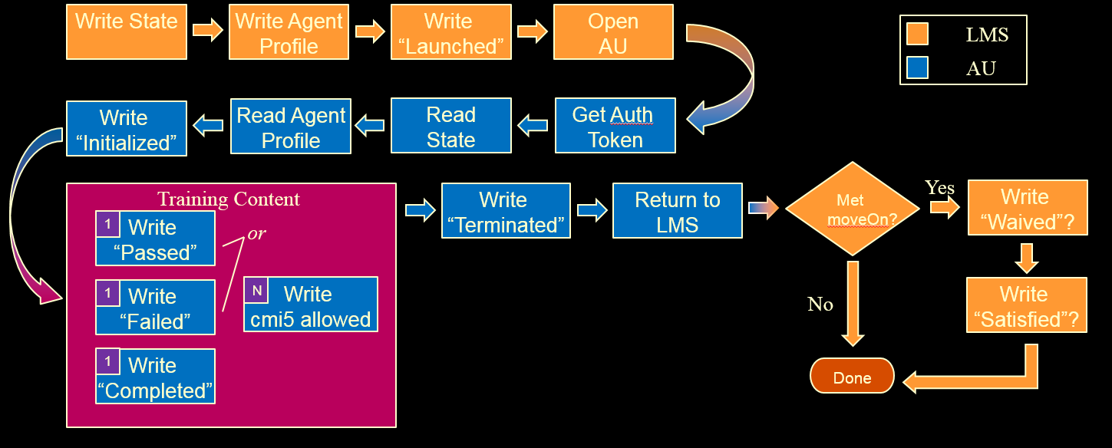
cmi5 Data Flow
Credit: RISC, Inc.

Slide 30
cmi5 = “xAPI with Rules”
Actor |  | Uses “account” for security purposes
Verbs |  | There can be only one! (use of each Verb) Specific order of Verbs, corresponding to events
Object |  | Is the AU and matches the activityId (content) AU used quite ubiquitously in this specification
Score |  | Not required, lumped in with pass/fail
Success/Completion |  | Designer (or Admin) decides the “how”, but success can directly relate to assessment
Registration |  | Establishes unique relationship between Actor and “course” Registrations are handled at the course level (AU registrations not allowed)
Notes:
Actor – uses “account” for security purposes
Verbs – There can be only one!
Use of each, that is – keeps things simple
Object – is the AU and matches the activityId (content)
AU used quite ubiquitously in this specification
Score – not required, lumped in with pass/fail
Success/Completion – designer decides the “how”, but success directly relates to assessment
Registration – dynamic relationship of Actor to “course”
Note: not AU, registrations are handled at the course level

Slide 31
“cmi5 Defined” vs. “cmi5 Allowed”
cmi5 categorizes the xAPI Statements during use:
"cmi5 defined" |  | Statements using cmi5 defined verbs Uses specific “category id” value for cmi5
"cmi5 allowed" |  | Statements using any verb and does not use the cmi5 specific “category id” Issued between “initialized” and “terminated” verbs
"cmi5 not-allowed" |  | Any statements not conforming with the cmi5 specification
Both “cmi5 defined” and “cmi5 allowed” use a “context template” |  | Context template is State information exchanged between the AU and LMS
Notes:
cmi5 categorizes the xAPI Statements during use:
"cmi5 defined" - Statements using cmi5 defined verbs
Uses specific “category id” value for cmi5
"cmi5 allowed" - Statements using any verb and does not use the cmi5 specific “category id”
Issued between “initialized” and “terminated” verbs
"cmi5 not-allowed" - Any statements not conforming with the cmi5 specification.
Both “cmi5 defined” and “cmi5 allowed” use a “context template”
Context template is State information exchanged between the AU and LMS

Slide 32
cmi5 Additional Features
Authorized Launch Mechanism
Course Structure
AU may provide launch parameters that the LMS will use when launching the AU.
In addition, when the LMS launches the AU the parameters include Actor, content id (of the AU), registration, and a URL for obtaining authorization.
Similar to the content package of SCORM… and different
Supports 1 or more Assignable Units (AU)
Optionally nested within Blocks
Designed for interoperability across systems
Notes:
Authorized Launch Mechanism
AU provides a URL with query string that the LMS parses
Includes Actor, content id (of the AU), and registration
Course Structure
Similar to the content package of SCORM… and different
Supports 1 or more Assignable Units (AU)
Optionally nested within Blocks
Designed for interoperability across systems

Slide 33
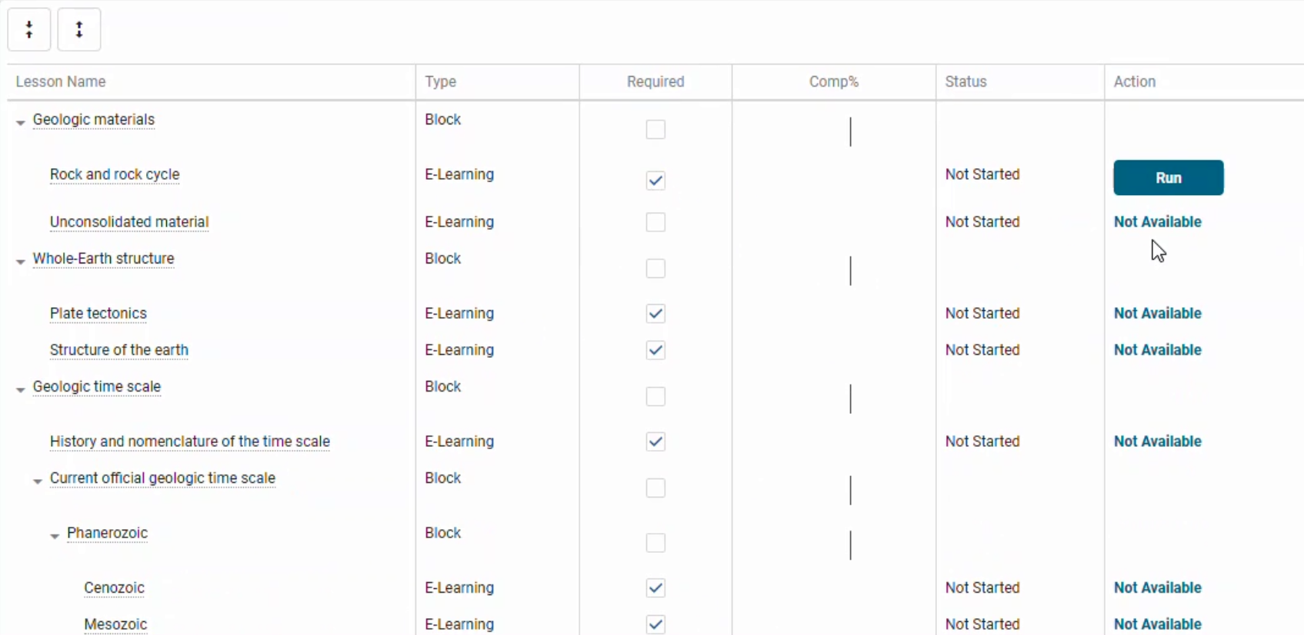
Course Structure Format
cmi5 = Assignable Units and Blocks
Credit: RISC, Inc.

Slide 34
cmi5 Versatility
Session Tracking
State API (ex: bookmarking)
Completion Criteria
cmi5 defines “Move On” criteria
Passed?
Completed?
Completed and Passed?
Mastery Score
Different scores for different roles
External Intervention
Allows "testing out" external to taking content (Administration)

Slide 35
cmi5 Data Flow (Revisited)
Credit: RISC, Inc.

Slide 36
Expected Learning Outcome #3
3
The learner will understand the application and use of xAPI Profiles. The learner will understand and be able to apply best practices for design of xAPI data for interoperability. The learner will understand how to “tag” xAPI statements with multiple profiles and how that functions within cmi5.

Slide 37

xAPI Designer
xAPI
Credit: Disney/Pixar

Slide 38


Credit: Disney/Pixar

Slide 39
Profiles – Where Do They Come From?
Communities of Interest (Practice)
Use Case + Technology Application
Organizes Interested Parties in a Specific Subject Domain
Forms a Working Group
Defines Requirements
Explores Solutions – Both Logistical and Technical
cmi5 Working Group founded before technology solution, with a specific use case
Later switched to an xAPI solution
Required definition of data for specific events
Inspired other xAPI solutions, effectively creating more xAPI Profiles
Notes:
Common Interests Shared
Organization Among Interested
Forms a Working Group
Defines Requirements
Explores Solutions – Both Logistical and Technical
Use Case + Technology Application = Definition of xAPI Profile
cmi5 Working Group founded before technology solution
Later switched to xAPI solution
Inspired other xAPI solutions, effectively creating more xAPI Profiles

Slide 40

What Does a Profile Do?
Is a Template of Technical Rules
Validates Sets of Statements
Employs Semantic Web Principles

Slide 41
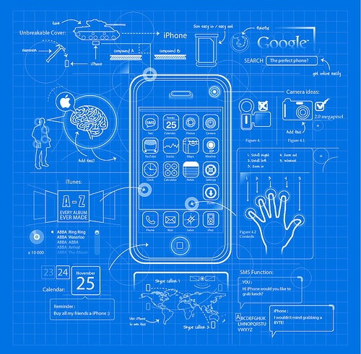

Tale of Two “Profiles”

Slide 42
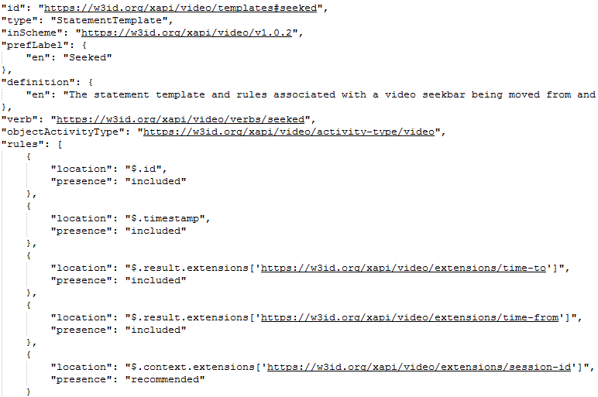
Examples of Parts of Each Profile
The video profile requires videos to have the ability to track a “fast forward” or “rewind” and include both the starting and ending points of that operation.

Slide 43






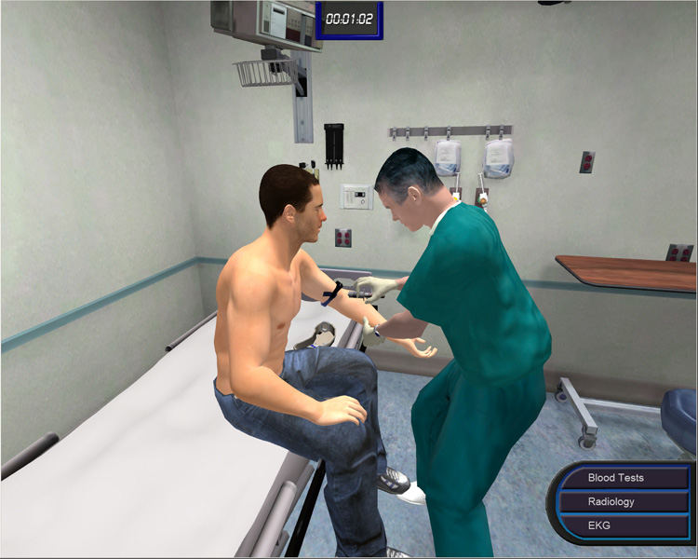
Incorporating Multiple Profiles in Solutions

Slide 44
cmi5 Defined vs. cmi5 allowed
Profiles are “tagged” in xAPI within Context
This is the same way “cmi5 Defined” was described before
Any additional profile is “cmi5 Allowed” in addition to the other types
Multiple Profiles in a course, page, or even same Statement is okay!

Slide 45
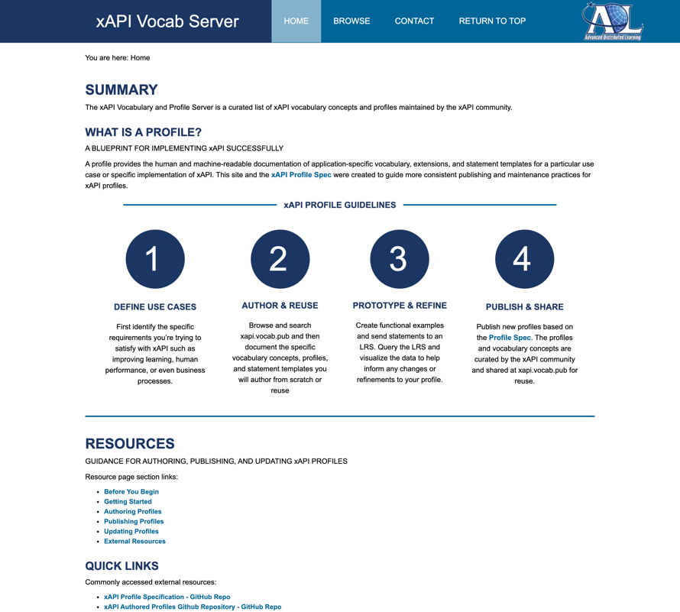
xAPI Profile Best Practices
Profile Best Practices More info at: http://xapi.vocab.pub/
(MAY UPDATE THIS LINK and Screenshot)
Look for reuse first (entire profile or individual “concepts” (generic term for any xAPI Property)
Conform and Test to xAPI Profile Specification
Follow Best Practices for Identifiers
Generate Quality Metadata
Share Your Work

Slide 46
Creating Persistent Identifiers – Why?
To ensure resolution of the identifiers used within xAPI, such that metadata can be retrieved
Resolution is necessary to allow Statement “consumption” for the End User (or End User Application)
Dashboards and Analytics
Figuring out how to figure out what a verb REALLY means - when the display says “run”
Consuming Statements allows traceability – “released” mean?
https://w3id.org/xapi/seriousgames/verbs/released
11/5/2020 - Verb - Profile: Serious Games Profile Indicates that the actor released the object from one's grip from or a specific state. Used when the player releases a previously pressed button.

Slide 47
Creating Persistent Identifiers – How?
To create a URI (for any Verb, etc.) that is resolvable, it is recommended to have the entity “coining” that term be in charge of where it resolves
In the current World Wide Web, this means a domain (www.adlnet.gov)
To create a URI that is unique, the entity create a schema that will guarantee uniqueness from that entity
This means simply appending to the already controlled domain (www.adlnet.gov/expapi/verbs/completed )
But what if ADL changed domains, or was no longer a Government Initiative?
Instead, we use Persistent URLs (PURLs) and have them redirect to a domain-controlled area

Slide 48
Creating Persistent Identifiers
W3ID is a standards organization controlled domain that is recommended
ADL controls the /xapi subdomain and gives out the next “layer” to working groups
These (Domain)(xapi)(profile)(concept_type)(unique_taxon)
”released” only needs to be unique TO the profile
Follow best practices regarding re-use and deconflicting
https://w3id.org/xapi/seriousgames/verbs/released
These redirect to a desired location (ADL Profile Server in this case)

Slide 49

Re-use Vs. Creation
Care should be taken to re-use where possible, particularly on verbs
Multiple “passed” verbs, for instance, could cause poor results in visualizations
Remember verb “display” allows more than one verb to appear the same
Only re-use if the use case fits the verb, different extensions can be okay
Only tag with the profile IF all rules are followed in a pattern (cmi5 “passed”)

Slide 50

Cmi5 Confession
cmi5 is not an xAPI Profile…it is more
cmi5 does contain an xAPI Profile
An xAPI Profile is just about the data
Things like a “context template” are not normally a part of xAPI Profiles

Slide 51
Expected Learning Outcome #4
4
The learner will understand design principles around creation of cmi5 data and integration of other xAPI data into cmi5 solutions. The learner will be able to take the principles that cmi5 uses, along with xAPI application in this example, to create their own xAPI data to record learning and performance data of their choosing.
This section will be based on instructional design decisions that must be made and will talk about xAPI data using the “lingo”, but not code.
It will discuss how to add domain-based data, media-based data, and function-based data as a part of the overall cmi5/xAPI solution.

Slide 52




The Big Picture
LMS
LRS

Slide 53
cmi5 Expanded Content Creation
Creating a cmi5 Course
Adding Domain-based Tracking
Adding Media-based Tracking
Adding Function-based Tracking

Slide 54
What is a “Course”?
Course Principles
Files consisting of or links to learning content assets
Manifest (listing) of those files/links and their structure (as AUs/Blocks)
Programming to connect to LMS / LRS
Action: Import
Action: Register
Action: Step-Through – Track with Web Events
Action: Complete, Possibly with Assessment
Context: Running in an authenticated and authorized environment (LMS)

Slide 55
Course Data Flow
Credit: RISC, Inc.
From our previous discussion, the flow of cmi5

Slide 56
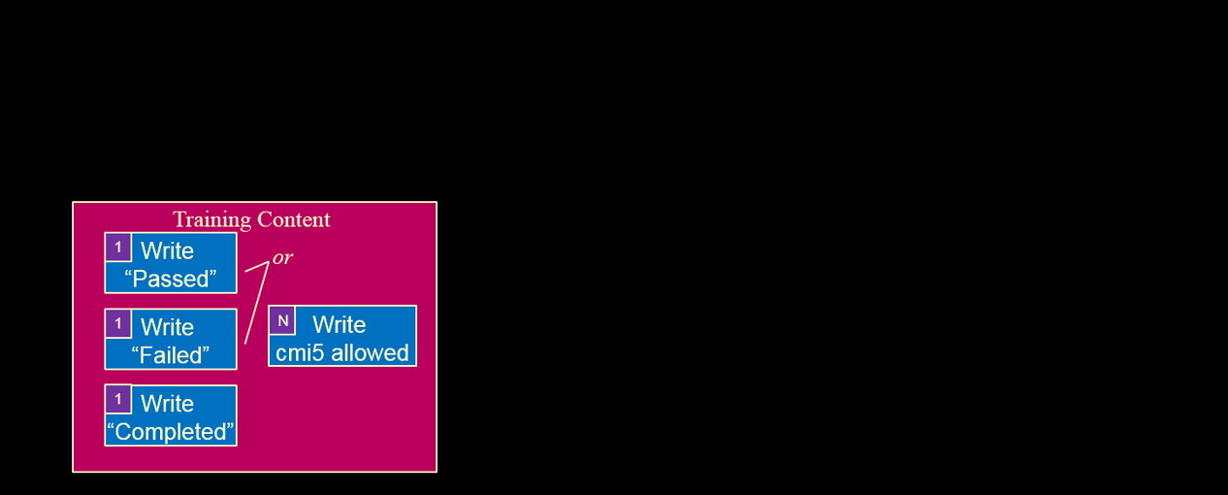
Course Data Flow
Credit: RISC, Inc.
Not all of this is the responsibility of the course designer

Slide 57
Design Decisions
cmi5 Design Principles
Focusing our efforts on what happens between the “Initialize” and “Terminate”
E.g. the content being displayed to the learner and being taken away
cmi5 Authoring solutions would allow us to not have to figure out anything except the basics
Determine pass/fail/completion criteria (cmi5 Defined)
Is completed viewing the last page? All of the pages?
Is there an assessment? If so, how is it scored and do we share out that score?

Slide 58
cmi5 Expanded Content Creation
Creating a cmi5 Course
Adding Domain-based Tracking
Adding Media-based Tracking
Adding Function-based Tracking

Slide 59

Goals
Goal: A domain-specific course, rich in content topics and activities
Now that we’ve designed the cmi5 portion, we have a traditional set of web-based assets
Our course needs to have some “meat” – we will be taking on the domain of meal planning
Topics will include
Diet Variance
Shopping
Meal Preparation
Activities will include
Meal Tracking
Inventory Management

Slide 60
What Data Are We Interested In?
Content Design
Basic web-based content should be covered by the previous template
Subject matter/domain will not influence a new vocabulary without unique web events
Knowledge assessment will be done independently from performance assessment on the activity
Activity Design
Within a web interface, there will be an activity that brings two distinct principles that are covered in the content to life
A subset of “The Fridge” that was discussed earlier, allowing effective inventory management.
We will also use a scheduler to plan when particular people will be around for meals
Could do many other things – recipes, portion sizes, etc.

Slide 61
Design Decisions
Domain Design Principles
Without specific activities, tying domain-based tracking to content is difficult
Activities should be “task driven” – don’t force-fit xAPI or any technology
It is key to understand if the activity has its own assessment component or not
xAPI can be used to track individual data, but doesn’t have to
E.g. You don’t have to create Statements for each question and answer….but you can
Some data is best left inside the course/application
E.g. If there is a complicated algorithm to determine portion size, the xAPI statement can just report out the size and not all of the math

Slide 62
What Data Are We Interested In?
In Thinking About the Data Design of the Activities:
We need to define specific foods
We need to define specific persons eating the meals
We need to define the specific meals (lunch on Tuesday the 30th, for example)
We need to know when a food leaves the fridge
We need to determine when a food enters the fridge
We need to determine when a person is added to a meal (for planning purposes)
We need to determine when a person is removed from a meal
We need to determine when a food is eaten (and its nutritional information)

Slide 63
Conversation with the xAPI Developer
We need the following xAPI data defined:
Objects for all foods in the supplied list
Actors for all persons defined in the activity and the Fridge
Activities for each meal of each day in the learning activity
“Fridge <removed> Food” Statements when it occurs in the activity
“Fridge <added> Food” Statements when it occurs in the activity
“Actor <ate> Food” tracking calories as a result and the meal as context
“Actor <was added to> Meal” Statements when it occurs in the activity
“Actor <was removed from> Meal” Statements when it occurs in the activity
The developer should then do the legwork on the vocabularies and report back – It is not the designer’s job to determine if the “added” and “was added to” are the same verb

Slide 64
cmi5 Expanded Content Creation
Creating a cmi5 Course
Adding Domain-based Tracking
Adding Media-based Tracking
Adding Function-based Tracking

Slide 65

Goals
Goal: Apply video tracking to our media assets
With a solid course created, we can focus on some tracking that will allow monitoring of learner activity
Seeing learner patterns allows us to effectively:
Ensure they are indeed completing the content
Learn where they may be struggling
Learn where our resources may require revisions (e.g. bad parts of the video)
Learn where supplemental material may be necessary (e.g. a new vocabulary term is brought up within the video)

Slide 66
What Data Are We Interested In?
Media-based xAPI Profiles
Highly tied to media type, device type, or technology
Still require corresponding “events”
Others could include audio, simulation, augmented/virtual reality
Video Design
Make the assumption that a video player is embedded and it has typical controls with it
Videos are considered streamed assets – not necessarily a content medium
Some video formats allow more complex behavior such as clicking objects within them
Determine which controls are going to be both important and available to tie to specific web events

Slide 67
Design Decisions
Media Design Principles – Lean on xAPI Profiles!
Profiles that revolve around a media type or function often will have established practices within an xAPI Profile (https://liveaspankaj.gitbooks.io/xapi-video-profile/content/statement_data_model.html)
Narrative and technical formats/fields are important
Learn the “lingo” of the design – “played”, “seeked”, “time from”, “time to”
This “lingo” is important because the developer can use the same resource as a code example!
“Description” and “Usage” parts of a seemingly technical document provide both usage alignment and use case ideas
Feel free to define use cases outside the xAPI Profile

Slide 68
What Data Are We Interested In?
In Thinking About the Data Design of the Video:
We want the video to be considered completed only when all parts have been watched
We want to capture when the learner skips part of the video, which part, and how much
We want to capture when the learner turns up the volume of the video
We want to capture when the learner turns down the volume of the video
We want to capture when the learner pauses the video
We want to capture when the learner resumes the video and how long the time was between pausing and resuming
We want to determine any parts of the video that are replayed
While “initialized” and “played” are critical parts of the video profile, we may leave that design detail out and expect our developer to bring that requirement to us.

Slide 69
Conversation with the xAPI Developer
We need the following xAPI data defined:
The Learner is the Actor
The “played segments” and “progress” Extensions will be necessary
Objects for each video asset will be necessary
“Actor <completed> video” Statements when all segments are played
“Actor <seeked> video” with the “time from” and “time to” Statements on relevant control
“Actor <played> video” and “Actor <paused>” video” Statements at appropriate time
“Actor <interacted> video” with context extension “volume” for both up and down
Capture the “played segments” and “progress” as shown in the Video Profile
Developer Tip: All of these non-cmi5 Statements are “cmi5 allowed”, but in this case would also be tagged with a video profile context activity as well

Slide 70
cmi5 Expanded Content Creation
Creating a cmi5 Course
Adding Domain-based Tracking
Adding Media-based Tracking
Adding Function-based Tracking

Slide 71
Goals (Will create similar graphic that is cleaner)
Goal: Add Competencies to the Course
We have a certificate as a goal, but we are going to add competencies
The benefit of competencies is to store learner achievement for future credit
Quick Definition of Terms
Competency - the set of skills and behaviors required in the performance of a task or activity
Credential – the earning of a competency by an individual as recognized by a certifying organization + “the admin stuff”
Certificate – the artifact of a credential that is owned by the earner
Knowledge
“Know What”
Skills
“Know How”
(Learned)
Abilities
“Know How”
(Natural)
Attitudes
“Know Why”

Slide 72
What Data Are We Interested In?
Competencies
Competencies can be determined in many different ways
The course can “give out” competencies based on success either a cumulative assessment or on assessment sections
An evaluator can “give out” competencies based on performance evaluated either in real time or by using evidence of achievement
A determination of competence can be made based the weight of various assertions of competence across any number of sources
Luckily, these are all essentially set up the same way in xAPI
Credentials and Certificates
An LMS could have a direct tie-in to award Credentials and Certificates based on the outcomes of earned competencies, which could be as simple as a single course

Slide 73
Design Decisions
Functional Design Information
Profiles that revolve around a media type or function often will have established practices within an xAPI Profile, but this one does not…yet
There is an ADL effort that deals with interoperability of competencies (https://cassproject.github.io/cass-editor/docs/guide/) which will be aligned to in this example, but only on the developer side
Many competency-based decisions will happen well outside the course level, it will be up to the designer to understand possible constraints
One large one would be that it may be hard to design a course that responds to gained competence outside the course
As in other things with xAPI, if the course itself determines competence, it doesn’t have to reveal all the algorithms or process

Slide 74
What Data Are We Interested In?
In Thinking About the Competency approach:
We want to provide specific competencies that are achieved by expressing a value of 1 (as in 100%)
This determination will be tied to performance on the activities and not the assessment
May have to revisit the idea of the activity being an assessed activities
We want to tie the completion of content and the passing/failing of assessments to competencies
However, we won’t declare competencies achieved in the course in this way
An external evaluation could be done on data such as these and issued outside the course

Slide 75
Conversation with the xAPI Developer
We need the following xAPI Data Defined:
The Learner is the Actor
Objects for each Competency will be necessary
A Competency “Map” or Framework will be provided by the Designer
Context Activities for each Competency will be necessary (the same id as the Object)
Our Meal-Planning Activities may need to be updated to indicate assessment
“Actor <achieved> Object (Competency) with Result “1” ” will be used when Meal-Planning Activities are successful
In “Actor <completed> Activity”, “Actor <passed> Activity”, and “Actor <failed> Activity” Statements, the Context Activity for that Competency should be used

Slide 76
More for the xAPI Developer
The following is also useful for the xAPI Competency Developer :
The CASS Project from ADL offers a way to implement competencies http://devs.cassproject.org/index.html?doc=1DZlrMrPd8Me2BsYHB0vUovtocWUMaj_VvKQD2_Ibb70#h.r5xxv2r1prwz that leverages xAPI.
An example of how to look at a summary of achievement to see competency could function as follows: “Actor <asserted> Object (Competency) with Result “(0-1)” Authority Credentialing Body with StatementRef (Statement)”
Don’t worry if this doesn’t make sense to you yet
The variety of implementation decisions available point to the strong need for an xAPI Profile in this area

Slide 77




Big Picture With cmi5/xAPI Data
cmi5 LMS
xAPI LRS

Slide 78
Maybe We Did Use ADDIE….
ADDIE on Data
Analysis – We figured out what we want to track
Design – We figured out how to correlate it to events in our content
Development – We hand it off to a developer to code it in
Implementation – That coder connects the course to an LMS
Evaluation – We looked what the data is like in analytics and dashboards and we consider revisions

Slide 79
cmi5 Defined vs. cmi5 allowed (Revisited)
Profiles are “tagged” in xAPI within Context
The necessary cmi5 Statements are “cmi5 Defined”
The meal planning, video, and competency Statements are “cmi5 Allowed”
“cmi5 Allowed” Statements are tagged as such AND with the appropriate Profile

Slide 80
Expected Learning Outcome #5
5
The learner will understand the products and services available that integrate cmi5. This includes content authoring tools, LMS/LRSs, and utilities. The learner will understand evaluation criteria to distinguish conformant tools from non-conformant tools. The learner will be given information on available online documentation, code libraries, and documented best practices.
5

Slide 81
xAPI Profile Specification and Server
The xAPI Profile Specification
Was created to provide uniformity to xAPI Profiles
All the “blueprints” use the same way of structuring Statements and measuring their contents
Allows validation through testing
Can Throw Out “Bad” Data
The xAPI Profile Server
Strongly ties Profiles to Communities of Practice
Publishing and Maintenance of xAPI Profiles
Allows permission-based exploration of xAPI Profiles
Validates a Profile is conformant to the xAPI Profile Specification

Slide 82
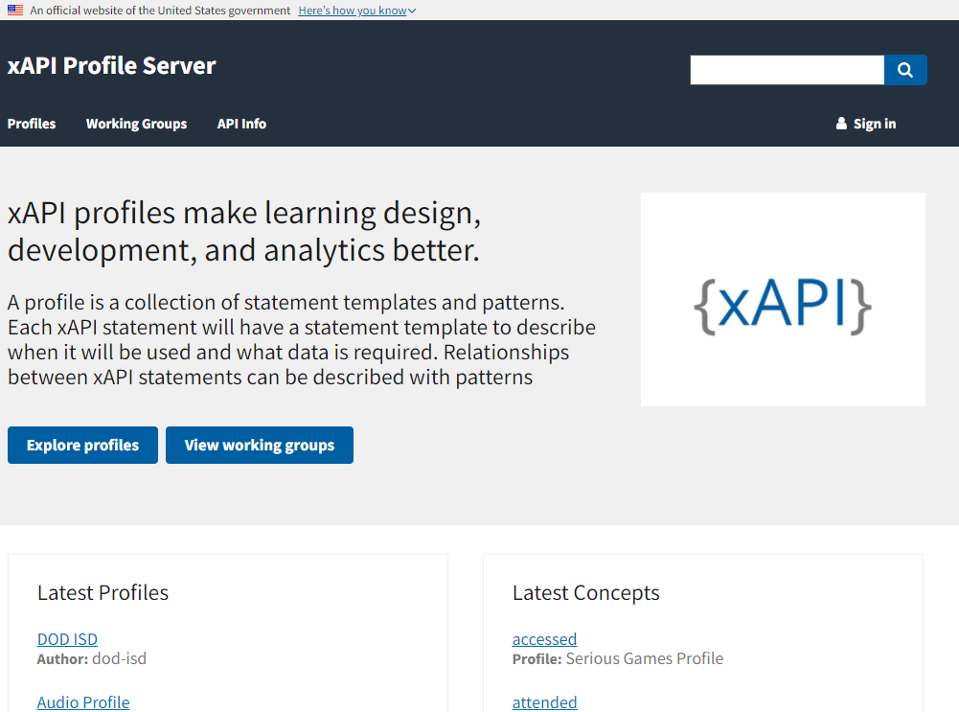
xAPI Profile Server

Slide 83
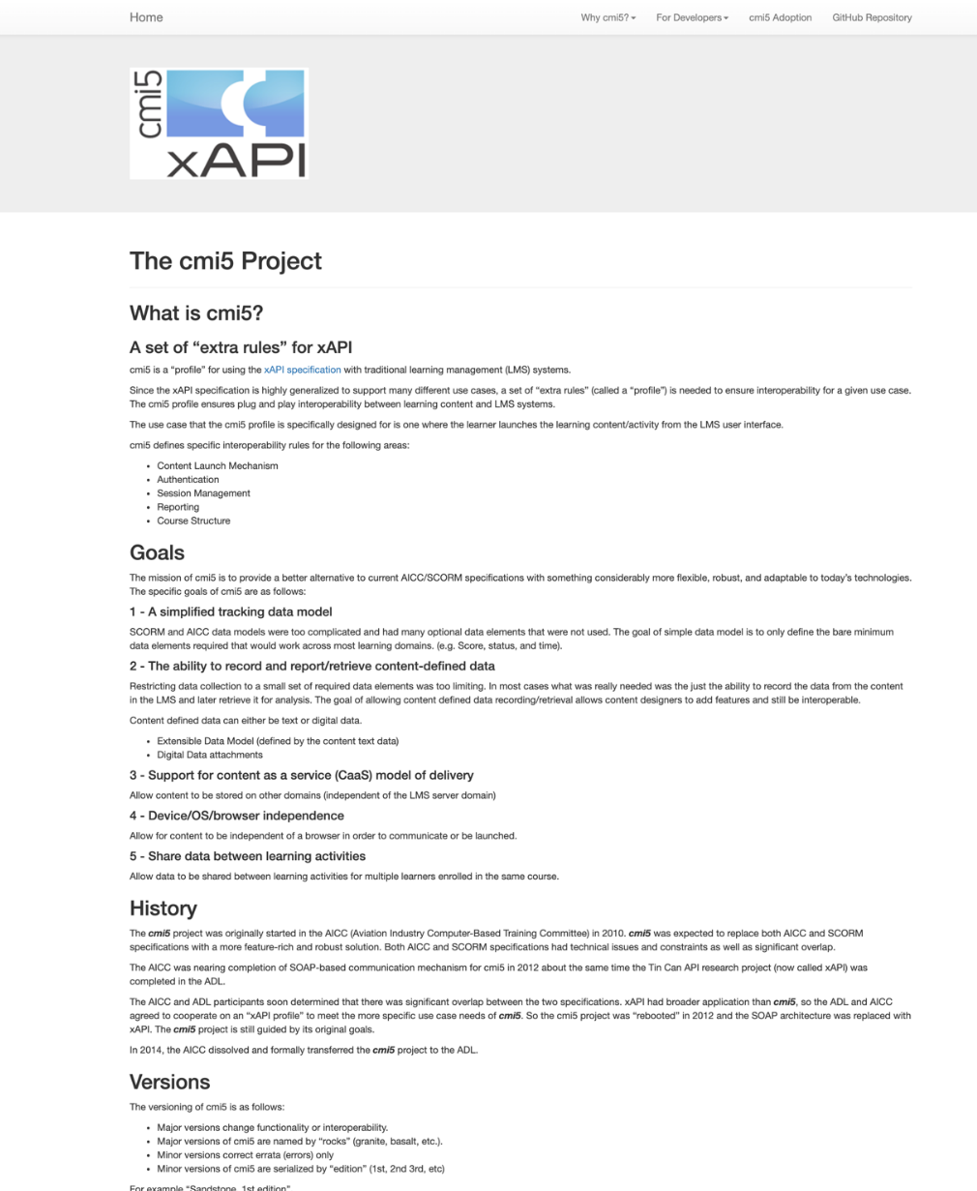
cmi5 Working Group
Behind every profile is a unified and hard-working group
cmi5 Working Group began BEFORE xAPI, with a completely independent organization
Considered WSDL and SOAP protocols (for any techies in the audience)
Open, free, and unaffiliated
Consider joining if interested (no experience required)
Website: https://aicc.github.io/CMI-5_Spec_Current/
Specification Document: https://github.com/AICC/CMI-5_Spec_Current
Many Links to Articles on Website and in Bibliography

Slide 84
Buying a cmi5/xAPI Product
Do NOT buy a product that simply claims xAPI Conformance
Look for specifically cmi5 or named xAPI Profiles
If an authoring tool, acquire sample output
Test with a known and trusted LMS/LRS
If an LMS/LRS, ask to test with a sample course
Test with a known and trusted course
Use the cmi5 Player, Test Suite, and Examples
ADL Project available late 2021!

Slide 85
Testing Criteria
Learning Record Store
Learning Management System
An LRS capability is NOT sufficient for cmi5 conformance, it must have additional capabilities found in an LMS
Test an LRS as an LMS
Verify all nine types of cmi5 Statements work
Verify all suspend/resume functionality works
Verify all roll-up works
Verify distributed learning content works
Investigate through integrated dashboards, whenever possible
Notes:
Learning Record Store
An LRS capability is NOT sufficient for a cmi5, it must have additional capabilities found in an LMS.
Test an LRS as an LMS.
Learning Management System
Verify all nine types of cmi5 Statements work
Verify all suspend/resume functionality works
Verify all roll-up works
Verify distributed learning content works
Investigate through integrated dashboards, whenever possible

Slide 86
Testing Criteria (Cont.)
Authoring Tools
An authoring tool’s output is a Course including a Course Structure Format
It will need to rely on a Learning Record Provider to create Statements
Statements handed to the Learning Record Provider should be full
Remember, not all cmi5 Statements are issued by the content
Ensure that the authoring tool is EXTENSIBLE, much of the benefit of cmi5 is expanding into xAPI
Authoring Tool Output and LMS Combinations CAN eliminate the need for an LRP, but is not guaranteed
Notes:
Authoring Tools
An authoring tool’s output is a Course including a Course Structure Format
It will need to rely on a Learning Record Provider to create Statements
Statements handed to the Learning Record Provider should be full
Remember, not all cmi5 Statements are issued by the content
Ensure that the authoring tool is EXTENSIBLE, much of the benefit of cmi5 is expanding into xAPI
Authoring Tool Output and LMS Combinations CAN eliminate the need for an LRP, but is not guaranteed

Slide 87

ADL Efforts to Improve Acquisition
IEEE Standardization of cmi5
Making it more enforceable
cmi5 Player Project
Giving early adopters a platform to deploy authored courses
cmi5 Test Suite Project
Allowing personal testing of content and systems (like SCORM)
All of these and Best Practice Guides and Templates!
https://github.com/adlnet/CATAPULT

Slide 88
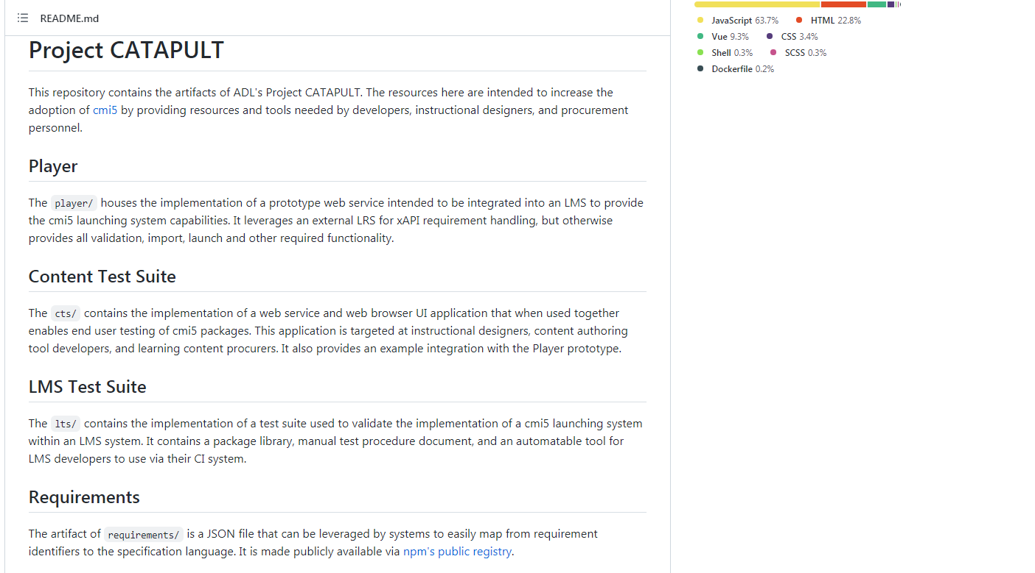
Tools At: https://github.com/adlnet/CATAPULT

Slide 89
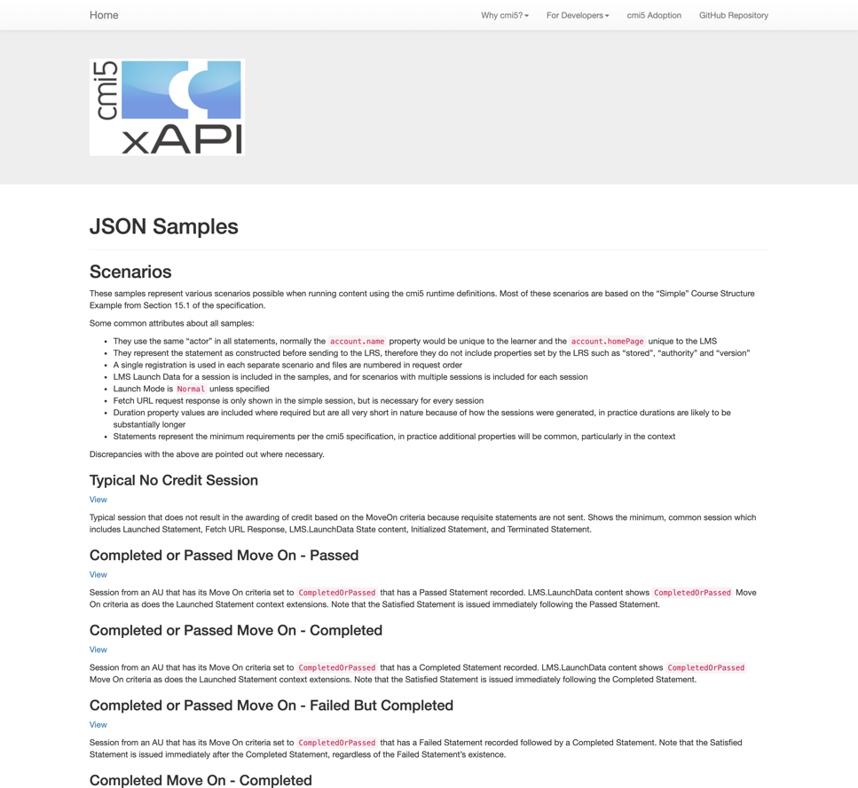
cmi5 Sample Statements
Full cmi5/xAPI Statements are available
https://aicc.github.io/CMI-5_Spec_Current/samples/
All necessary Statements for thirteen specific cmi5 scenarios
Goes perfectly with the Workflow shown earlier
Includes:
No Credit Sessions
Completed/Passed with MoveOn
Use of Mastery Score
Abandoned Sessions
Multiple Attempts
“cmi5 Allowed”

Slide 90
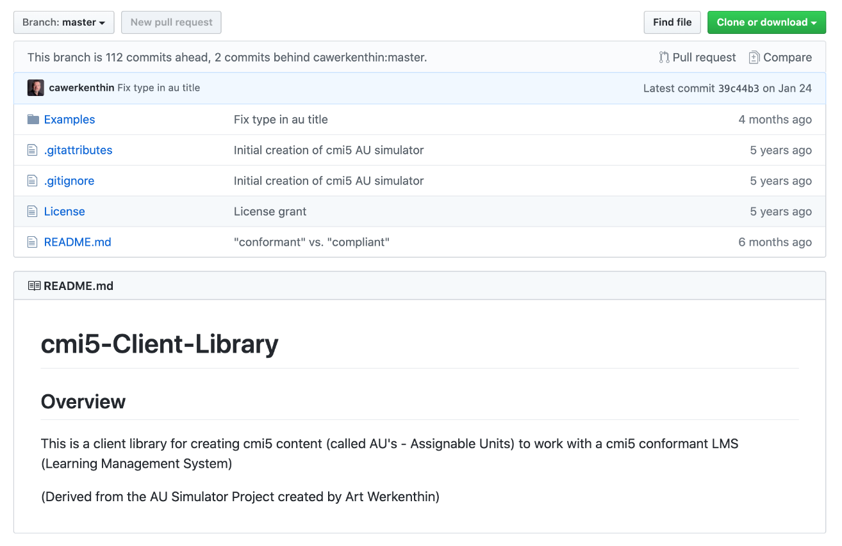
cmi5 Client (Content) Sample Code
Library of JavaScript Solutions
https://github.com/adlnet/cmi5-Client-Library
Includes Real Content, Code, and Scripts
Verified by cmi5 Working Group
Notes:
Statements are great, but understanding when to use them is also important

Slide 91
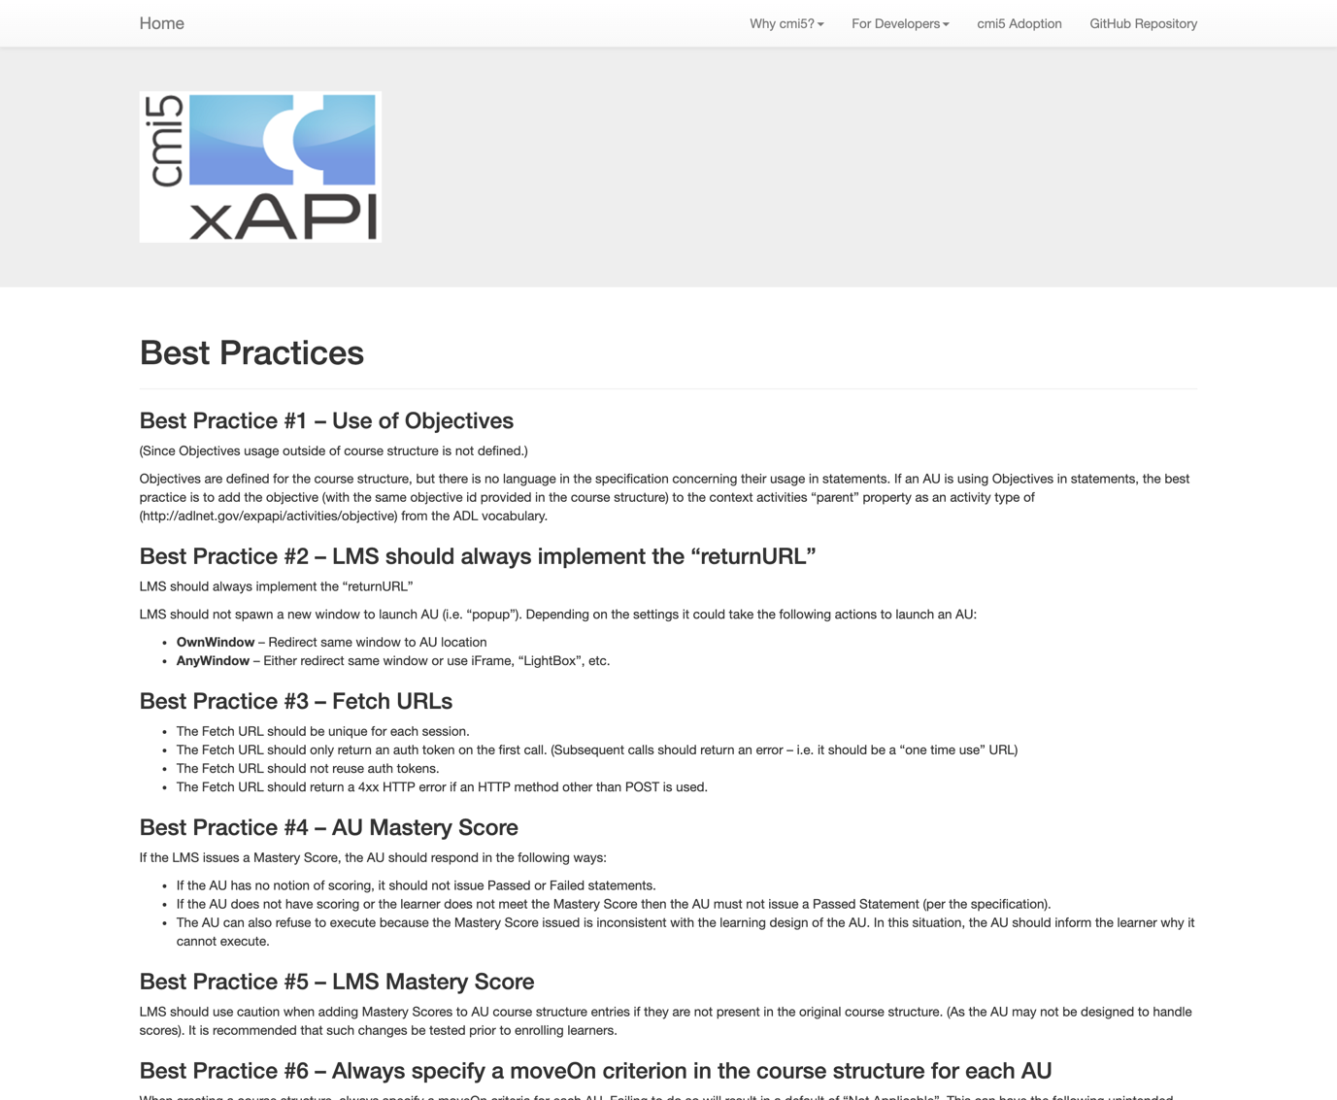
cmi5 Best Practices
Best Practices
https://aicc.github.io/CMI-5_Spec_Current/best_practices/
Discusses many of the tougher to implement parts of cmi5
Includes Advanced Topics such as:
The Authentication “Handoff”
Mastery Score
Mobile
Objectives
Error Handling

Slide 92
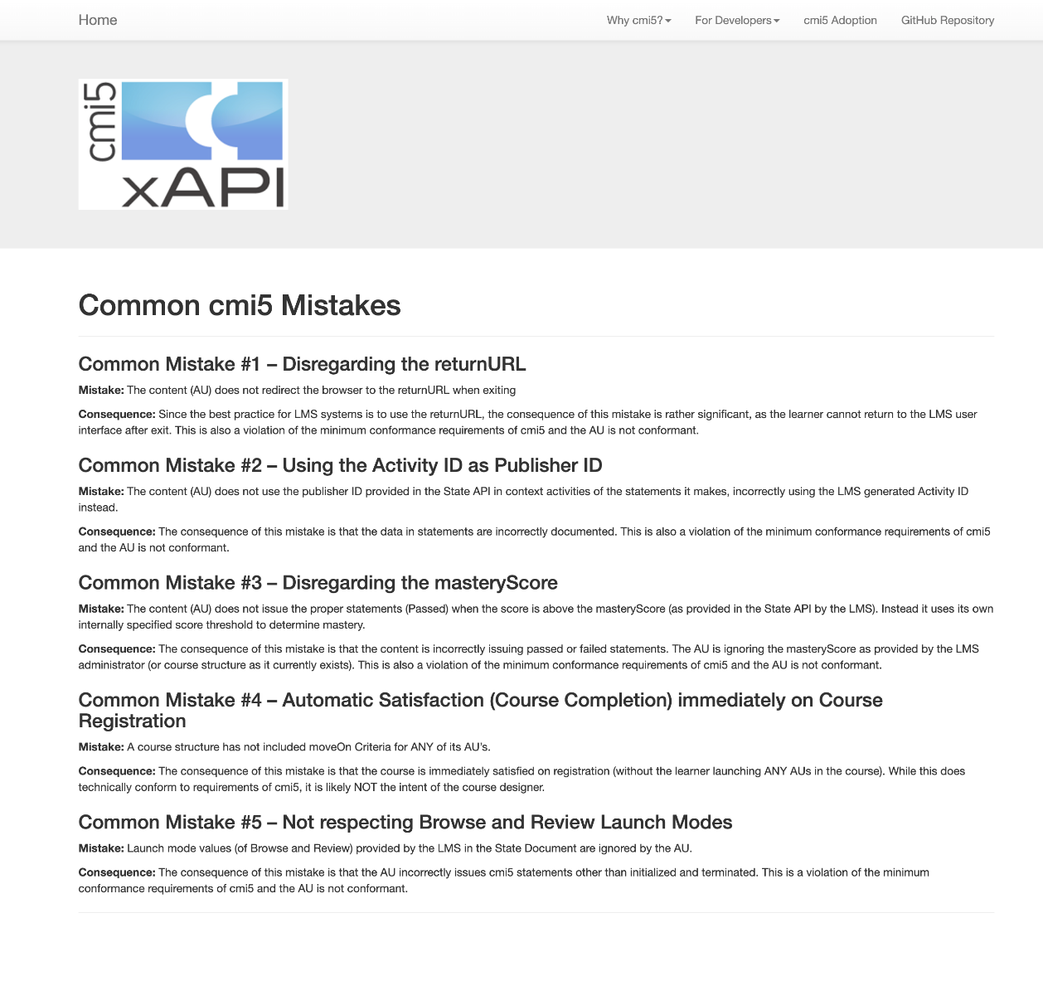
cmi5 Worst Practices
Worst Practices
https://aicc.github.io/CMI-5_Spec_Current/mistakes/
Discusses many of the pitfalls and early mistakes of adopters
Doesn’t include things like “don’t use the same id for every activity”
Includes Advanced Topics such as:
Activity vs. Publisher Id
Mastery Score
Registration
Launch Modes
Error Handling

Slide 93
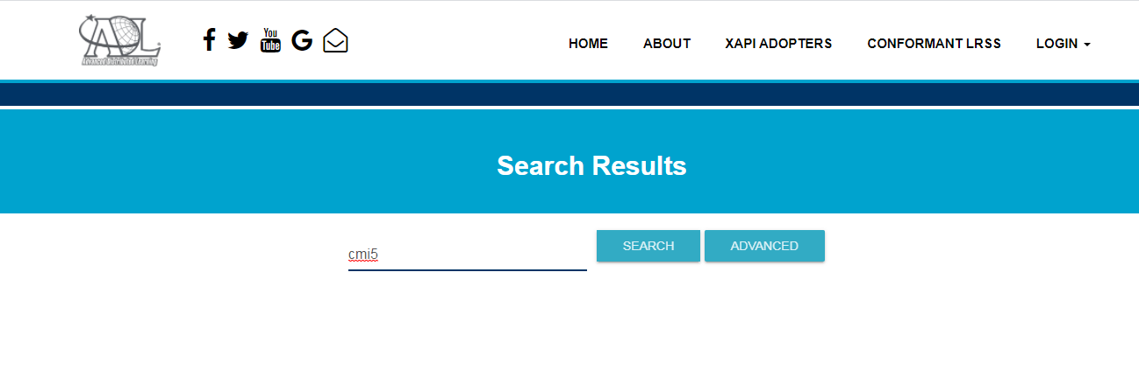
cmi5 Adopters
Results of All cmi5 Conformant LMSs Shown Below:

Slide 94
cmi5 Adopters
cmi5 Working Group maintains a list of adopters (see Bibliography)
Unbiased
Content Authoring Products
Articulate Global, Inc. - Storyline 360 (Content Authoring Tool)
Growth Engineering - Genie Game-based Authoring Tool
iSpring Solutions iSpring Suite (Content Authoring Tool)
Rustici Software SCORM Driver (Content Authoring Middleware)
Trivantis Lectora Publisher (eLearning Content Authoring Tool)
Trivantis CenarioVR (VR Content Authoring Tool)
xAPI.js – cmi5 Profile Library

Slide 95
cmi5 Adopters (Cont.)
LMS Products
Epignosis, LLC - Talent LMS
Grassblade xAPI Companion (Add-on for WordPress)
RISC Inc. Virtual Training Assistant™ (LMS)
Rustici Software SCORM Engine (LMS Middleware)
Rustici Software SCORM Cloud (LMS/LRS)
WP Courseware Learning Management System (Via Grassblade Integration)

Slide 96
Thank You to the cmi5 Working Group! (Will be Updated to reflect current membership and meeting link)
Chair:
Bill McDonald (and a thank you to Amazon for loaning us Bill every week)
Current Participants (Thank you to all past participants too):
Alan Mustafa, Alessio Breviglieri, Allyssa Thompson, Andy Johnson, Art Werkenthin, Ben Clark, Bill McDonald, Brandon Billings, Brian Duck, Brian Miller, Carsten König, Chetan Sachdev, Choompol Boonmee, Chris Horan, Chris Mangoine, Christopher Thompson, Christopher Krepich, Cole Tinney, Cristina Boyer, David Pesce, David Mallette, David Wang, Dennis Hall, Derek Redmond, Devlin Peck, Eilieen Quenin, Florian Tolk, Geir Fuhre Pettersen, George Vilches, Henry Ryng, Jack Bowden, Jason Haag, Jason Woodford, Jim Broadwell, Ketan Patel, Kevin Owens, Laurie Johnson, Marco Dal Colle, Marcus Birtwhistle, Matty Kahler, Megan Bowe, Michael Pack, Michelle Goodson, Mike Hernandez, Moges Kelklie, Nabin Test, Peter Hawkins, Prathiba Prathapan, Richard Shipmon, Robert Verner, Russ Engoran, Scott Powers, Seli Agbolosu-Amison, Shakhriyor Khudoyberdiev, Simon Hsu, Sriraman Raman, Stuart Simon, Tammy Rutherford, Thomas Turrell-Croft, Tim Edwards, Tracy Cowan, Udith Dilshan, Vijay Mandava, Vpad Dots, Willem Kupper, Yifei Dong, Yihua Liu
Join Us:
https://attendee.gotowebinar.com/register/4876843550305432332

Slide 97
ADL Efforts to Improve Acquisition
IEEE Standardization of cmi5
Making it more enforceable
cmi5 Player Project
Giving early adopters a platform to deploy authored courses
cmi5 Test Suite Project
Allowing personal testing of content and systems (similar to the SCORM Test Suite)
cmi5 Course Templates
Free templates with xAPI Statements from cmi5, video profile, etc.

Slide 98
Learning Outcomes
The Learner Now (Hopefully)
Is able to describe xAPI Concepts and how they relate to cmi5
Understands the use cases of cmi5 and its value to enable other xAPI solutions
Is able to describe xAPI Profiles and their critical role in interoperability
Is able to design learning resources using xAPI, xAPI Profiles, within a cmi5 framework
Understands available cmi5 resources and whether products are cmi5 compliant or not

Slide 99
Bibliography
xAPI 1.0.3 Specification - https://github.com/adlnet/xAPI-Spec
IEEE 9274.1.1_2021_D1 – TBD (as in, will populate before final)
xAPI Profile Server (https://profiles.usalearning.net/)
cmi5 Working Group Page – https://aicc.github.io/CMI-5_Spec_Current/
cmi5 Content Player, Test Suite, and Templates – TBD
cmi5 Adopters List (ADL) - TBD
SCORM vs. cmi5 Comparison (by cmi5 Working Group) - http://aicc.github.io/CMI-5_Spec_Current/SCORM/
cmi5 as SCORM Replacement Article - http://risc-inc.com/next-generation-scorm-cmi5/

Slide 100
Bibliography
cmi5 Working Group / Landing Page - http://aicc.github.io/CMI-5_Spec_Current/
cmi5 Overview - https://adlnet.gov/resources/cmi5-resources/
cmi5 Code Library - https://github.com/adlnet/cmi5-Client-Library
cmi5 Adopters List - https://aicc.github.io/CMI-5_Spec_Current/adoption/
cmi5 Best Practices - https://aicc.github.io/CMI-5_Spec_Current/best_practices/
cmi5 Worst Practices - https://aicc.github.io/CMI-5_Spec_Current/mistakes/
cmi5 Code Library - https://aicc.github.io/CMI-5_Spec_Current/client/
cmi5 Sample Statements - https://aicc.github.io/CMI-5_Spec_Current/samples/
SCORM to xAPI Wrapper - https://github.com/adlnet/SCORM-to-xAPI-Wrapper
Profile Guidance / Vocabulary Server - http://xapi.vocab.pub/

Slide 101
Bibliography
cmi5 Runtime Example video https://www.youtube.com/watch?v=nhJRIDNE96Q
Free AU simulator (and source) https://github.com/cawerkenthin/cmi5-AU-Simulator
Rapid Authoring Adopter http://www.ispringsolutions.com/blog/ispring-now-supports-cmi5-the-next-generation-of-scorm/
cmi5 Process Flow https://risc-inc.com/cmi5-overview-process-flow/
AU Flow - https://aicc.github.io/CMI-5_Spec_Current/flows/au-flow.html
LMS Flow - https://aicc.github.io/CMI-5_Spec_Current/flows/lms-flow.html

Slide 102



Questions?
Andy Johnson
Specs and Standards Manager (SETA)
andy.johnson.ctr@adlnet.gov
Art Werkenthin
CEO
artw@risc-inc.com
Mike Hernandez
Project Manager
Mike.hernandez@eduworks.com

