Slide 1


Basford, 2017
Advanced Air Mobility (AAM) and Flying Cars – Innovating Modeling & Simulation (M&S) Opportunities to Revolutionize the Future of Transportation (#21001)
Kevin F. Hulme, Ph.D., CMSP
The Stephen Still Institute for Sustainable Transportation and Logistics (SSISTL)
University at Buffalo
Co-authors:
Panagiotis Ch. Anastasopoulos, Ph.D.; Stephen E. Still, Ph.D.; Rachel Su Ann Lim; Sheikh S. Ahmed; Irina Benedyk, Ph.D. (SSISTL, University at Buffalo); Grigorios Fountas, Ph.D. (Edinburgh Napier University)

Slide 2
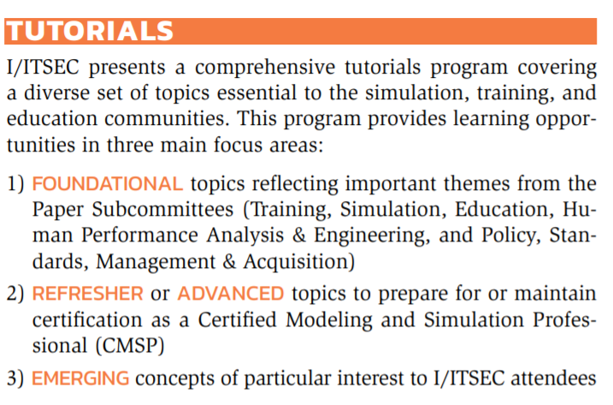


I/ITSEC Tutorial relevance (2020/2021)
2020: “The Future is Now”
2021: “Innovating and Accelerating Training – Adapting to an Unexpected Future”

Slide 3
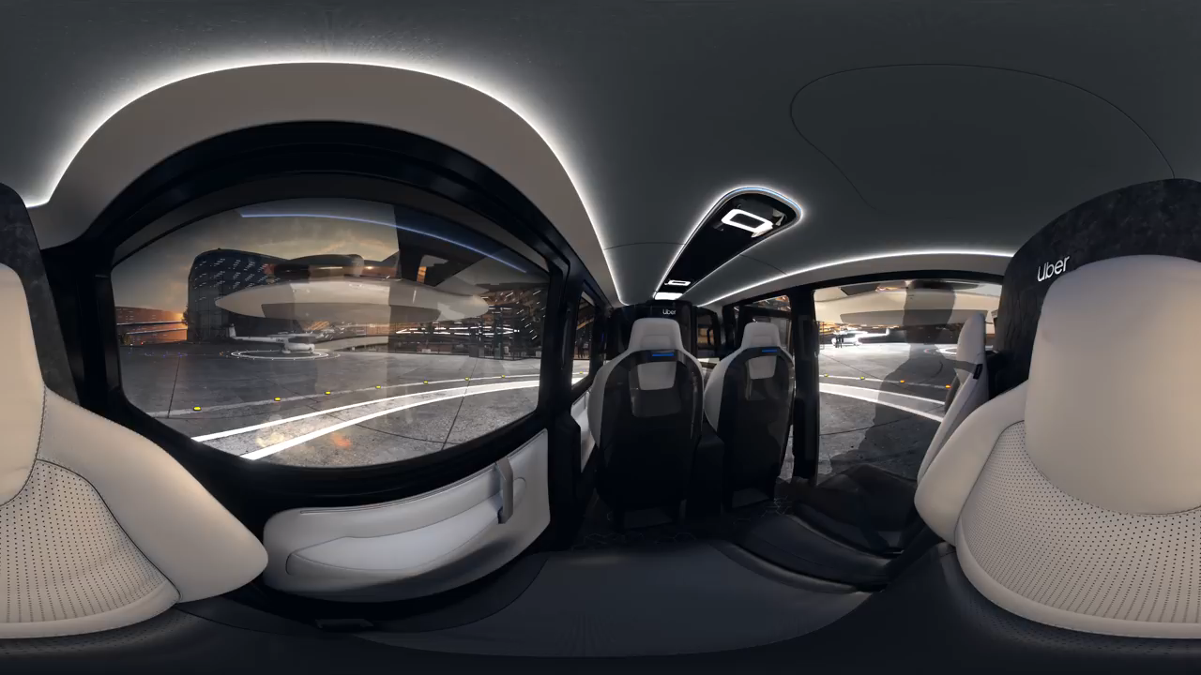
Preamble – The Future of Transportation?
CNN Business, 2019

Slide 4
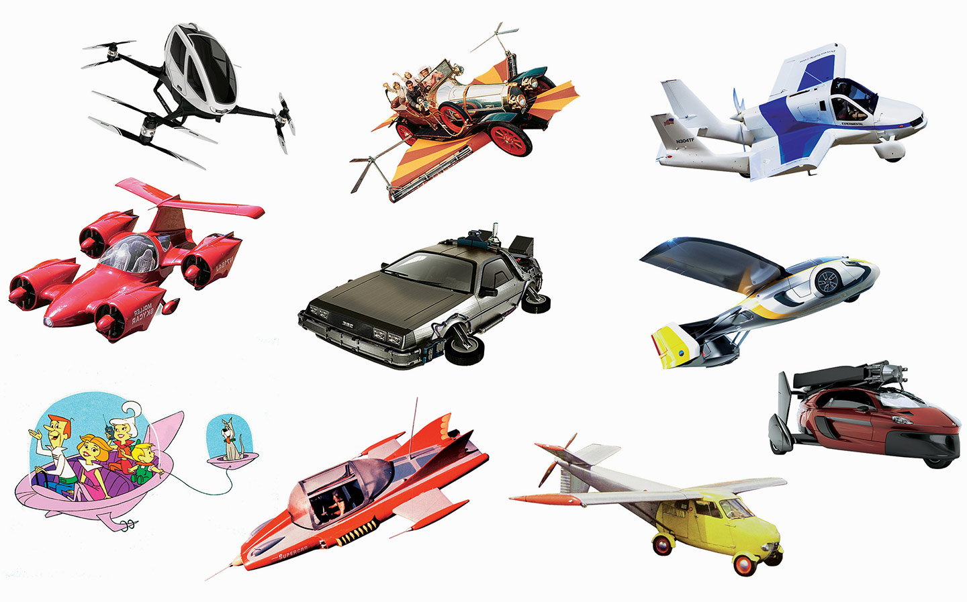
Tutorial Overview
Introduction & Learning Objectives (10 mins)
Background (5 mins)
Ongoing Challenges (15 mins)
AAM and M&S (20 mins)
Case Studies (20 mins)
Summary (5 mins)
Bibliography
Q/A (15 mins)
Rufford, 2017

Slide 5
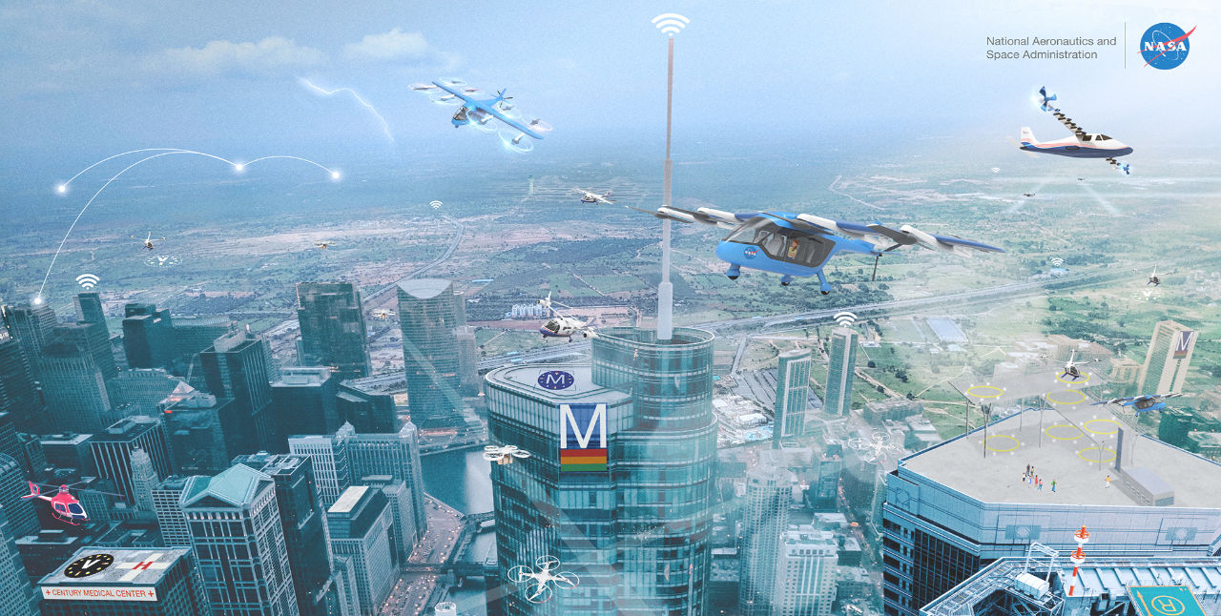
Introduction – Advanced Air Mobility (AAM)
Gipson, 2021
Garud-Barna, 2020
Advanced Air Mobility (AAM): safe development of an air transportation system that moves people and cargo between locations underserved by aviation – using revolutionary new forms of aircraft
AAM includes Urban Air Mobility (UAM), which is a safe and efficient air transportation system, including small package delivery drones and passenger-carrying air taxis operate above populated areas
The modern-day notion of “Flying Cars” falls within the domain of the more formalized AAM concept

Slide 6
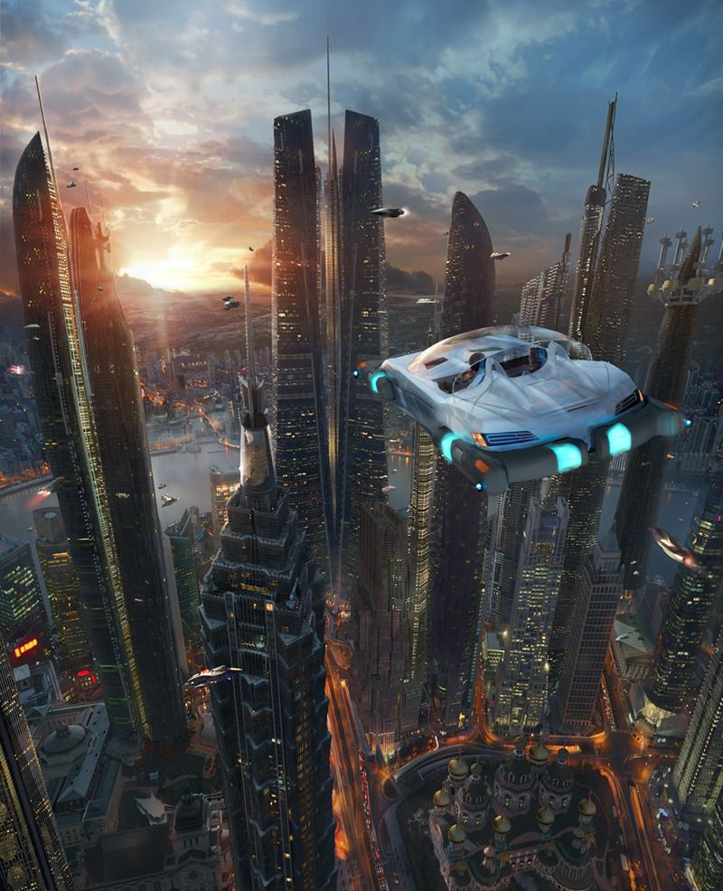
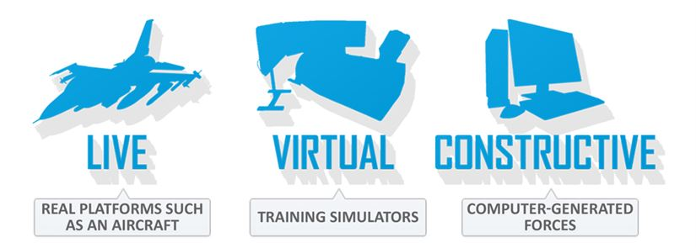
Introduction – relevance to I/ITSEC and M&S
The “Transportation Network of Tomorrow” seems nearer to science fiction than science fact, yet Flying Cars may be available for commercial use by 2025
Topic Relevance to M&S: emergent capabilities will advise future deployment of Flying Cars
The Live-Virtual-Constructive (LVC) taxonomy: LVC models and simulations (M&S) will be necessary for testing, experimentation, evaluation, validation
Downstream impacts upon Training, Simulation, and Education; Policies (PSMA); Human Performance (HPAE); Innovative Technologies (ECIT)
AlphaMecha, 2012
Doty, 2017
Davies, 2012
Gaudette, 2017

Slide 7
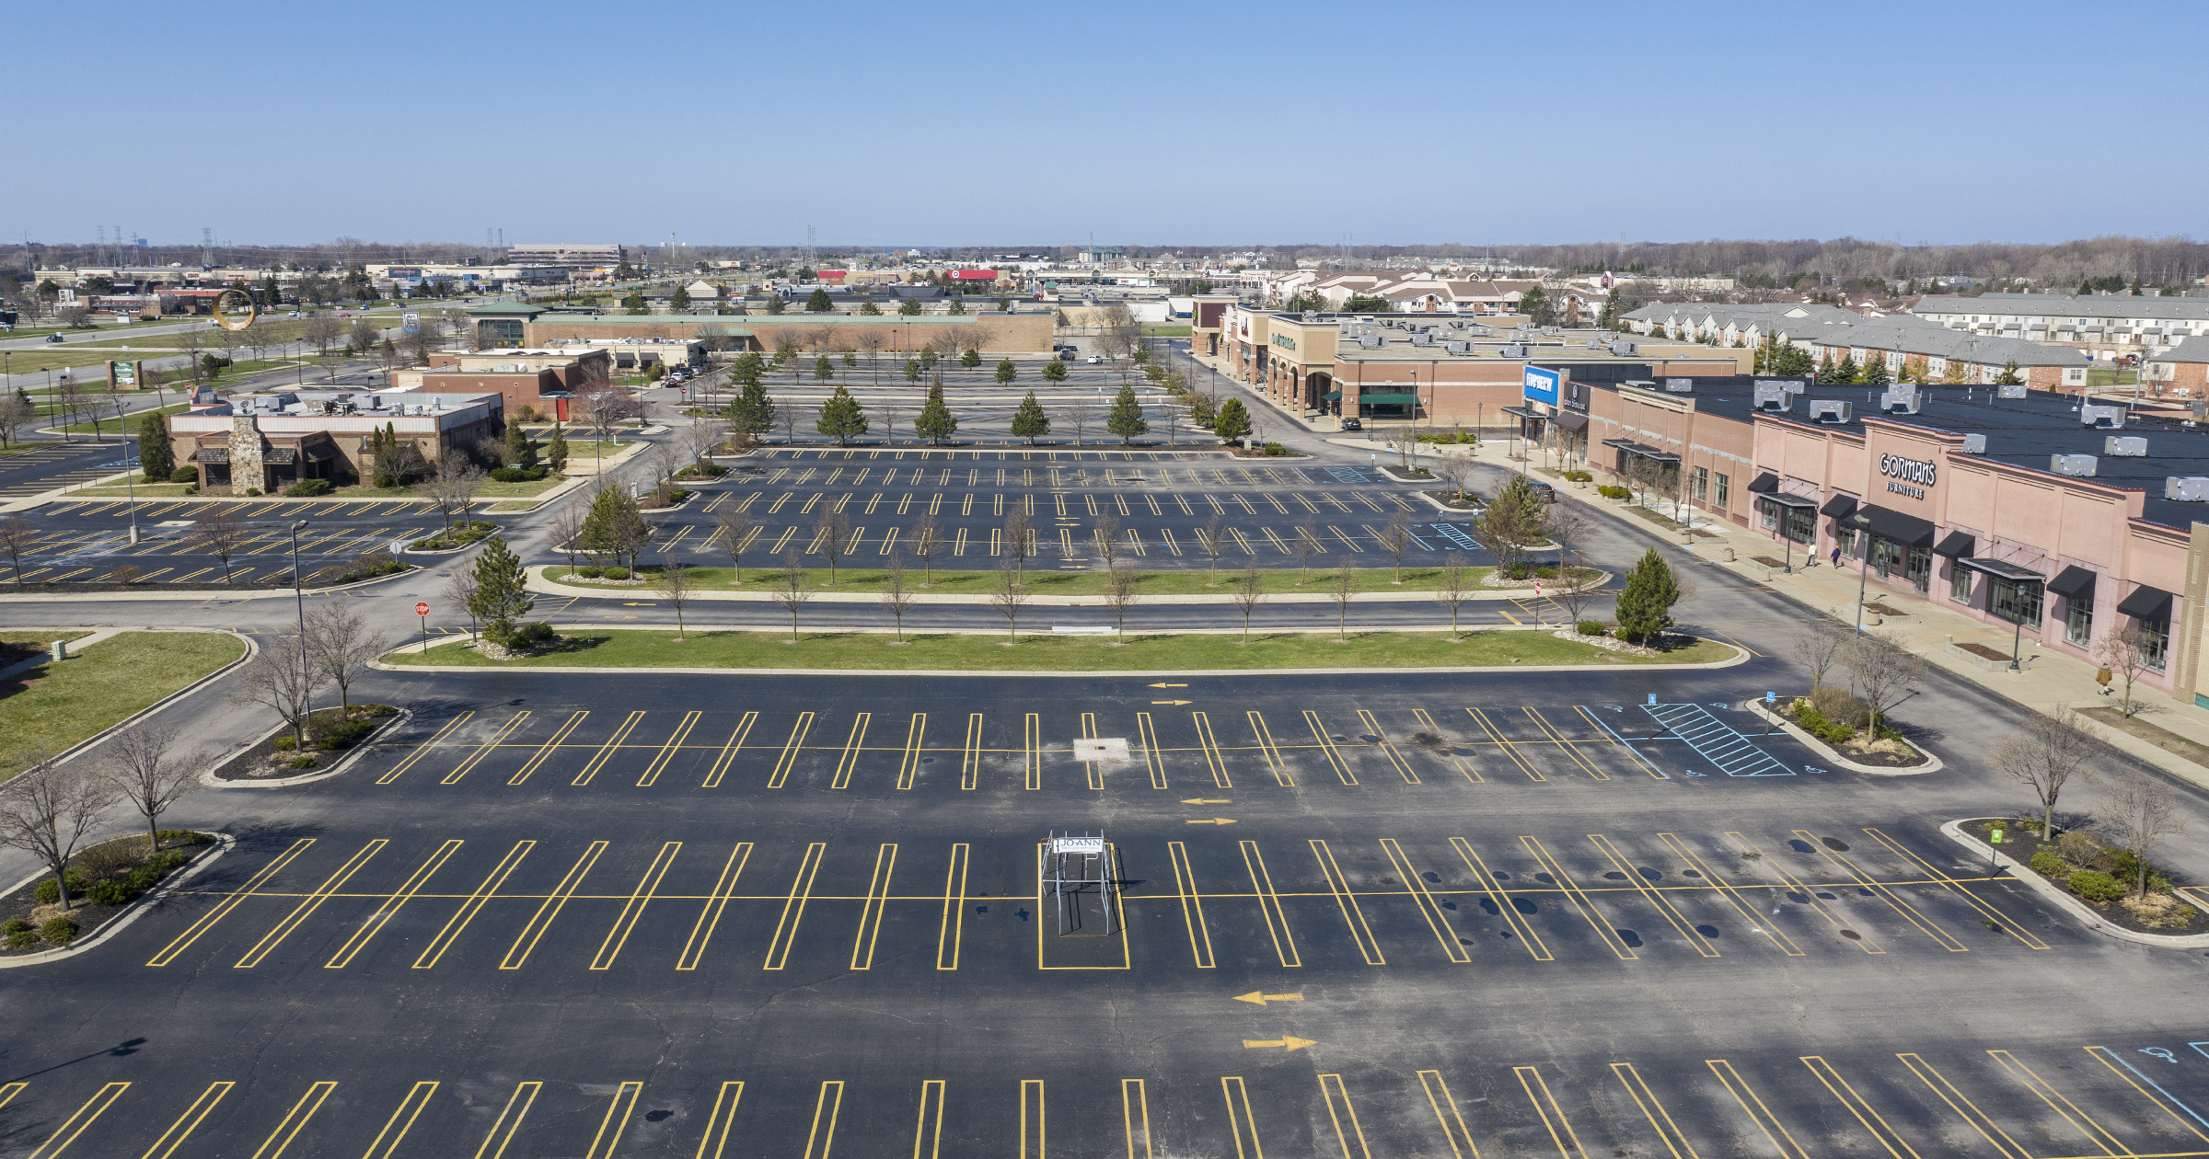
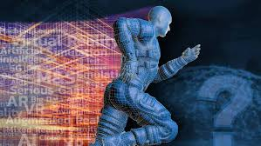
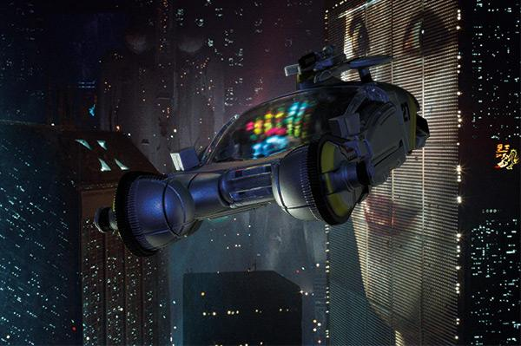
Introduction – 2021 Themes and COVID-19
“Innovating and Accelerating Training - Adapting to an Unexpected Future”: explore changing face of human transportation within a fully-integrated (ground/air) ecosystem
Recent COVID-19 has permanently altered the landscape for future urban and regional planning
Re-purposing geography and structures (e.g., office parks, shopping malls, plazas, parking lots)
Transformative “high-risk, high-reward” opportunities to improve and revolutionize transportation, sustainability, and logistics

Slide 8
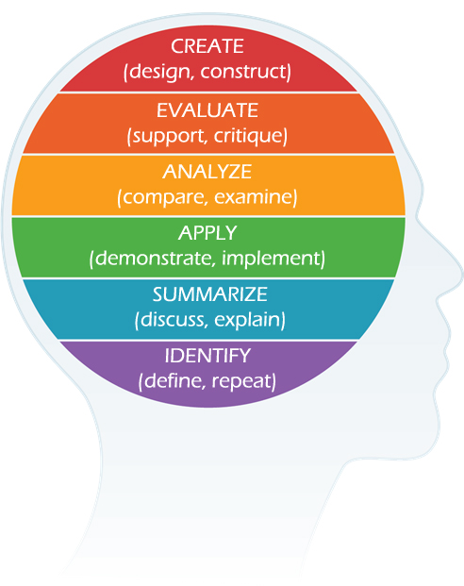
Learning Objectives
Identify: the current state-of-the-art with Flying Car technologies
Summarize: transportation challenges that mandate societal change and evolution
Apply: LVC fundamentals to enable sustenance and sustainability of Flying Car technologies
Analyze: timely Case Studies to assess associated technological and human factors impacts
Evaluate: to forecast next steps to leverage M&S in this emergent domain of interest
* (Advised by Bloom’s Taxonomy and I/ITSEC relevance)
Bloom, 2020

Slide 9
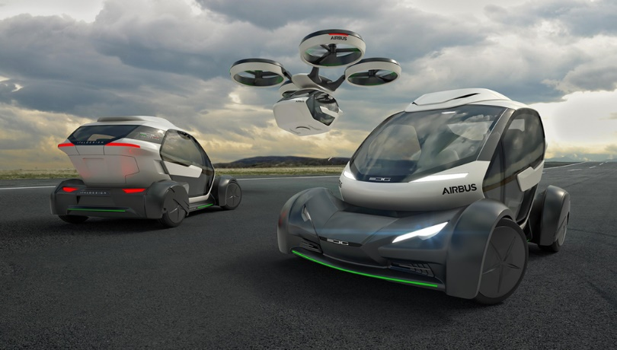
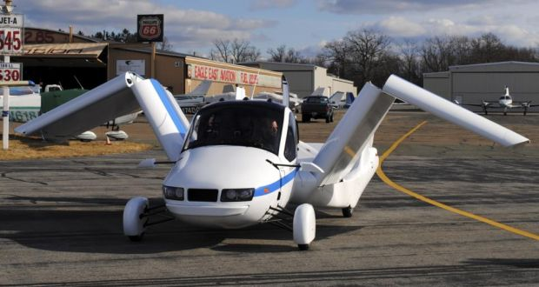
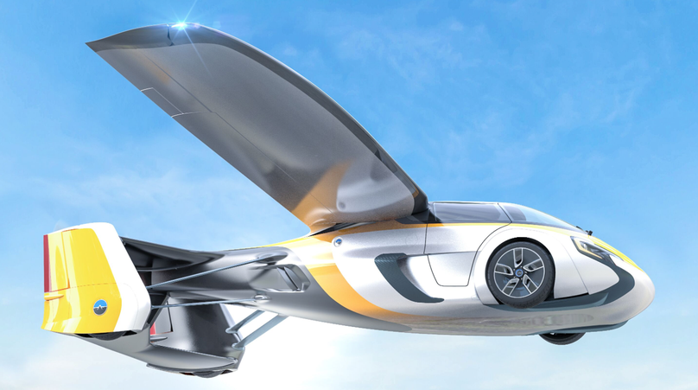
Background
Terminology: Flying Cars or Driving Planes?
Combine ideal characteristics of both planes and cars: 3D airspace vs. 2D roadways
Differences between proposed vehicles: a car with wings (Flying Car) vs. airplane with wheels (Driving Plane)
Ideal "flying cars" could more closely resemble a gyrocopter, and minimize dead-weight items (e.g., wheels, axles, transmission) required for ground transport
Carillo III, 2018; Del Balzo, 2015; Grady, 2017; Sigal, 2014; Rodriguez, 2017; Soffar, 2018

Slide 10
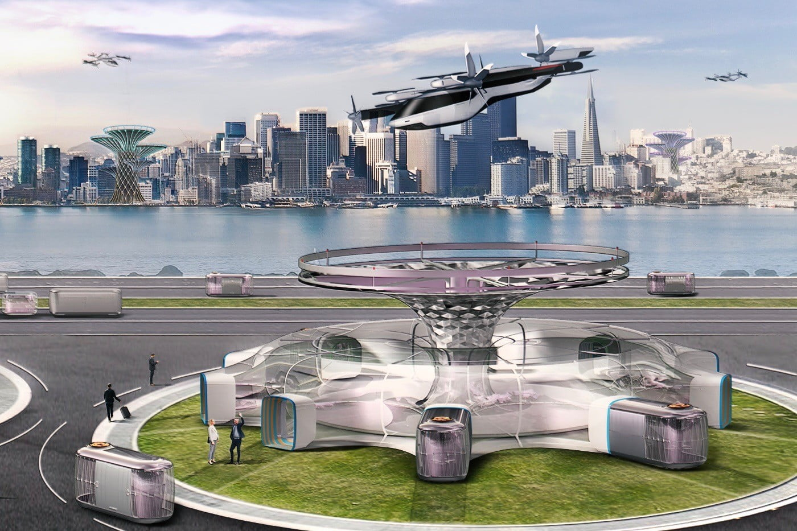
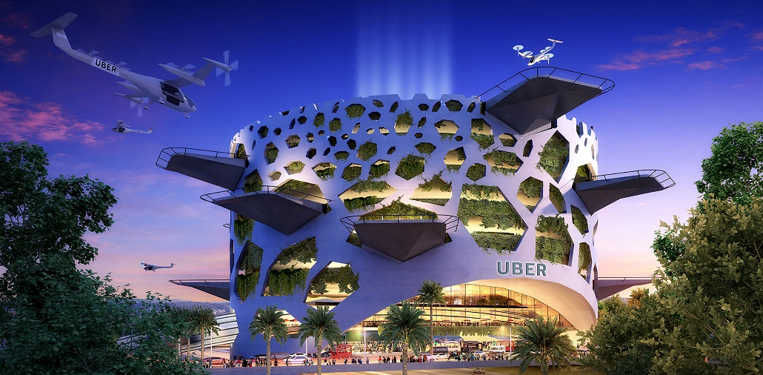
Background
Rideshare (e.g., Uber and Lyft) are forecasting vertical-takeoff-and-landing (VTOL) vehicles that are easier to fly than helicopters in a dedicated (segregated) airspace
On-demand aviation has potential to improve urban mobility (i.e., reduced time for daily commutes)
Niche requirements (e.g., short-range, point-to-point) egress could dictate near-term adoption logistics
Uber Elevate – leading engineers, investors, scientist, and policymakers to realize this future vision
CNN Money, 2020; Edelstein, 2019; Uber Elevate, 2020
2018 paper: (Stewart, 2018)

Slide 11
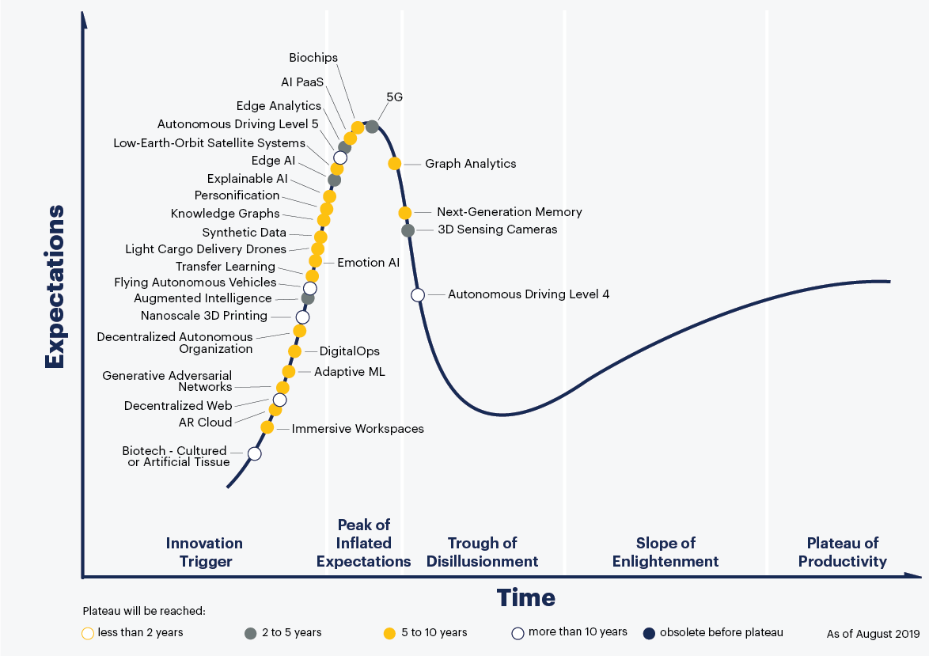
Background
AAM Technology: Hype Cycle
Flying Autonomous Vehicles are representative of a recent “innovation trigger”
That puts them about where self-driving cars were five years ago — and we're still waiting for those to arrive
Projected to achieve an inflated expectation peak sometime within a decade
Panetta, 2019

Slide 12
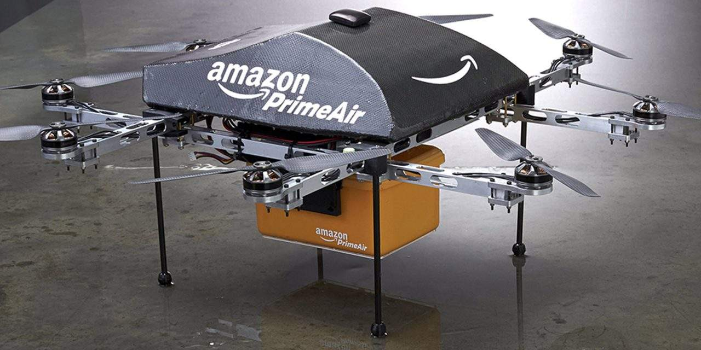
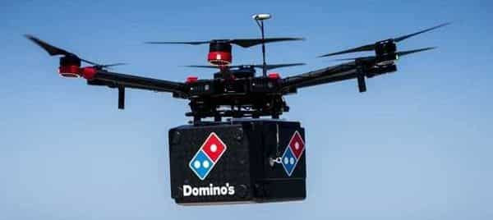
Background
AAM Technology: Market Potential
Projection: $115 billion by 2035; 280,000 employees
Piloted in the early stages; later - autonomous
Likely to start out carrying cargo; passengers later
With lower operating and maintenance costs, VTOLs could be much cheaper than the $9 per mile it costs now to fly on a helicopter — especially once the highly paid pilot is removed
Potential applications: Package (and pizza) deliveries; larger air shuttles hauling merchandise between warehouses, ferrying passengers to the airport; transport of military troops to the battlefield
Muller, 2021

Slide 13
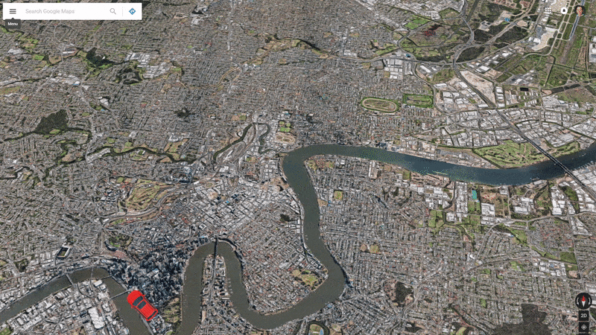
Challenges
Regulatory obstacles associated with AAM that will require cooperative modeling & simulation (M&S) – with I/ITSEC relevance to Policies, Standards, Management, and Acquisition:
Safety: Primary driver for technological viability
Sustainability: Legal standards; economies of scale
Logistics: Staged adoption patterns
Environmental: Energy, emissions, noise
Navigation: VTOL standards, vertiport design/layout
Cybersecurity: Forecasting/ regulating cybercrimes
Lineberger et al., 2018; Milford and Roberts, 2017

Slide 14
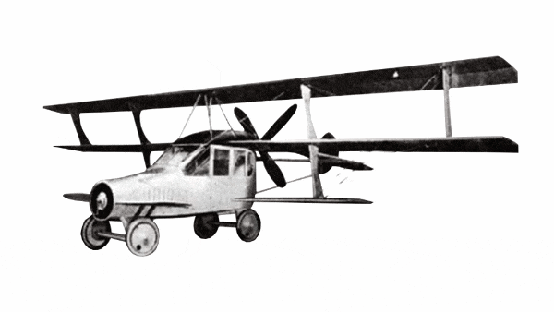
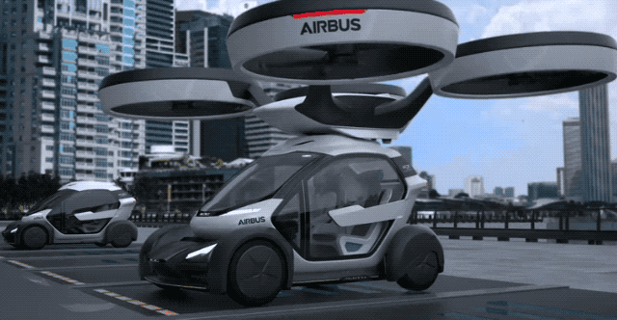
Challenges
Safety: Any publicized adverse safety incidents can taint public perception, and limit consumer acceptance
Flying Cars must have redundancy and safe mode capabilities (i.e., “on-the-fly” decision-making)
Sustainability: Design complexity - speeds that are much faster than standard ground vehicles
Flying Cars will mandate sustainable legal standards (e.g., operation, maintenance, ground/air control)
Etherington, 2017a; Garsten, 2018; Gohd, 2017; Hulme et al., 2019; Soffar, 2018

Slide 15
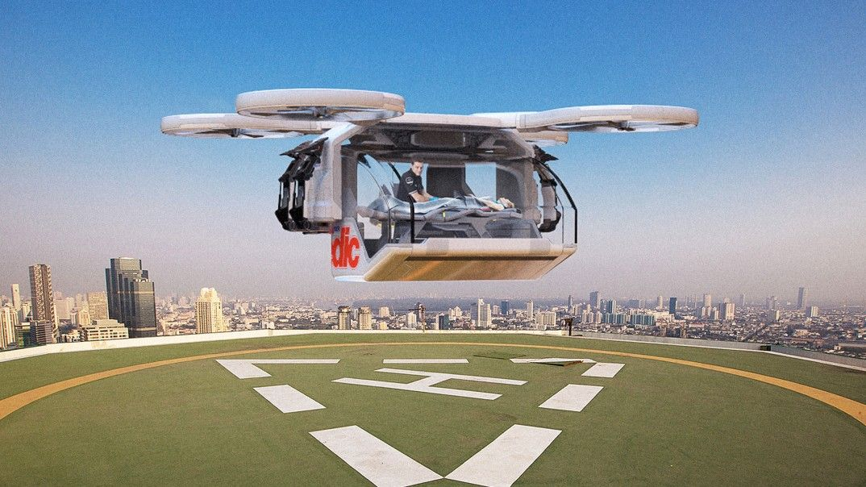
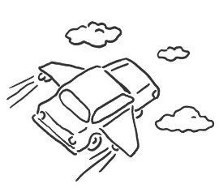
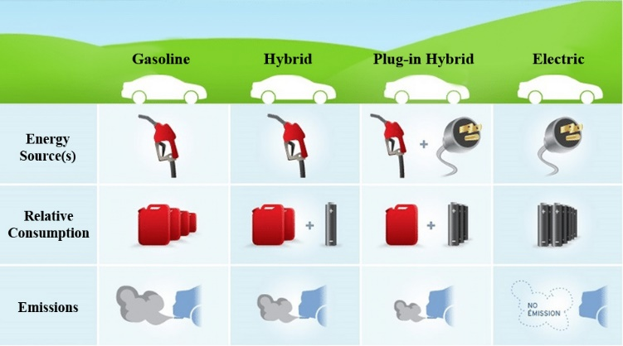
Challenges
Logistics: Staged initial deployment to meet our most critical transportation requirements
Military (e.g., mission critical; National security)
Emergency vehicles (e.g., police, fire, ambulance)
Niche corporations (e.g., Rideshare entities)
Civilians
Environmental: “Green” concerns regarding energy source (e.g., fuel vs. electric), resource consumption, noise ordinances, and emissions will be critical
Flying
Cars?
Adnan et al., (2016); Hulme et al., 2019; Templeton, 2018; Williams, 2020

Slide 16
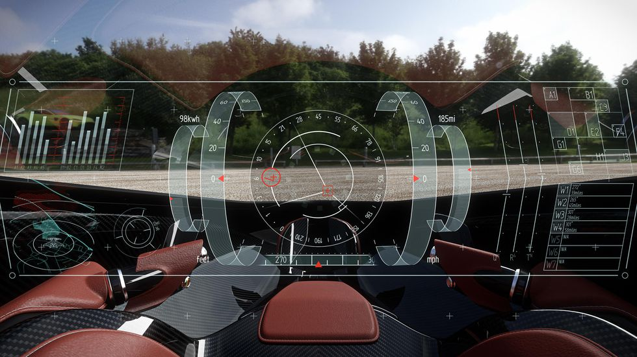
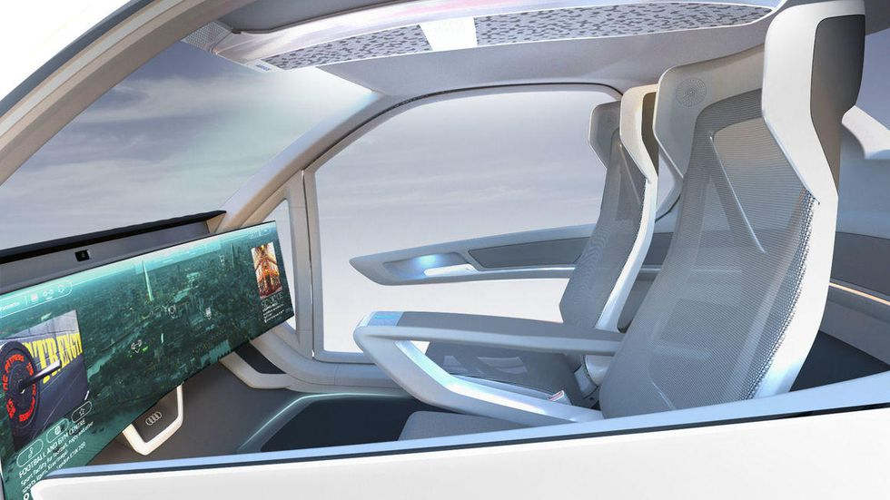
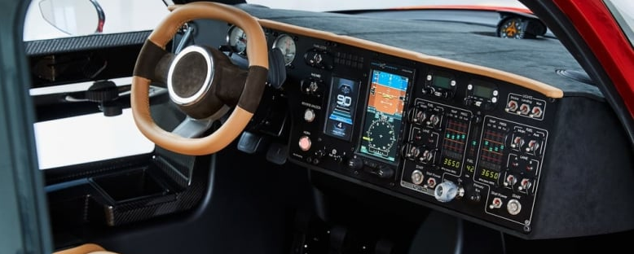
Challenges
Navigation: Heads-Up Display (HUD) requirements
Instead of “floating” intersections, lane markers, and roadway signage – use Augmented Reality to foster 3D “lane changes”, elevation transitions, and turns
Interactions: touch, voice and gesture recognition; head and eye tracking
Krok, 2018; PAL-V, 2020; Paukert, 2018

Slide 17
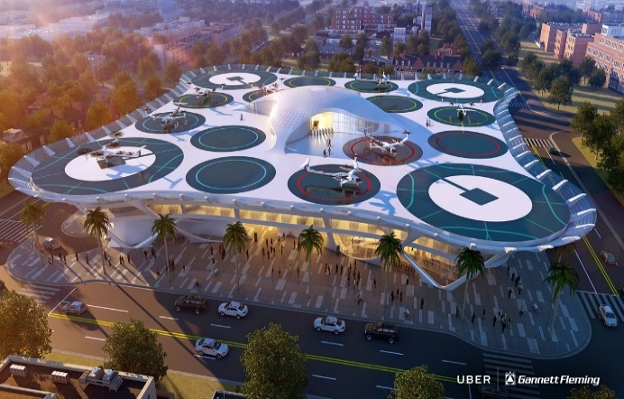
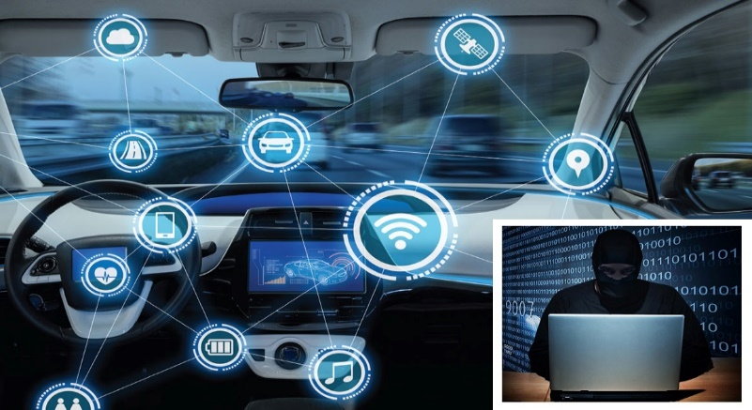
Challenges
Supporting Infrastructure: Safe takeoffs and landings, vehicle storage/parking - “vertiports”
Design/layout will require M&S to guarantee human safety and optimize operational efficiency
Cybersecurity: Protection of Flying Cars from hackers, terrorists, or other “cyber” criminals
Stochastic M&S will enable risk assessment and establishment of countermeasures
Filippidis, 2018; Hulme et al., 2019; Pohkrel and Tsokos, 2017; Ratti, 2017; Woodyat, 2019

Slide 18
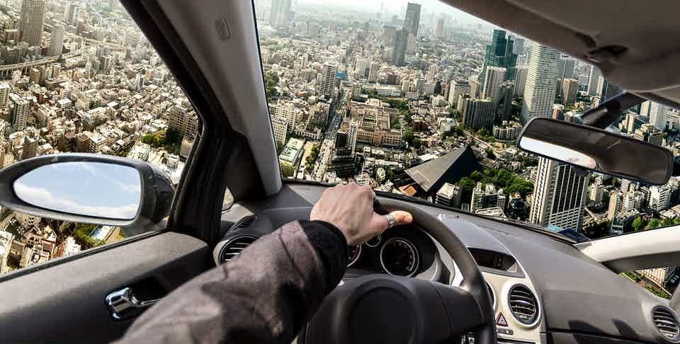

Challenges
Policies, Standards, and Regulations
Will drive technological development and dictate Test, Evaluation, Validation and deployment
M&S (LVC) is essential to establish guidelines for scalability, efficiency, cost-effectiveness, and sustainability as AAM evolves
See I/ITSEC Paper #19140 (Hulme et al.) for more details
Aitken, 2019

Slide 19
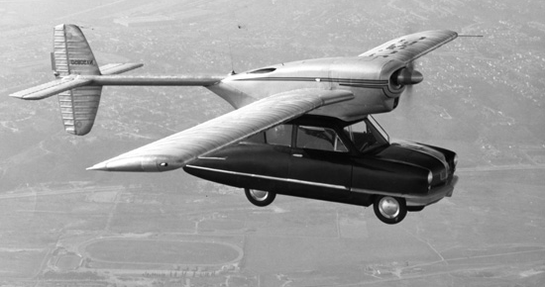
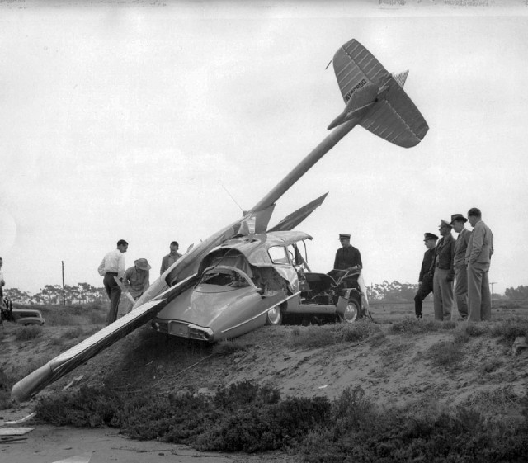
Challenges
AAM and technological sustainability
A cooperative network (within 3D space) will rely heavily on extensive Testing, Experimentation, and Validation
Handoff between manual/autonomous vehicle control
Complex transitions between ground and flight dynamics (e.g., for takeoffs/landings)
Convair Model 116/118 – 1946 precursor to modern day “Flying Cars” (designer: Theodore Hall)
Goran, 2016; Hall, {various}; Apophenia, 2017; Substance, 2016

Slide 20
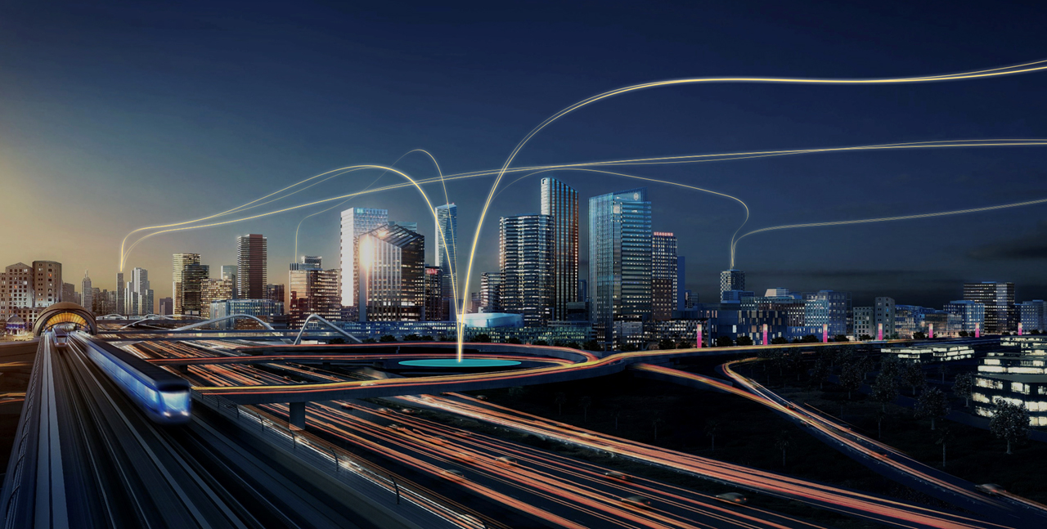
AAM and M&S
Etherington, 2017b
Technological sustenance will necessitate models and simulations (M&S) for testing and validation
Physical Test Beds
Full-scale examination of prototype Flying Car vehicles to improve understanding of interdisciplinary operational challenges
VTOL capabilities - essential to ensure operational feasibility in dense, urban environments where Flying Cars (e.g., Rideshare) are most likely to be transformative

Slide 21
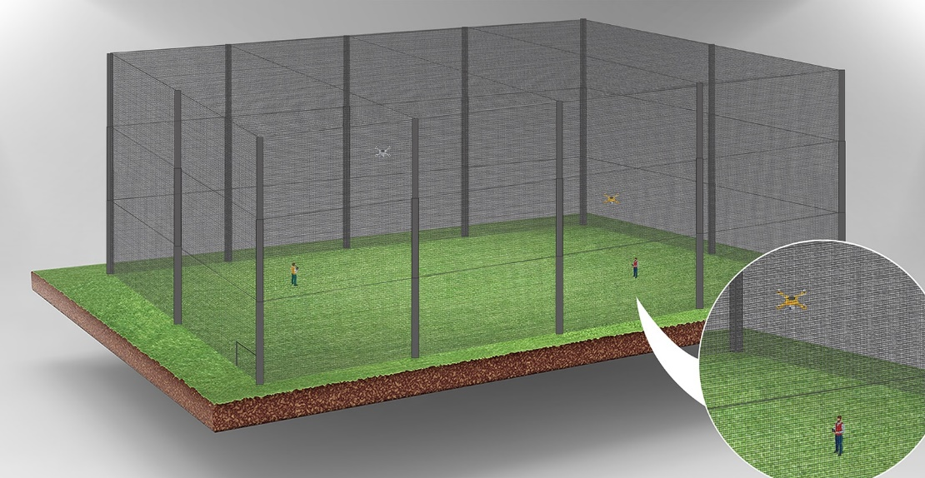
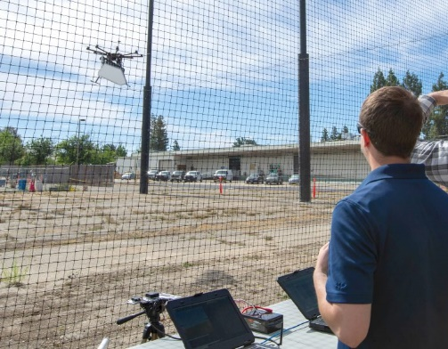
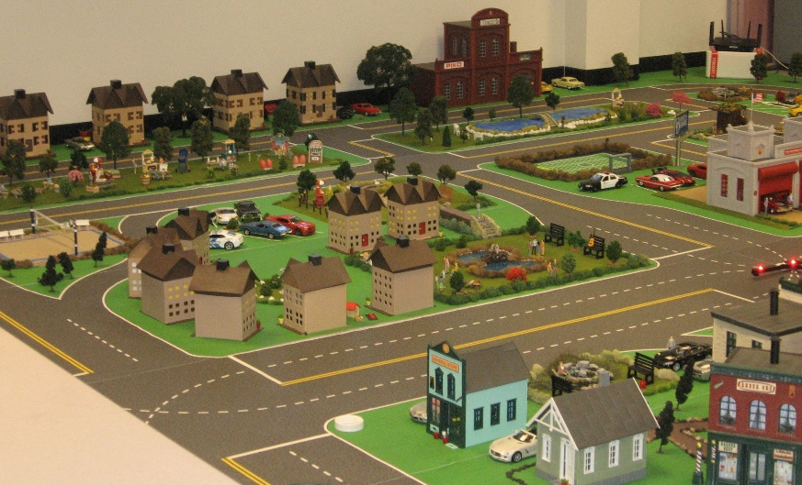
AAM and M&S
Scaled/miniature testing (drones)
Deploy physical enclosures to encapsulate and constrain testing region
Prototype and pre-visualize conceptual urban planning and design
Develop (e.g., cityscapes, heliports, and takeoff/landing zones) at partial-scale
Leverage additive manufacturing for cost-effective model development
GN Administrator, 2020; Nagengast, 2018

Slide 22
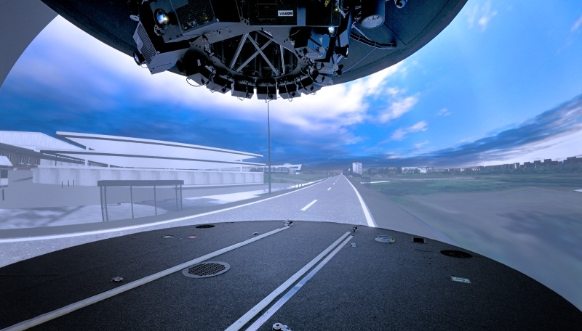
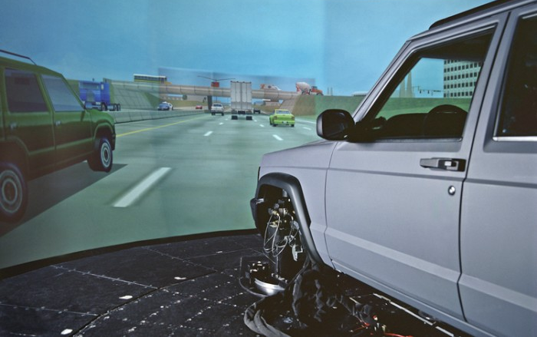
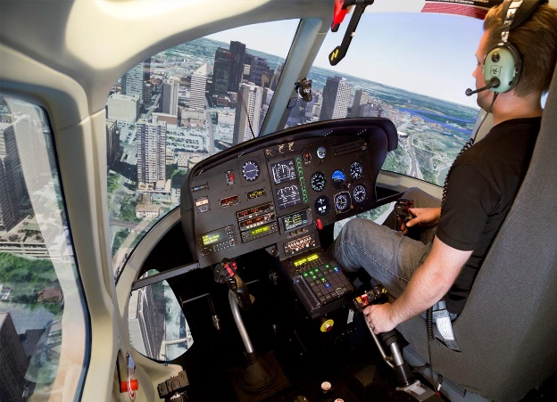
AAM and M&S
Human Factors Simulation
Excursions: both airborne and ground egress - both manual and autonomous
Transition zones (takeoffs/landings) will be most critical during preliminary deployment (when operations are manual)
Simulation will enable assessment of tolerance for the human-machine interface
Digital Projection, 2013; Frasca, 2020; SMAX, 2018

Slide 23
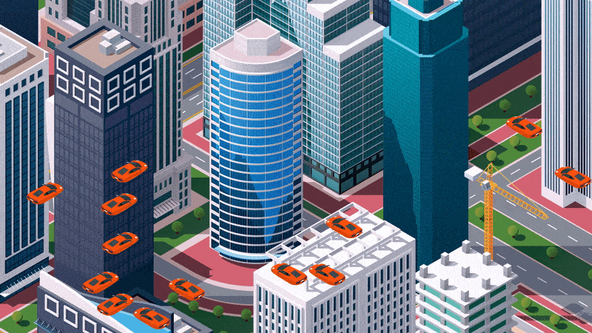
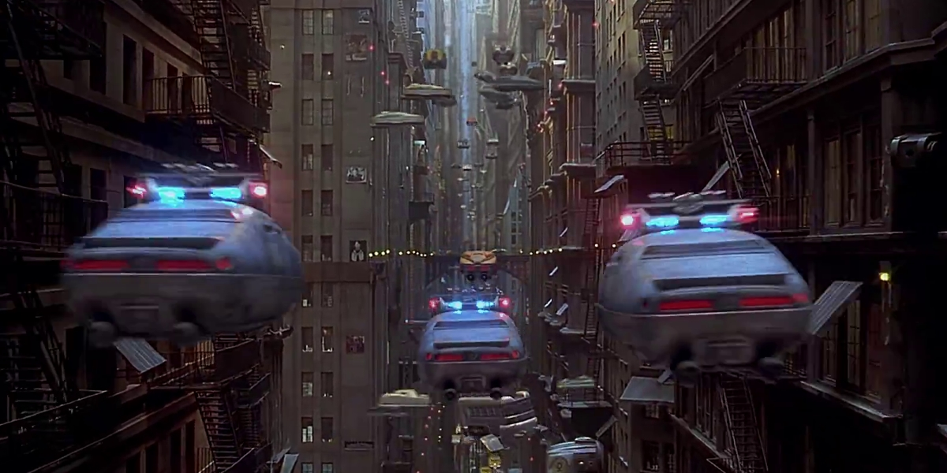
AAM and M&S
3D Traffic (Grid) Models
Leverage and embrace game engine technology (similar to military) to determine Flying Car flight network interoperation
Translate 2D (ground) traffic models to utilize the 3rd dimension of travel (going vertical)
Maximize cooperative flow (e.g., within travel tiers/grids) while guaranteeing safety
Becker, 2017; Bogaisky, 2018; Milford and Roberts, 2017; Simek, 2017

Slide 24
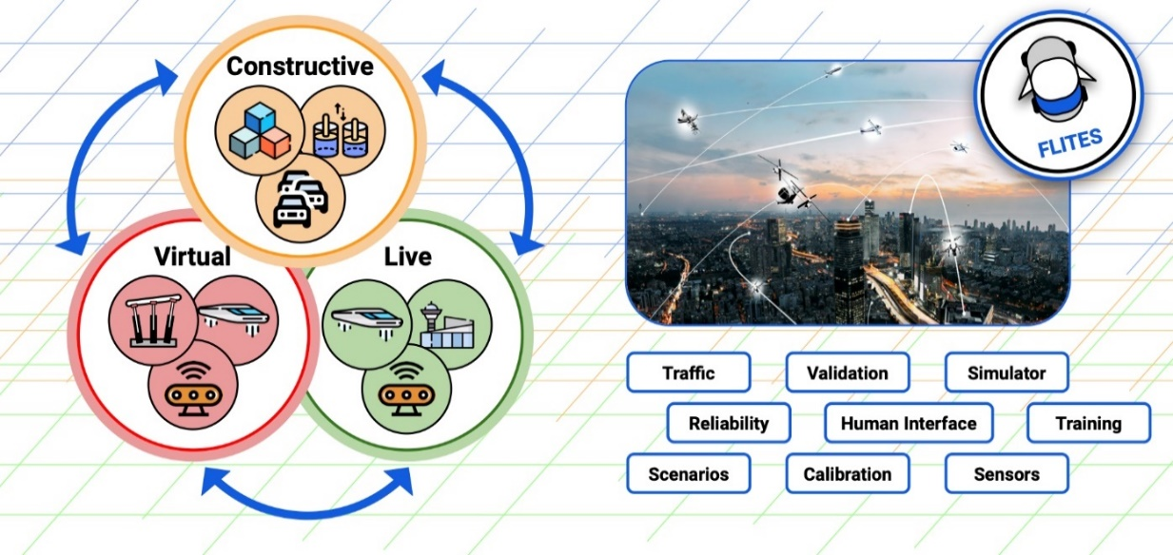
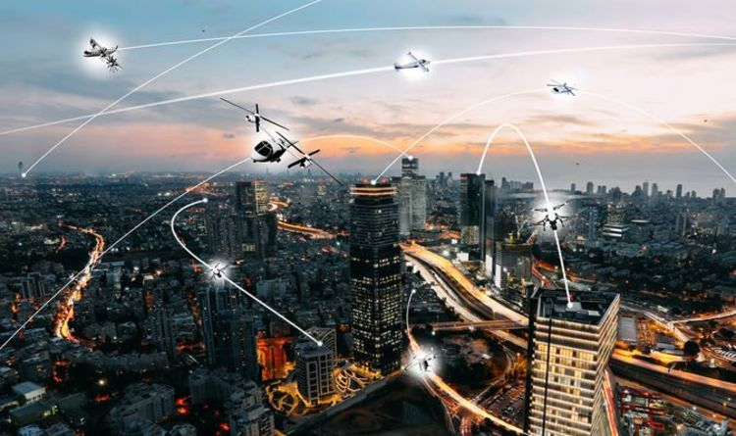
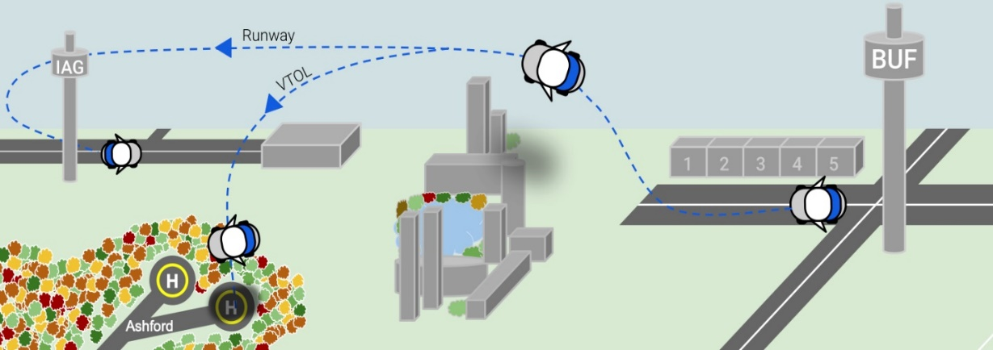
AAM and M&S
Live-Virtual-Constructive (LVC): taxonomy for research, simulation, and training will be essential for Flying Car testing, experimentation, and validation
Live: Partial-scale (UAV/drone) and Full-scale (piloted) testing of Flying Cars within a “physical” environment, with real people AND real systems
Examine Infrastructure and Navigation concerns (e.g., Vertiport layout, geometry, features, and placement to enable takeoffs and landings)
DoD, 1998; Kettley, 2019; Tolk, 2012

Slide 25
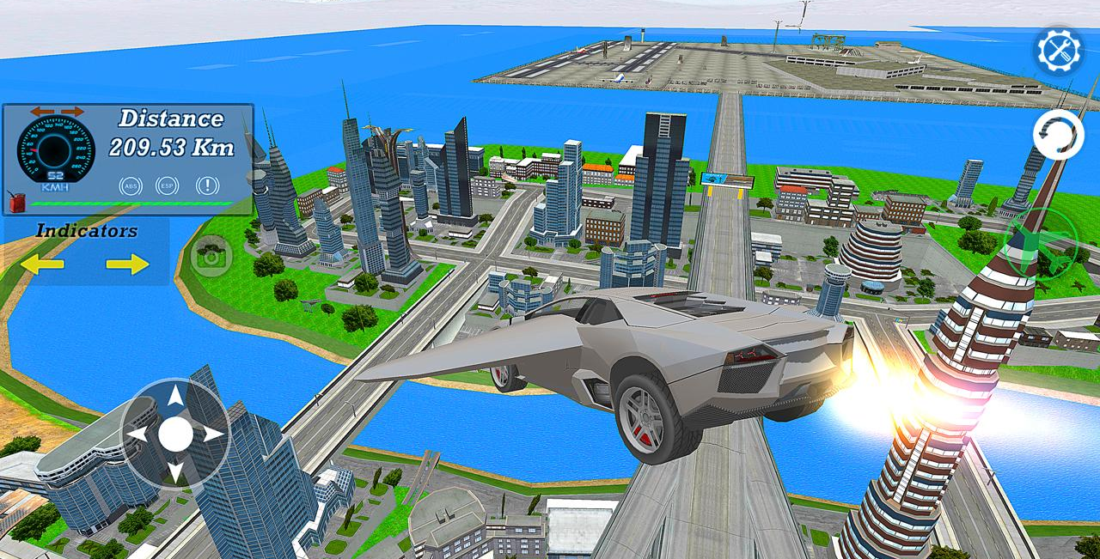
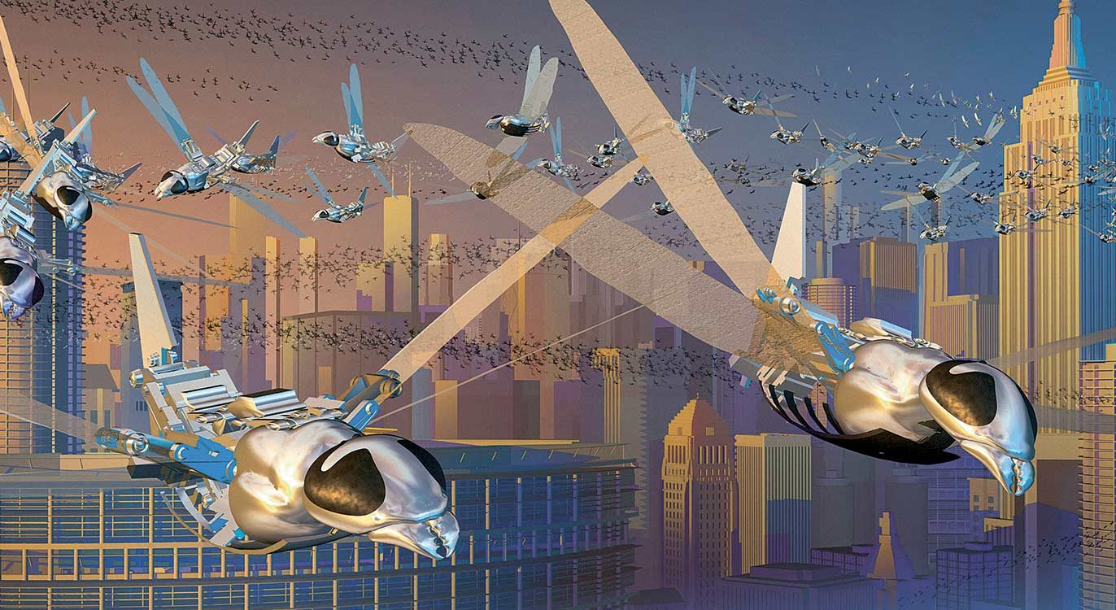
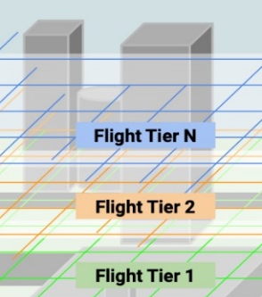
AAM and M&S
Virtual: High-fidelity motion-based Simulation is required with real people and simulated systems
Examine the complex human-machine interface (e.g., transitions between driving/flight modes)
Constructive: Micro-simulations of vehicle egress and interactions with simulated people AND systems
Examine 3rd dimension traffic models (e.g., swarm intelligence, distributed control strategies)
APKFab, 2020; Dantu et al., 2012; EPFL, 2020; Gharibi et al., 2019; Martinoli et al., 2004; Torres, 2012

Slide 26
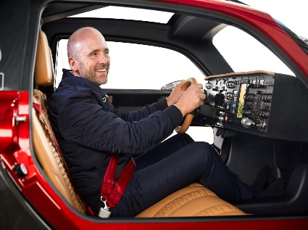
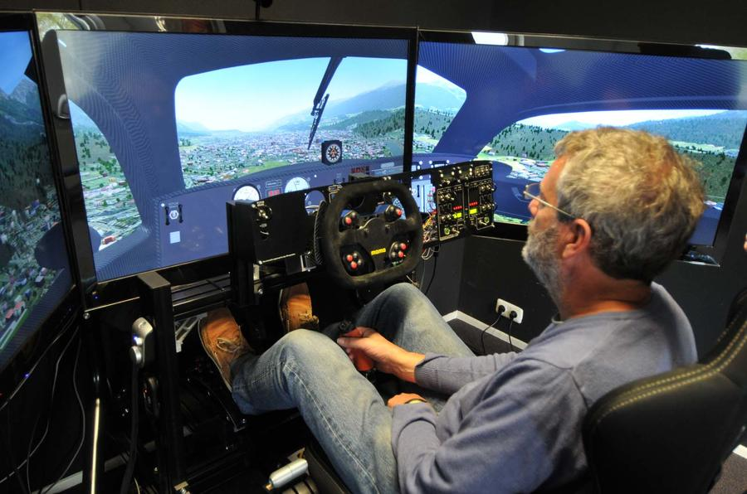
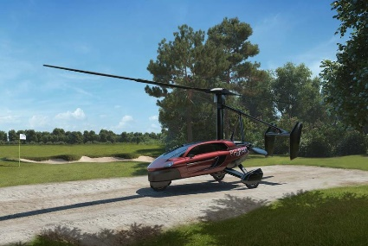



AAM and M&S
Impacts on Training (Military/Civilian)
Operation (Pilot Certification): skilled licensure both to drive and fly
Type Certification: Pilot approval for different (experimental) vehicle types (i.e., Flying Car vs. Driving Plane)
Maintenance: Highly-complex systems with many moving parts and failure points
Goodwin, 2020

Slide 27



AAM and M&S
Flying Cars: Air Force Aims to Turn Science Fiction into Science Fact (National Defense article, July 2020)
USAF Agility Prime initiative (agilityprime.com)
Take-off (like a helicopter), then fly (like an airplane); vertically oriented vehicles that transition to being forward-oriented
Key attributes: electric/hybrid propulsion and electric power source; manned, remote, or autonomous operational capability; VTOL; reduced lifecycle costs
Challenges: legitimate concerns about safety, security and privacy need to be addressed - without public acceptance, commercialization won’t be possible
Harper, 2020

Slide 28

Case Studies
2021 manufacturer status
Urban Air Mobility is a modern-day “disruptor” for end-to-end mobility solutions
Numerous manufacturers are developing Flying Cars, Air Taxis, Passenger Drones
We present a brief sampling of prospective technologies that are currently in development
Airbus, 2018; Hawkins, 2020; McNabb, 2019

Slide 29
Passenger Drone: all unpiloted platforms
Personal Flying Devices: unpiloted platforms designed for private use
Flying Car: unpiloted platforms which also serve as a road-legal car
Air Taxi: unpiloted platforms designed for commercial use in urban areas
VTOL: vertical takeoff and landing (Helipad, vertiport)
STOL: short takeoff and landing (very short runway)
CTOL: conventional takeoff and landing (regular runway)
eVTOL: battery-powered platforms with VTOL capability

Slide 30


Case Studies
2021 manufacturer status:
Opener Backfly: VTOL, single-passenger, eight-rotors, short-range (25-miles), non-urban, daylight-only flight (backed by Google co-founder Larry Page)
Rolls Royce EVTOL: electric VTOL, 5 passengers, turbine-powered (serves as a generator, with six propellers), long-range (500-miles)
Carrillo III, 2018

Slide 31


Case Studies
2021 manufacturer status:
Aston Martin Volante: VTOL, 3 passengers, hybrid-electric power, autonomous flight capable, ultra-sleek form-factor (partnership: Cranfield University, Cranfield Aerospace Solutions, and Rolls-Royce)
Audi/Airbus Pop.Up Next: VTOL quadcopter module companion with a (2 passenger) city car pod – both electric and fully autonomous (dronelike flying taxi & electric city car pairing)
Krok, 2018; Paukert, 2018

Slide 32


Case Studies
2021 manufacturer status:
Terrafugia TF-X: VTOL (requires 100 ft. diameter clearing), hybrid electric vehicle, 4 passenger, operates on unleaded fuel that will power electric motor pods; long 500 mile range (in cooperation with Volvo)
PAL-V Liberty Pioneer: STOL gyrocopter, dual-engine vehicle (100/200hp, w/ unleaded fuel), 2 passenger, 250-mile range, ~7 gallon/hour (fuel economy)
Hyatt, 2018; PAL-V, 2020; Starr, 2015

Slide 33


Case Studies
Human-machine Interface:
As technologies proceed, we must forecast our relationship with Flying Cars
Exploratory (N=692) surveys investigate the Human Factors associated with Flying Cars
We present a brief sampling of results which will influence future policies and regulations
Bennes, 2020; Kirschner, 2019

Slide 34


Case Studies
Human Factors – preliminary (self-report) results
Benefits vs. Concerns
Future adoption is directly associated with individual perceptions of benefits and concerns
Benefits: reduced travel time, and increased travel reliability (e.g., reduced traffic)
Concerns: most apprehensive about weather, and interactions with other vehicles
Eker et al., 2019; Hulme et al., 2019; Washington et al., 2020

Slide 35



Case Studies
Human Factors – preliminary (self-report) results
Use Cases
Activity: most often for entertainment and work
Duration: desire trips of LONGER duration
Time-of-day: more likely to use during daylight

Slide 36


Case Studies
Human Factors – preliminary (self-report) results
Willingness to Acquire/Hire
Bleeding-edge technologies tend to be expensive once initially deployed (e.g., automobiles, personal computers)
Willingness to pay for personal use: interest declines sharply with increased fiscal commitment (beyond $100k)
Willingness to hire (shared mobility services): need to establish further trust in automation

Slide 37


Case Studies
Human Factors – preliminary (self-report) results
Rate Expectations
Flying Car Rideshare is expected to cost more than ground-based travel
Humans willing to pay slightly more than current (ground) rates (per mile of travel)
Current threshold for tolerated increase is slight – i.e., a “few dollars more” per mile
Refer to 4th-order polynomial “trend line”
Kučírková, 2019

Slide 38

Case Studies
Testing & Experimentation (T&E):
Constructive experimentation will enable preliminary exploration of forecasted interactions between humans, vehicles, and infrastructure
Virtual evaluation will serve as a preliminary point-of-entry to advise vehicle operational traits
Live prototyping (both partial- and full-scale) will be necessary to emulate forecasted transport modes
We now present an overview of (T&E) that will directly enable (human factors, technological) evaluations
Ma, 2019

Slide 39

Case Studies
Testing & Experimentation (T&E): Proposed Instrument to advance Flying Car sustainability
LVC - Primary components:
  Live (physical) Flying Car testing framework
  Virtual high-fidelity Simulator
  Constructive 3D traffic flows
Measures:
  Driver/pilot behavior
  Cognition/physiological response
Outcomes:
  Policies and Standards
  Environment/infrastructure impacts
  Training requirements

Slide 40

Case Studies
Structure for Outdoor Autonomy Research (SOAR)
Enclosed test facility for drones, quadcopters, and other UAVs
Will directly enable Live testing involving real people operating real systems
Tethered full-sized experimentation of basic vehicle maneuvers (e.g., eVTOL)
Scaled-down (miniature) aviation vehicles and ground infrastructure

Slide 41





Case Studies
Virtual Campus for hybrid vehicle simulation
Through support from EPIC Games, we are developing a virtual campus for (hybrid) ground and flight vehicle testing
Virtual evaluation involving real people operating simulated systems
Real-time M&S for evaluation and assessment of human factors and human-machine interaction

Slide 42



Case Studies
Orlando regional relevance – tourism!
Lake Nona “vertiport” planned for 2025
First-of-its-kind in the United States
All-electric, five-seat vertical takeoff aircraft
Flight range: 186 miles within one hour of charging up
Moyer, 2020

Slide 43

Summary and Next Steps
AAM - the Transportation Network of Tomorrow
M&S will pervade development of emergent Flying Car capabilities and requirements for actionable regulations and governance
Technological sustenance will mandate the LVC taxonomy for testing, evaluation, and validation
Overarching disciplinary impacts upon the foundational pillars of I/ITSEC: Training, Simulation, and Education
dezeen, 2021

Slide 44


Summary and Next Steps
“Innovating and Accelerating Training – Adapting to an Unexpected Future”
Flying Cars – an evolving, disruptive technology that is representative of the “changing face” of human transportation - through emerging practices in planning, technology and policy
In this Tutorial, we explored ongoing challenges, key M&S inter-relationships, and a series of technology-based “Case Studies” that are illustrative of the current state-of-the-art
Borroz, 2020; Feltman, 2013

Slide 45



Summary and Next Steps
Verification, Validation, & Accreditation (VV&A)
M&S for new/innovative technologies rely on credible assumptions for LVC testing
VV&A is intended to:
  Ensure that only correct and suitable results are used
  Facilitate risk management within the training domain
Rigorous VV&A is critical for examining “experimental” vehicles (e.g., Flying Cars)
Verification: is the model right?
Validation: is it the right model?
Accreditation: formal certification
Ma, 2019; Masys et al., 2006; Ram, 2019; Wang et al., 2019

Slide 46
Summary and Next Steps
Confirm satisfaction of Learning Objectives
Identify: the current state-of-the-art with Flying Car technologies
Summarize: transportation challenges that mandate societal change and evolution
Apply: LVC fundamentals to enable sustenance and sustainability of Flying Car technologies
Analyze: timely Case Studies to assess associated technological and human factors impacts
Evaluate: to forecast next steps to leverage M&S in this emergent domain of interest
* (Advised by Bloom’s Taxonomy and I/ITSEC relevance)
Bloom, 2020

Slide 47

Bibliography (A-D)
Adnan et al., (2016). “A comprehensive review on theoretical framework-based electric vehicle consumer adoption research”, International Journal of Energy Research, https://doi.org/10.1002/er.3640
Apophenia, (2017). “Southern Aircraft Corporation Post-War Aircraft”, Secret Projects, https://www.secretprojects.co.uk/threads/southern-aircraft-corporation-post-war-aircraft.28615/
Airbus, (2018). “Innovation: Urban Air Mobility – the sky is yours”, Airbus.com, https://www.airbus.com/newsroom/stories/urban-air-mobility-the-sky-is-yours.html
Aitken, J., (2019). “Flying cars: automating the skies means playing with our lives”, The Conversation, https://theconversation.com/flying-cars-automating-the-skies-means-playing-with-our-lives-115102
AlphaMecha, (2012). “Metropolis of Tomorrow”, Tumblr, https://metropolisoftomorrow.tumblr.com/post/29484115444/via-hyperuniverse
APKFab, (2020). “Real Flying Car Simulator Driver”, APKFab, https://apkfab.com/real-flying-car-simulator-driver/com.BestGames.FlyingCarSimulatorDriver
Basford, S., (2017). “Uber Wants to Introduce Flying Cars in Two Cities By 2020”, Student Edge, https://studentedge.org/article/uber-wants-to-introduce-flying-cars-in-two-cities-by-2020
Becker, E.P., (2017). “Automotive Tribology”, Tribology and Lubrication Technology, http://digitaleditions.walsworthprintgroup.com/publication/?i=424345&article_id=2835021&view=articleBrowser&ver=html5
Bennes, L., (2020). “The Remarkable HMIs of Futuristic Cockpit Designs”, ANSYS blog, https://www.ansys.com/blog/hmi-futuristic-cockpit-design
Bloom, B., (2020). “Bloom’s Taxonomy (image)”, pngkit.com, https://www.pngkit.com/bigpic/u2e6a9y3r5i1i1r5/
Bogaisky, J., (2018). “Your Flying Car May Be Almost Here”, Forbes.com, https://www.forbes.com/sites/jeremybogaisky/2018/05/24/your-flying-car-is-almost-here/#473eb37e5724
Borroz, T., (2020). “Blade Runner & Flying Cars: Did They Get Anything Right?”, AutomoBlog, https://www.automoblog.net/2019/11/04/blade-runner-flying-cars/
Carillo III, M., (2018). “Automakers, aerospace and startups are banking on a 'flying car' future”, Road|Show by Cnet, https://www.cnet.com/roadshow/news/flying-car-vtol-roundup/
CNN Business, (2019). “Fly inside Uber's new air taxi cabin”, CNN Business, https://www.cnn.com/videos/business/2019/06/11/uber-air-taxi-cabin-design-orig.cnn-business
CNN Money, (2020). “Uber unveils flying car prototype”, CNN Money, https://www.cnn.com/videos/cnnmoney/2018/05/08/uber-flying-car-prototype-orig-cnnmoney.cnnmoney
Dante 3d dev, (2018). “The Legacy MX-1 Concept Art”, Twitter, https://twitter.com/dantemendes/status/948330773941309442
Dantu et al., (2012). “A Comparison of Deterministic and Stochastic Approaches for Allocating Spatially Dependent Tasks in Micro-Aerial Vehicle Collectives”, IEEE International Workshop on Intelligent Robots and Systems (IROS), https://doi.org/10.1109/IROS19467.2012
Davies, C., (2012). “NASA weighing $1.5m autonomous drone challenge: Jetsons cars ahoy!”, Slash Gear, https://www.slashgear.com/nasa-weighing-1-5m-autonomous-drone-challenge-jetsons-cars-ahoy-18252613/
Del Balzo, J., (2015). “Cars That Can Fly Will Challenge The FAA As To Certification & Operation!!!”, JDA Journal, http://jdasolutions.aero/blog/flying-cars-will-challenge-the-faa/

Slide 48
Bibliography (D-G)
Digital Projection, (2013). (curved-screen driving simulator – product image), Digital Projection, https://digitalprojection.com/wp-content/uploads/2013/12/NADS1_1-700x530.jpg
DoD, (1998). “Department of Defense - M&S Glossary”, DoD, http://www.acqnotes.com/Attachments/DoD%205000.59-M%20DoD%20Modeling%20and%20Simulation%20Glossary.pdf
Donatelli, M., (2008). “Modeling in Science – flowchart (image)”, Wikipedia, https://commons.wikimedia.org/w/index.php?curid=29967075
Doty, S.R., (2017). ““Believe the unbelievable”: Exercise NORTHERN EDGE 17 enhances interoperability with Live, Virtual, Constructive training”, Pacific Air Forces, https://www.pacaf.af.mil/News/Article-Display/Article/1176863/believe-the-unbelievable-exercise-northern-edge-17-enhances-interoperability-wi/
Edelstein, S., (2019). “Hyundai’s flying car program will take off at CES 2020 with concept vehicle”, Digital Trends, https://www.digitaltrends.com/cars/hyundai-flying-car-concept-ces-2020/
Eker et al., (2019). “An Exploratory Investigation of Public Perceptions towards Key Benefits and Concerns from the Future Use of Flying Cars”, Transportation Research Board (TRB), https://pubsindex.trb.org/view/2019/C/1572286
EPFL, (2020). “Aerial Robotics”, EPFL, https://www.epfl.ch/labs/lis/research/aerial-robotics/
Etherington, D., (2017a). “Airbus reveals a modular, self-piloting flying car concept”, Tech Crunch, https://techcrunch.com/2017/03/07/airbus-reveals-a-modular-self-piloting-flying-car-concept/
Etherington, D., (2017b). “Uber targets 2020 for on-demand VTOL demo flights in Dallas and Dubai”, Tech Crunch, https://techcrunch.com/2017/04/25/uber-targets-2020-for-on-demand-vtol-demo-flights-in-dallas-and-dubai/
Feltman, R., (2013). “Why Don't We Have Flying Cars?”, Popular Mechanics, https://www.popularmechanics.com/flight/a8680/why-dont-we-have-flying-cars-15128771/
Filippidis, K., (2018). “Uber's 'Skyport' plans are straight out of science fiction”, engadget, https://www.engadget.com/2018/05/10/uber-skyport-concept-air-taxi/
Frasca, (2020). “Global Medical Response to Acquire Two FRASCA Helicopter FTDs”, Frasca Flight Simulation, https://www.frasca.com/global-medical-response-to-acquire-two-frasca-helicopter-ftds/
Garsten, E., (2018). “Uber Resumes Autonomous Testing On Public Roads Months After Fatal Accident”, Forbes.com, https://www.forbes.com/sites/edgarsten/2018/12/21/uber-resumes-autonomous-testing-on-public-roads-months-after-fatal-accident/#45bf13cf6422
Garud-Barna, S., (2020). “Urban Air Mobility (UAM) Simulation”, NASA, https://www.nasa.gov/simlabs/uam
Gaudette, E., (2017). “Blade Runner: How Close Are We to Flying Cars and Replicants?”, Newsweek, https://www.newsweek.com/blade-runner-review-ai-flying-cars-elon-musk-678621
Gharibi et al., (2019). “3D traffic flow model for UAVs”, arXiv:1909.04838v1, https://arxiv.org/abs/1909.04838

Slide 49
Bibliography (G-L)
Gipson, L., (2021). “Advanced Air Mobility Mission Overview”, NASA, https://www.nasa.gov/aam
Gohd, C., (2017). “How Close Are We Really to Flying Cars? More importantly, are they even practical?”, Futurism, https://futurism.com/how-close-are-we-really-to-flying-cars
Goodwin, C., (2020). “Pal-V Liberty: exploring a flying car”, Autocar, https://www.autocar.co.uk/car-news/features/pal-v-liberty-exploring-flying-car
Goran, D., (2016). “The Convair Model 116/118, a flying car prototype which managed 66 test flights as a prototype but never made it into mass production”, The Vintage News, https://www.thevintagenews.com/2016/04/22/convair-model-116118-flying-car-prototype-managed-66-test-flights-prototype-never-made-mass-production/
GN Administrator, (2020). “Drone enclosures keep drones contained for research and development, or pilot training”, Gorilla Netting, https://www.gorillanetting.com/news/drone-netting-enclosures-keep-drones-contained-for-research-and-development-or-pilot-training/
Grady, M., (2017). “Airbus Unveils a Flying Car Concept”, Robb Report, https://robbreport.com/motors/aviation/airbus-unveils-flying-car-concept-265887/
Hall, T.P., (various). “The Descriptive Finding Guide for the Theodore P. Hall Personal Papers SDASM.SC.10061.O/S”, Online Archive of California, https://oac.cdlib.org/findaid/ark:/13030/c8xp79dj/entire_text/
Harper, J., (2020). “Flying Cars: Air Force Aims to Turn Science Fiction into Science Fact”, National Defense, https://www.nationaldefensemagazine.org/articles/2020/7/6/air-force-aims-to-turn-science-fiction-into-science-fact
Hawkins, A.J., (2020). “Hyundai will make flying cars for Uber’s air taxi service”, The Verge, https://www.theverge.com/2020/1/6/21048373/hyundai-flying-car-uber-air-taxi-ces-2020
Hulme et al., (2019). “The Flying Car - Emergent Modeling & Simulation (M&S) Policies and Standards concerns”, NTSA / I/ITSEC 2019 Conference, https://www.xcdsystem.com/iitsec/proceedings/index.cfm?AbID=26604&CID=48
Hyatt, K. (2018). “Pal-V Liberty flying car is defined by what it isn’t”, Road|Show by cnet, https://www.cnet.com/pictures/pal-v-liberty-flying-car-geneva-gallery/
ItalDesign, (2018). “Pop.Up Next 2018 (by ItalDesign)”, Youtube, https://www.youtube.com/watch?v=2LggHhR2kFk
Kettley, S., (2019). “NASA news: Space agency and Uber team-up to develop 'a new future' of flying cars”, Express UK, https://www.express.co.uk/news/science/1187534/NASA-news-flying-cars-Uber-Urban-Air-Mobility-flying-taxis-NASA-drones
Kirschner, M., (2019). “Dude, Where’s My Autonomous Car?”, Semiconductor Engineering, https://semiengineering.com/dude-wheres-my-autonomous-car/
Krok, A., (2018). “Slice through the sky in luxury in the Aston Martin Volante Vision”, Road|Show by cnet, https://www.cnet.com/pictures/aston-martin-volante-vision-flying-car-concept/
Kučírková, A., (2019). “Flight of Fancy: Flying Cars and the Future of Transportation”, Part Catalog, https://www.partcatalog.com/page/flying-cars
Lineberger et al., (2018). “Elevating the future of mobility - Passenger drones and flying cars”, Deloitte, https://www2.deloitte.com/us/en/insights/focus/future-of-mobility/passenger-drones-flying-cars.html?icid=dcom_promo_featured|bm;en

Slide 50
Bibliography (M-R)
Ma, J., (2019). “New Japanese Flying Car gets off the Ground for about a Minute”, Bloomberg, https://www.bloomberg.com/news/articles/2019-08-05/new-japanese-flying-car-gets-off-the-ground-for-about-a-minute
Martinoli et al., (2004). “Modeling Swarm Robotic Systems: a Case Study in Collaborative Distributed Manipulation”, The International Journal of Robotics Research, https://doi.org/10.1177/0278364904042197
Masys et al., (2006). “Verification, Validation and Accreditation (VV&A)-Leveraging International Initiatives”, Meeting
Proceedings RTO-MP-MSG-045, https://www.researchgate.net/publication/228678599_Verification_Validation_and_Accreditation_VVA-Leveraging_International_Initiatives
McNabb, M., (2019). “DRONEII: Flying Cars, Air Taxis, and eVTOLs -the Varieties and Specifications of Passenger Drones”, drone life, https://dronelife.com/2019/11/19/flying-cars-air-taxis-and-evtols-the-varieties-and-specifications-of-passenger-drones/
Milford and Roberts, (2017). “The Future of Flying Cars: Science Fact or Science Fiction?”, Real Clear Science, https://www.realclearscience.com/articles/2017/05/08/the_future_of_flying_cars_science_fact_or_science_fiction_110272.html
Moyer, M., (2020). “Flying cars in Orlando? The first U.S. 'air taxi' hub is coming to Lake Nona by 2025”, Orlando Weekly, https://www.orlandoweekly.com/Blogs/archives/2020/11/11/flying-taxis-and-the-first-us-vertiport-are-coming-to-lake-nona-by-2025
Muller, J., (2021). “Transportation's next big thing: flying taxis”, Axios, https://www.axios.com/transportations-next-big-thing-flying-taxis-4f6653cf-e847-4333-8962-3ac08cb80143.html
Nagengast, L., (2018). “UD researchers look at creating “smart cities” for driverless cars”, Delaware Public Media, https://www.delawarepublic.org/post/ud-researchers-look-creating-smart-cities-driverless-cars
Nake, B., (2019). “Disruptive Technologies in Procurement – Is the Change Coming?”, EYVO, https://www.e-procurement.com/disruption-in-procurement/
PAL-V, (2020). “Explore the PAL-V (Liberty)”, PAL-V, https://www.pal-v.com/en/explore-pal-v
Panetta, K., (2019). “5 Trends Appear on the Gartner Hype Cycle for Emerging Technologies, 2019”, Smarter with Gartner, https://www.gartner.com/smarterwithgartner/5-trends-appear-on-the-gartner-hype-cycle-for-emerging-technologies-2019/
Paukert, C. (2018). “Audi and Airbus present mind-blowing flying drone-car hybrid in Geneva”, Road|Show by cnet, https://www.cnet.com/pictures/audi-airbus-flying-drone-car-hybrid-geneva-auto-show/
Pohkrel and Tsokos, (2017). “Cybersecurity: A Stochastic Predictive Model to Determine Overall Network Security Risk Using Markovian Process”, Journal of Information Security, https://file.scirp.org/pdf/JIS_2017042817330706.pdf
Ram, B.S., (2019). “Ministry says RM20 million not for flying car project”, New Straits Times, https://www.nst.com.my/news/nation/2019/11/543058/ministry-says-rm20-million-not-flying-car-project

Slide 51
Bibliography (R-Z)
Ratti, C., (2017). “Flying cars are impractical and unnecessary. Here's why”, World Economic Forum, https://www.weforum.org/agenda/2017/11/heres-why-policy-makers-need-to-think-twice-about-flying-cars
Ravenscroft, T., (2021). “Flying cars will be in cities by 2030 says Hyundai chief”, dezeen, https://www.dezeen.com/2021/06/30/flying-cars-hyundai-2030-michael-cole/
Rodriguez, C. (2017). “Flying Cars Take Off And Are Set For Sale For Up To $1.6 Million”, Forbes.com, https://www.forbes.com/sites/ceciliarodriguez/2017/04/23/flying-cars-take-off-and-are-set-for-sale-for-up-to-1-6-million/#7a0a1c284dc1
Rufford, N., (2017). “Will Flying Cars Ever Take Off?”, The Sunday Times – Driving, https://www.driving.co.uk/news/features/will-flying-cars-ever-take-off/
Sigal, P., (2014). “Flying cars: Sky’s the limit but why has the concept not achieved take-off?”, The Irish Times, https://www.irishtimes.com/business/flying-cars-sky-s-the-limit-but-why-has-the-concept-not-achieved-take-off-1.1912030
Simek, P., (2017). “We Live in the Future: Dallas and the Flying Car”, D Magazine, https://www.dmagazine.com/frontburner/2017/04/we-now-live-in-the-future-dallas-and-the-flying-car/
SMAX, (2018). “180°/ 220°/ 360° Large Curved Projector Screen Flight Simulation Projection”, SMAX (product link), http://www.smaxscreen.com/180-220-360-Large-Curved-Projector-Screen-Flight-Simultaion-Projection-pd6351779.html
Soffar, H., (2018). “Future Flying cars advantages, disadvantages, design, types & developments”, Online Sciences, https://www.online-sciences.com/robotics/future-flying-cars-advantages-disadvantages-design-types-developments/
Starr, M., (2015). “Terrafugia unveils new TF-X flying-car design”, Road|Show by cnet, https://www.cnet.com/roadshow/news/terrafugia-unveils-new-tf-x-flying-car-design/
Substance, (2016). “Flying Cars: Models of the 40s”, Substance, https://substance.etsmtl.ca/en/flying-cars-models-40s
Templeton, B., (2018). “The Flying car -- and Flying Ambulance -- is closer than we thought”, Brad Ideas, https://ideas.4brad.com/flying-car-and-flying-ambulance-closer-we-thought
Tolk, A., (2012). “Engineering Principles of Combat Modeling and Distributed Simulation”, John Wiley & Sons, https://onlinelibrary.wiley.com/doi/book/10.1002/9781118180310
Torres, S., (2012). “Swarm Theory Applied To Air Traffic Flow Management”, Procedia Computer Science, https://doi.org/10.1016/j.procs.2012.09.105
Uber Elevate, (2020). “The Future of Urban Mobility”, Uber, https://www.uber.com/us/en/elevate/
Wang et al., (2019). “A survey on VV&A of large-scale simulations”, International Journal of Crowd Science, https://doi.org/10.1108/IJCS-01-2019-0004
Washington et al., (2020). “Statistical and Econometric Methods for Transportation Data Analysis”, CRC Press, https://sites.google.com/view/statecon3e
Williams, M., (2020). “The Evolution of UAVs: The Ambulance Drone”, hero^{x}, https://www.herox.com/blog/189-the-evolution-of-uavs-the-ambulance-drone
Woodyat, A., (2019). “Paris planning flying taxis by 2024”, CNN Travel, https://www.cnn.com/travel/article/paris-flying-taxi-olympics-intl-scli/index.html

Slide 52
I/ITSEC Tutorial Relevance Matrix
Topic | EDU | TRNG | SIM | HPAE | ECIT | PSMA | M&S | LVC
Advanced Air Mobility (AAM): safe development of an air transportation system that moves people and cargo between locations underserved by aviation | ✓ | ✓ | ✓ | ✓ | ✓ | ✓ | ✓ | ✓
Regulatory Changes & Obstacles |  |  |  | ✓ |  | ✓
Pilot Certification | ✓ | ✓ | ✓ | ✓ |  | ✓ | ✓ | ✓
Forecasting Use and Relationship with the Technology |  |  | ✓ | ✓ | ✓ |  | ✓
Aircraft/vehicle Design Complexity |  |  | ✓ |  | ✓ |  | ✓
Military Innovation Projects (i.e., USAF Agility Prime initiative ) | ✓ | ✓ | ✓ | ✓ | ✓ | ✓ | ✓ | ✓
Technology Testing and Experimentation |  |  | ✓ | ✓ | ✓ |  | ✓ | ✓
Verification, Validation, & Accreditation (VV&A) |  |  | ✓ | ✓ | ✓ |  | ✓ | ✓

Slide 53

Acknowledgements and Q/A
Moog, Inc. (East Aurora, NY) for their ongoing technical and financial assistance, and support for innovative simulation applications
The University at Buffalo Stephen Still Institute for Sustainable Transportation and Logistics (SSISTL)
Thank you!
Kevin F. Hulme, Ph.D., CMSP
Program Manager
The Stephen Still Institute for Sustainable Transportation and Logistics (SSISTL) | 204 Ketter Hall
Director of Operations
Motion Simulation Laboratory (MSL) | 106 Furnas Hall
716-645-5573
hulme@buffalo.edu
Dante 3d dev, 2018

Slide 54

Epilogue – “Adapting to an Unexpected Future”
ItalDesign, 2018

