Slide 1

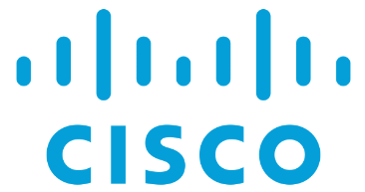
Zero Trust Security Architecture
Applied to LVC Networks
Joe Beel, Cisco Systems, Inc.
Neil Lovering, Cisco Systems, Inc.
Andrew Stewart, Cisco Systems, Inc.
1

Slide 2
Learning Objectives
The learner will be able to state the importance of a Zero Trust Security Architecture for effective cybersecurity.
The learner will be able to state the fundamental elements of network and data centers security.
The learner will be able to describe industry best practices for protecting networks.
The learner will be able to describe industry best practices for protecting data centers and applications.
The learner will be able to apply these principles to a modern LVC Architecture
2
Notes:
This tutorial will address these Learning Objectives

Slide 3
Outline
LVC Notional Architecture
Foundations of Cybersecurity – Zero Trust Philosophy
Secure Network Access
Secure Data Center & Hybrid Cloud
Secure Transport / Infrastructure
Tying It All Together
Q&A
3
Notes:
This tutorial will address these topics.
As an LVC construct is inherently networked due to the linkage between the various assets, a modern zero trust architecture for cybersecurity of LVC assets, infrastructure and operation is critical.

Slide 4
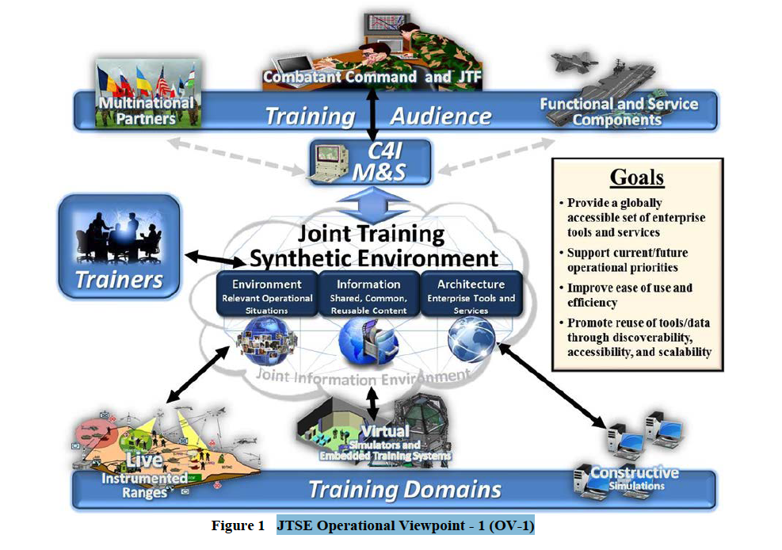
Notional LVC Architecture – NATO JTSE
Joint Training Synthetic Environment
4
Notes:
What is Live, Virtual and Constructive Training?
Live training involves real people operating real systems (e.g. aircrew flying aircraft). This, naturally, can be expensive and require considerable resources to stage, implement and maintain. Live, Virtual and Constructive Training, however, can provide many of the same benefits without the negative impacts. But what constitutes LVC? It starts with live training but adds two additional layers:
Virtual training that involves real people operating simulated systems (e.g. aircrew operating an aircraft simulator)
● Constructive training that involves simulated people operating simulated systems (e.g., a computer program generating and controlling missile threats presented to real aircrew in an aircraft simulator).
Live, Virtual, and Constructive (LVC) training blends these three approaches by using models and simulations individually or together to depict an air, space, land, sea, electronic and cyber operational environment/scenario.
Personnel or units not actually participating in a live training event may participate virtually and with constructive simulations that provide the ability to “inject” battlefield effects and simulated or constructed threats into live systems. Warfighting communities across the services utilize various models, simulations and simulators at different levels of fidelity. LVC technologies can replicate realistic mission conditions using real or simulated people, systems, threats and environments. LVC capabilities can also provide flexible, cost-effective means to develop skills, maintain proficiency, refine TTPs and rehearse missions. The various DoD services are still working to ensure they have the right mix of live, virtual, and constructive training in order to maximize cost savings but they are committed to finding that balance in order to be more cost effective.4 It is expected that the optimal mix will change over time, and from platform to platform, depending on the state of technology available and employed.
These are the different components that make up the LVC world
Live assets, usually on ranges
Constructive assets
Live or Real world command and control of assets
Virtual and Simulated assets
LVC brings these four components together for the purpose of enhancing the benefit of training while reducing cost

Slide 5
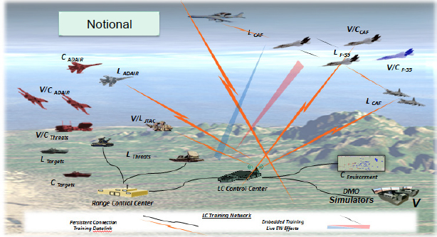
LVC Components – Interconnected System of Systems
Multiple Connections
Network Classified Information
Data Center Control Systems
Communications Data Links
End User Devices Private 5G
Collaboration Public 5G
Physical Security Operations
Accessing & Sharing Data Via:
5
Notes:
What’s behind the lightning bolts: Commercial off the Shelf (COTS) technologies
COTS will play an increasingly critical role in LVC systems as the government and its integrators attempt to reduce development and upgrade costs by leveraging the advances in commercial Information Technologies. The DoD will not usually drive the IT industry but rather will inherit what commercial industry drives in the IT industry. So to be successful, LVC training must leverage COTS IT capabilities and solutions to drive cost effectiveness and to fuel innovation. Some of the COTS IT technologies that may greatly benefit LVC training operations, support and delivery are:
Computing
Edge Computing
Optical Networking
Land Mobile Radios
Wireless INCLUDING 5G with lower latency and higher bandwidth
Collaboration
And it all has to be secured
All elements require cybersecurity from the data center to the edge
Virtual Machines in the data center
Network transport
Pre and Post-mission collaboration
Simulations
Range operations, etc.
The LVC interconnected system of systems is inherently networked. As LVC training scenarios are highly flexible, the Things or Subjects, connections and applications need to be covered by a zero trust cybersecurity architecture which enforces least privileged access as elements of the LVC architecture are connected in various ways or at different times. Building trust is critical to manage risk in highly complex and dynamic LVC events.

Slide 6
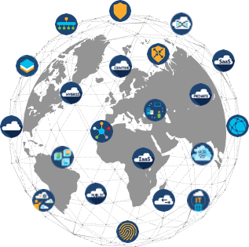
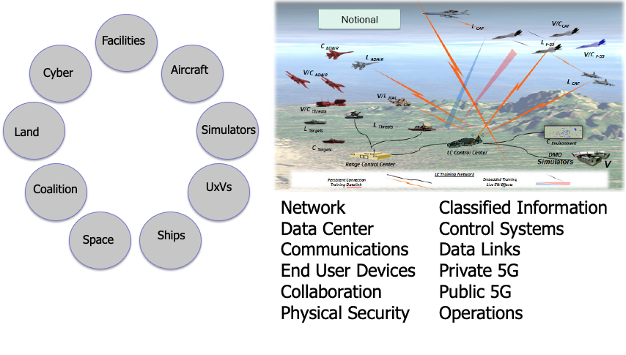

“Hybrid Cloud” - Interconnectivity from Edge to Cloud(s)
Characteristics:
Security model cannot be Perimeter-based – Embedded in Network Architecture!
Multiple users/devices are accessing applications/data from Multiple locations via Multiple means
One contiguous environment that spans data centers, edge and cloud to deliver one synthetic environment
Consumption model shift to elastic, agile, more optimal services
Data Center
Cloud aaS
Infrastructure
Network and Security
Architecture
Operational Landscape
Units / Post
Edge | IOT and OT
Connected Landscape
Base
6
Notes:
Bringing together a meaningful LVC experience requires managing resources across different infrastructure platforms to support distributed applications, sharing datat, as well as making decisions on cost and placement – it is not easy and IT teams are struggling. With all this complexity, how do you get full utilization of your infrastructure? And how can you be confident that your applications and data are secure and will continuously perform at the level LVC Requires? And how can you accomplish all this with ever-shrinking budgets?
In today’s expanding and multicloud world, managing all this complexity is beyond human capabilities.
LVC requires a digital experience that requires a broad number of connections that create one synthetic environment from the connection of many environments
In the commercial world, the scale and velocity of distributed apps and their corresponding on-prem and public cloud infrastructure has outstripped manual approaches to resource management – and this applies to LVC, too. It is necessary to connect all the dots and ensure security at scale and at the speed required for LVC Demands.
Continuously securing devices, infrastructure, and data/applications requires an approach to security where the border is defined at the moment of and point of access – The need for Zero Trust is now
There is no more perimeter.

Slide 7
Network Connects Subjects to Resources
People + Things
(Subjects)
Need Data
From Resources
Workforce
(Training Audience, Trainers, Administrators, Devices without users)
Workplace
(LVC Connectivity, Service Enterprises, Range Networks)
Workload
(Servers, Compute Platforms in Cloud or Datacenters)
Networking and Security Architecture
Connects Everything
7
Notes:
We’re going to dig deep into ZT – but, at its core, ZT is about connecting subjects to resources.
In the context of LVC, we can describe these components as the “subjects” who are user/devices of the Workforce,
The Workplace for the subjects are the core networks that connects and secures their access to the,
Workloads–These are the “resources” which are the data and applications the subjects need to get their mission done

Slide 8
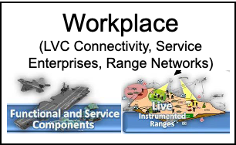
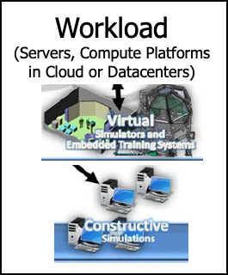
Functional Connection Requirements
Subjects (People + Things) need an Identity
Identity amplified by functional attributes and operational context
Identity attributes are dynamic – must be constantly checked
Software Defined Access to the Workplace
Resources must be classified based on data (“Need to Know”)
From
Resources
Subjects
Need
Data
Policy defines allowed relationship, access, and connections
Policy must be enforced as close to the Subject and/or Resources as possible – Workplace connects and helps enforce policy
Policy must be informed by Risk and Threat
8
Notes:
Let’s demystify some of the ZT Functional terms and make them applicable to LVC
Subject- a subject needs access to an enterprise resource. Access is granted through a policy decision point (PDP) and corresponding policy enforcement point (PEP)
Identity - can include the subjects user account (or service’s identity) and any associated attributes assigned by the enterprise to that account or artifacts to authenticate automated tasks. Requesting asset state can include device characteristics such as software versions installed, network location, time/date of request, previously observed behavior, and installed credentials. Behavioral attributes include, but not limited to, automated subject analytics, device analytics, and measured deviations from observed usage patterns.
Resources - Access to individual enterprise resources is granted on a per-session basis. Trust in the requester is evaluated before the access is granted. Access should also be granted with the least privileges needed to complete the task
Policy - is the set of access rules based on attributes that an organization assigns to a subject, data asset, or application.
Software Defined - software defined access or setting up a software defined perimeter (SDP) includes concepts from Software Defined Networks (SDN) and intent-based networking (IBN). In this approach, Policy Admin acts as the network controller that sets up and reconfigures the network based on the decisions made by the Policy Engine. Policy is dynamic and continually checks Identity, understands Threat, and makes risk-based decisions and enforces network access logically

Slide 9

Why is Zero Trust So Important?
Hybrid Cloud Environment - Not getting less “cloudy”
Security must be Identity-based, Not Perimeter-based
Threats Are More Advanced (Inside and Outside)
More Remote Users / Endpoints Than Ever – Hyperconnectivity – Need a more efficient approach
Greater Complexity
Solve with Greater Abstraction
9
Notes:
Before we go deeper into ZT, let’s discuss why this is so important / why you are hearing so much about ZT today. . .
Greater adoption of Cloud – “The border is down” – cannot draw a perimeter around your environment – that is why identity is the new border
Threats are more advanced – and we have to guard against both those from the outside as well as those that could come from the inside – especially in a large enterprise
More and more endpoints and users than ever before – always a goal of LVC to be inclusive – need to do so without sacrificing security.
Greater complexity requires more network abstraction to work at machine speed
All of this is directly applicable to LVC networks. LVC networks are leveraging multiple clouds for advanced capabilities such as artificial intelligence. LVC networks are fluid; they frequently change from training evolution or scenario to the next. As forces connect more and more devices and sensors across the battlefield, the attack surface greatly expands and the perimeter disappears. Trust of LVC elements must be verified based on the risk that they may present to the overall network or to mission success.

Slide 10
Foundations of Cybersecurity – Zero Trust Philosophy Least Privileged Access to Applications for Users and Devices
10
Notes:
LVC is inherently dependent on networking
The networked connection of live, virtual and constructive assets is key to training efficiency and effectiveness.
Secure network access is critical to ensure that only authorized users and devices are allowed on the network and that connections are tied to roles and responsibilities.
Role-based access is critical to ensure that connections and communications are only allowed between devices and users that should be allowed to talk to each other.
Access must be based on context: role, location, time, data type, etc.
Separation of data flows and the eventual access to data must be controlled and only offered to those who should have access
and this concept of ‘access’ is never treated as a one-and-done
as policy changes, so should the access rights across the network

Slide 11

Zero Trust ... Everybody has a Different Perspective
It’s a snake
It’s a wall
It’s a rope
It’s a tree
11
Notes:
RSA reference
The Zero Trust Market:
- In 2019, Zero Trust was an ~$16B market. In 2024, it is expected to be a $38B+ market (Source: Research & Markets)
- Gartner estimates 80% of new digital business applications will be accesses through Zero Trust Network Access
- Each of the vendors in this flooded cybersecurity market are trying to capitalize on Zero Trust.
This becomes a problem when:
- Vendors posturing their solutions as adding considerable security protection when they truly offer very little true security against today’s typical threats and modern hacker tactics and tradecraft.
- Vendors not being forthcoming about how challenging their product is to operate for real-time threat triage.
- Vendor recommendations that their product-only based solution is adequate.
- Vendors rebranding products as Security or Next-Gen or whatever is current when they merely offer basic collection and minimal analysis capabilities.
- Vendors promoting their solution using slick marketing or carefully tailored, canned demos.
As this series of slides will show, the concept or definition of Zero Trust will change between people, between expectations, between perceived capabilities, and between goals.
In this graphic, it appears that a snake is being displayed

Slide 12
Zero Trust ... Everybody has a Different Perspective
It’s a snake
It’s a wall
It’s a rope
It’s a tree
12
Notes:
RSA reference
This time, it seems as if a wall is in focus

Slide 13
Zero Trust ... Everybody has a Different Perspective
It’s a snake
It’s a wall
It’s a rope
It’s a tree
13
Notes:
RSA reference
Now, we see a rope that has frilled at one end

Slide 14
Zero Trust ... Everybody has a Different Perspective
It’s a snake
It’s a wall
It’s a rope
It’s a tree
14
Notes:
RSA reference
This time, we see a substantial tree trunk

Slide 15
Zero Trust ... Everybody has a Different Perspective
It’s a snake
It’s a wall
It’s a rope
It’s a tree
15
Notes:
RSA reference
When seen together, it is obvious that the pieces are all part of the same larger element, but when individual pieces are focused on, the larger picture can be lost. As with Zero Trust, the end goal must always be the target. A focus on any of the individual components, without seeing the role it plays in the larger scope, can complicate the end solution.
The Zero Trust Market:
- In 2019, Zero Trust was an ~$16B market. In 2024, it is expected to be a $38B+ market (Source: Research & Markets)
- Gartner estimates 80% of new digital business applications will be accesses through Zero Trust Network Access
- Each of the vendors in this flooded cybersecurity market are trying to capitalize on Zero Trust.
This becomes a problem when:
- Vendors posturing their solutions as adding considerable security protection when they truly offer very little true security against today’s typical threats and modern hacker tactics and tradecraft.
- Vendors not being forthcoming about how challenging their product is to operate for real-time threat triage.
- Vendor recommendations that their product-only based solution is adequate.
- Vendors rebranding products as Security or Next-Gen or whatever is current when they merely offer basic collection and minimal analysis capabilities.
- Vendors promoting their solution using slick marketing or carefully tailored, canned demos.
Zero Trust has been a concept for over 10 years. As such, many people have not only heard of one or more concepts of Zero Trust (there are many), but people have developed their own theories and perspectives of how Zero Trust “should” work. This is further complicated by the fact that practically ‘any’ security company will claim that they ‘are’ Zero Trust. In reality, Zero Trust is, has been, and always will be a collection of capabilities and features, likely provided by multiple vendors, all of which are continuously evaluated and updated (this process never ends) and the entire system/architecture is continually improved to account for the newest and latest threats. Central to any Zero Trust implementation, and any security architecture for the last many years, is consistent and thorough threat intelligence. Without this, even the best designed security system would only get an honorable mention.

Slide 16



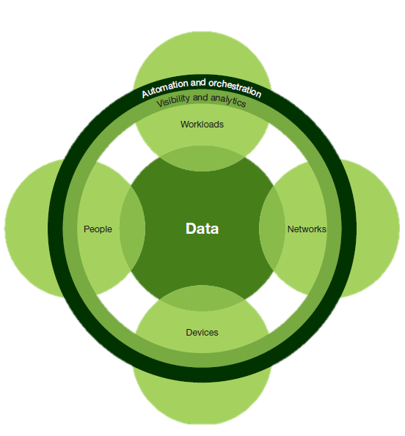
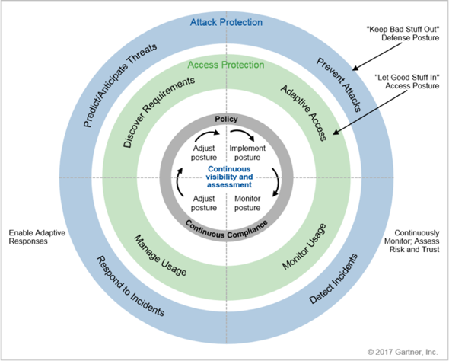
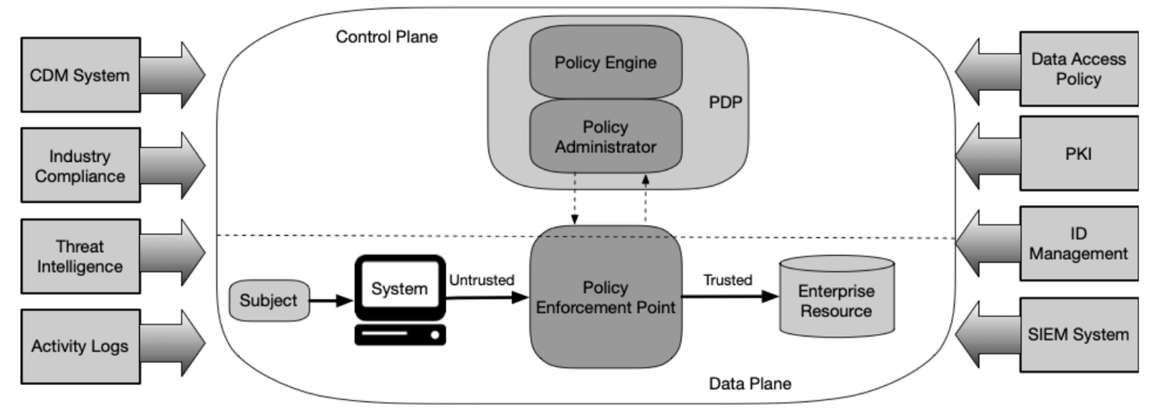
An Introduction to Zero Trust Architectures
Zero Trust eXtended
SP 800-207
Continuous Adaptive Risk and Trust Assessment
16
Notes:
You’ll here about several ZT models -- Forrester and Gartner are from industry
We’ll focus on the NIST model as it is from the Government and widely recognized as the best
There are three primary Zero Trust models or architectures. All three are somewhat similar, but the sources of each tend to create the focus of that particular model. The US Federal Government actually has their own standard (800-207) courtesy of NIST. As a result, any other model really has no bearing on the overall implementation of Zero Trust within Federal Government networks.

Slide 17
What Does Zero Trust Actually Mean?
Grant access – but make it specific!
The effect of Zero Trust is:
Ubiquitous Least-Privilege Access
OODA Loop:
Establish Trust, Enforce Trust-based Access, Continuously Monitor
17
Notes:
ZTA (Zero Trust Architecture) – “Architecture” is in the name.
- ZTA is not a product
“Least-Privilege,” “Authenticate,” “Verify” are age old security principles:
The Zero Trust OODA (Observe, Orient, Decide Act) Loop:
Establish Trust
Enforce Trust-Based Access: - enforce least privilege access based on established trust
Continuously Verify Trust - continuously verify that original tenants used to establish trust are still true for the duration of the session
That traffic is not introducing risk
Detecting risky, anomalous, and malicious behavior
Things can get very complex very fast if you are not deliberate with your security architecture!
The best way to summarize Zero Trust is: Ubiquitous Least-Privilege Access. This means that anybody and any device ‘should’ have access to any data. However, the people must be thoroughly identified (today, that is best done with multi-factor authentication where possible), and the devices must be fully scanned to ensure they are worthy of access to the network and access to the workloads. And once the people and devices are ‘vetted’, their access tightly focused on only the data that they truly need access to. And whenever such an access decision is made, the process is not done. Access to the network and workloads is continually monitored and critiqued, as requirements can change and external conditions can affect the “need” for access at any time.
Various security controls can, and should, be implemented to perform the initial device and human scanning, the network access, the visibility throughout the access event and the microsegmentation of the workloads to keep them safe from people, and other workloads. Segmentation and visibility are critical, because even the best security methods can be compromised. And when such a compromise occurs, the Zero Trust Architecture must be capable of automatically fending off attacks and cross-contamination.
The concept of the OODA loop is a way to continually evaluate the risk management framework applied to any and all security environments. Normally, risk management is a one-and-done concept. But for Zero Trust, risk management, just like overall policy and management, is a continuous process.

Slide 18
ZTA based on 5 fundamental assertions:
The network is always assumed to be hostile
External & Internal threats exist on the network
Network locality is not sufficient for deciding trust
Every device, user, and network flow is authenticated and authorized
Policies must be dynamic and calculated from as many sources of data as possible
The effect of Zero Trust is:
Ubiquitous Least-Privilege Access
18
Notes:
ZTA (Zero Trust Architecture) – “Architecture” is in the name.
- ZTA is not a product
“Least-Privilege,” “Authenticate,” “Verify” are age old security principles:
- Micro-segmentation is a key principle
- Focus on protecting resources / cyber resilience
- Jericho forum defined de-permiterisation back in 2003
Automation systems / Technology improvements are what allow a Zero Trust Network to be built and operated!
- Ability to dynamically assess current situation and make appropriate decision based on your security policy
Ubiquitous – present, being, or found everywhere; constantly encountered
Zero Trust does have some basic assumptions. The network itself is always assumed to be hostile. This does not mean that the network itself is bad, nor does it mean that the network should be ignored. It means that when a breach occurs, the network may be compromised first. As such, visibility and segmentation are key to keep attackers at bay and permit safe communications between users and data stores. And no single location should be considered ‘better’ or ‘safer’. The same security considerations should be applied to every portion of the network, wherever packets travel.
While we tend to think of threats as being ‘out there’, we can never forget that most threats actually come from the ‘inside’. Insider Threat is actually something that Zero Trust itself does not fully address, but a proper Zero Trust Architecture can help mitigate this threat.
Everything (device, person, application, script) must be scrutinized as it joins the network. This effort is complicated as more IoT is added to modern networks. A device, all by itself, really has no way to ‘authenticate’. It simply connects and starts to communicate. The network must be able to determine exactly ‘what’ these things are, classify them accordingly, and then isolate them so that their communicates are both appropriate and isolated. A device that doesn’t have proper authentication (by no fault of its own) is likely to be a device that is considered an opportunistic target.
And because there are so many devices, networks can be so large, with so many access points, and the data being access is both terrestrial and cloud-based, the ability to apply policy cannot depend on any manual method to distribute any updates or changes and hope that those adjustment are both correct and complete. Automation is absolutely key in both the reaction to any event, and the distribution of new policy or information either as a regular update cycle or in response to a security incident. Humans are certainly still part of the loop, but the necessary reaction speed suggests that automation is paramount.

Slide 19
Zero Trust is a Design Approach
A Zero Trust solution is not a single product or accomplished at a single point in the network
To implement a thorough Zero Trust solution, an architecture should consider
User and Device Access
Application and Workload Access
Network Access and Visibility
Trust
Architecture
User and/or Device Access
Workforce – All Corp IT
Workload – Data Center
App and Workload Access
Workplace – Corporate Network
Network Access and Visibility
Remember, this is C2C!
19
Notes:
Places in the Network:
- This is how you eat an elephant – a bite at a time!
Workforce – ensure only the right users and secure devices can access applications
Workplace – secure all user and device connections across your network, including IoT
Workload – secure all connections within your apps, across multi-cloud
While Zero Trust may be seen as a huge beast, it might help if the overall concept of Zero Trust is broken down in to consumable pieces. The NIST 800-207 standard itself does separate the Users/Devices from the Network Access from the Resources. Each of these three components are viable pieces of Zero Trust. One cannot be seen as more important than any other. And within any one of the three components, there may be multiple solutions that must be enabled because of the diversity of the applications and protocols within. So a focus on, how Cisco views it, the Workforce, Workplace and Workload, helps to keep the focus on individual concerns about security, while still maintaining a connection back to the larger Zero Trust story.

Slide 20
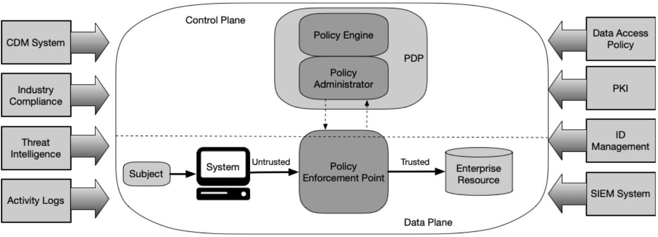
NIST Zero Trust Architecture
Published in 2020:
https://nvlpubs.nist.gov/nistpubs/SpecialPublications/NIST.SP.800-207.pdf
20
Notes:
NIST = National Institute of Standards and Technology
800-207 is 49 pages long
Define each component
This diagram comes directly from the US Government (NIST) definition of Zero Trust. Zero Trust itself is seen within the oval in the middle. The definition calls for a Policy Engine that administers that policy down to the (many) Policy Enforcement Points. Those polices are used to control who and what eventually access the Enterprise Resources (the data, the applications in the data center, the workloads). It goes without saying that any connection from a device to a resource must traverse a network. The network is where access control is defined. The network is where visibility is implemented. The network is where segmentation occurs, which itself helps to keep the Enterprise Resources safe. There is no one product, no one solution, no one company, who can easily provide the complete solution to Zero Trust. But some certainly fare better than others.
Outside of the Zero Trust oval are the external ’feeds’ to Zero Trust. While Zero Trust can survive without any of them, the Zero Trust Architecture is much better because of them. This is certainly where a multi-vendor approach to a complete Zero Trust solution comes to fruition. And now, the need for various products to work together (to integrate) is an absolute necessity. If a product or a vendor cannot integrate with existing products and solutions, then either the new vendor/product has to go, or the existing vendors/products have to go. This is not negotiable. This is not a popularity contest or a “my favorite tool” conversation. This is the creation of an entire security architecture, one that communicates and exchanges data between the various components, and works together in harmony. Egos must be left at the door.

Slide 21
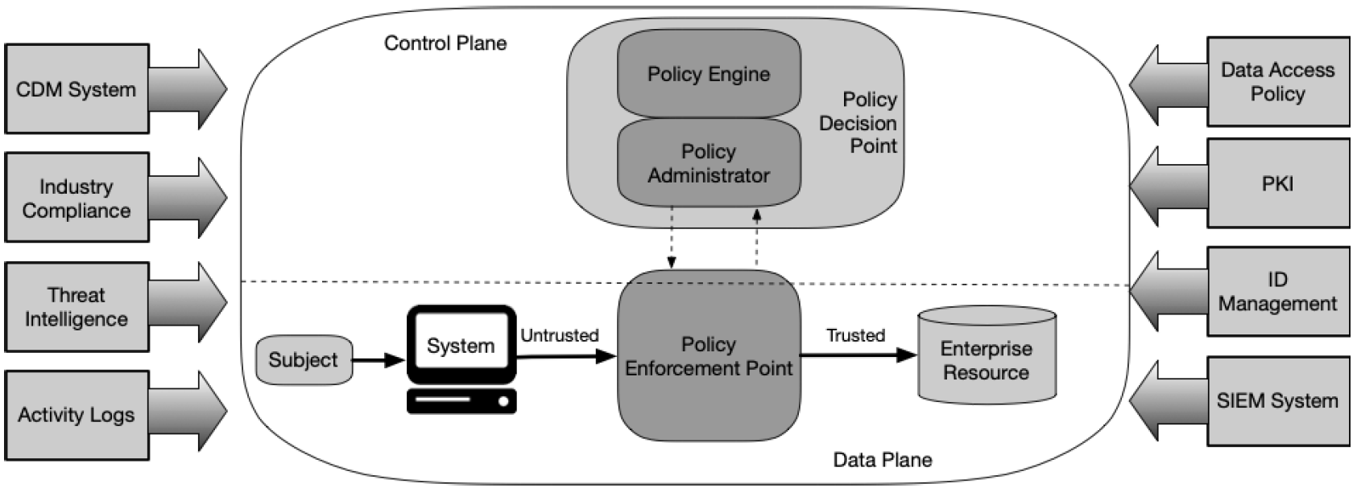
Zero Trust – NIST SP 800-207
External inputs and influences
Subjects
Resources
User and Device Access
Application and
Workload Access
Network Access and Visibility
Insider Threat and Network Visibility are considered threats associated with ZTA
The network plays a critical role in applied ZT principles
21
https://csrc.nist.gov/publications/detail/sp/800-207/final
Notes:
Let’s break this down further into Subjects, Network and Resources
Note the open interfaces – Using open-standards based interfaces like those defined by the IETF allow you to leverage existing capabilities and enhance the overall ZT solution
Since Zero Trust can be overwhelming, it helps to simplify the Zero Trust message by breaking a large process into consumable pieces. Each piece is important to the overall Zero Trust story. No one piece is more important than any other. The Subject and System (user and device) is the first piece of the Zero Trust puzzle. It is the people, via the devices, who try to access the data (the Resources). Access to the Resources will typically traverse the network, which is where network access control can assist with access decisions, visibility and help with insight and threat response, and segmentation can provide security before a subject is even allowed to get close to a Resource, And the Enterprise resources themselves also have their own unique security challenges and solutions. East-west communications in a data center often happen unnoticed. A compromised Resource can impact other Resources and the Systems that connect to them. Microsegmentation within the datacenter, where Resources reside, helps to isolate any such outbreak, and visibility down to the process level allows root cause analysis of any problem.

Slide 22
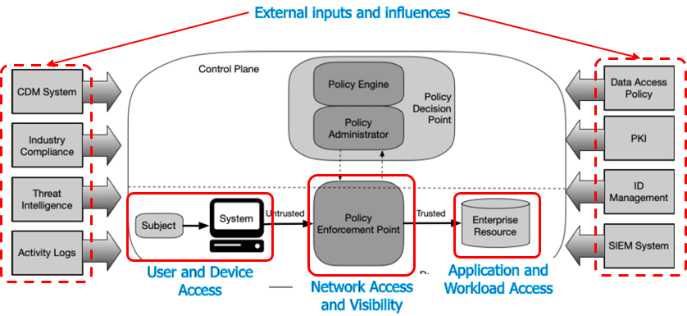
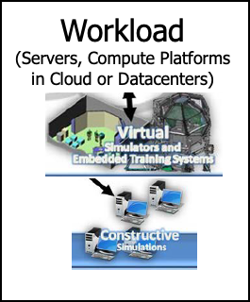
ZTA Applied to LVC Networks
22
Notes:
Now, let’s apply to LVC
Every network consists of the basic building blocks of Zero Trust: the Workforce, the Workplace and the Workload. Every network has people and devices who access it (or try to), every network has an opportunity to see what happens and to provide segmentation to traversing traffic, and every network has a collection of workloads and data stores with a need for data isolation and least-privileged access. The basic concepts of Zero Trust certainly apply to the LVC networks.

Slide 23
NIST Zero Trust Architecture Implementation
Security Control
Identity
Services
+ Multi-factor
Authentication
Network Fabric Automation and Analytics
User and Device Access
Application and Workload Access
Network Access and Visibility
23
https://csrc.nist.gov/publications/detail/sp/800-207/final
Notes:
Abstraction of information and policies in the Control plane provide the ability to scale across an entire LVC environment and makes it easier to enforce ZT
For example when we bring in Identity and MFA -- they help define the Subject’s function, role, how they are accessing the network – and provide a means to verify who they say they are.
Let’s bring in Network Automation and Analytics – Se how they provide visibility and enforce policy – and, enhance our understanding of the identities of the subjects – and, help identify potentially malicious behavior that would trigger automated policy enforcement and notifications.
When it comes to ZTA principles, and when trying to simplify the overall story and deployment, secure concepts can be applied to the ZT model which can later have actual products assigned. The users and devices all most be trusted before being allowed access. If possible, multi-factor authentication should be applied to every person, and device profiling should be performed on every device. Anything untrusted or anyone unknown should not have access to any resources. The network fabric is, by far, the best place to have visibility into all actions across the LVC network. And because of the scope of the LVC environment, automation is necessary for any sort of proper policy assignment. Automation is also critical when applied to the workloads and resources.

Slide 24









Integrated Threat Intelligence
Need Common, Relevant “Threat Picture” – Across Entire LVC Architecture
MASSIVE VOLUME
Telemetry
Network Intrusions
Network Flow Analysis
Web / URL
DNS/IP
Endpoint
Malware
Email
600 billion
Email samples
III00II 0II00II I0I0II0II0 I0 I0 I00 00I0 I000 0II0 00
III00II 0II00II I0I000 0II0 00I0I00 I0 I000I0I 0II 0I0I0I
1.5 million
Daily malware samples
00I00 I00I0I II0I0I 0II0I I0I00I0I0 0II0I0II 0I00I0I I0 00
II0III0I 0II0II0I II00I0I0 0I00I0I00 I0I0 I0I0 I00I0I00
II0II0I0I0I I0I0I0I 0I0I0I0I 0I0I00I0 I0I0I0I 0II0I0I0I
16 billion
Daily web requests
III00II I000I0I I000I0I I000I0I II 0I00 I0I000 0II0 00
00I I0I0I0 I0I0III000 I0I00I0I 0II0I0 I00I0I0I0I 000
0II00 I00I0I0 0I00I0I I00I0I0 I0I0I0I 0I0I0I 0I0I0I0
3.4 billion
Endpoint Queries
00I0I0 0I0I0I0 I0I0I00I 0I0I 0I0I 0I0I I0I0I 0I00I0I
II0III0I 0II0II0I II00I0I0 0I00I0I00 I0I0 I0I0 I00I0I00
III00II 0II00II I0I000 0II0 00I0I00 I0 I000I0I 0II 0I0I0I
UNPARALLELED EXPERTISE
300+
threat intel researchers;
24 – 7 – 365
20 billion
Threats blocked daily
Over 100 Threat intelligence partners
Cloud – Public, Private
24
Notes:
One of the external inputs into a ZTA is Threat Intelligence. A common and thorough threat intelligence source would be nirvana for any network. Since any network consists of a plethora of devices, there are many points of potential exploit. The ZTA message primarily discusses the users and devices that access the network resources. But the normal operations of any network has many other actions that occur, all of which become possible security events. A common, commercial threat intelligence organization such as Talos can provide threat intelligence to many different types of network devices. This way, there are no disputes between what should be considered “good” and what should be considered “evil”.

Slide 25
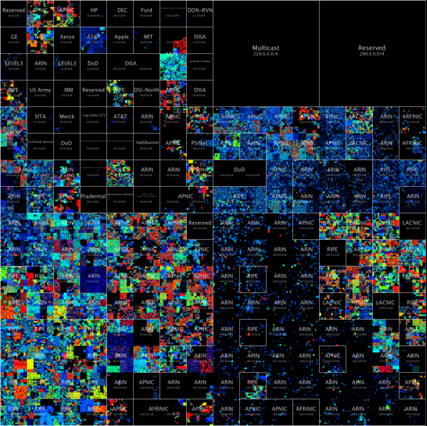
Threat Intelligence Map
Who’s who of the internet’s dark side
Models use up to 20 features of 150 million malicious, risky, or otherwise security-relevant endpoints on the internet.
These data features include domain data, whois data, TLS certificate data, usage statistics, and behavioral data for each server.
Image: http://census2012.sourceforge.net/images.html
25
Notes:
Models use up to 20 features of 150 million malicious, risky, or otherwise security-relevant endpoints on the internet.
Since most networks connect to the Internet, it can be assumed that an event in some other location will eventually affect everyone. Proper threat intelligence should have visibility into global events and pre-configure security policy to prevent the infestation before it arrives. The concept of a Threat Map, both figurative and literal, visually shows how the threat intelligence is absorbed, where the threats are, and how the threats evolve and spread.

Slide 26

Universal Zero Trust Tenants
Establish Trust
Enforce Trust-Based
Access
Continuously Verify
Trust
Original tenets used to establish trust are still true
Traffic is not threat traffic
Any risky, anomalous and malicious behavior
If compromised, then the trust level is changed
User & device identity
Device posture & vulnerabilities
Any workloads
App/service trust
Any indicators of compromise
Applications
Network resources
Workload communications
All workload users/admins
Workforce – Workspace - Workload
26
Notes:
Our approach for zero trust is to establish trust, enforce trust through polices at the point of access, but it doesn’t stop there as there is a need to continuously verify that the connection can still be trusted after the initial access is established.
1. Establish Trust: We establish trust by verifying: User and Device (assessing the health and posture of the device) both on the network and off the network, Workloads, Applications/Services
2. Enforce Trust-Based Access: We enforce least privilege access to: applications, network resources, workload communications, on all users/devices
3. Continuously Verify Trust: We continuously verify: that original tenants used to establish trust are still true for the duration of the session, that traffic is not introducing risk, detecting risky, anomalous and malicious behavior. If a compromise is detected, then change we adjust the trust level
It is important to both realize and accept that Zero Trust is not a single data point, but is a continual process in the life of any network. The principles applied to Zero Trust are designed for particular threats or to be used in particular areas of the network, but since the network and the environment continually evolve, the protections applied to the network must constantly be inspected and occasionally updated and even replaced or upgraded. The graphic shows the cyclical nature of any security story, and certainly that of Zero Trust. Trust must first be established before access is granted to any resource, but a single trust event does not imply ‘forever’. Access should be continually evaluated. Device posture should be continually evaluated. Threat intelligence should be continually absorbed and applied. Threat activity should be investigated and isolated. All of these actions happen all of the time.

Slide 27
Secure Network Access, Data Center & Hybrid Cloud
27
Notes:
The LVC network is not much use unless it can transport data.
Securing data in motion or secure transport is another key cybersecurity enable for LVC training
LVC is inherently dependent on networking
The networked connection of live, virtual and constructive assets is key to training efficiency and effectiveness.
Secure network access is critical to ensure that only authorized users and devices are allowed on the network and that connections are tied to roles and responsibilities.
Role-based access is critical to ensure that connections and communications are only allowed between devices and users that should be allowed to talk to each other.
Access must be based on context: role, location, time, data type, etc.
And it must not be forgotten that any network today likely has a terrestrial and a cloud component. It has both physical and virtual devices. This is certainly true for the LVC environment. The ZTA must be able to be applied across all pieces of the network, and must be able to react to the ever-changing logical and threat environments.

Slide 28
Authorization
3 Major Authorization Options for ‘Access Control’
Access Control List (ACL)
“DACL” or “Named ACL”
VLANs
Security Group Tags
Downloadable ACL (Wired) or Named ACL (Wired + Wireless)
Dynamic VLAN Assignments
TrustSec Software-Defined Segmentation
Remediation
Security Group Tag
Example:
“ALL_Exercise _
Control_Group”
Guest
VLAN 4
Employees
VLAN 3
Employee
permit ip any any
Contractor
deny ip host <protected>
permit ip any any
16 bit SGT assignment and SGT based Access Control
Per port/Per Domain/Per MAC
28
Notes:
ACL – permits or denies access to networks and hosts based on the source address of the authenticated user.
VLANs – put users into local networks based on their authenticated credentials.
SGTs - TrustSec uses the device and user credentials acquired during authentication for classifying the packets by security groups (SGs) as they enter the network. This packet classification is maintained by tagging packets on ingress to the TrustSec network so that they can be properly identified for the purpose of applying security and other policy criteria along the data path. The tag, called the security group tag (SGT), allows the network to enforce the access control policy by enabling the endpoint device to act upon the SGT to filter traffic.
The entry point to a network is the first opportunity to apply a security policy, as network entry is one of many possible enforcement points. Enforcement here does not mean that no further enforcement is needed. But enforcement upon entry sets the stage for thorough end-to-end visibility and control.
As a device, or a person on a device, attempts to access a network, there are a number of choices that can be made. One choice is ‘do nothing’. This may be an option if the user/device is completely trusted or there is a belief that future security controls will suffice.
It is also possible to apply an access control list (ACL) immediately upon access. This sets the stage for possible targets and protocols that may be used by the new device.
The entry VLAN can also be changed. This forces the entry device into a situation where an existing, upstream security policy can apply. This also ties an access control policy with an enterprise security policy. This type of integration creates a richer and more complete security policy because existing security controls can be reused.
Finally, an access control policy may ‘tag’ packets as they enter the network. This tag can act as a way to track the packets as they travel throughout the network. The tag can also be used later in the network as access control. A tag is another data point that can be part of an access control list and can provide precise filtering when needed. The tags can also be seen end-to-end, from the entry into the network to the application in the data center.

Slide 29

SD-Access Defines and Applies Group-Based Policies
802.1X for secure network access
Tagging and Segmentation for All
Tags by Function not IP Address (location)
Example Tags:
All_Red_Cell; Sim_BlueForces; Blue_Helos; Real_BlueForces; All_Range_Assets; All_LiveFire; All_OppFor; Blue_Infantry; Blue_Mech
Before: Box by box
Manual | Error-prone
After: Automated
Scalable | Simple
Design¹
2
15
Policy¹
4
5
Provision¹
5
5
hours
minutes
hours
minutes
hours
minutes
29
Notes:
The IEEE 802.1X standard defines a client and server-based access control and authentication protocol that restricts unauthorized clients from connecting to a LAN through publicly accessible ports. The authentication server authenticates each client connected to a switch port and assigns the port to a VLAN before making available any services offered by the switch or the LAN. Until the client is authenticated, 802.1X access control allows only Extensible Authentication Protocol over LAN (EAPOL) traffic through the port to which the client is connected. After authentication is successful, normal traffic can pass through the port.
Active Identity through a central or local Web Portal means using a web-based authentication mechanism which then reports back the authorized contexts after successful authentication. Authentications can include simple password challenge, or could include things like biometrics or two-factor authentication schemes.
Once a user/device has been authenticated, rules can be enforced to control/limit access as needed. These rules can be enabled a number of ways.
Downloadable/Named ACLs are access control lists that can define access based on Layer3/Layer4 attributes.
VLAN assignment would entail setting the connected port into a VLAN with access to the appropriate computers/servers.
Security Group TAGs (SGTs) - TrustSec uses the device and user credentials acquired during authentication for classifying the packets by security groups (SGs) as they enter the network. This packet classification is maintained by tagging packets on ingress to the TrustSec network so that they can be properly identified for the purpose of applying security and other policy criteria along the data path. The tag, called the security group tag (SGT), allows the network to enforce the access control policy by enabling the endpoint device to act upon the SGT to filter traffic.
URL Redirection is a mechanism used to redirect web queries to a protected server and display pages like “unauthorized access”.
(ASP) Auto SmartPort macros dynamically configure ports based on the device type detected on the port. When the switch detects a new device on a port, it applies the appropriate Auto SmartPorts macro. When a link-down event occurs on the port, the switch removes the macro. For example, when you connect a IP phone to a port, Auto SmartPorts automatically applies the IP phone macro. The IP phone macro enables quality of service (QoS), security features, and a dedicated voice VLAN to ensure proper treatment of delay-sensitive voice traffic.
In this example, the ‘before’ box shows how some unwelcome devices first show up, and are eventually discovered and removed. In this example, all sit on a common network, and each has IP reachability to any other device. The overall architectural concepts show that it would typically take more than 10 hours to hunt down and eliminate the threats that appeared. When this is compared to a model where the (packets from the) devices are tagged as they enter the network, communications are controlled far easier and segmentation becomes something that is simply part of the network, without any expensive upgrade or special purchases. The network becomes both the visibility grid and the enforcement mechanism.

Slide 30
Data Center Security
There is nothing “Center-ed” about data anymore!
Hybrid-Cloud approach
Security must be integrated across the Architecture (Workplace)
Employ Zero Trust principles of Visibility, Segmentation and Threat Protection
Operational Landscape
Data Landscape
30
Notes:
Many of us go back to the old days when there was one monolithic data center that was centered within an enclave –and, that quickly expanded to multiple data centers, all interconnected across an enterprise – but with high data concentrations in several centers of gravity.
Today there is nothing centered about data anymore. The edge is creating more data and performing computations locally (as its own data center) enhancing/reducing/enriching the data before pushing it to larger enterprise resources which could be hosted in larger, secure data centers or more likely, will be leveraging several cloud-hosted resources – The result is one large hybrid cloud approach that includes edge, on-prem core compute, and multi-cloud resources.
The scale creates amazing opportunities for the edge to interact with the core and the cloud and enhances core capabilities with the cloud -- but throughout it all, the networking and security architecture (or the workplace) must connect everything and security must be embedded into everything. So with this expansive threat surface, employing the zero trust principles of visibility segmentation and threat protection -- uniformly across the workforce the workplace and where are those applications and data live in those workloads – regardless of where the resources or data concentration resides

Slide 31
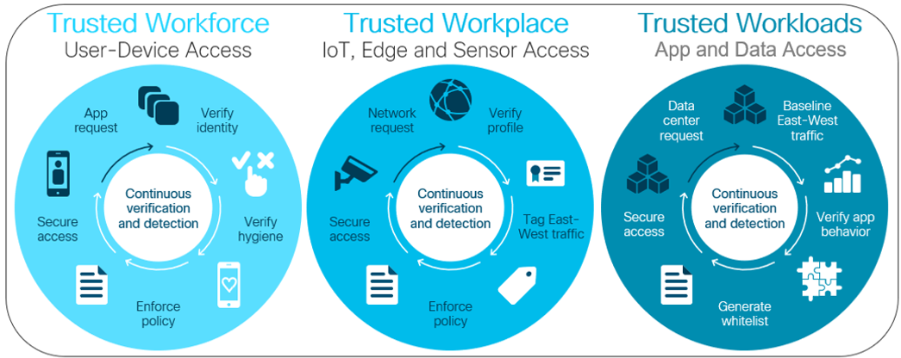
Zero Trust – Continuous Cycles
Places in the Network:
Workforce – user and device access
Workplace – network access
Workload – application and workload access
The Zero Trust OODA Loop:
Establish Trust
Enforce Trust-Based Access
Continuously Monitor
31
Notes:
So when we take zero trust to scale -- it really turns into a zero trust sort OODA that is operating constantly across workforce, workplace, and workloads. First establishing trust and understanding the “subjects” or user or device that's requesting access. Using as much context and as much identity features as possible. Then, enforcing trust-based access to the “resources” or the workloads, the applications, and the data. -- each and every time and access request is made from the edge to the core to the cloud and back . . . And continuously monitoring for changes unusual behavior or reacting to threats

Slide 32
Zero Trust Architecture with Integrated Network & Security
Fabric
Management
Data Center /
Private-Public Cloud
Identity Services
DC Policy
MGMT
Segmentation
NetFlow Analytics
32
Notes:
So when we implement those logical components from the NIST zero trust architecture, you can now see how software defined abstraction allows us to scale across an environment as complex as that required for LVC by using the automated features that integrated networking and security provides. With that level of abstraction, software defined networking allows us to define policy in the control plane (for subjects w/ enhanced Identity Services – and for the Data Center to manage application identity and data access via whitelisting). Then, we can enforce policies in the data plane logically with a software defined perimeter – And do so dynamically, every time at the time of access request and enforce policy as close as possible to either the subject making the request and/or to the resource being requested.

Slide 33
Secure Transport Securing Communications in LVC Networks & Trustworthy Systems
33
Notes:
The LVC network is not much use unless it can transport data.
Securing data in motion or secure transport is another key cybersecurity principle of zero trust and for enabling security for LVC training

Slide 34
Secure Transport Challenges
Many LVC elements were not designed for classified secure communications
Even range operations communications may reveal sensitive or classified information
Need a means to secure information transport while minimizing cost and challenges of Type1 encryption devices
34
Notes:
LVC depends on transport – how do your secure comms and data transport across the entire architecture?
LVC environments have mobile assets, IP networks, push to talk radios, SCADA system, etc. A significant challenge for secure transport.
Many systems do not have type I encryption and require some sort of NSA approved encryption. Type I cyrpto devices add significant cost to the system.
Micro-segmentation and scalable group tags can separate access, data, traffic and access based on user identity. The challenge is accreditation of systems using such technologies.
Physical separation may be required.
CSFC can help alleviate need for Type 1 encryptors with NSA approved solutions.
MLS may be required to allow multiple view with separation.
Management and Orchestration capabilities using YANG models can re-configure infrastructure as code very rapidly for may uses.
The next two slides show some the application of Commercial approaches that are based on NSA approved approaches to these challenges.

Slide 35
Commercial Solutions for Classified (CSfC)
Secure Multi-Site Connectivity – without Type1 Encryption Devices
Multiple Red regions may communicate across a common Grey/Black environment
Each Red region is independent and may not communicate with others
Reinforces ZT Segmentation and Security
https://www.nsa.gov/csfc/
35
Notes:
NSA has a program that helps significantly with secure transport. The traditional requirements for using Government Type1 equipment to secure classified information have been changed to allow for the use of Commercial VPN technologies.
NSA CSfC Capability Packages are the roadmaps for building a secure network design to allow for the transportation of classified information over commercial products.
CSfC is implemented using two encrypted tunnels, one inside another.
When discussing the two tunnels, the first tunnel is referred to as the INNER TUNNEL and the second tunnel is referred to as the OUTER TUNNEL. Both tunnels are implemented using IPSec (IP Security) and can either use “shared keys” or PKI (public key infrastructure).
This is all based on commercial crypto such as AES 256 that does not require the expense of type I crypto devices and does not require the overhead of CMS gear, custodians, PDSs, etc.
Establishing Layers of Trust is a critical design element within any CSFC Architecture.
It is a requirements to have two layers of encryption available across public infrastructure.
For customers who have classified communications, the use of type-1 encryptors to connect remote locations is simply the ‘cost of doing business’. The transport of classified traffic is certainly nothing that should be taken lightly. The NSA created the CSfC program (Commercial Solutions for Classified) to introduce a more cost-effective and speed-to-deployment model for such connection requirements. Unlike the single-tunnel approach of the type-1 encryptors, CSfC calls for a dual-tunnel to transport classified data. The concept is that if any of those tunnels fails, the entire communications medium fails and classified data is not exposed. This is critically important since the black network is typically some public transport, such as the Internet.
There are a number of options possible for securing the traffic as it travels out of the classified spaces. Today, elliptical curve cryptography (ECC) is the minimum standard for encryption of each of the layers. This ensures an incredibly secure means of transport and actually has less overhead than some of the older mechanisms. And the use of commercial gear (firewalls, routers) to provide the encryption means a far less expensive solution for any customer. And in the commercial world, when a new feature is needed, the vendor almost always rolls that feature into the next version, free of charge. And if there is ever an issue with code, bug fixes are done as part of routine (or even immediate) maintenance – also for free.

Slide 36
Secure Remote Solution – With Multi-Use Grey Management
https://www.nsa.gov/Resources/Commercial-Solutions-for-Classified-Program/Capability-Packages/
36
Notes:
NSA, through its Capabilities Packages provides for the encryption of multiple classification types over a single infrastructure
Building upon the previous slide, it is possible to extend mobile access solutions to multiple sites (with multiple EUDs) that can support securing the data of multiple security levels.
This shows a representative approach that has two types of protected networks (“Red or U.S.” and “Yellow or Coalition”) with two types of unencrypted classified data (“Red data” and “Yellow data”) which have different security level requirements. This enables customers to use the same physical infrastructure to carry traffic from multiple networks to multiple EUDs.
Although each of the protected networks will still require its own Inner Encryption Components, a site may use a single Outer VPN Gateway in the infrastructure to encrypt and transport traffic that has been encrypted by Inner Encryption Components of the different security levels. The NSA Mobile Access (MA) Capability Package provides complete details. Also, notice that a TLS-Protected server could support: VoIP call managers, mobile device management (MDM) services, VDI, and web server content.
End User Devices can implement either an Outer VPN Client or a Dedicated Outer VPN, that supports wireless connectivity and; thus, solutions such as, Cisco’s AnyConnect VPN client can enable the array of End User Devices (phone, tablet, laptop, etc.) using wireless access solutions for greater mobility.
In this example, a Federated Grey network provides the connectivity from any individual Red network to the common transport Black network. In a typical CSfC deployment, a customer is responsible for both the Red and the Grey networks. The Red is the “inside’ network, but the Grey is new. But both are required to support the dual-tunnels that CSfC calls for. A newer movement sees Federated Grey services appearing that offer connections from Red customers to the Internet, and then from the Internet back into the customer Red space. This helps simply the design and overall maintenance of a CSfC solution.

Slide 37
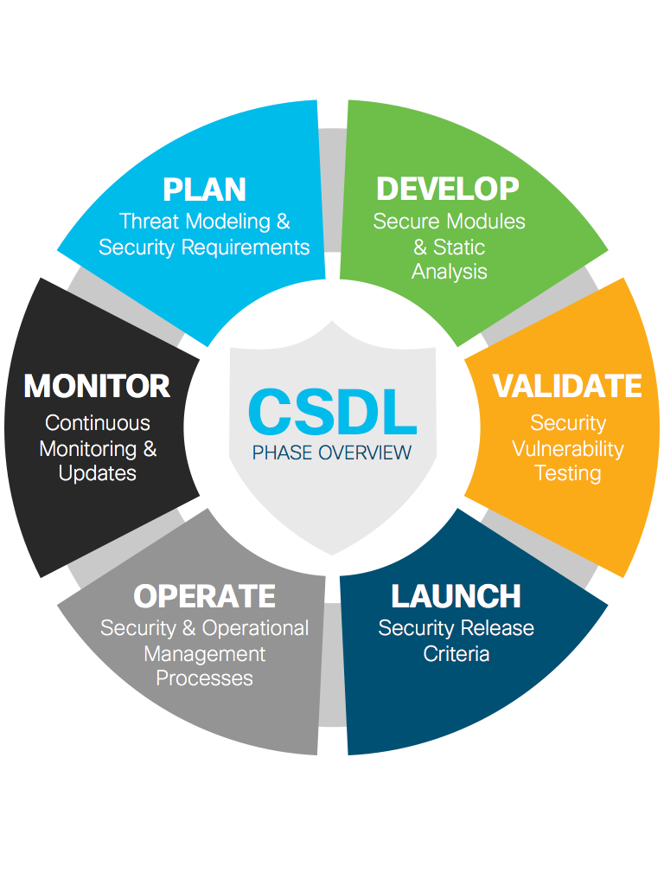

Trustworthy Systems & Value Chain
Secure Development Lifecycle
$$$
Trust Anchor Module
Trust Anchor Module
Value Chain Security
Build Security, Privacy + Data Protection into the Business
Secure Boot & Run Time Defenses
Reduced Vulnerabilities
and Risk
TAm
Visibility into
Platform Integrity
Prevent Vulnerabilities in Our Offers
Data Protection + Proper Use
Ensure Software + Hardware Integrity
Prevent Misuse of IP, Tamper + Counterfeit
Faster Identification
of Threats
Trustworthy technologies enhance the security and resilience of the LVC Architecture
37
Notes:
Today’s sophisticated cyberattacks increasingly seek to compromise the network infrastructure by attacking network devices like routers and switches. By doing so, attackers can eavesdrop on sensitive communications, steal or manipulate data, and launch attacks against other parts of the network. This includes advanced persistent threats that modify the hardware or software of network devices. These threats can go unnoticed for months, or even years, inflicting devastating damage.
Trustworthy solutions encompass products and solutions with multilayered security that protect against today’s threats. Trustworthy technologies provide a foundation of security and resilience. Trustworthy technologies such as image signing, secure boot, Trust Anchor modules (TAm), and runtime defenses help ensure that the code running on hardware platforms is authentic, unmodified, and operating as intended. A hardware-level root of trust, unique device identity, and validation of all levels of software during startup establish a chain of trust for the system.
Image signing: Image signing is a two-step process for creating a unique digital signature for a given block of code. First, a hashing algorithm, similar to a checksum, is used to compute a hash value of the block of code. The hash is then encrypted with a private key, resulting in a digital signature that is attached to and delivered with the image. Signed images may be checked at runtime to verify that the software has not been modified.
Secure boot: Secure Boot helps to ensure that the code that executes on hardware platforms is authentic and unmodified. Hardware-anchored secure boot protects the microloader (the first piece of code that boots) in tamper-resistant hardware, establishing a root of trust that helps prevent network devices from executing tainted network software.
Chain of trust: A chain of trust exists when the integrity of each element of code on a system is validated before that piece of code is allowed to run. A chain of trust starts with a root of trust element. The root of trust validates the next element in the chain (usually firmware) before it is allowed to start, and so on. Through the use of signing and trusted elements, a chain of trust can be created which boots the system securely and validates the integrity of software.
Trust Anchor module (TAm): This proprietary, tamper-resistant chip is found in many Cisco products and features nonvolatile secure storage, Secure Unique Device Identifier, and crypto services, including random number generation (RNG), secure storage, key management, and crypto services to the running OS and applications.
Runtime defenses (RTD): Runtime defenses target injection attacks of malicious code into running software. Runtime defenses include Address Space Layout Randomization (ASLR), Built-in Object Size Checking (BOSC), and X-space. Runtime defenses are complementary.

Slide 38
Tying IT All Together Zero Trust Philosophy Provides Security and Simplicity
38
Notes:
Let’s put it all together on ZT and how it applies to LVC – particularly with the outcomes of Security and Simplicity

Slide 39
Zero Trust Philosophy
Zero Trust is an evolutionary framework not a revolution
Zero Trust is not a technology but a design approach
Zero Trust augments other cybersecurity tools and practices rather than replacing them
Threat protection remains an important component of Zero Trust
Zero Trust is a maturation strategy and will provide a Positive ROI but may require upfront investment depending on current state
39
Notes:
We discussed the basic logical components defined by NIST. NIST is not one technology or a single product – it is a philosophy that influence how you design and operate your network.
You don’t have to rip and replace everything – but you do need to take a deliberate approach, especially with regards to Identity of Subject and how you will continuously verify them before access to a Resource is provided.
Threat protection is important – ZT assumes breach and must be continuously informed by the latest Threat Intelligence – as well as understanding network flows to identify insider threats.
Enhanced Visibility / Continuous Monitoring is often overlooked!
Zero Trust is a mature concept, but is also a requires a Maturing Strategy to implement – think of it as a Journey, not a destination.
Besides better security, when implemented, ZT has shown improved efficiencies in operations and high yields on investments
American Council for Technology-Industry Advisory Council – Zero Trust Cybersecurity Industry Trends (April 2019)
- https://www.actiac.org/system/files/ACT-IAC%20Zero%20Trust%20Project%20Report%2004182019.pdf

Slide 40
Zero Trust Applied to LVC Networks
Necessary Security Enhancement in order to realize one Synthetic LVC Environment
Provides visibility and enforcement across hybrid, multi-cloud LVC Architecture
Enables more efficient LVC design approach – Access based on functions and context, not location
Provides wholistic Threat-based and Risk-based approach to securing data across entire LVC Environment
Easier to Operate – Greater Efficiencies through software-defined abstraction
40
Notes:
Let's apply zero trust to LVC networks. it's obvious that in order to realize one synthetic environment across a wide-ranging workforce of many subjects, who are operating across a diverse networking and connectivity workplace, -- And, who are accessing many resources and workloads – That a simplified approach is not only necessary, it is a mission enabler to provide greater visibility and enforcement across a hybrid multicloud LVC architecture.
Taking this approach makes it easier to implement the design since now we are providing access based off of Identity by the function of subjects in context to their mission – not doing so based on location or VLAN assignment or other impositions on the network design. This is particularly important since once you create the policy and access design and implement it through software define networking, you don't have to change the entire network design as subjects and or resources are added or removed from the LVC environment. When you think about this in terms of network accreditation, this significantly enhanced enhances agility and aides the in the ATO process since you have implemented least privilege access by design and you can show how policy is continuously enforced – even if subject or resources must be changed, you are not beginning from square 1.
The approach also includes both threat and risk based approaches to securing data which is critical not only for responding to real time external threats with informed threat intelligence, but also being able to establish and implement protection against internal threats through continuous visibility.
Finally this level of software abstraction makes it far easier to operate the network and operators can focus on the performance of the LVC synthetic environment versus having to spend their time constantly adjusting network access and reengineering the network’s physical layer – which could actually cause greater security problems and degrade the LVC environment during execution
Certification and Accreditation can be applied to the software and hardware infrastructure to ensure a more agile environment. This has been accomplished within the Navy in the Virtual Pilot Ship program. C&A of the infrastructure is decoupled from the actual applications running on the PEO IWS Combat Systems infrastructure.

Slide 41
Learning Objectives
The learner will be able to state the importance of a Zero Trust Security Architecture for effective cybersecurity.
The learner will be able to state the fundamental elements of network and data centers security.
The learner will be able to describe industry best practices for protecting networks.
The learner will be able to describe industry best practices for protecting data centers and applications.
The learner will be able to apply these principles to a modern LVC Architecture
41
Notes:
This tutorial addressed these Learning Objectives

Slide 42
Bibliography
www.cisco.com/c/en/us/products/security/zero-trust.html
www.cisco.com/c/en/us/about/trust-center.html
“Future Construct/Architecture for Modeling and Simulation Support to Joint and Collective Training Across the Continuum of Military Operations,” Culton, Parkes and Walrond, STO-MP-MSG-143.
“Opportunities for the Employment of Simulation in the U.S. Air Force Training Environments,” A Workshop Report (2015). The National Academies Press.
“Zero Trust Architecture,” NIST SP 800-207, Rose, Borchert, Mitchell, Connelly, August 2020.
www.nsa.gov/csfc/
www.gartner.com/smarterwithgartner/new-to-zero-trust-security-start-here/
https://go.forrester.com/blogs/tag/zero-trust/

Slide 43
Q&A
Joe Beel jbeel@cisco.com
Neil Lovering, CCIE# 1772 nloverin@cisco.com
Andrew Stewart andrewst@cisco.com
43
Notes:
Please feel free to reach out to us afterwards, here at the event or anytime you have questions.
What can we address now?

