Slide 1

The Changing World of U.S. Export Controls 2020
Darren Riley, Riley Trade Law PLLC

Slide 2
Learning Objectives
Develop awareness and the ability to identify and apply the requirements of the U.S. export laws that govern exports of simulation-related data, software, hardware and services to international transactions.
Develop a practical understanding of the Order of Review.
Identify business advantages in implementing export compliance systems to successfully address the requirements of the U.S. export laws.

Slide 3
Agenda
Overview of the U.S. Export Laws
Order of Review - Export Control Jurisdiction and Classification
Determining Export Authorization Requirements
Discussion of Case Studies

Slide 4
The U.S. export laws in the news
U.S. - China Trade Disputes
Prohibitions against Huawei
WeChat and TikTok bans
Prohibitions against Chinese government
Venezuela and the Maduro regime
Sanctions on individuals affiliated with Maduro
Sanctions on Venezuelan governmental entities
Sanctions on government owned entities
Russia
Sanctions in individuals and entities involved with election interference
Sanctions on certain industry sectors result of Ukraine invasion

Slide 5
What are the U.S. export laws?
The Primary Export Control Laws:
International Traffic in Arms Regulations (ITAR)
Export Administration Regulations (EAR)
Other Laws
Office of Foreign Asset Control Regulations (OFAC Regulations)
U.S. Customs & Border Protection
Bureau of Alcohol Tobacco Firearms & Explosives
Reasons for the Laws
Protect national security
Advance foreign policy
Further interoperability with allies
Notes:
Benefits include protecting proprietary information for companies

Slide 6
The Scenario
Simulations R’ Us, Inc., is a U.S. company that manufactures an F-35 cockpit training simulator system with a 360-degree visual display system and accurately replicates all sensors, weapons and software used in the F-35. The UK MoD has purchased 4 of the training systems from Simulations R’ Us along with 5 years of technical support and training. The support includes periodic updates to the software used in the system. The systems are to be delivered by June 30, 2021. The UK MoD will use the systems to train pilots to fly the F-35.
What is happening in this scenario?

Slide 7

The Scenario
Initial Questions:
What is the U.S. company providing?
Where is it going?
What is the transaction?
Who are the parties involved?
How will the items be used?

Slide 8
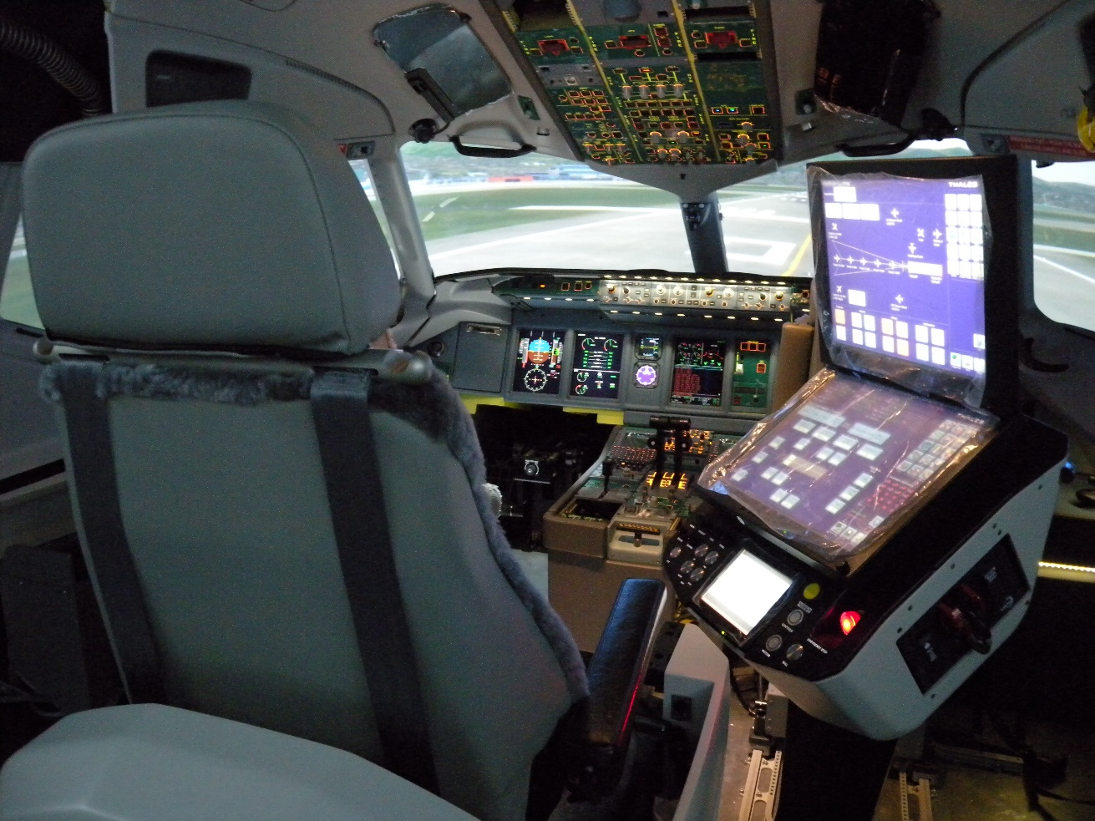
What is controlled?
Hardware
Computer systems
Simulated weapons
Simulated equipment
Data and Technology (including software)
Simulation programs
Databases
Services
Installation
Training
Design/Customization
This Photo by Unknown Author is licensed under CC BY-NC-ND
This Photo by Unknown Author is licensed under CC BY-SA
Notes:
Examples of potentially controlled transactions:
Installation of aircraft trainer in Qatar
Shipment of terrain generation software to the U.K. to a foreign subsidiary
Demonstrations of simulation software to foreign persons, including at trade shows such as I/ITSEC

Slide 9

The U.S. Export Laws
International Traffic in Arms Regulations (ITAR)
Administered by the Department of State, Directorate of Defense Trade Controls (DDTC)
Control defense articles, technical data, and defense services on the U.S. Munitions List (USML):
temporary and permanent exports
temporary imports
reexports
brokering
Examples: physiological flight trainers for fighter aircraft, weapons system simulators, battle management simulation software

Slide 10
ITAR Defense Articles
A “defense article” includes:
Any item or technical data designated on the U.S. Munitions List
It does not include basic marketing information on function or purpose or general system descriptions – but it may cover demonstrations
Trade shows such as I/ITSEC
Example:
Infrared scene generators
Missile launch trainers
Software that can be used to model or simulate battle management

Slide 11
ITAR Technical Data
“Technical data” includes:
Information which is required for the design, development, production, manufacture, assembly, operation, repair, testing, maintenance, or modification of defense articles, including blueprints, drawings, photographs, plans, instructions or documentation – ITAR 120.10
If it is technical information related to a defense article it is “technical data”

Slide 12
ITAR Technical Data
“Technical Data” also includes:
Classified information
Software related to a defense article
General scientific, mathematical or engineering principles, and public domain information, is generally excluded BUT these categories are specifically defined and limited in the ITAR.
Example:
Simulation software
Software operator manuals
Design documents
Technical proposals describing your solution

Slide 13
ITAR Defense Service
A “defense service” includes:
Furnishing of assistance (including training) to foreign persons, whether in the U.S. or abroad in the design, development, engineering, manufacture, production, assembly, testing, repair, maintenance, modification, operation, demilitarization, destruction, processing or use of defense articles – ITAR 120.9
Translation – If you are helping a foreign person and it relates to any type of military product or application, it is likely an ITAR-controlled defense service.

Slide 14
ITAR Defense Service
“Defense services” also include:
Furnishing to foreign persons of any technical data controlled under the ITAR
Military training of foreign units and forces
Be aware that defense services may be provided on the basis of only public domain information!
Examples:
Technical support for simulation software
Installation of equipment or software
Training on use of a trainer

Slide 15
ITAR and Simulation
ITAR USML Category IX pre-Export Control Reform (ECR):
Training equipment specifically designed, modified, configured or adapted for military purposes; simulation devices for ITAR-controlled articles
ITAR USML Category IX post-ECR (excerpts):
Devices that are mockups of articles enumerated in the ITAR subchapter used for maintenance training or disposal training for ordnance enumerated in this subchapter
Air combat maneuvering instrumentation and ground stations therefor
Physiological flight trainers for fighter aircraft or attack helicopters
Radar trainers specially designed for training on radar controlled by USML Category XI
Anti-submarine warfare trainers
Missile launch trainers
Radar target generators
Infrared scene generators
Software that can be used to model or simulate battle management or military test scenarios/models or effects of weapons enumerated in the ITAR

Slide 16

The U.S. Export Laws
Export Administration Regulations (EAR)
Administered by the Department of Commerce, Bureau of Industry and Security (BIS)
Control temporary and permanent exports and retransfers of equipment, materials, software and technology identified on the Commerce Control List (CCL) by Export Control Classification Number (ECCN) including some defense articles
Examples: human rated centrifuges, equipment “specially designed” for military training not on the USML
Notes:
Export Control Reform Act (passed August 13, 2018) requires BIS to identify Emerging Technologies essential to national security and implement controls.

Slide 17
Scope of the EAR
EAR 734
“Subject to the EAR”: Those items and activities over which BIS exercises regulatory jurisdiction under the EAR
In the United States
U.S. origin items
U.S. origin items integrated into foreign products
Foreign-made products of U.S. origin technology
EAR 738 – Commerce Control List Overview & Country Chart (Supplement No. 1)
EAR 774 – Commerce Control List
Notes:
De minimis

Slide 18
EAR Technology
“Technology” consists of specific information necessary for the “development”, “production”, or “use” of a product. The information takes the form of ‘technical data’ or ‘technical assistance’.
Similar to ITAR concept of technical data and defense service, but generally considered to be more narrow.
A service is only controlled under the EAR if it involves an export of technology.
Installation, for example, may not be controlled if you are not teaching a foreign person.

Slide 19

EAR Technology
Note that it is possible to perform an ITAR-controlled defense service on purely EAR-controlled hardware/software.
Modify an EAR-controlled trainer to incorporate specific battle management techniques?
Incorporate ITAR-controlled missile behaviors into an EAR-controlled trainer?
Provide tactical training to a foreign military using EAR-controlled simulation software?

Slide 20
EAR Control
Determining ECCN
Review general characteristics of the item and determine category on the CCL
Consider CCL index
Determine particular group
Identify specific ECCN
Ask the people with knowledge of the item
If no ECCN fits, item may be EAR99
“600 series” items are items moved from the ITAR and will be subject to more restrictive licensing (and no export to China)
Notes:
CCL Categories:
Category 0 - Nuclear Materials Facilities & Equipment [and Miscellaneous Items]
2018-10-29
Category 1 - Materials Chemicals Microorganisms and Toxins
2018-10-29
Category 2 - Materials Processing
2018-10-29
Category 3 - Electronics Design Development and Production
2019-05-23
Category 4 - Computers
2018-10-29
Category 5 Part 1 - Telecommunications
2018-10-29
Category 5 Part 2 - Information Security
2019-05-23
Category 6 - Sensors and Lasers
2019-05-23
Category 7 - Navigation and Avionics
2018-12-20
Category 8 - Marine
2018-01-08
Category 9 - Aerospace and Propulsion

Slide 21
EAR ECCNs
Each category organized into five groups (identified by letters A-E) controlled by the EAR:
A: Equipment, Assemblies and Components
B: Test, Inspection and Production Equipment
C: Materials
D: Software
E: Technology
All defined in EAR 772.

Slide 22
Sample ECCN - EAR
“0” is the CCL Category
“A” the Product Group
A -Systems, Equipment and Components
B - Test, Inspection and Production Equipment
C – Material
D - Software
E – Technology
“6” indicates 600 series
“14” generally tracks multilateral regime
Identifies certain license exceptions, definitions and descriptions of controlled items

Slide 23
EAR and Simulation
0A614 – Military Training Equipment
“Equipment” “specially designed” for military training that is not enumerated or otherwise described in USML Category IX
“This entry includes operational flight trainers, radar target trainers, flight simulators for aircraft classified under ECCN 9A610.a, human-rated centrifuges, instrument flight trainers for military aircraft, navigation trainers for military items, target equipment, armament trainers, military pilotless aircraft trainers, mobile training units and training “equipment” for ground military operation.”
0D614 – Software related to military training equipment
0E614 – Technology required for the development, production, operation, installation, maintenance, repair, overhaul, or refurbishing of commodities or software controlled by ECCNs 0A614, 0B614, or 0D614
Notes:
Restriction on export 600 series items to China

Slide 24
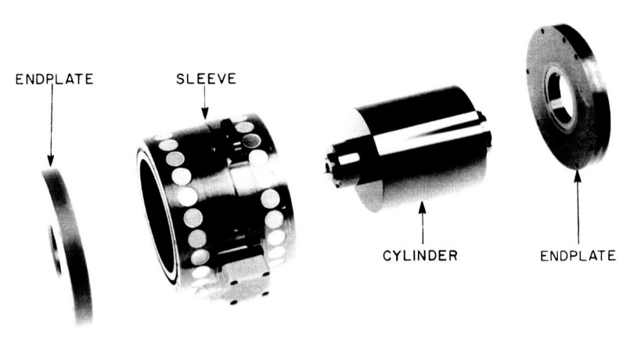
Things to be Aware of:
Foreign origin items in the U.S. or that include U.S. parts or technology, can be subject to the ITAR or EAR.
Foreign subsidiaries?
Foreign partners?
Joint ventures?
If a U.S. person modifies a foreign technology that has military applications, that can also create ITAR or EAR control
Notes:
- creating a trainer for a foreign aircraft or other platform
- modifying software to the needs of a foreign customer

Slide 25
Determining Export Control Jurisdiction
Which Regulations apply to the F-35 Cockpit Simulator System?
The jurisdiction and classification process is governed by an “Order of Review”
ITAR 121.1(b)(1)
Online Decision Tool:
http://pmddtc.state.gov/licensing/dt_OrderofReview.htm
EAR 774 Supplement No. 4
Online Decision Tool:
http://www.bis.doc.gov/index.php/export-control-classification-interactive-tool
The Order of Review defines the steps for reviewing the ITAR and then the EAR to assess jurisdiction and classification.

Slide 26
ITAR or EAR?
“Order of Review”
ITAR
USML
ITAR Specially Designed*
EAR
600 Series
EAR Specially Designed
EAR
CCL
EAR99
Only analyze “specially designed” if term is used in a catch-all paragraph

Slide 27
Jurisdiction/Classification
Always review the ITAR first!
Review the USML and determine whether any paragraph potentially captures your item.
This may include applying the “specially designed” analysis.
If you are unable to determine whether the item is included on the USML, ITAR 120.4 allows the submission of a Commodity Jurisdiction request to DDTC.
New DECCS system for submission of CJs
DDTC CJ Determination Database may also be helpful:
http://pmddtc.state.gov/commodity_jurisdiction/determination.html

Slide 28
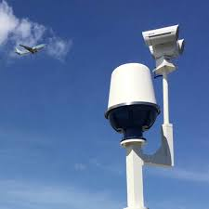
Order of Review
Is your item specifically enumerated within the United States Munitions List (USML)?
USML is divided into 21 categories, e.g., Ground Vehicles All USML Categories have been revised per ECR
Each category includes paragraphs for articles, technical data, and defense services
Review each category to determine whether your item is specifically listed (“enumerated”)
If yes, your analysis is complete and the item is ITAR controlled
28

Slide 29
USML Categories
I – Firearms, Close Assault Weapons and Combat Shotguns
II – Guns and Armament
III – Ammunition/Ordnance
IV – Launch vehicles, Guided Missiles, Ballistic Missiles, Rockets, Torpedoes, Bombs, and Mines
V – Explosives and Energetic Materials, Propellants, Incendiary Agents, and Their Constituents
VI – Surface Vessels of War and Special Naval Equipment
VII – Ground Vehicles
VIII – Aircraft and Related Articles
IX – Military Training Equipment and Training
X – Personal Protective Equipment
XI – Military Electronics

Slide 30
USML Categories
XII – Fire Control, Laser, Imaging, and Guidance Equipment
XIII – Materials and Miscellaneous Articles
XIV – Toxicological Agents, Including Chemical Agents, Biological Agents, and Associated Equipment
XV – Spacecraft and Related Articles
XVI – Nuclear Weapons Related Articles
XVII – Classified Articles, Technical Data and Defense Services Not Otherwise Enumerated
XVIII – Directed Energy Weapons
XIX – Gas Turbine Engines and Associated Equipment
XX – Submersible Vessels and Related Articles
XXI – Articles, Technical Data, and Defense Services Not Otherwise Enumerated

Slide 31
Order of Review
The USML is more “positive” and specific than before ECR
For example:
Pre- reform Category VIII(a): “Aircraft . . . specifically designed, modified or equipped for military purposes.”
Post-reform Category VIII(a): “Aircraft, as follows: bombers, fighters ... attack helicopters, unarmed military unmanned aerial vehicles...”
This should make it easier to determine whether your item is enumerated
31

Slide 32

Order of Review
Example:
USML Cat. IX(b)(1) – Simulators, as follows:
System specific simulators that replicate the operation of an individual crew station, a mission system, or a weapon of an end-item that is controlled in this subchapter
If that is what you are analyzing, your review is complete

Slide 33
Order of Review
If your item is not enumerated, move to the next step of the ITAR review
Review the USML to determine whether your item is described in a “catch-all” paragraph using the phrase “specially designed”
Example:
USML Cat. XI(c) – Military Electronics
Parts, components, accessories, attachments, and associated equipment as follows: ... (2) Printed Circuit Boards (PCBs) and populated circuit card assemblies for which the layout is specially designed for defense articles in this subchapter;
If yes, you must review the definition of “specially designed” in ITAR §120.41
If no (and your item is not enumerated), your item is not ITAR-controlled and the review moves to the EAR
33

Slide 34
EAR Classification
If your item is not on the USML, then you move to a review of the EAR, starting with “600 series” and “9x515” ECCNs.
Export Control Classification Numbers (ECCN) and destination determine whether an export license is needed.
The ECCN is an alpha-numeric code:
describes a particular item or type of item
shows the controls placed on that item
ECCN found in the CCL at Part 774 of the EAR.
Note - EAR99: a type of classification for items that are covered by the EAR but are not specified on the CCL.

Slide 35
EAR Classification
EAR provides a process, similar to the ITAR Commodity Jurisdiction, that permits submission of a Classification Request to BIS:
http://www.bis.doc.gov/index.php/licensing/commerce-control-list-classification/classification-request-guidelines
Note, this is not legally binding if the ITAR should have governed the item!

Slide 36
CCL Categories
0 - Nuclear Materials, Facilities & Equipment (Misc. Items)
1 - Materials, Chemicals, Microorganisms, and Toxins
2 - Materials Processing
3 - Electronics
4 - Computers
5 - Part 1 – Telecommunication
5 - Part 2 – Information Security
6 - Sensors & Lasers
7 - Navigation & Avionics
8 - Marine
9 - Aerospace & Propulsion

Slide 37
Sample ECCN
ECCN 7A611
“7” is the CCL Category
“A” the Product Group
A -Systems, Equipment and Components
B - Test, Inspection and Production Equipment
C – Material
D - Software
E – Technology
“6” indicates 600 series
“11” generally tracks multilateral regime
Identifies certain license exceptions, definitions and descriptions of controlled items

Slide 38
Order of Review
Use the same information you used on the ITAR side, to review the CCL
Review characteristics of item to determine applicable CCL category and product group, e.g., aircraft part, start with Category 9
Review applicable 600 series/515 ECCNs
Specifically enumerated items
“Catch-all” controls and EAR definition of “specially designed”
Review applicable non-600/non-515 series ECCNs

Slide 39
“Specially Designed”
ECR implemented a definition of the term “specially designed” which will be used in USML Categories and ECCNs, e.g., “radar trainers “specially designed” for training on radars controlled by Category XI.
ITAR 120.41 “specially designed” provides catch and release analysis for items used in defense articles with releases for such things as: minor items (screws, bolts, springs, wires); items that have equivalent commercial versions; or that were developed for military and commercial purposes.
A similar but not identical definition is found in EAR 772

Slide 40
Specially Designed
“Specially Designed” uses a “catch and release” structure. There are two “catches,” in paragraph (a).
A commodity or software is specially designed if it:
(a)(1) As a result of development, has properties peculiarly responsible for achieving or exceeding the controlled performance levels, characteristics, or functions described in the relevant USML paragraph; or
a)(2) Is a part, component, accessory, attachment, or software for use in or with a defense article
This is a very broad catch; the item need only be used in or with a defense article
40

Slide 41
Specially Designed
There are five possible “releases” in paragraph (b) that are only applicable to parts, components, accessories, attachments or software:
First release:
(b)(1) Is subject to the EAR pursuant to a CJ
Second release:
(b)(2) Is, regardless of form or fit, a fastener (e.g., screws, bolts, nuts, nut plates, studs, inserts, clips, rivets, pins), washer, spacer, insulator, grommet, bushing, spring, wire, or solder
41
Notes:
6 releases under the EAR
Same concepts reflected in both definitions

Slide 42
Specially Designed
Third release:
(b)(3) Has the same function, performance capabilities, and the same or “equivalent” form and fit as a commodity or software used in or with a commodity that:
Is or was in production (i.e., not in development); and
Is not enumerated on the USML
Is there another item out there that does the same thing but is used in a non-ITAR item?
42
Notes:
“Equivalent” is defined to mean form has been modified solely for fit purposes.
“Production” means all production stages, such as product engineering, manufacture, integration, assembly (mounting), inspection, testing and quality assurance.
“Development” is related to all stages prior to serial production, such as: design, design research, design analyses, design concepts, assembly and testing of prototypes, pilot production schemes, design data, process of transforming design data into a product, configuration, design, integration design, layouts.

Slide 43
Specially Designed
Form, Fit, Function and Performance Capability:
“Form” is defined by its configuration (including the geometrically measured configuration), material, and material properties that uniquely characterize it
“Fit” is defined by its ability to physically interface or connect with or become an integral part of another commodity
“Function” means the action or actions it is designed to perform
“Performance capability” is the measure of a commodity's effectiveness to perform a designated function in a given environment

Slide 44
Specially Designed
Fourth release:
(b)(4) Was or is being developed with knowledge that it is or would be for use in or with both defense articles and commodities not on the USML
Fifth release:
(b)(5) Was or is being developed as a general purpose commodity or software, with no knowledge for use in or with a particular commodity or type of commodity (e.g., an aircraft or machine tool)
EAR Definition has a sixth release:
(b)(6) Was or is being developed with knowledge that it would be for use in or with commodities or software described:
In an ECCN controlled for AT-only reasons and also EAR99 commodities or software; or
Exclusively for use in or with EAR99 commodities or software
44
Notes:
Must have documents contemporaneous with development
Contemporaneous documentation:
Design information, marketing plans, declarations in patent applications, or contracts
If you invoke a release, you need to be able to support the decision
Maintain a record

Slide 45
Let’s Practice
What is the jurisdiction and classification of the F-35 Cockpit Simulator System?
The MTB Company manufactures and exports various military simulation systems. The MASH Simulation System is used to train medical personnel and simulates real-time battlefield medical support scenarios. The MTB Company developed the MASH Simulation System for the US Army. What’s the jurisdiction and classification?

Slide 46
ITAR Export
What is an “export”?
Sending or taking a defense article out of the United States in any manner
Releasing or transferring technical data to a foreign person in the United States
Performing a defense service on behalf of, or for the benefit of, a foreign person, whether in the United States or abroad
Beware – an export does not require any person or product to leave the United States!

Slide 47
What is Not an Export?
ITAR 120.54 – Activities that are not Exports, Reexports, Retransfers, or Temporary Imports
Added March 25, 2020
Key Provisions:
120.54(a)(5) – Sending, taking or storing technical data that is:
Unclassified
Secured using end-to-end encryption;
Secured using cryptographic modules (hardware or software) compliant with FIPS 140-2….or by other cryptographic means that provide security strength that is at least comparable to the minimum 128 bits of security strength achieved by AES-128;
Not intentionally sent to or stored in a proscribed 126.1 country or the Russian Federation; and
Not sent from a proscribed 126.1 country or the Russian Federation

Slide 48
What is Not an Export?
120.54(b)(1) defines end-to-end encryption as:
The provision of cryptographic protection of data, such that the data is not in an unencrypted form, between an originator (or the originator’s in-country security boundary) and an intended recipient (or the recipient’s in-country security boundary); and
The means of decryption are not provided to any third party.
120.54(b)(2) - The originator and the intended recipient may be the same person. The intended recipient must be the originator, a U.S. person in the United States, or a person otherwise authorized to receive the technical data, such as by a license or other approval pursuant to this subchapter
120.54(c) - The ability to access technical data in encrypted form that satisfies the criteria set forth in paragraph (a)(5) of this section does not constitute the release or export of such technical data
Notes:
120.50 Release.
(a) Technical data is released through:
(1) Visual or other inspection by foreign persons of a defense article that reveals technical data to a foreign person;
(2) Oral or written exchanges with foreign persons of technical data in the United States or abroad;
(3) The use of access information to cause or enable a foreign person, including yourself, to access, view, or possess unencrypted technical data; or
(4) The use of access information to cause technical data outside of the United States to be in unencrypted form.
(b) Authorization for a release of technical data to a foreign person is required to provide access information to that foreign person, if that access infor

Slide 49
EAR Export
An actual shipment or transmission of items subject to the EAR out of the United States; or
Release of technology or source code:
Visual or other inspection by foreign national that reveals technology or source code
Oral or written exchange of technology or source code in the United States or abroad
EAR 734.18 Activities that are Not Exports, Reexports or Transfers has provision that is the same as the ITAR encryption provision
Notes:
Note that, from the EAR perspective, a foreign person must actually access controlled technology for an export to have occurred, i.e., opened the network file, not merely received theoretical access to it.

Slide 50

EAR Deemed Export
Deemed Export: the release of software or technology to a foreign national within the United States
“Deemed” to be an export to the foreign person’s country of nationality

Slide 51
Reexports
The ITAR and EAR also control “reexports”.
Exported items generally remain subject to the ITAR and EAR even after leaving the United States.
This means that foreign recipients must continue to track and identify ITAR and EAR-controlled items
Real-life impact: If you deliver software for a combat flight trainer to a prime contractor in France, and they incorporate it into the finished trainer, when they send it to their customer, the Australian Ministry of Defence, they need a reexport authorization from the U.S. Government.

Slide 52
Who is a U.S. Person?
ITAR and EAR U.S. Person
A U.S. citizen
A person who is a lawful permanent resident [of the U.S., also known as a green card holder]
A person who is a protected individual as defined by 8 U.S.C. 1324b(a)(3) (refugee, asylee)
Any corporation, business, association, partnership, society, trust, or any other entity organization or group that is incorporated to do business in the United States
Any governmental entity
Notes:
“U.S. person” and “foreign person” are the same as under the ITAR except that:
Under the EAR “last in time” citizenship governs.
Under the ITAR, all countries in which the foreign person has held or holds citizenship or permanent residency govern

Slide 53
Who is a Foreign Person?
ITAR and EAR Foreign Person
Any natural person or entity who is not a U.S. Person
This includes:
Persons in the U.S. on visas (e.g., H1B);
Foreign government entities;
Foreign companies or organizations such as NATO; and
Persons in the U.S., regardless of citizenship, who represent a foreign entity.
NOTE WELL: A foreign person located in the United States is still a foreign person, even if they are on a U.S. Government installation or employed by a U.S. company.

Slide 54



Foreign Persons
Persons may hold more than one citizenship or nationality – dual nationalities. Also may hold citizenship/nationality different than their foreign employer – third country nationals
Like U.S. companies, foreign companies employ persons from around the world.
You need to be confident that no one with a nationality or citizenship of an ITAR 126.1 country is involved, unless you are able to satisfy the requirements of ITAR 126.18
Notes:
Citizenship vs. Nationality
Citizenship is a legal status that varies by the law of each country.
Nationality is a concept used by DDTC to cover country of birth and ties back to that country as well as citizenship

Slide 55
Export Steps
Determine jurisdiction/classification of item.
Identify applicable licensing requirements based on:
Jurisdiction/classification
Destinations
End-users and Consignees
End-uses
Conduct screening.
Maintain appropriate records.

Slide 56
ITAR Export Licenses
Nearly all ITAR exports will require an authorization from the Department of State.
Defense Export Control and Compliance System (DECCS)
New System for ITAR Submissions
Used for Commodity Jurisdiction Requests, Advisory Opinions, Registration, Licensing
Licenses/Agreements
D-Trade system permits electronic application and approval of licenses
DSP-5 (6) - permanent export of unclassified defense articles and technical data
DSP-61 (62) – temporary imports of unclassified defense articles
DSP-73 (74)– temporary exports of unclassified defense articles
Require identification of articles and data, quantity, value, end-users, consignees and end-use
Generally valid for four (4) years
Generally approved in 30-60 days
All exports must be decremented on the license
License must be returned to DDTC when exhausted or expired

Slide 57
ITAR Export Authorizations
Technical Assistance Agreement (TAA)
Used for exports of technical data and defense services (assistance)
Format may change to a DSP-5
Manufacturing License Agreement (MLA)
Similar in form to a TAA, but includes manufacturing know-how/licensed manufacture of defense articles
Warehouse Distribution Agreement (WDA)
Authorizes establishment of a warehouse and distribution point abroad for defense articles exported from the U.S. and distribution within an approved sales territory
Let’s Practice: What type of licensing and/or authorization will be required for Simulation R’ Us to proceed with activities with the UK MoD?

Slide 58
ITAR Exemptions
In certain situations, the ITAR provide exemptions that permit exports or imports without prior approval from DDTC.
Each exemption includes specific requirements that must be fully satisfied before invoking the exemption.
Examples:
123.4 – Temporary imports of defense articles for specific purposes
124.2(a) – Training in the basic operation and maintenance of defense articles lawfully export or authorized for export to the same recipient
125.4(b)(1) – Exports of technical data disclosed pursuant to an official request or directive from the U.S. DoD
125.4(b)(9) – Exports of technical data sent by a U.S. corporation to a U.S. person employed by that corporation overseas or to a U.S. Government agency
126.5 (Canadian exemption) – Exports of technical data and defense articles to Canada

Slide 59
EAR Licensing
License determinations require a review of the ECCN, Country Chart and Reasons for Control.
Also should include a review of General Prohibitions and Red Flags.
Review the EAR General Prohibitions – EAR 736.2(b) including:
Export and reexport of controlled items to listed countries
Reexport and export from abroad of foreign-made items incorporating more than a de minimis amount of controlled U.S. content
Reexport and export from abroad of the foreign produced direct product of U.S. technology and software
Export or reexport to prohibited end-uses or end-users
New China, Russia and Venezuela military end-use and end-user restrictions
Export or reexport to embargoed destinations
Support of proliferation activities
Proceeding with transactions with knowledge that a violation has occurred or is about to occur
Notes:
June 29, 2020 – China, Venezuela and Russia Military end-use and end-user license requirement.

Slide 60
EAR License Exceptions
Many EAR-controlled exports will be eligible for a License Exception.
Pre-approved authorization to export items controlled under the EAR to certain destinations.
No need for license application.
Certain requirements need to be met.

Slide 61
EAR License Exceptions
17 license exceptions available, depending on circumstances and purpose
Examples include:
STA – Strategic Trade Authorization
GOV – Governments, International Organizations and International Inspections
TMP – Temporary Imports, Exports and Reexports
TSU – Technology and Software (Unrestricted)
TSR – Technology and Software Under Restriction

Slide 62

EAR Red Flags
Make sure the transaction passes the “smell test”
Examples of red flags include:
The customer or its address is similar to one of the parties found on a list
The customer or purchasing agent is reluctant to offer information about the end-use of the item
Routine installation, training, or maintenance services are declined by the customer
Addressing Red Flags
Duty to check out the suspicious circumstances and inquire about the end-use, end-user, or ultimate country of destination
Document this review
Contact BIS if necessary – (800) 424-2980
These Red Flags apply to ITAR transactions too!

Slide 63

Screening
Screen all parties to the transaction against the U.S. Government’s denied party lists:
Denied Persons List
Unverified List
Entity List
Specially Designated Nationals List
Debarred List
Screening should be done regardless if dealing with ITAR or EAR technology.
Know the parties to the transaction!
Notes:
Huawei and 69 entities on entities list

Slide 64

Requesting an EAR License
BIS 748-P: Multipurpose Application Form
Used for all exports
Classification requests
SNAP-R: Simple Network Application Process Redesign
Permits the submission of export and reexport applications, and commodity classification requests via the Internet in a secure environment.
Provides same day acknowledgment of your submission.
Provides online validations (e.g. electronic facsimile of export license) from BIS.

Slide 65
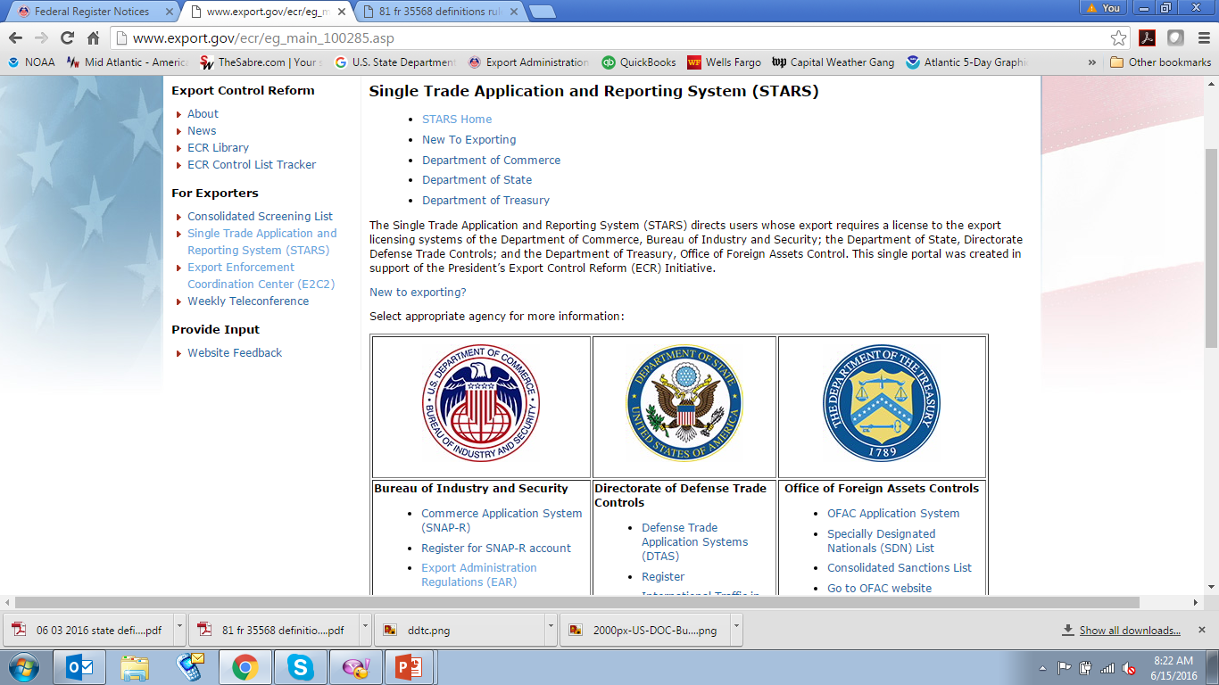
Licensing
DDTC and BIS are working toward a single license form.
Established the portal that will eventually lead to this form:
http://www.export.gov/ecr/eg_main_100285.asp

Slide 66
Time to Export
The MTB Company has sold the MASH Simulator Systems to the Japan MoD. You are the MTB trade compliance genius. What steps do you need to take to export the system?

Slide 67
Recordkeeping
ITAR §122.5 requires that all records concerning the manufacture, acquisition, and disposition of defense articles, technical data, and defense services, brokering, and political contributions, fees, and commissions be maintained for five years from the date of the transaction.
EAR §762 - All export records must be maintained
Documents must be readable and available for review in short order (rule of thumb is 48 hours).
May be maintained electronically or in hard-copy, as long as they have a “high-degree of legibility and readability.”
Notes:
Memoranda
Notes
Correspondence
Contracts
Invitations to bid
Books of account
Financial records

Slide 68
Consequences
Potential ITAR fines:
Upwards of $1,000,000 per violation for civil penalties
$1,000,000 per violation plus jail for criminal penalties
Potential EAR fines:
$300,000 per violation for civil penalties
$1,000,000 per violation plus jail for criminal penalties
Criminal prosecutions of export violations are rising and the Department of Justice has established a task force to increase focus on export violations

Slide 69
Consequences
State can also impose administrative requirements including:
debarment or suspending export privileges
special compliance officials
periodic internal and outside audits with reports provided to DDTC
revised and upgraded compliance programs
compliance hotlines
electronic licensing systems documenting compliance and licensing decisions
certifications of compliance by the Board of Directors or Senior Management

Slide 70
Resources
DDTC: www.pmddtc.state.gov
D-Trade: http://www.pmddtc.state.gov/DTRADE/index.html
BIS: www.bis.doc.gov
SNAP-R: https://snapr.bis.doc.gov/snapr/
ITAR: 22 CFR §§120-130
EAR: 15 CFR §§730-774
DoD ELISA: http://elisa.osd.mil/Elisa_Results.aspx
Society for International Affairs (international trade education): www.siaed.org
Screening: www.export.gov

