Slide 1
Understanding and Applying cmi5 in an xAPI Solution
Andy Johnson Advanced Distributed Learning (ADL) Initiative, SETA Contractor Art Werkenthin RISC Inc., CEO
Mike Hernandez Design Interactive, Senior Project Engineer

Slide 2
Learning Outcomes
The Learner Will…
Gain a baseline understanding of (Experience API) xAPI
Understand the subject matter of the cmi5 (not an acronym) specification
Understand the application and use of xAPI Profiles
Understand how to apply cmi5 as a replacement to SCORM to a traditional e-learning course
Understand the products and services available that integrate cmi5

Slide 3
Overview/Topics
Experience API Basics
cmi5 Deep Dive
xAPI Profiles
Available Products and Tools
Crafting cmi5 Solutions

Slide 4
Expected Learning Outcome #1
1
The learner will gain an understanding of xAPI, such that the additional requirements of cmi5 will be comprehensible. This includes the role and structure of xAPI Statements, the Learning Record Store, and additional xAPI Resources/Endpoints that are used in a holistic approach to Distributed Learning.

Slide 5





Why xAPI?
Learning analytics
Not restricted to customized reports
Not restricted to basic data (scores, pass/fail)
Learning can be recorded wherever it occurs
Learning does not have to be “launched” from an LMS
Mobile apps
Social Networking
Serious Games & Simulations
Correlation of general activity with learning data
Notes:
Learning can be recorded wherever it occurs
Specialized analytics
Not restricted to customized reports
Not restricted to only basic data (scores, pass/fail)
Learning does not have to be “launched” from an LMS
Mobile apps
Social Networking
Gaming & Simulations
Correlation of general activity with learning data

Slide 6
What is xAPI?
Basic Definition (Remember this one):
xAPI statements are data generated by a Learning Record Provider (LRP) and sent to a Learning Record Store (LRS).
Technical Definition (Look once and forget if you want):
Experience API (IEEE 9274.1.1) is the JavaScript Object Notation (JSON) data model format and a Representational State Transfer (RESTful) Web Service Application Programming Interface (API) for communication between Activities experienced by an individual, group, or other entity and a Learning Record Store.
Notes:
Basic Definition (Remember this one): User Experiences within content is tracked through a Learning Record Provider (LRP) and sent to a Learning Record Store (LRS).
Technical Definition (Look once and forget if you want): Experience API (IEEE 9274.1.1) is the JavaScript Object Notation (JSON) data model format and a Representational State Transfer (RESTful) Web Service Application Programming Interface (API) for communication between Activities experienced by an individual, group, or other entity and a Learning Record Store.

Slide 7
Necessary Context
Learning Management System (LMS) |  | An entire suite of web services used in traditional (SCORM) distributed learning solutions
Learning Record Provider (LRP) |  | Sender in xAPI
Learning Record Store (LRS) |  | Receiver (Web Service) in xAPI
Statement |  | Single artifacts of activity in xAPI – “I Did This”
Documents |  | Large sets of data (name, value) that keep state in xAPI
Resource/Endpoint |  | Interface within xAPI to programming methods (Means by which to send/receive)
Content |  | Any learning asset deployed in a Distributed Learning environment
Notes:
Learning Management System (LMS) – An entire suite of web services used in traditional (SCORM) distributed learning solutions
Learning Record Provider (LRP) – Sender (Web Service) in xAPI
Learning Record Store (LRS) – Receiver (Web Service) in xAPI
Statement – Single artifacts of achievement in xAPI – “I Did This”
Documents – Large sets of data (name, value) that keep state in xAPI
Resource/Endpoint – Interface within xAPI to programming methods (Means by which to send/receive)
Content – Any learning asset deployed in a distributed learning environment

Slide 8
xAPI Components
Resource/Endpoint
Creates
LRS
LRP
Content
Statements
Stores
Documents
Stores
Modifies
LRP = Learning Record Provider, LRS = Learning Record Store

Slide 9
Statement Parts
Actor |  | Doer in the Statement
Verb |  | Action in the Statement
Object |  | “Direct Object” in the Statement, often an actual web activity
Results/Context |  | Additional necessary information
Timestamp |  | When the experience happened
These allow the basic construction of human/machine readable expressions
Notes:
Actor – Doer in the Statement
Verb – Action in the Statement
Object – “Direct Object” in the Statement, often an actual web activity
Results/Context – Additional necessary information
Timestamp – When the experience happened
These allow the basic construction of human/machine readable expressions

Slide 10
Sample Statements
Andy | launched | Chemistry Quiz (Activity ID)
Andy | initialized | Chemistry Quiz
Andy | answered | Question 1 with choice “A”
Andy | passed | Chemistry Quiz
Andy | completed | Chemistry Quiz
Andy | terminated | Chemistry Quiz
Andy | satisfied | Chemistry Quiz
Andy | satisfied | Chemistry Unit
Notes:
Andy launched Chemistry Quiz
Andy initialized Chemistry Quiz
Andy answered Question 1 with choice “A”
Andy passed Chemistry Quiz
Andy completed Chemistry Quiz
Andy terminated Chemistry Quiz
Andy satisfied Chemistry Quiz
Andy satisfied Chemistry Unit

Slide 11

Designers and Developers Speaking The Same Language
“Andy passed Chemistry”
Got it! <Andy passed Chemistry>
Credit: www.theodysseyonline.com

Slide 12
Let’s Talk About “The Fridge”
To put a bow on “how language in xAPI works”, Let’s enable a “Smart Fridge”.
Different “Actors” interact with the Fridge, including the Fridge itself
Different actions or “Verbs” would align to functions the Fridge can perform
Different “Objects” can interact with the Fridge, these may be tangible (apples, cheese, bacon) or intangible (temperature setting)
Sometimes more details are needed, so “Results” or “Context” is used
Becky supplied apples to fridge
Tommy received bacon from the fridge
Fridge adds bacon (to shopping list)

Slide 13
Statements Go To the LRS
Server-Side Implementation of xAPI
The Learning Record Store is a “triple store” Actor/Verb/Object which is RESTful
RESTful refers to web services that are light weight, highly scalable and maintainable by following a set of constraints
Very little validation is done at run-time, which makes it fast and flexible
Won’t throw out “Andy friended Biochemistry quiz”
Other services will extract meaning from the data and expose it in interesting ways to the learner

Slide 14
LMS and LRS Capabilities
User Management
Learning Records
Scheduling
LMS
Course Management
LRS
Statistics
Grade Book
Run-Time
Repository
Search
Player
Sequencing
Delivery
Preferences
Reports
Assessment
14
Notes:
SCORM is effective in describing how a learner’s active session with learning content passes learning data to an LMS. However, SCORM does not currently describe how or if the LMS displays the data to the learner. This situation means the people who need the data the most may not have access to it. For example, a course administrator may not be able to access scores for all learners in a course. The LMS stores the data, but SCORM doesn’t specify how the LMS should expose it.
There is nothing stopping a single product from having all of these capabilities
14

Slide 15
Why Do I Need a Learning Record Provider ?
If Content Sent Statements wildly to the Learning Record Store
If LRS accepted Statements that were sent from “Content”
Is my content sending data correctly?
Does my content have permission on that system?
Will I get credit?
Does the institution/instructor of my content know who I am and can they get that to the LRS?
Is the learner who they say they are?
Is the institution/instructor on this Statement real?
Did they pay for the rights to take the content?
The Learning Record Provider is the trusted partner of the Learning Record Store, ensuring data is reliable and valid
Notes:
If Content Sent Statements wildly to the LRS
Is my content sending data correctly?
Does my content have permission on that system?
Will I get credit?
Does the institution/instructor of my content know who I am and can they get that to the LRS?
If LRS accepted Statements that was sent from “Content”
Is the learner who they say they are?
Is the institution/instructor on this Statement real?
Did they pay for the rights to take the content?

Slide 16

Let’s Talk About Linked Data
xAPI, through both Statements and Documents, creates semantic data relationships
Statements especially, being “triples”, have a natural integration into systems that can use the semantic web
In the Fridge example, could link apples to consumption, calories, cost, etc.
In the context of distributed learning, could have competencies that interrelate, are achieved by individuals, and aggregate for higher achievement

Slide 17
Expected Learning Outcome #2
2
The learner will understand the subject matter of the cmi5 specification, such that it can be described using instructional design language and specific coding logic required to create the lifecycle of cmi5 data. The learner will understand the data flow, authentication, session management, and storage capabilities of cmi5 as well as the additional requirements of a cmi5 LMS beyond an LRS.

Slide 18
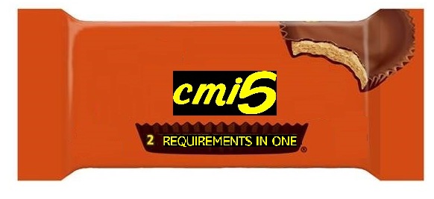
Why cmi5?
Like xAPI?
Need an LMS?

Slide 19
SCORM Negatives
All learning MUST be launched from LMS
Content must reside in same domain as LMS
Cannot put content on Content Distribution Network
Inefficient bandwidth
SCORM content MUST be run in a browser
Mobile and Offline use cases do not function
Notion of a “local server” fails
Easier to Cheat
LMS Accepts “blindly” what is sent to it
No timestamps = no “paper trail”

Slide 20
What is cmi5?
cmi5 is a set of “extra rules” to apply to xAPI that fit the current Distributed Learning paradigm, but readily enables future paradigms
cmi5 INCLUDES xAPI
cmi5 specifically addresses:
Content Launch Mechanism
Authorization (NOT Authentication)
Session Management
Reporting
Course Structure
Satisfaction Criteria

Slide 21
History of cmi5
Originally started in the AICC (Aviation Industry Computer-Based Training Committee) in 2010
cmi5 was expected to replace both AICC and SCORM
cmi5 was “rebooted” in 2012 and the previous architecture was replaced with xAPI after the group saw benefits and a clearer path to adoption
In 2014, the AICC dissolved and formally transferred cmi5 to the ADL
The cmi5 project is still guided by its original goals

Slide 22
Which Use Cases Does cmi5 Enable?
“Minimal LMS” |  | Support for dynamic amounts of information, but not as a ton of “optional” fields
“Content-defined Data” |  | In other words, content so specific that only the content needs it, but is still critical (Simulations, especially)
“Content as a service (CaaS) model of delivery” |  | Allow content to be stored on other domains
“Device/OS/browser independence” |  | Allow for content to be independent of a browser in order to communicate or be launched
“Share data between learning activities” |  | And between learners!
Notes:
“Minimal LMS”
Support for dynamic amounts of information, but not as a ton of “optional” fields
“Content-defined Data”
In other words, content so specific that only the content needs it, but is still critical (Simulations, especially)
“Content as a service (CaaS) model of delivery”
Allow content to be stored on other domains
“Device/OS/browser independence”
Allow for content to be independent of a browser in order to communicate or be launched
“Share data between learning activities”
And between learners!

Slide 23
cmi5 Roles and Responsibilities
Assignable Unit (AU) – Content + LRP (loosely)
Functions as content would be expected in xAPI – like a course.
Parses the parameters from the launching environment to determine where the LMS location is and initiate communication with the LMS.
Acting as a "client", sends and receives messages using the xAPI defined transport mechanism(s) and associated commands as prescribed in this specification.
Formats all data according to the defined data types and vocabularies that are defined in this specification.
Sends a "terminate" statement prior to terminating the AU's execution.

Slide 24
cmi5 Roles and Responsibilities Cont.
Responsibilities of the LMS
Create and maintain course structures.
Act as a "server" - receive and reply to messages using the xAPI defined transport mechanism(s) and associated commands as prescribed in this specification.
Format all data according to the defined data types and vocabularies that are defined in this specification.
Launch the specified AU contained in the content within the defined environment(s).

Slide 25
cmi5 Components
Resource/Endpoint
Creates
LRS
AU
Statements
Stores
Documents
Stores
Modifies
AU = Assignable Unit, LRS = Learning Record Store

Slide 26
The Nine cmi5 Verbs
Launched
Initialized
Completed
Passed
Failed
Abandoned
Waived
Terminated
Satisfied
Notes:
The 9 cmi Verbs:
Launched
Initialized
Completed
Passed
Failed
Abandoned
Waived
Terminated
Satisfied

Slide 27
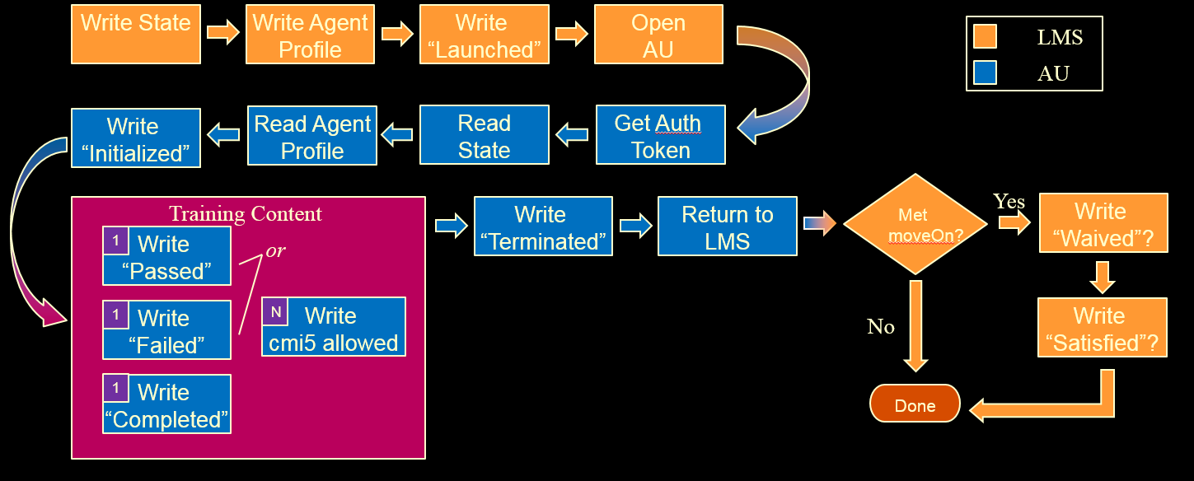
cmi5 Data Flow
Credit: RISC, Inc.

Slide 28
cmi5 = “xAPI with Rules”
Actor |  | Uses “account” for security purposes
Verbs |  | There can be only one! (use of each Verb) Specific order of Verbs, corresponding to events
Object |  | Is the AU and matches the activityId (content) AU used quite ubiquitously in this specification
Score |  | Not required, lumped in with pass/fail
Success/Completion |  | Designer (or Admin) decides the “how”, but success can directly relate to assessment
Registration |  | Establishes unique relationship between Actor and “course” Registrations are handled at the course level (AU registrations not allowed)
Notes:
Actor – uses “account” for security purposes
Verbs – There can be only one!
Use of each, that is – keeps things simple
Object – is the AU and matches the activityId (content)
AU used quite ubiquitously in this specification
Score – not required, lumped in with pass/fail
Success/Completion – designer decides the “how”, but success directly relates to assessment
Registration – dynamic relationship of Actor to “course”
Note: not AU, registrations are handled at the course level

Slide 29
cmi5 Additional Features
Authorized Launch Mechanism
Course Structure
AU provides a URL with query string that the LMS parses
Includes Actor, content id (of the AU), and registration
Similar to the content package of SCORM… and different
Supports 1 or more Assignable Units (AU)
Optionally nested within Blocks
Designed for interoperability across systems
Notes:
Authorized Launch Mechanism
AU provides a URL with query string that the LMS parses
Includes Actor, content id (of the AU), and registration
Course Structure
Similar to the content package of SCORM… and different
Supports 1 or more Assignable Units (AU)
Optionally nested within Blocks
Designed for interoperability across systems

Slide 30
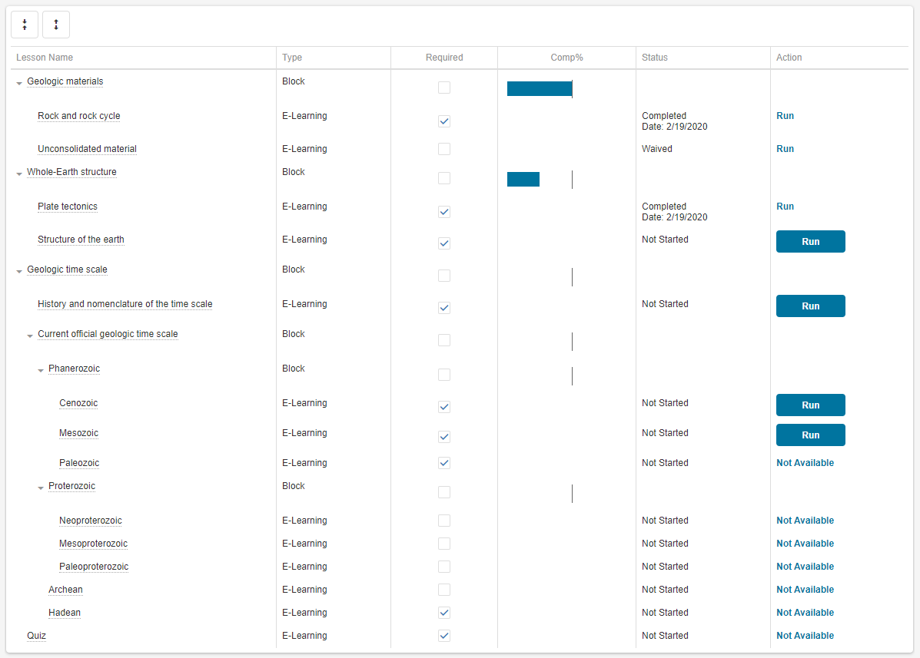
Course Structure Format
cmi5 = Assignable Units and Blocks
Credit: RISC, Inc.

Slide 31
cmi5 Versatility
Session Tracking
State API (ex: bookmarking)
Completion Criteria
cmi5 defines “Move On” criteria
Passed?
Completed?
Completed and Passed?
Mastery Score
Different scores for different roles
External Intervention
Allows "testing out" external to taking content (Administration)

Slide 32
“cmi5 Defined” vs. “cmi5 Allowed”
cmi5 categorizes the xAPI Statements during use:
"cmi5 defined" |  | Statements using cmi5 defined verbs Uses specific “category id” value for cmi5
"cmi5 allowed" |  | Statements using any verb and does not use the cmi5 specific “category id” Issued between “initialized” and “terminated” verbs
"cmi5 not-allowed" |  | Any statements not conforming with the cmi5 specification
Both “cmi5 defined” and “cmi5 allowed” use a “context template” |  | Context template is State information exchanged between the AU and LMS
Notes:
cmi5 categorizes the xAPI Statements during use:
"cmi5 defined" - Statements using cmi5 defined verbs
Uses specific “category id” value for cmi5
"cmi5 allowed" - Statements using any verb and does not use the cmi5 specific “category id”
Issued between “initialized” and “terminated” verbs
"cmi5 not-allowed" - Any statements not conforming with the cmi5 specification.
Both “cmi5 defined” and “cmi5 allowed” use a “context template”
Context template is State information exchanged between the AU and LMS

Slide 33
cmi5 Data Flow (Revisited)
Credit: RISC, Inc.

Slide 34
Expected Learning Outcome #3
3
Learners will understand the application and use of xAPI Profiles. This includes the use of multiple profiles in a single solution as well as best practices in creation and reuse of vocabulary found within xAPI Profiles. Learners will be able understand the difference between cmi5 defined and cmi5 allowed Statements.

Slide 35
Profiles – Where Do They Come From?
Use Case + Technology Application = Definition of xAPI Profile
Communities of Interest
Organizes Interested Parties in a Specific Subject Domain
Forms a Working Group
Defines Requirements
Explores Solutions – Both Logistical and Technical
cmi5 Working Group founded before technology solution
Later switched to xAPI solution
Inspired other xAPI solutions, effectively creating more xAPI Profiles
Notes:
Common Interests Shared
Organization Among Interested
Forms a Working Group
Defines Requirements
Explores Solutions – Both Logistical and Technical
Use Case + Technology Application = Definition of xAPI Profile
cmi5 Working Group founded before technology solution
Later switched to xAPI solution
Inspired other xAPI solutions, effectively creating more xAPI Profiles

Slide 36

What Does a Profile Do?
Is a Template of Technical Rules
Validates Sets of Statements
Employs Semantic Web Principles

Slide 37
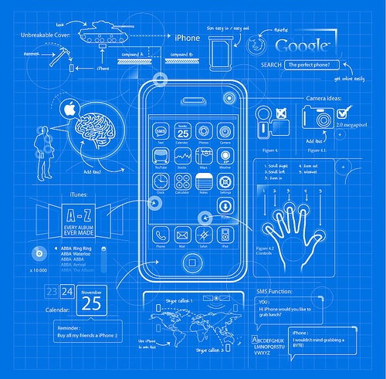

Tale of Two “Profiles”

Slide 38







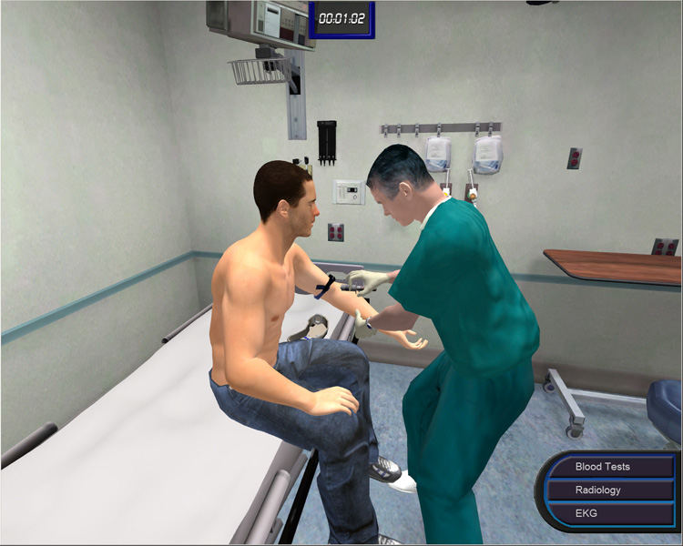
Incorporating Multiple Profiles in Solutions

Slide 39
cmi5 Defined vs. cmi5 allowed
Profiles are “tagged” in xAPI within Context
This is the same way “cmi5 Defined” was described before
Any additional profile is “cmi5 Allowed” in addition to the other types
Multiple Profiles in a course, page, or even same Statement is okay!

Slide 40
xAPI Profile Specification and Server
The xAPI Profile Specification
Was created to provide uniformity to xAPI Profiles
All the “blueprints” use the same way of structuring Statements and measuring their contents
Allows validation through testing
Can Throw Out “Bad” Data
The xAPI Profile Server
Publishing and Maintenance of xAPI Profiles
Allows permission-based exploration of xAPI Profiles
Validates a Profile is conformant to the xAPI Profile Specification

Slide 41
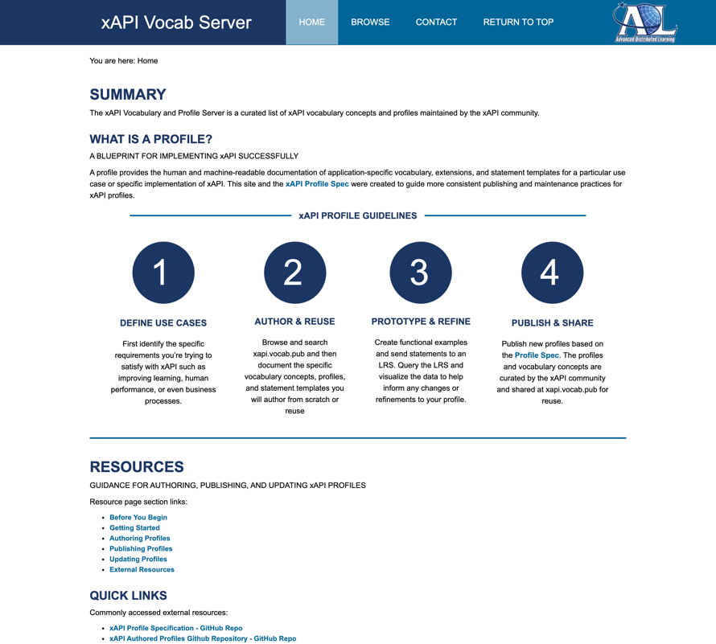
xAPI Profile Best Practices
Profile Best Practices More info at: http://xapi.vocab.pub/
Look for reuse first (entire profile or individual “concepts” (generic term for any xAPI Property)
Conform and Test to xAPI Profile Specification
Follow Best Practices for Identifiers
Generate Quality Metadata
Share Your Work

Slide 42
Expected Learning Outcome #4
4
The learner will understand how to apply cmi5 to a traditional e-learning course. This includes two varieties of courses: courses that have no e-learning standard applied, and courses that have SCORM 2004 3rd Edition (SCORM 1.2 acting as a subset) applied.

Slide 43
cmi5 Content Creation
Creating a cmi5 Course
Replacing a SCORM Course
Supplementing a SCORM Course
Adding any xAPI Profile to a Course

Slide 44
What is a “Course”?
Course Principles
Files consisting of or links to learning content assets
Manifest (listing) of those files/links and their structure (as AUs/Blocks)
Programming to connect to LMS / LRS
Action: Import
Action: Register
Action: Step-Through – Track with Web Events
Action: Complete, Possibly with Assessment
Context: Running in an authenticated and authorized environment (LMS)

Slide 45
Course Data Flow
Credit: RISC, Inc.
Not all of this is the responsibility of the course designer!

Slide 46
cmi5 Content Creation
Creating a cmi5 Course
Replacing a SCORM Course
Supplementing a SCORM Course
Adding any xAPI Profile to a Course

Slide 47
cmi5 Course From Scratch
Checklist
Files – The AUExample.html in the cmi5 Client Library
Manifest – The cmi5.xml in the cmi5 Client Library (blocks sold separately)
Programming – Scripts in the cmi5 Client Library
Import, Register – Job of the LMS, but authorization handled through FetchURL
Web Events, Completion/Assessment – Note specific calls to cmi5Controller.js and Match with HTML/Script
Environment – Does require a cmi5 LMS (or player)

Slide 48
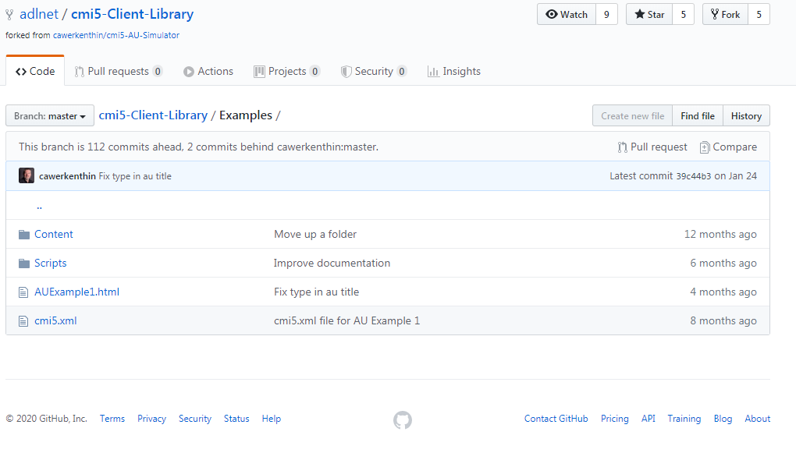
cmi5 Course From Scratch

Slide 49
cmi5 Content Creation
Creating a cmi5 Course
Replacing a SCORM Course
Supplementing a SCORM Course
Adding any xAPI Profile to a Course

Slide 50
cmi5 Course Replacing SCORM
Checklist
Files – All files from a SCORM Package (no links!)
Manifest – The cmi5.xml in the cmi5 Client Library (blocks sold separately)
Programming – Scripts in the cmi5 Client Library
Import – Use SCORM LMS Process
Register – Use LMS Process
Web Events, Completion – Content Predefines, Modifications to Statements necessary (slight changes based on Sample Statements), Additions/Subtractions/Substitutions allowed
Pseudo Authenticated/Authorized Environment – Shown solution has scripts with configurations (not secure)

Slide 51
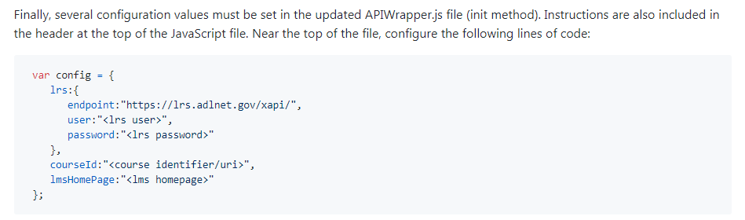
cmi5 Course Replacing SCORM
Configuration

Slide 52
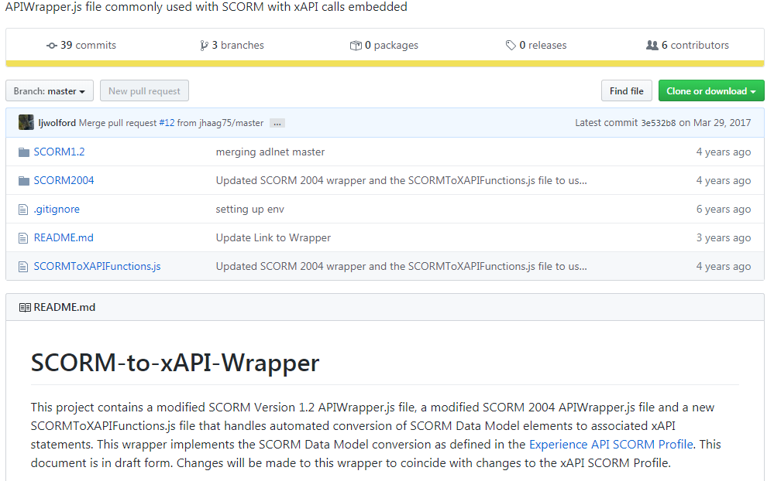
cmi5 Course Replacing SCORM

Slide 53
cmi5 Data Flow (Revisited)
Credit: RISC, Inc.
Yellow is also where SCORM “hands off” control

Slide 54
cmi5 Content Creation
Creating a cmi5 Course
Replacing a SCORM Course
Supplementing a SCORM Course
Adding any xAPI Profile to a Course

Slide 55
cmi5 Course Supplementing SCORM
Why would I want BOTH SCORM and xAPI/cmi5?
Prototyping
SCORM Visualizations Failing
Leverage non-cmi5 xAPI
SCORM is the default (trusted) system
cmi5/xAPI Sends to a Completely Different and Authenticated System (LRS)

Slide 56
cmi5 Course Supplementing SCORM
Checklist (This should look pretty much the same)
Files – All files from a SCORM Package (no links!)
Manifest – The cmi5.xml in the cmi5 Client Library (blocks sold separately)
Programming – Scripts in the cmi5 Client Library
Import – Use SCORM LMS Process
Register – Use LMS Process
Web Events, Completion – Content Predefines, Modifications to Statements necessary (slight changes based on Sample Statements), Additions/Subtractions/Substitutions allowed
Pseudo Authenticated/Authorized Environment – Shown solution has scripts with configurations (not secure)

Slide 57
cmi5 Course Supplementing SCORM
Configuration

Slide 58
cmi5 Course Supplementing SCORM

Slide 59
cmi5 Data Flow (Revisited)
Yellow is also where SCORM “hands off” control

Slide 60
cmi5 Course Supplementing SCORM
Checklist
Files – The AUExample.html in the cmi5 Client Library
Manifest – The cmi5.xml in the cmi5 Client Library (blocks sold separately)
Programming – Scripts in the cmi5 Client Library
Action: Import
Action: Register
Action: Step-Through – Track with Web Events
Action: Complete, Possibly with Assessment
Key: Running in an authenticated and authorized environment (LMS)

Slide 61
cmi5 Content Creation
Creating a cmi5 Course
Replacing a SCORM Course
Supplementing a SCORM Course
Adding any xAPI Profile to a Course

Slide 62
cmi5 Defined vs. cmi5 allowed (Revisited)
Profiles are “tagged” in xAPI within Context
This is the same way “cmi5 Defined” was described before
Any additional profile is “cmi5 Allowed” in addition to the other types
Multiple Profiles in a course, page, or even same Statement is okay!

Slide 63
Expected Learning Outcome #5
5
The learner will understand the products and services available that integrate cmi5. This includes content authoring tools, LMS/LRSs, and utilities. The learner will understand evaluation criteria to distinguish conformant tools from non-conformant tools. The learner will be given information on available online documentation, code libraries, and documented best practices.
This section will be a hybrid between general strategy and use of no-cost tools and templates
This section is more technical and can be (mostly) obsoleted by conformance of authoring tools and systems

Slide 64
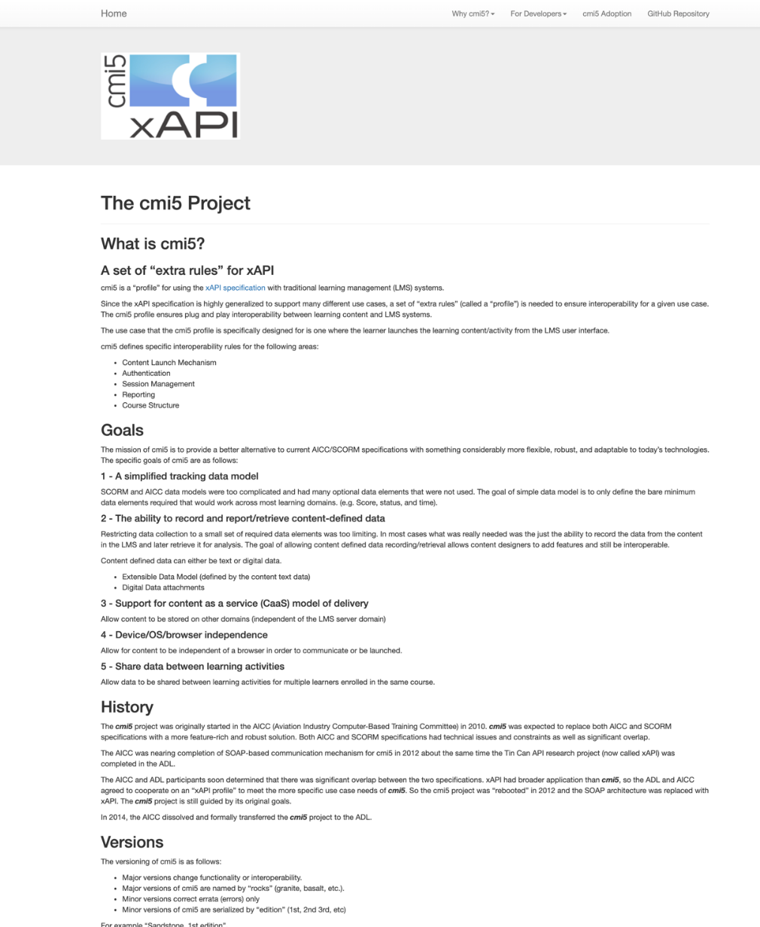
cmi5 Working Group
Behind every profile is a unified and hard-working group
cmi5 Working Group began BEFORE xAPI, with a completely independent organization
Considered WSDL and SOAP protocols (for any techies in the audience)
Open, free, and unaffiliated
Consider joining if interested (no experience required)
Website: https://aicc.github.io/CMI-5_Spec_Current/
Specification Document: https://github.com/AICC/CMI-5_Spec_Current
Many Links to Articles on Website and in Bibliography

Slide 65
Buying a cmi5/xAPI Product
Do NOT buy a product that simply claims xAPI Conformance
Look for specifically cmi5 or named xAPI Profiles
If an authoring tool, acquire sample output
Test with a known and trusted LMS/LRS
If an LMS/LRS, ask to test with a sample course
Test with a known and trusted course
Use the cmi5 Player, Test Suite, and Examples
ADL Project available late 2021!

Slide 66
Testing Criteria
Learning Record Store
Learning Management System
An LRS capability is NOT sufficient for cmi5 conformance, it must have additional capabilities found in an LMS
Test an LRS as an LMS
Verify all nine types of cmi5 Statements work
Verify all suspend/resume functionality works
Verify all roll-up works
Verify distributed learning content works
Investigate through integrated dashboards, whenever possible
Notes:
Learning Record Store
An LRS capability is NOT sufficient for a cmi5, it must have additional capabilities found in an LMS.
Test an LRS as an LMS.
Learning Management System
Verify all nine types of cmi5 Statements work
Verify all suspend/resume functionality works
Verify all roll-up works
Verify distributed learning content works
Investigate through integrated dashboards, whenever possible

Slide 67
Testing Criteria (Cont.)
Authoring Tools
An authoring tool’s output is a Course including a Course Structure Format
It will need to rely on a Learning Record Provider to create Statements
Statements handed to the Learning Record Provider should be full
Remember, not all cmi5 Statements are issued by the content
Ensure that the authoring tool is EXTENSIBLE, much of the benefit of cmi5 is expanding into xAPI
Authoring Tool Output and LMS Combinations CAN eliminate the need for an LRP, but is not guaranteed
Notes:
Authoring Tools
An authoring tool’s output is a Course including a Course Structure Format
It will need to rely on a Learning Record Provider to create Statements
Statements handed to the Learning Record Provider should be full
Remember, not all cmi5 Statements are issued by the content
Ensure that the authoring tool is EXTENSIBLE, much of the benefit of cmi5 is expanding into xAPI
Authoring Tool Output and LMS Combinations CAN eliminate the need for an LRP, but is not guaranteed

Slide 68
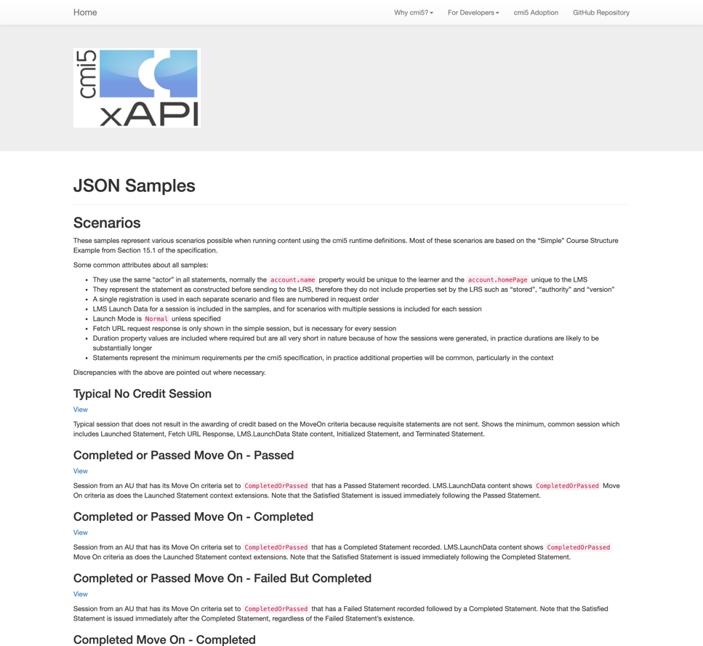
cmi5 Sample Statements
Full cmi5/xAPI Statements are available
https://aicc.github.io/CMI-5_Spec_Current/samples/
All necessary Statements for thirteen specific cmi5 scenarios
Goes perfectly with the Workflow shown earlier
Includes:
No Credit Sessions
Completed/Passed with MoveOn
Use of Mastery Score
Abandoned Sessions
Multiple Attempts
“cmi5 Allowed”

Slide 69
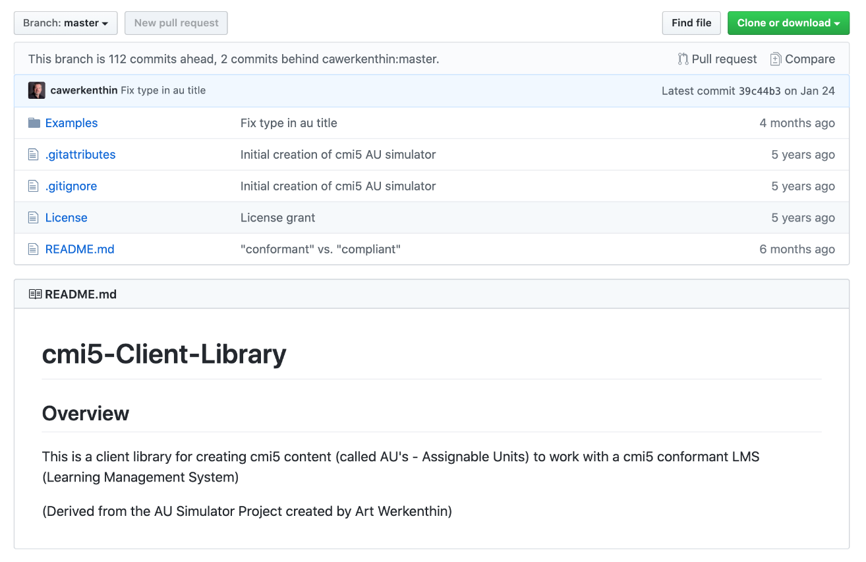
cmi5 Client (Content) Sample Code
Library of JavaScript Solutions
https://github.com/adlnet/cmi5-Client-Library
Includes Real Content, Code, and Scripts
Verified by cmi5 Working Group
Notes:
Statements are great, but understanding when to use them is also important

Slide 70
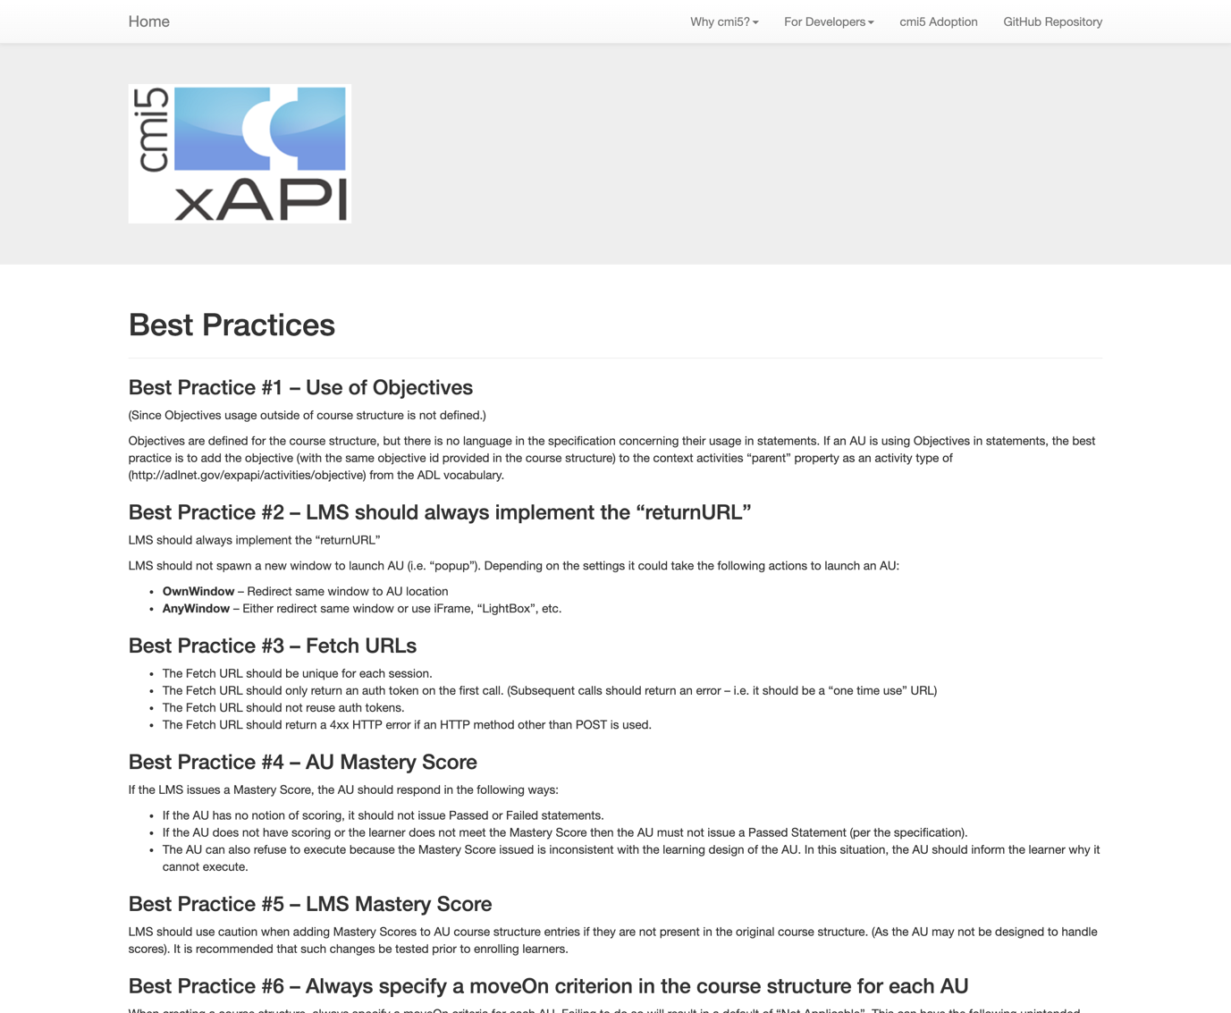
cmi5 Best Practices
Best Practices
https://aicc.github.io/CMI-5_Spec_Current/best_practices/
Discusses many of the tougher to implement parts of cmi5
Includes Advanced Topics such as:
The Authentication “Handoff”
Mastery Score
Mobile
Objectives
Error Handling

Slide 71
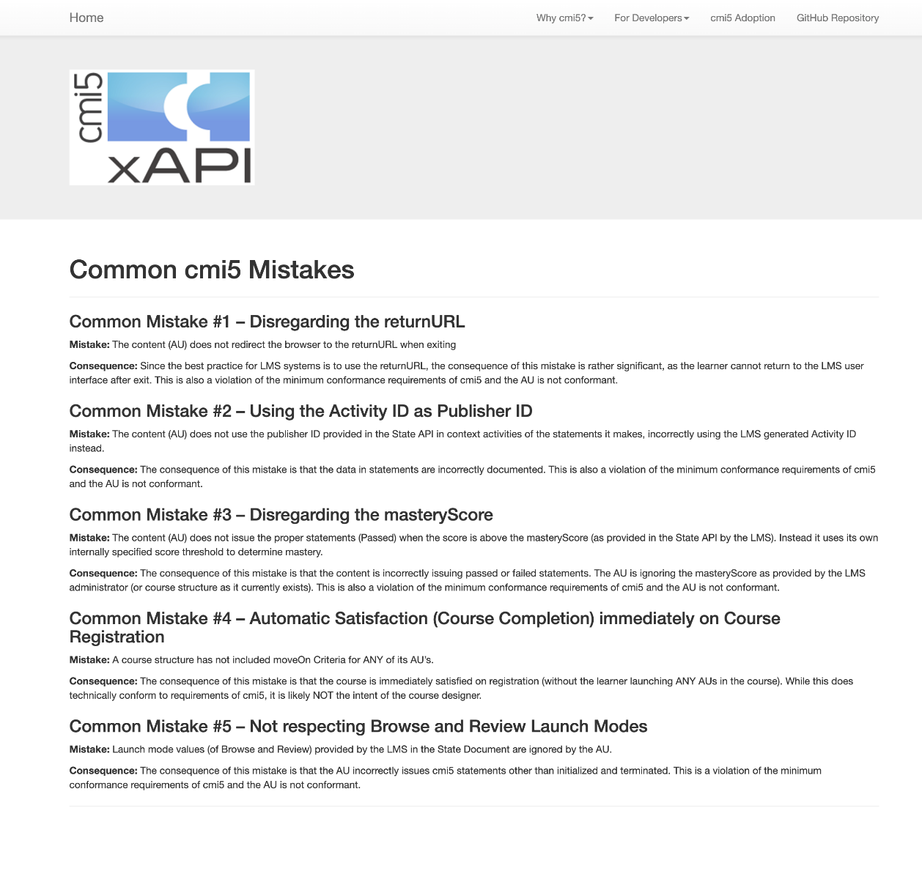
cmi5 Worst Practices
Worst Practices
https://aicc.github.io/CMI-5_Spec_Current/mistakes/
Discusses many of the pitfalls and early mistakes of adopters
Doesn’t include things like “don’t use the same id for every activity”
Includes Advanced Topics such as:
Activity vs. Publisher Id
Mastery Score
Registration
Launch Modes
Error Handling

Slide 72
cmi5 Adopters
cmi5 Working Group maintains a list of adopters (see Bibliography)
Unbiased
Content Authoring Products
Articulate Global, Inc. - Storyline 360 (Content Authoring Tool)
Composica (Content Authoring Tool)
Growth Engineering - Genie Game-based Authoring Tool
iSpring Solutions iSpring Suite (Content Authoring Tool)
Rustici Software SCORM Driver (Content Authoring Middleware)
Trivantis Lectora Publisher (eLearning Content Authoring Tool)
Trivantis CenarioVR (VR Content Authoring Tool)

Slide 73
cmi5 Adopters (Cont.)
LMS Products
Epignosis, LLC - Talent LMS
RISC Inc. Virtual Training Assistant™ (LMS)
Rustici Software SCORM Engine (LMS Middleware)
Rustici Software SCORM Cloud (LMS/LRS)

Slide 74
Thank You to the cmi5 Working Group!
Chair:
Bill McDonald (and a thank you to Amazon for loaning us Bill every week)
Current Participants (Thank you to all past participants too):
Marcus Birtwhistle, Megan Bowe, Ben Clark, Tracy Cowan, Michelle Goodson, Mark Grant, Jason Haag, Dennis Hall, Peter Hawkins, Mike Hernandez, Simon Hsu, Andy Johnson, Laurie Johnson, Matty Kahler, Moges Kelklie, Narender Kumar, Chris Mangione, Brian Miller, Alan Mustafa, Kevin Owens, David Pesce, Geir Fuhre Pettersen, Scott Powers, Henry Ryng, Richard Shipmon, Stuart Simon, Nabin Test, Christopher Thompson, Florian Tolk, David Wang, Art Werkenthin
Join Us:
https://attendee.gotowebinar.com/register/4876843550305432332

Slide 75

ADL Efforts to Improve Acquisition
IEEE Standardization of cmi5
Making it more enforceable
cmi5 Player Project
Giving early adopters a platform to deploy authored courses
cmi5 Test Suite Project
Allowing personal testing of content and systems (like SCORM)
cmi5 Templates
Applying cmi5 to legacy (SCORM) content to aid adoption

Slide 76

Review Learning Outcomes
The Learner Will…
Gain a baseline understanding of xAPI
Understand the subject matter of the cmi5 specification
Understand the application and use of xAPI Profiles
Understand how to apply cmi5 to a traditional e-learning course
Understand the products and services available that integrate cmi5

Slide 77
Bibliography
xAPI 1.0.3 Specification - https://github.com/adlnet/xAPI-Spec
IEEE 9274.1.1_2021_D1 – Publicly available early 2021 as a standard
SCORM vs. cmi5 Comparison (by cmi5 Working Group) - http://aicc.github.io/CMI-5_Spec_Current/SCORM/
cmi5 as SCORM Replacement Article - http://risc-inc.com/next-generation-scorm-cmi5/
cmi5 Working Group / Landing Page - http://aicc.github.io/CMI-5_Spec_Current/
cmi5 Overview - https://adlnet.gov/resources/cmi5-resources/

Slide 78
Bibliography
cmi5 Code Library - https://github.com/adlnet/cmi5-Client-Library
cmi5 Adopters List - https://aicc.github.io/CMI-5_Spec_Current/adoption/
cmi5 Best Practices - https://aicc.github.io/CMI-5_Spec_Current/best_practices/
cmi5 Worst Practices - https://aicc.github.io/CMI-5_Spec_Current/mistakes/
cmi5 Code Library - https://aicc.github.io/CMI-5_Spec_Current/client/
cmi5 Sample Statements - https://aicc.github.io/CMI-5_Spec_Current/samples/
SCORM to xAPI Wrapper - https://github.com/adlnet/SCORM-to-xAPI-Wrapper
Profile Guidance - http://xapi.vocab.pub/

Slide 79
Bibliography
cmi5 Runtime Example video https://www.youtube.com/watch?v=nhJRIDNE96Q
Free AU simulator (and source) https://github.com/cawerkenthin/cmi5-AU-Simulator
Rapid Authoring Adopter http://www.ispringsolutions.com/blog/ispring-now-supports-cmi5-the-next-generation-of-scorm/
cmi5 Process Flow https://risc-inc.com/cmi5-overview-process-flow/
AU Flow - https://aicc.github.io/CMI-5_Spec_Current/flows/au-flow.html
LMS Flow - https://aicc.github.io/CMI-5_Spec_Current/flows/lms-flow.html

Slide 80



Questions?
Andy Johnson
Specs and Standards Manager (SETA)
andy.johnson.ctr@adlnet.gov
@AndyJohnsonADL
Art Werkenthin
CEO
artw@risc-inc.com
Mike Hernandez
Senior Project Manager
mike.hernandez@designinteractive.net

