Slide 1


Distributed Interactive Simulation (DIS) 101: The Basics
Don Brutzman and Chris Fitzpatrick
Modeling, Virtual Environments, Simulation (MOVES) Institute
Naval Postgraduate School (NPS), Monterey California USA
brutzman@nps.edu christian.fitzpatrick@nps.edu
Notes:
Note that this tutorial is essential to core design of current Modeling and Simulation architectures. It complements I/ITSEC tutorials on Test and Training Enabling Architecture (TENA) and High Level Architecture (HLA).
Intended Audience. Practitioners interested in networking, simulation interoperability and shared virtual environments using open standards.
Abstract. The Distributed Interactive Simulation (DIS) protocol is a well-established IEEE standard for packet-level exchange of state information between entities in military simulations. DIS facilitates simulation interoperability through a consistent over-the-wire format for information, widely agreed upon constant enumeration values, and community-consensus semantics. Anyone can obtain the IEEE-1278 standard and implement their own compliant, interoperable, DIS application. A large variety of tools and codebases simplify this effort, and enable multi-architecture integration of simulations using the DIS stand baseline. DIS focus begins with real-time, physics-based, entity-scale simulations, providing state update and interaction mechanisms which can scale to large virtual environments. This tutorial is a "DIS 101" introduction for software implementers and an introduction to the DIS philosophy for simulation systems integrators. Examples are provided using the open-source Open-DIS library for DIS v7 and Enumerations support, available in multiple programming languages. Ongoing work is included in unit testing of DIS streams, and Web-based implementations using X3D Graphics, as well as Compressed DIS and DISv8 development.
Grateful acknowledgement: this tutorial was originally developed by Don McGregor NPS.

Slide 2
Learning Objectives
The learner will be able to…
Identify what standards are used by distributed simulations for military use.
Identify what types of communication protocols are used for various networks.
Identify what aspects needs to be standardized, and what aspects can be customized, to support diverse simulations with differing models and goals.
Identify how DIS techniques for dead reckoning (DR), visual smoothing and distributed collision detection can reduce network traffic.
Learn how to apply new capabilities expected for Compressed DIS and DISv8.
Notes:
Discuss how connecting all manner of simulations, namely Live Virtual Constructive LVC, is the necessary path for connecting to Command and Control (C2) systems. Establishing such connections between traditionally separate domains is central to conference theme,
“The Future is Now“
Note that, for example, common tutorial topic “What coordinate systems are used?” is also central to requirements for connecting C2 and M+S.
Slide 2 and last slide are identical.

Slide 3
Topics
What is distributed simulation? Scaling from isolated networks to the Web.
Military modeling & simulation, distributed simulation standards, interoperability
Underlying TCP/IP network requirements common to all distributed simulations
DIS: goals, design principles, basic structure, Entity State PDUs explained
DIS: distributed identification of all participants, Entity Types and Entity IDs
DIS: tracks and Coordinate Systems, real time clocks, packet PDUS, code APIs
DIS: collisions, shooting, Dead Reckoning, Smoothing, visual synchronization
DIS and Open-DIS: DIS standard development, ongoing implementation efforts
Resources and References for further activity, including latest software builds
Notes:
Communicate that this is a broad and deep topic. Much information is available. Ace card for participants: DIS “just works” across many systems, is much tested and strives to match/represent real-world activities. So experience in each domain being simulated is useful.

Slide 4
Distributed Simulation Terms
A distributed simulation runs on multiple cooperating hosts on the network.
State information describes the position, orientation, and other information about an entity at a point in time.
Live, Virtual, Constructive (LVC) simulation involves different hosts doing different aspects of simulation in one cooperative system.
Live: Real people, real systems
Virtual: Real people, simulated systems (human in loop)
Constructive: simulated people, simulated systems (AI controlled)
Notes:
Emphasize that terminological clarity is always important when modeling cross-domain interactions.

Slide 5
Live, Virtual, Constructive (LVC) Example
Automatic Identification System (AIS) is a standard for transmitting the current position of commercial ships in the real world; ships have a transmitter and receiver on board and send information in a standard format. This is a live component (real system, real people).
Ship simulators portray a simulated virtual view of navigation from the perspective of a ship’s bridge, perhaps in a “cave” environment with wall-sized screens. This is a virtual component (real people, simulated system).
We can also inject simulated, computer-generated ships controlled by AI into the simulation. This is a constructive component (simulated system controlled by simulated people).
As M+S LVC connects with C2 for warfighters, ever-greater synergies emerge.
Notes:
Stress final point, encourage participants to consider LVC in their individual domains of interest.

Slide 6
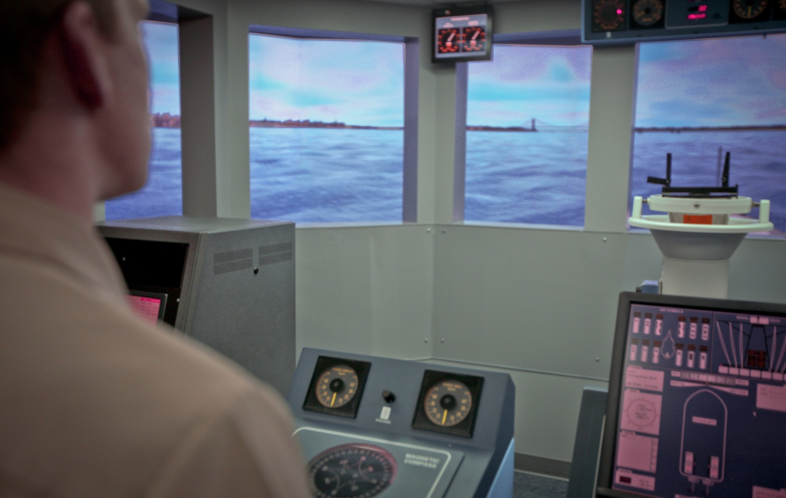
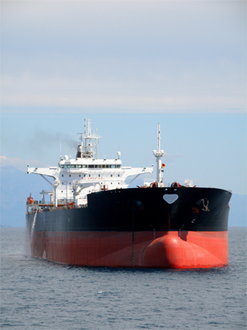
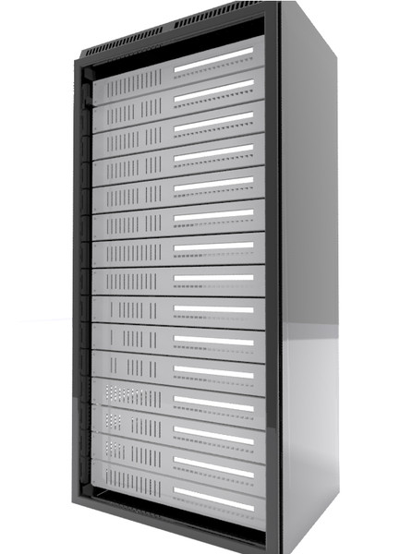
Live, Virtual, Constructive (LVC) Example, Illustrated
Virtual: bridge simulator
Live: AIS feed
Single
Shared LVC
Environment
Participants may be local or distributed
Constructive: computer-
generated ship traffic, controlled by AI agents
Notes:
This diagram is not showing “one way to do things,” rather many alternative variations are possible depending on scenarios of interest.

Slide 7
What Do We Want to Do?
DIS has been running and evolving since early 1990s, remains widely used in many applications.
People who want to learn about Distributed Interactive Simulation (DIS) usually are in the “virtual” or “constructive” domains, though it can also be used in the live domain.
They want to simulate ships, tanks or other entities in 3D world, controlled by humans or AI.
We need to exchange state information between hosts on the network about entities in the world.
To view someone else in the simulation, we need to know their position, orientation, and other state information, and this information needs to be sent to us by them.
Typically entities are controlled by different hosts that are connected via a network. The state information is usually exchanged over the TCP/IP protocol.
Notes:
Shared state is the essence of a distributed virtual environment. If participants can’t communicate well, then they can’t interact well.

Slide 8
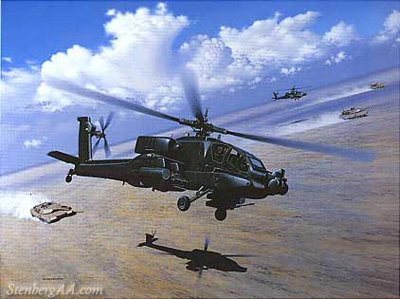

State Information in Distributed Simulations
Tank Simulator
State Information
Helicopter Simulator
Location, Orientation, Velocity, etc of Entities
Sent over a TCP/IP network
Notes:
The tank & helicopter in the simulation are controlled by different hosts. The simulation running the tank needs to know about the helicopter’s position, and the helicopter needs to know about the tank’s position
We have to come to all sorts of agreements to exchange information. It’s harder than it looks!
We want the information to be in a standard format, because we don’t want to be locked into one vendor.

Slide 9
What’s So Hard About That?
The format of state update messages needs to be exactly specified.
What coordinate system should you use? You need one that works well for ground and air systems, and can handle curvature of the earth issues.
Text or binary format messages?
The order in which the fields appear?
Network issues: what happens if a message is dropped?
Scalability issues: how can we get a reasonable number of entities to participate?
Latency: can we keep the message delay reasonable?
Do all participants have a consistent, coherent operational picture?
Notes:
Convey that all of this complexity must be handled sensibly and sharably, which is design basis of DIS.

Slide 10
Distributed Simulation Standards
There are many ways to exchange the state information, but we want a standard way so we can interoperate with simulations from many vendors rather than being locked in to one. We don’t want to use only one vendor’s proprietary method, for which we will pay dearly.
In the case of defense modeling and simulation, the “big three” are
TENA: Test and Training Enabling Architecture
HLA: High Level Architecture
DIS: Distributed Interactive Simulation
TENA and HLA borrow many semantic concepts from DIS. Understanding DIS has many carry-over benefits when working with other standards.
Notes:
Stable interoperability is essential for long-term use, re-use, sharing and advancing progress.

Slide 11
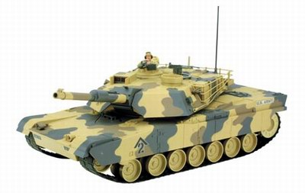
State Information Exchange Standards
The controlling host sends the state information update
via one of the standards to other hosts
DIS
HLA
Controlling Host
Receiving Host
TENA
State Information Updates
Notes:
Individual entities have best knowledge of their real-time state, and so each is typically sending their own information. This helps us achieve best realism.

Slide 12
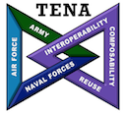
TENA
Used on ranges; often the “L” in Live-Virtual-Constructive simulations.
Designed for real time and embedded systems, real sensor systems, etc.
In effect it is thinly disguised CORBA distributed objects with multiple new features to help it work in a simulation environment.
Can gateway it to other standards, such as DIS or HLA.
See http://tena-sda.org
Notes:
CORBA = Common Object Request Broker Architecture, a distributed object model. https://en.wikipedia.org/wiki/Common_Object_Request_Broker_Architecture

Slide 13
High Level Architecture (HLA)
HLA is very general and intended to cover most defense modeling domains including training, analysis, and engineering in addition to virtual worlds.
Participants communicate via an agreed-upon Federation Object Model (FOM) and an API associated with a Run-Time Infrastructure (RTI).
Specification is maintained by SISO (http://sisostds.org), is IEEE standard 1516 and has implementations by
MAK (http://www.mak.com),
Pitch (http://www.pitch.se),
Portico (older version) (http://porticoproject.org) and others.
http://www.pitch.se/hlatutorial is a good introduction to HLA.
Notes:
Encourage participation in all three IITSEC tutorials, the technologies are complementary

Slide 14
Distributed Interactive Simulation (DIS)
DIS was the first standard to tackle these problems in a systematic way.
Originated in the SIMNET project in the 80’s. DARPA supported converting the SIMNET research into a standard; SISO developed the standard and took it to IEEE for approval.
Anyone can get standard from IEEE, implement it, and participate in simulation.
Development of standard continues; updated DIS standard version 7 is the latest approved version. SISO maintains DIS, presents it to IEEE for approval.
Substantial commercial support, open source implementations, many home grown implementations of portions of the standard.
Notes:
Encourage participation in all three IITSEC tutorials, the technologies are complementary

Slide 15
Distributed Interactive Simulation (DIS) functionality
What does DIS support?
A standardized way to exchange messages about entities in a virtual world
Common semantics for coordinate systems and other information, such as how to describe and specify entities
Common practices to ensure interoperability
Notes:
Essentials. All the detail flows from these design principles. Meaningful results are not otherwise possible.

Slide 16
Networking: the Protocol Stack
DIS defines the format of the messages, but doesn’t specify how to get the messages from one host to another. Almost always this is done via TCP/IP network protocol.
Knowing network basics helps you be a better simulation designer/user!
DIS software libraries
Application
Message passing
between hosts:
TCP/IP protocol, implemented by
each host machine’s operating system
TCP Sockets
UDP Sockets
IP
Link and Physical
Notes:
TCP/IP is the underlying substrate for almost all network communications. Web servers, streaming video, email and almost everything else you use on the internet all rely on TCP/IP.
Users typically implement things at the “application layer” at the top of the stack. This is where DIS lives
Somewhat confusingly, the DIS protocol is considered part of the “application layer” in addition to what users think of as the “application”, the visual simulation
The lower layers of the stack are responsible for delivering messages. We can usually ignore this part; it’s all handled by operating system vendors
We interact with the TCP/IP stack via either the User Datagram Protocol (UDP) or Transmission Control Protocol (TCP) APIs.
UDP messages are like postcards: they contain a fairly small amount of data, and we need to address them to a destination
We can send them to one host (based on IP number): called unicast
We can send them to all hosts on a local network: called broadcast
We can send them to those hosts, on the local network or not, that are interested in the message: called multicast
DIS messages are contained inside of UDP packets and can use any one of these addressing schemes. Broadcast is very common. Multicast is better.

Slide 17
TCP/IP and UDP
TCP sockets have higher latency, higher jitter (variation in latency), and doesn’t scale to large numbers of hosts as well.
UDP sockets have lower latency, lower jitter, scales to large numbers of participants better, but are unreliable.
DIS typically uses UDP.
Hold on—UDP is unreliable? What’s up with that?
Individual UDP messages may be dropped by the network; there’s no guarantee that each UDP message will be delivered. This tradeoff achieves lower latency and jitter, which in turn brings better scalability.
Not as big a deal as it might seem. If we get position updates from entity every 1/30th of a second, does it matter if we drop one? Better information is coming along shortly, so why resend dropped messages?
Notes:
In some ways TCP/UDP are yin/yang of networking. Helping participants understand this point helps them comprehend many other DIS design decisions.

Slide 18
DIS Messages
We know what we want to do: send a message that tells another host what the state of an entity is.
We know how we do this: send the message via TCP/IP, typically in a UDP message over broadcast or multicast.
What is actual format of the messages? This is specified by the DIS standard.
There are dozens of possible messages to send, relating to everything from logistics to electronic warfare to radio communications.
Each message type is called a “Protocol Data Unit” (PDU).
Notes:
PDUs are messages. So are email, SMS text, 2-way web-browser interactions, and even object-oriented method invocations.

Slide 19
DIS Messages
PDU
Entity Information
Warfare
…
Entity State
Collision
Fire
Detonate
Several dozen different message types (called Protocol Data
Units, or PDUs) to describe entity movement, collisions,
combat, radio communications, logistics, and many more.
The Entity State PDU is the most widely used.
Notes:
The world is a big place, many years of work by M+S community have established a rich vocabulary of messages supporting modeling and information sharing that reflects the real world.

Slide 20
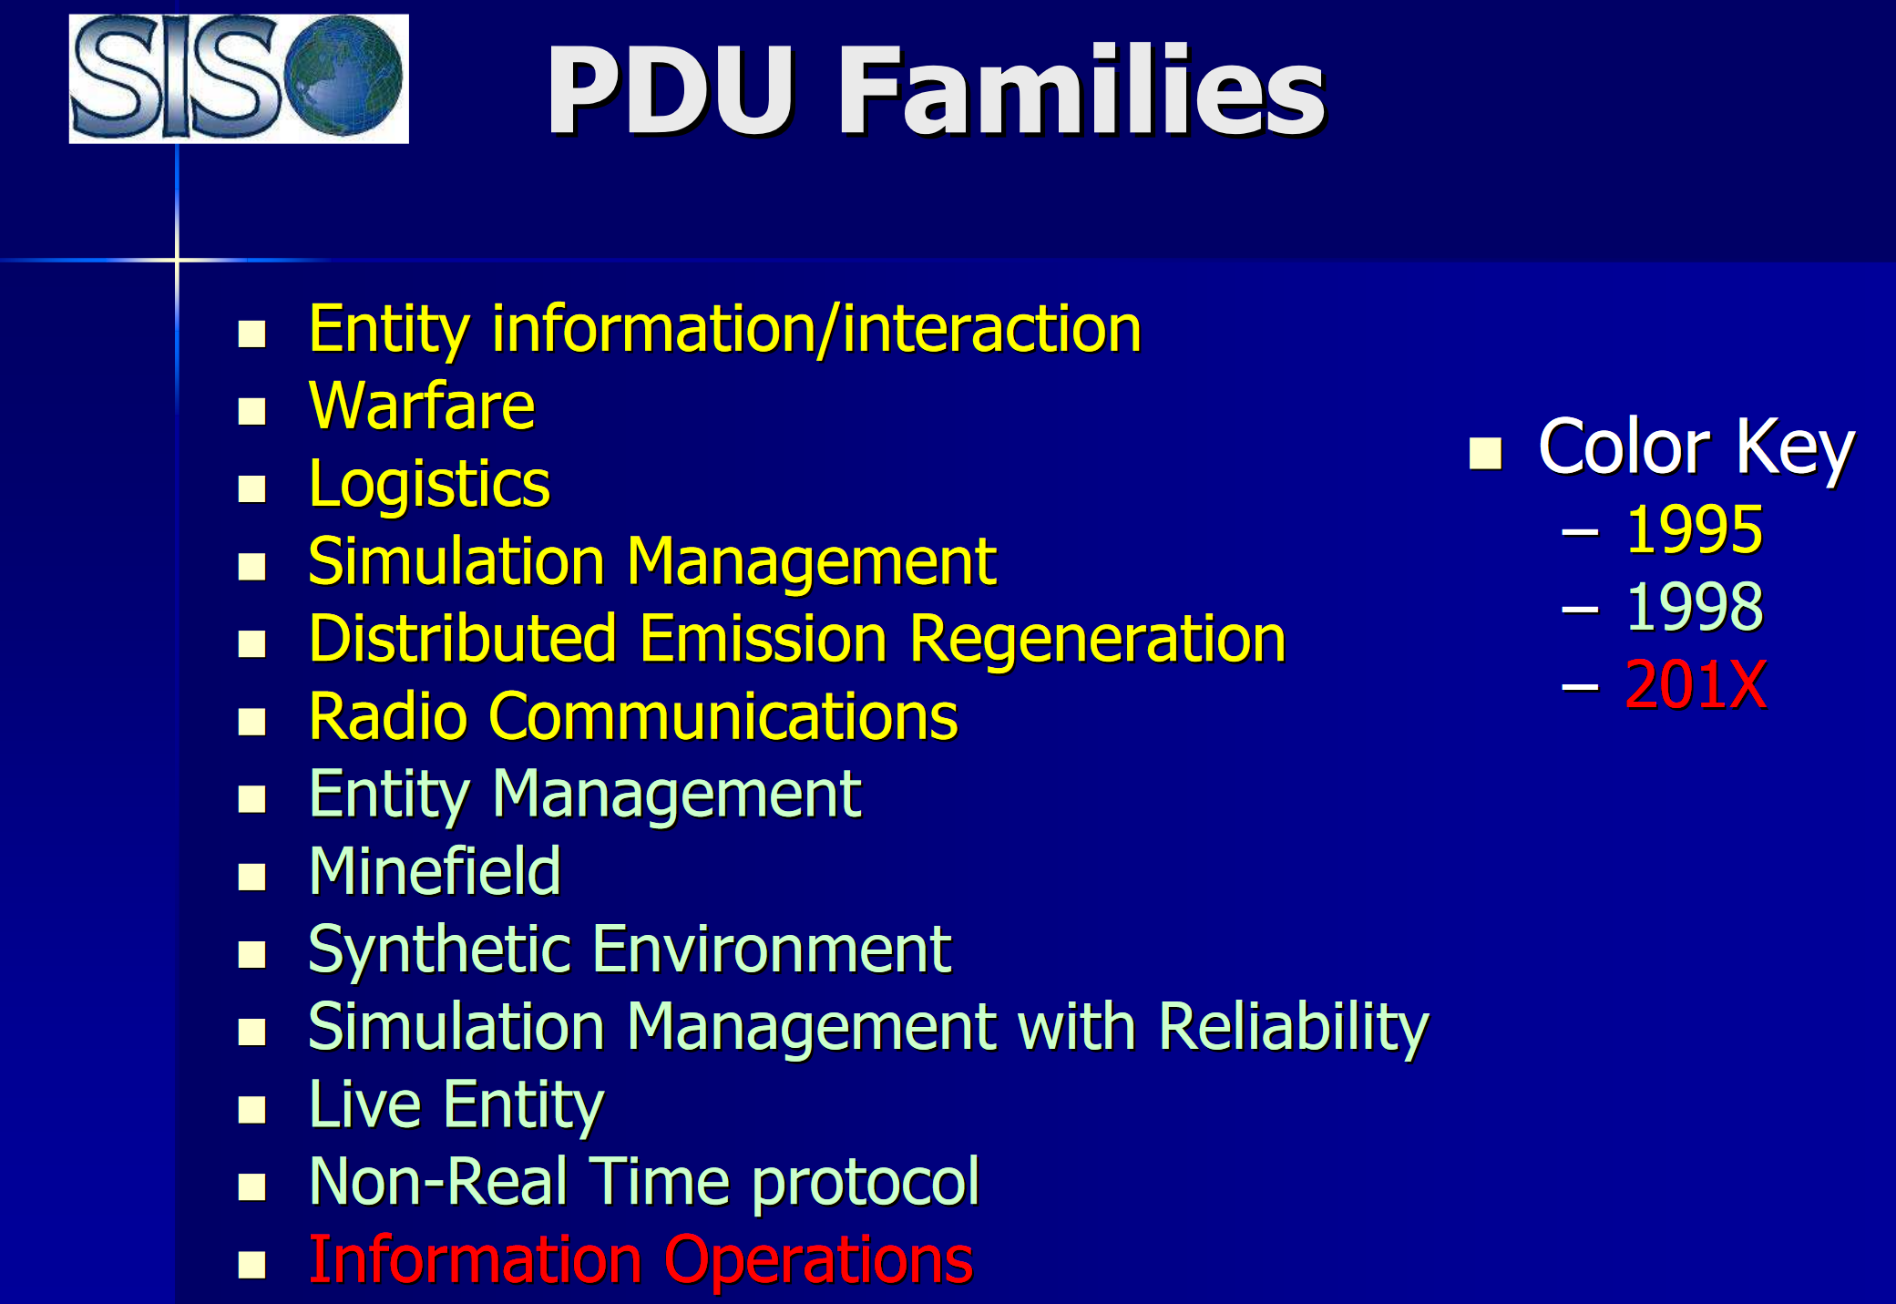
PDU Families are Diverse
Credit: from SISO slideset
IEEE 1278 Distributed Interactive Simulation (DIS) by Mark McCall and Bob Murray, 26 May 2010.
Many people have used and extended DIS Protocol so you can likely find what your system needs to do.
Notes:
Ask participants if they have knowledge of any of these domains.

Slide 21
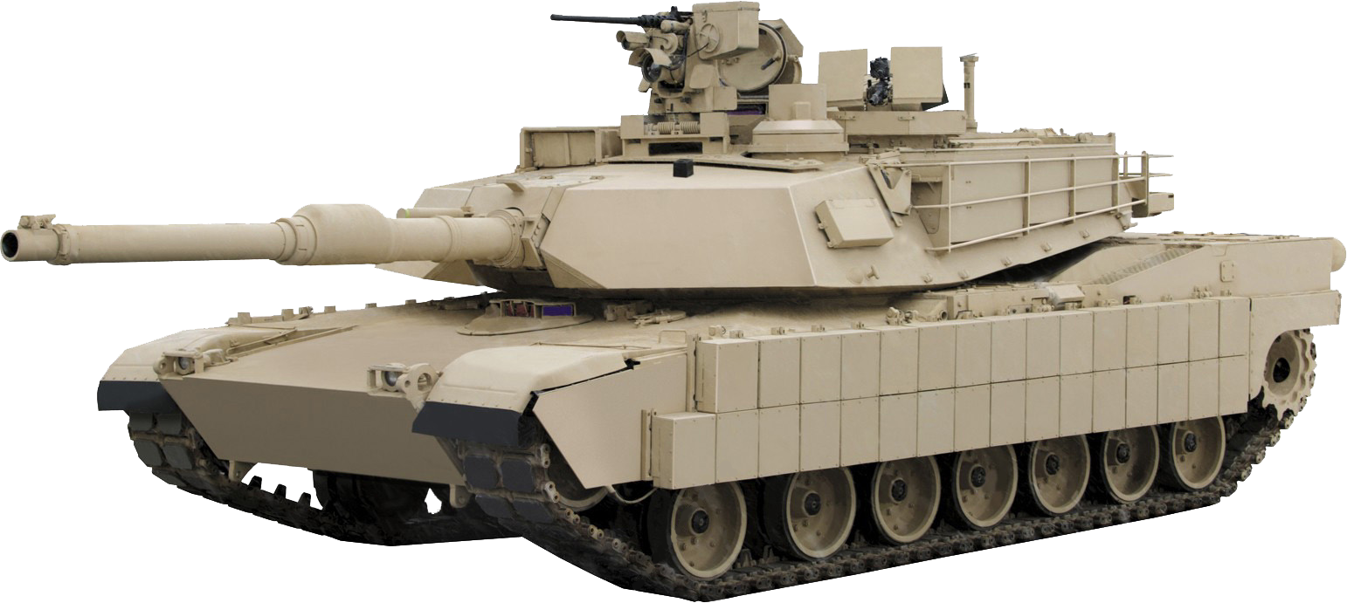

DIS Messages: Entity State PDU
We use ESPDU when want to inform other hosts of the position of an entity we control—the most common PDU
Entity sends ESPDU with
• Unique ID
• Position (xyz) in standard coordinate system
• Orientation
• What type of vehicle it is
• More….
Notes:
ESPDU is workhorse PDU, and also affects how other PDUs are interpreted.

Slide 22

Site, Application, Entity ID: a Unique Identifier
Before telling entities “hey you there, do that” we need a way to differentiate between entities.
The entity ID is a unique identifier for each simulation object in the world. In DIS this is accomplished via a triplet of three numbers: Site, Application, and Entity ID numbers.
This triplet of three numbers taken together must be unique for each entity.
Notes:
In practice, the site/application/entity hierarchy of “who is who in the zoo” is good way to keep track of many entities.

Slide 23
DIS: Entity IDs
Example: before the simulation starts we agree, simulation-wide, on the following arbitrary numbers. Here are simple possibilities:
Site | Number
China Lake | 42
Norfolk | 17
Orlando | 23
Application | Number
YoYoDyne M1A2 Simulator | 112
ACME UCAV Simulator | 417
JCATS | 512

Slide 24
Entity IDs
Tank Simulator
EID: (42, 112, 18)
EID: (42, 112, 19)
Helicopter
EID: (17, 417, 18)
YoYoDyne simulator (112) at
China Lake (42) controls two
distinct tanks, 18 and 19
ACME (417) simulator at
Norfolk (17) controls a
Helicopter (entity 18)
Notes:
Your “aha” moment: each of these triples designate “who” sent a given PDU, and thus identify any participant uniquely.

Slide 25
DIS: Entity Type
We may need some other information. What if we want to draw this entity? We need to know what kind of entity this is—a tank, a helicopter, a ship?
This is done via a field called the Entity Type, which in turn depends on a SISO document called the “Enumeration and Bit Encoded Values” (EBV).
The EBV document is a long listing of standardized record values that lets us identify military hardware.
Notes:
Designates “what” kind of thing this entity is.

Slide 26
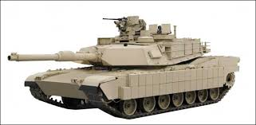
Entity Type
{
Kind: 1 (entity)
Domain: 1 (Land)
Country: 225 (US)
Category: 1 (Tank)
Subcategory:1 (M1)
Specific: 6 (M1A2)
}
Whenever a DIS message has an entity type record with the above settings
we know it’s referring to an M1A2 tank. What the numbers are doesn’t matter, as long as all participants agree on what they mean. SISO maintains the master list of arbitrary numbers, called the EBV document.
Notes:
Subcategories flesh out the details and variations corresponding to each entity type.

Slide 27
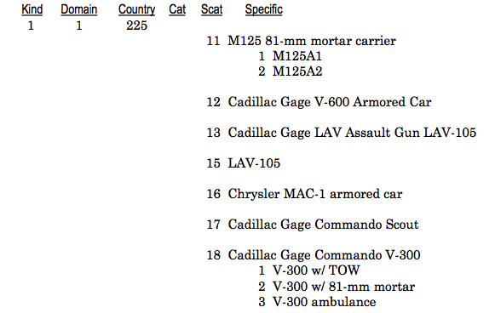
Entity Type From EBV Document
Notes:
Note this community has met for years. EBV values available in Word, XML and derivative forms.

Slide 28
Entity Type and EBV Values
The EBV document has gone through many versions as new hardware has been added. An important checkpoint for consistency: all participants in the simulation should agree on the current version of EBV document being used.
In reality this can sometimes be hard; some simulations have not been updated to reflect new EBV documents, and sometimes those implementing a simulation simply make up numbers, and no simulation implements all entities in the EBV.
You may need a gateway such as Joint Simulation Bus (JBUS) to act as a “shim” connection between simulations and change entity type values to match what is expected. The gateway can rewrite the entity type values in the PDUs to force them to match expectations.
The EBV enumerations are also often used in HLA RPR-FOM and in TENA.
Notes:
Note that Enumeration Bit Values (EBV) documentation for Entity Type goes to great pains to maintain backwards compatibility, so almost everything stays stable over time.

Slide 29
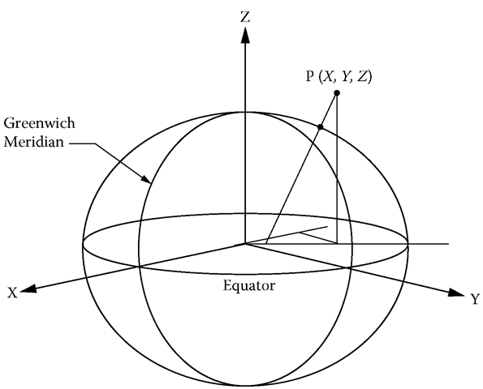
Entity State PDU: Position
What does it mean if we say an entity is at (x, y, z)? This has no meaning without a coordinate system. We need to agree on one, and where the origin is.
DIS chose to use a Cartesian, geocentric coordinate system because
It’s easy to convert from that to other coordinate systems, such as geodetic
(latitude, longitude, altitude) or military
Systems such as MGRS.
Notes:
If you want to specify the location of an entity in DIS, you have to specify it in terms of how far from the center of the earth it is. You should also agree on the shape of the earth (eg WGS-84) and terrain.
Using geocentric coordinates may seem strange, but DIS has to account for curvature of the earth issues if the simulation demands it. The geospatial people have done the math to convert geocentric coordinates to latitude, longitude, altitude, MGRS, or other coordinate systems. The geocentric coordinate system is often used in TENA and HLA
SEDRIS has provided an open source framework for dealing with these issues in their Spatial Reference Model (http://www.sedris.org/hdr1trpl.htm)

Slide 30
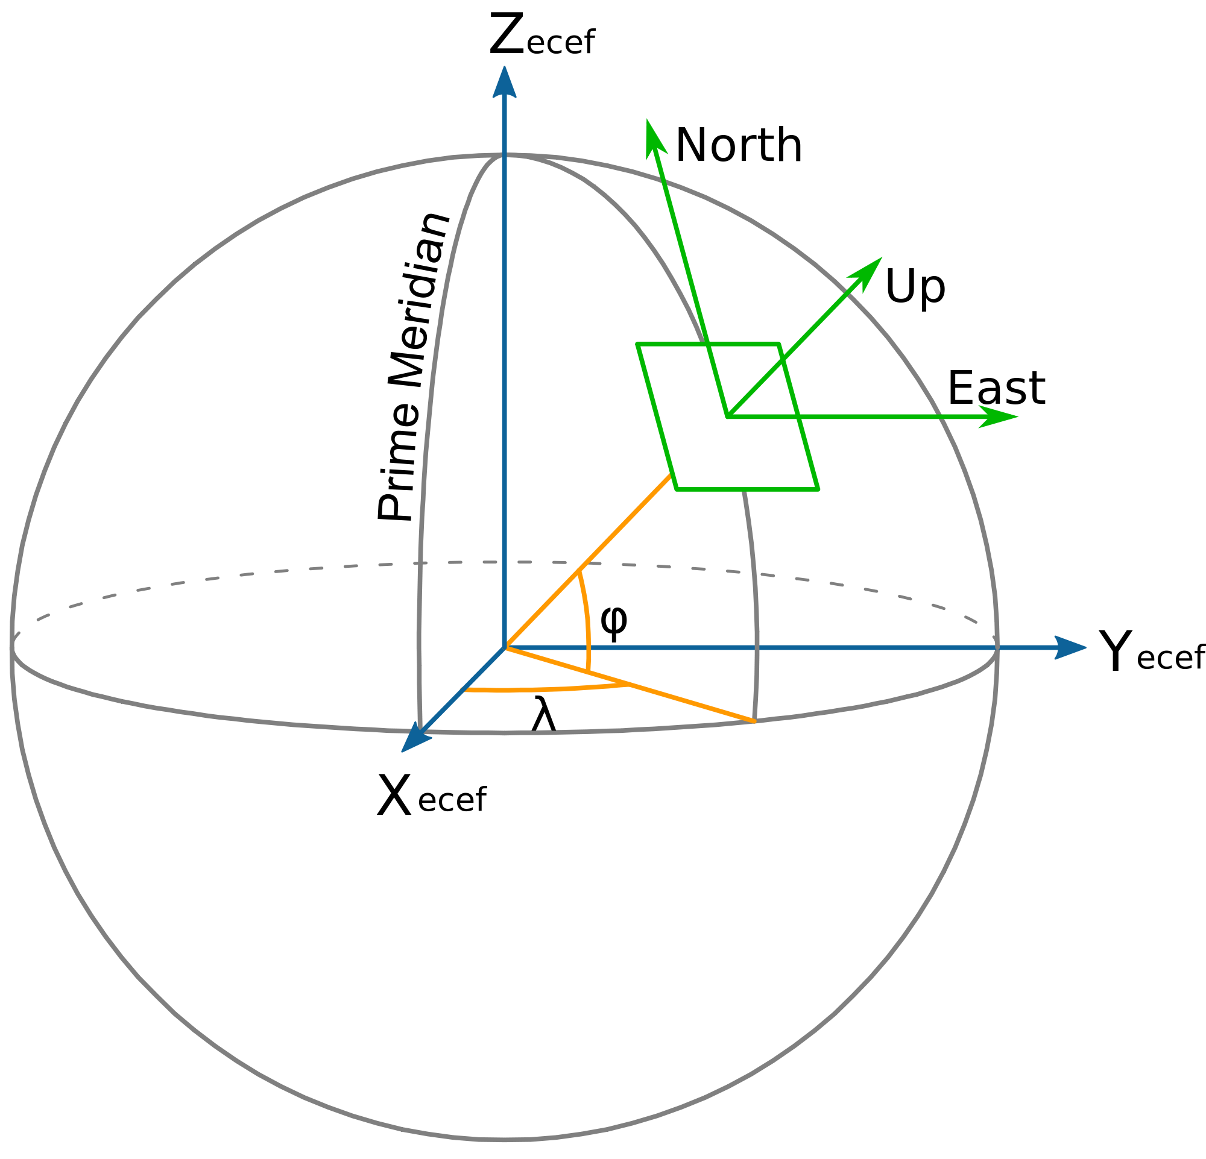
DIS: Coordinate Systems
Very often simulations set up a local, flat-plane coordinate system at a point tangent to a point on the earth’s surface, using that for local physics movement. When ESPDU is actually sent, local coordinates are changed back to the global coordinate system. The SEDRIS SRM package can do all the math.
Nobody will ever agree on which way the local coordinate system axes should point for all simulations.
Notes:
Utility methods for conversions are how codebases comply and cooperate.

Slide 31
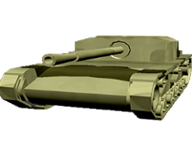
Coordinate Systems
A local Cartesian coordinate system origin is set at {lat, lon, alt}. The simulation
does all calculations and movement in this coordinate system, because it’s convenient. Before sending entity information out in a DIS ESPDU, convert from local to geocentric (DIS) coordinates:
Entity position can be expressed in:
Local: (10, 10, 1.4)
Geodetic: 43.21001 N, 78.12012W, 1.4
UTM: Zone 44N, 266061E, 4788172N, 1.4M
DIS: 958506.1, 455637.2, 4344627.4
We have enough information to convert
from one coordinate system to another,
if local coordinate system origin known.
Trusted validated algorithms necessary.
y (North)
z
z (East)
Local coordinate system origin at
lat 43.21, lon 78.12, alt 120m, WGS 84
X
Notes:
(Ensure participants understand these fundamental concepts: multiple coordinate systems, all uniquely correlatable.)

Slide 32
DIS: Dead Reckoning (DR) Algorithms
If we’re running a visual simulation, how often do we need to send ESPDUs?
If running at frame rate, maybe about every 1/30th of a second.
If we have 500 entities in a simulation, this works out to 15,000 UDP messages per second. If you’re doing other computation on host, this will tax your CPU and network.
Do we really need to send that fast? If we know how fast and in what direction an entity is moving, we can “dead reckon” in between receiving each ESPDU and then interpolate position to draw our entity there.
Sure, we’re lying to the user. Got a problem with that? If our DR is wrong, we just correct our position stealthily when we get better info on the next packet. The user won’t know the difference, probably.
Due to latency all simulation participants are a little out of sync anyway.
Notes:
This is applying relatively simple math to everyday physics. This is conceptual similar to how people fly, sail and drive.

Slide 33
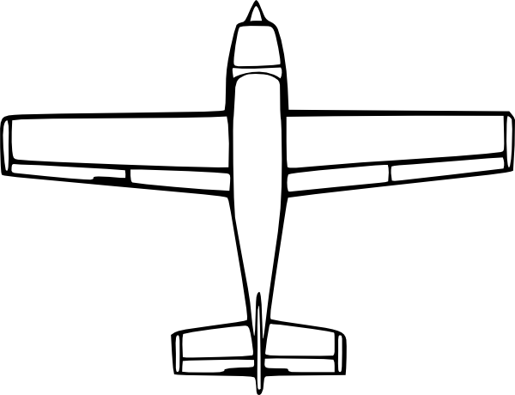
DIS: Dead Reckoning between ESPDU Snapshots
DR updates
Time
ESPDU Updates
ESPDU 2
ESPDU 3
Aircraft position & orientation updated by dead reckoning updates between ESPDU messages
Notes:
High-order handwaving! Walk through a maneuver, describe what happens from each participant’s perspective.

Slide 34
DIS: Dead Reckoning
What DR algorithm is best? (… wait for it…)
It depends! In some situations we might want to include acceleration or angular velocity, but not in others. The ESPDU sender specifies what DR algorithm to use.
The sender can also perform its own DR to determine what the recipients are seeing. If the sender decides the clients are probably wrong in their guess about where the entity is, it can issue another ESPDU with better location information.
Notes:
George Box: “All models are wrong, some are useful.”

Slide 35
Dead Reckoning (DR), Smoothing, Synchronization
Dead Reckoning (DR) is projection of entity location based on last received timestamp, position and vector-based velocities/accelerations.
Enables recipients to more accurately estimate entity state in-between PDU updates.
Enables senders to more accurately estimate when to send more-frequent updates.
Smoothing is a recipient-presentation technique for handling dropped packets.
Avoid sudden jerky jumps in motion, instead interpolate from prior estimate to new state.
No need to improperly distract user with corrective actions when recovery is satisfactory.
Synchronization among multiple players is a blend of capabilities.
Networking monitoring and management, simulation management, logging, etc.
Measurable metric: is a “fair fight” taking place among distributed participants?
Notes:
Hitting the “sweet spot” of where physics, math, networking, modeling, simulation, perception and reality align acceptably.

Slide 36
DIS: “keeping it real” with less throughput required
Dead Reckoning (DR) algorithms use projected trajectory information (such as linear or rotational velocities and accelerations to compute how often network updates need to be sent. Helpful for quiet and intensely active intervals.
Visual smoothing techniques hide when packets are dropped or arrive late. Entity display smoothly interpolates to the correct location and direction, avoiding distracting jumps that do not correctly represent behavior anyway.
Having each individual entity “honorably compute” whether collisions occurred takes advantage of highest fidelity information with least computation, avoiding expensive time delays and greater inaccuracies of server-based adjudications.
Notes:
No single optimization is possible. This is a tradeoff so that DIS can meet the shared expectations of participants. Cheating is… boring.

Slide 37
DIS: Learning About the World and Heartbeat
If we run a DIS simulation, how do we learn about all other entities in the world?
One design possibility is to use a master server. Instead, the designers chose for DIS to be peer-to-peer; there is no central server, and hosts talk to one another directly.
Discovery process is both essential for interaction and potentially overwhelming for large virtual environments.
In DIS essentially all we have to do is listen for ESPDUs. New-entity ESPDUs contain what we need to know: entity type, location, velocity, orientation. This is simple and avoids a single point of failure, making configuration easier.
There are also Simulation Management PDUs for announcing arrival, removal, etc.
To make this work, every entity must periodically send a time-stamped ESPDU even if its state hasn’t changed. This is called a heartbeat. Policy from DIS spec: usually entities must send an ESPDU at least once every five seconds.
Notes:
Discovery of new entities, confirmation of known entities, learning of lost entities.

Slide 38
DIS: Timestamp and out-of-order arrival
One of the oddities of UDP is that UDP packets may be duplicated during TCP/IP routing; we send a single packet, but two might arrive nevertheless.
UDP packets may also arrive out of order. We send packets in order A, B, C, but they arrive in order C, A, B ....
This creates problems for position updates! How to handle? ....
DIS includes a timestamp field to detect these kinds of problems:
The field typically represents time since the top of the hour (as common practice).
If the next packet we receive has a timestamp before the last packet we processed, then we can discard it; it’s old information that has been obviated by new data.
Time coordination between hosts is useful but not required.
Notes:
Accurate shared time is a great benefit that helps DIS accurately model interactions occurring across the network.

Slide 39
DIS: Timestamp and resolving ambiguity
2
1
1
2
Host A sends 1 and then 2. Host B receives 2, and then 1.
We should discard 1, because we know it’s older than 2,
due to its older timestamp.
Notes:
OMG the network isn’t perfect?? That is correct… this is an example of how we cope.
Note how DIS design turns a potential weakness into a robustness feature.

Slide 40
DIS: Entity State PDU
So far we’ve looked at an ESPDU, which contains
Timestamp
Entity ID (what and who is the sender)
Entity Type (in this case, ENTITY STATE PDU)
Position, orientation, velocities, accelerations, etc.
Specifies a recommended DR algorithm for the receiver to use
We’ve also seen that we need to agree upon a coordinate system, and agree on the enumerations that describe things like entity type.
Notes:
But wait there’s more… a lot more.

Slide 41
DIS: no approved Application Programming Interface (API) per se
DIS doesn’t have a common, fixed API. This seems strange to people coming from HLA or TENA, but reflects common practice in networking protocols.
The standardized part of DIS is the format of the messages on the wire: the bits themselves. The standard is silent about how to create or receive those messages.
Different DIS vendors have different APIs, but all produce the same format messages. This is in contrast to HLA, which has a standard API, but is silent about the format of messages on the wire. As a result, different HLA RTI vendors usually use different message formats for exchanging information. Caveat emptor…
TENA standardizes the API, and there is a single approved implementation of the RTI equivalent; this sidesteps the wire standard problem because there is only one approved equivalent of the RTI.
Notes:
Theme to convey: vive la difference.

Slide 42
DIS: Message Format Standardized
JCATS Sim Code
ACME Sim Code
Vendor A API for DIS
Vendor B API for DIS
Standard Format Messages
Network
Vendor C API for DIS
ONE-SAF Sim Code
Notes:
Can we all just get along? Yes, with commonly understood messages.

Slide 43
HLA: API Standardized
JCATS
ACME Sim
HLA RTI API
HLA RTI API
RTI Vendor-Specific Format Messages
Network
HLA RTI API
ONE-SAF
While the API is standard, implementations of HLA RTI API from different vendors are allowed to produce messages in different formats.
Notes:
Can we all just get along? Yes, with commonly accessed federated object models.

Slide 44
DIS: API
The implications of this are that while HLA has a standardized API, while by contrast HLA APIs (RTIs) from different vendors can’t typically talk directly to each other. This makes changing vendors easy, but makes getting RTIs from different vendors talking to each other hard--you need to use a gateway.
DIS in contrast makes changing vendors hard (since it involves changing the API your simulation code uses) but talking between vendors easy (since all the messages on the wire are in the same format)
The lack of an API can help when using a variety programming languages, such as Objective-C, C#, Python, and JavaScript. Since there’s no official API, just make one up that fits your application’s programming language. As long as they produce standard messages on the wire, the API creating packets doesn’t affect anyone else.
Notes:
Programmers need some kind of API to create and read PDUs. You may use any from a variety of software libraries (for example Open-DIS) but your PDU messaging mileage won’t vary.

Slide 45
DIS: PDU Format
Remember, all this information is being sent in binary format in (typically) a UDP packet.
The exact format that an ESPDU must have on the wire is specified in the DIS standard. This includes byte order.
For example, the EntityID field starts 12 bytes into the ESPDU message, is in the order (site, application, entity), and each field entry is 16 bits long, in network byte order, and unsigned.
Notes:
Attention to detail is necessary for the simulation plumbing to work properly. Pipes + water == network sockets + PDU messages.

Slide 46
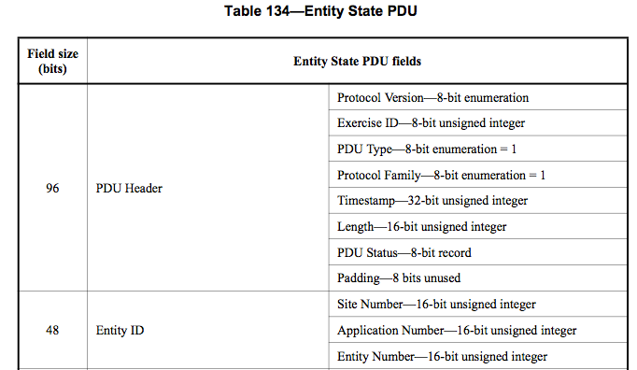
DIS: ESPDU Format
Notes:
Theme to convey: be not afraid, the IEEE DIS specification explains everything well. Proof point is decades of interoperability by diverse participants.

Slide 47
DIS: Looking at ESPDUs
What do ESPDUs look like? We can examine them on the network with a free tool called Wireshark, which can decode DIS packets
http://www.wireshark.org
Remember, it’s the format of the messages on the wire that count. The DIS standard specifies the exact format of binary messages, and any tool that produces or consumes those messages is fine with DIS. How you create them (or consume them) is none of DIS’s business.
Notes:
We are moving from theory to practice.

Slide 48
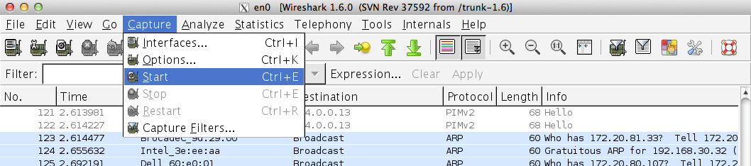
Wireshark: Capture Packets
Notes:
Describe wireshark’s immense generality, availability, capability. Viva open source!

Slide 49
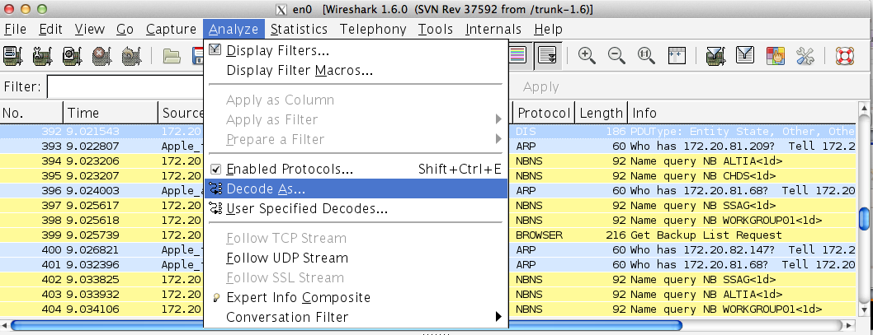
Wireshark: Decode Packets as DIS
Notes:
Wireshark does DIS too.

Slide 50
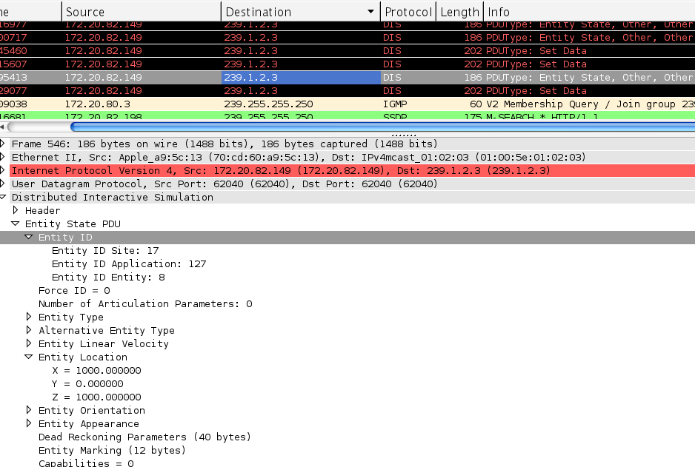
Wireshark: Examine DIS Packets
Notes:
Drill down to any/every level of detail lets everyone know what is really happening/working (and also enables debugging occasional mysteries).

Slide 51
DIS: Implementations
Format
We know what information we want to send: entity type, entity ID, position, orientation, etc.
We know what coordinate system we want to use.
We know where to find arbitrary, agreed-upon enumeration identifier values—the EBV document.
We know some PDU types: entity state PDU, etc.
How do we get the information into the format we want on the wire?
This is where DIS implementations come in.
Notes:
Review checkpoint. We’ve covered a lot – everyone on board?

Slide 52
DIS: Implementations
Where can you get a DIS implementation?
Write your own (cough cough)
Buy one. There are several commercial implementations and many have excellent support.
Use an open source version—”free as in free puppy” (also includes freedom to fix)
Open-DIS (https://github.com/open-dis - formerly http://open-dis.sourceforge.net)
Java updated to full coverage of DIS7, planning work on C-DIS and DIS8
Planning to regenerate C++, C#, Objective-C, JavaScript, Python in 2021
KDIS (http://sourceforge.net/projects/kdis) C++ (active)
Aquarius (http://sourceforge.net/projects/aquariusdispdu) C++ (retired)
JDIS (http://sourceforge.net/projects/jdis) Java (inactive)
Notes:
Have fun out there. Emphasize that Open-DIS strives for exact compliance, and errors (actual or perceived) can be fixed by the community.
Note current work to establish a DIS unit-test suite to confirm repeatability by software applications and API libraries.

Slide 53
DIS: Sending
Remember, DIS has no official API. Every implementation is different. This example will use the Open-DIS API codebase. Implementation available at https://github.com/open-dis
Source code now at https://gitlab.nps.edu/Savage/NetworkedGraphicsMV3500
Examples may contain supporting libraries for additional independent things .
All code is BSD open-source license; nonviral, use any way you see fit.

Slide 54
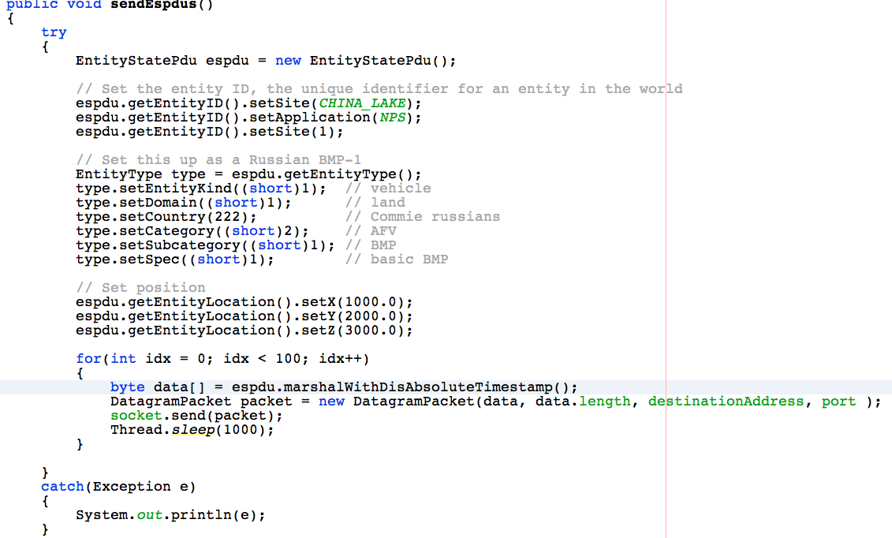
DIS: Send ESPDUs in Java
Notes:
Typical code excerpt for sending, uses Open-DIS

Slide 55
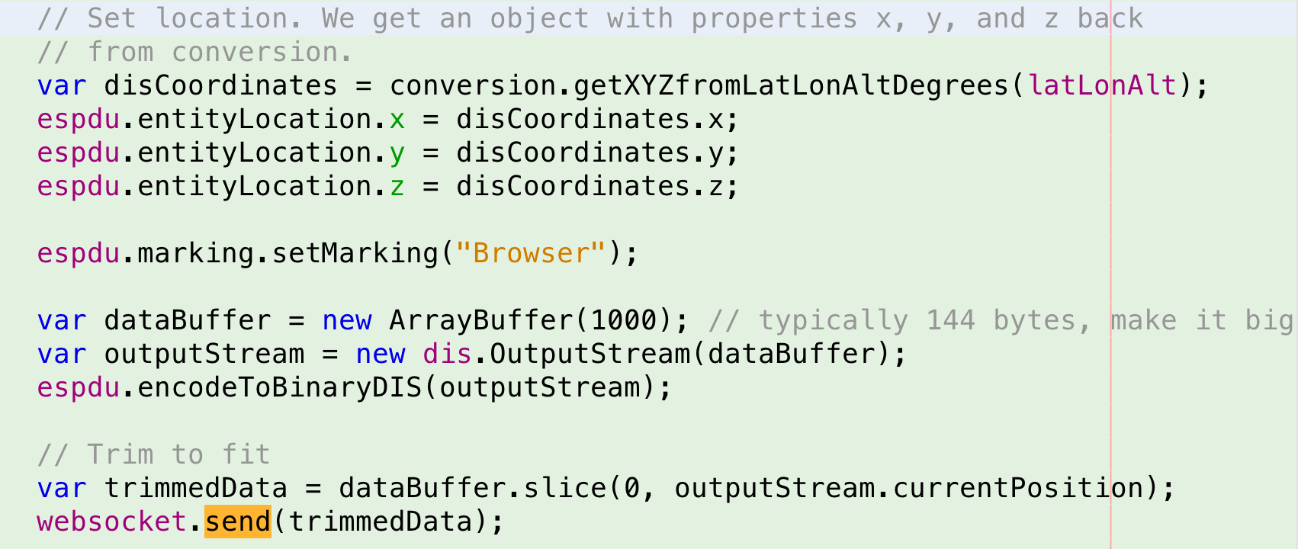
DIS: Send PDUs in Javascript
Can use HTML5 Browser geolocation and Javascript to send
DIS from a web page
Notes:
Typical code excerpt for sending to a web browser, uses Open-DIS

Slide 56
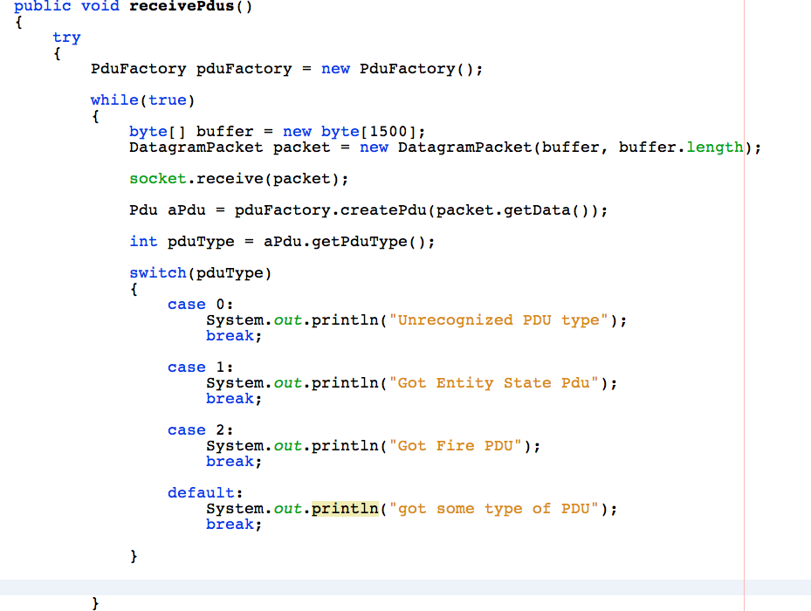
DIS: Receive PDUs in Java
Notes:
Typical code excerpt for receiving, uses Open-DIS

Slide 57
DIS Sending and Receiving PDUs
There are similar idioms for other languages such as C++, Objective-C (IOS/MacOS), JavaScript, Python, C# (Windows phone, Unity 3D)
Note that this requires that you do a bit of socket programming, which TENA and HLA hide from you. Socket programming isn’t that bad…
Notes:
Virtue of programming: you only have to get it right once!

Slide 58
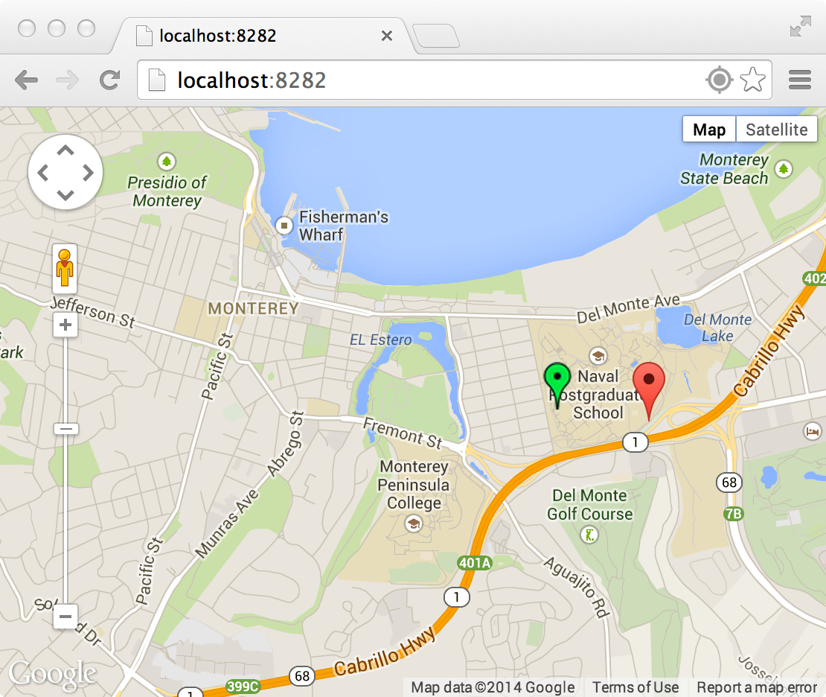
Visualizing DIS Data via Online Map using DISWebGateway
DISWebGateway running at
http://track.movesinstitute.org
Java sender & receiver for DIS
Can receive native DIS from existing DIS applications
Web-based map that shows DIS entity locations
Code refurbishment in progress…
Notes:
Exemplar demo. Server is being moved, will be ready for IITSEC (being updated for 2 classes at MOVES).

Slide 59
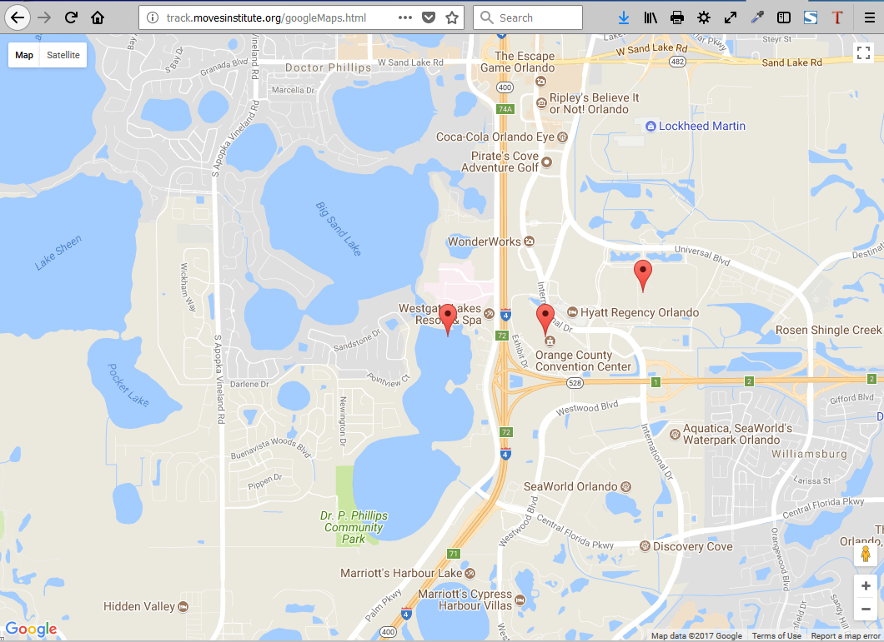
Notes:
A script moves entities around a GoogleMaps display by animating KML placemarks with DIS.

Slide 60
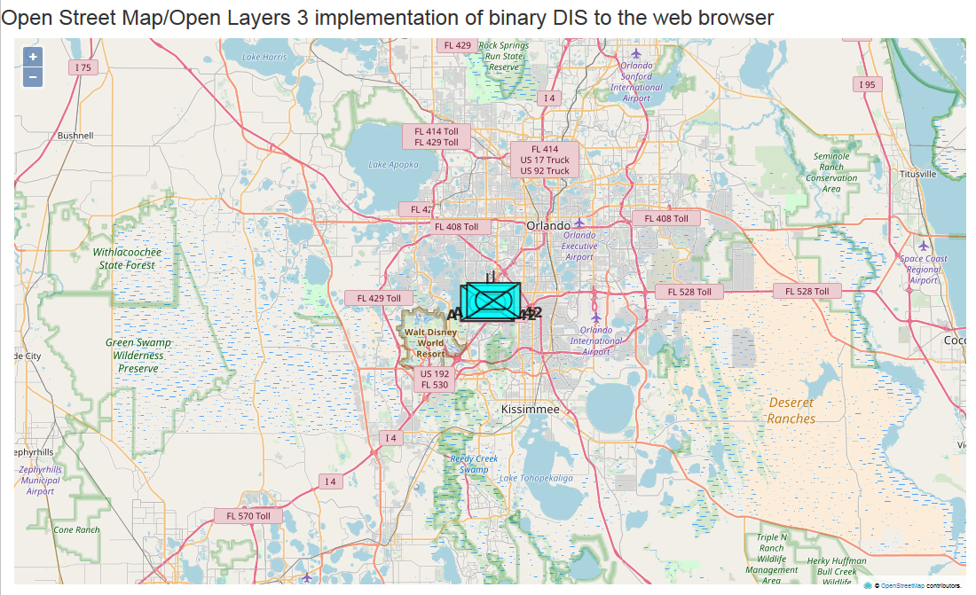
Notes:
A script moves entities around an OpenStreetMaps display by animating KML placemarks with DIS.

Slide 61
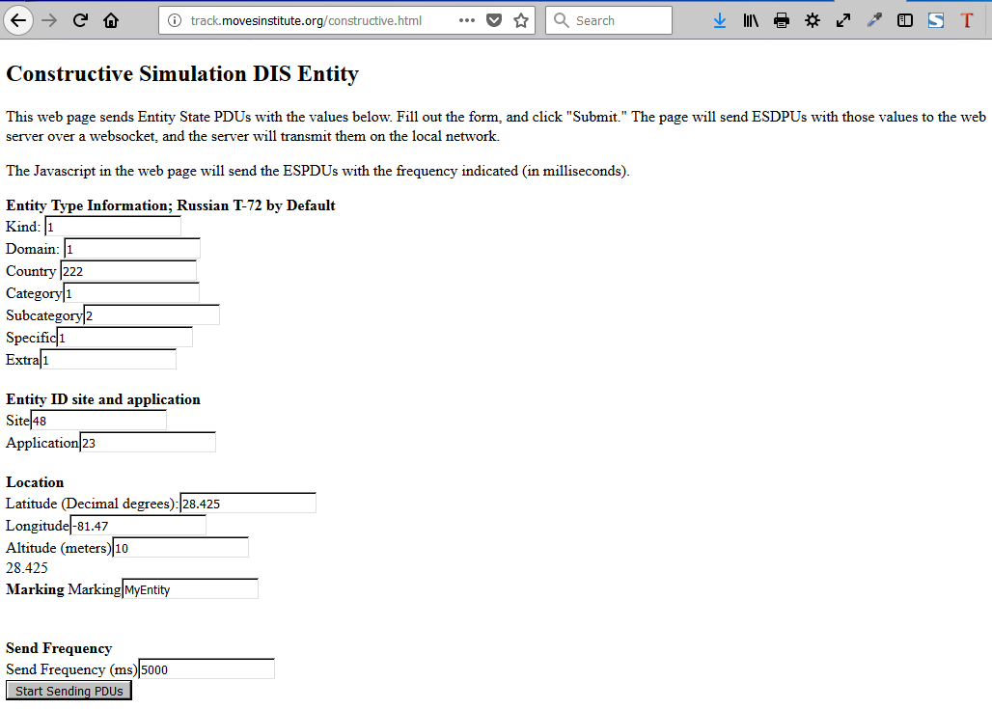
Code refurbishment in progress…
Notes:
An HTML web-page form is used to create and send DIS ESPDU stream, source-code script uses Open-DIS JavaScript library with HTML.

Slide 62
DIS: Shoot at Something
We’ve been sending ESPDU messages back and forth, but there are dozens of other sorts of messages. What if we want to shoot at someone? What does this involve?
We can use a Fire PDU, which contains
The entity ID of the shooter
The entity ID of the target (if known)
The type of munition being fired, fuse, quantity, etc. This is very similar to the entity type
Enough information to compute the path of the munition (if desired)
Notes:
We are now moving from sending/receiving to interacting.

Slide 63
DIS: Shoot at Something, then…
The Detonation PDU usually follows a Fire PDU. It contains
Location of detonation, shooter entity ID, target entity ID
Fuse, munition type, and so on
When a Detonation PDU is received simulations assess and report damage to their own entities, not to others.
This means simulations are on the “honor system” for determining their own damage; thus James T. Kirk can beat the unwinnable Kobayashi Maru scenario.
Here is a harsh adjective to describe cheating in distributed scenarios: boring.
For military simulations we are much more interested in strengths, vulnerabilities and possibilities that may occur in the real world. Thus cheating is also critically unhelpful.
Trusted participants using trusted software suites also reduces the risk of cheating.
Notes:
Shared state for collision dynamics is fundamental to many many virtual environment interactions: driving, shooting, sensing, tracking, etc. etc. etc.

Slide 64
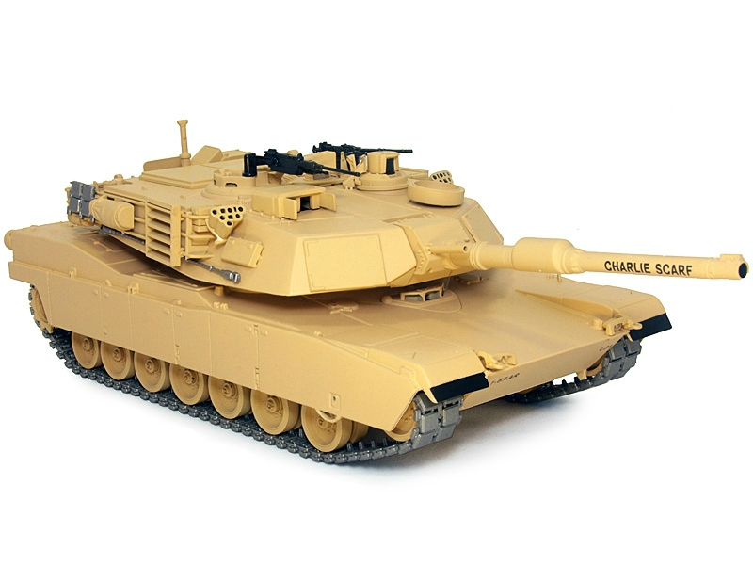
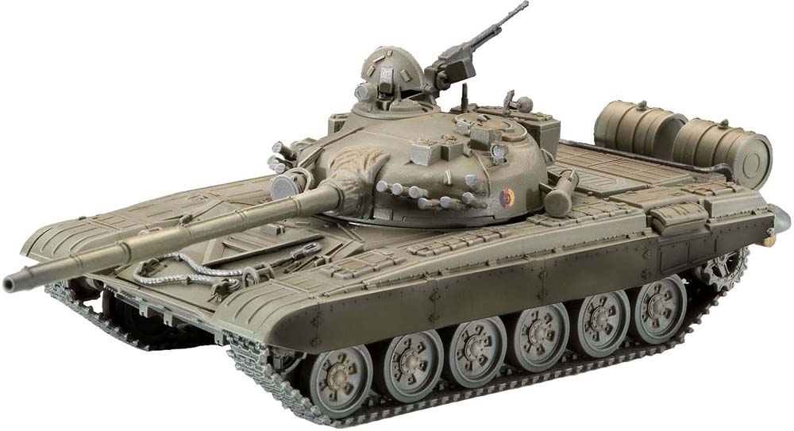
DIS Shooting
Fire! I’m entity (17, 23, 42), shooting
at entity (123, 7, 12) with a HEAT round
from (x, y, z)
Explosion! There’s an detonation of a HEAT
round at (x’, y’, z’).
All entities now assess the damage to themselves by the
Detonation at (x’, y’, z’)
Notes:
Walk through an interaction.

Slide 65
DIS: Arbitrary Data
You can also exchange arbitrary data between DIS simulation participants with the DataQuery and Data PDUs.
Participant sends a DataQuery PDU addressed to another participant
That participant responds with a Data PDU
The data itself is sent as “fixed variable datums” or “variable data datums”. Therefore it’s up to you to specify the exact format of these
Notes:
A protocol is a handshake, carefully choreographed.

Slide 66
DIS: Other messages
There are many other messages that can be used in DIS
Electronic warfare
Logistics
Directed energy weapons
Voice/Intercom
Collisions
Simulation management
Data exchange
It’s a big topic! Many different “conversations” can occur among entities.
But the basics are: a standard format for exchanging state information.
Notes:
Lots more can be said!

Slide 67
DIS and Other Standards: HLA, TENA
How can DIS interoperate with HLA or TENA?
HLA Real-time Platform Reference Federation Object Model (RPR-FOM)
Intentionally matches DIS, same entity types, same entity IDs and coordinate system, etc.
HLA object model mapping makes transition from DIS to HLA easy and consistent
Several gateways to translate between DIS and RPR-FOM. JBUS, AMIE, others
Guidance, Rationale and Interoperability Modalities (GRIM) for RPR-FOM standard provides further rules and usage information.
https://www.sisostds.org/productspublications/standards/sisostandards.aspx
TENA has generalized gateway functionality that can map TENA events to DIS and vice versa. It generally uses the same coordinate system, entity types, etc.
Notes:
There is a large community of practitioners and programmers out there.

Slide 68
DIS Research Topic: DIS in the Web Page
Websockets are a standard from IETF and W3C. The idea is to provide a direct Javascript-based TCP socket into a web page without having to use AJAX polling techniques. Widespread browser support.
JavaScript is a widely used language for dynamic web content.
WebGL is JavaScript binding for OpenGL which allows us to use accelerated 3D graphics inside the web page.
WebGL can be the substrate for higher level graphics standards such as Extensible 3D Graphics Standard (X3D).
Put all three together and you can implement a networked virtual environment in a web page.
Notes:
Lots of work, slowly steadily progressing. Web technology provides the greatest possible footprint, either on big internet or private military networks.

Slide 69
DIS Research Topic: 3D in the Web Page
Network with
conventional
binary-format
DIS packets
Web Server
Web pages with Javascript
WebGL scene updated by
DIS over a Websocket
Notes:
For example: it has to be simple to be repeatable and reusable.

Slide 70
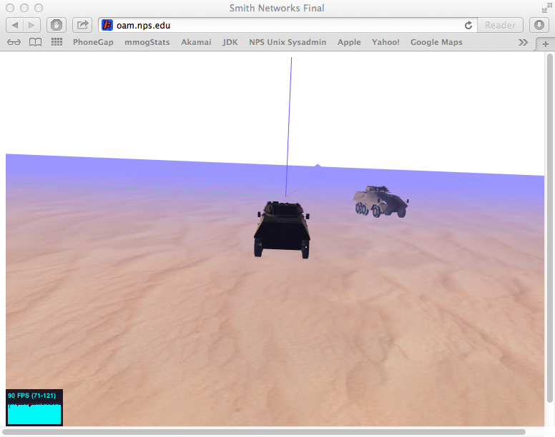
DIS Research Topic: 3D in the Web Page
Notes:
Demo. Server may change, details will be confirmed at IITSEC.

Slide 71
Applied Research using WebLVC
Excellent combinations of WebGL/X3D, WebSockets, and fast JavaScript in the web browser have emerged in recent years.
Open-DIS library can send DIS PDUs directly into a web browser.
SISO WebLVC Product Development Group (PDG)
https://www.sisostds.org/StandardsActivities/DevelopmentGroups/WebLVCPDG.aspx
One of many examples: Virtual World Framework
http://virtualworldframework.com and https://en.wikipedia.org/wiki/Virtual_world_framework
Active research topic… but no wide-scale “Ready Player One” arenas for DIS, yet
Notes:
There is no one single way to do it! There are many ways… and more work to do. Participants have an important role to play.

Slide 72
DIS Tutorial Summary
DIS applications exchange state information among distributed set of players.
Defines syntax and semantics for a series of binary-formatted messages, with each packet’s bytes, data representation and functionality exactly defined.
Different software APIs can implement the same “over the wire” data standard.
Applications focused on large-scale, high-fidelity, virtual / constructive simulations.
Common concepts: entity types, entity IDs, heartbeats, coordinate systems.
Notes:
Are we clear? Remembering key points remaining constant among many details.

Slide 73
Resources and References
SISO: http://sisostds.org
SISO DIS / RPR FOM Protocol Support Group: https://www.sisostds.org/StandardsActivities/SupportGroups.aspx
Open-DIS: https://github.com/open-dis and
SEDRIS SRM: http://sedris.org
Kdis: http://kdis.sourceforge.net
Wireshark: http://wireshark.org
X3D Graphics: http://www.web3d.org/x3d/what-x3d and http://x3dgraphics.com/slidesets
WebGL: http://www.khronos.org/webgl
WebLVC: https://www.sisostds.org/StandardsActivities/DevelopmentGroups.aspx
WebSockets: http://tools.ietf.org/html/rfc6455 , http://www.w3.org/TR/websockets
https://github.com/open-dis/open-dis7-java
This tutorial and additional examples can be found at
https://gitlab.nps.edu/Savage/NetworkedGraphicsMV3500
Notes:
More references available online. This takes study and, of course, we learn most of all from actual practice. Questions welcome, the community learns together.

Slide 74
TODO: lots of work in progress!
Much work is ongoing in DIS at NPS. Several areas of improved focus were realized during the SISO Simulation Interoperability Workshop (SIW) held in Orlando Florida February 2020. The following work is continuing for this year:
Improved Java enumerations (over 22,000 values) regularly autogenerated,
Improved OpenDIS7 library, full coverage of all 72 PDUs, growing set of examples,
Thesis work to support unit testing of simulations via DIS streams and LVC connectivity including Extensible 3D Graphics (X3D) Standard now available,
Planned work in Compressed DIS (C-DIS) encoding and DIS version 8 development, looking for sponsors or partners.
We look forward to steady tutorial, workshop and library improvements each year.

Slide 75
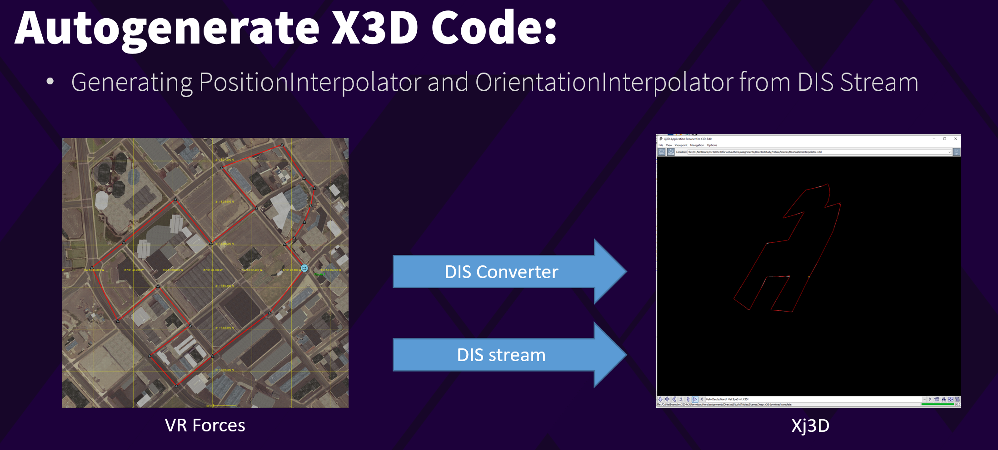
Thesis of Interest
Tobias Brennenstuhl, REPEATABLE UNIT TESTING OF DISTRIBUTED INTERACTIVE SIMULATION (DIS) PROTOCOL BEHAVIOR STREAMS USING WEB STANDARDS, Masters Thesis, June 2020. (online)
Notes:
Abstract. The IEEE Distributed Interactive Simulation (DIS) protocol is used for high-fidelity real-time information sharing among simulations and trainers across the entire international Modeling and Simulation (M&S) community. If archivally saved and replayed, DIS streams have the potential to become a valuable source of Big Data. The availability of archived prerecorded behavior streams for replay, adaptation, and analysis can benefit an immense variety of application areas. The computer science principle “a stream is a stream” indicates that data in motion is equivalent to data at rest. This characteristic can enable powerful capabilities for DIS.
This thesis presents prototypes to demonstrate how various forms of repeatability are key to gaining improved benefits from DIS stream analysis. Unit testing of DIS behavior streams allows confirmation of both repeatability and correctness when testing all manner of applications, exercises, simulations, and training sessions. A related use case is automated after-action review (AAR) from recorded DIS streams. This thesis also shows how a DIS stream is converted into autogenerated code that can animate an X3D Graphics model. Many obstacles were overcome during this work, and so various best practices are provided. Of note is that unit testing might even become a contract requirement for incrementally developing and stably maintaining Live Virtual Constructive (LVC) code bases. This progress provides many opportunities for future work.

Slide 76
Learning Objectives
The learner will be able to…
Identify what standards are used by distributed simulations for military use.
Identify what types of communication protocols are used for various networks.
Identify what aspects needs to be standardized, and what aspects can be customized, to support diverse simulations with differing models and goals.
Identify how DIS techniques for dead reckoning (DR), visual smoothing and distributed collision detection can reduce network traffic.
Learn how to apply new capabilities expected for Compressed DIS and DISv8.
Notes:
Discuss how connecting all manner of simulations, namely Live Virtual Constructive LVC, is the necessary path for connecting to Command and Control (C2) systems. Establishing such connections between traditionally separate domains is central to conference theme,
“The Future is Now“
Note that, for example, common tutorial topic “What coordinate systems are used?” is also central to requirements for connecting C2 and M+S.
Slide 2 and last slide are identical.

