Slide 1
Building an Education and Training Data Strategy
Data Concepts, Specifications And Standards to enable the Future Learning Ecosystem, Support Enterprise Learning Analytics And Pave The Way For Artificial Intelligence / Machine Learning In MPT&E
Brent Smith, Advanced Distributed Learning (SETA)
Jerry Gordon, Gibbs & Cox Maritime Solutions

Slide 2
Learning Outcomes
Learning Objective 1
The learner will be able to describe the elements of an integrated data strategy for any new or existing program of instruction.
Learning Objective 2
The learner will be able to use a Competency Frameworks to define the Knowledge, Skills, Abilities, and other characteristics required to perform specific jobs.
Learning Objective 3
Learners will be able to describe learning experiences, content, activities, resources, and educational alignment to the Competency Framework using metadata and paradata.
Learning Objective 4
Given a series of example learning events, learners will be able to decompose each event into the components of well-formed xAPI statements.
Learning Objective 5
The learner will be able to explain the relationship between learning data elements, the components of the future learning ecosystem, and learning events.
Notes:
Learning Objective 1:
The learner will be able to describe the elements of an integrated data strategy for any new or existing program of instruction.
Learning Objective 2:
Given a learning domain, the learner will be able to describe the use of a Competency Framework to relate the behaviors required for specific jobs, describes its relationship to other competencies, and aligns sources of evidence that can demonstrate proficiency for that competency.
Learning Objective 3:
Learners will be able to describe learning experiences, content, activities and their associated resources and educational alignment and define metadata and paradata.
Learning Objective 4:
Given a series of example learning events, learners will be able to decompose each event into the components of well-formed xAPI statements.
Learning Objective 5:
The learner will be able to explain the relationship between learning data elements, the components of the future learning ecosystem, and learning events.

Slide 3
Topics Covered
Lifelong Learning
  Ecosystem – Enclaves and Federations
  Learner Pathways along the Continuum of Learning
  Control Loops
  Learning Velocity and Career Trajectory
Future Learning Ecosystem
  Ecosystems and Federations
  Next Generation of Activities
  Data Ecosystem
  Enterprise Assets
Competency-Based Learning
  Credential Transparency Definition Language (CTDL)
  IEEE 1484.20.1 Reusable Competency Definition
  Badges and Links
Activity and Resource Metadata
  IEEE P2881 Learning Object Metadata (LOM) 2.0
Learning Activity Tracking
  IEEE 9274.1 Experience API
  IEEE 9274.2 xAPI Profile
  IEEE 9274.3 Master Object Model
Learner Records
  Lifelong Learner Records
  IEEE 1484.2 Integrated Learner Record
  Summary and Conclusions
Notes:
Please focus on consistency of font, paragraph spacing, and slide formatting in general – bullets in the left colum look single spaced while the bullets in the right column look like a multiple spacing. Future Learning Ecosystem is larger than Lifelong learning. Bullets are larger than higher level topics. Clean up the cosmetic issues – no substantive changes

Slide 4







Lifelong Learning
?
LIFELONG LEARNING
?
Notes:
This slide should be built out to better illustrate the lifelong learning journey. I like the footprints but think we need something to set the context for what the viewer is seeing.
Add text to describe the intent for this slide. What is the key take away?
Context is especially important for the I/ITSEC reviewers. Let’s make sure the slides stand on their own for telling the story we want to tell.

Slide 5













Organizational View
Motivational Focus
Learning Situations
Milestone
Occupational Alignment
Cultural Alignment
Credential
Life Skill
Informal
Formal
Non-Formal
Roles
Mentor/
Tutor/
Facilitator
Colleague/
Teammate/
Classmate
Student/
Employee/
Mentee/Learner
Learner
Organization
Relationship
Teacher/
Instructor/
Professor
Supervisor/
Manager/
Director
Resource
Credential = Certificate, badge, license, degree, qualification, achievement
Milestone = Job, Credential, Promotion, Selection, Screening

Slide 6










Resource View
Goal Structures
Resource Origin
Feedback and Control
Competency
ELO/TLO
Curated
Created
Resource Facilitated
Human Facilitated
Delivery Mode
Interactivity (Cognitive Alignment)
Learner
Organization
Relationship
Asynchronous
Synchronous
Passive
Immersive
Resource

Slide 7







Learner View
Learning Feedback and Regulation
Goal and Achievement Management
Social Reinforcement
Externally Regulated
Self Regulated
Self-Directed
Externally Directed
Learner State
Behavioral Reinforcement
Learner
Organization
Relationship
Goal
Task
Event
Resource

Slide 8

Control Loops
Physical Abilities
Control Loop 1: Optimize Current Activity
Formal Training
Informal Training
Work/Life Experience
Outcomes
Mission Effectiveness
Basic Aptitude
Primary Education
Career/Job Selection
Control Loop 2: Optimize Progress Towards Credential
Credential
Motivation
Control Loop 3: Optimize Credentials for Current Job
Job/Duty/Gig
Opportunity / Interest
Initial Conditions Set
Control Loop 4: Optimize
Career Trajectory
Career
5 CONTROL LOOPS
Career / MOS / AFSC / NEC
Control Loop 5: New Career Goals
Notes:
Control Loop 1: Optimize learner performance within a single course, lesson, or learning activity. This control loop includes data retrieved from student information systems, learning management systems, learner record stores, intelligent tutoring systems, games/simulations, and other sources derived through the execution of this effort.
Control Loop 2: Optimize courses, lessons, or learning activities in pursuit of a credential (e.g., degree, certification, other). This control loop includes the information included in the first control loop, but additional information may also be collected including operational systems (e.g., job training, performance support), schoolhouse transcripts, and other registries/data sources identified throughout the execution of this effort.
Control Loop 3: Optimize credentials in support of, or pursuit of a job. This control loop includes information related to job performance and the specific credentialing requirements associated with each job. Additional considerations will include the availability of data generated from an operational system (e.g., performance reviews, personnel system, mission outcomes) and its alignment to job performance indicators and the myriad of competencies required to successfully perform a job.
Control Loop 4: Optimize jobs in support of Career Goals (Career Trajectory). This control loop requires data outside the normal scope of training and education systems, derived from workforce planning tools, talent management systems, human resources, and other sources (e.g., that might be used to help tailor the skillset of the learner to the strategic and tactical needs of the organization.
Control Loop 5: Change in career goals or support new career trajectory. This control loop is comprised of data sources that support the alignment of current career trajectories, population models, or other lifelong learning data with new career trajectories.

Slide 9
The “Vector Map” of Lifelong Learning in the DOD
Accession and Initial Configuration
Measuring Learning
Goal Sequencing towards Career Milestone (Jobs)
Milestone Sequencing
Along Career Arc
3
4
Velocity
Trajectory
Optimizes Progress Towards a Goal
2
5
Optimizes Selection of Career Arcs
Career Milestones
Learning Goals
Optimizes Course or Learning Activity
Decision Points
1
Notes:
This needs a lot of clean up. Work with Liz to get this matured

Slide 10


Learning Ecosystem
Strategy
Value Exchange
Openness
LEARNING ECOSYSTEM
Technology
Participants
Complexity
Relationships
Domains
Notes:
Need to add a slide prior to this that includes something about data analytics and decision support – Answer the question about why we need a data strategy – This was added to the tutorial outline
May need a slide after this one to support another addition to the outline that states “Define the current training and education landscape). This slide might suffice, but I’m betting there’s a better way to visualize.

Slide 11


Enclaves, Federations and Ecosystems, Oh My!
Ecosystem
Organization 1 Network Enclave
Enclave
Federation
Core Services
Learning Record Providers
Authority To Connect
Core Data
Simulator System
Backend Service
Other Enclaves
Learning Record Providers
Enterprise Assets
Firewall
Federated Data
Schema services
Directory services
Conformance
Data Governance
Numerous Learning sites, Mobile Learning, Training Aids,
Devices, Simulators, and Simulations (TADSS), and other
Ubiquitous Learning Activities create a
Federation
Policy, Specifications, Standards,
& Governance Define the
Ecology
Notes:
From a systems engineering approach, lifelong learning can be decomposed into institutional enclaves that manage one or more learning experiences, federated data stores that communicate within or across enclaves, and an ecosystem of interoperable content, tools, and learning management systems.
Enclave: an institutions computer network boundary where all systems related to the delivery, management, or storage of learning data reside.
Federation: a geographically dispersed database management system that transparently maps multiple autonomous systems into a single federated database.
Ecosystem: plug and play content, tools, systems, and data reporting using commercially available standards and specifications.
Ecology: Policy framework and normative specifications and standards that define the ecosystem creation and connection rules

Slide 12

Enterprise Digital Learning Data Strategy
The DODI 13226.26 Policy Framework:
Federated Data Strategy for all training and education related data.
Derived from internationally accepted technical specifications and standards
Ensures portability of learning data between enclaves
Provides auditability and Non-Repudiation of Competencies and Credentials
Facilitates enterprise Analytics, Artificial Intelligence, and Automation
Activity and Resource Metadata
Activity Registry
  Activities and Content
  Competency Alignment
Metadata Strategy
  Alignment to Design/Development Activities
  Paradata
  Other Data
Learning Event Tracking
xAPI Profiles
  Controlled Vocabularies
  Domain Specific Context
  Cmi5 Specification
  Normalized Data
Experience context & sequencing
Paradata
Competency Framework
Competency Description
  Knowledge, Skills, Abilities, and Other Attributes
  Maps
  Conditions & Standards
  Level of Mastery
Job, Duty, Gig Alignment
Learner Records
Unique User ID (UUID) mapping
Learner Attributes
  C&C Ledger
  Experience Ledger
  Preferences
  Career Trajectory
Notes:
Watch consistency of font sizes across the different slides- Maintain the same look and feel by title sizes, bullet headers, and bullet the same across slides (different font sizes for each is fine)
Make sure same font is used throughout
Make sure paragraph spacing, line spacing, bullet spacing, etc is the same across all slides
We should update the graphic to include the same bullets that the slide does – maybe mention the relevant standard(s) for each

Slide 13
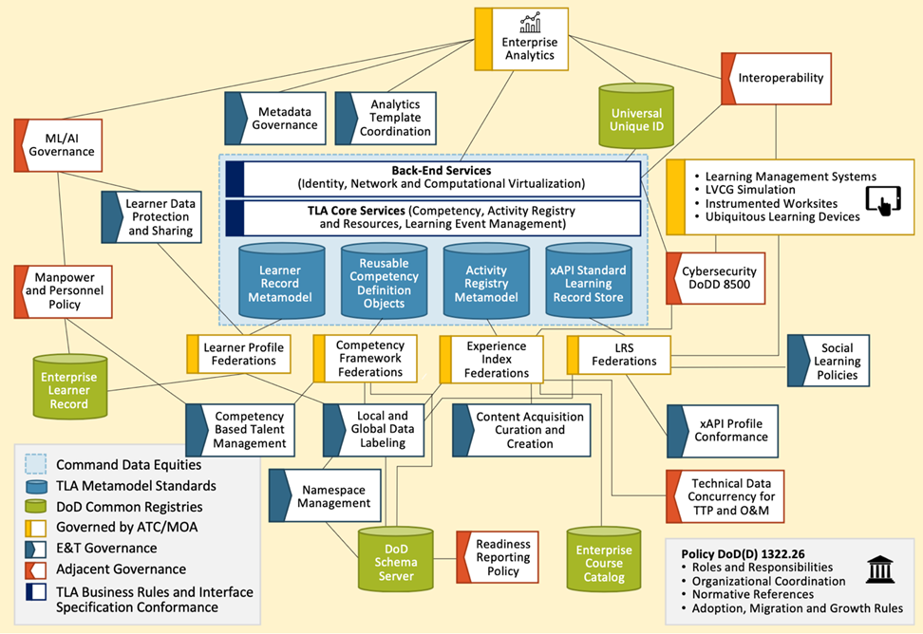
Enterprise Assets and Data Governance
Requires:
  A globally resolvable way to reconcile learner identity
  A globally resolvable way to share and advertise available learning assets
  A globally resolvable way to identify competencies and credentials
  A globally resolvable way to share learning attributes and locate records for leaners
  Processes for review, update, configuration status accounting, and crowdsourcing data and data metamodels

Slide 14





Enterprise Assets
Training and Education Assets
Lifelong Learner Records
Enterprise Level Asset
Search
Share
Registry of indices
Enterprise Level Asset
Summative learner competency and credentials
UIC, effective date, and geocache where gained
CEU and status
Pointer to source data
Data Governance
Curriculum and Quota Control
Management
Local to Regional attribute promotion
Regional to IEEE Standard promotion
Enterprise Analytics
FICAM Integration
Data Governance
Integration with M&P system data
Local to Regional attribute promotion
Regional to IEEE Standard promotion
Enterprise Analytics
FICAM Integration
Schema manager for credential definitions
Local Experience Index
Courses
Components and lab resources
Shareable assets
Local devices and corpora
Local Learner Profile
Local Credential Signatures
Links to evidentiary chain
Client component of badges
Learner State
Competencies/attributes

Slide 15

Competency-Based Learning
skills
COMPETENCY-BASED LEARNING
Knowledge
Abilities
Behaviors

Slide 16
Shift to Competency-Based Learning
Focus on the Job Context instead of Schoolhouse
Focus on filling gaps rather than completing course of instruction
Based on evidence instead of assessment
Compliments credentialing
Notes:
Keep font size consistent with other slides
Expand image to make it readable
What’s up with the foreign language?

Slide 17
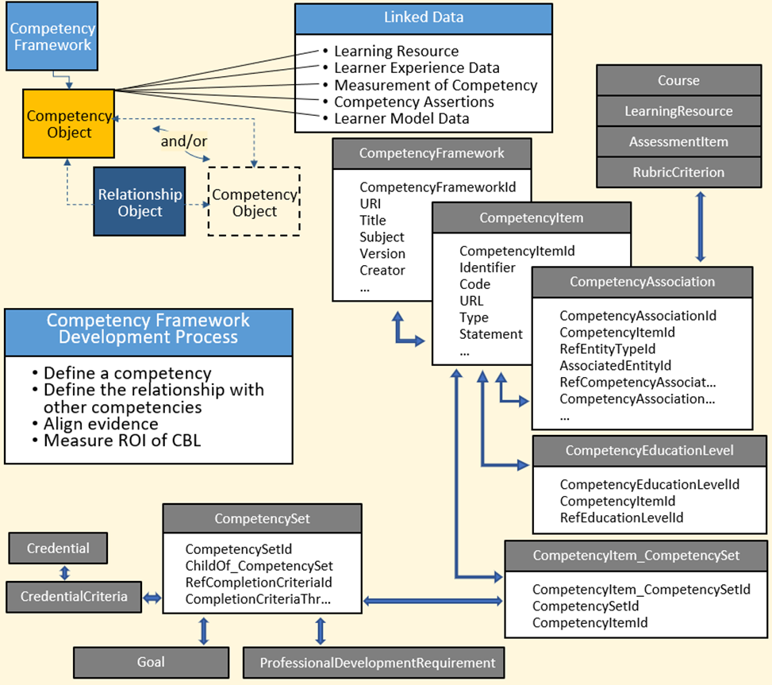
Reusable Competency Definition Objects
IEEE P1484.20.1
Supports “Directed Acyclic Graph” instead of Spanning Tree
Allows for creation of networks at multiple levels of mastery using same underlying behaviors
Can evolve over time
Notes:
Maintain consistent font & font size with other slides

Slide 18
Taxonomical Challenges in Defining “Competency”
What are the discriminators between what a generic person might be able to do, and a specific person can do?
  i.e. Competency object? Competency definition?
Does a Competency refer to any constituent KSAO?
  Does A stand for ability, attitude, or aptitude?
  Is Attitude just a superclass of “other behavior”
  Is there a taxonomy of “other behaviors”
  Is there a discriminator between a “base level” defined KSAO/Competency Object, and higher level?
Is there a syntactic standard for expressing competencies analogous to “task [actor, verb:bloom class, object], condition, and standard [ measure, criterion] for LO”?
  If so, what is it?
  If not, should there be?

Slide 19








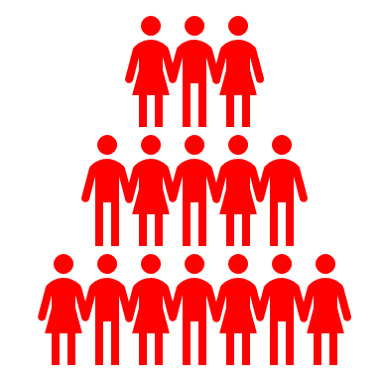



Factory Learning Model
Evaluation
Analysis
Design
Develop
Implementation
Job/Duty Tasks
Learning Objectives
Linear Curriculum
Knowledge
Training Task
Presented at Schoolhouse
Skill
Condition
Results in Credential
Lab
Practical
Ability
Standard
Behavior
Cohort Tracking
Common to both
Changes
Notes:
I like this slide. It should come together nicely with some quality Liz time

Slide 20












Shift to Competency-Based Learning
Assertions of Competency
Conferral of Credentials
Audit Trail
Inferences
Network of Job Requirements
Evidence of Competency
Trust and Verify
Job/Duty Tasks
Standards
Schoolhouse
Knowledge
Ability
Lab Practical
Skill
Behavior
Supervisor Evaluation
Level of Mastery
On-the-Job Experience
Job Site Context
Ubiquitous Learning
Behavioral Inventory
Common to both
Changes

Slide 21
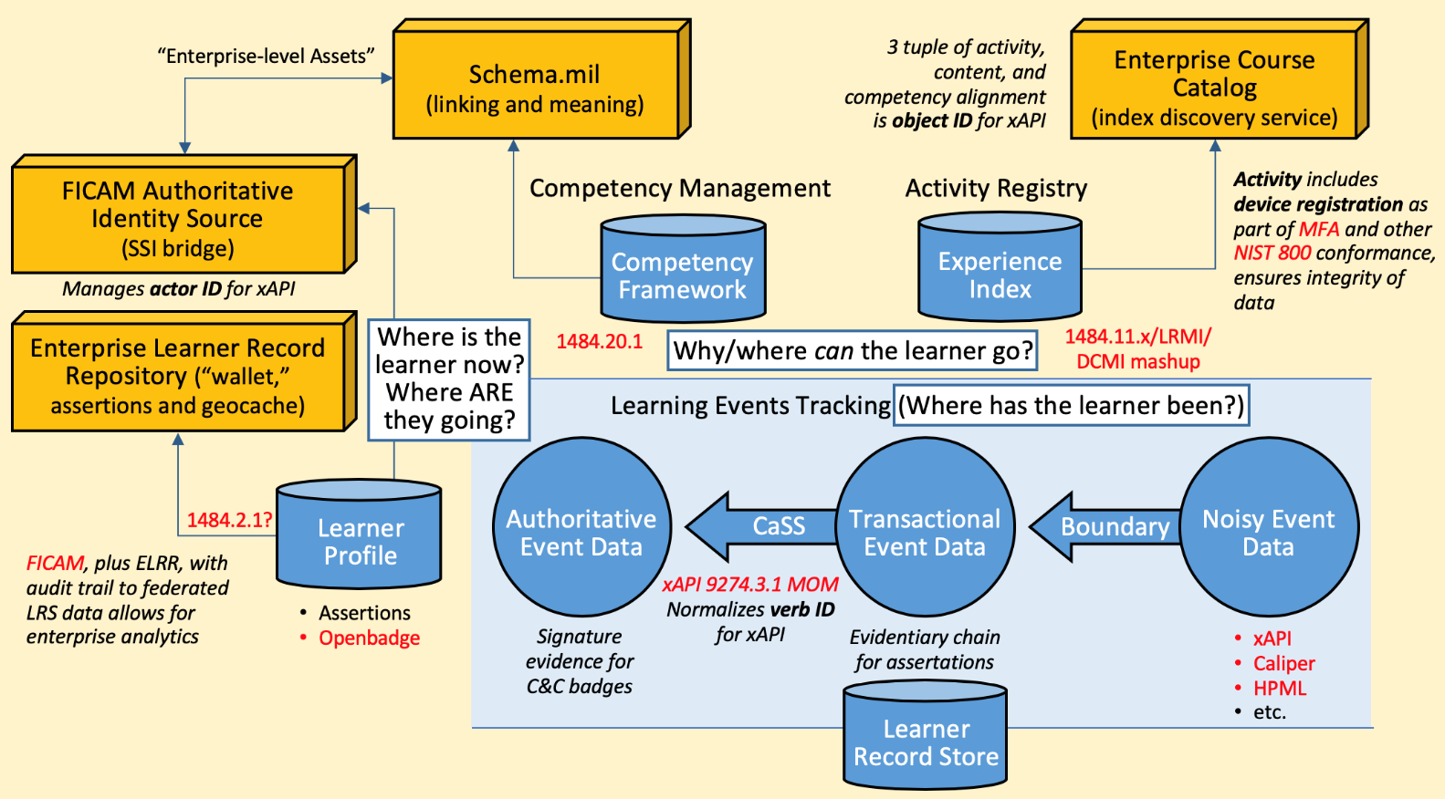

Chains of Evidence and Trust
Learning activities as edge systems provide and adjudicate learning opportunities
Activities generate a ledger of learner performance using xAPI
xAPI provides raw evidence
Competency systems make assertions of competency and recommendations to confer credentials
Learner profiles and authoritative data sources store digitally signed certificates of conferral
Enterprise assets ensure non-repudiable credentials by managing identity, access, credential names, composition, provenance, and state
Notes:
Watch font size and bullet spacing
Bullets are very close to graphic and graphic is cut off on the left side. Can we recreate the graphic to be more readable – reduce complexity – use animation if needed.

Slide 22
Exercise #1 Brainstorming Competencies
What are some examples of competencies for your organization?
What defines the "other behaviors" and soft skills that are required?
What kind of evidence of competency might you collect?
Leadership
Institutional
Professional
Technical
Behavioral
Team
Confidence
Detail-Oriented
Abstract Thinking
Communication
Empathy
Organized
Formal Assessments
Apprenticeship
Job Performance
Demonstrate
Annual Review
Key Performance Indicators

Slide 23


Credential Transparency Definition Language
Recognizes the variety of learning opportunities and constantly emerging technology
Uses “content” to normalize normative references and file resources
Uses “activity” to normalize modality and cognitive fit
“Experience” is 3 tuple of content, activity and educational alignment (competency objects)
Badges
Degree/Certificate
Requirements
Opportunities
Trust
Identity Management
Notes:
Formatting is clunky. Have Liz work her magic – font size under circles

Slide 24
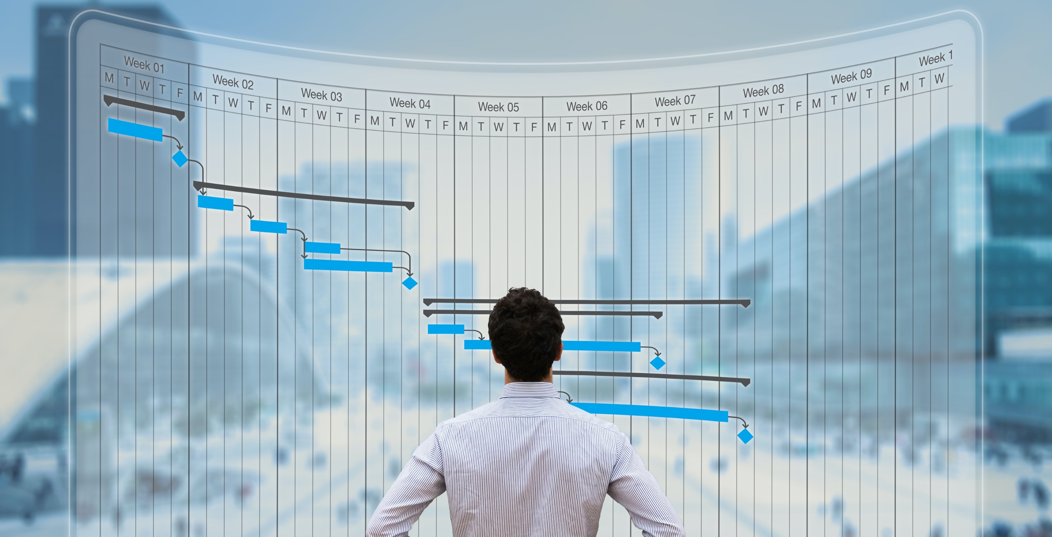




Activity and Resource Metadata
ACTIVITY AND RESOURCE METADATA
Notes:
Add text to let the view know what they’re looking at. How should this slide be interpreted and what’s the key takeaway?

Slide 25
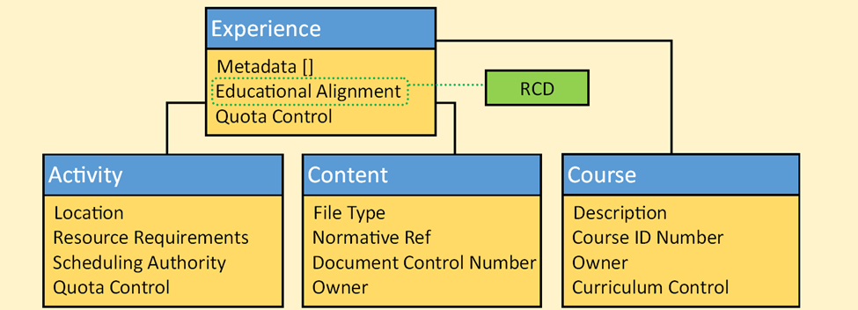
Experiences
Competency
Recognizes the variety of learning opportunities and constantly emerging technology
Uses “content” to normalize normative references and file resources
Uses “activity” to normalize modality and cognitive fit
“Experience” is 3 tuple of content, activity and educational alignment (competency objects)
Notes:
Font size & consistency with other slides
Make graphic larger if possible.

Slide 26
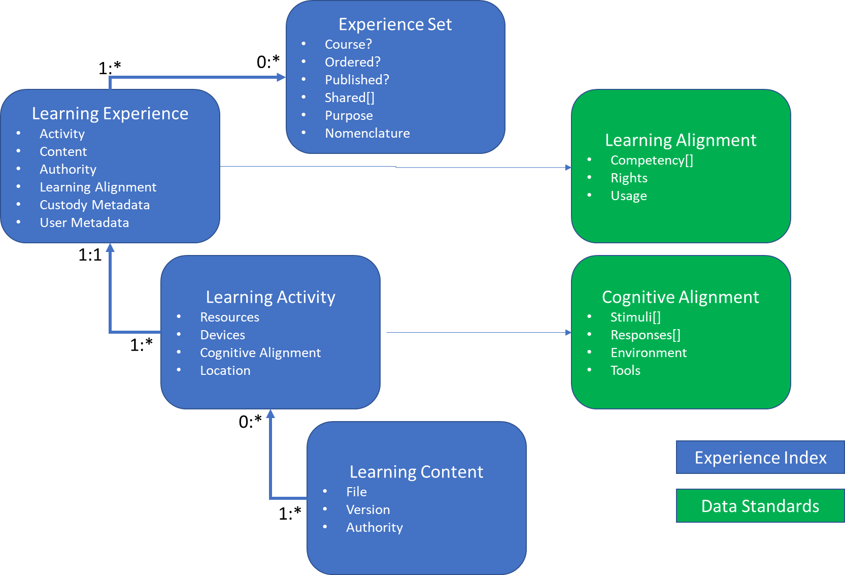
Metadata (Prospective) IEEE 2881 Model (Simplified)
Residual Questions
  Technical Metadata vs. Educational Metadata
  Which attributes belong where?
  Are the attributes orthogonal, or duplicates based on grain size or perspective?
  How does this metadata interoperate with other types of learning data (e.g., the learner?)

Slide 27
Learning Metadata
Experience Triple
Activity (Modality)
    Resources and Scheduling
    Cognitive Alignment (fitness for use)
Content (Learning Value)
    Files and Bookmarks
    User Specified Metadata
    Authority and CM
Learning Alignment
    Educational value
    Interactivity and learning environment
    Versioning and Rights

Slide 28
Exercise #2 Learning Object Metadata
Create Metadata for Learning Activities and Experiences
  What is the activity?
  What does it require to perform?
  Why would you do it?
  Who or what defines what “right” means?
  Why would this activity be a better choice than another?
  What parts of the instructional goal does it leave undone?
  What else might contribute to variances in learning outcomes from performing this activity?
Notes:
Change to exercise 2

Slide 29


Learning Event Tracking
LEARNING EVENT TRACKING
Notes:
Tutorial outline now says Learning Activity Performance Tracking – change title of slide to match

Slide 30
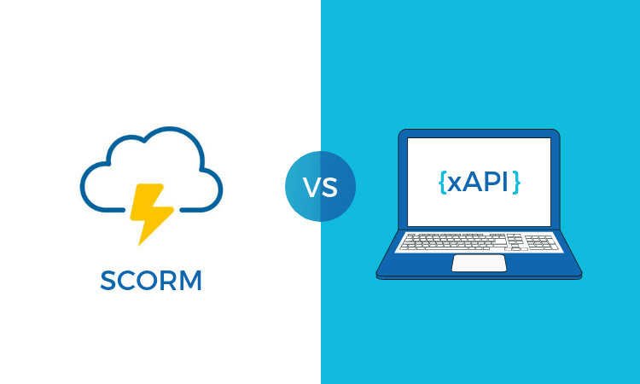
Learning Activity Records
Closed system LMS
Tied to “Player”
Counting
No clearing house for
metadata
IEEE 1484.11, etc
Open “Ecosystem”
Measuring
Not Limited to single system
IEEE 9274
Notes:
I think you mean IEEE 1484.12 for Learner Object Metadata. I believe 1484.11 is for SCORM’s Content Object Communication
Watch font, font size, spacing of bullets. Find a cleaner way to do the comparison list/graphics

Slide 31



Components of xAPI Statement
Actor:
Who or what generated the event?
Language:
Language in which the activity or content was conducted
Verb:
What action was done?
Result:
Normalized reporting against a standard
Object:
What was experienced?
Context:
Details from execution (who/where/how much)
Timestamp:
When did it happen? When was the record archived?
Authority:
Who or what authorized the recording of the experience?
Notes:
Center graphics/text on slide. Currently is sits towards the bottom.

Slide 32
Components of xAPI Statement
Learner Identity comes from Authoritative Data Source for Identity, Credentials and Access Management (ICAM)
Verbs come from activity descriptions, including the normalized Master Object Model (MOM) or cmi5
Objects relate to the activity, concept (e.g. credential, event), or experience
Results are adjudicated by the edge system according to the appropriate rubric and standard
Context comes from scenario/session management
Authority lists come from the device and experience registration process
Notes:
Center graphics/text on slide. Currently is sits towards the bottom.

Slide 33







Learner State and the Learner Object Model
Facilitates tracking of learning pathways
Interleaves “micro-curricula” within macrocurricula
Removes State Dependency for ecosystem components- “loosely coupled”
Normalizes performance data
xAPI Master Object Model (P9274.3.1)
Goal Setting
Planning
Scheduling
Launching
MOM Activity Streams
Learning Data
Learning Device
Capturing
Contextualizing
Evaluating Trust
Locating
MOM Activity Streams
Notes:
Font, font size, spacing consistency with other slides
Increase size of graphic to improve readability

Slide 34
Exercise #3 Learning Performance Measurement
Create extensions for xAPI fields for the activity you selected in Exercise #2:
  How did you verify user identity?
  How did you report out grading results?
  How did you grade the activity (how long did it take, who used what process, etc.)?
  What things can you control that changed the way one student would experience the activity over another
  Was it a team or individual activity?
    How did you determine roles?
    Was there an aggregate score for the exercise or per role?
  What configuration went into conducting or modifying the exercise?
  How did you decide which modifications to use?
  Are there any files or artifacts that you would want to archive for later AAR or audits?
Notes:
Font, font size, spacing, bullet types consistent with other slides

Slide 35


Learner Records
LEARNER RECORDS

Slide 36



Learner Profiles
Authoritative Identity
Maintain and track career arc
Globally relevant learner Data
Authoritative source for badging
IEEE 1484.2 Integrated Learning Record
Others (i.e. IMS Global CLR)
Conferrals of Credentials and Status Management
Assertions of Competency
Learner Attributes and Preferences
Notes:
Font, font size, spacing consistency with other slides

Slide 37






Open Badging Technology
Badges:
Credential Transparency Definition Language (CTDL)
OpenBadge™
Evidence Based
Portable – *Self Sovereign
Free and Open
Stackable
Notes:
What’s the take-away with this slide? It looks like these are all attributes. Would a simple “badge =“ on the left help infer that badges are evidence based, free and open, etc?
Consistency with other slides

Slide 38





*Addressing DoD Challenges to Self Sovereign Identity
Enabling
Ubiquitous Learning
Multi Factor Authentication
Zero Trust Networks
Sight Verification
Job Context
Security Applications
Credentials/PIV/CAC
Security Clearances
Device Profiles
Knowledge
OPSEC
RSA/Certificates
Notes:
Clean up with Liz.

Slide 39
Summary
Data Standards are emerging to help corral Learning and Learner Data
Future Learning Ecosystem will require strongly typed data contracts
Modern Learning opportunities and needs don’t model well as single dimensional, course grained, processes
Enterprise systems require a phase approach and a data federation strategy

Slide 40
Acknowledgements
The Director and ADL Initiative staff for their tireless efforts in the Total Learning Architecture (TLA ) Research Portfolio
The Center for Defense Security Excellence for their partnership on investigating Identity Management issues
Our vendors and partners for their innovative ideas and work contributions
The IEEE Learning Technology Standards Committee
Council for Educational Data Standards (CEDS), The T3 Initiative, and ED 3.0 User Communities

Slide 41
Bibliography
2019 TLA Report https://www.adlnet.gov/assets/uploads/2019%20Total%20Learning%20Architecture%20Report.pdf
Data Analytics and Visualization Environment for xAPI https://www.adlnet.gov/assets/uploads/2019-11%20---%20xAPI%20TLA%20DAVE%20Learning%20Analytics%20Algorithms.pdf
Competency Based Learning https://apps.dtic.mil/dtic/tr/fulltext/u2/1077111.pdf
Talent Development Toolkit Architecture and Requirements Report https://www.adlnet.gov/assets/uploads/TDT%20Report.pdf
Veracity curated list of xAPI resources https://veracitytc.com/xapi_developer_ultimate_resource_list

Slide 42


Questions?
Brent Smith
Research, Development, and Engineering Principal
brent.smith.ctr@adlnet.gov
Jerry Gordon
New Job Title
jerry.gordon@gibbscox.com
Feel free to reach out to either of us to discuss what you developed during the exercises?
Notes:
Make sure you let them know up front that you want to collect the results from each exercise and that you’ll use this data to both improve the data models we’re building, but also to improve the tutorial for future years.

