Slide 1


An Introduction to RIEDP Concepts for Environmental Data Sharing
(Tutorial 20020 )
Reuse and Interoperation of Environmental Data and Processes (RIEDP)
Jean-Louis GOUGEAT (jlgougeat@sogitec.fr )
Notes:
This Tutorial was built with the RIEDP Group

Slide 2
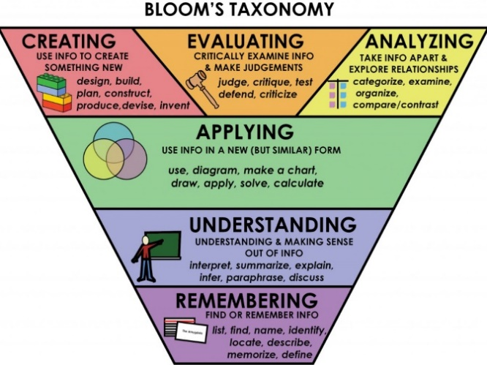
Tutorial Objectives
At the completion of this tutorial the attendee will be able to:
  Recognize the main interoperability and reuse issues associated with use of terrain/environmental data in distributed simulation
  Discuss the general process steps in creation of environmental databases, and the various data involved
  Recognize/name the two SISO RIEDP Products, their role, and their main components
  Employ the appropriate RIEDP products and principles to efficiently share environmental databases
  Contrast details of the RIEDP components with the issues to solve
  Judge the use of RIEDP in a simulation project
  Support the evolutions of the RIEDP Products
Product = Result of a SISO standardization effort
Non-commercial !
Notes:
Not in the scope anymore :
Relate to the origin of RIEDP and the development process of the RIEDP Products
Differentiate RIEDP concepts from other similar efforts

Slide 3
Problem – Importance - Relevance
What is the problem
  Building terrain databases still very expensive
  Sharing saves cost, and also increases consistency, but …
  Shared data often not clear - Conventions and Semantics not always uniform or standardized
  This leads to interoperability problems and high costs
Why is this important
  Consistency in Terrain Representation key to Fair Fight in Distributed Simulation / LVC
  Consistency required for Services, Joint and International /Coalition Training
Who should care
  Customers/Users, Program Mangers, Engineers in Distributed Simulation / LVC
  Interested in stand-alone or networked M&S applications, including visualization, training, analysis, rehearsal, testing (using traditional, VR, or AR visualizations)
Notes:
Who is it for
What is the pb
What is a solution
Why is this important
Goal
Standardize the rules, methods, and semantics for sharing environmental data from key stages of the simulation database generation process, while leveraging (those) existing source data formats commonly used in GIS and simulation applications
Challenges
Environmental data products are widely used in stand-alone or networked M&S applications, including visualization, training, analysis, rehearsal, testing (using traditional, VR, or AR visualizations)
The process of building simulation environmental data products (or databases) requires various types of source data, including (but not limited to) data in popular GIS formats
Variations and different parameters used in the databases building process can significantly impact the interoperability of the simulation systems that use these databases
Semantics of the content in these formats are not always uniform or standardized
What is a solution
RIEDP provides a standardized terrain data generation process model that can be used as a reference, and identifies the stages from which data can be shared
RIEDP defines standard rules, methods, and semantics for sharing the content in these popular data formats

Slide 4
How RIEDP adresses this
RIEDP is a SISO standard for communicating and sharing environmental data
Building M&S environmental data products (or databases) requires various types of source data, including (but not limited to) data in popular GIS formats
RIEDP leverages those popular formats and standardizes a comprehensive framework comprising:
  A data generation process model to align/understand completeness of shared terrain data
  A data model to represent and organize terrain data, and
  The semantics, rules, methods and conventions to unambiguously share the data
RIEDP does not impose internal solutions on data producers

Slide 5
Agenda
The Operational Context
The RIEDP Approach
The RIEDP Components
  RPM Stages
  RADM
  RADM Parts
Semantics for RIEDP data sharing
RIEDP and Other Similar Initiatives
Summary and Q/A
Notes:
The agenda :
The Background :
what requirements RIEDP is addressing (“sharing environmental data to improve LVC efficiency”)
How RIEDP is developed (initial phase Study Group, Development of Two Products, quick overview)
Then a zoom on 1st Product components (Product 1 is now published)
And an overview the second product currently under development
Comparison between RIEDP and other similar initiatives
Summary and discussion
Introduction (20 min)
Problem
Not new, focus (unified solution for common DB Gen process and exchange, especially for Air sims)
Background
Include origin of SG and Special Event in 2009
RIEDP standards developed, based on use of existing formats and standards (not inventing new formats), and strong review process with more than 200 comments that were adjudicated and resolved
How RIEDP solves this
Use of common formats and a standardized process
Relation to existing methods for solving the problem (this may be repeated at the end)
Why RIEDP’s approach is important
RIEDP products and components Development
Product 1, Product 2
Zoom on product 1
RPM Stages (10 min)
RADM Overview (10 min)
Metadata Schema (10 min)
Data organization on media (10 min)
Profiles (5 min)
Conformance (5 min)
Overview of Product 2 under development (5 min)
RIEDP and Other Initiatives
Summary (5 min)
Go over what has been presented
Relation to existing methods for solving the problem
What is next
Q&A/Discussion (5 min)

Slide 6
The Operational Context

Slide 7

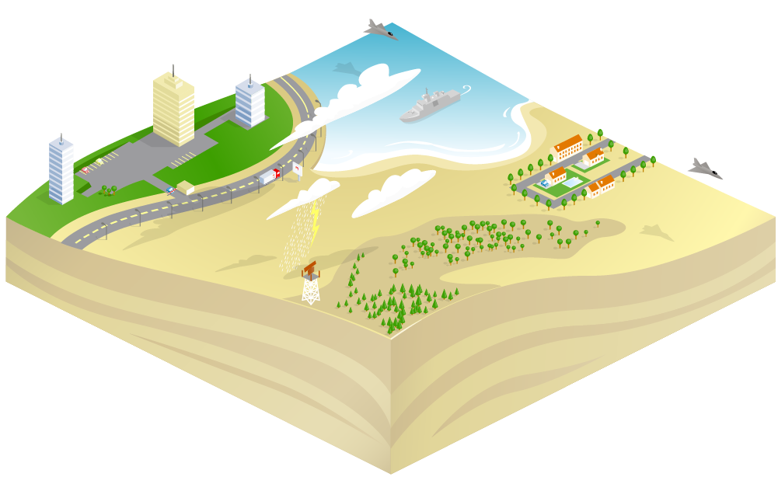

Live Virtual Constructive Training
Full Mission Sim 1
Heavy Constraints on
Synthetic Environment
Full Mission Sim 2
Computer Generated Forces
Real Actors
Exercise Controller
Ground Based Air Defence
HLA or other Protocol
At Stake : Avoiding duplication of costs, Inconsistency during execution, …
Solution : Standard? But not if every Organization has its own!
Notes:
LVC Training involves Flight Simulators, CGF, IOS and C2 Systems, and Real Actors, all being networked by know runtime protocols.
But before runtime, interoperability relies on sharing a consistent Synthetic Environment, even more challenged by real actors.
At Stake : Avoiding duplication of costs, Inconsistency during execution, …
Solution : Standard? But not if every Organization has its own!

Slide 8
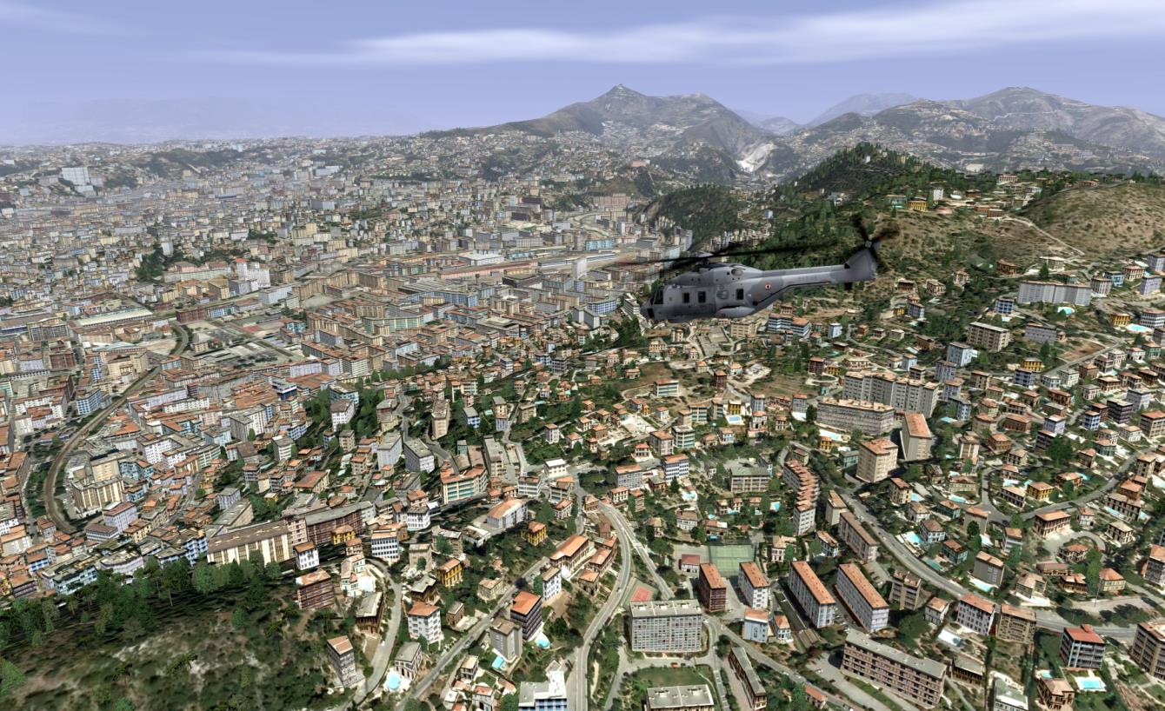
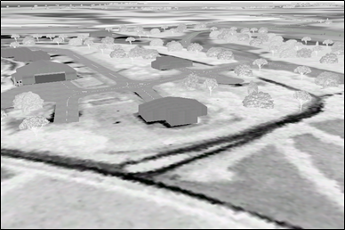
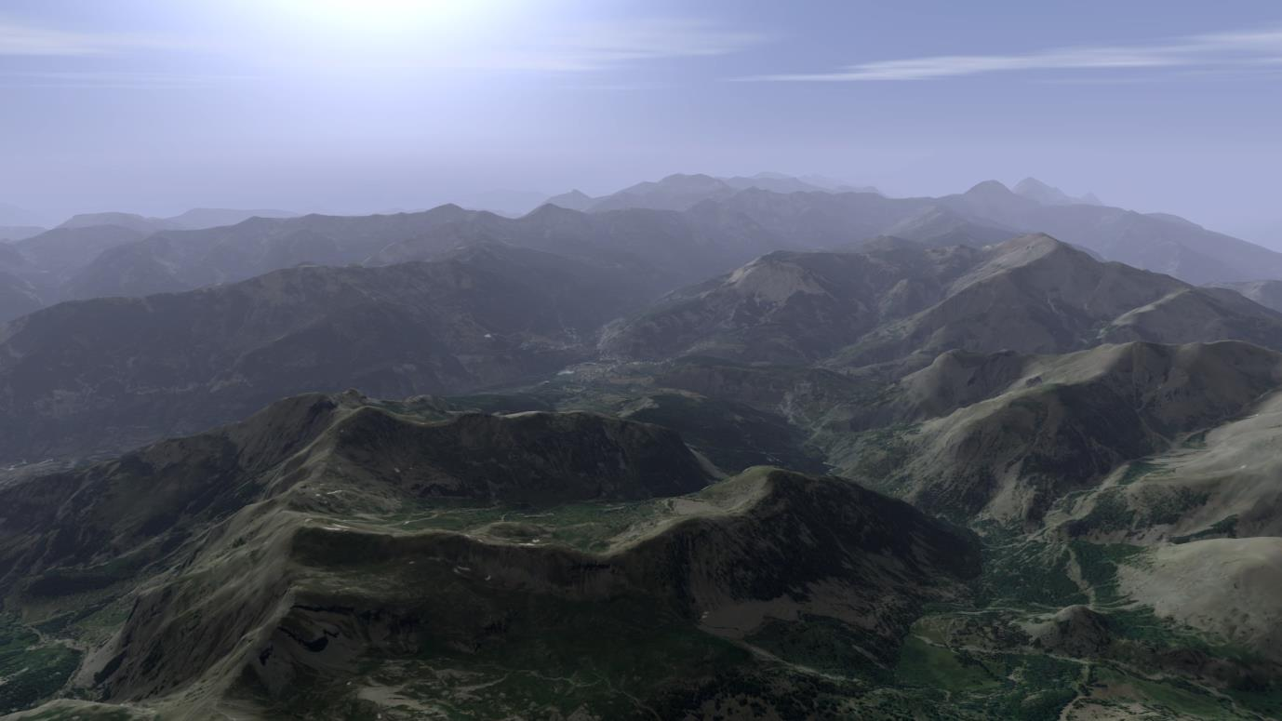
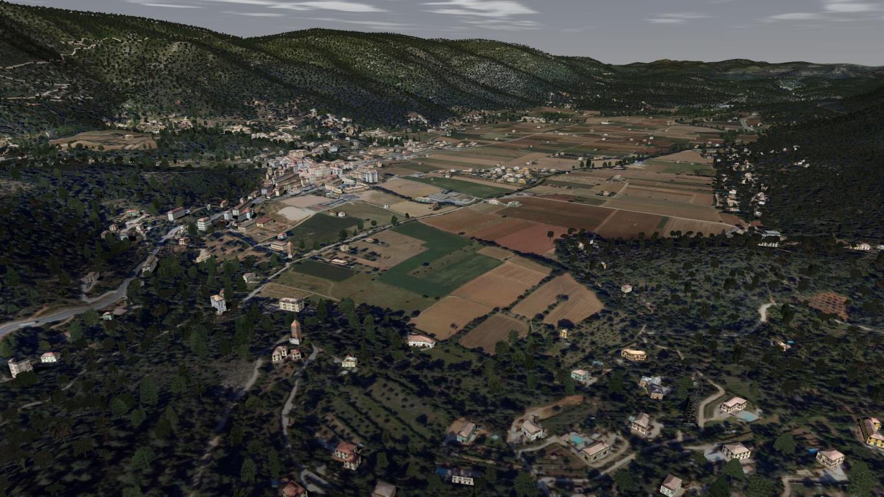
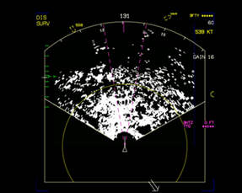

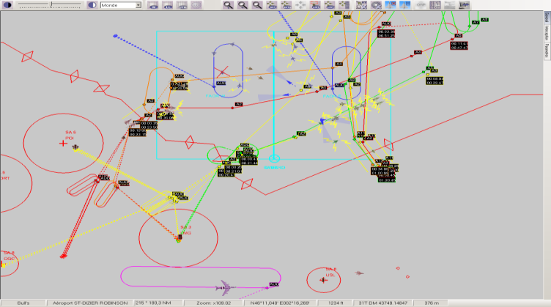
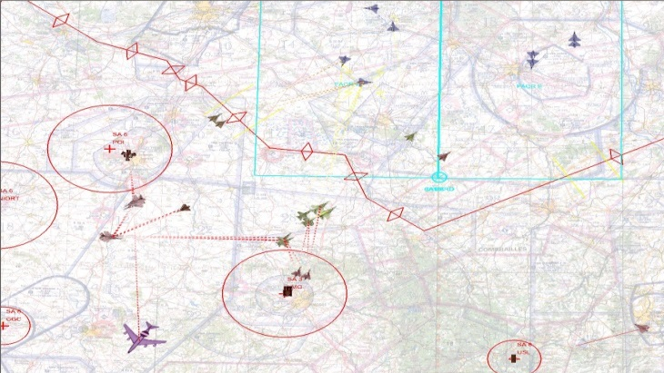
SE Requirements for an Aircraft Simulator
Large Areas
Diversity of Terrain Natures
Diversity of Target applications
(Visuel, Sensors, IOS, CGF, C2…)
Notes:
Flight Training systems introduce very demanding SE Requirements.
- Multiple target applications are required , from Visual “Out The Window” to sensor modes and C2 applications
- Large terrain and diversity of content

Slide 9

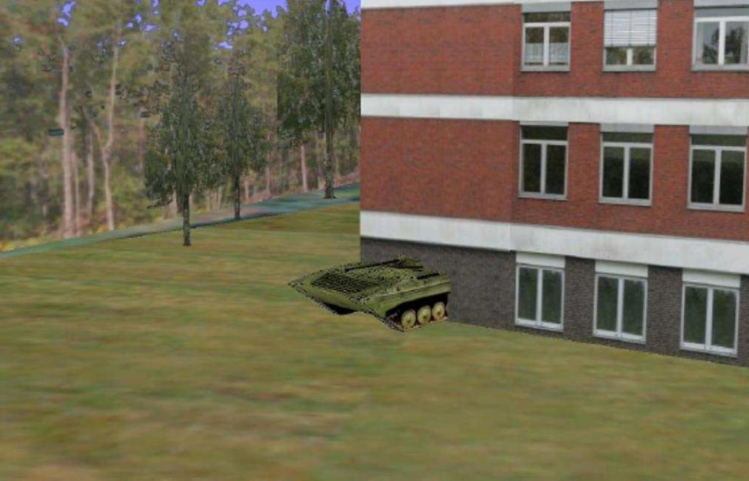

SE Requirements / Consistency
Well, it is not really in the edge of the treeline !!
Can you see the Tank at the edge of the treeline ?
© Images courtesy of Aditerna
Notes:
Obviously, this kind of situation is to be avoided ! (vehicle going though terrain or obstacles)

Slide 10
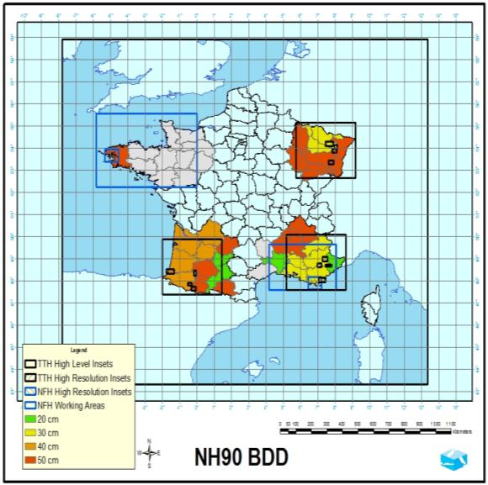
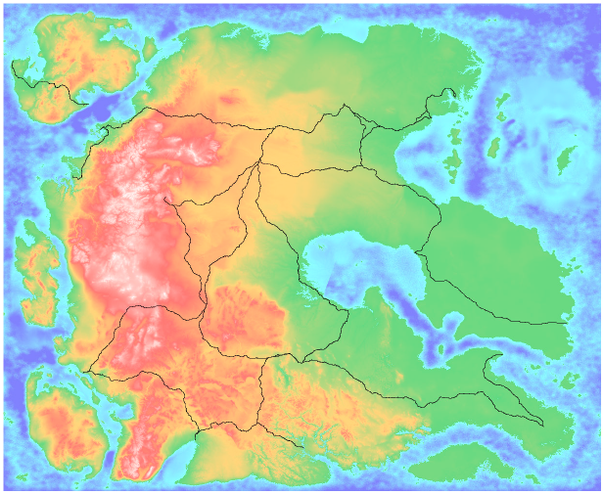
SE Requirements / Large Areas
NATO “Missionland”
2000x2000 km
Notes:
Large terrain means several 100s of square degrees
Including various insets of higher resolution
The Mission Land DB is a fictitious continent in the middle of North Atlantic Ocean, similar in size to Western Europe.

Slide 11
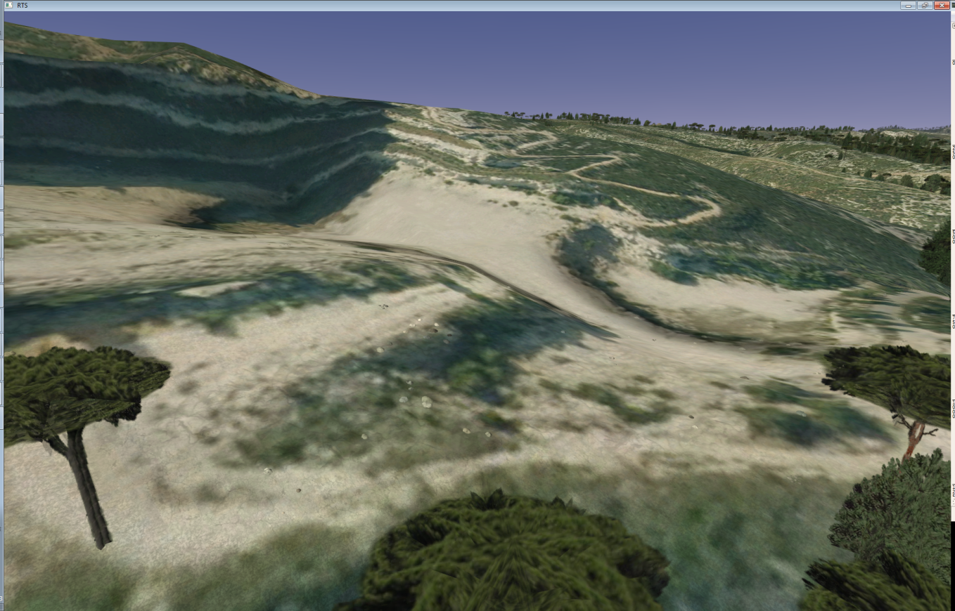
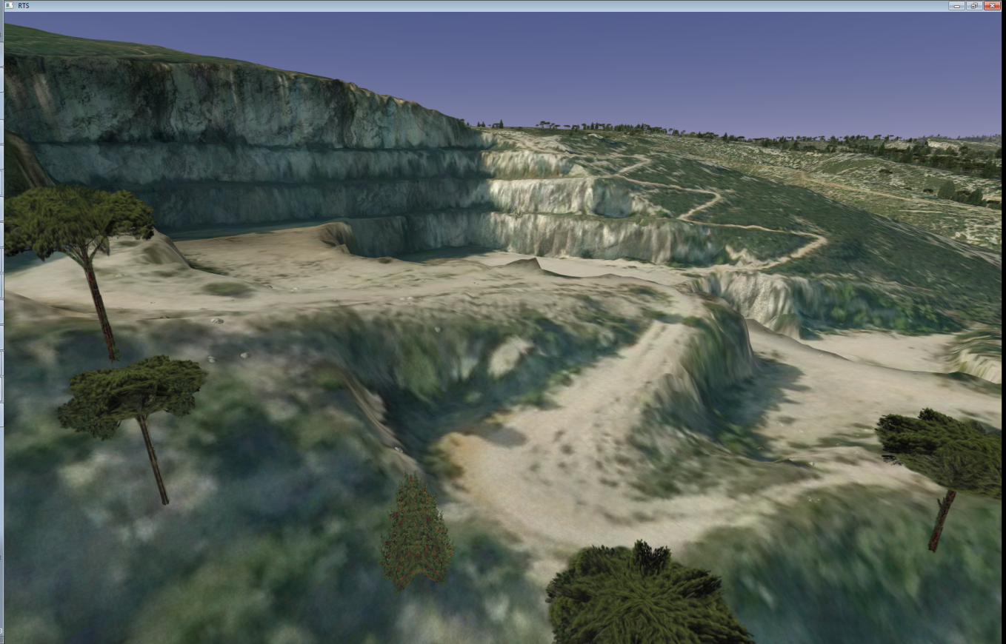
SE Requirements / Fidelity
  Elevation Grid: 25 m
  Elevation Grid: 1 m
Notes:
Fidelity also becomes a significant requirement, because of the « Live » component of the LVC, or because of Mission Rehearsal !
And fidelity is not only a matter of Imagery: These two pictures show how elevation data are also very important.
Landing decision making by an helicopter pilot will probably not give the same outcome …

Slide 12




Building a Simulator Database
€ / $
Target
Databases
Database
Requirements
Visual DB
Source
Data
Database
Creation
Radar DB
Infra Red DB
Other Sensors
CGF DB
Operate !
Geospatial & Others
Find the data
Solve IPR
Clean the data
Correlate the data
Create missing data
Format the data
Intensify the data
Specialize the data
Maps
Others
Not Easy
Notes:
Building a Sim database is a complex process:
Starting from the Customer’s requirements
You need to find the appropriate Source data … and to make sure you have the right to use it ! Not so easy !!
Then the transformation process with several stages (we ‘ll be back on this later on), a somewhat long and costly process
And in the end of the process, for each target its own database fitting the runtime needs
Before operating the Simulator

Slide 13
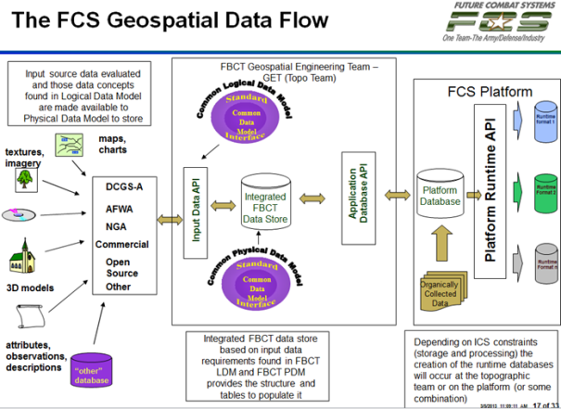
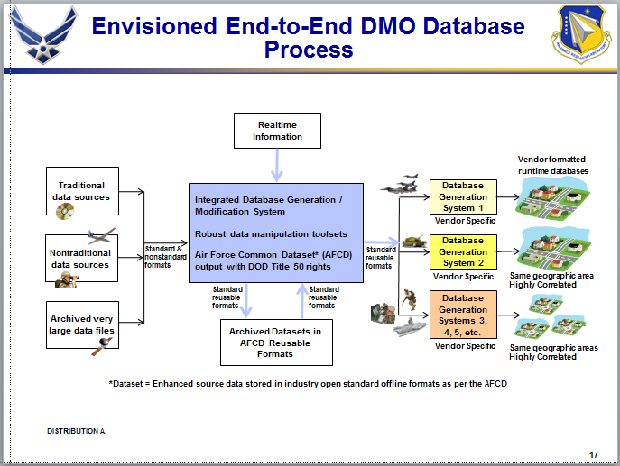
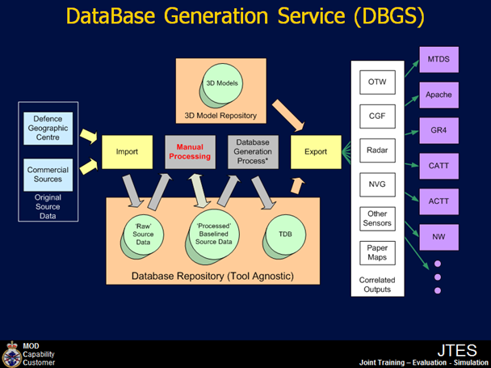
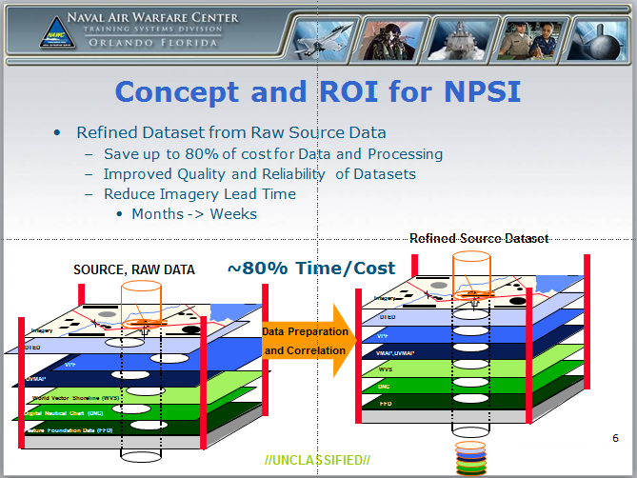
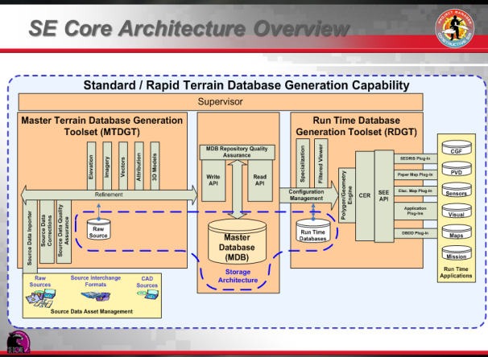
Terrain Database Generation – A Universal Process
It looks very similar
But the Devil is in the details
Images courtesy of their respective programs
Notes:
This is not new ! (nothing new under the sun !)
The data Transformation processes of the main sim programs are organized this way, with some king of Central Database allowing two share the data within the Project. But within the Project only !!
Why not, as they are using the same GIS data!
What about this GIS data ?

Slide 14
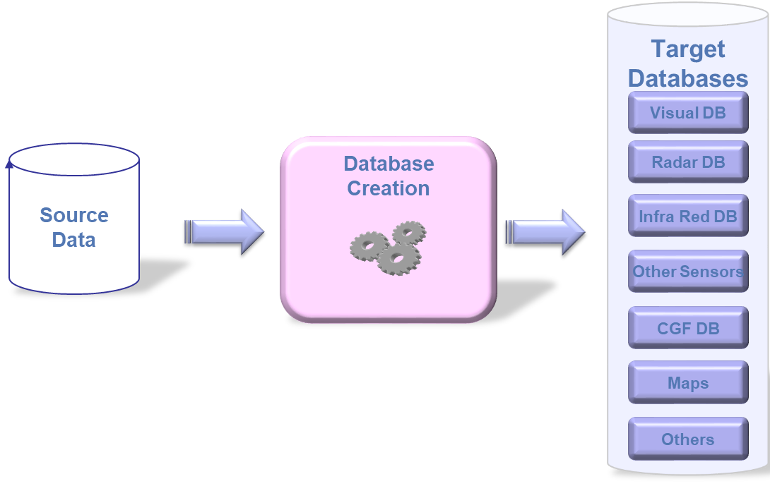










Additional issues for Distributed Simulation / LVC
Reuse – Correlation – Interoperability ….
Duplication of efforts
Duplication of Cost
Time to market
Sim A - Provider 1
Consistency ?
Schedule ?
Requirements
Sim B - Provider 2
M&S Interoperability is
even more critical in the International Arena
with
Multiple Providers and Multiple M&S Solutions
Sim C – Provider 3
Notes:
Distributed simulation / LVC brings in additional constraints.
The situation is as follows:
Let’s consider 3 simulators from 3 providers
Hopefully the same customer’s requirements
Every provider is doing the same Process
Which leads to duplication of efforts (and costs) and consistency risks in the end.
In the international arena, Interoperability is even more critical with greater diversity of Providers and M&S Solutions

Slide 15
Examples of Interoperability issues in Large Exercises
Events: I/ITSEC Operational Blended Warrior (OBW), NATO MSG-165 Spartan
Typical Issues
  Many points of view: Ops Team, Tech Team, Sim. providers, data providers/consumers …
  Different understanding – sometimes wrong understanding – of the concepts
  Communication/Miscommunication, Semantics (Example case – Sample dialog)
Significant contributors to these Semantics problems:
  Terrain-related issues
  Interchange standards
Interoperability and reuse suffer from these issues
  Critical in the International Arena with Multiple Providers and Multiple M&S Solutions

Slide 16


M&S Interoperability
What it is NOT
  The same Product and associated Solutions for everyone
    Does not work, certainly not in the International Arena
    Puts Innovation at risk
    What product to choose? Single Solution sufficient? What constraints?
What it is
  Consistency in Modelling, associated Data and Semantics at Component Level
  Allowing Components to work together at System & System-of-Systems Levels
  Fostering Multiple-Provider Solutions (e.g. : I/ITSEC/OBW Federations)
Simulation Interoperability relies on Appropriate Standards
  Open, based on Consensus, not Vendor Specific
  Within the simulation community : SISO
Notes:
M&S interoperability:
What it is not: not the same tool for everyone (no body wants the little Dictator on the top right )
It is already difficult to acheive inside a nation,
It does not work in the international arena,
It would put innovation at risk
And what would be the good solution ??
What it is :
It is rather consistency in Modelling
Relying on appropriate Standards developped by M&S experts
This is the world of SISO,
A joint effort as show on the bottom right

Slide 17
The RIEDP approach

Slide 18
Data Transformation Process – Two main phases
Target
Databases
GIS World
M&S World
Visual DB
Source
Data
Synthetic
Environment
Intermediate
Data
Database
Creation
Radar DB
Phase 1
Data
Cleaning &
Enhancement
Phase 2
Target
DBs
Generation
IR DB
Other Sensors
Standardize here
at appropriate Intermediate stages
CGF DB
Maps
Manual Work: 80% 20%
Computation Time: 20% 80%
Others
Notes:
It is interesting to note that the Transformation Process is composed of two main / high level phases
One is in the GIS World (where the data come from)
The other is in the M&S world (where the data will be used)
And also that the manual part of the work (costly and long) is mostly in the GIS world (using GIS Data and tools)
So it makes sense to have some standards here to make sure data can be shared efficiently

Slide 19
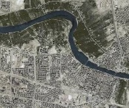

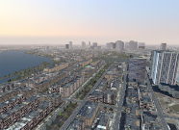
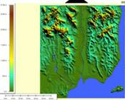
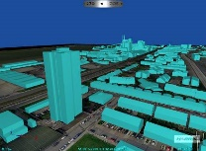
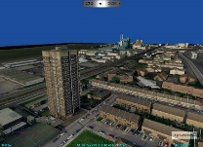

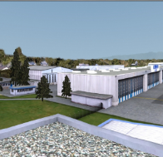
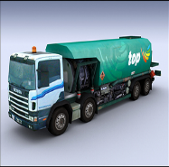
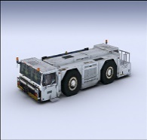

Source Data from Various Origins
  From GIS world : DTED, DFAD, VMAP, SHAPEFILE, GEOTIFF, GML, KML, …
    Application to simulation
      Elevation, Vector (roads, rivers and building positions), Geo-referenced satellite imagery
  From Photography World : BMP, ECW, JPEG ,JPEG 2000, RGB, TIFF™
    Application to simulation
      Texture for Terrain or objects to add visual realism, without complex geometric models
  From Architecture/Game Worlds : COLLADA, OpenFlight™, VRML, X3D, …
    Application to simulation
      Formats from 3D modelers (e.g. 3DS ™, Maya ™, ACRON ™, Creator ™, ... )
      Application to simulation : Dedicated to 3D Objects modeling for visual Systems.
Notes:
In the 3D Category, formats also known for their applications to the design community as well as the game community
They are the Formats from 3D modelers, as 3DS ™, Maya ™, ACRON ™, Creator ™, ...
They are dedicated to 3D Objects modeling (buildings, vehicles, cultural) for visual Systems.
COLLAborative Design Activity
COLLADA was intended originally by SONY as an intermediate format for transporting data from one digital content creation (DCC) tool to another
However, some applications have adopted COLLADA as their native format or as one variety of native input rather than simply using it as an intermediate format
19

Slide 20
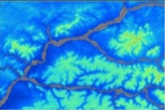

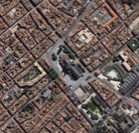
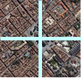
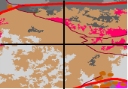
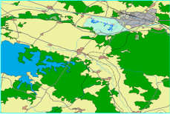




Phase1 : Generation of the Intermediate Datasets
Source Dataset
Projection Conversions
Format Conversions
Tiling (mosaïc)
Harmonisation (between Tiles)
Corrections of Source errors
Reconciliation between Layers
Intermediate
Dataset
Elevation
Geographical
Added Value
Elevation (Tiled )
Imagery
Imagery (Tiled )
Material Classification
Classification
Planimetry
Attribution Definition
Assignation of 3D models to Classes
Definition of Procedural Generation
Rules for Features (Off or on line)
Planimetry
& Attribution
Simulation
Added Value
3D Models
Attribution Definition
Creation of new models in Library
3D Models
Notes:
In phase 1 (GIS phase), the source data from the various layers is processed in various ways.
This is mostly about Geographical added value, but also the beginning of Simulation Added value (creation of rules)
I will be back on this later on, with the Reference Process Model describing all these stages

Slide 21
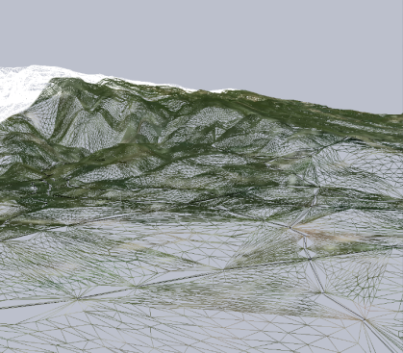
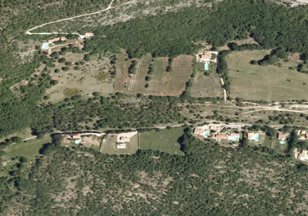
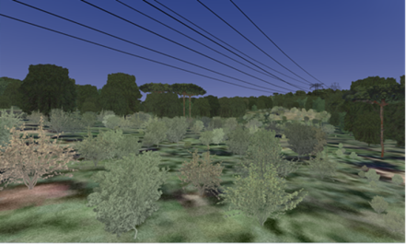
Phase 2 : Generation of Target DBs
Intermediate
Datasets
Runtime DB
Creation of 3D Terrain
(Polygons, Levels of Detail, …)
Elevation
(Tiled )
3D Terrain
Images
(Tiled )
Texturation (projection of
images on the 3D Terrain)
Classification
Enrichment of terrain
with 3D elements
(Cultures, Buildings, Networks,..)
Geo-specific
Textures
Features
& Attribution
Competition
➔ Proprietary
Solutions & Formats
3D Models
3D objects
Notes:
In phase 2, the content of the various layers is improved and then merged using rules to eventually provide the components needed in runtime.
These final tasks are very target application specific.
This is an area for competition, between the IG providers for instance.
They keep developping new solutions to increase the richness of the Scene while also increasing the rendering quality.
This means proprietary solutions and tradeoffs, which reduce the possibility of data sharing (except between same target application, … same provider and same generation of tools …)

Slide 22

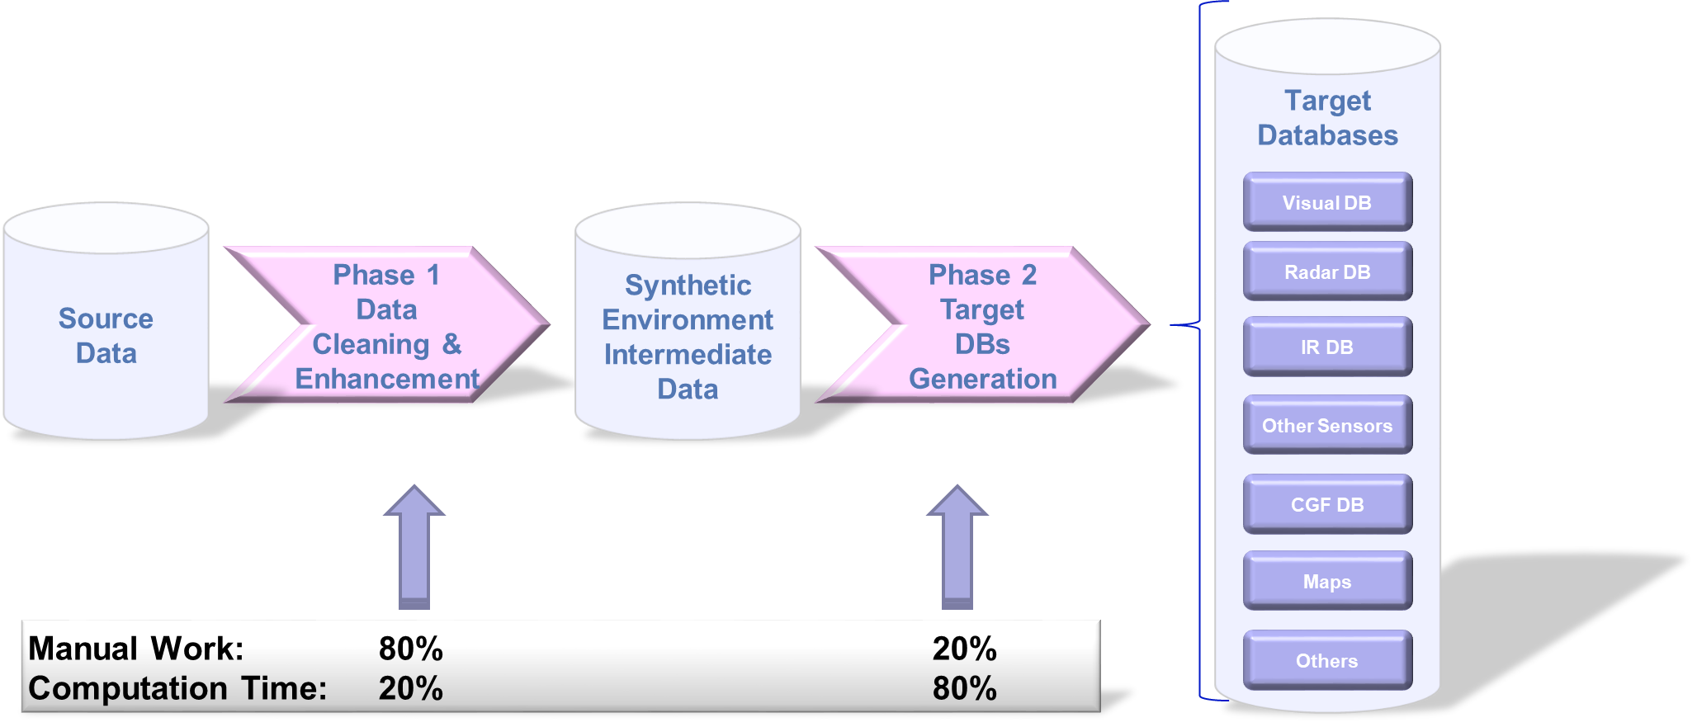

Data Transformation Process – Possible Improvement
The process may be made more efficient in Mission Training via Distributed Simulation (MTDS)
  If Source data is comprehensive and consistent
    Within each and between the layers → Depends on Data Providers
  If previous creation efforts may be reused
    At Source Data Level (Linked to GIS World)
    At Intermediate Level
    Requires Common Processes, Representations, and Formats at this level
RI EDP
Reuse of Intensification efforts
Hardly Reusable
(Unless same target platforms)
Providers
Data Diversity
Data Quality
Competition
Discovery & Access
Metadata
Repository
Various Trade-offs
Notes:
So, every transformation process is a pipeline, with little variation depending on the Provider.
This transformation process could be made more efficient, with a better final interoperability :
If Source data are even better and consistent (this depends on the data providers)
If previous effort can be reused:
At Source level (this means being able to discover and access the data)
At Intermediate Level, where the transformation effort can be shared
Knowing that runtime data is hardly reusable (outside the same project) because of runtime specific constraints, and associated tradeoffs made in a simulation which may be unvalid for another.

Slide 23
Key Topics for Database sharing
When reusing data from a partner, you need to know
  How the database was built → Tasks performed or not
  How the database is represented → Conceptual Model
  How the database is spatially referenced → Spatial Reference Model
  How the database is structured → Physical data model
  How the database is organized on the media → Files/Folders/Hierarchies
  How well the database conforms to Standards → Compliancy & Profiles
  Information about the data product → Metadata
No existing solution fully satisfies all of these requirements
Notes:
This is what you need to know when you want to share or reuse data from a partner.
And no existing solution FULLY satisfies this.

Slide 24
International M&S Initiatives & Standardization Efforts
Process oriented
DB oriented
Nature | M&S standards |  | Projects / Initiatives |  |  |  |  |  | Geospatial
Name | SIF | SEDRIS | NPSI | AFCD | MDB | CDB | Mission Land | Other | OGC CDB
Origin | US DOD | US DOD | US Navy | USAF | US Army | US SOCOM | NATO | e.g. French Air Force | PRESAGIS
Introduction Date | 1991 | 1994 | 2004 | 2006 | 2008 | 2004 | 2010 | 2006 | 2013
Publication Date | Yes | 2005 | - | - | - |  |  |  | 2016
Standard | Yes | Formal ISO/IEC | User Standard | User Standard | User Standard | User & Commercial Standard | User Standard | User Standard | Formal OGC
Open Standard | Format according to standard | Yes | limited | limited | limited | Limited | limited | limited | Yes
Approach | Obsolete | Standardized Semantics and Data Model + Format according to standard |  |  |  |  |  |  | Similar to US SOCOM CDB but with formalized semantics and Conceptual Data Model
Availability of Commercial Support Tools | SIF | Tools developed in SEDRIS COI |  |  |  |  |  |  | PRESAGIS tools
RIEDP addresses these Topics
(see how in RPM and RADM)
Based on de-facto standard formats (GIS Source)
but
- No consistent Semantics or Data Model
- Similar but not Standard Data Generation Process
Commercial tools
for commercial & standard formats
  AFCD: Air Force Common Dataset
  EDS: Enterprise Data Services
  NPSI: NAVAIR Portable Source Initiative
  CDB: Common Database
  SE Core: Synthetic Environment Core
  SIF: SSDB (Standard Simulator Database) Interchange Format
24

Slide 25
RIEDP – Two Products
RIEDP provides what is needed to share Environmental data :
  A Reference Process Model (RPM)
  A Reference Abstract Data Model (RADM)
  A Tiling Scheme and Spatial Referencing
  A List of Formats from the GIS and M&S worlds
  A Consistent Semantics (through Features, attribution rules)
  An Organization on the Media
  A Metadata structure
  A set of Exchange Profiles
Product 1: RIEDP Data Model Foundations
Product 2: RIEDP Detailed Features Description

Slide 26
The RIEDP Components:
The RPM
Reference Process Model
Notes:
After this introduction on the Development of both Products, it is time to see the components of these products

Slide 27
RIEDP Reference Process Model / Process Flow
Requirements
  Typical Generation Process for a Database
Export Stage
Using RIEDP does not require
changes to the user’s workflow
7 Creation Stages
Runtime Stage
Notes:
The Reference Process Model represents a Typical Generation Process for a Database.
Several stages :
from the Requirement definition,
the transformation process :
source data collection in the various layers
cleaning of this data in the layers
aligning the layers,
agregatin the layers into a single base line
And then intensifying the data, that is to say preparing all connections between these data (for instance Feature and 3D Models)
This is where we get the most added value, without any constraint from the runtime phase
And then the Specialisation phase, where some filtering can be done to fit some specific needs/ tradeoff, for instance to optimize the DB for Fighter A/C or for an Helicopter, while keeping the consistency
At the right end side of the process, the final stage « Generation of the Target Databases », which is out of the RIEDP Scope
And between all stages, the export stage can be used
It is important to note that RIEDP does not mandate how a producer accomplishes his transformation process (Product 1 is only a guidance), but only how he is supposed to export its data in case he claims compliance to RIEDP.
Now let’s see some details on these stages.

Slide 28
RIEDP Reference Process Model
Data Flow
Export Stage
See RPM details in Product 1 - § 4.2.2
Runtime Stage
Notes:
As a summary, this view of the RPM shown as a data flow.
From the Base line stage, the data becomes more an more integrated as a database.
At the Export Stage, the RIEDP Database, in various states of richness, is available for inclusion in a Community Repository.

Slide 29
The RIEDP Components:
The RADM
Reference Abstract Data Model
Notes:
We have just seen the RPM which describes the Process of Database building,
let’s see now the Reference Abstract Data Model, which shows the structure of a Environmental Database

Slide 30
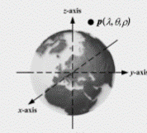
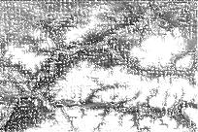
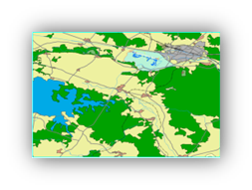
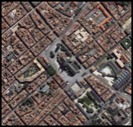
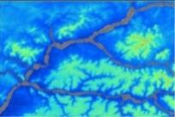
Main Components of a Database
Repository
Spatial
Reference Frame
Catalog
DB
Metadata
Tiling
Metadata
Library
Metadata
Layers
3D Models
Feature
Templates
Metadata
Attribution
Textures
Special Areas
Other Raster
Reference
Tables
Features
Imagery
Elevation
Notes:
What are the components of a Database.
To explain this, imagine we want to build the database of Western Europe (It would work also for another planet BTW)
The area of interest is divided in to Tiles, and may be subtiles for very rich areas
Each tile is composed of various layers : Elevation, Imagery, Features, and possible other Raster Layers (ex : Tactics, Material, Pathfinding, …)
The elements of these layers are described by their formats, and may be further described by some detailed semantics from the library : For instance, 3D Models linked to Feature points, textures, Feature Templates, Reference tables content, Special Areas, ….
All these elements must be consistently located in the area of interest, with a Spatial reference Frame
Tiles, Library + SRF compose a Database.
Then, data about all the data are needed to help the user find what is in the DB without having to dive into the content.
This is metadata.
Database + metadata allow to populate Repositories with their catalogues.
This symbolic view is quite simple in fact !

Slide 31
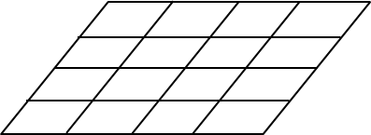

RIEDP Reference Abstract Data Model (upper part)
Repository
Catalogue
BDD
Metadata
Special Areas
Reference
Tables
Feature
Templates
3D Models
Textures
Notes:
In this upper part, you can recognize all the elements from the the symbolic view :
Database
Repository and Catalogue
Tiles
Layers
Library
Spatial Reference Frame

Slide 32
RIEDP Reference Abstract Data Model (Lower part)
Layers
Library
Special Areas
Reference
Tables
Feature
Templates
3D Models
Textures
Attribution
Metadata
Notes:
And in the lower part :
Metadata
Detailed attribution

Slide 33
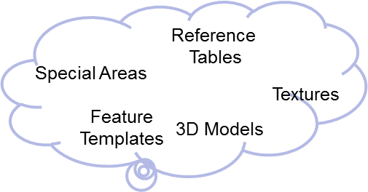
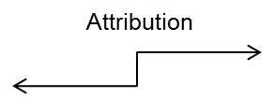
RIEDP Reference Abstract Data Model (Full)
Repository
Catalogue
BDD
Metadata
See RADM details in Product 1 - § 4.3.3
Metadata
Notes:
(In fact, you can recognize all the elements from the symbolic view ☺
As a summary (very quick)
Database
Repository and Catalogue
Tiles
Layers
Library
Spatial Reference Frame
Metadata
Detailed attribution

Slide 34
RIEDP Reference Abstract Data Model
High Level Concepts of a Database
Showing areas of convergence and variability among initiatives
Tiles, Layers Library,
COTS
Attribution
Convergence
Metadata,
Common format
Variability
Notes:
This UML view shows how the High Level Concepts of a Database are shared between the users in the Training Community
The upper part of the RADM (highlighted in solid purple) means that all initiatives may share (even though the RADM may not cover all cases) a similar view of the high level concepts of a database at the integrated level:
The DB is composed of geo-referenced tiles containing a set of layers: elevation, features, object, texture …
Feature instances of the real world are attached to tiles, and their rendering characteristics (visual, behavior …) are provided by the objects (and their attributes) from the library to which they are linked.
The middle part of the RADM (highlighted in dashed purple) may also be shared by all initiatives, as it is supported by their use of common GIS formats:
DTED, GeoTIFF, … for elevation;
Shapefiles for features;
OpenFlight for 3D objects;
JPEG2K, GeoTIFF, … for textures.
The lower part of the RADM (highlighted in yellow) corresponds to the attribution aspect of Shapefiles which is not constrained by the format. As a consequence, this is an area of divergence between initiatives.
Miscellaneous: other possible areas of divergence have been identified (yellow areas):
The Special areas, including for example airports and urban areas, that may be described either as features not related to tiles, or as OpenFlight objects;
The linkage between the objects of the Library and the Features;
Metadata associated to the database, which eventually feeds the catalog associated to the repository.

Slide 35
The RIEDP Components:
The RADM Parts
List of Formats
Spatial Reference Frame
Attribution Model
Data Organization on the Media
Metadata Schema
Profiles
Notes:
After this general view of the RADM, let’s see its components a little bit more in detail :
Not too much, please have a look for all the details in the document (Product 1)
List of Formats
Spatial Reference Frame
Attribution Model
Data Organization on the Media
Metadata Schema
Profiles

Slide 36
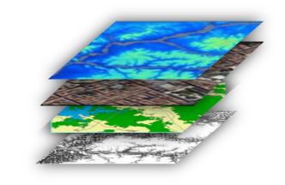
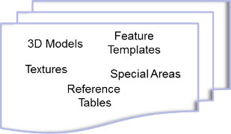
RIEDP-exchange formats
The data formats required for RIEDP-compliant data exchange:
  GeoTIFF (revision 1.0 October 1995), for terrain elevation data.
  ESRI Shapefile (technical description White Paper July 1998), for instances, and possibly for classes of terrain features and vector data.
  GeoTIFF (revision 1.0 October 1995) or JPEG 2000 (ISO/IEC 15444 – Part 1) for terrain imagery data, as well as other raster-based data.
  OpenFlight (version 16.0 or higher), for 3D models, both natural and man-made, placed on the terrain or dynamically included in the environment.
  PNG (ISO/IEC 15948:2004), SGI RGB or SGI RGBA, image formats for texture maps, used in portraying object surfaces and some terrain surfaces.
  In addition, XML (and associated XML schema) is used to provide those RIEDP-required data that is not supported through the above formats.
NOTE :
  RIEDP does NOT impose RIEDP-exchange Formats for use within a Data Producer’s internal Processes
  The list of RIEDP-required formats may be extended, updated, or modified through amendment or revision of this specification. Condition : Candidate formats shall comply with the RADM principles.
See details in Product 1 - § 4.4
See details in Product 1 - § 4.6
Notes:
When it comes to data from the various Layers and the Library, a RIEDP compliant data exchange must comply with the following list of formats.
(see slide)
You probably know these formats …
and you may not see some formats that you would expect. For instance Collada instead of OpenFlight, or Geopackage instead of Shapefiles.
And you are probably right … As soon as you find some other users who may be interested by the same formats than you.
Because you need to remember that :
RIEDP scope is data sharing at the export stage
RIEDP does NOT impose RIEDP-required Formats for use within a Data Producer’s internal Processes!
So if you think that RIEDP should take into account other formats … (next slide)

Slide 37
Export Database
GeoTIFF
Shapefiles
XML
OpenFlight
PNG RGB
RIEDP Exchange Formats
Additional formats can be introduced through
SISO EDRS Product Support Group
XML
Notes:
This is were RIEDP compliance is to be achieved.
From any stage (except runtime), the data content is converted to the various RIEDP required Formats, depending on the Layers (we will see this in the RADM very soon).

Slide 38
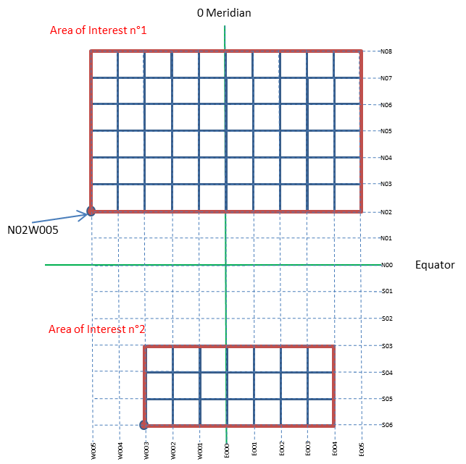
RIEDP Geospatial Conventions / Tiling
Tiling:
  Division of the area of interest
  1square degree
Region
  Single Block
  For those who do not consider Tiles
See details in Product 1 - § 4.3.3.2.7
Notes:
Tiling.
This is easy, and in line with the usage in the GIS community :
- 1 Square degree cells
A reference point at the bottom left
Note that for those who do not want Tiling (or for small areas), RIEDP defines the notion of Region.

Slide 39

RIEDP Geospatial Conventions / Spatial Reference
RIEDP-compliant <Database> conforms to the following:
  Database_SRF: GEODETIC_WGS_1984
  Database_Origin: longitude value, latitude value, (and optionally, height value)
  Database_Spatial_Domain:
    Coordinate values : longitude, latitude,
    (and optionally height)
    for the Lower Left and Upper Right corners of the database, in that order
  3DModel_SRF: LOCAL_SPACE_RECTANGULAR_3D SRF
  OrientationVectorSpace_SRF: LOCAL_TANGENT_SPACE_EUCLIDEAN
  Orientation_Values_Convention: Intrinsic_Euler_ZYX or ZY’X”
See details in Product 1 - § 4.3.3.2.5
Notes:
In addition to this, RIEDP provides what is needed to exchange the position and orientation of objects:
WGS 84,
Latitude, Longitude, and option Height above Ellipsoïd
And
3DModel_SRF: LOCAL_SPACE_RECTANGULAR_3D SRF
OrientationVectorSpace_SRF: LOCAL_TANGENT_SPACE_EUCLIDEAN
Orientation_Values_Convention: Intrinsic_Euler_ZYX or ZY’X”
This is for experts !
But this is very important : when you plug an 3d object on the terrain, you need to know what are the orientation conventions

Slide 40
RIEDP Attribution Model
Related to Feature instances and Templates
  Detailed Characterization of their Properties
    For Geospatial information
    For Formats Organization (structure of the data in a format)
    For Process guidance (how to eventuallyprocess the data)
  Factored out into Library through Templates
Example : A road
  Concept from the Real World : Polyline + Size + Lanes Number + Type
  GIS Attributes from Provider
  Augmented with attributes from a template in the Library
    Cross Section, Visual representation, Sensor representation
    Rules for conforming to the terrain
    Detailed properties captured in Reference Tables
Attribution Schema and Semantics to be standardized (next Section)
See details in Product 1 - § 4.3.3.3
Notes:
The RIEDP attribution model
This is how the detailed semantics is captured for templates : instances or templates which allow to factor out common characteristics among the instances
Some GEeo attributes are provided by the GIS providers, and they have to be complemented for M&S applications.

Slide 41
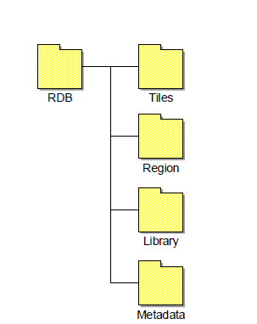
RIEDP Data Organization
Physical Organisation on the Media
  Layers in Tiles or Region Folder
  Library
  Metadata
See details in Product 1 - § 4.5
Notes:
The RIEDP Data Organization, because the data has to be physically organized to be provided to another user.
This organization is straight forward, in accordance with the RADM, and simple naming conventions.
You will find some example in Product 1

Slide 42
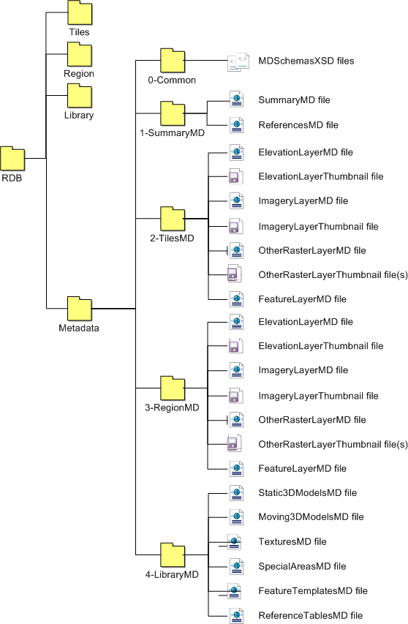
RIEDP Metadata - Organization
Metadata
Successful data exchange relies heavily on the appropriate use of metadata
RIEDP Compliant Data products shall include the appropriate metadata classes, as specified by the RADM
  Structured metadata
  Based on XML files for each component of the RADM
  According to rules captured in XML schemas
See details in Product 1 - § 4.3.3.4
Notes:
We took a long time to analyze the need in this area, for every component of a RIEDP DB.
As a result, XML Schemas are provided (0-Common folder) to make sure the user can comply with the rules for all the metadata files.

Slide 43
RIEDP Profiles
  RIEDP-compliant Data Products shall conform to one of the RIEDP Profiles
  A Profile specifies:
    A stage in the RPM
    Mandatory and Optional Data in accordance with the RADM
See details in Product 1 - § 4.7.
Notes:
Last and really not least important component of RIEDP : the profiles.
RIEDP-compliant Data Products shall conform to one of the RIEDP Profiles
A Profile specifies:
A stage in the RPM
Mandatory and Optional Data in accordance with the RADM
The current specification defines 12 RIEDP profiles, allowing for instance
to exchange a simple layer
to exchange a database for a Full Flight Sim
And many variations between these

Slide 44
Conformance
RIEDP specifies the conformance requirements for:
  RIEDP RPM stages,
  RIEDP RADM classes,
  RIEDP Profiles, and
  RIEDP-compliant data products.
The conformance requirements apply to any of the following:
  Database generation systems or processes,
  Data models that represent RIEDP products,
  Interchange of RIEDP data products,
  Applications that produce or consume RIEDP data products.
Conformance requirements define the degree of flexibility allowed for all uses of RIEDP.
See details in Product 1 - § 5

Slide 45
Semantics for RIEDP data sharing
Notes:
We have seen the Background
The Development process
Details on Product 1
Now let see Product 2, with less details are it is still under development

Slide 46
Areas of data semantics in RADM
Feature Instances & Feature Templates
Lights Characteristics
Material Characteristics
3D Model Characteristics
Visual Characteristics
Other Characteristics
Elevation and Imagery Attribution
And Process Attributes
(which apply within areas above for data generation and consumption)
4
5
1
7
3
2
6
46
Notes:
The Product 2 Program of work was obvioulsy defined against the RADM.
7 areas of work.
Texure is not forgotten, it is related to Topic 5.

Slide 47
Detailed Features Description - Goal
Improve Data Interoperability through:
  Identification of List of Features, Definitions, Attributes, …
  Organization of the Document to help the Database Provider
  Not reinventing the wheel by referring to Standard Dictionaries
  Providing the Information needed by the International Training Community
  Allowing future Evolution
  EDCS, + DFDD when not enough, + AMDB for Airport,
    and RIEDP notions when not enough
  Use of Existing definitions (Changes to be requested to Source Organization)
  RIEDP own Code Space
Notes:
From the Early ages of RIEDP, we identified Features as the main issue for interoperabiliy.
This is because Shapefiles provides too many user-defined options in terms of Semantics.
This is why it is the core of Product 2.
RIEDP does not reinvent the wheel and relies on Standard Dictionaries for Semantics.
EDCS, + DFDD when not enough, + AMDB for Airport,
and RIEDP notions when not enough
RIEDP uses existing definitions (Changes to be requested to Source Organization), but its own Code Space.

Slide 48
Relating Features and Attributes
List of Tables Related to the Semantics of Features and/or Attributes
  Features
  Attributes
    Including Process-related attributes
  Associated enumerations
  Supplementary
    Including Themes, Units , Scales…
  Prescribed feature-attribute combinations along with their:
    Valid value ranges,
    Their specific enumerations (if any),
    Default values (including enumerates)
    Applicable units, scale
These tables are evaluated through test DB conversion efforts
Table structures are specified in Product 2
Notes:
As a result, RIEDP will provide a set of tables for :
Features
Attributes
Enumerations for attributes
And
feature-attribute relationships

Slide 49
Feature Instance & Feature Templates
A template allows to factor out common characteristics of features
(saved in Library).
Note:
The RADM representation for Features is not specific to Shapefiles

Slide 50
Vector data in shapefiles
  A Shapefile stores geographic features (point, linear, and areal) and attribute data as a collection of files
    .shp - the file that stores the geometry of feature instances.
      Each record describes a shape with a list of its vertices.
    .dbf - the dBASE file that stores the attribute information of feature instances.
      Each record contains attributes for a feature.
    .shx - the file that connects the geometry file and the attributes file via index values.
.shp
.dbf
.shx
Records
Shape 1
Shape 2
Shape n
Attrib 1 | Attrib 2 |  | Attrib n
Values

Slide 51

RIEDP Attribution Model : Features (Shapefiles + XML)
Characterization of Feature instances and Templates
Notes:
The diagram that we just saw on the top right is the instanciation of the Attribution Schema from Product 2
And the work in terms of attribute definition consist in defining:
what can stay in the DBF File
what can be transfered in the various xml files
What are the attributes needed to organize the structure (indexes and tags of the xml files)

Slide 52

Example : Material Characteristics
Areal
x
y
LinkTo_Template |  |  |  | LinkTo_MatChar
TemplateX |  |  |  | Wood
TemplateY
Feature_Templates
  <FTEntry>
    <Name>TemplateX
      <Attribute n>
      <LinkTo_LightChar></LinkTo_LightChar>
      <LinkTo_MatChar> Wood</LinkTo_MatChar>
      <LinkTo_VisualChar></LinkTo_VisualChar>
      <LinkTo_OtherChar></LinkTo_OtherChar>
  </FTEntry>
  <FTEntry>
    <Name>TemplateY
    <Name>TemplateZ
Does it make sense for features ?
Yes, for Predominant Material
<MatChar_Table>
  <MatChar_Entry> Name « Wood »
    <Group> « Basic_Mode »
    <Group> « Advanced_Mode »
    <Group> « Expert_Mode »
  <MatChar_Entry> Name « Metal »
    <Group> « Basic_Mode »
    <Group> « Advanced_Mode »
    <Group> « Expert_Mode »
  <MatChar_Entry> Name « Soil »
    <Group> « Basic_Mode »
    <Group> « Advanced_Mode »
    <Group> « Expert_Mode »
3D Model/Polygon/Texture
For Basics
For Training
Wood
For Physics Experts
or for 3D Model
Metal
Raster/Pixel
Mapping Table
RVB - Index → MatChar_Entry
0/0/255 – 1 → « Water »
or OtherRaster Layer
See details in Product 2
12 Feb 2020
Tutorial RIEDP - SISO SIW 20

Slide 53
The Experts’ Corner
Experts interested in details of the following topics can consult the listed documents/sections:
Topic | Document and Section
RPM Stages (details) | Product 1 - § 4.2.2 and 4.2.3
RADM Component (details) | Product 1 - § 4.3.3
Spatial Referencing | Product 1 - § 4.3.3.2.5
Tiling (details) | Product 1 - § 4.3.3.2.7
3D Model Structure (details) | Product 1 - § 4.3.3.2.15 & Product 2 – being assigned
Library Concepts | Product 1 - § 4.3.3.2.6
Feature Templates (Object reuse) | Product 1 - § 4.3.3.2.14 & Product 2 – being assigned
Reference Tables | Product 1 - § 4.3.3.2.17 & Product 2 – being assigned
Material Characteristics (details) | Product 2 – being assigned
Profiles | Product 1 - § 4.7
Conformance | Product 1 - § 5
Metadata details | Product 1 - § 4.3.3.4
Introducing new formats in RIEDP | Product 1 - § 4.6

Slide 54
RIEDP and the other Initiatives
How do they relate ?

Slide 55

RIEDP and other Initiatives - Process view
RIEDP Scope
AFCD / NPSI Scope
CDB scope
SE Core Scope
SEDRIS Scope

Slide 56
Comparison of different database sharing solutions
Expressed
Non-existent or unexpressed
Partial or specific or limited

Slide 57
Summary &
Conclusion

Slide 58





RIEDP – Two Products
RIEDP provides what is needed to share Environmental data :
  A Reference Process Model
  A Reference Abstract Data Model
  A Tiling Scheme and Spatial Referencing
  A List of Formats from the GIS and M&S worlds
  A Consistent Semantics (through Features, attribution rules)
  An Organization on the Media
  A Metadata structure
  A set of Exchange Profiles
RIEDP Data Model Foundations
RIEDP Detailed Features Description

Slide 59
Take away
RIEDP
  Takes benefit of the lessons learnt from all related Initiatives
  Reuses and relies on existing standards (such as SEDRIS ISO/IEC standards and PNG ISO/IEC standard), as well as formats commonly used in the community
  Represents the best common denominator by providing a Reference Process Model (RPM), a formal Reference Abstract Data Model (RADM), relying on use of existing Formats, specifying unique Profiles, and focusing on metadata and attribution semantics
  Does not impose internal solutions on producers
  Provides a common data sharing approach that relies on a formal abstract data model (RADM), along with specific metadata and attribution (Product #2)
This allows the best sharing of data, independently from target applications implementation,
  with a current scope addressing static terrain.
  See NATO Group MSG-156 on dynamic terrain and weather

Slide 60

Q & A
More information:
  Download the Specification from www.sisostds.org
    PDG SISO Library File Folder – Access PDG Documents
    Select SISO Digital Library > Development Groups > RIEDP PDG
  Get involved in RIEPD PDG and EDRS PSG
Any questions on:
  The Requirements ?
  The RIEDP Products ?
  How is RIEDP different ?
  Other challenges for Environmental databases ?
  Any other Environmental Data related subject ?

Slide 61
Backup slides for the Q&A session

Slide 62
RIEDP-Required formats
Guidelines for Evaluation of Candidate Formats
For the exchange of RIEDP-compliant products and databases, RIEDP specifies existing file formats applicable to the various layers of the RADM.
In response to dynamic changes in technology and evolving requirements, the list of RIEDP-exchange formats may be extended, updated, or modified through amendment or revision of this specification.
All changes shall conform to the following criteria:
  Preservation of RADM and/or RPM compatibility shall be the primary objective, when modifications or replacement of existing formats are being considered.
  Candidate formats shall comply with the RADM principles.
  For instance, the addition of a new 3D model or feature format shall include the definition and compliancy of the corresponding attributes and attribution rules. As needed, open and free tools will be provided to ensure conversion to and from the candidate format are possible.
This is to be analyzed during the Support Phase.
Notes:
So RIEDP recognizes that new formats may have to be integrated.
With some constraints, in particular to comply with the other RIEDP principles, and firstly the RADM.
In this case, this will be taken care of in accordance with the SISO process during the Support Phase

Slide 63


Current Status of RIEDP Products
Product n°1
  RIEDP Data Model Foundations
    SISO Guidance Document
    Submitted to Balloting : During March ’18
    Approval During Fall ’18 SIW
    Published
Product n°2
  RIEDP Detailed Features Description
    SISO Standard Document
    Development initiated Summer 2017
    Conclusion expected End ’20
RIEDP DM Foundations
V 1.2a

