Slide 1
Simulation Conceptual Modeling Theory and Application
Mr. Jack “Jake” Borah
jborah@sprynet.com
(407) 929-9370

Slide 2
Learning Objectives
After this tutorial, the attendees should be able to
List five purposes for simulation use
Define simulation conceptual modeling (SCM) terminology
Recognize SCM development phases
Explain differences between informal and formal SCMs
Describe how to use tools for conceptual modeling

Slide 3
Tutorial Outline
Background for Tutorial
Modeling and Simulation (M&S) Development
SCM Construction
SCM Best Practices Guidance

Slide 4
Why have this tutorial?
“Conceptual Models” and “Conceptual Modeling” are nebulous terms for most simulation developers
Work by Haddix (2001) and Lacy (2001) have highlighted the need to reconcile multiple views of conceptual modeling
A critical shortcoming is that the purpose of conceptual models has not been clearly understood in the community

Slide 5
Modeling and Simulation (M&S) Basics
Terminology
Model (noun): “a pattern of something to be made”
Model (verb): “to produce a representation of or simulation of”
Simulation: “the imitative representation of the functioning of one system or process by means of the functioning of another”
The terms Model and Simulation are often incorrectly used.
The subtle but very important difference is that simulation is a model implemented over time.
This implies that models are static while simulations are dynamic.

Slide 6
The Reason for Simulation
The military definition of a model being “a physical, mathematical, or otherwise logical representation of a system, entity, phenomenon, or process” is a good starting point, however, a major part is missing.
The definition of a “model” from simulation experts supplies the missing part: the motivation for building the model and subsequently the simulation.
A representation of a system for the purpose of studying the system. (Banks, 1996)
A set of assumptions about how a system works in the form of mathematical or logical relationships which is used to try to gain some understanding of how the corresponding system behaves. (Law, 2000)

Slide 7
The Benefit of Simulation
Or in other words:
“… cost-effective use of something in place of something else for some purpose.” (Rothenburg, 1991)
In simulation, humans can:
Simplify complex parts of the real world
Abstract items or events of interest
Synthesize simplified, or abstracted elements into an alternate arrangement.

Slide 8
Simulation Purposes
Five purposes have been generally established for simulation
An aid for thought
An aid to communication
An aid for training and instruction
An aid to experimentation
A tool of prediction
But before starting simulation development a SCM should be constructed
To help the simulation stakeholders understand what is going to built

Slide 9
SCM Features
An abstraction from either the existing or a notional physical world that serves as a frame of reference
Documents simulation-independent views of important entities and their key actions and interactions
Describes what the simulation will represent, the assumptions limiting those representations, and other capabilities needed to satisfy the stakeholder’s requirements
Bridges between these requirements, and simulation design
Notes:
Read the bullet list

Slide 10
SCM Considerations
Perhaps most complex task of M&S engineering
Method to transform human ideas into executable hardware and software components
Simulation development begins with sponsor/user interaction
Proceeds through several diverse working groups prior to delivery in final form
Core engineering team
Simulation designers
Systems and network administrators
Software engineers
Verification and validation team
Notes:
Each Group has a DIFFERENT PERSPECTIVE

Slide 11
Simulation Development Steps
Problem Formulation/System Definition
Data Collection
Model Conceptualization
Model Validation
Model Translation
Model Verification
Model Production
Model Acceptance Testing
Model Delivery
Model Support
Notes:
SIMULATION USERS FREQUENTLY HAVE MULTIPLE PERSPECTIVES AS WELL

Slide 12
Simulation Development Process Flow
Real World
Start
Yes
Establish Purpose & Scope
Done?
Refine & Optimize Model
Analyze Output
No
0
0
0
0
Model
Development
Model
Application
Execute Simulation
Formulate Conceptual Model
Acquire & Analyze Data
Design Detailed Model
Verify & Validate Model
Design Experiments
Fig. 1: The Simulation Modeling Process
Notes:
Contributor: M. L. Loper.

Slide 13
Mistakes Made During Modeling and Simulation Development
Failure to have a well-defined set of objectives at the beginning
Failure to communicate with sponsors on a regular basis
Inappropriate level of model detail
Treating using simulation as if it were primarily a complicated exercise in computer programming

Slide 14
Simulation Development Elements
Simulation Conceptual Modeling - a Communications Bridge
Model
Modeling
Simulation
“A Bridge”
Real System
Computer
Notes:
Dr. Bernard Zeigler presented this diagram in his book Theory of Modeling and Simulation
In his view there are 3 fundamental elements in a simulation development process. This figure shows them and how they are related
We model when we extract from the real world the key factors we think influence the problem we are attempting to study or the process we are trying to imitate
We simulate when we transform our model into computer code and observe the changes in our model over time

Slide 15
Communicating Through Simulation Conceptual Modeling
Conceptual modeling supports communication
“The long term contribution of any modeling effort lies in the benefits it affords, either by direct use or by guidance for further development, to science and industry” (Zeigler, 1976)
Communication is achieved through:
Informal description of the model
Formal description of the model structure

Slide 16
SCM Construction
Informal and formal models are built during the simulation development process for differing audiences
A transformation process underlies simulation development
The real world is too complex to be understood much less modeled by humans
Most practical approach is to abstract key elements forming reasonable approximation of real world

Slide 17
SCM Transformations
Simplification- analytical technique in which unimportant details are removed in order to define simpler relationships
A problem solving technique to produce useful approximations of complex problems that yield usable results
Abstraction- an intuitive technique transforming the essential features of a real system into a different form
A model demonstrating the qualities and behaviors of the real system without being a direct emulation of the system

Slide 18
The Resultant Model
It represents an idealized approximation of the original complex real world system
Result of the “Art of Modeling” or the process of analysis, abstraction, simplification, and synthesis within a simulation development project
Synthesized combination of simplified and abstracted parts of real world
Part of Rothenburg’s cost-effective model constructed for a cognitive purpose
Embodiment of the communications of Zeigler’s modeling process

Slide 19
Formal and Informal SCMs
Conceptual Model
Informal
Formal
Modeling
Simulation
Real System
Computer

Slide 20
Informal SCM
1.
1.
2.
2.
1.
3
3
2.
3
1.
1.
2.
2.
1.
Domain Experts
2.
Publications
Regulations
Structured, Synthesized
Legacy Systems
Information
Domain Analysis

Slide 21
The Informal SCM
Written using natural language and contains assumptions made during its construction
Plays fundamental role during the period of activity when the modeler conceives, programs, debugs, and tests models
Helps users and colleagues comprehend basic outline of the model from their perspective on how the real world operates
Notes:
These are the characteristics of the informal model--<read the bullet list>

Slide 22
Informal SCM Representations
Natural Language Requirement
Shortcomings of specialized syntax and semantics tools
Unfamiliarity
Complexity
Cost
General purpose office suite
Word processor
Graphics or Drawing application
Spreadsheet
Notes:
Go with slide bullets

Slide 23
Informal SCM (Example in a Tabular Format I)

Slide 24
Informal SCM (Example in a Tabular Format II)

Slide 25
Informal SCM (Example in a Tabular Format III)

Slide 26
Informal SCM (Example in a Document Format I)

Slide 27
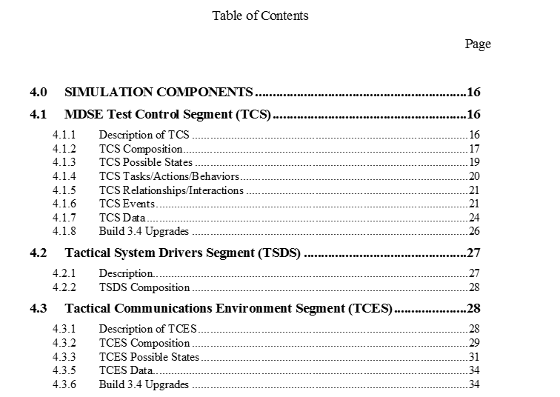
Informal SCM (Example in a Document Format II)

Slide 28
Informal SCM (Example in a Mind Mapping Format)
The informal SCM is first component of full and complete SCM
Freemind Mind (freeware) mapping software was used to frame this informal SCM
Notes:
Go with slide bullets

Slide 29
Mind Mapping Software
General purpose office suite shortcoming
“Expressive Power”
Mind mapping software
Organizing tool for disorganized mind
A diagram used to represent words, ideas, tasks or other items linked to and arranged radially around a central key word or idea. … It is an image-centered diagram that represents semantic or other connections between portions of information
Expressive
Transportable
Inexpensive
Notes:
Go with slide bullets

Slide 30
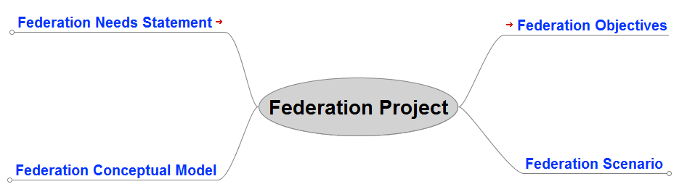
Mind Mapping Informal SCM (v1)

Slide 31
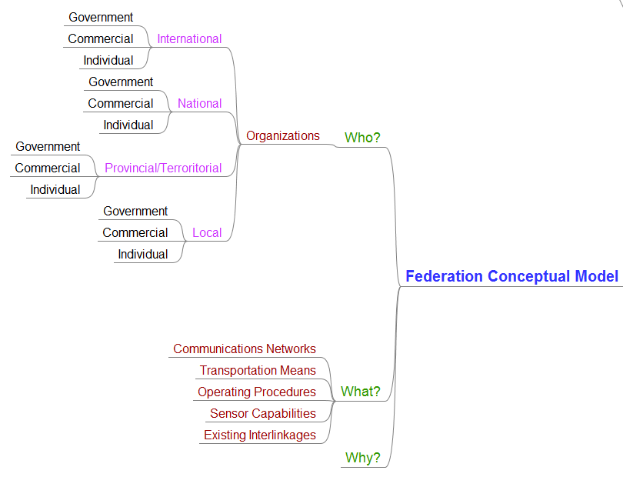
Mind Mapping Informal SCM (v1 Expanded)

Slide 32
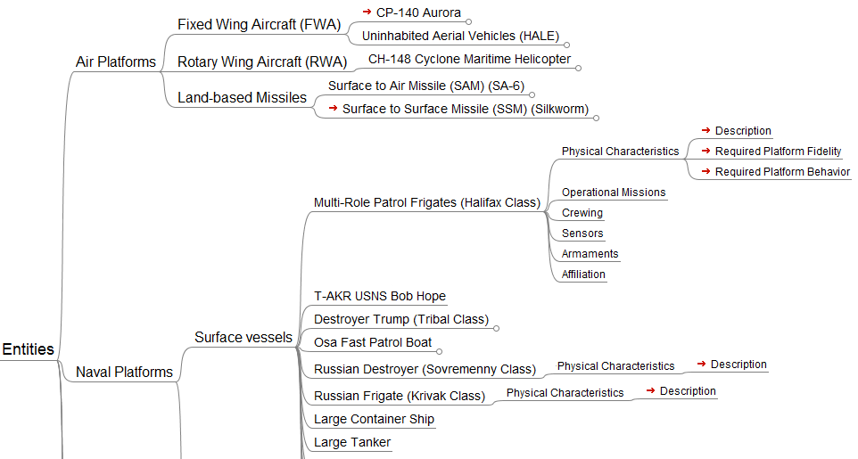
Mind Mapping Informal SCM (v2 Expanded)

Slide 33
Formal Simulation Conceptual Modeling
“IS-A”
“HAS-A”
Associations
Problem
Domain
Static Structure Diagrams
Use Case
Sequence
Collaboration
Dynamic Structure Diagrams
Domain Analysis
Domain Modeling

Slide 34
The Formal SCM
Unambiguous description of model structure separated from software implementation
Useful once users and colleagues understand informal model and want more detail
Used as an aid to detect omissions and inconsistencies and resolve ambiguities inherent in informal models
Notes:
These are the characteristics of the formal model --<read the bullet list>

Slide 35
Formal Conceptual Model as UML Diagram

Slide 36
Precepts of Simulation Conceptual Modeling I
A SCM should be malleable and adopt a coherent form located within one model appropriate for each particular simulation development phase
Highly unstructured, informal models are sufficient during early simulation definition
Structured and enhanced formal models appropriate during simulation development
Notes:
Read the bullets

Slide 37
Precepts of Simulation Conceptual Modeling II
No single conceptual model due to the essence of the “Art of Modeling”
Multiple iterations of a SCM which evolve as required in simulation development
A “living” document that grows from an informal description to a formal description to communicate between the diverse groups (sponsors/users, modelers, systems engineers, and software developers) participating in a simulation development
Notes:
Read the first bullet. Perhaps I should have stated “fixed” or “stand-alone” Conceptual Model
Read the second bullet. Here multiple iterations could also be thought of as “extensions” or “embellishments”
Read the last bullet

Slide 38
Well-formed SCM Characteristics
Simple to understand by the user
Goal or purpose oriented
Robust, in that it does not give absurd answers
Easy for the user to control and use
Complete on important issues
Adaptable (in a maintenance sense)
Evolutionary (grow in sophistication over time)

Slide 39
SCMs Observations
A simulation developer’s method of translating modeling requirements into a detailed design framework (Pace, 2003)
Result of the “Art of Modeling” or the process of analysis, abstraction, simplification, and synthesis within a simulation development project
A role of the SCM is to document all requirements of the system and subsequent requirements and analysis of the models/federations.
This allows for the systems engineering to flow into the simulation development.
Notes:
Which leads us to the question of what is the role of a Conceptual Model
Here is what has been presented before at the SIWs

Slide 40
Simulation Conceptual Modeling Problems
No hard and fast rules concerning model formulation (Uncertainty for both the developer and user)
What does a Conceptual Model look like?
No magic formulas governing what should be included in a model in the form of variables and parameters, descriptive relationships and constraints, or criterion for judgment of effectiveness (Lack of Standardized Processes)
What should a Conceptual Model contain?
Nobody solves the problem, rather everybody solves the model that they have constructed of the problem (Diversity and Inherent Incompatibility)
What technique to use? UML, DoDAF, IDEF0,….
Notes:
LET’S TRANSITION FROM A THEORETICAL DISCUSSION TO PRACTICAL EXAMPLES.

Slide 41
Example SCM- Problem Definition
Constructive Air Warfare Simulation
A tool to support Air Component Staff training in Command and Control procedures
The simulation will provide credible representations of offensive and defensive air and ground forces present in the Joint Force Area of Responsibility
The Air Component Staff will be the training audience
Higher and lower echelons will be simulated through automation or by role players
The Air Component Staff will interface with the simulation through real world C4I systems
Simply stated the simulation is the data engine for the training environment
Notes:
Read the bullets

Slide 42
Example SCM - Purpose Definition
Should the simulation be stochastic or deterministic?
Stochastic would produce variable outcomes based upon random variables in probabilistic algorithms
Deterministic would produce consistent outcomes based nonrandom variables in ordered algorithms
A simulation used for training should generate consistent outcomes
Instructors will want a simulation that produces predictable outcomes so that training objectives will be met
A simulation used for analysis should generate variable outcomes
Analysts will want to approximate the characteristics of a study population
The purpose of the simulation will have an impact during the implementation phase of the simulation
Notes:
IMPORTANT POINT- EVENTUAL USERS OF SIMULATION DID NOT APPRECIATE THIS ASPECT OF SIMULATION DESIGN. ONE SPECIFIC SUBGROUP WANTED THE SIMULATION TO PROVIDE THE EXACT SAME RESULT EACH EVENT, WHILE OTHER USERS WERE COMFORTABLE WITH VARIABLE RESULTS.

Slide 43
Example SCM- Model Conceptualization
How to provide credible representations of offensive and defensive air and ground forces present in the Joint Force Area of Responsibility?
First Step
Document the key entities which should be represented in the training environment
Second Step
Document the behaviors of the key entities which should be represented in the training environment
Important to remember this is a simulation not an emulation of the real world
Just because it exists in the real world is not automatic justification to include it a simulation
Notes:
Read the bullets

Slide 44
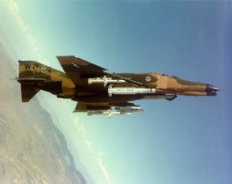
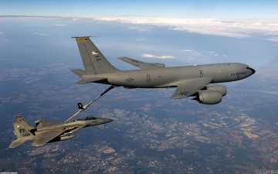
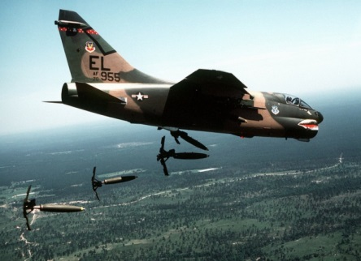
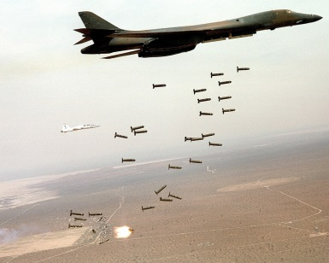
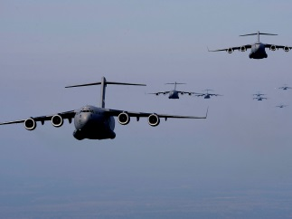
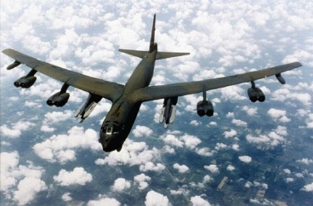
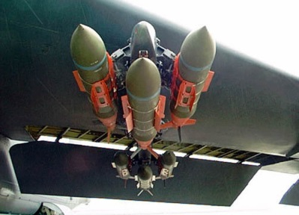
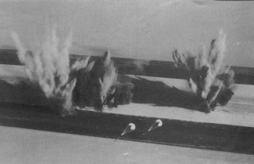
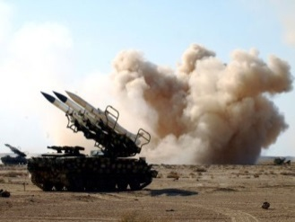
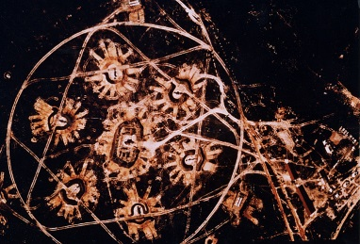
Model Conceptualization- Static View
Aircraft
Munitions
Targets
Notes:
Read the bullets

Slide 45
Model Conceptualization- Dynamic View
Taxi
Preflight Maintenance
Outbound Flight
Rearm
Offensive Aircraft Flight Operations
Target Attack
Repair
Return Flight
Recovery
Notes:
Read the bullets

Slide 46
Use Case 1 – Lack of Attention to Detail
How to represent global flight paths?
Several coordinate systems describe the Earth
Latitude and Longitude
Universal Transverse Mercator (UTM)
Universal Polar Stereographic (UPS)
Geodetic Height
Cartesian Coordinates
The one chosen for simulation implementation:
Latitude and Longitude
Notes:
Read the bullets

Slide 47
Use Case 1 – Lack of Attention to Detail
If using latitude and longitude, then global flight path becomes an algorithm calculating latitude and longitude coordinates
Simple solution for modeling in the most of the world
Except for the coordinate system boundaries
Notes:
Read the bullets

Slide 48
Use Case 1 – Lack of Attention to Detail
Latitude / longitude coordinate system boundaries
The Equator
The North and South Poles
The Greenwich Meridian
The Anti-Meridian
Why are these boundaries a problem?
First, boundary needs to be recognized
Second, calculation algorithm needs to transpose coordinates
Simple solution to implement
Notes:
Read the bullets

Slide 49
Use Case 1 – Lack of Attention to Detail
Simple solution to implement
Unless the developer does not know the boundary definitions and/or the correct methods to transpose coordinates when crossing boundaries
The Equator:
0 degrees Latitude; Direction reverses N > S, S > N
The North and South Poles:
90 degrees Latitude; Value increases toward pole, decreases away from pole
The Greenwich Meridian:
0 degrees Longitude; Value decreases approaching meridian, increases away from meridian, Direction reverses E > W, W > E
The Anti-Meridian
180 degrees Longitude; Value increases approaching meridian, decreases away from meridian, Direction reverses E > W, W > E
Including combinations!
Notes:
Read the bullets

Slide 50
Use Case 1 – When the Problem Appears
Simulation A is used to support an intelligence training scenario
Multiple logistics aircraft flights are scripted to indicate activity
One aircraft given a flight path which parallels a longitude meridian to the North Pole
Simulation B crashes in the middle of the night during scenario flight out
Developer doesn’t find a reason for crash
Simulation B crashes second time during repetition scenario
Developer discovers Simulation B receives “unallowable” flight position coordinates from Simulation A
“Unallowable” coordinate is a 3 digit Latitude value in excess of 90 degrees
Post-event a Change Request is written to remedy this miscalculation
Notes:
Read the bullets

Slide 51
Use Case 1 – How the Problem Propagates
Simulation A developer writes new software for Change Request
Asks Change Request Submitter to review new software
Submitter discovers the developer doesn’t understand physics of problem
Developer correctly limits latitude maximum value to 90 degrees
Developer correctly calculates the latitude increases toward the North Pole, decreases away from North Pole
Developer incorrectly calculates the longitude coordinates once aircraft “flies” over the North Pole
Developer did not understand the difference between latitude and longitude calculations
Developer incorrectly assumed that longitude would only require change of direction
Correct solution would also require transposition of longitude value from “X” to “180-X” in addition to change of direction
Notes:
Read the bullets

Slide 52
Use Case 1 – Problem Impacts
Primary effects
Initial problem occurrence disrupts training event operations
Simulation A generates incredible simulation results
Simulation A causes Simulation B to crash
Waste of Time and Resources
Simulation B Developer spends time investigating Simulation B crash
Secondary effects
Additional waste of Time and Resources
Simulation A Analyst spends time investigating Simulation A behavior
Simulation A Developer develops initial solution for problem
Simulation A Analyst identifies error in solution
Simulation A Developer revises problem solution
Notes:
Read the bullets

Slide 53
Use Case 2 - Simulation Implementation
How to represent air-to-ground and ground-to-air interactions?
First Method
Designate target
Employ Munitions
Calculate Munitions Time of Flight
Calculate Munitions Effect based upon Cumulative Probabilities
Second Method
Designate target
Employ Munitions
Calculate Munitions Effect using Probability of Destruction Random Number table
Notes:
Read the bullets

Slide 54
Use Case 2 - Model Conflict
Either Method could provide realistic results
But… What happens when there are 2 developers working independently on different parts of the simulation?
And... Developer 1 simulates offensive operations uses the First Method while Developer 2 simulates defensive operations uses the Second Method?
Notes:
Read the bullets

Slide 55
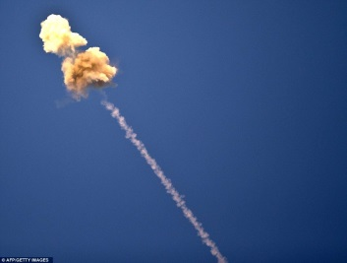
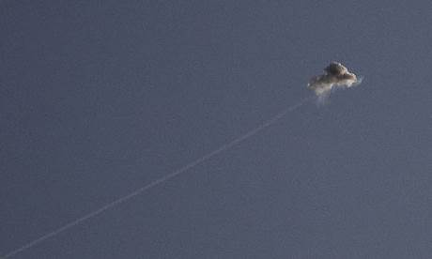
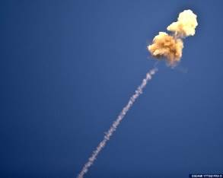
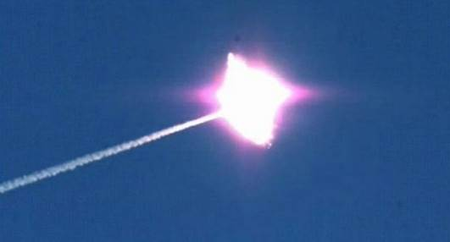
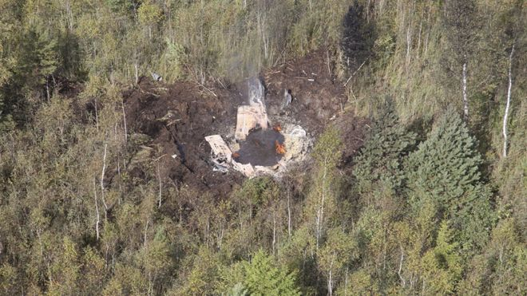
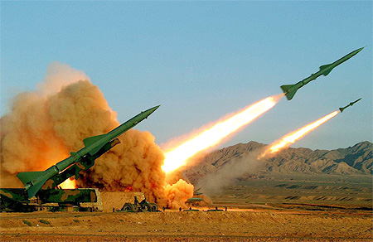
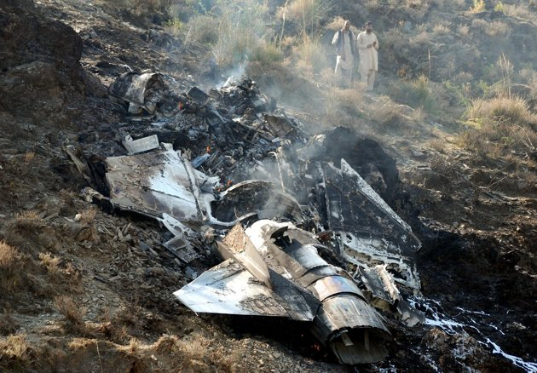
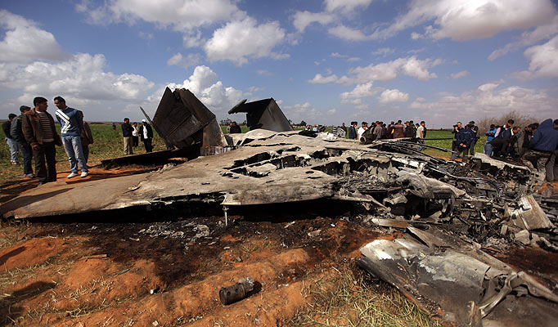
Use Case 2 - Simulation Provides Incredible Results
In 1 game turn, 1 obsolete SAM system shoots down 4 Fighters and 16 air-to-ground missiles
Notes:
Read the bullets

Slide 56
Use Case 2 - What caused the Incredible Results?
Lack of an Overarching SCM:
Allowed the developers to employ two credible simulation methods in a conflicting manner
Masked a ground-based SAM system self defense behavior that took precedence over other simulation activities
Hid a simulation interdependency which was that the reload rate for a missile site was based upon the simulation visual display refresh rate
The Result:
Incredible results convinced simulation operators to manually control engagement outcomes
The Impact:
Unplanned expenditure of Operator Time troubleshooting scenario
Unplanned expenditure of Developer Time to rewrite and test software
Notes:
Read bullets

Slide 57
Benefits of Building a SCM
A Well-Formed SCM should provide:
Assumptions and limitations for model
Interconnections and dependencies within a model
A method to detect internal model conflicts
A preview of possible model output
A means to discover missing parts
Early detection of problems prevents wasteful expenditure of limited resources
Notes:
Read bullets

Slide 58
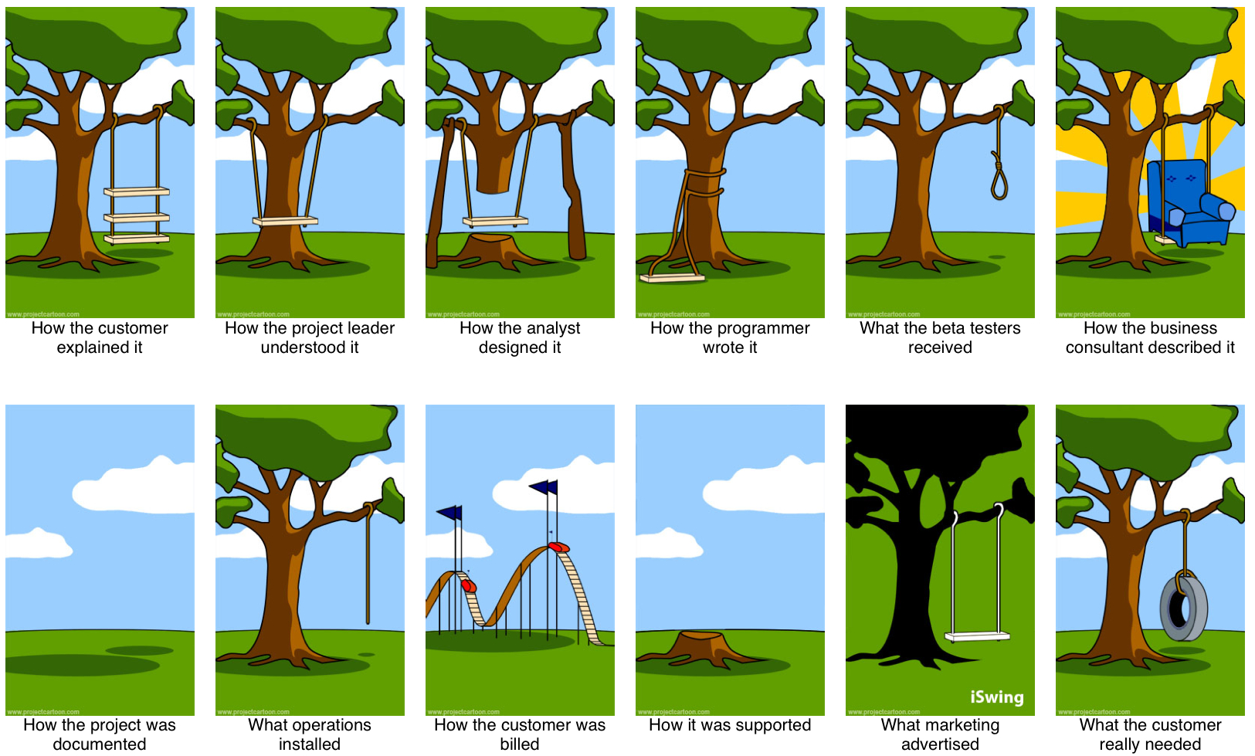
Building Versus Using a SCM
Facilitates
Communication
Between
the Developer
and the End User
Notes:
CONCEPTUAL MODELING WOULD ALSO BE A KEY ENABLER FOR GAO REPORT 17-77 “DETAILED SYSTEMS ENGINEERING PRIOR TO THE PRODUCT DEVELOPMENT POSITIONS PROGRAMS FOR SUCCESS”

Slide 59
Where To Go For Guidance?
Limited Authoritative Reference Material on how to do Conceptual Modeling as a part of Simulation Development Process
“Conceptual Modeling” is not a term discussed in modeling and simulation textbooks
Web searches on “Conceptual Modeling” have led to a diverse set of web sites that contributed little if anything the body of knowledge
Most often “Conceptual Modeling” was in relation to Database Modeling
Notes:
Read bullets

Slide 60
One Helpful Resource
Final Report of MSG 058
RTO-TR-MSG-058 - Conceptual Modeling (CM) for Military Modeling and Simulation (M&S) Modélisation conceptuelle (MC) pour la modélisation et la simulation (M&S) militaires
ISBN 978-92-837-0150-7
https://www.sto.nato.int/publications/pages/results.aspx?k=final report of msg 058&s=Search ALL STO Reports
Notes:
Read bullets

Slide 61
MSG-058 Report - CM Development Process Phases (PP)
PP 1
INITIATE
CM Development
PP 2
DEFINE
CM Requirements
PP 3
ACQUIRE
CM Knowledge
PP 4
DESIGN
Conceptual Model
PP 5
BUILD
Conceptual Model

Slide 62
MSG-058 Report - INITIATE CM Development Process Activities (PA)
PA 1.1
Identify and Map Stakeholder Responsibilities
PA 1.3
Identify Constraints on
the Modeling and Simulation Effort
PA 1.2
Define Purpose and Intended Use
of Modeling and Simulation Effort
PA 1.4
Impose Mandatory Enterprise Policies

Slide 63
MSG-058 Report - DEFINE CM Requirements Process Activities (PA)
PA 2.1
Identify, Analyse and Record CM,
Mission and Simulation Space Requirements
PA 2.3
Synergize CM, Mission
and Simulation Space Requirements
PA 2.2
Verify Requirements with respect to
Needs, Constraints and Policies
PA 2.4
Derive Mission and
Simulation Space Knowledge Needs

Slide 64
MSG-058 Report - ACQUIRE CM Knowledge Process Activities (PA)
PA 3.1
Identify Authoritative Knowledge Sources
PA 3.4
Gather, Structure and Document Knowledge
PA 3.2
Search for Re-usable Knowledge
PA 3.5
Generate/Extend a Domain Ontology
PA 3.3
Identify Knowledge Gaps and Bounds
PA 3.6
Review Validity of Knowledge wrt
Authoritative Knowledge Sources

Slide 65
MSG-058 Report - DESIGN CM Process Activities (PA)
PA 4.1
Search for Existing CMs that may be Partially
or Fully Re-used to Support CM Development
PA 4.4
Select Views to Support Stakeholders
PA 4.2
Identify and Select Conceptual Primitives and
Model Kinds to Represent Acquired Knowledge
PA 4.5
Select a Notation Suitable
to Express the Chosen Formalism
PA 4.3
Select Formalism(s) for CM Specification
PA 4.6
Evaluate Design for Adequacy/Relevance
With respect to Requirements

Slide 66
MSG-058 Report - BUILD CM Process Activities (PA)
PA 5.1
Populate the CM Using the Chosen Primitives,
Model Kinds, Formalism and Notation
PA 5.4
Validate CM Consistency with respect to
Mission Space and Simulation Space Knowledge
PA 5.2
Create the Specified Views
PA 5.5
Ensure Acceptance of CM
by Authorized Stakeholder
PA 5.3
Verify CM Consistency with respect to CM Design

Slide 67
MSG-058 Report - Phase Diagrams
act PP1 Activity Diagram: Initiate CM Development
Start PP1
PA1.2 Define Purpose and
P1.2 Need
Intended Use of M&S Effort
Statement
PA1.1 Identify and Map
P1.1 Stakeholder
Stakeholder
Description
Responsibilities
PA1.3 Identify Constraints
on the M&S Effort
PA1.4 Impose Mandatory
P1.3 Constraints
Enterprise Policies
and Policies
End PP1

Slide 68
MSG-058 Report - CM Development Products
P 1.4 Conceptual Model Metadata
PP 1
INITIATE
CM Development
PP 2
DEFINE
CM Requirements
PP 3
ACQUIRE
CM Knowledge
PP 4
DESIGN
Conceptual Model
PP 5
BUILD
Conceptual Model
P 1.1
Stakeholder
Description
P 2.1
CM
Requirements
Specification
P 3.1
Validated
Knowledge
P 4.1
Conceptual Model
Design
P 5.1
Conceptual Model
P 1.2
Need
Statement
P 2.2
CM Knowledge
Acquisition
Needs
P 1.3
Constraints and
Policies

Slide 69
References I
Slide | Reference Data
4 | Haddix, Furman, “Conceptual Modeling Revisited: A Developmental Model Approach for Modeling & Simulation” Paper 01F-SIW-098, Proceedings of the Fall 2001 Simulation Interoperability Workshop, September 9-14, 2001, Orlando, FL.
4 | Lacy, Lee, Youngblood, S., and Might, R., “Developing a Consensus Perspective on Conceptual Models for Simulation Systems”, Paper 01S-SIW-074, Proceedings of the Spring 2001 Simulation Interoperability Workshop, March 26-30, 2001, Orlando, FL
5 | Merriam-Webster Unabridged. Retrieved from http://unabridged.merriam-webster.com
6 | Banks, J., J.S. Carson, and B.L. Nelson, Discrete Event Simulation, 2nd ed., Prentice Hall, New Jersey, 1996.
6 | Law, Averril M., Simulation Modeling & Analysis, 3rd ed., McGraw-Hill, New York, 2000.
7 | Rothenburg, Jeff, “Knowledge-Based Simulation at the RAND Corporation”, Knowledge-Based Simulation: Methodology and Application, Fishwick and Modjeski (eds.), Springer-Verlag, 1991.

Slide 70
References II
Slide(s) | Reference Data
12 | Benjamin, P., Patki, M, and Mayer, R., “Using Ontologies for Simulation Modeling”, Proceedings of the Winter Simulation Conference, 2006.
15 | Zeigler, Bernard P., Theory of Modeling and Simulation, Wiley, New York, 1976.
38 | Pace, Dale K., “Thoughts About the Simulation Conceptual Model”, Paper 03S-SIW-009, Proceedings of the Spring 2003 Simulation Interoperability Workshop, March 30-April 4, Orlando, FL.
57 | Gushue, John, “What the Customer Really Wanted, Revisited”, Retrieved from http:/johngushue.typepad.com/bolg/2009/08/what-the-customer-really-wanted-revisited.html
59-67 | Final Report of MSG 058. Retrieved from https://www.sto.nato.int/publications/pages/results.aspx?k=final report of msg 058&s=Search ALL STO Reports

Slide 71
References III
Additional References
Roca, Ric, Pace, D., Robinson, S., Tolk, A., and Yilmaz, L., “Paradigms for Conceptual Modeling”, Proceedings of the 48th Annual Simulation Symposium, 2015.
Pace, Dale K., “Ideas About Simulation Conceptual Model Development”, Retrieved fromhttps://pdfs.semanticscholar.org/7100/0df6164dce9f4e948e48688378291fa34528.pdf
Pace, Dale K., “Conceptual Model Development for C4ISR Simulations”, Retrieved from http://citeseerx.ist.psu.edu/viewdoc/download?doi=10.1.1.536.1247&rep=rep1&type=pdf

Slide 72
Learning Objectives
Now, the attendees should be able to
List five purposes for simulation use
Define simulation conceptual modeling (SCM) terminology
Recognize SCM development phases
Explain differences between informal and formal SCMs
Describe how to use tools for conceptual modeling

Slide 73
Conclusion
Questions / Comments?
Contact Information
Mr. Jack “Jake” Borah
Phone: (407) 929-9370
E-mail: jborah@sprynet.com

