Slide 1



Securing Real-Time Distributed LVC Simulations at Scale with Data Distribution Service TM (DDS)
Presenter 1, Rob Proctor/Real-Time Innovations
Presenter 2, Dan King/Real-Time Innovations

Slide 2
Agenda
Intro to Data Distribution Service (DDS), Object Management Group (OMG) Standard
What it is, what it does, how it came to be
DDS is ‘under the hood’ of many standards
RTPS wire protocol, DCPS API, Quality of Service
Intro to DDS Secure, OMG Standard
Authentication, Role Based Access Control, Encryption, Data Tagging and Event Logging
Securing individual data topics
Examples of securing real-time distributed LVC simulations with DDS
DDS within Simulation Interoperability Standards Organization (SISO)
Common Image Generator Interface (CIGI)
Layered Simulation Architecture (LSA)
Notes:
Tutorial Title: (10 words or less)
Securing Distributed LVC Simulations with Data Distribution Service (DDS)
Abstract: (400 words or less)
Integrating simulation and training systems is hard. Legacy systems use differing standards for data, voice, and video. Modern architectures demand the use of cloud-based and distributed assets. New security requirements challenge integrators to become experts in information assurance. While these challenges drive integration time up, meeting today’s emerging threats requires training environments that can be quickly assembled and reconfigured from ready-made components. Attend this tutorial to learn how Data Distribution Service (DDS) eases integration while providing NSA-tested security in real-time systems.
The Data Distribution Service (DDS) is an open standard managed by the Object Management Group. DDS is the connectivity framework that successfully meets the stringent interoperability and real-time requirements of the defense industry in hundreds of deployed systems. DDS seamlessly stitches together legacy simulations while adding humans and hardware in the loop to create new secure live, virtual, and constructive environments sharing real, augmented, and virtual realities. These run in a single lab or across multiple sites while matching physics-speed response times.
This tutorial gives an introduction to the DDS and DDS Secure standards. You will learn how to use DDS Secure to secure real-world Hardware-In-Loop (HIL) systems that already communicate over DDS to distributed Live, Virtual, Constructive (LVC) Simulations. The tutorial will describe how to integrate DDS with existing simulation-based standards such as HLA and DIS while adding robust security. Finally, the tutorial will provide some recent experiences of the use of DDS in NATO M&S groups and an overview of deployed systems using DDS today. This tutorial is intended for all audiences; however, some familiarity with basic principles of distributed computing is recommended.

Slide 3
Tutorial Learning Objectives
After taking this tutorial you should be able to:
Describe the DDS standard
Explain the principles of the DDS Secure standard for securing communications between distributed simulations over WAN/Cloud/RF/Lossy networks
Explain how DDS works with the simulation architectures TENA, HLA and DIS
Summarize how DDS works with real-world Hardware In the Loop (HIL) for secure distributed LVC simulations at scale
Describe how DDS is working within SISO

Slide 4
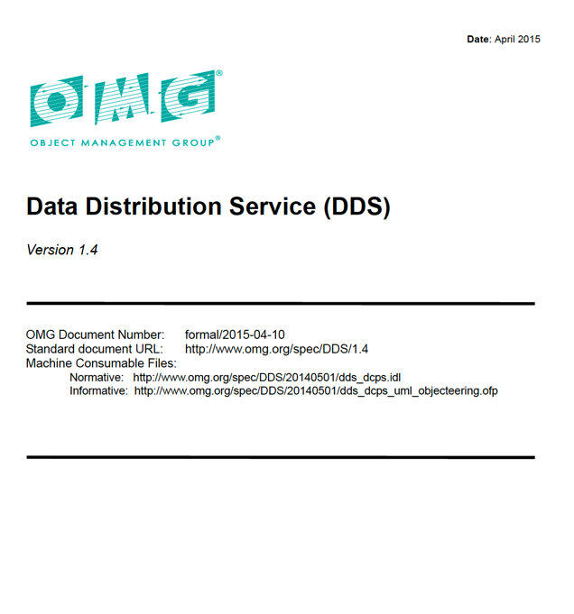
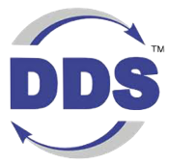
The OMG Data Distribution Service Standard
From OMG, systems software standards organization
UML, XML, IDL, CORBA, DDS
Standard can be downloaded for free by anyone
More than a dozen commercial implementations available
First version of the DDS standard was released in 2004
Most recent updates were May 2019
A family of 13 standards covering API, wire protocol, security, type evolution, etc.

Slide 5
The OMG Data Distribution Service Standard
DDS is a standard for data-centric connectivity and interoperability for real-time systems
Data-Centric Publish-Subscribe model for distributed application communication and integration
Standardizes wire protocol, serialization format and API
DDS is open and multi-vendor
Open Standard and Open Source
12+ implementations
Interoperability between source written for different vendors
DDS APIs: Data Centric Publish Subscribe (DCPS)
DDS Security
Plug-In
QoS
Distribution Fabric
QoS
QoS
Real-Time Publish Subscribe
Wire Protocol (RTPS)
Interoperability between applications running on different implementations

Slide 6
The OMG Data Distribution Service Standard
DDS is Publish-Subscribe, Data-Centric and Peer-to-Peer
DDS also supports request-reply patters: Multiple Replies, Multiple Repliers
Designed for real-time mission critical and safety critical systems
Started in Robotics and SW Defined Radios using Tactical Data Links
Navy wanted it turned into an open standard, it now ‘floats the Navy’
DDS applications share large amounts of data quickly, securely and reliably at massive scale
DDS provides location transparency, decentralized operation, dynamic scalability and real-time performance
Every DDS Vendor will tell you why theirs is the fastest
Its widespread use in distributed real-time military systems has led to strong interest in the modeling, simulation and training community

Slide 7
The OMG Data Distribution Service Standard
Data-centric design that simplifies application development
The interface is the DATA, not in worrying about messages
Strongly typed, loosely coupled and extensible
Can easily take DIS PDUs or TENA / HLA FOMs and convert them to DDS Topics
Programming language / Operating System independent
DDS Secure has been vetted at the Cybersecurity Warfare ranges at Quantico, VA and Orlando, FL
USAF has funded a SBIR project for Multi-Level Security for LVC simulations
DDS is a natural fit for Multi-Domain Operations systems
Joint Battle Command Platform (JBC-P)
Integrated Air and Missile Defense Battle Control System (IBCS)
Cooperative Engagement Capability (CEC)
Universal Ground Control Station (UGCS)
All branches of the military, including Space Force, use DDS

Slide 8

That’s nice, but

Slide 9
But Why?
Ok, so what? That sounds a little like the ‘big three’ simulation interoperability standards. Dr. Powell is right…
Yes, it is Pub/Sub
But DDS has no data model of simulation entities; No FOMs or PDUs here
So if DDS is not a simulation interoperability standard, what is it?
An interoperability framework for Real-Time systems
That uses the notion of a logical software-based Databus
DDS supports ANY data model
In fact the DDS connectivity framework is something that you build upon when you set out to create a new interoperability standard based on an industry-specific data model
The result is that DDS underpins a lot of familiar standards…

Slide 10
DDS is under the hood of many standards
Standard | Industry
Advanced Modular Mannequin (AMM) | Simulation / Healthcare
ALert MAnagement Service (ALAMS) | Defense
Application Management and Systems Monitoring (AMSM) | Defense
Future Airborne Capabilities Environment (FACE) | Defense
Generic Vehicle Architecture (GVA) NATO Generic Vehicle Architecture (NGVA) | Defense
Land Open Systems Architecture (LOSA) | Defense
Medical Simulation Training Architecture (MSTA) | Simulation / Healthcare
Open Field Message Bus (OpenFMB) | Power / Energy
Open Mission Systems (OMS) | Aerospace
Open Process Automation Forum (OPAF) | Process Automation
Standard | Industry
Open Robotics Robotic Operating System v2 (ROS2) | Horizontal / Robotics
Sensor Open System Architecture (SOSA) | Defense
Tactical Microgrid Standards Consortium (TMSC) | Energy
Unmanned Systems (UxS) Control Segment (UCS) Architecture | Defense
Unmanned Systems (UxS) Control Segment (UCS) Architecture | Defense / Aerospace
Joint Architecture for Unmanned Systems (JAUS) | Defense / Robotics
Naval Open Systems Architecture (OSA) | Defense
Control Architecture for Robotic Agent Command and Sensing (CARACaS) | Aerospace / Robotics
Multi-Robot Operator Control Unit (MOCU) | Aerospace / Robotics
Unmanned Maritime Autonomy Architecture (UMAA) | Defense / Robotics

Slide 11
Why is DDS so widely used ‘under the hood’ for these standards?
Well, consider these guys…
HTTP – universal transport
REST – universal API
Used together they build the vast majority of web-based applications
Good for human speed, but tends to be 1-1; you connect to the bank, email, website, etc.
But what about real-time applications?
And what about live real-time systems that might be:
1 to many
many to 1
many to many
with real-time speeds and security requirements

Slide 12
DDS is made for real-time interoperability
DDS defines
Open API for portability
Open wire protocol for interoperability
Transport agnostic
Open explicit defined QoS and discovery
Highly configurable
Multiple language bindings
C, C++, Java, C# .NET, Ada
LabView, Matlab/Simulink
Python, NodeJS
Multi platform support
Windows, Linux, Unix, embedded OS, Docker, Kubernetes
Application
Standard API
DDS Middleware
Standard Protocol
UDP
TCP
Qs/ports
Shmem
Operating System

Slide 13

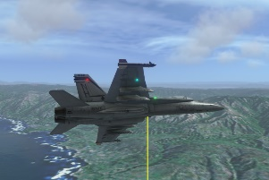
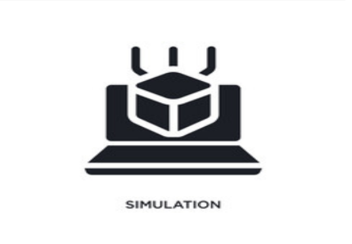
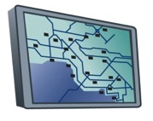
Data-Centric Publish Subscribe
Global Data Space
Sensor
Source** | string
Speed | float
Altitude | float
Actuator
Id** | string
Command | string
Status | float
Reliable
100 Hz
DDS Databus
Reliable
25 Hz
Altitude < 5000 ft
Best effort
2x / Sec

Slide 14
DDS Data-Centric Model
Data objects addressed by Domain ID, Topic and Key
Data Writer
Data Reader
License Plate | Speed | Battery Remaining | GPS Location
DKW 8307 | 41 | 73% | 39.9524, -75.1636
YQC 4149 | 64 | 55% | 28.3794, -81.5494
Data Writer
Data Reader
Data Writer
Traffic Light | State | Time Left | Operational Mode
35803 | Green | 23 sec | Automatic
82915 | Red | 6 sec | Manual Override
Data Writer
Data Reader
Notes:
Introduction to definitions

Slide 15
DDS Data-Centric Model
Data objects addressed by Domain ID, Topic and Key
Domains provide a level of isolation
Domain
Data Writer
Data Reader
License Plate | Speed | Battery Remaining | GPS Location
DKW 8307 | 41 | 73% | 39.9524, -75.1636
YQC 4149 | 64 | 55% | 28.3794, -81.5494
Data Writer
Data Reader
Data Writer
Traffic Light | State | Time Left | Operational Mode
35803 | Green | 23 sec | Automatic
82915 | Red | 6 sec | Manual Override
Data Writer
Data Reader
Notes:
Introduction to definitions

Slide 16
DDS Data-Centric Model
Data objects addressed by Domain ID, Topic and Key
Domains provide a level of isolation
Topic groups homogeneous subjects (same data-type & meaning)
Data Writer
Topic
Data Reader
License Plate | Speed | Battery Remaining | GPS Location
DKW 8307 | 41 | 73% | 39.9524, -75.1636
YQC 4149 | 64 | 55% | 28.3794, -81.5494
Data Writer
Data Reader
Data Writer
Traffic Light | State | Time Left | Operational Mode
35803 | Green | 23 sec | Automatic
82915 | Red | 6 sec | Manual Override
Data Writer
Data Reader
Notes:
Introduction to definitions

Slide 17
DDS Data-Centric Model
Data objects addressed by Domain ID, Topic and Key
Domains provide a level of isolation
Topic groups homogeneous subjects (same data-type & meaning)
Key is a generalization of subject
Data Writer
Key (subject)
Data Reader
License Plate | Speed | Battery Remaining | GPS Location
DKW 8307 | 41 | 73% | 39.9524, -75.1636
YQC 4149 | 64 | 55% | 28.3794, -81.5494
Data Writer
Data Reader
Data Writer
Traffic Light | State | Time Left | Operational Mode
35803 | Green | 23 sec | Automatic
82915 | Red | 6 sec | Manual Override
Data Writer
Data Reader
Notes:
Introduction to definitions

Slide 18
DDS Data-Centric Model
Data objects addressed by Domain ID, Topic and Key
Domains provide a level of isolation
Topic groups homogeneous subjects (same data-type & meaning)
Key is a generalization of subject
Instance individual update
Data Writer
Data Reader
License Plate | Speed | Battery Remaining | GPS Location
DKW 8307 | 41 | 73% | 39.9524, -75.1636
YQC 4149 | 64 | 55% | 28.3794, -81.5494
Data Writer
Instance
Data Reader
Data Writer
Traffic Light | State | Time Left | Operational Mode
35803 | Green | 23 sec | Automatic
82915 | Red | 6 sec | Manual Override
Data Writer
Data Reader
Notes:
Introduction to definitions

Slide 19
DDS Data-Centric Model
Data objects addressed by Domain ID, Topic and Key
Domains provide a level of isolation
Topic groups homogeneous subjects (same data-type & meaning)
Key is a generalization of subject
Instance individual update
Data Writer
Data Reader
License Plate | Speed | Battery Remaining | GPS Location
DKW 8307 | 41 | 73% | 39.9524, -75.1636
YQC 4149 | 64 | 55% | 28.3794, -81.5494
Data Writer
YQC 4149 | 68 | 48% | 28.3903, -81.5141
Data Reader
Data Writer
Traffic Light | State | Time Left | Operational Mode
35803 | Green | 23 sec | Automatic
82915 | Red | 6 sec | Manual Override
Data Writer
Data Reader
Notes:
Introduction to definitions

Slide 20
DDS Data-Centric Model
Data objects addressed by Domain ID, Topic and Key
Domains provide a level of isolation
Topic groups homogeneous subjects (same data-type & meaning)
Key is a generalization of subject
Instance individual update
Data Writer
Data Reader
License Plate | Speed | Battery Remaining | GPS Location
DKW 8307 | 41 | 73% | 39.9524, -75.1636
YQC 4149 | 64 | 55% | 28.3794, -81.5494
Data Writer
YQC 4149 | 68 | 48% | 28.3903, -81.5141
Data Reader
YQC 4149 | 70 | 47% | 28.4118, -81.4802
Data Writer
Traffic Light | State | Time Left | Operational Mode
35803 | Green | 23 sec | Automatic
82915 | Red | 6 sec | Manual Override
Data Writer
Data Reader
Notes:
Introduction to definitions

Slide 21
DDS Data Centric Publish Subscribe API
The DDS API lets applications publish data to, and subscribe to data from the DDS Databus
This DDS API is called Data Centric Publish Subscribe (DCPS)
The API is standardized in the DDS v1.4 standard, as a “Platform Independent Model” (PIM)
API operations are mapped to different languages through a “Platform Specific Model” (PSM)
The DCPS API is divided up into “entities” (way different than a simulation entity) which allow an application to:
connect to the DDS Databus
create topics
get notified of infrastructure-level events (new subscriber, new publisher, …)
publish and subscribe to application data
Each DDS entity has a set of QoS settings that determine the behavior of the entity

Slide 22
DDS Publish Subscribe API: Entities
DomainParticipant
Create & manage connection to DDS Databus

Slide 23
DDS Publish Subscribe API: Entities
DomainParticipant
<< creates >>
Topic
Create a proxy to a topic in the application

Slide 24
DDS Publish Subscribe API: Entities
DomainParticipant
<< creates >>
<< creates >>
Manages group of DataWriters
Manages group of DataReaders
Publisher
Topic
Subscriber
<< creates >>
<< creates >>
DataWriter
DataReader

Slide 25
DDS Publish Subscribe API: Entities
DomainParticipant
Publisher
Topic
Subscriber
<< creates >>
<< creates >>
DataWriter
<< uses >>
DataReader
<< uses >>
Publishes data to DDS Topic
Subscribes to data from DDS Topic

Slide 26
DDS Publish Subscribe API: Entities
DataReaders (DRs) and DataWriters (DWs) are strongly typed
Their APIs are generated from IDL
struct ShapeType {
string<128> color;
long x;
long y;
long shapesize;
};
ShapeTypeDataWriter_write
ShapeTypeDataWriter_dispose
ShapeTypeDataReader_read
ShapeTypeDataReader_take

Slide 27
DDS Topic Data Types
struct MyType {
long sensorID; //@Key
long plantID; // @Key
float sensorVal0;
float sensorVal1;
float sensorVal2;
float sensorVal3;
float sensorVal4;
Version version;
Time currentTime;
}
struct Version {
string firmwareVersion;
string hardwareVersion;
string modelNumber;
string serialNumber;
}
Strongly Typed

Slide 28
DDS Topic Data Types
struct MyType {
long sensorID; //@Key
long plantID; // @Key
float sensorVal0;
float sensorVal1;
float sensorVal2;
float sensorVal3;
float sensorVal4;
Version version;
Time currentTime;
}
struct Version {
string firmwareVersion;
string hardwareVersion;
string modelNumber;
string serialNumber;
}
struct MyType {
string data;
}
Where data =
<SENSOR>
<SensorID>438</SensorID>
<PlantID>192</PlantID>
<Value0>21.0546</Value0>
<Value1>43.6</Value0>
<Value2>56.34</Value0>
<Value3>12.11</Value0>
<Value4>20.00</Value0>
<firmware>1.24b</firmware>
<hardware>2.39</hardware>
<model>M56A743</model>
<serial>1429709<serial>
</SENSOR>
Strongly Typed
Loosely Typed

Slide 29
DDS Topic Data Types
struct MyType {
long sensorID; //@Key
long plantID; // @Key
float sensorVal0;
float sensorVal1;
float sensorVal2;
float sensorVal3;
float sensorVal4;
Version version;
Time currentTime;
}
struct Version {
string firmwareVersion;
string hardwareVersion;
string modelNumber;
string serialNumber;
}
struct MyType {
long sensorID; //@Key
long plantID; // @Key
string data;
string version;
}
Where data =
<SENSOR>
<Value0>21.0546</Value0>
<Value1>43.6</Value0>
<Value2>56.34</Value0>
<Value3>12.11</Value0>
<Value4>20.00</Value0>
</SENSOR>
version =
<VERSION>
<firmware>1.24b</firmware>
<hardware>2.39</hardware>
<model>M56A743</model>
<serial>1429709<serial>
</VERSION>
struct MyType {
string data;
}
Where data =
<SENSOR>
<SensorID>438</SensorID>
<PlantID>192</PlantID>
<Value0>21.0546</Value0>
<Value1>43.6</Value0>
<Value2>56.34</Value0>
<Value3>12.11</Value0>
<Value4>20.00</Value0>
<firmware>1.24b</firmware>
<hardware>2.39</hardware>
<model>M56A743</model>
<serial>1429709<serial>
</SENSOR>
Strongly Typed
Mixed Type
Loosely Typed

Slide 30
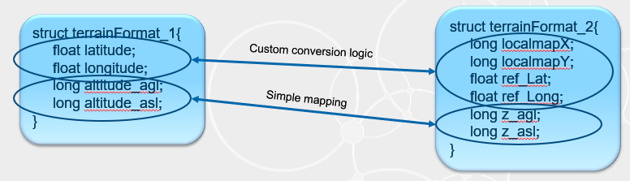
Data Type Extensibility
Final Type
Type definitions are strictly defined
Extensible Type
Newer applications can add fields to existing base types
Mutable Type
Type representations can differ from each other with Additions, Deletions and Transpositions
Support for Optional Fields
struct Track {
long id; //@key
float range;
float bearing;
}
struct Track {
long id; //@key
float range;
float bearing;
}
struct Track {
long id; //@key
float range;
float bearing;
}
struct AirTrack {
long id; //@key
float range;
float bearing;
float elevation;
}
struct Track {
long id; //@key
float range;
float bearing;
}
struct AirTrack {
long id; //@key
float elevation;
}

Slide 31
Simple API Interface
void publisher_main(int domain_id) {
// Initialize
dds::domain::DomainParticipant participant (domain_id);
// Create a Topic
dds::topic::Topic<dds::core::StringTopicType> topic (participant, "MyTopic");
// Create a Data Writer
dds::pub::DataWriter<dds::core::StringTopicType> writer(dds::pub::Publisher(participant), topic);
// Create some data
dds::core::StringTopicType sample("Hello World");
// Write the data
writer.write(sample);
}

Slide 32
Common Distributed Application Challenges
DDS QoS Features
Reliability
In-Order Delivery
Content Filtering
Resource Limits
Partition
Deadine
Batching
Presentation
Ownership
Transports
Time Based Filter
Durability
Lifespan
Flow Control
Multi-Channel
Liveliness
Latency Budget
History
User, Group, Topic Data
Async Publisher
Transport
UDP
TCP
1-1, 1-Many
1 to 1
No Reliability
Reliability
Flow Control

Slide 33


Using DDS QoS to Shape Data Flow
Collision avoidance application
Publisher
Radar Track
Topic
Reliable; 1 Hz; get history
Subscriber
Publish reliably
10 Hz
600 sample history
Best effort; 0.2 HZ; get history
NOC Sim
Subscriber
Nearby tracks with altitude < 5000m
ATC Sim
Subscriber
Discovery matches publishers and subscribers of a topic
Topics tied to Data type, allowing smarter databus
Quality of Service describing application data needs must be compatible to communicate
Specifying and relying only on these data properties enables decoupled, resilient systems

Slide 34
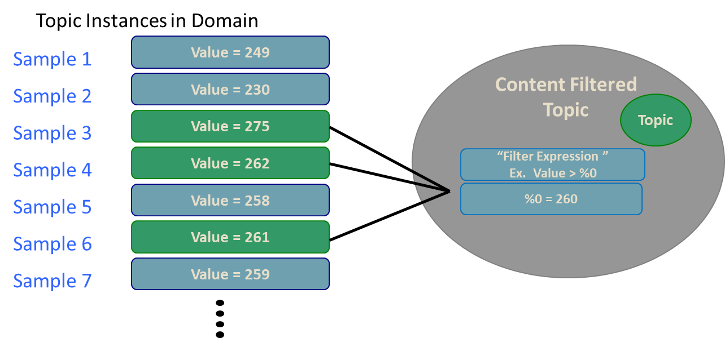
Content Filtered Topics
The Filter Expression and Arguments will determine which instances of the Topic will be received by the subscriber

Slide 35
DDS Publish Subscribe API: QoS conflicts
The DataReader and DataWriter QoS must match if connectivity is to be established
QoS does not need to be equal. It is ok if a DataWriter offers “more” than what a DataReader asks for
Example: DW = Reliable, DR = Best Effort
DataReader
BEST EFFORT
BEST EFFORT
DataWriter
DataReader
RELIABLE

Slide 36
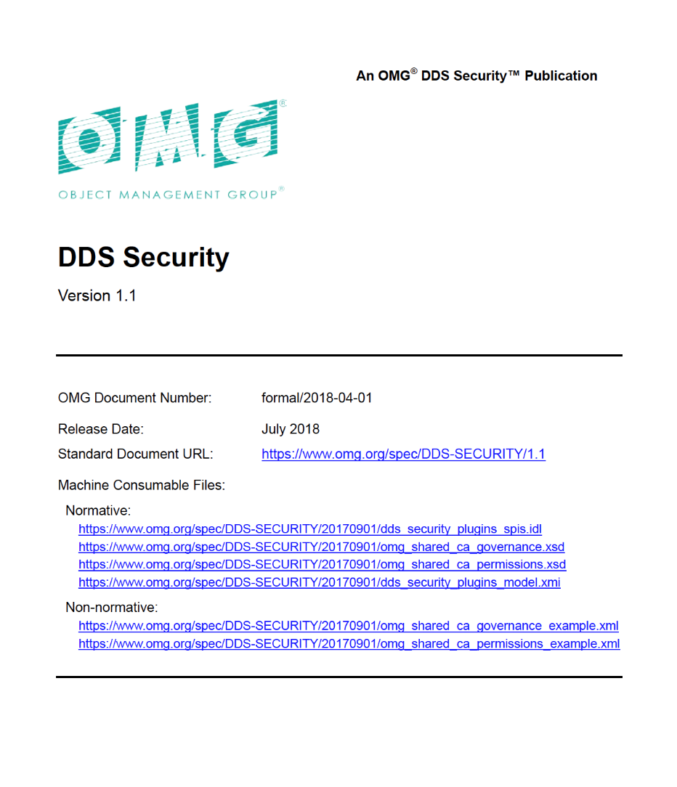

OMG DDS Security Standard
OMG released the DDS Security specification (v1.1) in July 2018
Collaboratively developed by several DDS vendors
Defines:
DDS Security Model
Service Plugin Interface (SPI) Architecture

Slide 37
Practical Security Needs Many Layers
System edge
Host
Machine/OS/Applications/Files
Network transport
Media access (layer 2)
Network (layer 3)
Session/Endpoint (layer 4/5)
Dataflow
Control application interaction
DDS Security
Secure systems need all four

Slide 38
DDS: Data-Centric, Fine-Grained Security
Per-Data-Topic Security
Control r,w access for each function
Ensures proper dataflow operation
Complete Protection
Discovery authentication
Data-centric access control
Cryptography
Tagging and logging
Non-repudiation
Secure multicast
100% standards compliant
Simulate
Visualize
Control
Operator
Applications
Data Topics
BaseEntity
Detonation
Fire
Data Topic Security model:
Simulate: Fire(r), BaseEntity(w)
Visualize: BaseEntity(r), Detonation(w)
Control: BaseEntity(r), Fire(w)
Operator: *(r), Fire(w)

Slide 39
Pluggable Architecture
Requires trivial or no change to existing DDS apps and adapters
Includes default plugins; customizable
Runs over any transport
Including low bandwidth, unreliable
Does not require TCP or IP
Multicast for scalability, low latency
Completely decentralized
High performance and scalability
No single point of failure
Application
Authentication
Secure DDS Library
Access Control
Encryption
Logging
Data Tagging
Any Transport (e.g., TCP, UDP, multicast, shared memory…)

Slide 40
Standard Capabilities (Built-in Plugins)
Authentication | X.509 Public Key Infrastructure (PKI) with a pre-configured shared Certificate Authority (CA) Digital Signature Algorithm (DSA) with Diffie-Hellman and RSA for authentication and key exchange
Access Control | Configured by domain using a (shared) Governance file Specified via permissions file signed by shared CA Control over ability to join systems, read or write data topics
Cryptography | aes-128-ctr for encryption HMAC-SHA256 for message authentication and integrity aes-128-gcm, aes-192-gcm and aes-256-gcm for encryption with authentication Certicom and Windows CNG for FIPS 140-2
Logging | Log security events to a file or distribute securely over DDS
Data Tagging | Tags specify security metadata, such as classification level Can be used to determine access privileges (via plugin)

Slide 41
Configuring & Deploying DDS Security
Domain Governance
Document
Identity CA Certificate
Permissions CA Certificate
Shared By All Participants
P2 Permissions File
P1 Permissions File
P2 Identity Certificate
P1 Identity Certificate
P2
P1
P2 Private Key
P1 Private Key

Slide 42
Domain Governance File
The domain governance document is an XML document that specifies which DDS domain IDs shall be protected and the details of the protection
It is signed by the permissions CA

Slide 43
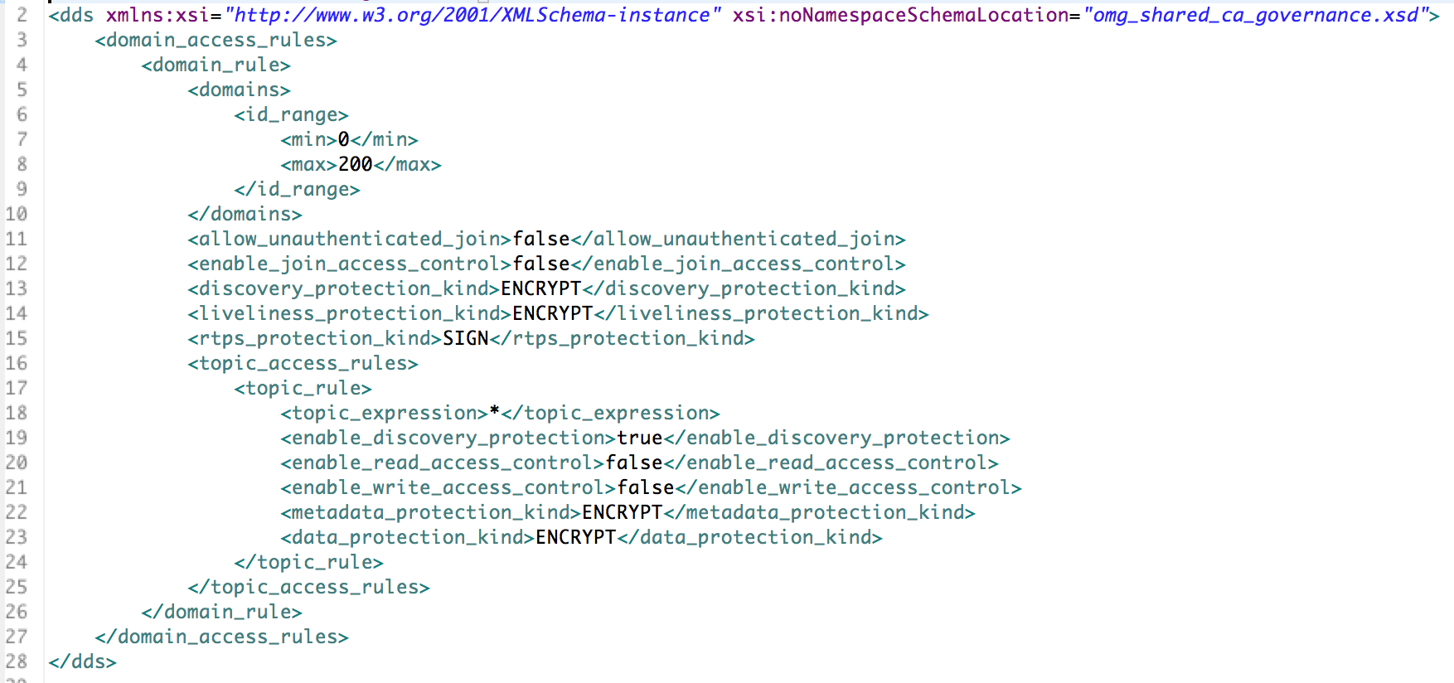
A Sample Governance File

Slide 44
Configuration Possibilities
Are “legacy” or un-identified applications allowed in the Domain?
If yes, an unauthenticated application will:
See the “unsecured” discovery Topics
Be allowed to read/write the “unsecured” Topics
Is a particular Topic discovered over protected discovery?
If so, it can only be seen by “authenticated applications”
Is access to a particular Topic protected?
If so, only authenticated applications with the correct permissions can read/write
Is data on a particular Topic protected? How?
If so, data will be sent signed or encrypted then signed
Are all protocol messages signed? Encrypted?
If so, only authenticated and authorized applications will see anything

Slide 45
Permissions Document
For each participant, specifies:
What domains it can join
What Topics it can read/write
What Tags are associated with Readers & Writers

Slide 46
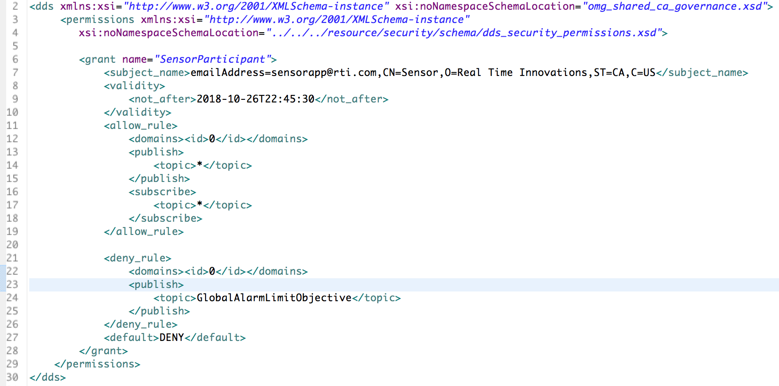
A Sample Permissions File

Slide 47
Using DDS with distributed LVC simulations
Can leverage/ integrate existing system software
Hundreds of DoD systems (Navy, Air, Army) already being built using DDS
DDS is mandated by Navy OA for combat management systems
DDS specified by US DoD for the unmanned vehicle control (OSD-UCS)
DDS specified by UK-MOD for army vehicle communications
With DDS, simulation systems could easily reuse and integrate software components from actual systems
This has already been happening for years

Slide 48
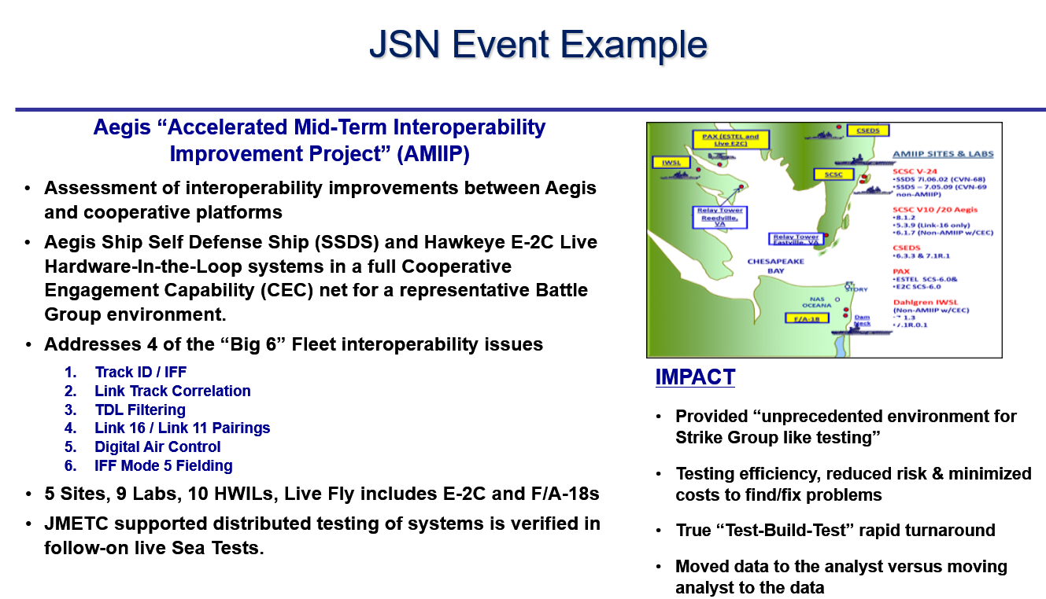
DDS in Simulation: JMETC

Slide 49
Securing distributed LVC simulations with DDS
Can leverage/integrate mission data
Recorded data from actual mission execution could be combined with simulation data and be used for training
This approach is already followed in the US Navy OATM
Rapid feedback from mission to training is key to an agile and effective force.
Can leverage/integrate DDS Security into new distributed simulations
Secure training and simulations over WAN/Cloud/RF/Lossy Networks/TDL
Role-based access allow for joint Coalition forces to train alongside US forces
Multiple SBIRs with different defense agencies for secure LVC simulations

Slide 50
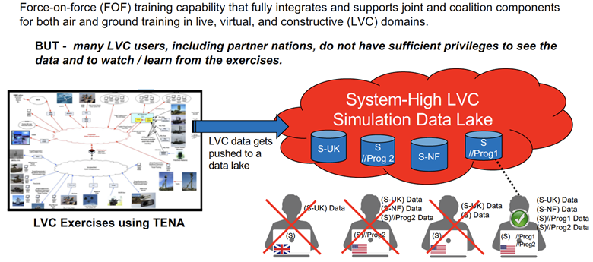
USAF Live Mission Operations Capability (LMOC) Multi Level Secure (MLS) capability for LVC Simulations

Slide 51
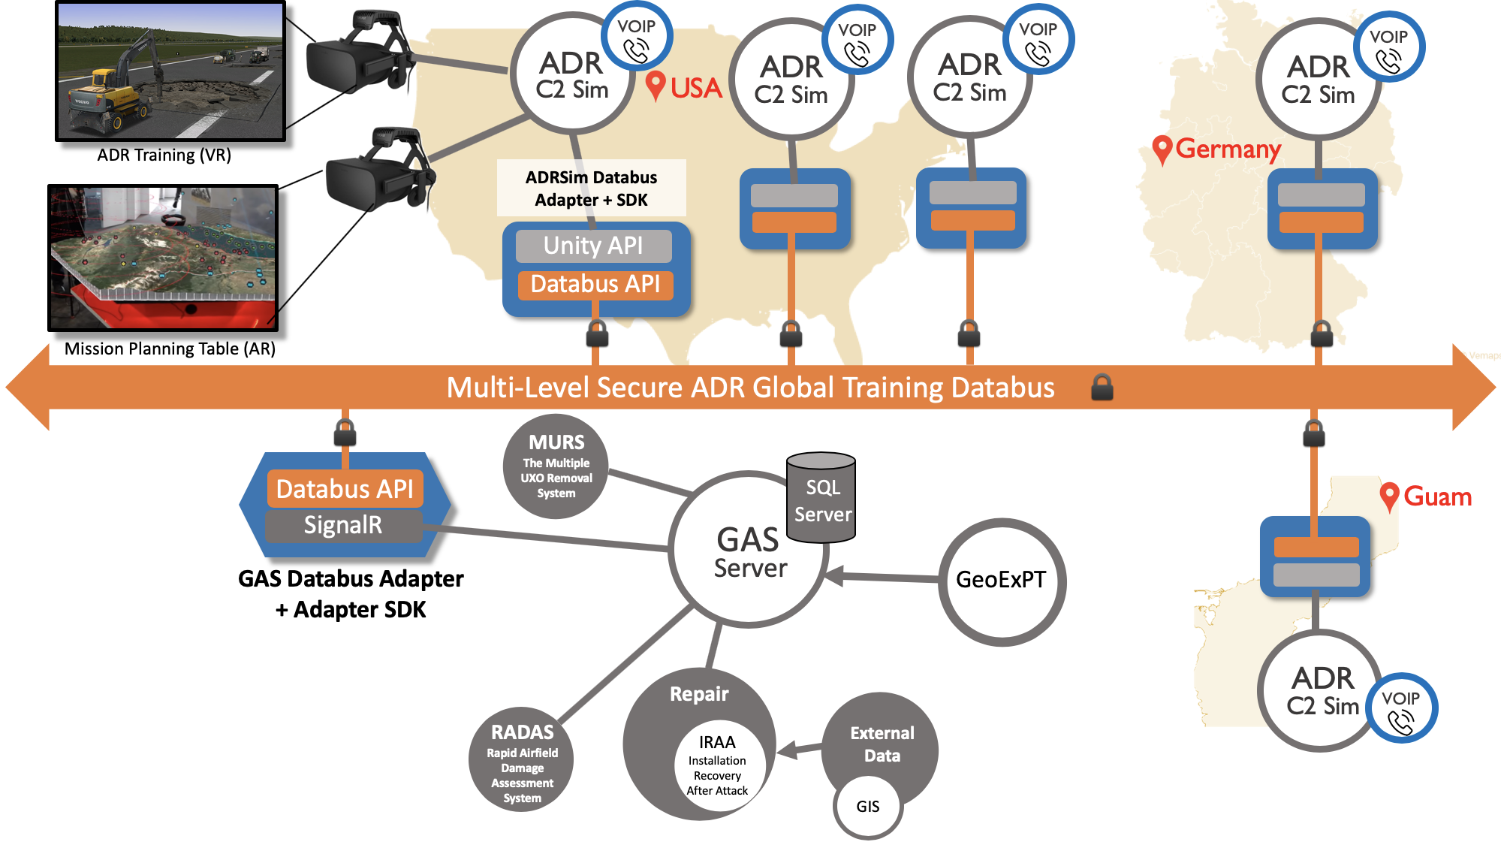
Global Connectivity for USAF Training Simulations

Slide 52
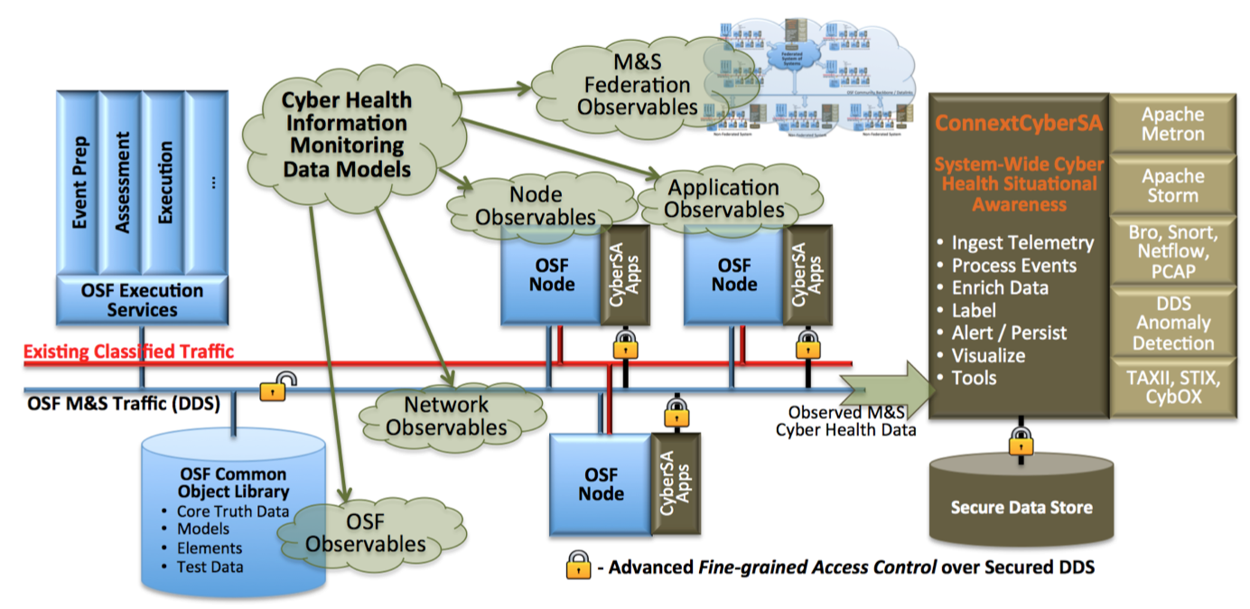
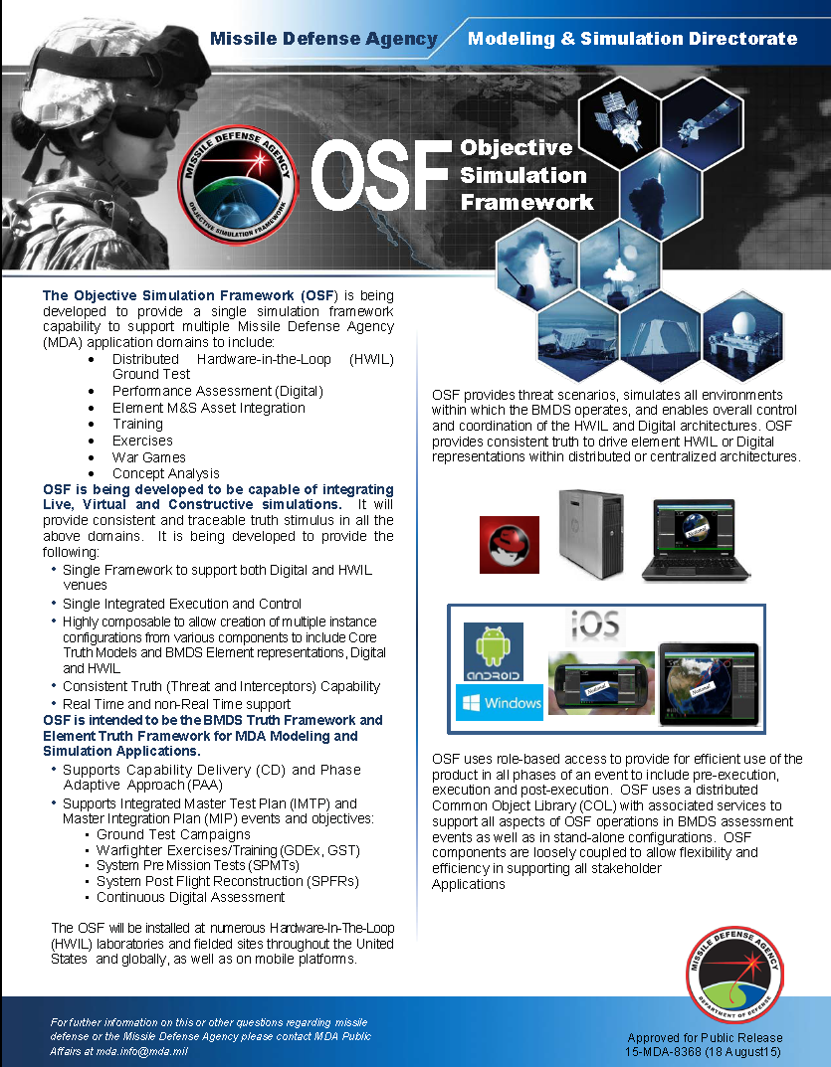
Missile Defense Agency – Objective Simulation Framework
Fully Distributed, Real-Time,
Secure Cyber Situational Awareness for MDA OSF

Slide 53


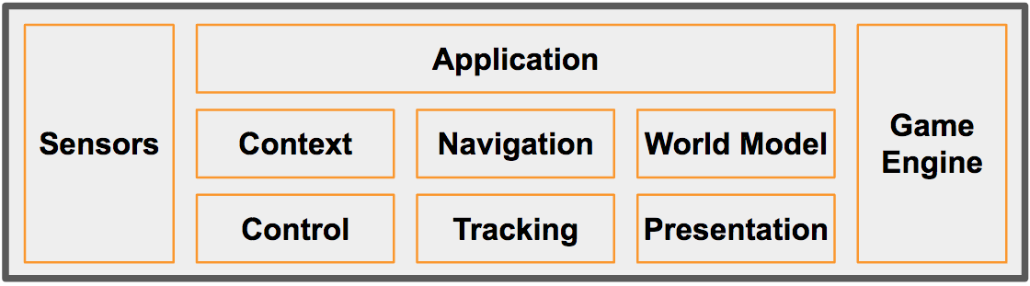
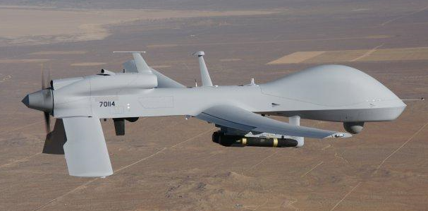
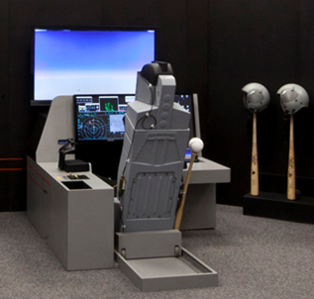

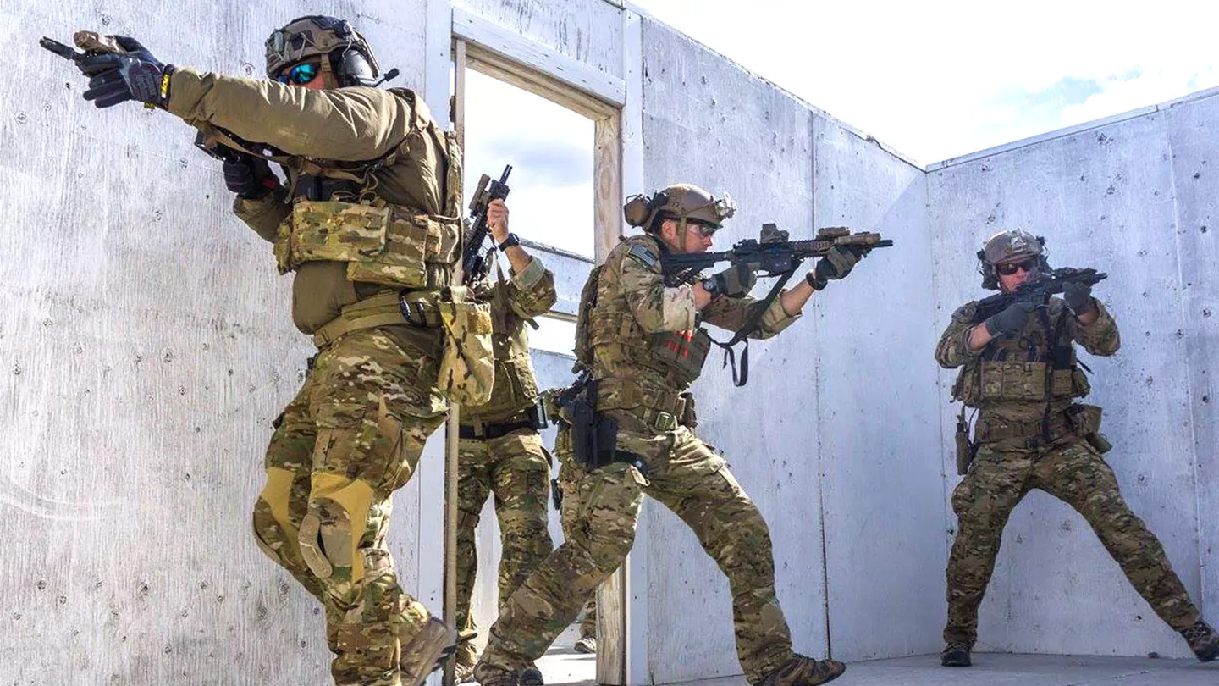
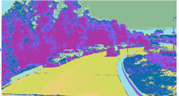
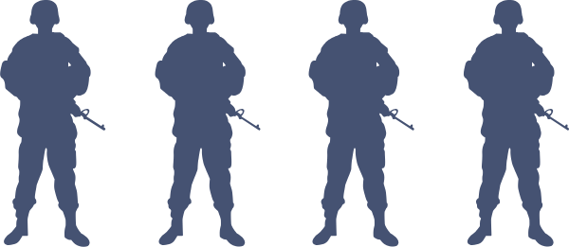

Mixed-Reality Wargaming Platform
Cloud
A Hierarchical, Loosely-Coupled Design Enables:
Local Ownership
Disconnected Operation
Open Architecture
Capability-as-a-Service
e.g., AI, Simulation, Data, Devices
Management
Logging
Analytics
Other
Services
Secure Global DDS Databus
Secure
Gateway
Protocol/Data Interoperability
Data Routing/Filtering
Management
Logging
Analytics
Secure Cross-System DDS Databus (Local/Regional)
DDS
Processing Location Agnostic / Transparent
DataBus
Gateway
AI Training
Scenarios
Protocol
Gateway
One World
Terrain
Protocol XYZ
OtherSim
Autonomous Systems
AI/ML/DL
Augmented
Reality
Real World Twin
Local Mgmt
Simulated Worlds
Simulation DataBus
Simulation DataBus
Real World
Sim@ NATO 2
Simulation Connext DataBus
Sim@ NATO 1
Air
Helo
Sim@ SOCOM
Edge
Unity
Unreal
Maritime
Ground
Simulated
Actors
Digital
Twins

Slide 54
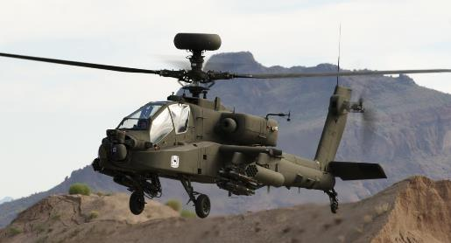


CCDC Aviation & Missile Center - SED System Integration Labs
Hardware-in-the-Loop labs for the UH-60V, CH-47F and AH-64E Army Helicopters

Slide 55
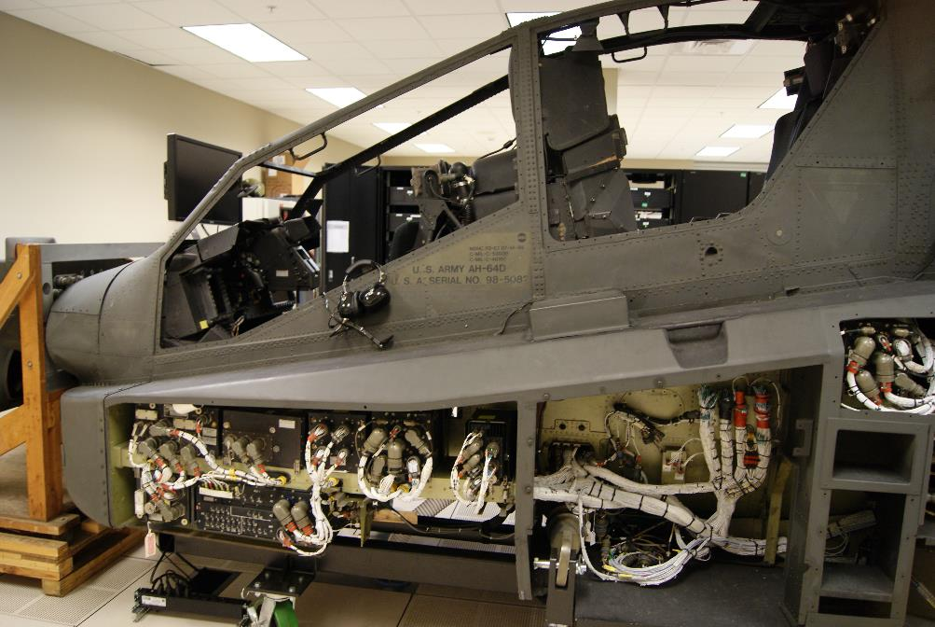
CCDC AvMC S3I - Apache AH-64E
HAT/HOT
Flight Model
Visuals
Flight
Controls
Visuals
Image Generators
Database
DDS
Data Record /
Playback
Data Analysis
Workstation
TBD
LabVIEW
Science
Experiments
RadAlt Model
Aberdeen I/O
ADC Model
EGI Model

Slide 56
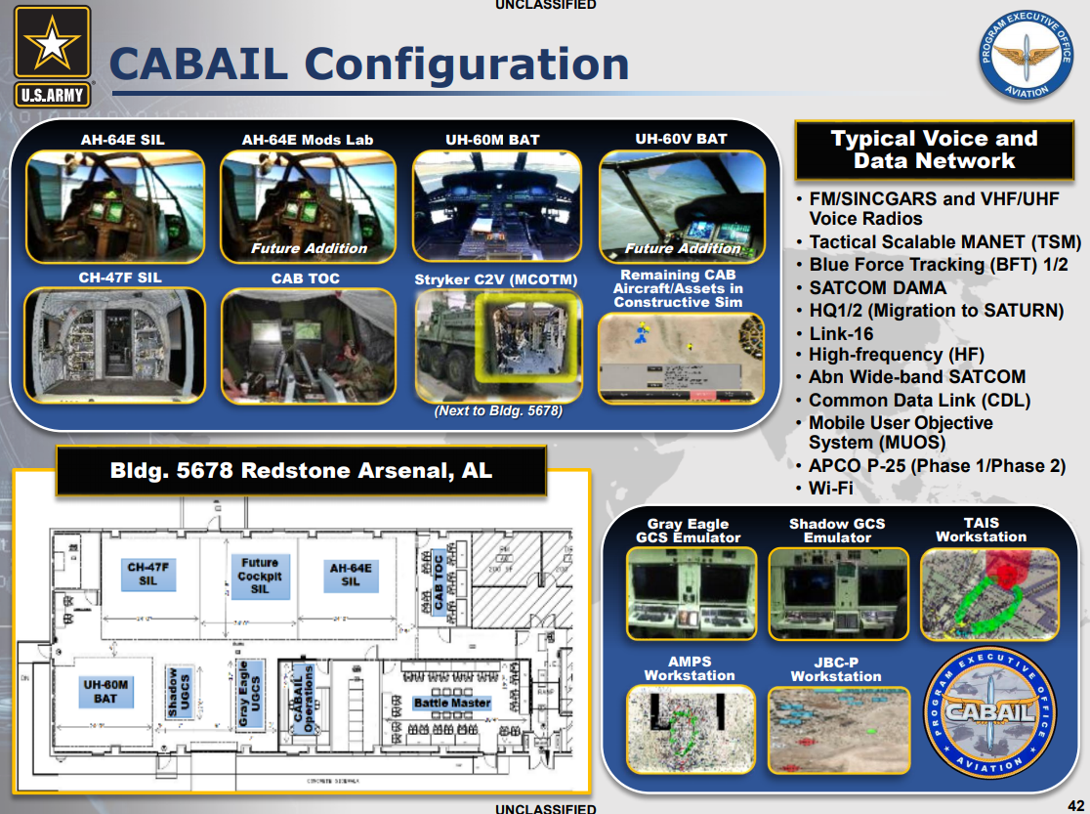
PEO Aviation - Combat Aviation Brigade Architecture Integration Lab (CABAIL)
AH-64E and CH-47F SILs already use DDS to reduce hardware and development costs for HIL experimentation
JBC-P Network Operations Center(NOC) was re-architected using DDS for significant code reduction and performance improvement

Slide 57
Using DDS with Simulation Standards
The DDS specification has been be leveraged for the middleware APIs as well as the wire protocol
APIs could use the DDS API
Wire protocol communications could use the Interoperability Wire protocol from DDS
This combination would leverage the performance, scalability, robustness and interoperability from DDS.
The simulation entities from TENA/HLA/DIS could be leveraged
They would provide the “entity data model dictionary”
This would leverage the conventions and semantics of the simulation standards
The simulation defined types could be described using the DDS Extensible Types
This leverages the extensibility, dynamic APIs and backwards compatible path to type evolution of the DDS Type system
Gateways/brokers exist
HLA-RTI provider supports multiple DDS Vendors

Slide 58
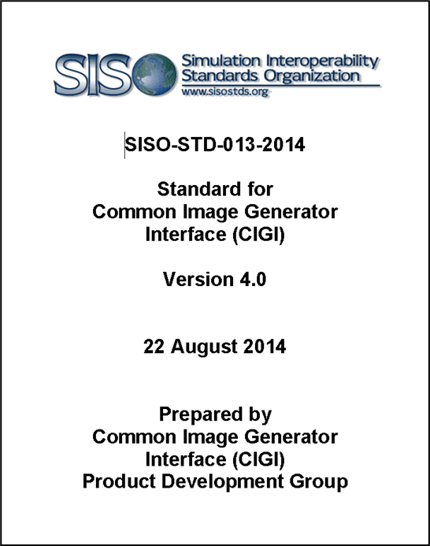
SISO CIGI and DDS
Common Image Generator Interface (CIGI) is an on-the-wire data protocol that allows communication between an Image Generator and its host simulation
The interface is designed to promote a standard way for a host device to communicate with an image generator (IG) within the industry
“CIGI Next” now rebranded as the Synthetic Environment Generation Interfaces (SEGI) is considering using DDS as a transport
Could eliminate the need for hosts, you would communicate directly to the IG
Please join the SISO CIGI PDG!

Slide 59
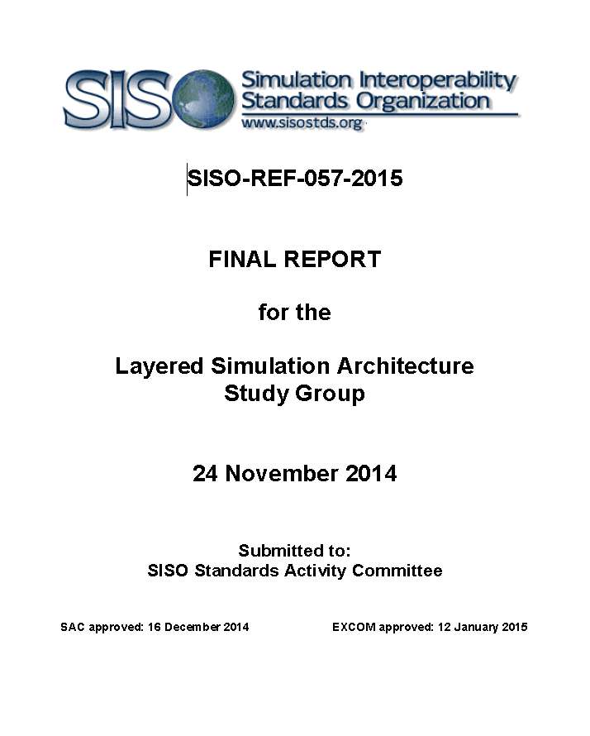
DDS ‘Under the hood’ at SISO?
Layered Simulation Architecture
Study Group at SISO
Putting DDS ‘under the hood’ of HLA/DIS
Use DDS RTPS with Simulation Entities as topics
Study Group recommended that LSA become a SISO standard; stalled at that point
Need a collation of the willing to revive this
Open source prototype would be needed
DDS Secure was not considered at the time of this study group, but could easily be added and add much needed security to the Simulation standards

Slide 60
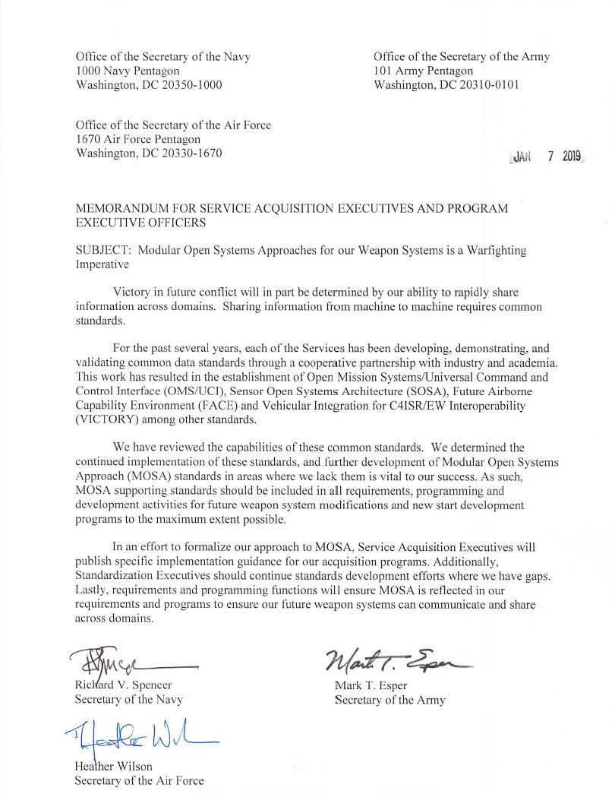
DDS with MOSA Requirement
Tri-Service acquisition memorandum signed by the Secretaries of the U.S. armed services – directed using Modular Open Systems Approach (MOSA)
Specifically cites standards
Sensor Open Systems Architecture (SOSA)
Open Mission Systems/Universal Command and Control Interface (OMS/UCI)
Future Airborne Capability Environment (FACE)
Vehicular Integration for C4ISR/EW Interoperability (VICTORY)
…“as vital to our success”
DDS is certified conformant and/or aligned to every standard called out in the provided memorandum

Slide 61
Conclusions
DDS is a mature standard from OMG
Platform neutral: Operating Systems and Programming Languages
Mandated and deployed worldwide in military systems with demanding real-time applications
Portable API DCPS and Interoperable Wire Protocol RTPS
Deployed DDS Security Standard specification
DDS focuses on efficient data-distribution for real-time & high-performance systems
DDS is suited for integration of distributed training systems that have security requirements
Authentication, Role-Based Access to data, Multiple Levels of Security (MLS)
Evolvable Type System
Real-Time Quality of Service (QoS)
Eases integration and reuse of system software and mission data

Slide 62
Original Tutorial Learning Objectives
After taking this tutorial you should be able to:
Describe the DDS standard
Explain the principles of the DDS Secure standard for securing communications between distributed simulations over WAN/Cloud/RF/Lossy networks
Explain how DDS works with the simulation architectures TENA, HLA and DIS
Summarize how DDS works with real-world Hardware In the Loop (HIL) for secure distributed LVC simulations at scale
Describe how DDS is working within SISO

