Slide 1

RHC Verification & Survey Process
Cecilia Sherraden, BSN, RN | April 22, 2026

Slide 2

RHC Verification & Survey Process
Cecilia Sherraden, BSN, RN
Program Manager, Risk Management and Rural Health Clinics
Kansas Department of Health and Environment
Cecilia.Sherraden@ks.gov
Kdhe.riskmanagement@ks.gov

Slide 3
RHC Verification & Survey Process
Additional KDHE Contacts
Bureau Director: Jerry Smith
Email: Gerald.Smith@ks.gov
Deputy Bureau Director: Marilyn St. Peter
Email: Marilyn.St.Peter@ks.gov
Deputy Bureau Director: Catherine Lenz
Email: Catherine.Lenz@ks.gov

Slide 4
RHC Verification & Survey Process
Additional KDHE Contacts
Program Manager: Lois Wilkins
Email: Lois.Wilkins@ks.gov
Certification Coordinator: Janiene Winborne
Email: Janiene.A.Winborne@ks.gov

Slide 5
RHC Verification & Survey Process
Objectives
Understand the Verification Process.
Learn About the Survey Process.
Discuss Methods to Prepare for a Survey.

Slide 6
Verification Process

Slide 7
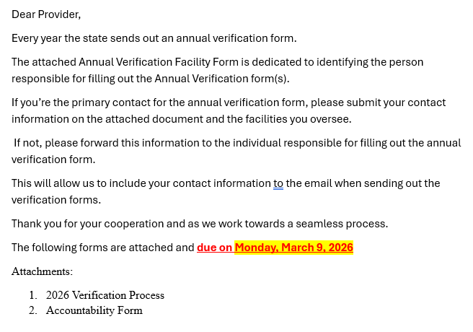
Verification Process
Annual Verification Facility Form

Slide 8
Verification Process
2026 Verification Process
Email forwarding – Forward verification email and its entirety to the responsible party.
Look under provider type – first three letters of your facilities name for schedule.
  Or read the Subject line for provider type, group and due date
  Locate your facility in the 2026 Schedule for due dates
Column (3.) Last Contact – is your due date.
Wait for the State's Verification Form – Do not submit forms ahead of schedule.
Use the Fillable Form – Only print for signatures if necessary.

Slide 9
Verification Process
2026 Verification Process
Include Required Credentials – If the form requests them, attach and send with form.
Accreditation – include the full survey, plan of correction and AO letter with dates.
Sign the Document – Ensure all the documents are signed.
Use the Pre-Formatted Subject Line – Forward or reply without altering the subject line it if formatted for verification purposes.
Letter of Intent (LOI) – If required, ensure it’s on the facility letterhead and include supporting documentation for the facility changes start/end dates, and addresses- full names, titles.

Slide 10
Verification Process
Valid reasons for submitting an LOI:
Any changes to the admin’s information or facility’s (new admin, email, phone, or fax change).
Address changes (must include the 855-approval letter).
Provider name change (must include the 855-approval letter).
If the Provider name differs from what’s in the Federal database or 855.

Slide 11
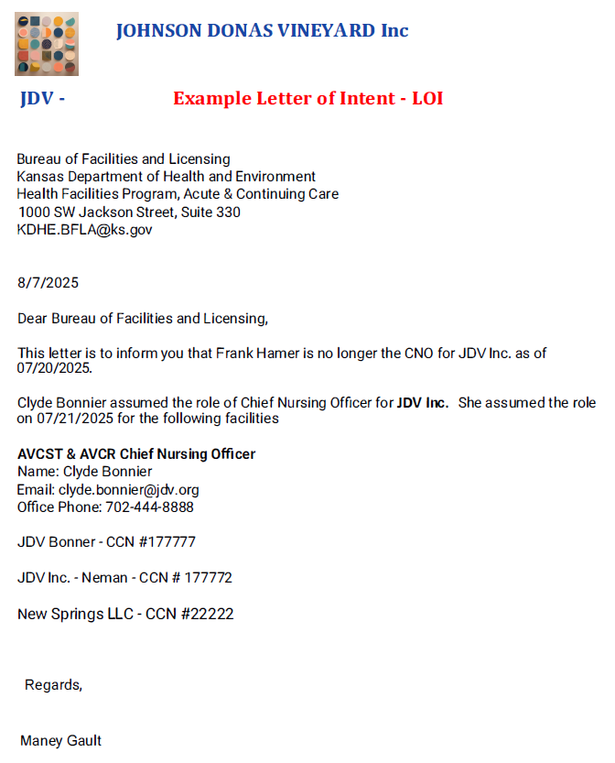
Verification Process
Example LOI

Slide 12
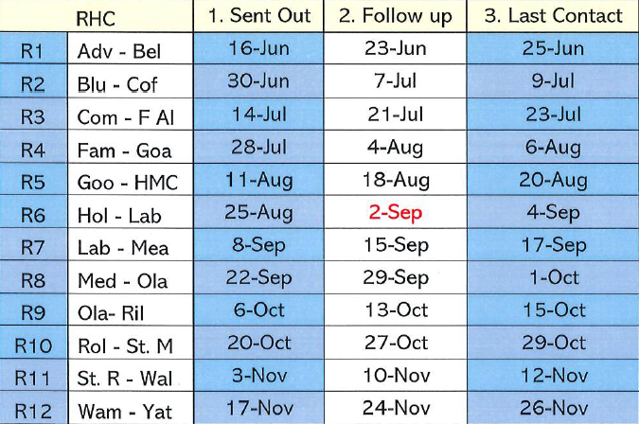
Verification Process
2026 RHC Verification Schedule:

Slide 13
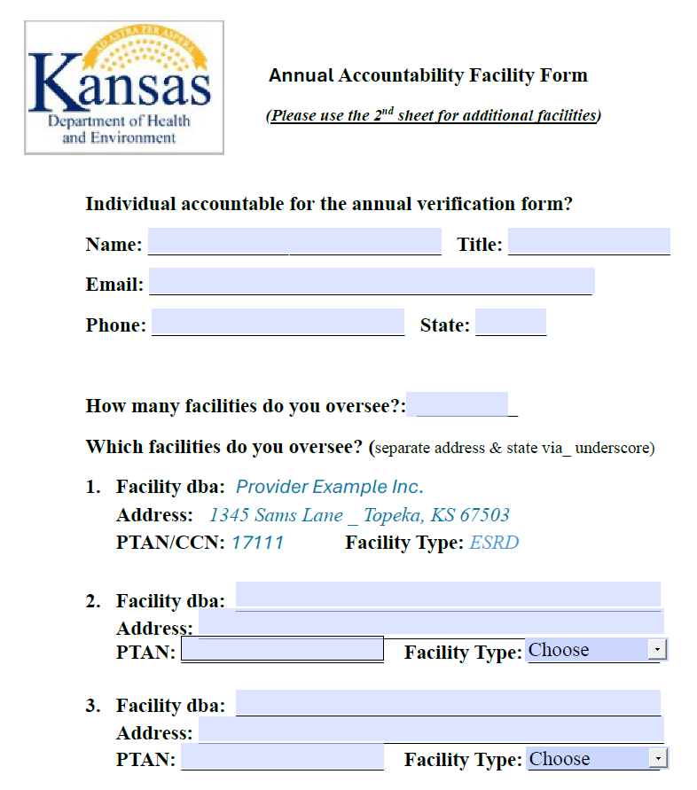
Verification Process
Annual Accountability
Facility Form

Slide 14
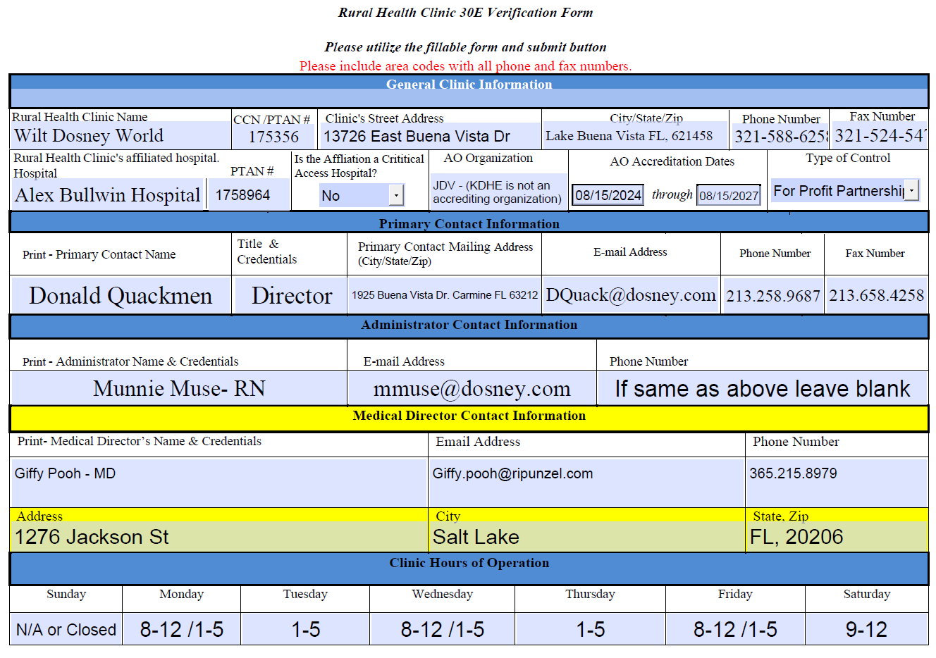
Verification Form Example

Slide 15
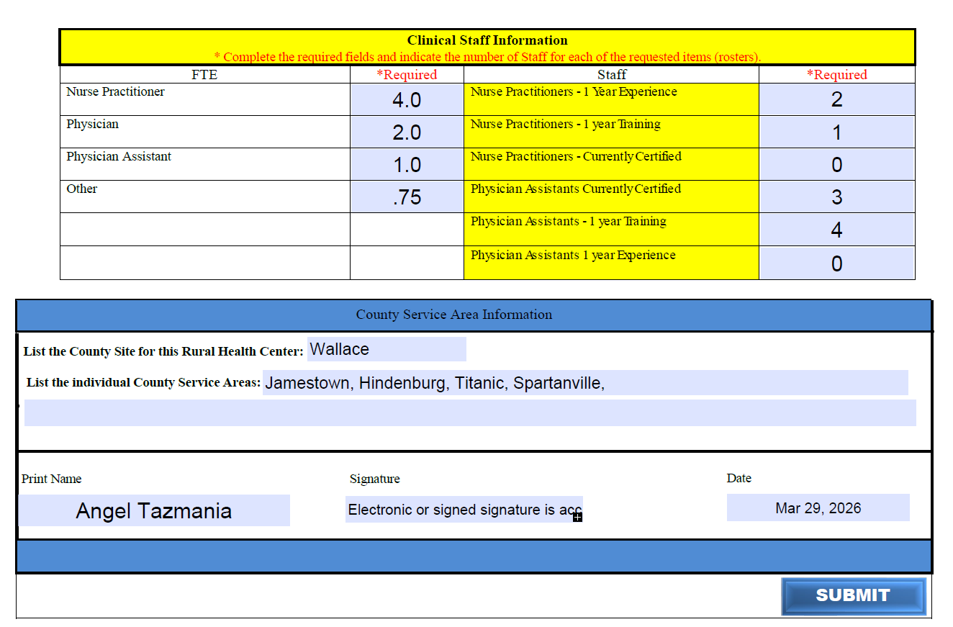
Verification Form Example

Slide 16
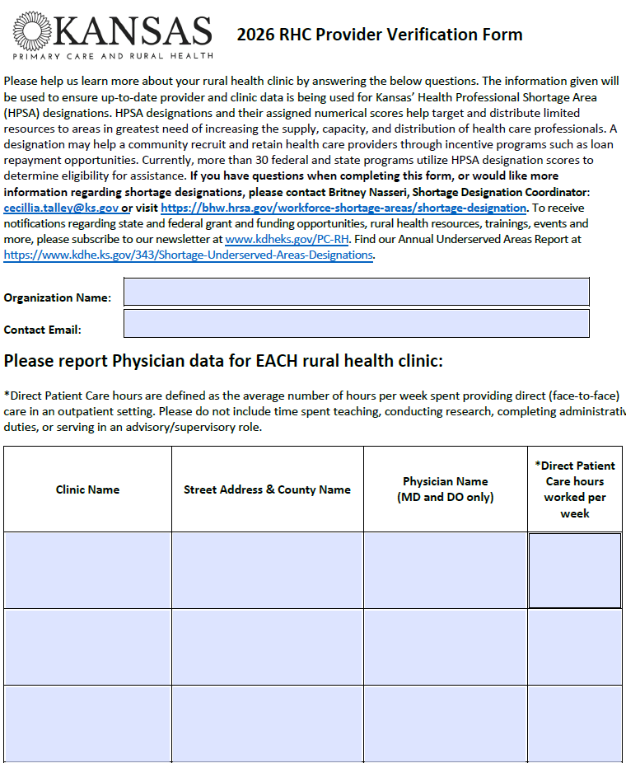
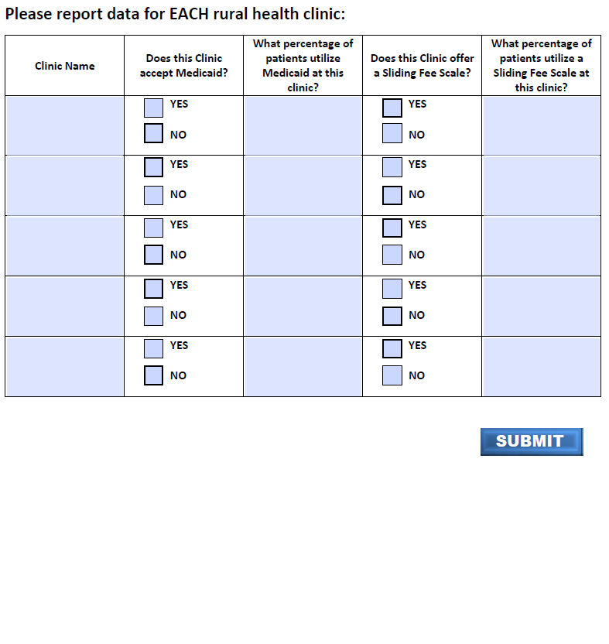
Additional Verification Form

Slide 17
Survey
Process

Slide 18
The Basic Survey Process
All surveys are unannounced
Should an individual or entity refuse to allow immediate access upon reasonable request to either a State Agency, CMS surveyor, a CMS-approved accreditation organization, or CMS contract surveyors, the RHC’s Medicare provider agreement may be terminated. (SOM Appendix G)
Surveys generally occurs during daytime working hours (Monday – Friday).
Upon arrival:
Present Surveyor Identification.
Present Introductory Letter from KDHE.
Announce a surveyor is being conducted to Admin, or person in charge.
Presents the CMS 2802 (deemed providers only).

Slide 19
The Basic Survey Process
Entrance Conference
Determine how the facility will ensure surveyors are able to obtain photocopies or electronic files for records and other information as they are needed.
Obtain names, locations and contact information of key staff for questions.
Arrangements for a location or conference from where the team may meet privately.
Provide a list of required documents and the timeframe the documents are expected to be provided to the Team Coordinator (TC).

Slide 20
The Basic Survey Process
Documents requested but are not limited to:
Schedule for the day of entry.
Schedule of patients for the past 90 days.
Organizational charts.
List of all personnel.
List of all physicians, APRNs, and PAs with their credential files.
Self-assessment for the past two years.
List of all services provided.
Copy of the floor plan.
Preventative maintenance program and logs.
Medical records – system use, retention of records, protection of the records, policy for release of records.

Slide 21
The Basic Survey Process
Facility tour:
The Health Facility Surveyors (HFS) will complete a tour of the facility.
During the survey HFS:
Should always maintain a professional working relationship with facility staff.
Always need to respect patient privacy and maintain patient confidentiality during the survey.
Should maintain their role as representatives of a regulatory agency - the HFS is not a consultant role.
Can decide to allow facility personnel to accompany them on the survey based on the circumstances at the time of the survey.
Should maintain open and ongoing dialogue with the facility staff throughout the survey process.

Slide 22
The Basic Survey Process
The objective of the survey process is to determine the provider’s compliance with the Medicare Conditions of Participation (CoP) through the observations of care/services provided to the patient, patient and/or family interviews, staff interviews, and document/record reviews.

Slide 23
The Basic Survey Process
Observations provide first-hand knowledge of RHC practice.
Interviews provide a method to collect information and to verify and validate information obtained through observations.
Document/record review focuses on a facility’s compliance with the CoP.
The HFS reviews and analyzes all the information collected from observations, interviews, and document/record reviews, and determines whether the provider/supplier is compliant.

Slide 24
The Basic Survey Process
Tips for Employees When Talking to a Surveyor:
Relax and take deep breath.
Make sure you understand the question.
After giving it some thought, answer the question.
If you don’t know the answer, don’t guess - tell the surveyor where you could find the answer or who can help provide the answer.
Stop talking once you answer the question.
Avoid words such as attempt, try, sometimes, or usually.

Slide 25
The Basic Survey Process
Exit Conference
The general objective of the Exit Conference is to inform the facility staff of the team’s preliminary findings.
Situations that justify refusal to continue or conduct an exit interview:
  When the provider is represented by counsel who tries to turn the conference into an evidentiary hearing.
  The provider creates a hostile or intimidating environment.

Slide 26
The Basic Survey Process
Recording the Exit Conference
If the facility wishes to audio tape the conference, it must provide two tapes and tape recorders, recording the meeting simultaneously.
The HFS will take one of the tapes at the conclusion of the conference.
Videotaping is permitted if it is not disruptive to the conference, and a copy is provided at the conclusion of the conference.
It is at the sole discretion of the surveyor(s) to determine if videotaping is permitted.

Slide 27
The Basic Survey Process
Basic Ground Rules for Exit Conference
TC will explain how the team will conduct the exit conference and any ground rules.
Ground rules may include waiting until the surveyor finishes discussing each deficiency before accepting comments from facility staff.
The provider will have an opportunity to present new information after the exit conference for consideration after the survey.

Slide 28
The Basic Survey Process
Exit Conference Continued
The TC will:
Present the preliminary findings.
Explain the statement of deficiencies (Form CMS-2567).
Inform the facility that a written plan of correction must be submitted to the SA.

Slide 29
Survey
Readiness

Slide 30
Survey Readiness
Why is Readiness for CMS Surveys Important to Accredited Providers?
Validation Surveys:
Conducted on deemed RHCs, if requested by CMS.
Used to validate the accreditation process.
Complaint Investigations:
Complaints are reviewed by the CMS Regional Office to determine if there is a possibility that a Condition of Participation is out of compliance.
CMS Regional Office will then authorize the State Survey Agency to investigate one or more Conditions of Participation.
State Survey Agency will use the regulations, survey procedures and interpretative guidelines to determine compliance.

Slide 31
Survey Readiness
Why is Readiness for CMS Surveys Important to
Non-Deemed Providers?
Recertification Surveys:
The recertification frequency for continuing and acute care providers must follow the CMS Mission and Priority Document.
RHCs that are certified for Medicare participation based on a State Agency survey should be recertified on a schedule consistent with the survey guidelines for non-deemed RHCs issued by CMS each fiscal year.
Complaint Investigations:
Complaints are reviewed by the State Survey Agency to determine if there is a possibility that a Condition of Participation is out of compliance.
State Survey Agency will authorize an investigation of one or more Conditions of Participation.
State Survey Agency will use the regulations, survey procedures and interpretative guidelines to determine compliance.

Slide 32
Survey Readiness
Tips For How to Assess Whether Your Facility is Prepared for a Survey
Facility wide assessment should be based upon comprehensive review of the State Operations Manual (SOM) Appendix G
Assessment should be based upon:
  Review of regulations and interpretative guidelines
  Review of changes that have occurred in the SOM since last review
  Mock surveys
  Chart reviews
  Patient Observations
  Executive rounding
  Patient or family complaints/grievances

Slide 33
Survey Readiness
Know Where to Find the Regulations and Surveyor Interpretative Guidelines
State Operations Manual
Appendix G - Survey Protocol, Regulations and Interpretive Guidelines for Rural Health Clinics
  https://www.cms.gov/files/document/appendix-g-state-operations-manual

Slide 34
Survey Readiness
Tips For How to Assess Whether Your Facility is Prepared for a Survey
Tools that can be used to assess survey readiness:
  Federal and State databases.
  Federal regulations and interpretative guidelines.
  State licensing regulations.
  State trends in deficiencies.
  Facility’s last accreditation or state survey.
  Any complaint investigations.
  Understand the basic survey process.

Slide 35
Survey Readiness
Additional Resources
Electronic Code of Federal Regulations (eCFR)
  eCFR : Title 42 of the CFR -- Public Health
CMS Quality Safety & Oversight (QSO) memoranda, guidance, clarifications and instructions to State Survey Agencies and CMS Locations
  https://www.cms.gov/medicare/provider-enrollment-and-certification/surveycertificationgeninfo/policy-and-memos-to-states-and-regions

Slide 36
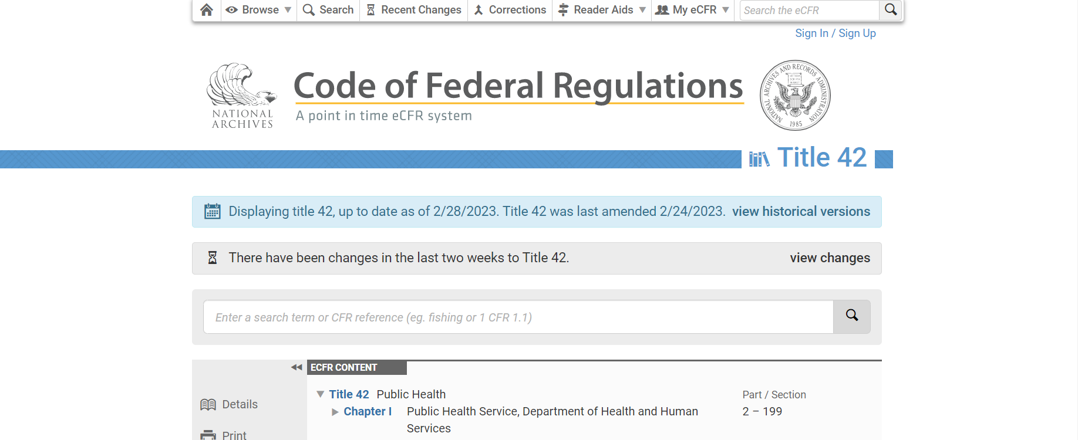
Survey Readiness

Slide 37
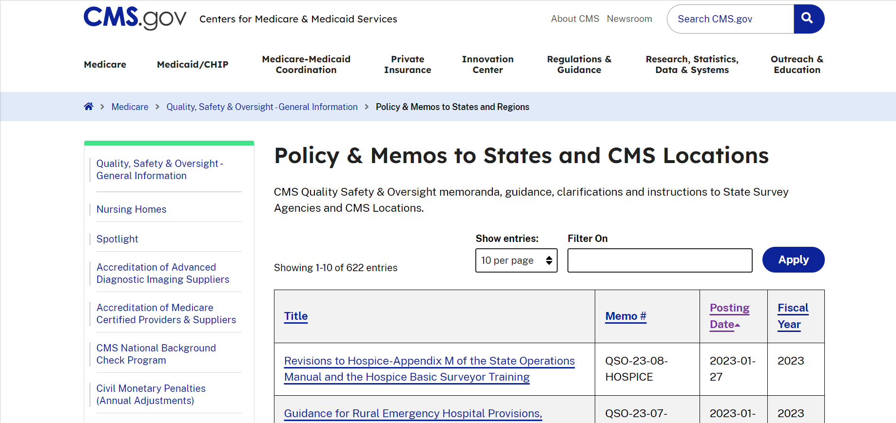
Survey Readiness

Slide 38
Survey Readiness
  Additional Resources
  Quality, Certification and Oversight Reports
  https://qcor.cms.gov
  This website can be used to look up survey results.
  You can use this website for nation-wide results, region-specific results, or state-specific results.
  The search results can be narrowed down in many ways including deemed/non-deemed, certification, etc.

Slide 39
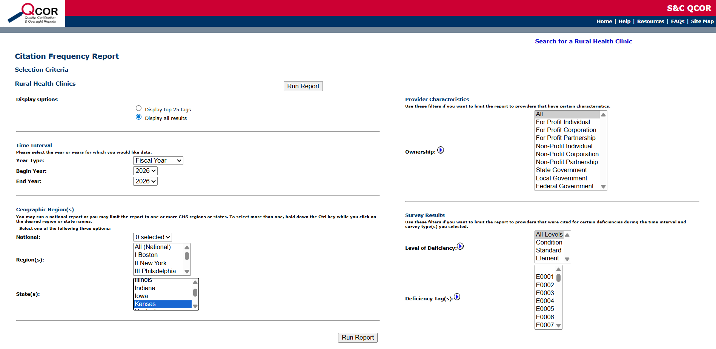
Survey Readiness

Slide 40
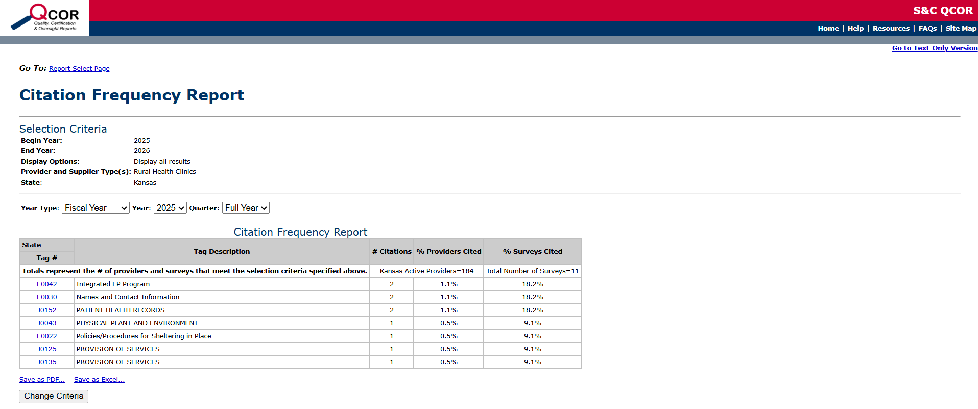
Survey Readiness

Slide 41
Survey Readiness
  Tips for Survey Success
Keep front line staff advised of what to do when the SA survey team enters the facility.
Have a designated surveyor meeting or conference room.
Respond to surveyor requests as soon as possible.
Keep open lines of communication.
Know your electronic medical record process.
Surveyor Entrance Checklists.
Signage.

