Slide 1


From Doing to Leading:
How to Delegate for Greater Impact
2026 Kansas MGMA Annual Conference
April 23, 2026
Jeff Whitehorn, MBA, LFACHE, ACC

Slide 2

What is your #1 job responsibility?

Slide 3
KYBBOYBB

Slide 4
Keep Your Boss’s Boss Off Your Boss’s Back!!!

Slide 5
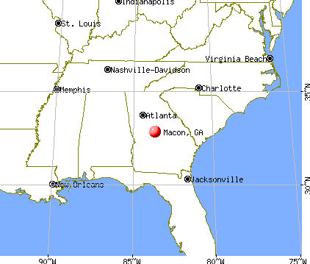
Where is Macon, GA?

Slide 6
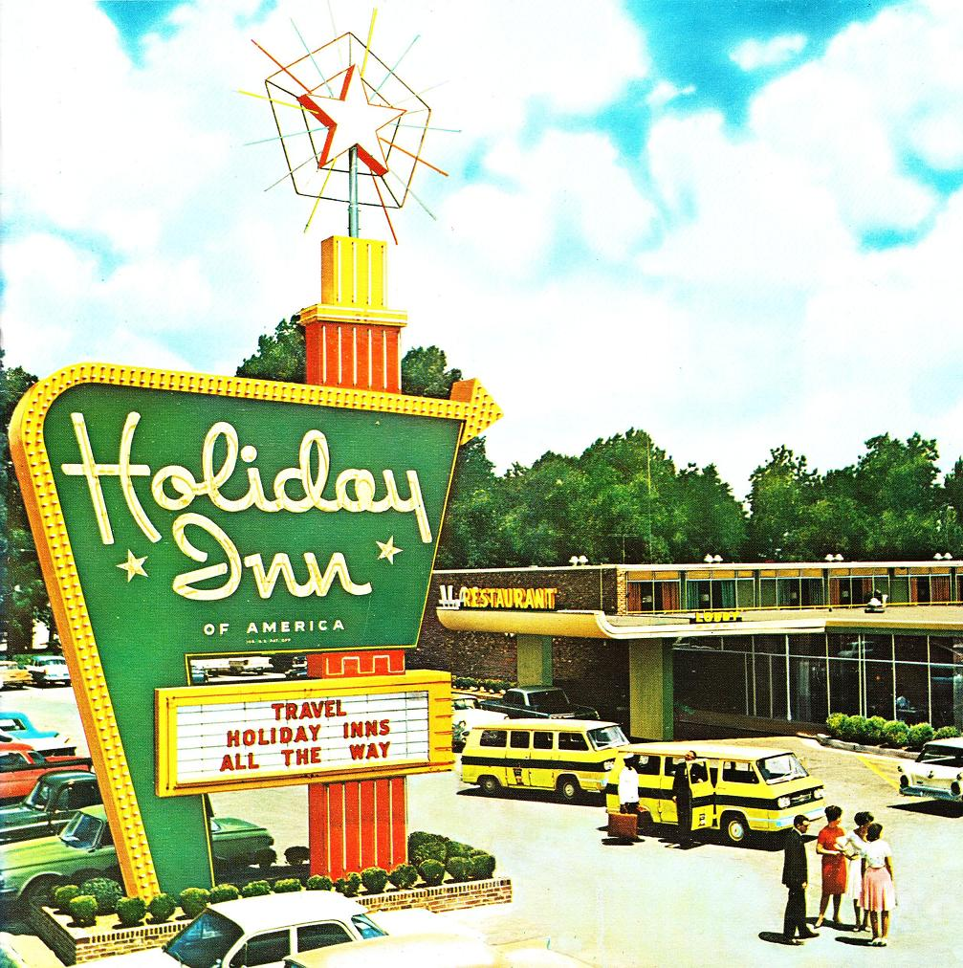

Slide 7
Polling question: Who makes the best donuts?
LaMar’s Donuts and Coffee
The Donut Whole
Crispy Donuts
Krispy Kreme
Dunkin’
Other

Slide 8


Slide 9

Delegating for impact

Slide 10
Polling question: How do you rate yourself as an effective delegator?
Excellent
Pretty good
Average
I want to be, but I can do it quicker and faster

Slide 11
“Only 30% of managers believe they can delegate well; and only 1 in 3 of them is considered a good delegator by their team.”
- Dr. John Hunt, London Business School

Slide 12

From doing to leading…
Transactional
to
transformational leadership

Slide 13
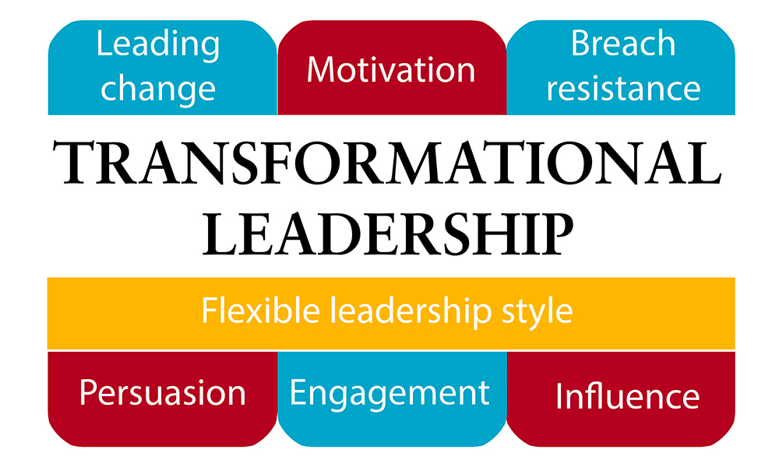
The Leadership Mindset Shift

Slide 14
What are the benefits of delegation?
Prevents a leader from…

Slide 15


Slide 16
What are the benefits of delegation?
Prevents a leader from drowning!
Creates time to focus on priorities
Reduces work hours
Develops staff

Slide 17
Possible negative effects to the supervisor who fails to effectively delegate?
Long, long work hours
Decreased job satisfaction
One step closer towards burnout
Unpromotable

Slide 18

Delegating with impact

Slide 19
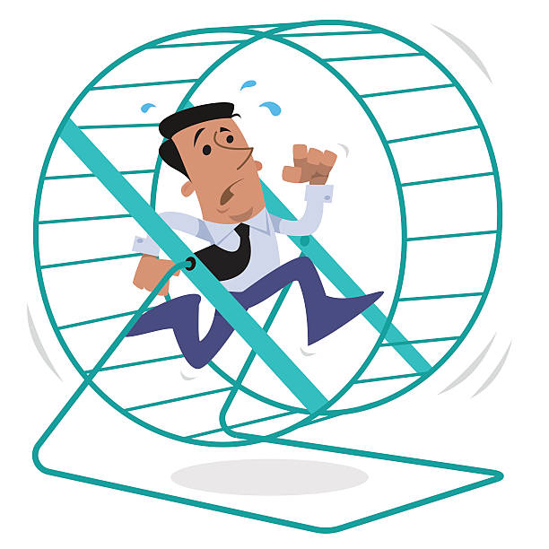

Slide 20
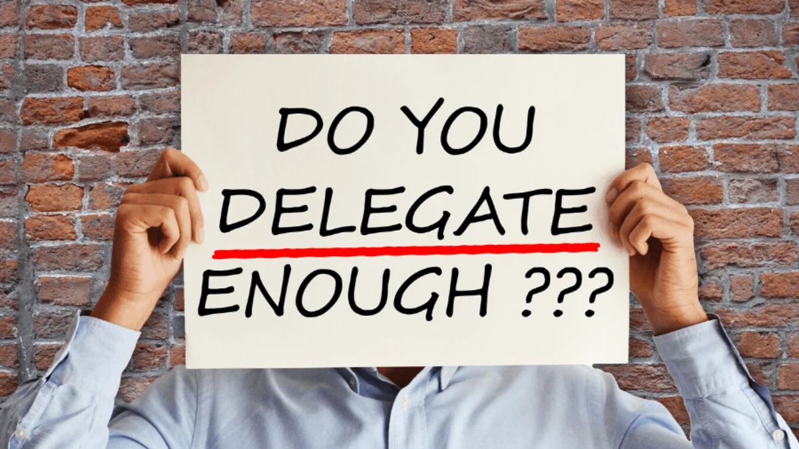

Slide 21
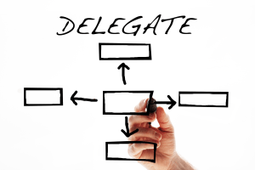
The “CLEAR” Delegation Model
Clarify the outcome
Level of authority
Equip with resources
Agree on checkpoints
Review and recognize

Slide 22
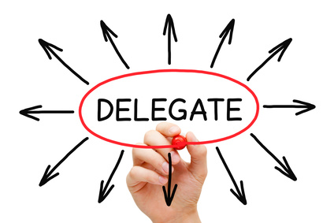
Four ways to delegate with impact

Slide 23
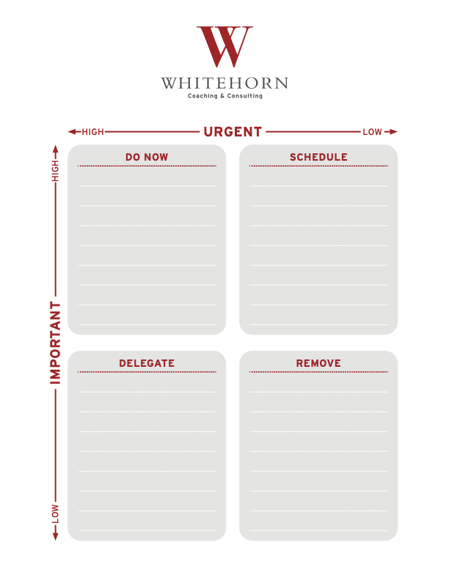
#1 URGENT/IMPORTANT MATRIX

Slide 24
DO NOW (Urgent and Important)

Slide 25
DO NOW (Important and Urgent) tasks:
Crises
Pressing problems
Deadlines
Meetings
Projects

Slide 26
SCHEDULE (Important but Not Urgent)

Slide 27
SCHEDULE (Important but Not Urgent)
Goals setting
Planning
Building key relationships
Preparation

Slide 28
REMOVE (Not important, Not urgent)

Slide 29
REMOVE (Not Important and Not Urgent)
Busy work
Some phone calls
Irrelevant mail or emails
Your own special time-wasters

Slide 30
DELEGATE (Not important, Not urgent)

Slide 31
DELEGATE (Not Important but Urgent) tasks:
Unimportant meetings
Projects
Unimportant phone calls
Routine reports
Analyses that can be prepared by others and you review

Slide 32

#2 “What can I live with?”

Slide 33

Overcoming perfectionism

Slide 34

#3 The 80/20 rule for delegation

Slide 35

#4 Block “upward delegation”

Slide 36
Polling question: Have you accepted “upward delegation” in the past?
Yes
No
Maybe I did, but I didn’t realize it?

Slide 37
Do this:
Don’t own it!
Ask them for three ways to solve the problem
Ask for their recommendation
Smile!

Slide 38
Delegation apps
Task management – Trello/Ticktick/Asana
Tracking and accountability - Todoist
Delegation dashboard - Notion

Slide 39
Additional time management tips
Just say “No” to unnecessary meetings
Utilize the 15/35/10 productivity exercise
Email management tips

Slide 40


“2 Do” app

Slide 41



Slide 42
The “CLEAR” Delegation Model
Clarify the outcome
Level of authority
Equip with resources
Agree on checkpoints
Review and recognize

Slide 43
Tips to delegation with impact
Utilize the Urgent/Important Matrix
What can I live with?
The 80/20 rule for delegation
Block upward delegation
Delegation apps
Additional time management tips (Just say “No”)

Slide 44

JEFF WHITEHORN, MBA, LFACHE
jeffw6261@gmail.com
615-587-1970
LinkedIn
Author: Leadership Treasure (Amazon)

Slide 45




Available on

