Slide 1
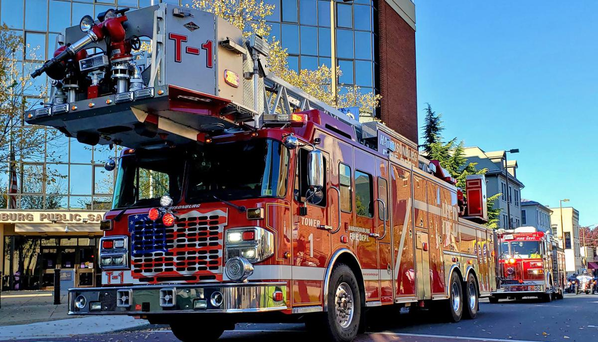


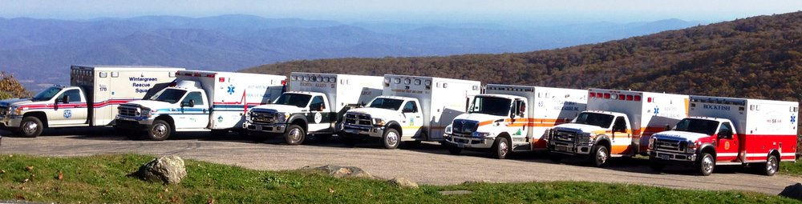
Emergency Vehicle Operator’s Course T-T-T Update
Updated 11/01/2025
Notes:
New Logo – Added Updated Date 11/01/2025.

Slide 2

INSTRUCTOR
INTRODUCTIONS
1-1
Notes:
Introduce all instructors present and identify whether VAVRS or VDFP instructors

Slide 3
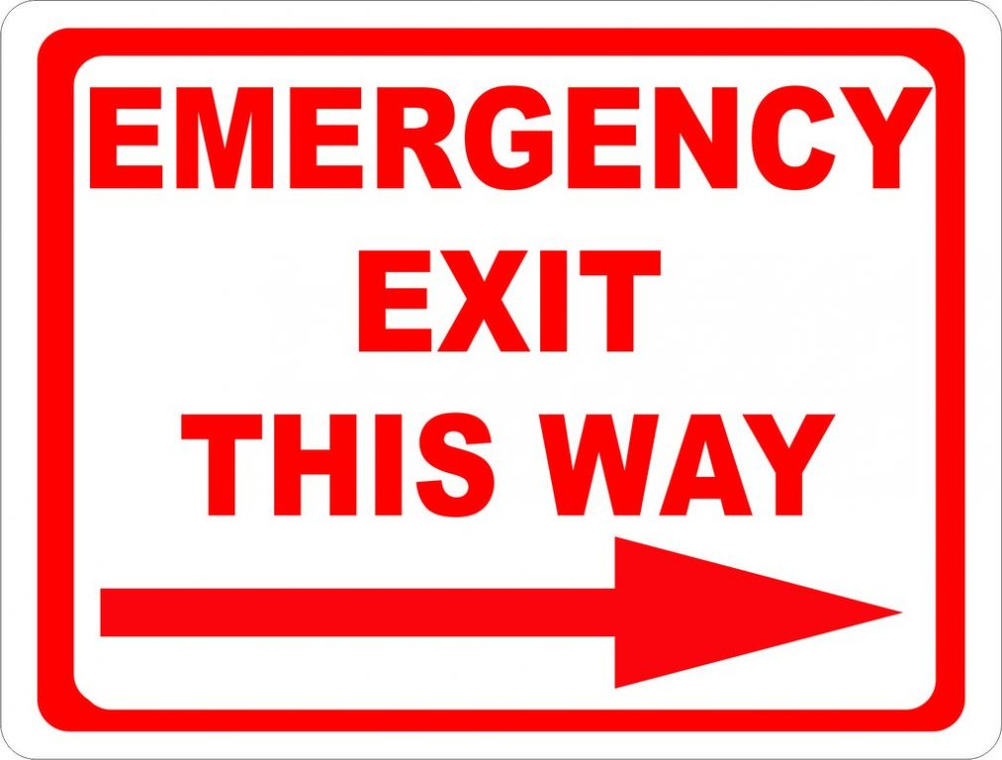
Housekeeping
Bathrooms
Emergency Exits
Smoking Areas
Snack Locations
Trip Hazards
1-6
Notes:
Cover any classroom rules or special circumstances

Slide 4
Course provided by the
Virginia Department of Fire Programs
and the
Virginia Association of First Responders
1-1
3

Slide 5
Session 1
1-2
Notes:
Session 1

Slide 6
Course Pre-Requisites
Minimum 18 years of age the first day of course
Have any valid driver’s license
Be affiliated or have pending affiliation with an Emergency Services Organization
1-3
Notes:
If anyone in class is less than eighteen (18) years of age on the first day they cannot participate in the Course. Check individual’s driver’s licenses and ask each participant for their agency affiliation.

Slide 7
Certification Requirements
Must attend 100% of the course
Must successfully complete written examination with a score of 70% or above
Must successfully complete practical skills evaluation (cone judgement course)
1-4
Notes:
All students must return promptly after breaks and if they leave to run an incident, they will not meet the minimum requirements for Course attendance.

Slide 8
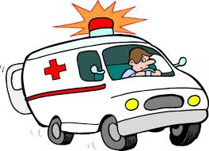
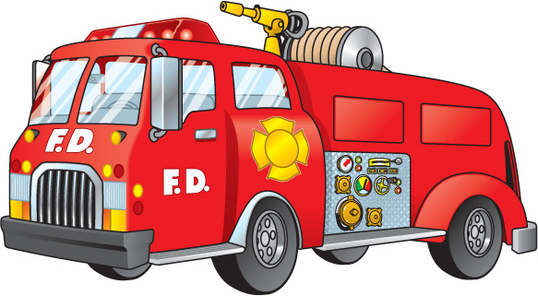
Driving Experience
It is highly recommended that a student have prior driving experience in the vehicle type and classification in which they are attempting to gain certification.
1-5
Notes:
Encourage participants to get some driving practice with the type of vehicle(s) they intend to seek a Certificate of Attendance for.

Slide 9
Class Objectives
To acquaint the student with the theories and practices of emergency vehicle operations.
Allow the student to demonstrate their skills in vehicle operations through the use of predetermined practical evolutions.
1-6
Notes:
Alert students that some of the content may be a review of what they already know from their Driver’s Education Program, but this review is the basis for improving their success in driving emergency vehicles during highly stressful situations.

Slide 10
Class Objectives
It is designed to explain how emergency driving differs from non-emergency driving and to test the driving skills of the student. Completion also satisfies the minimum requirements for an operator of an emergency vehicle as defined by the Virginia Office of EMS.
This course DOES NOT teach the student to drive and completing this course DOES NOT designate you as a driver in your agency.
1-7
Notes:
Emphasize the course DOES NOT authorize them to drive agency vehicles – the operational leadership and/or agency protocols / procedures cover those requirements. The Virginia Office of Emergency Medical Services recognition of an EVOC certification from a VAOEMS recognized course is an absolute requirement to operate an emergency vehicle on an emergency call. This recognition does not expire even if the EVOC Certificate of Attendance has an expiration date. There are no regulations that require EVOC for the fire service in the Commonwealth of Virginia, however many agencies have that requirement. EVOC is a requirement by the Virginia Department of Fire Programs to obtain certain levels of additional certification for Driver / Operator – Pumper and Driver / Operator – Aerial certification courses.

Slide 11
Vehicle Class Designations
Class 1
0 – 10,000 pounds. Cars and small vehicles.
Class 2
10,001 – 26,000 pounds. Most ambulances
and smaller fire apparatus.
Class 3
26,001 + pounds. Most large fire apparatus and
heavy rescue vehicles.
1-8
Notes:
Announce to the students, which class they will be completing during your course and how to obtain a higher level if they have the desire after completion of your course. VDFP has different practical evolution requirements and should be explained if this is a VDFP course.

Slide 12
Vehicle Class Designations
Class 4
Tractor Drawn Apparatus - Aerial, Tanker / Tender, and Specialized Apparatus. All connections pivot over rear drive axles
Class 5
Aircraft Rescue and Fire Fighting Apparatus (Vehicle Class only used by agencies operating this type of vehicle).
1-9
Notes:
These courses are available through the Virginia Department of Fire Programs but have special circumstances such as a much larger cone course and the availability of specific types of vehicles.

Slide 13
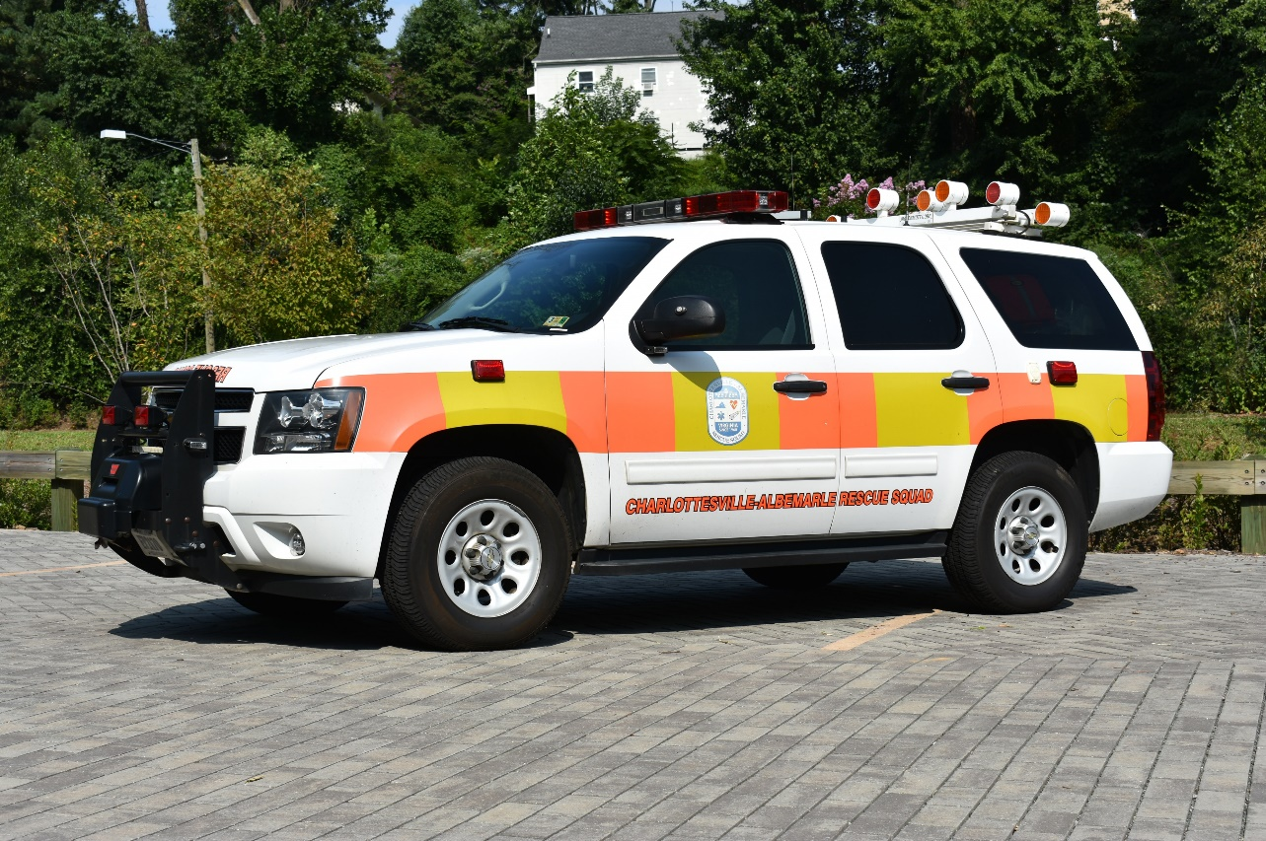
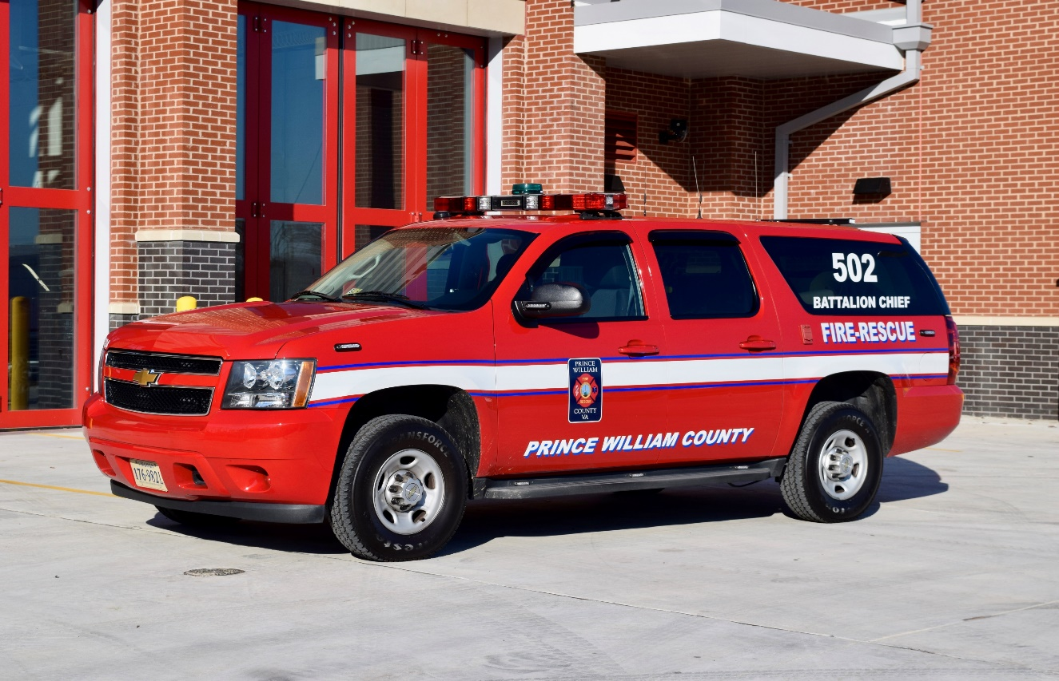
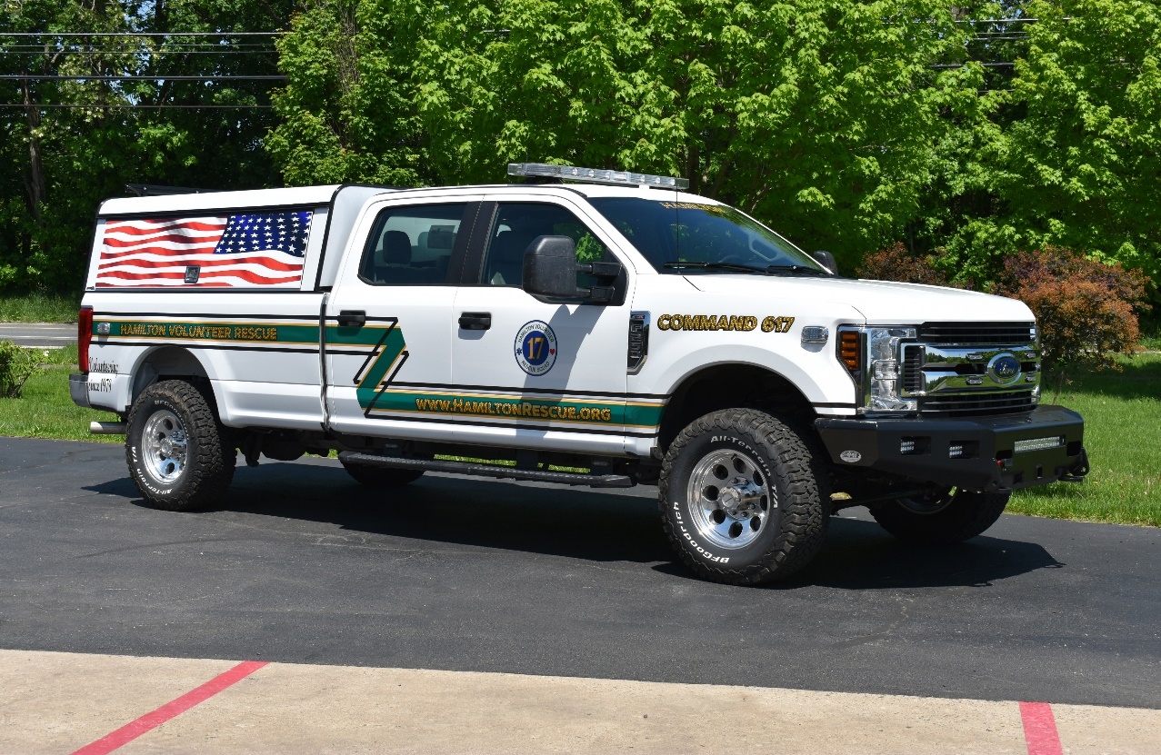
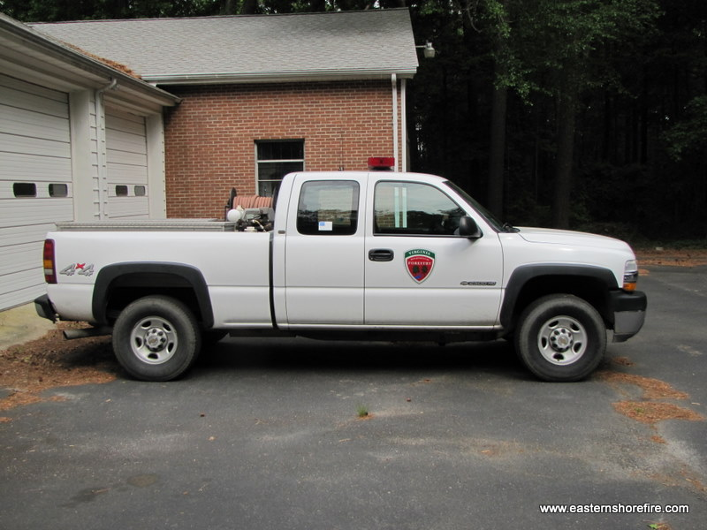
Class 1 Vehicles
1-10
Notes:
Updated Photos – Special thanks to Michael N. Sanders Photography for the usage of their photographs.

Slide 14
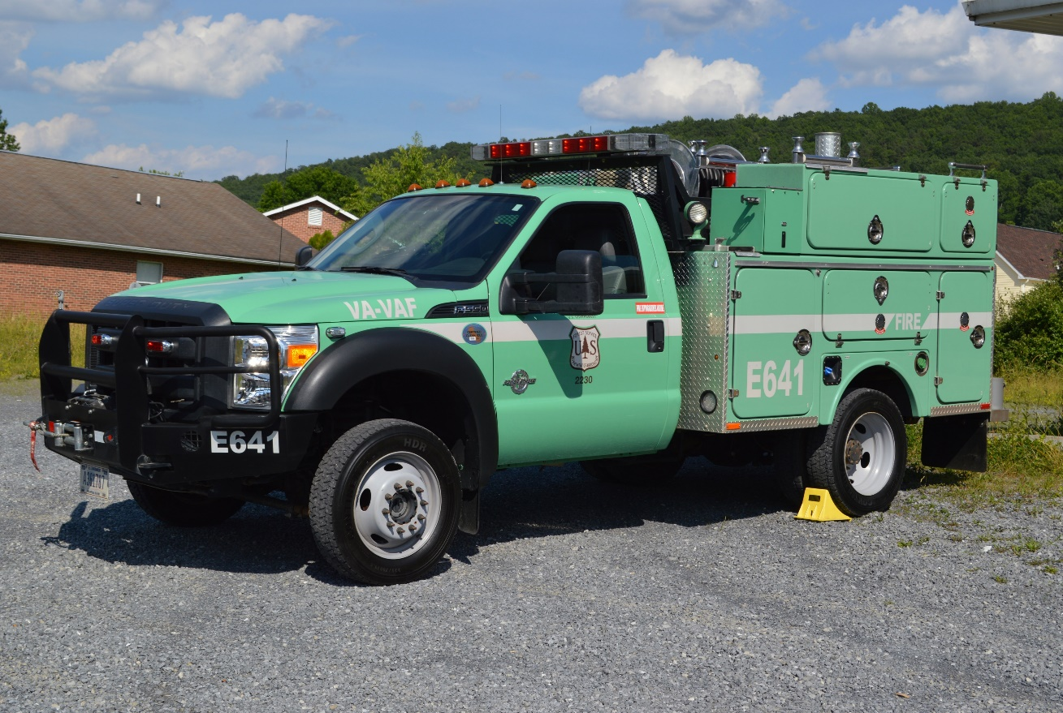
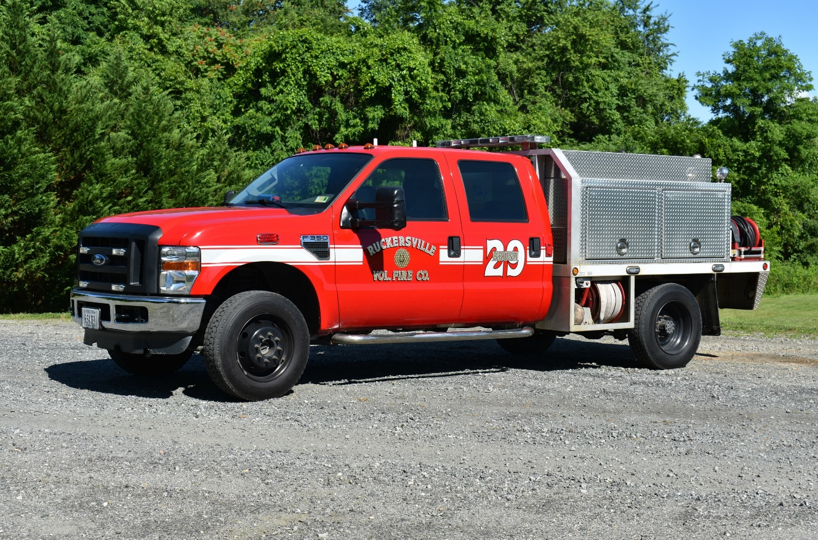
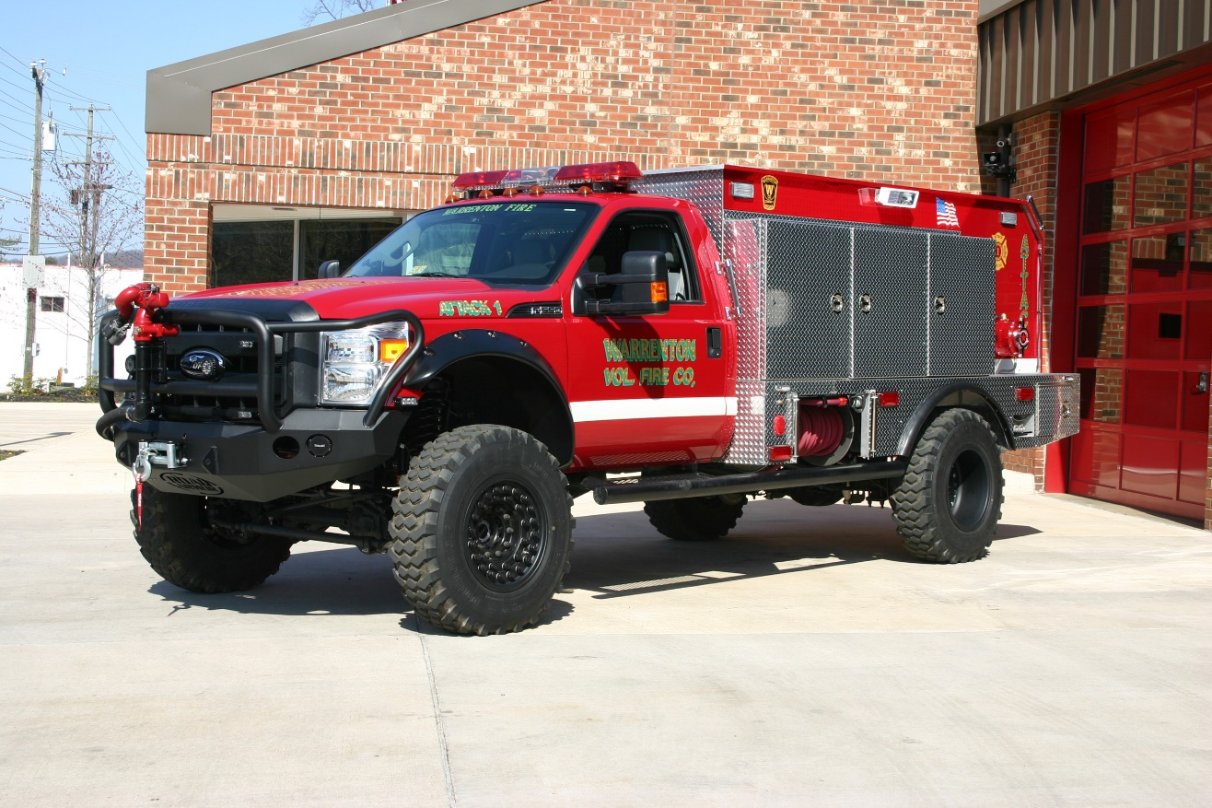
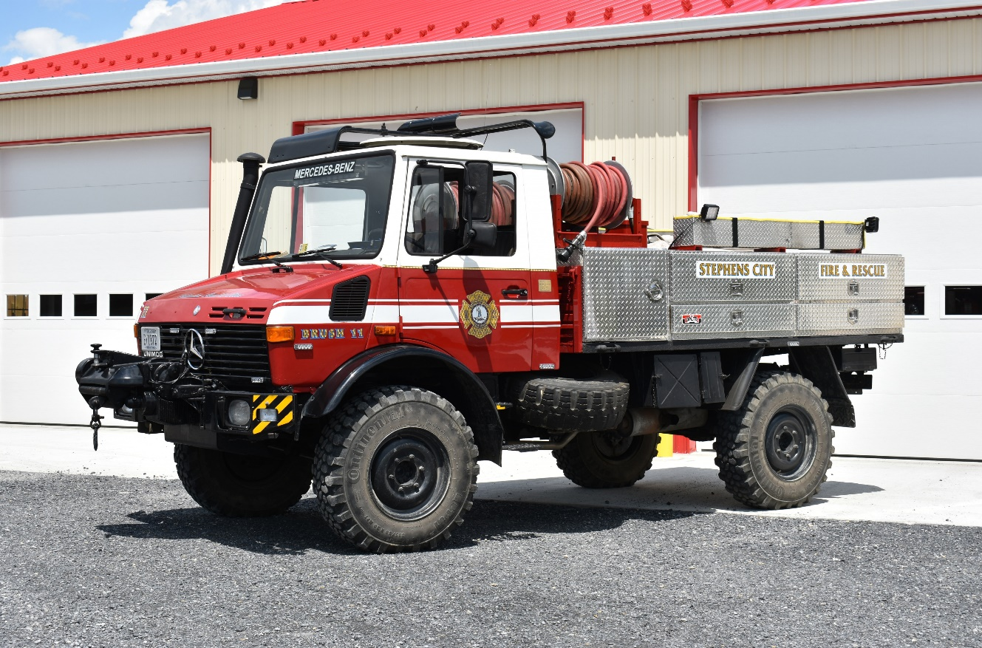
Class 2 Vehicles
1-11
Notes:
Updated Photos – Special thanks to Michael N. Sanders Photography for the usage of their photographs.

Slide 15
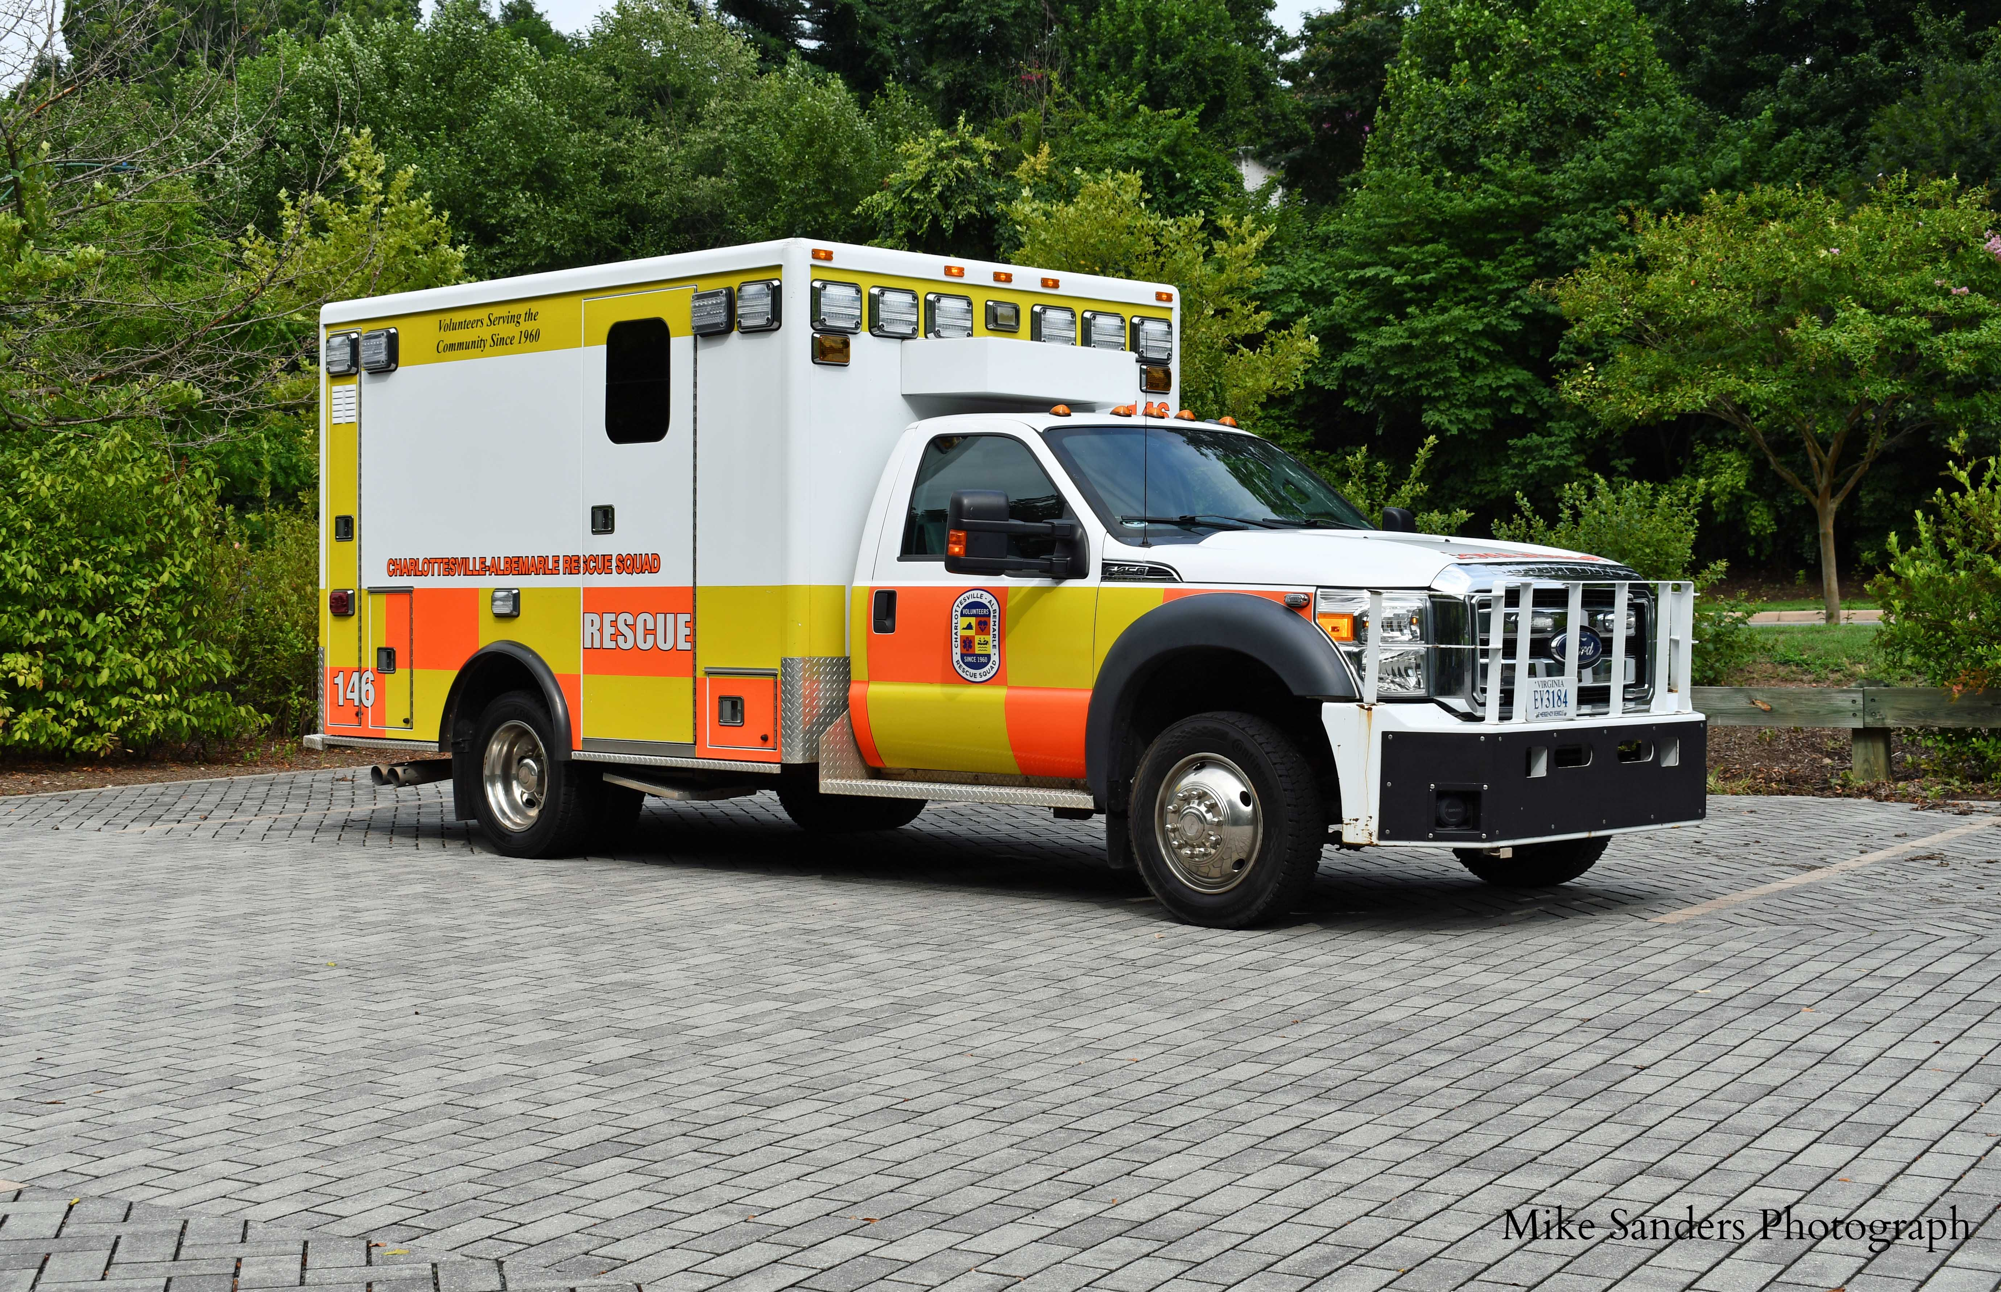
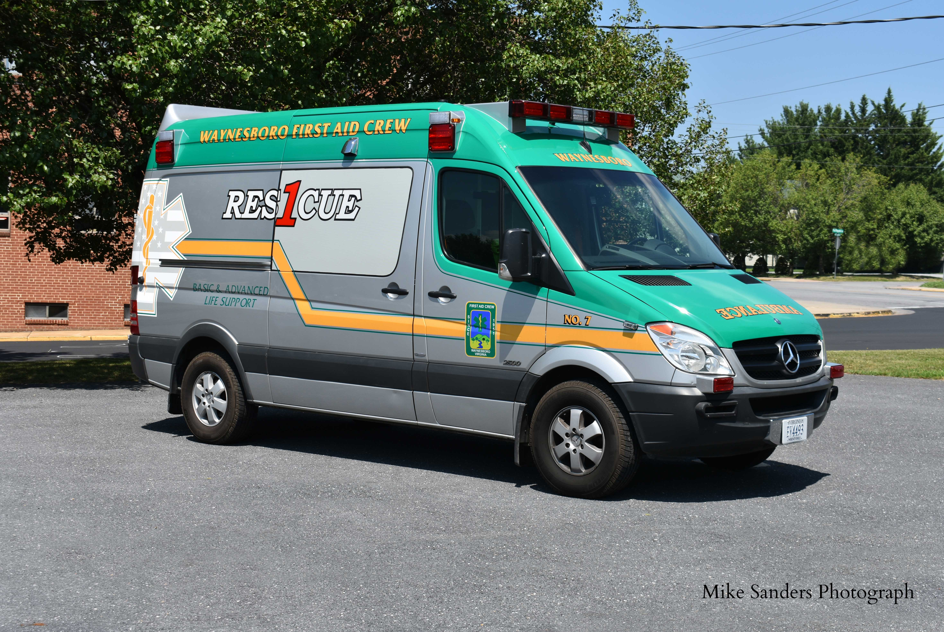
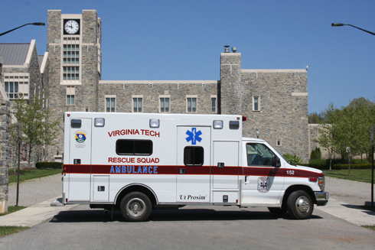
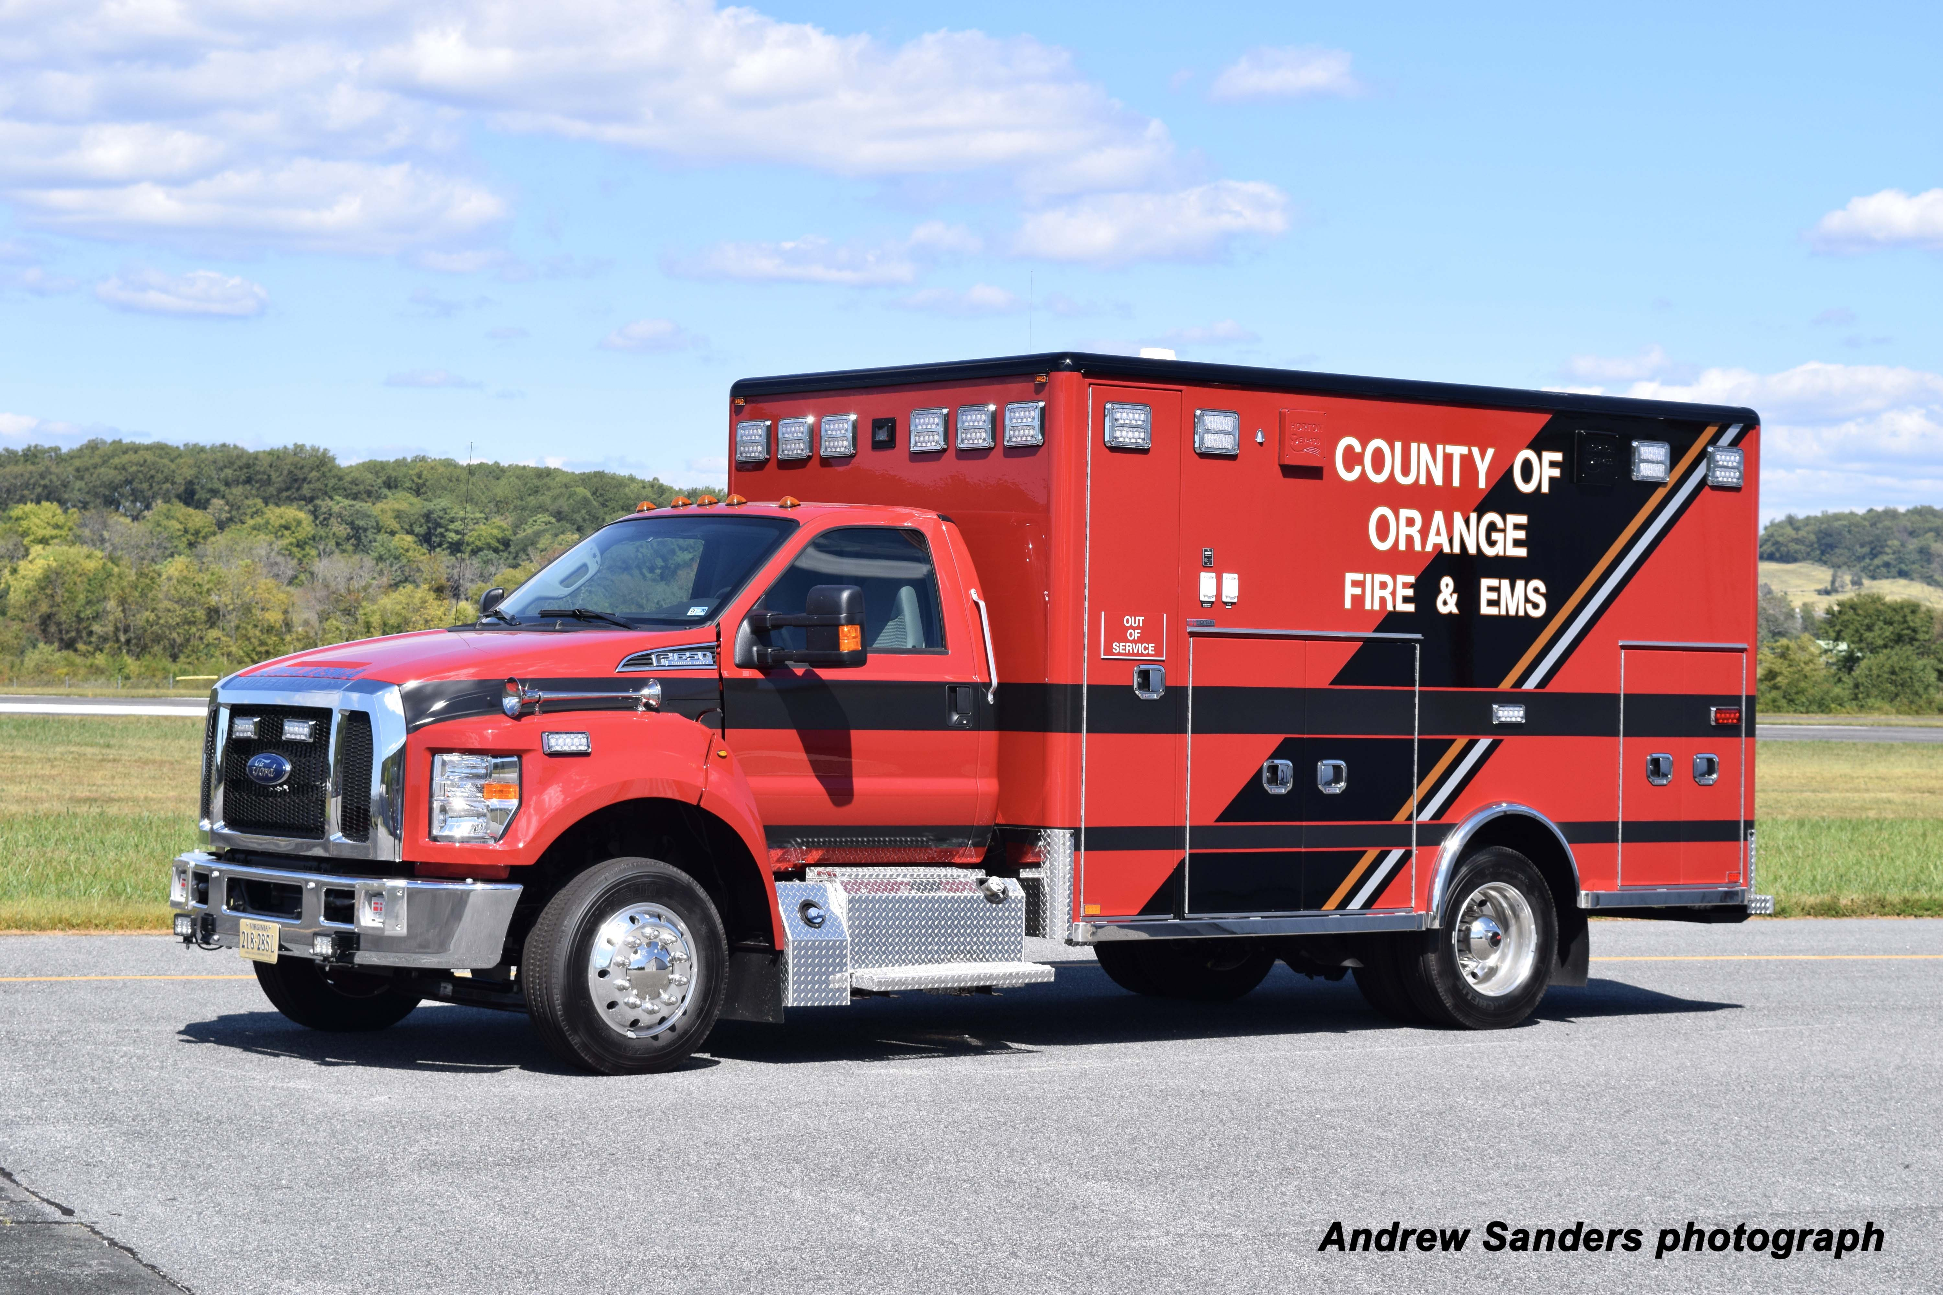
Class 2 Vehicles
1-12
Notes:
Updated Photos – Special thanks to Michael N. Sanders Photography for the usage of their photographs.

Slide 16
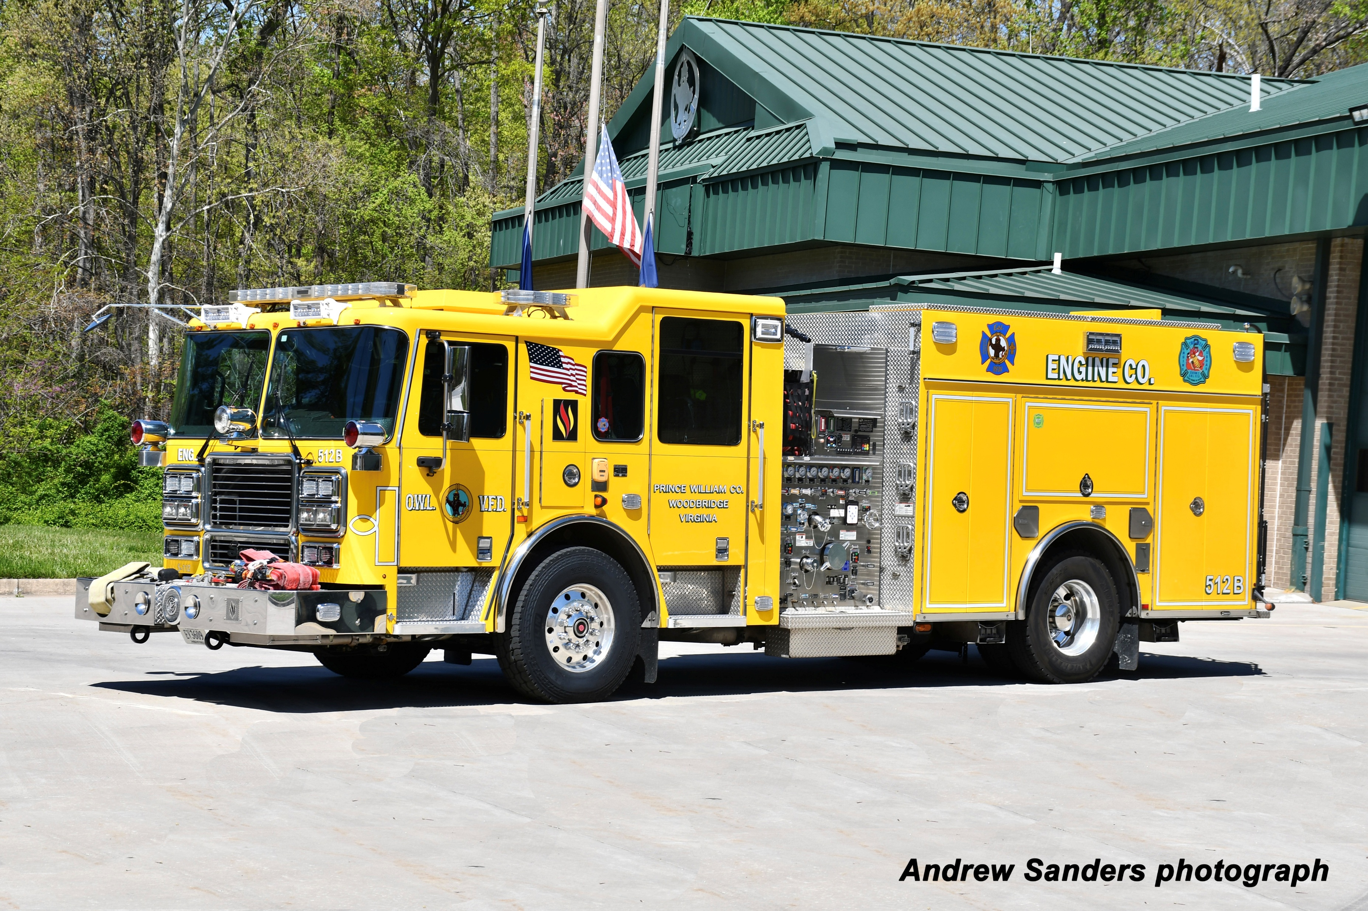
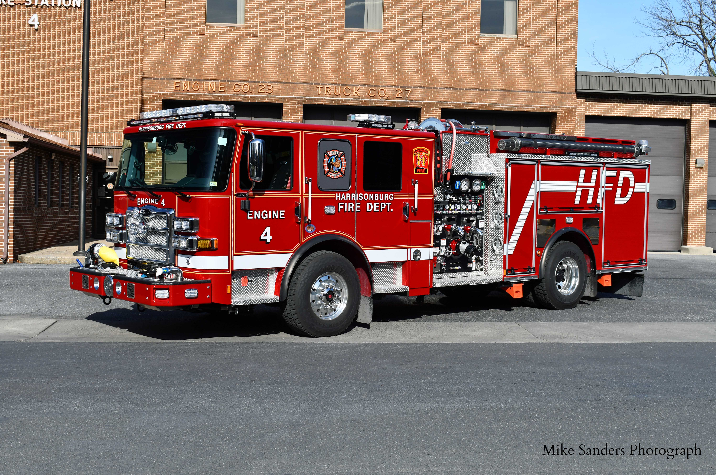
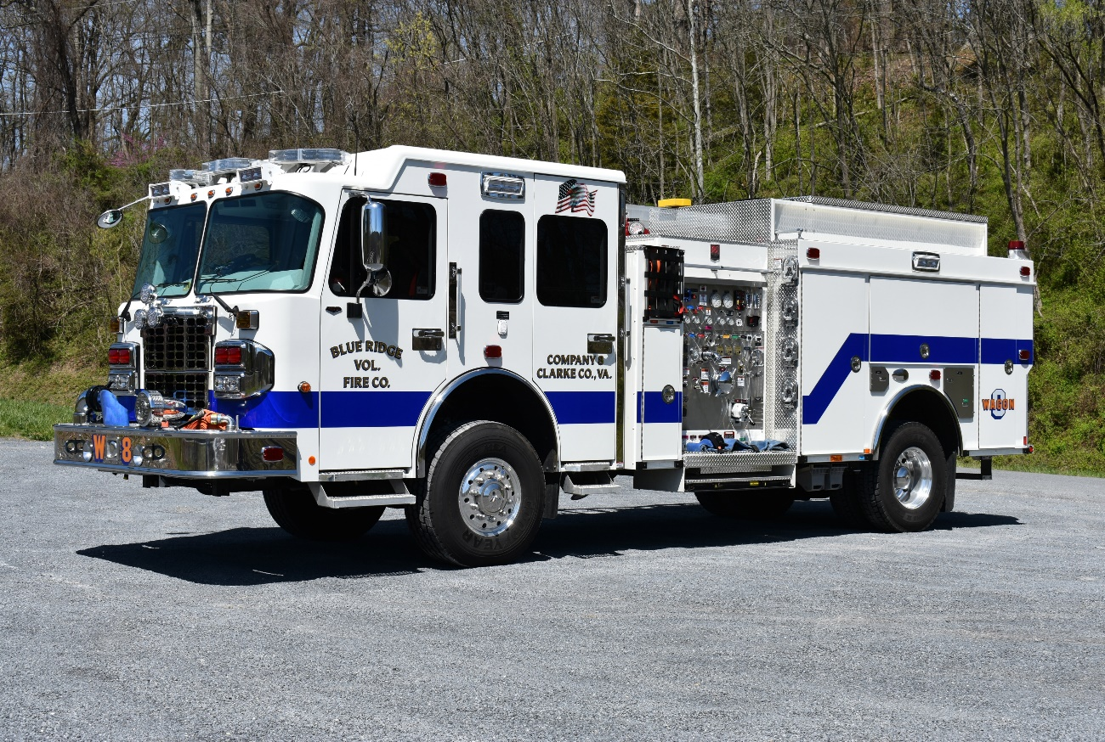
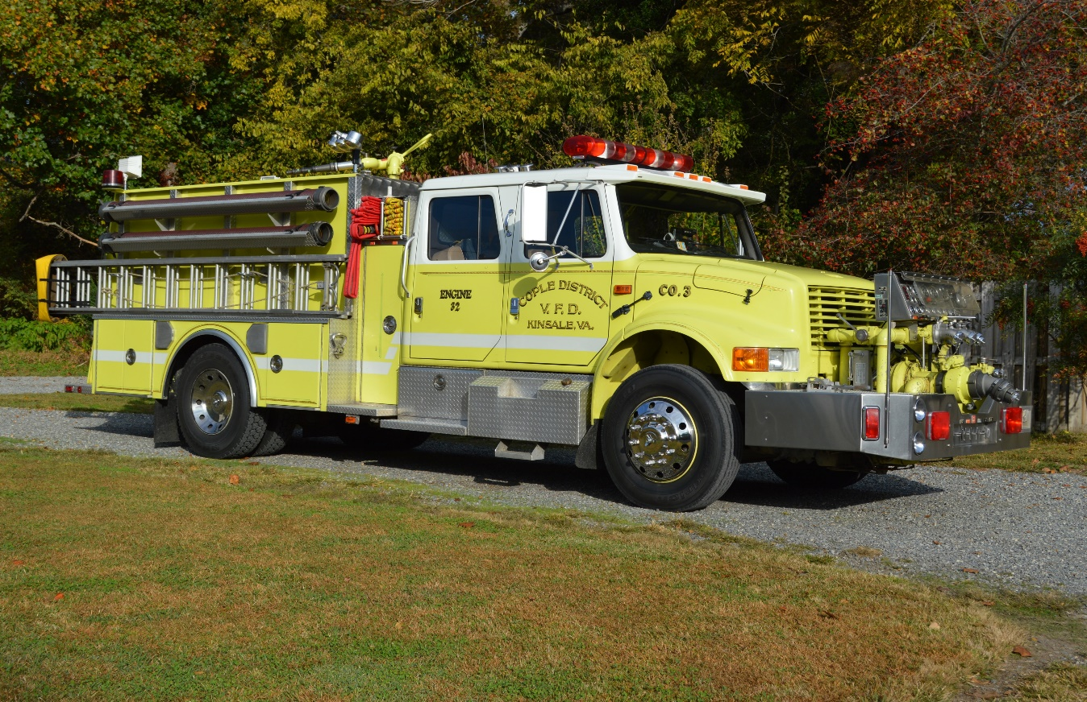
Class 3 Vehicles
1-13
Notes:
Updated Photos – Special thanks to Michael N. Sanders Photography for the usage of their photographs.

Slide 17
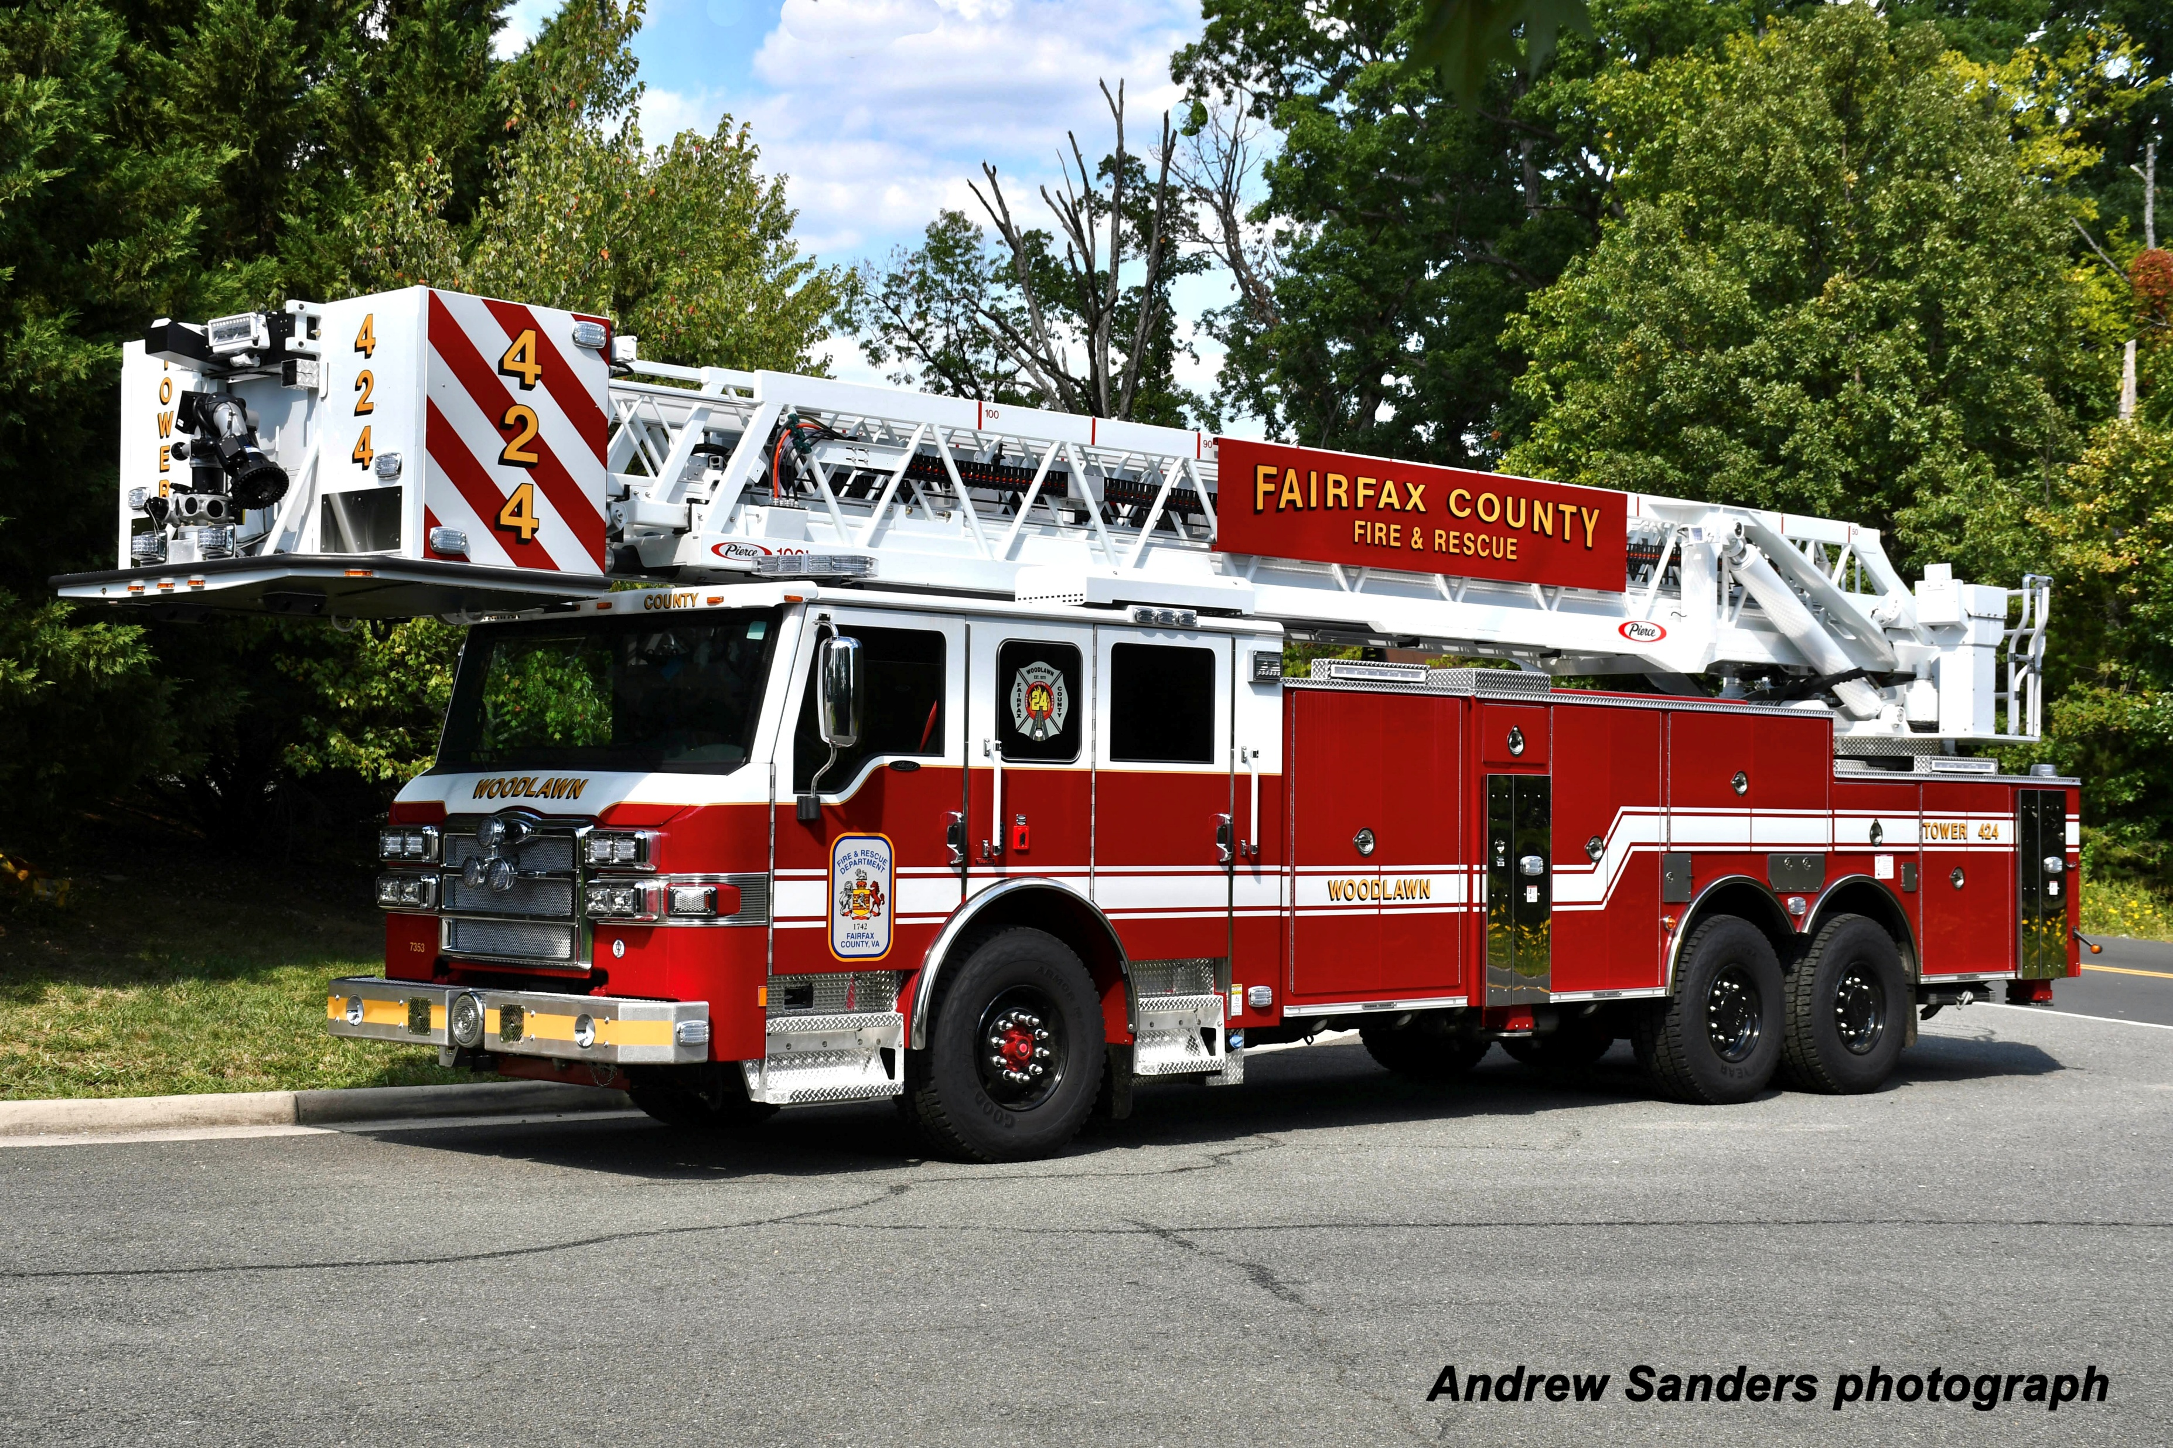
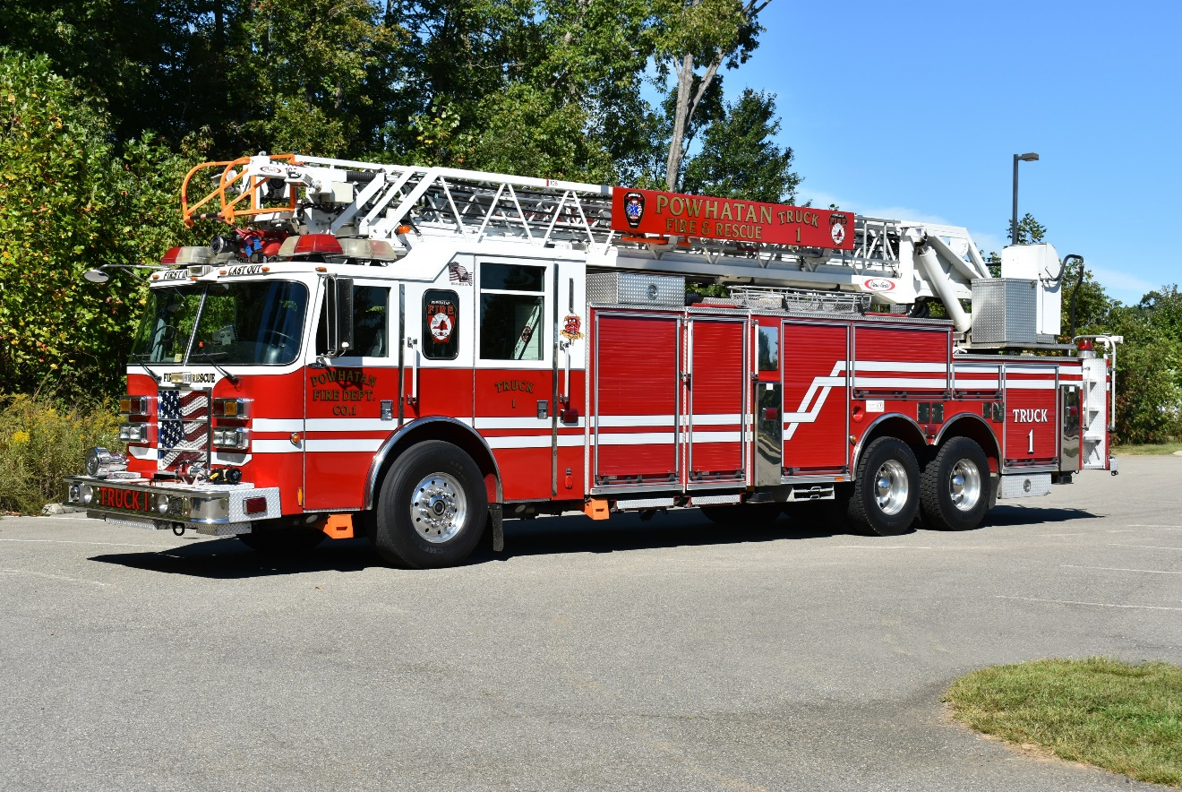
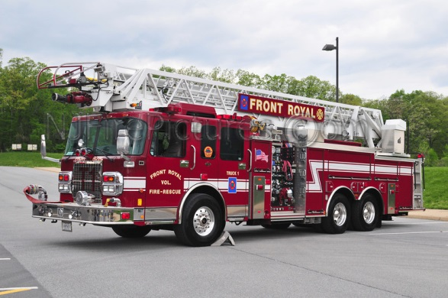
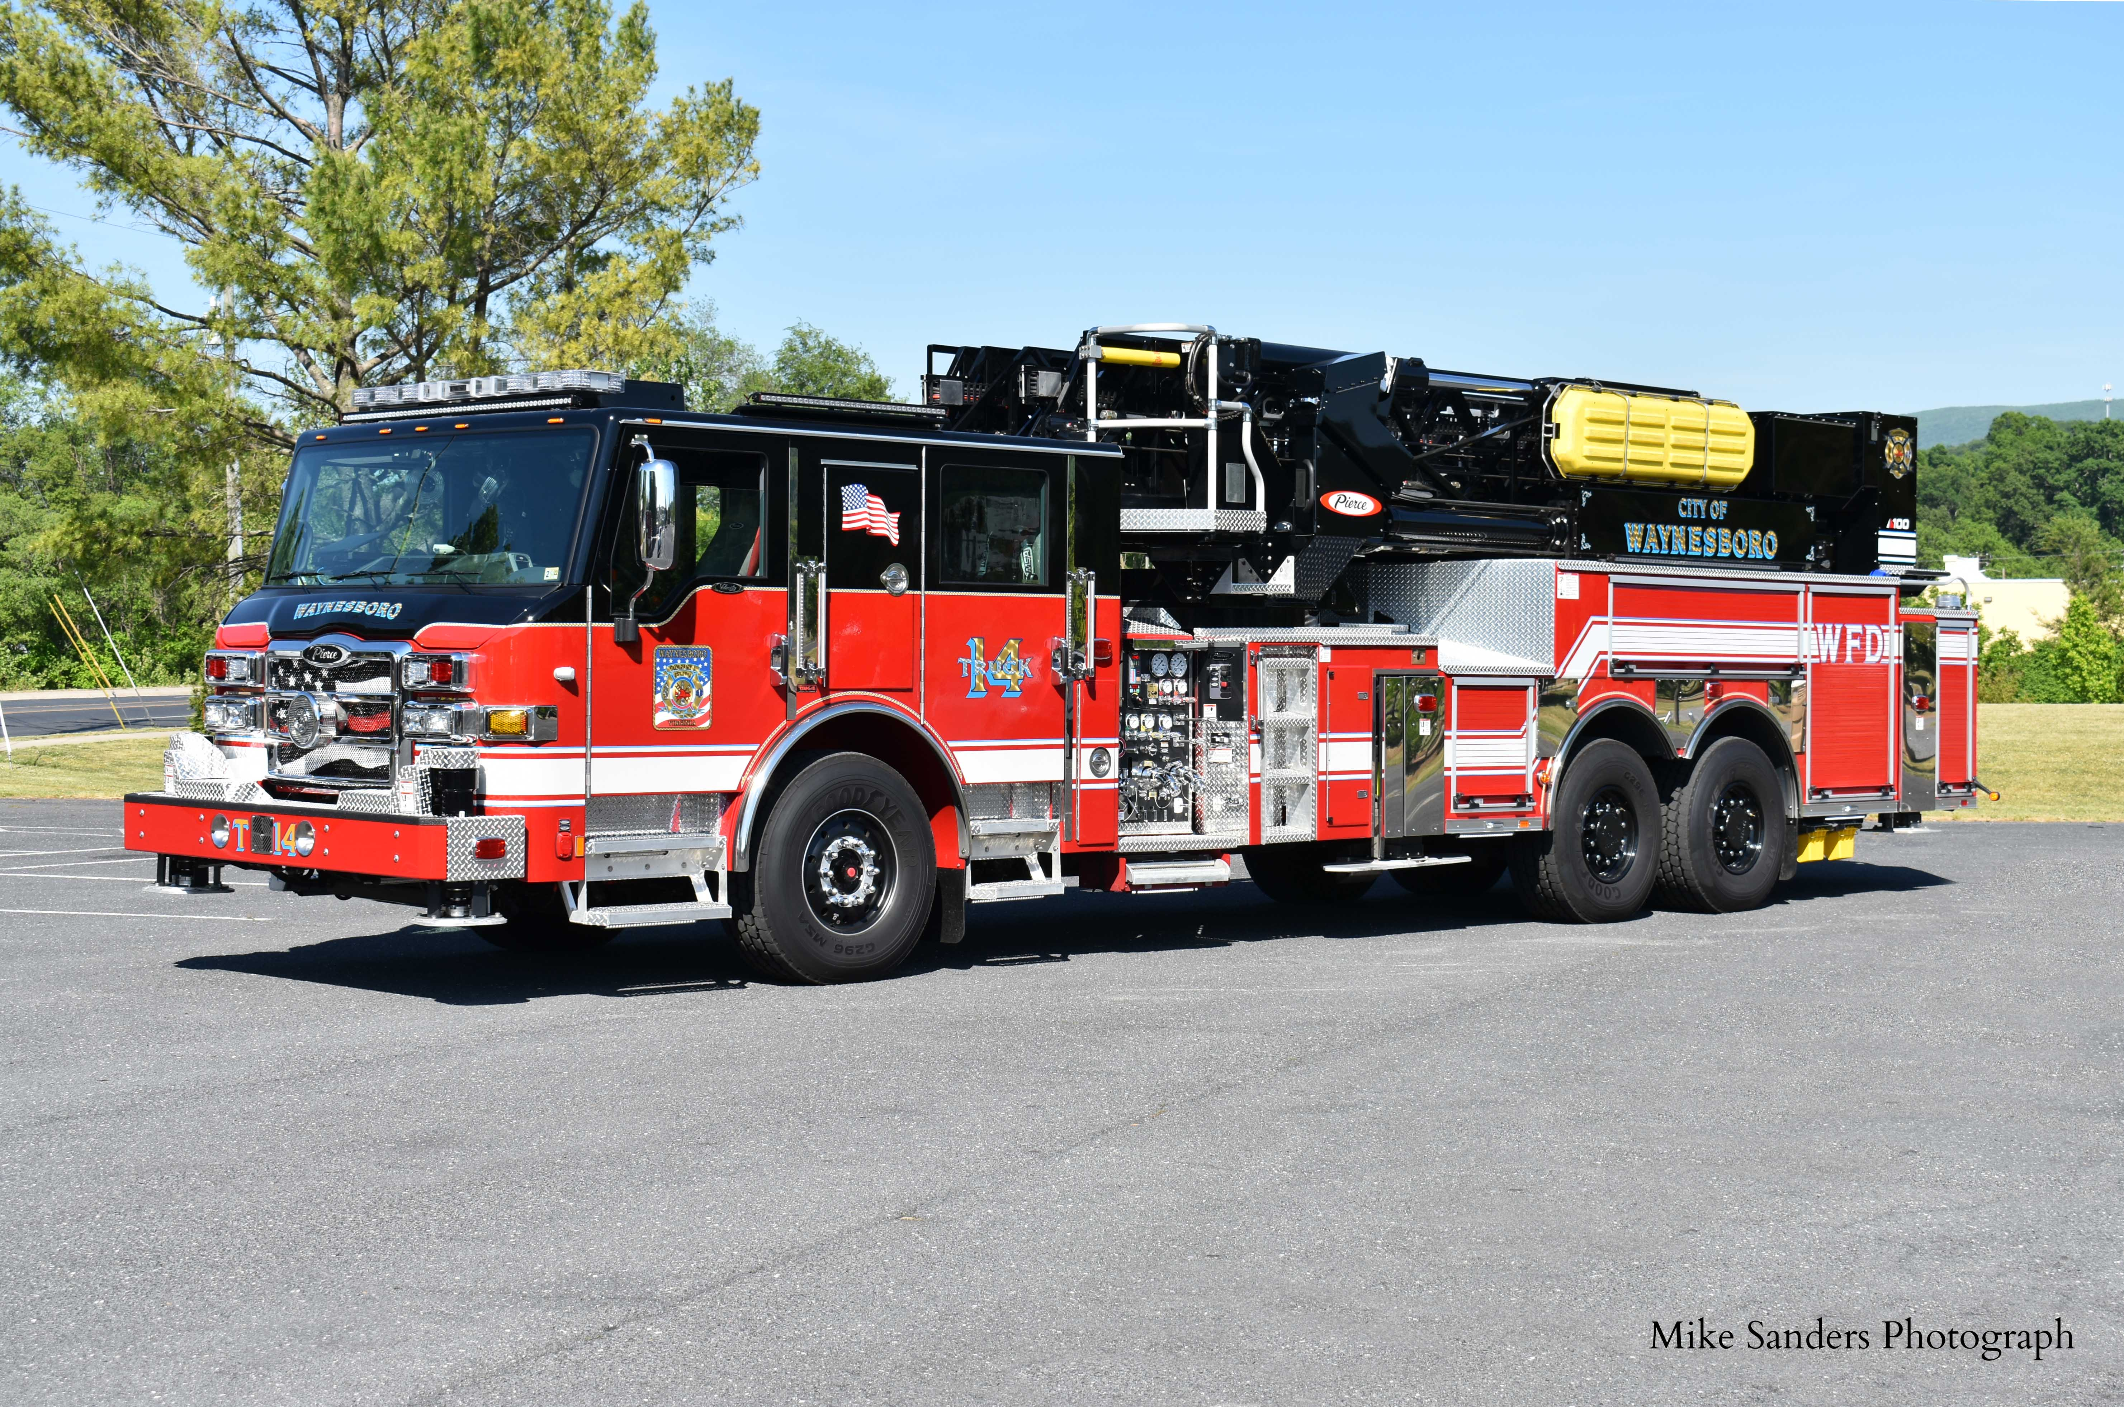
Class 3 Vehicles
1-14
Notes:
Updated Photos – Special thanks to Michael N. Sanders Photography for the usage of their photographs.

Slide 18
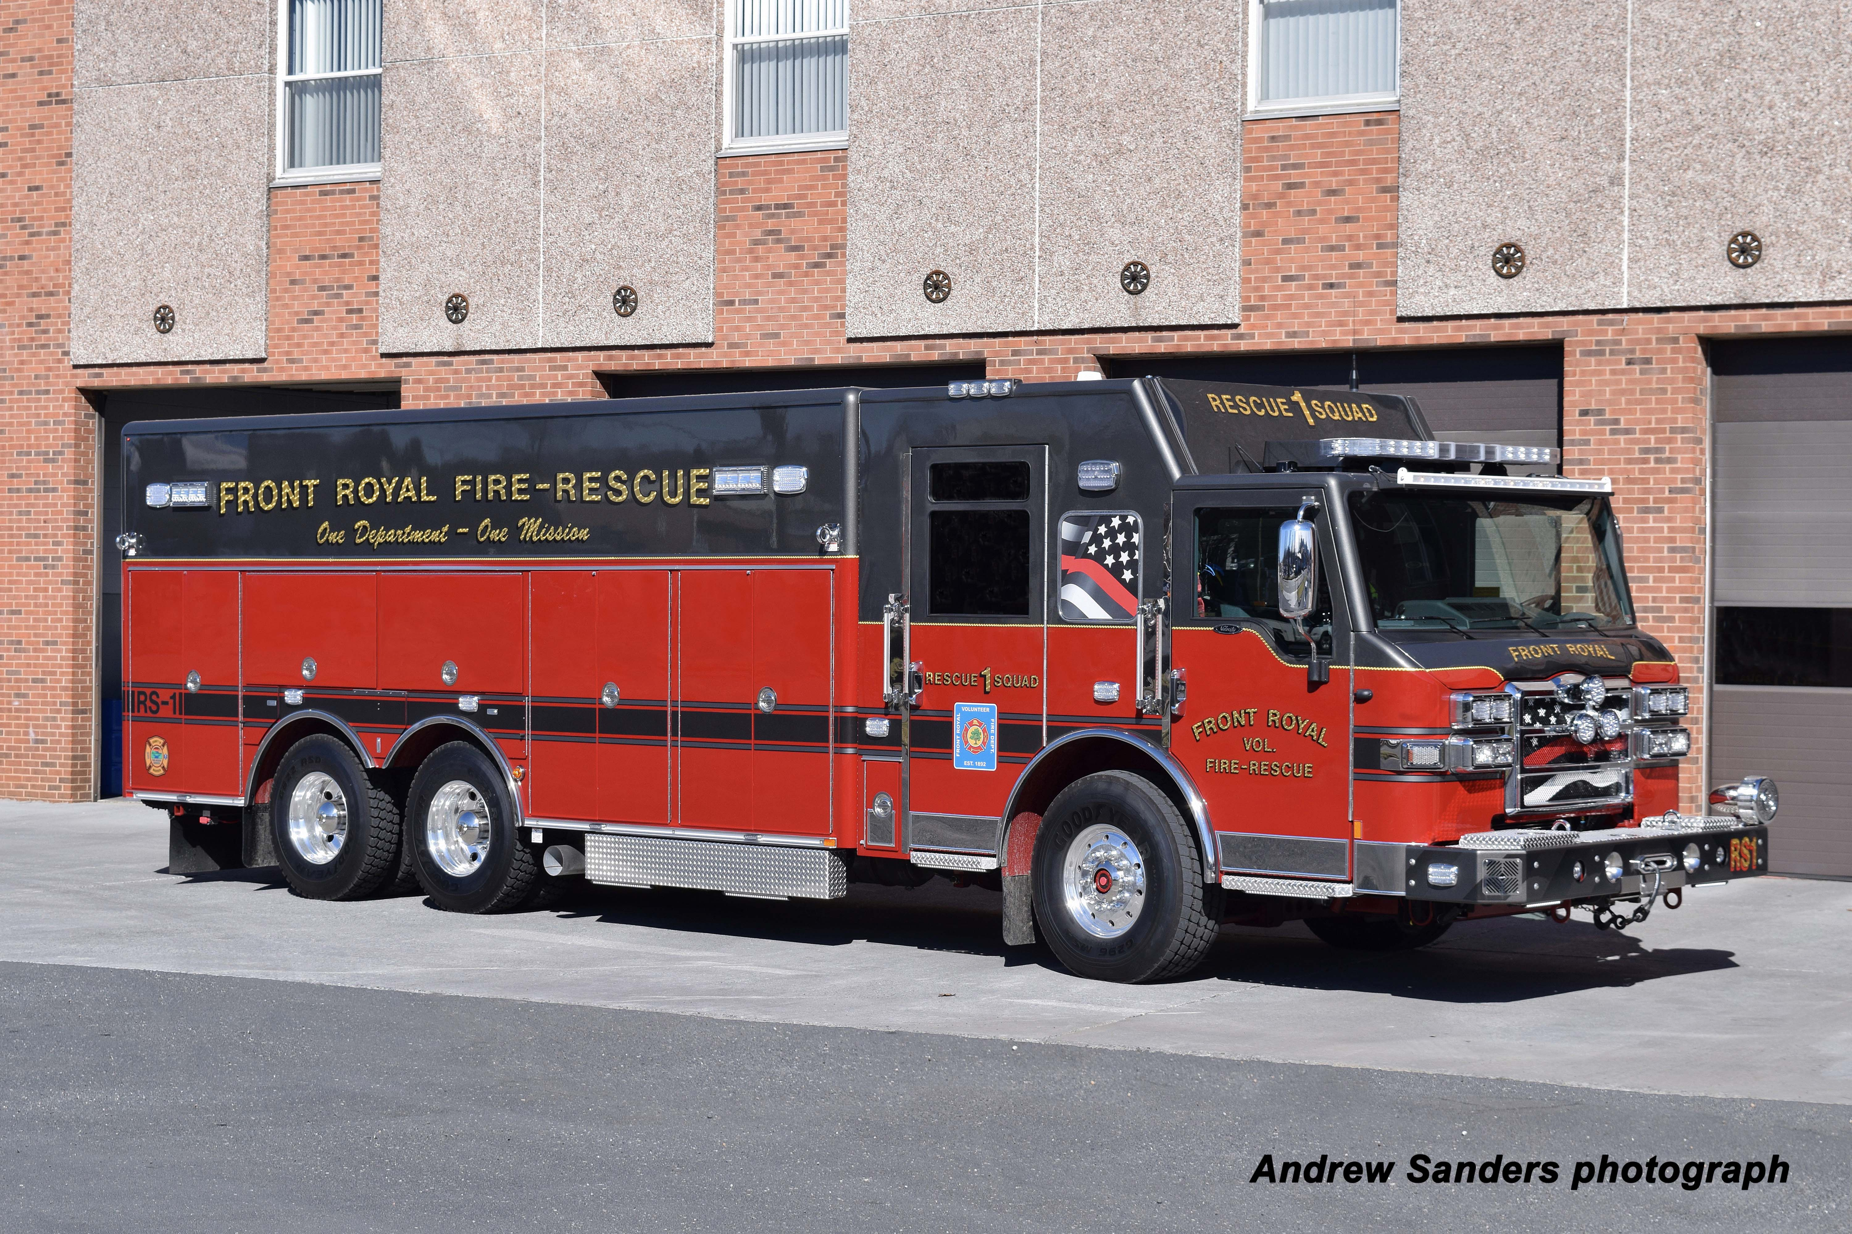
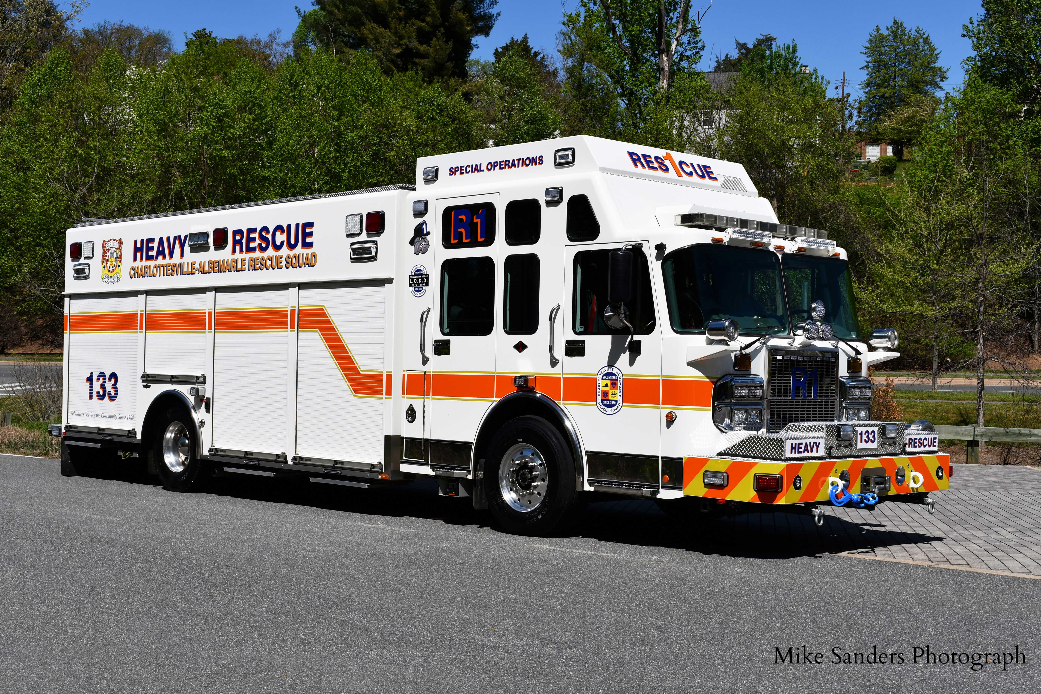
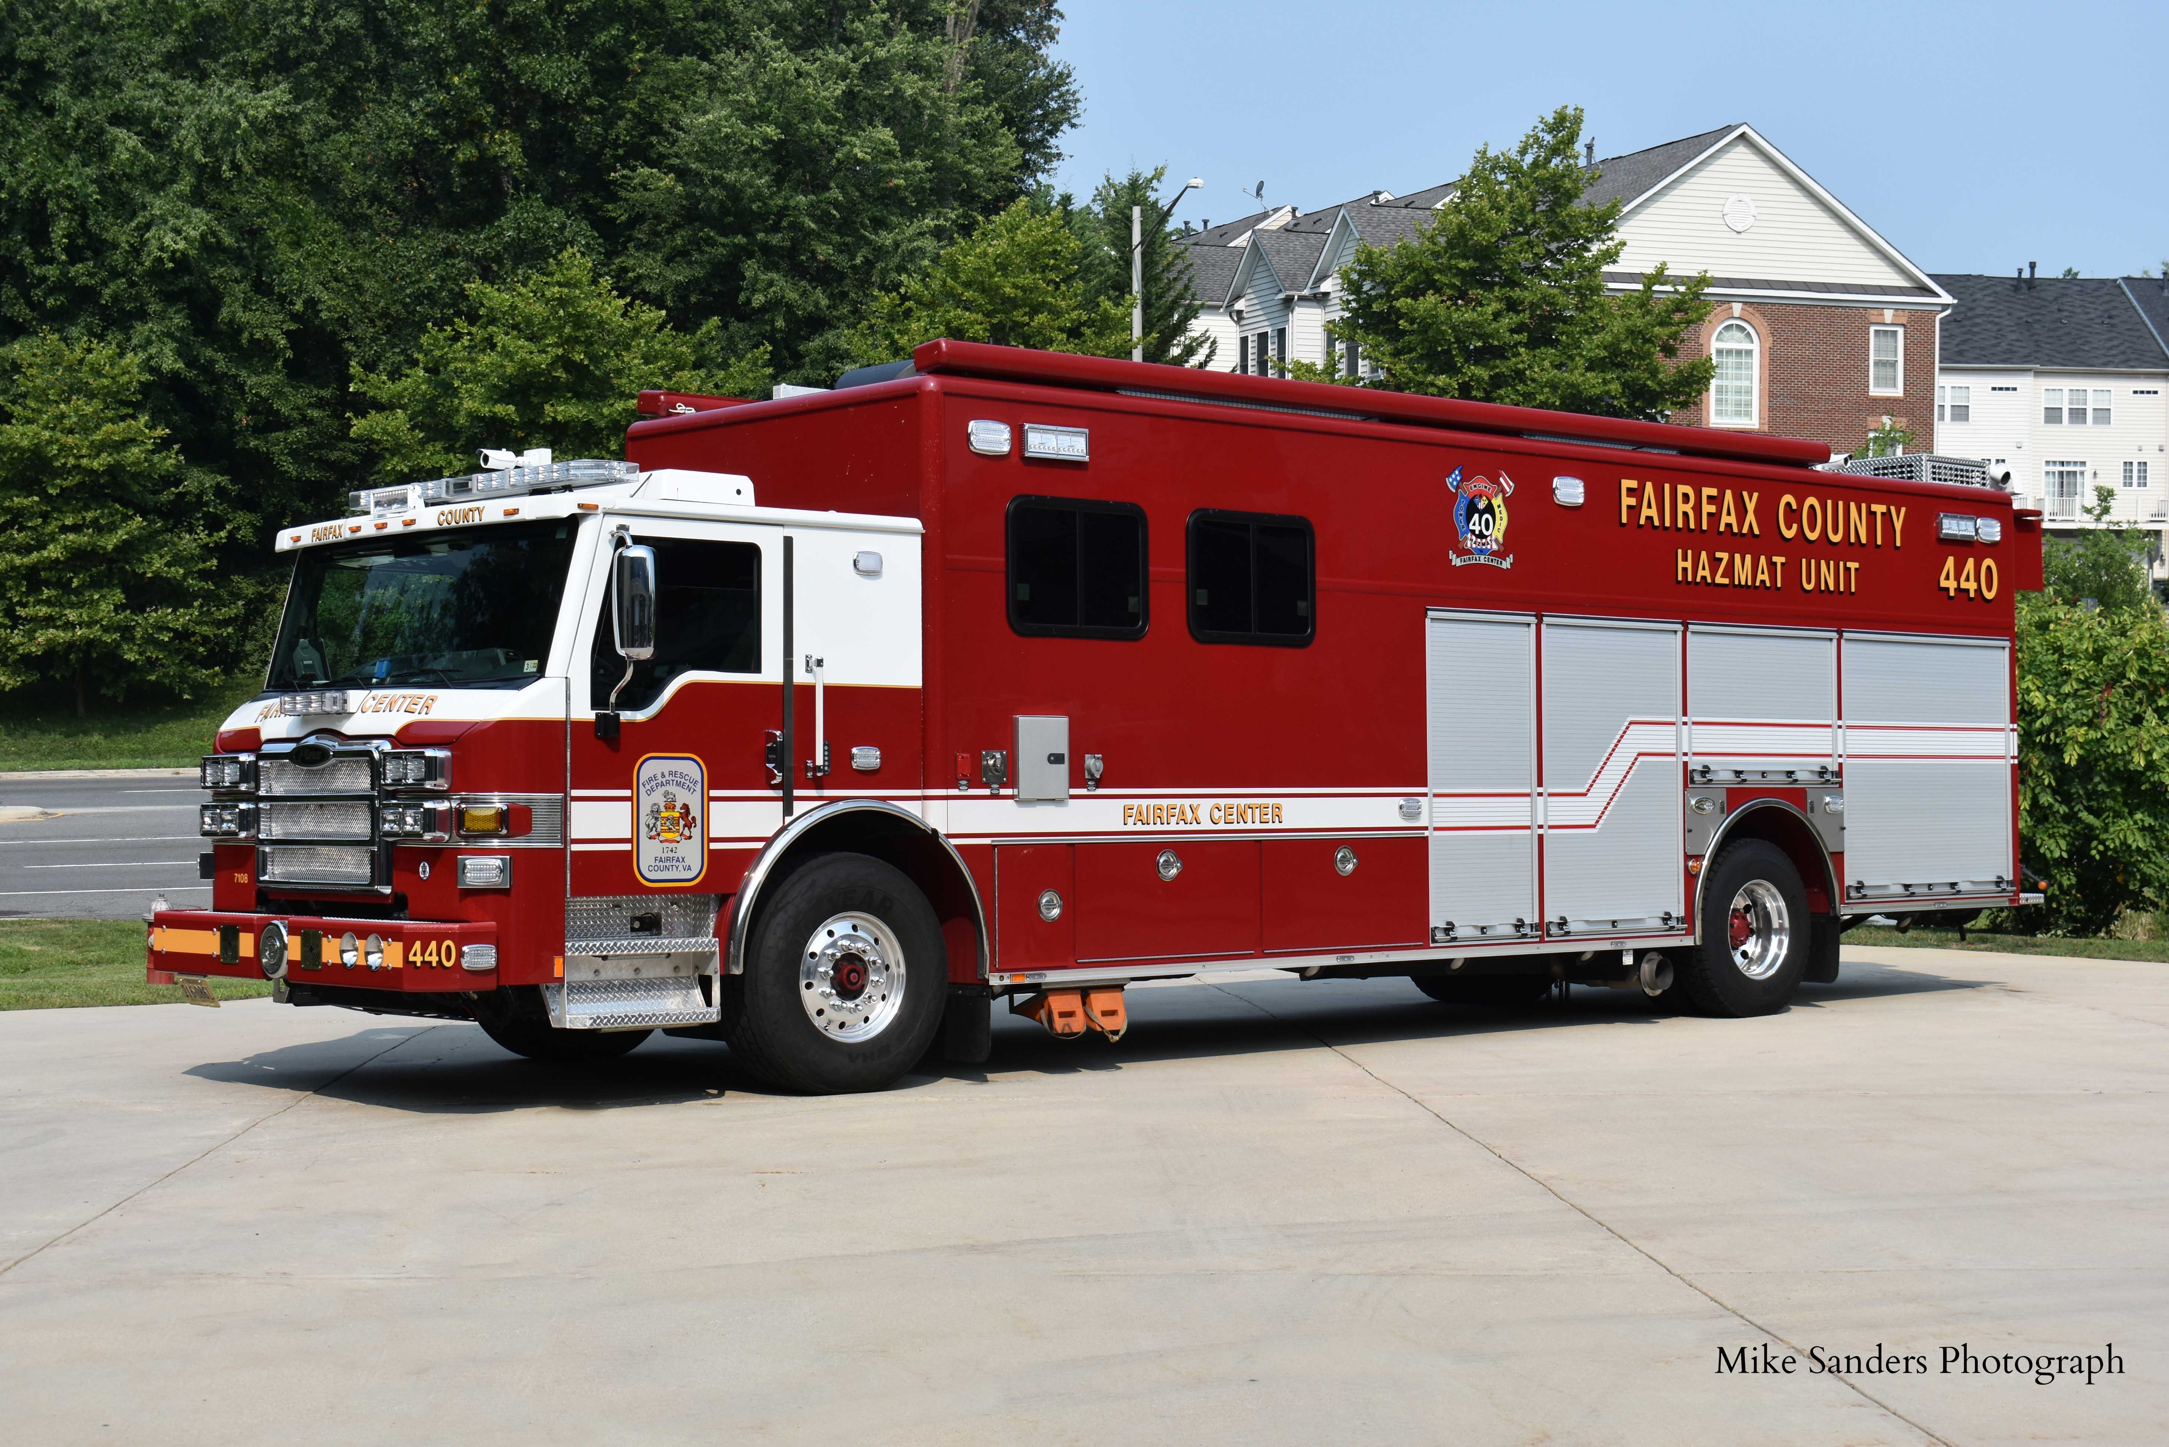
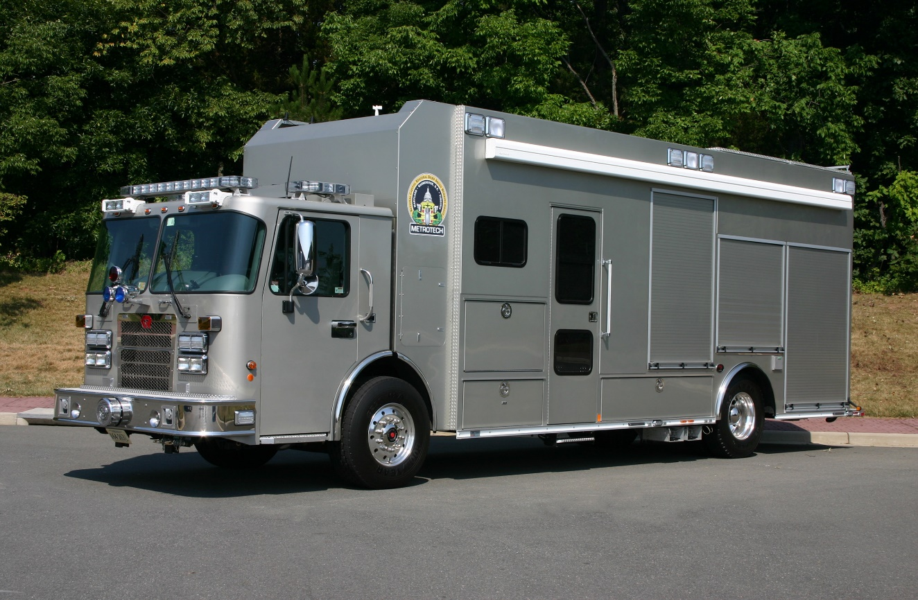
Class 3 Vehicles
1-15
Notes:
Updated Photos – Special thanks to Michael N. Sanders Photography for the usage of their photographs.

Slide 19
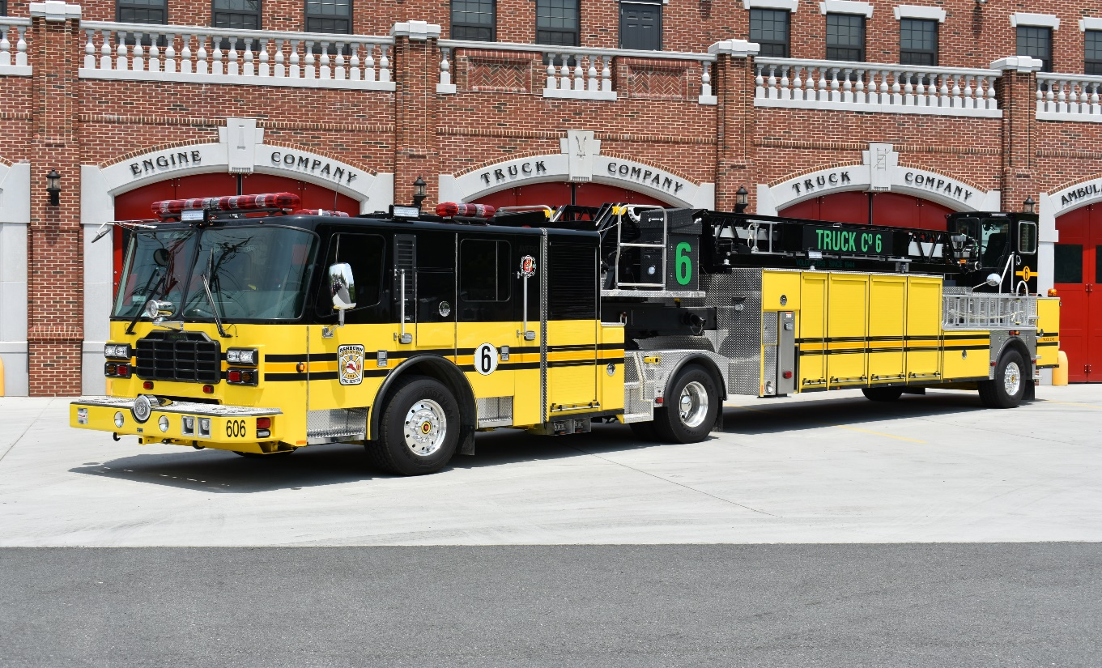
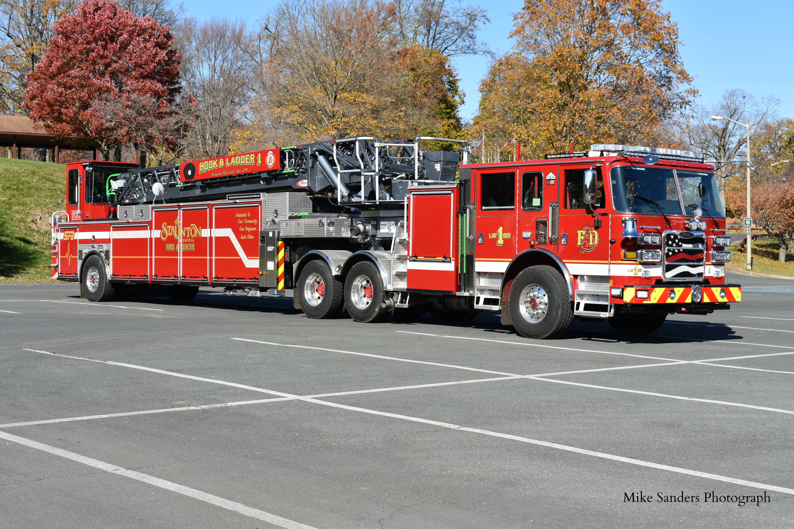
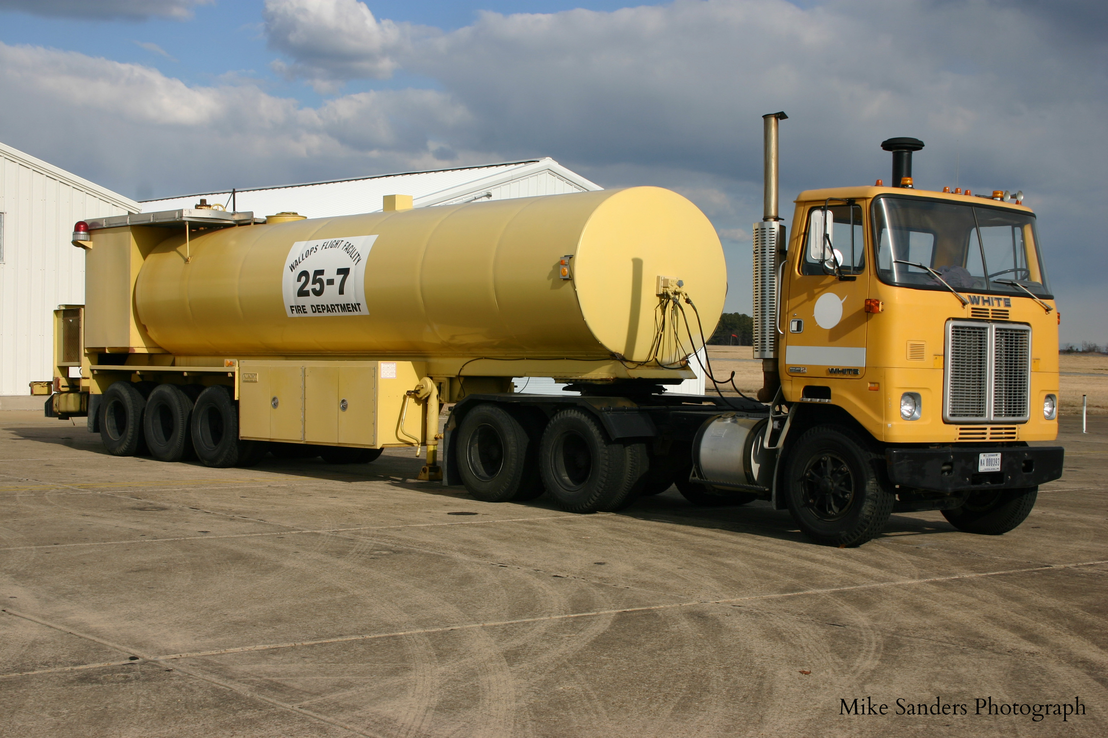
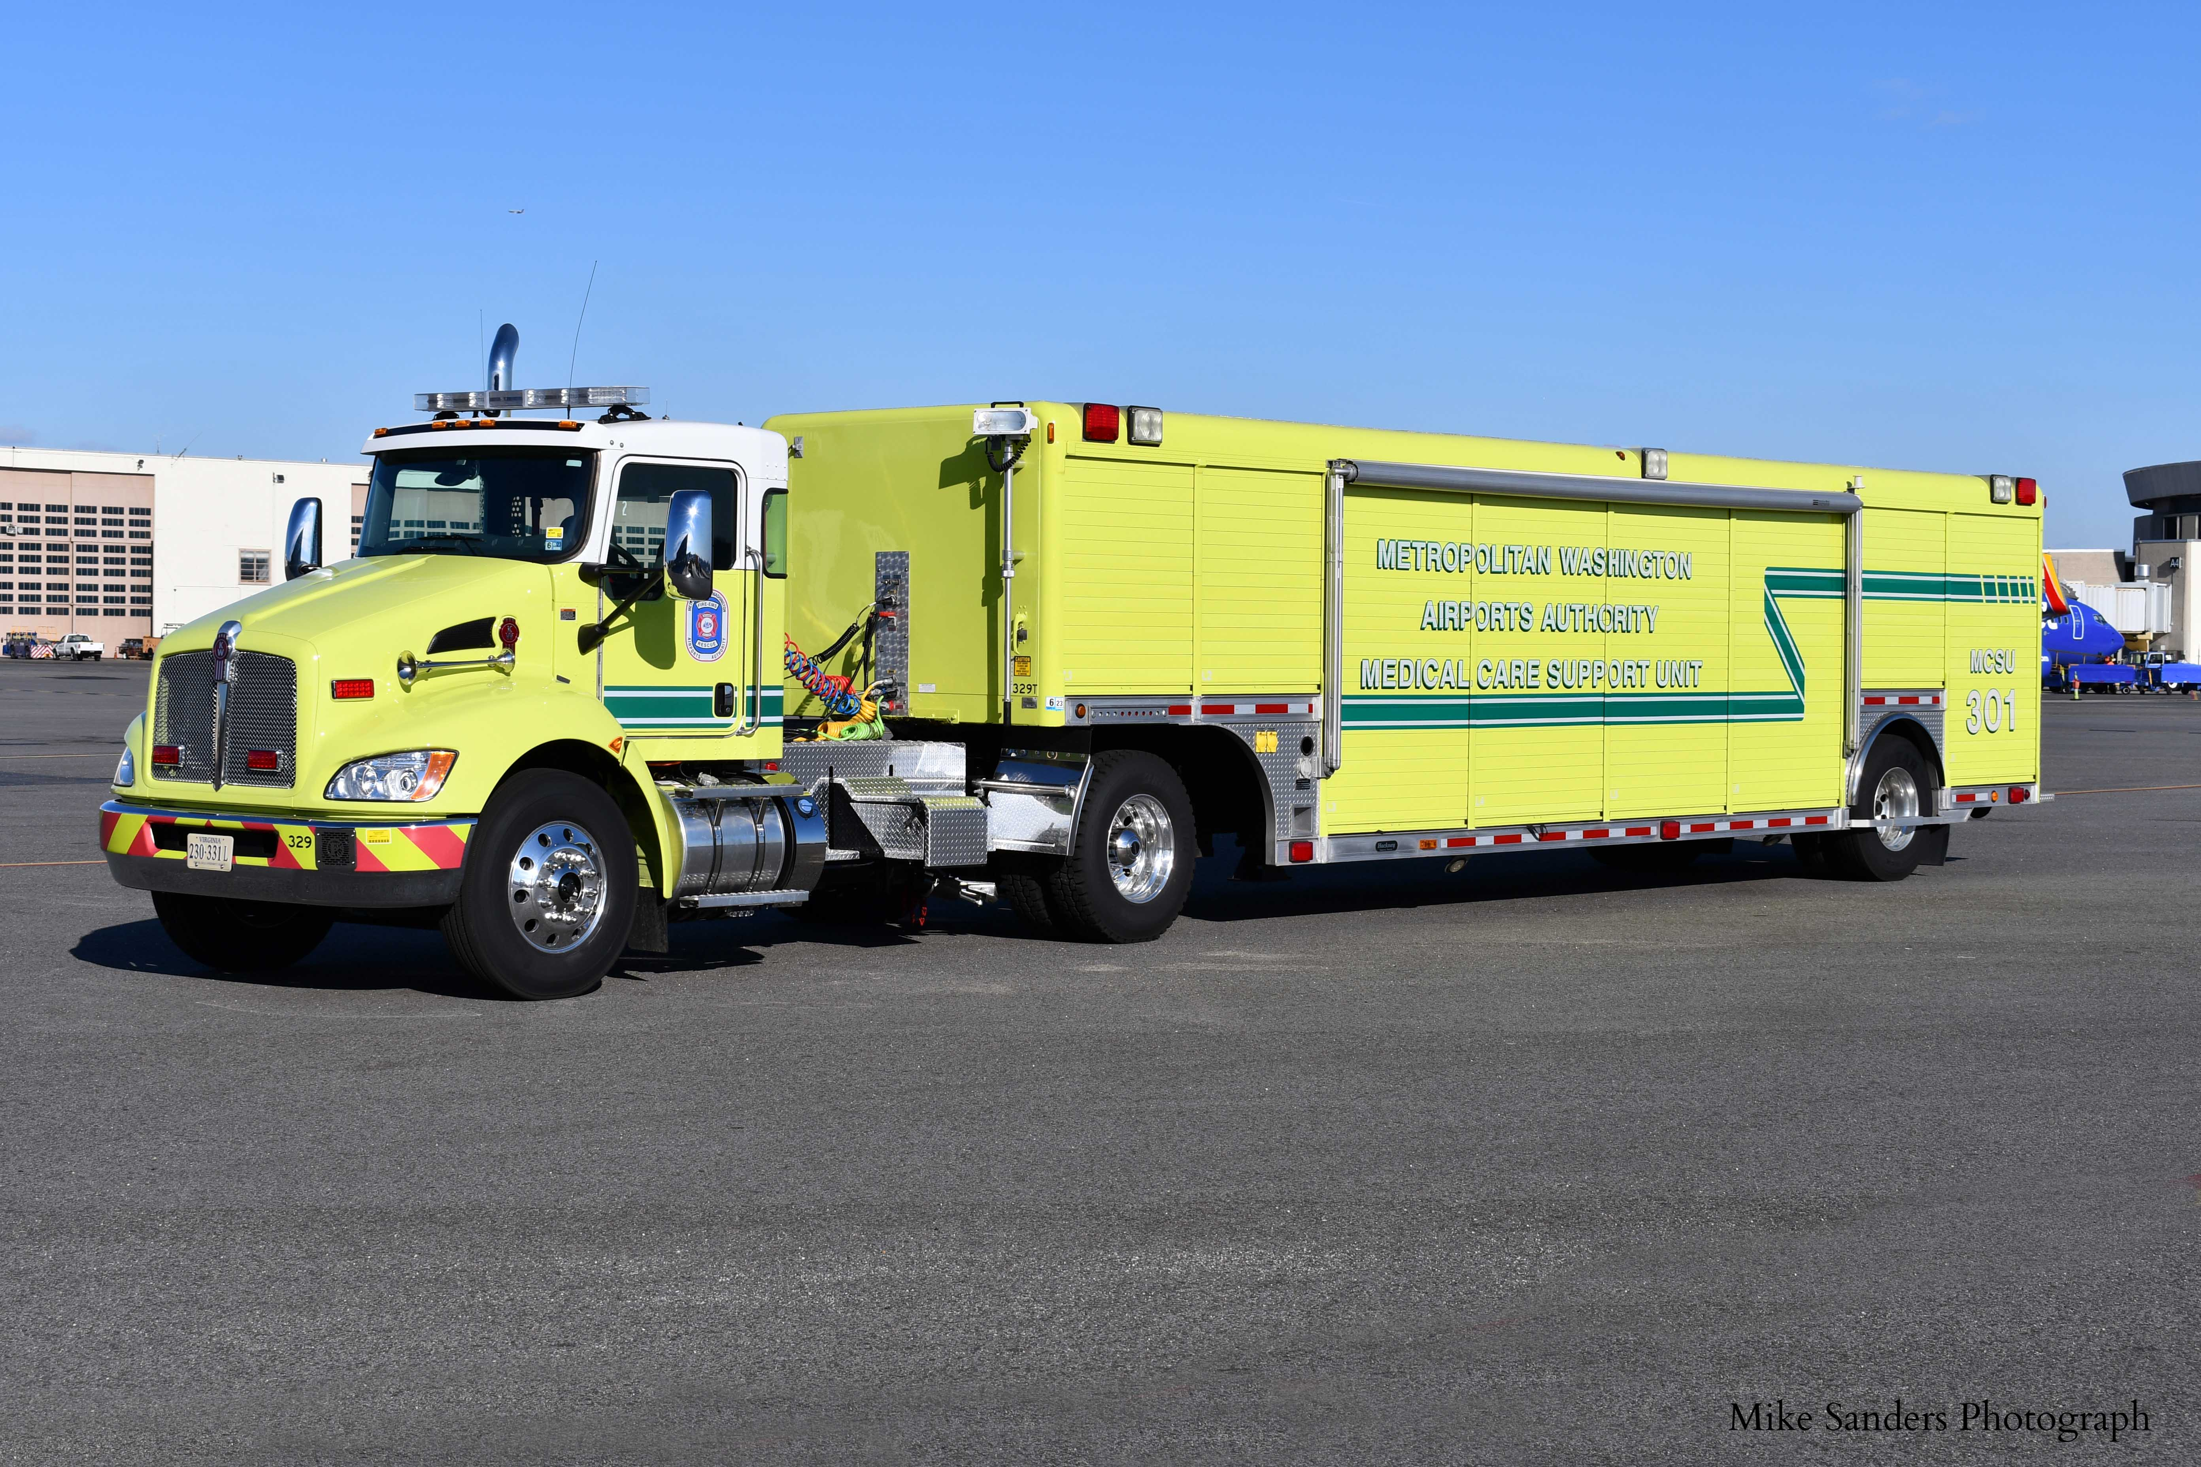
Class 4 Vehicles
1-16
Notes:
Updated Photos – Special thanks to Michael N. Sanders Photography for the usage of their photographs.

Slide 20
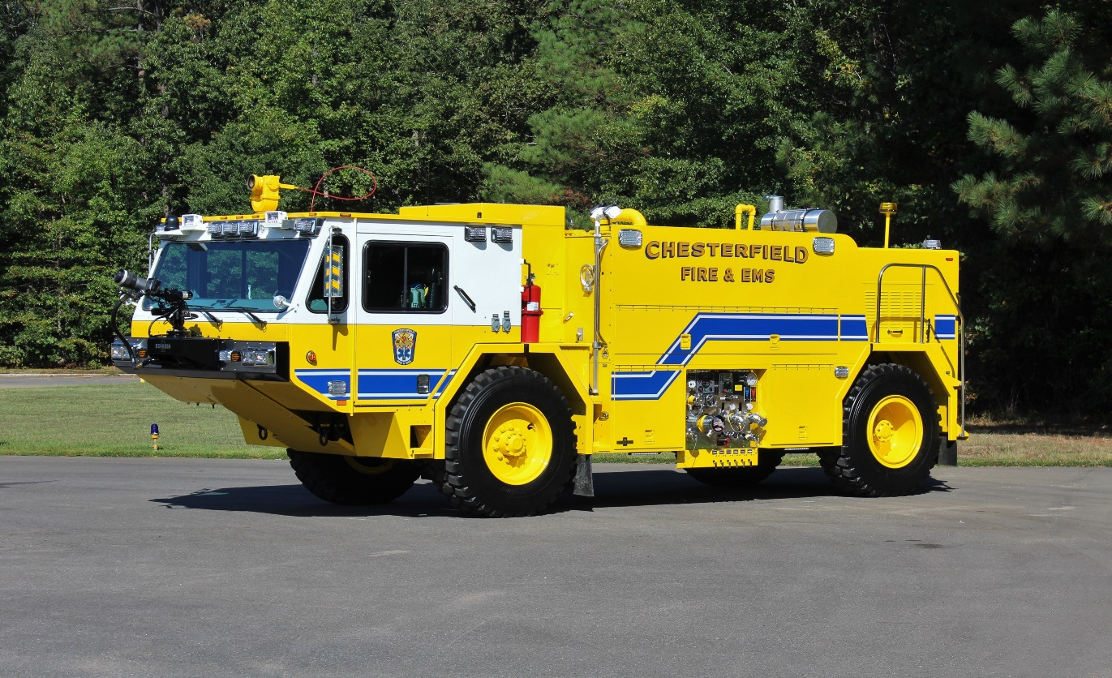
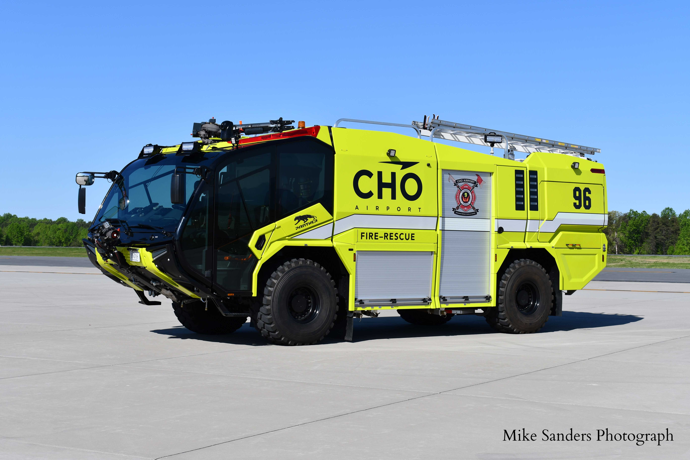
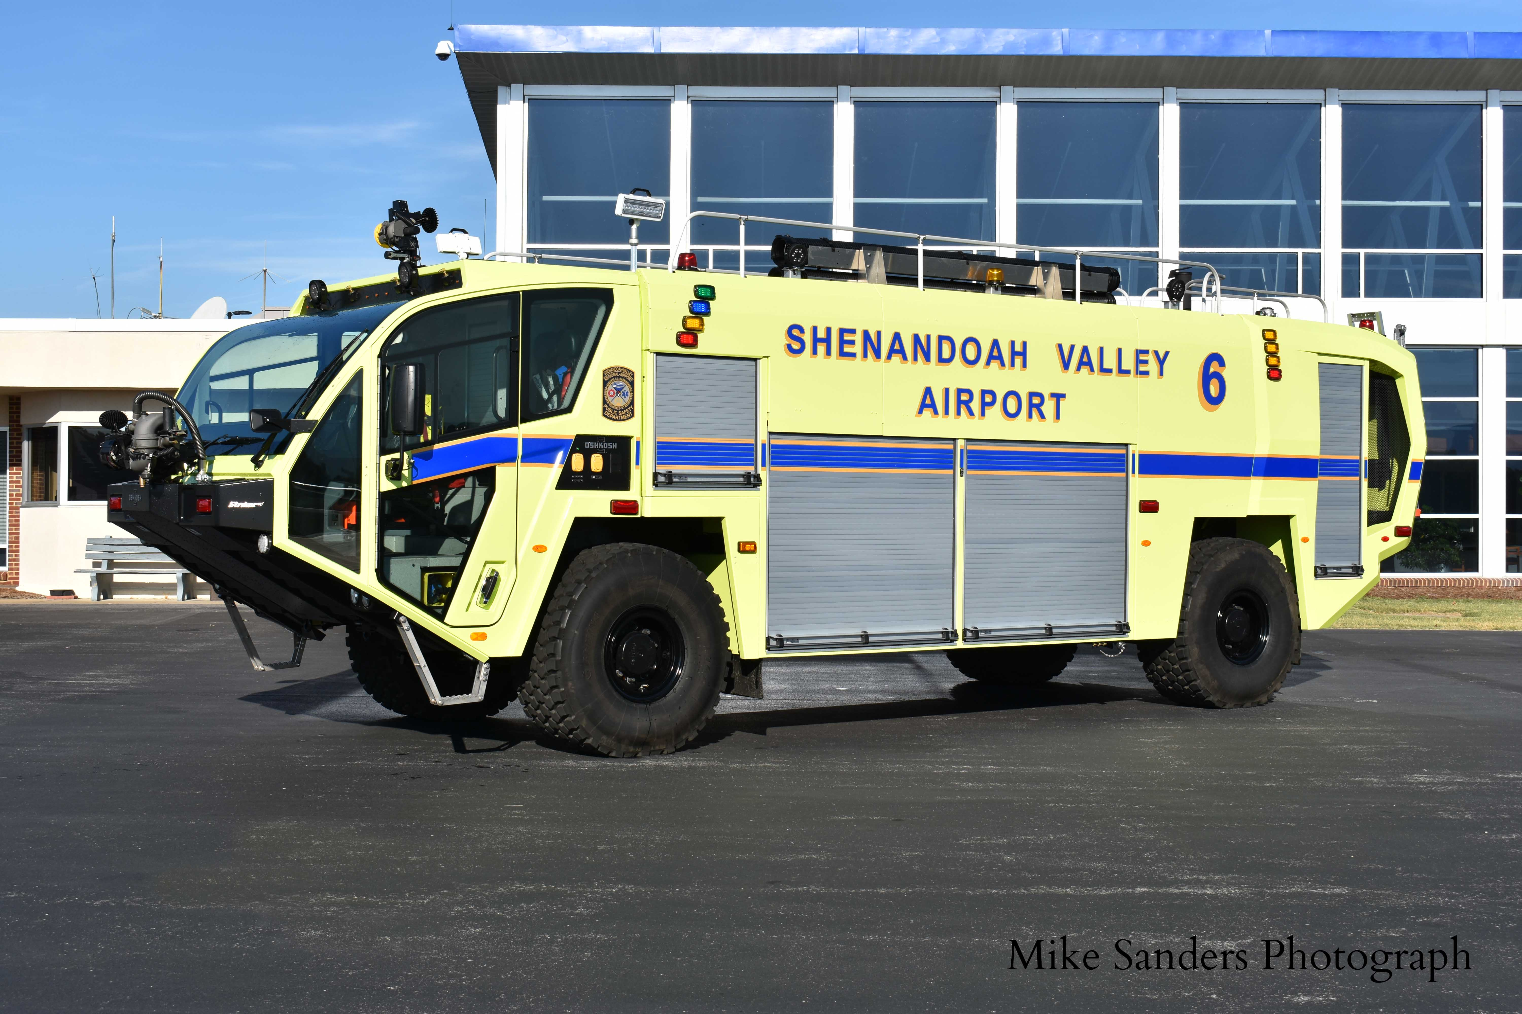
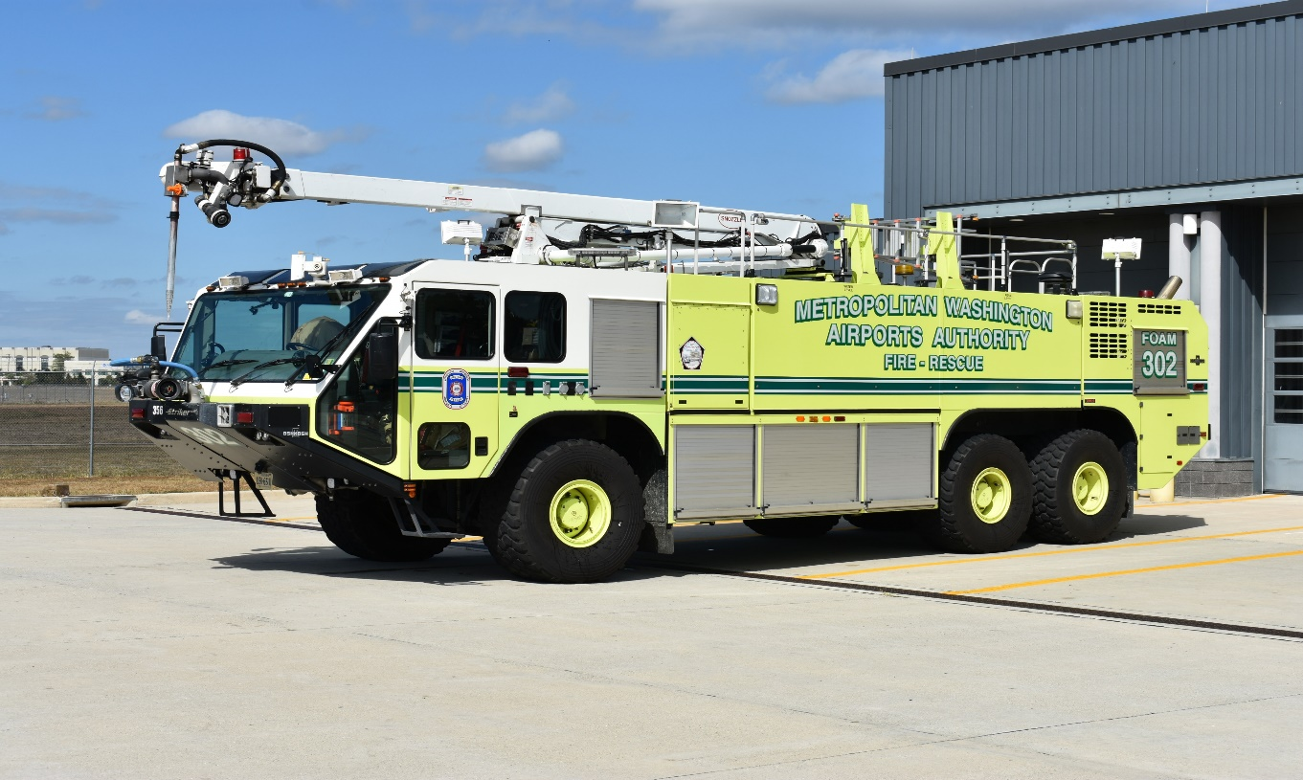
Class 5 Vehicles
1-17
Notes:
Updated Photos – Special thanks to Michael N. Sanders Photography for the usage of their photographs.

Slide 21
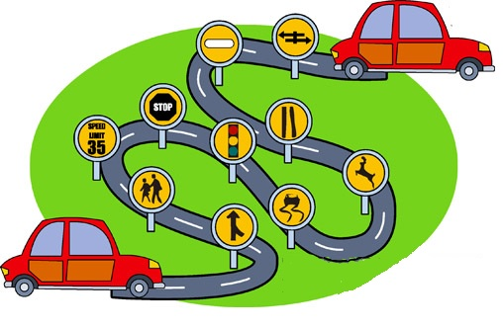
Desirable Student Attributes
Skills
Reading
Writing
Mechanical
Physical Fitness
Vision
Hearing
Disabilities
1-18
Notes:
These are minimum attributes required by the Virginia Department of Motor Vehicles for driver license requirements.

Slide 22

Driver Selection
Often selected through promotions
Often selected based on experience, training and certification requirements.
Drivers must have desire and put forth an effort to learn
1-19
Notes:
Again, remind the students that the agencies designate drivers and have requirements beyond completion of this basic EVOC Course.

Slide 23
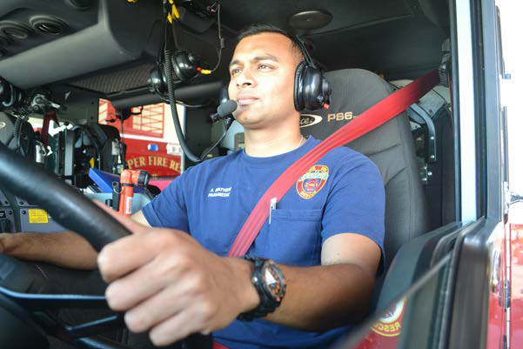
Driver Selection
Requirements
Agency / Department
Insurance
Age
Training
NFPA Standards
1010
1400
1550
1580
1-20
Notes:
NFPA Standard 1010 (Standard On Professional Qualifications For Firefighters) combines the old NFPA 1001 (Standard For Fire Fighter Professional Qualifications), NFPA 1002 (Standard For Fire Apparatus Driver / Operator Qualifications), NFPA 1003 (Standard For Airport Fire Fighter Professional Qualifications), and NFPA 1005 (Standards For Professional Qualifications For Marine Fire Fighting For Land-Based Firefighters) into one (1) document and it now is listed as a 2024 Edition.
NFPA Standard 1400 (Standard On Fire Service Training) combines the old NFPA 1402 (Standard On Facilities For Fire Training and Associated Props), NFPA 1403 (Standard On Live Fire Training Evolutions), NFPA 1404 (Standard For Fire Service Respiratory Protection Training), NFPA 1407 (Standard For Training Fire Service Rapid Intervention Crews), NFPA 1408 (Standard For Training Fire Service Personnel In The Operation, Care, Use, and Maintenance Of Thermal Imagers), NFPA 1410 (Standard On Training For Initial Emergency Scene Operations), and NFPA 1451 (Standard For Fire and Emergency Service Vehicle Operations Training Program) into one (1) document and will be listed as a 2026 Edition.
NFPA Standard 1550 (Standard For Emergency Responder Health and Safety) combines the old NFPA 1500 (Standard On Fire Department Occupational Safety, Health, and Wellness), NFPA 1521 (Standard On Fire Department Safety Officer Professional Qualifications), and NFPA 1561 (Standard On Emergency Services Incident Management System and Command Safety) into one (1) document and it is now listed as a 2024 Edition.
NFPA Standard 1580 (Standard For Emergency Responder Occupational Health and Wellness) combines the old NFPA 1581 (Standard On Fire Department Infection Control Program), NFPA 1582 (Standard On Comprehensive Occupational Medical Program For Fire Departments), NFPA 1583 (Standard On Health-Related Fitness Programs For Fire Department Members), and NFPA 1584 (Standard On The Rehabilitation Process For Members During Emergency Operations and Training Exercises) into one (1) document and it is now listed as a 2025 Edition.
Agency protocols / procedures have specific requirements regarding age and insurance as well as training requirements beyond basic EVOC Certificate of Attendance requirements.

Slide 24
Additional Information
Advanced behind-the-wheel driver training teaches drivers to drive more defensively.
Trained operators can anticipate the actions of other drivers on the road and avoid situations that could cause a crash.
Drivers learn to position themselves better in traffic, stopping and starting less often and causing less wear and tear on agency vehicles.
Additionally, driver training can result in better fuel economy and lower overall maintenance costs.
1-21
Notes:
Take the training seriously and give your full attention to Course content and the information that is covered.

Slide 25
Statistical Information
*Studies show that people without driver training experience are involved in 62% more crashes than those who have attended driver safety courses.
Such training can, for you, establish and maintain lower insurance costs, increase ability to avoid crashes, and lessen the degree of the crash should one occur.
*Source – US Fire Administration EMS Safety
1-22
Notes:
We offer EVOC training because the results of comprehensive training is a reduction in motor vehicle crashes and emphasizes safety of personnel.

Slide 26
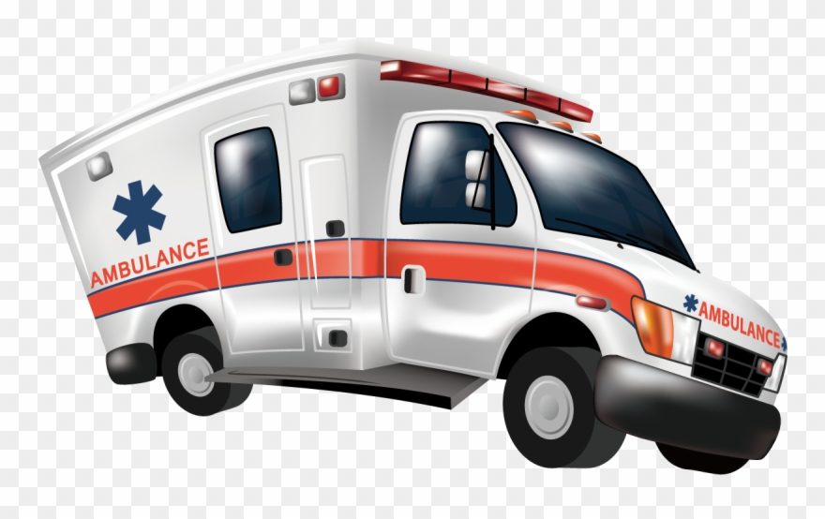
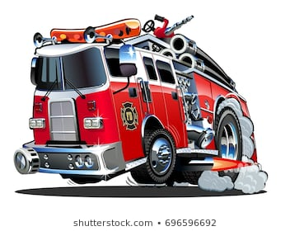
Statistical Information
*Research has shown, approximately 95 percent of all 9-1-1 EMS calls ARE NOT true emergencies.
Of the rest, less than 3 percent turn out to be life-threatening or potentially life-threatening.
*Source – US Fire Administration EMS Safety
1-23
Notes:
Bottom line – in a vast majority of emergency responses, speed, lights and sirens are not necessary.

Slide 27
Public Relations Concern
You are your agency’s best or worst public relations agent.
The public views you more while you are driving than at any other time.
1-24
Notes:
Show respect to the public and other drivers. Be alert in that how you drive is being watched at all times.

Slide 28

Good Public Relations
Safe driving displays professionalism and respect for the public
Show courtesy
Keep vehicles clean
Initiate and maintain public information programs
1-25
Notes:
Always remember you represent your agency and the community, and have a responsibility to protect life, limb, and property.

Slide 29
Bad Public Relations
Vehicle crashes involving emergency services vehicles may have serious consequences.
Emergency efforts are delayed to the original scene
A second emergency scene is created
Vehicles and property may be damaged
Potential for injuries to personnel and the public
Public image of your department suffers
Driver / Department may be subject in a lawsuit
1-26
Notes:
Driver safety should be part of a regular conversation at education and training sessions.

Slide 30

Additional Bad Public Relations Issues
Improper languages; gestures
Unkempt appearance
Driving recklessly
Impatience in dealing with the public
1-27
Notes:
Bad public relations (PR) affects donations and community support for your agency.

Slide 31
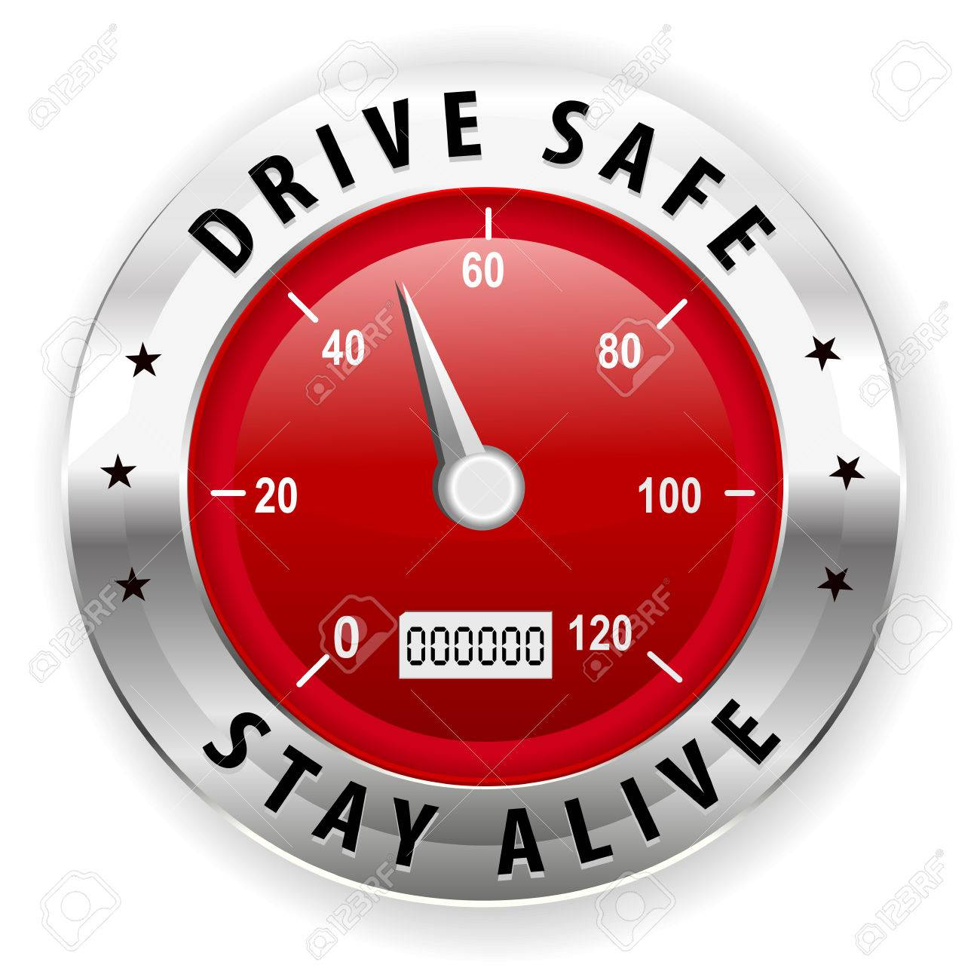
Defensive Driving
Driving to prevent
crashes in spite
of incorrect actions
of others or adverse
conditions.
“Distracted drivers make this more important than ever.”
1-28
Notes:
Driving to save lives, time, and money, in spite of the conditions around you and the actions of others – transition: “Distractions make this more important than ever.”
We live in a society that engages in many distractions while behind the wheel. In other words, they practice “Offensive Driving”. We must be on the defensive at all times when we are on the road. That can be exhausting. Often, we have a partner in the cab with us that can help navigate around these hazards. Remember, two (2) sets of eyes are better than one (1). Some logical pointers for safer driving will be covered in the following slides.

Slide 32
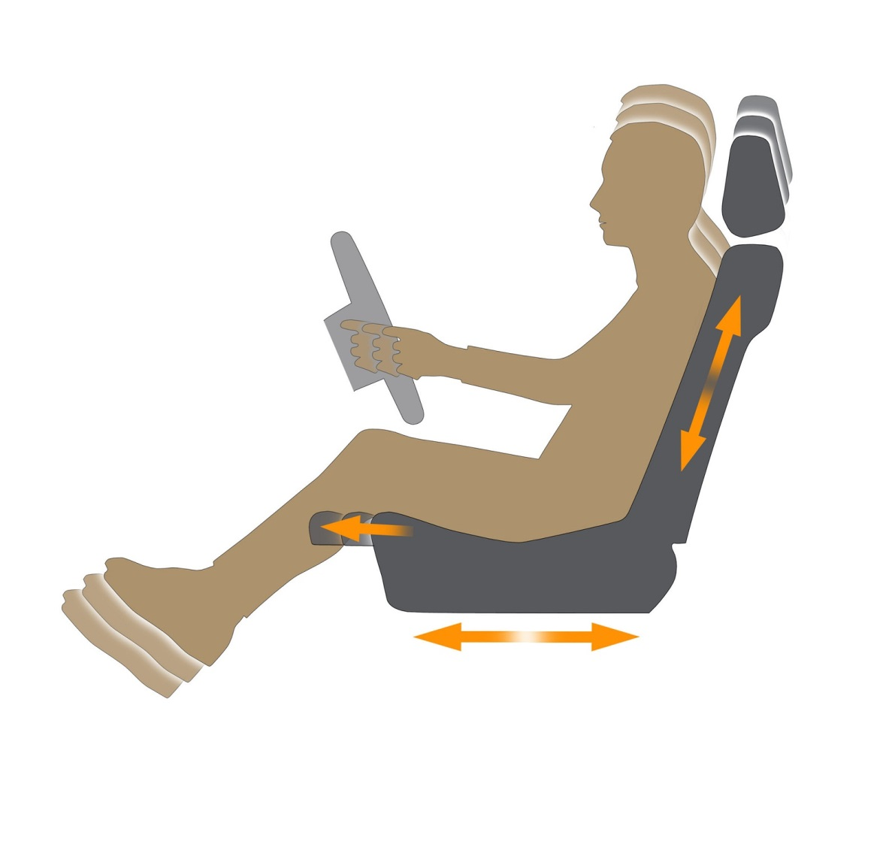
Seat Adjustment
Proper hand positioning
Legs slightly bent at knees
Proper seat height
1-29
Notes:
Put yourself in a position to be able to reach controls and pedals.

Slide 33
Position and Use of Feet
Right Foot
Placed squarely over accelerator
Over brake only in anticipation of braking
Left Foot
Never used for braking
Rest on floorboard to assist with balance
1-30
Notes:
Do not ride the brake or rest either foot on the brake pedal.

Slide 34

Position of Hands
Holding the wheel
Firm grip with both hands
Do not let wheel spin freely
Do not palm the wheel
Do not allow wheel to slide through hands
1-31
Notes:
Develop good habits in driving by always driving with two (2) hands.

Slide 35
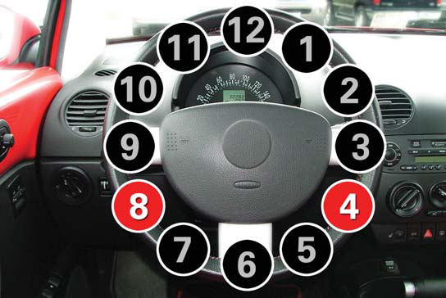
Proper Hand Position
Sit straight but relaxed and place your hands on the steering wheel. If your steering wheel were a clock, your hands should be at the 8 o’clock and 4 o’clock positions. Hold the wheel with your fingers and thumbs. Avoid gripping it with your palms. (pp 13-Virginia Driver’s Manual)
1-32
Notes:
Taken from the Virginia Driver’s Manual. This hand position should be used in the student’s personal vehicle as well as when driving an emergency vehicle.

Slide 36
Shuffle Steering
Hands do not cross each other
Both hands remain in contact with wheel
Used for turns and for counter-steering
Becomes more comfortable with practice
1-33
Notes:
Give it a legitimate try – shuffle steering gives your patient / crew a comfortable ride and also, controls vehicle dynamics by keeping the vehicle stable.

Slide 37
Vehicle Mirrors
Drivers need to utilize mirrors effectively!
Adjustments
Prior to moving vehicle
Allow vision of side of vehicle and as much of lane as possible
Use convex mirrors to get the “big picture”
1-34
Notes:
Adjust your mirrors to eliminate as many blind spots as feasible.

Slide 38
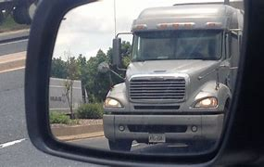
Blind Spots
Know location of your vehicle’s blind spots – each vehicle is different
Compensate by using others to assist you
When possible, use spotter(s) while backing
Cameras may assist but may also be a distraction
Blind spot warning indicators
1-35
Notes:
If another vehicle “hangs out” in your blind spot, slow down, and let them pass.

Slide 39
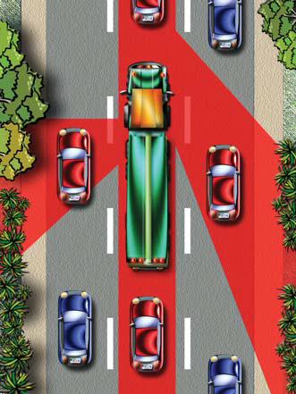
Blind Spots / “No Zone”
Don’t “hang out” on either side of large vehicles.
Don’t tailgate.
Pass safely
If you cannot see the driver in mirror, they can’t see you.
Virginia Driver’s Manual
1-36
Notes:
Graphic is from Virginia Driver’s Manual – make sure YOU do not hang out in the no zones.

Slide 40
Signaling
Every driver must legally use signals to assist others in knowing what their intentions are.
“Do Not” use hazard (four-way) flashers while moving – most turn signals do not operate while hazard flashers are on.
Fire apparatus and ambulances must be equipped with backup alarms.
Sound horn prior to backing as an additional precaution.
1-37
Notes:
It is our responsibility to advise the driving public of our intentions: stopping, turning, and backing!

Slide 41
Braking
Only accomplished with right foot.
Gradual steady pressure on pedal.
Engine retarders or engine brakes help in vehicle control.
Reduce excessive brake wear.
Follow manufacturers recommendations for wet / slippery roads.
1-38
Notes:
Respect your brakes – don’t over-estimate their capabilities.

Slide 42
Braking
Avoid locking-up brakes
Requires a greater distance to stop
Interferes with steering control
Most vehicles are equipped with Anti-Lock Braking Systems (ABS)
Abrupt stops can cause injury, mechanical failure, and skidding
1-39
Notes:
Do not pump the brakes on vehicles with Anti-Lock Braking Systems (ABS). If you lock-up the wheels you will loose steering control, so the ANTI-LOCK nature of the braking system is extremely important to understand.

Slide 43
Braking
** IMPORTANT NOTE **
Anti-Lock Brakes require a steady pressure applied to the pedal.
DO NOT “pump” the brake pedal on vehicles equipped with Anti-Lock Braking Systems!
1-40
Notes:
Again – DO NOT PUMP THE BRAKES!

Slide 44
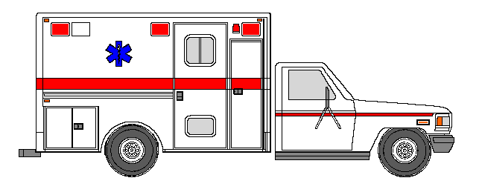
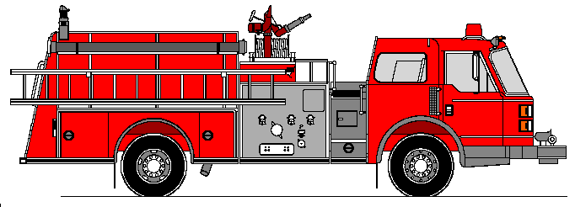
Stopping Distance Formula
R.D. + B.D. = S.D.
Reaction
Distance
Braking
Distance
TOTAL STOPPING DISTANCE
Reaction Time = 3/4 Second
Braking Distance
INCREASES
with vehicle SIZE and SPEED
1-41
Notes:
The higher the weight of the vehicle, the longer it takes to bring the vehicle to a stop. Slow down when you anticipate a need to come to a stop.

Slide 45
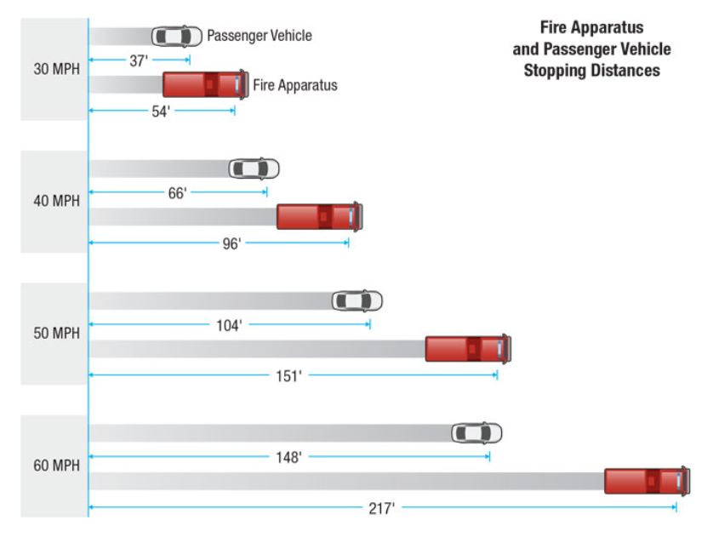
Braking Distance Estimates by Vehicle Size
1-42
Notes:
Good graphic that helps you visualize the increased length of the braking distance for large vehicles. These are estimates and may vary with road conditions and weight of vehicle. Need to include reaction distance into this diagram.

Slide 46
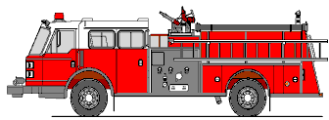

FOLLOWING DISTANCE FORMULA UNDER NORMAL CONDITIONS 3 SECOND RULE
1001, 1002, 1003
WHEN DRIVING LARGER VEHICLES YOU MUST INCREASE YOUR FOLLOWING DISTANCE!
1-43
Notes:
Probably a rule you learned in Driver’s Education – still applicable today. Increase to four (4) seconds for larger vehicles and adverse conditions. This is at non-emergency speeds. In an emergency response, the Emergency Vehicle will be overtaking slower traffic. Allow for time to react to any hazards.

Slide 47
Stopping Distance vs. 3 Second Rule Heavy Two-Axle Trucks
MILES
PER
HOUR
30
40
50
60
FEET
PER
SECOND
45
60
75
88
TOTAL
STOPPING
DISTANCE
54 feet
96 feet
157 feet
217 feet
3 SECOND
SPACE
135 feet
180 feet
222 feet
264 feet
AS SPEEDS INCREASE
AND VEHICLE SIZE INCREASES
INCREASE YOUR FOLLOWING DISTANCE
1-44
Notes:
Good visual of the increased stopping distance of large two (2) axle vehicles. Varying speeds of vehicles can impact the effectiveness of the three (3) second space cushion.

Slide 48

The Smith System
Five Principles of Safe Driving
Aim high in steering
Get the big picture
Keep eyes moving
Allow an out
Keep vehicle visible
1-45
Notes:
We will break down each of these five (5) principles in the following slides – use this information to improve your defensive driving and avoid collisions.

Slide 49
Five Principles of Safe Driving
The Smith System states that following these five rules can dramatically reduce the risk of major accidents on highways and roads.
Aim High in Steering The driver should focus their attention high – - VIEW THE WHOLE ROAD.
Get The Big Picture “Be aware of your surroundings at all times”. Having the whole picture means that you are doing your part to keep your vehicle as safe as possible while moving 100 feet a second.
1-46
Notes:
Allow students to read the information –
Aim High In Steering The driver should steer and focus their attention high, so as to view the road as whole and not just a few feet ahead. The first rule of the “Smith System” means to stay alert of the dangers and traffic ahead because it not only avoids rear-end collisions, but it also alerts other drivers behind your vehicle to slow down.
Get The Big Picture “Be aware of your surroundings at all times” may seem obvious to say, but distracted drivers are just as dangerous as intoxicated ones. Erratic and angry drivers take up a large portion of the traffic we see daily, so avoid major accidents by noticing how other drivers behave on the road. Having the whole picture means that you are doing your part to keep your vehicle as safe as possible while moving one hundred feet (100’) per second. There are a variety of hazards between your own vehicle and other drivers, and a keen awareness of these dangers will reduce these risks.

Slide 50
Keep Your Eyes Moving Remain alert consistent eye movement prevents your body from entering the trance state, keeping you alert to every driving condition ahead of you.
Allow An Out Don’t let other drivers box you in while selecting their lanes. Always anticipate what choices other drivers make.
Keep Vehicle Visible The final rule for the Smith System prevents accidents by removing assumptions made behind the wheel. As a driver, make sure that other drivers can see you and anticipate your move. If you feel you are coming into another driver’s blind spot, use the horn to get their attention.
1-47
Notes:
Keep Your Eyes Moving The third standard of the Smith System asks drivers to remain alert. Energy drinks can only do so much before they cause the body to crash, and any repetitive motion sends us into a trance. Consistent eye movement prevents your body from entering the trance state, keeping you alert to every driving condition ahead of you.
Allow An Out This means ensure that other drivers do not box you in while selecting their lanes. Do not follow other vehicles too closely and always anticipate what choices other drivers make.
Keep Vehicle Visible The worst thing a driver can do is assume. Assume other drivers can see them, assume other drivers are not dangerous, or even assume that they will just get to their destination safely. The final rule for the Smith System prevents vehicle crashes by removing assumptions made behind the wheel. As a driver, make sure that other drivers can see you and anticipate your move. If you feel you are coming into another driver’s blind spot, use the horn to get their attention.

Slide 51

S-I-P-D-E
A five-step approach to safe driving behaviors
Scan (Sense and Search)
Identify
Predict
Decide
Execute
1-48
Notes:
Read the information about each of the letters in the acronym SIPDE that is on the graphic.

Slide 52
Sirens
Usage specified by Virginia Motor Vehicle Code (used with “reasonable necessity”)
Be Aware that sudden usage behind a vehicle may startle the driver
Better response to sounds that change pitch often
Don’t rely on siren
1-49
Notes:
We will cover the Code of Virginia’s requirements for siren usage during Session #2.

Slide 53
Sirens
Short bursts of air horns and constant up and down siren oscillation most effective
Emergency vehicle operators must be aware of other emergency vehicles
Difficulty in hearing sirens of other emergency vehicles
Report approach to common intersections by radio
1-50
Notes:
Think of siren use as a way getting attention of other drivers and advising them of our REQUEST for the right of way and not a DEMAND.

Slide 54
Siren Projection
> > > >
40 MPH
300 FEET EFFECTIVE
> > >
60 MPH
12 FEET EFFECTIVE
KEY POINT: DON’T OUTRUN IT
1-51
Notes:
Also, the point is unless our siren gets the attention of other drivers and pedestrians; we cannot expect them to yield the right of way. Modern vehicle construction and audio system can limit the driver’s ability to hear outside noise.

Slide 55
Disadvantages Of Siren Use On Highways / Interstates
Traffic normally moving at speeds equal to or greater than safe response speed
Vehicles stopping or trying to get out of the way can cause serious crashes and traffic jams
Evaluate the legal implications of not using siren
1-52
Notes:
Think about it, most of the other vehicles on the Interstate (Limited Access Highways) are traveling at speeds faster then most large fire and rescue apparatus are capable of.

Slide 56

Seat Belts
Safety of others in the vehicle is the driver’s responsibility
Be fully dressed before getting on
All riders should wear seat belts
Shall be seated and not permitted to stand
Riding on tailboard is UNSAFE and is NOT ACCEPTABLE
1-53
Notes:
Virginia Motor Vehicle Codes (Law) will be covered during Session #2 of the course – but basically requires all occupants in the cab to be belted.
Driver is required to assure everyone and everything is secured.

Slide 57

Passenger Restraints
Patient Compartment:
Always alert the driver when you are unbelted and providing patient care.
Supplemental Restraint Devices / Systems
Air Bags
Seat Belt Pre-Tensioners
1-54
Notes:
Ask the group – “Do you use seat belts every time you drive?
It is the law! “Click it or Ticket!”
Remember many vehicles have supplemental restraint systems as well.

Slide 58



Securing Occupants and Equipment
Everyone and everything restrained
Soft bags versus hard cases
Unnecessary equipment in compartments
Seatbelts for surprise equipment
1-55
Notes:
“Everyone and Everything Restrained”.
Purpose: The risk of occupational injury and death is disproportionately high for EMS personnel and the majority of those casualties are associated with transportation incidents. Simply put, ambulances are not built or used in the same manner as standard passenger vehicles, resulting in safety concerns for both caregiver and patient. While there are inherent risks to occupants in an ambulance, some of the vulnerability can be reduced by properly restraining occupants and equipment.

Slide 59

NIOSH Video Squad bench view of 30 mph crash
Click on the video to play and replay
1-56
Notes:
Video: Interior view of same crash test. Medic on your left is unrestrained. Medic on right is only wearing a lap belt. Patient is fully secured, including shoulder restraints.
58

Slide 60

Adult Patient Restraint
Challenges
No single position works for all patients
Comfort issues
Facing rearward
Secure all straps / shoulder restraints
Head elevated
Medical equipment in use
Limitations of equipment
1-57
Notes:
Why is it difficult to restrain adult patients? Some factors include: No one position works for all patients. Patient comfort issues. Medical equipment in use. Limitations of our own equipment.
As appropriate you might have a class discussion about the patient in this picture and the usefulness of the shoulder straps especially since she is sitting upright.

Slide 61

NIOSH Video Overhead view of a 30 mph crash
Click on the video to play and replay
1-58
Notes:
Video: Same crash test as before, overhead view.
60

Slide 62


Potential Projectiles
Collision
Rollover
Sudden Deceleration
Secure all equipment
1-59
Notes:
Ask students, “What are some potential objects that could become projectiles during a collision and/or sudden deceleration or rollover?”
Some potential projectiles: Oxygen Cylinders, Cardiac Monitors, Jump Kits, Radios, Computer Laptops / Tablets, Sharps Containers, etc.

Slide 63

Potential Projectiles
PPE Gear
Patient Belongings
Medical Devices
Personal / Firefighting Gear
Wheelchairs
Flight Team Equipment
1-60
Notes:
Image explanation: Ambulance was involved in a crash, items on floor were either loose in the patient compartment or fell from compartments during the crash. Any of these additional items could become projectiles during a collision and/or sudden deceleration or rollover. To the extent possible, store these items in exterior compartments.

Slide 64
Occupants and Equipment
Final thought about securing everyone and everything
“First Responders must do a better job securing ourselves, patients and equipment. We often see the adverse results of others who don’t use seatbelts or child seats, so let’s set the standard.”
“LEAD BY EXAMPLE”
1-61
Notes:
Just a thought to leave them with regarding securing everything and everyone.

Slide 65



The Transportation System
The transportation system is made up of three (3) components:
The Vehicle
The Driver
The Environment
1-62
Notes:
Announce that we will discuss each of the Transportation System’s components in detail. Each student should reflect on what aspects of these components they can control.

Slide 66
The Vehicle
Daily Maintenance Checks
Accomplished at the beginning of shift
Approaching the vehicle
Is the vehicle clean
Is the vehicle sitting level
Fluid leaks underneath
Condition of glass and lights
Tire condition
1-63
Notes:
Advise the students to be diligent with their vehicle checks and not take anything for granted with regard to the safety of themselves, crew, and/or patient.

Slide 67
The Vehicle
Engine Compartment Checks
Fluid checks – oil, power steering, cooling system, brake, transmission, windshield washer
Batteries, hoses, and belts
Refer to manufacturer’s recommendations
1-64

Slide 68
The Vehicle
Cab Compartment Components
Controls and gauges
Seat adjustment, mirror adjustment, and seat belts
Equipment secure in cab
Windshield clean
1-65
Notes:
Be a strong proponent of a clean windshield. Debris, bugs, bird droppings, and other things will be a visual distraction during operation of the vehicle.

Slide 69
The Vehicle
System Checks
Lights, gauges, wipers, radios
Emergency equipment (lights, sirens, air horns, etc.)
1-66
Notes:
The check should involve the entire crew.

Slide 70
The Vehicle
Equipment In Compartments
Properly stored and secured
Cleanliness
Proper working order
1-67
Notes:
Keep compartments clean and well organized.

Slide 71
The Vehicle
Road Check
Steering
Transmission
Brakes and suspension
Document all defects and/or needed repairs
1-68
Notes:
Report all defects and do not take chances if issues are noted.

Slide 72

The Vehicle
Maintenance – Weekly / Monthly
Same as daily but with greater detail – checks of all components and inventory
Check undercarriage for leaks and/or loose connections
1-69
Notes:
During Monthly Checks – nothing should go unchecked.

Slide 73






Vehicle Dynamics
Vehicle Size
1-70
Notes:
Different Vehicles – Different Dynamics – know your vehicle.

Slide 74
Vehicle Dynamics
Weight and Height
Vehicle dynamics change as weight and height changes
Four-wheel drive vehicles
Common Causes of Weight Transfer
Drivers must become familiar with the normal handling characteristics of their vehicles
1-71
Notes:
Ambulances are traditionally “top heavy”. Know your vehicle limitations.

Slide 75
Starting and Driving The Vehicle
Follow manufacturers recommendations for starting, driving, and operating emergency vehicles.
Driver should review incident location, response route, and other pertinent factors prior to responding.
GPS usage and directional adjuncts
Ensure all personnel are dressed and seated with seat belts on prior to moving.
1-72
Notes:
Use the information in the vehicle manual – knowledge of your response route aids in your ability to control your vehicle.

Slide 76
General Driving Practices
Drivers must become familiar with normal operating and gauge readings associated with each vehicle.
Drivers must be thoroughly familiar with operator’s manual and consult them for permissible limits when in doubt.
Engine shutdown should never be made immediately after full-load operation.
Allow hot engine to idle until cool. Do not race engine prior to shutdown. Turbochargers must cool or severe engine damage will result.
1-73
Notes:
KNOW WHAT THE GAUGE READINGS MEAN – always let the vehicle cool down after an emergency response.

Slide 77


The Driver – Attitude
The most important factor that you control in emergency vehicle operations is Driver Attitude!
The number one cause of vehicle crashes is Driver Error or Driver Inattention.
1-74
Notes:
It is a proven fact – you will drive an emergency vehicle in a similar fashion that you drive your own vehicle – some of those attitudes and habits will need to change.

Slide 78
The Driver – Attitude
Pitfalls
Overconfidence
False ideas
Impatience
Tension
Exhibitionist
“Road Rage”
Professionalism
Maturity
Responsibility
Courtesy
Desire
Restraint
1-75
Notes:
Be professional and avoid these pitfalls.

Slide 79



Distraction Free Driving
Human aspects we can control
1-76
Notes:
Distractions increase the risk of collisions. These distractions (music, conversation, sight seeing, cell phones, GPS, etc.) are the Human Aspects that we can control when we are driving. When are any of these distractions appropriate and when are they not?

Slide 80
Types of Distractions
Visual
Auditory
Biomechanical
Cognitive
Text Messaging
“Protective” Distractions
1-77
Notes:
Each will be covered in slides that follow.

Slide 81

Visual Distractions
Things that take your eyes off the road
1-78
Notes:
Visual Distractions, these things take your eyes off the road. Ask students, “What are examples of visual distractions?”

Slide 82




Auditory Distractions
Sounds that attract your attention and your eyes off the roadway
1-79
Notes:
Auditory Distractions, are sounds that take your mind off the road.
Ask students, “What are some examples of auditory distractions?”
Child / Ooccupants
Siren
Mobile Data Terminals (M.D.T.s) or Mobile Computer Terminals (M.C.T.s)
Cellular Telephone Alerts
Pager Alerts
Radio Tones
DVD Players
CD players
Radios, etc.

Slide 83

Biomechanical Distractions
Things that take your hands off the wheel
1-80
Notes:
Biomechanical Distractions, are things that take your hands off the wheel.
Ask students, “What are some examples of biomechanical distractions?”
Anything that requires manual control.
Global Positioning Systems (G.P.S.)
Computers
Emergency Radios
Siren Controls
Rear View Cameras, 360 Degree Cameras, etc.

Slide 84

Cognitive Distractions
Thoughts that take your mind off the road
After work I have a lot of errands to run.
1-81
Notes:
Cognitive Distractions, are things that take your mind off the road.
Ask students, “What are some examples of cognitive distractions?”
An argument you just had.
Shopping list.
Errands you need to run.
Personal issues / problems, etc.

Slide 85

Text Messaging
Is the perfect storm of distraction
Visual, manual, and cognitive distractions all in one.
Let me read and respond to these messages.
1-82
Notes:
Texting is a "perfect storm." It requires you to: Look at the keyboard (Visual), manually manipulate the keys (Biomechanical / Manual), alert tones (Auditory), think about what you're writing (Cognitive).
This means texting is a visual, biomechanical, auditory, and cognitive distraction all in one.

Slide 86

Text Messaging
Highest risk of crashing
1-83
Notes:
Discussion of the magnitude of the risk related to texting. Ask students, “How many have responded to a texting related crash?” Data from Virginia Tech shows that texting increases your odds 23.2 times of having a crash.

Slide 87

“Protective” Distractions
Some improve safety – Example “Clear Right.”
Car coming out of driveway on the right. You got it?
1-84
Notes:
Some distractions actually improved safety and may have a protective effect, such as talking to a passenger or adjusting the radio, may help combat fatigue. Passengers also may serve as a collision warning.
When you have a partner riding “shotgun”, they should always assist you at intersections by assuring the right-of-way is available to you.

Slide 88

Fatigue
Effects of Fatigue
Slowed motor skills
Delayed reaction time
Poor concentration
Bad judgement
Blurred vision
Driving too slowly or fast
Driving across lanes
Rolling stops
Agitation and /or impatience with other drivers.
1-85
Notes:
Twenty-four (24) hour shifts, long transports, and back-to-back-to-back responses challenge our body systems and can easily fatigue our performance, especially driving.

Slide 89

The Driver – Mental Fitness
Operation of an emergency vehicle often involves high speeds, driver stress, and danger to life and/or property.
Driving under emergency conditions requires extra sensitive judgment and refined driving skills.
1-86
Notes:
BE ALERT – Driving an emergency vehicle requires one hundred percent (100%) of your attention. Focus on the task and always work to refine your driving skills.

Slide 90
The Driver – Mental Fitness
Personal habits – behavior patterns developed through repetition
Knowledge
Judgment
Stress and reaction to stress
Experience – continued practice of good driving habits on which the driver can rely
1-87
Notes:
A list taken right from the Virginia Driver’s Manual.

Slide 91
The Driver – Mental Fitness
Substance Abuse – commonly seen in high stress positions
Researchers estimate that between the hours of 10 PM and 2 AM three (3) out of every ten (10) drivers are drunk.
Nearly fifty percent (50%) of the drivers arrested for DUI are social to moderate drinkers. Don’t think that it won’t happen to you.
Coffee does not speed up the elimination of alcohol and/or other substances from the body
1-88
Notes:
A no tolerance rule for substance use that affect the operation of a motor vehicle or machinery is an absolute necessity.

Slide 92

Physiological Aspects
Visual Perceptions
90% - 95% of all incoming data is obtained through VISION!
1-89
Notes:
Tired, red eyes will limit your ability to take in all the information that is necessary for your brain to make great decisions.

Slide 93


Physiological Aspects
Visual Perceptions
Eyesight
Glare recovery
Depth perception
Peripheral vision
1-90
Notes:
Avoid looking directly at bright lights during night driving. If your pupils are allowed to fully constrict you will be driving “blind” when the light passes.

Slide 94
Physiological Aspects
Visual Perceptions
“Moth Effect” – tendency for the eyes, especially when fatigued or drug influenced, to be attracted to light.
You will drive in the direction you are looking if sustained.
1-91
Notes:
Formerly referred to as “Phototropism” – just be aware of the effects.

Slide 95

Tunnel Vision
“A tendency to focus exclusively on a small area”
Effects Increase With Vehicle Speed
1-92
Notes:
Remember, we are responsible for “getting the big picture” and that cannot be possible if we only focus just on the things that are in front of us.

Slide 96
Physiological Aspects
Disabilities and Injuries
Any driver suffering from a disability or injury which affects that driver’s ability to drive in any way, should be relieved from performing the task.
Chronic Conditions
Those conditions, both mental and physical, which develop over a long period of time.
1-93
Notes:
Another reference from the Virginia Driver’s Manual – individually we are responsible to report any issues to the operational leadership of the agency.

Slide 97
The Environment – Weather
Adverse Conditions
Visibility
Traction
Traction is affected by the weather.
Compensate by adjusting your speed.
1-94
Notes:
We may not be able to control weather, but we can control the decisions we make when we experience environmental issues.

Slide 98
Adverse Conditions
Stopping distances increase dramatically on snow and ice.
Snow tires and chains reduce stopping distances and increase traction.
Keep windshield clean with good wipers and defroster.
1-95
Notes:
It is just common knowledge that when the road is slick, braking is affected. Use that common sense to be aware of the limitations the environment places on us. Discuss difference between chains and electrically / hydraulically operated chains “OnSpots”.

Slide 99
Traction
FRICTION
Static = 100% Efficiency
Rolling = 40% – 50% Efficiency
SLIDING = 0% Efficiency
1-96
Notes:
No one likes “friction” during a conversation, but friction is absolutely necessary for traction to be efficient for braking and steering.

Slide 100
Natural Forces
Velocity
Distance traveled in a specified amount of time.
Measured in miles-per-hour (mph) or feet-per-second (fps).
20 mph = 29.33 (30) fps
40 mph = 58.66 (60) fps
60 mph = 88.00 (90) fps
(As you can see feet-per-second is about 1.5 times that of miles-per-hour)
1-97
Notes:
Memorizing the formula is not necessary but knowledge that velocity affects impact during a collision.
(Number of miles per hour) X (5,280) mile = fps divided by 3,600 seconds per hour.

Slide 101


Natural Forces
Kinetic Energy
Energy of motion.
As speed increases so does the kinetic energy.
Must be dissipated before the object will come to a stop.
Force of Impact
The force with which two objects collide.
1-98
Notes:
There is a lot of force during impact with an immovable object, but that force is potentially more than doubled when the object is moving towards us.

Slide 102

Road Types
Interstate – higher speeds, few entrances and exits, crossovers, hard surface, good traffic flow, and few intersections, merging traffic
1-99
Notes:
Interstate response has many challenges – MOVE OVER laws help but unless they are followed by all the driving public, we cannot just trust the law to protect us.

Slide 103

Road Types
Primary Roads – moderate to high speeds, increased business traffic, hard surface, and more intersections.
1-100
Notes:
In city and town responses traffic is quite a problem and presents its own challenges.

Slide 104


Road Types
Secondary Roads – moderate speeds, may not be hard surface, and increase in pedestrian and animal traffic.
1-101
Notes:
Rural communities do not experience emergency traffic with great frequency so be extremely careful at all intersections.

Slide 105



Road Designs
Banked
Flat
Crowned
1-102
Notes:
Note that traveling on these types of road designs will affect vehicle dynamics.

Slide 106


Road Designs
Shoulders
Grooved
curves
Straight
1-103
Notes:
Note that traveling on these types of road designs will affect traction because they affect friction.

Slide 107

Roads Surface Construction
Concrete
Asphalt
Tar and gravel
Dirt
1-104
Notes:
Again, these surface construction materials affect traction because they affect friction.

Slide 108

Population
City (Urban / Suburban)
Usually heavier traffic – vehicular and pedestrian
County (Rural)
Higher speeds
Pedestrians and wildlife
Possible poor design and construction
1-105
Notes:
More reasons to STAY ALERT and SLOW DOWN.

Slide 109

Population
Time of Day
Rush hour (time depends on area)
School hours
Late night, early morning
Day of Week
Monday through Friday
Weekends
Holidays
1-106
Notes:
Many things come into play during certain times of day and day of the week – know your area.

Slide 110
Advice To Live By
You are a PROFESSIONAL driver
Anything that takes your attention away from the road is dangerous
Safe driving is not something you practice just some of the time
Make a commitment to take driving safely seriously
1-107
Notes:
Key points, advice to live by.
You are a professional driver. You drive more than you intubate yet you practice intubations more. Practice your driving.
Anything that takes your attention from the road is dangerous.
Safety is not something you can practice just some of the time. Make a commitment to take safety seriously.

Slide 111
“Top Ten” Safe Driving Behaviors
1. Eliminate distractions
2. Don’t drive drowsy
3. Maintain a safe following distance
4. Don’t speed, know your limits
5. Communicate your intentions to other drivers and pedestrians
1-108
Notes:
THOMCO – Ambulance Insurance Vendor provides us with the “Top Ten” Safe Driving Behaviors for EMS and Fire Departments.

Slide 112
“Top Ten” Safe Driving Behaviors
6. Continually survey your surroundings
7. Slow down in rain, snow, ice and fog
8. Be cautious of every intersection-regardless of right-of-way
9. Never roll-through a stop sign
10. When backing up, use a spotter
1-109
Notes:
THOMCO – Ambulance Insurance Vendor provides us with the “Top Ten” Safe Driving Behaviors for EMS and Fire Departments.

Slide 113
SUMMARY!!
1-110
Notes:
We have discussed basic vehicle principles and the Transportation System – The vehicle, the driver and the environment – you only control a portion of these issues so you must be aware of the limitations of yourself and the vehicle.

Slide 114

Any Questions?
1-111
Notes:
We have completed Session 1 – any questions?

Slide 115
Emergency Vehicle Operator’s Course
Updated 11/01/2025
Notes:
New Logo – Added Updated Date 11/01/2025.

Slide 116
SESSION 2
2-1
Notes:
Session 2 – Legal Aspects – Virginia Motor Vehicle Code (Laws).

Slide 117



Legal Aspects
2-2
Notes:
We will cover many Virginia Motor Vehicle Codes (Laws) – some in detail. A complete list of Codes (Laws) that affect Emergency Vehicle Operations is printed in their entirety in the provided Virginia Criminal and Motor Vehicle Codes (Laws) Booklet.

Slide 118
Legal Aspects
Moral Implications
Public Relations – poor driving skills and practices reflect directly on the agency / department as a whole.
Self-Esteem – nobody wants to be involved in a vehicle crash. Causing a vehicle crash can affect you for the rest of your life.
Crashes can be avoided, even if you have to give up your legal right-of-way to the other driver.
2-3
Notes:
Everything about first responder activities have moral implications but none more than the moral implications during motor vehicle operation.

Slide 119

Legal Aspects
Civil Implications
You can be sued by anyone, for any reason, at any time.
The Good Samaritan Law does not apply to emergency vehicle operation.
2-4
Notes:
Emphasize that the Good Samaritan Law does not protect anyone during the operation of a motor vehicle.
The entire Good Samaritan Law is located in Virginia Code: § 8.01-225. Be smart to avoid civil liabilities.

Slide 120
Legal Aspects
Driving Regulations
Emergency Vehicle Operators are subject to all Motor Vehicle Codes in the Commonwealth of Virginia unless specifically exempted by the law.
Civil liability and criminal prosecution for negligent actions. Exemptions only apply if due regard is taken for the safety of persons and property.
Vehicles must be covered by liability insurance according to the Code of Virginia, and/or have a certificate of self-insurance.
2-5
Notes:
All laws apply to the operation of emergency vehicles unless there is a specific exemption – we will cover all the exemptions.

Slide 121

Legal Aspects
Negligence
Any action which violates a standard practice or care.
Necessary Elements
Duty to Act
Breach of Duty
Injury or Loss
2-6
Notes:
Awareness of the potential of negligence in motor vehicle operation is important so we can protect ourselves and our agencies.

Slide 122
Legal Aspects
Exemptions from traffic codes apply
only if the Emergency Vehicle Operator:
OPERATES THE VEHICLE WITH
“DUE REGARD”
FOR THE SAFETY OF OTHER PERSONS AND PROPERTY
2-7
Notes:
A widely accepted way of determining "due regard" is, "A reasonably careful person performing similar duties and under the same circumstances, would act in the same manner."

Slide 123
Virginia Traffic Laws
Title 46.2
The Code of Virginia, Title 46.2, contains
certain motor vehicle laws which pertain
specifically to emergency vehicle operation
and which are in addition to other laws
governing the operation of motor vehicles.
Your knowledge of these laws, some of
which will be discussed at length, is
essential to the safe operation of all
vehicles.
2-8
Notes:
You can research any Law in the Commonwealth of Virginia at the following website: https://law.lis.virginia.gov/ or Google.

Slide 124
Motor Vehicle Code – Title 46.2
§ 46.2-818.2
Use of handheld personal communications devices in certain motor vehicles; exceptions; penalty.
A. It is unlawful for any person, while driving a moving motor vehicle on the highways in the Commonwealth, to hold a handheld personal communications device.
B. The provisions of this section shall not apply to:
1. The operator of any emergency vehicle while he is engaged in the performance of his official duties;
2-9
Notes:
A recent law (January 1, 2021) regarding use of cell phone – EMS/Fire is exempt only if the use of the cell phone is in the performance of official duties - use caution because of the distraction from driving it causes. As of this edition of EVOC, there are no specific case laws related to this Motor Vehicle Code.

Slide 125
Motor Vehicle Code – Title 46.2
§ 46.2-829
Approach of law-enforcement or fire-fighting vehicles, rescue vehicles, or ambulances; violation as failure to yield right-of-way.
§ 46.2-859
Passing stopped school buses; penalty; prima facie evidence.
§ 46.2-861.1
Drivers to yield right-of-way or reduce speed when approaching stationary vehicles
§ 46.2-890
Stopping in vicinity of fire or emergency
2-10
Notes:
Emergency vehicles are not exempt from the laws prohibiting passing of school buses that are loading and/or discharging occupants.

Slide 126
Motor Vehicle Code – Title 46.2
§ 46.2-920
Emergency vehicles exempt from regulations in certain situations; exceptions and additional requirements.
A. The driver of any emergency vehicle, when such vehicle is being used in the performance of public services, and when such vehicle is operated under emergency conditions, may, without subjecting himself to criminal prosecution:
2-11
Notes:
The most important Virginia Motor Vehicle Code (Law) with regard to exemptions provided emergency vehicles – there are seven (7) exemptions, and we will cover each of them. Foremost, these exemptions only apply under certain conditions: Must be an emergency vehicle, must be in performance of official duties, must be responding to an emergency, and each “may” be taken when these and other requirements are met. Define “may” as “can if you want to (allowed to) and “shall” as you have to.

Slide 127
Motor Vehicle Code – Title 46.2
§ 46.2-920
Emergency vehicles exempt from regulations in certain situations; exceptions and additional requirements.
1. Disregard speed limits, while having due regard for safety of persons and property;
2-12
Notes:
First exemption: Disregard speed limits with due regard.

Slide 128
Motor Vehicle Code – Title 46.2
§ 46.2-920
Emergency vehicles exempt from regulations in certain situations; exceptions and additional requirements.
2. Proceed past any steady or flashing red signal, traffic light, stop sign, or device indicating moving traffic shall stop if the speed of the vehicle is sufficiently reduced to enable it to pass a signal, traffic light, or device with due regard to the safety of persons and property;
The safest practice is to come to a complete stop at all intersections!
2-13
Notes:
Second exemption: Run through a traffic light, stop sign, if you “slow down” and drive with due regard. BEST PRACTICE: come to a complete stop at all intersections, if clear, then proceed.

Slide 129
Motor Vehicle Code – Title 46.2
§ 46.2-920
Emergency vehicles exempt from regulations in certain situations; exceptions and additional requirements.
3. Park or stop notwithstanding the other provisions of this chapter;
2-14
Notes:
Third exemption: Park any where you absolutely need to.

Slide 130
Motor Vehicle Code – Title 46.2
§ 46.2-920
Emergency vehicles exempt from regulations in certain situations; exceptions and additional requirements.
4. Disregard regulations governing a direction of movement of vehicles turning in specified directions so long as the operator does not endanger life or property;
2-15
Notes:
Fourth exemption: Turn in any direction – doesn’t mean you can drive the wrong way on a one-way street or wrong way on an interstate, but you can turn in a different direction than a traffic control device instructs.

Slide 131
Motor Vehicle Code – Title 46.2
§ 46.2-920
Emergency vehicles exempt from regulations in certain situations; exceptions and additional requirements.
5. Pass or overtake, with due regard to the safety of persons and property, another vehicle at any intersection;
2-16
Notes:
Fifth exemption: Pass other vehicles at intersections – again, with due regard.

Slide 132
Motor Vehicle Code – Title 46.2
§ 46.2-920
Emergency vehicles exempt from regulations in certain situations; exceptions and additional requirements.
6. Pass or overtake with due regard to the safety of persons and property, while en route to an emergency, stopped or slow-moving vehicles, by going to the left of the stopped or slow-moving vehicle either in a no-passing zone or by crossing the highway centerline;
2-17
Notes:
Sixth exemption: Pass in a stopped / slow moving vehicle in a no-passing zone or across a double sold line - use extreme caution and due regard.

Slide 133
Motor Vehicle Code – Title 46.2
§ 46.2-920
Emergency vehicles exempt from regulations in certain situations; exceptions and additional requirements.
7. Pass or overtake with due regard to the safety of persons and property, while en route to an emergency, stopped or slow-moving vehicles, by going off the paved or main traveled portion of the roadway on the right. Notwithstanding other provisions of this section, vehicles exempted in this instance will not be required to sound a siren or any device to give an automatically intermittent signals.
2-18
Notes:
Seventh exemption: Pass on the right – use due regard and use siren with caution.

Slide 134
Motor Vehicle Code – Title 46.2
B. The exemptions granted to emergency vehicles by subsection A in subdivisions A1, A3, A4, A5, and A6 shall apply only when the operator of such vehicle displays a flashing, blinking, or alternating emergency light or lights as provided in § 46.2-1022 and § 46.2-1023 and sounds a siren, exhaust whistle, or air horn designed to give automatically intermittent signals, as may be reasonably necessary. *
Continued on next slide
2-19
Notes:
More requirements for five (5) of the exemptions – must have emergency lights activated and must use siren “as may be reasonably necessary”.

Slide 135
Motor Vehicle Code – Title 46.2
The exemption granted under subdivision A2 shall apply only when the operator of such emergency vehicle displays a flashing, blinking, or alternating emergency light or lights as provided in § 46.2-1022 and § 46.2-1023 and either (a) sounds a siren, exhaust whistle, or air horn designed to give automatically intermittent signals or (b) slows the vehicle down to a speed reasonable for the existing conditions, yields right-of-way to the driver of another vehicle approaching or entering the intersection from another direction or, if required for safety, brings the vehicle to a complete stop before proceeding with due regard for the safety of persons and property.
(Commonly referred to as “Ashley’s Law” which was enacted because of a 2008 fatal crash in Fairfax County that killed Ashley McIntosh when she was hit broadside at an intersection by a police cruiser responding to an assault.)
2-20
Notes:
More requirements – for Second exemption – run traffic light / stop sign. Must have lights activated, sound siren, SLOW DOWN, yield the right-of-way of other vehicles in the intersection, drives with due regard AND slows down or stops if safety requires you to stop. (Commonly referred to as “Ashley’s Law” because of a 2008 fatal crash in Fairfax County that killed Ashley McIntosh when she was hit broadside by a police cruiser responding to an assault.)

Slide 136
Motor Vehicle Code – Title 46.2
§ 46.2-921
Following or parking near fire apparatus or rescue squad vehicle.
§ 46.2-922
Driving over fire hose.
§ 46.2-1020
Other permissible lights.
2-21
Notes:
Other Motor Vehicle Codes (Laws) that cover following / parking near emergency vehicles and other equipment.

Slide 137
Motor Vehicle Code – Title 46.2
§ 46.2-1022
Authorizes flashing blue, red and blue, blue and white, or red, white, and blue warning lights for law enforcement vehicles.
§ 46.2-1023
Authorizes use of red or red and white warning lights on fire apparatus, rescue vehicles, and ambulances.
2-22
Notes:
Warning light Motor Vehicle Codes (Laws) for emergency vehicles.

Slide 138
Motor Vehicle Code – Title 46.2
§ 46.2-1024
Authorizes use of flashing or steady-burning red or red and white warning lights on one privately owned vehicle of fire fighters and rescue squad personnel. (Updated Code July 1, 2024!)
§ 46.2-1025
Flashing amber, purple, or green warning lights. (Updated Code July 1, 2024!)
2-23
Notes:
Motor Vehicle Codes (Laws) that allows emergency lights on private vehicles. Virginia Law allows ONE (1) vehicle OWNED by the operator to have no more than four (4) lights (one lens is one light) that can be activated as a courtesy light when responding to an emergency. Activation of this light does not give anyone the right-of-way they would not normally enjoy unless the driving public gives up that right as a courtesy.

Slide 139
Motor Vehicle Code – Title 46.2
§ 46.2-1028
Auxiliary lights on fire-fighting, Virginia Department of Transportation, and other emergency vehicles.
§ 46.2-1028.1
Illuminated identification systems on certain emergency vehicles.
§ 46.2-1029.1
Flashing of headlights on certain vehicles.
2-24
Notes:
Authorization for use of flashing headlights on emergency vehicles and other auxiliary lights.

Slide 140
Motor Vehicle Code – Title 46.2
§ 46.2-1029.2
Certain vehicles may be equipped with secondary warning lights.
§ 46.2-1061
Sirens or exhaust whistles on emergency vehicles.
§ 46.2-1078
Unlawful to operate motor vehicle, bicycle, electric personal assistive mobility device, electric power-assisted bicycle, or moped while using earphones.
2-25
Notes:
More authorization for warning lights.

Slide 141
Motor Vehicle Code – Title 46.2
§ 46.2-1094
Occupants of front seats of motor vehicles required to use safety lap belts and shoulder harnesses; penalty.
§ 46.2-1095
Child restraint devices required when transporting certain children; safety belts for other children less than sixteen years old required; penalty.
2-26
Notes:
Prohibits earphones that cover both ears – this section does not apply to drivers of emergency vehicles.

Slide 142
Regulations Relating To Emergency Vehicle Operators
The Code of Virginia, Title 46.2 contains a number of laws other than driving regulations which directly impact emergency vehicle operations.
The Superintendent of State Police has broad powers to regulate and approve safety equipment for emergency vehicles.
Some of these laws must be observed before emergency vehicle exemptions to driving regulations are valid and effective.
2-27
Notes:
The Superintendent of the Virginia State Police has the approval right for equipment on emergency vehicles.

Slide 143
Motor Vehicle Code – Title 46.2
Other Considerations
The Motor Vehicle Code-Title 46.2 does not specifically define what constitutes an emergency response.
Due regard is the actions of a prudent person in an emergency.
Individual agency / department policies cannot legally allow other exemptions than those stated by Virginia Law.
2-28
Notes:
Emergency response is not defined in the Motor Vehicle Code – so use due regard in all responses. Standard Operating Procedures (SOPs) and agency protocols can require more restraint, but the Commonwealth of Virginia Laws are the minimum standard.

Slide 144
Other Pertinent Laws
§44-146.16. Definitions.
§ 8.01-225.3
Immunity for volunteer first responders en route to an emergency.
Notwithstanding any other provision of law, no volunteer firefighter or volunteer emergency medical services personnel shall be liable for any injury to persons or property arising out of the operation of an emergency vehicle as defined in § 46.2-920 when such volunteer is en route to respond to a fire or to render emergency care or assistance to any ill or injured person at the scene of an accident, fire, or life-threatening emergency and the emergency vehicle displays warning lights as provided in § 46.2-1022 or 46.2-1023 and sounds a siren, exhaust whistle, or air horn, unless such injury results from gross negligence or willful or wanton misconduct.
2-29
Notes:
Code definitions – “Emergency” is defined in this law but not in the Motor Vehicle Code.

Slide 145
Other Pertinent Laws
There are many other pertinent laws that govern the safe operations of motor vehicles and other reference criminal laws listed in your student manual.
Please review these referenced laws.
2-30
Notes:
Show the students the laws referenced in the Virginia Criminal and Traffic Codes (Laws) Manual and be prepared for questions.

Slide 146
SUMMARY
You must obey all Virginia Laws unless a specific exemption is granted to emergency vehicles.
If an exemption is granted you must adhere to all the requirements specified in that exemption.
Remember and apply “Due Regard” at all times.
If you are utilizing emergency lights, you must engage your siren as “may be reasonably necessary”.
2-31
Notes:
Be knowledgeable of the restraints and exemptions required and allowed by the Commonwealth of Virginia Law and always drive with due regard using your siren as reasonably necessary.

Slide 147

2-32
Notes:
We have completed Session 2 – any questions?

Slide 148
Emergency Vehicle Operator’s Course
Updated 11/01/2025
Notes:
New Logo – Added Updated Date 11/01/2025.

Slide 149
Session 3
3-1
Notes:
Session 3 – Responding To The Incident.

Slide 150
Responding To The Incident
Emergency Driving
An extremely complicated form of driving
Higher speeds
Evasive maneuvering
Communications
Vital link in our system
While not under our control, dispatchers can influence how we respond
Driver should take time to review incident location and factors, which may affect response route
3-2
Notes:
Check on definition of Emergency Driving, updated.

Slide 151
Responding To The Incident
Intersections
The number one place where emergency vehicle crashes occur.
Negotiating Safely
Blind and heavily traveled intersections should be approached and crossed at 15 mph or less.
Use of warning devices is essential.
The safest practice is to come to a complete stop at all controlled intersections!
3-3

Slide 152
Responding To The Incident
Negotiating Safely
Make eye-to-eye contact with each driver at the intersection to insure they see you.
Check for hazards by looking left, then right, then left again.
Multiple lane intersections are challenging for driver operators and require each lane to be cleared prior to proceeding.
** Your closest danger is from the left! **
3-4

Slide 153

Responding To The Incident
Passing
Pass on the left whenever possible.
School Bus
Loading and/or unloading
YOU MUST STOP !
Wait for the red warning lights to deactivate and the driver’s signal to pass.
3-5

Slide 154
Responding To The Incident
Short Cuts
Should not be used because you are unfamiliar with road conditions.
Neighborhood residents (children) are not used to emergency vehicles and rush to the street to see the action.
3-6

Slide 155
Responding To The Incident
Sirencide – the emotional reaction of emergency vehicle drivers when they begin to feel a sense of power and urgency that block out reason and prudence, leading to reckless operation of the emergency vehicle.
A driver depends on his / her siren to move traffic for him / her and will eventually get over-relaxed to the conditions.
The only way to prevent it is to know that it happens and guard against it.
3-7

Slide 156
Responding To The Incident
Six Dimensional Thinking
What is in front and back of you?
What is to your left and right?
What is above and below you?
3-8

Slide 157
Responding To The Incident
Headlights –
The most effective warning lights you have.
Daylight Running Lights (DRL) are recommended.
Following Other Emergency Vehicles
Units responding along the same route should maintain 500 feet distance between them.
Use a different siren tone than the vehicle ahead of you.
3-9

Slide 158



Responding To The Incident
Speed Adjustment
Type of call
Weather conditions
3-10

Slide 159
Responding To The Incident
Traffic Control Devices
Remote controlled traffic devices along pre-determined routes.
Some cities use strobe lights on emergency vehicles and sensors on traffic lights (Preemption Systems - Opticom, etc.).
Traffic control devices have increased efficiency but should not be considered fool proof.
3-11

Slide 160
Responding To The Incident
Roundabouts: Tips for driving safely through a roundabout:
As you approach the roundabout, slow down; look for the street and direction signs. This will help you know which exit to take. These signs should be posted along the roadside before you reach the roundabout.
When you arrive at the roundabout, yield the right-of-way to pedestrians and bicyclists. You also must yield to any vehicles already in the roundabout. Sometimes your entry point will be controlled by a stop or yield sign, or traffic signal. When the way is clear, you may enter the roundabout.
Virginia Driver’s Manual
3-12

Slide 161
Responding To The Incident
Pedestrians are especially prone to serious injury when struck.
Be careful around schools, playgrounds and in residential areas where small children may be playing or crossing the street.
Look out for the elderly, who may have poor vision and hearing. Remember that the elderly and people with disabilities may move slowly.
Be especially aware of pedestrians when making a right or left turn. They have the right-of-way. Allow pedestrians to completely cross the street before beginning your turn.
Passing at a crosswalk is illegal. You may not see pedestrians crossing the road in front of other vehicles.
Be alert for pedestrians at all times. Slow down and be prepared to stop.
Virginia Driver’s Manual
3-13

Slide 162
Responding To The Incident
Bicycles
Bicycles are considered vehicles and have the same right-of-way as motor vehicles.
Bicyclists are allowed to ride in the center of the lane, when necessary, such as when they are about to turn left or when the lane is too narrow to share side-by-side with a car.
Bicyclists are legally allowed on all public roads except interstates and most freeways (limited access highways).
Bicyclists may also be riding in either direction on sidewalks.
Bicyclists are expected to obey the same traffic rules and regulations as vehicle drivers; however, some may not know or obey the rules.
Virginia Driver’s Manual
3-14

Slide 163

Responding To The Incident
Bicycles
Check your blind spots.
Slow down when you approach bicyclists.
Using marked bicycle lanes is prohibited by motor vehicles, including while passing.
State law requires motorists to pass cyclists with at least three feet of clearance.
Give them plenty of room when passing and be prepared to stop suddenly.
A bicycle’s small size allows it to slip into your blind spot easily.
Always check for bicyclists before you pull out, change lanes, turn, back up, open the door, or proceed through an intersection.
Virginia Driver’s Manual
3-15

Slide 164




Crash Avoidance
3-16

Slide 165

Crash Avoidance
Driver Error
The leading cause of vehicle crashes.
Types of Crashes
Vehicle Ahead of You
Vehicle Behind You
Collision from Side
Passing Other Vehicles
Vehicle Passing You
Head-On Collision
3-17

Slide 166

Crash Avoidance
The two vehicle crash accounts for more fatalities, injuries, and property damage than any other type.
*70% of serious vehicle crashes are at intersections!!
*Source – US Fire Administration EMS Safety
3-18

Slide 167

Crash Avoidance
Time of Day
Allow extra space cushion
Consider lane choice
Be aware of impaired drivers
3-16
3-19

Slide 168

Crash Avoidance
Backing
Use spotter whenever possible
Accomplish slowly
Concentrate attention (on spotter and in the direction you are backing)
Rear and side cameras are considered tools to supplement vision
3-20

Slide 169

Crash Avoidance
Avoid backing whenever possible. Always utilize a spotter (ground guide) when available.
Department policy
Spotter positioning
Areas of responsibility
Communication
3-21
Notes:
Backing is an important space management issue. Don’t back (unless absolutely necessary). Adjust and use your mirrors and/or camera(s).
Use a spotter / ground guide.
According to the United States Department of Transportation (USDOT):
Backing collisions account for twenty-five percent (25%) of all commercial vehicle collisions.
There are approximately fifteen thousand (15,000) injuries each year from backing collisions of which two thousand seven hundred (2,700) are children.
There are over five hundred (500) deaths each year caused by backing vehicles.
Considering the average driver operates in reverse less than one (1) mile per year, these are alarming statistics.
Don’t disarm backup alarm – WHENEVERY POSSIBLE, ALWAYS USE A SPOTTER!

Slide 170




Crash Avoidance
Hand signals need to be visible from a distance.
Right
Straight Back
Stop
3-22
Left
Notes:
Backing is an important space management issue. Don’t back (unless absolutely necessary). Adjust and use your mirrors and/or camera(s).
Use a spotter.
According to the United States Department of Transportation (USDOT):
Backing collisions account for twenty-five percent (25%) of all commercial vehicle collisions.
There are approximately fifteen thousand (15,000) injuries each year from backing of which two thousand seven hundred (2,700) are children.
There are over five hundred (500) deaths each year caused by backing vehicles.
Considering the average driver operates in reverse less than one (1) mile per year, these are alarming statistics.
Don’t disarm backup alarm – WHENEVERY POSSIBLE, ALWAYS USE A SPOTTER!

Slide 171




Crash Avoidance
Hand signals need to be visible from a distance.
Right
Straight Back
Stop
3-23
Left
Notes:
Hand signals need to be visible in all lighting conditions.

Slide 172


Crash Avoidance
Hand signals need to be visible from a distance and in all conditions.
3-24
Notes:
Picture taken looking into the mirror. Firefighter has on turnout gear and a vest. Using adjunct lighting at night or during poor visibility is recommended.

Slide 173


Crash Avoidance
Braking Techniques
Apply steady pressure.
Pumping action not recommended for ABS equipped vehicles.
Do not lock brakes
3-25

Slide 174

Crash Avoidance
Skids
Loss of traction between road surface and tires
3-26

Slide 175
Crash Avoidance
Types of Skids
Front wheel – front wheel(s) locked
Rear wheel – rear wheel(s) locked
Four wheel – all wheels locked
Power skid – excessive acceleration
Spin out – too fast for turns
Hydroplaning – tires riding on fluids instead of road surface (can begin at 30 m.p.h.)
3-27

Slide 176
Crash Avoidance
Skids
Weight shifts can contribute to skids
Adequate tire pressure and tread are critical for skid prevention
Skid Control
Release brakes
Turn steering wheel in direction of skid
Do not over steer – secondary skid is usually worse
Once skid is controlled, gradually apply power
3-28

Slide 177
Crash Avoidance
REMEMBER – DO NOT OVERREACT
3-29

Slide 178


Crash Avoidance
Lessen the severity of the crash
Decrease speeds
Go off the road if necessary
3-30

Slide 179
Summary Of Responding To The Incident
We’ve discussed the importance of responding to the incident safely.
How do we maintain our safety once we arrive on the scene?
Scene safety is a priority, but even by doing things the correct way.
Bad Things Happen To Good People!
3-31

Slide 180
Organizational Philosophy
“Firefighters responding to calls need to operate as if someone is trying to run them over.”
James Joyce, Retired Commissioner
Chicago Fire Department
3-32

Slide 181
Organizational Philosophy
“All highly predictable incidents are highly preventable incidents!”
Dennis Rubin, Fire Chief
Atlanta Fire Department
3-33

Slide 182

Impact Of Roadway Incidents
Congestion
Clearance Time
Secondary Events
Responder Struck-Bys
3-34
Notes:
Traffic incidents account for one-quarter of all congestion on U.S. roadways.
Every minute a freeway lane is blocked during peak travel, it takes four (4) minutes to clear.
Secondary events in the traffic queue are frequent and cause additional congestion, injuries, and deaths.
Responder Struck-bys at these incidents are increasing.
Source: National Traffic Incident Management Consortium (NTIMC) “Traffic Incident Facts”.

Slide 183

Three Classes Of Traffic Incidents
Major – expected duration of more than two (2) hours.
Intermediate – expected duration of thirty (30) minutes to two (2) hours.
Minor – expected duration under thirty (30) minutes.
3-35

Slide 184
“Best Practices”
Limit the Exposure
Minimum apparatus and personnel
Limit crews on scene to only those necessary
Limit the Time On Scene
Clear-up crews as soon as possible
3-36

Slide 185

Five Parts of the Temporary Traffic Control Zone
3-37

Slide 186

Upstream and Downstream
Departing traffic is:
Downstream
If incident is here…
Approaching traffic is:
Upstream
3-38
Notes:
Traffic that is departing or past the incident is considered “Downstream” traffic.
Traffic that is entering or approaching the incident scene is considered “Upstream” traffic.
Relate these terms as being similar to how running water flows past a fixed point – upstream and downstream.

Slide 187

Left Lane or Lane 1
Right Shoulder
Left Shoulder
Right Lane or Lane 4
Left Center Lane or Lane 2
Right Center Lane Or Lane 3
3-39
Photo by Ron Moore, McKinney (TX) Fire Dept.

Slide 188



Staging Distance At The Scene (Recommendations)
Distances:
50 feet (no fire involved)
150 feet (potential for fire)
2,000 feet (binocular distance) for possible Hazardous Materials Incident. ERG recommendations
3-40

Slide 189


Staging Distance At The Scene (Recommendations)
DANGER ZONE
Apparatus Positioning Locations
Uphill, if possible Upwind, if possible
3-41

Slide 190
Highways Responses (General)
Interstates
Block traffic as necessary – cooperate with law enforcement
Use vehicle as safety barrier
Curved and Straight Roads
Anticipate hazards from both directions
Place warning devices to channel traffic to desired areas
3-42

Slide 191
Highways Responses (General)
Warning Device Placement (General)
Appropriate distance for road speed
Should be visible during all conditions
Should not create additional hazards
Do not use flares near fuel spills
Cones are more common and cost effective
3-43

Slide 192

Vehicle Placement (General)
Every incident presents its own requirements
Type of Incident
EMS
Fire
Rescue
Location of Incident
Hazards
Congested areas
Amount of room / space needed
3-44

Slide 193
Vehicle Placement (General)
Type of Vehicle
Ambulance / Medic – patient care
Engine – attack and water supply
Rescue Squad – extrication
Aerial – limited reach
Support Vehicle(s) – specialized equipment and/or personnel
3-45

Slide 194

“Best Practices”
Apparatus Positioning and Arrangement
Block left, block right
Guard the scene, guard the crew
Park apparatus at an angle and turn the
wheels away from incident
3-46

Slide 195

“Best Practices”
Work on side away from traffic
Look! Before disembarking apparatus
Consider Pump Operators and location of equipment
3-47

Slide 196
“Best Practices”
Scene Lighting
Reduce emergency lights, use “Blocking” mode, (Sign Boards, Arrow Boards, Arrow Sticks off while vehicle is in motion)
If available, turn off all forward-facing lights while vehicle is parked at incident scene
Provide scene illumination after dark
Presence of law enforcement vehicles shown to slow traffic
3-48

Slide 197

Traffic Control Devices
Cones
28” minimum height, 36” height suggested
Cones utilized at night require a 6” retroreflectorized band with a 4” retroreflectorized band spaced 2” apart
Orange color approved for roadway usage, lime-green or other colors are not approved
NFPA 1901 Revision
6”
28”- 36”
4”
3-49

Slide 198

Cone Placement
Posted Speed Limit Distance Steps
35 mph 100 feet 35
45 mph 150 feet 50
55 mph 200 feet 70
> 55 mph 250+ feet 100
3-50

Slide 199
Temporary Traffic Control (TTC)
Cone Deployment
At a minimum apparatus should be able to deploy a 200’ taper with five (5) cones placed at 50’ spacing between cones.
A “safety cone” should be placed approximately 10’ behind the apparatus, located so that it provides a safe work zone next to the vehicle.
3-51

Slide 200



Taper Setup
Temporary Traffic Control (TTC)
3-52
Notes:
Animation: Click forward to start taper set up, placement of each cone requires two (2) clicks for a total of eleven (11) clicks.
Florida Gulf Coast University in Fort Myers worked on a Justice Department grant related to nighttime traffic control devices.
As a related issue, they developed a deployment technique that fills a historical training gap.
The deployment of five (5) cones to block one (1) traffic lane is demonstrated.
In this example, the skip lines are used to guide taper set up and are approximately 40 feet between them.
The methodology has the responder use the refuge of the shoulder throughout deployment.
The responder retrieves available cones from the trunk placing one (1) at the rear of the responder vehicle on the edge line.
Walking along the shoulder, facing traffic, a cone is subsequently placed on the edge line at each skip line (alternatively, they can be placed every ten (10) paces).
When the last cone has been placed on the edge line, the responder begins walking backwards until the next cone is reached.
The responder takes one (1) lateral step into the travel lane and places the cone, immediately returning to the shoulder – facing traffic.
The responder again walks backwards until the next cone is reached and then takes two (2) lateral steps into the travel lane to place the cone, immediately returning to the shoulder.
The steps are repeated until all cones are deployed.

Slide 201

Traffic Control Devices
Signs
48” X 48” standard size
Orange prismatic lens sheeting for daytime or nighttime operations is the standard background color with black lettering
Fluorescent Pink (Coral) for daytime or nighttime operations is now an option for emergency responders
3-53

Slide 202
3-54
Notes:
Example of a single Engine Company response for an incident (vehicle fire) in the right-hand lane of a limited access highway. You respond with one (1) engine. How would you stage your equipment and cones for this scenario? What are some safety factors to consider?

Slide 203
3-55
Notes:
Example of a single Company response for an incident in the right-hand lane and shoulder of a limited access highway. You respond with one (1) engine and an EMS ambulance to a two (2) vehicle crash. How would you stage your equipment and cones for this scenario? What are some safety factors to consider?

Slide 204
3-56
Notes:
Example of a multiple Company response for an incident in two (2) lanes of a limited access highway.
You respond with two (2) engines and an EMS ambulance to a two (2) vehicle crash. How would you set up your equipment and cones for this scenario? They have blocked in a V pattern with the EMS ambualance in front. What are some safety factors to consider?

Slide 205
3-57
Notes:
Example of a multiple Company response for an incident in the median of a limited access highway. You respond with two (2) engines and one (1) EMS ambulance to a two (2) vehicle crash. How would you set up your equipment and cones for this scenario? They have a lane to block in each direction. What are some safety factors to consider?

Slide 206
3-58
Notes:
Example of a multiple Company response for an incident in a multiple lane intersection. You respond with two (2) engines and two (2) EMS ambulances to a two (2) vehicle crash. How would you set up your equipment and cones for this scenario? They have blocked with engines and cones. What are some safety factors to consider?

Slide 207
3-59
Notes:
Example of a Company response to an incident in a residential neighborhood with emergency apparatus backed into the driveway. You respond with one (1) engine and one (1) EMS ambulance. How would you set your equipment and cones for this scenario? What are some safety factors to consider?

Slide 208
3-60
Notes:
Example of a Company response to an incident in a residential neighborhood. You respond with one (1) engine and one (1) EMS ambulance. The property owner has their car in the driveway; EMS ambulance is on the street with the engine company. How would you set up your equipment and cones for this scenario? What are some safety factors to consider?

Slide 209



Take Action!
Strategy and Tactics
Awareness
S.O.G.’s
Training
Equipment (New and Existing)
Leadership
Don’t Be A Target!
3-61

Slide 210
SUMMARY!!
3-62

Slide 211
3-63
Notes:
We have completed Session 3 – any questions?

Slide 212
Emergency Vehicle Operator’s Course
Updated 11/01/2025
Notes:
New Logo – Added Updated Date 11/01/2025.

Slide 213
Session 4
4-1
Notes:
Session 4 – Cone Course Rules of Engagement / Safety Briefing.

Slide 214
GUIDELINES FOR THE DRIVING RANGE
Driving Range Considerations:
Weather conditions
Rest room breaks and locations
Parking at the range
Staging area
Clothing – appropriate footwear
Window down for communication with Instructor (s)
Horn selection and usage designated by Lead Instructor
4-2

Slide 215
GUIDELINES FOR THE DRIVING RANGE
Driving Range Rules
Arrive on time.
Recommend no persons allowed in the vehicle except the driver during evaluation
Seat belts will be worn at all times.
Horn must be sounded before any reverse maneuver.
Engage parking brake and wheel chocks (Class 3 and above) when vehicle is stopped.
Emergency flashers on when vehicle is parked.
Door closed when driver exits vehicle.
Other course / location / vehicle specific rules.
4-3

Slide 216
GUIDELINES FOR THE DRIVING RANGE
Vehicle Orientation
Vehicle Maintenance Check-off Sheets
Vehicle controls and operations
Vehicle overhead and width clearances
Front bumper / Back step locations and design
Seat and mirror adjustment
4-4
Notes:
Discuss the specific controls and characteristics of the vehicle with each student before they drive.

Slide 217






GUIDELINES FOR THE DRIVING RANGE
Vehicle pivot points and how they relate to driving the course.
Center of Axle
Front or rear of Axle
4-4
Notes:
Explain how the position of the vehicle in relation to the pivot point dictates when you can start your turn.

Slide 218
EVALUATION FOR THE DRIVING RANGE
Lead Instructor has final determination on range setup and Student Performance Criteria!
Students must pass minimum skills evaluation requirements (on all events) – minimum of five (5) events.
Successfully complete each course set-up on the range.
Does not exceed the number of points assigned to the driving course by the Lead Instructor.
Points are assessed for cone strikes and range rule violations.
A student may be tested up to two (2) times during the course. Any further remediation can be delayed until other students have completed the course or at discretion of Lead Instructor.
Time requirements for completing the driving course are flexible according to the course set-up.
Adjust event size for vehicle being used in evaluation.
4-5

Slide 219
Backing Spotter Exercise
Background Information
Since the majority of vehicle crashes occur while backing at slow speeds, this exercise is one of great importance. This exercise emphasizes the use of a spotter to assist the driver in a backing situation. This exercise is not counted as 1 of the 5 courses required for completion of course, but is required of every student.
Objectives:
Proper Spotter Position
Proper Communication
Common Problems:
Loss of Spotter in Mirrors
Poor Hand Signals
Driver Inattention
4-6

Slide 220
Backing Spotter Exercise
Range Set Up:
Utilize any Course that Requires Backing
Driver not evaluated
Student Information:
The speed at which the vehicle is driven is SLOW. The spotter must successfully guide the driver thru the course. Drivers’ sometimes need assistance getting out of a tight spot. Therefore, the spotter should also assist the driver going forward out of the course.
Success Completion:
Demonstrate Proper Signaling both forward and backward
4-7

Slide 221
Blindside Backing Exercise (J Curve
Backing Maneuver
12’
Back into alley passenger side –Stop bumper within 12 inches of cones – Exit alley.
Adjust course for vehicle dimensions as needed.
12’
* Possible Spotter Course *
4-8
Notes:
Position vehicle to start your backing. Back to the passenger side of the vehicle – identifying specific pivot point cone is essential for success.
Back to within twelve inches (12”) of bumper / cone. Pull forward out of the course allowing for the caster of the vehicle and front bumper.

Slide 222
Diminishing Clearance Exercise
START
Enter course from a stopped position then proceed forward until vehicle is completely out of course.
13’
75 – 100 feet
50 feet minimum
Adjust exit width for vehicle as needed.
9’ or vehicle + 4”
4-9
Notes:
Drive forward through course and maintain vehicle in the center of the lane. Difficulty increases as course narrows.

Slide 223
Light Bulb / Traffic Circle Exercise
Enter course – Proceed to the right – Follow around light bulb – Exit course.
Adjust course for vehicle dimensions.
* Possible forward spotter course *
Can Use Reverse Directions to increase difficulty – NOT Required!
4-10
Notes:
Drive into course to the right – then circle left around circle – then exit to the right. Reversing thru the course is an excellent training tool for mirror usage and vehicle positioning but is not required in the evaluation.

Slide 224
Offset Alley / Lane Change Exercise
Drive thru course – Alternating lanes – Stop when entire vehicle is out of the course.
Corrections may be made while in the course.
Back thru course optional.
Adjust course for vehicle dimensions as needed.
30’
Lanes 12’ Wide
or
Vehicle Width + 24“
30’
150’
30’
30’
30’
* Possible Spotter Course *
START
4-11
Notes:
Drive thru the course alternating lanes and exit opposite end. Stopping and making adjustment is allowed for successful completion

Slide 225
Parallel Parking Exercise
10’
* Possible Spotter Course *
From Start position – Drive forward and position for backing into course – Back into course – Pull forward to straighten vehicle inside the cones – Entire vehicle should be inside course and parallel with the cones on passenger side – Back vehicle inside event for position – Exit event.
Length of vehicle plus
6’
9’
START
4-12

Slide 226
Perpendicular Backing Exercise
Start 1
Drive into course -
Back into alley from driver’s side to within 12” of cones – Exit forward to Start 1.
Start – 2
50’
* Possible Spotter Course *
15’
Adjust for vehicle
35’ + -
Reposition vehicle
Start 2
Drive into course – Back into alley from passenger side – Exit forward to Start 2.
50’
28’
Start – 1
4-13
Notes:
This course simulates backing into a confined space / bay or driveway from both the drivers’ side and then the passenger / officer side.

Slide 227
Serpentine Exercise
Forward
* Possible Spotter Course *
Forward and Reverse
Reverse
190’
Starting with cones on driver side – Drive thru serpentine alternating back and forth – Stop at far end and position vehicle to back thru in opposite direction with first cone on passenger side – Continue back to start position.
30’ – 38’
Adjust for vehicle
Start
4-14
Notes:
The serpentine should be started with the first cone on the driver’s side – alternate around each cone and completely exit course – position vehicle to back into course with the first cone on the passenger / officer side – alternate around cones until exit.

Slide 228
Straight Line – Close Clearance Exercise
Front Bumper
12 Inches
Vehicle length or 50’
From START position - Drive thru course –
Stop within 12” of cones with front bumper.
Back thru course to start
Adjust course for vehicle as needed
75’ – 100’
* Possible Spotter Course *
START
4-15
Notes:
Drive vehicle thru the course and stop with front bumper within twelve (12) inches of cones – assist student with making corrections after their first attempt if needed – back thru course to the start.

Slide 229
Turn and Back Exercise
12“
From the start position the student will enter the lane and proceed to the left – Then back down the course to within 1” of the cones – The student will then exit the course. Repeating the course to the right is allowed for additional skills practice but is not required.
Vehicle length + 6’
1 ½ X vehicle width
Adjust for Vehicle
12 ft.
START
1 ½ X vehicle width
Vehicle length + 6’
12”
* Possible Spotter Course *
Forward and reverse
4-16

Slide 230
Cone Course Layout - Example #1
Diminished Alley
START
Serpentine
Lane Change
J - Curve
Turn Around
4-17

Slide 231
Cone Course Layout - Example #2
Turn Around
Serpentine
Light bulb
Finish
Lane Change
4-18

Slide 232
Cone Course Layout Example # 3
Turn Around
J - Curve
Lane Change
START
FINISH
4-19

Slide 233
Cone Course Layout - Example #4
Parallel Park
Straight Line – Close clearance
Serpentine
Turn Around
Lane Change
FINISH
4-20

Slide 234


Emergency Vehicle Operator’s Course
Buckle Up! Slow Down! Stay Alert!
4-21

