Slide 1
Iowa Medical and Classification Center
Department of Corrections

Slide 2
Learning Objectives:
Mission of the Iowa Medical and Classification Center (IMCC)
Overview of the Reception and Intake Process for Incarcerated Individuals
Specialized Populations at IMCC

Slide 3
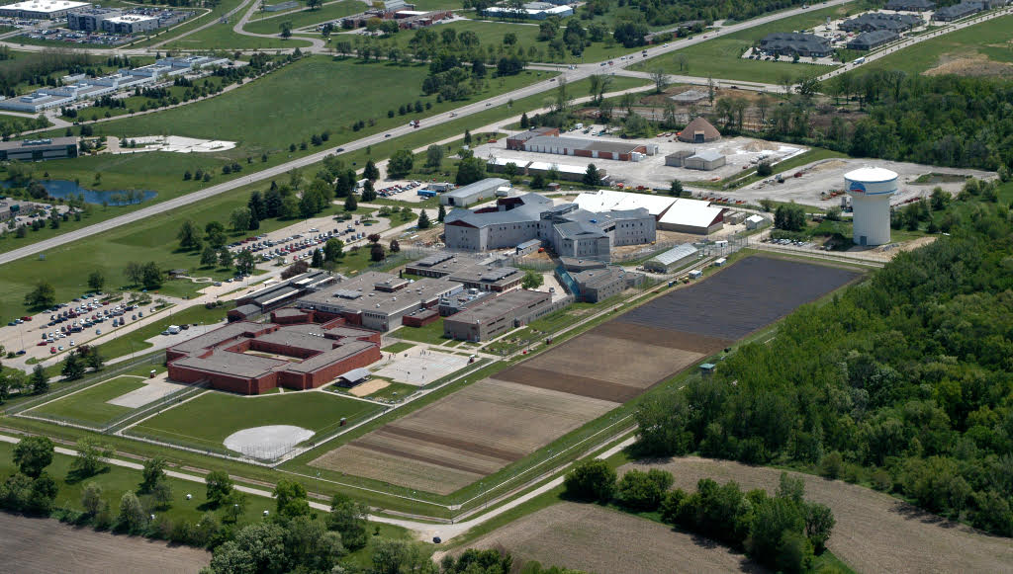
Overview of IMCC
Reception - Houses 483
General Population - Houses 298
Youthful Offender Unit - 6 Adjudicated as adults
Forensic Psychiatric Hospital - 12 Restoration and evaluations
Medical Units - House 78
Mental Health Units - 132 Acute and Subacute mental health patients throughout the department
UIHC/NLMC
Transportation

Slide 4
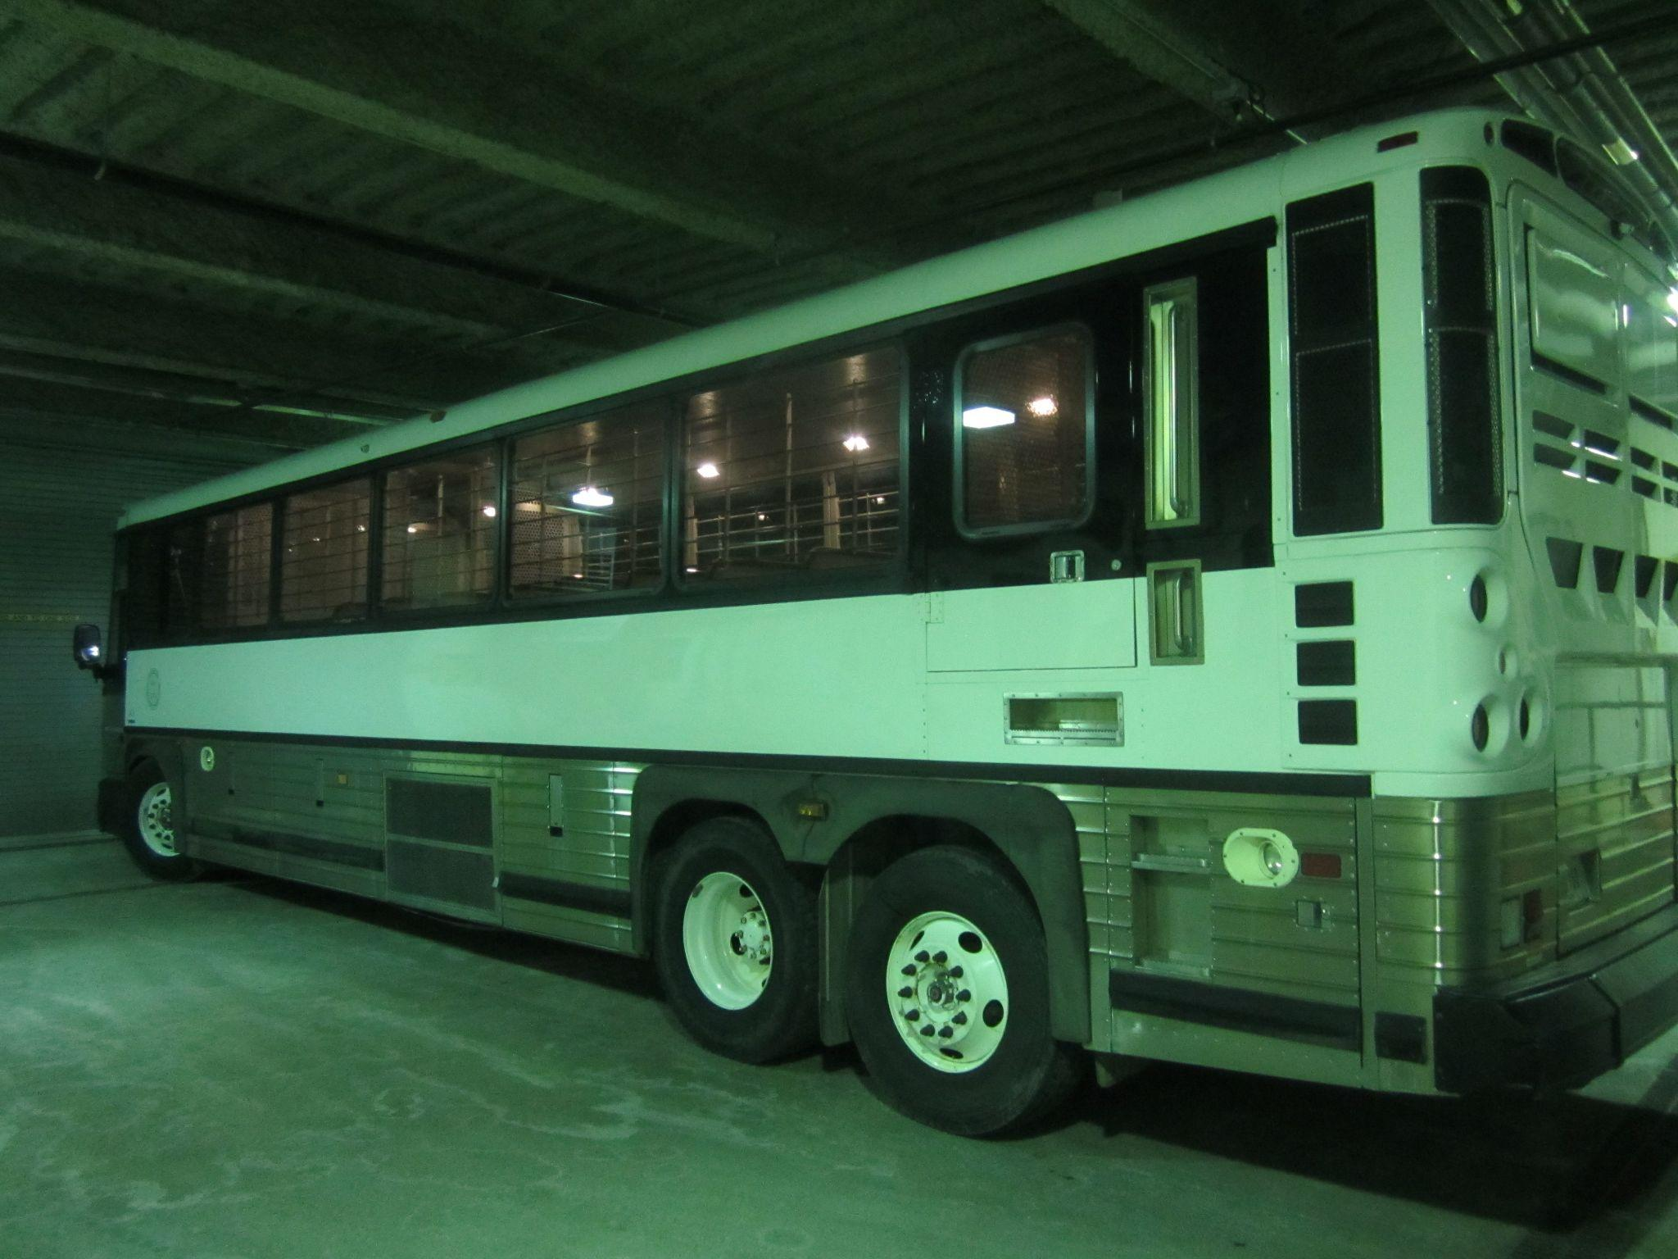
Overview of IMCC
UIHC/NLMC
Transportation
Total Count: 891
Statewide Count: 8486
Community Based Corrections: 41, 212

Slide 5
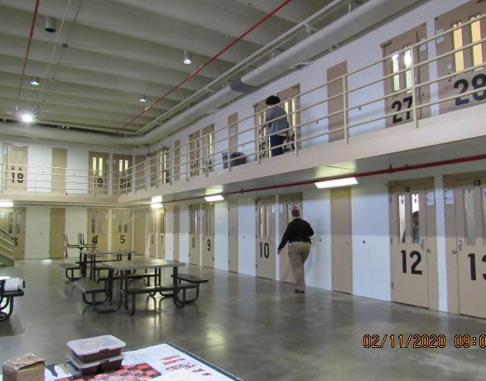
Overview of the Reception and Intake Process for Incarcerated Individuals
Average weekly admissions: 75
Assessments:
Custody
Housing
Educational
Medical/ Mental Health
Programing (IVVI)
Average Length of Stay
Final Placement

Slide 6
Specialized Populations
Reception
Youthful Offender
Forensic Psychiatric Hospital
Medical Units
Mental Health Units

Slide 7
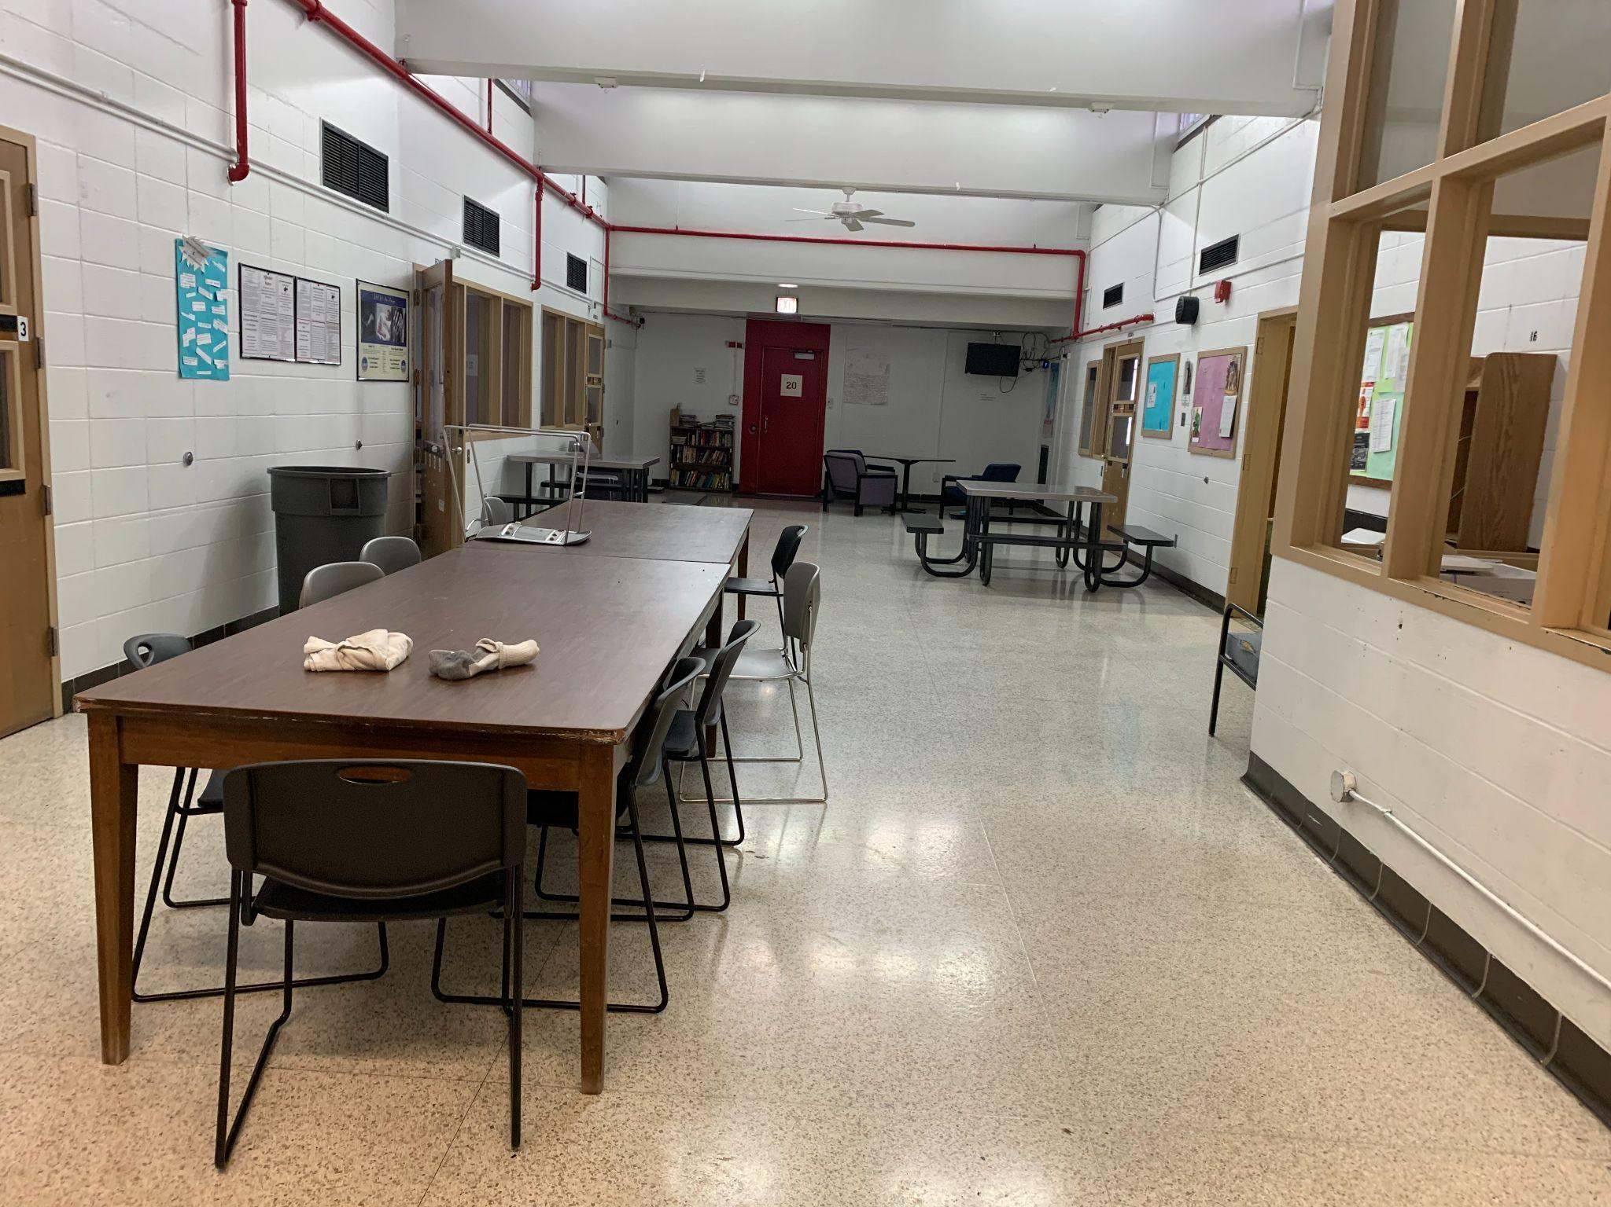
Youthful Offender Unit
Under 18 adjudicated as adults
Programing
Education
Moral Recognation Therapy
Social Skills
Recreation
Federal law requirements
Transition to adult

Slide 8
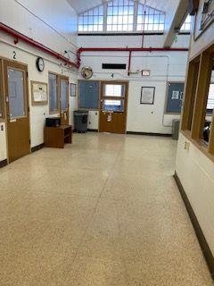
Forensic Psychiatric Hospital
Licensed Psychiatric Hospital (DIAL)
Patients are co-ed
Court ordered for competency 812.3
Inpatient and outpatient
Court ordered for restoration 812.6
Inpatient
Programming
Activities Specialist
Restoration Groups

Slide 9
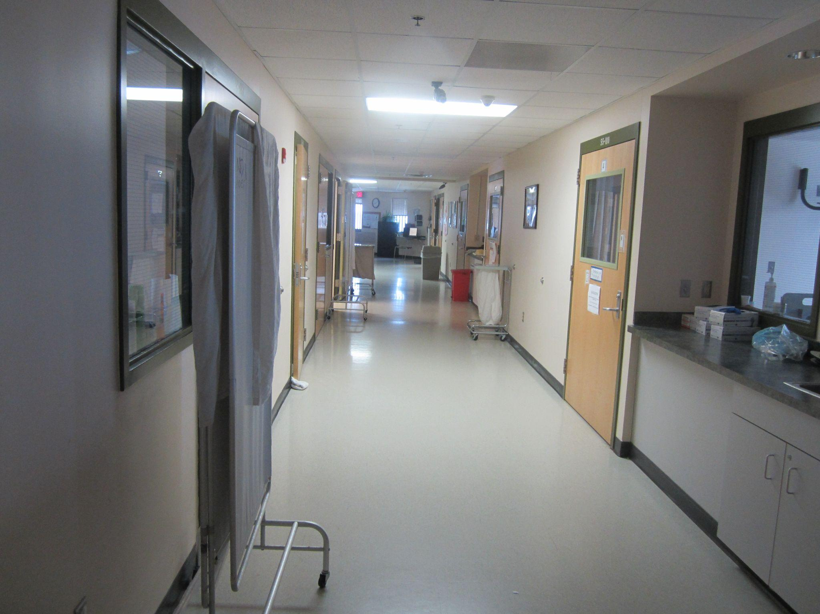
Medical Units
3 Medical Units with different levels of care
Infirmary (6)
Short-Term Ambulatory Care (26)
Long-Term Ambulatory Care (28)
Movement is driven by their medical needs

Slide 10
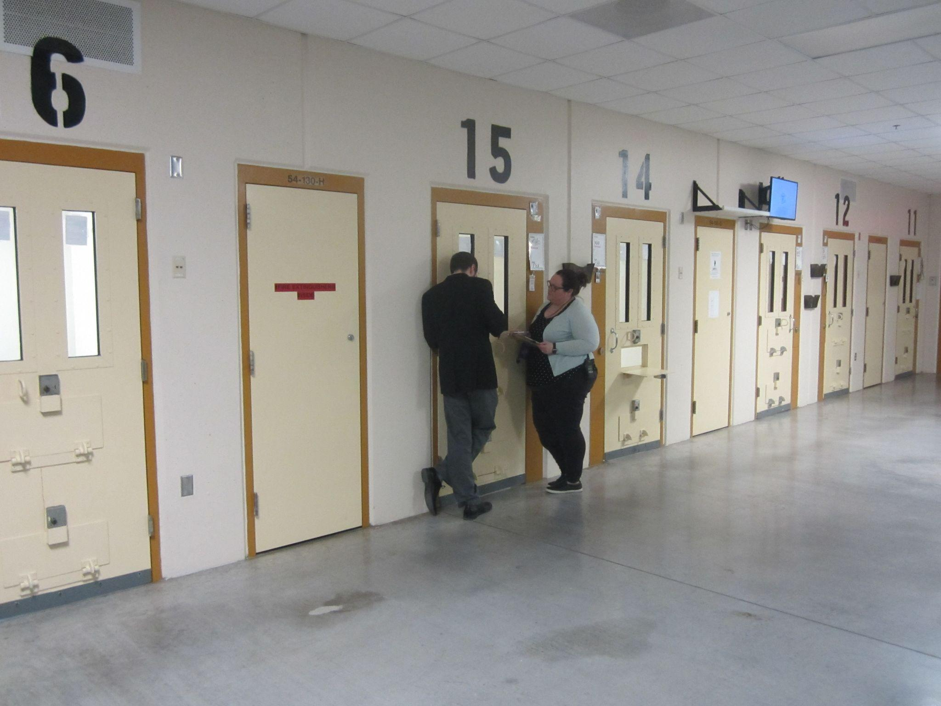
Mental Health Units
5 Mental Health Units
O Unit (16)
M Unit (14)
Q Unit (18)
P Unit (29)
A Unit (47)
Movement driven by their Mental Health Needs

Slide 11
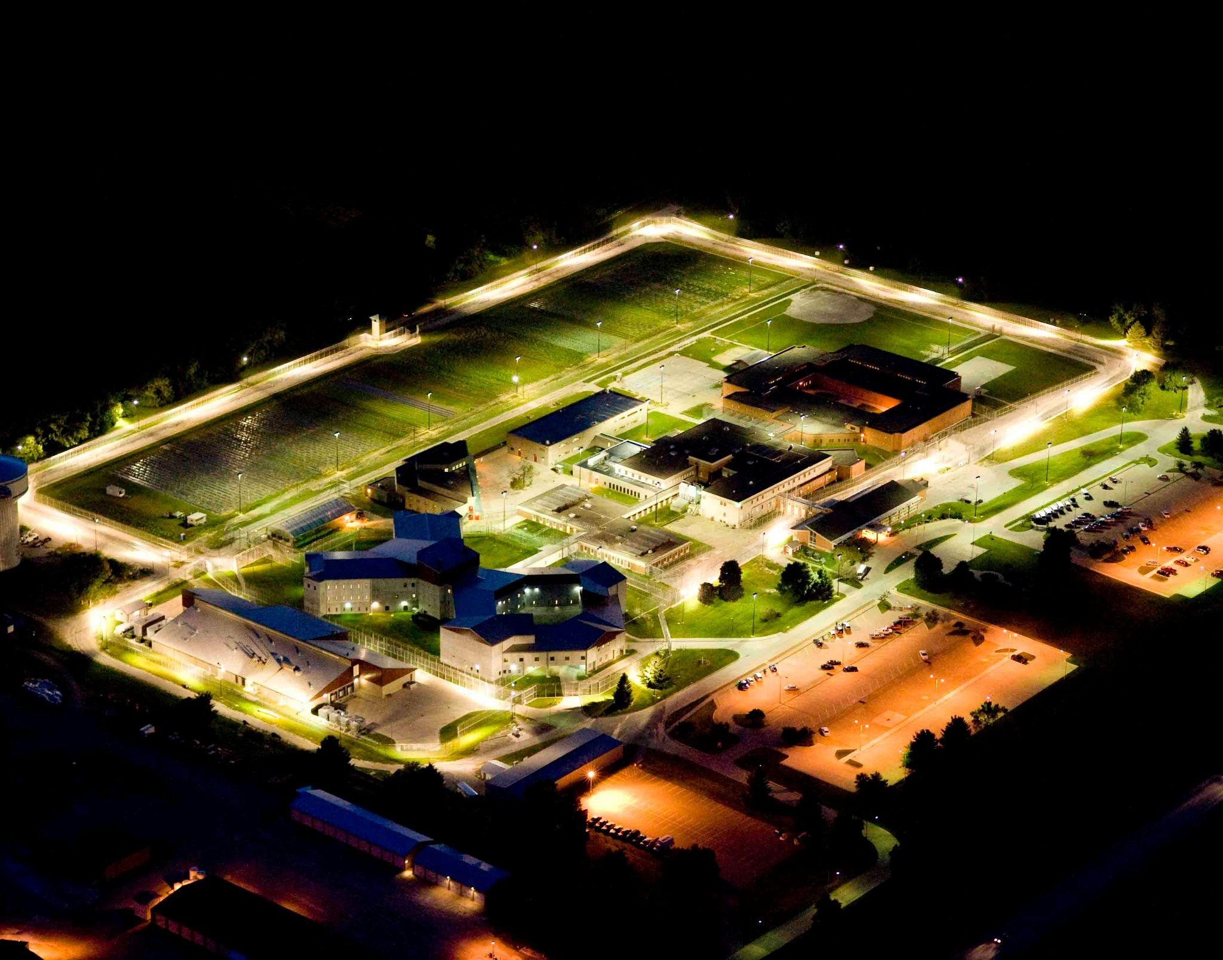
Any Questions?
Thank you for your time!

