Slide 1
HOW LAW PRACTICE HAS CHANGED IN THE LAST 40 YEARS AND WHAT CHANGES MAY BE COMING
Ed Mansfield
Iowa Supreme Court
edward.mansfield@iowacourts.gov
515-490-6266

Slide 2
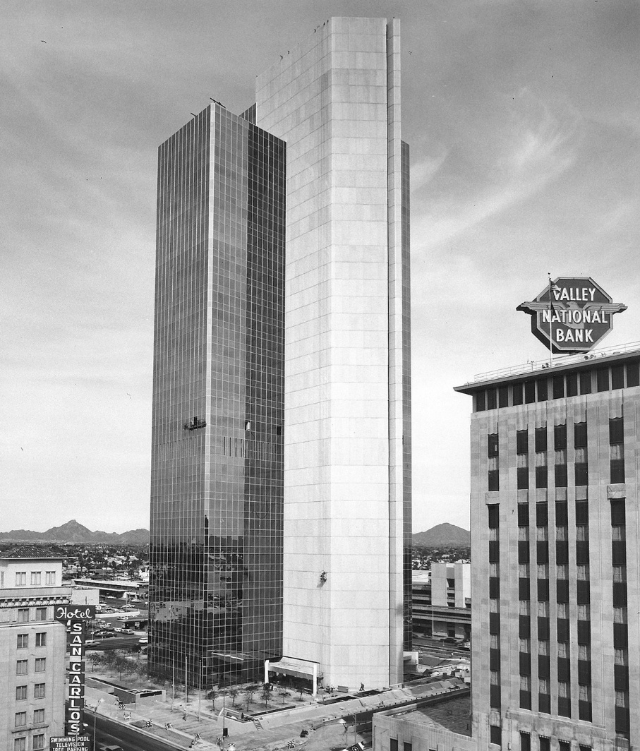
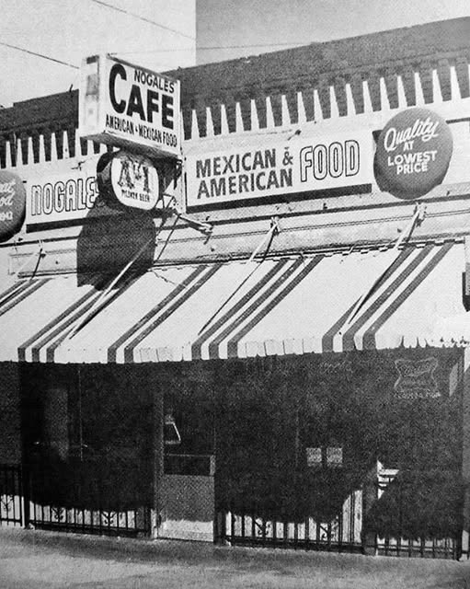

AGENDA
I started practicing law in 1983
Notes:
I started practicing in Phoenix in 1980s.
Toyota Tercel
Miranda of “you have the right to remain silent” fame
Anyone been to Taliesin West
Inside of the offices were bright orange

Slide 3
THE AGENDA
Go backward and then maybe forward
How our work has evolved
Maybe where we are heading
“Then 'tis like the breath of an unfeed lawyer- you gave me
nothing for’t.”
Shakespeare, King Lear, act I, scene 4
Notes:
Interactive

Slide 4
THE 1980s
Bankruptcy
Environmental law
Filings and correspondence are typed on a typewriter, not prepared on a PC, although the PC was starting to appear
Research by the book
“Go Fish” and “Come and get it” discovery
Lots and lots of depositions and trials
Lawyers had assistants answering their calls for them
The fax showed up (replacing the telex)
Notes:
Our law firm, not very big, had a law librarian
Demonstration by IBM

Slide 5
THE 1990s
The rise of tort
Insurance disputes
Products liability
The rise of experts
Video depositions
Long-lasting depositions
Still mostly book research; LEXIS and Westlaw were too expensive
Pleadings and correspondence prepared on the PC; heavy use of the fax
Floppy disks
Lawyers using voicemail and carphones
Notes:
Daubert - 1993

Slide 6
THE 2000s
IP litigation
The rise of mediation; reduction in trials
Limits on discovery emerged
Email and e-discovery arrived; the end of the fax
LEXIS and Westlaw started to supplant book research
After-hours filing
The internet starting to thrive
Flip phones and Blackberries

Slide 7
THE 2010s
Email and text
The internet booms
Scanning and PDFs
Electronic filing
E-discovery with search terms
Traditional law libraries are shrinking and disappearing
Social media emerges
Nobody is using the phone

Slide 8
THE 2020s
Litigation involving the government
Antitrust
COVID and the rise of remote meetings, depositions, and hearings
Everything is recorded somewhere
The rise of AI
E-discovery, research, and writing aided by AI
Pro se, aided by AI

Slide 9
THE LEGAL SYSTEM MOVES SLOWLY
Lots of trends we don’t notice until they have already happened
Examples:
US v. Google
FTC v. Meta
“With lawyers in the vacation, for they sleep between
term and term and then they perceive not how Time moves.”
Shakespeare, As You Like It, act III, scene 2
Notes:
US v. Google – filed at end of first Trump Administration
Google pays Apple $20 billion a year so its search engine is the default search engine on iPhones
People aren’t doing searches anymore. They are asking for AI answers
Google is competing with Claude and Grok and ChatGPT
FTC v. Meta – another case filed at the tail end of the first Trump Admn
Meta monopolizing social networking – acquiring WhatsApp
pp and Instagram
The judge just dismissed the case. People aren’t social networking anymore. They are watching vshort videos preselected by AI – TikTok, Instagram
Case was dismissed a few months agto.

Slide 10
A COMPARISON
1983 – 600K attorneys and 50K paralegals nationally
2025 – 1.3 million attorneys and 375K paralegals nationally
2X increase in attorneys, but a 7X increase in paralegals
Notes:
AI – different answer each time.
You guys are getting more important

Slide 11
WHAT’S NEXT
Historically technology hasn’t reduced the need for legal services; it has just reshaped how they are provided and what law firms do
The experience of my daughter the paralegal
Notes:
The more the clients do for themselves, the more we have to do for them. They mess things up and then we have to help them.

Slide 12
WHAT’S NEXT
A hypothesis – a wealthy country where the social fabric is fraying is more likely to utilize the legal system
We are a wealthy country, although it’s not evenly distributed and it’s tilted in favor of older Americans
Average net worth of a person aged 65 to 74 in the US in 2022?
  $1.8 million – WSJ, Feb. 18, 2026
  The median is far less; but still the number surprised me
Notes:
Germany
Like me

Slide 13
WHAT’S NEXT
The fraying social fabric
Our country is becoming more libertarian at the same time it is adopting more laws/regulations/rules than ever
We are now up to 8 volumes of the Iowa Code
This means more work for the judicial system
Notes:
Backdrop of more work for legal system

Slide 14
WHAT’S NEXT
We as judges are being overwhelmed. Too much to read.
In particular, our court system will have to find a way to deal with the proliferation of pro se, AI-based filings
Some ideas:
  Charge a fee for filings above a certain number
  Have the litigants appear in person to argue their case, instead of making filings
Notes:
For us

Slide 15
WHAT’S NEXT
Summarizing done by AI, but you will be able to do more with those summaries
Contract drafting will be done by AI, but then contracts will be more sophisticated and comprehensive
The use of statistical analyses in litigation, both to analyze events being litigated and litigation risk
What are the odds someone was going to be injured by that sidewalk?
What are the odds this judge will rule for me?
From fantasy football to fantasy judges
Notes:
One judge in the Fifth District

Slide 16
WHAT’S NEXT
Growth areas within law:
  Employment law
  IP law (e.g., NIL)
  Immigration law
  Property and land use law
Notes:
Employment – steady
IP – the right of publicity
Immigration – 15 million Americans who are not legally authorized to be here

Slide 17
WHAT’S NEXT
There will always be a role for personal interaction
Most clients have no idea how good or bad your legal work is, but they know if you return calls and emails
Look at internet reviews of attorneys and see what they criticize law firms for
Young people crave personal interaction; they just get it in different ways
Notes:
Rock concerts

Slide 18
CONCLUSION
Questions?
“The web of our life is of a mingled yarn, good and ill together.”
Shakespeare, All’s Well That Ends Well, act IV, scene 3

