Slide 1
ITG & Title Theft Coverage—Introducing the ALTA 49 Endorsement Series
Dillon D. Malone | Iowa Title Guaranty Director
Iowa Title Guaranty

Slide 2
Title Fraud—What is it?
Someone impersonates the true owner of property and seeks to sell the property to an otherwise legitimate buyer
Often involves an entity seller
Can involve vacant, unimproved land or non-owner-occupied property, sometimes even owner-occupied
Rarely involves property subject to a mortgage
Also called seller impersonation fraud, vacant land fraud, deed fraud
Though still very prevalent and important to keep an eye on, we are not discussing wire fraud today

Slide 3
Title Fraud—Stats
28% of title insurance companies experienced at least one title fraud attempt
85% of companies reported that title fraud was “at least somewhat common” for vacant land transactions
Similar for all-cash transactions and mail-away signing transactions
26% of title fraud transactions were not caught until post-closing

Slide 4
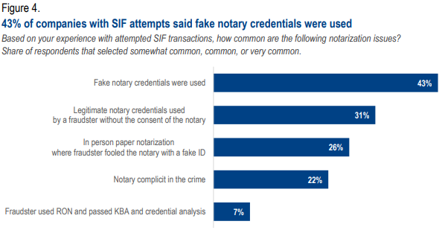
Title Fraud—Stats

Slide 5
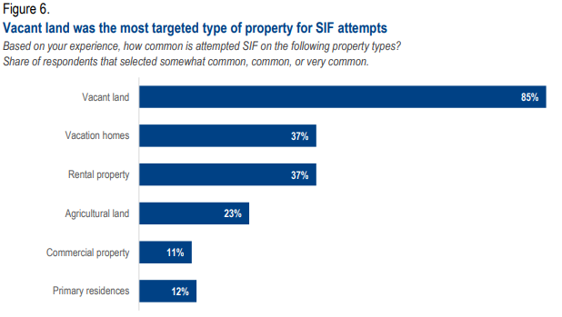
Title Fraud—Stats

Slide 6
National Association of Realtors Data
In a 2025 Study:
63% of all respondents said they were aware of instances of deed fraud in their state or area in the last 12 months
53% of Midwest respondents

Slide 7
Examples
ITG Claim
In May, Buyer purchases 4 acres of unimproved land from a seller, who is a trust. Pays $210,000.00.
In September, Trust calls the County Treasurer to ask why he hasn’t received the tax bill for his 4 acres. Treasurer informs him that it was sold in May.
Trust calls Buyer and Real Estate Agent, who promptly file a claim.

Slide 8
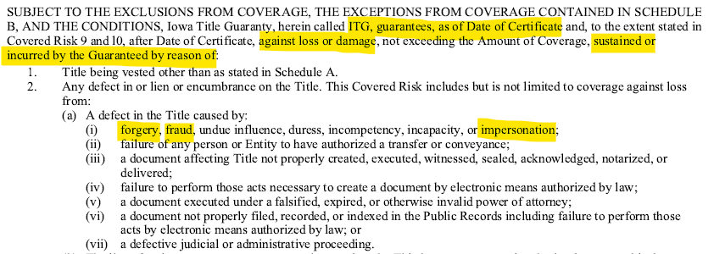
Examples—ITG Claim
Notes:
Once we accepted coverage, we had a valuation done on the property to ensure the property was worth what was paid. Buyer paid $210,000 and valuation came back at $212,000 – 237,000.

Slide 9
Examples—ITG Claim
Claim Resolution
Paid the Amount of Coverage to Buyer -- $210,000.00.
Paid for the preparation of a Quit Claim Deed from Buyer to Trust, along with a title opinion and Owner’s Certificate for Trust.
BUT, parties were not entirely made whole
Tax proration
Work done on the property
Faith in the system?

Slide 10
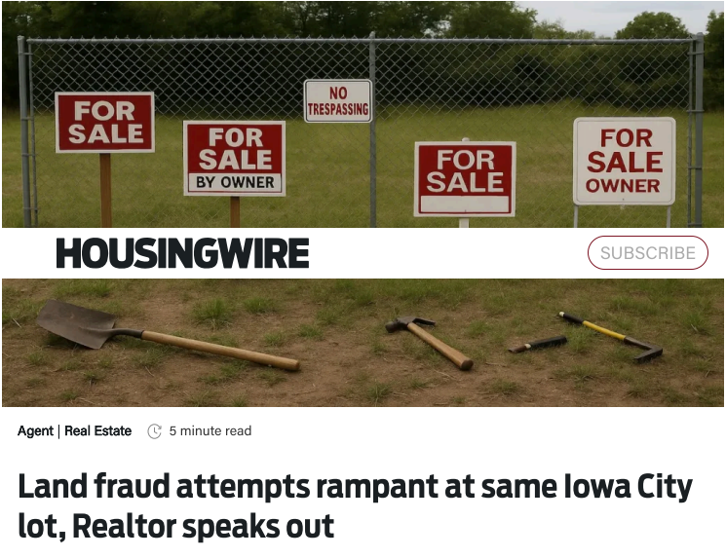
Examples—Iowa City
Notes:
One lot has been the target of more than 10 fraud attempts.
Real owner called 7 hours after it was listed.

Slide 11
Prevention
ALTA Best Practices
Seller Letter
Notification Systems
ITG Coverage
Legislative Fix?

Slide 12
ALTA Best Practices
“ALTA Best Practices Framework: Title Insurance and Settlement Company Best Practices”
Each participating abstractor, attorney, and independent closer with ITG agrees to be bound by ALTA Best Practices
Contains 7 Pillars
Licensure
Escrow controls
Written Information Security Plan (“WISP”)
Consumer financial protection laws and contractual obligations
Policy production
Insurance coverage
Consumer complaints

Slide 13
ALTA Best Practices
Pillar 4 was updated August 2025
Now requires “companies” to “create and implement an identity fraud prevention program”
Includes staff training, controls, ID validation
ALTA also published guidance on Identity Verification
Incorporates in-person verification and software verification
Notes:
In software verification, discuss need to verify photo with ID number and photo in databases

Slide 14
Seller Letter
For a questionable transaction, at the outset of the transaction, send a letter to the seller’s mailing address as shown on the County Assessor’s website
Gives notice to the seller that there is a pending transaction and to call your office if anything is false.

Slide 15
Notification Systems
Title Lock
County Recorder Notification Systems
Notification systems will not stop fraud, but they can help stem the losses

Slide 16
County Notifications System
Polk County
Sign Up for Property Check to Get Notifications - Polk County Iowa
https://www.polkcountyiowa.gov/county-recorder/news/sign-up-for-property-check-to-get-notifications/
Jasper County
PropertyCheck - Recorder - Jasper County Government, Iowa
https://www.jasperia.org/recorder/property_fraud_alert/

Slide 17
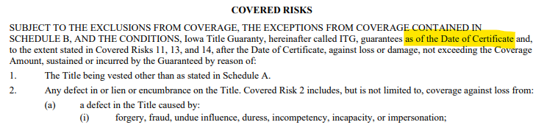
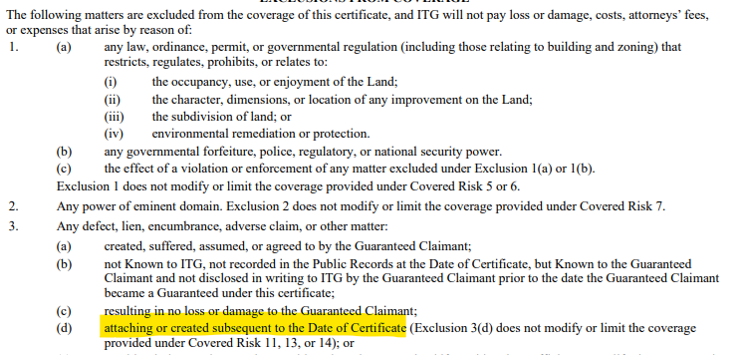
ITG Coverage—Today

Slide 18
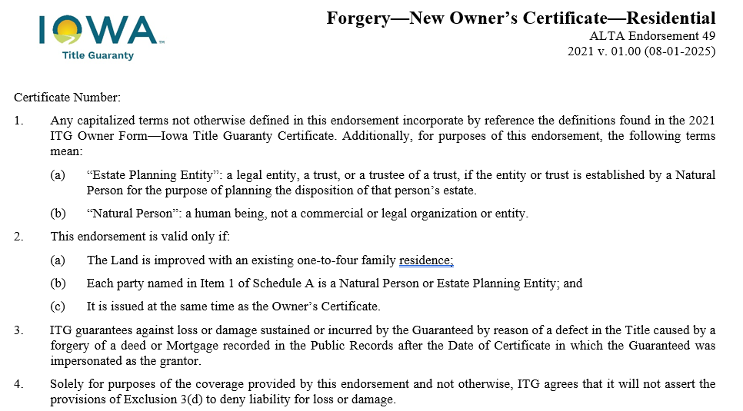
ALTA 49 Endorsement

Slide 19
ALTA 49 Underwriting Requirements
Confirm there is a 1-4 family residence on the property
Confirm the titleholders on Schedule A are an individual or estate planning entity
Ensure the titleholders have signed up for a property fraud alert, if available in their county
Obtain and review CMAs
Obtain and review the ALTA 49 Affidavit
Send the Seller Confirmation Letter

Slide 20
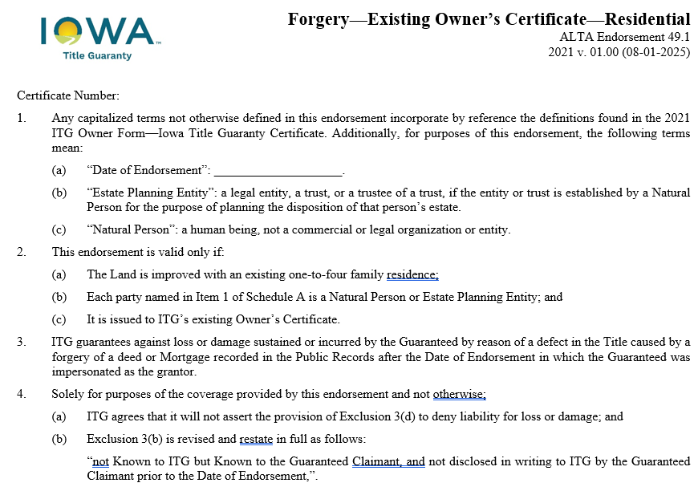
ALTA 49.1 Endorsement

Slide 21
ALTA 49.1 Underwriting Requirements
Review the public records from the Date of Certificate to Present to ensure
The parties in Schedule A are still the titleholders
There is nothing in the records indicating a present fraud/claim of ownership issue
If a lien appears, confirm with the titleholders that they placed it or were aware of it
Confirm there is a 1-4 family residence of the property
Confirm the titleholders on Schedule A are an individual or estate planning entity
Ensure the titleholders are signed up for a property fraud alert, if available in their county
Obtain and review Owner/Seller CMA from the Titleholders
Obtain and Review the ALTA 49.1 Affidavit

Slide 22
Title Theft and Estate Planning
Don’t let the fraudsters prevent you from adequate estate planning!
Estate planning + Insurance/coverage
Life insurance
Property insurance
Title insurance

Slide 23
THANK YOU
Dillon D. Malone | Iowa Title Guaranty Director
Iowa Title Guaranty

