Slide 1
Office of Professional Regulation and the Unauthorized
Practice of Law
ALLISON A. SCHMIDT
DEPUTY DIRECTOR, ATTORNEY DISCIPLINARY BOARD
ADMINISTRATOR, UNAUTHORIZED PRACTICE OF LAW COMMISSION
Iowa Supreme Court
Office of Professional Regulation

Slide 2
Agenda
Overview of the Office of Professional Regulation (OPR)
What is the Unauthorized Practice of Law?
What is the difference between legal information and legal advice?
How can paralegals and other non-attorneys avoid UPL?
What are the ethical implications for attorneys?

Slide 3
Overview of OPR
Iowa Court Rules - Chapter 49
Oversight of attorneys and certified shorthand reporters
Commissions and boards: judges, attorneys, and lay members
Financially supported by attorneys
Over 9,400 active Iowa attorneys
Notes:
OPR was established by Chapter 49 of the Iowa Court Rules
OPR has the responsibility to administer the functions of the various boards and commissions of the Iowa Supreme Court.
Oversight of attorneys and certified shorthand reporters
Commissions and boards administered by our office are a key vehicle for supervision of Iowa attorneys
The Commissions and boards are comprised of judges, attorneys and lay persons
Financially supported primarily by attorneys, completely without resort to tax dollars
Oversight of over 9,400 active Iowa attorneys – number fluctuates as attorneys retire and join the profession, but this is roughly the number
…
Principle Objectives of OPR:
Maintain and enhance the professional responsibility and professional competence of Iowa attorneys
Compensate persons monetarily damaged through dishonesty of Iowa attorneys
Help support legal services for low-income persons and law-related education

Slide 4
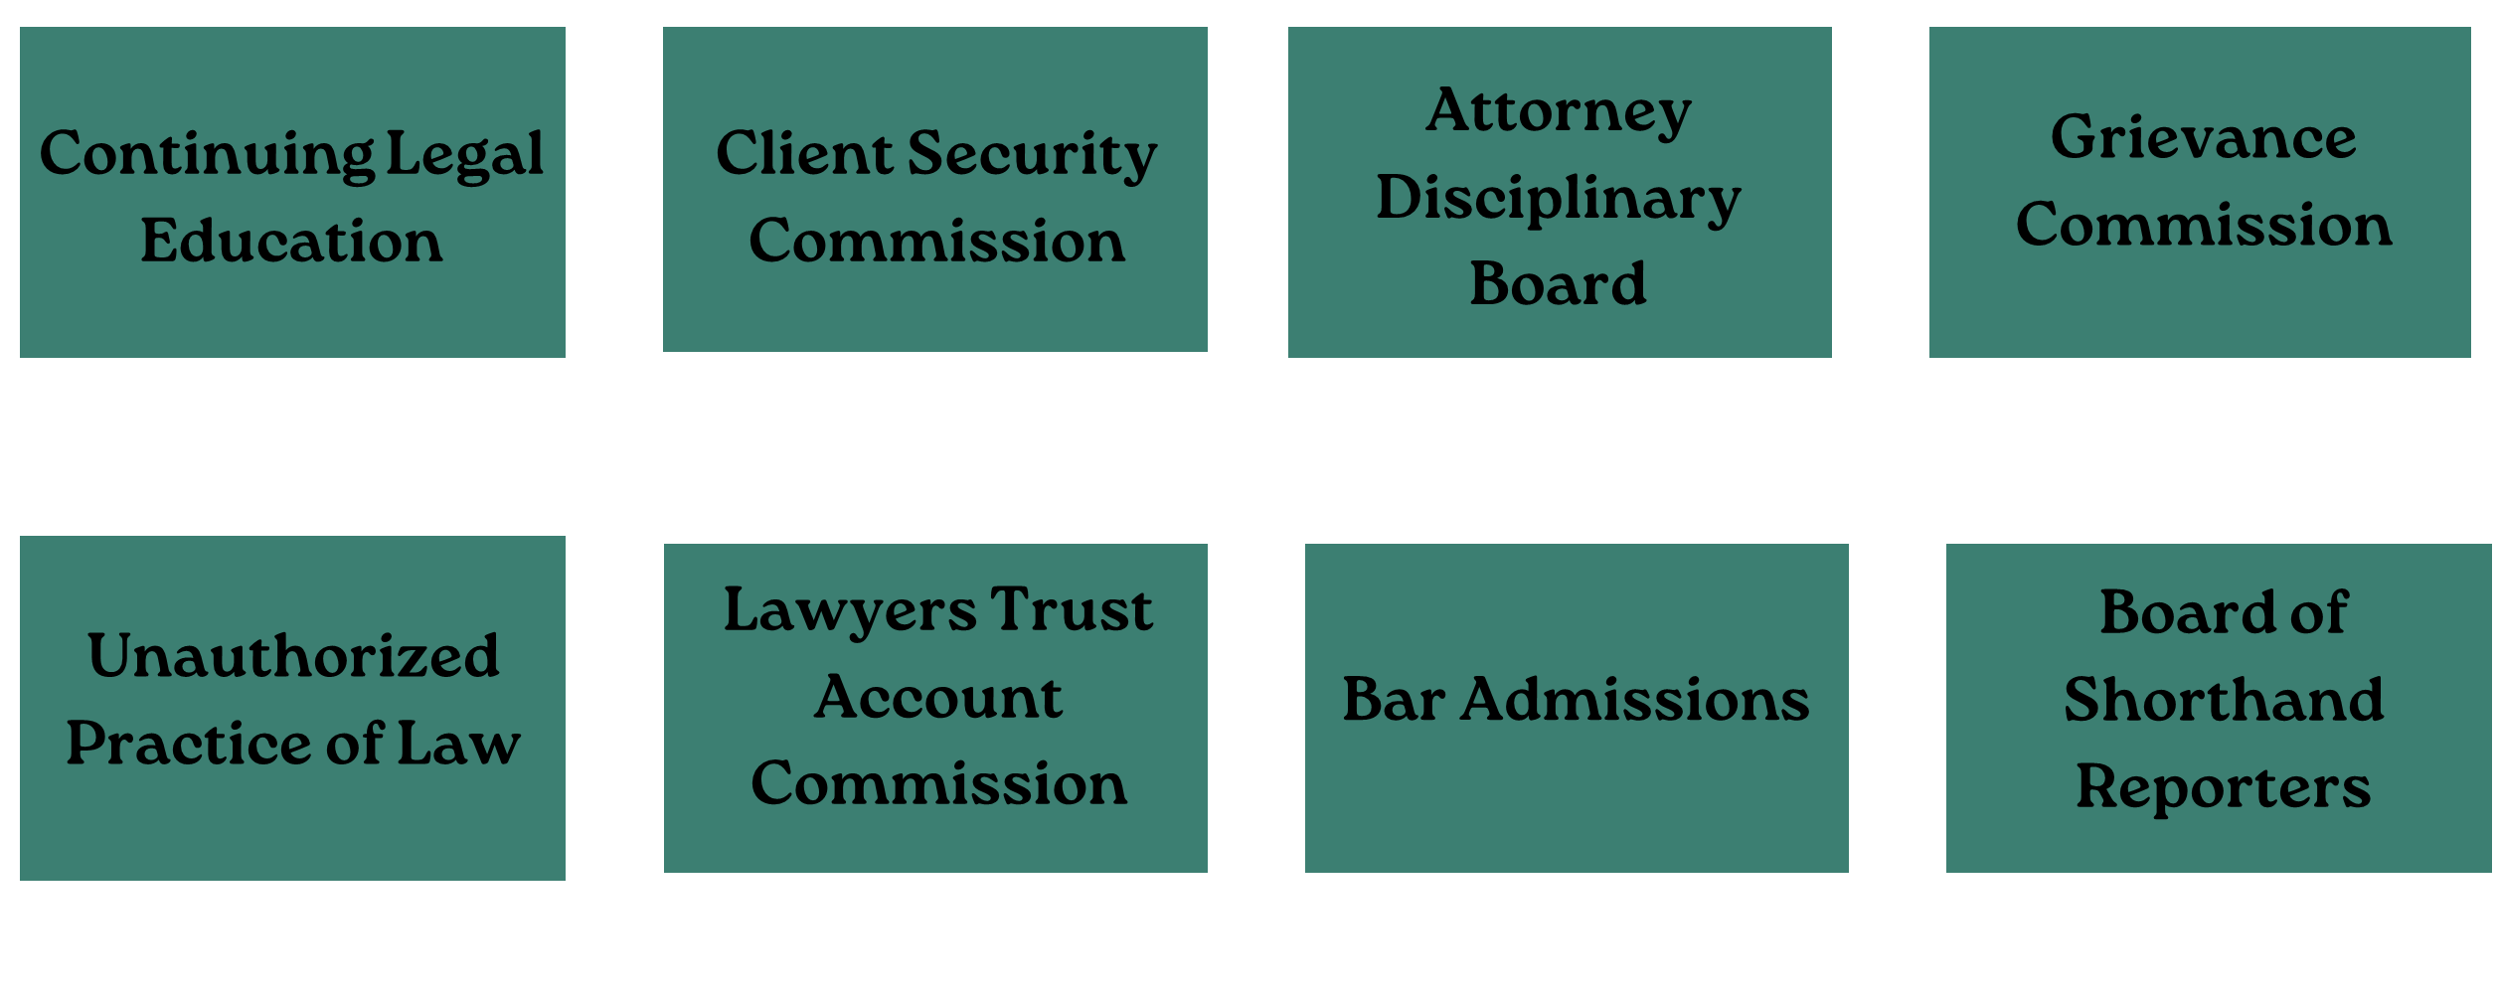
OPR Boards & Commissions

Slide 5
OPR Boards & Commissions
Notes:
CLE
The CLE Commission administers the continuing education program for Iowa attorneys.
The Commission on Continuing Legal Education (CLE) is made up of 10 attys and 2 lay members appointed by the Court. Can serve 2 3-year terms
The Commission’s staff reviews and approves every CLE event submitted for approval in Iowa.
More than 13,000 CLE events are reviewed each year.
If a program is denied, the decision can be appealed to the commission. The commission will review and make a final decision on accreditation.
The Commission meets twice per year.

Slide 6

OPR Boards & Commissions
Notes:
Client Security
The CS Commission administers the Client Security Trust Fund, which is totally attorney-funded.
The Client Security Commission is comprised of 5 attorneys and 2 lay members
The Client Security Trust Fund reimburses claims based on dishonesty of Iowa attorneys engaged in practice or fiduciary duties, subject to certain limits and the discretion of the commission.
The fund does not cover malpractice, fee disputes, or quality or quantity of service issues.
Trust account auditors employed by the commission perform regular periodic and on-demand special audits of all attorney trust accounts in Iowa.
The Commission meets twice per year.

Slide 7
OPR Boards & Commissions
Notes:
Lawyers Trust Account Commission
The Lawyer Trust Account Commission administers the Interest on Lawyer Trust Account (IOLTA) program.
The IOLTA program produces interest income from pooled trust accounts that were not interest-bearing prior to initiation of the program.
Banks forward interest on pooled trust accounts to the commission no less often than quarterly.
The Supreme Court approves grants from IOLTA funds each year to help support legal services to the poor and law-related education.
Receipts of over $25 million have been distributed since the commission's founding in 1985.
The Commission meets twice per year.

Slide 8
OPR Boards & Commissions
Notes:
Board of Law Examiners
The Board of Law Examiners reviews the qualifications of law school graduates seeking admission to practice law in Iowa.
The board administers the Iowa Bar Examination to assess the legal knowledge and skills of bar applicants.
The board supervises the grading of the examination and recommends to the Supreme Court all applicants who pass the examination and who meet the character and fitness requirements.

Slide 9
OPR Boards & Commissions
Notes:
Board of Examiners of Shorthand Reporters
The Board of Examiners of Shorthand Reporters administers the examination and certification process for shorthand reporters in Iowa.
The board also administers continuing education requirements and disciplinary actions with respect to shorthand reporters.
The board advises the court on policies regarding shorthand reporting in Iowa.
The Board meets twice per year.

Slide 10
OPR Boards & Commissions
Notes:
Let’s turn to attorney discipline, which includes the ADB and GC, so we’ll talk about them together.

Slide 11
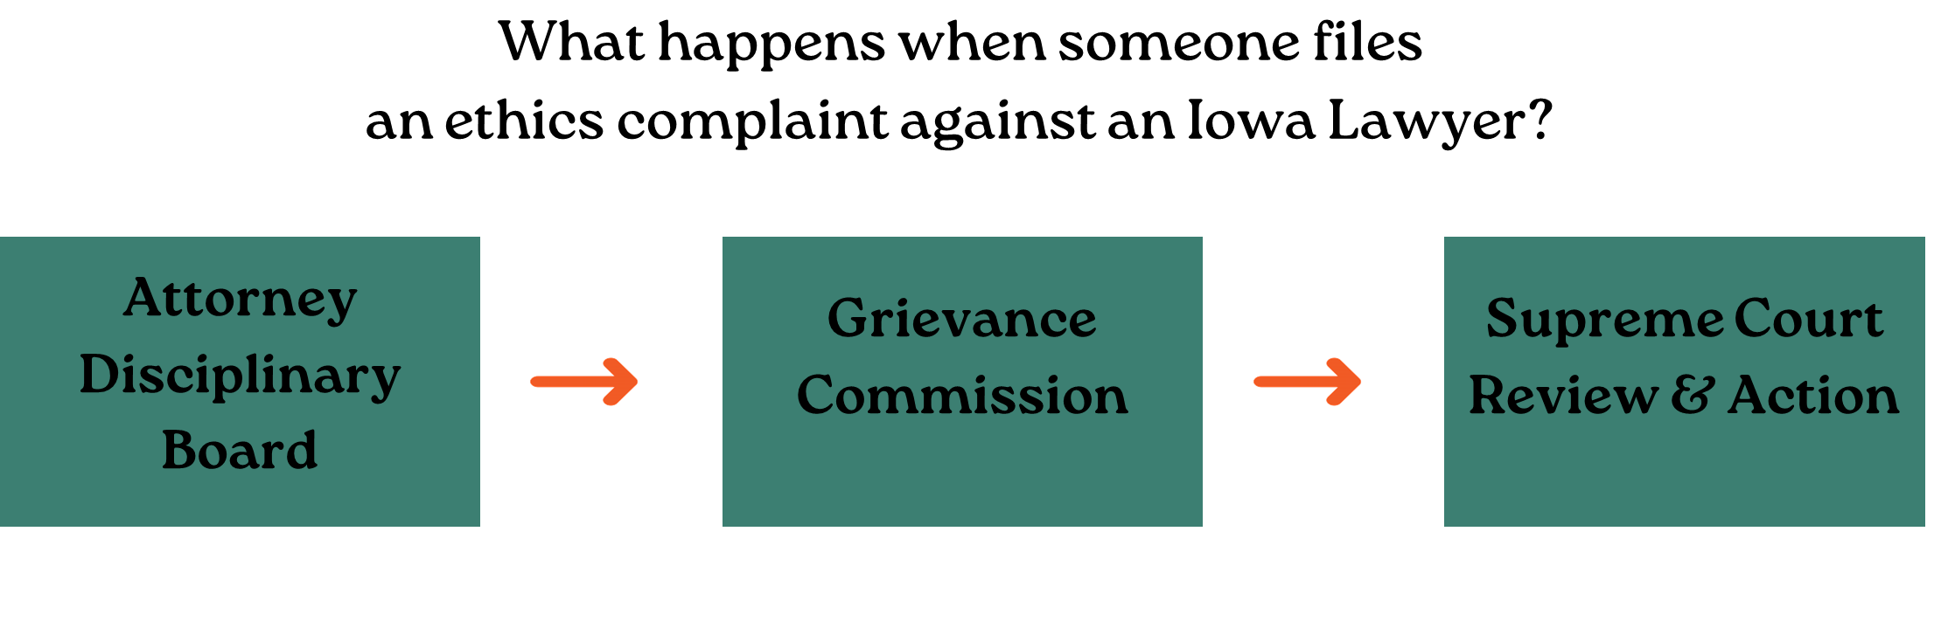
Attorney Discipline
Notes:
Attorney Disciplinary Board
The Attorney Disciplinary Board receives and investigates complaints of alleged unethical conduct by Iowa attorneys and attorneys practicing in Iowa (includes pro hac, out of state attorneys)
If ADB determines there is any merit to the complaint, the attorney will get a chance to respond.
Board meets quarterly to review complaints and make determinations
Many complaints are resolved at the ADB level. A small fraction go to Grievance.
The Board may dismiss, admonish, reprimand (with Court concurrence), or prosecute a complaint before the Grievance Commission.
Grievance Commission
The Grievance Commission hears the ethics complaints formally prosecuted by the Attorney Disciplinary Board.
Over 125 unpaid volunteers, appointed by the court. The GC is physically and operationally separate from the ADB.
GC holds fact-finding hearings on ethical complaints not able to be resolved through the ADB process
Accepts complaints only from the ADB ethics counsel
The Grievance Commission may dismiss, admonish, or recommend discipline to the Supreme Court.
There is no set schedule of meetings for the Grievance Commission as they are convened on an "as needed" basis.
-Clerk of the Grievance Commission maintains the case docket, serves as “trial court” clerk
-Chair of the Grievance Commission appoints a Division (5 members + 2 alternates) to hear the case, designates a President
-Division President rules on motions, issues orders
Rules of Civil Procedure apply
-Hearings are closed, filings are confidential
Filings are confidential unless the commission ultimately recommends public discipline, in which case complaint and report become public
Division may dismiss; issue private admonishment; or recommend public reprimand, suspension or revocation of license
Majority vote of division controls; dissenting opinions are permitted
Supreme Court Review & Action
Court may impose a lesser or greater sanction than recommended by the division
Disposition may range from dismissal of charges through revocation of license
Suspensions usually range from one month to three years
Revocation – may apply for readmission after 5 years.

Slide 12
OPR Boards & Commissions
Notes:
Moving on now to the main attraction: the Unauthorized Practice of Law

Slide 13

Commission on the Unauthorized Practice of Law

Slide 14
What is the unauthorized practice of law (UPL)?
First, we must ask:
  What is the practice of law?
  Who is authorized?
  Who is not authorized?
    (and why not?!)

Slide 15

What does “practice of law” even mean?
I don’t know how to be any clearer, David.
Notes:
Not easy to define. This is why we have an entire commission dedicated to reviewing complaints.

Slide 16
Practice of Law
Baker (1992) “It is neither necessary nor desirable to attempt the formulation of a single, specific definition of what constitutes the practice of law.”
ABA Task Force on the Model Definition of the Practice of Law (2003) declined to adopt a model definition
  Provided guidance and encouraged states to craft their own
Iowa Court Rule 32:5.5, comment 2:
“The definition of the practice of law is established by law and varies from one jurisdiction to another. Whatever the definition, limiting the practice of law to members of the bar protects the public against rendition of legal services by unqualified persons.”
Notes:
Goal – protect the public

Slide 17
One Definition in the
Iowa Court Rules
Rule 41.9(3): “The practice of law as that term is employed in this rule includes: the examination of abstracts; consummation of real estate transactions; preparation of legal briefs, deeds, buy and sell agreements, contracts, wills, and tax returns; representation of others in any Iowa courts; regular preparation of legal instruments, securing of legal rights, advising others as to their legal rights or the effect of contemplated actions upon their legal rights, or holding oneself out to so do; instructing others in legal rights; being a judge or one who rules upon the legal rights of others unless neither the state nor federal law requires the person so judging or ruling to hold a license to practice law.”
Notes:
This Rule deals with CLE reciprocity for out-of-state attendance of equivalent hours for attorneys not practicing law in Iowa. Very similar language appears in Iowa Court Rule 34.23(4), which lists activities suspended attorneys must refrain from performing.

Slide 18
A practical definition
“Practically speaking, professional judgment lies at the core of the practice of law. When lawyers use their educated ability to apply an area of the law to solve a specific problem of a client, they are exercising professional judgement.” Comm’n on Prof’l Ethics & Conduct v. Baker, 492 N.W.2d 695, 701 (Iowa 1992).
Professional judgment
Applying the law to solve a specific problem
Notes:
Essentially, do not apply law to the facts of the case, and do not give directions of what should be done in any aspect of the legal process

Slide 19
Who is “authorized”?
Iowa Attorneys (with an active license)
Non-Iowa Attorneys
  Multi-Jurisdictional Practice – Rule 32:5.5
  Emeritus Attorney – Rule 31.19
  Emergency Services – Rule 31.17
  Pro Hac Vice – Rule 31.14
  Some Admin. Proceedings – Rule 31.14
  In-House Counsel – Rule 31.16
Non-attorneys
  Domestic Violence and Sexual Assault Victim Counselors – Rule 37.4
  Limited Real Estate Practice – Rule 37.5
  Law Students/Recent Grads – Rule 31.15
  Accredited Representatives – 8 CFR § 292.2
  Small Claims Exception - Iowa Code § 631.14(1)
  Property Management – Iowa Code § 631.14(2)
Notes:
Iowa Attorneys with an active license (not inactive/exempt, suspended, retired, or revoked).
Attorneys licensed in another jurisdiction – limited practice
Emeritus – could be exempt, retired, or admitted in another jurisdiction; legal services only, supervised (exception for COVID hotline)
Non-attorneys – non-exhaustive list (USPTO, bankruptcy, other federal entities)

Slide 20
Small Claims Exception
Iowa Code § 631.14(1):
  “Actions constituting small claims may be brought or defended by an individual, partnership, association, corporation, or other entity. In actions in which a person other than an individual is a party, that person may be represented by an officer or an employee.”
Iowa Code § 631.14(2):
  Residential Rental Property
  Employee of titled owner OR property management employee/officer

Slide 21
Document Preparers
Non-UPL
Potential UPL
Provide legal forms but don’t provide assistance in completing the forms
Provide legal forms AND provide assistance/advice on how to complete the forms
File forms
Fact question: How much assistance is too much assistance?
Notes:
What about selecting the forms? Does a person walk into an office and say “I need you to complete the following immigration forms for me?” Not likely.

Slide 22
UPL Commission
Commission of the Iowa Supreme Court
Considering, investigating, and seeking prohibition of UPL matters
Prosecuting alleged offenders
Iowa Court Rule 38.1
Notes:
Makeup of the Commission (7 attorneys, 2 laypeople)
Meet 4 times a year
My job as administrator
---investigation process, approval by commission—ultimately the commission directs me after I make recommendations

Slide 23
The UPL Commission Toolbox
Injunction/Contempt
Letter of Inquiry
Other Inquiries
Refer to Other Agencies
Public Announcement
Notes:
Injunction – commission reviews a number of factors (harm to public, number of complaints, foreseeable to continue in the future, likelihood of success in court).
Letter of inquiry to respondent – sometimes this is enough
Inquiries from complainants – investigation – follow up with complainants or other witnesses
Refer to other agencies – AG consumer protection – they have more powerful tools (Online Divorce Technology– form-filling software instructing people to file documents on paper after EDMS, so people were paying them and they were doing it wrong, also charging for monthly subscription service; AG got settlement for 200 Iowans)
Press releases – Law grad UPLing in Fairfield – had worked in law office and was taking people’s money

Slide 24
Rule 37.2(1) Injunction
Reasonable belief someone is:
  Engaging in the practice of law; or
  Holding out as qualified to provide services constituting the practice of law in this state….
Could result in a permanent injunction
Notes:
Commission can make a finding under this rule
Practical effect of the injunction: watch yourself!

Slide 25
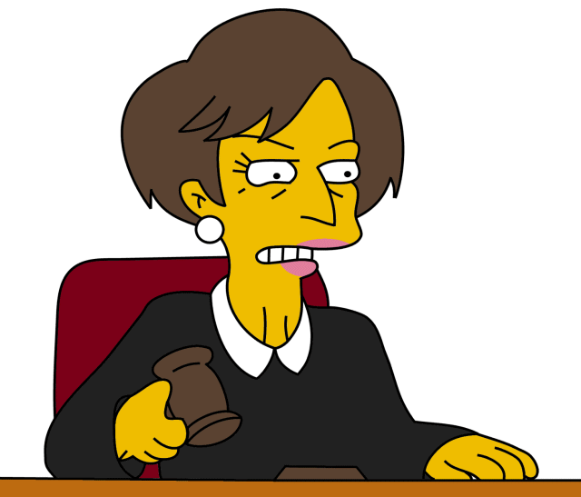
Next Step: Contempt!
Notes:
After injunction entered, UPLer could be held in contempt for violation of a court order. Need to bring a contempt (show cause) action, hold hearing.

Slide 26
§ 665.3(2) Contempt
…any court of record may punish the following acts or omissions as contempts:
Assuming to be an officer, attorney, or counselor of the court, and acting as such without authority.
Not initiated by the UPL Commission but sua sponte by the court.
Notes:
Another type of contempt – sua sponte by judge.
Comes up when someone appears in court – it happens, and sometimes we get complaints from judges or attorneys (but not always).

Slide 27
How to file a complaint
Send UPL complaint form via mail or email to: UPL@IowaCourts.gov
All complaints are confidential – no copy sent to the respondent unlike attorney discipline
  Note: if injunction sought, filed docs are public under the rules
Remedy: Injunction = prevent future action
Goal of protecting the public
Notes:
You may file a complaint and never hear what the outcome is.

Slide 28
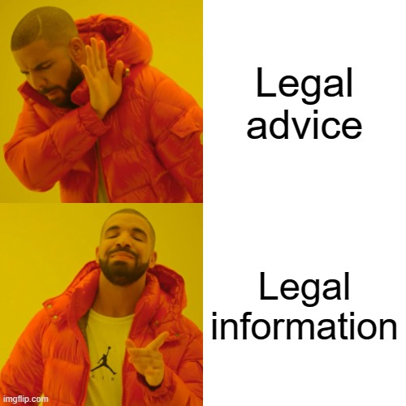
How can non-attorneys avoid UPL?

Slide 29
Legal Information
Generally:
  Describe and explain court procedures, the law, or legal terminology without interpretation, reference or application to a specific actual or potential case or situation.
For paralegals:
  Inform clients of the date of a hearing or deadline.
  Inform clients of the next step in the legal process.
Notes:
Legal Information is a written or oral statement that describes and explains court procedures, the law, legal terminology and options available to court users without interpretation, reference or application to a specific actual or potential case or situation.
For paralegals specifically – inform clients. I’m sure I’m missing lots of things a paralegal does

Slide 30
Legal Advice
Applies or interprets the law as it relates to an actual or potential case or situation and/or recommends a specific course of action for the case or situation.
Telling a client what their chances are of winning.
Formulating a legal strategy for client.
Drafting documents/letters without an attorney’s review.
Notes:
Legal Advice is a written or oral statement that applies or interprets the law as it relates to an actual or potential case or situation and/or recommends a specific course of action for the case or situation.
Generally, questions seeking legal advice contain the words “should I” or “whether.”

Slide 31
Ethical Obligations
NALA Code of Ethics and Professional Responsibility
Canon 1
A paralegal must not: (a) engage in, encourage, or contribute to any act which could constitute the unauthorized practice of law; and (b) establish attorney-client relation­ships, set fees, give legal opinions or advice or represent a client before a court or agency unless so authorized by that court or agency; and (c) engage in conduct or take any action which would assist or involve the attorney in a violation of professional ethics or give the appearance of professional impropriety.
Notes:
Many of the canons address UPL, but Canon 1 focuses on it specifically (canon 1 – duties of attorneys; canon 2 – delegation and supervision).
No UPL!
No attorney-client relationship
No setting fees
No legal opinions or advice
No representation before court or agency (unless permitted)
No assisting atty in violating ethics or giving appearance of professional impropriety

Slide 32
Tips for Avoiding UPL
Do not apply law to specific facts
You may:
  Direct to resources
  Define common legal terms
  Recite common court rules/procedures
Don’t recommend specific action
Don’t make guarantees
Stick to a script or pre-approved responses for individual legal issues
When in doubt, ask a supervisor or say you can’t give legal advice but an attorney will get back to them
Notes:
2. Resources include pertinent statutes, Judicial Branch Forms, ISBA forms,—direct to attorney
3. Looking back to the definition of what constitutes UPL—examples, who to sue, how much to ask for, theories,
4. Attorneys really shouldn’t even make guarantees. But you also don’t want to say “in your situation, a judge is likely do this” Why not? Applying law to facts.
Be like a mall directory: there are shoe stores here, but don’t say which shoes to buy…or be like Siri—shows a list of restaurants, but won’t tell you what to eat, or even to eat

Slide 33
Tips for Avoiding UPL
Do not provide legal advice, draft documents, etc. unless you are working under the direct supervision of an attorney licensed in Iowa and have been instructed to do so.
Important to have good communication between non-attorney staff and supervising attorney.

Slide 34
Rule 32:5.3 Responsibilities Regarding Nonlawyer Assistance
Managing attorneys must make reasonable efforts to ensure the firm has measures in effect giving assurances that nonlawyer conduct is compatible with the professional obligations of the lawyer.
Any attorney having direct supervisory authority over a nonlawyer must ensure that person’s conduct is compatible with professional obligations.
An attorney is ultimately responsible for a nonlawyer’s violation of the rules of professional conduct if:
  1) the attorney orders or ratifies the specific conduct; or
  2) knows of conduct but fails to take action when consequences could have been avoided.
Notes:
“nonlawyer” is word used in the rules – presumably to cover all non-attorney staff
Managing attorneys – ensure firm has measures in effect (internal policies)
Any attorney having direct supervisory authority over a nonlawyer must ensure that person’s conduct is compatible with professional obligations.
A supervising attorney is ultimately responsible for a nonlawyer’s violation of the rules of professional conduct if the attorney orders or ratifies the specific conduct, or knows of conduct but fails to take action when consequences could have been avoided.

Slide 35
Rule 32:5.3, Comment 2
Nonlawyers Within the Firm
[2] Lawyers generally employ assistants in their practice […] A lawyer must give such assistants appropriate instruction and supervision concerning the ethical aspects of their employment, particularly regarding the obligation not to disclose information relating to representation of the client, and should be responsible for their work product. The measures employed in supervising nonlawyers should take account of the fact that they do not have legal training and are not subject to professional discipline.
Notes:
Within the firm
Lawyer must give appropriate instruction and supervision concerning ethical aspects of their employment, particularly regarding the obligation not to disclose information (confidentiality)
Lawyer is responsible for work product
Do not have legal training (maybe not exactly true for paralegals, law grads)
Not subject to discipline
Within firm allows for closer supervision (ideally)

Slide 36
Rule 32:5.3, Comment 3
Nonlawyers Outside the Firm
[3] A lawyer may use nonlawyers outside the firm to assist the lawyer in rendering legal services to the client. […] When using such services outside the firm, a lawyer must make reasonable efforts to ensure that the services are provided in a manner that is compatible with the lawyer’s professional obligations. […]When retaining or directing a nonlawyer outside the firm, a lawyer should communicate directions appropriate under the circumstances to give reasonable assurance that the nonlawyer’s conduct is compatible with the professional obligations of the lawyer.
Notes:
Examples include the retention of an investigative or paraprofessional service, hiring a document management company to create and maintain a database for complex litigation, sending client documents to a third party for printing or scanning, and using an Internet-based service to store client information.
See also rules 32:1.1 (competence), 32:1.2 (allocation of authority), 32:1.4 (communication with client), 32:1.6 (confidentiality), 32:5.4(a) (professional independence of the lawyer), and 32:5.5(a) (unauthorized practice of law).
Importance of clear communication to ensure conduct is compatible with lawyer’s professional obligations.

Slide 37
Attorney Disciplinary Cases
Dunahoo (2011)
  Multiple ethical violations alleged.
  Assistant mistakenly told client they needed to pay a $1200 fee.
  When a nonlawyer makes a mistake that is not a direct consequence of the attorney’s inattentive supervision, the attorney does not violate rule 32:5.3.
  No finding of violation of 32:5.3.
  Iowa Sup. Ct. Att’y Disciplinary Bd. v. Dunahoo, 799 N.W.2d 524, 534 (Iowa 2011).
Notes:
Multiple ethical violations alleged (violation of court order, competence, trust accounting, communication…), including 32:5.3
Client called the office after not receiving documents the attorney promised to send. Talked to assistant who mistakenly told them they needed to pay $1200 to file a bankruptcy petition.
Court found that it was plausible the assistant simply made a mistake that was not a direct consequence of inattentive instruction or supervision by Dunahoo. The Court found insufficient evidence Dunahoo failed to make “reasonable efforts” to prevent this incorrect billing communication.
He was suspended for one year for all of the other ethical violations.

Slide 38
Attorney Disciplinary Cases
Barnhill (2014)
  Multiple ethical violations.
  Employee had previously embezzled money from the law firm.
  Attorney allowed employee to continue handling money, including client funds, and to sign the attorney’s name on trust account checks.
  Attorney took some measures, but not enough. Employee stole again.
  Attorney suspended for sixty days.
Iowa Sup. Ct. Att’y Disciplinary Bd. v. Barnhill, 847 N.W.2d 466 (Iowa 2014).
Notes:
Barnhill had supervisory authority over her employee and was aware her employee had previously embezzled money from the law firm.
Barnhill specifically authorized and directed the employee to handle money and continued to allow the employee to sign Barnhill's name on trust account checks. The employee completed these acts without Barnhill's supervision. The employee subsequently wrote at least one check payable to herself from the trust account, and Barnhill eventually fired her for her unauthorized use of the law firm's line of credit.
Court noted that Barnhill attempted to supervise her employee. However, these measures were inadequate. Barnhill failed to reasonably supervise her employee. She could have prevented the employee's conduct of stealing money from the trust account with reasonable supervision, particularly when she was aware of her employee's prior embezzlement. Thus, the court found that Barnhill violated the rule and suspended for 60 days.

Slide 39
Attorney Disciplinary Cases
Mathahs (2018)
Attorney overbilled the State Public Defender (hours, mileage).
Relied on secretary to interpret and transcribe his dictation.
Knew of her lack of attentiveness and diminished mental state.
Found billing errors but continued to allow her to prepare expense forms.
Should have taken more care to supervise.
Attorney ultimately failed to ensure the accuracy of the expense forms his secretary completed.
Attorney suspended for sixty days.
Iowa Sup. Ct. Att’y Disciplinary Bd. v. Mathahs, 918 N.W.2d 487 (Iowa 2018).
Notes:
Mathahs – attorney overbilled SPD, explained that errors were due to his secretary’s inattentiveness. Secretary was struggling in the aftermath of her ex-husband’s murder. AG found errors were accidental and not theft, but Court still found violation of 5.3(b) and suspended for 60 days.

Slide 40
Attorney Disciplinary Cases
Pauly (2019)
Attorney’s employee filed guardianship petition with herself as proposed guardian, using attorney’s EDMS account.
Attorney knew employee intended to file and advised her regarding guardianship. Attorney claimed she did not know that employee used her EDMS account.
Attorney attempted to absolve herself by saying that she “can’t protect herself from things that have been hidden from her.” Board noted that attorney has an ongoing obligation to monitor the cases in her account.
Board found multiple violations, including 32:5.3 for failing to monitor her EDMS account.
Result: public reprimand.
Notes:
(Unpublished PR)
Issue of nonattorney using attorney’s EDMS account for personal matters
Employee files guardianship; two years later, biological parents find out about it because they were never provided proper notice. Judge asks atty to come to hearing where she claimed to not know about it.
Texts b/t atty and employee show she advised her
Other violations for misconduct, deceptive acts

Slide 41
Attorney Disciplinary Cases
Noyes (2016 and 2019)
Law grad/paralegal in firm holding self out as attorney (UPL Commission handled him separately).
Attorney received public reprimand in 2016 for failing to supervise.
After audit of the firm’s client trust account, multiple negative balances and accounting errors were found.
Attorney relied on office manager, who was not sufficiently trained.
Court found violation of 32:5.3(a), by failing to put in place measures sufficient to ensure his client trust accounts were managed in accord with the rules of professional conduct.
  Iowa Sup. Ct. Att'y Disciplinary Bd. v. Noyes, 936 N.W.2d 440 (Iowa 2019)
Notes:
Rogue paralegal (UPL got injunction) – last heard he was in Utah practicing medicine
Paralegal was holding self out, filing in court, preparing pleadings, negotiating settlements with opposing counsel
UPL got injunction and sent out press releases, media covered
2019: Atty admitted he did not understand his own accounting system.

Slide 42
Attorney Disciplinary Cases
Noyes (continued)
  “Blaming an office manager for trust account violations is ‘view[ed] with unbounded skepticism, and never with admiration.’ Comm. on Prof’l Ethics & Conduct v. Postma, 430 N.W.2d 387, 389 (Iowa 1988). ‘[W]e have a strong negative reaction to a lawyer’s attempt to blame professional shortcomings on an employee.’ Herrera, 560 N.W.2d at 595. ‘Nothing commands our attention more quickly than when a lawyer mishandles a client’s money. Our cases are clear that an attorney who does so will not be excused . . . by blaming the mishandling on an employee.’ Id. at 593.”
  Noyes at 447.

Slide 43
Attorney Disciplinary Cases
Pazdernik (2025)
Attorney filed a brief containing cited cases that did not stand for asserted propositions, incorrect citations, and entirely fictitious citations.
After the court ordered the attorney to provide it with copies of the cited cases, the attorney claimed that the brief contained transcription errors, but in reality, the attorney knew that the issues arose from his staff’s use of AI in editing the brief.
Attorney filed an amended brief that contained similar citation problems.
Board found multiple violations, including 32:5.3 for failing to supervise his staff and failing to check citations before filing documents.
Result: public reprimand.

Slide 44
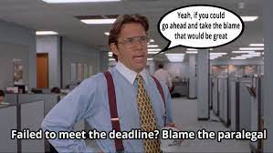

Slide 45
Contact me:
allison.schmidt@iowacourts.gov
515-348-4685

Slide 46
Questions?

