Slide 1


Slide 2


Slide 3
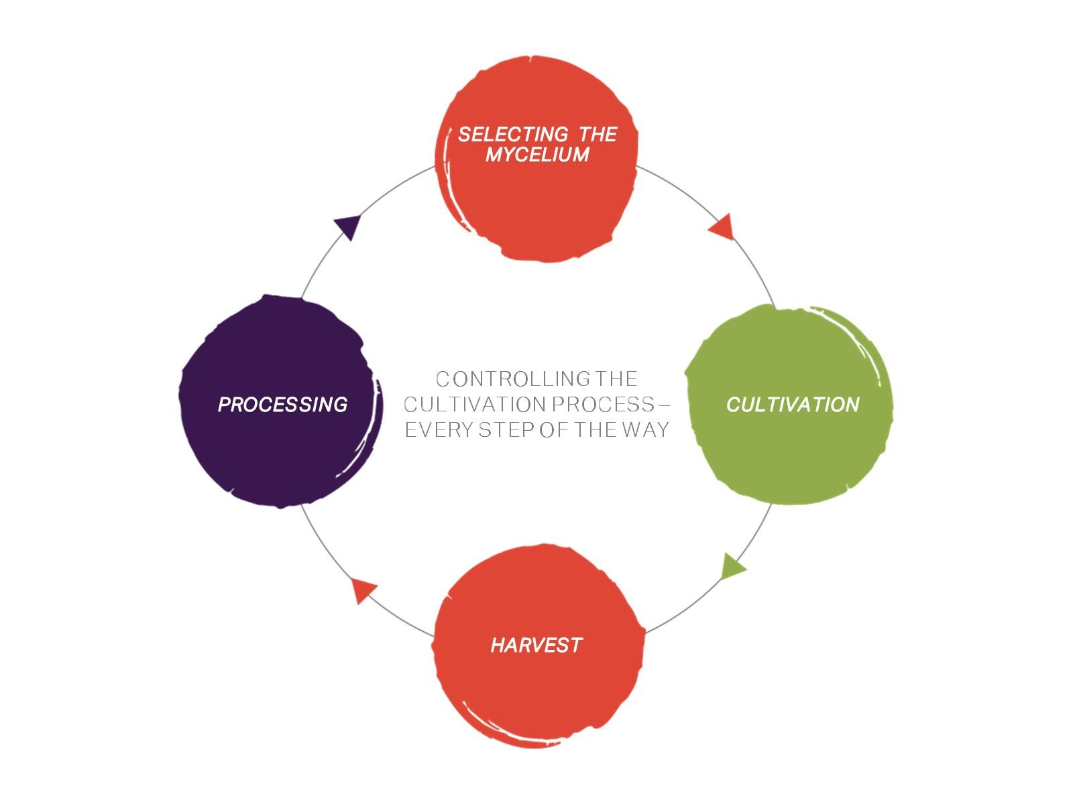

Slide 4
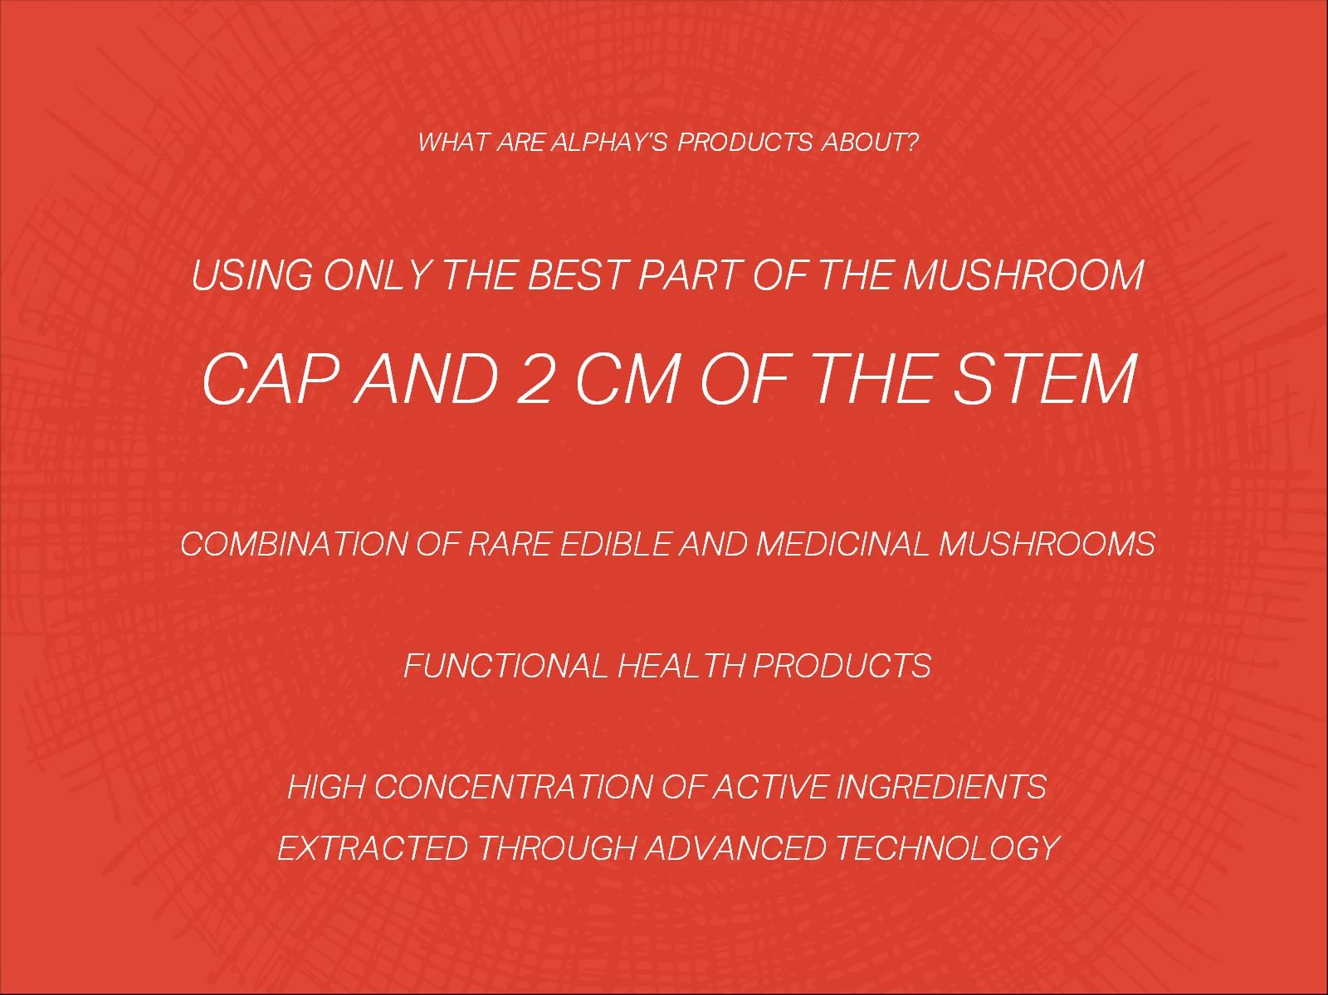

Slide 5
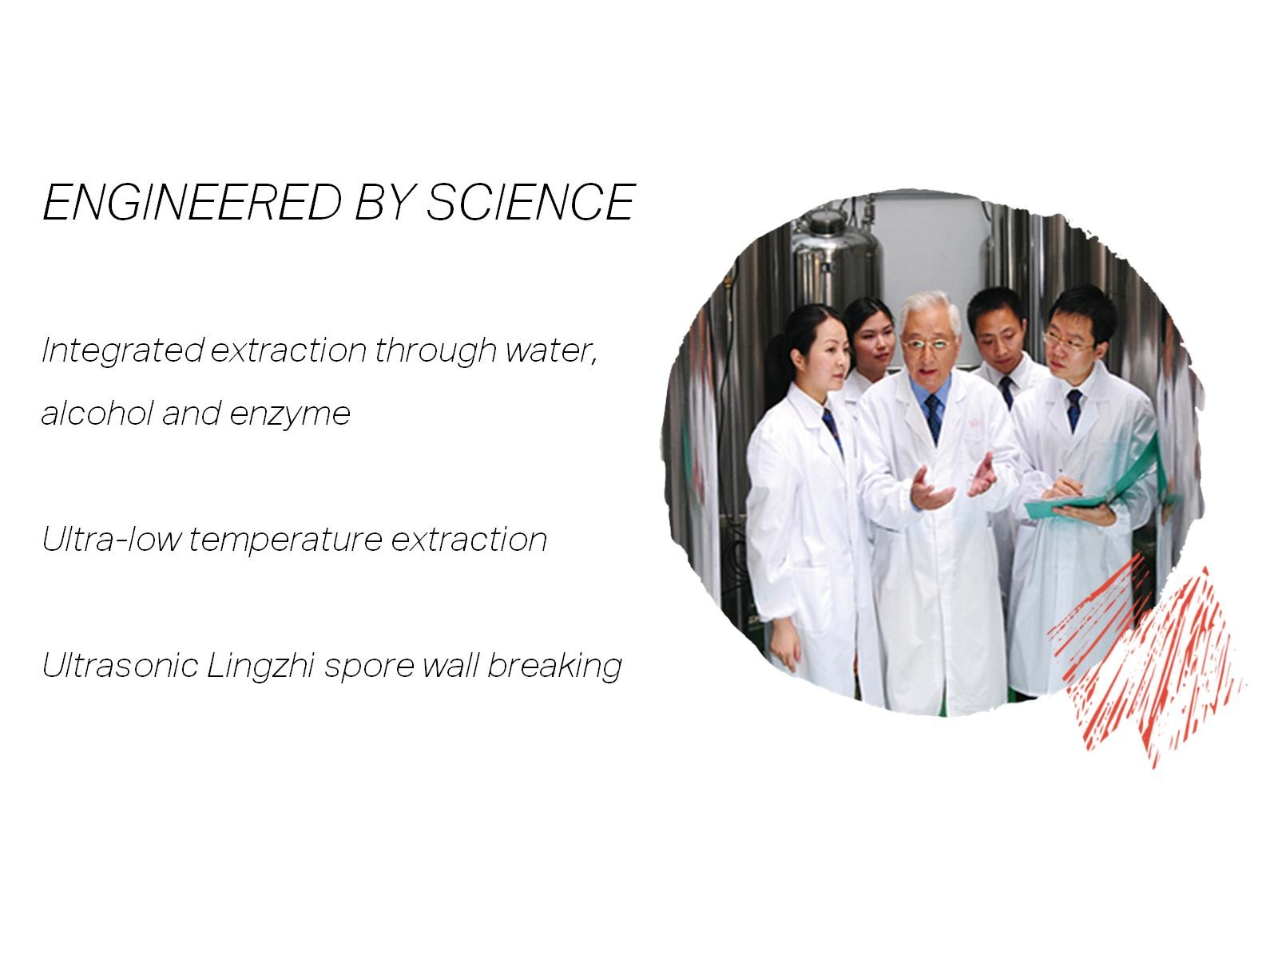

Slide 6
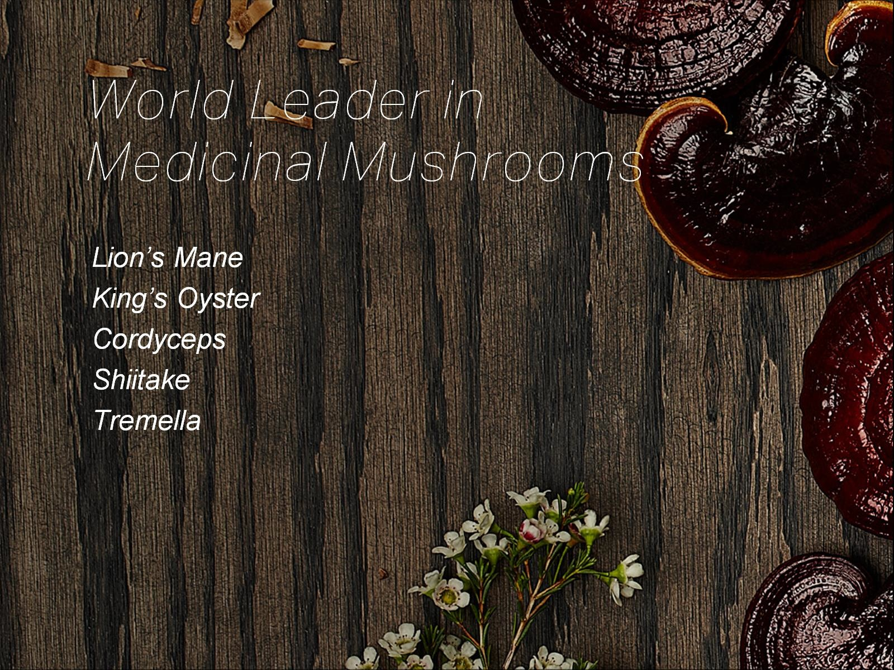

Slide 7


Slide 8
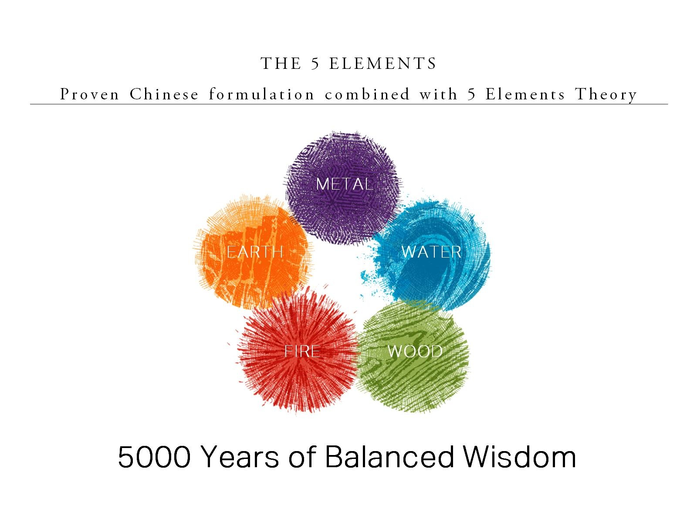

Slide 9
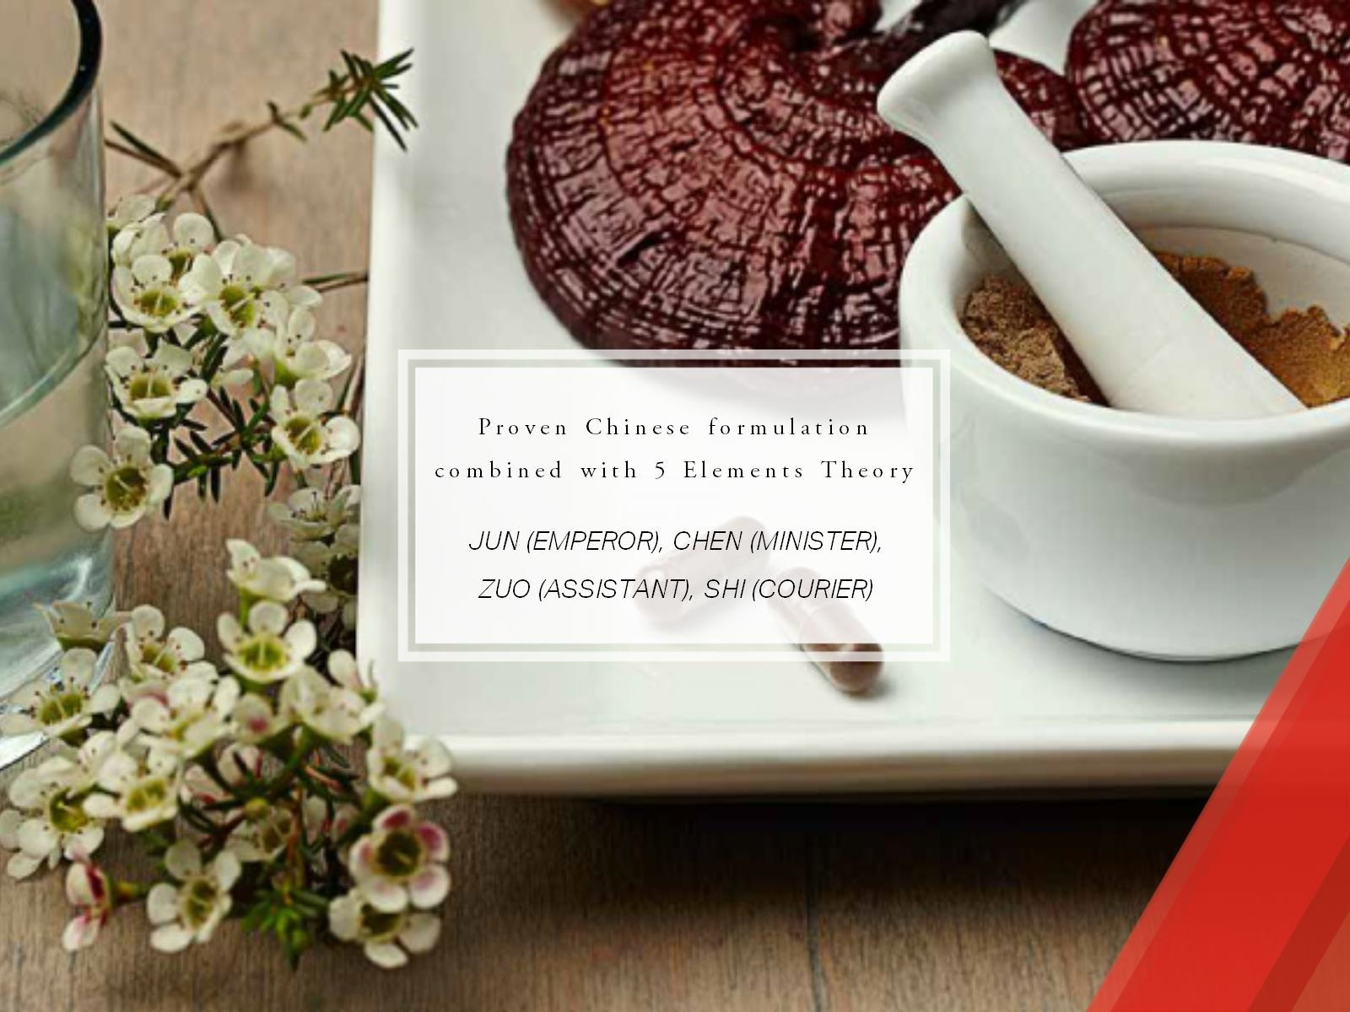

Slide 10
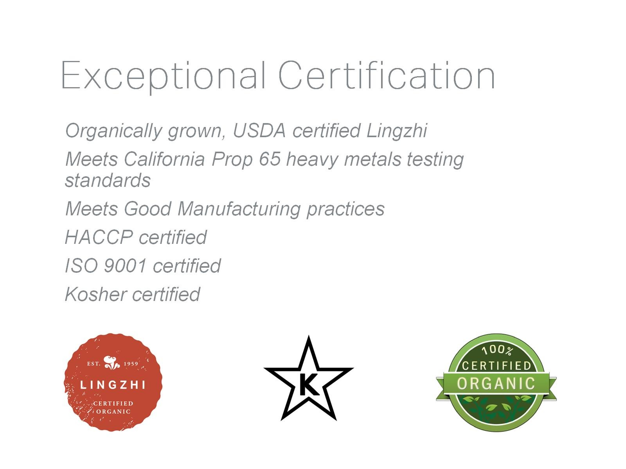

Slide 11
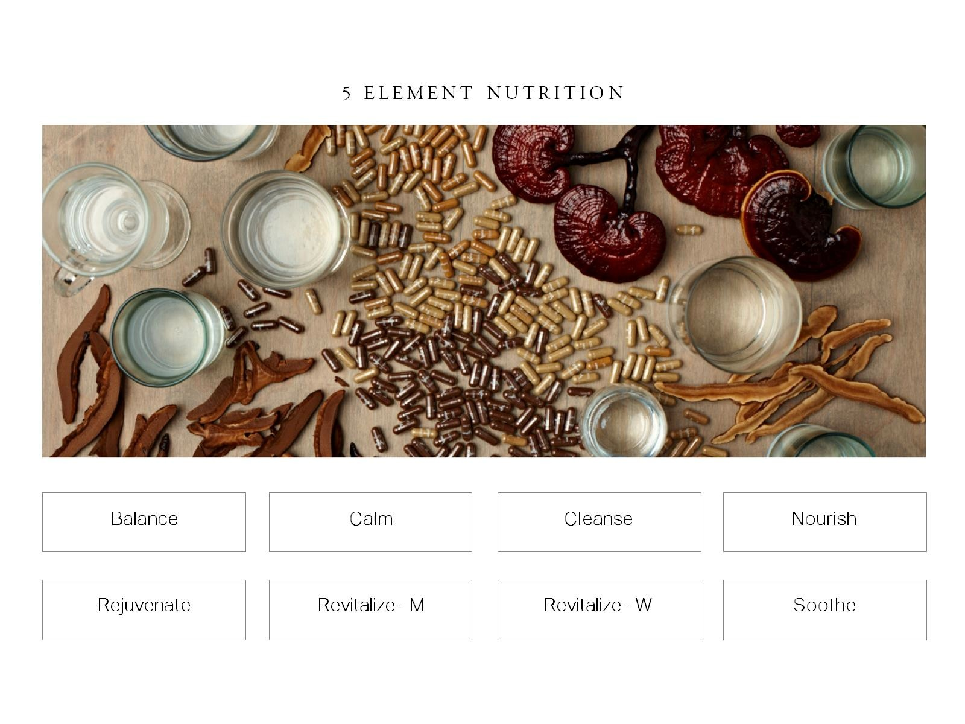

Slide 12
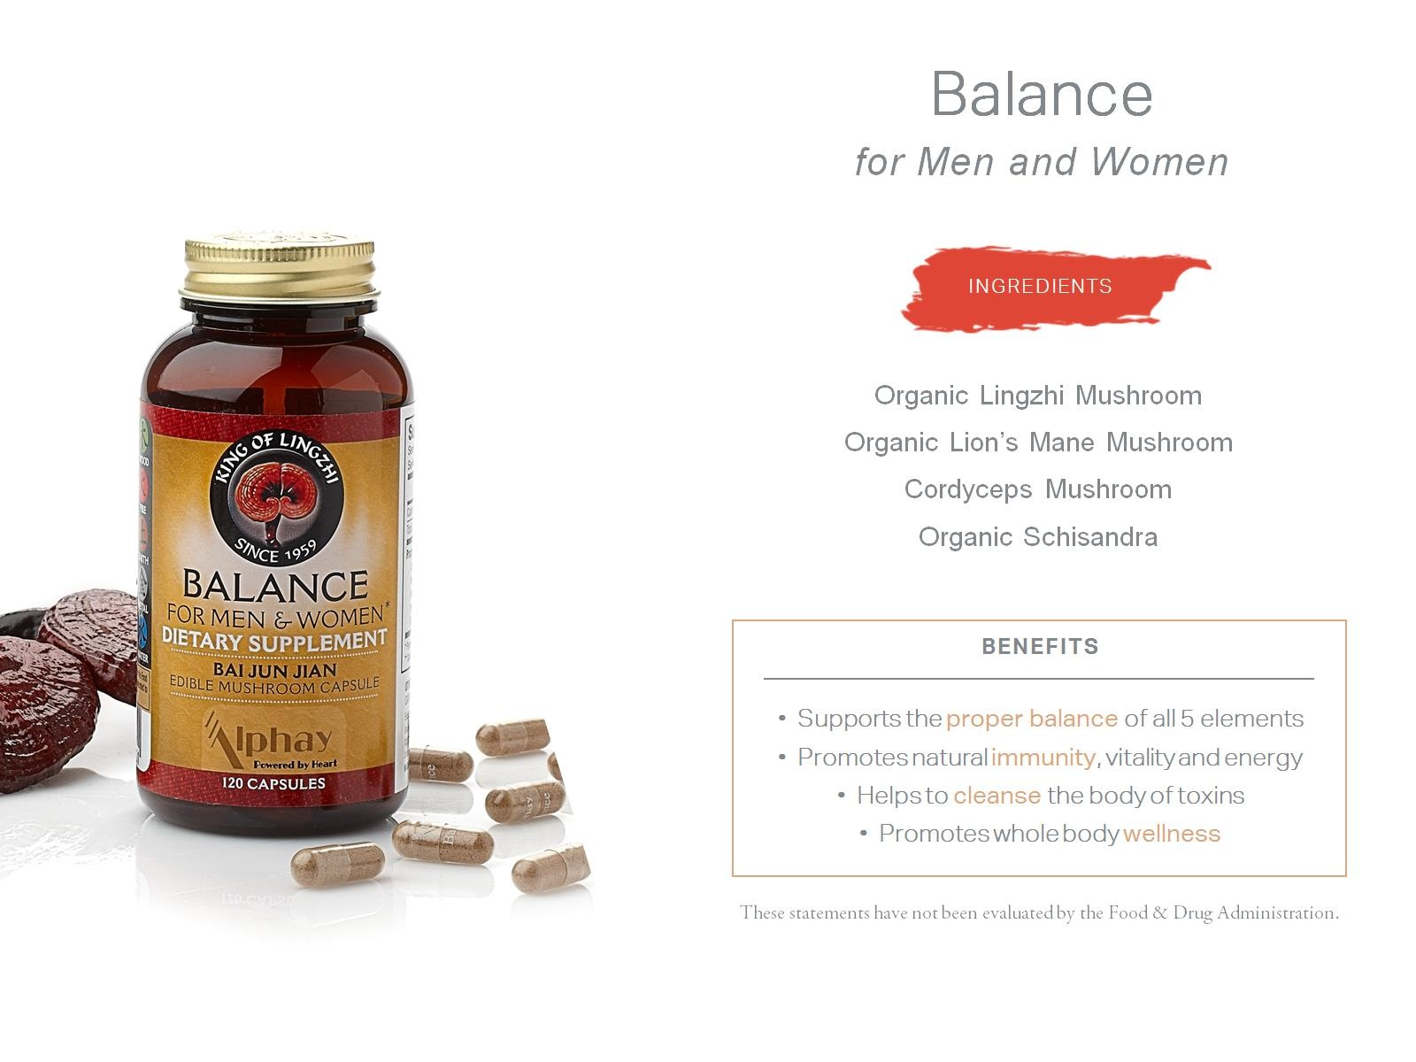

Slide 13
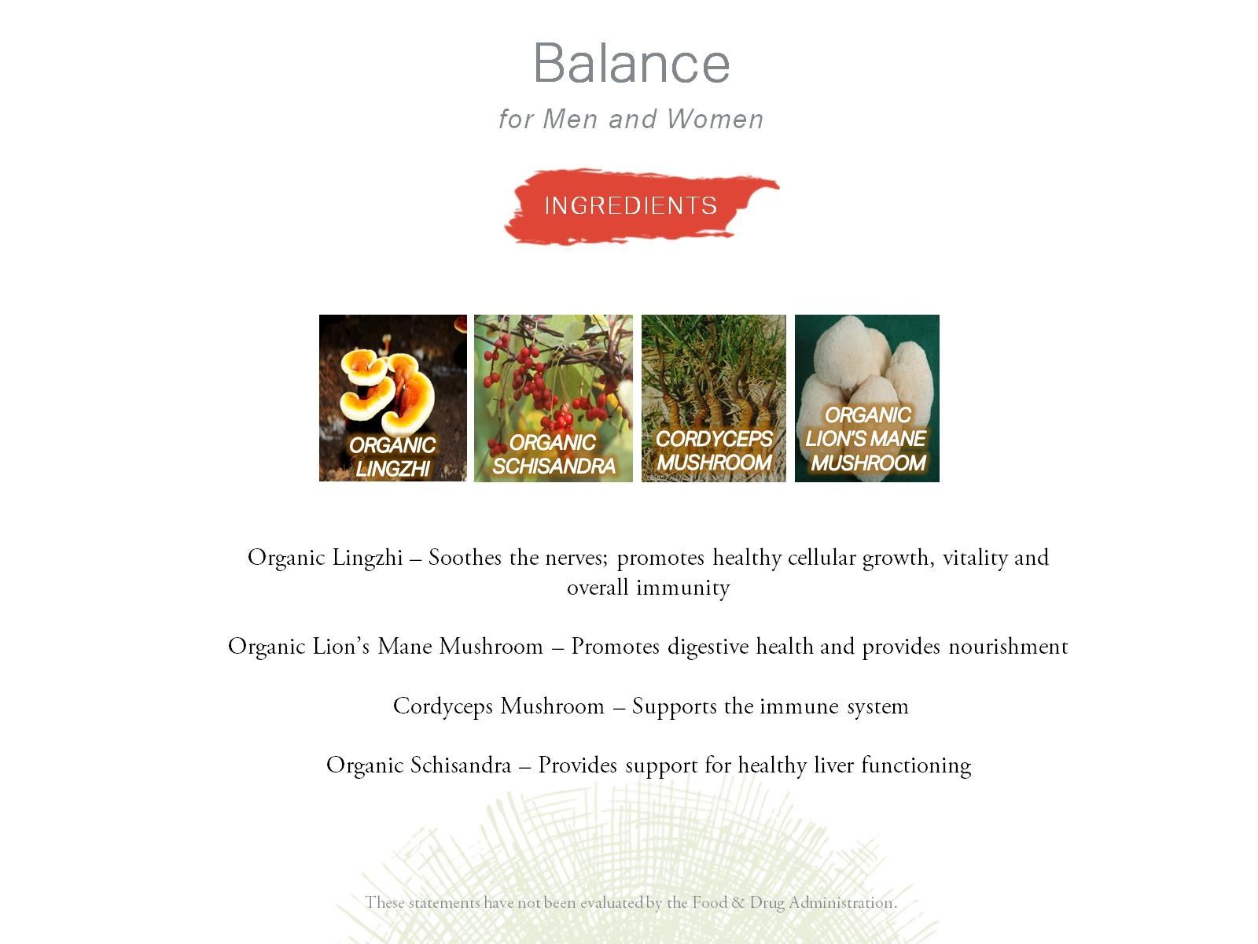

Slide 14
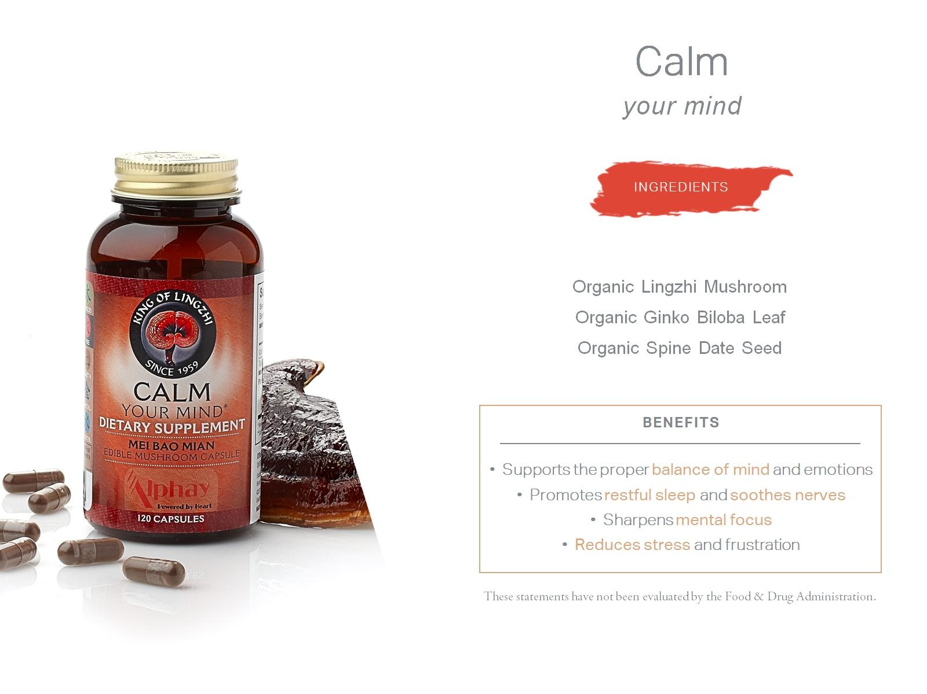

Slide 15
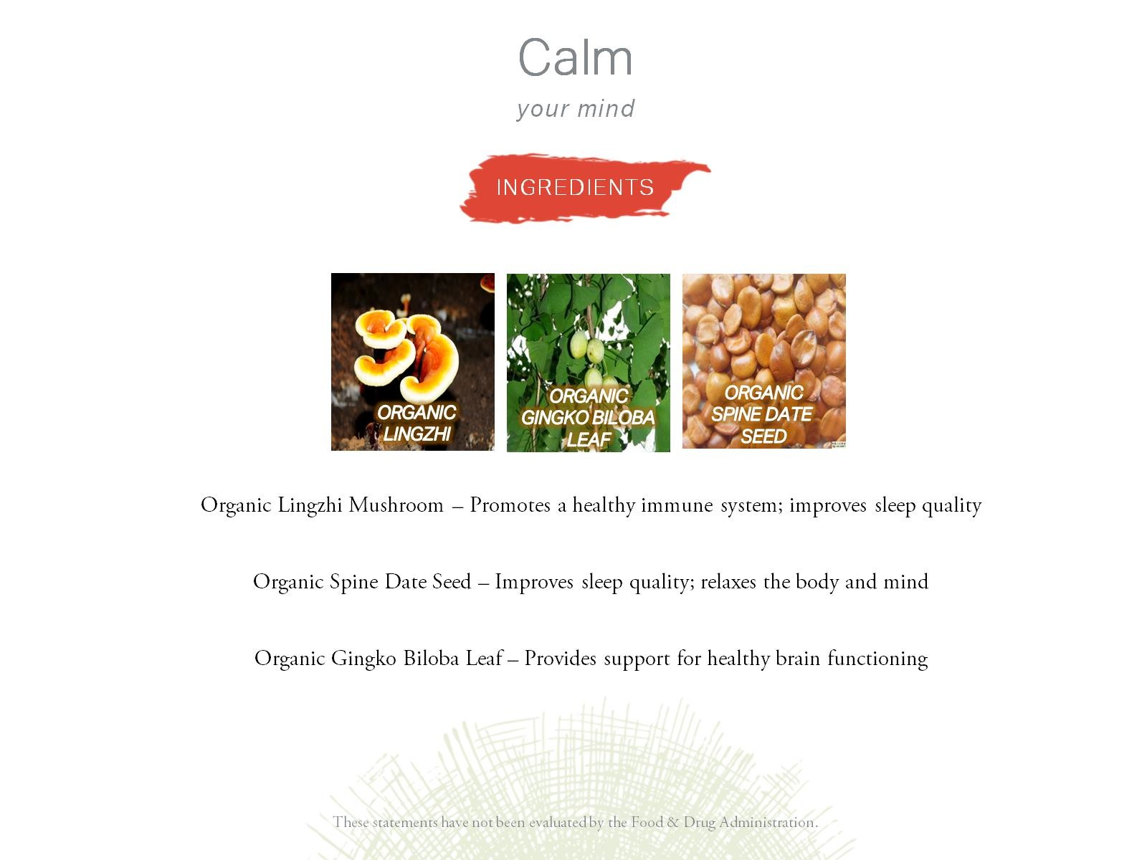

Slide 16


Slide 17


Slide 18
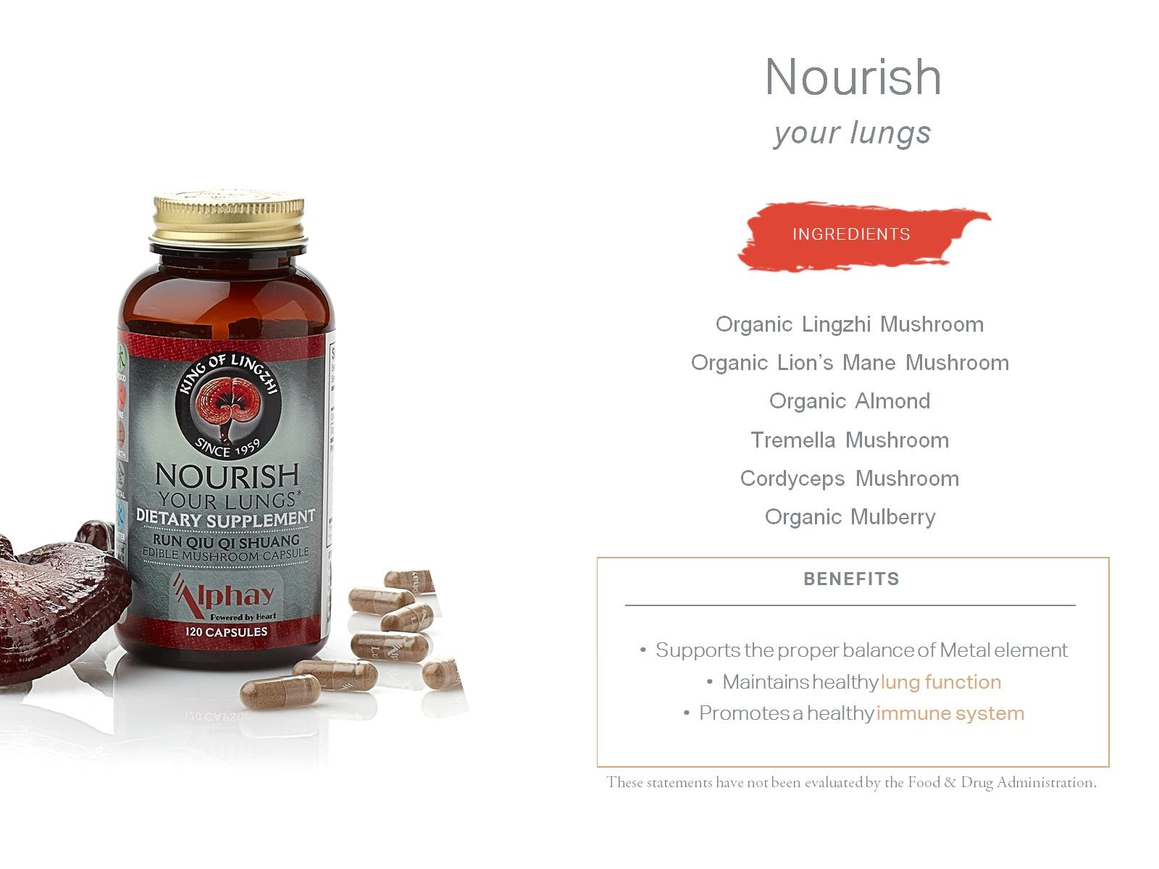

Slide 19
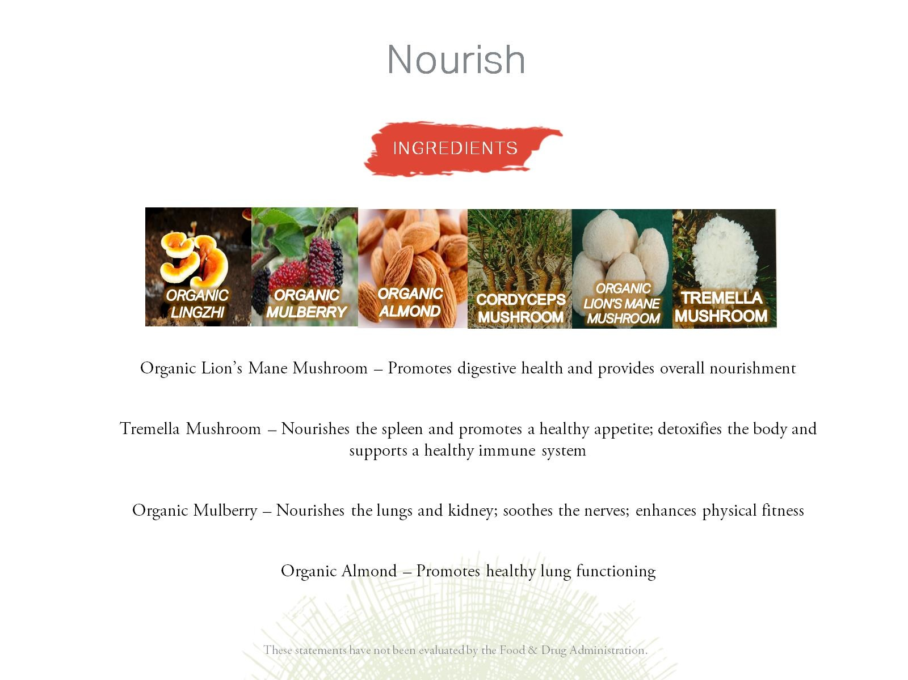

Slide 20
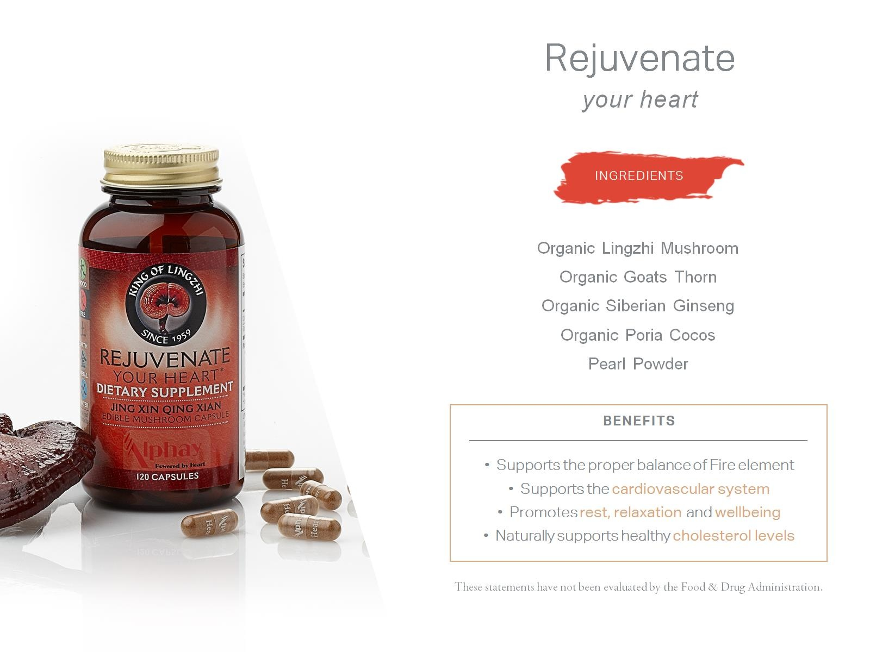

Slide 21
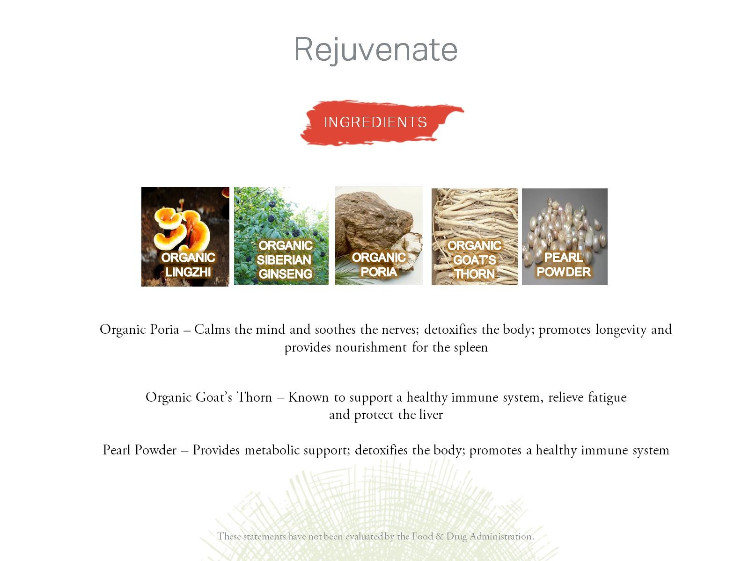

Slide 22
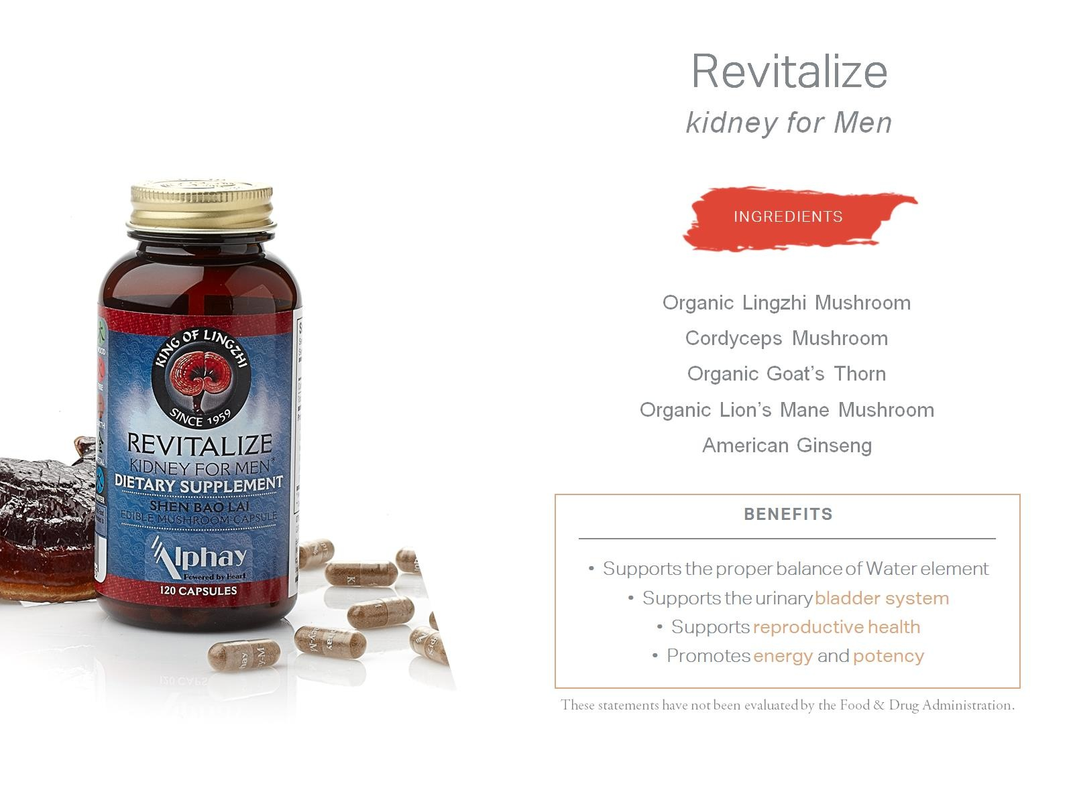

Slide 23
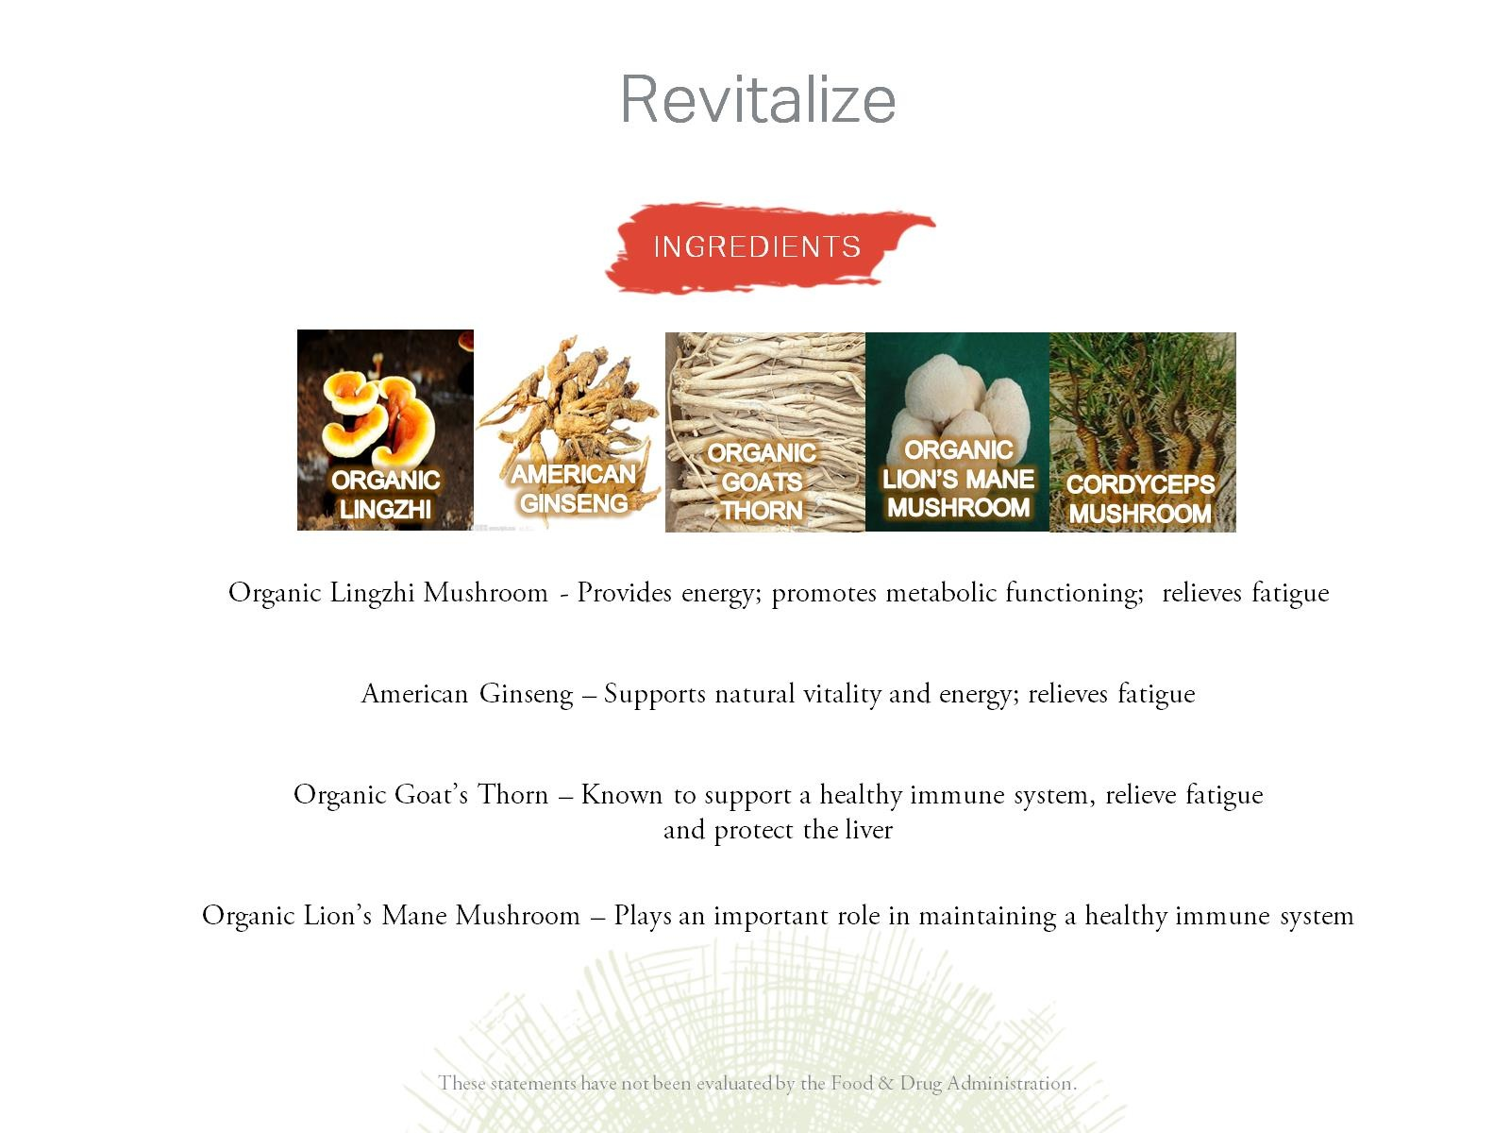

Slide 24
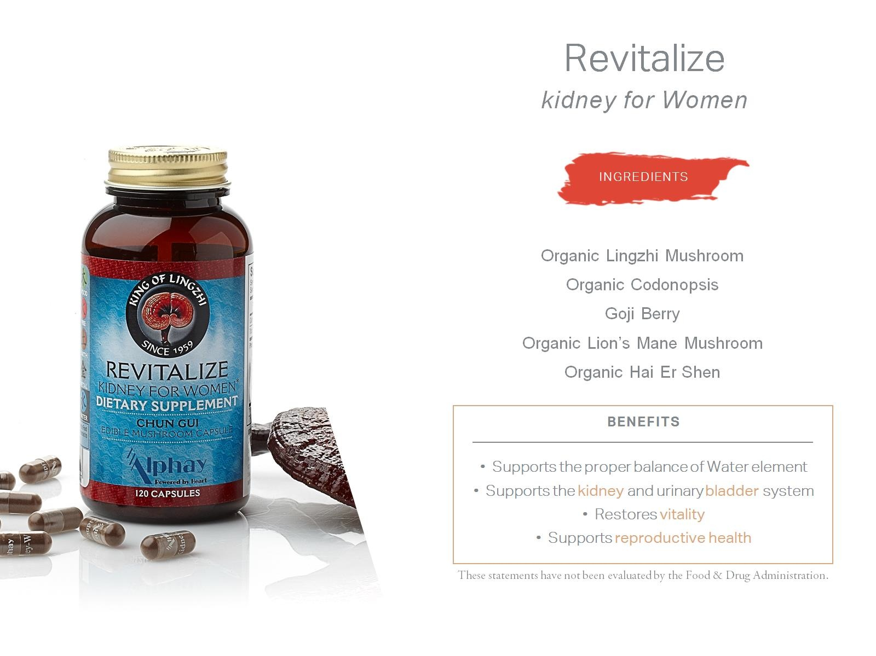

Slide 25
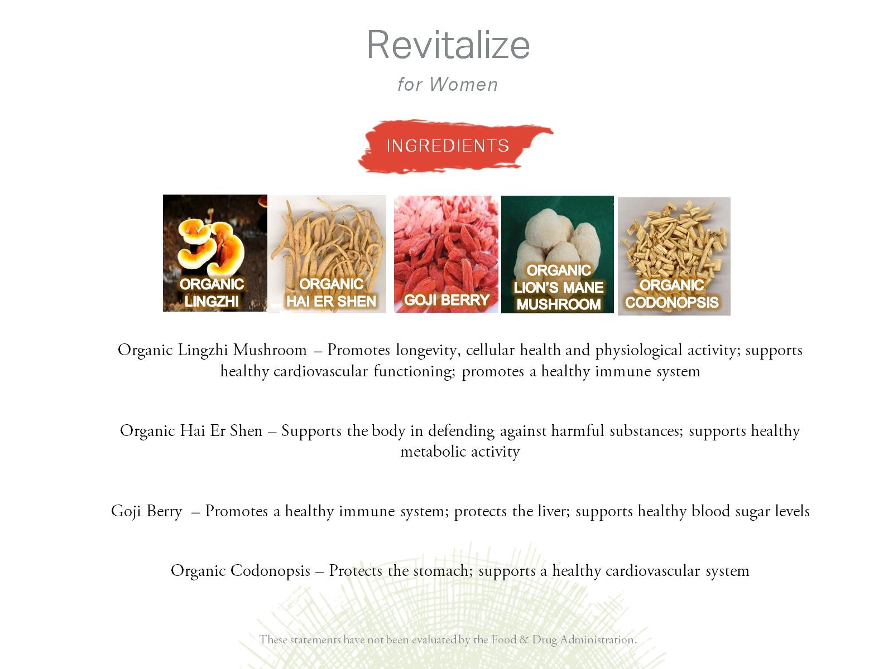

Slide 26


Slide 27
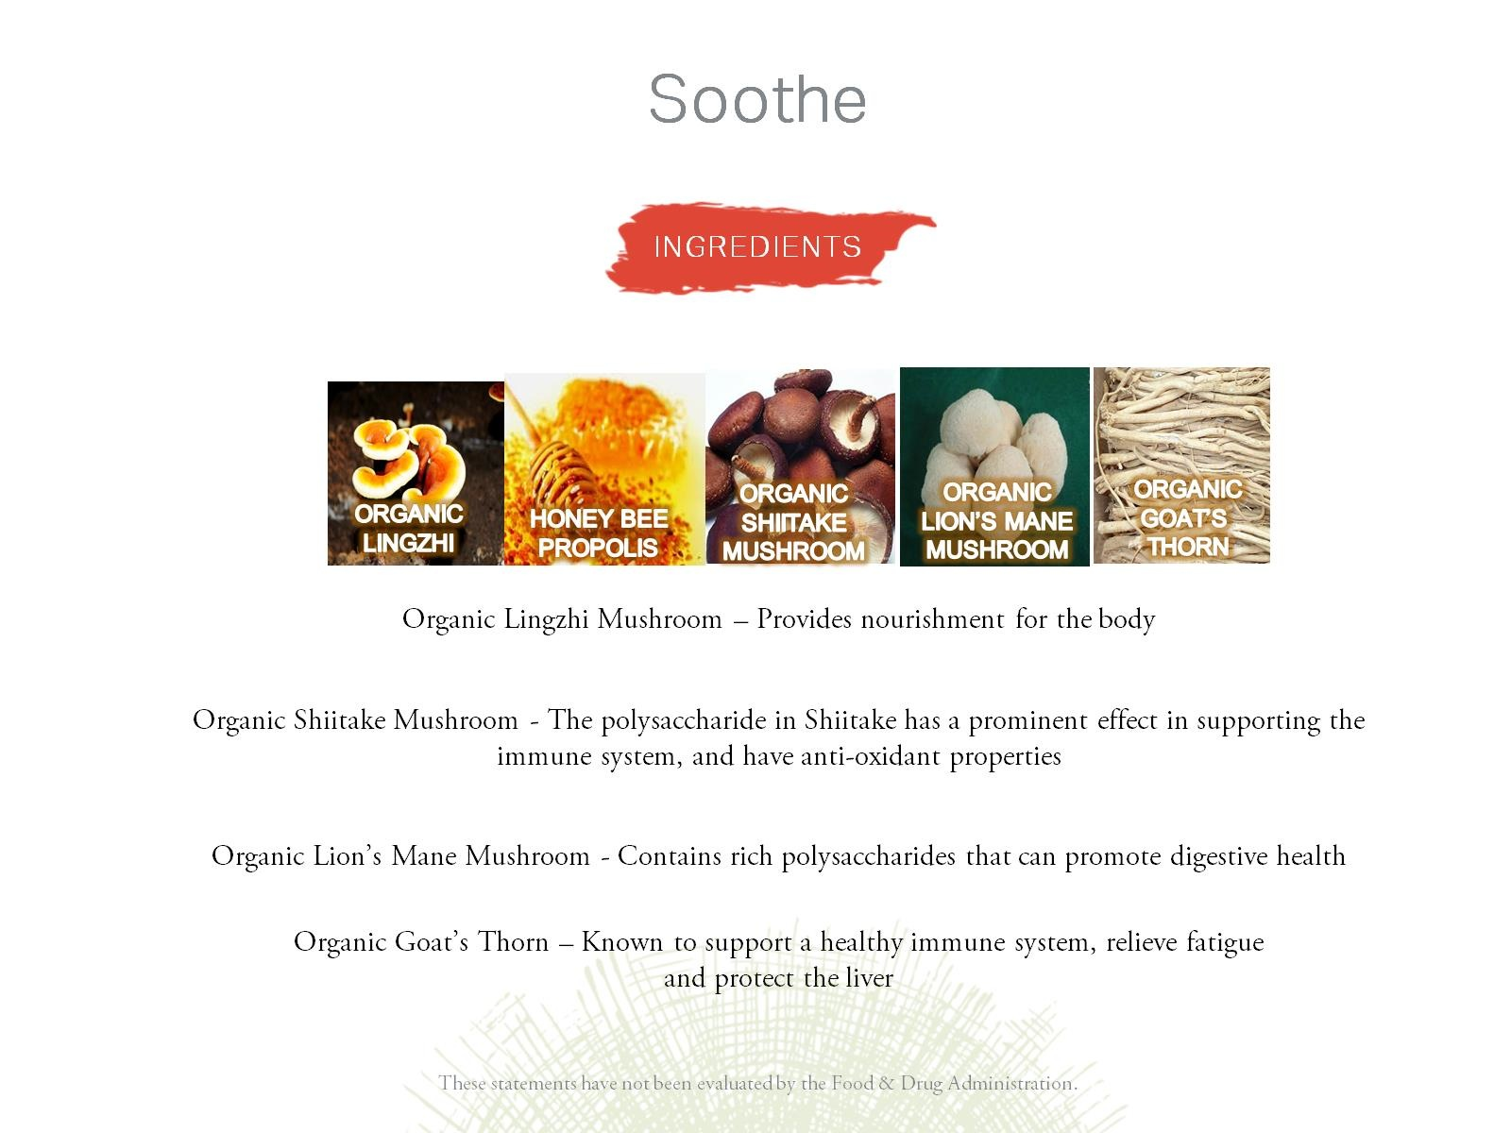

Slide 28


Slide 29


Slide 30
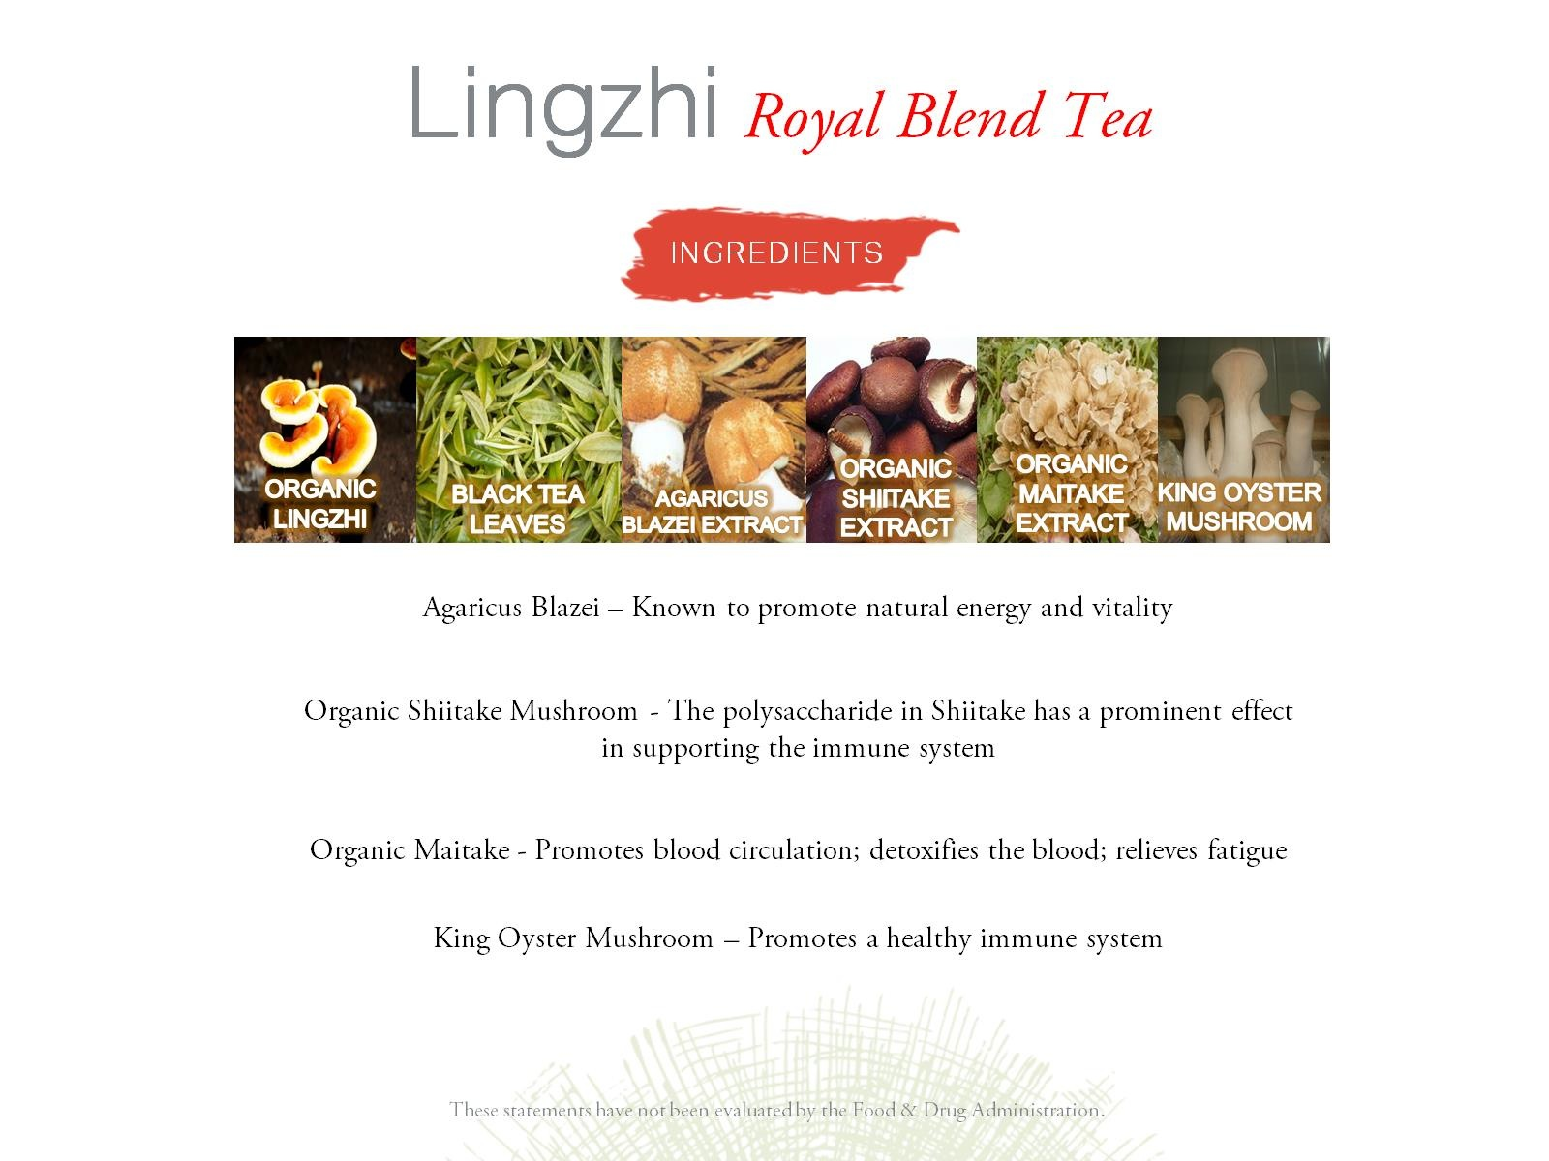

Slide 31


Slide 32


Slide 33
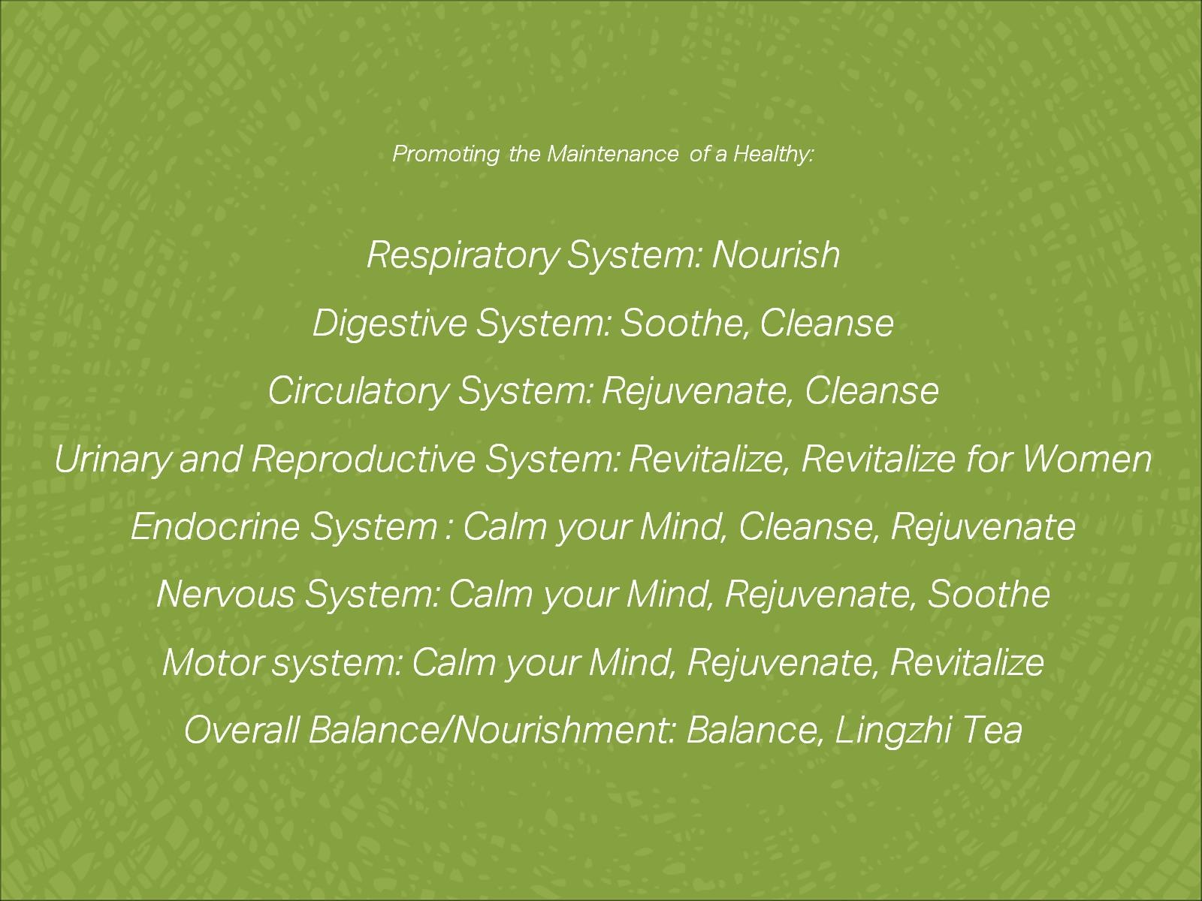

Slide 34
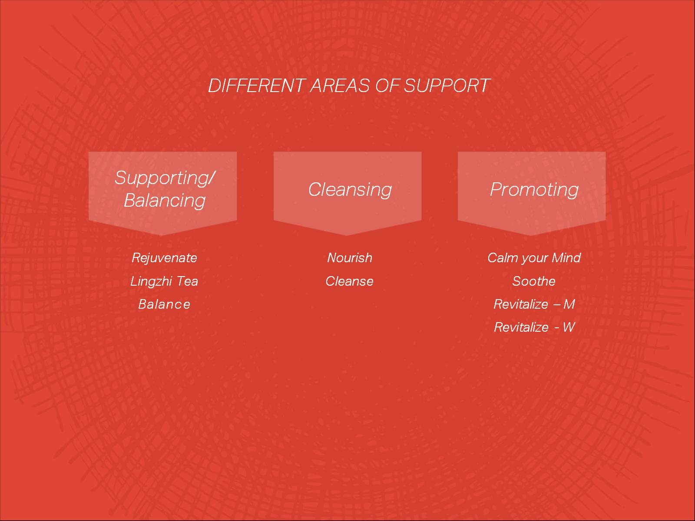

Slide 35


Slide 36


Slide 37


Slide 38
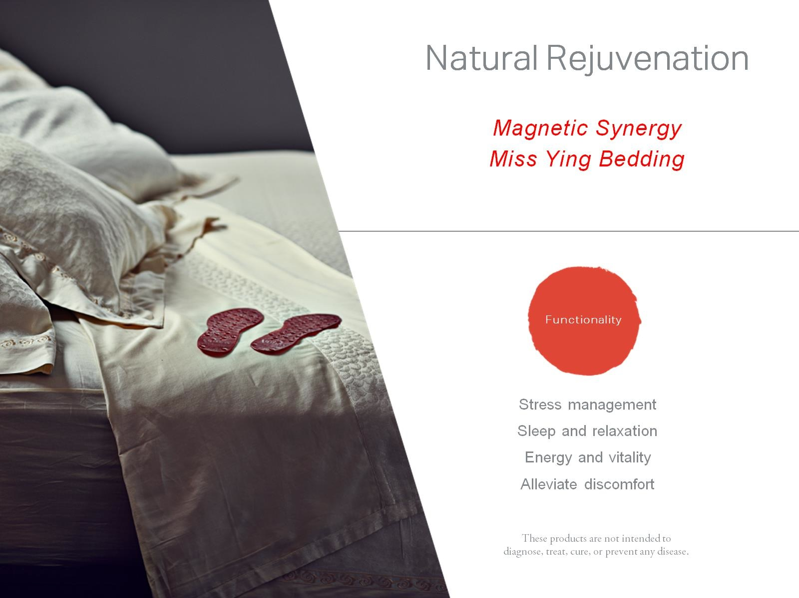

Slide 39
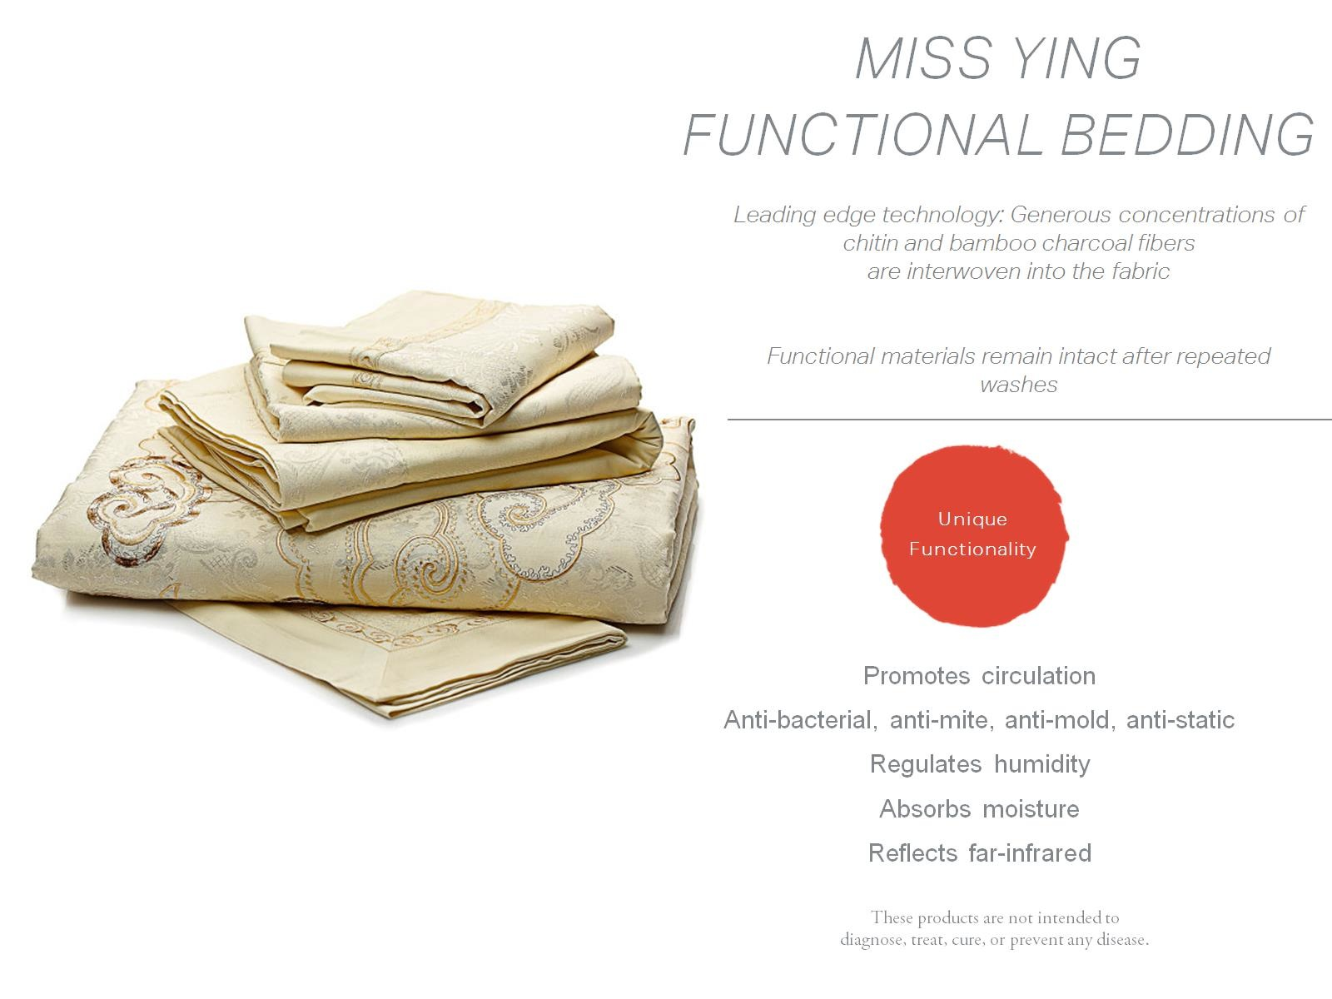

Slide 40
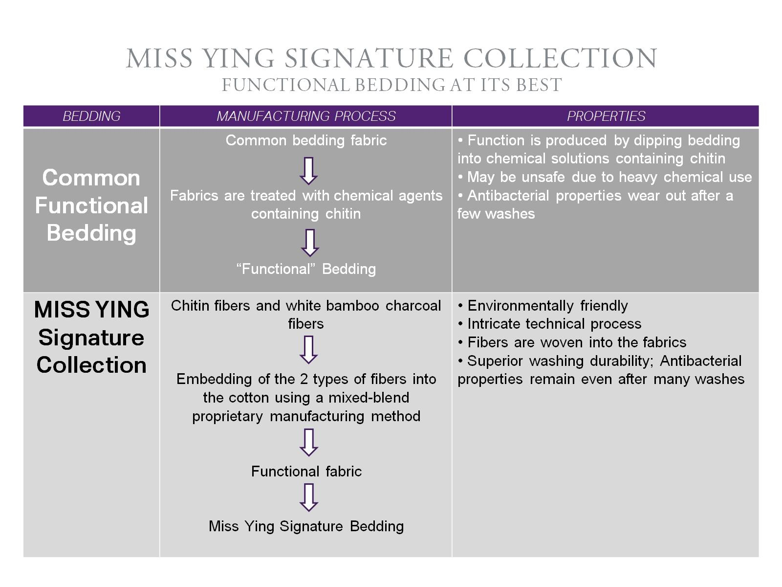

Slide 41
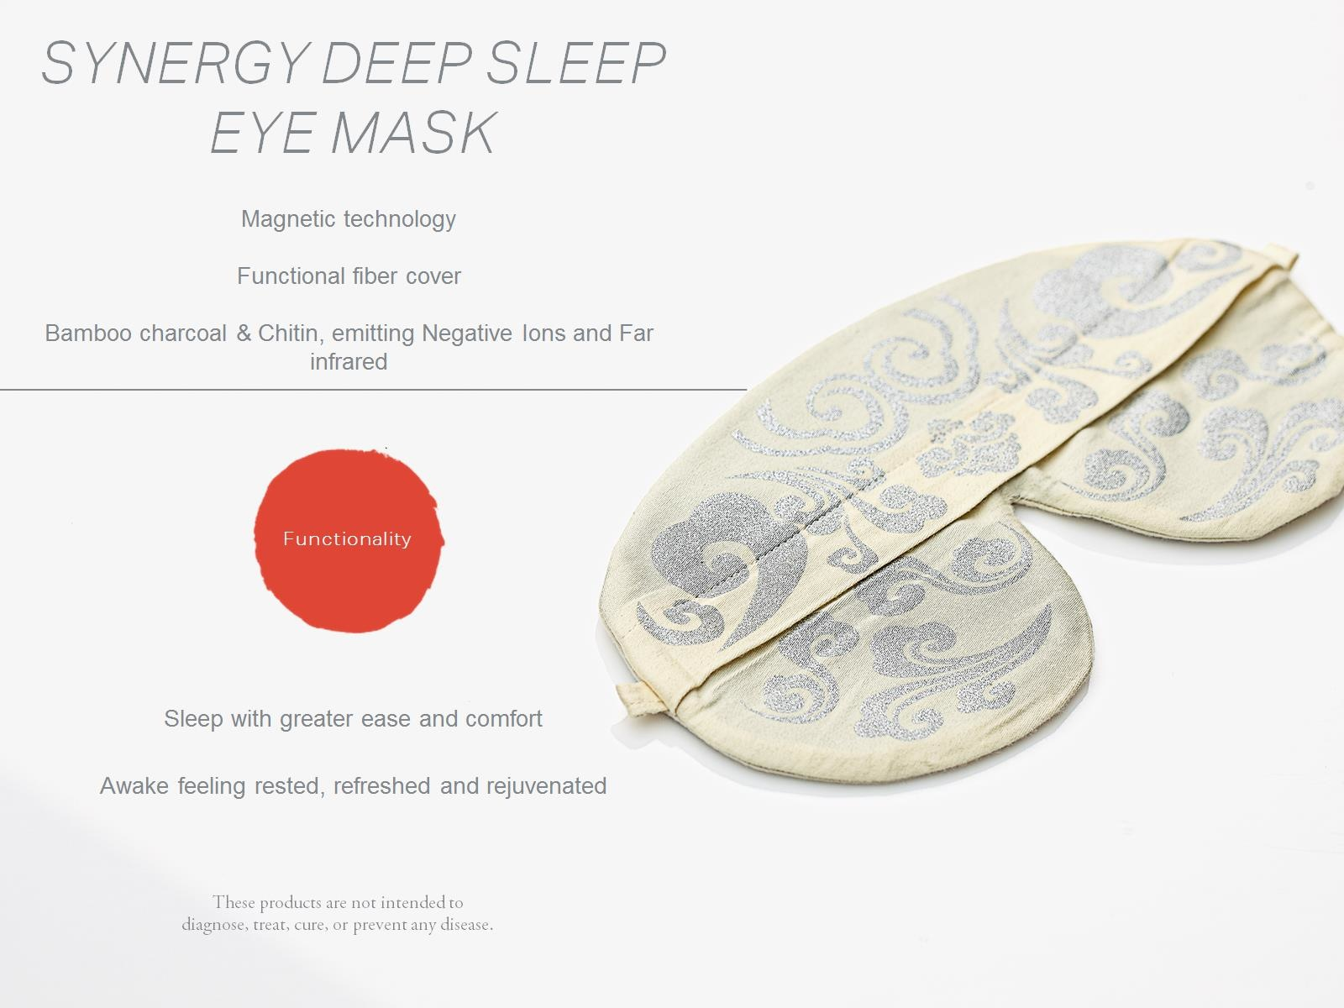

Slide 42
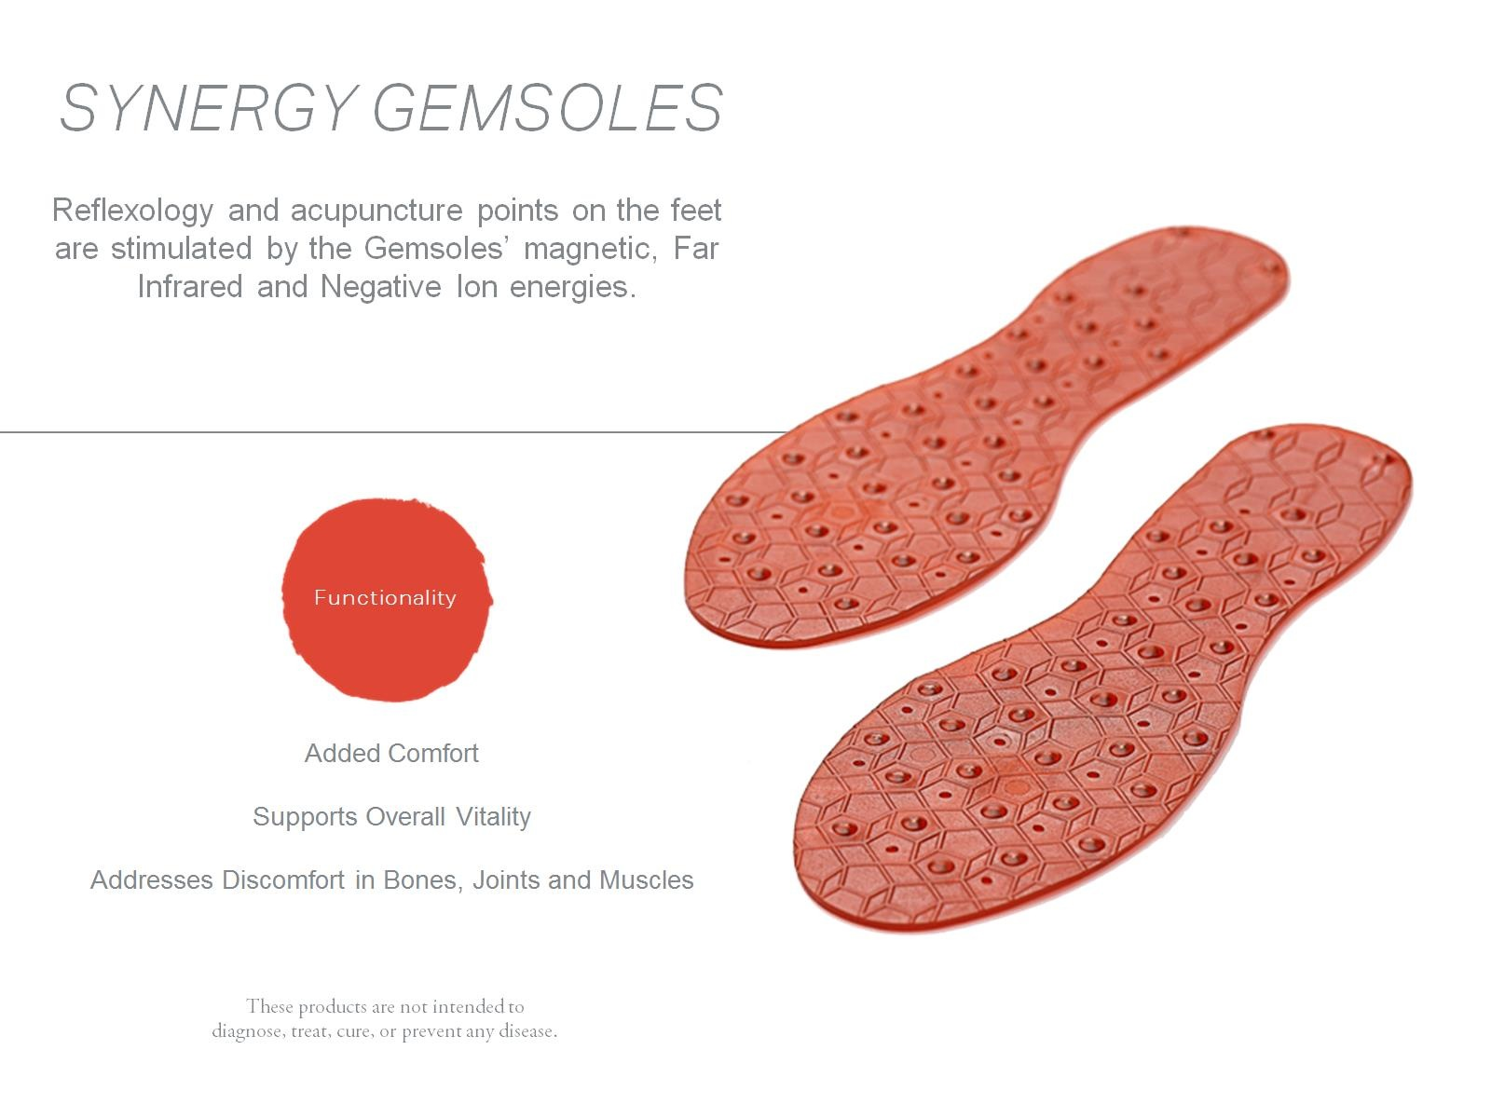

Slide 43
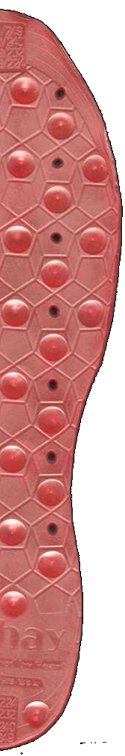


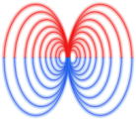

SYNERGY GEMSOLES
How it Works
Far Infrared energy
Negative ions
Magnetic energy
Notes:
Synergy Gemsoles feature far-infrared and negative-ion-emitting tourmaline gemstones, along with the rejuvenating power of magnets, to instinctively sense the right amount of energy boost your body needs throughout the day. Once you nestle them inside your favorite shoes, you’ll never want to go anywhere without Synergy Gemsoles again.
Alphay’s products support blood flow in the body by building chi, and the fact that the body needs nutrition to move the blood.
In the fields of energetics and magnetics – we look at our ability to provide energy to the body through energy properties. And, this brings us to Alphay’s exclusive Gemsole.
A unique combination of magnetics, far infrared, negative ions, and the semi-precious gem, tourmaline, the Alphay gemsole promotes circulation, energizes the body from the foot up.
Why do they work? They work because the body needs these properties to function, and the Gemsole combines them all, in a single substrate that is pliable, washable, and affordable.
Over 70,000 nerve endings are in the human foot!
When you walk barefoot on the beach or place your blanket on the ground for a picnic, you are getting energy from the earth. Using magnets to promote good health is nothing new. Magnets have been used in medicine for over 4000 years. It is only since the late 1950s that doctors have studied the use of magnets in restorative and preventative medicine.

Slide 44


