Slide 1

Pancreatic Cystic Lesions: What are They and When do I Need to Worry?
Nuzhat A. Ahmad, MD
Associate Professor of Medicine
Associate Director of Endoscopy
Director, PENN Pancreatic Cyst Program
University of Pennsylvania, Perelman School of Medicine

Slide 2
Introduction
Most pancreatic cystic lesions are detected incidentally
  ~1.2% of patients undergoing abdominal CT or MRI (Spinelli. Ann Surg 2004;239:651-7)
  20% prevalence of cysts in patients undergoing abdominal MRI for other indications (Radiology 2002;223:547-53)
More than half of incidental cysts are neoplastic (Spinelli. Ann Surg 2004;239:651-7)
Autopsy series (Kimura W. Int J Pancreatol 1995;18:197-206)
  16% with “atypical” epithelium
  3% with carcinoma in situ (high grade dysplasia)
Up to 1/6 of lesions may be malignant

Slide 3
Classification of Pancreatic Cysts
Non-neoplastic | Neoplastic
Pseudocysts | Pancreatic Cystic Neoplasms
Non-Neoplastic Pancreatic Cysts | Serous cystic tumors
True cysts | Solid pseudopapillary neoplasms
Retention cysts | Mucinous cystic neoplasms
Lymphoepithelial cysts | Intraductal papillary mucinous neoplasms
 | Cystic Degeneration of Solid Tumors
 | Endocrine tumors
 | Ductal carcinoma
 | Acinar cell carcinoma

Slide 4
Questions for the clinician
Is this a malignancy?
What is this malignant potential of this cystic neoplasm?
Can this cyst be observed, or does this lesion need to be operatively resected?

Slide 5
WHO Histological Classification of Pancreatic Cystic Neoplasms
Serous cystic tumors
Serous cystadenoma
Serous cystadenocarcinoma
Mucinous cystic tumors
Mucinous cystadenoma
Mucinous cystadenoma with moderate dysplasia
Mucinous cystadenocarcinoma Noninfiltrating Infiltrating
Solid pseudopapillary tumors
Intraductal papillary mucinous tumors
Intraductal papillary mucinous adenoma
IPMN with moderate dysplasia
Intraductal papillary mucinous carcinoma Noninfiltrating Infiltrating

Slide 6
Serous Cystadenoma
Considered benign neoplasms originating from centro-acinar cells
Comprised of multiple fluid-filled cysts (microcystic adenoma)
Historically found in women in seventh decade
Arise in any region of the pancreas

Slide 7
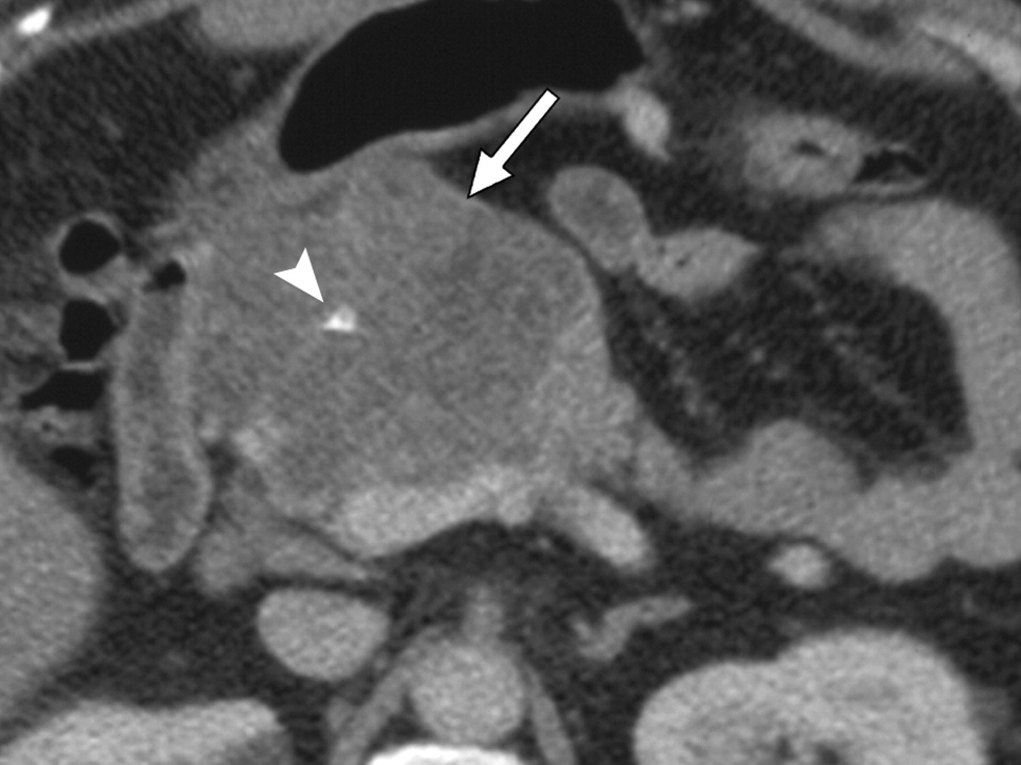
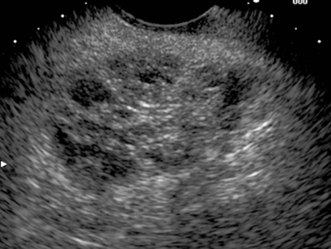
SCA Imaging features
CT
EUS
Focal, well-demarcated lesion
20% have a central scar or “sunburst” calcification
Lobular macro- and microcystic lesion with a honeycomb appearance

Slide 8
Serous Cystadenoma
Very low malignant potential
  Series of 257 patients with operatively resected SCAs (Khashab. Am J Gastroenterol 2011;106:1521-6)
  14 with locally advanced tumors: Large tumor size and HOP location were independent predictors of aggressive behavior
Management
  Asymptomatic lesions can be observed
  Resection for symptoms

Slide 9
Solid Pseudopapillary Tumors
Rare neoplasms – malignant potential has not been well studied
Growth rate can be dramatic
Historically diagnosed in women in their 20’s-30’s
Typical presentation: abdominal mass
Solid and cystic mass lesion with occasional calcifications

Slide 10
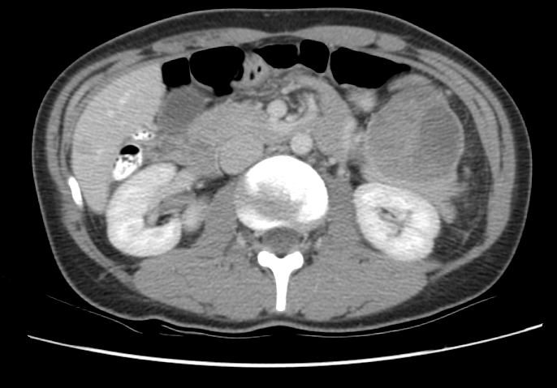
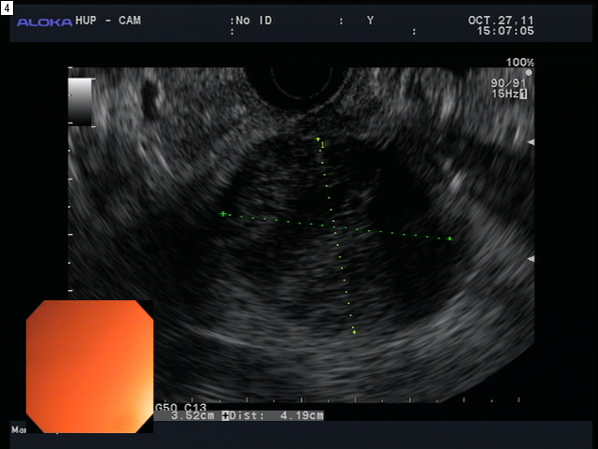
Solid Pseudopapillary Imaging features
CT
EUS
Solid and cystic mass with occasional calcifications

Slide 11
Solid Pseudopapillary Tumors
Series of 62 consecutive patients undergoing resection (Arch Surg. 2008;143(12):1218-1221)
  47 adults, 15 children
  Most common presentation in adults: incidental mass
  Lesion identified in 67% in HOP in children; 88% in body/tail in adults (P=.001)
  9 patients (14.5%) with malignant tumors
    No clinical factor that was predictive of malignancy
    No tumor-related deaths
Management
  With the excellent prolonged survival and chance for cure along with the inability to reliably predict malignancy, operative resection is recommended

Slide 12
Mucinous Cystic Neoplasms
Neoplasm that secretes mucin, but does not communicate with the pancreatic duct
Demonstrates ovarian-like stroma
Affects women, usually in the 5th to 7th decade
Predominantly in the body/tail

Slide 13
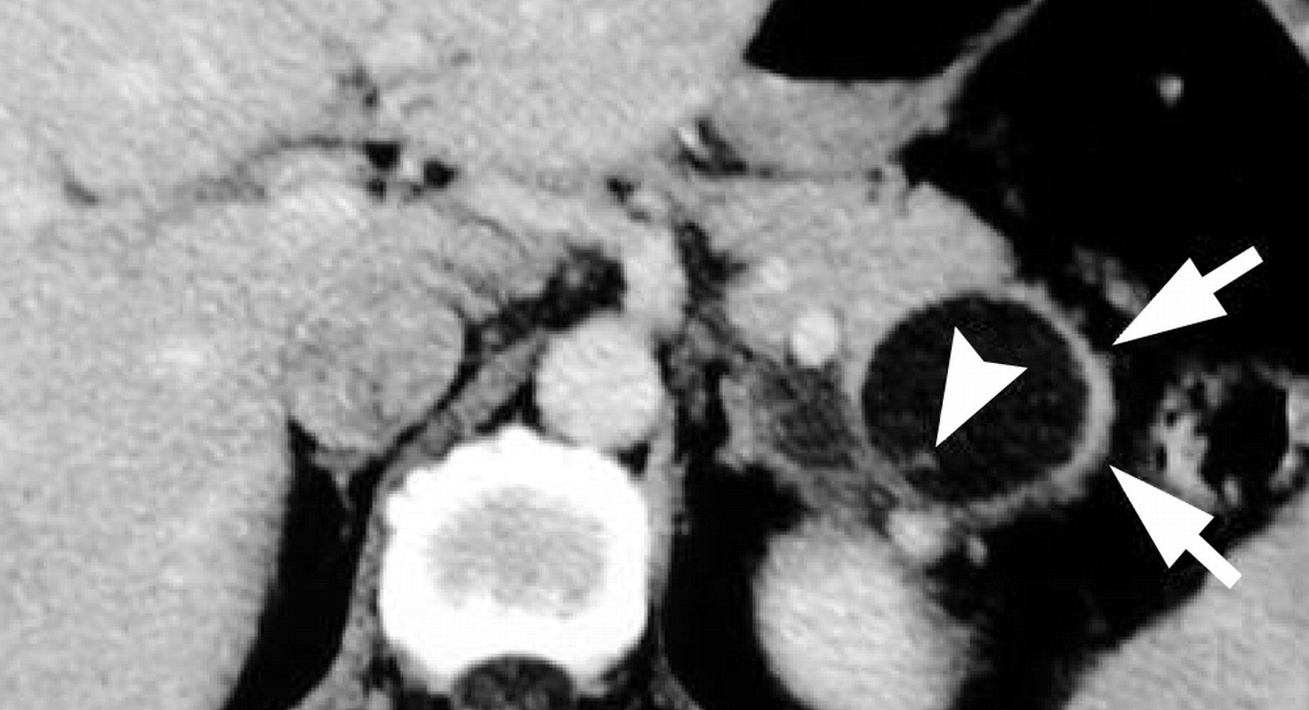
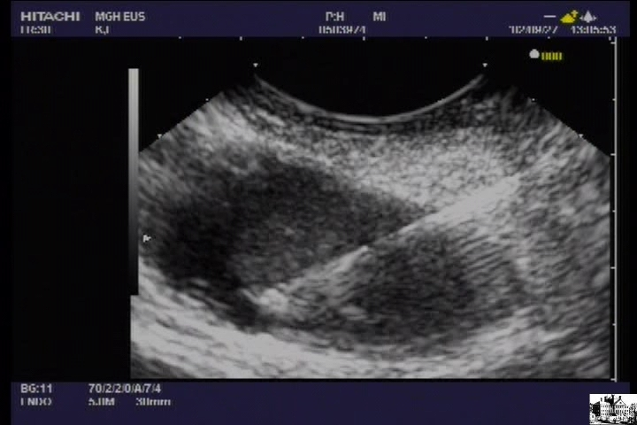
MCN Imaging features
CT
EUS
Unilocular or septated cyst that may include wall calcifications typically in the body/tail

Slide 14
MCN malignant potential
Actual malignant potential unclear
  Confusion with the definition: mucinous lesion that does not communicate with PD vs. ovarian-type stroma
Malignant potential ranges from 6-36%
Reddy. Clin Gastroenterol Hepatol 2004;2:1026-31
Thompson. Am J Surg Pathol 1999;23:1-16
Zamboni. Am J Surg Pathol 1999;23:410-22

Slide 15
Mucinous Cystic Neoplasms
Management
  For patients deemed at appropriate surgical risk, operative resection is recommended due to the risk of malignancy
  Surveillance is not recommended after resection
  For small lesions in patients deemed to be at a higher surgical risk, follow-up is not recommended

Slide 16
IPMN
Mucin-secreting neoplasms in communication with the pancreatic duct
Male > Female distribution
Historically patients are in the 5th-7th decade
Often multifocal or diffuse
Results in dilation of the pancreatic ducts
  Main duct IPMN
  Branch duct IPMN
  Mixed-type IPMN

Slide 17
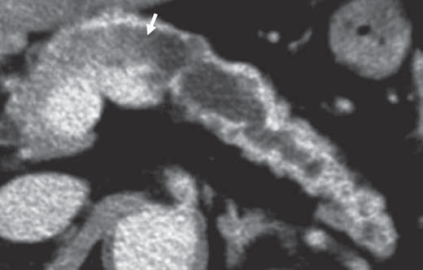
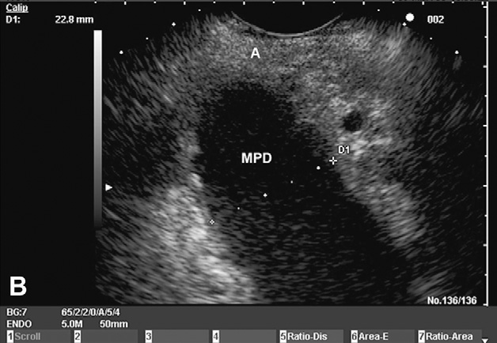
Main Duct IPMN Imaging features
CT
EUS
Focal or diffuse dilation of the main PD

Slide 18
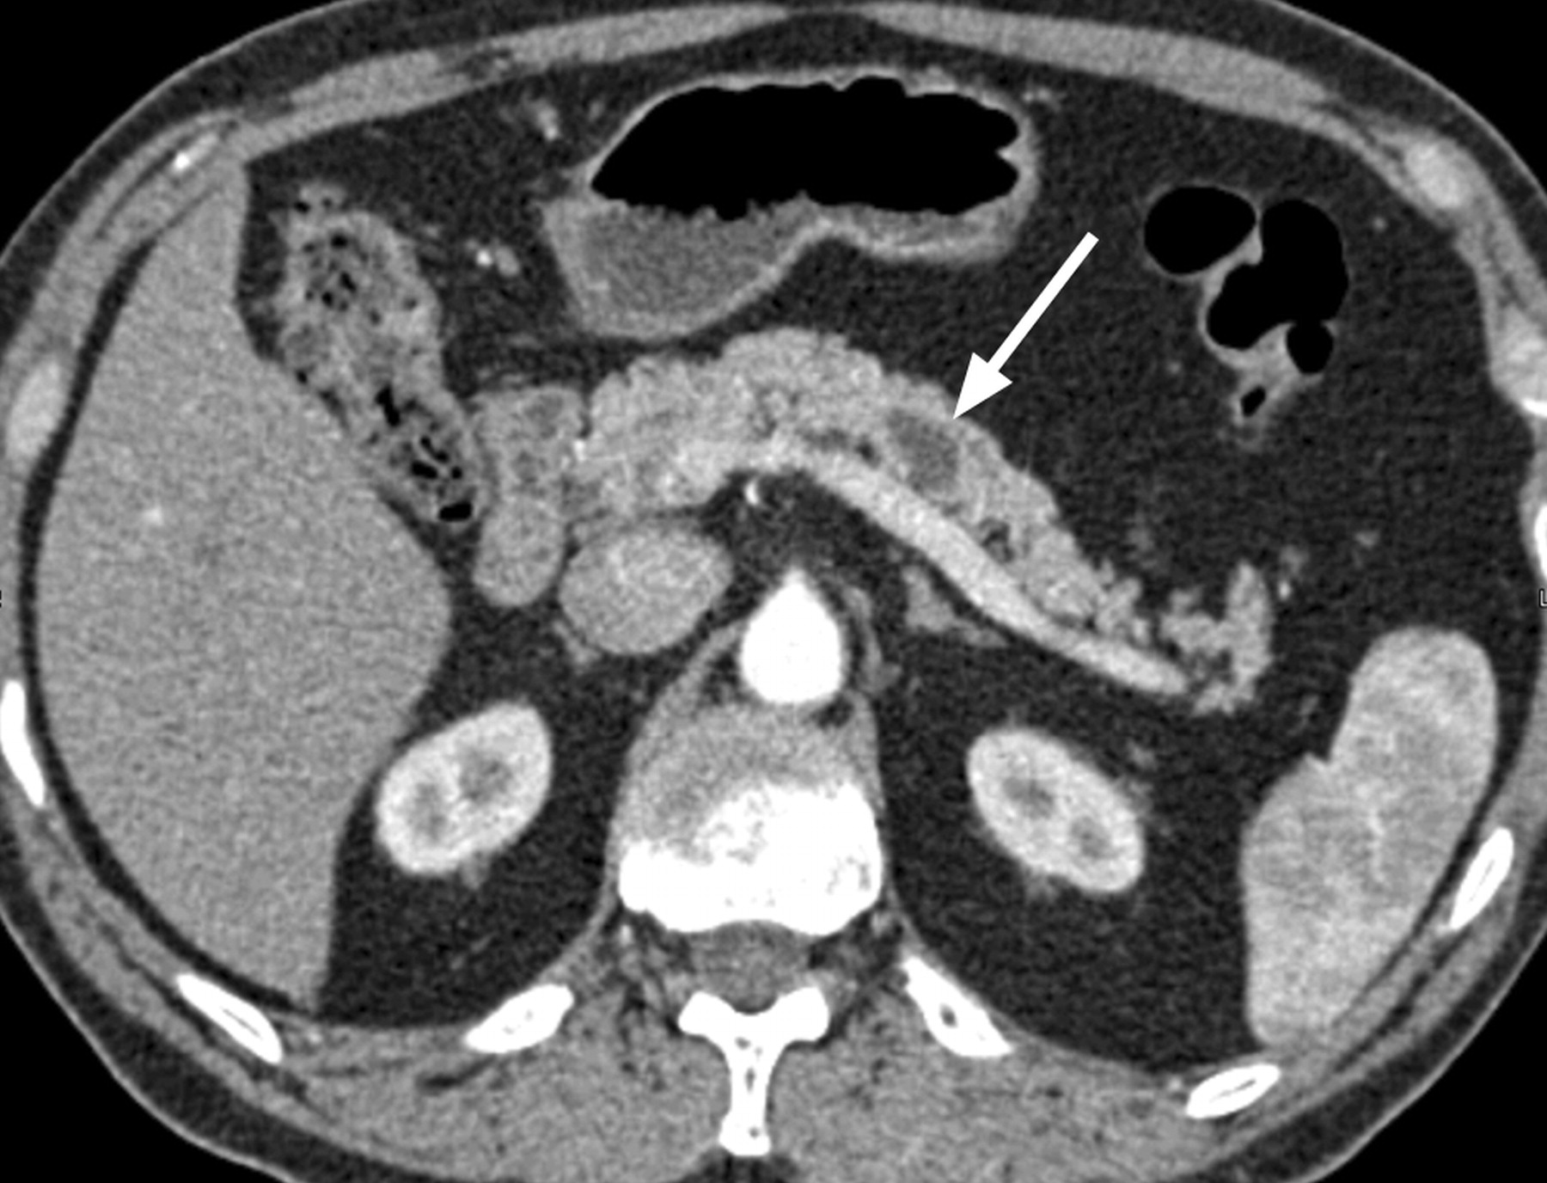
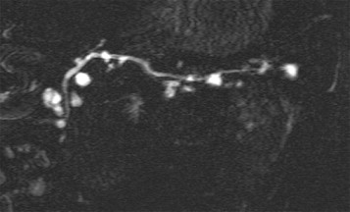
Branch Duct IPMN Imaging features
CT
MRI
Single or multiple dilated PD side branches “cluster of grapes”

Slide 19
Malignancy arising from IPMNs
Believed to be an adenoma to carcinoma sequence
Risk of Malignancy
  Main Duct IPMN: Mean 61.6%, range 36-100%
  Branch Duct IPMN: Mean 25.5%, range 6-46%
  Tanaka. Pancreatology 2012;12:183-197.

Slide 20
EUS-FNA for assessing IPMN Malignant potential
Although CEA can discriminate mucinous from non-mucinous pancreatic lesions, CEA level does not predict malignancy (Gastro 2004;126:1330-6 ; Gastrointest Endosc 2009;69:1106-10; Gastrointest Endosc 2009;69:1095-102)
Similarly, presence of K-ras mutation is useful for identifying mucinous lesions, but is not associated with IPMN histologic progression (Gastrointest Endosc 2009;69:1095-102)
Elevated amounts of cyst fluid DNA and high-amplitude mutations are associated with malignant IPMN (Gastrointest Endosc 2009;69:1095-102)
hTERT (human telomerase reverse transcriptase) has a strong association with malignant IPMN (Pancreas 2012. Epub)

Slide 21
IPMN subtypes
Based on the cell lineage of the “papillary component”
Gastric type
  Majority of BD-IPMNs
  Low grade with small % developing into carcinoma (tubular)
Intestinal type
  Large intestinal-type IPMNs can have invasive carcinoma with indolent behavior (colloid)
Oncocytic type
  Large IPMNs with relatively uncommon and limited invasion
Pancreatobiliary type
  Least common, thought to be a high-grade version of the gastric-type (tubular)

Slide 22
Sendai Consensus Guidelines
Operative Resection recommended for all MD-IPMN and BD-IPMN for the following conditions
  Symptoms
  PD dilation >6 mm
  Mural nodules
  Positive cytology
  Size >30 mm
Tanaka. Pancreatology 2006;6:17-32.

Slide 23
Natural History of IPMN
In a retrospective multicenter study of 349 patients with BD-IPMN without nodules, 320 (91.7%) were followed without an operation over a range of 1-16.3 years (median 3.7 years)
Maguchi. Pancreas 2011;40:364-70
Reinforces the fact that BD-IPMN can be followed with continued surveillance without operative intervention, regardless of size

Slide 24
Fukuoka 2012 Consensus Guidelines
MD-IPMN
  Operative Resection recommended for all MD-IPMN
  Threshold has been lowered to >5 mm
BD-IPMN
  Introduction of “High Risk Stigmata” vs “worrisome features”
  Patients with high risk stigmata are recommended to have an operation
  Patients with worrisome features are recommended to undergo EUS
Tanaka. Pancreatology 2012;12:183-197.

Slide 25
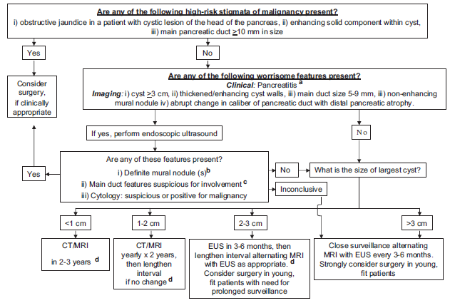
Fukuoka 2012 Consensus Guidelines

Slide 26
Management after resection for IPMN
Noninvasive IPMN (adenoma, dysplasia, HGD), 0-10% risk of recurrence in remnant gland
Invasive IPMN, risk of recurrence is 50-90% (Sakorafas. Surg Oncology 2011;20:e109-18.)
Recurrence rates are similar for invasive IPMN after partial pancreatectomy (67%) or total pancreatectomy (62%) (Chari. Gastro 2002;123:1500-7)
  Surveillance needs to be performed after resection of IPMNs, but the interval and modality remains unclear

