Slide 1

Diagnostic Testing:
What I Need to Know and When to Order Studies
David C. Metz, MD
Prof. Medicine
Division of Gastroenterology
University of Pennsylvania School of Medicine

Slide 2
35 Year old Woman with “Refractory GERD”
35 year old F with 3 yr history of postprandial heartburn and regurgitation, intermittent dysphagia for solids>liquids and mild weight loss
Initially treated with once daily PPI by her PCP but failed to respond.
UGI Xray was normal and her PPI dose was increased to BID with only a marginal improvement
EGD with biopsies excluded EoE (and PPI-responsive eophageal eosinophilia) and she is now referred to you for “PPI-refractory GERD”

Slide 3
What Could this be and How can Physiology Testing help?
Dyspepsia – all in the history (not addressed)
Inadequately treated GERD –Bravo or catheter-based (imp)/pHmetry
Achalasia – Hi Res Manometry
Functional esophageal disease – diagnosis of exclusion

Slide 4
UGI Physiology Studies
Ambulatory pH testing
  Catheter (pH plus impedance)
  Bravo (wireless, pH only)
High resolution manometry with impedance
Hydrogen breath testing (with methane)
  Overgrowth (Lactulose)
  Dissaccharidase deficiency (Lactose, Fructose, Sucrose)
Urea breath testing (14C-Urea)
Others:
  Gastric emptying and Smart Pill
  Gastric analysis and secretin testing
  Small bowel and anal manometry
  Endoflip

Slide 5
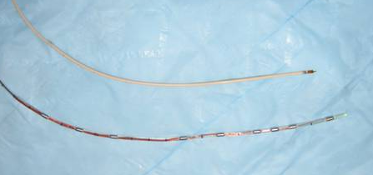
Impedance
Measurement of resistance to flow of current (in Ohms) between adjacent electrodes along a catheter
Tolerability similar to standard pHmetry catheters

Slide 6
Impedance: Physics
A Voltage Is Applied Across Ring Set
No bolus = few ions = high impedance
AC Generator
Intraluminal Ions Support Current Flow
Bolus present = many ions = low impedance
AC Generator

Slide 7
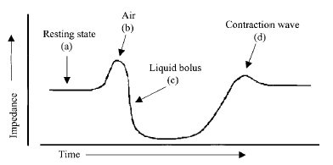
Impedance During a Normal Swallow
Low Conductivity
Air
Impedance
Mucosa
Saliva
Food
Gastric Juice
High Conductivity

Slide 8
Measuring Bolus Transit
By dispersing electrodes along the catheter can determine:
  Direction of bolus transit (anterograde/retrograde)
  Bolus clearance
  Transit time
By convention liquid bolus entry is signaled by 50% drop in impedance at the recording site and exit by return ≥50% of baseline
  Validate with studies using videofluoroscopy and barium esophagram
Simren et al. Gut 2003
Sifrim et al. Gut 2004

Slide 9
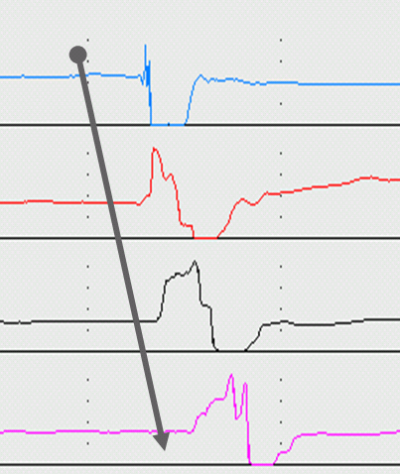
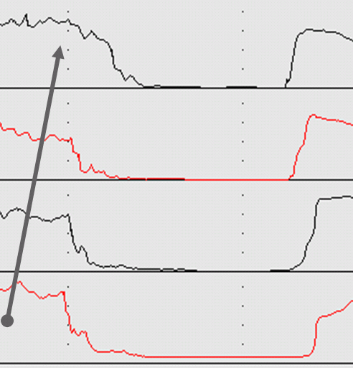
Antegrade (swallow)
Retrograde (reflux)

Slide 10
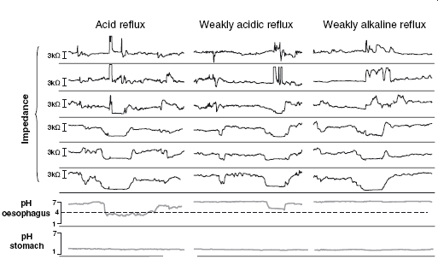
Ambulatory Impedance-pH Testing: Reflux Types

Slide 11
Impedance/pH vs. Bravo
Chemical Properties | Acid / weak acid / nonacid | Acid / weak acid only
Physical Properties | Liquid / gas / mix | None
Bolus direction/ presence/height | Yes | No
Tolerability | Less | More
Duration | Shorter | Longer
Therapy | On or Off | Off (or On)

Slide 12
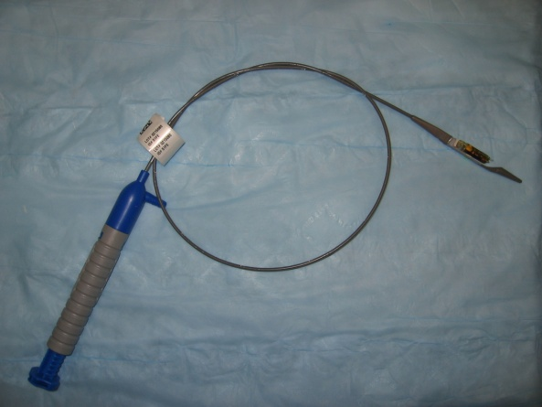
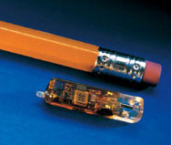
Ambulatory pH
Testing: Bravo
Catheter free reflux monitoring (wireless telemetry)
Contraindicated with implanted electrical devices, prior bowel resection
Probe placed 6 cm above the GE junction
Detects changes in pH only
48 to 96 hour study (generally 48 hour)
Risks: pain, obstruct, no MRI for 4 weeks

Slide 13
Ambulatory pH Testing: Bravo
Advantages of Bravo
  Patient preference
    87% of patients preferred Bravo¹
  Tolerability
    Less interference with work & daily life^{1,2}
  Prolonged measurement
    Day to day variation; improvement in diagnostic sensitivity³
Disadvantages
  Only measures acid; Less useful ON therapy
¹ Wenner et al. AJG 2007 ²
Grigolon et al. Dig and Liv Dis 2007
³ Fox et al. AJG 2007

Slide 14
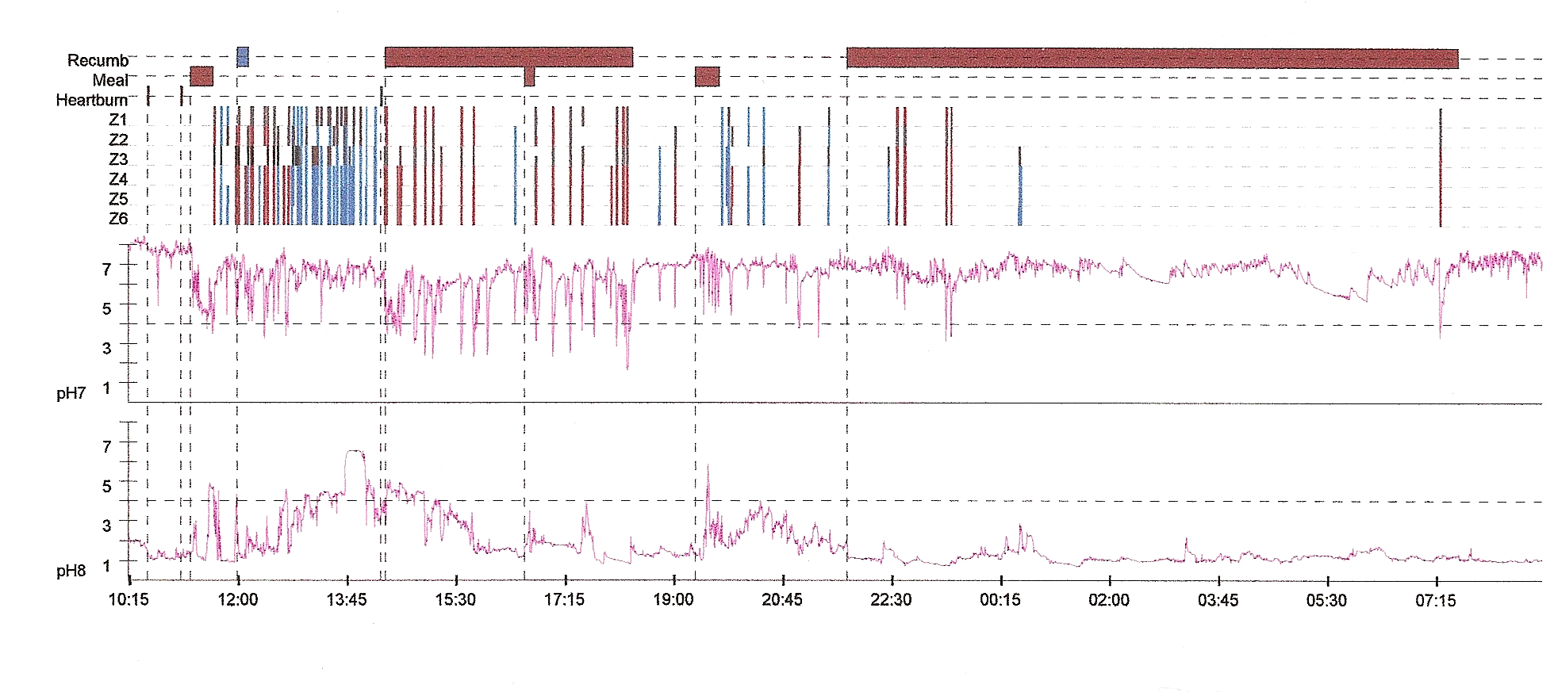
Impedance-pH Testing:
Off Therapy Positive

Slide 15
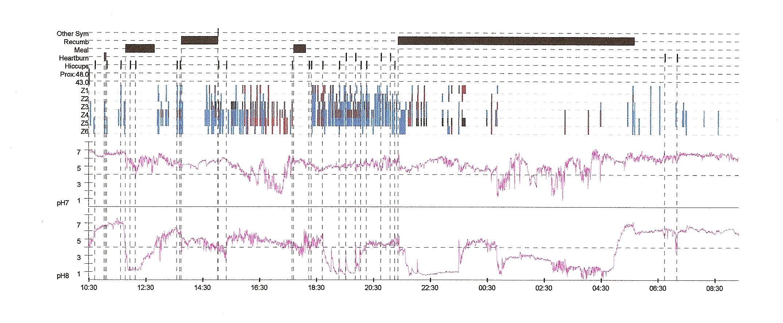
Impedance-pH Testing:
On Therapy Positive

Slide 16
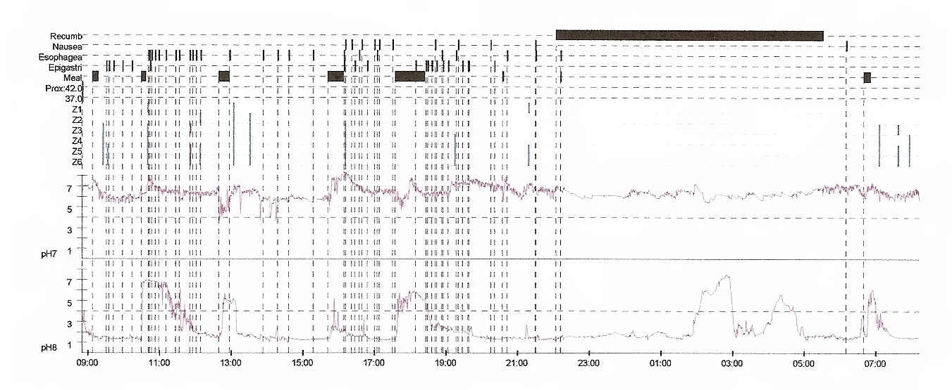
Impedance-pH Testing:
Off Therapy Negative

Slide 17
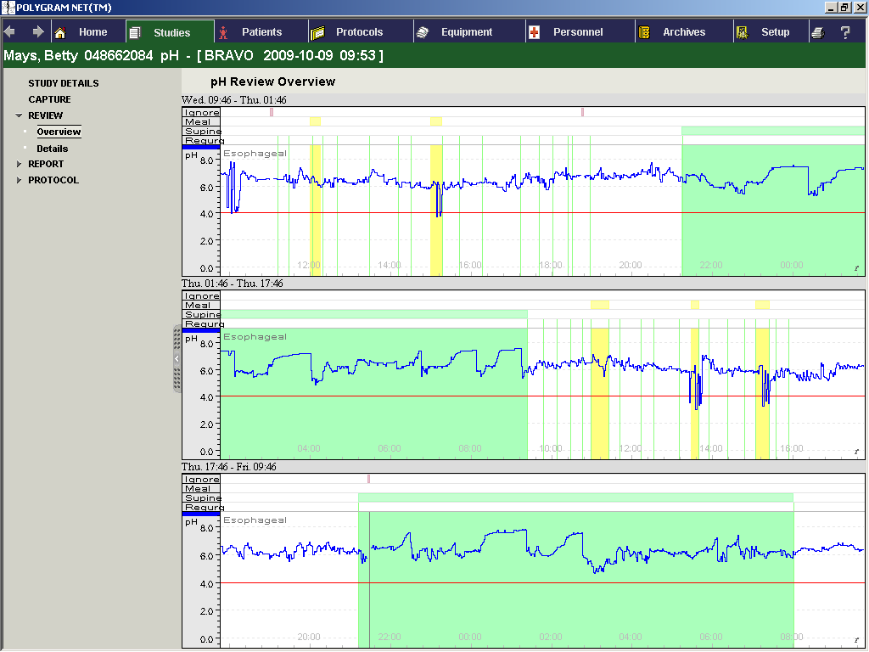
Bravo Off Therapy: Negative

Slide 18
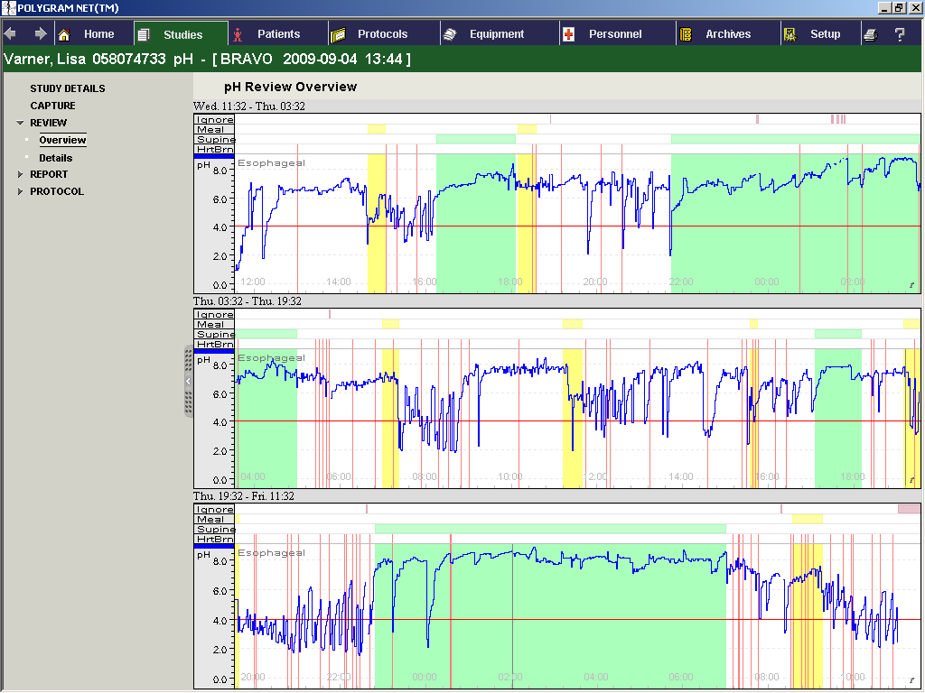
Bravo Off Therapy: Positive

Slide 19
You elect for an Imp/pHmetry
ON Twice daily PPI
Esophageal acid exposure is virtually absent
Gastric acidity is appropriately suppressed
Non-acidic reflux episodes are well within normal limits
The Symptom index is NEGATIVE
  many symptom episodes UNRELATED to GER events
This is NOT refractory GERD
Could she have achalasia?

Slide 20
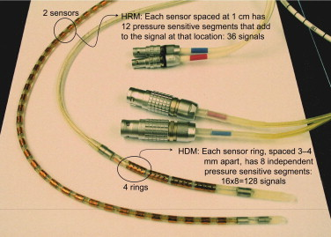
High Resolution Manometry
36 channel catheter spanning entire esophagus to study all anatomic zones from pharynx to stomach
Converts waveform to topographic display
Combined with impedance

Slide 21
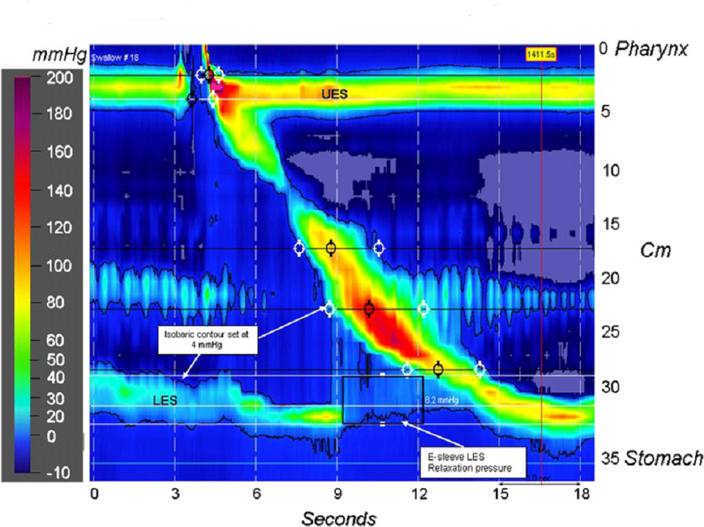
High Resolution Manometry Plot

Slide 22
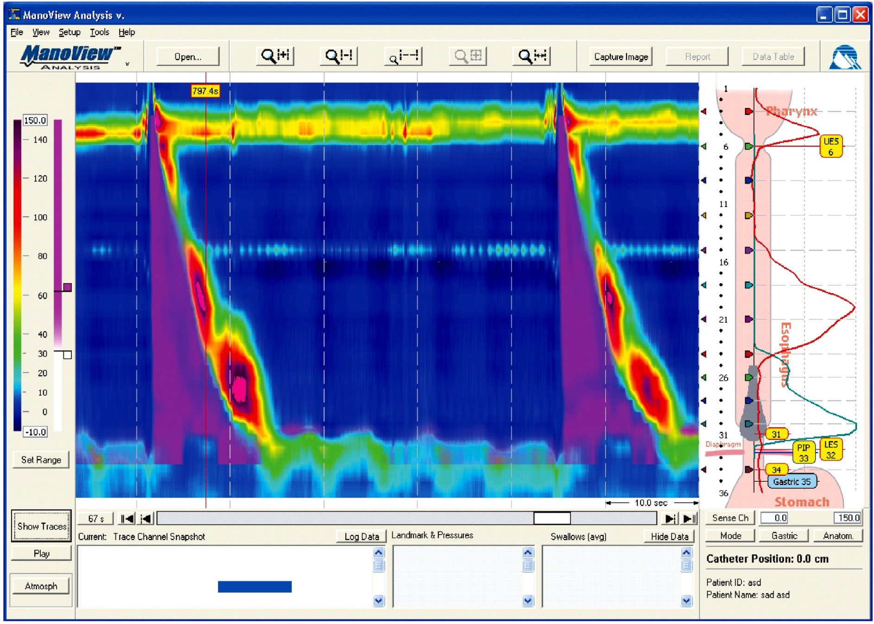
Hi. Res. Manometry with Impedance

Slide 23
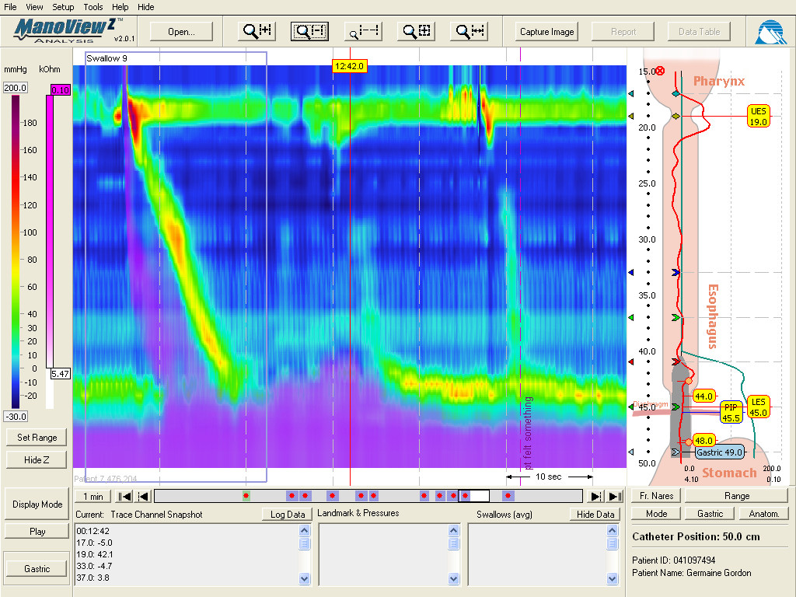
Normal Swallow Followed by a TLESR

Slide 24
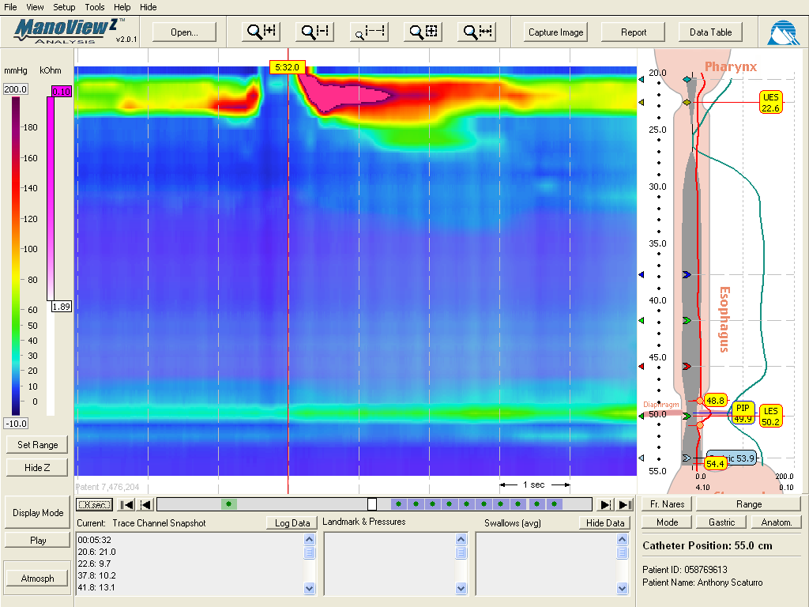
Back to our Patient: Hi Res Mano
Type 1: Classical Achalasia
Absent peristalsis
LES non-relaxation

Slide 25
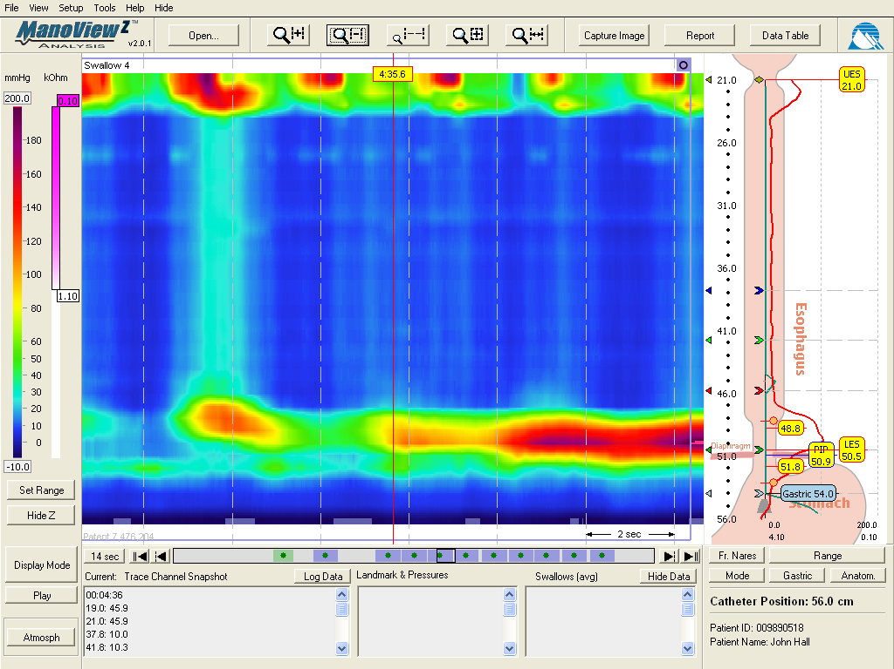
Type 2:Achalasia with Pan-Esophageal Pressurization
Pan-esophageal
Pressurization
LES non-relaxation

Slide 26
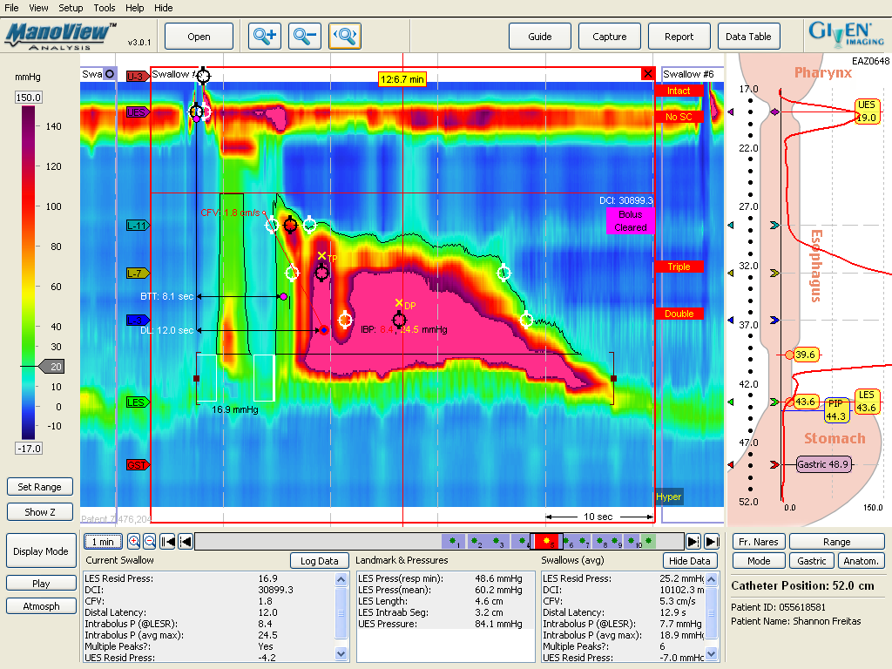
Type 3:Achalasia with Esophageal Spasm
Spasm
LES non-relaxation

Slide 27
Simplified Chicago Classification
Impaired EGJ relaxation
  Classical Achalasia
  Achalasia with esophageal pressurization
  Achalasia with spasm
  Functional EGJ obstruction (normal peristalsis)
Normal EGJ relaxation
  Absent peristalsis (scleroderma, Rxed achalasia)
  Hypotensive peristalsis (IEM, GERD, connective tissue)
  Hypertensive peristalsis (nutcracker esophagus)
  Spasm
Modified from Pandolfino JE, et al. Am J gastroenterol 2007;102:1-11

Slide 28
But the Mano is normal too……..
Refractory GERD is out
Achalasia is unlikely too
Double back and RECONSIDER
  EoE
  Dyspepsia
If all excluded, need to consider functional heartburn

Slide 29

Breath Testing

Slide 30
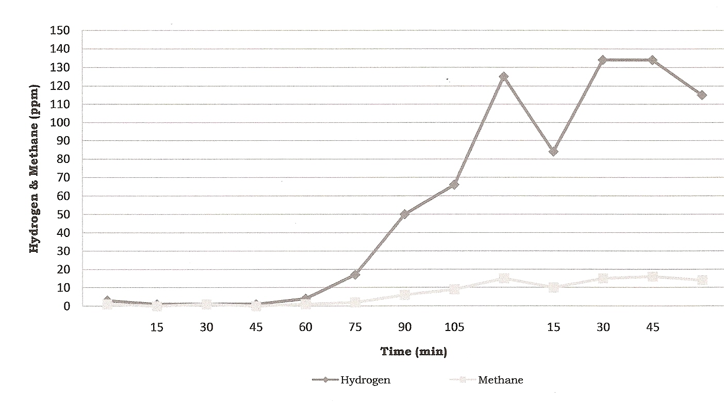
Hydrogen Breath Testing: Normal
Oro-cecal transit time
Lactulose

Slide 31
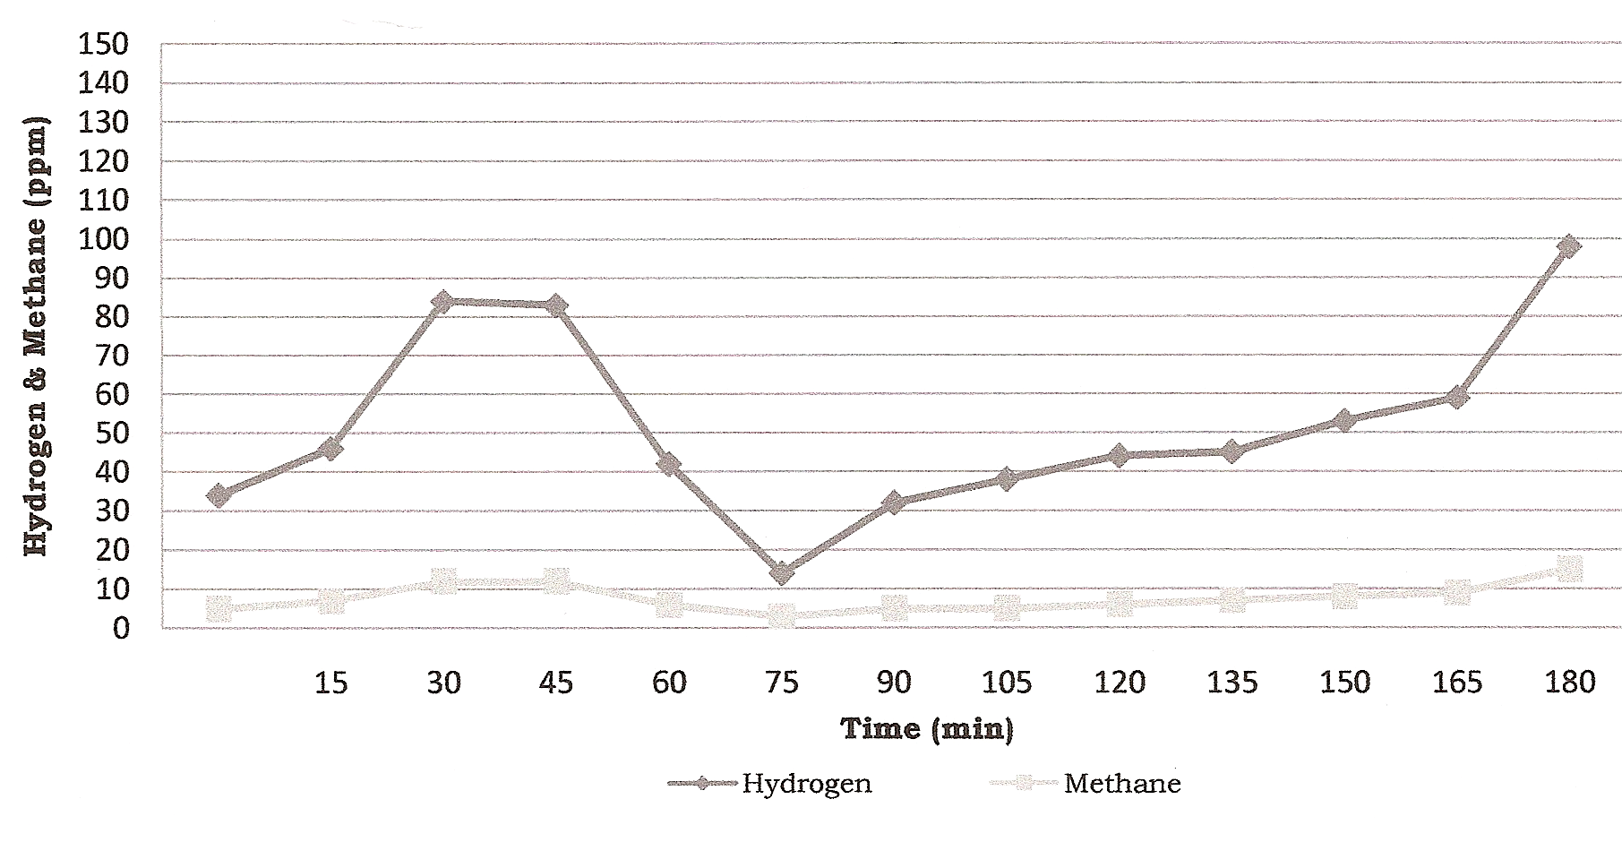
Hydrogen Breath Testing: Overgrowth (Lactulose)
Lactulose

Slide 32
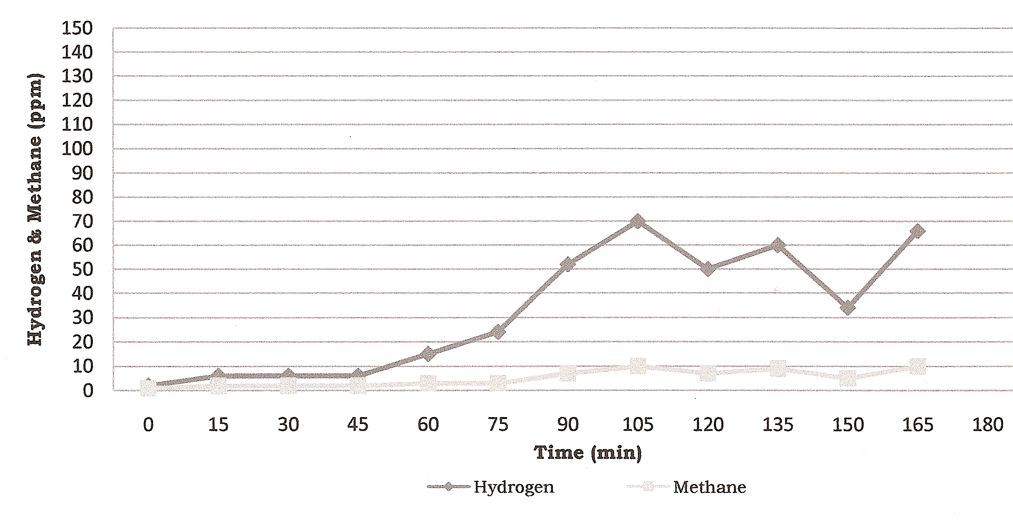
Hydrogen Breath Testing: Dissaccharidase Deficiency
Lactose

Slide 33
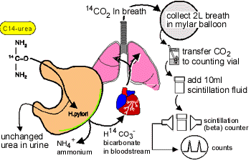
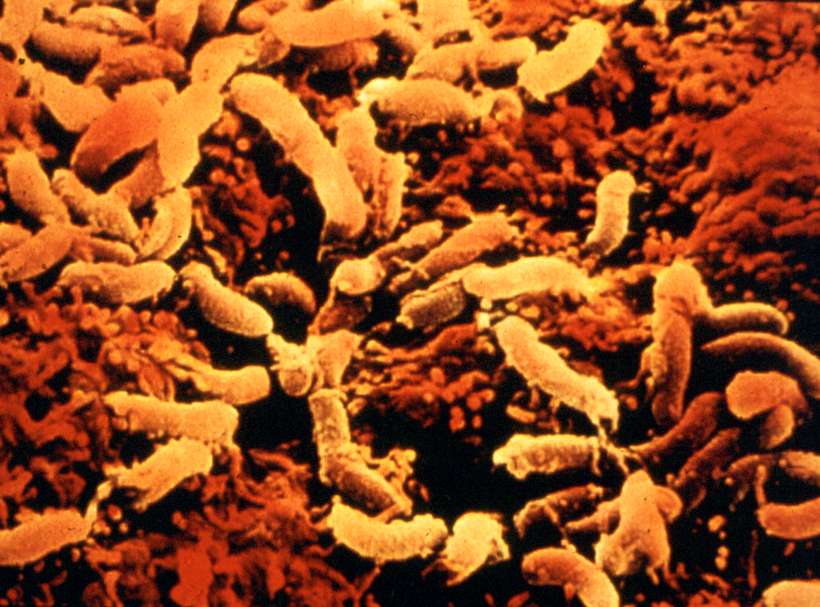
Urea Breath Testing (14C-Urea)

Slide 34
Change in Guidelines
All patients treated for H. pylori infection require post treatment testing to document cure status
Options:
  Non-invasive: UBT, HpSA
  Invasive: Endoscopy and Bx (H+E, IHC, Culture)
  Antibody testing is no longer acceptable (serologic scar)

Slide 35
Tests of Gastric Emptying
UGI / endoscopy inaccurate
Radio-opaque markers
Radiolabelled solid scintigraphy “gold standard”
“Smart Pill”
Gastroduodenal manometry, octanoic acid, and ultrasound measures of emptying are investigational / research techniques
Electrogastrography measures gastric rhythm (also investigational / research uses)

Slide 36
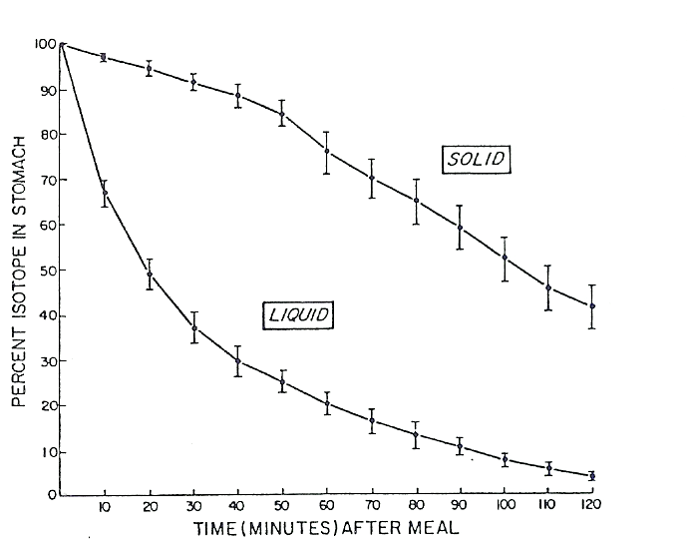
Gastric Emptying Scan:
Gold Standard is a Four Hour Test
Normal residual is
<10% of a standardized
meal at four hours

Slide 37
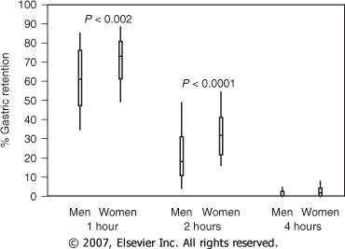
Feldman, M. Sleisenger & Fordtran's Gastrointestinal and Liver Disease; 2007

Slide 38
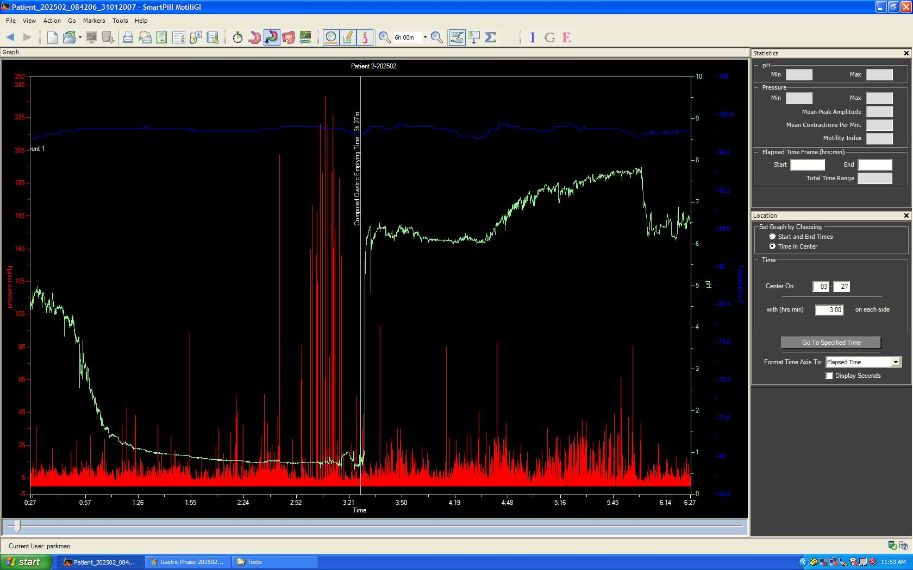
SmartPillTM for Gastric Emptying
Ingestible capsule that measures pH, pressure and temperature using miniaturized wireless sensor technology – measures whole gut transit
Courtesy Henry Parkman, MD

Slide 39
Conclusions
GI Physiology testing helps in the diagnosis and management of patients with non-structural diseases of the upper (and lower) GI tract
In general should be performed AFTER (normal) structural studies have been done
Best to target testing to presenting symptoms

