Slide 1
Artificial Intelligence and the Future of War
Paul Scharre
Vice President and director of studies
Center for a New American Security

Slide 2
The Information Revolution
The United States was a first-mover in the information revolution, using sensors, stealth, networks, & guided munitions to gain a decisive advantage over others.
That advantage has waned as the technology has proliferated and others can turn it against us (i.e., “anti-access” capabilities).
At the same time, the information revolution continues to evolve, but now much more globalized.
The winners will be those who can rapidly adapt digital technologies to military advantage.

Slide 3
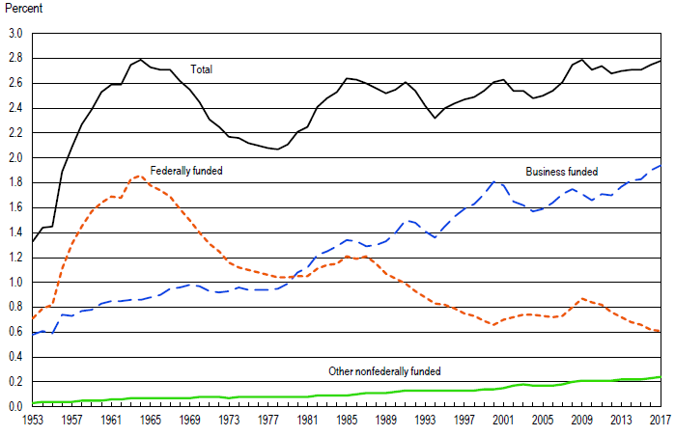
DoD Must Adapt to a Changing Technology Landscape
U.S. R&D Funding as a Percentage of Gross Domestic Product
In the 1960s, the federal government funded two-thirds of U.S. R&D. Today, that has declined to less than one quarter with the private sector filling the gap.
DoD must adapt to a technology landscape where the bulk of technological innovation will happen outside DoD.
National Science Foundation

Slide 4
U.S. is No Longer the Driver of Global Tech Innovation
U.S. Share of Global R&D
1960
2018
The same is true on a larger scale globally. DoD is not in a position to drive the shape of global tech development.

Slide 5
DoD is Not in the Driver’s Seat for Technology Trends
U.S. Share of Global R&D
1960
2018
DoD must adapt to exogenous tech trends and import tech developed outside the defense sector faster than competitors.

Slide 6
Global IT spending is nearly 2X military spending
Many ”spin-in” applications to defense (computers, networks)
New opportunities in defense and security and vulnerabilities (cyber, social media)
Technological art of the possible is constantly changing

Slide 7
Digital Systems
Exponential growth in:
Networking
Data
Computing power

Slide 8
Networks of People
The rest of the world is coming online
Active internet users: 5.3 billion (over 2/3 of world’s population)
Every day, more than a million people join social media
As more people come online, their data comes online as well. Their lives become digitized (email, text, search history, location data, etc.)

Slide 9
Networks of Things
The internet is colonizing the physical world
Estimated 24 billion connected devices, growing 10% annually to an estimated nearly 30 billion by 2023
Internet of Things (IoT) devices (smart meters, medical devices, home appliances, industrial applications) will account for over half of all connected devices by 2023
250 exabytes (10^18 bytes) of data transmitted per month in 2020
Global internet traffic growing 26% per year, projected to hit nearly 400 exabytes of data per month in 2022
Broadband speeds to double and wireless speeds to triple from 2018 to 2023
Notes:
To give a sense of scale, if the amount of data transmitted through global networks every day in 2020 were represented on paper, it would be a stack of paper that would stretch from the earth to the sun and back. Every day. By 2022, that stack of paper would have grown roughly 50 percent taller, doing one and a half round trips from the earth to the sun every day.

Slide 10
A Tsunami of Data
In the past few years, more data has been created than the past 5,000 years of recorded human history
Data is quantifying human behavior, preferences, and genetics
Much of this data is unstructured and unlabeled, requiring new artificial intelligence tools to sort, analyze, and make sense of it
Larger, more diverse datasets are fueling more powerful AI models

Slide 11
The AI Revolution
An explosion in artificial intelligence and machine learning (AI/ML) since 2012
Large datasets + increased computing power (“compute”) = train machines to learn from data
Machine learning is one AI method to build intelligence machines
Today’s AI systems exhibit ”narrow” or task-specific intelligence. Machines are still a far cry from the generalizability of human intelligence.

Slide 12
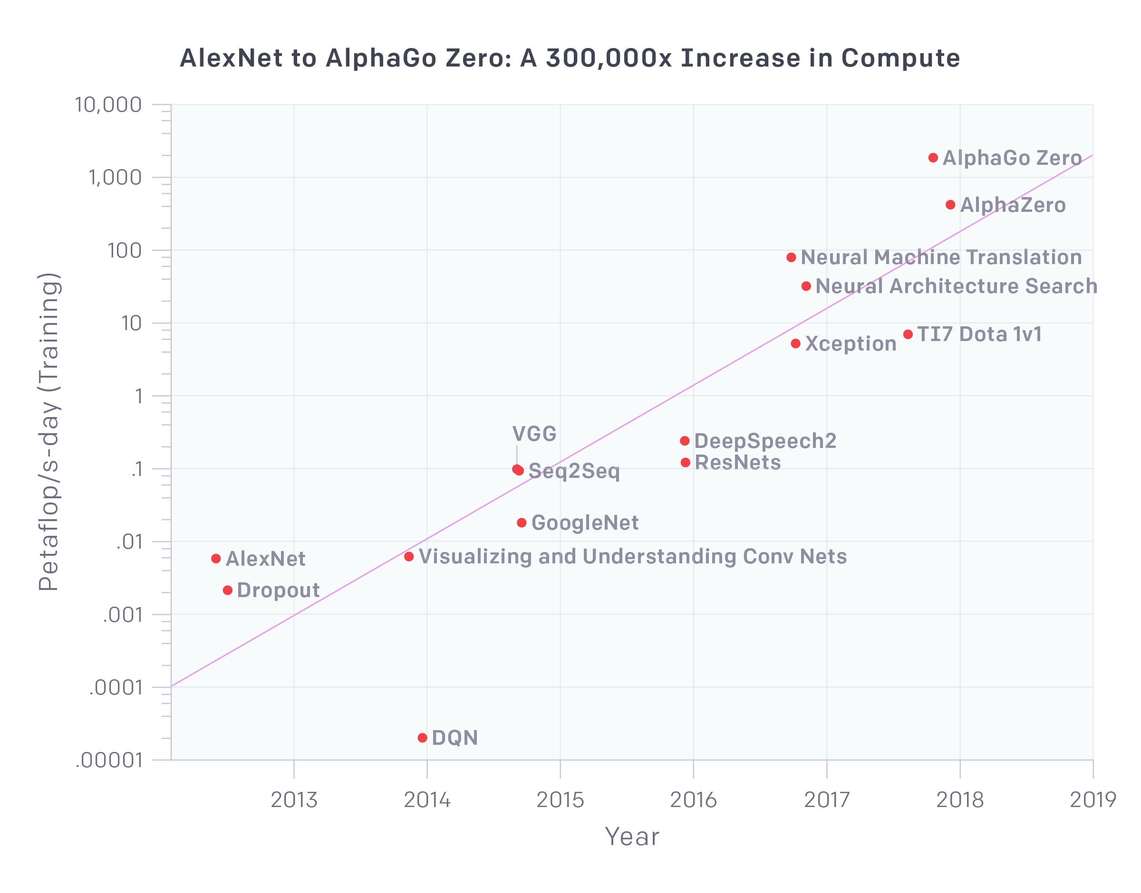
Dominant Global Tech Trend is the Information Revolution
Exponential growth in information technology. 300,000-fold increase in the amount of computing power (“compute”) used in major AI research projects from 2012 to 2019 (doubling every 3.4 months).
Exponential growth in information tech (data, bandwidth, compute) contrasts with incremental growth in physical attributes (speed, range, payload).
OpenAI

Slide 13
Key Defense Tech Areas
Most dramatic changes likely in digital technologies
Networking
Sensors
Data integration
Artificial intelligence
Autonomy
Electronic warfare
Cyber
Information warfare
Human-machine integration

Slide 14
Disruptive Change in Warfare
Historical examples of disruptive shifts in the way militaries fight (“revolutions in warfare”)
During periods of disruptive change, the metrics for combat power change
We are in a period of similar disruptive change today
The most important metrics for power are no longer physical attributes of military systems, but digital ones
Smarter weapons > bigger, faster dumb weapons

Slide 15
Lessons from History
The winners during periods of disruptive change are not those who invent the technology first or have the best technology, but those who come up with the best ways of using it.
Competitive advantage today, for companies and nations, will come from rapidly integrating digital technologies to change how militaries fight.

Slide 16
AI and Global Security
Artificial intelligence is an enabling technology, like electricity. The AI revolution is likely to change warfare as much as past industrial revolutions.
Prior industrial revolutions led to the creation of machines that were stronger than people. These machines were then used in war (locomotive, airplane, tank, submarine.)
AI enables machines that are smarter than humans for narrow tasks. This will likely change human society in profound and unexpected ways.

Slide 17
AI Revolution & Int’l Security
More broadly, the AI revolution is likely to change international relations and security in profound and unexpected ways, as did prior industrial revolutions.
Shifts in balances of power among global actors
Changes in the key drivers of power and competitive advantage (data, compute, talent, institutions)
Global stability dynamics (example, “race to the bottom” on AI safety)

Slide 18
National Security Uses of AI
There will be many national security-relevant uses of AI by states, non-state groups, and individuals.
Military: robots, swarms, autonomous weapons
Intelligence: surveillance, collection, analysis
Information: propaganda, influence
Economic: financial warfare, destabilize economies
Political: decision-making

Slide 19
AI + War
AI will empower militaries with greater situational awareness, precision, coordination, and speed
Likely to lead to a battlefield that is faster paced, more transparent (harder to hide), and more lethal
New tactics will be needed as a result
AI will dramatically change command-and-control

Slide 20
AI Agent Tactics
In chess, go, poker, Starcraft II, Dota2, capture-the-flag, etc. AI agents have demonstrated not only superhuman performance, but the ability to play differently than humans
  Faster reflexes and superior reaction times
  Greater holistic situational awareness across space and time
  Superior coordination among multiple agents
  Superior ability to manage resources
  Ability to radically change risk-taking and aggression

Slide 21
Limitations of AI
Inability to understand context
Brittleness / lack of robustness
Learning / goal-driven failure modes
Vulnerabilities to hacking, poisoning, manipulation

Slide 22
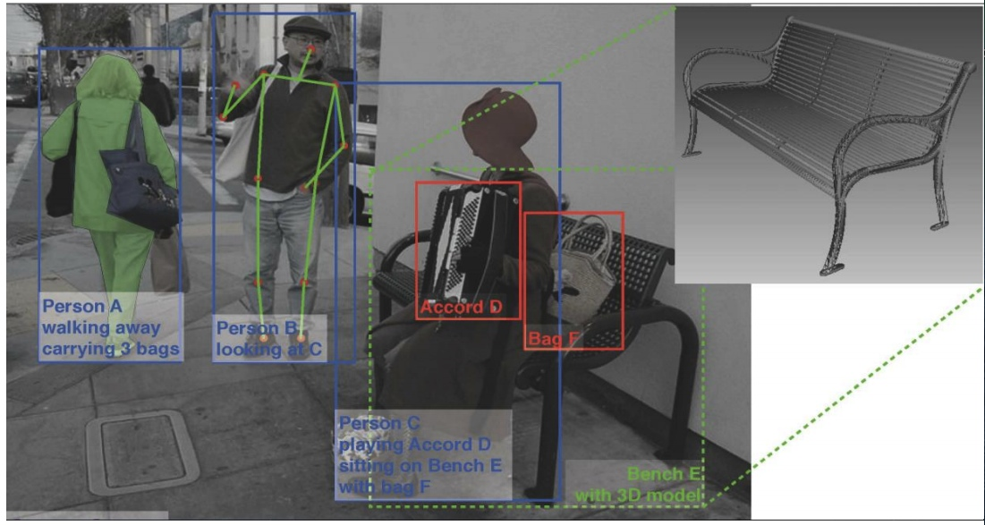
Understanding Context

Slide 23
Brittleness
Today’s AI-enabled systems are “brittle.” They can often achieve super-human performance in narrow domains. When pushed outside the boundaries of their programming, however, they can fail – and fail badly.
They can go from super smart to super dumb in an instant.
Unlike humans, machines cannot flexibly adapt to novel situations. They will do precisely what they are programmed to do.

Slide 24
AI Vulnerabilities
AI-enabled systems will introduce their own vulnerabilities that could be new vectors for attacks:
  Data theft / poisoning
  Altering reward function
  Manipulating behavior
  Adversarial data (spoofing attacks)

Slide 25
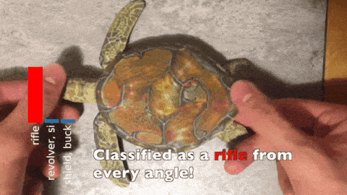
Cognitive Hacking
Athalye et al.
Notes:
Anish Athalye, Logan Engstrom, Andrew Ilyas, Kevin Kwok, “Synthesizing Robust Adversarial Examples,” Proceedings of the 35th International Conference on Machine Learning, PMLR 80:284-293, 2018, http://proceedings.mlr.press/v80/athalye18b/athalye18b.pdf

Slide 26
Challenges Ahead
Ensuring effective human-machine teaming
How do we build AI systems that are robust, reliable, and secure?
How do we establish well-calibrated trust in AI systems?
How do we manage the possibility of surprise by AI systems?
Which tasks should be done by humans and which by machines?
How do we manage the fact that this line will shift over time?
What tasks in war require uniquely human judgment, and why?

Slide 27
Challenges Ahead
Strategic stability
How do we avoid a “race to the bottom” on AI safety in a rush to deploy insufficiently tested AI systems?
How do we manage risks of accidental escalation (“flash war”) from AI-enabled / autonomous weapons?
How do we manage risks of an accelerating tempo of war: a “battlefield singularity” in which the pace of war eclipses the speed of human reaction time?
Where is human control needed in war and how do we ensure it?
What confidence-building measures could states adopt to mitigate these risks?

Slide 28
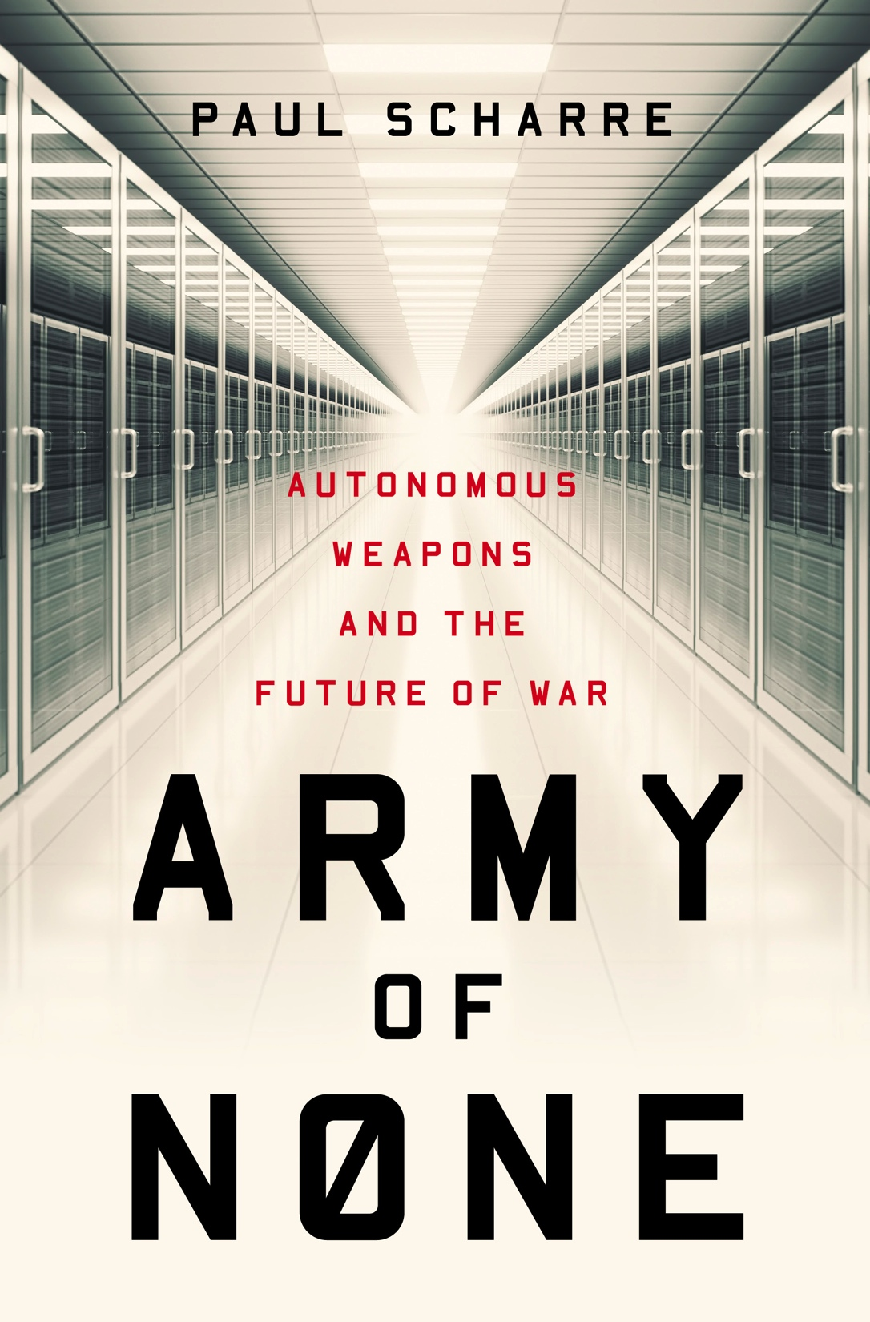
Thank you. Questions?
Paul Scharre
Email: pscharre@cnas.org
Twitter: @paul_scharre
Web: paulscharre.com

