Slide 1
Artificial
intelligence
Priorities
Maj Jorge Ramirez
Chief, Agile Weapons Futures
AFLCMC/EBZX
AIRFORCEWEAPONS.COM

Slide 2
DoD Artificial Intelligence Definitions
“The DoD AI Strategy defines AI as “the ability of machines to perform tasks that
normally require human intelligence.” This definition includes decades-old DoD
AI, such as aircraft autopilots, missile guidance, and signal processing system. Most of the breakthroughs and excitement about AI in the past decade have focused on Machine Learning (ML), which is a subfield of AI. Machine Learning is closely related to statistics and
allows machines to learn from data.” - Greg Allen, Chief of Strategy & Communications
Joint Artificial Intelligence Center (JAIC)
“As I learned back in 2017 and am reminded daily in my role as the Director of the Joint AI Center (JAIC), AI is not an elixir. It is an enabler – one that is critical to our future national security.” -Lieutenant General John N.T. “Jack” Shanahan
Notes:
Ahead of a PoR requirement pulls aligning common requirements (SDR, Autonomy, etc.) into prototype systems enables future PoR starting points.

Slide 3
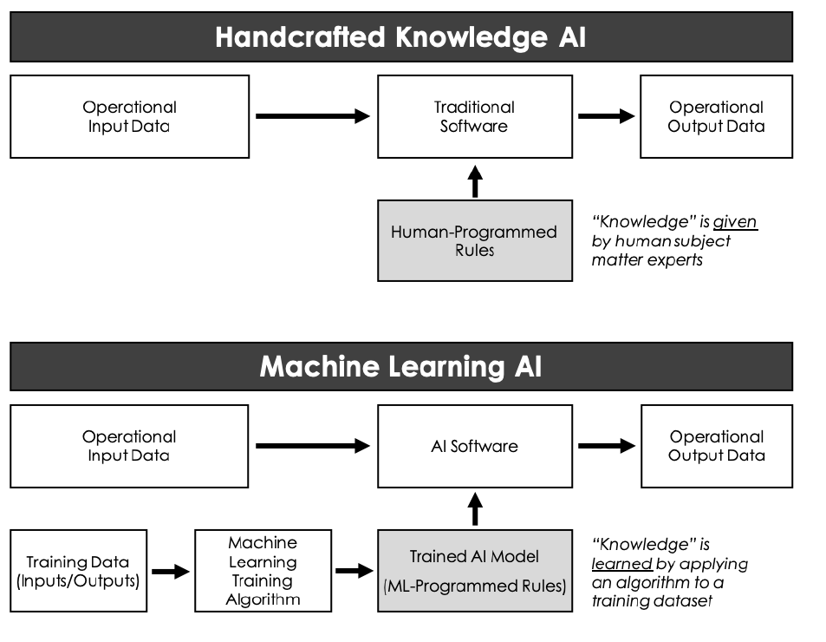
DoD Artificial Intelligence Definition
Notes:
Ahead of a PoR requirement pulls aligning common requirements (SDR, Autonomy, etc.) into prototype systems enables future PoR starting points.

Slide 4
DoD Artificial Intelligence Ethical Principles
Responsible: DoD personnel will exercise appropriate levels of judgment and care, while remaining responsible for the dev, deployment, and use of AI capabilities.
Equitable: Will take deliberate steps to minimize unintended bias in AI capabilities.
Traceable: The Department' s AI capabilities will be developed and deployed such that relevant personnel possess an appropriate understanding of technology, development processes, and operational methods applicable to AI capabilities, including transparent and auditable methodologies, data sources, and design procedure and documentation.
Reliable: The Department's AI capabilities will have explicit, well-defined uses, and the safety, security, and effectiveness of such capabilities will be subject to testing and assurance within those defined uses across Al capabilities' entire life-cycle.
Governable: The Department will design and engineer AI capabilities to fulfill their intended functions while possessing the ability to detect and avoid unintended consequences, and the ability to disengage or deactivate deployed systems that demonstrate unintended behavior.
Notes:
Ahead of a PoR requirement pulls aligning common requirements (SDR, Autonomy, etc.) into prototype systems enables future PoR starting points.

Slide 5
Where do we go from here…
Lay the ground work:
  Define & refine AI/ML opportunities within current/future business practices and greater weapons enterprise
  Engage requirements teams to ID evolving adversary capabilities that will drive an AI/ML solution
Ease integration risk:
  ID efficient integration opportunities for AI/ML capabilities within the Weapons Government Reference Architecture
  Maximize commercial best practices and technical approaches
Get educated:
  https://www.ai.mil/
  https://digitalu.af.mil/
  https://www.diu.mil/responsible-ai-guidelines
Notes:
Ahead of a PoR requirement pulls aligning common requirements (SDR, Autonomy, etc.) into prototype systems enables future PoR starting points.

