Slide 1
Quality and
Performance Improvement

Slide 2
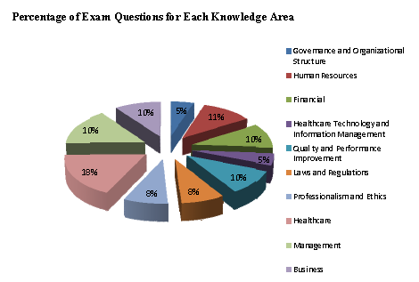
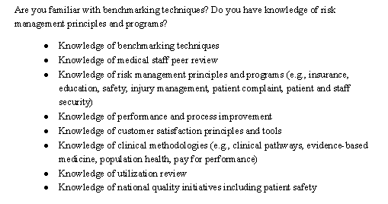
Quality/ Performance Improvement Topic
20 Questions, 10% of the Exam

Slide 3
Introduction of Faculty/ Presenter
Michelle Adzhemyan, MHA, FACHE
Senior Consultant, Acute Care Services, The Southeast Permanente Medical Group (TSPMG)
Has spent career working with hospital departments and medical groups to make improvements to patient throughput and satisfaction through application of Lean, Six Sigma, and Innovation tools
Prior to move to Georgia in 2016, worked for a number of large health care systems in California, including Dignity Health, Providence Health & Services, and Sutter Health
Received her FACHE in 2013 and her Black Belt Certification in 2010
Received her Master in Healthcare Administration from the University of Minnesota in 2006 and Bachelor Degrees in Psychology and Biology from St. Olaf College in 2004
Taught the Quality and Performance Improvement BOG content to FACHE students in Southern California for 2 ½ years

Slide 4
Today’s Agenda
The Quality Definition
Quality Improvement
  Foundation
  Evolution
  Types
  Lean
  PDCA (Shewhart cycle or Deming Wheel)
  Value vs. Waste
Process Improvement Toolkit
Risk, Regulation & Reporting
Medical Staff
Quality and Reimbursement
Review – 20 Practice Exam Questions

Slide 5
Culture of Performance Improvement
“What determines how great a healthcare organization will become is how well its leadership system creates a culture of excellence and safety, improves the enterprise system and effectively implements best practices.”
“Change Healthcare Organizations from Good to Great”
American Society for Quality 11/2005

Slide 6
The Quality Definition
In Crossing the Quality Chasm, the Institute of Medicine (IOM) provided
a six-part definition of health care quality that some view as the emerging standard.
According to the IOM, health care should be:
Safe – avoiding injuries to patients from the care that is intended to help them;
Effective – providing services based on scientific knowledge to all who could benefit and refraining from providing services to those not likely to benefit (avoiding underuse and overuse, respectively);
Patient-centered – providing care that is respectful of and responsive to individual patient preferences, needs, and values and ensuring that patient values guide all clinical decisions;
Timely – reducing waits and sometimes harmful delays for both those who receive and those who give care;
Efficient – avoiding waste, including waste of equipment, supplies, ideas, and energy; and
Equitable – providing care that does not vary in quality because of personal characteristics such as gender, ethnicity, geographic location, and socio-economic status
Crossing the Quality Chasm, Institute of Medicine, 2001

Slide 7
The Quality Improvement Definition
Quality Improvement (QI) is a term used to describe a body of knowledge, which consists of the processes and tools needed to continuously improve quality of services and products within organizations.
  QI techniques and practices have become known to the business world under many different names (CQI - continuous quality improvement, TQM - total quality management, Six Sigma, etc.) but are all built on the same foundation of customer requirements, statistical measurement, top down support and employee participation.
Very simply, Quality Improvement strives to reduce (if not eliminate) and prevent defects in the flow of work that will decrease costs, enhance the work environment, reduce errors, and improve results in the form of products, services and outcomes.

Slide 8
Foundation of Quality Improvement
All QI approaches share a common base of knowledge and principles despite some differences in technique or vocabulary.
Process–Oriented Thinking
Continuous Quality Improvement (CQI): The reiterative process of improving stems from a philosophy that suggests quality is not something attained, but rather continually sought. The status quo is not sufficient.
There is an interconnectivity of processes and systems; as one part of the system is improved, the relationship or functioning between parts of the system can also be improved as a result.
Better decisions are made when they are:
  Based on data, with proper analysis (not based on intuition/subjectivity)
  Empower stakeholders/staff by including them in the decision-making process, without fear.
  Managers relinquish historic unilateral decision-making
The Process Improvement toolkit can be used to improve the measurement, analysis and reliability of data.

Slide 9
Foundation of Quality Improvement
All QI approaches share a common base of knowledge and principles despite some differences in technique or vocabulary.
Customer Requirements
There is a customer and a supplier in every step of every process both internally and externally.
Process
All work, no matter how simple, is part of a process that can be defined and mapped, step-by-step.
Continuous
QI is a continuous cycle that requires the discipline to apply the techniques over and over. Steps toward the desired goal are measured, monitored and adjusted, then re-measured to determine the best plan to minimize variation.
Variation
All work processes, from the most simple to the most elegantly automated, are subject to variation and reducing variation makes improvement.

Slide 10
Evolution of Health Care QI Programs
900 AD
Peer Review
  Medicare mandated, medical staff performance-oriented.
Quality Assurance (QA)
  Reliance on inspection in the form of retrospective review without system-wide improvement techniques.
Quality Improvement (QI)
  Health care begins to recognize the advantage of systematic improvement with cooperation from different disciplines. (Interdisciplinary cooperation mandated in some areas by regulatory agencies).
Total Quality Management (TQM)
  The role of leadership is included in the regulatory QI standards. TQM was widely being used in other industries.
Continuous Quality Improvement (CQI)
  QI models (Plan, Do, Check, Act cycle) were adopted to appease regulators that a systematic quality program is in place. Industry begins to look at "outcomes” measurement.
Performance Improvement (PI)
  Accrediting bodies broaden the concepts of QI and require benchmarking to meet the standard.
1979
1986
1993

Slide 11
Quality Improvement – Current State
QI has been used as both a management philosophy and a scientific methodology with systematic data collection and analysis at its core. Any model of QI must be believable, sustainable and replicable, as is the case in the traditional scientific method of observation, hypothesis, testing, and conclusion.
Evidenced Based Practice (EBM) – Evidenced Based Medicine, is the latest model of clinical improvement to become popular in Healthcare delivery systems. The principle methodology of EBM works toward the same goals as quality improvement processes in terms of basing decisions on systematically collected and analyzed data. The EBM methodology considers not only the most effective clinical intervention, but also the most economical. This approach is closely related to the CQI process.
Malcolm Baldrige Criteria for Performance Excellence in Healthcare – The Baldridge criteria for performance excellence has been in existence for over a decade. More recently criteria were developed for health care. If used, these criteria encourage overall organizational assessment, facilitate the use of best practices and work toward improved organizational performance through the use of QI principles. The criteria can be used as a systemwide model for performance improvement.
Six Sigma – This method is based on a structured, disciplined approach using steps known as DMAIC. DMAIC is an acronym meaning Define, Measure, Analyze, Improve, and Control. The goal of using this methodology is to achieve “Six Sigma” or 3.4 defects per million opportunities. It is just beginning to be utilized in healthcare.
PDCA – While a number of QI approaches exist, one of the most widely adopted is the PDCA method. The “Plan, Do, Check, Act” framework was developed by Walter Shewhart and can be known as the Shewhart model of improvement.

Slide 12
What is Lean?
Lean is a systematic approach to identify and eliminate waste or non-value-added activities in a supply chain or process by continuous improvement through participation of all employees
Lean strives for perfection by providing a defect-free product/service, one request at a time, when wanted and needed, safely and with no waste
Provide the right products or services, at the right time, at the highest possible quality, and at the lowest possible cost.
Doing what the customer needs, when it is needed, the right way, the first time

Slide 13
Value-Added and Waste
“Value-Added” is from the customer’s perspective.
  Who is your customer?
  What is your product?
Value - Activities that contributes to what your customers want our of your product or service
Non-Value or Waste - Work that adds no value in the eyes of your customers – think of “TRIMWOOD”
    Waste of Transportation
    Waste of Resources
    Waste of Inventory
    Waste of Motion
    Waste of Waiting
    Waste of Overproduction
    Waste of Overprocessing
    Waste of Defects (6 sigma)
Goal = Continuous flow of value-added steps

Slide 14
Technology is Not the Solution
“Errors won't go away just because it seems logical that there should be fewer errors with more expensive equipment, more computerization, and more automation…
Orderly processes, when operated in an environment of disorder, will still be subject to errors. All errors are important and we must start by eliminating those most directly under our control.”
James O. Westgard, PhD,
Professor of Pathology and Laboratory Medicine
University of Wisconsin Medical School, Madison
President QC Inc

Slide 15
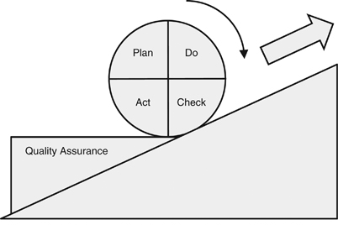
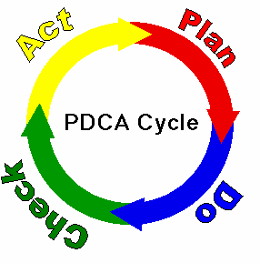
Deming Wheel or Shewhart Cycle
Step 1: Plan
  Problem Identification
  Role Identification and Team Selection
  Understand Current Process
  Define Problems and Set Measurable Goals
Step 2: Do
  Establish Criteria for Solution
  Develop and Analyze Potential Solutions
  Select a Solution
  Act on Solution
Step 3: Check
  Analyze Results
  Monitor and Report Results
Step 4: Act
  Standardize the Solution
  Adopt a System-wide Implementation
  Plan for Ongoing Monitoring
  Disseminate Information
  Look for Other Opportunities

Slide 16
Value Equation of Health Care
“Total quality activity can begin only if top management is conscious of the critical need for companywide commitment to quality and its own responsibility for introducing such activity” - Noriaki Kano
VALUE = QUALITY / COST
Although there are many strategies for reducing waste and enhancing value in health care, they tend to be isolated in focus and frequently do not address the system dynamics of health care.
Noriako Kano outlines three possible approaches to improving the quality of product or service – and thereby increasing value:
  Eliminate the quality problems that arise because the customers expectations are not met
  Reduce cost significantly while maintaining or improving quality
  Expand customers’ expectations by providing products and services perceived as unusually high in value.

Slide 17
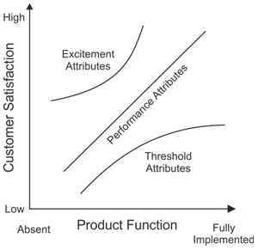
Kano Model

Slide 18
Process Improvement Toolkit

Slide 19
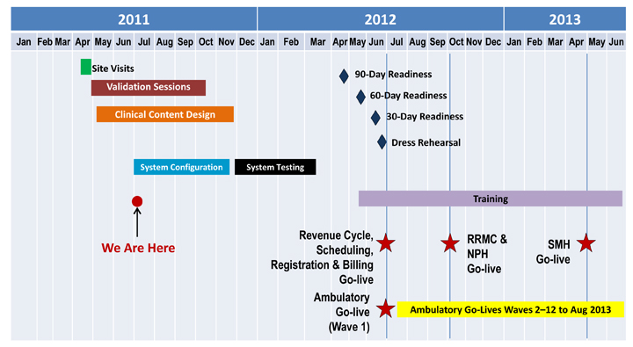
Process Improvement Toolkit:
Gantt Chart/ Project Plan
Action Plan/Project Plan/Gantt Chart
  An action plan is a list of activities needed to clearly indicate the who, what, where, when and how of the improvement process. This is needed to implement and monitor progress on the solution.
  Gantt Chart is a visual tool that tracks progress against plan and display relationship against different tasks.

Slide 20
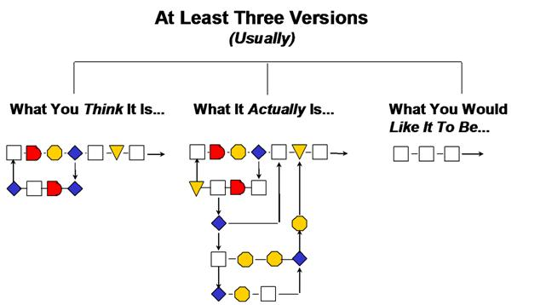
Process Improvement Toolkit:
Process Flow Chart & Value Stream Map
A process flow diagram, often called a flow chart, is a graphic representation of the sequence of steps performed in producing some output.
A value stream map accomplishes the following:
  Enables an organization to understand its current process
  Creates a common vision of what is achievable with quantifiable gains for everyone who is connected to the targeted value stream
  Provides a plan with quantifiable gains to aim for in the short, medium, and long term
  Provides visual roadmap for the team to allocate the appropriate resources

Slide 21
Value Stream Map Example

Slide 22

How to Draw a Process Map
1
Define Boundaries
(Where the process starts and stops)
4
List Key Milestones or Running Time Across the Top
2
5
Engage staff to List Functions
Identify Opportunities
3
List Process Steps According to the Staff that Performs It
Timeline
10 min
20 min
30 min
40 min
50min
Patient
Pt Enters Clinic
Pt Exits Clinic
1
Front Desk
Check-in Patient
Collect Co-pay
Nurse
Room Patient
Take Vitals
Draw Blood
Yes
Patient need lab work?
Physician
Exam Patient
No
Opportunities
1. 20% of co-pays are not collected
22
Notes:
22
2. (Roles or departments, not names of people) Identify the relevant departments that play a part of the process flow and include their input into development of the map
3. List the activities/steps in the process at a level appropriate for the level of analysis you are trying to accomplish
5. Show opportunities for improvement by placing a Kaizen burst near the area
22

Slide 23
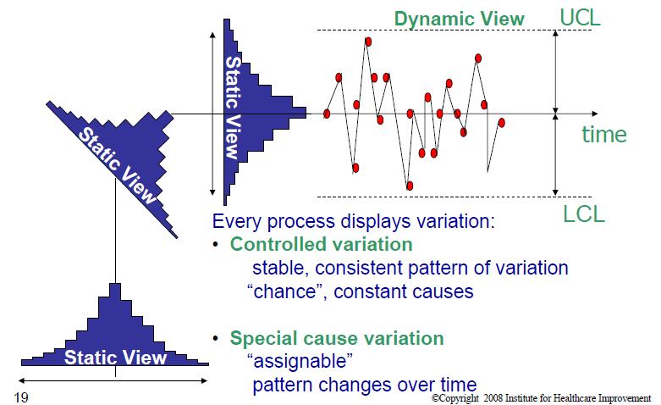
Process Improvement Toolkit:
Control Chart
Control Chart
  A control chart is a quantitative display tool to track performance over time by studying process variation and its source. It is a common language for discussing process performance. It measures the stability of the process and evaluates the progress after process change. It also distinguishes the special cause variation from the common cause variation. It is a visual way to identify acceptable and unacceptable trends.
  Generally, control limits are established at three standard deviations from the mean--indication that 99.75 percent of the points will fall between the upper and lower control limits.

Slide 24
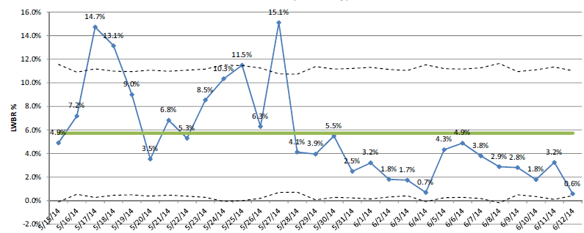
Control Chart Example:
Percent of Patients Who Left Without Being Registered (LWBR) in a Hospital ED
Did they improve?

Slide 25
Process Improvement Toolkit: Fishbone Diagram
Fishbone diagram
  The “fishbone” diagram is also called the cause and effect or Ishikawa diagram. The diagram helps to organize and display various ideas for the potential causes of a problem. Although it lists all the possible factors and the possible relationships between the cause, it does not show the magnitude of each possible cause. It creates a snapshot of the team’s collective knowledge by focusing on the causes not the symptoms. It also stimulates thinking during a brainstorming session when looking for potential causes. This also helps to discourage the jumping to an obvious solution.
Machine
Manpower
Name of problem or effect being analyzed
Information
Methods

Slide 26
Modeling
PERT Charting –
  Program Evaluation and Review Technique is a method to analyze the involved tasks in completing a given project, especially the time needed to complete each task, and to identify the minimum time needed to complete the total project.
b. Stochastic Modeling –
  Stochastic modeling is a technique of presenting data or predicting outcomes that takes into account a certain degree of randomness, or unpredictability.
c. Monte Carlo Simulation –
  A problem solving technique used to approximate the probability of certain outcomes by running multiple trial runs, called simulations, using random variables.

Slide 27
Process Improvement Toolkit:
Histogram
A histogram is a quantitative data display tool that summarizes data from a process that has been collected over a period of time. It graphically presents and analyzes data as a frequency distribution and variance. Information is presented in bar graphs to make it easier to identify distribution patterns. It provides useful information for predicting future performance and helps to identify possible changes in the process. The tool may help to facilitate root cause analysis or to determine if the process is capable of meeting customer needs.

Slide 28
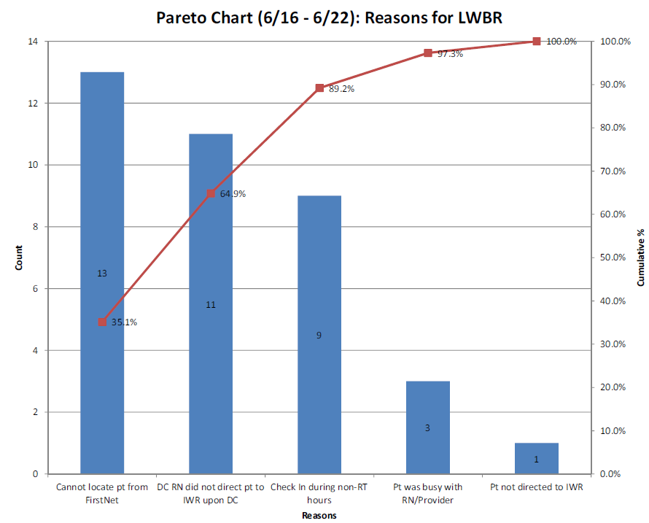
Process Improvement Toolkit:
Pareto Analysis
A Pareto Analysis is a quantitative data display tool that shows relative frequency or size in a bar graph allowing determination of the most important issues. It displays the pattern of occurrence for a problem by ranking the most-frequently to the least-frequently occurring issues. The tool helps to select and define the “vital few” improvements that will give the biggest yield. It can also help to build consensus in the group.

Slide 29
Process Improvement Toolkit:
Benchmarking (1 of 2)
Benchmarking
  Benchmarking is a tool used to measure your process against best practices. It specifies processes and results that represent best practices and excellent performance in similar activities, inside and outside of the organization. It adds objectivity to assumptions regarding the performance excellence since most people believe they are doing excellent work.
    Internal Benchmarking – Compare within the organization for similar process, product or service.
    Competitive Benchmarking – Compare your organization against your toughest and best competitor.
    Functional Benchmarking – Compare your organization to a “world-class” organization in the same industry.
    Generic benchmarking – Compare yourself to a “world-class” organization not in the same industry but using similar processes
Service Access Metrics | Goal | 11-Mar | 18-Mar | 25-Mar | 1-Apr | 8-Apr | 15-Apr | 22-Apr | 29-Apr | 6-May | 13-May | 20-May | 27-May | 3-Jun
6ICU
ED Green Light Placement Times | 1:00 | 1:25 | 1:14 | 1:14 | 0:54 | 0:50 | 1:16 | 0:44 | 1:02 | 1:04 | 1:26 | 1:11 | 1:16 | 1:18
ED Request to Patient Ready | 1:00 | 0:45 | 2:20 | 1:07 | 1:14 | 1:14 | 0:55 | 2:12 | 1:01 | 0:47 | 0:42 | 1:17 | 1:18 | 0:44
PACU Green Light Placement Times | 1:00 | 0:50 | 1:31 | 0:50 | 0:51 | 1:29 | 0:41 | 0:40 | 0:56 | 0:59 | 0:51 | 1:51 | 1:06 | 0:44
PACU Request to Patient Ready | 1:00 | 1:35 | 0:53 | 1:24 | 1:57 | 0:45 | 1:11 | 1:25 | 1:17 | 1:00 | 1:05 | 0:44 | 1:21 | 0:59
6N
ED Green Light Placement Times | 1:00 | 0:47 | 1:06 | 1:24 | 1:30 | 1:14 | 1:27 | 0:57 | 1:05 | 0:57 | 1:26 | 1:12 | 1:11 | 0:46
ED Request to Patient Ready | 1:00 | 1:34 | 2:10 | 1:08 | 1:01 | 1:40 | 1:16 | 1:28 | 1:48 | 1:24 | 0:42 | 1:20 | 1:00 | 2:01
PACU Green Light Placement Times | 1:00 | 1:21 | 1:02 | 1:08 | 0:52 | 1:09 | 0:59 | 0:48 | 0:47 | 1:11 | 1:03 | 0:50 | 1:11 | 0:43
PACU Request to Patient Ready | 1:00 | 1:21 | 1:05 | 1:35 | 1:16 | 0:34 | 1:06 | 1:35 | 1:11 | 1:16 | 0:52 | 1:23 | 0:41 | 1:14
Infection Control | Target | Jan-Mar 2010 | Apr-Jun 2010 |  |  | Jul-Sep 2010 |  |  | Oct-Dec 2010 |  |  | Jan-Mar 2011
6 ICU
CA-BSI (rate per 1,000 pt days) | 2.66 | 0.70 | 0.00 |  |  | 1.80 |  |  | 0.00 |  |  | 0.00
C-Diff (rate per 1,000 pt days) | 1.20 | 2.09 | 0.00 |  |  | 1.40 |  |  | 0.50 |  |  | 0.00
MRSA (rate per 1,000 pt days) | 0.00 | 0.00 | 0.50 |  |  | 0.00 |  |  | 0.00 |  |  | 0.00
VAP (rate per 1,000 pt days) | 1.94 | 1.00 | 0.00 |  |  | 1.40 |  |  | 0.80 |  |  | 0.00
VRE (rate per 1,000 pt days) | 0.85 | 0.00 | 0.00 |  |  | 0.50 |  |  | 0.50 |  |  | 1.00
Handwashing MAPS Audits | 100% | 98% | 96% | 81% | 83% | 77% | 94% | 93% | 98% | 96% | 96% | 92% | 95% | 97%
6N
MRSA (rate per 1,000 pt days) | 0.41 | 0.49 | 0.00 |  |  | 0.00 |  |  | 0.00 |  |  | 1.40
VRE (rate per 1,000 pt days) | 0.20 | 0.00 | 0.50 |  |  | 0.50 |  |  | 0.00 |  |  | 0.50
C-Diff (rate per 1,000 pt days) | 0.51 | 0.00 | 0.00 |  |  | 0.90 |  |  | 1.40 |  |  | 0.47
Handwashing MAPS Audits | 100% | 95% | 86% | 95% | 86% | 96% | 86% | 94% | 89% | 97% | NA | 97% | 97% | 96%

Slide 30
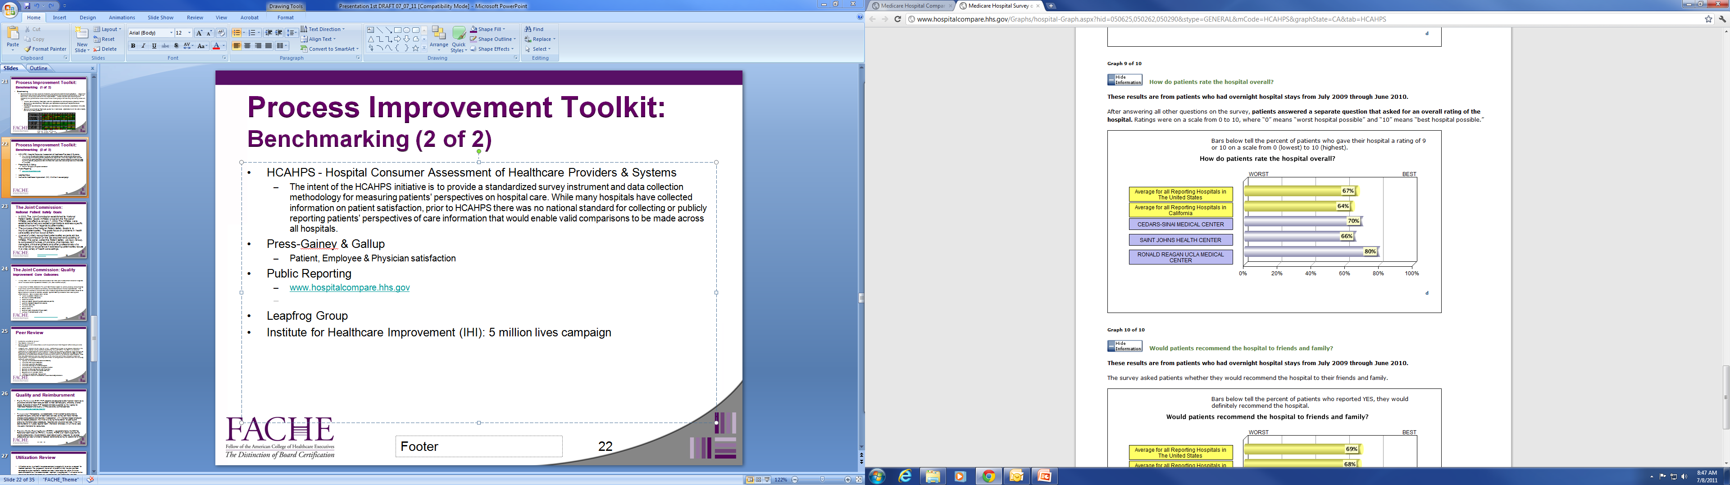
Process Improvement Toolkit:
Benchmarking (2 of 2)
HCAHPS - Hospital Consumer Assessment of Healthcare Providers & Systems
  The intent of the HCAHPS initiative is to provide a standardized survey instrument and data collection methodology for measuring patients' perspectives on hospital care. While many hospitals have collected information on patient satisfaction, prior to HCAHPS there was no national standard for collecting or publicly reporting
Public Reporting
  www.hospitalcompare.hhs.gov
Press-Ganey & Gallup
  Patient, Employee & Physician satisfaction
Leapfrog Group
  Consortium of businesses represents 40 million people
Institute for Healthcare Improvement (IHI)
  5 million lives campaign
  Providing leadership in evidence-based best practices

Slide 31
Risk, Regulation & Reporting:
Quality Assurance & Clinical Review

Slide 32
Quality Assurance
The primary purpose of the quality assurance/risk management program is to: monitor, control and direct the institution’s efforts toward achieving delivery of the optimal level of care.
To increase the level of involvement among management personnel in quality assessment and assurance: Develop an in-house program using trained key personnel for presenting and discussing quality assurance and its implications for the organization.
The governing body of a healthcare institution meets its responsibility for the quality of patient care by: establishing, maintaining and supporting through the medical/professional staff and management staff an ongoing program of review and evaluation of patient/client care and action on findings.
Continuous Quality Improvement (CQI): The reiterative process of improving stems from a philosophy that suggests quality is not something attained, but rather continually sought. The status quo is not sufficient.

Slide 33
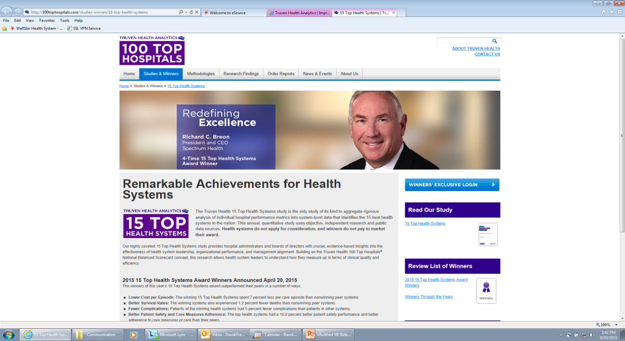
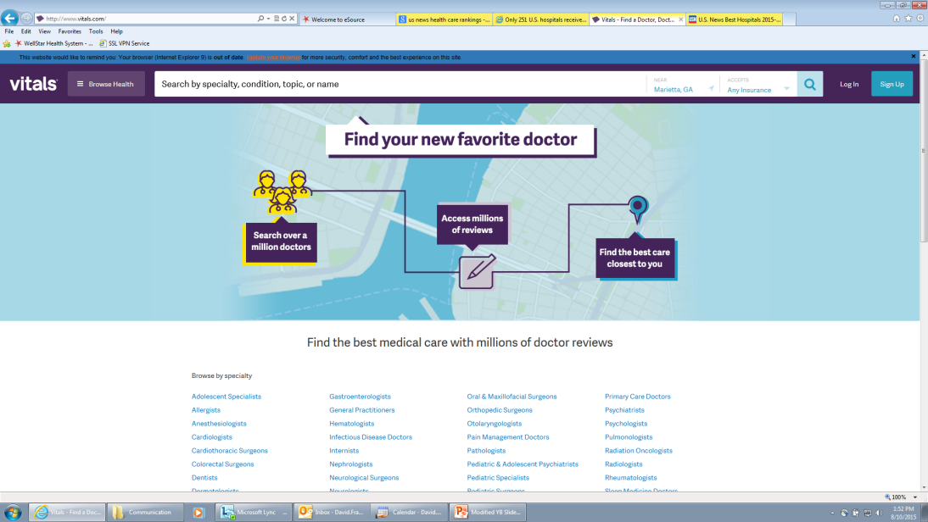
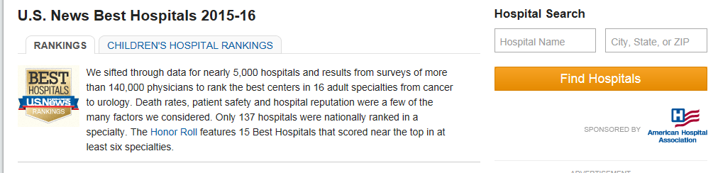
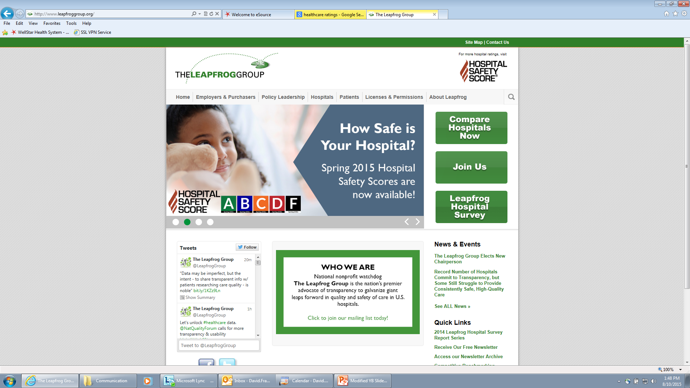
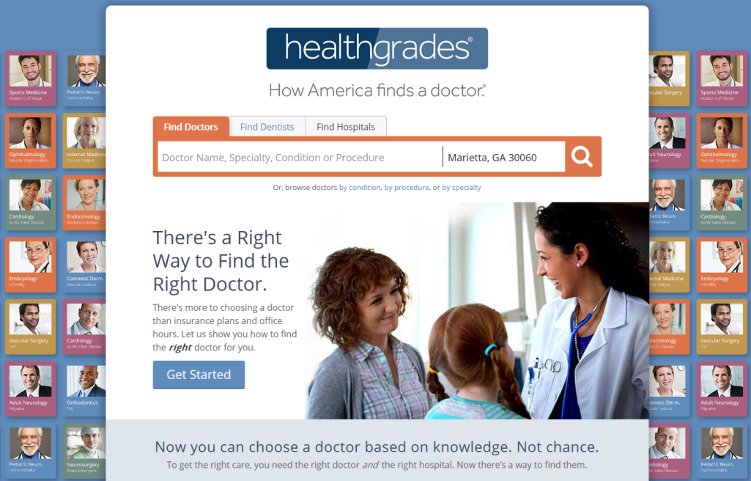
Public Reporting and Ranking

Slide 34
Quality-Focused Organizations
National organizations that focus on improving healthcare quality (examples):
Centers for Medicare & Medicaid Services (CMS)
The Joint Commission
The Institute for Healthcare Improvement (IHI)
Leapfrog Group
National Committee for Quality Assurance

Slide 35
The Joint Commission:
National Patient Safety Goals
In 2002, The Joint Commission established its National Patient Safety Goals (NPSGs) program; the first set of NPSGs was effective January 1, 2003. The NPSGs were established to help accredited organizations address specific areas of concern in regards to patient safety.
2018 National Patient Safety Goal categories (16 goals in total):
  Identifying patients correctly
  Improving staff communication
  Using medicines safely
  Using alarms safely
  Preventing infection
  Identifying patient safety risks
  Preventing mistakes in surgery
A panel of widely recognized patient safety experts advise The Joint Commission on the development and updating of NPSGs.
  This panel, called the Patient Safety Advisory Group, is composed of nurses, physicians, pharmacists, risk managers, clinical engineers and other professionals who have hands-on experience in addressing patient safety issues in a wide variety of health care settings.

Slide 36
The Joint Commission:
Quality Improvement Core Outcomes
In May 2001, the Joint Commission announced four initial core measurement areas for hospitals, which included acute myocardial infarction (AMI) and heart failure (HF).
In November of 2003, CMS and The Joint Commission began to work to precisely and completely align these common measures so that they are identical between the two organizations. This resulted in the creation of one common set of measure specifications documentation known as the Specifications Manual for National Hospital Inpatient Quality Measures to be used by both organizations. Core Measure Sets Include:
  Acute Myocardial Infarction (AMI)
  Children's Asthma Care (CAC)
  Heart Failure (HF)
  Hospital Based Inpatient Psychiatric Services (HBIPS)
  Hospital Outpatient Department Measures
  Perinatal Care (PC)
  Pneumonia (PN)
  Stroke (STK)
  Surgical Care Improvement Project (SCIP)
  Venous Thromboembolism (VTE)

Slide 37
Center for Medicare & Medicaid Services: Conditions of Participation
CMS: Conditions of Participation
Conditions of Participation (CoPs) and Conditions for Coverage (CfCs) that health care organizations must meet in order to begin and continue participating in the Medicare & Medicaid programs
These minimum health and safety standards (24 conditions with 75 specific standards) are the foundation for improving quality and protecting the health and safety of beneficiaries
CMS also ensures that the standards of accrediting organizations recognized by CMS (through a process called “deeming”) meet or exceed the Medicare standards set forth in the CoPs/CfCs.
Examples of Conditions of Participation:
Compliance with Federal, State and local laws
Governing body
Physical environment
Quality assurance
Medical staff and nursing services

Slide 38
Center for Medicare & Medicaid Services:
H-CAHPS
Consumer Assessment of Healthcare Providers and Systems, Hospital Survey
Collect and compare self-reported patient satisfaction
Data available on CMS website (https://www.medicare.gov/hospitalcompare/search.html?)
Focus Areas of Survey:
Nursing Care
Physician Care
Hospital Environment
Hospital Experience
Leaving the Hospital
Overall Hospital Rating
Understanding Your Care When You Left the Hospital

Slide 39
Medical Staff

Slide 40
TJC Standards: Medical Staff
The self-governing organized medical staff provides oversight of the quality of care, treatment, and services delivered by practitioners who are credentialed and privileged through the medical staff process
The organized medical staff is also responsible for the
  Ongoing professional practice evaluation (OPPE) of the competency of practitioners who are privileged
  Delineating the scope of privileges that will be granted to practitioners
  Providing leadership in performance improvement activities within the organization
Notes:
40

Slide 41
TJC Standards: Medical Staff Bylaws
The organized medical staff must create and maintain a set of bylaws that define its role within the context of a hospital setting and responsibilities in the oversight of care, treatment, and services
The medical staff bylaws, rules, and regulations create a framework within which medical staff members can act with a reasonable degree of freedom and confidence
Notes:
41

Slide 42
TJC Standards: Medical Staff Structure
The organized medical staff must be structured using the following guiding principles:
  Designated members of the organized medical staff who have independent privileges provide oversight of care, treatment, and services provided by practitioners with privileges
  The organized medical staff is responsible for structuring itself to provide a uniform standard of quality patient care, treatment, and services
  The organized medical staff is accountable to the governing body
Notes:
42

Slide 43
TJC Standards: Medical Staff & Leadership (Governing Board)
The hospital’s governing body has the ultimate authority and responsibility for the oversight and delivery of health care rendered by licensed independent practitioners (LIP), and other practitioners credentialed and privileged through the medical staff process or any equivalent process
Governing board is accountable for the quality of care
Notes:
43

Slide 44
TJC Standards: Ensuring Quality of the Medical Staff
Credentialing – the process of obtaining, verifying, and assessing the qualifications of a health care practitioner to provide patient care services in or for a health care organization
Privileging – the process whereby a specific scope and content of patient care services (clinical privileges) are authorized for a health care practitioner by a health care organization, based on evaluation of the individual’s credentials and performance
Peer recommendation – information submitted by individuals in the same professional discipline as the applicant reflecting their perception of the practitioner’s clinical practice, ability to work as part of a team, and ethical behavior or the documented peer evaluation of practitioner specific data collected from various sources for the purpose of evaluating current competence
Notes:
44

Slide 45
Accountability for Hospital Quality
Hospital Board’s delegation
Hospital management
-System performance improvement
Medical staff
-Individual & aggregate physician performance improvement

Slide 46
Peer Review
Morbidity & Mortality (M&M) – The objectives of a well-run M&M conference are to learn from complications and errors, to modify behavior and judgment based on previous experiences, and to prevent repetition of errors leading to complications. Conferences are non-punitive and focus on the goal of improved patient care. The proceedings are generally kept confidential by law.
Peer review is the process by which a committee of physicians examines the work of a peer and determines whether the physician under review has met accepted standards of care in rendering medical services.
Sentinel Event is an unexpected occurrence involving death or serious physical or psychological injury, or the risk thereof. Serious injury specifically includes loss of limb or function. The phrase “or the risk thereof” includes any process variation for which a recurrence would carry a significant chance of a serious adverse outcome.
  Such events are called “sentinel” because they signal the need for immediate investigation and response.
  The terms “sentinel event” and “medical error” are not synonymous; not all sentinel events occur because of an error and not all errors result in sentinel events.
Root Cause Analysis:
  What happened?
  Why did it happen?
  What are the steps in the process, as designed? (A flow diagram may be helpful here)
  What were the most proximate factors?
  What steps were involved in (contributed to) the event?
  What systems and processes underlie those proximate factors?
  Improvements to reduce risk should ultimately be implemented in all areas where applicable, not just where the event occurred.

Slide 47
Quality & Reimbursement

Slide 48
Quality & Reimbursement
Pay for Performance (P4P) - P4P programs are designed to offer financial incentives to physicians and other health care providers to meet defined quality, efficiency, or other targets. Examples of recent P4P research and tools supported by the Agency for Healthcare Research and Quality (AHRQ) are briefly summarized here: http://www.ahrq.gov/qual/pay4per.htm
Transparency – Transparency is a broad-scale initiative enabling consumers to compare the quality and price of health care services, so they can make informed choices among doctors and hospitals. In cooperation with America's largest employers and the medical profession, this initiative is laying the foundation for pooling and analyzing information about procedures, hospitals and physician services. When this data foundation is in place, regional health information alliances will turn the raw data into useful information for consumers.

Slide 49
Quality & Reimbursement
Physician Quality Reporting System (PQRS) - was established by the 2006 Tax Relief and Health Care Act (TRHCA). Currently, PQRS is an incentive payment for eligible professionals who satisfactorily report data on quality measures for covered professional services furnished to Medicare beneficiaries during the second half of 2007.
Value-Based Purchasing - The Centers for Medicare & Medicaid Services proposal, issued January 2012, incorporates 17 clinical process-of-care measures used in five health categories, acute myocardial infarction, heart failure, pneumonia, healthcare associated infections and surgical care improvement. It also will use eight measures from the Hospital - Consumer Assessment of Healthcare Providers and Systems (HCAHPS) survey that reflects how patients view their care experiences.
  These 25 measures will be used to generate FY 2013 DRG payments.
  Hospitals have their funding reduced starting with 1% in fiscal year 2013, rising to 2% by FY 2017, but will have a chance to earn that money back, and perhaps more, under the incentives algorithm

Slide 50
Utilization Review
Utilization review is a payor’s opportunity to review a request for medical treatment. The purpose of the review is to confirm that the plan provides coverage for a plan member’s medical services. It also helps the payor minimize costs and determine if the recommended treatment is appropriate. A utilization review also gives the patient the opportunity to confirm that their health plan provides adequate coverage for their particular condition. If the company denies coverage as a result of a utilization review, the patient can always appeal the decision.
Most health plans have predetermined criteria or clinical guidelines of care for a given condition. Once a precertification request is submitted to an insurance company, a committee reviews these guidelines and determines if the patient has met the criteria for coverage. If necessary, the committee may contact your health care provider.

Slide 51
Questions/ Discussion

Slide 52
Appendix: References

Slide 53
Arthur, J., Six Sigma Simplified Quantum Improvement Made Easy, Lifestar, Denver Colorado, 2001.
Balestracci, D. & Barlow, J.L., MPH Quality Improvement, Practical Applications for Medical Group Practice, Center for Research in Ambulatory Health Care Administration, Englewood, Colorado, 1996.
Baxter, Quality Leadership Process, Meeting Customer Requirements,
Baxter Healthcare Corporation, 1991.
Bemowski, K., TQM: Flimsy Footing or Firm Foundation, Quality Progress, July 1995, pp 272.
Berwick, D. A., Escape Fire, Plenary Address for the Eleventh Annual, National Forum on Quality Improvement in Health Care, New Orleans, December, 1999.
Berwick, D., “Quality Leadership: Sustaining Your Connection,” The Healthcare forum on Quality Improvement Network Strategy, April 1993.
Berwick, D., Improving Health Care Quality, A Comprehensive Curriculum for Kaiser Permanente Health Care Executives, Managers and Physician Leaders, March, 1991.
Berwick, D., “Continuous Improvement as an Ideal in Health Care,” New England Journal of Medicine, 320:53-56, January 5, 1989.
Cole, R. E., “From Continuous Improvement to Continuous Innovation,” Quality Management Journal, Vol. 8, Issue 4, October, 2001, pp 7-21.
Crouch, M., “Quality for One: What You Can Do to Improve Quality,” Quality Digest, July 1997.
Deming, W. E., Notes on Management in a Hospital by Me, September, 1987.

Slide 54
Deming, W. E., Out of Crisis, Cambridge, MA: MIT Press, 1986.
Franklin, D.W. Quality & Performance Improvement, Fundamentals of Healthcare Management for FACHE Georgia Class, 2017.
Goonan, K.J., The Juran Prescription Clinical Quality Management, Jossey-Bass, Inc., 1995.
Hardie, N., “The Effects of quality on Business performance,” Quality Management Journal, Vol. 5, Issue 3, 1998, pp 65-83.
Horn, S. & Hopkins, D., Clinical Practice Improvement: A Technology for Developing Cost-Effective Quality Heath Care, Faulknes & Gray’s Medical Outcomes and Practice Guideline Library, Vol. 1, 1994.
Horn, S & Hoplins, D., Clinical Practice Improvement: A New Technology for Developing Cost Effective Quality Health Care, Faulkner & Gray, 1994.
Hoyer, R.W. & Brooks, B.Y., “What is quality?” Quality Progress, July 2001, pp 53-62.
Joiner, B. L. & Gaudard, M.A., “Variation, Management and W. Edwards Deming,” Quality Progress, December 1990, pp 29-37.
Kaiser Permanente, Toolbox, Kaiser Permanente, Version 2.0 4/7/95.
Kelley, D. L., “More New Twists on Traditional Quality Tools and Techniques, “ The Journal for Quality and Participation, Fall 2000, pp 30-31.
Kohn, L.T., Corrigan, J.M. & Donaldson, M.S. (Editors), To Err is Human: Building a Safe Health System, Committee on the Quality of Health Care in America, Institute of Medicine, National Academy of Sciences, 2000.
Langley, G.J., Nolan, K.M., Nolan, T.W., Norman, C.L. & Provost, L.P., The Improvement Guide, A Practical Approach to Enhancing Organizational Performance, Josey-Bass, 1996.
Lawson, R.L., Creating a Customer-Centered Culture Leadership in Quality Innovation and Speed, ASQC Quality Press, Milwaukee, Wisconsin, 1993.
Lynn, M. L., “Deming's Quality Principles: A Health Care Application,” Hospital and HealthSservices Administration, Spring 1991, 36:1, pp 112-120.

Slide 55
Masters, R.J., “Overcoming the Barriers to TQM's Success,” Quality Progress, May 1996, pp 53-55.
National Institute of Science and Technology, Criteria for Performance Excellence in Healthcare, 2001.
Noguchi, J., “The Legacy of W. Edwards Deming,” Quality Progress, December1995, pp. 35-37.
Pearson, T., “A Measuring for Six Sigma Success,” Quality Progress, February 2001.
Peters, T., Rule #3 Leadership is Confusing as Hell, Fast Company, March 2001, pp124-140.
Phillips-Donaldson, D., “Champions of Quality: the New Breed,” Quality Progress, November 2001, pp 35-39.
Plsek, P. Creativity, Innovation and Quality. ASQ Quality Press, Milwaukee, Wisconsin, 1997.
Plsek, P., Innovation Through Reengineering, Kaiser Permanente Operations and Support Services, 1995.
Provost, L. P. & Langley, G. J., “The Importance of Concepts in Creativity and Improvement,” Quality Progress, March 1998, pp 31-38.
Schroer, B.J., Adams, M., Stewart, S. & Componations, P.J., “Continuous Process Improvement the Quick Step Way,” Quality Progress, February 1998, pp 85-89.
Sivaram, C. A. & Tan, M. W., “Donald Berwick on American Healthcare and the Institute for Health Care Improvement,” Journal for Health Care Quality, Vol. 23, No. 1, January/February 2001.
Sloan, D. M., How to Lower Health Care Costs by Improving Health Care Quality Results Based Continuous Quality Improvement, ASQC
Quality Press, Milwaukee, Wisconsin, 1994.
US Department of Health and Human Services, A Leadership Guide to Quality Improvement for Emergency Services, July 1997.
Whitacre, T. A., “A Message for Everyone, Here's How to Get Your Organization to See Why Quality is a Part of Their Jobs, Too,“ Quality Progress, November 2001, pp 31-33.
Whiteley, R. & Hessan, D., Customer Centered Growth, Addison-Wesley Publishing Company, New York, 1966.

Slide 56
My BOG Test-Taking Strategies
Participated in Spring 2013 BOG Study Series
Spent two months after series ended preparing for exam
  Exam date: August 17, 2013
Did in-depth research in all areas of BOG study materials where I wasn’t comfortable and/or got test prep questions wrong
  Ended up with a list of 125 topics to review
  Used mostly Google, Wikipedia, and HFMA
Did not read “The Well Managed Health-Care Organization” at all (tried referencing a few topics but did not find answers in the book)
Spent 1-7 hours studying every weekend
Passed with highest scores being in Quality & PI (91%) & Finance (85%); lowest scores were in HR, Governance, & Laws & Regulations (scored in 60s for all three)

Slide 57
Practice Exam Questions

Slide 58

Preparing For The Exam
Refer to the
Following
Questions
2, 56, 75, 77, 109, 135, 162,
190, 191, 194

Slide 59
Question #2
The principles of quality improvement require that healthcare executives change their philosophy from:
Finding fault with employees to finding problems in processes.
b. Finding fault with employees to involving them in the improvement of processes.
c. Focusing on enhanced inspection techniques to focusing on variance.
d. Focusing on employees’ roles to focusing on process outcomes.
Notes:
Answer is A

Slide 60
Question #56
Continuous quality improvement assumes that:
a. Achievement will be rewarded.
b. There is direction from top management.
c. There is no upper limit to excellence.
d. Interconnected work teams are in place.
Notes:
C

Slide 61
Question #75
Performance improvement teams should consist of:
a. Experts in process management.
b. Members from the involved Microsystems.
c. Middle managers with experience.
d. Physicians and other users.
Notes:
B

Slide 62
Question #77
A bar chart format, with the items rank ordered on a dependent variable, such as cost, profit, or satisfaction that Examines the components of a problem in terms of their contribution to it is known as:
a. A run chart.
b. A frequency table.
c. Pareto analysis.
d. Deming cycle.
Notes:
C

Slide 63
Question #109
Which is the Shewhart process for performance improvement:
a. Plan, check, do, act.
b. Plan, do, check, act.
c. Analyze, formulate, implement, evaluate.
d. Analyze, implement, control, evaluate.
Notes:
B

Slide 64
Question #135
Which of the following would be a discrete measure in continuous improvement:
a. Gender.
b. Weight.
c. Height.
d. Temperature.
Notes:
A

Slide 65
Question #162
In a hospital setting, a critical pathway is best described as:
a. A document that focuses on efficiency and describes a standard set of activities to be performed for a defined category of patients.
b. A set of guidelines that focus on identifying those decision points which should lead to the consistent provision of appropriate clinical practice.
c. Any attempt to standardize clinical activities based upon diagnostic categories and projected outcomes.
d. Decision tree that focuses on physician decision making.
Notes:
A

Slide 66
Question #190
The arrival of women for obstetrical deliveries or patient flow in an emergency department can best be analyzed through the use of which technique?
a. Pert Charting
b. Stochastic Modeling.
c. Gant Charting.
d. Monte Carlo Simulation.
Notes:
B

Slide 67
Question #191
One approach for measuring technical quality of clinical support services is:
a. Patient satisfaction scores.
b. Degree of continuity of care.
c. Appropriateness testing.
d. Process review.
Notes:
D

Slide 68
Question #194
The applicability of continuous improvement in healthcare organizations assumes:
a. An upper limit of improvement.
b. The physician’s perspective is dominant.
c. An organizational commitment.
d. The elimination of outliers.
Notes:
C

Slide 69
Questions/ Contact Information
Michelle Adzhemyan
  (404) 279-4677, michelle.d.adzhemyan@kp.org

