Slide 1
GAHE Fellow Exam Tutorial
2018
Logistics and Exam Overview
Presented by
Matt Jernigan, MBA, FACHE
Prepared by
Kimberly G. Bell, MHA, FACHE
Past President - GAHE and
Past Member - Regent’s Advisory Council

Slide 2
DISCLAIMERS
Although the content of this course was derived from ACHE materials, ACHE was not involved with the development or in the presentation of this course, and it does not guarantee that completion of this course will ensure passing results on the Board of Governors (BOG) Exam.
Completion of this course alone will NOT result in a passing score on the ACHE BOG Exam. Instead, it is meant to provide tools, resources and information to assist you as you prepare and study to sit for the exam.

Slide 3
Logistics

Slide 4
Advancement Requirements
Source: ACHE, December 8, 2016

Slide 5
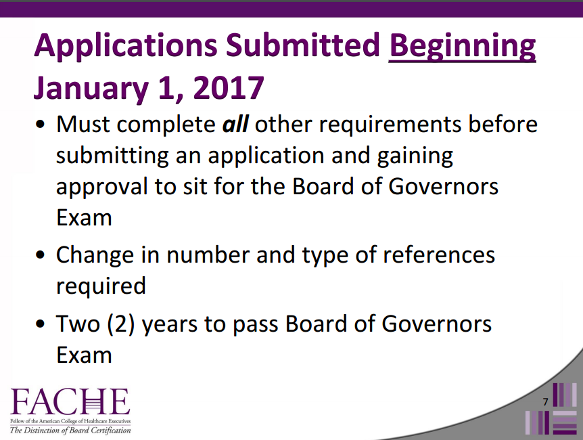
Advancement Requirements (con’d)
Source: ACHE, December 8, 2016

Slide 6
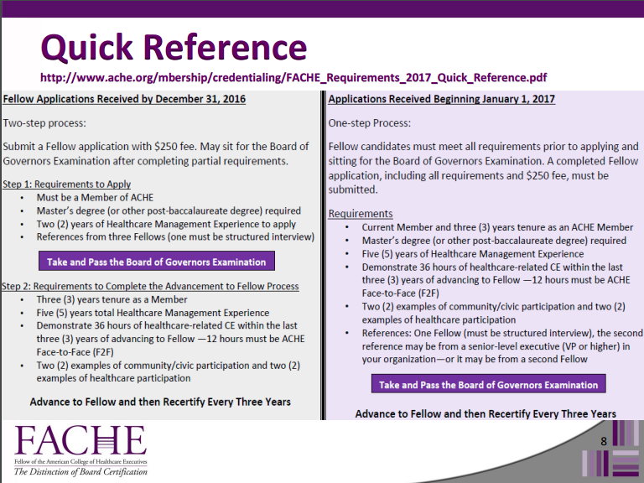
Advancement Requirements (con’d)
Source: ACHE, December 8, 2016

Slide 7

Advancement Requirements (con’d)
Source: ACHE, December 8, 2016

Slide 8
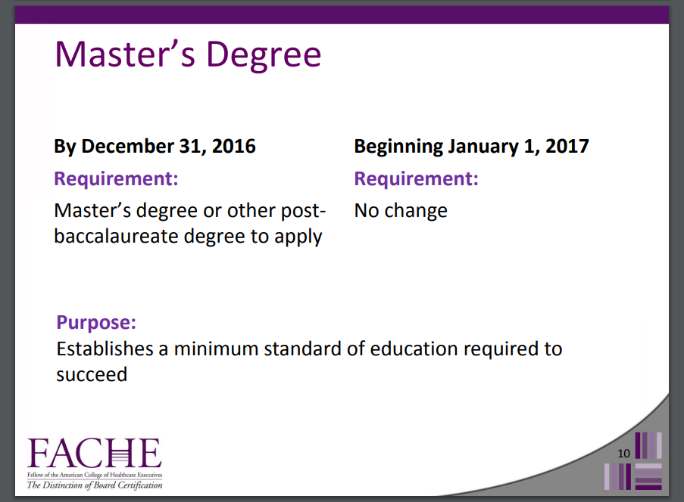
Advancement Requirements (con’d)
Source: ACHE, December 8, 2016

Slide 9
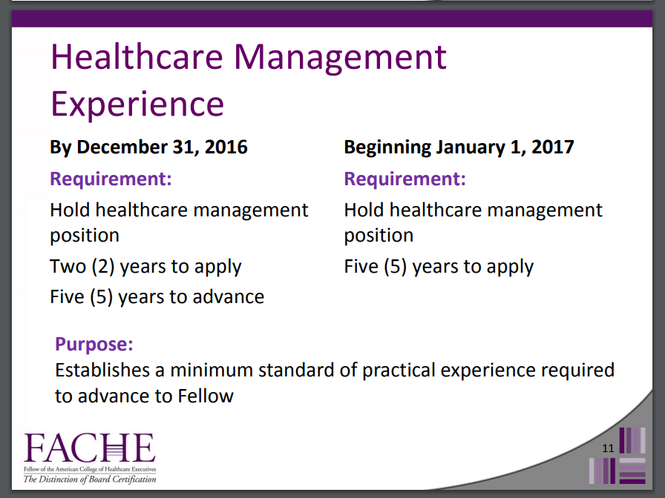
Advancement Requirements (con’d)
Source: ACHE, December 8, 2016

Slide 10
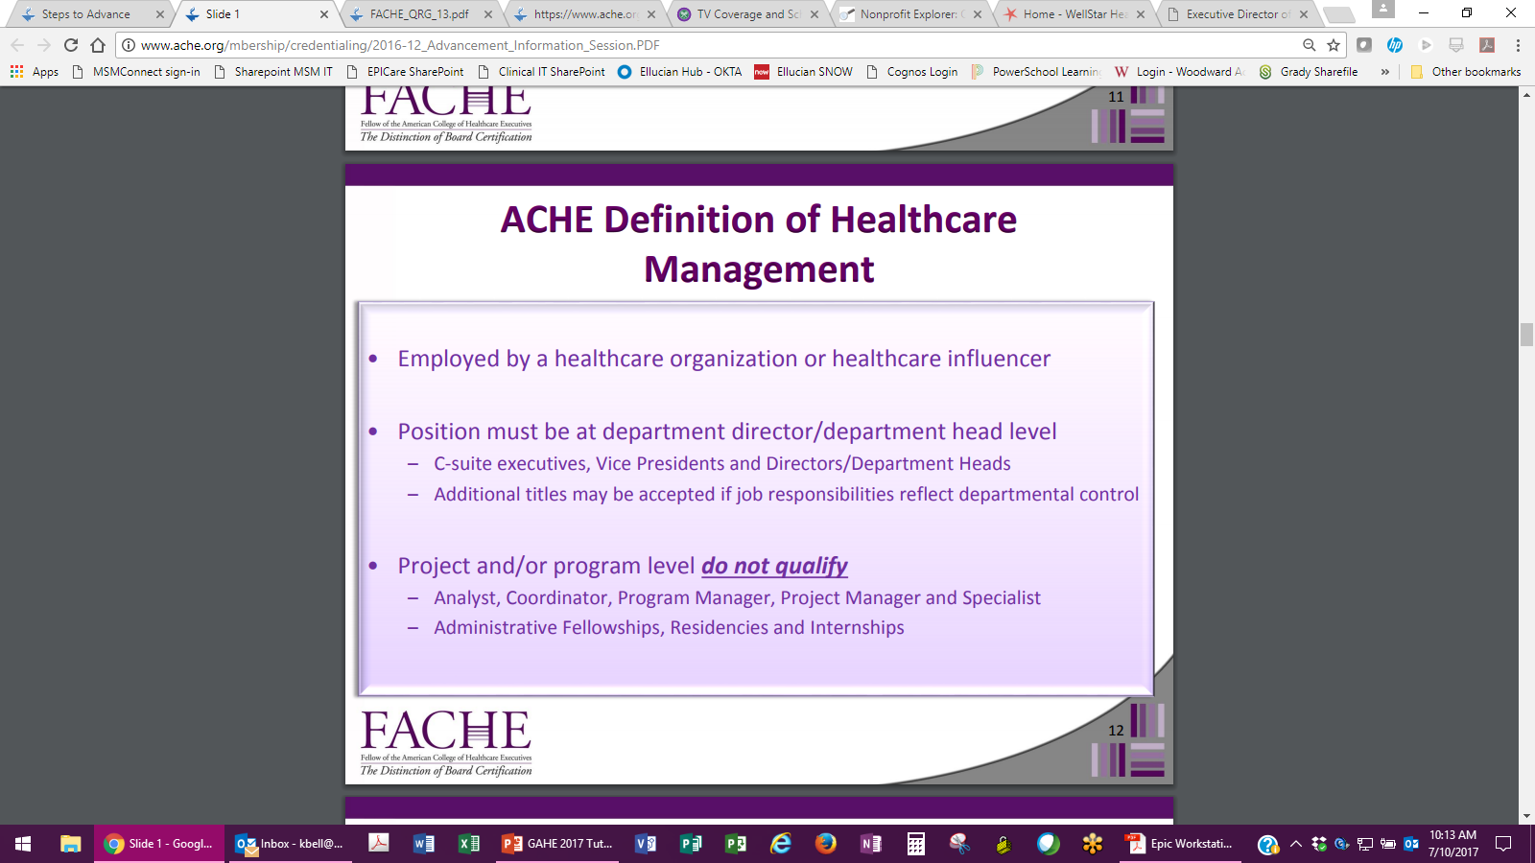
Advancement Requirements (con’d)
Source: ACHE, December 8, 2016

Slide 11
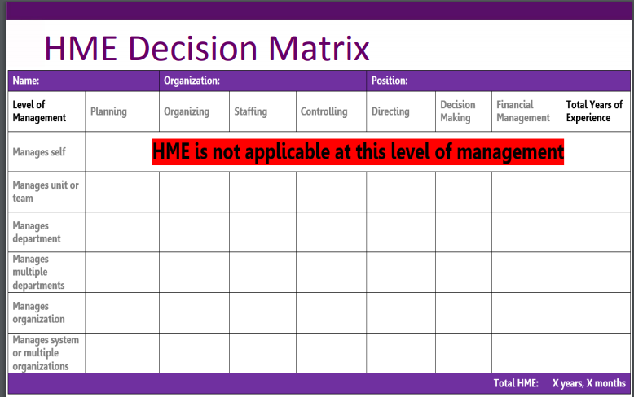
Advancement Requirements (con’d)
Source: ACHE, December 8, 2016

Slide 12

Advancement Requirements (con’d)
Source: ACHE, December 8, 2016

Slide 13

Advancement Requirements (con’d)
Source: ACHE, December 8, 2016

Slide 14
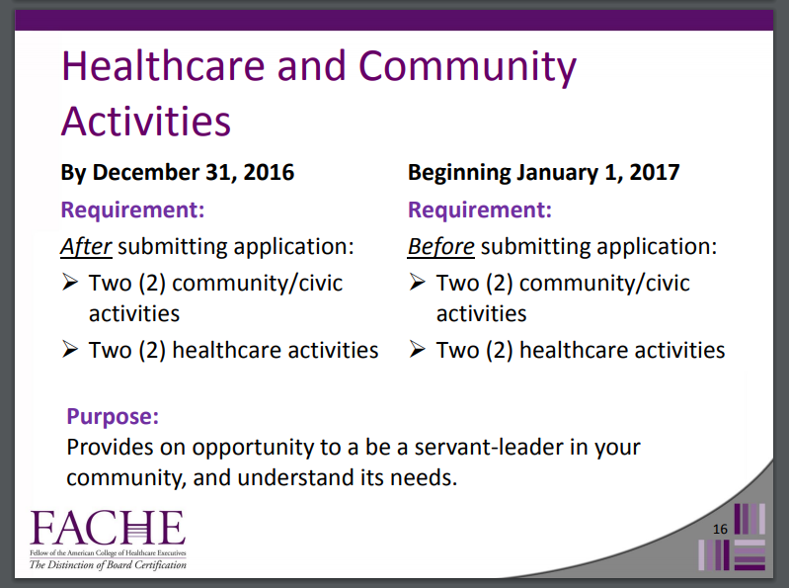
Advancement Requirements (con’d)
Source: ACHE, December 8, 2016

Slide 15
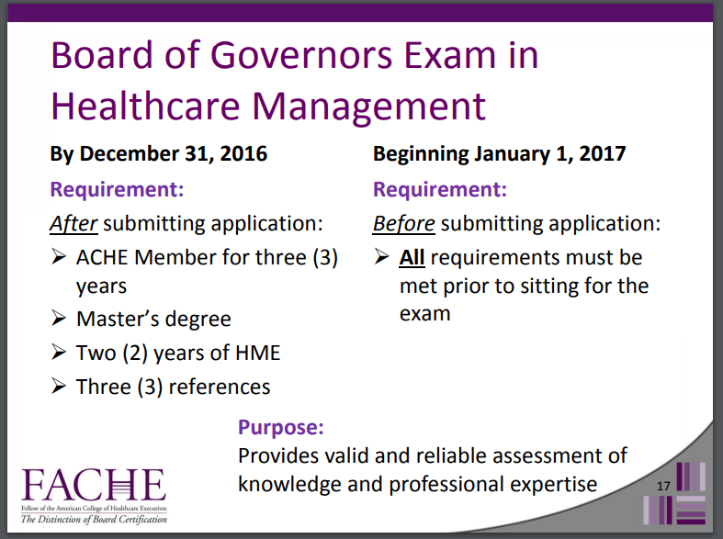
Advancement Requirements (con’d)
Source: ACHE, December 8, 2016

Slide 16
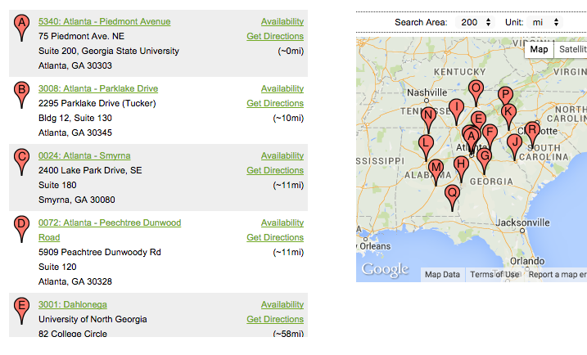

Testing Sites
Two Options
Offered at Prometric computer testing sites located throughout the United States (immediate scoring)
Paper and pencil at Congress in March (Scoring = 8-10 weeks)
Prometric Test Centers

Slide 17
Registering for the Exam
After your application for Fellow status is accepted, you will receive an exam registration form
Return the exam registration form to ACHE along with your exam registration fee or coupon
Select an exam site
Follow directions on your confirmation letter to register at the desired site
Prometric FAQs
* Please pay close attention to the Prometric rules which are included in your confirmation as well as at the online Prometric site. They are very specific and Prometric will not deviate from them.

Slide 18
Preparing for the
Board of Governors Exam

Slide 19
Exam Preparation
Allow 3-6 months to prepare, depending on expertise
and experience
Determine your most effective study style
Know the 10 key knowledge areas
Consider enrolling in the BOG Exam Review course or Online Tutorial course
Visit the Credentialing area of ache.org at ACHE Credentialing for additional resources (FAQs, videos/webinars, documents)

Slide 20
ACHE BOG Exam Review Course
Exam Review Course:
  2 ½ day in-person taught by the experts
  $1,425 Tuition
    $200 Exam Fee WAIVED (if exam taken within 6 months)
  19 ACHE Face-to-Face credits
  October 15-17, 2017 in Scottsdale, AZ

Slide 21

Online Tutorial
Upcoming 12-week sessions:
  August 15 – November 13, 2018
  December 12, 2018 – March 19, 2019
  $495 ($410 if you have latest
  edition of Well-Managed
  Healthcare Organization)
6 ACHE Qualified Education credits

Slide 22

Online Community
ACHE Community Announcements
Resource links
Events
Study Groups
Ask ACHE
Discussion Areas
ACHE BOG Exam Online Community

Slide 23
Exam Overview

Slide 24

Taking the Exam
6 hours to complete the exam
Computer testing is easy to navigate
  You will have the ability to mark items to which you wish to return
At the conclusion of the exam, you will receive a printout stating whether or not you passed the exam
Printout includes a breakdown of the 10 knowledge areas and the percent of questions answered correctly in each area

Slide 25
Taking the Exam (con’d)
Short biographical data questionnaire
230 questions:
  200 scored
  30 pretest questions
    Do not affect score
    Placed throughout the examination/cannot be identified
  4 possible answers
No penalty for incorrect answers = Answer every question!
No credit for questions with more than one response
BOG Exam Scoring

Slide 26
10 Core Knowledge Areas
Knowledge Area # of questions % of 200 scored questions
  Healthcare Knowledge 36 18%
  Management Knowledge 30 15%
  Human Resources 22 11%
  Business Knowledge 20 10%
  Financial Knowledge 20 10%
  Quality & PI 20 10%
  Laws & Regulations 16 8%
  Professionalism & Ethics 16 8%
  Govt. & Org. Structure 10 5%
  Healthcare Tech & Info 10 5%

Slide 27
10 Core Knowledge Areas (con’d)
Healthcare
  Broad range of organizations and professions involved in the delivery of healthcare.
  Includes managed care models, healthcare trends and ancillary services provided.
Management
  General management principles (planning, organizing, directing and controlling) to address overall organizational objectives.
Human Resources
  Assessing the need for and the supply of professional staff and other personnel:
    recruitment, selection, training, compensation and evaluation of such personnel
    how to examine ways of evaluating productivity and monitory accountability for results

Slide 28
10 Core Knowledge Areas (con’d)
Business
  Specific areas/concepts of the organization (e.g., marketing, business planning, strategic planning).
Finance
  Planning, development, establishment, analysis and assessment of financial management processes for an organization’s capital, budget, accounting and related reporting systems.
Quality and Performance Improvement
  Development, implementation and evaluation of organizational accountability, including quality improvement theories and frameworks , quality assessment and assurance philosophies, policies, programs and procedures.

Slide 29
10 Core Knowledge Areas (con’d)
Laws and Regulations
  Identifying and interpreting the impact of government regulations
  and law on the organization:
    identifying the need for and working with others to develop new regulations and laws
    investigating, monitoring, documenting and enforcing existing statutes
    maintaining communication and cooperation with both public and private organizations
Professionalism and Ethics
  Development, monitoring and maintenance of procedures to ensure the needs of professional staff are met. Ethics includes:
    identifying, monitoring and disseminating codes of professional conduct
    understanding the implications of ethical decisions
    providing procedures to monitor standards of behavior within the organization
    determining, maintaining and monitoring accountability procedures

Slide 30
10 Core Knowledge Areas (con’d)
Governance and Organizational Structure
  Development and analysis of the organizational structure and with delineating responsibility, authority and accountability at all levels of the organization.
  Functions include the development and implementation of policies and procedures for the governance process.
Healthcare Technology and Information Management
  Management information and clinical information systems such as:
    computer-based support for management
    assessing how current technologies and major innovations are changing the way healthcare executives manage
    using information systems for short-and long-range planning
    using clinical information systems
    acquiring information systems

Slide 31

Score Printout

Slide 32
Exam Retakes
Must retake exam at a scheduled site or at a computer-based testing site
Retake fee of $200
Application is only valid for 3 years
You must wait 60 days before retaking the exam at a computer-based testing site
Notes:
You must wait 60 days prior to retaking the exam at a computer-based testing site. Your application is only valid for three years, so be sure to schedule within the timeframe allotted. There will be a $200 fee to retake the exam.

Slide 33
Study Hints & Practical Tips
Be sure to read each question carefully
Read all responses for each question before selecting answer
Mark one answer – multiple answers are invalid
No penalty for guessing, so answer every question
Skip difficult questions and return to them later
Do not go back and change answers – your first “hunch” is most often correct
Evaluate questions from a general healthcare management perspective. The correct response will apply equally to all healthcare organizations, regardless of type, size or location.

Slide 34
Study Hints & Practical Tips (con’d)
Remember the exam is national in scope and is not defined in terms of individual states and their laws and regulations
The most inclusive answer is usually the correct answer. However, if the question includes a qualifier (words such as except or least, generally printed in italics) then the most specific answer is usually the correct choice.
For Congress paper & pencil test - Write in the test booklet if you feel it will help you. Circle key words. Cross off poor answers to help you focus on the best answer.
For Prometric Centers – you will be given blank paper and a pencil to write notes on. You cannot take the paper with you.

Slide 35
Study Hints & Practical Tips (con’d)
If you want to return to a question on the computerized exam, you may “mark” it. The computer will keep track of your “marked” questions, and you may return to them.
Do not become discouraged by difficult or complex questions. If a question confuses you, it will probably confuse other examinees as well. The exam pass point is set with the expectation that candidates will score higher on some areas than in others. This is a general knowledge exam, and you are not expected to be an expert in every area.

Slide 36
If You Have Questions -
Call Membership at 312.424.9400
E-mail membership contact@ache.org
Visit the web site www.ache.org
Notes:
If you have any questions or would like additional information, please contact ACHE’s Membership Division. You may call us at (312)424-9400, e-mail the Membership Division at membership1@ache.org, or visit our web site www.ache.org and click on the link “Credentialing”.

