Slide 1
Governance and Organizational Structure
J. Larry Tyler, FACHE, FHFMA, CMPE
Chairman and CEO, Practical Governance Group
Chairman Emeritus, Tyler & Company
American College of Healthcare Executives

Slide 2
Governance and Organizational
Structure Knowledge Area
Percentage and Number of Exam Questions in Each Knowledge Area Knowledge Area |  | Percentage | Number of Questions
Healthcare |  | 17% | 34
Management and Leadership |  | 15% | 30
Human Resources |  | 11% | 22
Finance |  | 11% | 22
Quality and Performance Management |  | 10% | 20
Business |  | 9% | 18
Professionalism and Ethics |  | 8% | 16
Laws and Regulations |  | 7% | 14
Governance and Organizational Structure |  | 6% | 12
Healthcare Technology & Information Management Knowledge |  | 6% | 12
 |  | 100% | 200

Slide 3
Governing Boards
1.41 million nonprofits registered with IRS
Public charities make up >75% of 501(c)(3) revenues and expenses
Health care organizations (~13% of reporting public charities), account for nearly 3/5 of public charity revenues and expenses
Source: Data for 2013, Urban Institute,
“The Nonprofit Sector in Brief 2015”

Slide 4
What is a fiduciary?
A legal obligation of one party to act in the best interest of another. The obligated party is typically a fiduciary; that is, sometime entrusted with the care of money or property.
Source: Employee fiduciary responsibility and fraud. (n.d.). Retrieved March 9, 2018, from https://www.financierworldwide.com/employee-fiduciary-responsibility-and-fraud/#.WqbYX2rwavE

Slide 5

Fiduciary Duties
Duty of Care
Duty of Loyalty
Duty of Disclosure
Duty of Obedience
Business Judgment Rule
Confidentiality
Source: Corporate director's guidebook (6th ed.). 2011. Chicago, IL: American Bar Association, Section of Business Law.

Slide 6
Duty of Care
Directors exercise appropriate diligence
in good faith to become informed in
making decisions and overseeing
management.
Actions
Attend and actively participate in meetings
Require management to provide adequate reports concerning the facility’s operation
Diligently inquire about any potential problems they see that could arise
6

Slide 7

Duty of Loyalty
A director’s conduct
must be in the best interest
of the organization.
Actions
Disclose conflicts of interest
Reveal any related business opportunities

Slide 8

Conflicts of interest
Annually sign conflict statement
Recuse themselves from any decision in which they are conflicted
Hold others accountable for conflicts
Avoid even the appearance of conflicts of interest

Slide 9

Duty of Disclosure
Directors inform fellow
directors and management
of information known to
the director that is material
to corporate decisions.

Slide 10

Duty of Obedience
Actions
Follow all laws
Follow all regulations
Follow the board’s bylaws

Slide 11
Business Judgement Rule
This rule protects a disinterested
director from personal liability if the
decision that the director approved is
a mistake.
Presumes the director acted in an informed and good-faith basis
Presumes the director firmly believed the decision was the best for the organization

Slide 12

Confidentiality Rule
Director must keep confidential all matters involving
the organization that have not been disclosed to the
general public.

Slide 13
Functions of the Governing
Board
Maintain management capability
Establish the mission, vision, and values
Approve corporate strategy and annual implementation
Ensure quality of clinical care
Monitor performance against plans and budgets
Improve board performance
Source: White, K. and Griffith, J. 2016. The Well-managed Healthcare Organization (8th ed.). Chicago, Ill.: Health Administration Press.

Slide 14
Five Responsibilities of a
Governing Board
The Board has the ultimate responsibility for envisioning and formulating the organization’s mission, vision, and goals and strategy.
To select, encourage, advise, evaluate, and if need be, replace CEO. A Board must assume ultimate responsibility for ensuring high levels of executive management performance by focusing its attention on the CEO.
Source: Practical Governance Group

Slide 15
Five Responsibilities of a
Governing Board (cont.)
A Board must assume ultimate responsibility for ensuring the quality and safety of the service of the organization and operating efficiency.
A Board must assume ultimate responsibility for ensuring the organization’s financial health.
A Board must assume responsibility
for itself.
Source: Practical Governance Group

Slide 16

Board Job Descriptions
Job descriptions
should be required for
chair, vice-chair and
all board members.

Slide 17

Board terms
Board terms usually last three years with option to renew
Term limits can remove poorly functioning Board members, but also remove highly functioning members as well
“Could rob the Board of critical expertise”
  Council of Institutional Investors
Board self-evaluations are important

Slide 18
RiskMetrics group comments
“There is no research or evidence that the
existence of director term limits or retirement ages
improves performance. It’s time to kick these
crutches aside.”
Patrick McGurn, JD
EVP – Special Counsel
ISS/RiskMetrics
Notes:
18

Slide 19
Mission statement
Mission, vision and values drive everything
Mission, vision and values should be printed on cards, board agendas, payroll deposit slips and all around the hospital

Slide 20
Sample mission statements
Emory Healthcare
To serve humanity by improving health through integration of education, discovery and health care.
Gwinnett Health System
We exist to provide quality health services to our community.
Navicent Health
To provide a comprehensive range of high-quality, reasonably priced health care services to the central and south Georgia community.
Southeast Georgia Health System
To provide safe, quality, accessible, and cost-effective care to meet the health needs of the people and communities it serves.

Slide 21
Working together as a board
Board size
  8 or fewer Too small
  20 or more Too large
  9 to 19 Ideal size
  Relationship to Executive Committee
  Source: Practical Governance Group

Slide 22
Current board sizes
 | Average numbers of board members
Freestanding hospital | 12
Hospital subsidiary | 12
System headquarters | 16
2014 Average all respondents = 13
2011 Average all respondents = 12
Source: 2014 National Health Care Governance Survey Report

Slide 23

Purpose of board self- assessments
Characteristic of good governance
Self-assessment appears on lists for outside evaluation;
i.e., rating agencies
Allows the board to begin dialogue leading to more open discussion
Eliminates the need for board term limits

Slide 24

Purpose of board self- assessments (cont.)
Refresh the board’s understanding of its role and responsibilities
Identify important areas of board operation that need attention or improvement
Measure progress toward existing plans, goals and objectives

Slide 25

Purpose of board self- assessments (cont.)
Define the criteria for an effective and successful board
Build trust, respect and communication among
board members and the President/CEO
Enable individual board members to assess their own contributions and work more effectively as part of a team

Slide 26
Summary of responses
(Self-assessment for Board of Directors)
Strongly Somewhat
QUESTION Agree Agree Disagree Disagree
1. Familiar with mission
2. Mission appropriate 3/15 2/15 6/15 4/15
(20%) (13%) (40%) (26%)
3. Board adopted plan
4. Concept of “co-opetition”
5. Physician participation
6. Board open to physicians
7. Reappointment of medical
8. Review of quality reports
9. Board adopts budget
10. Board adopts financial ratios
11. Capital expenditure plan
12. Selecting new members
13. Board performance 2/15 6/15 3/15 4/15 (13%) (40%) (20%) (26%)
14. Board reviews structure
26

Slide 27
What can we do as a board to ensure that our decisions are consistent with our mission?

Slide 28

Common board committees
Executive Committee
Strategic Planning Committee
Finance Committee
Quality and Safety Committee
Audit Committee
Governance Committee

Slide 29
Common board committees
2014 AHA Health Care Governance Survey Report

Slide 30

Finance Committee
Focuses on financial health of the organization
Duties include budget review, approval of financing mechanisms, and investment philosophy

Slide 31
Quality and Safety Committee
Responsible for analyzing the quality of care and patient safety of the facility’s population
Must be active in obtaining data reports and benchmarks against other facilities
Must be diligent in staying ahead of benchmarks recommended by outside organizations

Slide 32
Executive Committee
Made up of the board officers
Should be used sparingly
Often handles issues such as CEO performance appraisals and compensation
On large boards, the Executive Committee can make many decisions alone

Slide 33

Governance Committee
Once called the Nominating Committee or Bylaws Committee
Oversees board member recruiting, training, continuing education and
self-evaluation

Slide 34
Governance Committee
Improves board’s own functioning
Reviews the board’s structure and composition
Makes nominations for new members
Directs the board’s continuing education programs
Designs new member orientation program
Directs the board’s self-assessment process
Plans the annual board retreat
Reviews bylaws

Slide 35

Audit and Compliance Committee
Works with outside auditors to ensure financial statements are accurate
Now separate from the Finance Committee because of Sarbanes-Oxley
Works with Chief Compliance Officer

Slide 36

Strategic Planning Committee
Focused on the future of the organization
Responsible for program and building planning
Strategic plans are usually three to five years
Monitors plan and progress on plan

Slide 37

Executive Compensation
Committee
Sets parameters for
C-suite
Works with outside compensation experts
Reviews and sets bonus for C-suite

Slide 38

Fundraising/Development
Committee
Raises funds for the healthcare organization
Many organizations have a separate foundation and foundation board for fundraising efforts

Slide 39
Community Benefit/Mission
Committee
Sets goal and initiates projects to further the mission
Prepares community benefit statement

Slide 40

Government Relations Committee
Interfaces with public officials
Explains issues to public officials

Slide 41

Appointing committee members
Members are generally appointed by the
Chair of the Committee with concurrence of Executive Committee

Slide 42

Selection process for physician
Board members
Be aware of physicians with potential conflicts of interest and carefully evaluate

Slide 43

Selection process for physician Board members (cont.)
Look for experience on other boards
DO NOT ask medical staff for recommendations
Review additional educational achievements
Consider physicians from outside community
Use same criteria for selecting other
board members

Slide 44
Physician input into Governance
President of medical staff should be a voting member of the board
President-elect or next in rotation attends board meetings, with or without vote
Physicians serve on various committees
  Schedule mindfully
Other physicians serving on board provide physician perspective, and do not speak for the collective medical staff

Slide 45
Physician input into Governance (cont.)
Other physicians go through same nomination process as non-physicians
No hospital-based physicians or those with significant hospital contracts, especially in board leadership positions
Governance education for physicians going onto board is essential

Slide 46
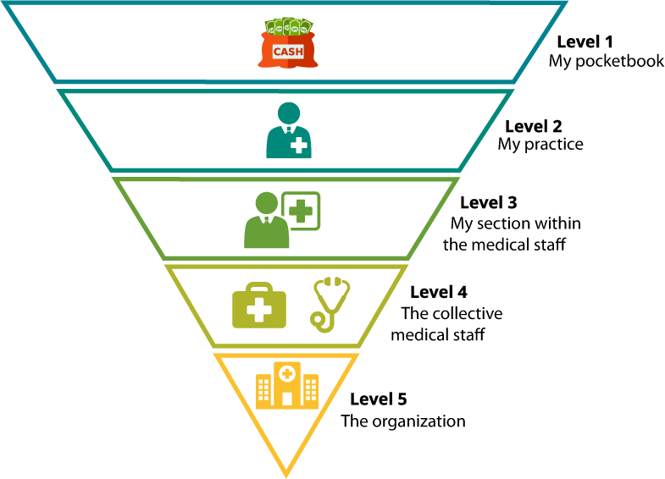
How some physicians make decisions

Slide 47

Role of the CEO in Governance
Make sure the board is fully informed as it makes decisions
Provide timely information to the board

Slide 48
Role of the CEO in Governance
(cont.)
Never surprise the board; give it a “heads up” on potentially negative information
Help recruit new board members
Ensure the board stays involved in governance, not management
Help actuate annual board retreats

Slide 49
CEO as member of board
46% of hospital CEOs are board members (Governance Institute Study, 2013)
17% are non-voting members
Helps strategic partnership with board

Slide 50

Board retreat
Review mission, vision, and values of the organization
Board should review strategic plan and progress on the plan
Provide governance education
Invite non-members to the retreat to hear new opinions

Slide 51
Governance vs. management:
Why Boards micromanage (cont.)
No job descriptions
Specialized knowledge
Directors have special interests
Pride and emotional connection
No effective orientation program

Slide 52
Governance vs. management:
Why Boards micromanage (cont.)
Board manages when given management
(as opposed to governance) information
Crisis arises
Management ineffective

Slide 53
Frequency of Board meetings
 | Average number of board meetings
Freestanding hospital board | 11
Hospital subsidiary board | 8
Local hospital board with limited authority | 7
Local hospital board with no fiduciary duties | 8
Local hospital board with significant authority | 9
System headquarters board | 8
Average all respondents = 9
Source: 2014 National Health Care Governance Survey Report

Slide 54

CEO succession plan
Should be a top priority for boards
Board driven, collaborative process
Involves identifying (and developing) several leaders
Assures key stakeholders of leadership continuity
Internal candidates get generally better results

Slide 55
Intermediate sanctions
Not-for-profit directors can cause organization to lose non-profit status
Intermediate Sanctions have caused directors to be liable for their actions
Sanctions are brought when transactions involve “disqualified persons,” or an individual who is in position to exercise substantial influence over the organization
See www.irs.gov/Charities-&-Non-Profits/Charitable-Organizations/Intermediate-Sanctions

Slide 56

Actions resulting in intermediate sanctions
Paying unreasonable compensation
Paying revenue-based compensation
Participating in bargain sales

Slide 57

Basics for a “good” Board
Job descriptions for Board
and Board officers
Up-to-date bylaws
Board self-evaluations
Conflict of interest policies enforced
Good relationship with CEO, but not in CEO’s pocket

Slide 58
Basics for a “good” Board (cont.)
Effective orientation for new Board members
Board is into policy setting, not operations
Annual Board retreats
Up-to-date strategic plan
CEO evaluation annually

Slide 59
Characteristics of an advanced
Board
Eliminate term limits and age limits
Individual Board evaluations
No monthly board meetings
Spend as much time on quality as on finance
Engaged in public policy initiatives
Board members self-identify conflicts early and recuse themselves

Slide 60
Characteristics of an advanced
Board (cont.)
Board member automatically resigns over continuing conflicts
Board has dealt with “physician member” issues
Board has added members outside of the community
Ask members to leave the board for good reason

Slide 61

Characteristics of an advanced board (cont.)
Reputation of board is so good people ask to join
CEO succession plan in place
Board members are engaged in continuing education on governance

Slide 62

Governance websites
Compensationstandards.com
NACDonline.org
Boardsource.org
Thecorporatelibrary.net
Greatboards.org
Healthpolicyinstitute.pitt.edu
Trustees.aha.org
Practicalgovernancegroup.com

Slide 63
Key terms
Board of directors
Fiduciary duties
Confidentiality Rule
Board responsibilities
Bylaws
Business Judgement Rule
Intermediate sanctions

Slide 64
Key terms (cont.)
Board committees
Executive sessions
Board retreat

Slide 65


Questions

Slide 66
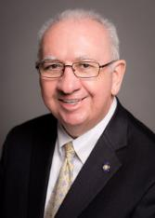
Contact
J. Larry Tyler, FACHE, FHFMA, CMPE
Chairman and CEO, Practical Governance Group
Chairman Emeritus, Tyler & Company
Contact
678-296-6775 (phone)
ltyler@pgghealthcare.com (email)
www.JLarryTyler.com (LinkedIn)
Insight
practicalgovernancegroup.com (website)
Youtube.com/practicalgovernancegroup (YouTube)

