Slide 1
Project Community
A permaculture design for the local community.

Slide 2
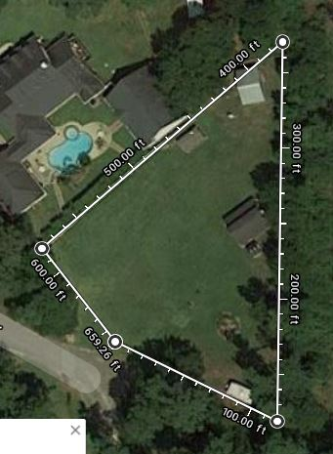
Starting Point
A 1/2 acre property in the humid subtropics, 78 miles from the Gulf of Mexico. The property receives on average 44” of rain per year but could be as much as double or half of that making water harvesting and storage a top priority.
Most access and structure have already been installed and have been determined to be sufficient to remain intact with no changes.

Slide 3
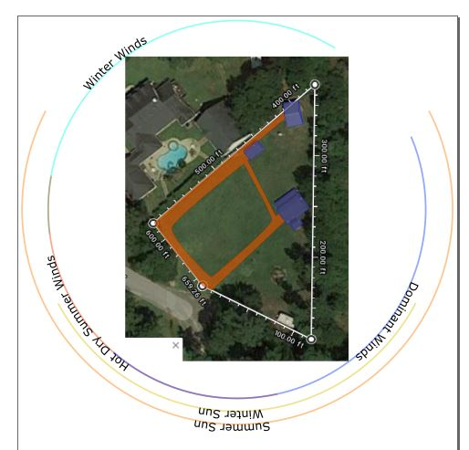
Sector Analysis
Considerations for summer and winter sun angles, predominant winds as well as the hot summer winds and the cold winter winds.
The view was also considered since the homeowner told me she wished to be more private considering the neighbors.

Slide 4
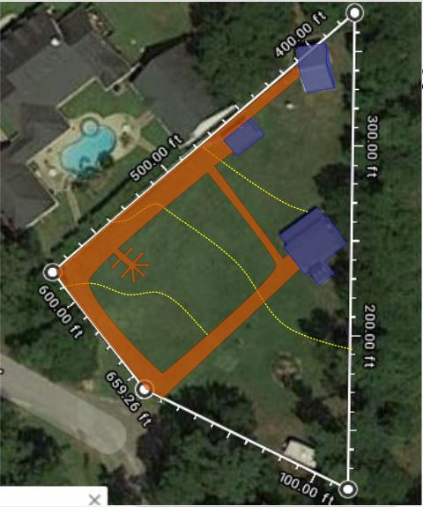
Structure & Access
Existing Structures include a barn, pump house, shed and a small well.
Access consists of dirt driveway and that comes from street into barn. This access is acceptable and will be preserved.
These structures and access are permanent and acceptable and can be used for harvesting water.

Slide 5
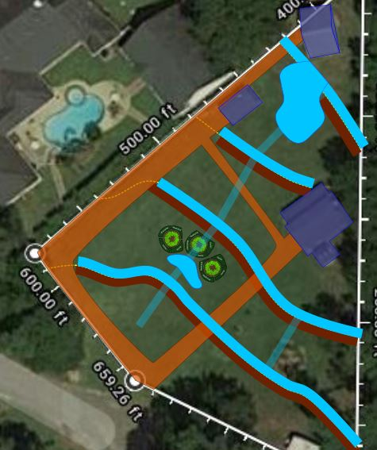
Water
Water resources are scarce on the property even though there is a decent size pool and a a well on the property.
Pool is for recreation but can be used as an irrigation source, see pool drain.
Rainwater is collected from roof runoff via rain gutters and is currently diverted away from the house. I suggest taking advantage of that runoff and directing it productive areas
The installation of a pond is recommended at the top of the property to the north of the first swale. This is optional, but highly recommended to allow drought proofing and water table recharge of the property to ensure maximum health of your system. This pond will catch runoff from a swale constructed to maximize water catchment from the land.
The pond will include a level sill to allow pacified water to overflow to the swale below it.
3 swales are installed to catch and hold water that will charge the water table and to supercharge the trees installed on the swale berms. Level sills are installed in the swales to allow pacified water to sheet over, reducing erosion and allowing for soakage and storage below ground.
Note: even without the pond, the swales will still catch and hold (in the ground-not above ground) a lot of water but the pond will enhance those drought years we often have in our area.
Notes:
Pond and swales will be a future addition, big undertaking and we are uncertain about the best use of the pasture. We have decided to get a horse instead of sheep.

Slide 6
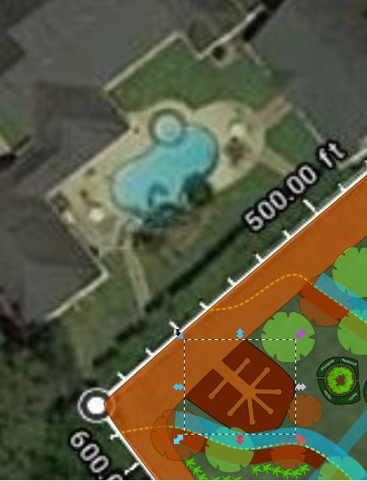
Zone 1
Permaculture sections the landscape into zones for more efficient use of space. Zone 1 is the area you will spend most of your time and visit multiple times per day.
Zone 1 includes the kitchen and herb garden and relaxation areas that you spend time in often.
Zone 1 is very small in this design due to the fact that this is a community food forest and the homeowner needs very little production.
This Zone 1 is planned as a mandala garden, or a multiple keyhole garden.
Notes:
The patio garden is a bit longer than pictured and runs by the two story patio. See changes.

Slide 7
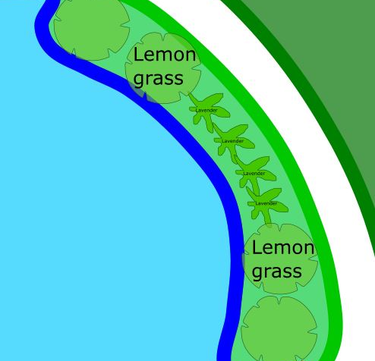
Pool Area
The existing rock waterfall will stay.
Minitature fruit will be planted, like dwarf apples and oranges to create a welcoming stay.

Slide 8
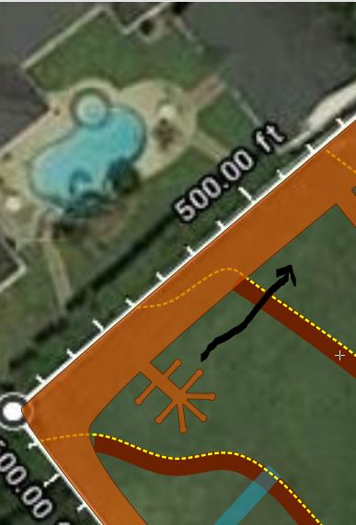
Kitchen Garden
The kitchen garden has been designed to be right outside of the gate. This allows for optimal placement as to the kitchen and will also allow for harvest as needed dependent on kitchen.
This garden can be placed as located on plan or can be moved to slightly higher ground with more sun as the arrow indicates. Be aware that in the humid subtropics less evening sun may be best.
Notes:
Due to the high number of critters in the area, we will need to enclose this kitchen garden in chicken wire. Otherwise love this idea.

Slide 9
Zone 2
Zone 2 is for small livestock and chickens are planned in the future for both egg production and insect and disease control. However, specific design has not yet been done for this plan. More research is needed.

Slide 10
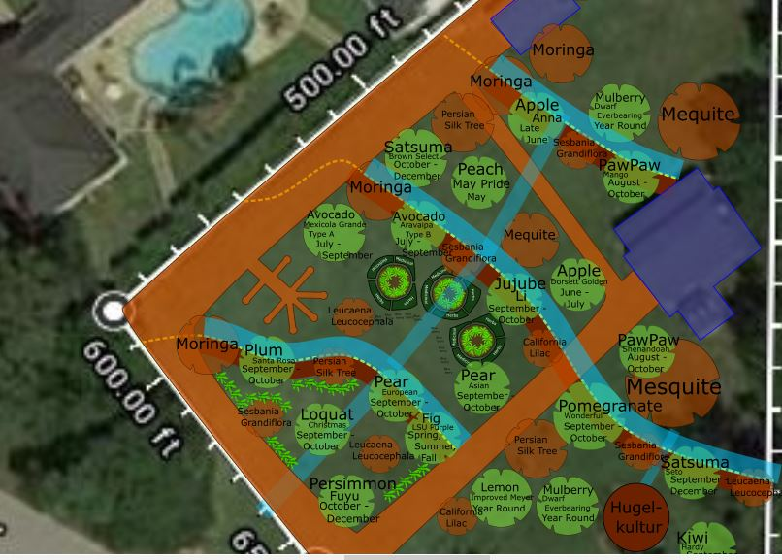
Food Forest
Here you have your Zone 2 food forest.
A food forest is a system that is self stable and will continue to get better with time. Very little intervention is necessary and maintenance is only required several times per year.
A food forest consists of 7 layers, possibly more or less depending on climate. You will have your overstory trees which provide stability and is usually a large nut or fruit tree followed by an understory, then a shrub layer, an herbaceous layer, ground cover, rhizome and vines. These layers are there whether or not we put them in so we do put them in to discourage unproductive species from invading.
Banana circles has also been included in this food forest. Details provided in next slide.
Notes:
See fig tree placement. Can we add citrus in front? Improved Meyer Lemon, Key Lime, Navel Orange?

Slide 11
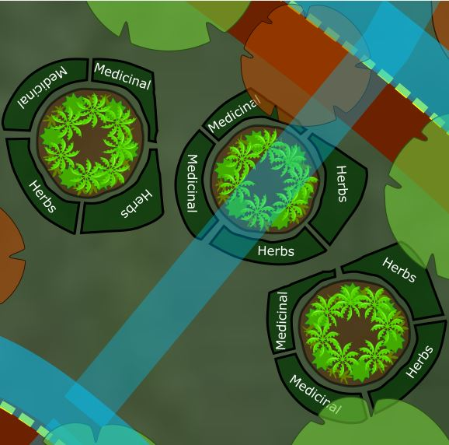
Banana Circle
A banana circle is a way to stack functions.
First, we grow bananas, great!
Second, we find a place for any extra mulch and compostable material we have that we don’t have anything to do with, conveniently.
A banana circle is about 6 foot in diameter and has a 3 foot pit in the center that is filled with mulch, which quickly decomposes into rich, fertile compost.
There are also other plants that go into a banana circle. Lemongrass keeps out weeds and varmint. Comfrey provides nutrient accumulation. Sweet potato provides a lovely ground cover, salad greens and the sweet edible tuber. Taro also provides greens and tubers. Peas and beans can be grown in alternating seasons to provide edibles as well as fix nitrogen in the soil.
A view of the recently installed banana circle at my property on the next slide.
Notes:
Love it

Slide 12
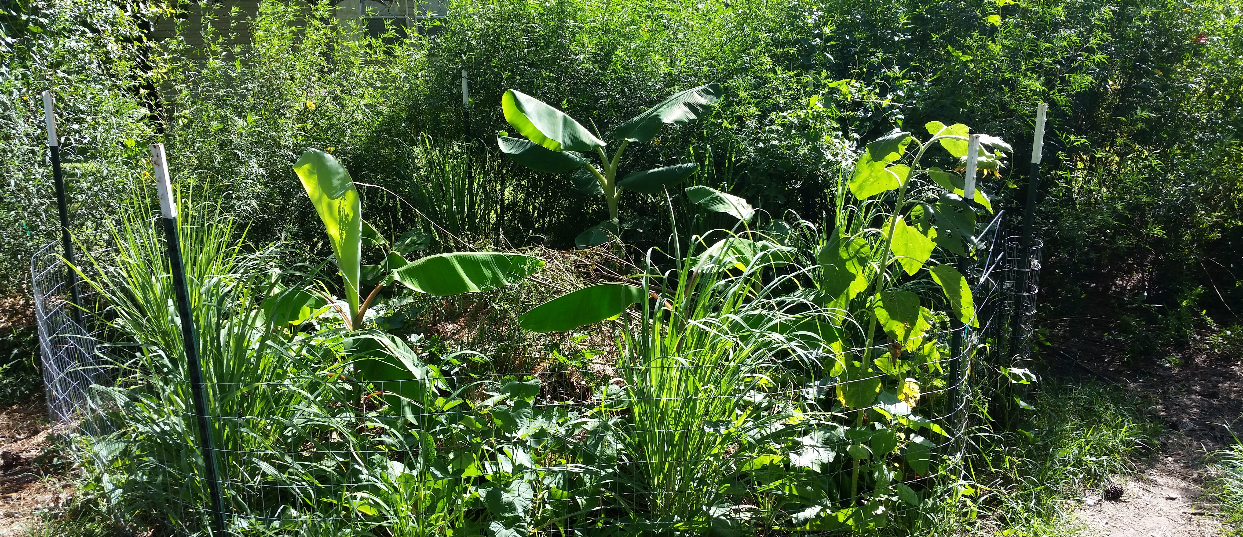
Real example of a Banana Circle
This was planted the 1st week of May, 2017 and this photo was taken just 2 ½ months later. The growth in this type of system is absolutely amazing!

Slide 13
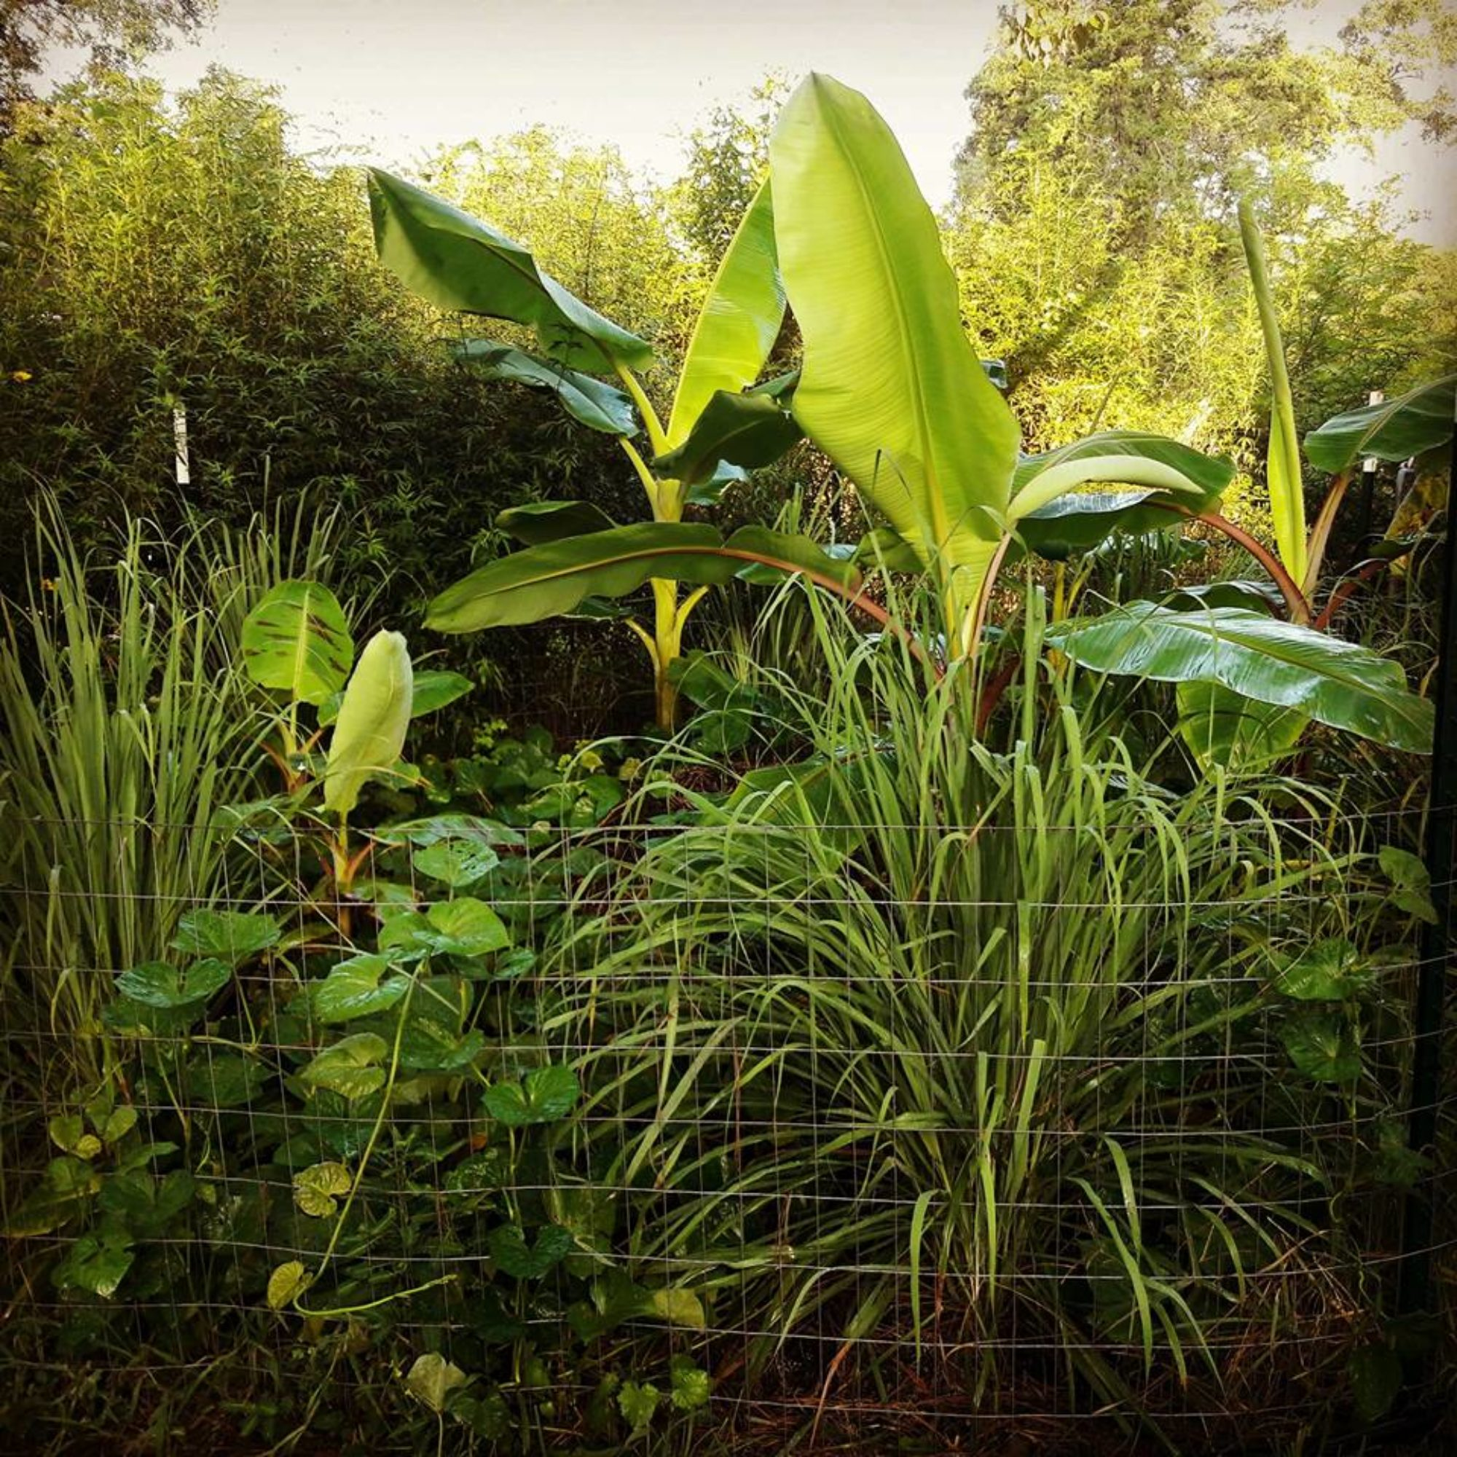
This is my favorite photo! The growth in this type of T=system is absolutely amazing!

Slide 14
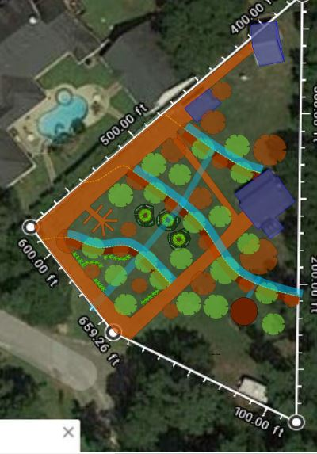
Zone 3
Zone 3 moves us into an area where we are much less involved and nature really shines. This can be grazing area, less intensively managed food forests or other wood products like firewood, timber production, cord wood, and the like.
The zone 2 and zone 3 here kind of blend. We will be in some parts of this system more often than others and the lines will blend. I hesitate to call 1 part zone 2 and another zone 3.
Notes:
We are getting a horse instead of sheep. Not sure if new trees are a good idea with a horse? We may try to level some of the pasture out for riding, so the plans back there are uncertain but we like the swale idea. Definitely want a pond in the future for the horse to get water and maybe to raise ducks or geese.

Slide 15
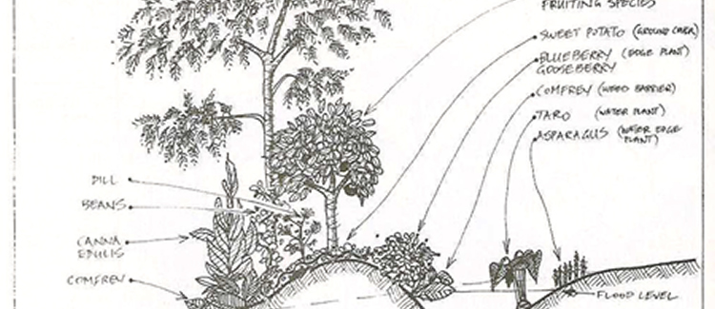
Swales, In Focus
Here you can see a swale in action. A trench is dug on contour, soil laid on the down side of the trench creating an uncompacted mound. Water loving plants are grown below the flood level while acidic loving plants like blueberries are grown on the inside of mound where the soil is most acidic due to the moisture level. Ground covers are planted immediately to provide soil stability and to fix nitrogen. Fast growing species should be chosen here. Productive fruit and nut trees are grown on the top of the mound and supporting species planted within the system. Insectaries, herbs, mulch plants, nitrogen fixers and chop and drop sacrificial plants are all part of the system. Not shown here is the overflow sill, which must be completely level at each point. The swale itself is also built completely level in order to pacify the water for maximum soil infiltration.

Slide 16
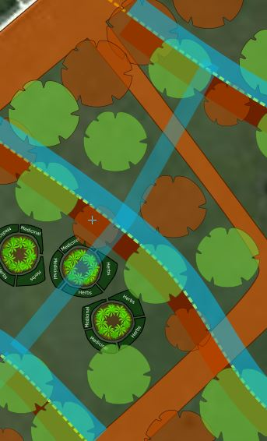
Swales Close Up
Not all design elements have been added in this picture but most of the productive and support species are here. I have chosen beautiful support species which flower, attracting bees and butterflies, are visually stunning and also fix nitrogen in the soil and provide nitrogen rich mulch with their falling foliage and any trimming or pruning you choose to do.
We have found that ducks will often come and visit after rains also depositing nutrient into the swale system and helping reducing any pest insect pressure.

Slide 17
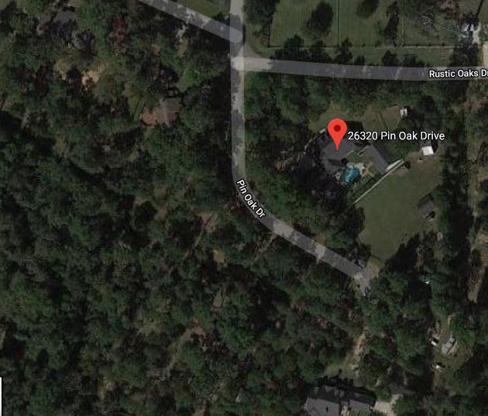
Zone 4
Zone 4 is for conservation. There is minimal pruning and is mostly for wild forest with some cultivation. This is an excellent place for mushroom cultivation, wildlife conservation and observation.
You naturally have some wooded area that is thinned out and have said you’d like to be able to observe deer in that area. We will plant deer attracting plants along the edges and in the clearings.
We could also design in other habitat as well, such as duck habitat or any specific birds you’d like to observe. Bald eagles have been spotted in your area!
Imagination leads design.

Slide 18
Zone 5
Zone 5 is Wilderness. It is undisturbed and we only enter to observe from nature and for recreation. Nature is our teacher and this is where we learn.
Zone 5 consists of the outer edges of your property and we will continue to observe these areas while also utilizing existing edge.

Slide 19
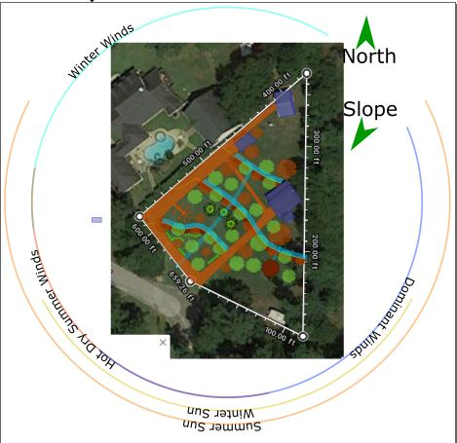
Whole Design
An overview of the design.
All energies have been observed and documented.
Water has been slowed, spread and stored.
Access is acceptable.
Structure is existing.
Imagination and determination is under way.
Change is inevitable!

