Slide 1

James 1:5-8
Notes:
WE OFTEN TRY TO MAKE THE SIMPLE COMPLICATED
THIS IS ESPECIALLY TRUE WHEN IT COMES TO ENDURING TRIALS
WE SPEND A LOT OF TIME READING BOOKS OR STUDYING PSYCHOLOGY OR THE FIV STAGAES OF GRIEF – ANALYZE AND RESEARCH
TRY TO FIND SOLUTIONS ON OUR OWN
JAMES TELLS US IT IS SIMPLE
WE SIMPLY NEED TO GO TO GOD IN PRAYER AND ASK

Slide 2
Ask For Fortitude In Trials
Notes:
TITLE – REVIEW LAST WEEK FROM JAMES
“BUT”
IF ANYONE LACKS WISDOM – ASK
PAUL – LED BY THE SPIRIT AND YOU WILL NOT FULFILL THE DESIRES OF THE FLESH
JAMES ASK GOD FOR WISDOM
CONTEXT – RESPONSE OF FORTITUDE IN TRIALS AND THE CORRESPONDING GROWING IN CHRISTLIKENESS UNTO PERFECTION
WE CANNOT DO THIS ON OUR OWN – IT IS IMPROBABLE IF NOT IMPOSSIBLE
WE NEED HELP

Slide 3
Knowledge - Word Understanding – How To Apply Wisdom - Doing
Notes:
WRONG THINKING – WISDOM OF GOD – DIFFICULT, SIMPLE,
WISDOM – THREE COMPONENTS – WE MAY LACK IN ONE OR MORE OF THESE AREAS
MUSEUM OF THE BIBLE
BE STUDENTS OF THE WORD OF GOD – NO SHORTCUTS TO GOD’S WISDOM – WE ARE NOT GOING TO FIND IT EMBROIDERED ON PILLOWS – CAREFUL DAILY DEEP OBSERVATION, INTERPRETATION, AND APPLICATION OF GOD’S WORD
UNDERSTANDING – HOW TO TAKE THE PRINCIPLES AND ASK HOW DO I APPLY THIS TO MY LIFE – BY THE HOLY SPIRIT – UNDERSTANDING IS NOT TRYING TO FIGURE OUT THE WHY
WISDOM – IS ACTUALLY PUTTING IT INTO PRACTICE.
DICK CHENEY – SHOT HIS BUDDY
TALKING ON THE TV – SEEMED PATIENT, KNOWLEDGEABLE, ASTUTE
HUNTING – IMPATIENT AND RECKLESS – DIDN’T CHECK HIS LINE OF FIRE BEFORE SHOOTING
WISDOM IS PROVEN BY OUR ACTIONS
NONE OF US CAN BECOME CHRISTLIKE ON OUR OWN – SPIRITUALLY APPRASIED
NEED TO HUMBLE OURSELVES

Slide 4
1. Ask A Faithful God
Notes:
ANYONE WHO SEEKS – REALIZE YOUR LACK AND COME TO YOUR SAVIOR
SOLOMON ASKED GOD FOR WISDOM
OUR OWN PRIDE – THE NATURAL MAN REBELS AGAINST THE SIMPLICITY
OUR OWN DESPAIR – IN TRIALS, NOT SEE TO ASK
LET HIM ASK – GOD – THE SOURCE OF OUR SPIRITUAL LIFE
NOT BOOKS, NOT MEN - ONLY ONE SOURCE OF WISDOM
WISDOM IS A SPIRITUAL BUSINESS
GOD IS A GIVER – WHO GIVES TO THOSE WHO ASK
GENEROUSLY – SIMPLY, SINGLE MINDEDLY, GOD IS 100 PERCENT DEVOTED TO GIVING YOU HIS WISDOM AND ALL THAT YOU NEED FOR LIFE AND GODLINESS

Slide 5

Notes:
EXPERT GARDENER – PREPARING A ROSE FOR SHOW AT THE FAIR
HE PLANTS THE ROSE – RIGHT SOIL – RIGHT SHADE AND SUNLIGHT
HE FERTILIZES IT – ALL THE NUTRIENTS IT NEEDS
PRUNES THE ROSE SO THAT ALL OF THOSE NUTRIENTS ARE FOCUSED FOR ITS BENEFIT
PERFECT TIME – HE HARVESTS IT – MORNING OF THE DAY OF THE FAIR
KEEPS IT COOL AND PROTECTED UNTIL IT GETS THE FAIR – PERFECT WINDOW OF TIME WHEN A ROSE CAN BE ENTERED FOR SHOW
SO SIMPLE AND SINGLE MINDED IS GOD’S GENEROSITY IN BESTOWING HIS WISDOM UPON US

Slide 6
2. Ask Without Wavering
Notes:
DOUBT – NOT A ONE TIME, LACK OF FAITH, CHARACTER OF LIFE UNSTABLE, BACK AND FORTH - UNDECIDED
PROFESSES FAITH – DOESN’T LIVE IT OR EMBACE IT
ONE FOOT IN THE WORLD AND ONE FOOT WITH GOD
UNSURE IF THERE IS A GOD
UNSURE IF THAT GOD IS GOOD AND FAITHFUL, SOVEREIGN
NOT AN ATHIEST – NOT CONVINCED IN YOUR OWN HEART THERE IS A GOD
NOT A PAGAN – NOT CONVINCED IN YOUR OWN HEART OF YOUR COMMIMENT TO THIS GOD – NO MATTER WHAT
NOT A REBEL – NOT CONVINCED THAT YOU WILL SUBMIT TO GOD NO MATTER WHAT

Slide 7
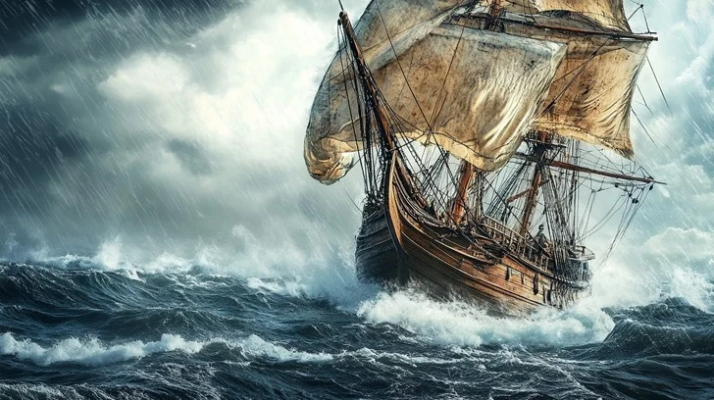
Notes:
EVER BEEN OUT ON THE OCEAN OR A LAKE
WHEN THE WIND COMES UP IN THE OPPOSITE DIRECTION
HARD TO STEER – TAKES FOREVER TO GET TO WHERE YOU WANT TO GO
WAVES PUSH AGAINST THE BOAT
MANY PEOPLE – HELP IN TROUBLE IS FOUND IN HUMAN WISDOM
BOOKS – OR PSYCHOLOGY
SPIRITUAL HELP – WORD OF GOD
FAITH – CONVINCED NOT HAVING ONE FOOT IN THE WORLD
BRINGS ME TO MY NEXT POINT

Slide 8
3. Ask In Christ’s Confidence
Notes:
WHERE IS THE SOURCE OF WISDOM?
DEBATE PSYCHOLOGY – MAN WRITTEN BOOKS - SCIENCE
OR SHOULD WE TURN TO THE WORD OF GOD
ONLY THE WORD OF GOD THAT CAN UNITE US WITH CHRIST
WORLDLY WISDOM WILL NEVER RENEW OUR SPIRIT
EVEN IF PSYCHOLOGIST – WORLDLY PERSPECTIVE, STUMBLES UPON A GRAIN OF TRUTH
INSUFFICIENT TO TRANSFORM THE SOUL
ONLY CHRIST CAN GIVE SPIRITUAL WISDOM

Slide 9
1 Corinthians 1:24 but to those who are called, both Jews and Greeks, Christ the power of God and the wisdom of God.
Notes:
WISDOM OF GOD FOOLISHNESS TO THE JEWS AND THE GREEKS
MUST BE CALLED – MUST BE BORN AGAIN – WORK OF THE HOLY SPIRIT
CIRCUMCISING OUR HEART
UNITED TO CHRIST – CHRIST BECOMES TO US THE POWER OF GOD
GIVES US THE POWER TO PUT INTO PRACTIVE THE WORD
WISDOM OF GOD – UNDERSTANDING – WHY’S
HOPE THAT BRINGS CHRIST LIKENESS

Slide 10
1 Corinthians 2:13 And we impart this in words not taught by human wisdom but taught by the Spirit, interpreting spiritual truths to those who are spiritual.
Notes:
SPIRITUAL WISDOM – IMPARTED TEACHING OF THE WORD OF GOD
NOT BY MAN – TAUGHT BY THE SPIRIT
ONLY CHRIST – THROUGH SPIRIT – GIVE US WISDOM
SPIRITUAL TRUTH
BORN AGAIN - MUST BE SPIRITUAL

Slide 11
1 Corinthians 2:16 But we have the mind of Christ.
Notes:
HOLY SPIRIT – BORN AGAIN
MIND OF CHRIST – GIVEN FREELY

Slide 12
Application: Personal Trials
1. Pray For Fortitude 2. Start A Journal 3. Pray for Strength To Accept Help - Prayer Partner

Slide 13
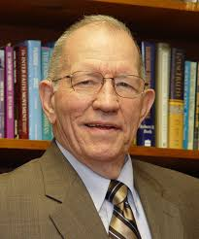
Al Martin - Trinity Baptist – Montvilee, NJ
Notes:
AL MARTIN - GREAT ENCOURAGEMENT TO PASTORS
TAPE MINISTRY – LIGONIERS – BANNER OF TRUTH BOOKS
LADY IN HIS CHURCH WHO SUFFERED FOR YEARS WITH A DIGENERATIVE CONDITION
BY FAITH – NOT TO LOOK AT HER CIRCUMSTANCES
HEALTH PROBLEMS – CONTINUED TO DECLINE
BY FAITH – BY THE SPIRIT – CHOSE TO MAKE HER HOUSE A HOUSE OF PRAYER
BOUND TO HER HOUSE – PRAYED CONSTANTLY
CHANGED – GIVEN WISDOM FROM ABOVE
VISITED – ENCOURAGED THEM AND PRAYED FOR THEM.
IF ANY OF YOU LACKS WISDOM, LET THEM ASK.

