Slide 1


LIFE IS TOO SHORT TO FEEL GUILTY & PARALYZED
Part 1-Mark 2:1-12
Sunday, August 24, 2025
Rev. Steve Vaughn

Slide 2

If your life was a bumper sticker, what would it say?

Slide 3
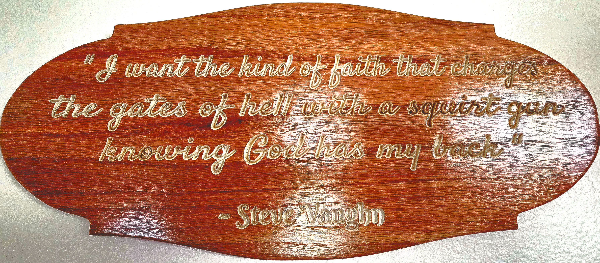

Slide 4
Life is too short
1. Feeling guilty over missing one workout
2. Crying over bad boyfriends
3. Working a job, you hate
4. Insulting yourself
5. Uncomfortable underwear
6. Not sharing your dreams
7. Being too lazy to make changes in your life
8. Comparing yourself to others
9. Not spending your money on travel
10. Being critical of others

Slide 5
The Church is in the business of proclaiming that good news, because "life is too short to feel guilty." In the text today two things are proclaimed.
Faith and healing.

Slide 6
A few days later, when Jesus again entered Capernaum, the people heard that he had come home. They gathered in such large numbers that there was no room left, not even outside the door, and he preached the word to them. Some men came, bringing to him a paralyzed man, carried by four of them.
Mark 2:1-5 NIV

Slide 7
Since they could not get him to Jesus because of the crowd, they made an opening in the roof above Jesus by digging through it and then lowered the mat the man was lying on. When Jesus saw their faith, he said to the paralyzed man, "Son, your sins are forgiven."
Mark 2:1-5 NIV

Slide 8
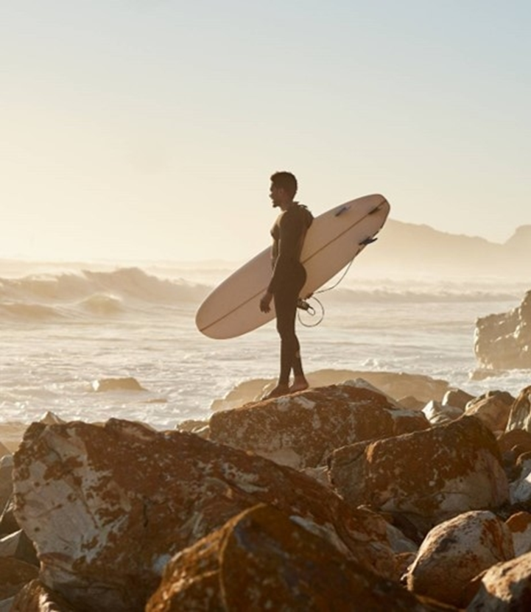
WE MUST HAVE A SEEING FAITH
-the faith of others
“God does not expect us to submit our faith to him without reason, but the very limits of our reason make faith a necessity.”
–Augustine

Slide 9
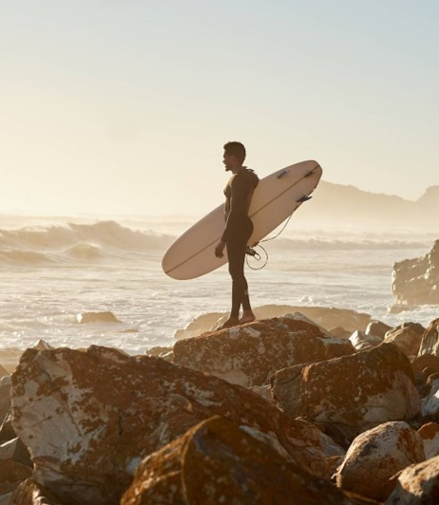
Now some teachers of the law were sitting there, thinking to themselves, "Why does this fellow talk like that? He's blaspheming! Who can forgive sins but God alone?" Immediately Jesus knew in his spirit that this was what they were thinking in their hearts, and he said to them, "Why are you thinking these things? Which is easier: to say to this paralyzed man, 'Your sins are forgiven,' or to say, 'Get up, take your mat and walk’?
Mark 2:6-9 NIV

Slide 10

From the divine vantage point, faith is acknowledged when it manifests itself in action.
“Yes, a man will say, you have faith, and I have works: show me your faith apart from your works, and I, by my works, will show you my faith.”
James 2:18 NIV

Slide 11
But I want you to know that the Son of Man has authority on earth to forgive sins." So he said to the man, "I tell you, get up, take your mat and go home." He got up, took his mat and walked out in full view of them all. This amazed everyone and they praised God, saying, "We have never seen anything like this!"
Mark 2:10-12 NIV

Slide 12
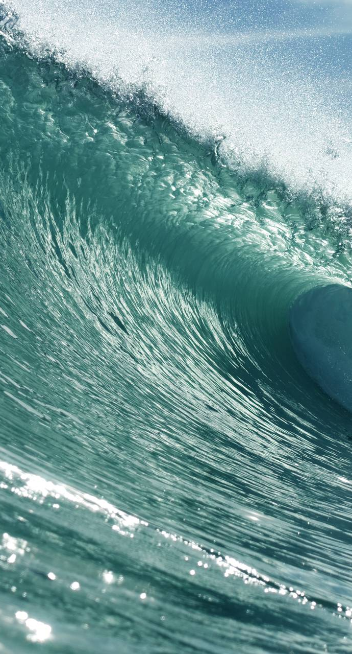
God sees your faith, and honors it, when that faith is manifested in doing His will.

Slide 13
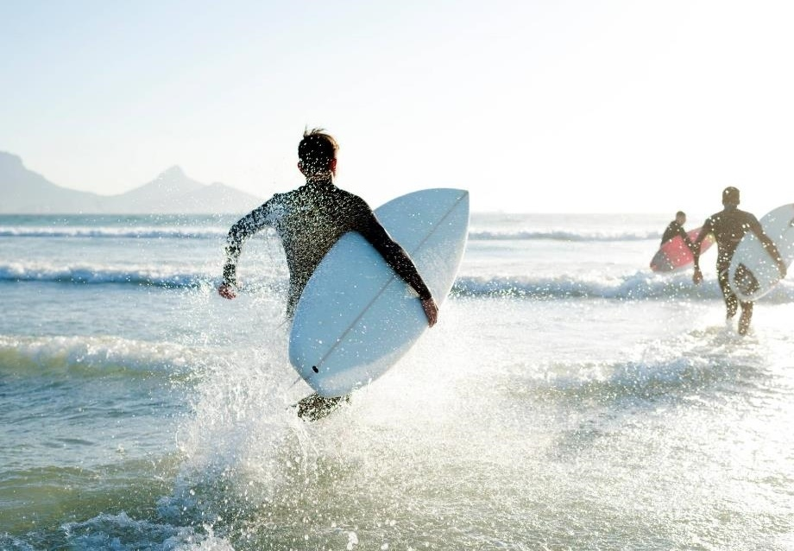
Seven insights that we can manifest our faith in others.
1) Their faith is a wise faith in that it brought the paralytic to the only One who could heal.
2) It is a persistent faith because it is undeterred by seemingly overwhelming obstacles.

Slide 14
Seven insights that we can manifest our faith in others.
3) It is a sacrificial faith in that it gives of its time and effort to bring the paralytic before Christ.
4) It is an unintimidated faith because it is unashamedly displayed in public.

Slide 15
Seven insights that we can manifest our faith in others.
5) it is a humble faith since the friends do not ask Jesus to come to him but take him to Jesus.
6) it is a loving faith because the friends willingly expend great effort to get him real help.

Slide 16
Seven insights that we can manifest our faith in others.
7) Finally, it is an active faith in that they take the man to Christ rather than sit around complaining and grumbling about their friend's sorry condition.

