Slide 1


Sunday , August 2, 2026
Rev. Chris Tiner

Slide 2
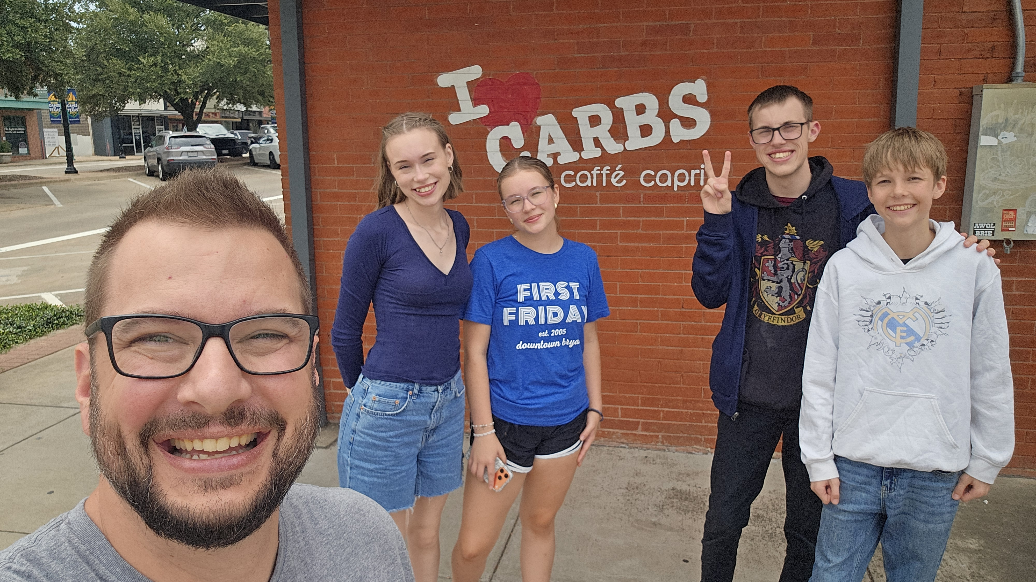

Slide 3
Luke 24:13-35 (NLT)

Slide 4
1. Disappointment Clouds Our Vision

Slide 5
“My Grandma had cancer, and she was one of the most faithful people ever, and she’s one of the main reasons I had a relationship with God in the first place. My faith was the strongest it had ever been, I was praying every night that He would heal her, and then she died. I couldn’t eat and I couldn’t sleep; I was so distraught. Why would He do that? It got to a point where I was like, I don’t know if I believe in God anymore.

Slide 6
But it forced me to pay attention to the small things. I had to sit with myself for so long, in silence. Until I finally understood that God doesn’t always come in the very moment I wanted Him to. I had to remind myself of the story in the Bible where there was a fire and a hurricane, but God was in a whisper.
I formed a lot of resentment toward God. Until I realized I don’t have to understand the ‘why’ about everything and I can still understand that God is good.” - E

Slide 7
1. Disappointment Clouds Our Vision
2. Jesus Joins Us In Our Journey

Slide 8
“Jesus presents you with a calm. You can always know that He is with you. Even if it isn’t part of your plan, you’re part of His.” - L

Slide 9
1. Disappointment Clouds Our Vision
2. Jesus Joins Us In Our Journey
3. Jesus Rekindles Hope

Slide 10
“One time at Christmas, I got a Junie B. Jones book for Christmas from my Bomma, and I cried. I was really mad at her. It is not what I wanted. But it changed my life because it turns out I am Junie B. Jones, which got me into books and reading.” – KJ
“Relationships I was hoping would work out, but the peace in my life without them has been more good for me than it would have been by trying to make it work.” - KJ

Slide 11
“For a long time, I wanted my anxiety to be cured right away, which would still be nice, but the tools I’ve gained based on it not going away but having to work at it has helped me help other people and helped me cope with other things besides anxiety.” - KJ

Slide 12
“Sometimes you’re asking God, why did you let me go through this? And He says, it’s so you know the way out when I send you back in for somebody else.” - E

Slide 13
1. Disappointment Clouds Our Vision
2. Jesus Joins Us In Our Journey
3. Jesus Rekindles Hope
4. Hope Changes Our Direction

Slide 14
“The back of Tapestries look really messy, there’s strings sticking out, and it makes no sense. But if you walk to the other side it’s a whole picture. It doesn’t always make sense when you’re looking at it from your side. But God can see the whole picture and He’s making the whole picture, but you can’t always see that from where you’re standing. It’s okay to acknowledge that it’s hard, that you don’t know what’s going on, that it feels like a mess, and also know that God has a plan and He is going to work for your good. Like, I don’t get it, but I’m going to trust You anyways.” - E

