Slide 1

Part 3
“How Does God’s Love Break Through?”
LifeGate Sermon September 27, 2026

Slide 2
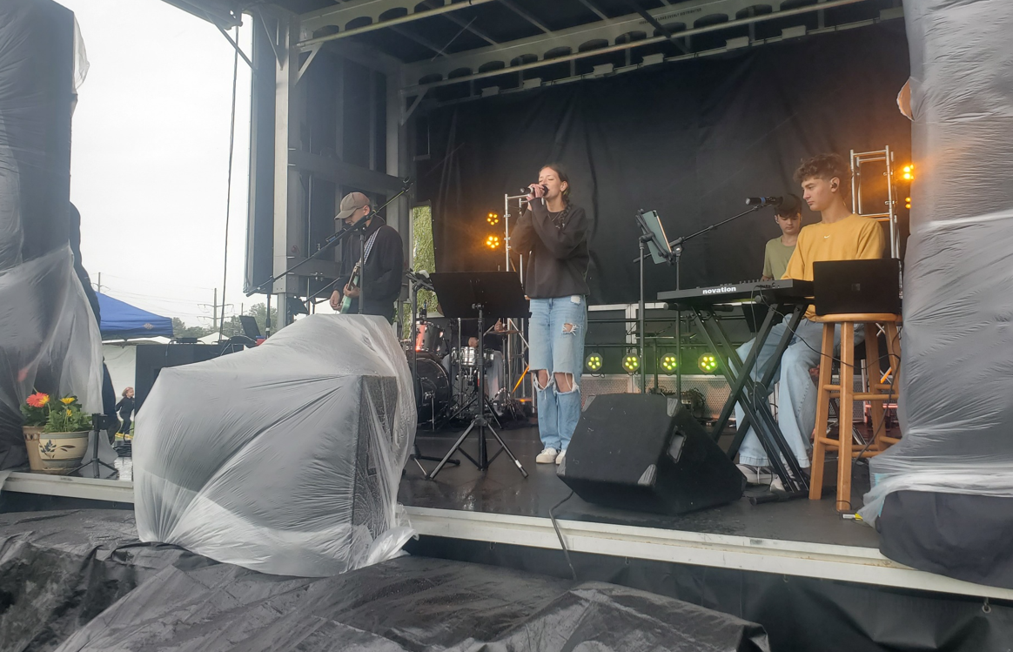
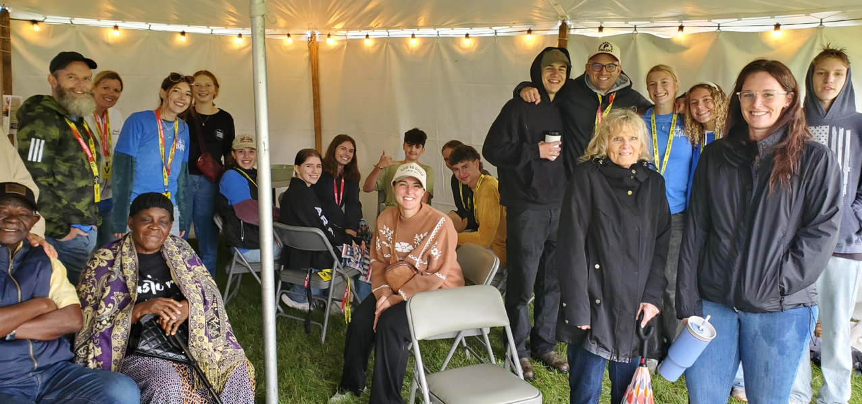
Blessed By The Sacrifice
Take Me Higher
Revival In The Rain

Slide 3

This Wednesday Night At LifeGate

Slide 4

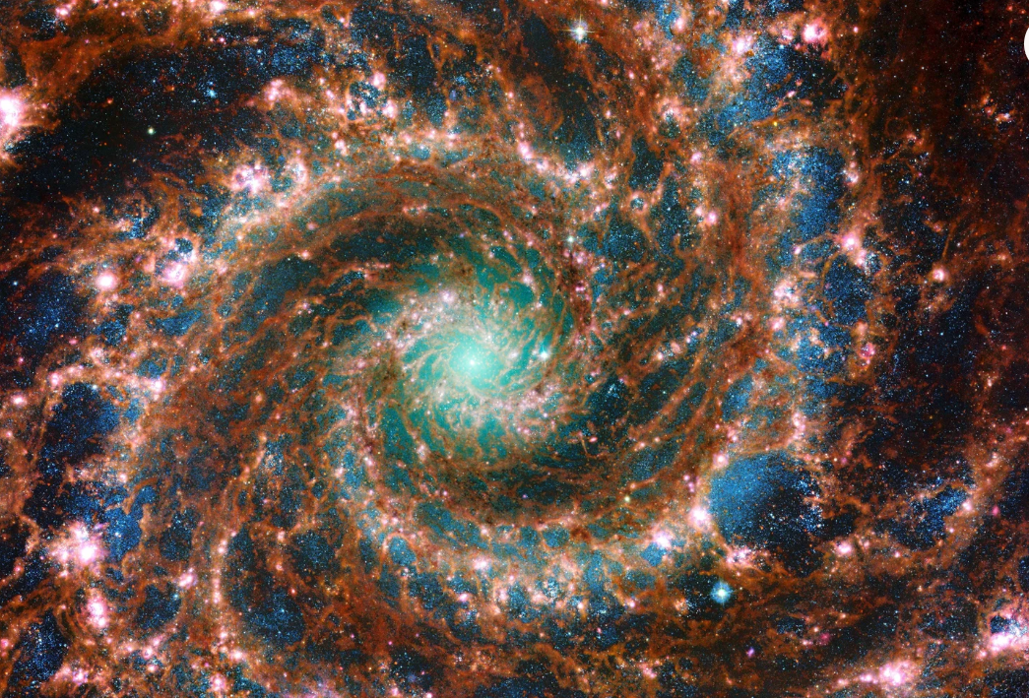
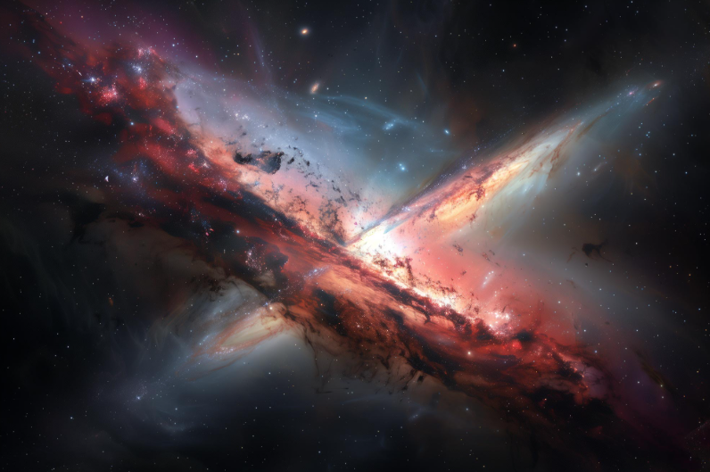
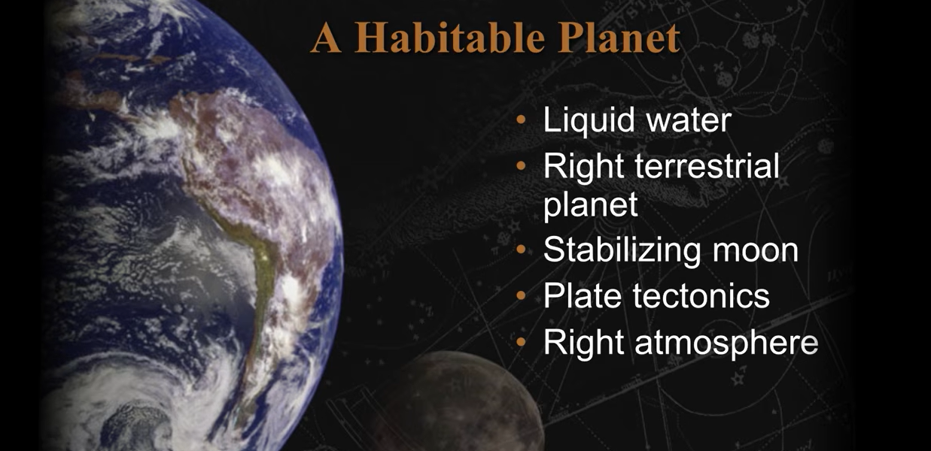
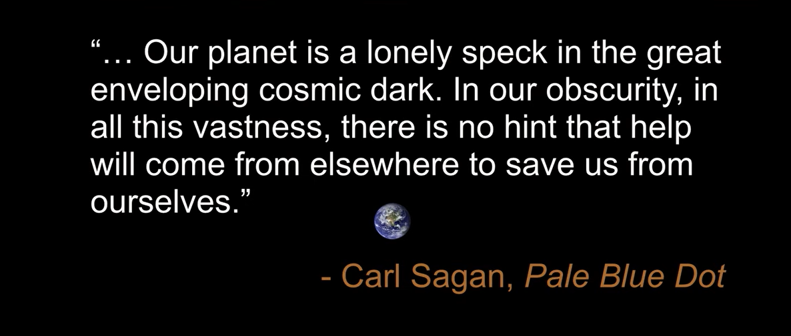
Why Did God Go To All This Effort?
Since what may be known about God is plain to them, because God has made it plain to them. ²⁰ For since the creation of the world God's invisible qualities--His eternal power and Divine nature--have been clearly seen, being understood from what has been made, so that men are without excuse (indefensible).
Romans 1:19-20 (NIV)
February 14, 1990, by NASA's Voyager 1 spacecraft from a record distance of about 4 billion miles

Slide 5
Maybe God Spent All That
Creativity For the Last Days Techno-Barbaric
Generation To Realize They Are Tiny
But Still Know -
I’m Loved/ belong
I Can be made Secure
I Can Have a Purpose
We have this hope as an anchor for the soul, firm and secure. It enters the inner sanctuary behind the curtain, Hebrews 6:19 (NIV)

Slide 6
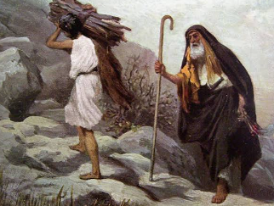
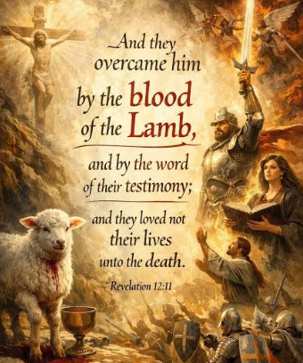
When Was Love First Mentioned In The Bible?
The Word “Love” and its variations occur 500 – 900 times in the Bible
Then God said, "Take your son, your only son, Isaac, whom you love, and go to the region of Moriah. Sacrifice him there as a burnt offering on one of the mountains I will tell you about." Genesis 22:2 (NIV)
They overcame him (enemy) by the blood of the Lamb and by the word of their testimony; they did not love their lives so much as to shrink from death. Revelation 12:11 (NIV)

Slide 7
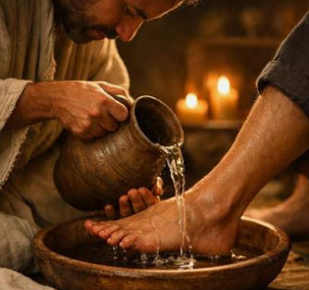
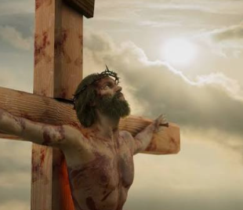
Jesus Showing The Full Extent Of His Love
It was just before the Passover Feast. Jesus knew that the time had come for Him to leave this world and go to the Father. Having loved His own who were in the world, He now showed them the full extent of His love. ² The evening meal was being served, and the devil had already prompted Judas Iscariot, son of Simon, to betray Jesus. ³ Jesus knew that the Father had put all things under His power, and that He had come from God and was returning to God; ⁴ so He got up from the meal, took off His outer clothing, and wrapped a towel around His waist.
John 13:1-4 (NIV)

Slide 8
But We Need to Go The Whole Way
Back To Defining What Is Biblical Love
“And I pray that you, being rooted and established in love, ¹⁸ may have power, together with all the saints, to grasp how wide and long and high and deep is the love of Christ, ¹⁹ and to know this love that surpasses knowledge--that you may be filled to the measure of all the fullness of God. Ephesians 3:17-19 (NIV)

Slide 9

The Love Of God Compels Us
And it Protects us
From The Encroachment of the World
The love of God is shed abroad in our hearts by the Holy Spirit which is given unto us. Romans 5:5 (KJV)

Slide 10
If We Get the Love Of God
Truly Get It –
We Will Be Forever Changed
¹ How great is the love the Father has lavished on us, that we should be called children of God! And that is what we are! The reason the world does not know us is that it did not know him. ² Dear friends, now we are children of God, and what we will be has not yet been made known. But we know that when he appears, we shall be like him, for we shall see him as he is. ³ Everyone who has this hope in him purifies himself, just as he is pure. 1 John 3:1-3

Slide 11
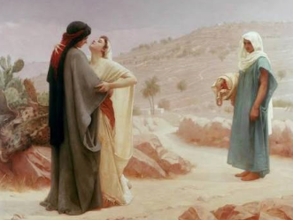
RUTH – THE FATHER’S LAVISH LOVE OF REDEMPTION DISPLAYED TO A FOREIGNER
You are Born on the “wrong-side of town:
Desolation comes
to your house
Because You Are in PROXIMITY to a Covenant means of grace
You follow not knowing where it will lead (NAOMI) – (Gospel)
The Providence of God brings an unforeseen TURN OF EVENTS
BOAZ (Christ) – A Kinsman redeemer – buys back all the property that has been taken over – and restores everything and marries Ruth an undeserving foreigner

Slide 12
What Are The Most Essential Qualities
Of God’s Lavish Love
Holy - uncorrupted
Universal – no favorites
Unconditional – His choice
Merciful/ Just – He will call to the undeserving but will remain holy and punish all wickedness

Slide 13
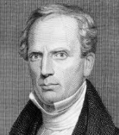
Foundational
Scripture from 1st John
This is how we know what love is: Jesus Christ laid down His life for us. And we ought to lay down our lives for our brothers.
1 John 3:16 (NIV) (This is How We Know Occurs 7 times)
“Example is the highest moral influence that can be exerted. If God, or any other being, would ask and require others to be loving, He must first manifest love Himself. If the love manifested on the cross does not subdue the selfishness of sinners, their case is hopeless.” –Charles Finney

Slide 14
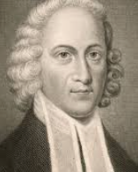
The Excellency Of Christ – Jonathan Edwards
As I rode out into the woods for my health, in 1737,
having left my horse in a remote place, I had a view,
that was for me extraordinary, of the glory of the Son of God as Mediator between God and man and His wonderful, great, pure and sweet grace and love, and meek and gentle condescension. This grace that appeared so calm and sweet appeared also great above the heavens, the person of Christ appeared deeply excellent and an excellency great enough to swallow up all my thoughts and conceptions, which continued, as near as I can judge, for about an hour, which kept me a greater part of the time in a flood of tears and weeping aloud. I felt an fire in my soul to be emptied and annihilated, to lie in the dust and to be full of Christ alone, to love Him with a holy and a pure love, to trust in Him, to live upon Him, to serve Him, and to be perfectly sanctified and made pure with a Divine and heavenly purity.” Jonathan Ewards

Slide 15
I’m Going To Let Scriptures Build The
Glorious Revelation Of God’s Love For Us
1
GOD MADE A CHOICE – OUT OF HIS LOVE – TO ACT ON OUR BEHALF – WHILE WE WERE YET SINNERS - GOD’S LOVE IS ALWAYS IN ACTION
God commended His love toward us in that "while we were yet His enemies, Christ died for us.“ Romans 5:8
He who did not spare His own Son, but gave Him up for us all--how will He not also, along with Him, graciously give us all things? Romans 8:32 (NIV)
But when the time had fully come, God sent His Son, born of a woman, born under law, ⁵ to redeem those under law, that we might receive the full rights of sons. Galatians 4:4-5 (NIV)

Slide 16
GOD SOUGHT THE HIGHEST BLESSING OF THE UNIVERSE BY PURSUING A WAY TO REDEEM SINFUL MANKIND AND EXPRESS HIS MERCY AND JUSTICE AT THE SAME TIME – THIS WAS AN INFINITE DISPLAY OF SELF DENIAL- A WILLINGNESS TO ENDURE SUPREME SACRIFICE TO SECURE A FAR GREATER GOOD
2
"For God so loved the world, that He gave His only begotten Son, that whosoever believeth in Him should not perish, but have everlasting life.“ John 3:16
God the Father gave His Highest valued Gift
Thanks be to God for His indescribable gift!
2 Corinthians 9:15 (NIV)

Slide 17
3
GOD’S LOVE IS COMPLETELY VOLUNTARY AND UNCONDITIONAL AND PERFECT IN ITS EXPRESSION – IT IS WITHOUT FAVORITISM AND IT EMBRACES ALL CREATION—FROM THE HIGHEST ARCHANGEL TO SPOILED ROTTEN MANKIND TO THE WILD BEASTS OF THE FIELD AND THE SMALLEST INSECT.
“For He makes His sun to rise on the evil and on the good, and sends rain on the just and on the unjust.” Matthew 5:45

Slide 18
GOD’S LOVE IS HOLY AND JUST WITHOUT COMPROMISE – HE WILL NEVER GLOSS OVER REBELLION OR ALLOW SIN INTO HEAVEN
4
Maintaining love to thousands, and forgiving wickedness, rebellion and sin. Yet He does not let the guilty unpunished. Exodus 34:7 (NIV)
He will strike the earth with the rod of His mouth; with the breath of His lips He will slay the wicked. Isaiah 11:4 (NIV)
He will punish those who do not know God and do not obey the Gospel of our Lord Jesus. ⁹ They will be punished with everlasting destruction and shut out from the presence of the Lord and from the majesty of His power 2 Thessalonians 1:8-10 (NIV)
After this I heard what sounded like the roar of a great multitude in heaven shouting: "Hallelujah! Salvation and glory and power belong to our God, ² for true and just are His judgments." Revelation 19:1-2 (NIV)

Slide 19
5
GOD’S UNFAILING LOVE IS MERCIFUL – HE LOOKS FOR A JUST WAY TO HAVE MERCY ON SINNERS AND MADE THAT WAY THROUGH THE CROSS OF JESUS CHRIST.
Your love, O LORD, reaches to the heavens, your faithfulness to the skies. Psalm 36:5 – also Psalm 57 (NIV)
God is "slow to anger, and abundant in goodness and truth... keeping mercy for thousands.“ Exodus 34:6 / Psalm 103:8
This is how God showed His love among us: He sent His one and only Son into the world that we might live through Him. 10 This is love: not that we loved God, but that He loved us and sent His Son as an atoning sacrifice for our sins. 1 John 4:9-10 (NIV)

Slide 20
We All Need A Daily Life- Injection
Of God’s Saving and Healing Love
“When people aren’t shown healthy, genuine love, they’ll often settle for whatever version of love they can find, even if it hurts them. Many don’t choose toxic relationships because they enjoy pain. They choose them because pain has become familiar. If you’ve only ever been loved conditionally, manipulated, rejected, or abused, unhealthy love can start to feel normal.
But that’s not the kind of love God has for you.”
“God doesn’t ask you to earn His love. He demonstrated it already at the cross. His love heals what sin, rejection, and broken people have wounded in you . Don’t mistake survival for love. Let God redefine what love truly looks like, because when you experience His love, you’ll stop settling for counterfeits. “We love Him because He first loved us.”
1 John 4:19 - Nathan Housman 2026

Slide 21
How Does God’s Love Break Through?
Like a foolish dreamer, trying to build a highway to the sky
All my hopes would come tumbling down, and I never knew just why
Until today, when You pulled away the clouds that hung like curtains on my eyes
Well I've been blind all these wasted years and I thought I was so wise - But then You took me by surprise
Chorus:
Like waking up from the longest dream, how real it seemed
Until Your love broke through
I've been lost in a fantasy, that blinded me
Until Your love broke through
All my life I've been searching for that crazy missing part
And with one touch, You just rolled away the stone that held my heart
And now I see that the answer was as easy, as just asking You in
And I am so sure I could never doubt Your gentle touch again
It's like the power of the wind

Slide 22
When God’s Love Breaks Through
It Ruins You – It Changes Everything
When God draws me near for correction and repentance it is Him saying, “ I love the daylights out of you will you just quit fighting Me? Will you give up being a jerk and give up being prideful because I can heal you because I love you and I died on the cross for the exact issue you are dealing with. Right NOW I am not loving you less because I’m confronting your selfishness - you're running from My love – so actually I am loving you more than you ever realize.”
Consequently, God’s love begins to break through and activate a response - activate a turning back to His heart – and activate a gratefulness He didn’t squash me like a bug.

Slide 23
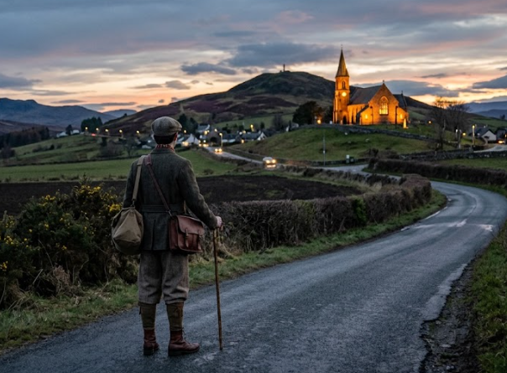

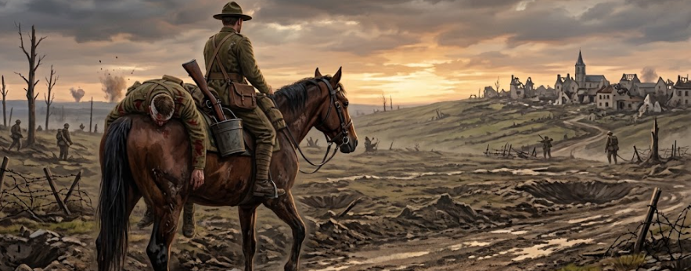
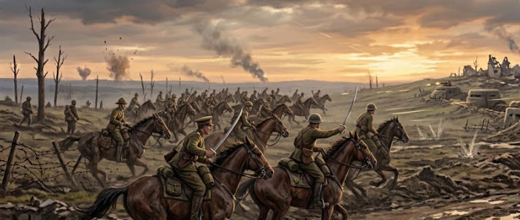
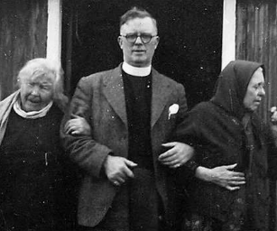
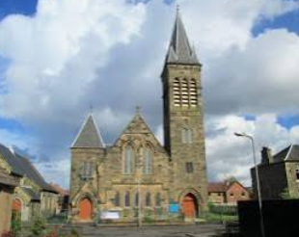
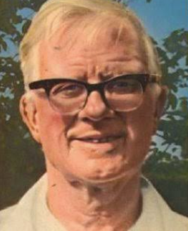
Duncan Campbell
“Oh God I’m Dying Will you make me a holy as a saved man can be!” The baptism of the Holy Spirit came upon me on that horse's back it was an invasion of the supreme reality of Jesus I loved Him because He first loved me and purchased my pardon. Oh how wonderful was the revelation wave after wave of Divine realization swept through my soul. And even into the casualty clearing station Sinners cried to God for mercy and found the Savior.

Slide 24
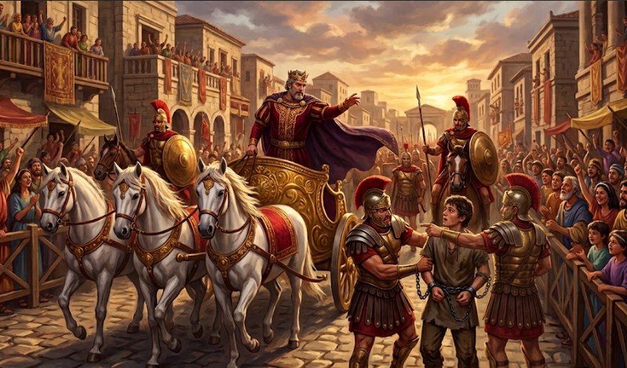
Is It Possible To Even Get Close To
Illustrating The Extravagant Love Of God
And The Divine Reversal It Is For a
Undeserving Sinner Who Repents

Slide 25

We Took Up Arms Against A Benevolent King
And We Have A Critical Heart Condition

Slide 26
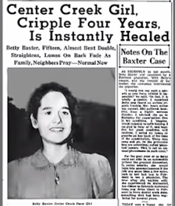
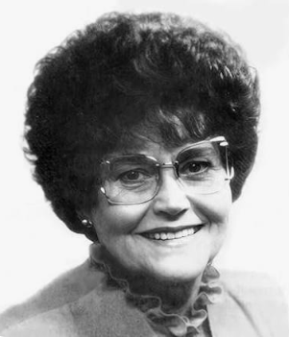
Betty Baxter 1941
Instantly Healed
Betty Baxter Went on to have a healing ministry.

Slide 27
APPLICATION
BE AGGRESSIVE TO PUSH INTO THE LORD’S LOVE – HE WELCOMES YOU- and begin to operate in AGAPE love towards others.
LET HIS LOVE BREAKTHROUGH INTO AREAS OF YOUR LIFE AND RELATIONSHIPS THAT SEEM IMPOSSIBLE – BE HEALED IN JESUS NAME
Get a BOLD FAITH BECAUSE GOD’S LOVE INVITES YOU TO BE HIS INTERCESSORS TO BRING HIS LIGHT TO OTHERS.

Slide 28


Slide 30
Godly Love Truly Looks Out For
The Best Interest of God and the Other Person
It is God's will that you should be sanctified: that you should avoid sexual immorality; ⁴ that each of you should learn to control his own body in a way that is holy and honorable, ⁵ not in passionate lust like the heathen, who do not know God; ⁶ and that in this matter no one should wrong his brother/ sister or take advantage of him/ her. The Lord will punish men for all such sins, as we have already told you and warned you. 1 Thessalonians 4:3-6 (NIV)
So if I’m a single godly man dating a beautiful Christian woman and the flesh says let’s “make out” tonight – I’m in a conundrum of following the Spirit or following the flesh. But even deeper – I’m going to have to operate in God’s love or a worldly, fleshly, perverted counterfeit erotic love. Because, if I obey the flesh (Even if in weakness she wants me to) – Here’s the catch I AM NOT LOOKING OUT FOR GOD’S OR HER BEST INTEREST. It comes back on me. I’m not truly loving her. I am leading her into sin and that is not her best interest. Sure the flesh says I can get forgiveness – but that is pathetic.

Slide 31

Chloe Cole From California
Experienced The False Love of Compromise
Background and Medical History
She was born on July 27, 2004, and grew up in California.
She socially transitioned from a girl to a guy around age 12.
At age 13, she began receiving puberty blockers and testosterone.
YOU HAVE TO HAVE A SENSE OF PURPOSE TO HOLD YOU UP – “I didn’t have one.”
Playing God – this is going to make you who you really want to be.

Slide 32
When the Love Of God Is MISSED
If there is a God who created me – why am I suffering?
In order to open my eyes to the light – God awakened me
God was always working in the background
I Resented myself
I Resented my parents
I Resented doctors
Thinking that you are irredeemable is the biggest lie the enemy plays on us.
We are not a mistake
God has a purpose
We cannot run away from our problems but can Overcome them.
You have to see yourself as someone who has a future
I thought I was always broken - None of us are enough

Slide 33

