Slide 1
Ministers to the Lord
Your role in the order of the royal priesthood

Slide 2
Then the seventh angel blew his trumpet, and there were loud voices in heaven, saying, “The kingdom of the world has become the kingdom of our Lord and of his Christ, and he shall reign forever and ever.”
(Revelation 11:15, ESV)

Slide 3
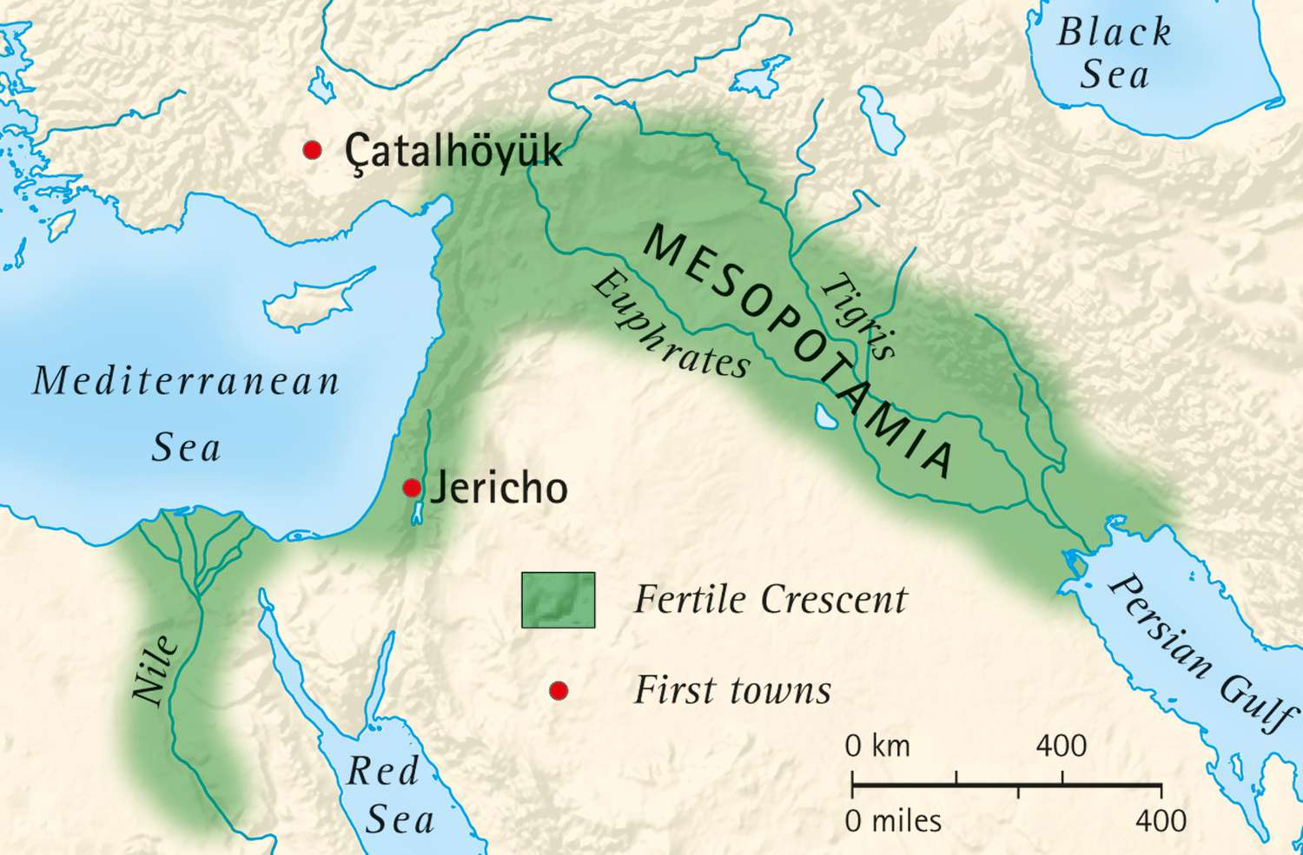

Slide 4
Meditating on the singularity (uniqueness) of our God:
Monotheistic (One God vs. thousands of deities)
Supreme over all His creation (vs. warring with other deities)
Holy
A God who made man in His image and Who intensely desires not only their well-being, but to have fellowship with them

Slide 5
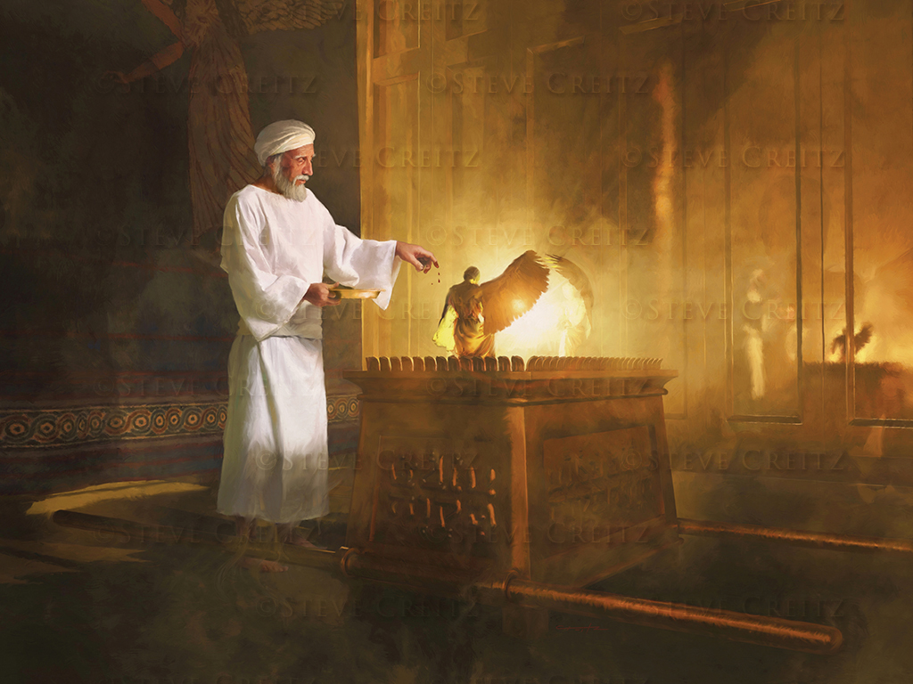
Meditating on the singularity (uniqueness) of our ability
to approach a holy God:
According to scripture, only a priest can approach God
The requirements for how and when to approach God are strict and precise
The consequences of not meeting these requirements – or if the priest’s sacrifice was rejected – are swift and severe

Slide 6
Hebrew šāraṯ (pronounced shaw-rat) to minister, to serve, to wait on
Greek leitourgeō also means to minister, to serve, and carries with it the strong connotation of being a public servant

Slide 7
What were the duties of the priests?
Offering Sacrifices: The priests were responsible for performing the various sacrifices and
offerings prescribed in the Law. (Leviticus 1-7)
2. Maintaining the Sanctuary: The priests were charged with the care and maintenance of the Tabernacle and its furnishings. Exodus 27:20-21
3. Teaching the Law: Priests were also tasked with teaching the Israelites God's statutes and laws. They served as judges in certain disputes and were responsible for instructing the people in matters of ritual purity and holiness (Leviticus 10:11).
4. Blessing the People: The priests were given the authority to bless the people in the name of the Lord. (Numbers 6:23-27)

Slide 8
What were the duties of the Levites?
The Levites were set apart for service to assist the priests and to perform various duties related to the
Tabernacle and Temple.
1. Assisting the Priests: The Levites were responsible for assisting the priests in their duties, including the preparation and handling of sacrifices and offerings. (Numbers 3:6-9)
2. Guarding the Tabernacle: The Levites were charged with the protection and transportation of the Tabernacle and its sacred objects during the Israelites' wilderness journeys. (Numbers 1:50)
3. Singing and Music: In the Temple period, the Levites were also involved in the musical aspect of worship, providing songs and instrumental music during the services. (1 Chronicles 15:16)
4. Teaching and Judging: Some Levites were also involved in teaching the Law and serving as judges, similar to the priests. They played a role in educating the people and ensuring adherence to God's commandments (Deuteronomy 33:10).

Slide 9
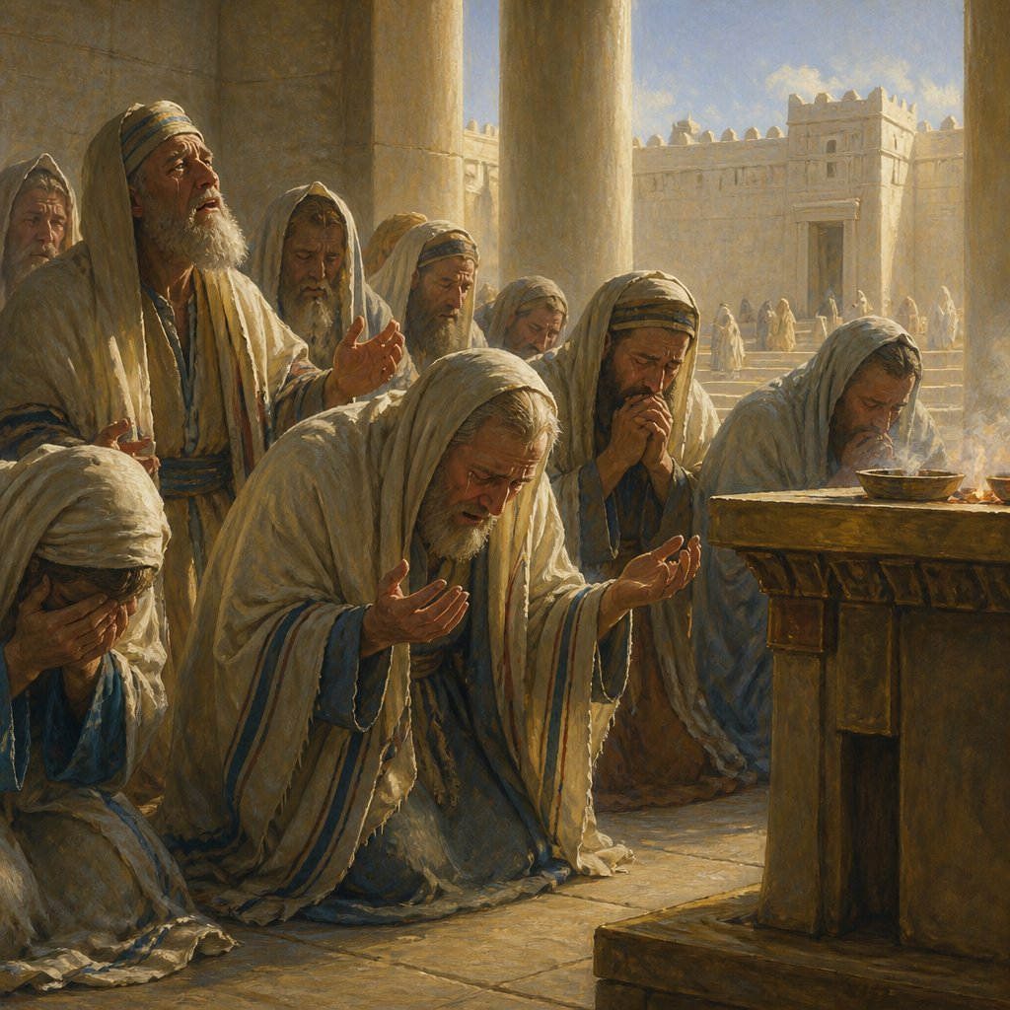
Intercession
Let the priests, who minister before the LORD, weep between the portico and the altar. Let them say, “Spare your people, LORD. Do not make your inheritance an object of scorn, a byword among the nations. Why should they say among the peoples, ‘Where is their God?’” (Joel 2:17)

Slide 10
The Old Testament, or Covenant, was only a shadow of things to come
“For the law is only a shadow of the good things to come, not the realities themselves. It can never, by the same sacrifices offered year after year, make perfect those who draw near to worship” (Hebrews 10:1)

Slide 11
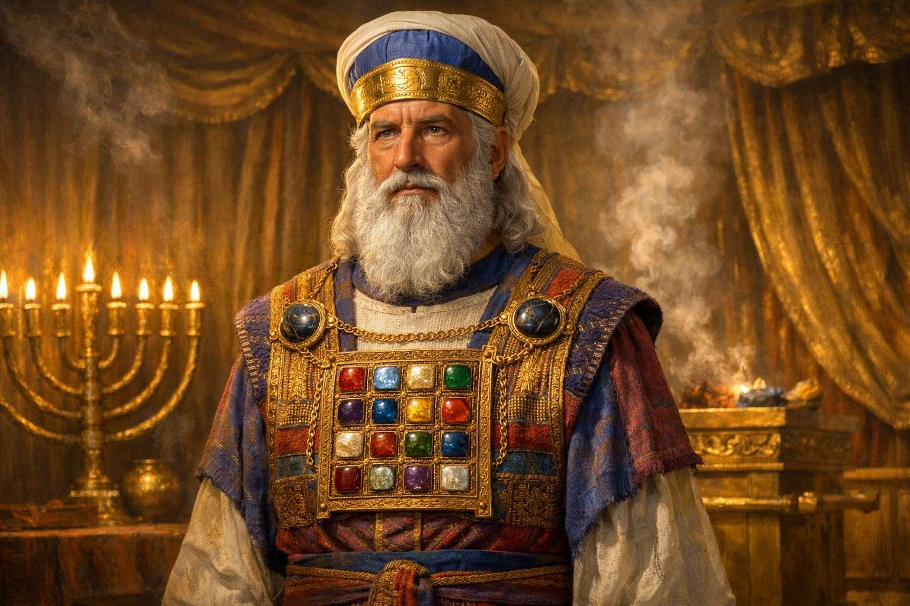
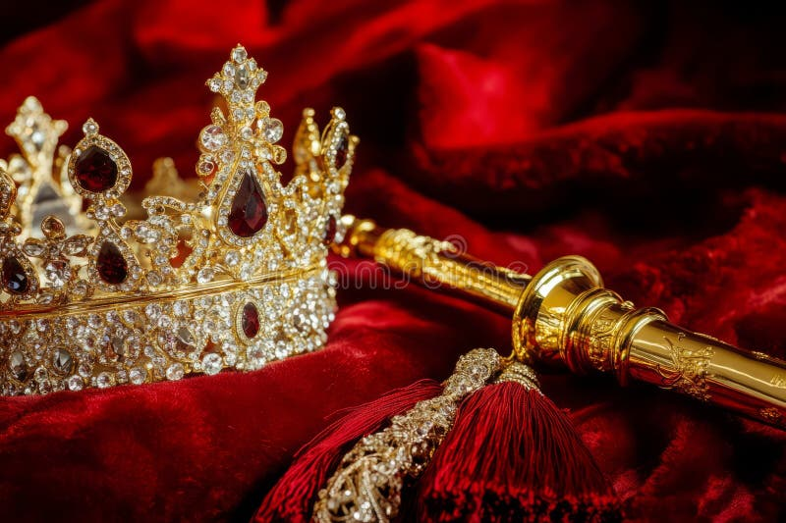
“But you are a chosen race, a royal priesthood, a holy nation, a people for his own possession, that you may proclaim the excellencies of him who called you out of darkness into his marvelous light.” (1 Peter 2:9)
“He has made us kings and priests to His God and Father, to Him be glory and dominion forever and ever. Amen.” (Revelation 1:6)

Slide 12
“…but Jesus became a priest with an oath by the One who said to Him: ‘The Lord has sworn and will not change His mind: ‘You are a priest forever.’
Because of this oath, Jesus has become the guarantee of a better covenant.”
…Because Jesus lives forever, He has a permanent priesthood. Therefore He is able to save completely those who draw near to God through Him, since He always lives to intercede for them.” (Hebrews 7:21-25)
Notes:
1but Jesus became a priest with an oath by the One who said to Him:
“The Lord has sworn and will not change His mind:
‘You are a priest forever.’”c
22Because of this oath, Jesus has become the guarantee of a better covenant.

Slide 13
Since then we have a great high priest who
has passed through the heavens, Jesus, the Son of God, let us hold fast our confession. ¹⁵ For we do not have a high priest who is unable to sympathize with our weaknesses, but one who in every respect has been tempted as we are, yet without sin. ¹⁶ Let us then with confidence draw near to the throne of grace, that we may receive mercy and find grace to help in time of need. (Hebrews 4:14-16)

Slide 14
All the Levites who were musicians…stood on the east side of the altar, dressed in fine linen and playing cymbals, harps and lyres. They were accompanied by 120 priests sounding trumpets. ¹³ The trumpeters and musicians joined in unison to give praise and thanks to the Lord. Accompanied by trumpets, cymbals and other instruments, the singers raised their voices in praise to the Lord and sang:
“He is good;
his love endures forever.”
Then the temple of the Lord was filled with the cloud, ¹⁴ and the priests could not perform their service because of the cloud, for the glory of the Lord filled the temple of God. (2 Chronicles 5:12-14)

Slide 15
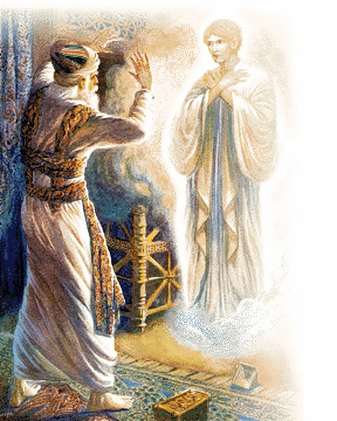
There was a priest named Zechariah…and he had a wife from the daughters of Aaron, and her name was Elizabeth. ⁶ And they were both righteous before God, walking blamelessly in all the commandments and statutes of the Lord. ⁷ But they had no child, because Elizabeth was barren, and both were advanced in years.
⁸ Now while he was serving as priest before God when his division was on duty, ⁹ according to the custom of the priesthood, he was chosen by lot to enter the temple of the Lord and burn incense. ¹⁰ And the whole multitude of the people were praying outside at the hour of incense. ¹¹ And there appeared to him an angel of the Lord standing on the right side of the altar of incense. (Luke 1)

Slide 16
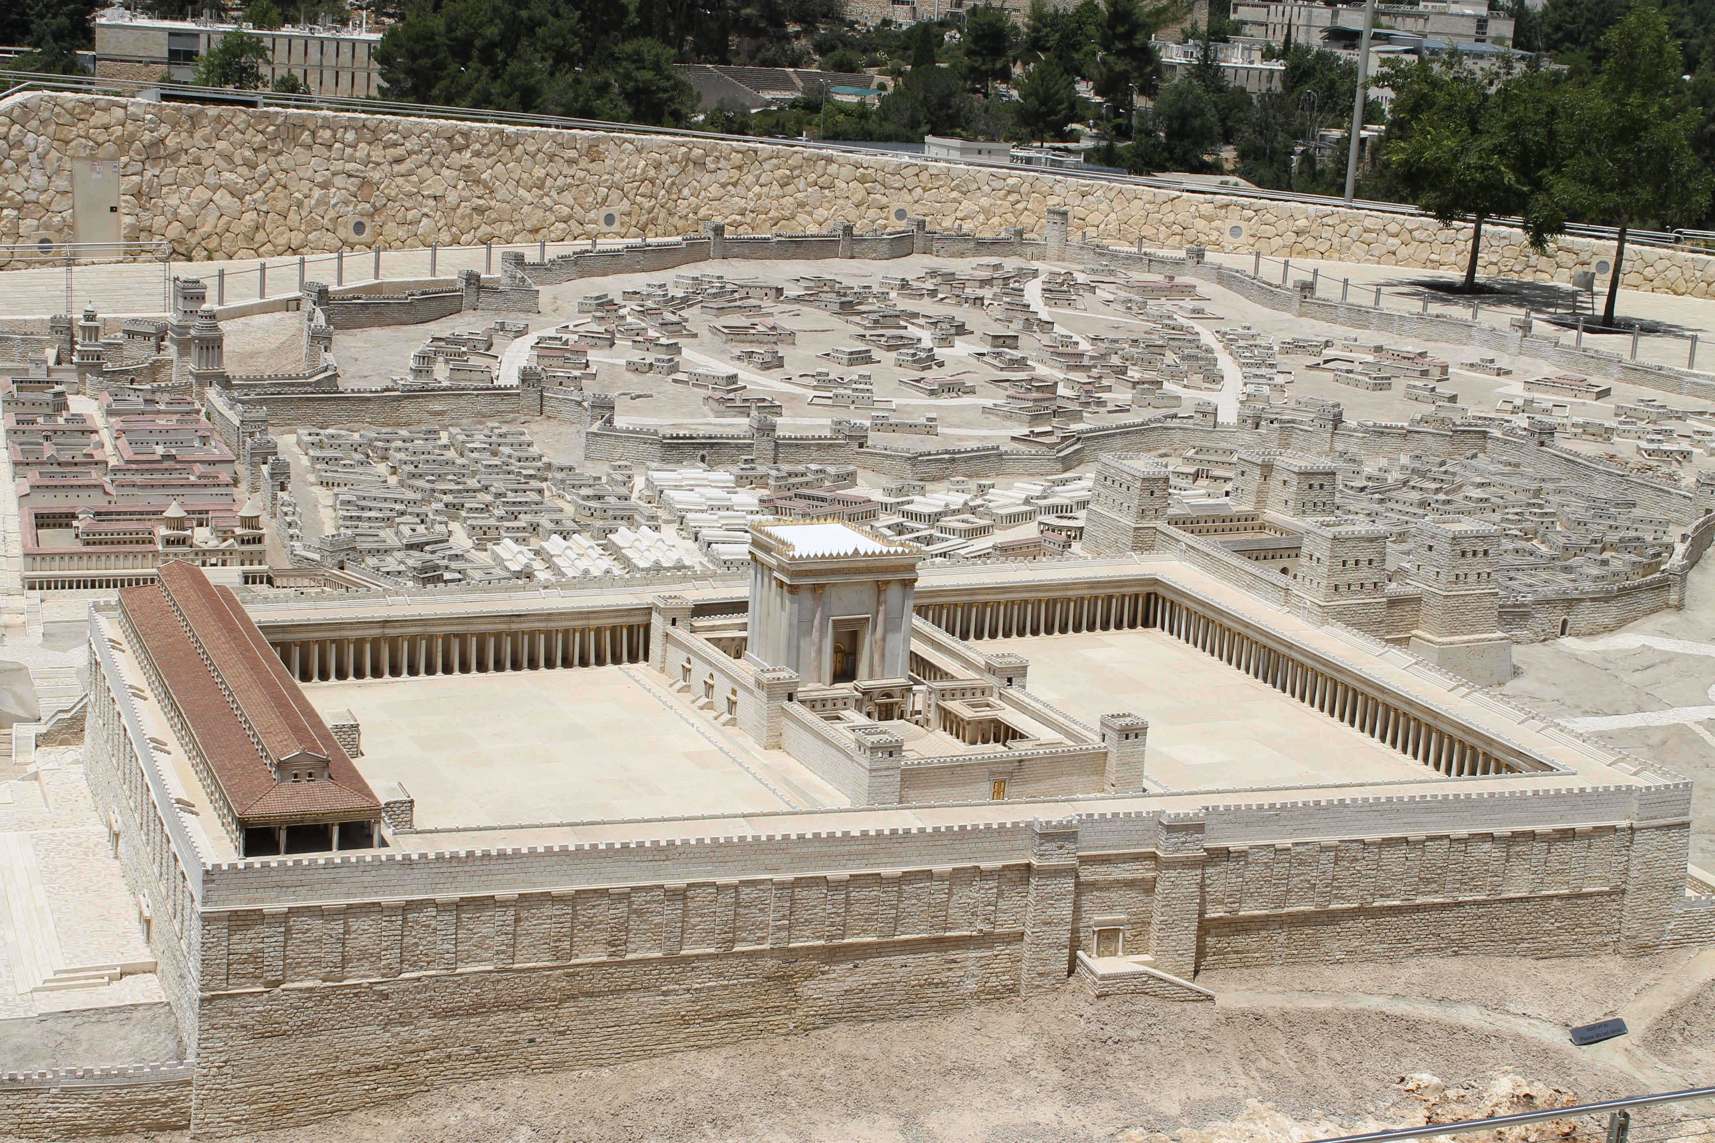
And there was a prophetess, Anna, the daughter of Phanuel, of the tribe of Asher. She was advanced in years and had lived with her husband for seven years after
her marriage, and then as a widow to the age of eighty-four. She did not leave the temple grounds, ministering night and day with fasts and prayers.
Coming up to them at that very moment, she gave thanks to God and spoke about the child to all who were looking forward to the redemption of Jerusalem (Luke 2:36-38)

Slide 17
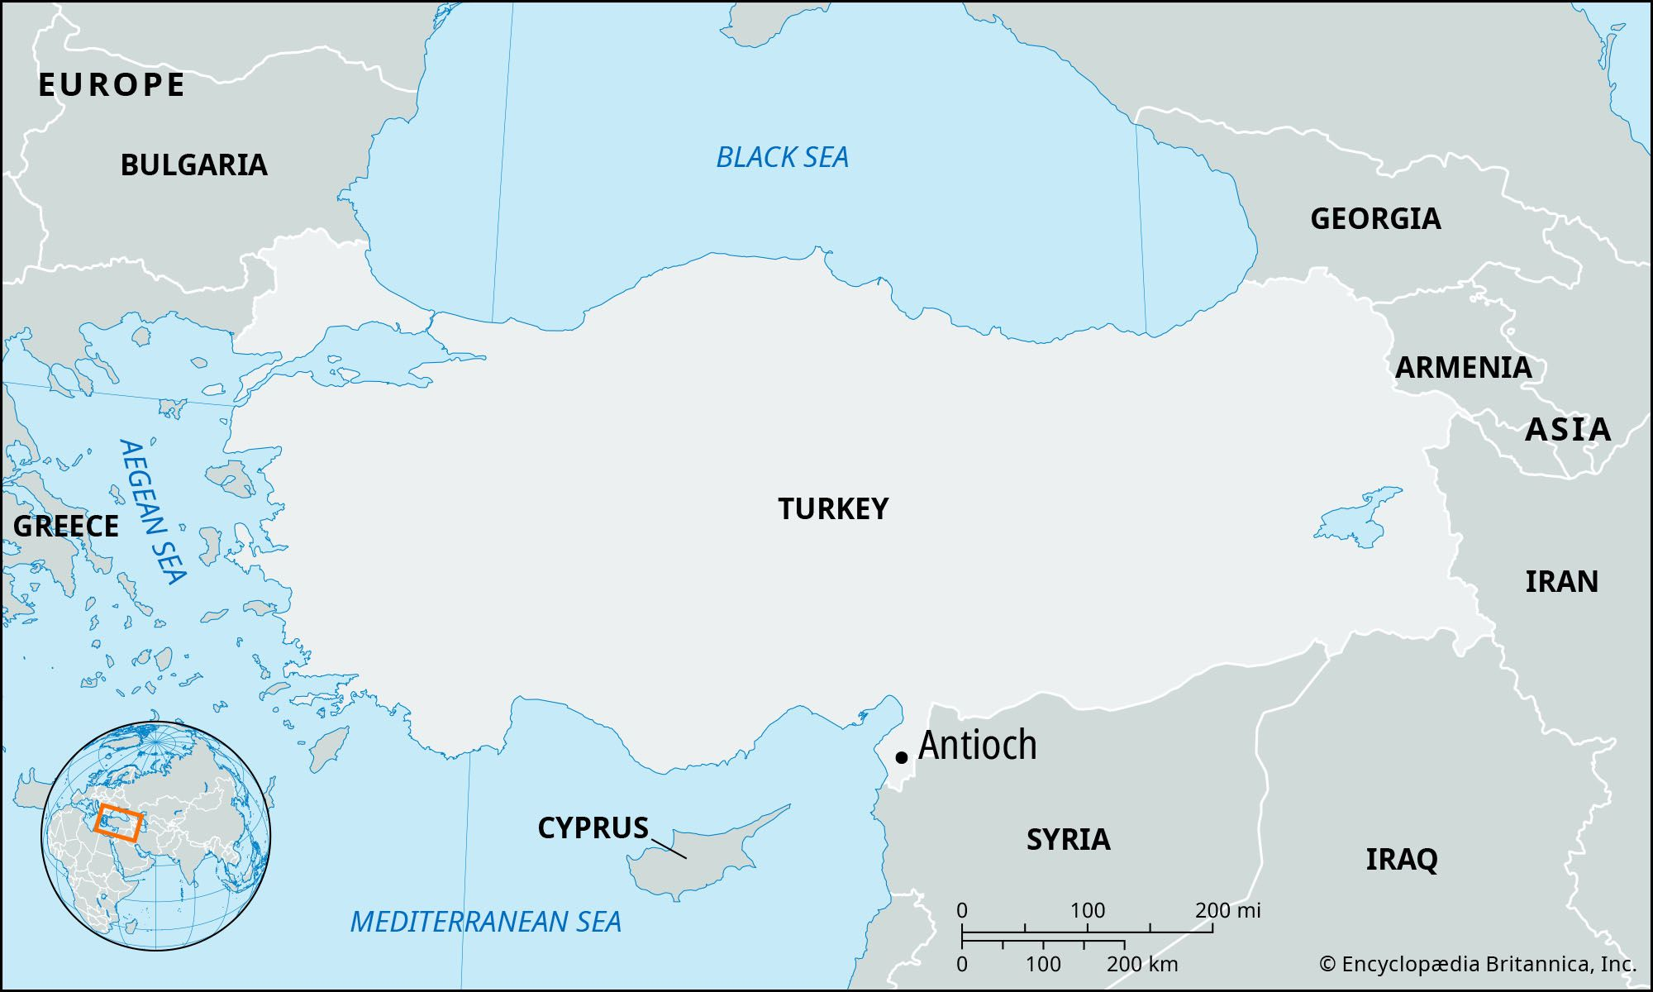
“Now in the church at Antioch there were prophets
and teachers…As they ministered to the Lord and fasted, the Holy Spirit said, ‘Now separate to Me Barnabas and Saul for the work to which I have called them’.” (Acts 13:1-2)

Slide 18



What ministers to you?

Slide 19


Slide 20
We want to make the Lord’s heart glad
“What a friend we have in Jesus” – but are we a friend to Him?
Do we care about the things He cares about? Do we immerse ourselves regularly in His word?
Do we ask Him to speak to us about what He desires for us?

Slide 21
How do we minister to the Lord?
Sacrifices: giving thanks, praise and worship
Fasting
Obedience and Repentance
(Greek word for “repent” is metanoeō, which means “to change one’s mind”)
Interceding for and ministering to others

Slide 22
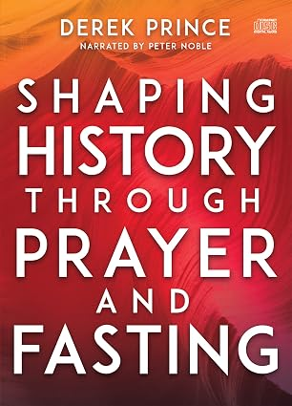

Slide 23
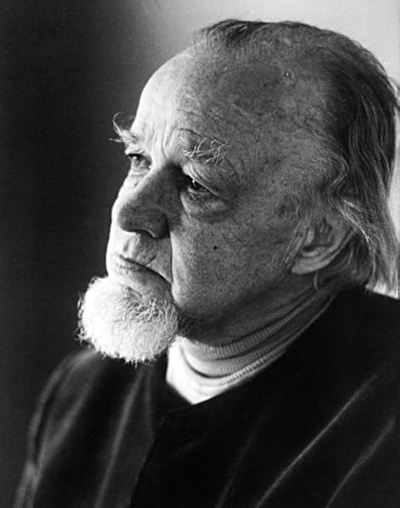
As part of the Lord’s royal priesthood we
Discern/Judge – what is true from what is false
“There is no other way to come to God except on the basis of His
finished work, but unless this is framed in the concept that we're talking about truth and not just an endless series of relativistic things, merely talking about
accepting Christ as Savior will never meet the humanist dilemma.
There is only one real solution and that's right back where the early
church was. The early church believed that only the Bible was the final
authority. What these people really believed and has given them their
whole strength was in the truth of the Bible as the absolute infallible
Word of God.”
(Dr. Francis Schaeffer, How Shall We Then Live)

Slide 24
“We must pay the most careful attention, therefore, to what we have heard, so that we do not drift away. For…how shall we escape if we neglect so great a salvation?” (Hebrews 2:1-3)

Slide 25
“You adulterous people! Do you not know that friendship with the world is enmity with God? Therefore whoever wishes to be a friend of the world makes himself an enemy of God” (James 4:4)

Slide 26
Ministering to the Lord:
reveals the Father’s heart; sin in our lives; the times we are in
equipes us to render judgments – “do you not know that the saints will judge the world? And if the world is to be judged by you, are you incompetent to try trivial cases?” (1 Corinthians 6:2)

Slide 27
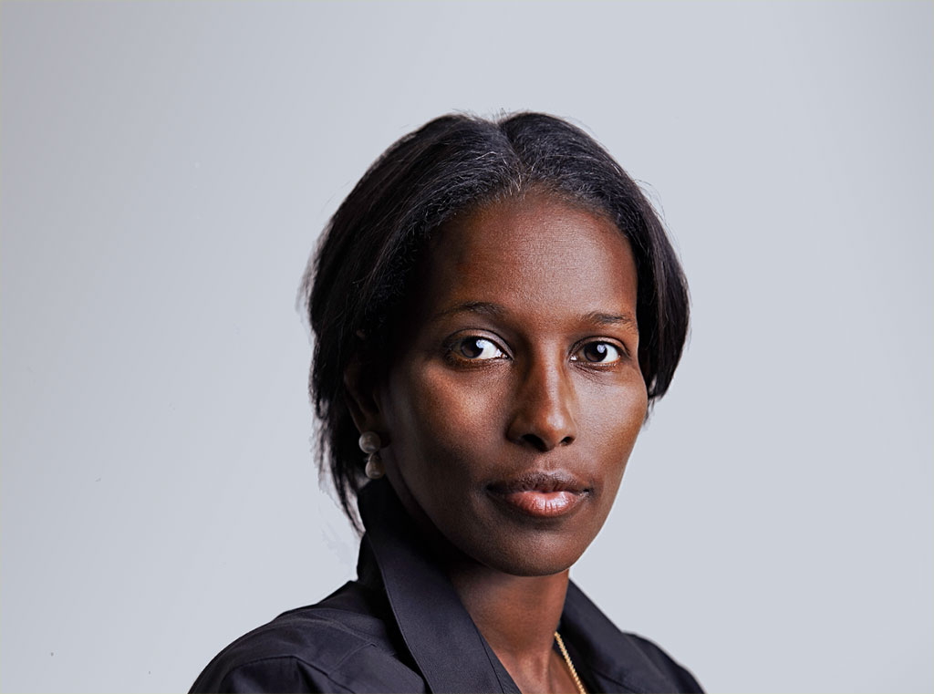
https://www.youtube.com/watch?v=QPLRMcal8xc

