Slide 1

Part 4
“Keep yourself in the LOVE of God”
LifeGate Sermon October 4, 2026

Slide 3
Jude 3
Beloved, while I was very diligent to write to you concerning our common salvation, I found it necessary to write to you exhorting you to contend earnestly for the faith which was once for all delivered to the saints.

Slide 4
Jude 4
⁴ For certain individuals whose condemnation was written about long ago have secretly slipped in among you. They are ungodly people, who pervert the grace of our God into a license for immorality and deny Jesus Christ our only Sovereign and Lord.

Slide 5
Apostasy
v 5 People saved out of Egypt were destroyed
v. 6 Angels who did not keep their proper domain he reserved in everlasting chains for judgement

Slide 6
Jude 20
²⁰ But you, dear friends, by building yourselves up in your most holy faith and praying in the Holy Spirit,

Slide 7
Jude 21
²¹ keep yourselves in the love of God, looking for the mercy of our Lord Jesus Christ unto eternal life.

Slide 8
Jude 22
²² Be merciful to those who doubt; ²³ save others by snatching them from the fire; to others show mercy, mixed with fear—hating even the clothing stained by corrupted flesh.

Slide 9
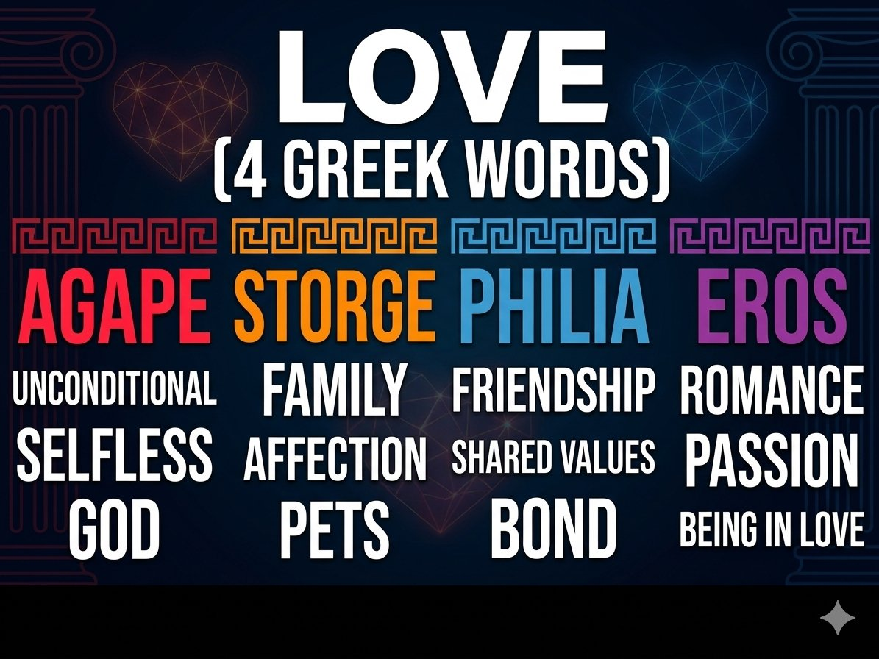

Slide 10
Galatians 5:22
²² But the fruit of the Spirit is love, joy, peace, longsuffering, kindness, goodness, faithfulness, ²³ gentleness, self-control. Against such there is no law. ²⁴ And those who are Christ’s have crucified the flesh with its passions and desires. ²⁵ If we live in the Spirit, let us also walk in the Spirit. ²⁶ Let us not become conceited, provoking one another, envying one another.

Slide 11
The LOVE Chapter: 1Cor 13
⁴ Love suffers long and is kind…
A divine love that gives and gives, even if it’s never responded to, thanked, or acknowledged.

Slide 12
“Suffereth Long”- compound of two words:
Makrothumia
Makros- long, distant, far, or long duration
thumos- anger, swelling emotions or strong growing passion about something

Slide 13
“Kind”- chresteuomai
A willingness to serve or to change in order to meet the needs of others.
Agape does not demand that others become like you. It makes you want to bend over backwards to become what others need you to be for them.

Slide 14
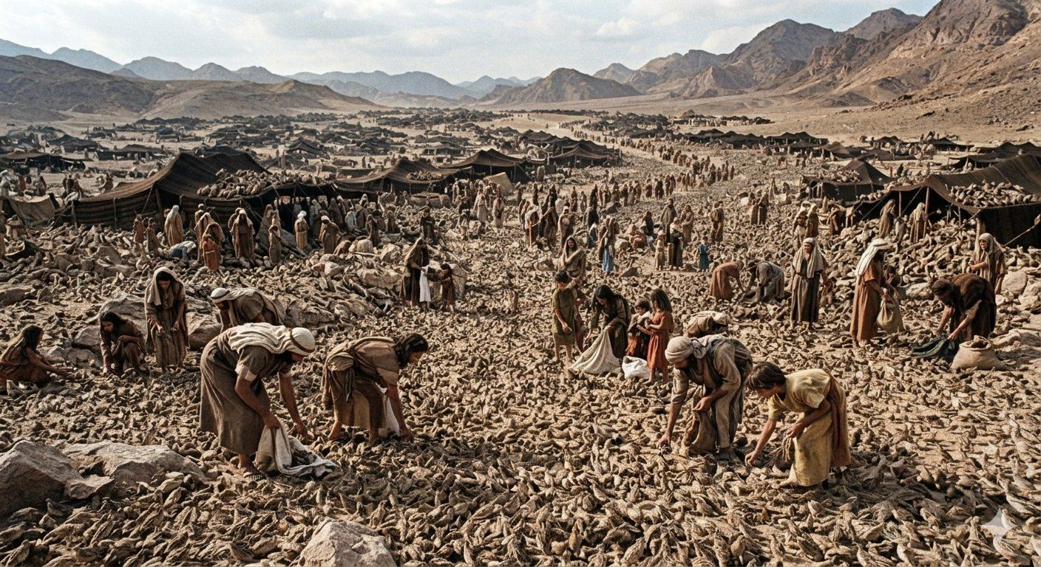
90,000,000 quail for 3 milion people to each to 30 days

Slide 15
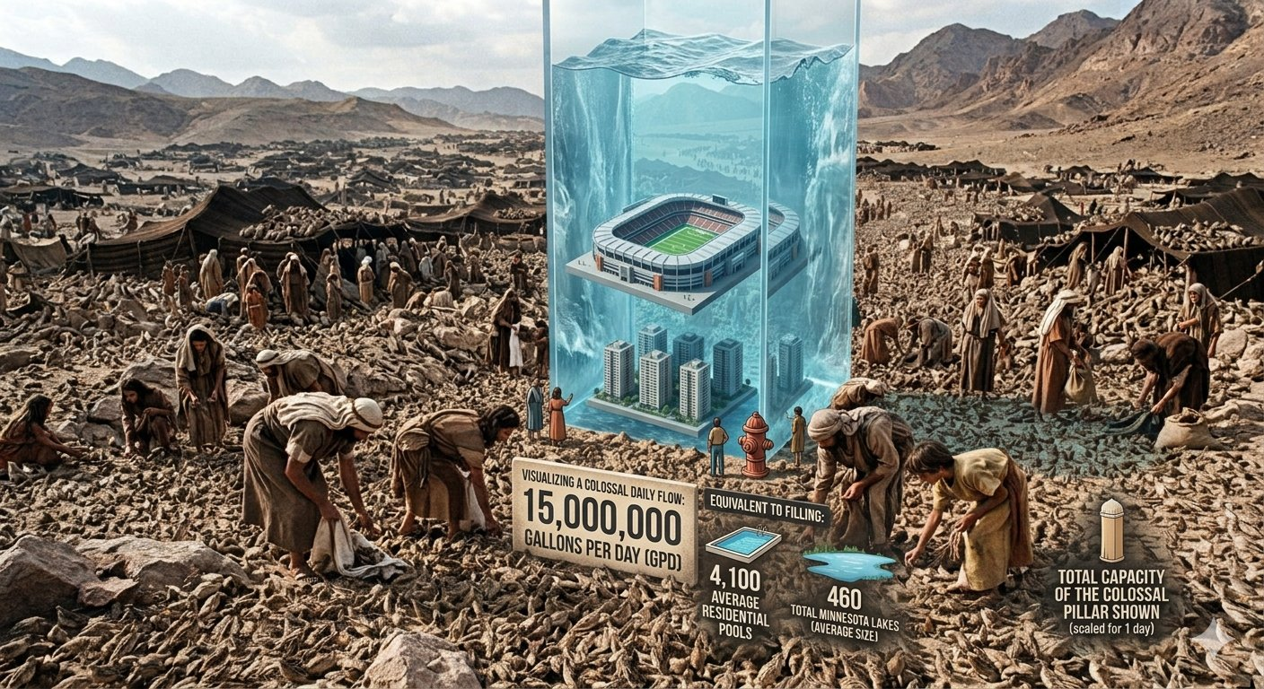
15,000,000 gallons of water per day

Slide 16

Daily Provision
4,500 TONS OF MANNA
The Daily Sustenance Requirement in the Wilderness

Slide 17
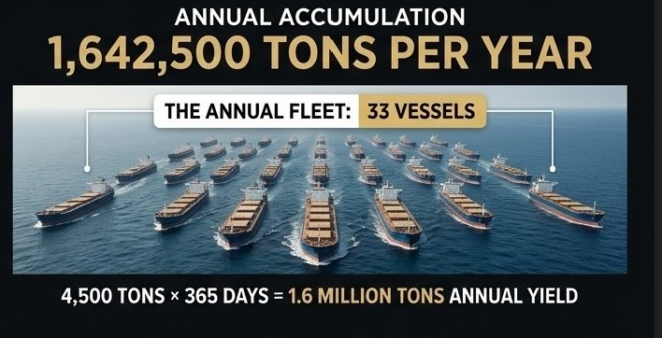
The Annual Fleet Requirement
33 CARGO SHIPS / YEAR

Slide 18
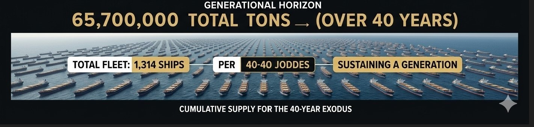
The 40-Year Horizon
1,314 CARGO SHIPS
The Total Provision for an Entire Generation (40 Years)
• Generational Mass: 1,642,500 tons/year × 40 years = 65,700,000 Total Tons.

Slide 19
Agape is a love that has no strings attached. It isn’t looking for what it can get, but for what it can give. Its awe of the one who is loved is so deep that it is compelled to shower love upon that object or person regardless of the response.

Slide 20
This is the profound love God has for the human race, for He loved when he was still lost in sin
With no ability to love Him back. God simply loved mankind without any thought or expectation of receiving love in return.

Slide 21
1 John 3:16,18
¹⁶ By this we know love, because He laid down His life for us. And we also ought to lay down our lives for the brethren.

Slide 22
¹⁷ But whoever has this world’s goods, and sees his brother in need, and shuts up his heart from him, how does the love of God abide in him?

Slide 23
¹⁸ My little children, let us not love in word or in tongue, but in deed and in truth.

Slide 24
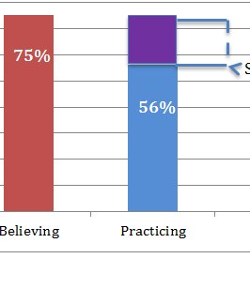

Slide 25
1 Cor 14:1
Pursue love, and desire spiritual gifts, but especially that you may prophesy.

Slide 26
Pursue- (dioko,- to hotly pursue.
Hunting term to follow the tracks of an animal until you finally get your game.

Slide 27
If agape is the basis of your sexual relationship instead of eros , you will always seek to serve and please your spouse rather than being self-centered and focused only on your needs.
If agape is the basis of your family relationships rather than stergo, you will always remain devoted to your family, regardless of disappointments that may occur along the way.

Slide 28
If agape is the basis of your friendships rather than phileo, you will be a faithful, immovable friend for life rather than a come-and-go friend who is faithful only as long as you get what you want out of the relationship.

Slide 29
If agape is the driving motivation of your life and the force behind all your relationships, it will make you to be the best, most devoted, faithful and reliable friend anyone has ever known.

Slide 30
Acts 4:32-35
³² Now the multitude of those who believed were of one heart and one soul; neither did anyone say that any of the things he possessed was his own, but they had all things in common. ³³ And with great power the apostles gave witness to the resurrection of the Lord Jesus. And great grace was upon them all.

Slide 31
How do I possess this Agape love?
It is impossible!

Slide 32
In this flesh, that is selfish and self-focused, therefore it can not love that highly.
But because the seed of God’s word has been sown into your own human spirit, the potential for this divine love is within you all the time. It is up to you to shove this flesh aside and release the love of God from inside you. If you let the Spirit of God release it from your heart, you will discover and enjoy the fruit of the Spirit called “love”.

Slide 33
#1 Guard Rail: Being Filled with the Holy Spirit

Slide 34
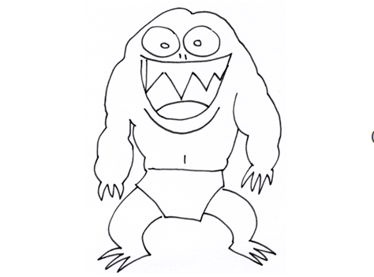
Flesh represents the sinful, corrupted desires of our heart, Mind, Will and Emotions
Flesh

Slide 35
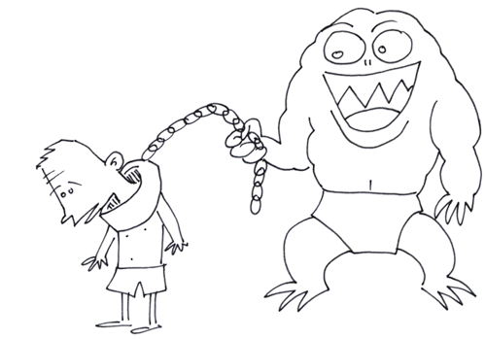
The Bible says that we are slaves to our sinful desires

Slide 36
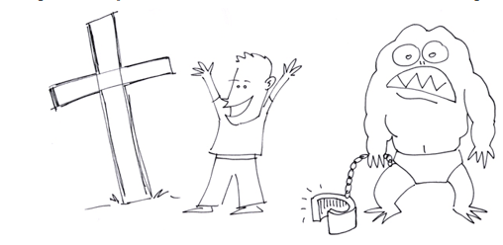
Our spirit is made alive when we come to Christ and are no longer slaves of sin.

Slide 37
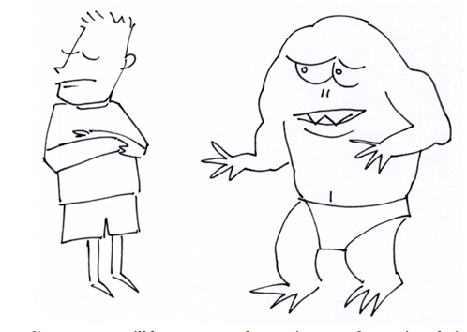
Our Flesh no longer has full control

Slide 38
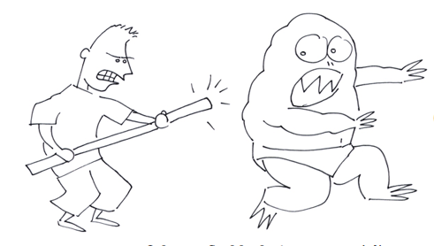
²⁷ but I train like a champion athlete. I subdue my body and get it under my control… 1 Corinthians 9:27

Slide 39
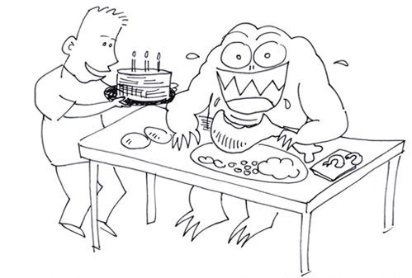
When we feed the flesh…

Slide 40
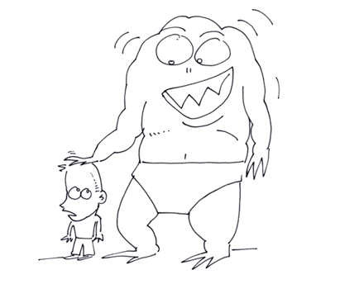
Our Flesh grows stronger than your spirit.

Slide 41
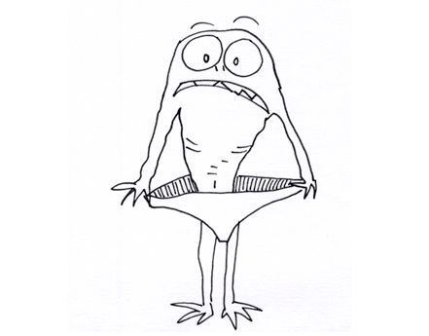
When you are filled with the Holy Spirit, you will not gratify the desires of the flesh.

Slide 42
¹⁴ Instead fully immerse yourselves into the Lord Jesus, the Anointed One, and don’t waste even a moment’s thought on your former identity to awaken its selfish desires.
Romans 13:14

Slide 43
#1 Guard Rail: Being Filled with the Holy Spirit
Eph 5:18 “And don’t get drunk with wine, which is rebellion, instead be filled with the fullness of the Holy Spirit.” (TPT)

Slide 44
Eph 5:19-21 ¹⁹ And your hearts will overflow with a joyful song to the Lord.
Keep speaking to each other with words of Scripture, singing the Psalms with praises and spontaneous songs given by the Spirit!

Slide 45
²⁰ Always give thanks to Father God for every person he brings into your life in the name of our Lord Jesus Christ.
²¹ And out of your reverence for Christ be supportive of each other in love.

Slide 46
Prayer
Lord help me to turn my attention to your kind of high-level love and make it a part of my daily life. Forgive me for those times when I’ve fallen into low-level, “you-scratch-my-back and-I’ll-scratch-yours” love that gets easily offended.

Slide 47
Help me to climb up to the higher realms of love that YOU desire to be manifested in my life. Holy Spirit, it is impossible to continually walk in this kind of love in the power of my flesh, so I turn to YOU to awaken this divine love inside me and to help me manifest it in my life.

Slide 48
Declaration
I confess that I am hotly pursuing agape love in my life. I want to attain this high level of love and regularly walk in it, so I treat this fruit of the Spirit like it is one of the most important aims of my life. Because the seed of God’s Spirit and Word is sown in my human spirit, I have the potential for this divine love within me all the time.

Slide 49
So right now I determine to shove the flesh aside and release the power of God from deep inside. Because agape is the driving motivation of my life and the force behind all my relationships, I am the best, most devoted, faithful, and reliable friend anyone has ever known. I declare this in Jesus’ Name!

