Slide 2
Dimensions of Glory in the Early Church
Great Power
Acts 4:33 ³³ And with great power the apostles gave witness to the resurrection of the Lord Jesus. And great grace was upon them all.

Slide 3
Three Areas of Great Power
1. Signs and Wonders
Acts 5:12
¹² And through the hands of the apostles many signs and wonders were done among the people. And they were all with one accord in Solomon’s Porch.

Slide 4
Three Areas of Great Power
2. Healings and Deliverances
Acts 5:14,16 ¹⁴ And believers were increasingly added to the Lord, multitudes of both men and women, ¹⁵ so that they brought the sick out into the streets and laid them on beds and couches, that at least the shadow of Peter passing by might fall on some of them. ¹⁶ Also a multitude gathered from the surrounding cities to Jerusalem, bringing sick people and those who were tormented by unclean spirits, and they were all healed.

Slide 5
Three Areas of Great Power
3. Preaching
Acts 5:29,30 ”But Peter and the other apostles answered and said “We ought to obey God rather than men. The God of our fathers raised up Jesus whom you murdered by hanging on a tree.”

Slide 6
Three Areas of Great Power
3. Preaching
Acts 5:31,32 ^{31 ”}Him God has exalted to His right hand to be Prince and Savior, to give repentance to Israel and forgiveness of sins. ³² And we are His witnesses to these things, and so also is the Holy Spirit whom God has given to those who obey Him.”

Slide 7
Great Grace Acts 4:32-37
1. Unity and Commonality
2. Honor for Leaders

Slide 8
Unity and Commonality Acts 4:32-35
³² Now the multitude of those who believed were of one heart and one soul; neither did anyone say that any of the things he possessed was his own, but they had all things in common. ³³ And with great power the apostles gave witness to the resurrection of the Lord Jesus. And great grace was upon them all.

Slide 9
³⁴ Nor was there anyone among them who lacked; for all who were possessors of lands or houses sold them, and brought the proceeds of the things that were sold,
³⁵ and laid them at the apostles’ feet; and they distributed to each as anyone had need.

Slide 10
Honor for Leaders Acts 4:36
³⁶ And Joses, who was also named Barnabas by the apostles (which is translated Son of Encouragement), a Levite of the country of Cyprus, ³⁷ having land, sold it, and brought the money and laid it at the apostles’ feet.

Slide 11
John 17:22 When The Spirit Comes, He Makes Us One
²² And the glory which You gave Me, I have given them, that they may be ONE just as We are ONE

Slide 12
We've got some of the greatest shepherds in the body of Christ that are in our midst. Shepherds. We need to grow in honor.
We need to grow in honor because grace flows through honor.
Grace flows through honor

Slide 13
Great Fear Acts 5:11
Lying to the Holy Spirit (Acts 5:1-10)

Slide 14
5 But a certain man named Ananias, with Sapphira his wife, sold a possession. ² And he kept back part of the proceeds, his wife also being aware of it, and brought a certain part and laid it at the apostles’ feet. ³ But Peter said, “Ananias, why has Satan filled your heart to lie to the Holy Spirit and keep back part of the price of the land for yourself?
⁴ While it remained, was it not your own? And after it was sold, was it not in your own control? Why have you conceived this thing in your heart? You have not lied to men but to God.”

Slide 15
⁵ Then Ananias, hearing these words, fell down and breathed his last. So great fear came upon all those who heard these things. ⁶ And the young men arose and wrapped him up, carried him out, and buried him.
⁷ Now it was about three hours later when his wife came in, not knowing what had happened. ⁸ And Peter answered her, “Tell me whether you sold the land for so much?”
She said, “Yes, for so much.”

Slide 16
⁹ Then Peter said to her, “How is it that you have agreed together to test the Spirit of the Lord? Look, the feet of those who have buried your husband are at the door, and they will carry you out.”
¹⁰ Then immediately she fell down at his feet and breathed her last. And the young men came in and found her dead, and carrying her out, buried her by her husband.

Slide 17
2. Great Fear in the Church Acts 5:11
¹¹ So great fear came upon all the church and upon all who heard these things.

Slide 18
3. Fear on the Outside World (Acts 5:13,14)
¹³ Yet none of the rest dared join them, but the people esteemed them highly. ¹⁴ And believers were increasingly added to the Lord, multitudes of both men and women,

Slide 19
Great Wisdom Acts 6:1-4
6 Now in those days, when the number of the disciples was multiplying, there arose a complaint against the Hebrews by the Hellenists, because their widows were neglected in the daily distribution. ² Then the twelve summoned the multitude of the disciples and said, “It is not desirable that we should leave the word of God and serve tables.

Slide 20
Great Wisdom Acts 6:1-4
³ Therefore, brethren, seek out from among you seven men of good reputation, full of the Holy Spirit and wisdom, whom we may appoint over this business; ⁴ but we will give ourselves continually to prayer and to the ministry of the word.”

Slide 21
⁵ And the saying pleased the whole multitude. And they chose Stephen, a man full of faith and the Holy Spirit, and Philip, Prochorus, Nicanor, Timon, Parmenas, and Nicolas, a proselyte from Antioch, ⁶ whom they set before the apostles; and when they had prayed, they laid hands on them.
⁷ Then the word of God spread, and the number of the disciples multiplied greatly in Jerusalem, and a great many of the priests were obedient to the faith.

Slide 22
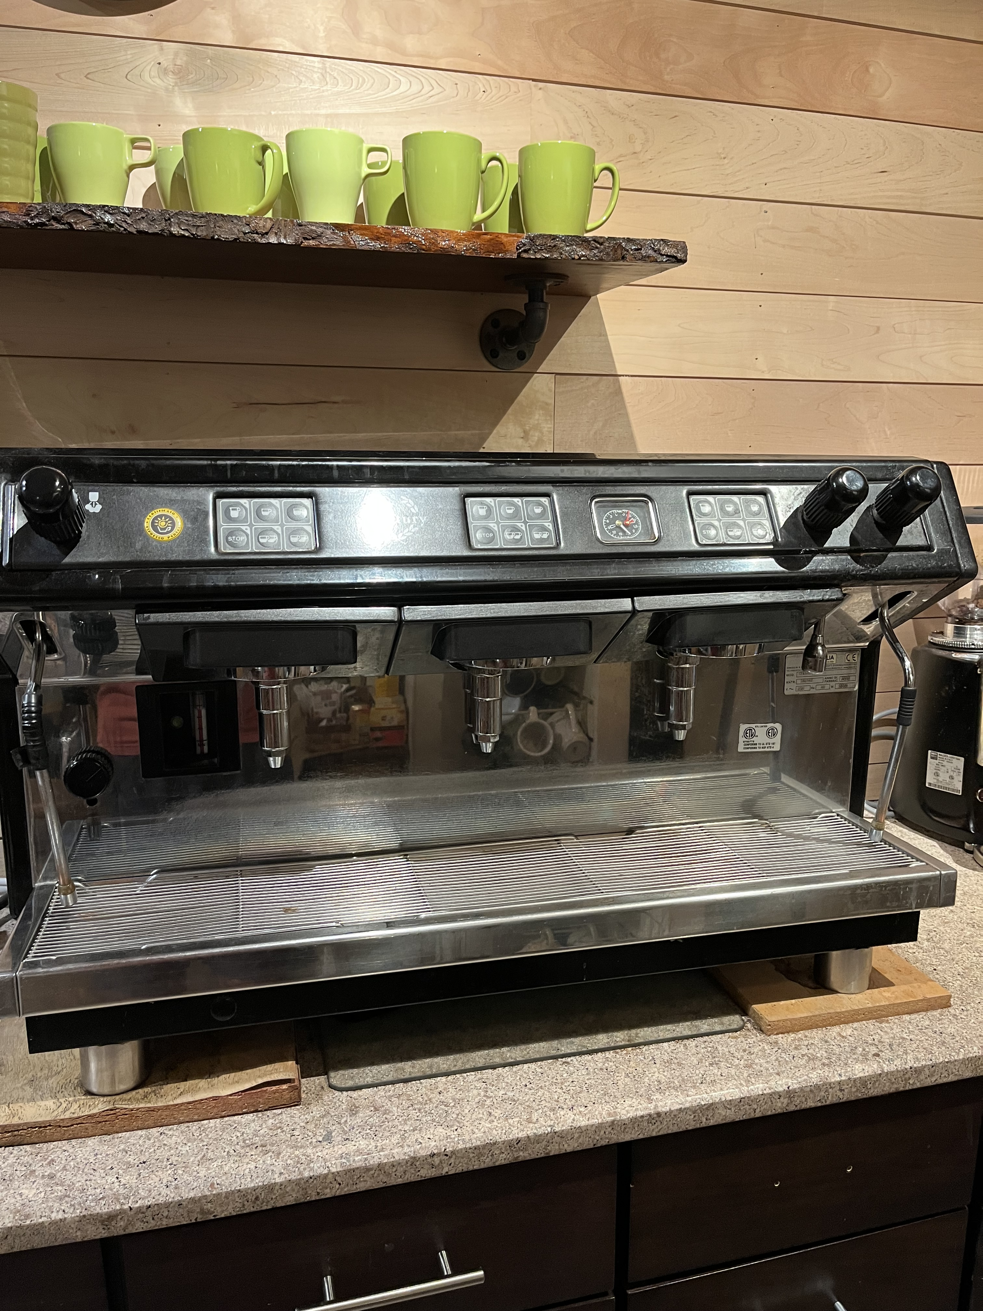

Slide 23
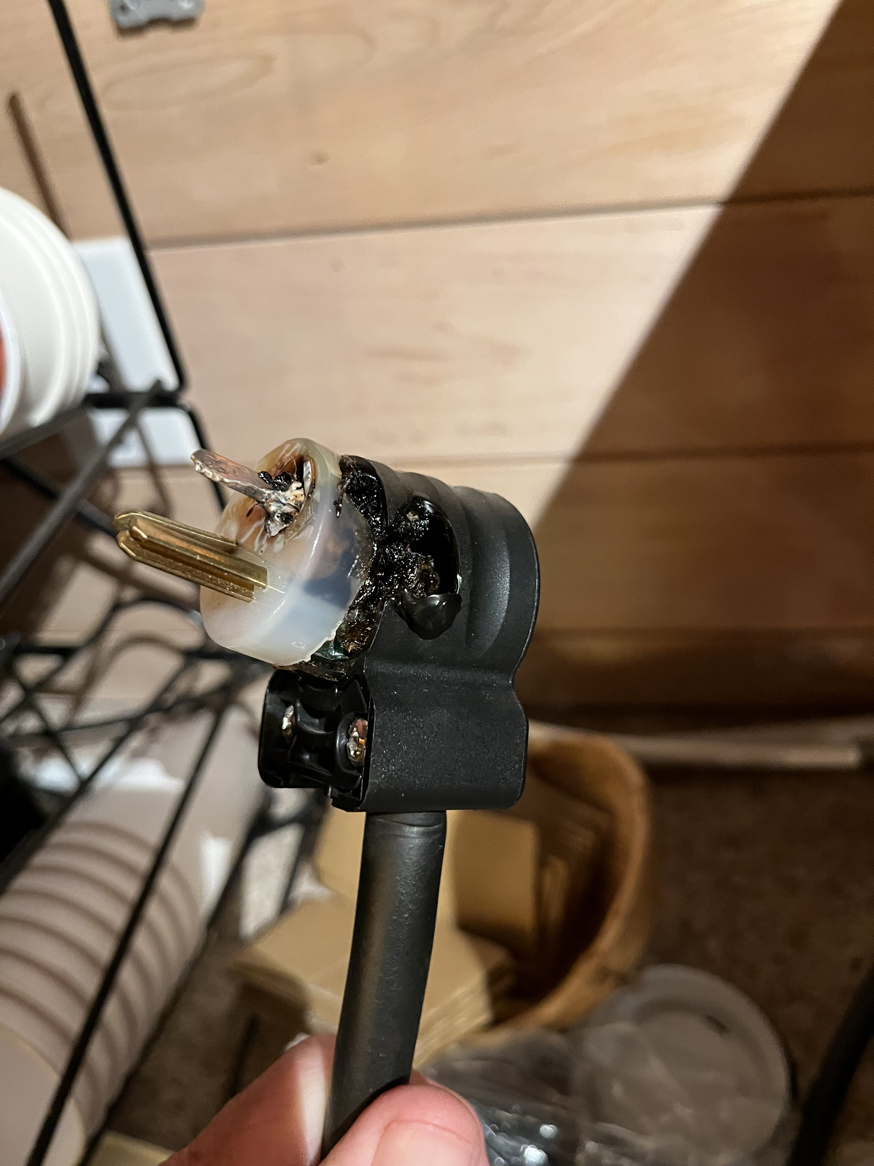

Slide 24
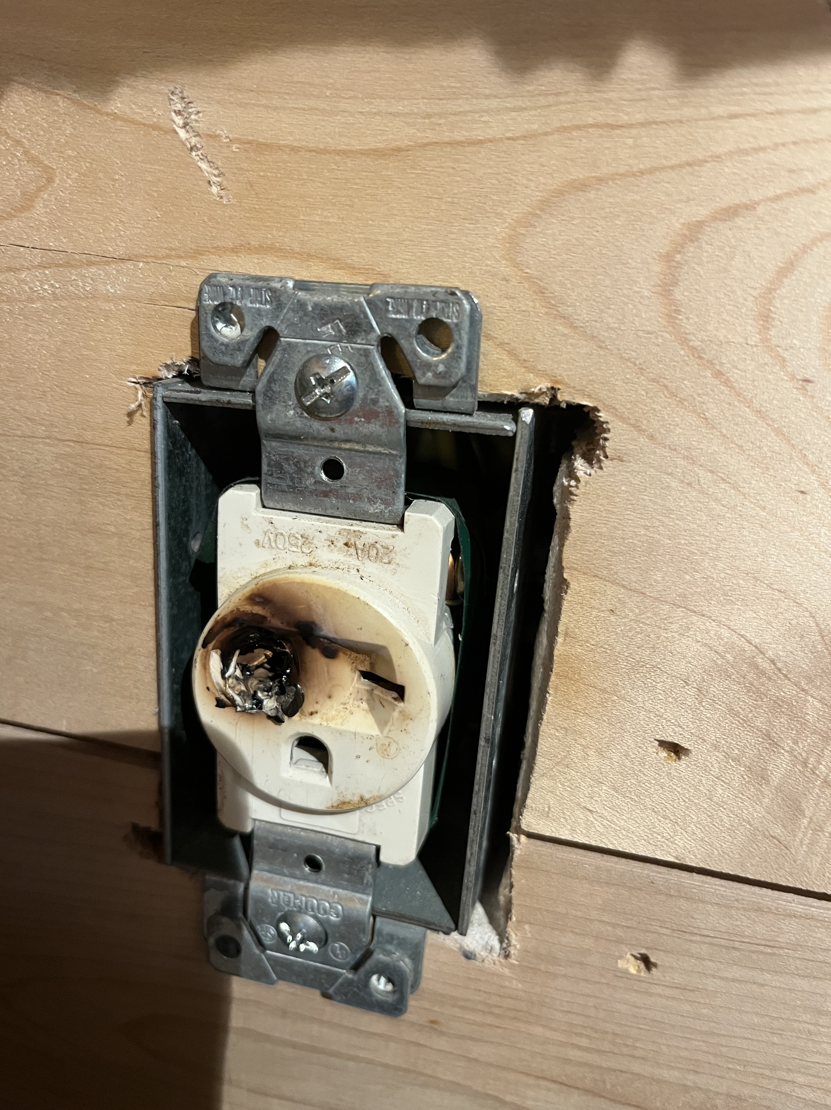

Slide 25
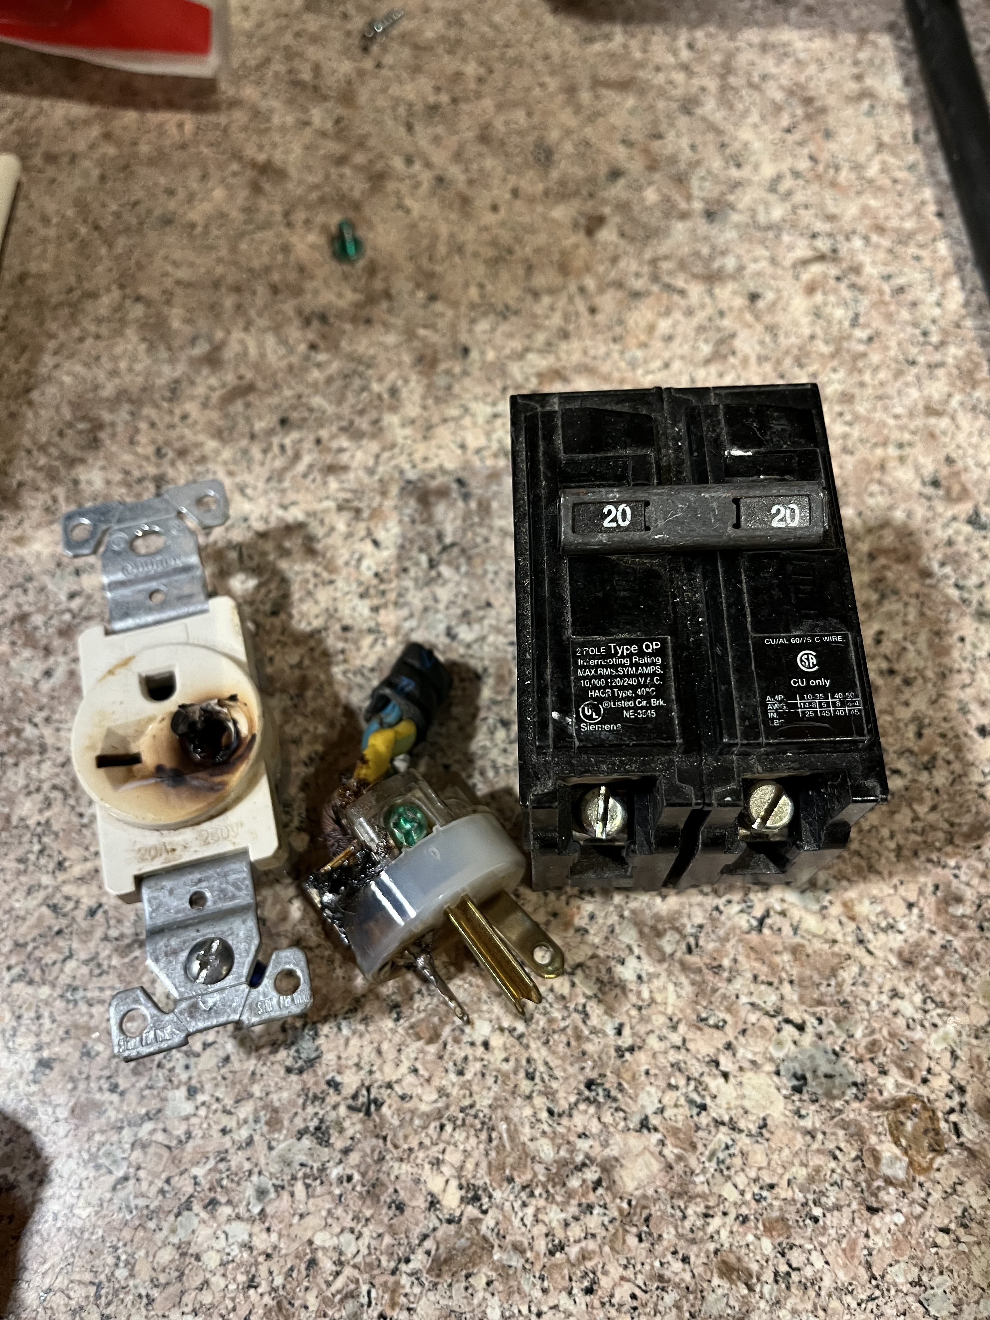

Slide 26
Current I = P
V
= 5000 watt
220 volt
= 22.727272727273 amps

Slide 27
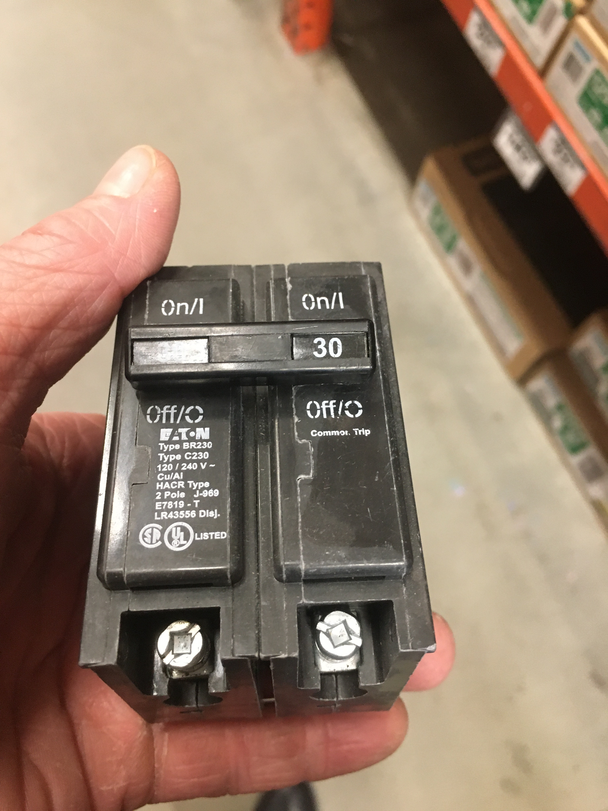

Slide 29
“All Things in Common Church”
What if?
I had a church of 200 people who were trying to live by Acts chapter 4, where they had all things in common, and no one claimed that any possession was their own, and there wasn’t anyone among them that lacked anything. How would that look, given all the economic levels of income and ages of the members and skills and desires of the members?

Slide 30
A modern 200-person church living out Acts 4 would function as a highly collaborative, intergenerational network where private assets serve public needs and resource allocation shifts from individual ownership to shared stewardship. This is not a strict commune where everyone lives in one building or earns the same salary. Instead, it is a community of independent households choosing to treat their wealth, skills, and time as a collective pool to eliminate lack.

Slide 31
Income & Financial Levels
An Acts 4 ecosystem does not require everyone to earn the same salary, but it redefines ownership through voluntary equity sharing and structured resource pooling.

Slide 32
CENTRAL COMMUNITY FUND
(Administered by Chosen Stewards)
AGE NEEDS
• Elder Care
• Childcare
• Education
ECONOMIC SHIFTS
• Debt Payoffs
• Rent/Housing
• Medical Bills
SKILLS EXCHANGE
• Legal & Tax
• Medical Care
• Maintenance

Slide 33
Skills Utilization & Labour Exchange
A specialized internal economy replaces standard commercial outsourcing with structured, mutual aid.
Professional Services: Attorneys, accountants, and financial planners within the 200-member church manage the legal trusts, non-profit tax filings, and investment structures required to run a pooled economy. Doctors and nurses run an internal clinic or manage medical advocacy for members.

Slide 34
Trades & Maintenance: Mechanics, plumbers, electricians, and contractors maintain the homes and vehicles owned by community members. This eliminates costly external repair bills, which are a primary driver of modern household debt.

Slide 35
Administration & Operations:
Highly organized members manage the logistics of asset sharing, scheduling shared vehicles, coordinating bulk grocery purchasing, and vetting emergency financial requests.

Slide 36
Income & Financial Levels
An Acts 4 ecosystem does not require everyone to earn the same salary, but it redefines ownership through voluntary equity sharing and structured resource pooling.

Slide 37
High Earners: Professionals pool surplus income into a centralized, church-administered community fund or trust. They hold their primary real estate with open hands, utilizing equity to underwrite communal needs.

Slide 38
Variable & Low Earners: Freelancers, gig workers, and minimum-wage workers gain a baseline safety net. Their living expenses (housing, healthcare, emergencies) are subsidized by the pooled fund, decoupling survival from a low-wage job.

Slide 39
Asset Management: Rather than liquidating all private property immediately, members retain legal ownership for modern compliance (insurance, taxes) but sign internal community covenants giving the church stewardship over the assets. High-value assets like vacation homes or spare vehicles become shared, reserve community resources.

Slide 40
“All Things in Common Church”
What if?
I had a church of 200 people who were trying to live by Acts chapter 4, where they had all things in common, and no one claimed that any possession was their own, and there wasn’t anyone among them that lacked anything. How would that look, given all the economic levels of income and ages of the members and skills and desires of the members?

Slide 41
If the members did not live by the standards of the Christian values and were selfish and were not led by the Holy Spirit, what would this look like?

Slide 42
Without shared spiritual values and the selflessness modeled in Acts 4, this structure would rapidly collapse into a toxic dynamic of exploitation, resentment, and systemic failure. Stripped of its spiritual foundation, it would function like a poorly managed, forced commune or a dysfunctional welfare state.

Slide 43
Status Anxiety and Gossip: Because outward displays of wealth would be socially banned, people would find sneaky ways to compete for status. Power, social influence, and closeness to the fund managers would become the new currency, leading to intense gossip, manipulation, and tribalism.
Enforced Uniformity: Individual agency would be crushed. Anyone wanting to pursue a unique career, start a business, or spend money on a personal hobby would be publicly shamed for being "selfish," killing all innovation and creativity.
Total System Breakdown: Ultimately, the 200-person church would split into warring factions. The community would dissolve into lawsuits over shared assets, leaving the members deeply disillusioned, bitter, and financially ruined.

Slide 44
A Tale of Two Churches
Acts 4 Unity vs. Worldly Individualism

Slide 45
Economic Foundation
Shared Assets
• Voluntary resource pooling.
• Equity used for the community.
• No one claims exclusive ownership.
Socioeconomic Divides
• Wealth dictates social status.
• The rich stay isolated.
• Lower earners left to struggle.

Slide 46
Community & Generational Care
Intergenerational Net
• Elders fully supported.
• Families receive free childcare.
• Youth debt is paid by the church.
Isolated Individualism
• Seniors left to lonely retirement.
• Parents crushed by childcare costs.
• Youth carry heavy debt alone.

Slide 47
Operational Culture
Non-Market Skill Pools
• Free internal medical/legal aid.
• Contractors fix members' homes.
• Eliminates modern household debt.
Transactional Consumerism
• Sunday-only entertainment.
• Members pay market rates outside.
• Relationships are shallow.

Slide 48
Steps to Transition
Step 1: Shift the Mindset
Move from 'What do I get?' to 'What can I share?' through teaching.
Step 2: Map the Capital
Inventory the community's hidden skills, tools, and spare assets.
Step 3: Launch Local Pilots
Start small with car-sharing pools, bulk food buys, or a debt relief fund.
Step 4: Codify the Covenant
Establish transparent, legal structures for voluntary resource pooling.

