Slide 2
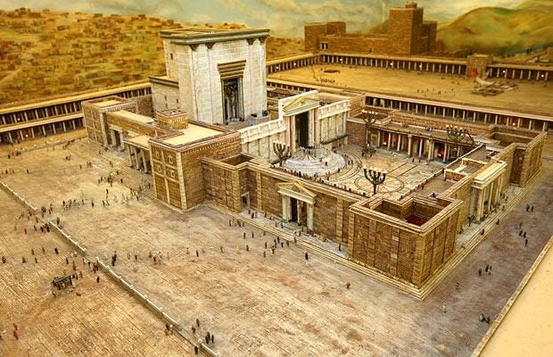
Temples and Priests

Slide 3
Matthew 24:3
³ As He was sitting on the Mount of Olives, the disciples came to Him privately, saying, "Tell us, when will these things happen, and what will be the sign of Your coming, and of the end of the age?"

Slide 4
Matthew 25:1-13
¹ "Then the kingdom of heaven will be comparable to ten virgins, who took their lamps and went out to meet the bridegroom. ² "Five of them were foolish, and five were prudent. ³ "For when the foolish took their lamps, they took no oil with them,
Parables: Ten Virgins

Slide 5
⁴ but the prudent took oil in flasks along with their lamps. ⁵ "Now while the bridegroom was delaying, they all got drowsy and began to sleep. ⁶ "But at midnight there was a shout, 'Behold, the bridegroom! Come out to meet him.' ⁷ "Then all those virgins rose and trimmed their lamps. ⁸ "The foolish said to the prudent, 'Give us some of your oil, for our lamps are going out.'

Slide 6
⁹ "But the prudent answered, 'No, there will not be enough for us and you too; go instead to the dealers and buy some for yourselves.' ¹⁰ "And while they were going away to make the purchase, the bridegroom came, and those who were ready went in with him to the wedding feast; and the door was shut. ¹¹ "Later the other virgins also came, saying, 'Lord, lord, open up for us.' ¹² "But he answered, 'Truly I say to you, I do not know you.' ¹³ "Be on the alert then, for you do not know the day nor the hour.

Slide 7
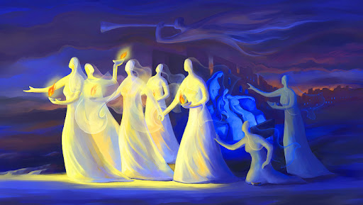

Slide 8
1= God
2= The Two Tablets (10 Commandments)
3= Patriarch, Unity, Trinity
4= Earth
5= Five Books of Moses (Torah)
6= Sinful Mankind, Incompletion
7= Completion, Wholeness
10= Covenantal/Community Fullness
12= Twelve Tribes of Israel

Slide 9
Oil to Stay Lit Forever
Exodus 27:20,21
²⁰ "You shall charge the sons of Israel, that they bring you clear oil of beaten olives for the light, to make a lamp burn continually. ²¹ "In the tent of meeting, outside the veil which is before the testimony, Aaron and his sons shall keep it in order from evening to morning before the LORD; it shall be a perpetual statute throughout their generations for the sons of Israel.”

Slide 10
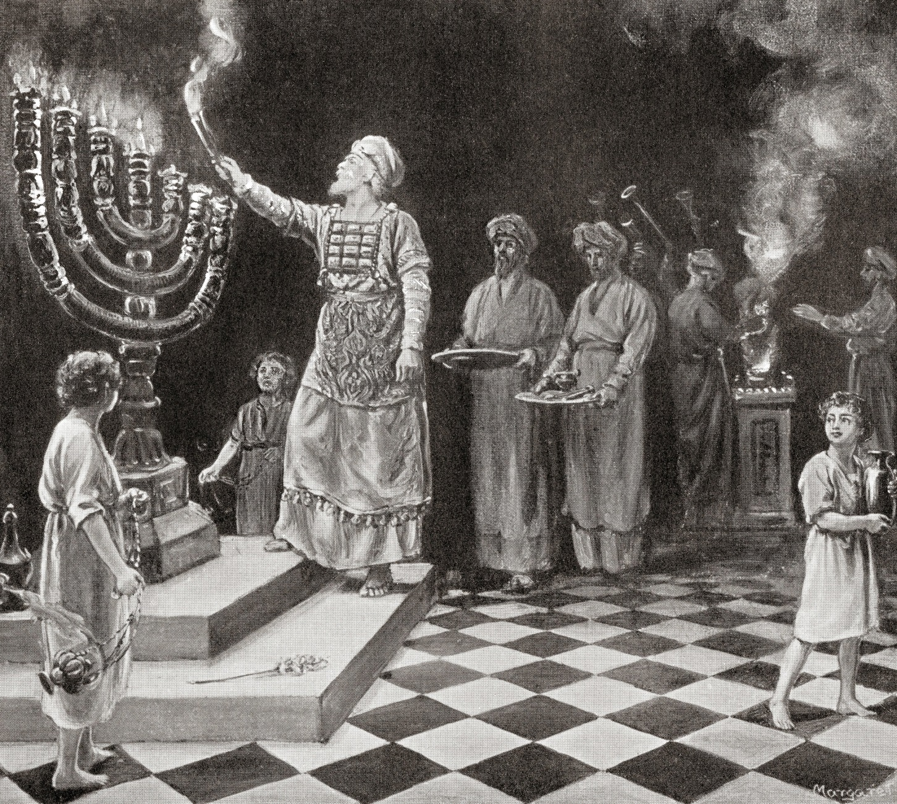
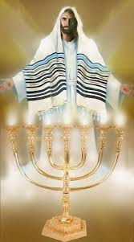

Slide 11
Jeremiah 31:31,32
³¹ "Behold, days are coming," declares the LORD, "when I will make a new covenant with the house of Israel and with the house of Judah, ³² not like the covenant which I made with their fathers in the day I took them by the hand to bring them out of the land of Egypt, My covenant which they broke, although I was a husband to them," declares the LORD.

Slide 12
We are the temple building
Eph 2:19-22
¹⁹ So then you are no longer strangers and aliens, but you are fellow citizens with the saints, and are of God's household, ²⁰ having been built on the foundation of the apostles and prophets, Christ Jesus Himself being the corner stone, ²¹ in whom the whole building, being fitted together, is growing into a holy temple in the Lord, ²² in whom you also are being built together into a dwelling of God in the Spirit.

Slide 13
1 Peter 2:4,5
⁴ And coming to Him as to a living stone which has been rejected by men, but is choice and precious in the sight of God, ⁵ you also, as living stones, are being built up as a spiritual house for a holy priesthood, to offer up spiritual sacrifices acceptable to God through Jesus Christ.

Slide 14
Q. Does that hit you right where you are today? If not, why not?
Q. Are you as a disciple of Jesus Christ maintaining God’s eternal presence and increasing the magnitude of His temple?
Q. Are you taking your role and responsibility as the priest seriously?
Why not?

Slide 15
“LET it not be forgotten that prayer was one of the great truths which He came into the world to teach and illustrate. It was worth a trip from Heaven to earth to teach men this great lesson of prayer. A great lesson it was, a very difficult lesson for men to learn. Men are naturally averse to learning this lesson of prayer. The lesson is a very lowly one. None but God can teach it. It is a despised beggary, a sublime and heavenly vocation. The disciples were very stupid scholars, but were quickened to prayer by hearing Him pray and talk about prayer.” E.M. Bounds

Slide 16
Q. What are you doing differently that will move you past where you were last year?
Q. Would Jesus call you faithful, steady?
Why or why not?

Slide 17
Faith vs. Unfaithfulness
Exodus 17:11-13
¹¹ So it came about when Moses held his hand up, that Israel prevailed, and when he let his hand down, Amalek prevailed. ¹² But Moses' hands were heavy. Then they took a stone and put it under him, and he sat on it; and Aaron and Hur supported his hands, one on one side and one on the other. Thus his hands were steady until the sun set. ¹³ So Joshua overwhelmed Amalek and his people with the edge of the sword.

Slide 18
emunah (אֱמוּנָה), which means faithfulness, steadfastness, firmness, or reliability, emphasizing that it was faith and support.
Root word for “Amen”
Rev 3:
¹⁴ "To the angel of the church in Laodicea write: The Amen, the faithful and true Witness, the Beginning of the creation of God, says this”

Slide 19
Kingdom of Priests Rev 1:5-7
⁵ Jesus Christ, the faithful witness, the firstborn of the dead, and the ruler of the kings of the earth. To Him who loves us and released us from our sins by His blood— ⁶ and He has made us to be a kingdom, priests to His God and Father—to Him be the glory and the dominion forever and ever. Amen. ⁷ BEHOLD, HE IS COMING WITH THE CLOUDS, and every eye will see Him, even those who pierced Him; and all the tribes of the earth will mourn over Him. So it is to be. Amen.

Slide 20
Hebrews 3:5,6 Steady = Faith
⁵ Now Moses was faithful in all His house as a servant, for a testimony of those things which were to be spoken later; ⁶ but Christ was faithful as a Son over His house—whose house we are, if we hold fast our confidence and the boast of our hope firm until the end.

Slide 21
You need a prayer life that is bigger than your temptation
Get out of the Hope Deferred (Delayed answer) mentality and press in and cultivate a prayer life that God can get behind.
The Devil is lurking, the Seasons are changing, the tide is changing
We are on the verge of a big transition in the global body of Christ.
We are on a huge shift Geopolitically
We are on the verge of a Huge Transition in the Eternal Story line of God.
Not an hour to be pulling your heart back from the fight. Going through the motions. It is no longer acceptable to be knowing how to do the show of churchianity. Living a life of safety, protected with lots of boundaries. Protecting your inner man and stop reaching for the fullness.
Temptation is to not reach for the fullness. Settle into it because you had it for a season. I don’t want to change the world. I just want to be faithful to my wife, love my family and finish well.
That sounds awesome, nice. But are we tempted to play it safe and coast into glory. You weren’t made to coast. Get out of the shallow end of the kiddie pool of prayer!

Slide 22
WE CALL FORTH A JESUS-CENTERED REVIVAL
LORD, FATHER WE DECREE AND DECLARE A JESUS EXALTING RADICAL REPENTANCE AND CONVERSION MOVE OF GOD
LORD, FATHER WE DECREE AND DECLARE A JESUS EXALTING RADICAL PREVAILING INTERCESSION MOVE OF THE SPIRIT
LORD, FATHER WE DECREE AND DECLARE A JESUS EXALTING RADICAL DELIVERANCE MOVE OF THE SPIRIT
LORD, FATHER WE DECREE AND DECLARE A JESUS EXALTING RADICAL HEALING/ MIRACLE MOVE OF THE SPIRIT
LORD, FATHER WE DECREE AND DECLARE A JESUS EXALTING RADICAL DISCIPLESHIP MOVE OF THE SPIRIT
LORD, FATHER WE DECREE AND DECLARE A JESUS EXALTING RADICAL MISSIONS MOVE OF THE SPIRIT
LORD, FATHER WE DECREE AND DECLARE A JESUS EXALTING RADICAL NATIONAL REFORMATION REVIVAL

