Slide 1
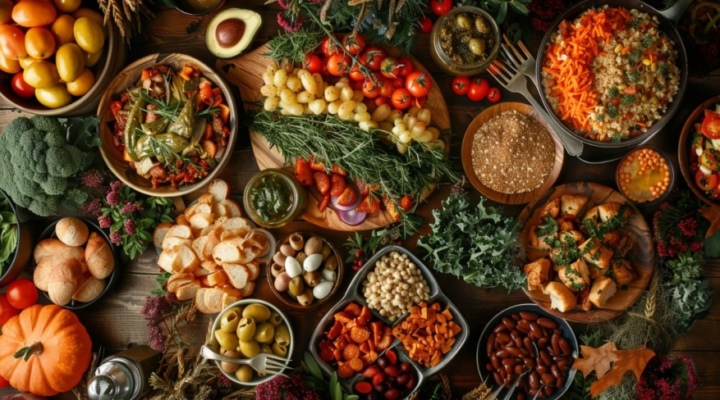
Expect Fruit

Slide 2
Colossians 4:7-18
⁷ Tychicus will tell you all the news about me. He is a dear brother, a faithful minister and fellow servant in the Lord. ⁸ I am sending him to you for the express purpose that you may know about our circumstances and that he may encourage your hearts. ⁹ He is coming with Onesimus, our faithful and dear brother, who is one of you. They will tell you everything that is happening here.

Slide 3
¹⁰ My fellow prisoner Aristarchus sends you his greetings, as does Mark, the cousin of Barnabas. (You have received instructions about him; if he comes to you, welcome him.) ¹¹ Jesus, who is called Justus, also sends greetings. These are the only Jews among my co-workers for the kingdom of God, and they have proved a comfort to me.

Slide 4
¹² Epaphras, who is one of you and a servant of Christ Jesus, sends greetings. He is always wrestling in prayer for you, that you may stand firm in all the will of God, mature and fully assured. ¹³ I vouch for him that he is working hard for you and for those at Laodicea and Hierapolis. ¹⁴ Our dear friend Luke, the doctor, and Demas send greetings.

Slide 5
Epaphras- Pastor of the Church in Colossae.
1:7 You learned it from Epaphras, our dear fellow servant, who is a faithful minister of Christ on our behalf, ⁸ and who also told us of your love in the Spirit.

Slide 6
2 Corinthians 11:28,29
²⁸ Besides everything else, I face daily the pressure of my concern for all the churches. ²⁹ Who is weak, and I do not feel weak? Who is led into sin, and I do not inwardly burn?

Slide 7
Who is wrestling in prayer for you?
Who are you wrestling in prayer for?

Slide 8
Ephesians 6:12
¹² For we do not wrestle against flesh and blood, but against principalities, against powers, against the rulers of the darkness of this age, against spiritual hosts of wickedness in the heavenly places.

Slide 9
¹⁵ Give my greetings to the brothers and sisters at Laodicea, and to Nympha and the church in her house.
¹⁶ After this letter has been read to you, see that it is also read in the church of the Laodiceans and that you in turn read the letter from Laodicea.
¹⁷ Tell Archippus: “See to it that you complete the ministry you have received in the Lord.”
¹⁸ I, Paul, write this greeting in my own hand. Remember my chains. Grace be with you.

Slide 10
Fruit for the Laodicean church Revelation 3:15-22
¹⁵ I know your deeds, that you are neither cold nor hot. I wish you were either one or the other! ¹⁶ So, because you are lukewarm—neither hot nor cold—I am about to spit you out of my mouth. ¹⁷ You say, ‘I am rich; I have acquired wealth and do not need a thing.’ But you do not realize that you are wretched, pitiful, poor, blind and naked.

Slide 11
¹⁸ I counsel you to buy from me gold refined in the fire, so you can become rich; and white clothes to wear, so you can cover your shameful nakedness; and salve to put on your eyes, so you can see.

Slide 12
¹⁹ Those whom I love I rebuke and discipline. So be earnest and repent. ²⁰ Here I am! I stand at the door and knock. If anyone hears my voice and opens the door, I will come in and eat with that person, and they with me.

Slide 13
²¹ To the one who is victorious, I will give the right to sit with me on my throne, just as I was victorious and sat down with my Father on his throne. ²² Whoever has ears, let them hear what the Spirit says to the churches.”

Slide 14
Prayer of an apostle for the church
⁹ For this reason, since the day we heard about you, we have not stopped praying for you. We continually ask God to fill you with the knowledge of his will through all the wisdom and understanding that the Spirit gives,¹⁰ so that you may live a life worthy of the Lord and please him in every way: bearing fruit in every good work, growing in the knowledge of God,

Slide 15
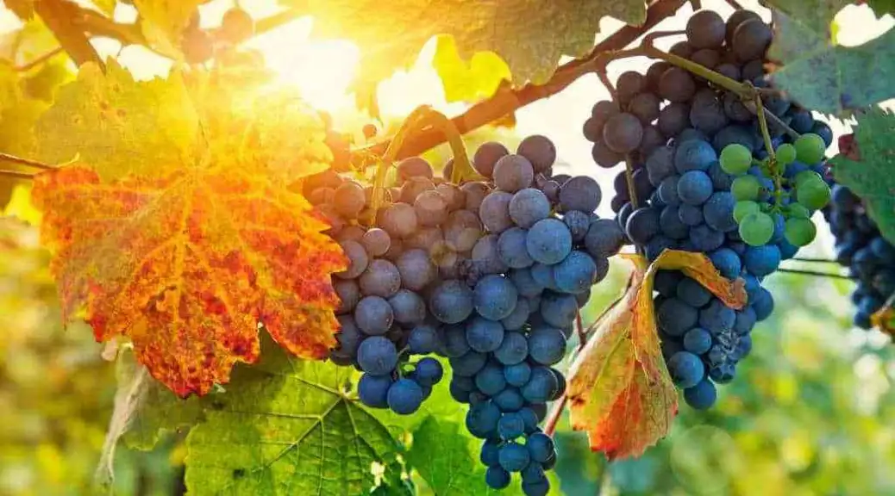
What happens when you are bearing fruit?

Slide 16
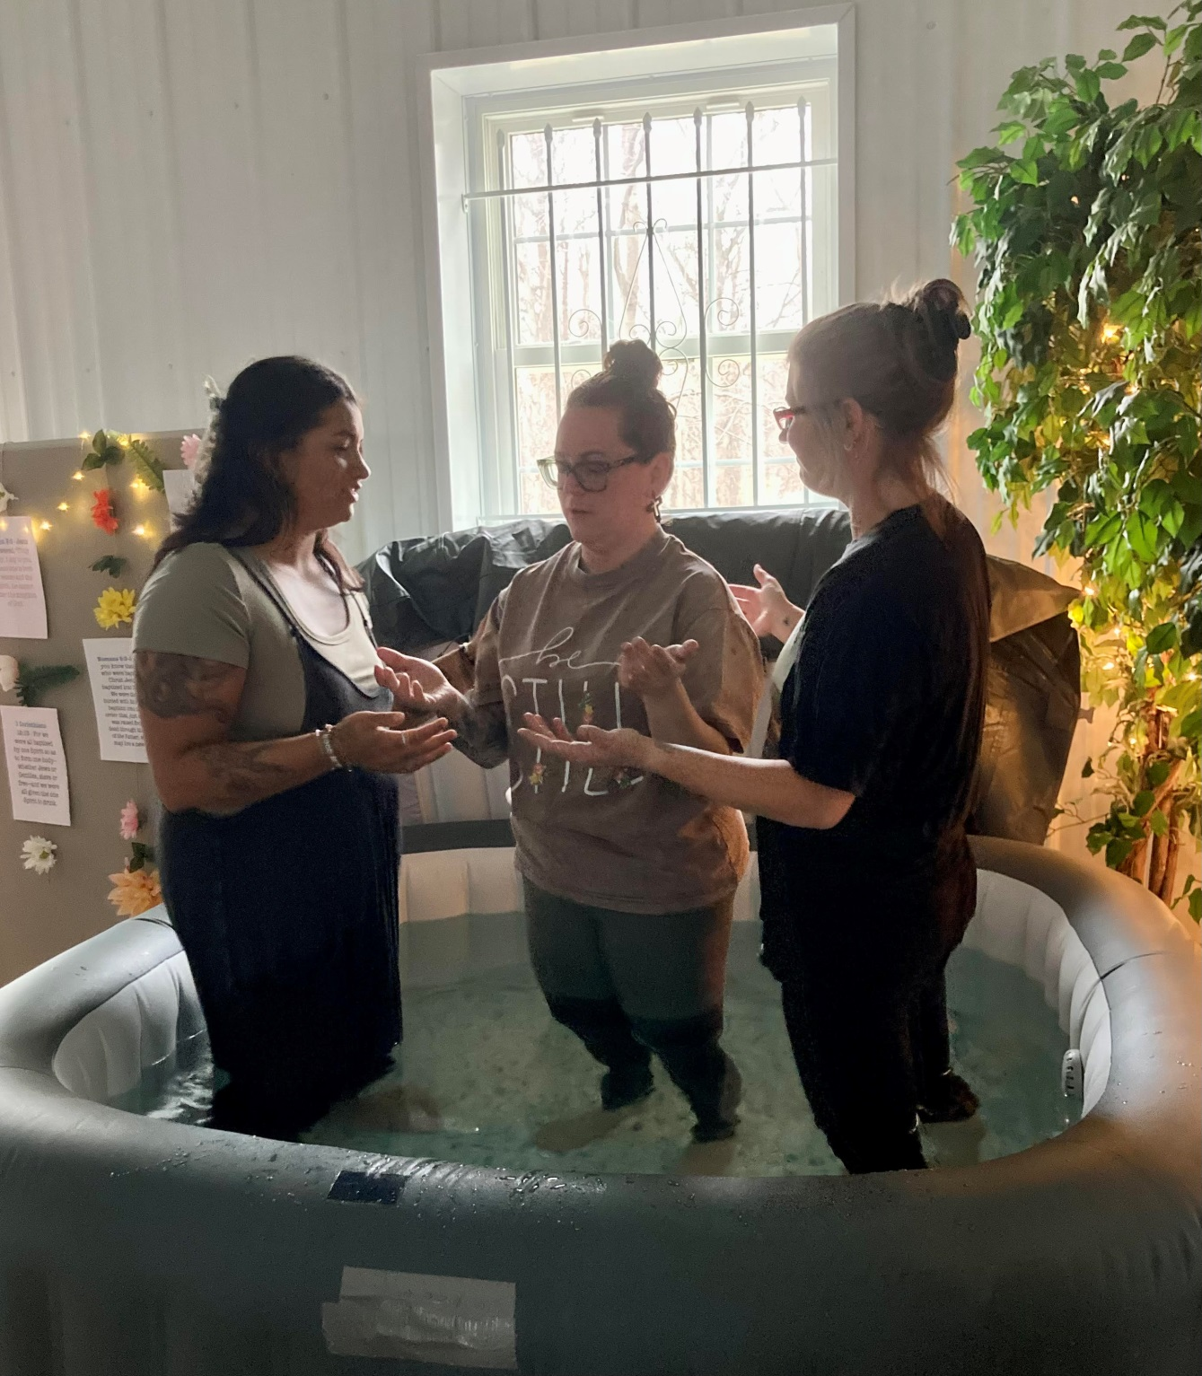

Slide 17
¹¹ being strengthened with all power according to his glorious might so that you may have great endurance and patience,
¹² and giving joyful thanks to the Father, who has qualified you to share in the inheritance of his holy people in the kingdom of light.
¹³ For he has rescued us from the dominion of darkness and brought us into the kingdom of the Son he loves,
¹⁴ in whom we have redemption, the forgiveness of sins.

Slide 18
John 15:1-4
“I am the true vine, and my Father is the gardener.
² He cuts off every branch in me that bears no fruit, while every branch that does bear fruit he prunes so that it will be even more fruitful.
³ You are already clean because of the word I have spoken to you.
⁴ Remain in me, as I also remain in you. No branch can bear fruit by itself; it must remain in the vine. Neither can you bear fruit unless you remain in me.

Slide 19
kathairo (καθαίρω): This verb means "to cleanse, to purify, to prune".

Slide 20
⁵ “I am the vine; you are the branches. If you remain in me and I in you, you will bear much fruit; apart from me you can do nothing. ⁶ If you do not remain in me, you are like a branch that is thrown away and withers; such branches are picked up, thrown into the fire and burned. ⁷ If you remain in me and my words remain in you, ask whatever you wish, and it will be done for you. ⁸ This is to my Father’s glory, that you bear much fruit, showing yourselves to be my disciples.

Slide 21
Pray these for each other:
God to fill me with the knowledge of your will.
Holy Spirit give me the wisdom and understanding.
Help me to live a life worthy of you Lord and please you in every way.
I want to be bearing fruit in every good work.
I want to grow in the knowledge of you God.
Strengthen me with all power according to your glorious might

Slide 22
Lord grant me to have great endurance and patience
Lord help me to be giving joyful thanks to you Father.
Thank you for qualifying me to share in the inheritance of your holy people in the kingdom of light.
Thank you for rescuing me from the dominion of darkness
Thank you for bringing me into the kingdom of the Son you love
Thank you for redemption, the forgiveness of all of my sins.

Slide 23
Action Steps:
Get into a Life Group (Do the Christian Life together) Heb 10:25
Pray Daily for each other (regularly and consistently) 1 Samuel 12:23
Make Faith Declarations over yourself and your loved ones (on earth as it is in heaven) Matthew 6:9-13
Develop the fruit of persevering prayer. James 5:16

Slide 24
Demas
Philemon 1:24: Demas is listed as a "fellow worker" with Paul
Colossians 4:14: Demas is mentioned along with Luke, the physician and writer of the Luke–Acts
2 Timothy 4:9,10: ⁹ Do your best to come to me quickly, ¹⁰ for Demas, because he loved this world, has deserted me and has gone to Thessalonica.

Slide 25
Mark
Mark 14:50-52 ⁵⁰ Then everyone deserted him and fled.
⁵¹ A young man, wearing nothing but a linen garment, was following Jesus. When they seized him, ⁵² he fled naked, leaving his garment behind.

Slide 26
Tradition says that the Upper Room was the home of Mark and his parents and that he was the young man carrying the waterpot.
Paul did not want to take John (Mark) because he had deserted him in Pamphylia. Acts 15:36
Colossians 4:Mark, the cousin of Barnabus, (about whom you received instructions: If he comes to you, welcome him). They have been a comfort.
2Tim 4: ¹¹ Only Luke is with me. Get Mark and bring him with you, because he is helpful to me in my ministry.

Slide 27
Barnabus: The ministry of Encouragement
Sold his land and gave it to the apostles Acts 4:36
Advocated for Saul when the believers didn’t believe he was a disciple Acts 9:26
Believed in John Mark and gave him a second chance Acts 15
When he saw the Grace of God, he was glad and encouraged them all that with purpose of heart they should continue in the Lord. Acts 11:23
He was a good man, full of the Holy Spirit and of faith. And a great many people were added to the Lord. Acts 11:21-24

