Slide 2
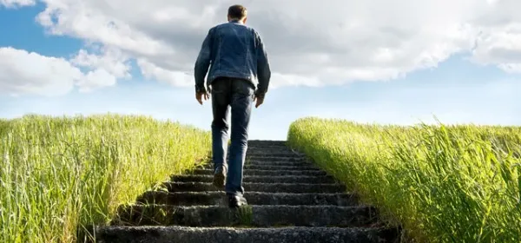
Discipleship Track of Jesus

Slide 3
Luke 6:40 “A student is not above the teacher; but everyone, when he has been fully trained, will be like his teacher”.

Slide 4
In the World
"Now I am no longer in the world, but these are in the world, and I am coming to You. Holy Father, keep them in Your name, that they may be one just as We are" (John 17:11).

Slide 5
Not of this World
"I have given them Your word, and the world has hated them because they are not of the world, just as I am not of the world" (John 17:14).

Slide 6
Prayer for you
Ephesians 1:17-23
17 I keep asking that the God of our Lord Jesus Christ, the glorious Father, may give you the Spirit of wisdom and revelation, so that you may know him better.

Slide 7
Ephesians 1:17-23
18 “I pray that the eyes of your heart may be enlightened in order that you may know the hope to which he has called you, the riches of his glorious inheritance in his holy people,

Slide 8
V 19 and his incomparably great power for us who believe.”

Slide 9
You were Dead!
Ephesians 2:2-6
As for you, you were dead in your transgressions and sins, ² in which you used to live when you followed the ways of this world and of the ruler of the kingdom of the air, the spirit who is now at work in those who are disobedient. ³ All of us also lived among them at one time, gratifying the cravings of our flesh and following its desires and thoughts. Like the rest, we were by nature deserving of wrath.

Slide 10
⁴ But because of his great love for us, God, who is rich in mercy,
⁵ made us alive with Christ even when we were dead in transgressions—it is by grace you have been saved.
⁶ And God raised us up with Christ and seated us with him in the heavenly realms in Christ Jesus,

Slide 11
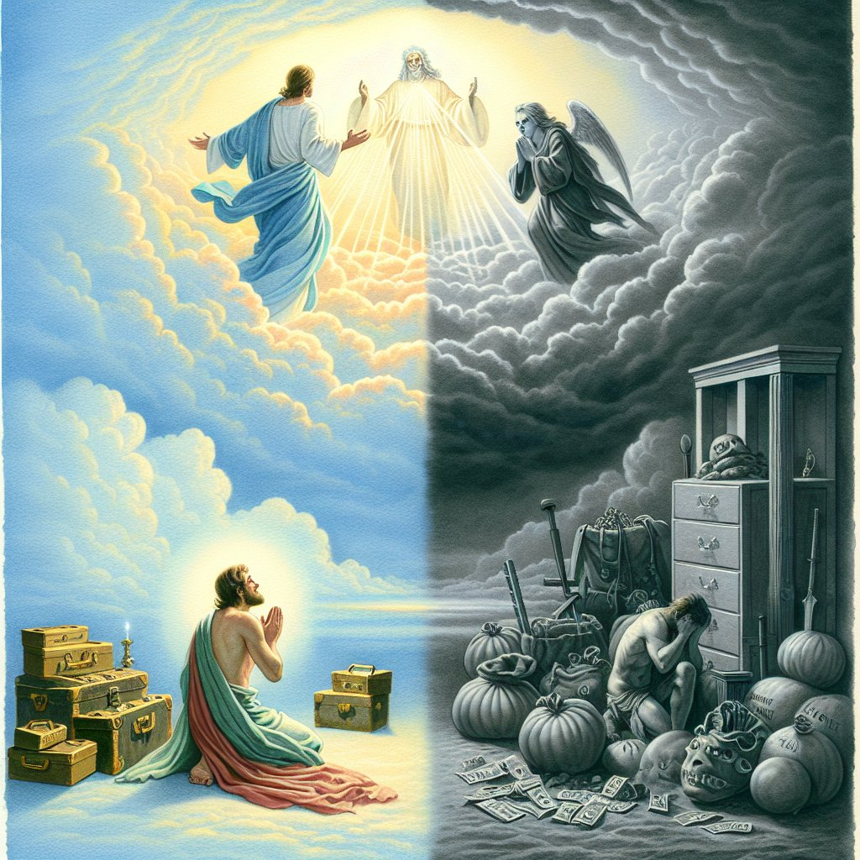
Two Masters
Luke 16:13 “No one can serve two masters.”

Slide 12
Colossians 3:2 “Set your mind on things above not on earthly things.”

Slide 13
James 4:4
⁴ You adulterous people, don’t you know that friendship with the world means enmity against God? Therefore, anyone who chooses to be a friend of the world becomes an enemy of God.

Slide 14
John 15:18,19 “If the world hates you, know that it has hated me before it hated you. If you were of the world, the world would love you as its own. But because you are not of this world, therefore the world hates you.”

Slide 15
1 John 5:19 “The whole world lies in the power of the evil one.”

Slide 16
John 3:19 “Light has come into the world and people love the darkness rather than light because their deeds were evil.”

Slide 17
Babylon System
Babylon is the system of the world.
“Come out of her, my people! Run for your lives! Jeremiah 51:45
Revelation 18:4,5 “‘Come out of her, my people,’ so that you will not share in her sins, so that you will not receive any of her plagues; for her sins are piled up to heaven, and God has remembered her crimes.

Slide 18
“Come out of her, my people! Run for your lives!” Jeremiah 51:45

Slide 19
Jesus’ Prayer for you
"Now I am no longer in the world, but these are in the world, and I am coming to You. Holy Father, keep them in Your name, that they may be one just as We are" (John 17:11).
"I have given them Your word, and the world has hated them because they are not of the world, just as I am not of the world" (John 17:14).

Slide 20
1 John 2:15-17
¹⁵ Do not love the world or anything in the world. If anyone loves the world, love for the Father is not in them. ¹⁶ For everything in the world—the lust of the flesh, the lust of the eyes, and the pride of life—comes not from the Father but from the world. ¹⁷ The world and its desires pass away, but whoever does the will of God lives forever.

Slide 21
1 Peter 1:15,16
But as he who called you is holy, you also be holy in all you conduct, since it is written, you shall be holy, for I am holy.”
Holiness is the evidence of salvation. It’s not perfection, its direction! It is the visible fruit of a heart that has been made new.

Slide 22
Titus 2:12 “For the Grace of God has appeared, bringing salvation for all people, training us to renounce ungodliness and worldly passions.”

Slide 23
Hebrews 12:14 “Strive for peace with everyone and for the holiness without which no one will see the Lord.”

Slide 24
How do I become a disciple?
1. Get into Discipleship mode.
2. Decide who you want to follow.
3. Get into the God’s word.
4. Get God’s word into you.
5. Get into the Secret place Every Day!
6. Pray with your spouse, kids or with others every day.
7. Pray in the Spirit (night and day)
8. Repent often.
9. Evaluate your heart condition.

Slide 25
Where is your secret place?
Exodus 33:18 ¹⁸ Then Moses said, “Now show me your glory.”
Psalm 27:4 “One thing I ask from the Lord, this only do I seek: that I may dwell in the house of the Lord all the days of my life, to gaze on the beauty of the Lord and to seek him in his temple.”

Slide 26
Jesus’ Dream for you: John 17
²⁴ “Father, I want those you have given me to be with me where I am, and to see my glory, the glory you have given me because you loved me before the creation of the world.”

Slide 27
Private Victories Won in the secret Place
^{1 Samuel 17:34-37}
³³ Saul replied, “You are not able to go out against this Philistine and fight him; you are only a young man, and he has been a warrior from his youth.”
³⁴ But David said to Saul, “Your servant has been keeping his father’s sheep. When a lion or a bear came and carried off a sheep from the flock, ³⁵ I went after it, struck it and rescued the sheep from its mouth. When it turned on me, I seized it by its hair, struck it and killed it.

Slide 28
Private Victories Won in the secret Place
³⁶ Your servant has killed both the lion and the bear; this uncircumcised Philistine will be like one of them, because he has defied the armies of the living God.
³⁷ The Lord who rescued me from the paw of the lion and the paw of the bear will rescue me from the hand of this Philistine.”
Saul said to David, “Go, and the Lord be with you.”

Slide 29
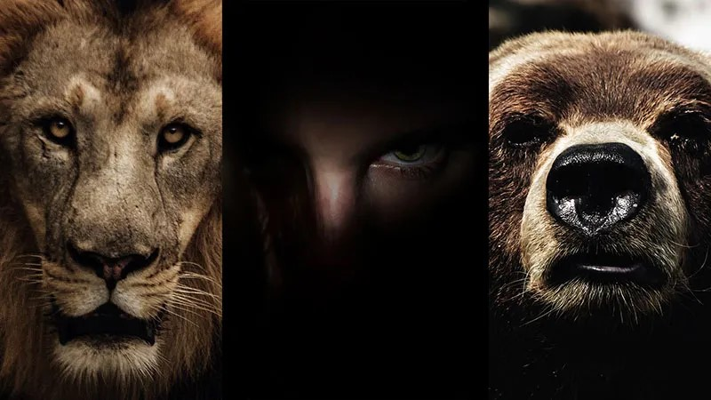
You can’t kill a giant unless you are a lion and bear killer!

Slide 30
What are the “Lions” and “Bears” that you need to beat in order to make you ready to face the Giants?
… And What are the “Giants?”

Slide 31
Are your works Flammable or Fireproof?
1 Corinthians 3:11-14
¹¹ For no one can lay any foundation other than the one already laid, which is Jesus Christ. ¹² If anyone builds on this foundation using gold, silver, costly stones, wood, hay or straw, ¹³ their work will be shown for what it is, because the Day will bring it to light. It will be revealed with fire, and the fire will test the quality of each person’s work. ¹⁴ If what has been built survives, the builder will receive a reward. ¹⁵ If it is burned up, the builder will suffer loss but yet will be saved—even though only as one escaping through the flames.

Slide 32
7 Weapons of Spiritual Warfare
Praise and worship
The Word of God (Declarations)
The Holy Spirit
Obedience to God
The Armor of God
Walking in our New Identity
Prayer

Slide 33

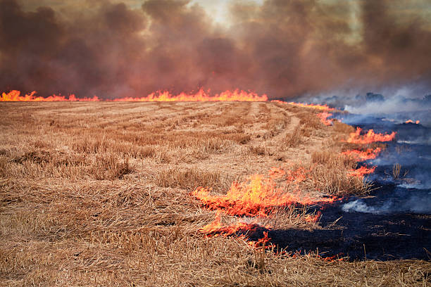
With What Material are you building?
Under ground and no one can see it
Found in small quantities (Rare)
You have to work/dig to get it
Unlimited in value
Above ground, Everyone can see it
Found in large quantities (easy to find)
Doesn’t cost you anything Limited value
Big in the eyes of men, small in the eyes of God

Slide 34
Building happens in the secret place so that when these happen, you’re ready!
Trouble
Persecution
Hardships
Health Issues
Trials
Attacks

Slide 35
Jesus is saying to his followers “You are going to have to slay these three Enemies in your life which are designed to destroy your spiritual growth.
Here are three lethal stones to use that will prepare you (refine you and make you precious to the possessor) to live this life in VICTORY”.

Slide 36
Victories are developed in the “Secret Place”
Discipline of Giving Matt.6:1-4
Discipline of Prayer Matt. 6:5-15
Discipline of Fasting Matt. 6:16-18

